Slide 1
Newborn Jets in NGC 1275
Yutaka Fujita（Osaka）
Fujita & Nagai 2017, MNRAS, 465, L94
Nagai, Fujita, Nakamura, Orienti, Kino, Asada, & Giovannini, 2017, ApJ, 849, 52

Slide 2
Contents
Introduction
Our observations
  Subparsec jets in NGC 1275 (3C 84)
    Counter jets
      Origin of non-thermal emissions from the galaxy
      Absorption by circum-nuclear disk
    Polarization at the hot spot
      Accretion flow toward the supermassive black hole
  ALMA observations at the center of the galaxy (preliminary)
Summary

Slide 3
Introduction

Slide 4
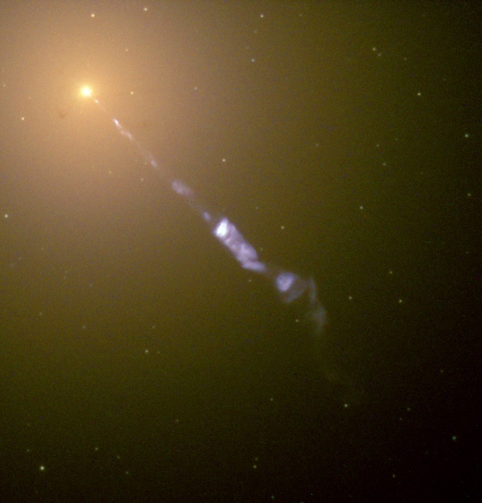
Nearby AGNs
Nearby AGNs are important targets to study their innermost structures
Sagittarius A* (~ 8 kpc)
    Almost inactive
Extragalactic
  M87 (z = 0.004233)
    Weak activity
  NGC 1275: (z = 0.017559)
    Moderate activity
M87 (NASA)

Slide 5
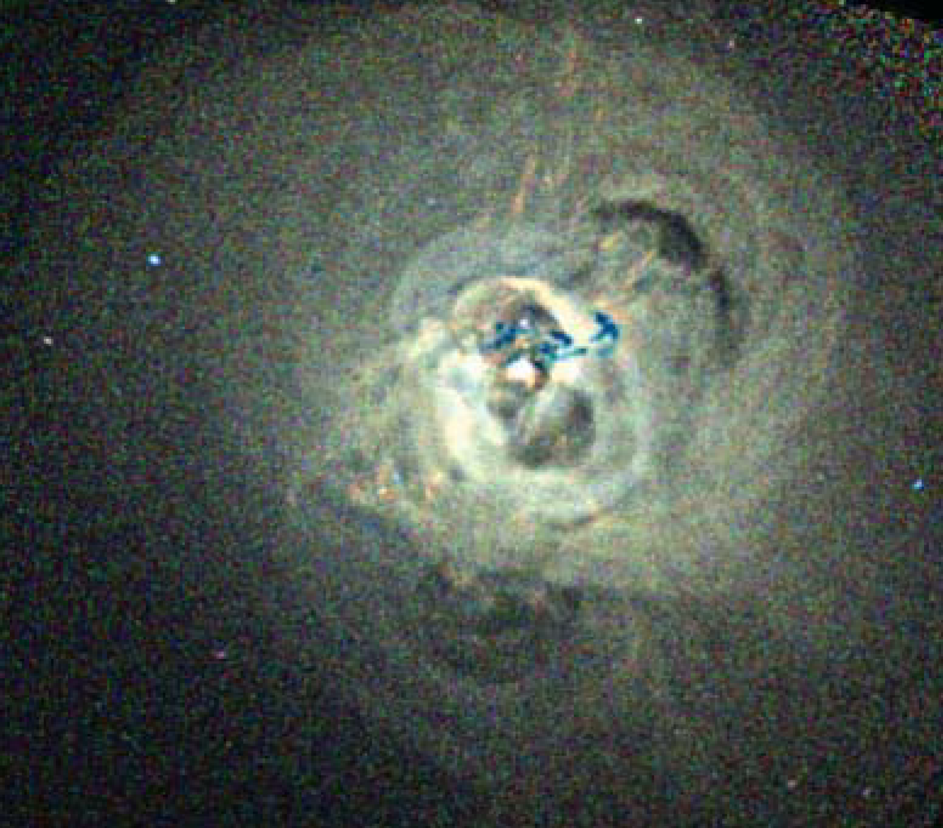
NGC 1275
NGC 1275 is located at the center of the Perseus cluster
The galaxy has an AGN (3C84)
  The AGN seems to be heating the cluster core
    But it does not create strong turbulence
AGN
~ 100 kpc
Chandra image of the
core of the Perseus cluster
(Fabian et al. 2008)
Hitomi Collaboration (2016)

Slide 6
Supermassive black hole
NGC 1275 has a black hole with the mass of ~10⁹ M• (Scharwächter et al. 2013)
The luminosity is about 0.4% of the Eddington luminosity
  The accretion flow is thought to be RIAF
H₂ velocity map
(Scharwächter et al. 2013)
400 pc
Notes:
H2, [FeII] line を見ている。

Slide 7
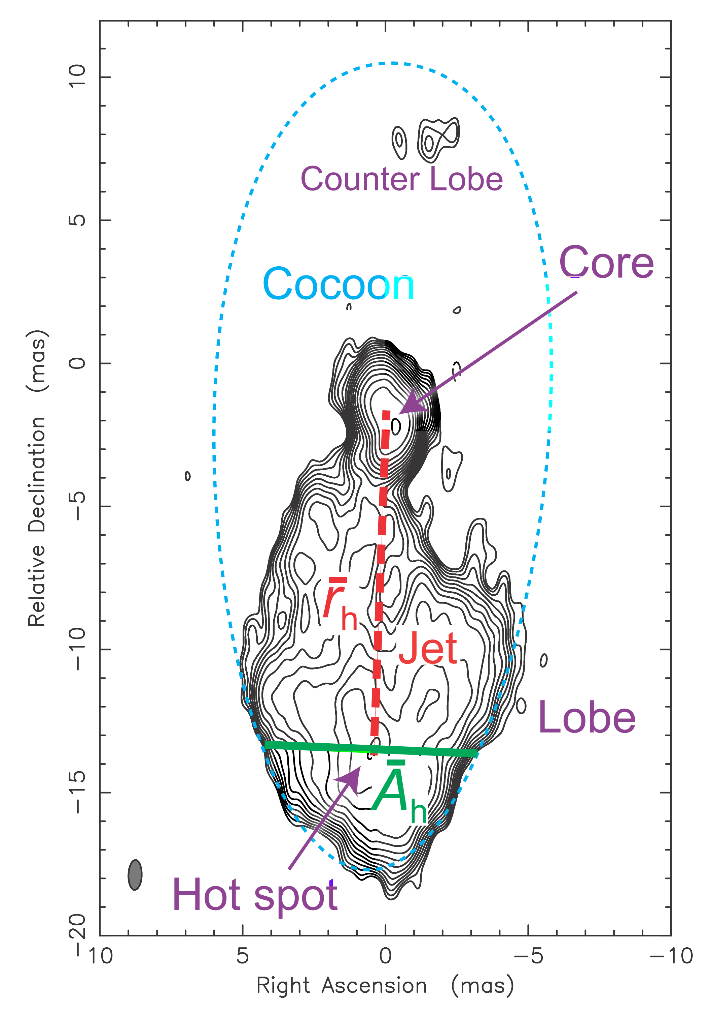
Jet activities
3C 84 shows intermittent activities
  Jets on the scale of ~8 pc (outer jets)
    Jet extension: v ~ 0.3 c
    These jets launched in ~1959
      e.g. Walker et al. (1994), Vermeulen et al. (1994)
Counterjet
Light curves
3C84
(VSOP 5GHz)
distance (mas)
Jet
γ-rays
2 pc
Radio
Asada et al. (2006)
Fujita, Kawakatu, Shlosman, Ito (2015)
Dutson et al. (2014)

Slide 8
New jet activates
A new southern jet (~1 pc) was recently discovered inside the old outer jet
  AGN activities since 2005
    Increase of γ-ray flux
    Jet extension: v ~ 0.2-0.3 c
      e.g. Nagai et al. (2010), Suzuki et al. (2012)
  However, the counterjet had not been identified
  We report the discovery
VLBA 43 GHz
Jan. 24, 2013
(Nagai et al. 2014)
Core
1pc
Southern
Jet

Slide 9
Our observations

Slide 10
Counter jet

Slide 11
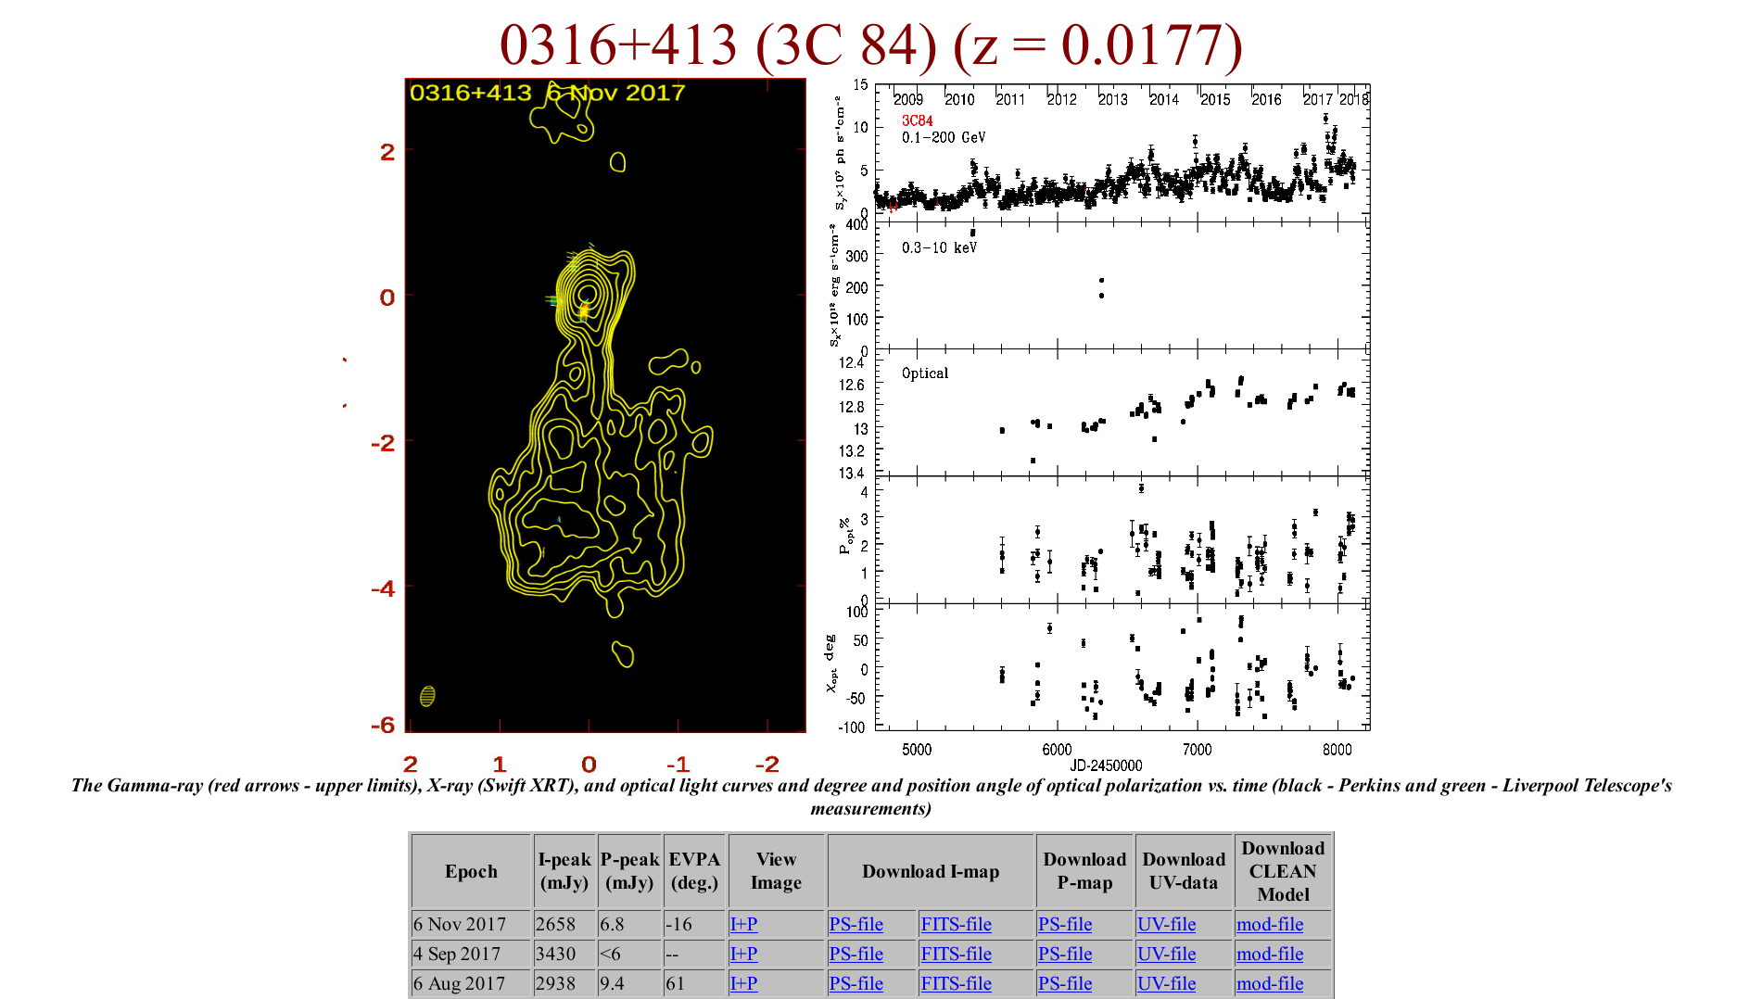
Observations
VLBA data at 15 and 43 GHz
  Archival data of the two monitoring projects
    Monitoring Of Jets in Active galactic nuclei with VLBA Experiments (MOJAVE)
    Boston University (BU) Blazar Monitoring Program
      They have been observing 3C84 several times a year
http://www.bu.edu/blazars/VLBA_GLAST/0316.html

Slide 12
Detection of the counterjet (N1)
43 GHz
15 GHz
Counterjet
Counterjet
1pc
Core
Core
Southern jet
Southern jet
2015, Dec. 5
(24 σ detection)
2016, Jan. 22
(17 σ detection)
Fujita & Nagai (2017)

Slide 13
Counterjet
From this detection of the counterjet, we can discuss various topics
  Inclination angle of the jets
    Constraint on γ-ray emission models
  Absorption by the circum-nuclear disk
    Properties of the circum-nuclear disk around the black hole

Slide 14
Inclination angle
From the apparent ratio of the jet lengths (D=1.22±0.16), the inclination angle θ can be determined assuming that the two jets are symmetric
  β_{a}c: apparent velocity of C3
    β_{a} = 0.23 ± 0.11
      Nagai et al. (2010)
We found θ = 65➢±16➢
Hotspot (N1)
Jet
Core (C1)
θ
Observer
Hotspot (C3)
Notes:
core shift は無視できる。

Slide 15
Inclination angle
The obtained angle is not much different from that for the outer jets
  The jet angle has not changed for ~50 years
Inner jets launched in 2005
(this study)
Outer jets launched in
1959
(Asada et al. 2006)
Counterjet
Core
Southern jet
θ = 65➢±16➢
θ = 53➢±8➢

Slide 16
Implications
SED of NGC 1275
6 deg
γ-rays have been detected from NGC 1275
    Abdo et al. (2009), Aleksić et al. (2014)
  Misaligned blazar?
    Emissions from the jets
The large angle we obtained is inconsistent with misaligned blazar models
  They cannot explain TeV emissions
  γ-rays may not be emitted close to the base of the jets
18 deg
25 deg
Γ ~ 3-10
Tavecchio & Ghisellini (2014)
Notes:
角度が大きいとローレンツブーストが効かなくなり、γγの optical depth が大きくなる。

Slide 17
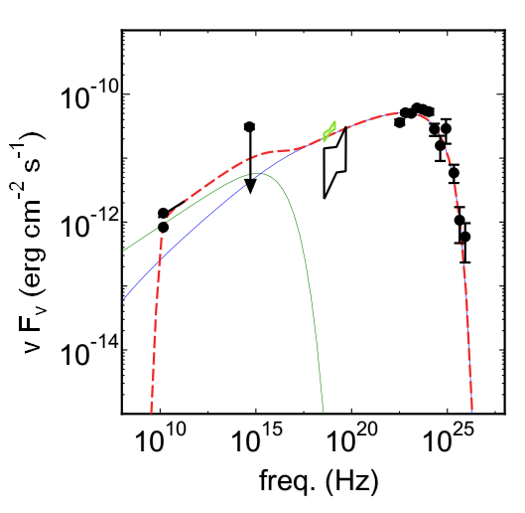
Origin of the non-thermal emissions
Hot spot (C3)?
  Actually, the γ-ray luminosity has increased as C3 becomes brighter in the radio band
  One-zone toy model (Synchrotron + SSC)
    No-beaming
SED
One-zone model (preliminary)
Light curves
γ-rays
Radio
Dutson et al. (2014)

Slide 18
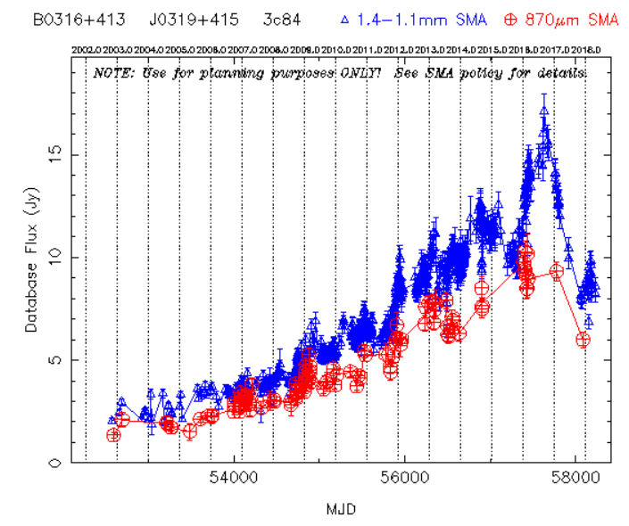
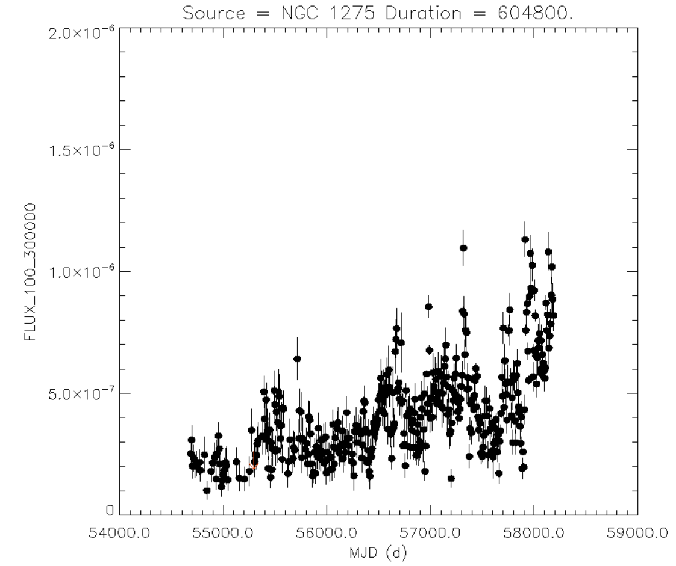
However
Most recently, radio and γ-ray fluxes show different behaviors
Radio
γ-rays
1/1/2017
1/1/2017
SMA observer center
Fermi/NASA

Slide 19
Absorption
If the northern (N1) and southern (C3) jets are symmetric, the ratio of their fluxes should be R~2
  It depends on the inclination angle θ and jet velocity β (Doppler boost)
    We know them from our observations
  However, the observed ratio is R_{obs} = 45 (43 GHz) and 600 (15 GHz)
    Northern jet is very dim
      The spectrum is inverted
    It must be absorbed by the cirum-nuclear disk
Hotspot (N1)
Observer
Jet
Core (C1)
Hotspot (C3)
Disk

Slide 20
Absorption
Free-Free absorption is likely (e.g. Levinson et al. 1995)
  Optical depth
From the comparison of the non-absorbed case (R~2) with the absorbed case (R_{obs} = 45 or 600 ), we can estimate the density of the disk
disk thickness
Notes:
SSAが効くためには異常に大きな磁場が必要。

Slide 21
Results
For T = 10⁴ K, and the thickness L = 0.8 pc (L ~ r ; geometically thick disk)
  n_{e} ~ 10⁵ cm⁻³
  If the disk is thin (L < 0.8 pc), the density is higher
Optical depth
    τ_{ff} ∝ ν ^{-0.6} (observation)
    τ_{ff} ∝ ν ⁻² (theory for homogeneous medium)
    The disk may be inhomogeneous
τ_{ff} 1
τ_{ff}  1
Disk

Slide 22
Disk structure
Combined with the previous results for the absorption of the outer jets (Silver et al. 1998; Walker et al. 2000)
  Emission measure (EM)
  n_{e}² L ~ 7×10⁹ (r/pc)^{-2.6} pc cm⁻⁶ (r ~ 0.8－30 pc)
The disk has a power-law structure

Slide 23




Environment around the jet head
Momentum balance at the jet head
If we assume that the current jet power L_{j} is the same as the time-averaged one (~10⁴⁴ erg s⁻¹; Rafferty et al. 2006),
AGN
Ram-pressure
Fujita & Nagai (2017)

Slide 24
Are we right?
VLBA+VLA
23 GHz
So far, we have interpreted N1 as the counter jet …
However, a feature was observed at the position of N1 in the 1990s
  N1 might actually be a fixed structure
    Hole in the accretion disk?
    Deep, long-term observations are required
1 pc
N1
Something
bright
(inhomogeneous
jet?)
Observer
Deep observation in 1998
(Walker & Anantharamaiah 2003)
Disk

Slide 25
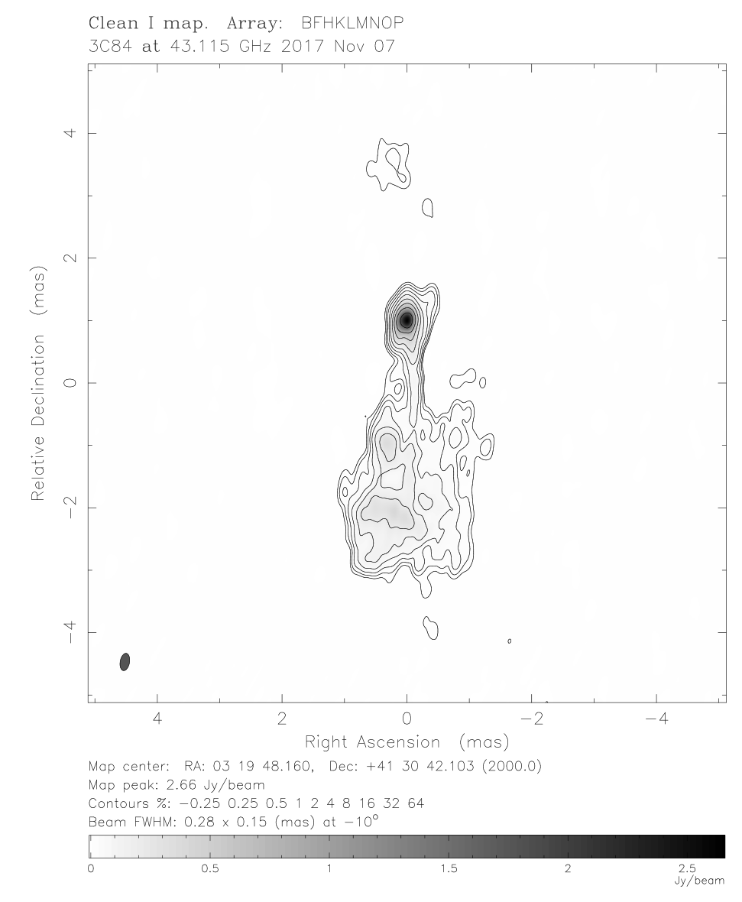
Very recent observations
The counter jet is still seen
  It is premature to conclude the debate on the motion
Nov. 7, 2017
Counter jet
(N1)
Dec. 5, 2015
Fujita & Nagai (2017)
Boston University (BU) Blazar Monitoring Program

Slide 26
Polarization

Slide 27
Polarization
Polarization has become prominent since the middle of 2015
  @ 43 GHz
  @ hot spot (C3)
    Polarization percentage ~1-2%
      Polarization flux ~ 30 mJy
    RM ~ 10⁵ rad m⁻²
  Position angle changes on the timescale of a month
    Constrain the size of the hot spot
VLBA image of 3C 84
on April 22, 2016
Core
0.4 pc
C3
Nagai, Fujita et al. (2017)

Slide 28
Previous observations
CARMA, SMA (Plambeck et al. 2014)
  The observations were performed in 2011-2013
  @210-345 GHz
  The core and jets were not resolved
Polarization
  RM ~ 9×10⁵ rad m⁻²
    Similar to our value at 43 GHz
    Polarization percentage ~1-2%
      Polarization flux ~ 100 mJy
        Lager than that at 43 GHz
  What does the polarization tell us?
Notes:
SMA の分解能は 0.4”, CARMA は 0.15”。SMA はハワイ、CARMA はカリフォルニアにある。中心に行くほど高周波で明るいのは SSA opacity が中心で大きいことと、冷却がまだ効いていないため。

Slide 29
Model 1
Spherical accretion + disk
  Polarization at 43 GHz and that at 210-345 GHz has the same origin
    Hot spot
  Faraday rotation is caused by the gas in the RIAF
Pros
  Same RM
Cons
  Inverted spectrum cannot be explained
RIAF
Nagai, Fujita, et al. (2017)

Slide 30
Model 2
Spherical accretion with a funnel + disk
  Funnels are created by jets
  210-345 GHz emission comes from the inner jets
Pros
  210-345 GHz flux is larger than 43 GHz flux
Cons
  210-345 GHz emission should have a larger RM than 43 GHz emission
    Inconsistent with observations
  RM at 43 GHz may be too small
    Funnels are empty
RM
Nagai, Fujita, et al. (2017)

Slide 31
Model 3
Spherical accretion with a funnel + disk + clumpy gas
  Emission from the hot spot is intercepted by a gas clump
Pros
  210-345 GHz emission is brighter than 43 GHz emission
  Same RM
    43 GHz emission affected by the clump
    We prefer this model
RM
Clump
RM
Nagai, Fujita, et al. (2017)

Slide 32
Inhomogeneous gas accretion
Our observations of the counter jets (circum-nuclear disk) and the polarization suggest that the accretion flow is highly clumpy and chaotic
  Clumps tend to be dense and cold
  Accretion of the cold clumpy gas may be dominant over hot gas accretion
    Accretion flow may not be a simple RIAF (hot gas accretion)
      Fuel supply may be in the form of cold gas

Slide 33
Inhomogeneous gas accretion
Numerical simulation
Recent numerical simulations support the chaotic cold gas accretion
  The flow is affected by thermal instability close to the central black hole
Recent observations also support clumpy accretion
  Abell 2597 (z = 0.0821)
ρ
~ 1 kpc
Gaspari et al. (2013)
ALMA observation
of Abell 2597
Tremblay et al. (2016)

Slide 34
ALMA observations (preliminary)

Slide 35
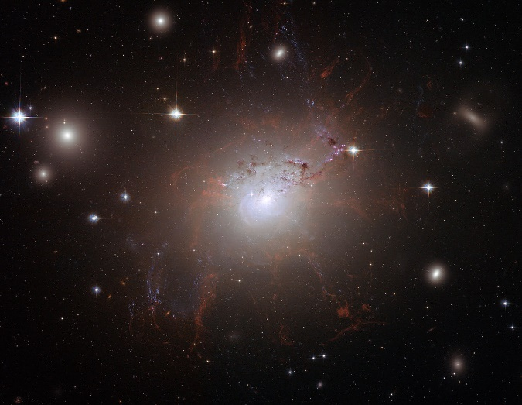
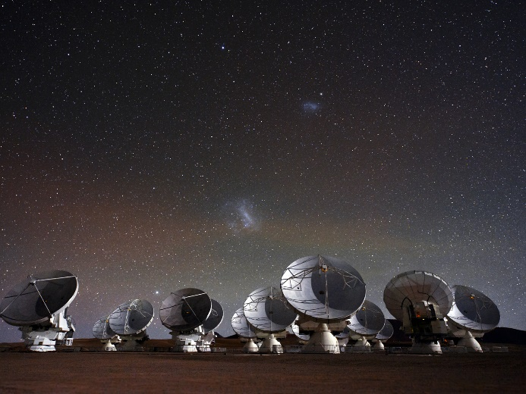
NGC 1275 and ALMA
NGC 1275
  Dec: +41.5°
ALMA
  Latitude: -23.0°
NGC 1275 is marginally observable with ALMA
NGC 1275 (ESA/NASA)
ALMA (ESO)

Slide 36

Difference from M 87
M 87 does not have much cold gas
  M_{mol} = 5×10⁵ M•
    Simionescu et al. (2018)
NGC 1275
  M_{mol} = 1.6×10¹⁰ M•
    Bridges & Irwin (1998)
What makes the difference?
  Future study
M87 (NASA)

Slide 37
Inner jet-core region
RadioAstron space-VLBI mission
  Large initial opening angle (~130⬆)
    Larger than M87 (~100⬆)
  Limb-brightened structure
From accretion to jet launch
NGC 1275 center
0.04 pc
360 r_{g}
Core
Jet
Giovannini et al. (2018)
Notes:
M87 は limb-brightented

Slide 38
Summary
From archival data of VLBA, we discovered the new counterjet of 3C84 in NGC 1275
  Associated with the AGN activities since 2005
Jet inclination angle
  Relatively large (θ = 65➢±16➢)
  Constrain γ-ray emission models
Absorption of the counter jet (N1) by the cirum-nuclear disk
  Density 10⁵ cm⁻³
  Probably inhomogeneous
  The disk has a power-law structure

Slide 39
Summary
Environment around the jet head
  Density ~8 cm⁻³
Mysterious structure observed in the 1990s
  A hole in the disk?
Polarization at the hot spot has been recognized since 2015
  Maybe evidence of a clumpy accretion flow

Slide 40
Summary
We are now analyzing ALMA data
  Rotation of cold gas has been observed
    Cold gas disk
  Hopefully, we will detect cold gas disk inside the conventional Bondi radius
    Evidence of cold gas accretion
    Cold gas accretion may be dominant over hot gas accretion

