Slide 1
Physics and Astrophysics of Radiation mediated shocks
Amir Levinson
Tel Aviv University & YITP
Collaborators: H. Ito, B. Stren, E. Nakar, K. Ioka, O. Bromberg, S. Keren..

Slide 2
Outline
Overview of radiation mediated shocks
Collisionless versus RMS
Shock breakouts
Applications: GRBs, SNe, NS merger

Slide 3
What is a Radiation Mediated Shock?
Shock mechanism: generation and scattering of photons
downstream energy dominated by radiation
upstream plasma is decelerated by scattering of counter streaming photons
Scattered
photons
Upstream
Radiation dominated fluid
Shock transition
mediated by Compton scattering
downstream

Slide 4
Under which conditions RMS form?
Radiation dominance downstream:
Jump conditions :
But requires photon trapping:
(may be altered by PP and KN)

Slide 5
Why is it interesting?
The conditions required to form RMS are always satisfied below the photosphere of fast flows
properties of RMS are vastly different than those of collisionless shocks
Examples: shock breakout in SNe, LLGRB, etc
sub-photospheric shocks in LGRBs
NSNS mergers
accretion flows

Slide 6

Shock breakout
Transition from RMS to collisionless shock..
Breakout signal depends on structure of RMS
Breakout when
- From edge of stellar envelop (SNe).
- From a stellar wind (SNe, LLGRB)
- From a moving ejecta (LGRBs, NS mergers)
simulations: Gotellib + 17

Slide 7
Collisionless shocks versus RMS
collisionless
Scale: c/ω_{p} ~ 1(n₁₅)^{-1/2} cm , c/ω_{B}~ 3ε(B₆)⁻¹ cm
can accelerate particles to non-thermal energies.
Plasma turbulence
Upstream
downstream
Shock transition mediated by collective plasma processes
RMS
scale: (σ_{T} n β_{s})⁻¹ ~ 10⁹ n₁₅⁻¹ cm
microphysics is fully understood
cannot accelerate particles (important implications for HE neutrino production)
Scattered photons
Upstream
Radiation dominated fluid
downstream
Shock transition mediated by Compton scattering

Slide 8
Photon source: two regimes
Photon starved shocks: photon production inside the shock (SNe, LLGRB, NS merger)
Photon rich shocks: photon advection by upstream fluid (LGRBs)
Photon advection
Upstream
downstream
Photon production - ff

Slide 9
Photon rich shocks
AL+Bromberg 08; Bromberg+11; AL12; Keren+AL14; Beloborodov16; Ito+17
Radiation upstream characterized by:
Inertia ratio
Photon-to-baryon ratio
Downstream temp:
Vigorous pair production at:

Slide 10
Thermalization layer
shock transition
Immediate downstream
T_{d}, e_{rd}
Upstream
Thermalization layer
T_{BB} < T_{d}
AL 12
Free-free: τ′_{ff} = 10⁵Λ_{ff}⁻¹ (n_{u15})^{−1/8}γ_{u}^{3/4} R
τ′_{ff} = 10^{5.5}Λ_{ff}⁻¹ (n_{u15})^{−1/8} β_{u}^{11/4} NR
T/T_{d}
Double Compton: τ′_{DC}= 10⁶ Λ_{DC}⁻¹ (n_{u15})^{−1/2}γ_{u}⁻¹

Slide 11
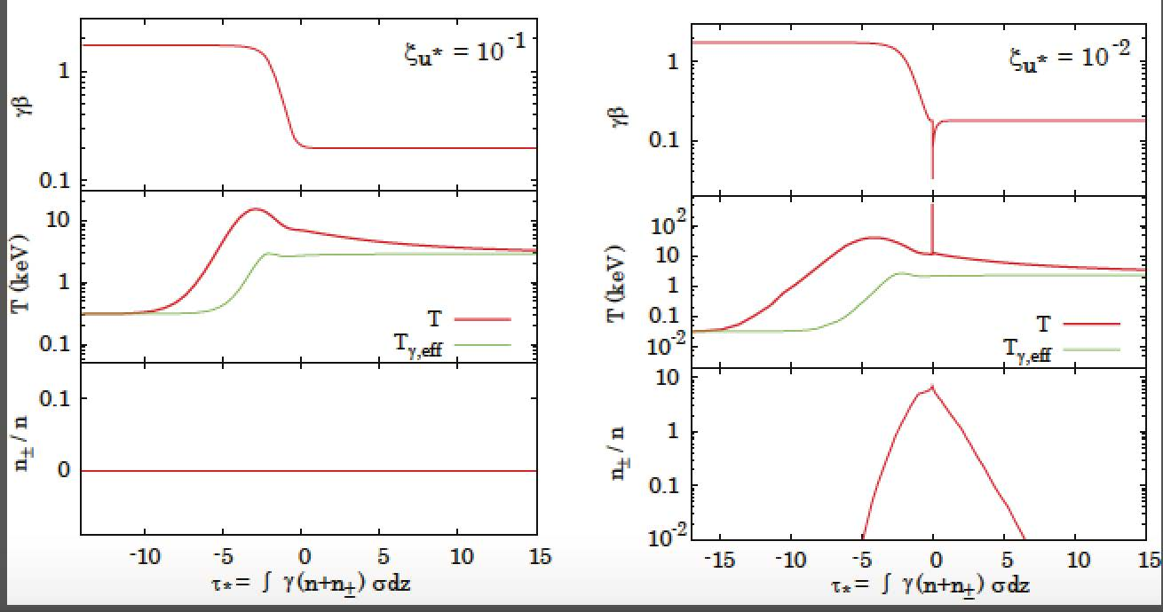
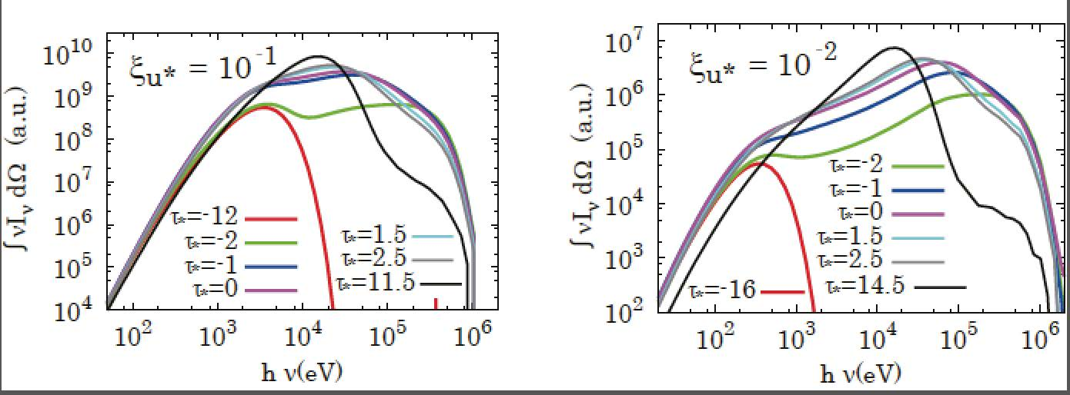
Monte-Carlo simulations (Ito + 18)
includes
- Inverse Compton
- pair creation
- Exchange with bulk
- Bremsstrahlung
- energy-momentum solver

Slide 12
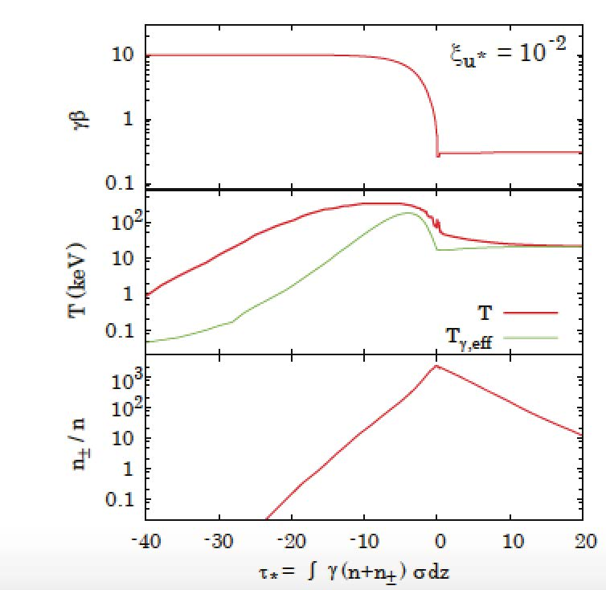
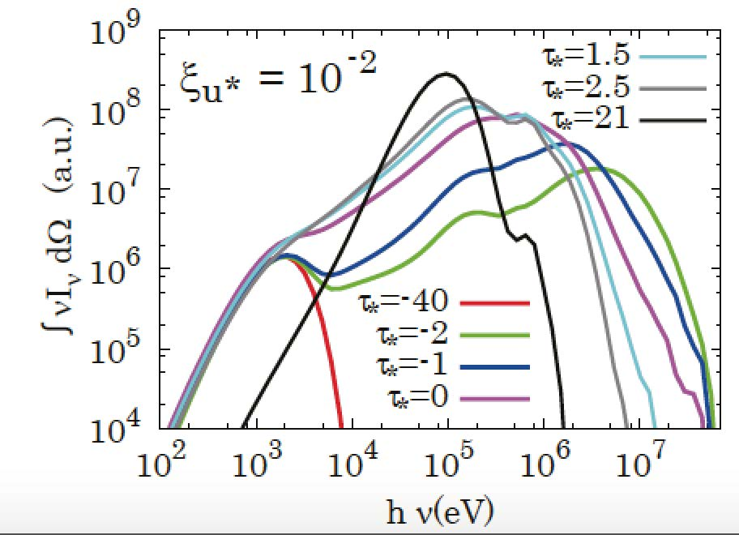
Highly relativistic RMS

Slide 13
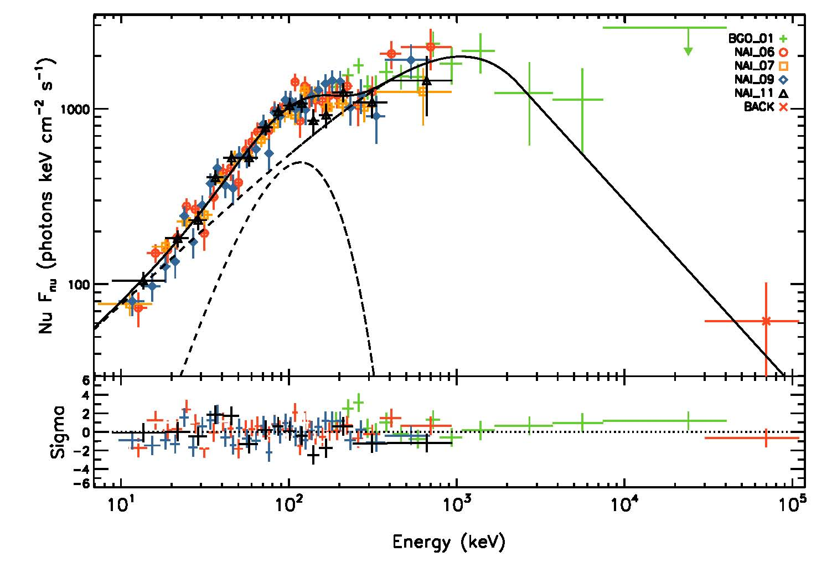
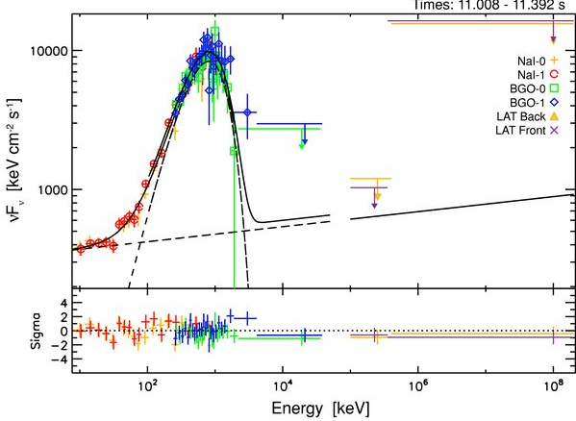
GRBs: sub-photospheric shocks
AL 12, AL+Keren 14, Beloborodov 17, Ito+18
Evidence for photospheric emission ? (Peer+Ryde)
Band spectrum from photospheric emission? (Beloborodov 13, Vurm+ 13, Keren+AL 14, Ito + 15, Lazzati 16)

Slide 14
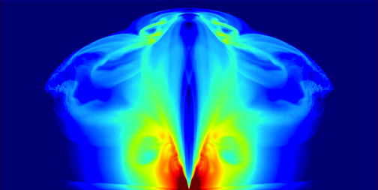
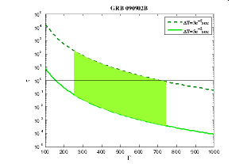
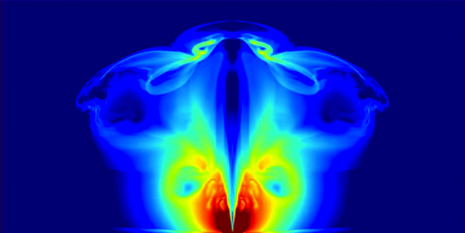
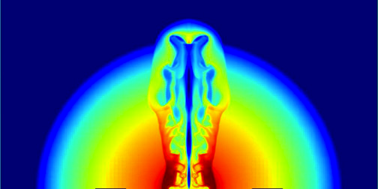
Formation of sub-photospheric RMS
High specific entropy → photon rich RMS (AL 12)
Oblique shocks
Internal shocks
Sub-photospheric shocks
collisionless shocks
Bromberg + 11
Lazzati + 09

Slide 15
Spectra from Monte-Carlo sim. (Ito+18)
downstream moving photons
upstream moving photons
Calculations during breakout phase needed !!

Slide 16
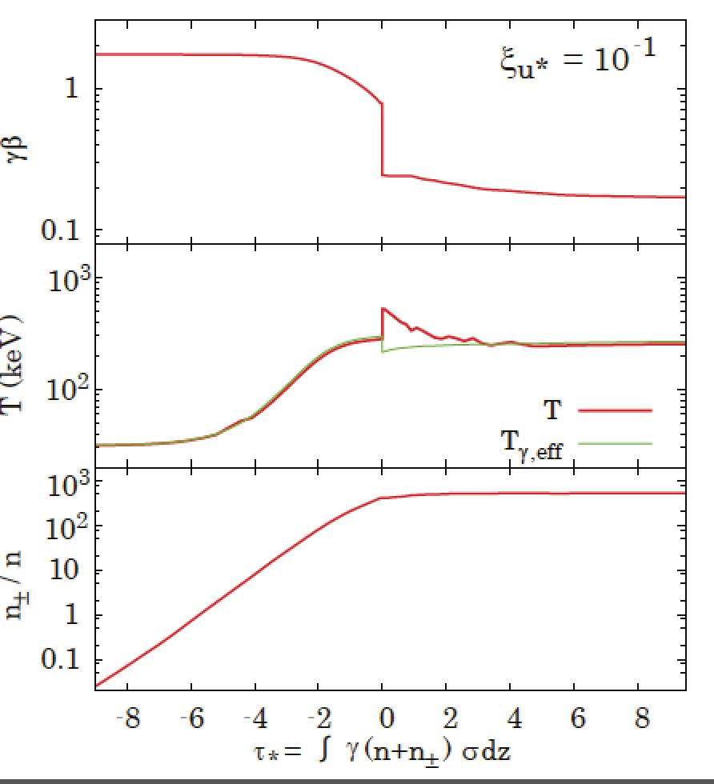
Transition to photon starved regime
Exmp: no photon generation
# of photons needed to mediate the shock:
Collisionless subshock
In reality if upstream photon generation inside shock dominates

Slide 17
Photon starved RMS
Form when
Photons are generated via bremsstrahlung inside the shock
Apply to SNe, LLGRBs, NS mergers

Slide 18
Solutions: cold upstream (eg., shock breakout in SN)
KN effects + self opacity by pp important !
Numerical solutions – Budnink +10
Analytic solutions - Nakar+Sari 12, Granot+18
Shock width
(in shock frame)
Δ_{s}=0.01(σ_{T}n_{u})⁻¹γ_{u}²
Optical depth inside shock is dominated by e± pairs
Velocity profile

Slide 19
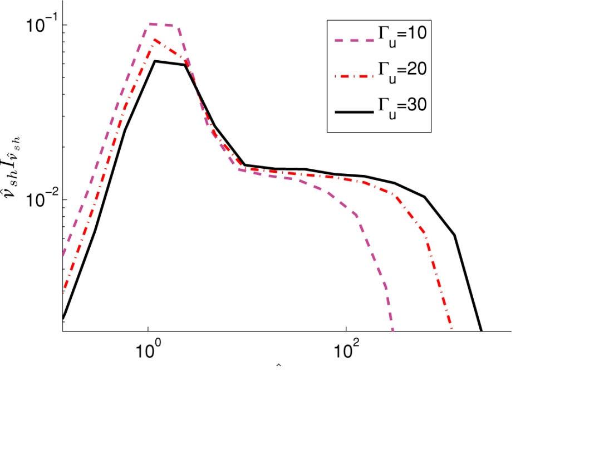
Cold upstream - SED in shock frame
T_{s} ∼ 200 keV
hν/m_{e}c²
Budnik et al. 2010
Temperature in immediate downstream is regulated by pair production

Slide 20
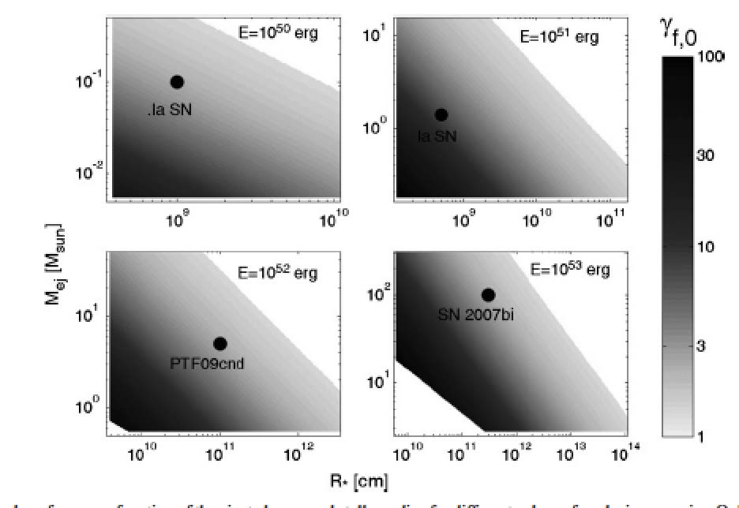
Relativistic RMS from stellar explosions
Nakar+Sari 12

Slide 21
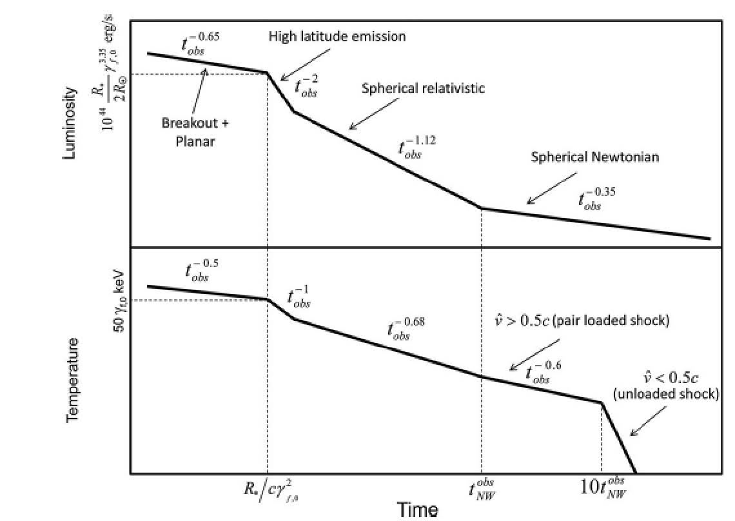
Breakout from a stellar envelope
Nakar+Sari 12
Observables can be used to extract information on the progenitor.

Slide 22
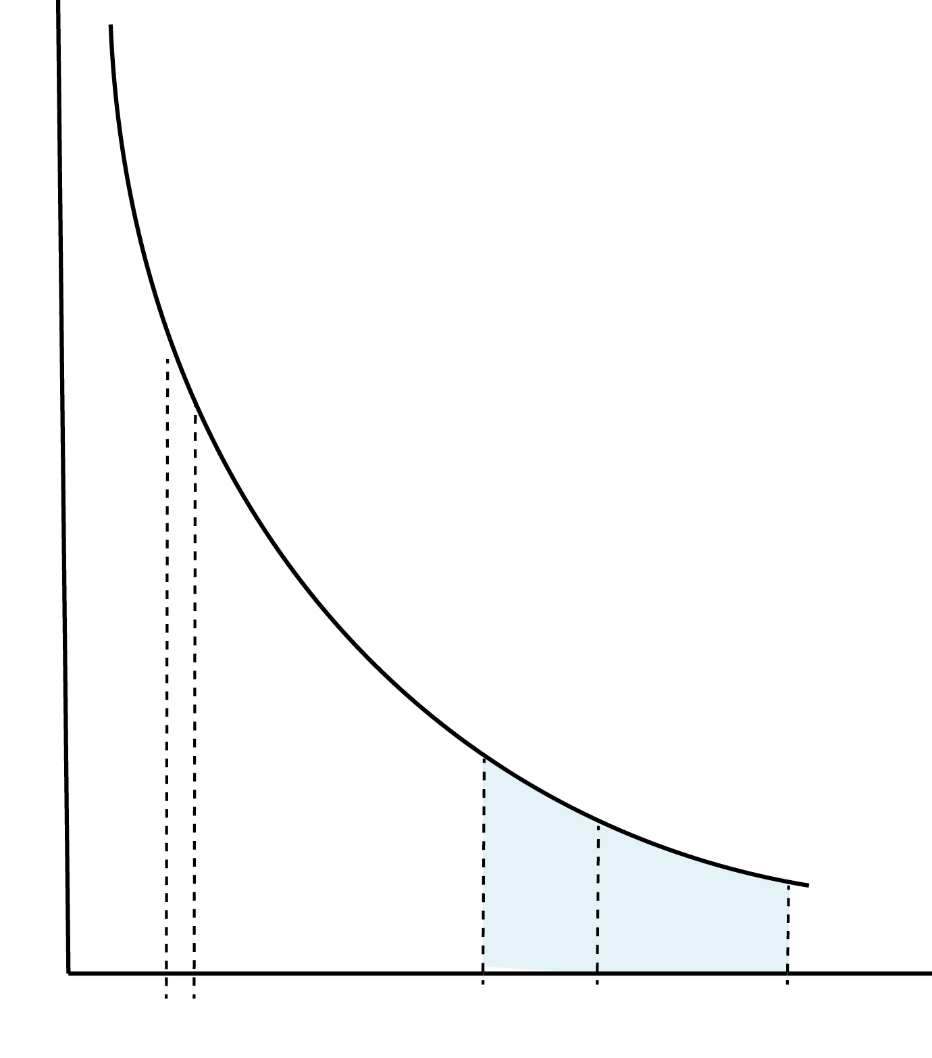
Breakout from a thick stellar wind
Granot, Nakar, AL 18
Optical depth decline as as shock moves out
Photon leakage commences when
Complete breakout when.
Photons trapped
Leakage starts
breakout

Slide 23
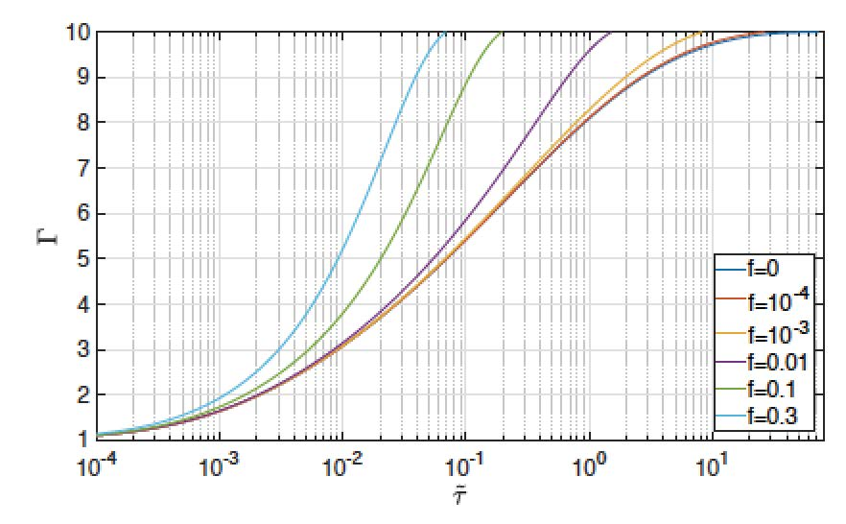
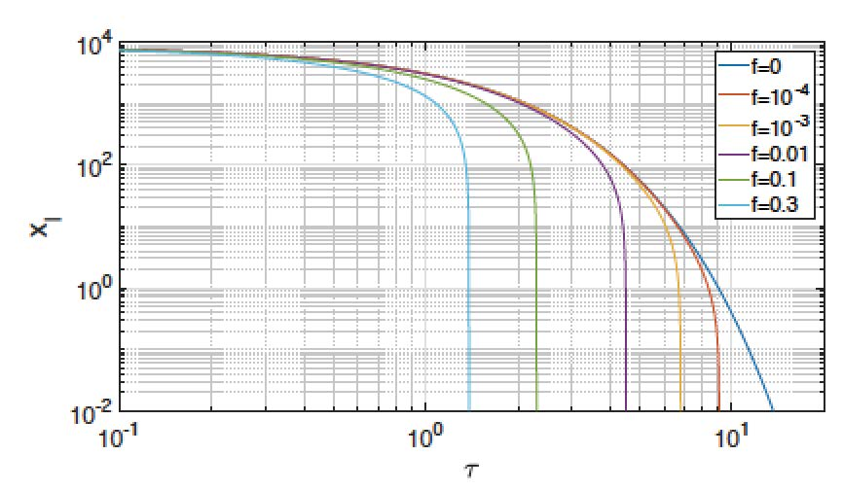
Solutions with photon escape
Granot +18
f = fraction of (downstream) photons that escape
Pair loading

Slide 24
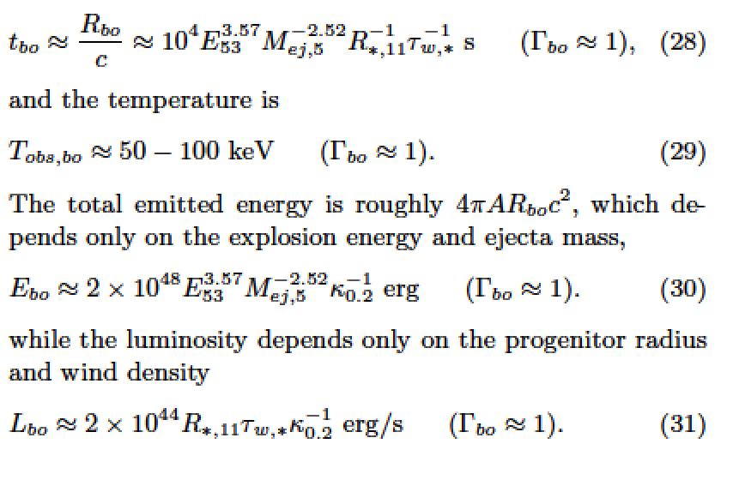
Breakout signal is different than in sharp edge .

Slide 25
NS merger: cocoon breakout from a chocked jet (Kasliwal+17, Gottelibe+17, Nakar+17)
simulations: Gotellibe/Nakar

Slide 26
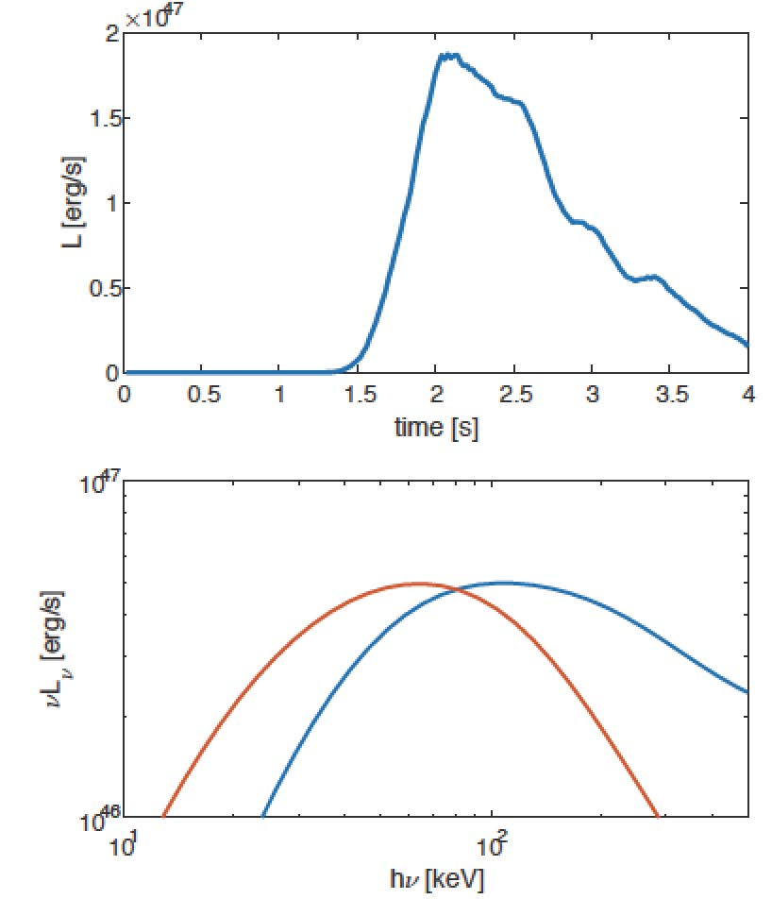
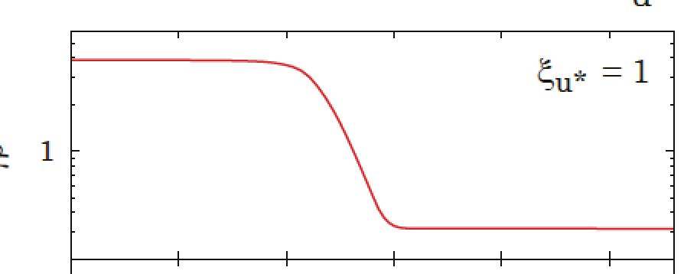
Light curve and spectra from model
Gotellibe+17
Main pulse from breakout shell. Hard spectrum
Soft component from deeper shocked shells

Slide 27
Conclusions
RMS are expected to form in regions where the Thomson optical depth exceeds unity.
Such conditions prevail in stellar envelopes, thick stellar winds, NS merger ejecta, LGRBs, etc.
Shock breakout signal depends on RMS structure

