Slide 1


A Numerical Explanation of llGRBs high rate in the local Universe
Hamid Hamidani
Yukawa Institute For Theoretical Physics
Yukawa Institute For Theoretical Physics, Kyoto
May 16th 2018

Slide 2
Collapsar Model For LGRBs
Woosley 1993; MacFadyen et al., 1999 & Woosley et al., 2006
Theory:
The energy output: ~ 10⁵² ergs
Can produce relativistic jets (Γ>100)
Observation:
Found in high SFR/low Z environment (Savaglio et al., 09)
GRB-SN connections: SN1998bw, 2003lw…
(Credit: T. Totani)

Slide 3
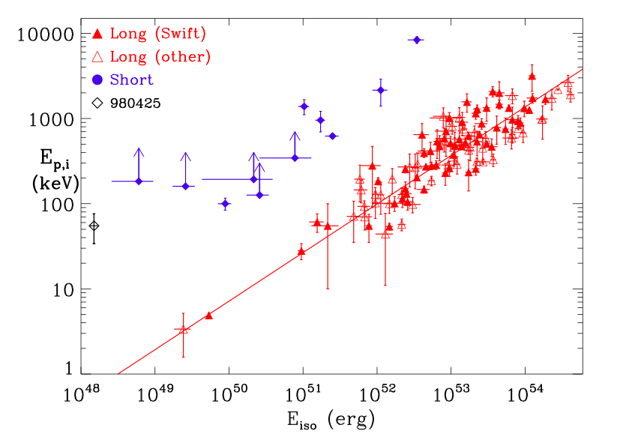
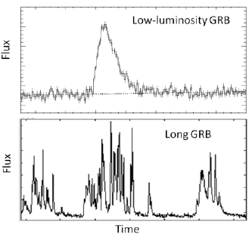
A new team: llGRBs
Smoother and ~10 000 softer than LGRBs
  Mildly relativsitic Shock breakouts (Bromberg+ 2012, Nakar+ 2014, 2015)
Nearby ➔ Huge rates!
Associated with exceptionally energetic SN (BL)
SGRBs
LGRBs
llGRBs
Mind the gap!
llGRBs
Amati et al., 2008 & 2010

Slide 4
llGRB features: I. Rates
I) Huge rates, ~100 times LGRBs
  Coward 2005: ~220 Gpc⁻³ yr⁻¹
  Piran et al., 2006: ~110 Gpc⁻³ yr⁻¹
  Soderberg et al., 2006: ~260 Gpc⁻³ yr⁻¹
  Cobb et al., 2006: the rate of llGRBs/GRBs ~300 - 1000
  Liang et al., 2007: ~325 Gpc⁻³ yr⁻¹
  Guetta & Della Valle 2007: ~380 Gpc⁻³ yr⁻¹
  (The rate of GRB is ~1 Gpc⁻³ yr⁻¹ Piran+ 2006)
II) Strong SN connection
  980425/1998bw
  031203/2003lw
  060218/2006aj
  100316D/2010bh
  120422A/2012bz
  All associate with BL SNe
  Ibc rate is ~9 000 Gpc⁻³ yr⁻¹ & BL rate is ~450 Gpc⁻³ yr⁻¹ (Soderberg+06)
Nearby Universe
GRB | SN | z | T₉₀ (s) | E_{iso} (10⁴⁹ erg) | E_{K} (10⁵² erg)
980425 | 1998bw | 0.0085 | 35 | 9 | 5
031203 | 2003lw | 0.1055 | 37 | 17 | 6
060218 | 2006aj | 0.0334 | 2100 | 4 | 0.2
100316D | 2010bh | 0.0591 | 1300 | 6 | 1
Credit: Liang et al., 2007 & Hjorth & Bloom 2011

Slide 5
The General Picture
llGRBs
  Weak prompt emission
  Bright SN
LGRBs
  Bright prompt emission
  SN-less

Slide 6
Regularities and Irregularities
llGRBs (BL SN)
  SN-less nearby llGRB-like events:
  GRB060505 (z ~ 0.089)
  GRB111005A (z ~0.01 2nd closest)
LGRBs (SN-less)
RareLGRB-SN associations:
- LGRB 030329 (Mazzali+03) (why?)
- A trio of LGRB SNe (Cano+13)
SN-less :
e.g. GRB060614 (z ~ 0.125)
    M_{Ni56} < 0.001 M_{sun}
Credit: Melandri+12; Cazo+13

Slide 7
e.g. GRB 060614
Hjorth 2011 & 2013

Slide 8
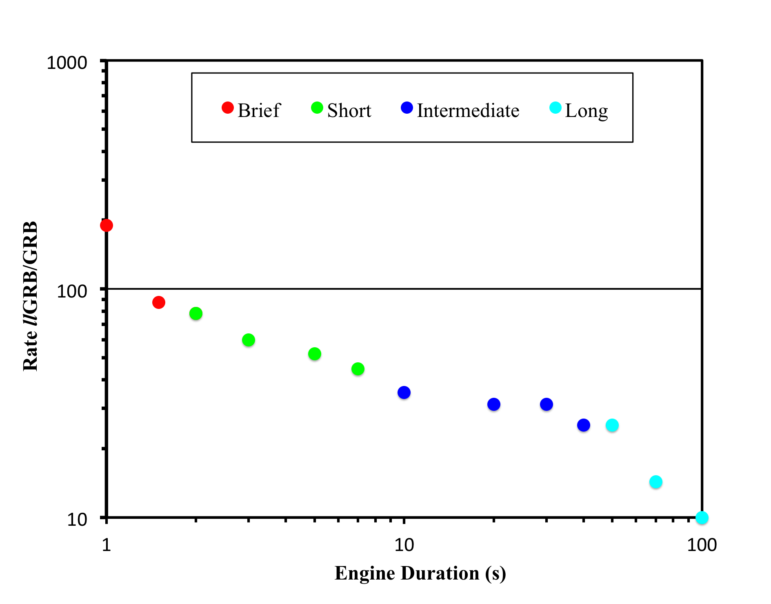
llGRBs
domain
GRBs
domain
Notes:
The regin where llgrb are 100 times is the rregion of how our universe looks like

Slide 9
Regularities and Irregularities
llGRBs:
Type1 Rarely Weak/No SN
Type2 Frequently Powerful SN
LGRBs:
Type1 Frequently Weak/No SN
Type2 Rarely Powerful SN
llGRBs
domain
GRBs
domain
Notes:
The regin where llgrb are 100 times is the rregion of how our universe looks like

Slide 10
llGRBs origin:
Off-axis successful jet Vs. failed jet

Slide 11
Decoupling of the
Central Engine & Stellar Envelope
  T_{eng} T_{breakout}
Jet head
log ρ
Backflow
Stellar surface
Cocoon pressure
Cocoon
CSM
Collimated jet
(shocked)
Turbulence
Energy deposition
collimation
shock
Pre-collimated jet
(unshocked)
Central engine
Notes:
Produce different collapsars with different degree of failure success in the lab
Tinj is a proxy

Slide 12
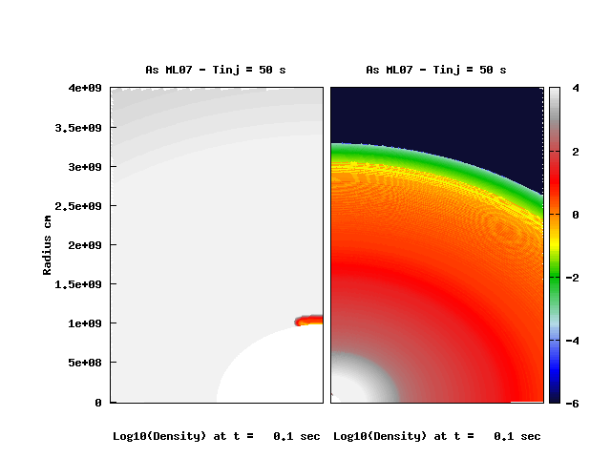
A Successful jet
Notes:
Produce failed jets in the laboratory

Slide 13
Jets Failure or Success
A quantitative manipulation
  T_{inj} = 0.01-100s → T_{inj} / T_{breakout} ~ 0.1-20
Jet head
log ρ
Backflow
Stellar surface
Cocoon pressure
Cocoon
CSM
Collimated jet
(shocked)
Turbulence
Energy deposition
collimation
shock
Pre-collimated jet
(unshocked)
Central engine
Notes:
Produce different collapsars with different degree of failure success in the lab
Tinj is a proxy

Slide 14
Method: 2D HD simulations
Stellar Model
  Progenitor: 25 solar mass WR star
  Radius: ~ 3.3×10¹⁰ cm (Umeda et al., 2005)
Jet Initial conditions:
  T_{inj} ： from 0.01 to 100s
  θ_{op} = 10º
  f_{th} = 0.975
  Γ₀ = 5 (Bernoulli equation: Γ_{max} = hΓ = 160)
Grid:
  R_{in} = 10⁸ to R_{out} = 3×10¹² (∆r_{min} = 9.7×10⁶ to ∆r_{max} = 10¹⁰ cm )
  N_{θ} = 256 (from ∆θ₀ = 0.088° to ∆θ_{max} = 0.896°)
Credit: Tominaga et al., 2007

Slide 15
The assumptions
Prompt Emission
Γ < 10 outflow has no contribution
(Morsoney, Lazzati, Begelman 2007)
Radiation efficiency 1- 10%
(From Swift LGRBs’ jet break; Zhang+ 2007)
The SN
Material with v < c/10 energetically contributes to E_{K,sn}
GRB-SNe powered in the jet-star interaction (Zhang, Woosley, MacFadyen 2003)

Slide 16
Data/Observations → Mechanism → Origin

Slide 17


Hydrodynamic Spreading
1/Γ
E, Γ
Notes:
This approximately accounts for the hydrodynamic spreading (or sideways expansion) of that element of the jet and for the relativistic beaming of radiation eventually emitted by that material.

Slide 18
I) Rates

Slide 19
Deriving the probability of observation
Hydro → Angular distribution (assumptions) → P(E_{iso})
E_{iso}(θ)
E_{iso} (P)
Radius
Energy integration overtime
Estimation of the prompt emission energy
“E_{iso}”
10⁵²⁻⁵⁴ erg
P(GRB)
Relativistic jet
P(llGRB)
10⁴⁷⁻⁴⁹ erg
Central Engine
Angle θ
Angle θ
Probability

Slide 20
Angular distribution & Probabilities
P(GRBs)
E_{iso}(θ)
E_{iso}(P)
T_{inj}/T_{b}
P(llGRBs)
L
I
S
B
θ
P(E_{iso})
Notes:
Failed can make LGRBS

Slide 21
The rates’ ratio
Failed jets (alone) result ~ 100 llGRBs per one LGRB
Remember: LGRBs ~1Gpc/yr; llGRBs~100Gpc/yr
llGRBs
domain
No GRB
Ib/c SN?
llGRB estimated rates
GRBs
domain
Successful
(<65 Cobb+06)
Non-relativistic
<<1
Failed
<1
Notes:
The regin where llgrb are 100 times is the rregion of how our universe looks like

Slide 22
Allowed Collapsar duration distribution in the universe
➔A power law index ≥ 1 is needed to explain llGRBs high rates…
Bromberg+12: simple extrapolation suggest p ~ 3-4
Not enough llGRBs
Bromberg+12:
~3 – 4

Slide 23
Two Contribution channels
llGRBs:
Successful jet (off-axis) (low P )
Failed jet (off-axis) (high P)
LGRBs:
Successful jet (on-axis) (high P)
Failed jet (on-axis) (low P)
llGRBs
domain
GRBs
domain
Notes:
The regin where llgrb are 100 times is the rregion of how our universe looks like

Slide 24
II) The SN

Slide 25
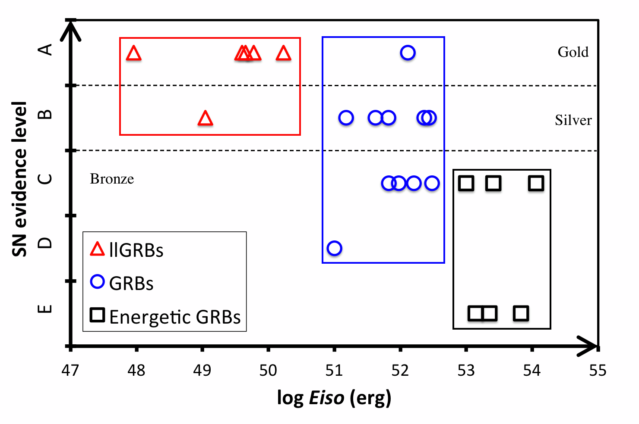
SN-GRB connection
The less energetic the GRB, the higher the SN evidence is:
  Biased with redshift?
    GRB 060614 & GRB 060505 are at low redshift, though SN-less GRBs…
  ➔ Are the SNe fundamentally different? e.g in the energy?
Hjorth 2011 & 2013; Zhang et al., 2012

Slide 26
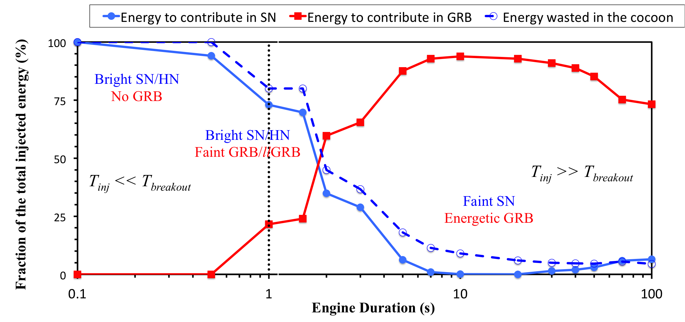
SN vs. GRB energy reservoir
SN reservoir (solid): Non-relativistic ejecta (< 30 000 km/s) (Zhang+03)
GRB/jet reservoir: Relativitc outflow (Γ > 10) (Morsony+07)
Cocoon energy (dashed): Energy wasted in the cocoon (Ramirez-Ruiz+02)
➔llGRB => Energetic SN
➔GRB => Much less energetic SN (observationally SN-less LGRBs?)

Slide 27
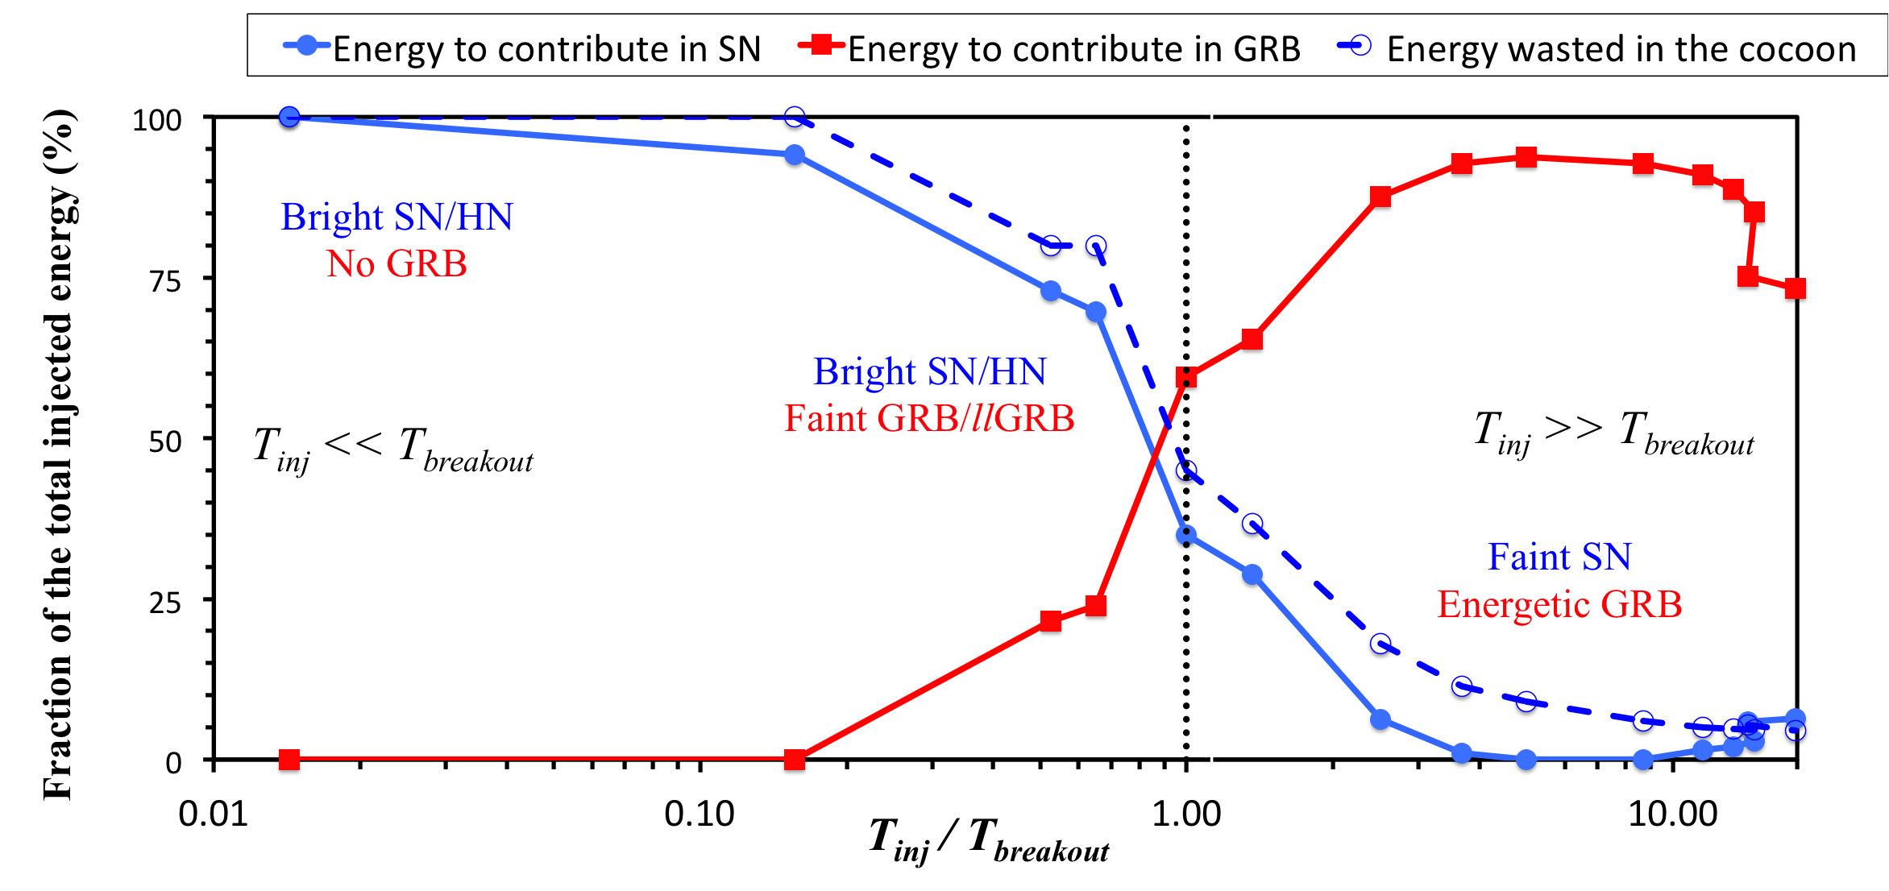
T_{inj} ~ T_{breakout}
Ramirez-Ruiz et al., 2002 & Zhang et al., 2003

Slide 28
⁵⁶Ni synthesis (preliminary)
llGRBs
domain
GRBs
domain
Failed (T_{inj} / T_{breakout} ~ 0.5)
t = 0.1s: M_{ni} ~ 0.0416 M_{sun}
Successful (T_{inj} / T_{breakout} ~ 5)
t = 0.1s: M_{ni} ~ 0.0016 M_{sun}
Notes:
The regin where llgrb are 100 times is the rregion of how our universe looks like

Slide 29
Two Contribution channels
llGRBs:
Successful jet (off-axis) (high P) Weak SN
Failed jet (off-axis) (high P) Powerful SN
LGRBs:
Successful jet (on-axis) (low P) Weak SN
Failed jet (on-axis) (low P) Powerful SN
llGRBs
domain
GRBs
domain
Notes:
The regin where llgrb are 100 times is the rregion of how our universe looks like

Slide 30
Naïve Predictions
The SN-less GRB 060614:
An off-axis observation of a successful jet (T_{inj}/T_{b}>>1)
LGRB 030329 / SN 2003dh:
An on-axis observation of a failed jet (T_{inj}/T_{b}<1)
SN-less llGRB 111005A:
An off-axis observation of a successful jet (T_{inj}/T_{b}>>1)

Slide 31
Conclusion
Rates:
llGRB high rate relative to LGRB can be explained with failed jets
  Brief engine, large θ, M_{ext} (Nakar 15), Progenitor…
An index p ≥ 1 for T_{ing} distribution can explain the whole rates!
  Small T_{inj}/T_{b} should be favored
SN:
General trend (llGRB-SN & LGRB SN-less) explained
Outliers/irregularities also explained
Prediction:
Dimer transients than llGRBs with order of magnitudes even higher rate yet to be detected…

Slide 32
Backup Slides

Slide 33
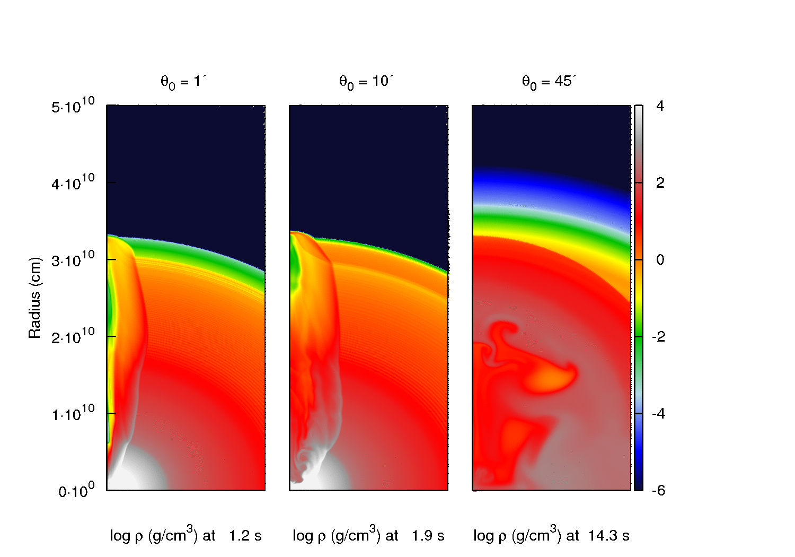
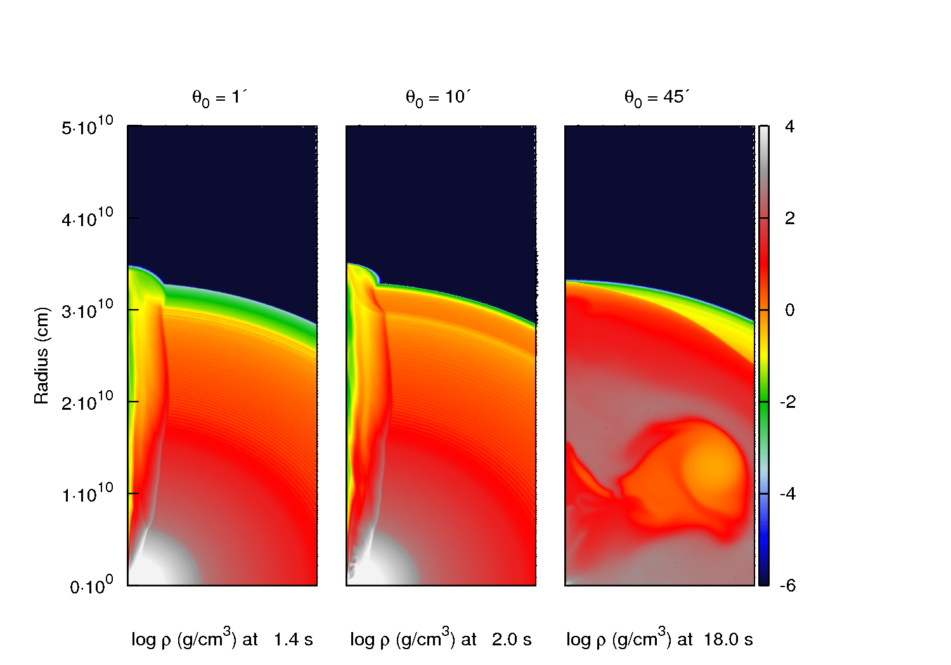
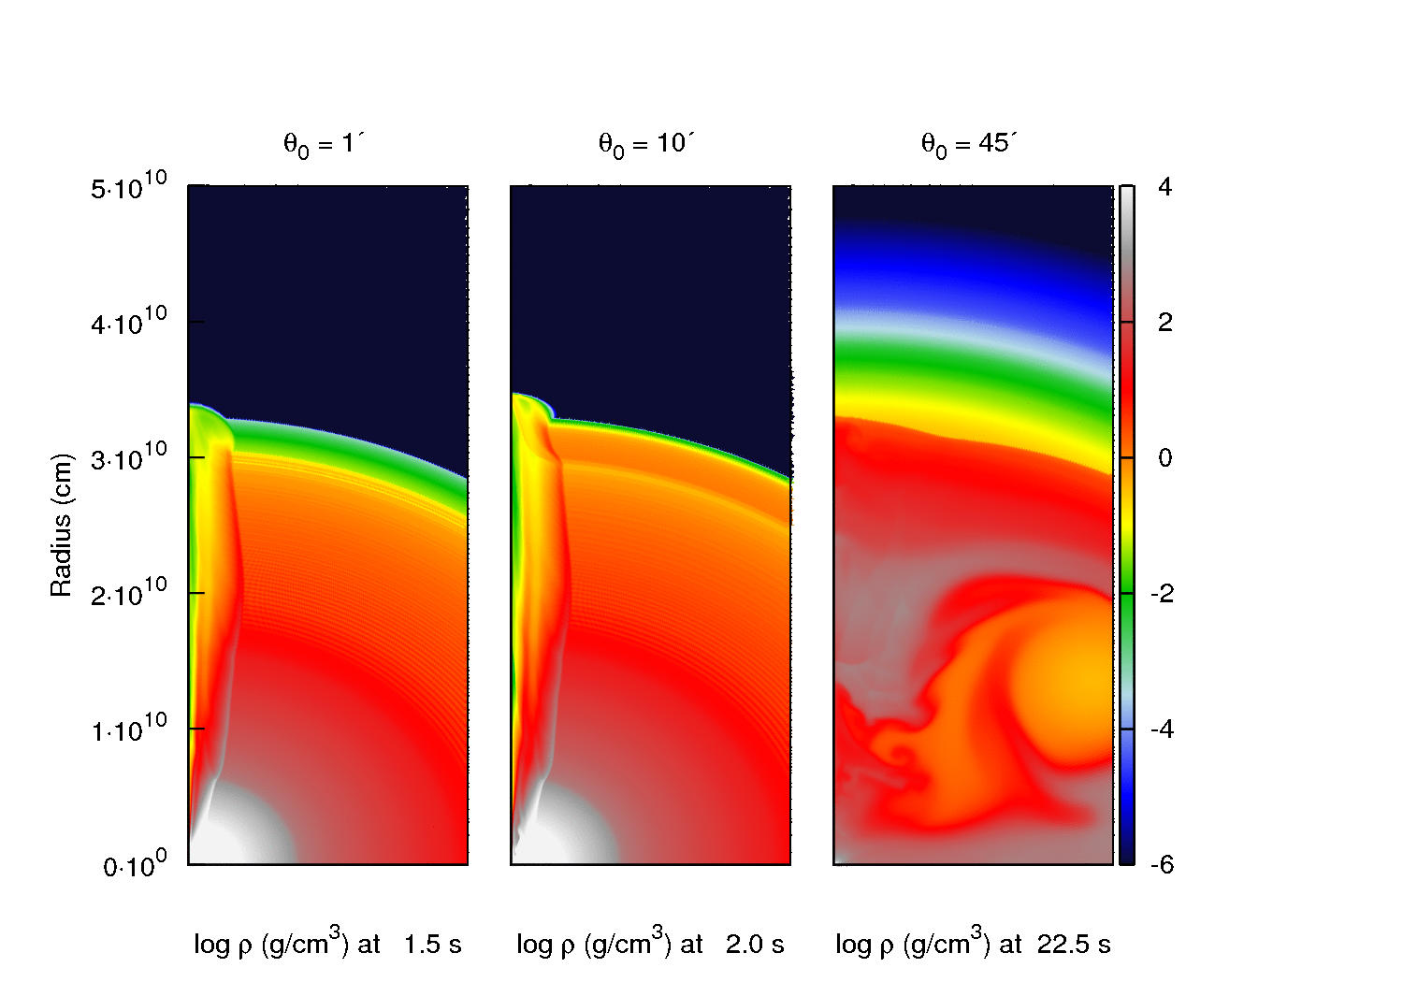
Wide Jets → large T_{inj}/T_{breakout}

Slide 35
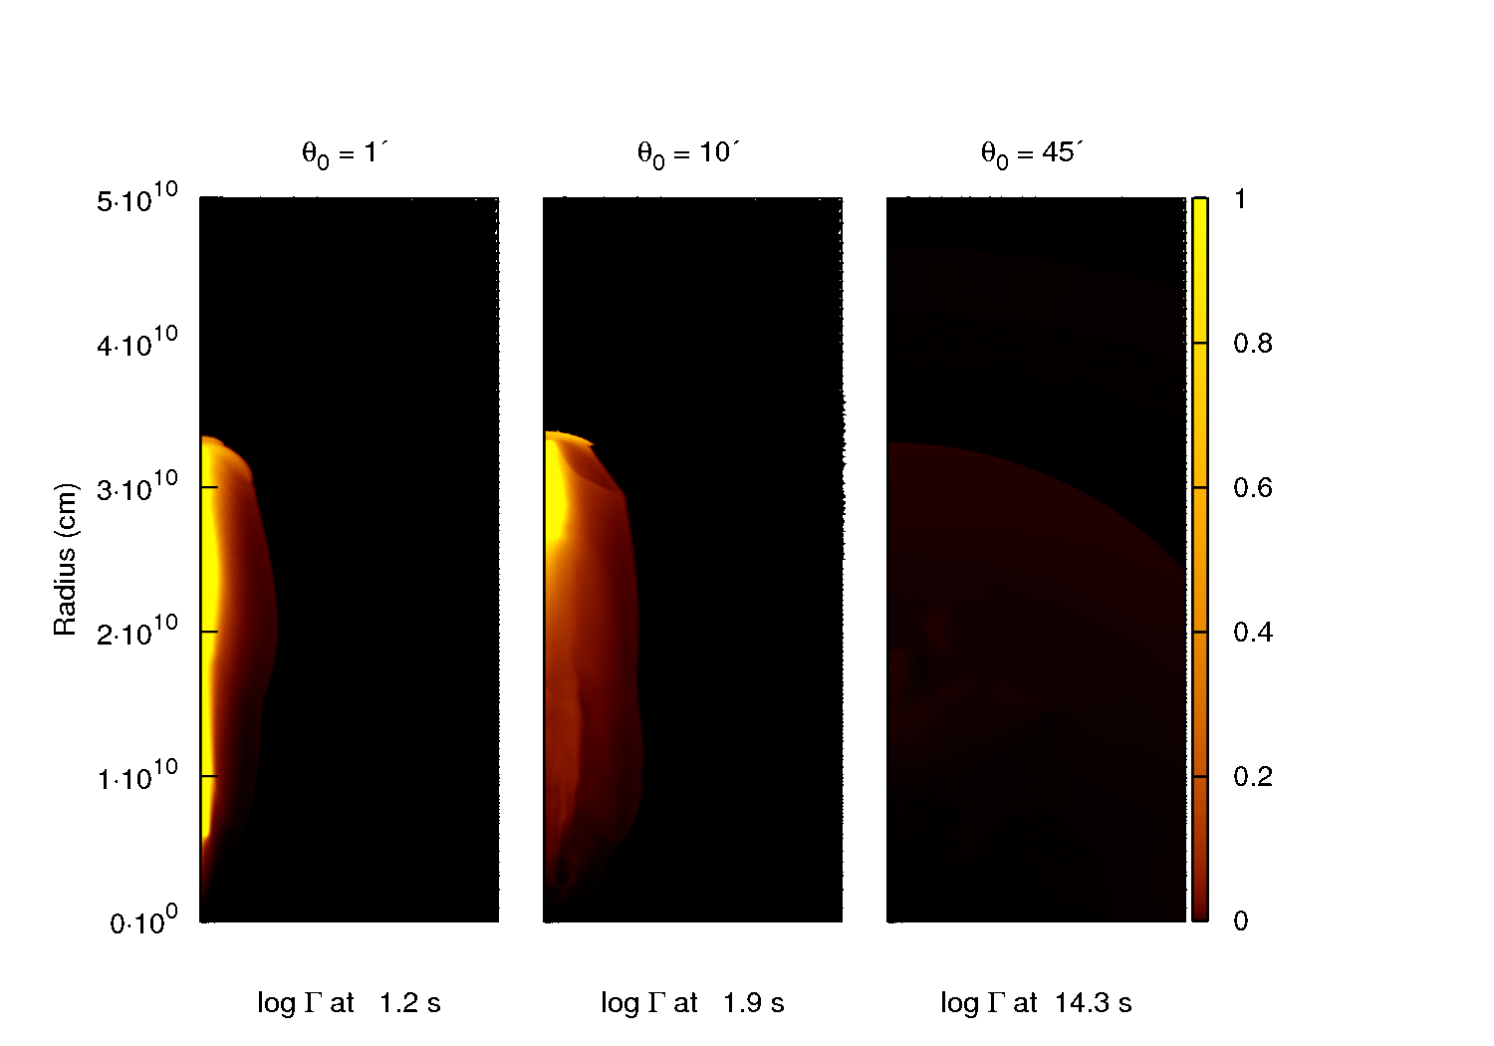
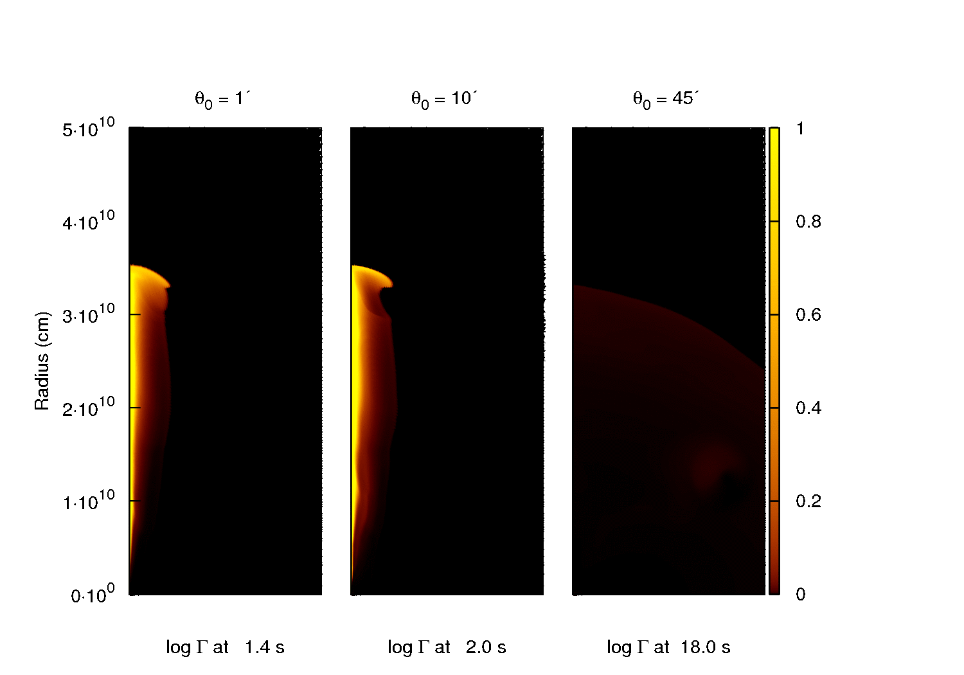
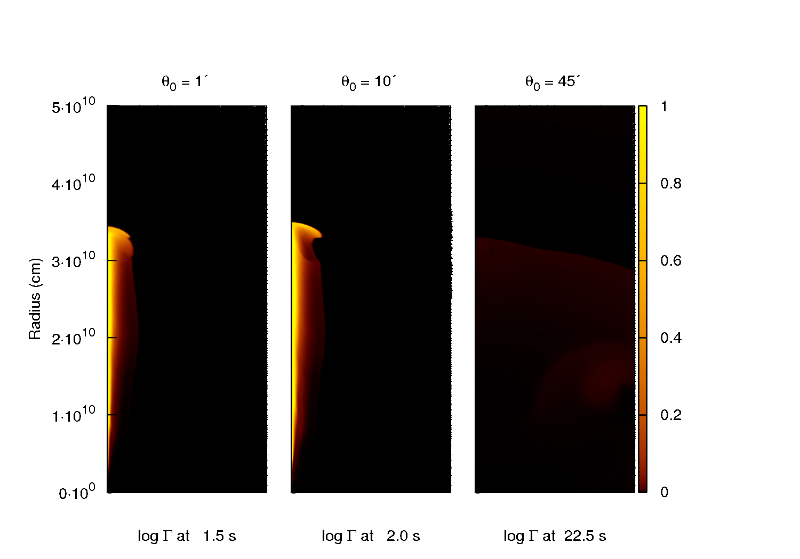
Breakouts
Not all long jets are successful
Breakout times differ significantly
Engine Duration (T_{inj}):
1s
5s
10s
Opening Angle (θ₀):
45, 10 & 1°

Slide 36
The Main Findings

Slide 37
A trio of gamma-ray burst supernovae:
GRB 120729A, GRB 130215A/SN 2013ez, and GRB 130831A/SN 2013fu
Not Ic BL SNe
Unusually low expansion velocities (lowest ever for a GRB-SN):
  ~4000 – 6350 km s⁻¹
Credit: Cano et al., 2014

Slide 38
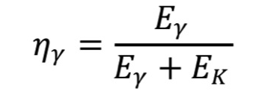
Some Assumptions
Radiative efficiency η_{γ} = 1% (Zhang et al., 2007) for outflow moving with Γ > 10 :
Prompt emission is released inside the computational domain (Lazzati et al., 2010)
llGRB: E_{iso} ≤ 10⁴⁹ erg & LGRB: E_{iso} ≥ 10⁵² erg
Hence, probability to observe E ≥ x, and the rates ratio llGRB/GRB can be written as:
SGRBs
LGRBs
llGRBs
Mind the gap!
llGRBs
Zhang et al., 2007 & Amati et al., 2009

Slide 39
LGRB
Progenitor?
Compact WR star of ~ 25 solar mass & 10¹⁰⁻¹¹cm (Iwamoto+98; Matzner 03 & Campan+06)
Mechanism?
Deposition?
  Polar: θ_{op} ~ 10º
  Hot: f_{th} = 0.975
Mildly: Γ₀ = 5
Collapsar engine: Neutrino/MHD (MW99; Nagataki+07; Harikae+09)
The engine timescale T_{inj}?
Explosion energy?
θ_{op}
f_{th}
Γ₀
Theoretically: Not well-understood
From GRB-SN: ~10⁵² ergs
(Iwamoto+ 98; Nomoto+ 06; etc.)
From observations:
T₉₀ distribution
10⁵² erg collapsar
I. Lazzati+13:
~10 – 20s for BATSE (<100s)
Short T_{inj} as well!
- Numerical study -
The role of T_{inj}:
10⁵² erg collapsars with various T_{inj} (0.1-100s) & θ_{op}
(link to GRB diversity?)
II. Bromberg+ 12:
Power law ~3 to 4 (<100s)

Slide 40
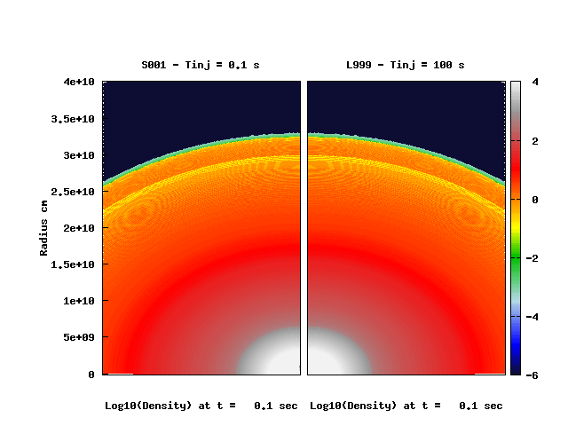
The contrast: Brief vs. Long

