Slide 1
Relativistic Radiation Mediated Shocks
Hirotaka Ito RIKEN
Collaborators
Amir Levinson (Tel Aviv Univ)
Boris Stern (INR RAS)
Shigehiro Nagataki (RIKEN)
＠ Jet and Shock Breakouts in Cosmic Transients 2018 /5/16

Slide 2
Plan of this talk
Introduction
・Brief overview of Radiation Mediated Shocks (RMS)
・Non-relativistic and Relativistic RMS (RRMS)
・Motivation
Self-consistent calculation of RRMS
・Method for deriving steady solution for RRMS
・Results
Summary

Slide 3
Radiation Mediated Shocks (RMS)
Scattered
photons
Upstream
Radiation dominated fluid
Shock transition
mediated by Compton scattering
downstream
downstream energy dominated by radiation
upstream plasma approaching the shock is decelerated by scattering of counter streaming photons

Slide 4
Under which conditions a RMS forms ?
Weaver 1976
(I) Radiation dominance downstream: aT_{d}⁴ > n_{d} kT_{d}
from jump conditions: n_{u}m_{p}c²β_{u}² ≈ aT_{d}⁴
⇓
β_{u} > 4×10⁻⁵ (n_{u} /10¹⁵ cm⁻³)^{1/6}
(II) Photon trapping at shock region
Diffusion time t_{D} ≈ shock crossing time t_{sh}
⇓
τ >> τ_{dec} ∼ 1/ β_{u}
Relevant Astrophysical Phenomena
Shock breakout (e.g, SN, LLGRB, BNS merger)
Shocks in Accretion flows (e.g., AGN, μQSO)
Shocks in Jet (GRB)

Slide 5
Non-relativistic .vs. Relativistic
Non-relativistic RMS
small energy gain: Δε/ε<<1
diffusion approximation holds.
Zeldovich & Raiser 1967; Weaver 1976; Blandford & Payne 1981;
Relativistic RMS (RRMS)
photon distribution is anisotropic
energy gain large: Δε/ε >1
optical depth depends on angle: τ α (1−β cosθ)
copious pair production
Levinson & Bromberg 08; Katz et al. 10; Budnik et al. 10; Beloborodov 2017

Slide 6
Self-consistent numerical calculation of RRMS
Photon Rich regime : photons advected from the upstream is dominant
Levinson & Bromberg (2008)
Energy integrated intensity, Klein-Nishina effect, pair production neglected
Beloborodov (2017)
Full radiation transfer, effects of magnetic field considered,
pair production neglected
Lundman et al. (2018)
Full radiation transfer, pair production effect included,
some approximation is given on the temperature calculation
Ito et al. (2018)
Full radiation transfer with pair production, no optimistic approximation
wide range of upstream condition is covered
Photon Starved regime : photons produced in the downstream is dominant
Budnik et al. (2010)
Full radiation transfer with pair production and bremsstrahlung emission
some assumption on cross sections. 6 < Γ < 30
Shock Breakout simulation has not been performed

Slide 7
Self-consistent numerical calculation of RRMS
Photon Rich regime : photons advected from the upstream is dominant
Levinson & Bromberg (2008)
Energy integrated intensity, Klein-Nishina effect, pair production neglected
Beloborodov (2017)
Full radiation transfer, effects of magnetic field considered,
pair production neglected
Lundman et al. (2018)
Full radiation transfer, pair production effect included,
some approximation is given on the temperature calculation
Ito et al. (2018)
Full radiation transfer with pair production, no optimistic approximation
wide range of upstream condition is covered (15 models)
2< Γ_{u} < 10, 0.01 < ξ_{u} < 10, 10³ < n < 10⁵
structure, spectra, application to GRBs

Slide 8
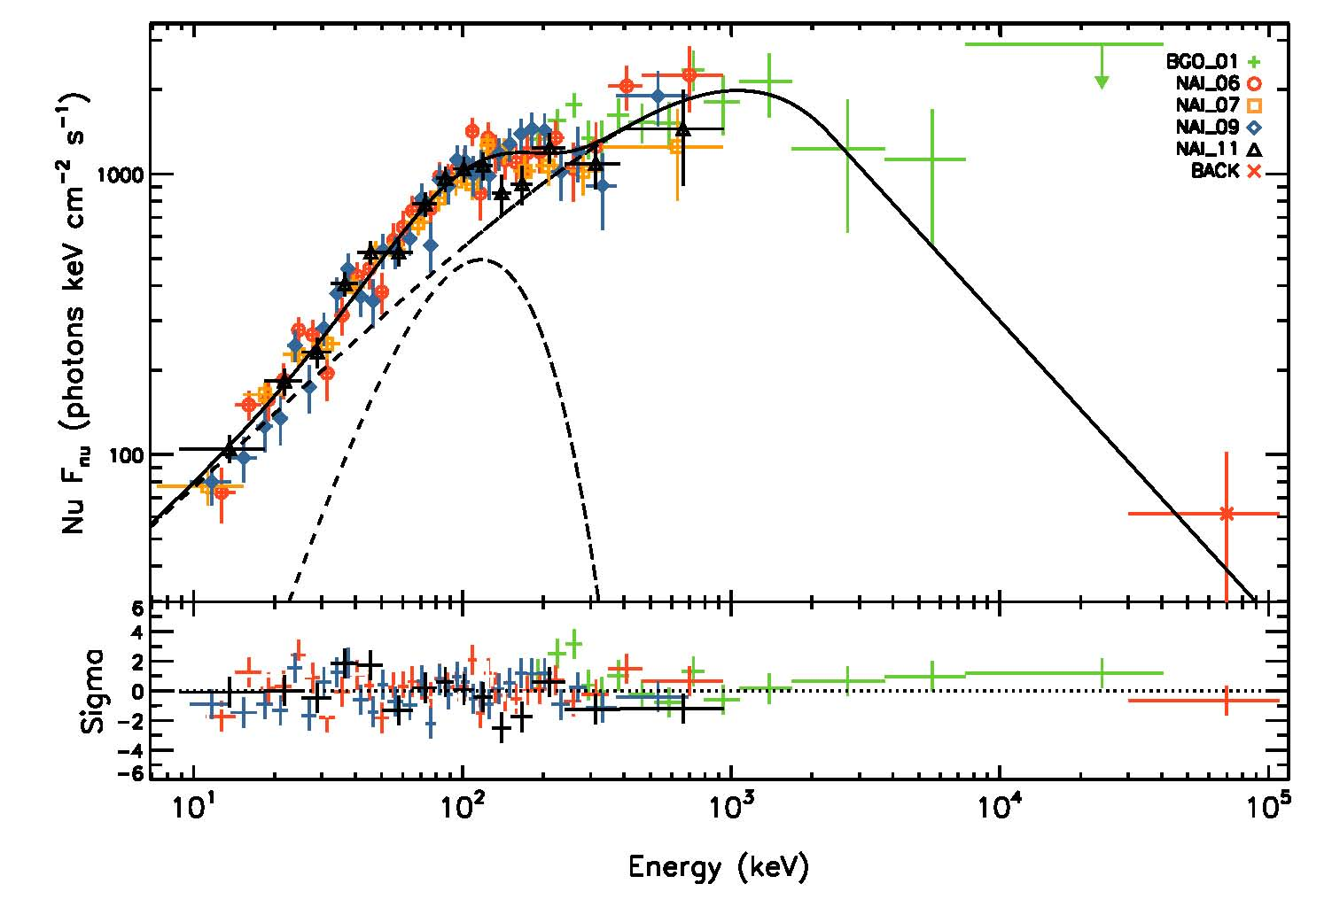
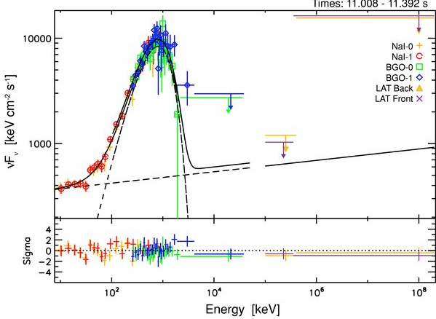
GRBs: sub-photospheric shocks
AL 12, AL+Keren 14, Beloborodov 17, Ito+18
Evidence for photospheric emission ? (Peer+Ryde)
Band spectrum from photospheric emission? (Beloborodov 13, Vurm+ 13, Keren+AL 14, Ito + 15, Lazzati 16)

Slide 9
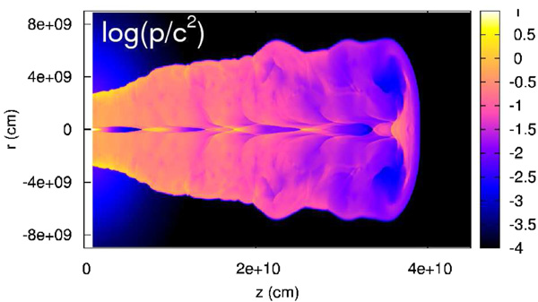
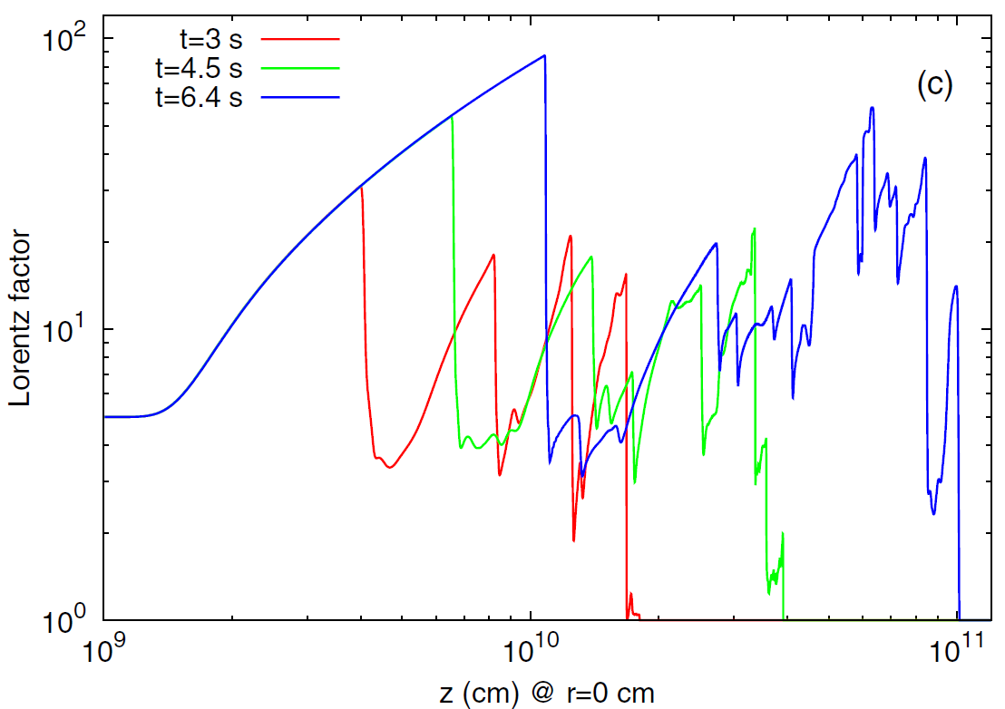


Application to GRBs
Mizuta & Ioka 2013
RRMS naturally develops within jet
Condition for RMS to form
Weaver 1976
・Optically thick（τ>>1）
・propagation velocity
always satisfied for GRB fireball at subphotospheric region
(e.g., Bromberg + 2011)

Slide 10
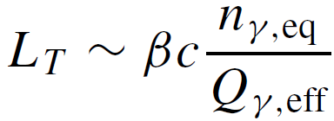
Thermalization depth
RRMS in GRB fireball
Hot upstream (n_{γ} /n_{p}~ 10⁴ -10⁶ >>1)
Photon generation: Bremst. + double Compton
Free-free: τ′_{ff} = 10⁵Λ_{ff}⁻¹ (n_{u15})^{−1/8}γ_{u}^{3/4}
Double Compton: τ′_{DC}= 10⁶ Λ_{DC}⁻¹ (n_{u15})^{−1/2}γ_{u}⁻¹
Thermalization length >> shock width (τ～few)
Photon advection dominant (Photon Rich)
(Photon generation and absorption can be neglected)
Levinson 2012

Slide 11
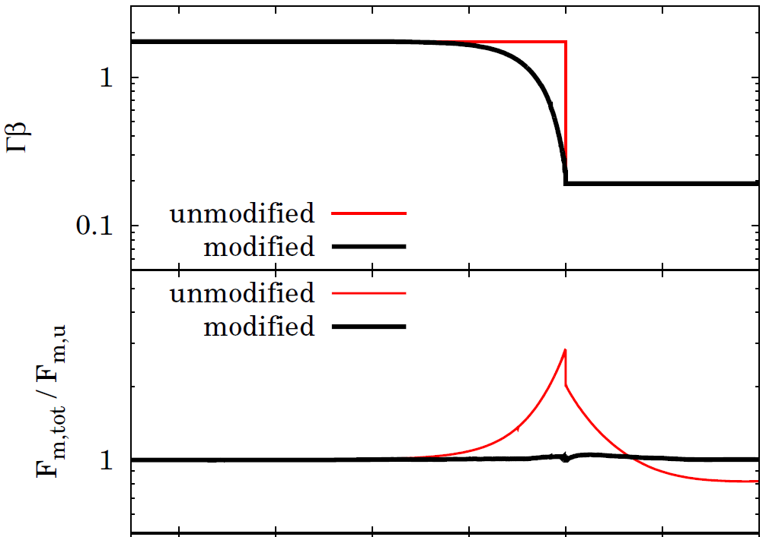
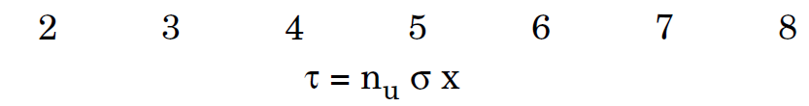
Method・Model
Give plasma profile (n,T,Γ)
feedback
Solve radiation transfer using Monte-Carlo Method
deviation from steady state
Evaluate the deviation from steady profile
Iterate until convergence
Assumption
・advection dominated
（emission、absorption neglected、only scattering）
・pair production/annihilation included
・thermal distribution at far up stream
・large photon to proton ratio
(n_{ph} / n_{p} = 10³ - 10⁵)
・electron has Maxwellian distribution
Γ_{u} = 2 - 10

Slide 12
Parameters
Γ_{u} : Lorentz factor of shock
n = n_{ph} / n_{p} : photon to baryon number ratio
ξ_{u} = 3n_{ph} k_{B} T_{u} / n_{p}m_{p}c² : photon to baryon inertia ratio
~
@ far upstream region
Dependences on :
ξ_{u}
~
(II) n
(III) Γ_{u}

Slide 13
Parameters
Γ_{u} : Lorentz factor of shock
n = n_{ph} / n_{p} : photon to baryon number ratio
ξ_{u} = 3n_{ph} k_{B} T_{u} / n_{p}m_{p}c² : photon to baryon inertia ratio
~
@ far upstream region
Dependences on :
ξ_{u}
~
n = 10⁵ Γ_{u} = 2
~
(II) n
(III) Γ_{u}

Slide 14
ξ_{u} = 3n_{ph} k_{B} T_{u} / n_{p}m_{p}c² = 10
~
Γ_{u} = 2 n = 10⁵
Radiation dominant US
”force-free“ flow profile
no strong anisotropy appears
Beloborodov 2017
Spectra is mostly thermal

Slide 15
ξ_{u} = 3n_{ph} k_{B} T_{u} / n_{p}m_{p}c² = 1
~
Γ_{u} = 2 n = 10⁵
No pair is present

Slide 16
ξ_{u} = 3n_{ph} k_{B} T_{u} / n_{p}m_{p}c² = 1
~
Γ_{u} = 2 n = 10⁵
Deceleration in Δτ ~ 1
Anistropy and
Non-thermal spectra appears

Slide 17
ξ_{u} = 3n_{ph} k_{B} T_{u} / n_{p}m_{p}c² = 0.1
~
Γ_{u} = 2 n = 10⁵
Deceleration in Δτ ~ 1
Anistropy and
Non-thermal spectra appears

Slide 18
ξ_{u} = 3n_{ph} k_{B} T_{u} / n_{p}m_{p}c² = 0.01
~
Γ_{u} = 2 n = 10⁵
Deceleration in Δτ ~ 1
Anistropy and
Non-thermal spectra appears

Slide 19
ξ_{u} = 3n_{ph} k_{B} T_{u} / n_{p}m_{p}c² = 0.01
~
Γ_{u} = 2 n = 10⁵
Significant pair production
Deceleration in Δτ ~ 1
Anistropy and
Non-thermal spectra appears

Slide 20
ξ_{u} = 3n_{ph} k_{B} T_{u} / n_{p}m_{p}c² = 0.01
~
Γ_{u} = 2 n = 10⁵
subshock
Deceleration in Δτ ~ 1
Anistropy and
Non-thermal spectra appears

Slide 21
ξ_{u} = 3n_{ph} k_{B} T_{u} / n_{p}m_{p}c² = 0.01
~
Γ_{u} = 2 n = 10⁵
subshock
Significant pair production
Deceleration in Δτ ~ 1
Anistropy and
Non-thermal spectra appears

Slide 22
ξ_{u} = 3n_{ph} k_{B} T_{u} / n_{p}m_{p}c² = 0.01
~
Γ_{u} = 2 n = 10⁵
subshock
Post subshock plasma is rapidly cooled and accelerated by the radiation
Rapid IC cooling produces
isothermal shock-like structure
Significant pair production
* negligible fraction of energy is dissipated in the weak subshock

Slide 23
Dependence on ξ_{u}

Slide 24
Parameters
Γ_{u} : Lorentz factor of shock
n = n_{ph} / n_{p} : photon to baryon number ratio
ξ_{u} = 3n_{ph} k_{B} T_{u} / n_{p}m_{p}c² : photon to baryon inertia ratio
~
@ far upstream region
Dependences on :
ξ_{u}
~
(II) n
ξ_{u} = 0.1 Γ_{u} = 2
(III) Γ_{u}

Slide 25
~
n = n_{ph} / n_{p} = 10⁴
ξ_{u} = 0.1 Γ_{u} = 2
~
T_{d} ~ 30 (Γ_{u} / 2) ( n / 10⁴)⁻¹ keV
Pair enrichment is enhanced due to high temperature

Slide 26
~
n = n_{ph} / n_{p} = 10³
ξ_{u} = 0.1 Γ_{u} = 2

Slide 27
~
n = n_{ph} / n_{p} = 10³
ξ_{u} = 0.1 Γ_{u} = 2
subshock
Strong subshock plasma is appears for n_{ph} / n_{p} < m_{p} / m_{e}
E_{ph,max} = Γ_{u} m_{e} c²
Necessary condition for conversion
from kinetic energy to radiation
Γ_{u} n_{p} m_{p} c² < n_{ph} Γ_{u} m_{e} c²
* Reasonable range of parameter, photon generation cannot be neglected
=> subshock may disappear or be significantly weaker

Slide 28
~
Dependence on n

Slide 29
Parameters
Γ_{u} : Lorentz factor of shock
n = n_{ph} / n_{p} : photon to baryon number ratio
ξ_{u} = 3n_{ph} k_{B} T_{u} / n_{p}m_{p}c² : photon to baryon inertia ratio
~
@ far upstream region
Dependences on :
ξ_{u}
~
(II) n
(III) Γ_{u}
~
ξ_{u} = 0.1 n = 10⁵

Slide 30
Γ_{u} = 10
ξ_{u} = 0.1 n = 10⁵

Slide 31
Γ_{u} = 10
ξ_{u} = 0.1 n = 10⁵
subshock

Slide 32
Γ_{u} = 10
ξ_{u} = 0.1 n = 10⁵
511 keV line
Pair enrichment is enhanced due to strong bulk Comptonization

Slide 33
Dependence on Γ_{u}

Slide 34
Spacially averaged spectra
Rev. shock
Rev. shock
Fw. shock
Fw. shock
Highly non-thermal spectra appears near the shock
Notes:
衝撃波面の近辺において、光子は非熱的スペクトルを示す。定量的には、光子による減速がより強く働く必要があるため、よりハードなスペクトルとなる。 F_{m,rad} >> F_{m,matt}おいては撃波面（紫）における光子スペクトルは、ローレンツ因子によらず νf_{ν} ∝ν⁰ となる。
ガンマ線バーストの非熱的な高エネルギーのスペクトルを再現できる。
ただ、γγが入っていないが、実際は聞くはず。定性的に強い非熱的スペクトルが見えるはずだが、定量的にどの程度ずれるかは、計算してみないと分からないので、future work

Slide 35
Spacially averaged spectra
Rev. shock
Rev. shock
α = -0.5
β = -2.5
β = -2.5
α = -1
Fw. shock
Fw. shock
α = -1
α = -1
Highly non-thermal spectra appears near the shock
Possible origin of Band spectrum
* For an accurate estimation, photon escape (breakout) must be considered
Notes:
衝撃波面の近辺において、光子は非熱的スペクトルを示す。定量的には、光子による減速がより強く働く必要があるため、よりハードなスペクトルとなる。 F_{m,rad} >> F_{m,matt}おいては撃波面（紫）における光子スペクトルは、ローレンツ因子によらず νf_{ν} ∝ν⁰ となる。
ガンマ線バーストの非熱的な高エネルギーのスペクトルを再現できる。
ただ、γγが入っていないが、実際は聞くはず。定性的に強い非熱的スペクトルが見えるはずだが、定量的にどの程度ずれるかは、計算してみないと分からないので、future work

Slide 36
Simulation with escape
τu = infinite
τu = 3
τu = 1
τu = 4
τu = 2
Subshock is necessary
when escape is prominent
Iteration not converged (subshock not included)

Slide 37
Effects of magnetic field
Beloborodov 2017
Certain fraction of DS energy is contained in compressed B-field
Subshock is formed
Lundman et al. 2018
Synchrotron emission at subshock can be an important source of photons

Slide 38
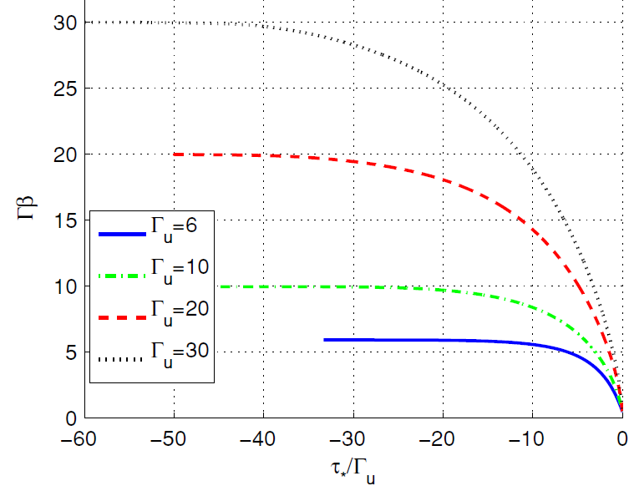
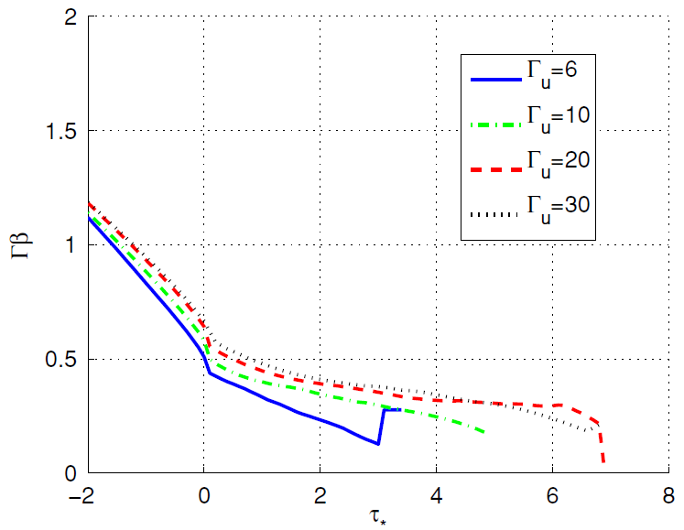
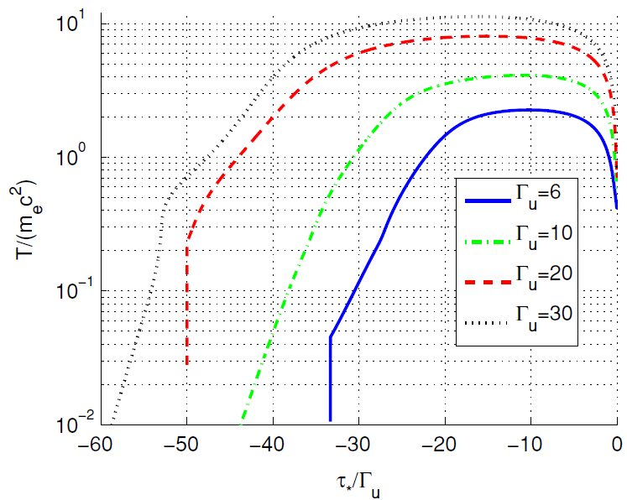
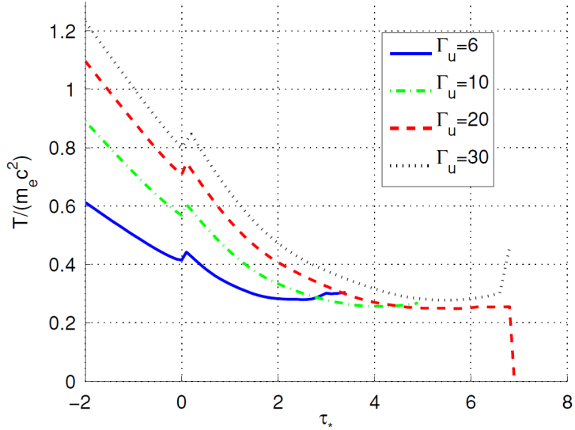
Photon Starved regime
Budnik et al. 2010
4-velocity
Temperature

Slide 39
Photon Starved regime
Budnik et al. 2010
4-velocity
subshock
Temperature

Slide 40
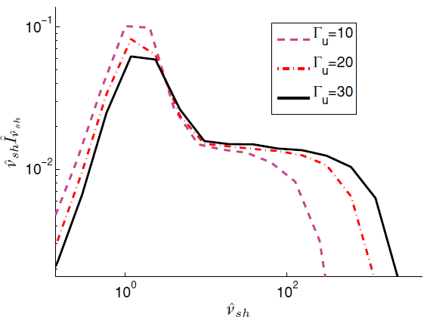

Photon Starved regime
Budnik et al. 2010
Spectrum inside the shock
Temperature in immediate downstream is regulated by pair production

Slide 41
Summary
RRMS in Photon rich regime is computed
-
As in the previous studies we find the deceleration length to be Δτ ~ 1
-
Strong anisotropy develops near the shock and give rise to highly non-thermal spectrum and copious pair production
-
Necessity of subshock for 3n_{ph} k_{B} T / n m_{p} c² << 1
n_{ph} / n_{p} < m_{p} / m_{e}
-
Possible origin of Band spectrum
Future work
・Implementation of escape
・Implementation of photon production and absorption
・Implementation of magnetic fields

