Slide 1
Neutrino-induced meson production model for neutrino oscillation experiments
Satoshi Nakamura
Nuclear Theory Group

Slide 2
Contents
Introduction νΝ scattering for neutrino exp.
Dynamical coupled-channels (DCC) model for
γΝ, πΝ ➔ πΝ, ππΝ, ηΝ, ΚΛ, ΚΣ
Application of DCC model to
νΝ ➔ πΝ, ππΝ, ηΝ, ΚΛ, ΚΣ

Slide 3
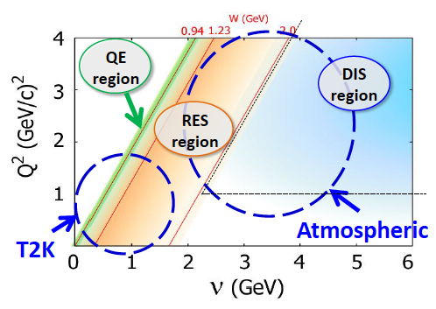
θ₁₃ ≠ 0 (Daya-Bay, RENO, T2K, MINOS, Double-Chooz)
Next-generation exp. ➔ leptonic CP, mass hierarchy
ν−nucleon (nucleus) scattering needs to be understood more precisely
ν−nucleus cross section
⬇
Neutrino flux ⬅ # of events of ν−nucleus interaction
Near detector
Far detector
LBL
Comparison ➔ oscillation ➔ θ, Δm²
Collaboration at J-PARC Branch of KEK Theory Center
http://j-parc-th.kek.jp/html/English/e-index.html
Wide kinematical region with different characteristic
➔ Combination of different expertise is necessary

Slide 4
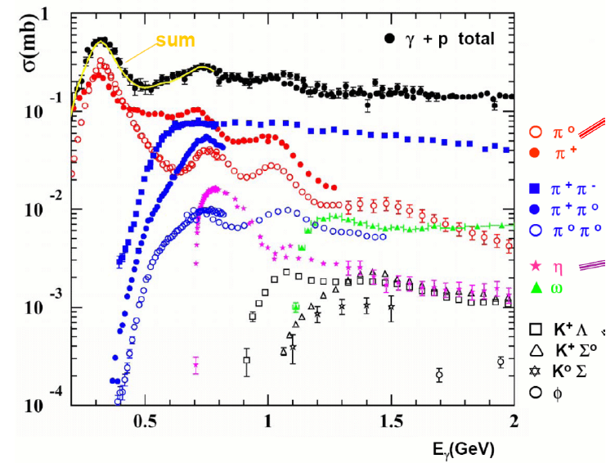
Resonance region
(Data)
2nd
3rd
Δ
(MeV)
Multi-channel reaction
• 2π production is comparable to 1π
• η, Κ productions (background of proton decay exp.)
Many nucleon resonances in 2nd and 3rd resonance region
Not only 1π production but also …

Slide 5
Dealing with multi-channel reaction
Problems
Unitarity is missing in previous models
Important 2 π production model is missing
Previous models for Κ and η production are not well tested by data
Unitary coupled-channel model needs to be developed
Dynamical coupled-channels model for γΝ, πΝ ➔ πΝ, ππΝ, ηΝ, ΚΛ, ΚΣ
Application to νΝ ➔ πΝ, ππΝ, ηΝ, ΚΛ, ΚΣ

Slide 6
Dynamical Coupled-Channel model for γΝ, πΝ ➔ πΝ, ππΝ, ηΝ, ΚΛ, ΚΣ
Kamano, Nakamura, Lee, Sato

Slide 7
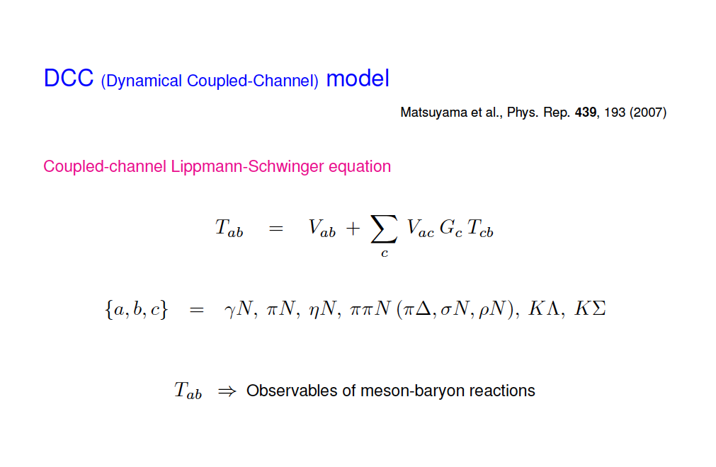
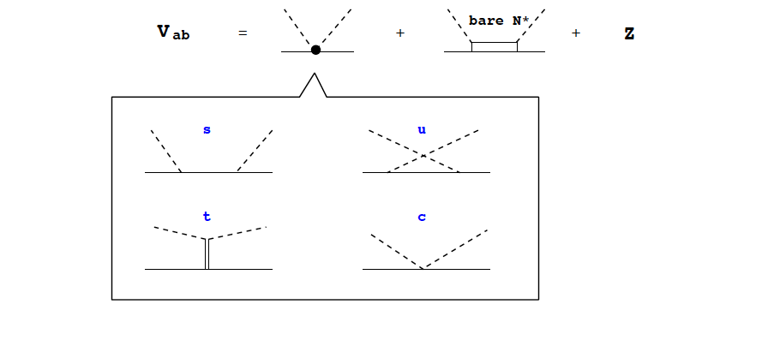
Coupled-channel unitarity is fully taken into acount

Slide 8
DCC analysis of meson production data
Fully combined analysis of γΝ, πΝ ➔ πΝ, ηΝ, ΚΛ, ΚΣ
(W ≤ 2.1 GeV)
Fitting ~380 parameters (N* mass, N* ➔ MB couplings, cutoffs)
to ~ 20,000 data points

Slide 9
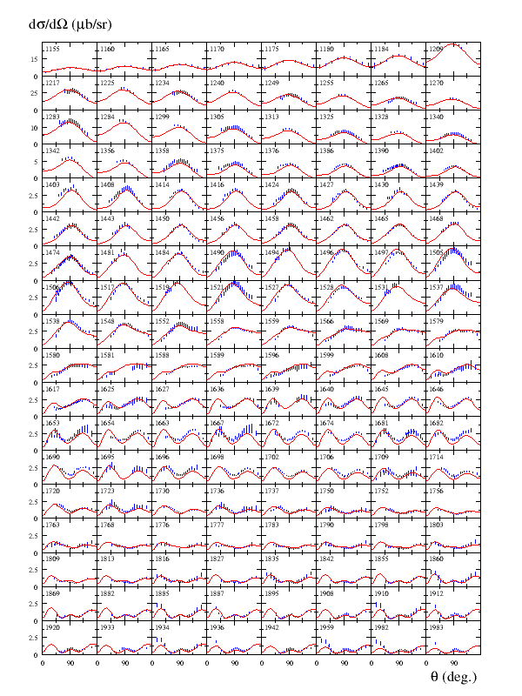

Kamano, Nakamura, Lee, Sato, 2012
Vector current (Q²=0) for 1π
Production is well-tested by data

Slide 10
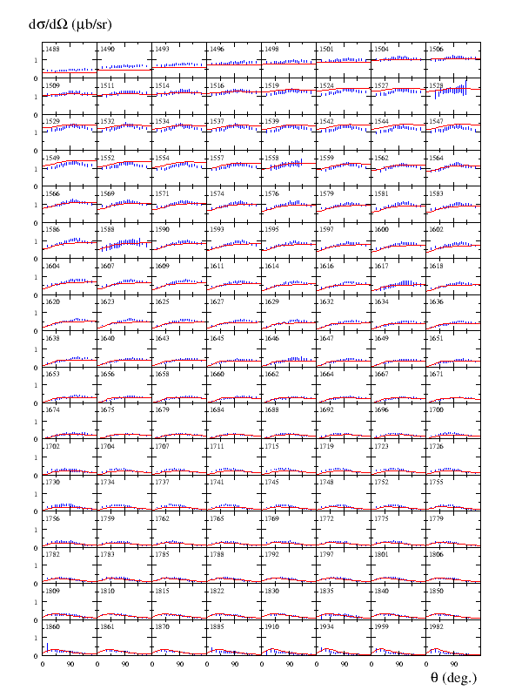

Kamano, Nakamura, Lee, Sato, 2012
Vector current (Q²=0) for η
Production is well-tested by data

Slide 11
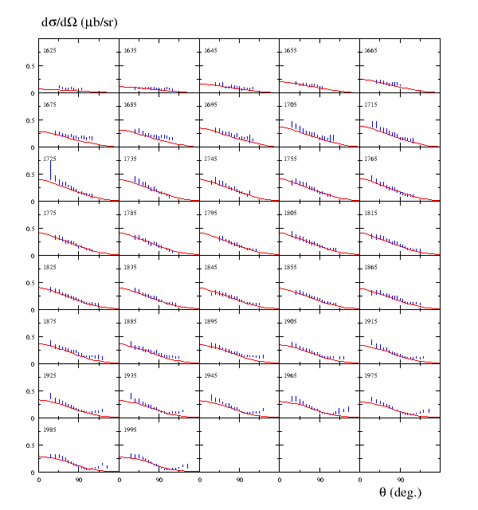

Kamano, Nakamura, Lee, Sato, 2012
Vector current (Q²=0) for Κ
Production is well-tested by data

Slide 12
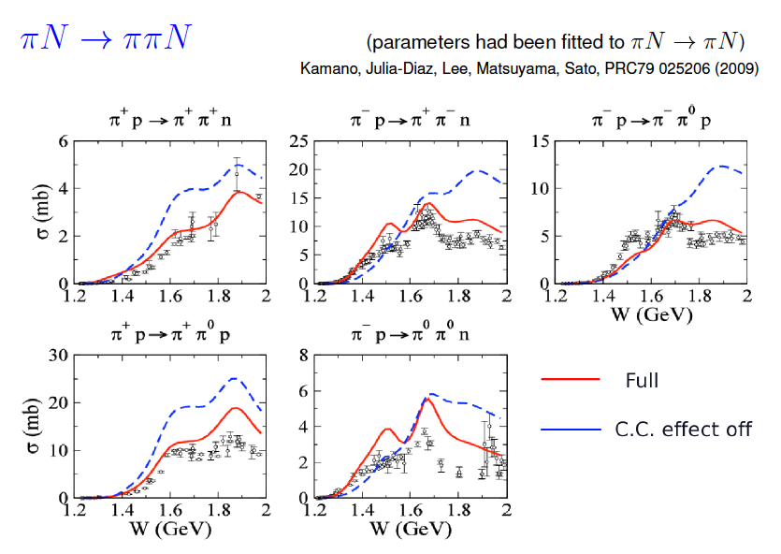

Slide 13
Short Summary
DCC model for γΝ, πΝ ➔ πΝ, ππΝ, ηΝ, ΚΛ, ΚΣ developed
Model has been extensively tested by data
➔ reliable vector current to be applied to ν-scattering
Check out JPS monthly magazine next (X 2,3) months for a review

Slide 14
PCAC-based application of DCC model to forward νΝ ➔ πΝ, ππΝ, ηΝ, ΚΛ, ΚΣ
Kamano, Nakamura, Lee, Sato, PRD 86, 097503 (2012)

Slide 15


Objectives
Set a starting point for full dynamical model
… we study only Q²=0 here.
Relative importance of different channels (πΝ, ππΝ, ΚY..)
Comparison with Rein-Sehgal model (in most MC code)
PCAC-based calculation of νΝ reaction
νΝ reaction, vector and axial currents contribute.
For Q²=0 , only survives.
PCAC relation, is used.
νΝ reaction amplitude is related to πΝ reaction amplitude

Slide 16
Results
πN
SL
ηN
ππN
ΚΣ
ΚΛ
Prediction based on model well tested by data
πΝ dominates for W ≤ 1.5 GeV
ππΝ becomes comparable to πΝ for W ≥ 1.5 GeV
Smaller contribution from ηΝ and ΚY O(10⁻¹) - O(10⁻²)

Slide 17
Comparison with Rein-Sehgal model
Lower Δ peak of RS model
RS overestimate in higher energy regions (DCC model is tested by data)

Slide 18
Comparison with Rein-Sehgal model

Slide 19
Summary
DCC model for forward νΝ ➔ πΝ, ππΝ, ηΝ, ΚΛ, ΚΣ via PCAC
Prediction based on model well tested by data
ππΝ comparable to πΝ for W ≥ 1.5 GeV (first νΝ ➔ ππΝ)
First data-based prediction for νΝ ➔ ηΝ, ΚY
Comparison with Rein-Sehgal model :
Significant difference
Full development of dynamical axial current is underway

Slide 20
BACKUP

Slide 21





Formalism
Cross section for νΝ ➔ X ( X = πΝ, ππΝ, ηΝ, ΚΛ, ΚΣ )
θ ➔0
Q²➔0
CVC & PCAC
LSZ & smoothness
Finally
σ_{πΝ➔X} is from our DCC model

Slide 22
Previous models for ν−induced 1π production in resonance region
resonant only
Rein et al. (1981), (1987) ; Lalalulich et al. (2005), (2006)
+ non-resonant (tree-level)
Hernandez et al. (2007), (2010) ; Lalakulich et al. (2010)
+ rescattering (π N unitarity)
Sato, Lee (2003), (2005)

Slide 23
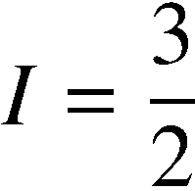
Partial wave amplitudes of pi N scattering
Real part
Kamano, Nakamura, Lee, Sato, 2012
Previous model
(fitted to πN → πN data only)
[PRC76 065201 (2007)]
Imaginary part

Slide 24


Eta production reactions
Kamano, Nakamura, Lee, Sato, 2012

Slide 25




KY production reactions
Kamano, Nakamura, Lee, Sato, 2012
1732 MeV
1757 MeV
1792 MeV
1845 MeV
1879 MeV
1879 MeV
1985 MeV
1966 MeV
1966 MeV
2031 MeV
2059 MeV
2059 MeV

Slide 26
J-PARC proposal πN → ππN in high-mass N* region
(K. Hicks, K. Imai et al.)
→ There is NO practical data that can be used for testing models
for πN → ππN above W > 1.5 GeV.
→ For W > 1.5 GeV, πN → ππN becomes the dominant process of
the πN reactions. (same applied to ν-scattering)
Model for νΝ → ππN will be essetial piece in MC
πN → ππN data are essential to develop νΝ → ππN model
Please support the proposal !

Slide 27
F₂ from RS model

Slide 28
F₂ from RS model

Slide 29

Spectrum of N* resonances
Kamano, Nakamura, Lee, Sato ,2012
Real parts of N* pole values
Ours
PDG 4*
 | PDG | Ours
N* with 3*, 4* | 18 | 16
N* with 1*, 2* | 5
PDG 3*
L_{2I 2J}

Slide 30
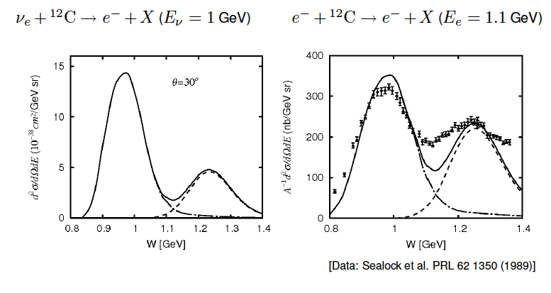
SL model applied to ν−nucleus scattering
1 π production
Szczerbinska et al. (2007)

Slide 31
SL model applied to ν−nucleus scattering
coherent π production
γ + ¹²C ➔ π⁰ + ¹²C
ν_{μ} + ¹²C ➔ μ⁻ + π⁰ + ¹²C
Nakamura et al. (2010)

Slide 32
Dealing with multi-channel reaction
e.g., ν-induced Κ production
Tree-level models
ΔS=0 : Adera et al., (2010)
ΔS=1 : Rafi Alam et al., (2010), (2012)

Slide 33
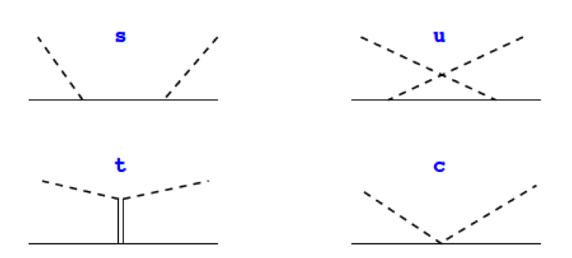
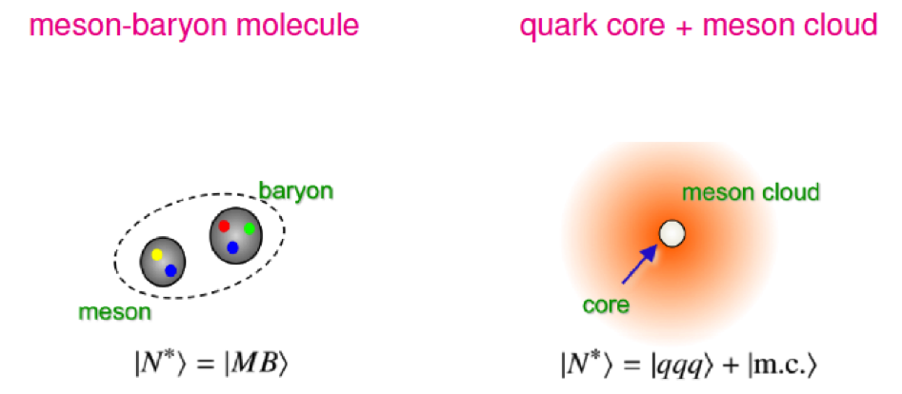
DCC model for γΝ, πΝ ➔ πΝ, ηΝ, ΚΛ, ΚΣ reactions
* Well-established meson-exchange mechanism for meson-baryon interactions
For analyzing data to identify nucleon resonances (Baryon spectroscopy)
* Description of nucleon resonance (N*)
* Unitarity ➔ γΝ, πΝ, ηΝ, ππΝ ( πΔ, ρΝ, σΝ), ΚΛ, ΚΣ coupled-channels
γ , π
M
N*
N
B

Slide 34
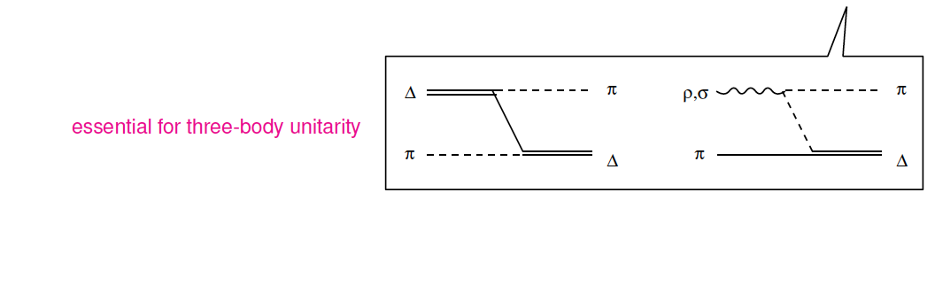
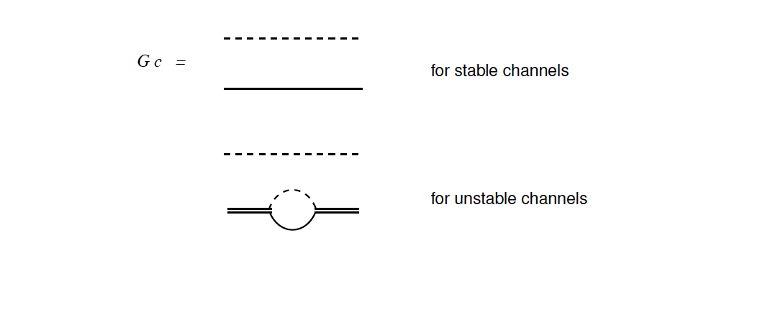


Slide 35
Resonance region
2nd
3rd
Δ
(MeV)
Many nucleon resonances in 2nd and 3rd resonance region

