Slide 1
Yang-Lee Zeros from Canonical Partition Functions
Kenji Morita
Ref) KM, A.Nakamura, arXiv:1505.05985

Slide 2

How to look for Phase Transition?
Critical Point?
1st Order PT?
Grand-Canonical
Canonical
Critical Point?
1st Order PT?

Slide 3
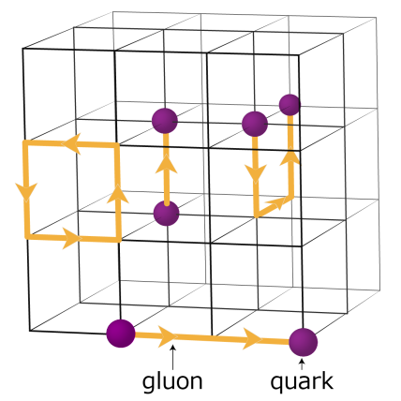
Z(N), Z(m) and Phase Transition
Sign Problem!
Lattice QCD
Grand Canonical Z(m)
Ejiri
Nakamura, Nagata,
Zn Coll.
etc
Canonical Z(N)
Thermodynamic quantities
From jicfus.jp
Yang-Lee zeros
Multiplicity distribution of conserved charges
Nakamura-Nagata
How large N can we get?

Slide 4
Tail of Z(N) is important!
c₆ < 0
O(4) crossover
KM et al., PRC88 ’13
PLB741 ‘15

Slide 5
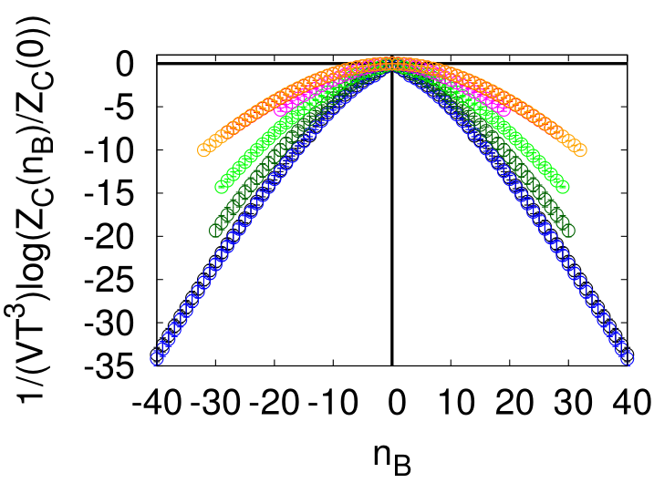
Limitation in obtaining Z(N)
max. baryon number in a box
O(1) events for the tail
Suffer from stat. error
inevitable truncation
Summation over N : N_{max} < N*
Effects on fluctuations and Yang-Lee zeros?
Check with solvable models
Nakamura et al., arXiv:1504.04471

Slide 6
Chiral Random Matrix Model
Grand Partition Function
M.Stephanov, PRD73 ‘06
Baryon number conservation U(1)_{B}
Periodicity in imaginary m
“truncated” partition function
Tail of Z(N) not included

Slide 7
Solution of the model
imaginary m : periodic order parameter, larger amplitude at higher T
(Consistent with QCD)
real m : Tricritical/Critical point
“Expected” phase diagram

Slide 8
Distribution of Yang-Lee zero

Slide 9
N_{max} dependence
Odd order polynomials
Stable against cutting N_{max}
Closest to the real axis
(Edge Singularity)

Slide 10
Same behavior at other T
Critical point (Branch point on the real axis)
1st order (Cut across real axis)
Closest zero to the real axis is stable

Slide 11
Lattice QCD
Similar behavior at T > T_{c}
Bifurcation of the distribution can be understood as a truncation effect
Roberge-Weiss transition
Nagata et al., PTEP2012

Slide 12
Model w/o phase transition
Reference : Skellam distribution
Move against cut
All zeros go to infinity as N_{max}→∞

Slide 13
Concluding Remarks
Canonical approach to phase transition
  Higher order terms in λ-expansion?
  Relevant for lattice QCD and HIC experiments
Yang-Lee zeros
  Study with solvable models (ChRM, Skellam)
  Distribution is sensitive to cutting Nmax
  Zero closest to real axis is stable against cut
    Useful check – stability against smaller Nmax
  Too small Nmax : no information on the true phase boundary, similar to Skellam model

Slide 14
Outlook
Estimation of N_{max}
  Comparison：6th order
    Ns=60 RM : N_{max}=6 for c₆
    100 : N_{max}=7 for c₆
Closest zeros
21
30
s² ～ 0.5 even for Ns=100
RHIC : s²～10, LHC : s²～15
Comparison Not straightforward
Very challenging

