Slide 1
HABEMUS SUPERSTRATUM
MASAKI SHIGEMORI
(YITP Kyoto)
Strings 2015
ICTS-TIFR Bengaluru, India
June 25, 2015
Notes:
A new class of microstate geometries. In some sense, the most general microstate geometries ever constructed for the 3-charge black hole.

Slide 2
MAIN MESSAGES
Black hole microstates involve complicated structure of branes called superstrata
Basic superstrata solutions explicitly constructed in sugra as smooth geometries

Slide 3
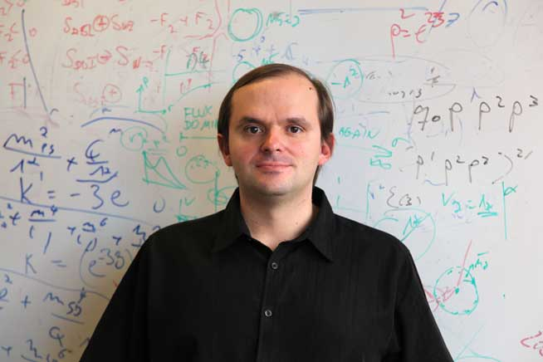
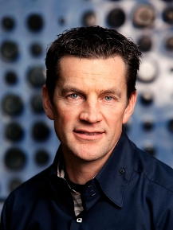
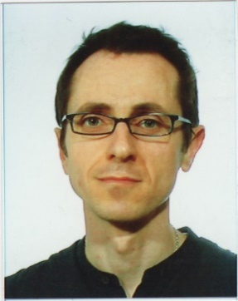
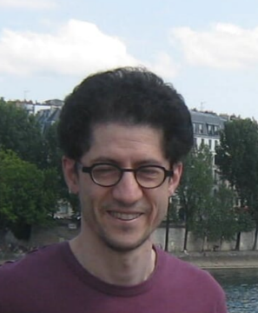
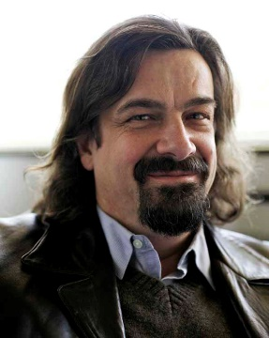
Iosif Bena
Jan de Boer
Stefano Giusto
Rodolfo Russo
Nick Warner
Notes:
Fantastic collaborators. Nick talked about strata at strings at Princeton, but back then we didn’t have an explicit solution.

Slide 4
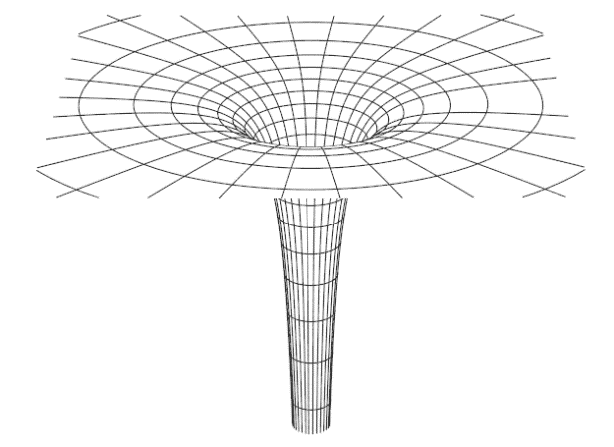
MICROSTATE GEOMETRY PROGRAM:
no horizon, no singularity
How much of black hole entropy can be accounted for by smooth, horizonless solutions of classical gravity?
D1-D5-P BH: $S_{BH}=2π\sqrt{N_{1}N_{5}N_{P}}$
Notes:
I only consider susy blacks holes in this talk for which this MGP has more hope of working.

Slide 5
SOME HISTORY
1915 | Einstein: general relativity
1975 | Hawking radiation
1996 | Strominger-Vafa (field theory counting of 3-charge BH)
2001 | Lunin-Mathur geometries (2-charge microstates) → fuzzball conjecture, microstate geometry program
2006 | Microstate geometries in 5D (3- and 4-charge microstates)
2010 | Double bubbling & superstrata (into 6D)
2015 | Explicit construction of superstrata
This talk
Notes:
“To put things into a context” LM led Mathur to put forth fuzzball. It also led to MGP. I’ll talk about the last two.

Slide 6
DOUBLE BUBBLING
(OR MULTIPLE SUPERTUBE TRANSITION)

Slide 7
SUPERTUBE TRANSITION
[Mateos+Townsend ’01]
new dipole charge
$$Q_{1}$$
$$Q_{2}$$
$$λ$$
polarize (“bubble”)
arbitrary curve
Spontaneous polarization phenomenon
Produces new dipole charge
Cross section = arbitrary curve
(cf. Myers effect)
Notes:
One of very fundamental processes in string theory.

Slide 8
SUPERTUBE: F1-P FRAME
$$F1\left(9\right)+P\left(9\right)→F1(λ)$$
compact
$$x^{9}$$
polarize
F1(9)
P
wiggly F1
$$…$$
$$x^{8}$$
$$λ$$
$$x^{1}$$
$$ℝ^{8}$$
$$ℝ^{8}$$
transverse
To carry momentum, F1 must wiggle in transverse $ℝ^{8}$
$$x^{i}=F^{i}(x^{9}−t)$$
Projection onto transverse $ℝ^{8}$ is an arbitrary curve
Notes:
Can’t fluctuate in longitudinal direction. New dipole charge F1(\lambda)

Slide 9
SUPERTUBE: D1-D5 FRAME
$$D1(5)+D5\left(56789\right)→KKM(λ6789,5)$$
KKM
D1
D5
$$λ$$
polarize (“bubble”)
arbitrary curve
$$\vec{x}=\vec{F}\left(λ\right)∈ℝ_{1234}^{4}$$
LM geometries (2-charge microstate geometries)
Arbitrary curve → large entropy $S_{geom}∼\sqrt{N_{1}N_{5}}$
AdS/CFT dictionary well understood
[Lunin-Mathur ’01]
[Rychkov ’05]
[Lunin-Mathur ’01] [Kanitscheider-Skenderis-Taylor ’06, 07]

Slide 10
DOUBLE BUBBLING
[de Boer-MS ’10, ’12]
[Bena-de Boer-MS-Warner ’11]
3-charge system: real BH
$$D1\left(5\right)$$
$$D5\left(56789\right)$$
$$P(5)$$
$$D5\left(λ6789\right)$$
$$D1(λ)$$
$$KKM\left(λ6789,5\right)$$
$$5_{3}^{2}(θ6789,λ)$$
$$1_{3}^{6}\left(θ,λ56789\right)$$
$$KKM\left(λ6789,θ\right)$$
$$θ$$
D1
D5
$$λ$$
$$λ$$
P
arbitrary curve: supertube
arbitrary surface:
“superstratum”
BH microstates involve arbitrary surface = superstratum
Exotic and non-geometric in general ($5_{3}^{2}, 1_{3}^{6}, …$)
Arbitrary surface → larger entropy $S_{geom}∼\sqrt{N_{1}N_{5}N_{P}}$ ?
Notes:
Can happen in principle. Can show this is compatible with susy. Kinematically allowed. Dynamics is a different question

Slide 11
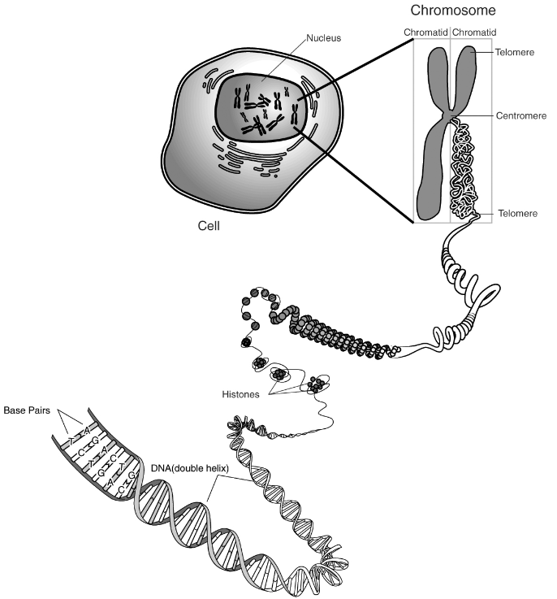
ENDLESS BUBBLING?
$$⋮$$
?
$$⋮$$
A black hole is made of an extremely complicated structure (fuzzball) of puffed-up branes.
Courtesy of the National Human Genome Research Institute

Slide 12
EXOTIC BRANES
[de Boer-MS ’10, ’12]
“Forgotten” branes in string theory
Codimension 2
U-duality monodromy (“U-fold”)
Non-geometric
[Elitzur-Giveon-Kutasov-Rabinovici ’97]
[Blau-O’Loughlin ’97] [Hull ’97] [Obers-Pioline ’98]
exotic
brane
U-duality monodromy
generalization of F-theory 7-branes

Slide 13
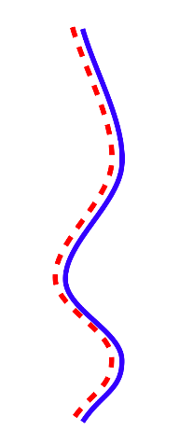
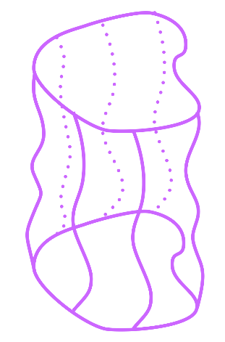
A GEOMETRIC CHANNEL
[Bena-de Boer -MS-Warner ’11]
$$D1\left(5\right)$$
$$D5\left(56789\right)$$
$$P(5)$$
$$D5\left(λ6789\right)$$
$$D1(λ)$$
$$KKM\left(λ6789,θ\right)$$
wiggly KKM
$$x^{5}$$
D1
D5
wiggly D1
wiggly D5
=
P
geometric superstratum
$$…$$
$$x^{4}$$
$$x^{1}$$
Can use geometric intuition (smoothness)
Dependence on $x^{5}$ is crucial → 6 dimensions

Slide 14
SUMMARY:
BH microstates involve double-bubbled superstrata
Geometric superstratum in 6D is important for microstate geometry program
Notes:
I argued that…. Possible in principle. Need to substantiate the claim.

Slide 15
EXPLICIT CONSTUCTION OF SUPERSTRATA
[Bena+Giusto+Russo+MS+Warner ’15]

Slide 16
GOAL:
Explicitly construct “superstrata” = wiggly KKM in 6D
They must depend on functions of two variables: $F(x,y)$

Slide 17
SUSY SOLUTIONS IN 6D
IIB sugra on $T_{6789}^{4}$
Require same susy as preserved by D1-D5-P
[Gutowski+Martelli+Reall ’03] [Cariglia+Mac Conamhna ’04]
[Bena+Giusto+MS+Warner ’11] [Giusto+Martucci+Petrini+Russo ’13]
$ds_{10}^{2}=−\frac{2α}{\sqrt{Z_{1}Z_{2}}}\left(dv+β\right)\left(du+ω+\frac{1}{2}ℱ\left(dv+β\right)\right)+\sqrt{Z_{1}Z_{2}}ds^{2}(ℬ^{4})+\sqrt{\frac{Z_{1}}{Z_{2}}}ds^{2}(T^{4}$)
$$e^{2Φ}=\frac{αZ_{1}}{Z_{2}}$$
$$α≡\frac{Z_{1}Z_{2}}{Z_{1}Z_{2}−Z_{4}^{2}}$$
$$\dot{}≡∂_{v}$$
$$𝒟≡d_{4}−β∧∂_{v}$$
$$H_{3}=−\left(du+ω\right)∧\left(dv+β\right)∧\left(𝒟\left(\frac{αZ_{4}}{Z_{1}Z_{2}}\right)−\frac{αZ_{4}}{Z_{1}Z_{2}}\dot{β}\right)$$
$$+\left(dv+β\right)∧\left(Θ_{4}−\frac{αZ_{4}}{Z_{1}Z_{2}}𝒟ω\right)+\frac{αZ_{4}}{Z_{1}Z_{2}}\left(du+β\right)∧𝒟β+∗_{4}(𝒟Z_{4}+Z_{4}\dot{β})$$
$$F_{1}=𝒟\left(\frac{Z_{4}}{Z_{1}}\right)+\left(dv+β\right)∧∂_{v}\left(\frac{Z_{4}}{Z_{1}}\right)$$
$$F_{3}=−\left(du+ω\right)∧\left(dv+β\right)∧\left(𝒟\left(\frac{1}{Z_{1}}\right)−\frac{1}{Z_{1}}\dot{β}+\frac{αZ_{4}}{Z_{1}Z_{2}}𝒟\left(\frac{Z_{4}}{Z_{1}}\right)\right)$$
$$+\left(dv+β\right)∧\left(Θ_{1}−\frac{Z_{4}}{Z_{1}}Θ_{4}−\frac{1}{Z_{1}}𝒟ω\right)+\frac{1}{Z_{1}}\left(du+β\right)∧𝒟β+∗_{4}(𝒟Z_{2}+Z_{2}\dot{β})−\frac{Z_{4}}{Z_{1}}∗_{4}(𝒟Z_{4}+Z_{4}\dot{β})$$
Notes:
Characterized by functions and forms

Slide 18
BPS EQUATIONS
Give 4D base
0th layer
$□A=0,$ $□B=0$
1st layer
$$□C=AB$$
2nd layer
Linear if solved in the right order
Notes:
Will give a rough picture of the structure of the problem and a sketch of how we constructed solutions.
A,B,C represent functions and forms that enter the solution.

Slide 19
0TH LAYER
Take flat $ℝ^{4}$
Give 4D base
This is the base for:
round LM geometry (2-charge)
$□A=0,$ $□B=0$
$$=$$
round superstratum with no wiggle (yet)
$$□C=AB$$
$$=$$
$$S^{3}$$
pure $AdS_{3}×S^{3}$

Slide 20
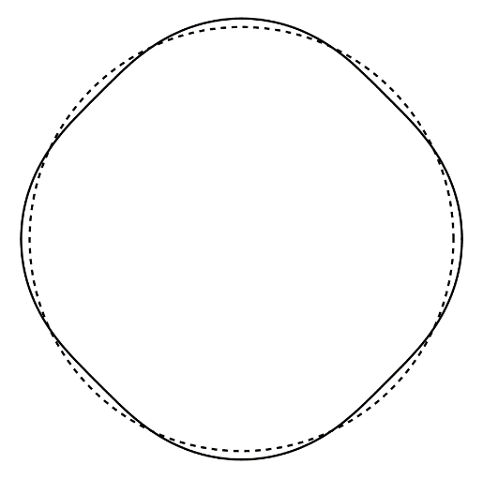
1ST LAYER
Take known linear solution with P
Give 4D base
[Mathur+Saxena+Srivastava ’03]
Mode numbers: (𝑘,𝑚)
$□A=0,$ $□B=0$
$$S^{3}$$
$$□C=AB$$

Slide 21
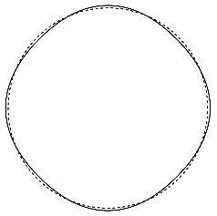
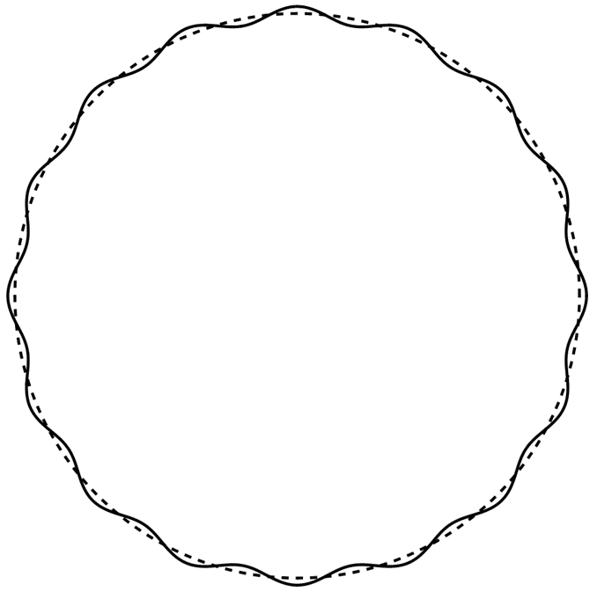
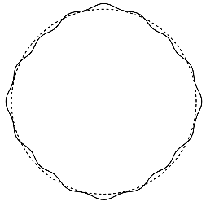
1ST LAYER (2)
Give 4D base
Superpose modes to get function of 2 variables
$$A=\sum_{k,m}{a_{k,m}Y_{k,m}}$$
$□A=0,$ $□B=0$
$$□C=AB$$
$$+$$
$$=$$

Slide 22
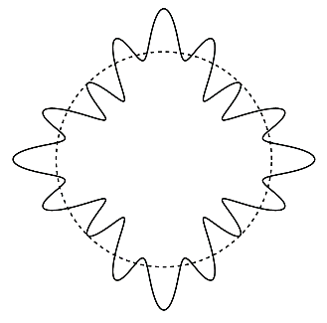
2ND LAYER
Find 𝐶 as non-linear solution
Do it for pair of modes $\left(k_{1},m_{1}\right), \left(k_{2},m_{2}\right)$
Regularity fixes solution
Give 4D base
$□A=0,$ $□B=0$
NL completion
$$□C=AB$$

Slide 23
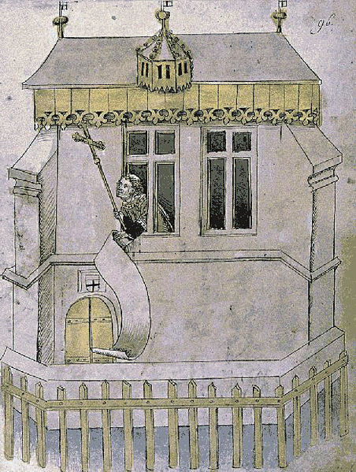
SUMMARY:
Constructive proof of existence of superstrata!
Big step toward general 3-charge microstate geometries
Most general microstate geometry with known CFT dual

Slide 24
CFT PICTURE

Slide 25
BOUNDARY CFT
D1-D5 CFT
2D $𝒩=(4,4)$ SCFT, $c=6N$, $N≡N_{1}N_{5}$
Target space: orbifold ${\left(T^{4}\right)}^{N}/S_{N}$
Orbifold CFT
Twist sectors represented by component strings
$$1$$
$$1$$
$$1$$
$$2$$
$$2$$
$$3$$
………
$$k$$
$$N$$
Notes:
Rough sketch.

Slide 26
2-CHARGE STATES (1)
Round LM geom
$$1$$
$$1$$
$$1$$
$$1$$
$$1$$
………
$$1$$
$↔$ NS vacuum
Notes:
Superstrata are 3-charge states with P charge, but start with 2-charge states with no P.
Array of strings

Slide 27
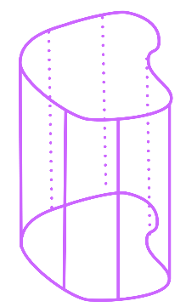
2-CHARGE STATES (2)
Linear fluct around round LM
$$k$$
$$1$$
$$1$$
$$1$$
$$1$$
$$1$$
………
$$1$$
$↔$ “single-trace” chiral primary
General LM geom
[Lunin-Mathur ’01]
$$1$$
$$1$$
$$2$$
$$3$$
$$5$$
………
$↔$ general chiral primary
Notes:
Still no P.

Slide 28
KNOWN 3-CHARGE STATES
P-carrying linear fluct around round LM
“known linear solution”
[Mathur+Saxena+Srivastava ’03]
$$k,m$$
$$1$$
$$1$$
$$1$$
………
$$1$$
$m$: momentum number
State of a single supergraviton with quantum numbers $(k,m)$
$↔$ descendant of chiral primary
$$k,m$$
$$∼{\left( J_{−1}^{+}\right)}^{m}σ_{k}^{++}$$
Notes:
Now states with P. Start with the dictionary for known 3-charge state

Slide 29
SUPERSTRATA
General P-carrying fluct around round LM
$n_{1}$ strings
$n_{2}$ strings
$$k_{1}m_{1}$$
…
$$k_{1}m_{1}$$
$$k_{2}m_{2}$$
…
$$k_{2}m_{2}$$
………
$$1$$
…
$$1$$
Various modes $\left(k,m\right)$ turned on with finite amp.
The most general microstate geometry with known CFT dual
State of supergraviton gas (D1-D5 1/8-BPS version of LLM)
$↔$ descendant of non-chiral primary
Notes:
Non-linear → arbitrary number.

Slide 30
TOWARD MORE GENERAL STRATA

Slide 31
WHAT’S MISSING
Does this class of superstrata reproduce $S_{BH}$?
Not yet ☹
These correspond to supergraviton gas = fluct around $S^{3}$.
Entropy parametrically smaller.
[de Boer ’98]
$$S^{3}$$
Notes:
The important question is if it reproduces S.
Backreacted graviton gas + fluctuation around S^3, non-linearly completed. with stringy exclusion principle → not enough.

Slide 32
MORE GENERAL SUPERSTRATA
Next steps:
$$S^{3}$$
$$S^{3}$$
Other backgrounds
multiple $S^{3}$’s, $ℤ_{k}$ orbifolds
$$S^{3}$$
$$S^{3}/ℤ_{k}$$
multi- superstratum
CFT side:
Need higher and fractional modes of $SL{(2,ℝ)}_{L}×SU{\left(2\right)}_{L}$
$${\left(J_{−1}^{+}\right)}^{m} σ_{k}^{++}$$
$$→$$
$$J_{−2}^{+} σ_{k}^{++}$$
$$J_{−\frac{1}{k}}^{+} J_{−\frac{2}{k}}^{+} σ_{k}^{++}$$
Notes:
Go beyond S3

Slide 33
CONCLUSIONS

Slide 34
CONCLUSIONS:
Superstratum
Represents a new class of microstate geometries
Depends on functions of two variables
Represents the most general microstate geometry with known CFT dual
More general superstrata out there; Construct them. Can they reproduce $S_{BH}$?
Notes:
Still a long and fun way to go.

Slide 35
STAY TUNED
Notes:
Stay tuned for further developments

Slide 36
Thanks!

