Slide 1
Baryon vs Proton Number Fluctuations
MK, Asakawa, PRC85,021901C(2012); PRC86 , 024904(2012)
20min
Time Evolution of
Higher Order Cumulants
MK, et al., in preparation
30min
Masakiyo Kitazawa
Osaka U.

Slide 2
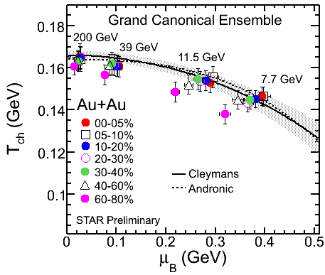
Beam-Energy Scan
STAR 2012
high
beam energy
T
low
Hadrons
Color SC
0
μ
LHC RHIC-BES SPS FAIR,NICA,…

Slide 3
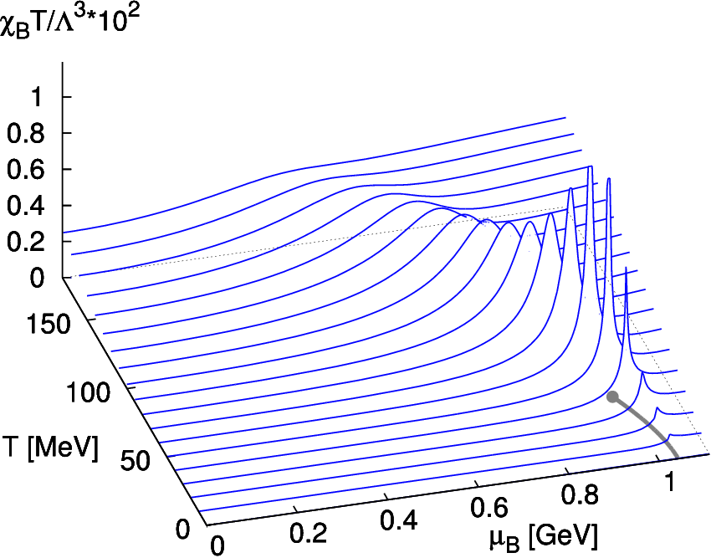
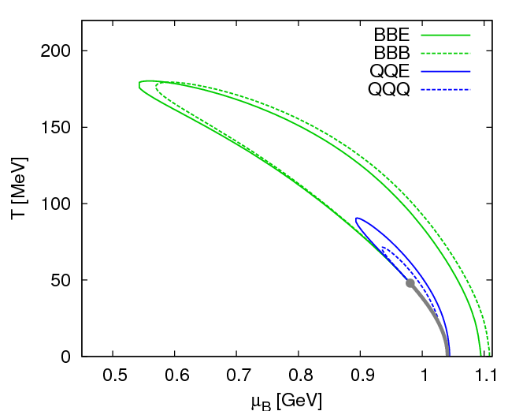
Fluctuations
Fluctuations reflect properties of matter.
Enhancement near the critical point
Stephanov,Rajagopal,Shuryak(’98); Hatta,Stephanov(’02); Stephanov(’09);…
Ratios between cumulants of conserved charges
Asakawa,Heintz,Muller(’00); Jeon, Koch(’00); Ejiri,Karsch,Redlich(’06)
Signs of higher order cumulants
Asakawa,Ejiri,MK(’09); Friman,et al.(’11); Stephanov(’11)

Slide 4
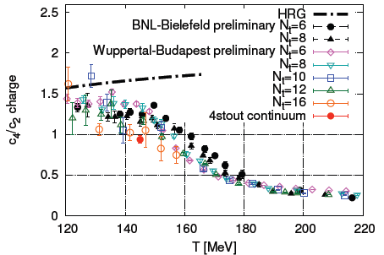
Conserved Charges : Theoretical Advantage
Definite definition for operators
as a Noether current
calculable on any theory
ex: on the lattice

Slide 5
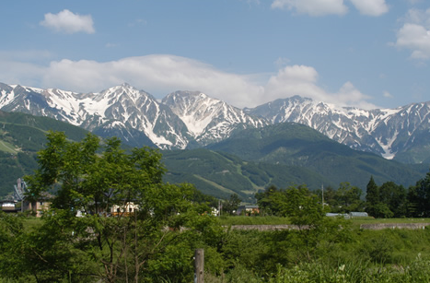
Conserved Charges : Theoretical Advantage
Definite definition for operators
as a Noether current
calculable on any theory
ex: on the lattice
Simple thermodynamic relations
Intuitive interpretation for the behaviors of cumulants
ex:

Slide 6
Fluctuations of Conserved Charges
Under Bjorken expansion
t
Δy
N_{Q}
z
Δy
Count number of particles in Δy in the final state
Variation of a conserved charge in Δy is slow, since it is achieved only through diffusion.
The variation is controlled by transport coefficients.

Slide 7
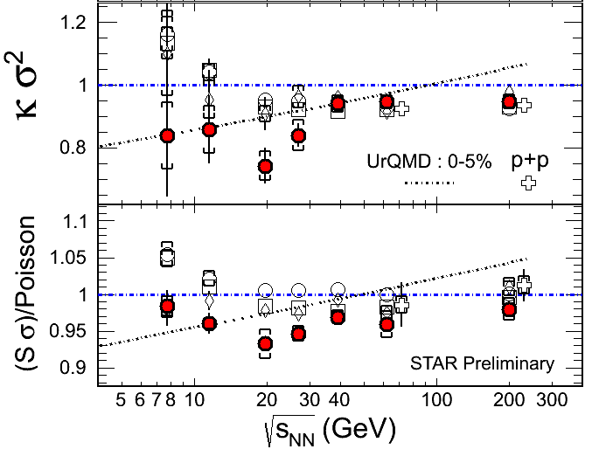
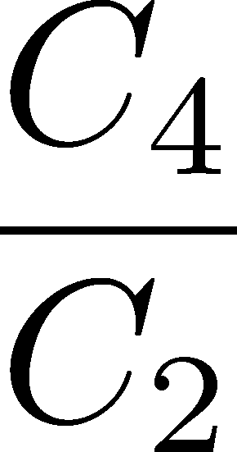
Proton # Fluctuations @ STAR-BES
No characteristic signals on
phase transition to QGP nor QCD CP

Slide 8
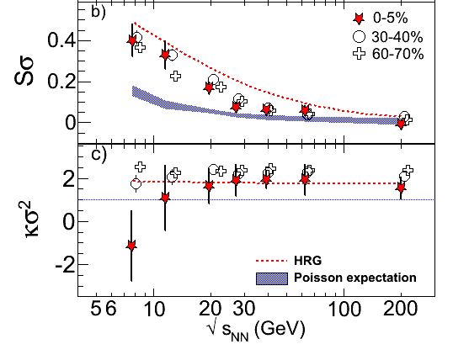
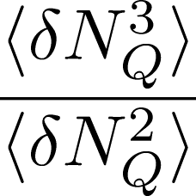
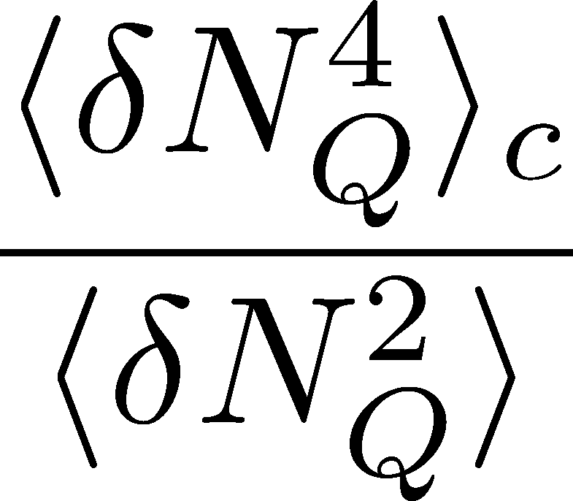
Charge Fluctuations @ STAR-BES
STAR, QM2012
No characteristic signals on
phase transition to QGP nor QCD CP

Slide 9
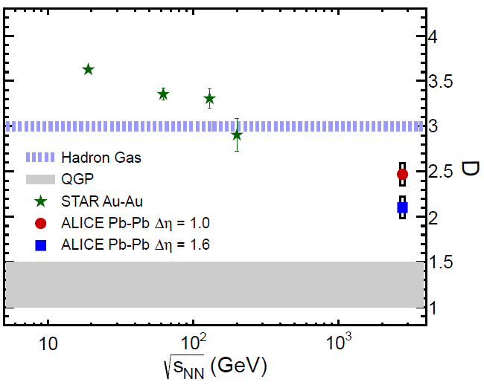
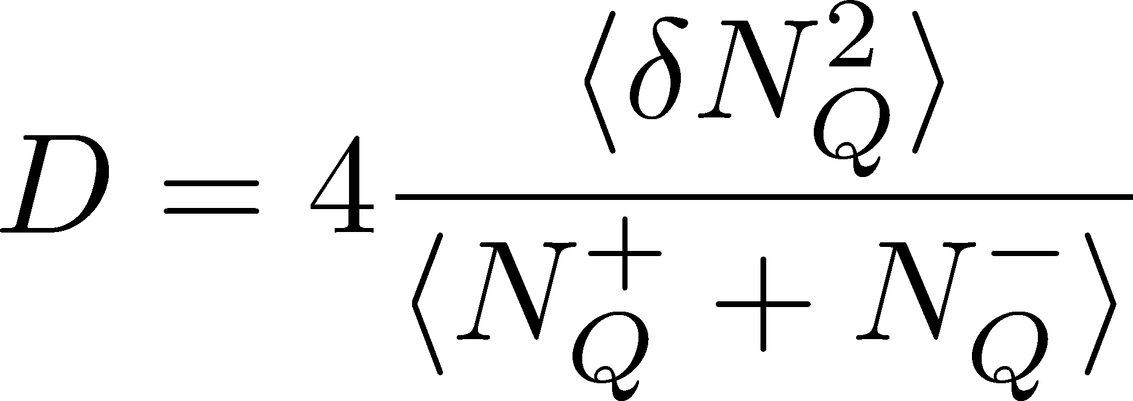
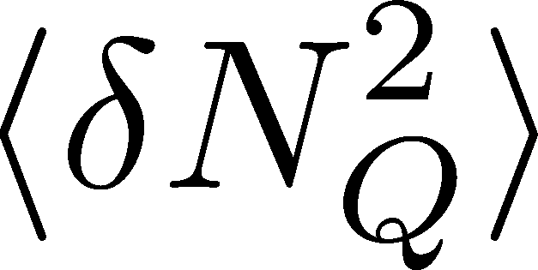
Charge Fluctuation @ LHC
ALICE, 1207.6068
D-measure
D ~ 3-4 Hadronic
D ~ 1 Quark
LHC:
significant suppression
to quark-gluon value
RHIC:
consistent with
hadronic value
is not equilibrated at freeze-out at LHC energy!

Slide 10
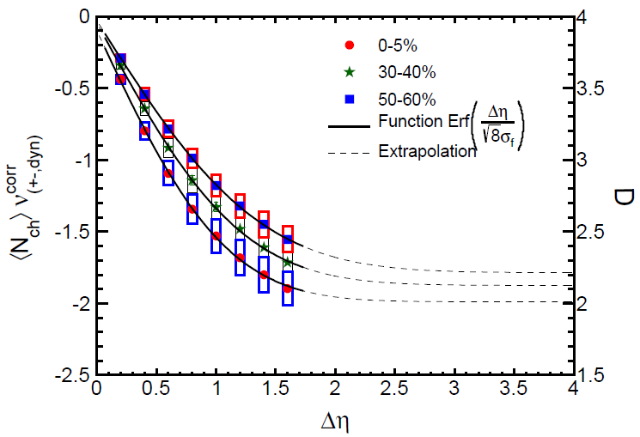
Δη Dependence @ ALICE
ALICE
1207.6068
t
Δη
z
Charge fluctuation is strongly dependent on Δη.
The larger Δη, the more significant suppression.

Slide 11
Evolution of Fluctuations
Fluctuation
in initial state
Time evolution
in the QGP
approach to HRG
by diffusion
experimental effects
particle missID, etc.
volume fluctuation

Slide 12
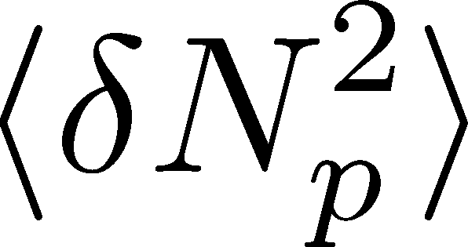
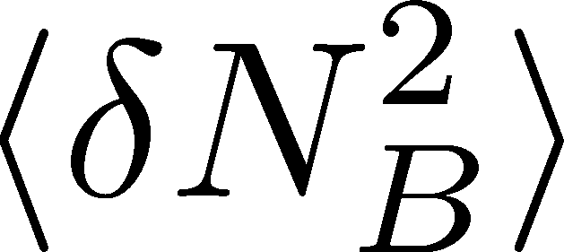
<δN_{B}²> and < δN_{p}² > @ LHC ?
should have different Δη dependence.

Slide 13
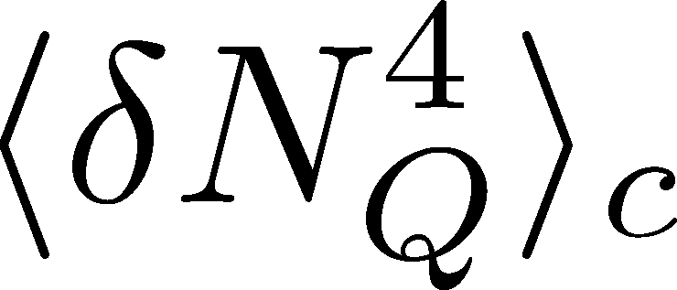
<δN_{Q}⁴> @ LHC ?
How does behave as a function of Δη?
Left
(suppression)
Right
(hadronic)
or

Slide 14
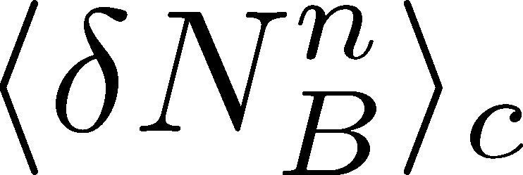
Baryon vs Proton Number Fluctuations
MK, Asakawa, PRC85,021901C(2012); PRC86 , 024904(2012)
are experimentally observable

Slide 15
Nucleon Isospin as Two Sides of a Coin
N
p
n
Nucleons have
two isospin states.
MK, Asakawa,2012

Slide 16
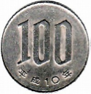
Nucleon Isospin as Two Sides of a Coin
a coin
N
p
n
Nucleons have
two isospin states.
Coins have two sides.
MK, Asakawa,2012

Slide 17
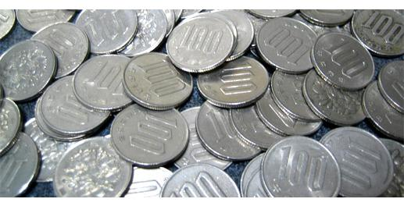
Slot Machine Analogy
= +
P (N)
N
P (N)
N

Slide 18
Extreme Examples
Fixed # of coins
Constant probabilities
N
N
N
N

Slide 19
Reconstructing Total Coin Number
P (N )= P (N )B_{1/2}(N ;N )
:binomial distr. func.

Slide 20
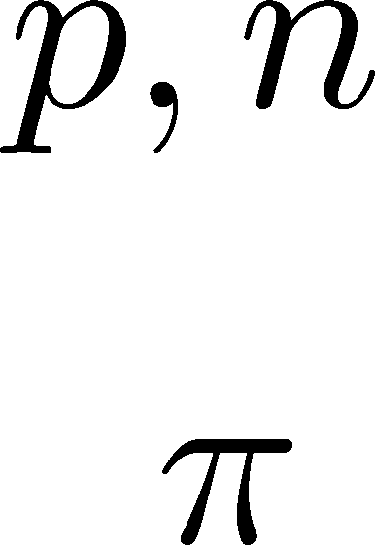
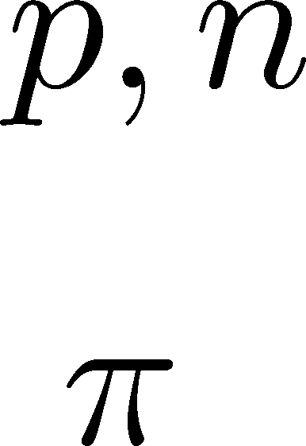
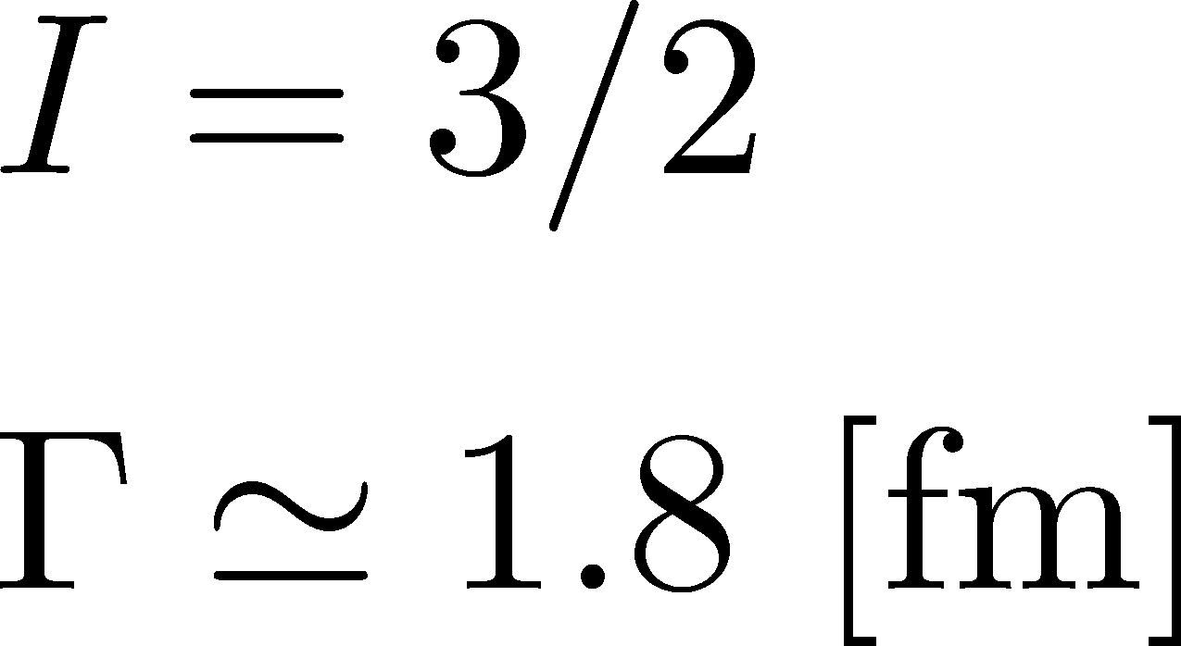
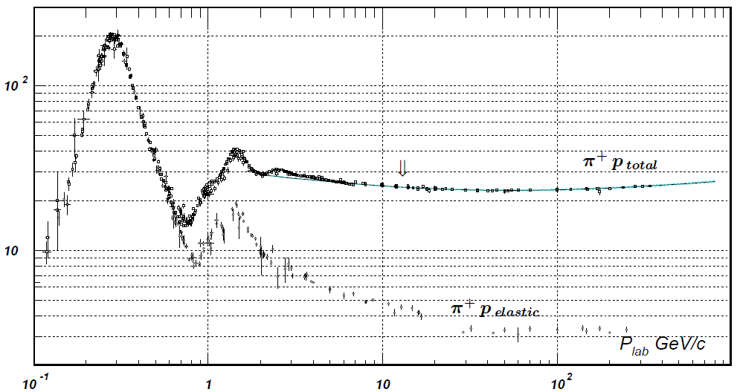
Nucleon Isospin in Hadronic Medium
Isospin of baryons can vary after chemical freezeout
via charge exchange reactions mediated by Δ(1232):
200mb=20fm²
cross section

Slide 21
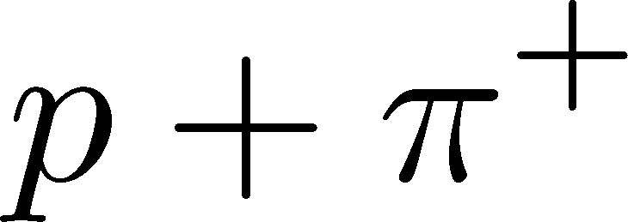
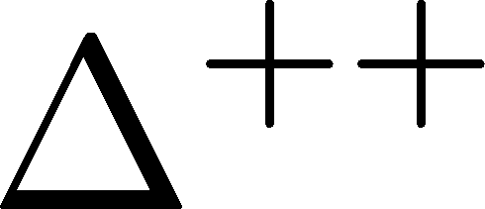
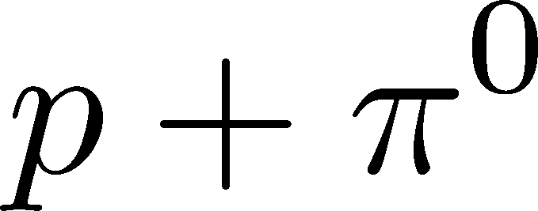
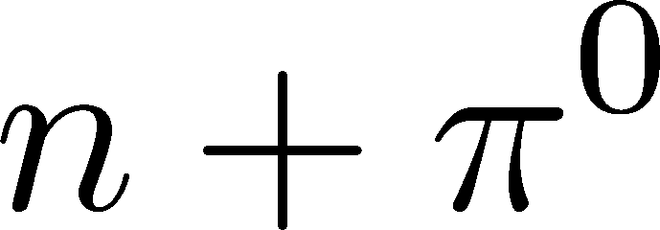
Δ(1232)
cross sections of p
3
1
2:1
2
1:2
decay rates of Δ

Slide 22
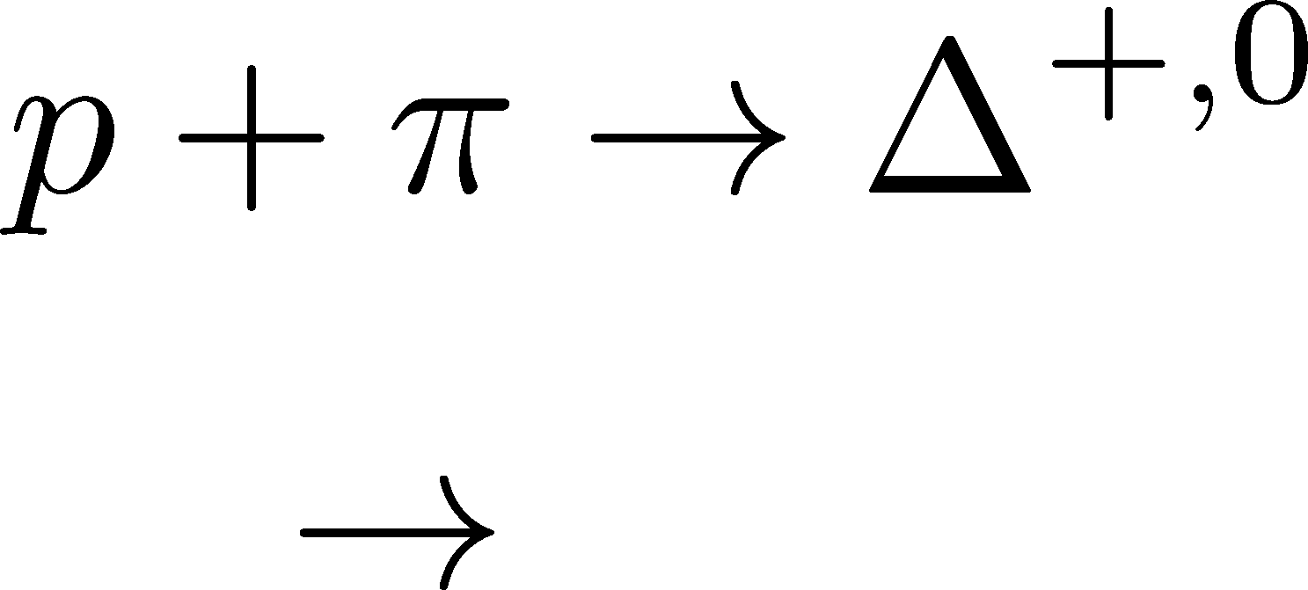
Δ(1232)
cross sections of p
3
1
2:1
2
1:2
decay rates of Δ

Slide 23
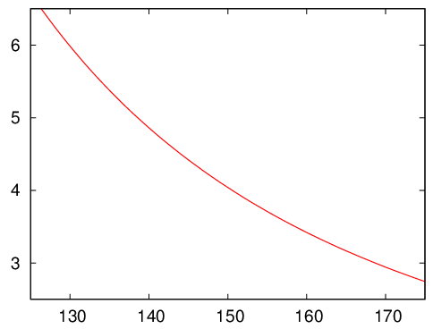
Δ(1232)
cross sections of p
3
1
2:1
2
1:2
decay rates of Δ
BW for σ & thermal pion
Lifetime to create Δ⁺ or Δ⁰

Slide 24
Nucleons in Hadronic Phase
time
chem. f.o.
hadronize
10~20fm
kinetic f.o.
rare NN collisions
no quantum corr.
mesons
baryons
many pions

Slide 25
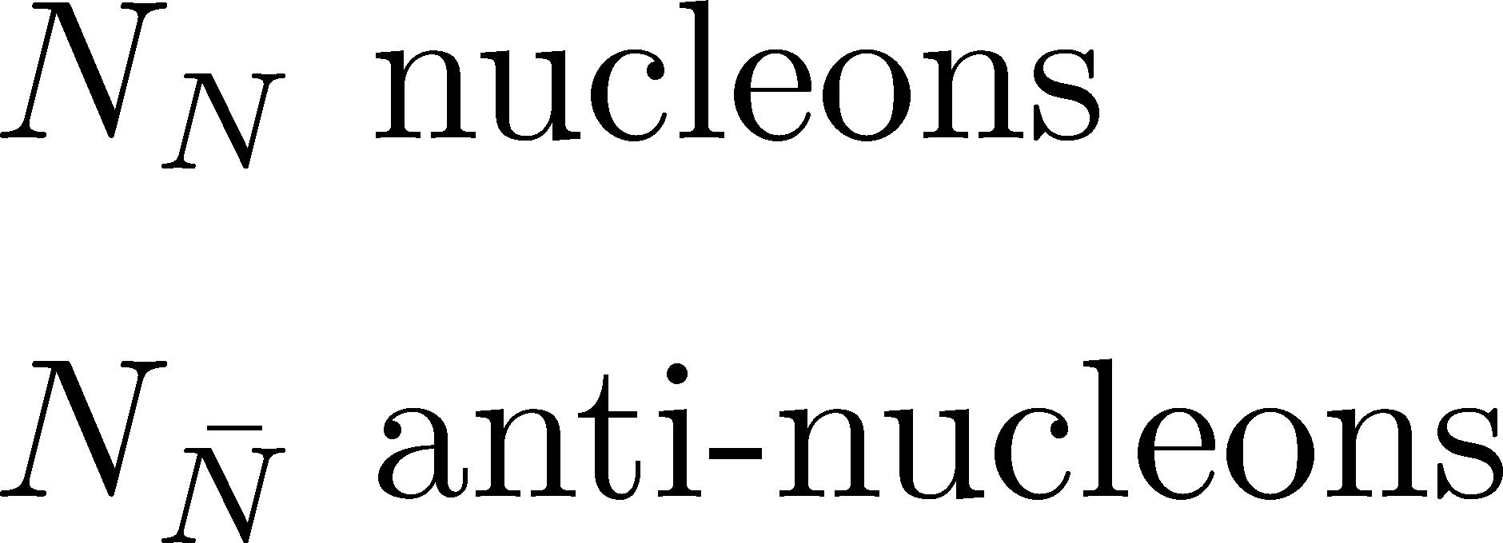
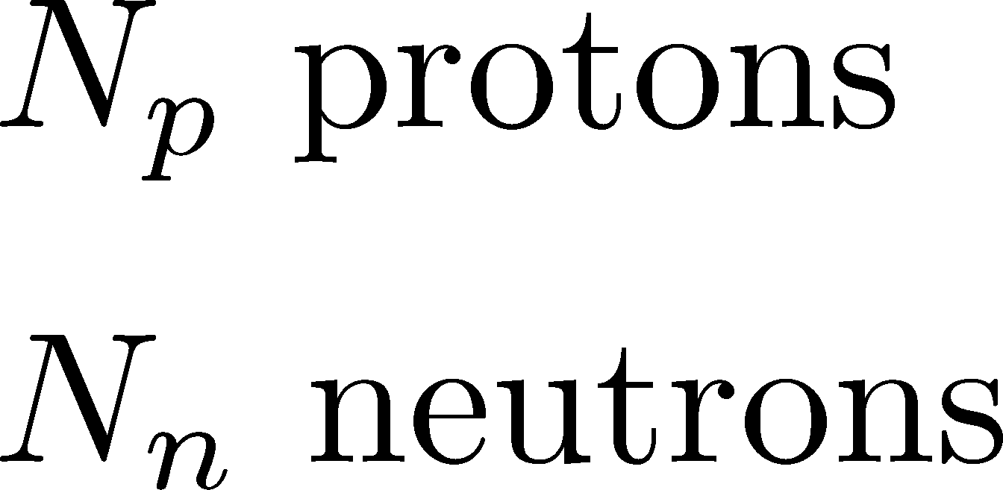
Probability Distribution
Detector
binomial distribution func.
for any phase space in the final state.

Slide 26
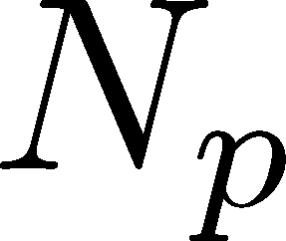
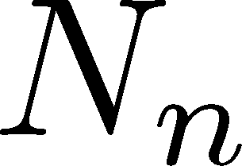
Nucleon & Proton Number Fluctuations
for isospin symmetric medium
effect of isospin density <10%
Similar formulas up to any order!
For free gas

Slide 27
3rd & 4th Order Fluctuations

Slide 28
Difference btw Baryon and Proton Numbers
(1)
deviates from the equilibrium value.
(2) Boltzmann (Poisson) distribution for

Slide 29
Difference btw Baryon and Proton Numbers
(1)
deviates from the equilibrium value.
(2) Boltzmann (Poisson) distribution for
genuine info.
noise
For free gas

Slide 30
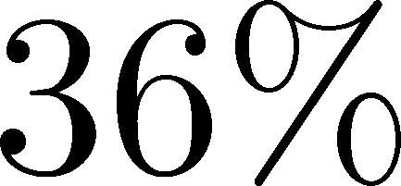
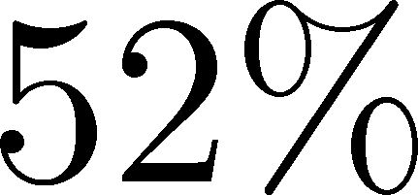
Strange Baryons
Decay Rates:
Decay modes:
Regarding these ratios even, protons from these decays
is incorporated into the binomial distribution. Then, N_{N}→N_{B}

Slide 31
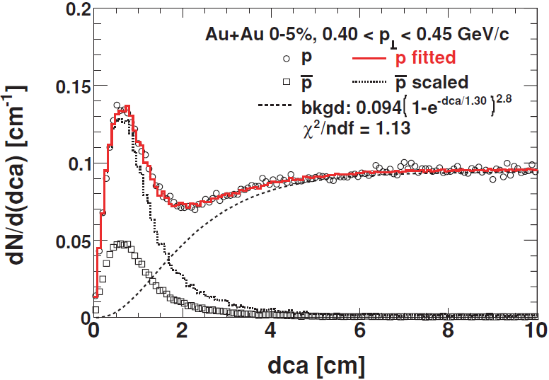
Secondary Protons
MK+, in preparation
Secondary (knockout) protons
20% of observed protons @ STAR
detector
dca [cm]
Measurement
STAR, PRC79,034909(2009)

Slide 32
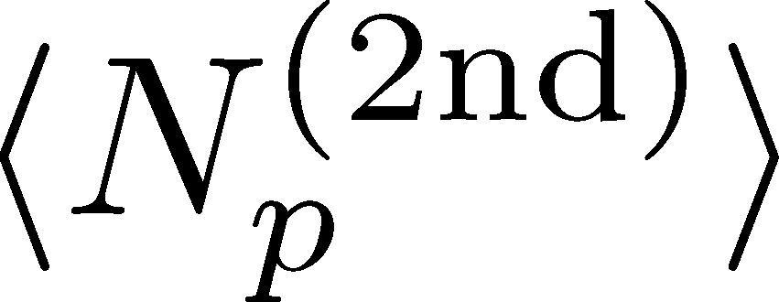
Secondary Protons
MK+, in preparation
Secondary (knockout) protons
20% of observed protons @ STAR
detector
dca [cm]
Measurement
STAR, PRC79,034909(2009)
Their contribution can be eliminated!

Slide 33
Time Evolution of
Higher Order Cumulants
MK, et al., in preparation

Slide 34
<δN_{Q}⁴> @ LHC ?
How does behave as a function of Δη?
Left
(suppression)
Right
(hadronic)
or

Slide 35
Stochastic Diffusion Equation
Conservation Law
Fick’s Law

Slide 36
Stochastic Diffusion Equation
Stochastic force
Local correlation
(hydrodynamics)
Equilibrium fluc.

Slide 37
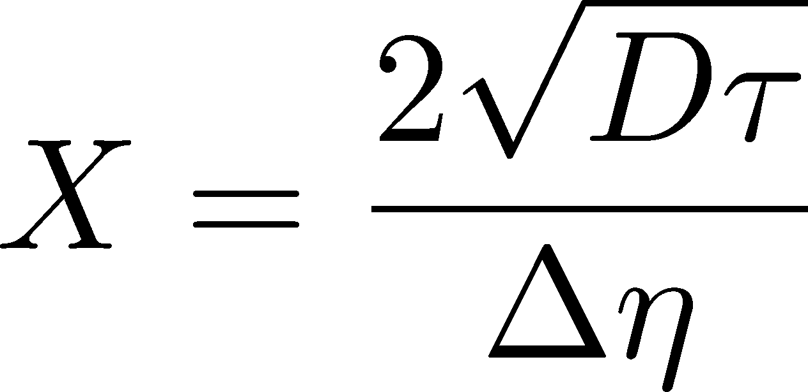
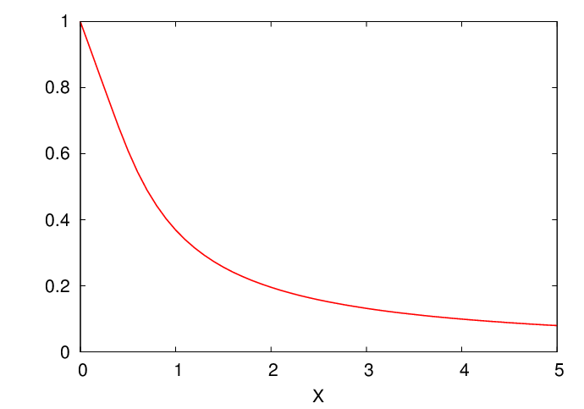
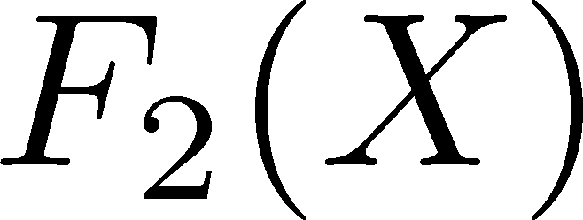
Time Evolution
Shuryak, Stephanov, 2001
Initial condition:
Translational invariance
initial
equilibrium
initial
equilibrium

Slide 38
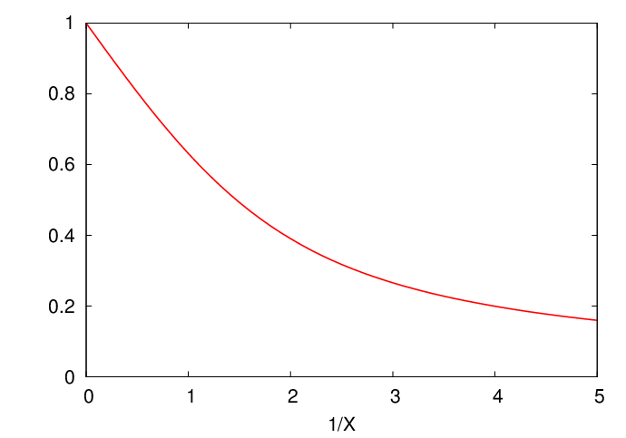
Δη Dependence
Shuryak, Stephanov, 2001
Initial condition:
Translational invariance
initial
equilibrium
equilibrium
initial

Slide 39
Δη Dependence
Shuryak, Stephanov, 2001
Initial condition:
Translational invariance
initial
equilibrium
equilibrium
initial

Slide 40
Non-Gaussian Stochastic Force??
Stochastif Force : 3rd order
Local correlation
(hydrodynamics)
Equilibrium fluc.

Slide 41
Caution!
diverge in long wavelength
Markov process + continuous variable
Gaussian stochastic force
cf) Gardiner, “Stochastic Methods”
Hydrodynamics
Huge particles in a small volume
Gaussian distribution (central limit theor.)

Slide 42
Caution!
diverge in long wavelength
Markov process + continuous variable
Gaussian stochastic force
cf) Gardiner, “Stochastic Methods”
Hydrodynamics
Huge particles in a small volume
Gaussian distribution (central limit theor.)
NOTES
Near the CP, locality is violated.
Analysis of higher-order cumulants without a critical phenomena should be a particular problem in physics!

Slide 43
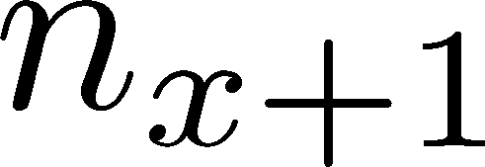
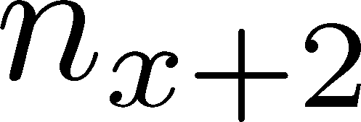
Diffusion Master Equation
Divide spatial coordinate into discrete cells
probability

Slide 44
Diffusion Master Equation
Divide spatial coordinate into discrete cells
probability
Master Equation for P(n)
x-hat: lattice-QCD notation
Solve the DME exactly, and take a→0 limit
No approx., ex. van Kampen’s system size expansion

Slide 45
Solution of DME
1st
initial
Deterministic part is the diffusion equation
at long wave length (1/a<<k)
Appropriate continuum limit with γa²=D

Slide 46
Solution of DME
1st
initial
Deterministic part is the diffusion equation
at long wave length (1/a<<k)
Appropriate continuum limit with γa²=D
2nd
Consistent with stochastic diffusion eq.
for sufficiently slowly-varying initial condition.

Slide 47
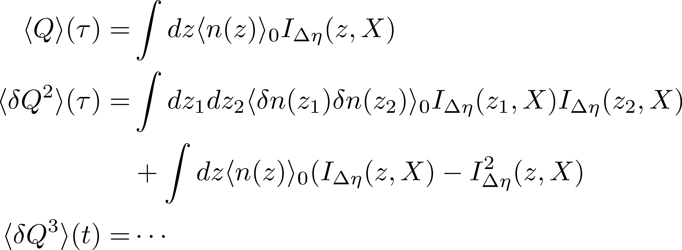
Total Charge in Δη
FT of step func.
0
1
x

Slide 48
Time Evolution of <δQ^{n}>_{c}
Uniform and fixed Initial condition
Particle numbers in all cells are M.

Slide 49
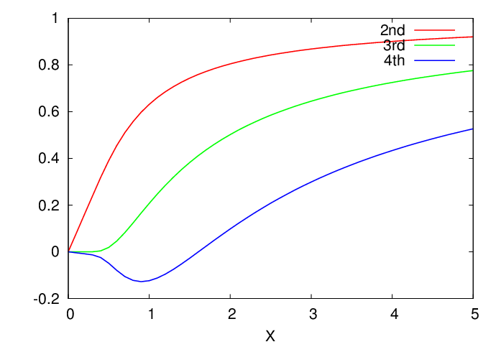
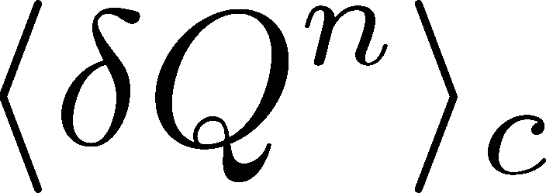
Time Evolution of <δQ^{n}>_{c}
Uniform and fixed Initial condition
Particle numbers in all cells are M.
2nd
3rd
4th
Slow enhancement for higher order
Negative 4th cumulant
Similar behavior for small initial fluc.

Slide 50
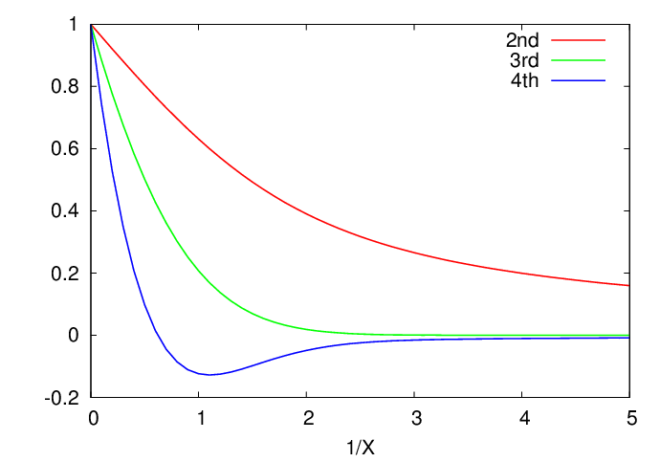
Time Evolution of <δQ^{n}>_{c}
Initial condition
Particle numbers in all cells are M.
2nd
3rd
4th

Slide 51
Net Charge Number
Prepare 2 species of (non-interacting) particles
Same time evolution except for
Poisson → Skellam

Slide 52
<δN_{Q}⁴> @ LHC
Bjorken expansion
small fluctuations at hadronization
short correlaition in hadronic stage
Assumptions
Strong suppression of
4th-order cumulant is anticipated at LHC energy!

Slide 53
Chemical Reaction 1
x: # of X
a: # of A (fixed)
Master eq.:
Cumulants with fixed initial condition
initial
equilibrium

Slide 54
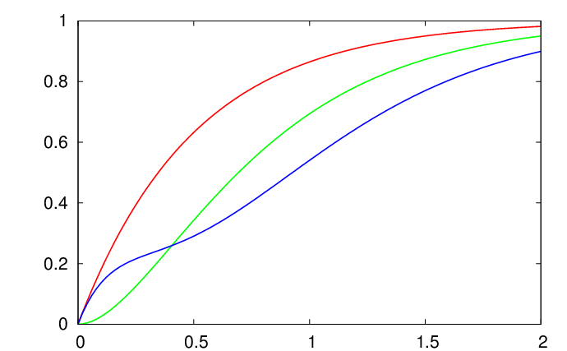
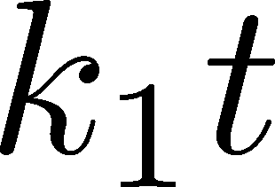
Chemical Reaction 2
2nd
3rd
4th
Higher-order
cumulants
grow slower.

Slide 55
Summary
Δη dependence of cumulants encodes plenty of physics.
Cumulants with different order have different time evolution.
Our analysis with a diffusion master equation shows that
Approach to equilibrium from small fluctuation is slower for higher orders.
ALICE will observe a small
4th order cumulant.
or, we miss something…

Slide 56
Open Questions & Future Work
Why the primordial fluctuations are observed only at the LHC, and not the RHIC ?
Extract more information on each stage of fireballs using fluctuations
Model refinement
Including the effects of
nonzero correlation length / relaxation time
global charge conservation
Non Poissonian system ← interaction of particles

Slide 57
Evolution of Fluctuations
Fluctuation
in initial state
Time evolution
in the QGP
approach to HRG
by diffusion
experimental effects
particle missID, etc.
volume fluctuation

Slide 58
Fluctuations
Free Boltzmann → Poisson

Slide 59
Nonzero Isospin Density
Effect of nonzero isospin density is
well suppressed down to sqrt{s}~10GeV

Slide 60
Solving DME
(1) Factorial Generating Func.
(2) Solution with Fixed Initial Condition
(3) Time evolution of factorial cumulants
(4) Factorial cumulants → cumulants
(5) Superposition of cumulants

Slide 61
Time Evolution of Cumulants
Fixed initial condition
Particle number in each cell is fixed to M_{x}.
Solution
In coordinate space (1/a<<k)
Deterministic part is controlled by the diffusion eq.
Appropriate continuum limit with γa²=D

Slide 62
Time Evolution of Cumulants
Fixed initial condition
Particle number in each cell is fixed to M_{x}.
Solution
Consistent with stochastic diffusion eq.
with sufficiently slow initial condition

