Slide 1
Time Evolution of Non-Gaussianity in Heavy-Ion Collisions
Masakiyo Kitazawa
（Osaka U.）
MK, Asakawa, Ono, in preparation
TIFR, 2/May/2013

Slide 2
Beam-Energy Scan
T
Hadrons
Color SC
0
μ

Slide 3

Beam-Energy Scan
STAR 2012
high
beam energy
T
low
Hadrons
Color SC
0
μ

Slide 4

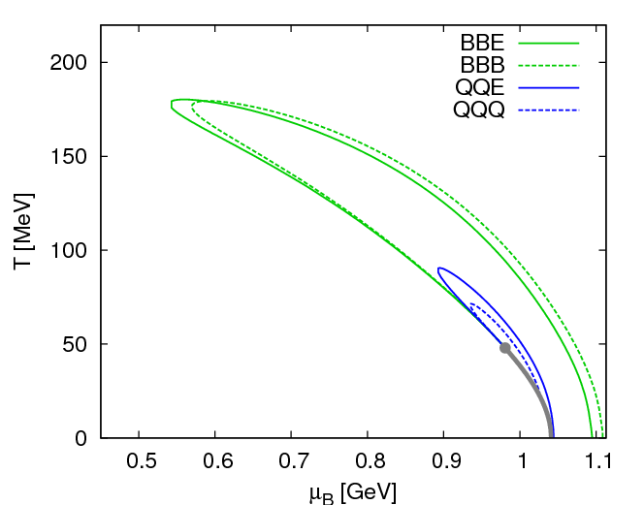
Fluctuations
Fluctuations reflect properties of matter.
  Enhancement near the critical point
  Stephanov,Rajagopal,Shuryak(’98); Hatta,Stephanov(’02); Stephanov(’09);…
  Ratios between cumulants of conserved charges
  Asakawa,Heintz,Muller(’00); Jeon, Koch(’00); Ejiri,Karsch,Redlich(’06)
  Signs of higher order cumulants
  Asakawa,Ejiri,MK(’09); Friman,et al.(’11); Stephanov(’11)

Slide 5
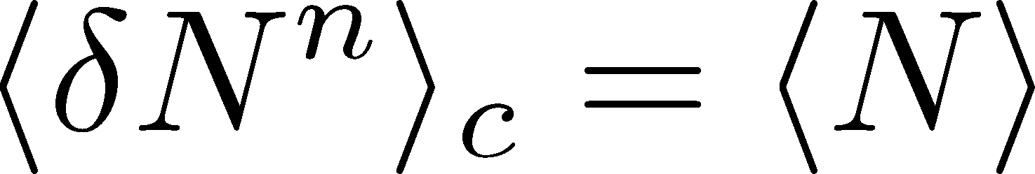
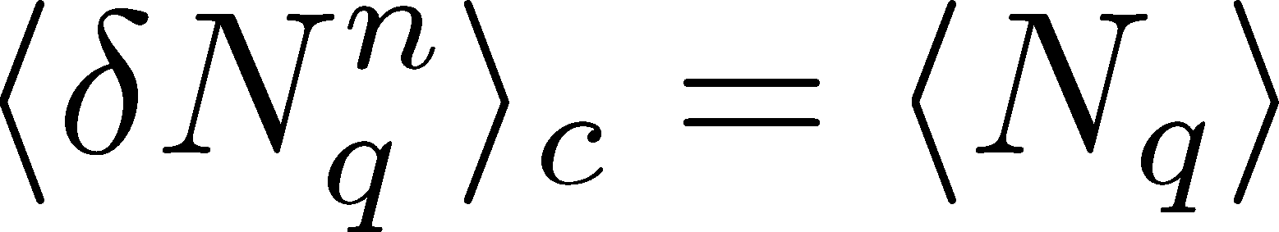
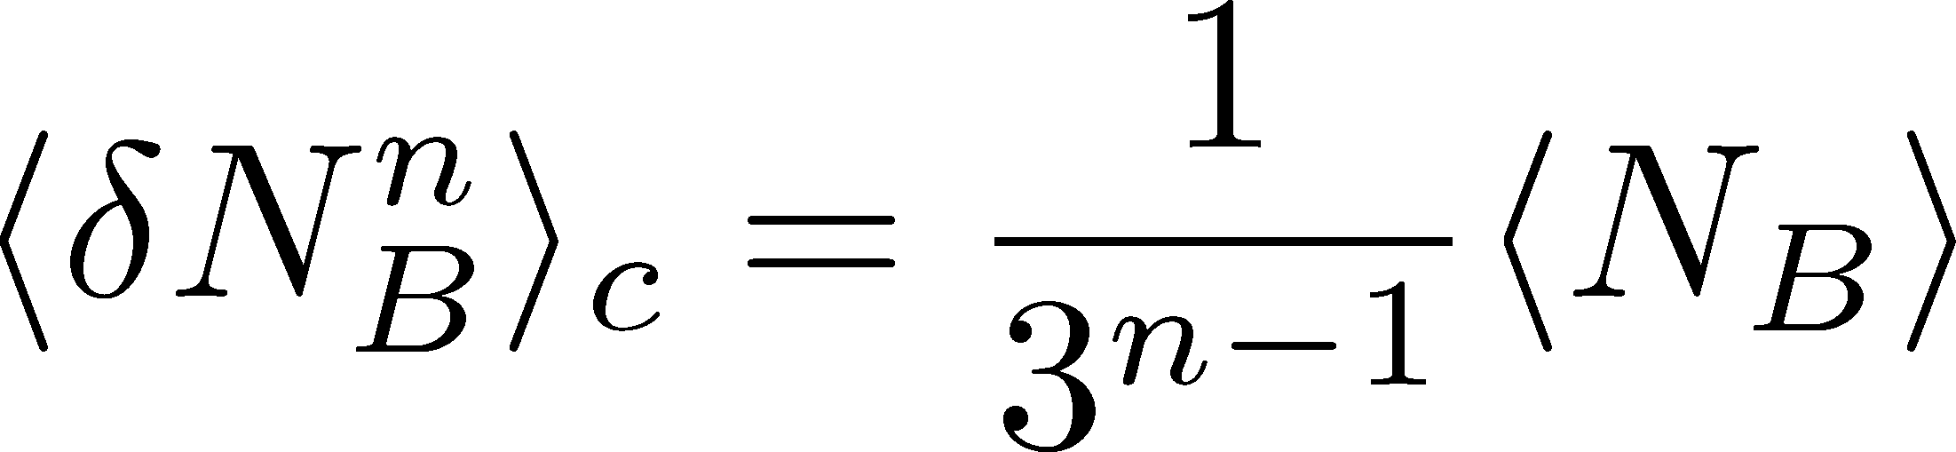
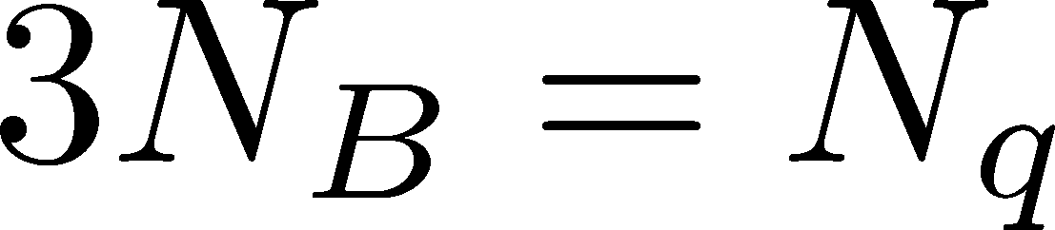
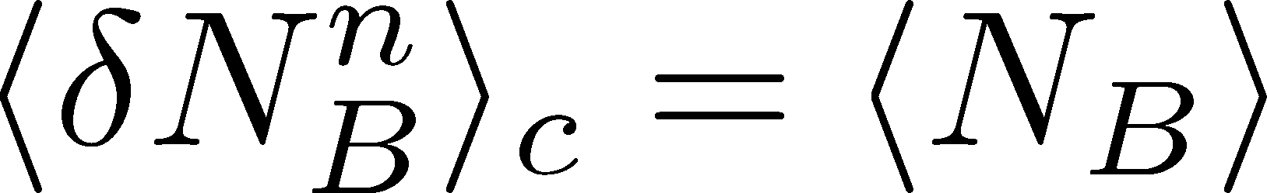
Fluctuations
Free Boltzmann → Poisson

Slide 6
Fluctuations
Free Boltzmann → Poisson
RBC-Bielefeld ’09

Slide 7
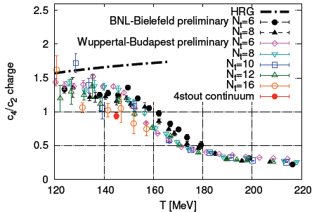
Conserved Charges : Theoretical Advantage
Definite definition for operators
as a Noether current
calculable on any theory
ex: on the lattice

Slide 8
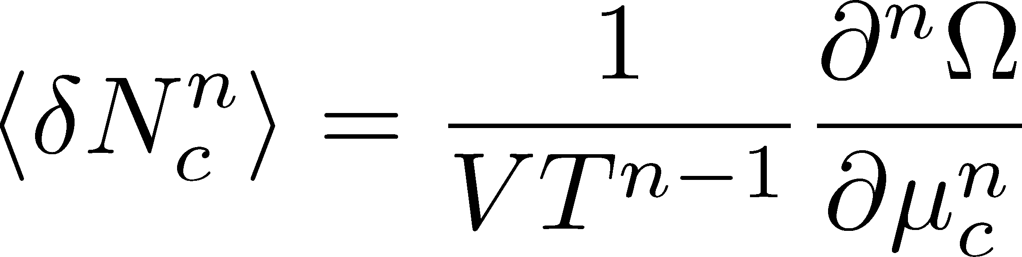

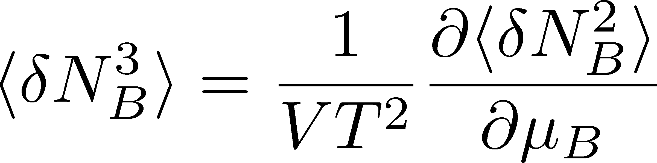
Conserved Charges : Theoretical Advantage
Definite definition for operators
as a Noether current
calculable on any theory
ex: on the lattice
Simple thermodynamic relations
Intuitive interpretation for the behaviors of cumulants
ex:

Slide 9
Fluctuations of Conserved Charges
Under Bjorken expansion
Asakawa, Heintz, Muller, 2000
Jeon, Koch, 2000
Shuryak, Stephanov, 2001
t
Δy
N_{Q}
z
Δη
Variation of a conserved charge in Δη is slow, since it is achieved only through diffusion.
Primordial values can survive until freezeout.
The wider Δη, more earlier fluctuation.

Slide 10
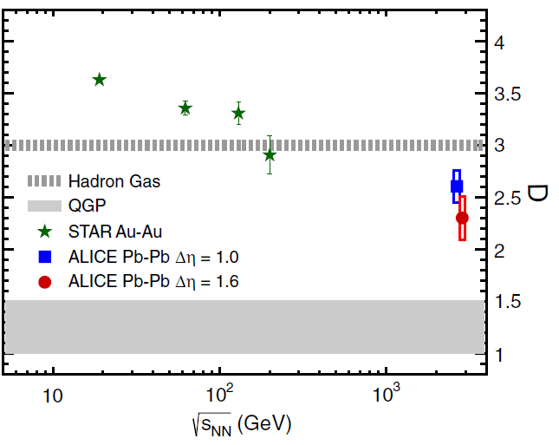

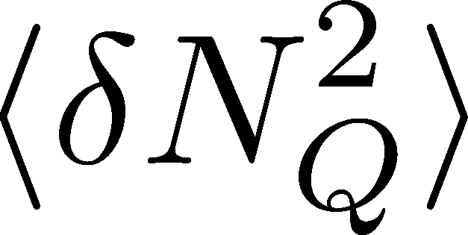
Charge Fluctuation @ LHC
ALICE, PRL110,152301(2013)
D-measure
D ~ 3-4 Hadronic
D ~ 1 Quark
LHC:
significant suppression
from hadronic value
is not equilibrated at freeze-out at LHC energy!

Slide 11

Δη Dependence @ ALICE
ALICE
PRL 2013
t
Δη
z
rapidity acceptane
Higher-order cumulants as
thermometer?
HotQCD,2012

Slide 12
Δη Dependence @ ALICE
ALICE
PRL 2013
t
Δη
z
Δη dependences of fluctuation observables
encode history of the hot medium!
rapidity acceptane
Higher-order cumulants as
thermometer?
HotQCD,2012

Slide 13


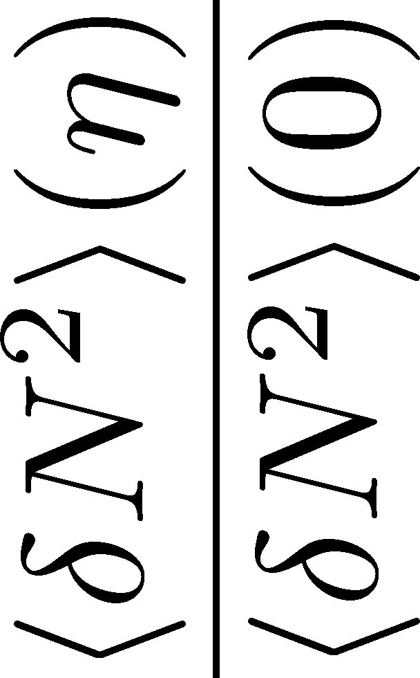
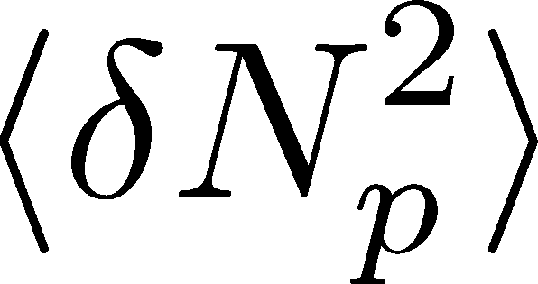

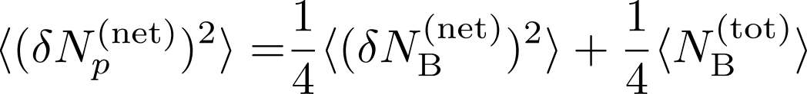
<δN_{B}²> and < δN_{p}² > @ LHC ?
should have different Δη dependence.

Slide 14
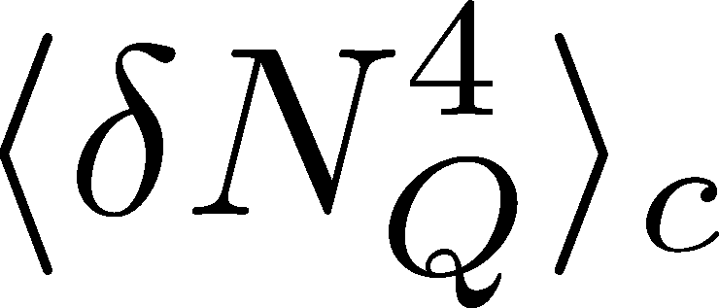

<δN_{Q}⁴> @ LHC ?
How does behave as a function of Δη?
Left
(suppression)
Right
(hadronic)
or

Slide 15
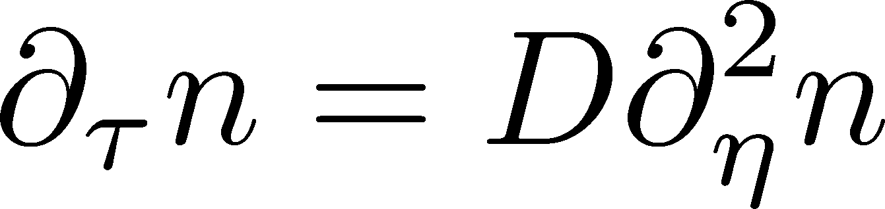

Hydrodynamic Fluctuations
Landau, Lifshitz, Statistical Mechaniqs II
Kapusta, Muller, Stephanov, 2012
Diffusion equation
Stochastic diffusion equation

Slide 16
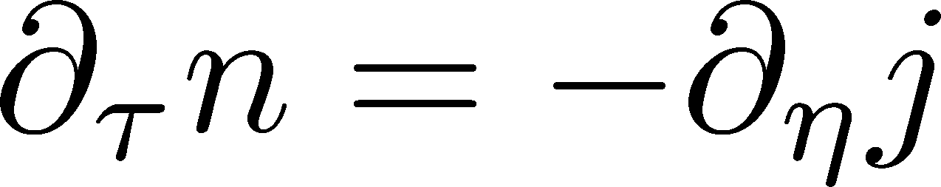
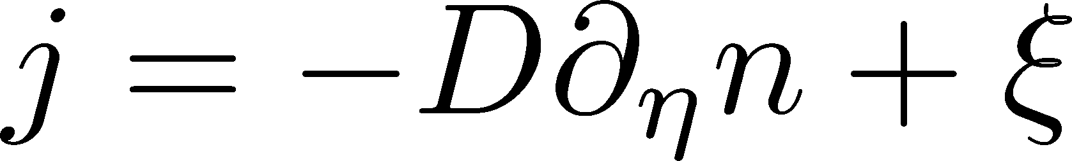
Hydrodynamic Fluctuations
Landau, Lifshitz, Statistical Mechaniqs II
Kapusta, Muller, Stephanov, 2012
Diffusion equation
Stochastic diffusion equation
Conservation Law
Fick’s Law

Slide 17
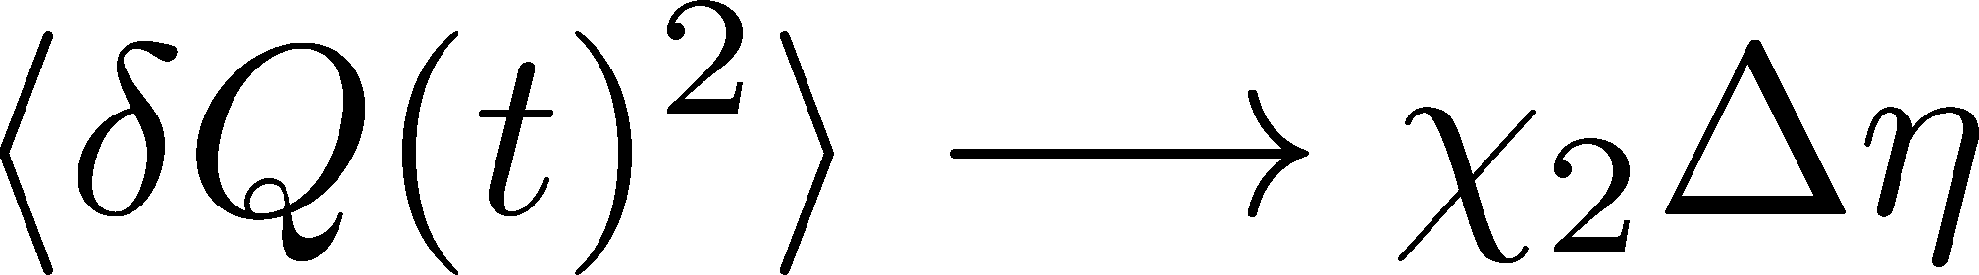
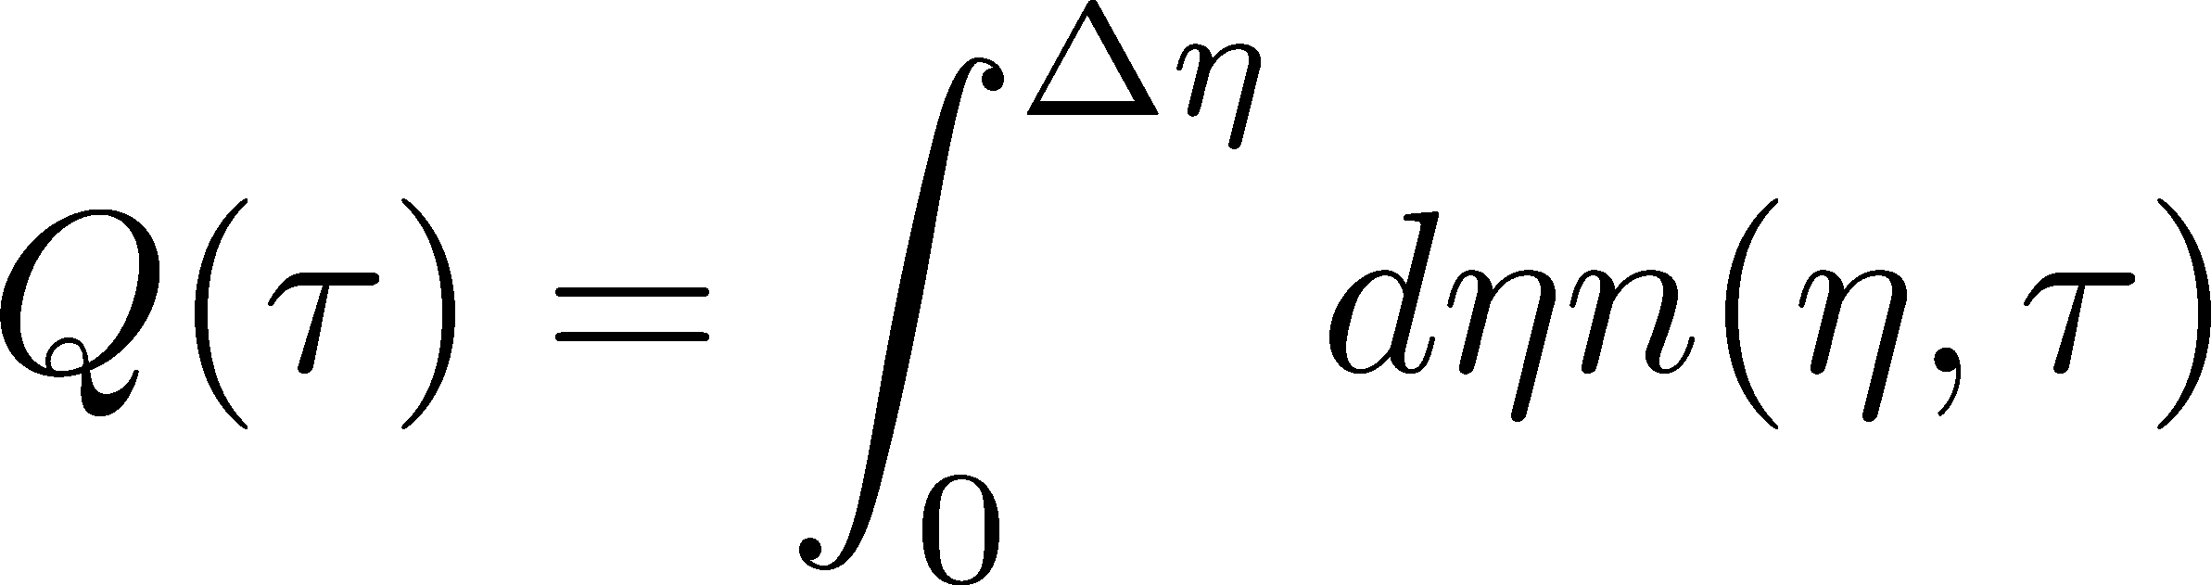
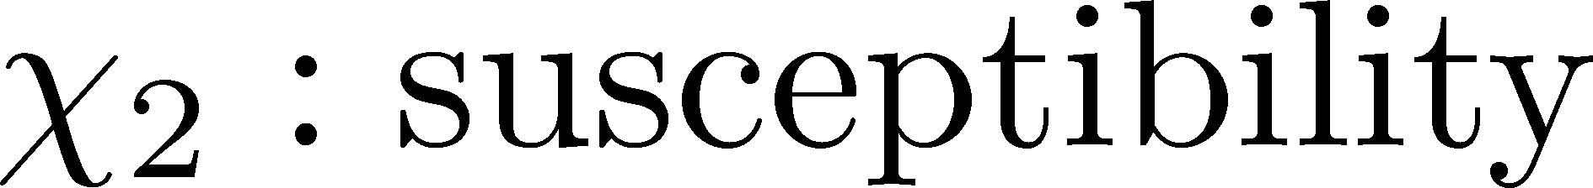
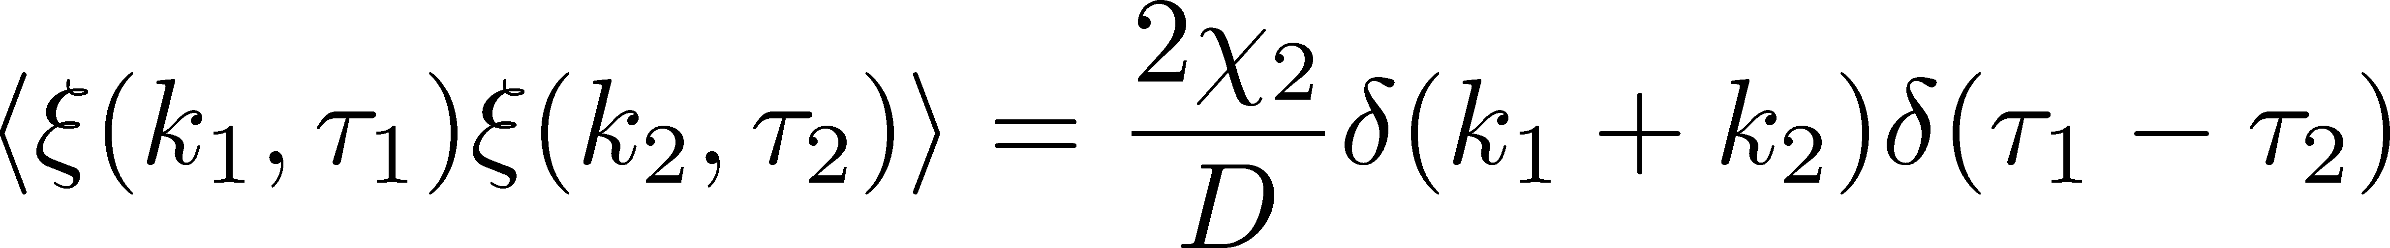
Fluctuation-Dissipation Relation
Stochastic force
Local correlation
(hydrodynamics)
Equilibrium fluc.

Slide 18
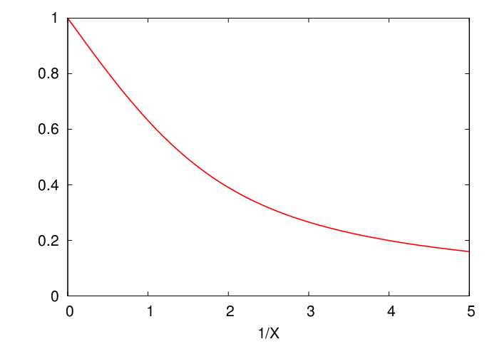
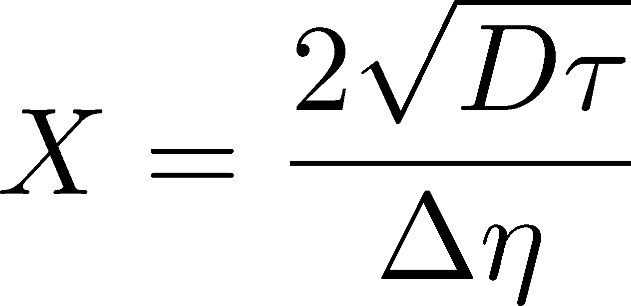
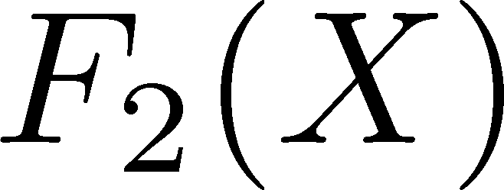

Δη Dependence
Shuryak, Stephanov, 2001
Initial condition:
Translational invariance
initial
equilibrium
initial
equilibrium

Slide 19
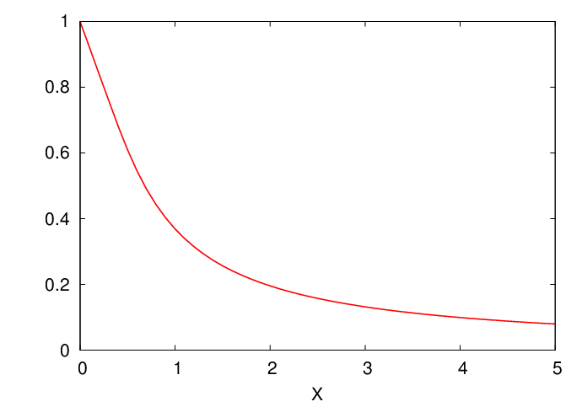

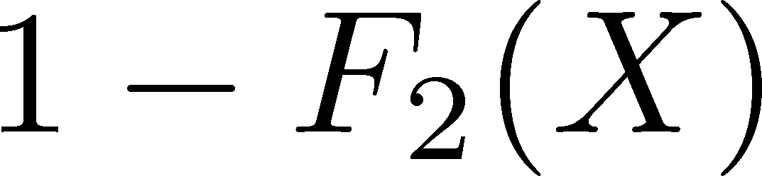

Δη Dependence
Shuryak, Stephanov, 2001
Initial condition:
Translational invariance
initial
equilibrium
equilibrium
initial

Slide 20
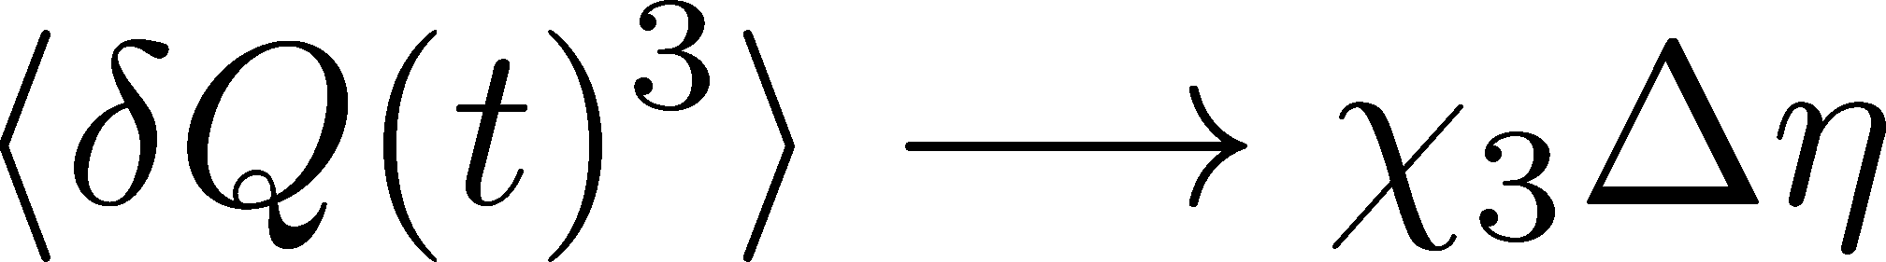
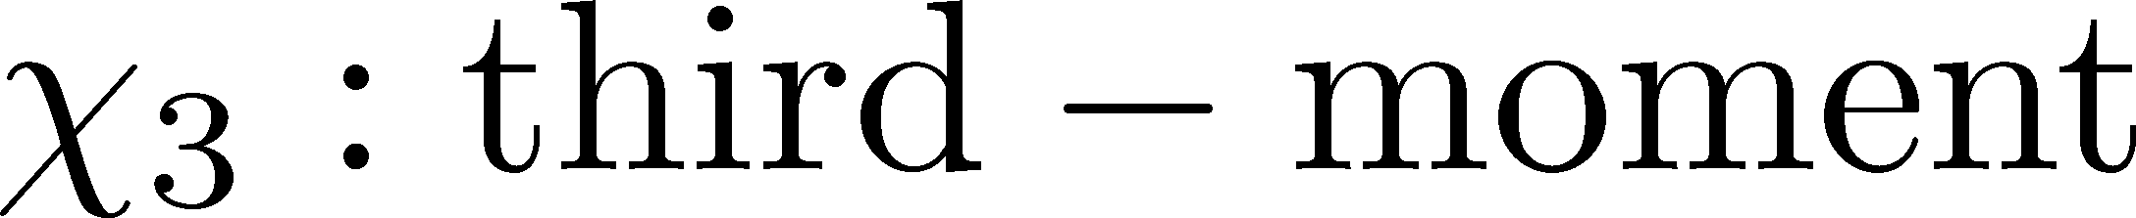
Non-Gaussian Stochastic Force ??
Stochastif Force : 3rd order
Local correlation
(hydrodynamics)
Equilibrium fluc.

Slide 21
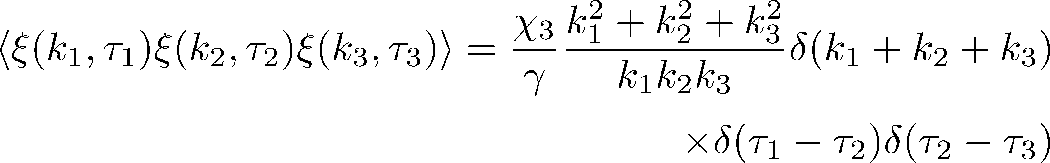
Caution!
diverge in long wavelength
No a priori extension of FD relation to higher orders

Slide 22
Caution!
diverge in long wavelength
No a priori extension of FD relation to higher orders
Markov process＋continuous variable
Theorem
➔Gaussian random force
cf) Gardiner, “Stochastic Methods”
Hydrodynamics
Local equilibrium with many particles
Gaussian due to central limit theorem

Slide 23
Thee “NON”s
Physics of non-Gaussianity in heavy-ion
collisions is a particular problem.
Non-Gaussian
Non-critical
Non-equilibrium
Non-Gaussianitiy is
irrelevant in large systems
fluctuations observed so far
do not show critical enhancement
Fluctuations are not
equilibrated

Slide 24
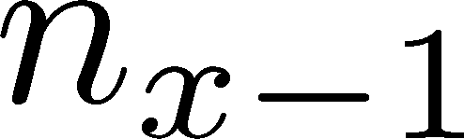






Diffusion Master Equation
Divide spatial coordinate into discrete cells
probability

Slide 25
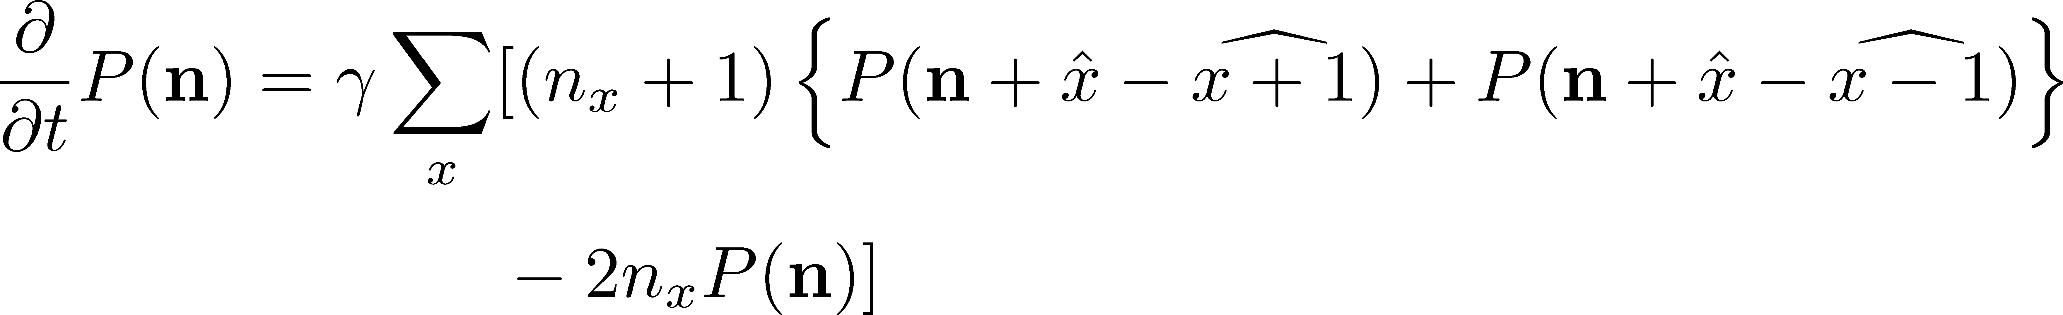
Diffusion Master Equation
Divide spatial coordinate into discrete cells
probability
Master Equation for P(n)
x-hat: lattice-QCD notation
Solve the DME exactly, and take a→0 limit
No approx., ex. van Kampen’s system size expansion

Slide 26
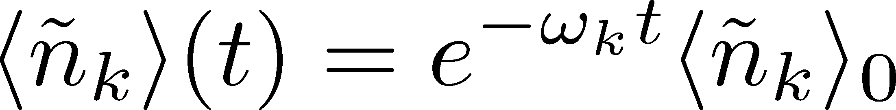
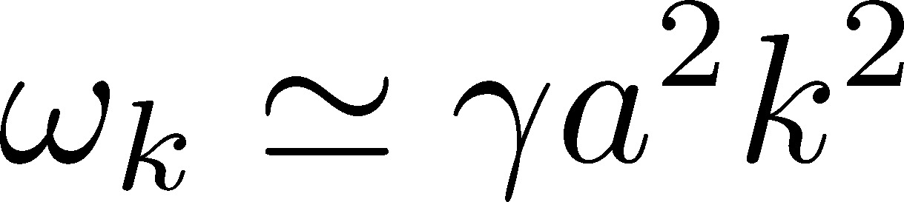
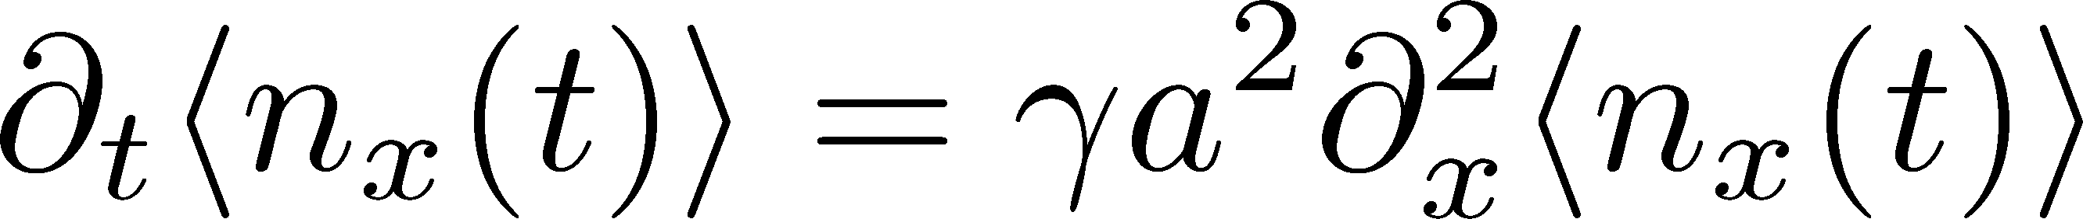
Solution of DME
1st
initial
Deterministic part follows diffusion equation
at long wave length (1/a<<k)
Appropriate continuum limit with γa²=D

Slide 27
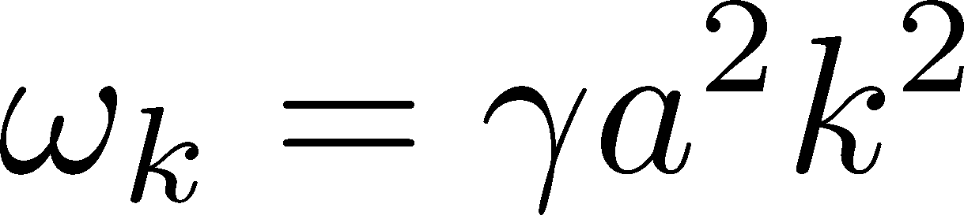
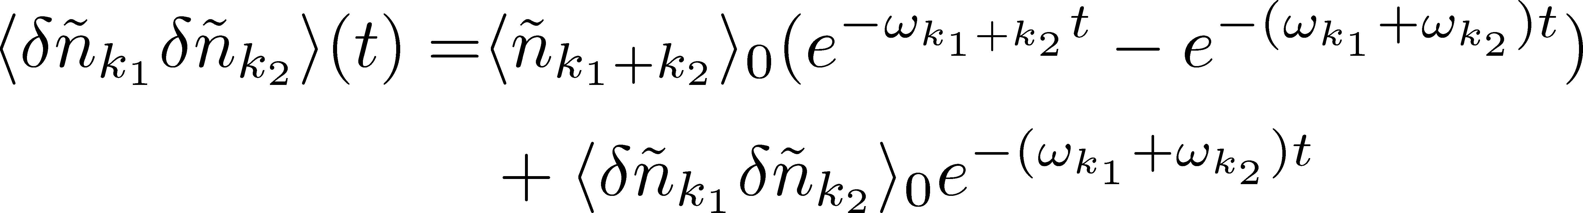
Solution of DME
1st
initial
Deterministic part follows diffusion equation
at long wave length (1/a<<k)
Appropriate continuum limit with γa²=D
2nd
Consistent with stochastic diffusion eq.
for sufficiently slowly-varying initial condition.

Slide 28
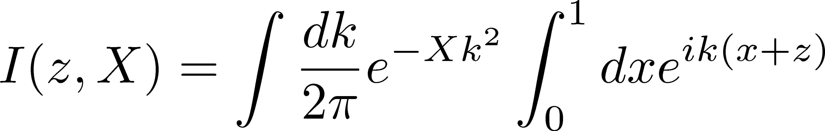
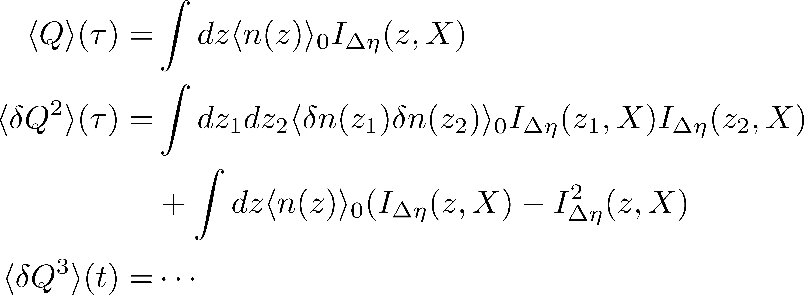
Total Charge in Δη
FT of step func.
0
1
x

Slide 29
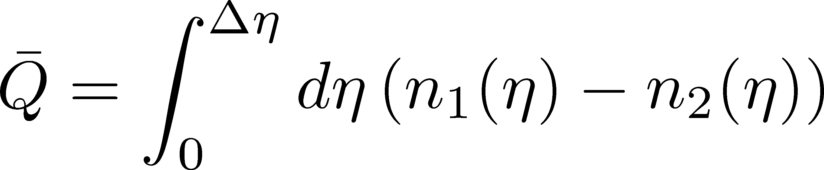
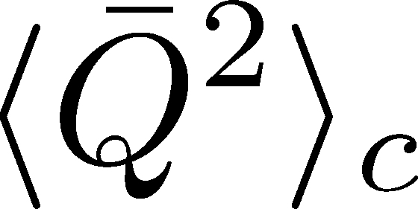
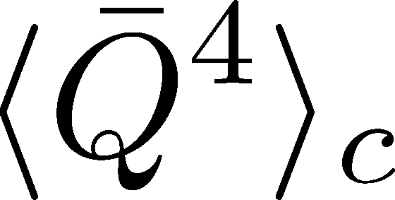
Net Charge Number
Prepare 2 species of (non-interacting) particles
Let us investigate
at freezeout time t

Slide 30

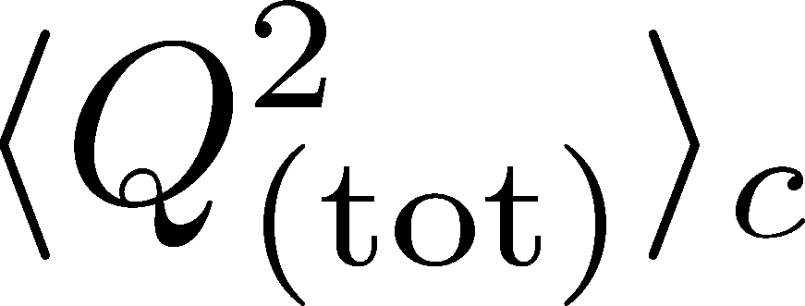
Initial Condition at Hadronization
Boost invariance / infinitely long system
Local equilibration / local correlation
Initial fluctuations
suppression owing to
local charge conservation
strongly dependent on
hadronization mechanism

Slide 31


Δη Dependence at Freezeout
Initial fluctuations:
2nd
4th

Slide 32
<δN_{Q}⁴> @ LHC
boost invariant system
tiny fluctuations of CC at hadronization
short correlaition in hadronic stage
Assumptions
Suppression of
4th-order cumulant is anticipated at LHC energy!

Slide 33
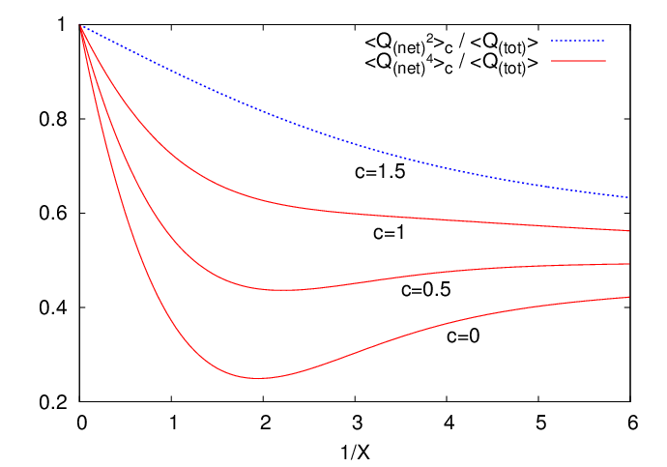
Δη Dependence at Freezeout
Initial fluctuations:
2nd
4th

Slide 34
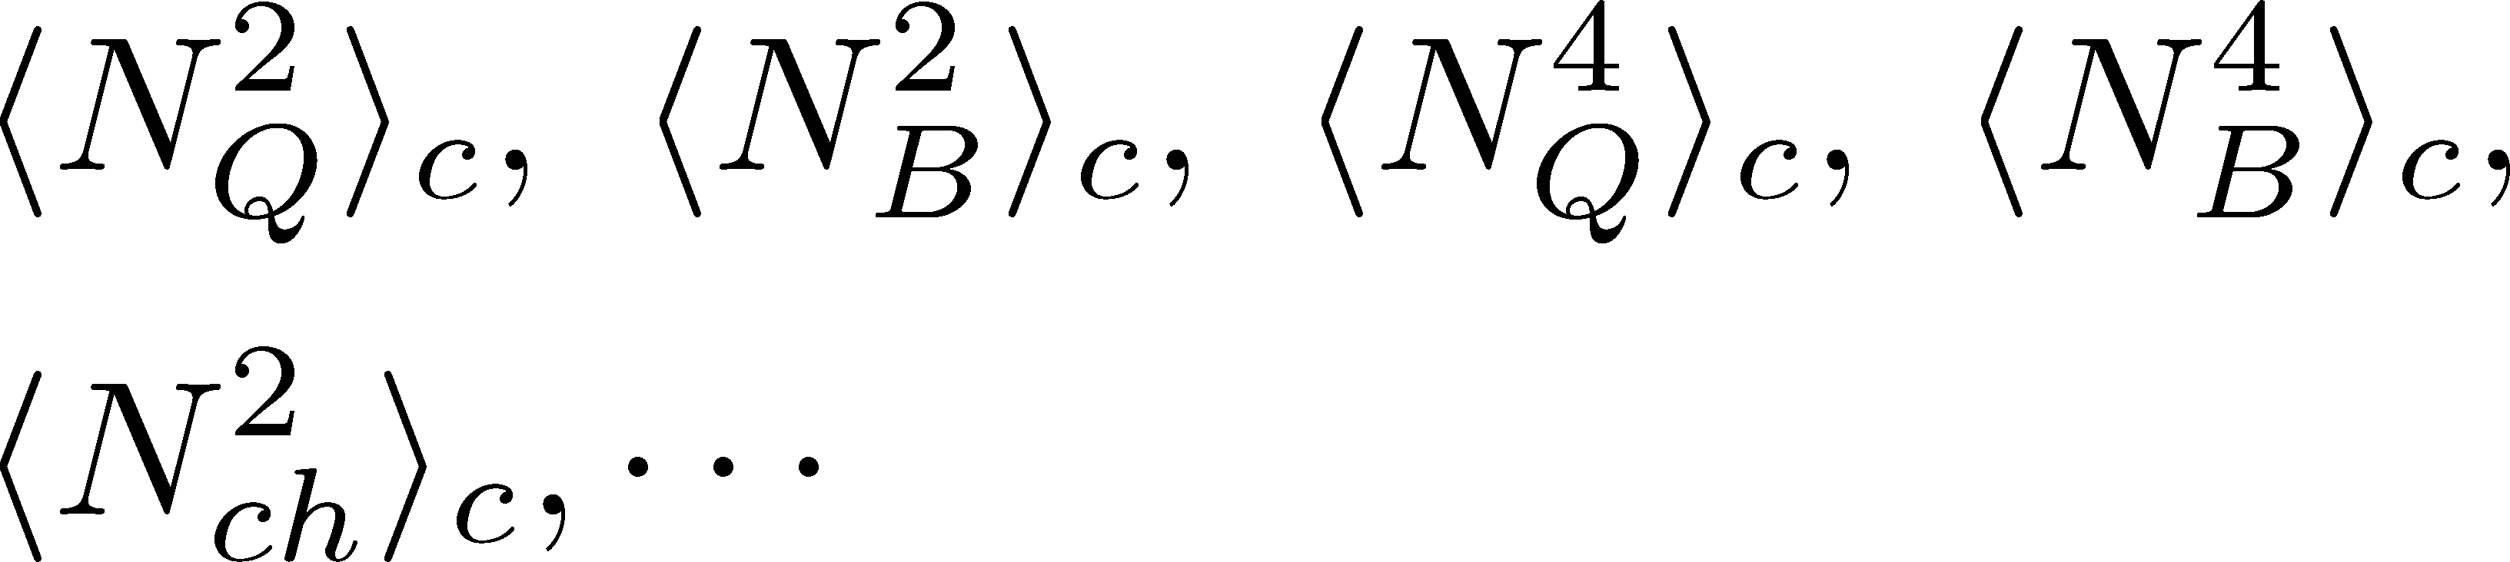
Summary
Plenty of physics in Δη dependences of
various cumulants
Diagnozing dynamics of HIC
history of hot medium
mechanism of hadronization
diffusion constant
Physical meanings
of fluctuation obs.
in experiments.

Slide 35
Summary
Plenty of physics in Δη dependences of
various cumulants
Diagnozing dynamics of HIC
history of hot medium
mechanism of hadronization
diffusion constant
Physical meanings
of fluctuation obs.
in experiments.
Search of QCD Phase Structure

Slide 36
Open Questions & Future Work
Why the primordial fluctuations are observed only at the LHC, and not the RHIC ?
Extract more information on each stage of fireballs using fluctuations
Model refinement
Including the effects of
nonzero correlation length / relaxation time
global charge conservation
Non Poissonian system ← interaction of particles

Slide 37
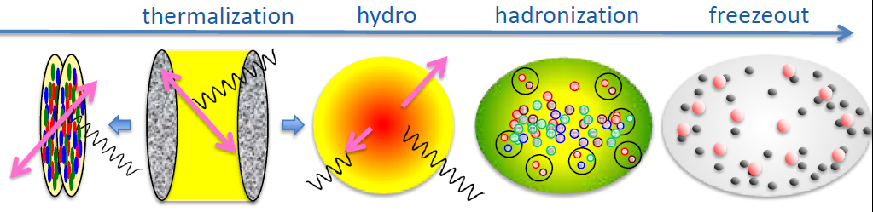
Evolution of Fluctuations
Fluctuation
in initial state
Time evolution
in the QGP
approach to HRG
by diffusion
experimental effects
particle missID, etc.
volume fluctuation

Slide 38



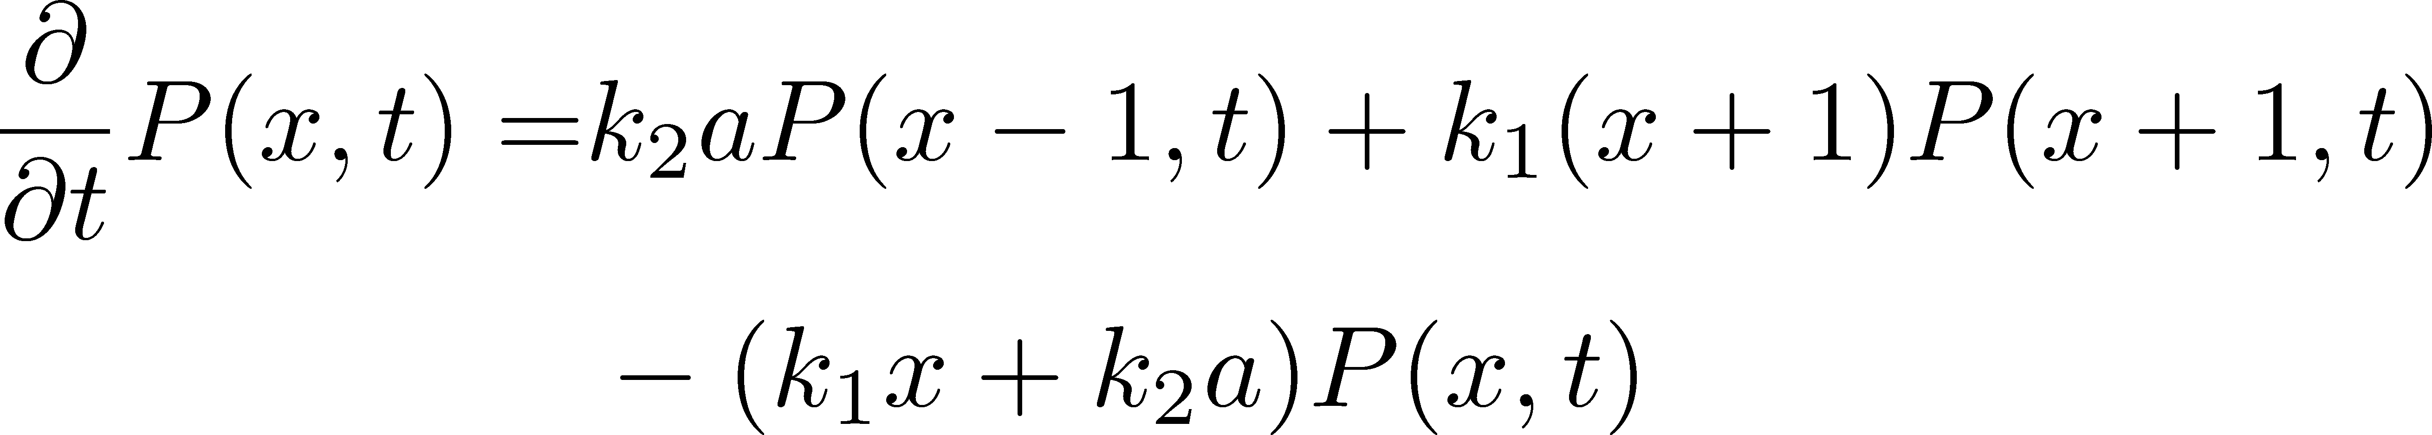

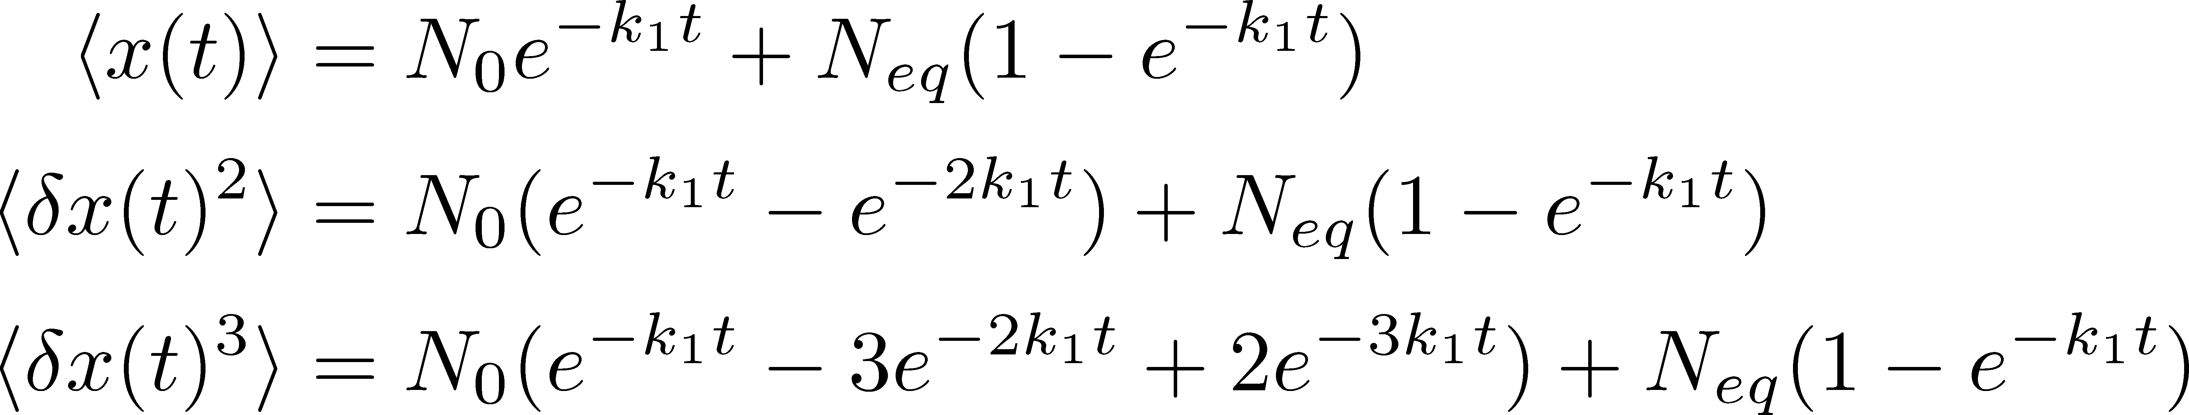
Chemical Reaction 1
x: # of X
a: # of A (fixed)
Master eq.:
Cumulants with fixed initial condition
initial
equilibrium

Slide 39
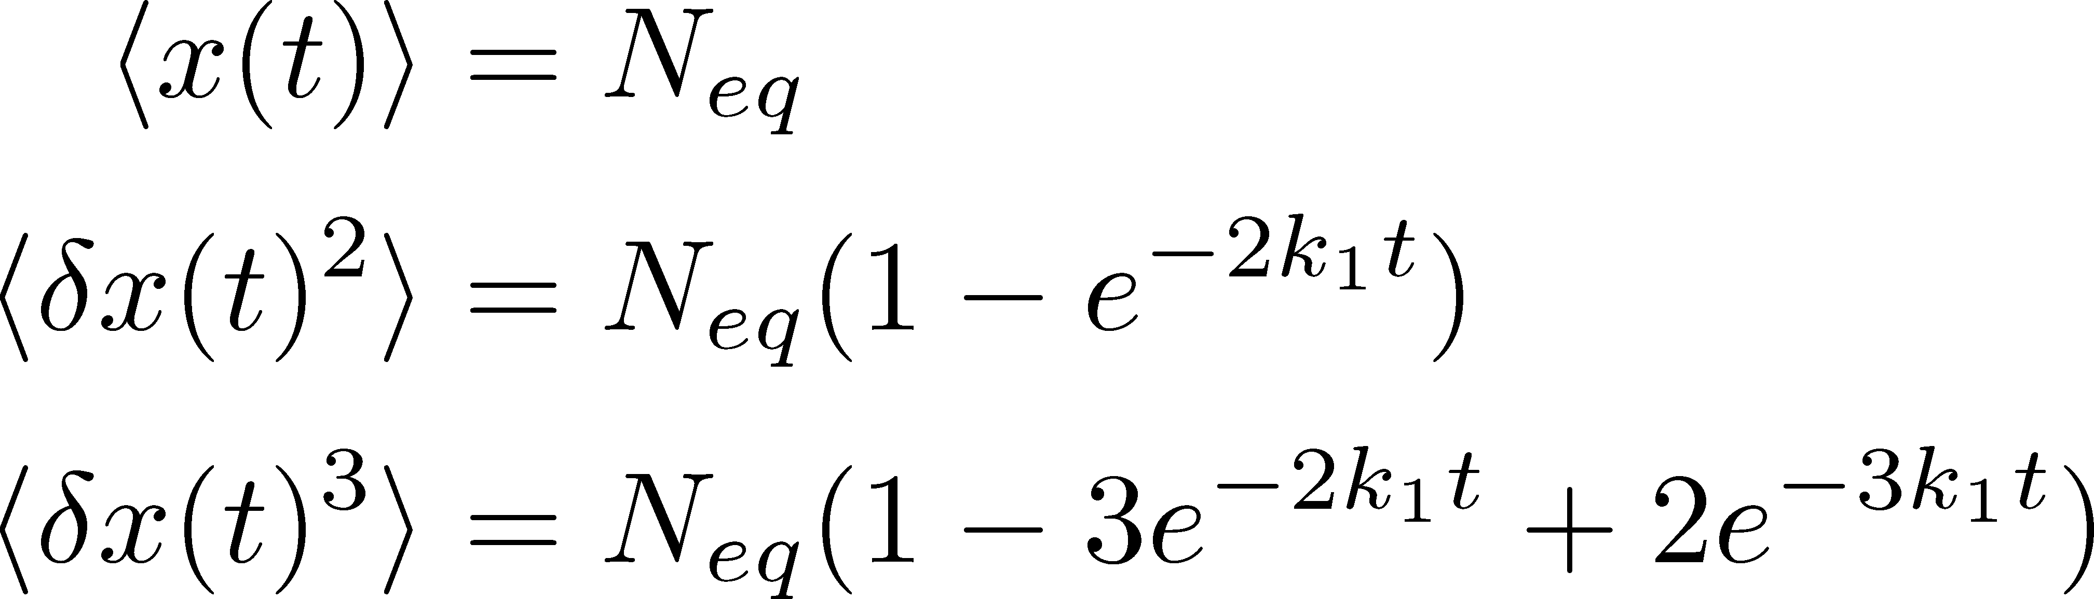

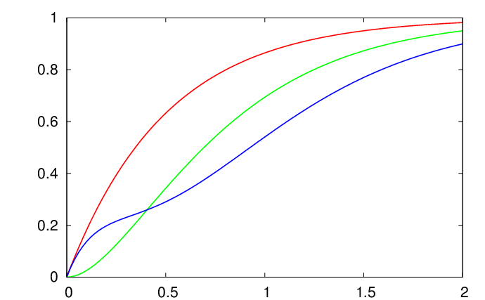


Chemical Reaction 2
2nd
3rd
4th
Higher-order
cumulants
grow slower.

Slide 40



Proton # Cumulants @ STAR-BES
STAR,QM2012
No characteristic signals on
phase transition to QGP nor QCD CP

Slide 41



Charge Fluctuations @ STAR-BES
STAR, QM2012
No characteristic signals on
phase transition to QGP nor QCD CP

Slide 42


Baryon vs Proton Number Fluctuations
MK, Asakawa, PRC85,021901C(2012); PRC86 , 024904(2012)
are experimentally observable

Slide 43
Nucleon Isospin as Two Sides of a Coin
N
p
n
Nucleons have
two isospin states.
MK, Asakawa,2012

Slide 44


Nucleon Isospin as Two Sides of a Coin
a coin
N
p
n
Nucleons have
two isospin states.
Coins have two sides.
MK, Asakawa,2012

Slide 45




Slot Machine Analogy
= +
P (N)
N
P (N)
N

Slide 46
Extreme Examples
Fixed # of coins
Constant probabilities
N
N
N
N

Slide 47


Reconstructing Total Coin Number
P (N )= P (N )B_{1/2}(N ;N )
:binomial distr. func.

Slide 48







Nucleon Isospin in Hadronic Medium
Isospin of baryons can vary after chemical freezeout
via charge exchange reactions mediated by Δ(1232):
200mb=20fm²
cross section

Slide 49










Δ(1232)
cross sections of p
3
1
2:1
2
1:2
decay rates of Δ

Slide 50



Δ(1232)
cross sections of p
3
1
2:1
2
1:2
decay rates of Δ

Slide 51




Δ(1232)
cross sections of p
3
1
2:1
2
1:2
decay rates of Δ
BW for σ & thermal pion
Lifetime to create Δ⁺ or Δ⁰

Slide 52




Nucleons in Hadronic Phase
time
chem. f.o.
hadronize
10~20fm
kinetic f.o.
rare NN collisions
no quantum corr.
mesons
baryons
many pions

Slide 53








Probability Distribution
Detector
binomial distribution func.
for any phase space in the final state.

Slide 54







Nucleon & Proton Number Fluctuations
for isospin symmetric medium
effect of isospin density <10%
Similar formulas up to any order!
For free gas

Slide 55




3rd & 4th Order Fluctuations

Slide 56


Difference btw Baryon and Proton Numbers
(1)
deviates from the equilibrium value.
(2) Boltzmann (Poisson) distribution for

Slide 57


Difference btw Baryon and Proton Numbers
(1)
deviates from the equilibrium value.
(2) Boltzmann (Poisson) distribution for
genuine info.
noise
For free gas

Slide 58













Strange Baryons
Decay Rates:
Decay modes:
Regarding these ratios even, protons from these decays
is incorporated into the binomial distribution. Then, N_{N}→N_{B}

Slide 59

Secondary Protons
MK+, in preparation
Secondary (knockout) protons
20% of observed protons @ STAR
detector
dca [cm]
Measurement
STAR, PRC79,034909(2009)

Slide 60



Secondary Protons
MK+, in preparation
Secondary (knockout) protons
20% of observed protons @ STAR
detector
dca [cm]
Measurement
STAR, PRC79,034909(2009)
Their contribution can be eliminated!

