Slide 1
重イオン衝突実験と
非ガウスゆらぎ
北沢正清
（阪大理）
MK, Asakawa, Ono, in preparation
松本研究会, 2013/Jun./22

Slide 2
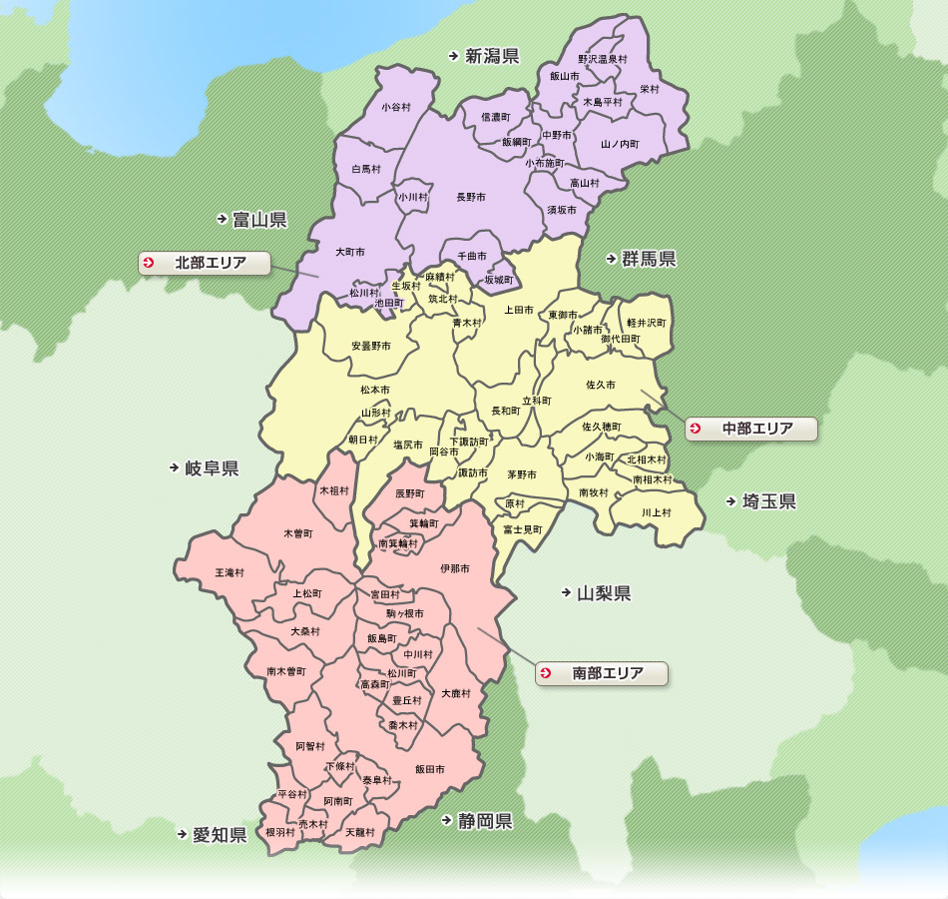
北沢の生い立ち
信州新町
小２～小６
長野市
中、高
大町市
誕生～1.5歳
南箕輪村
1.5歳～小１
飯田市
実家
茨城県へ
大学

Slide 3
Beam-Energy Scan
T
Hadrons
Color SC
0
μ

Slide 4

Beam-Energy Scan
STAR 2012
high
beam energy
T
low
Hadrons
Color SC
0
μ

Slide 5
Fluctuations
Observables in equilibrium are fluctuating.
P(N)
N
V
N

Slide 6
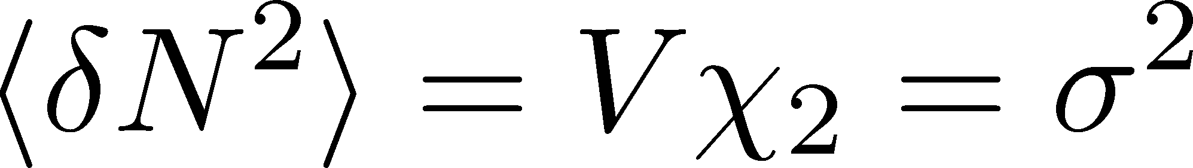
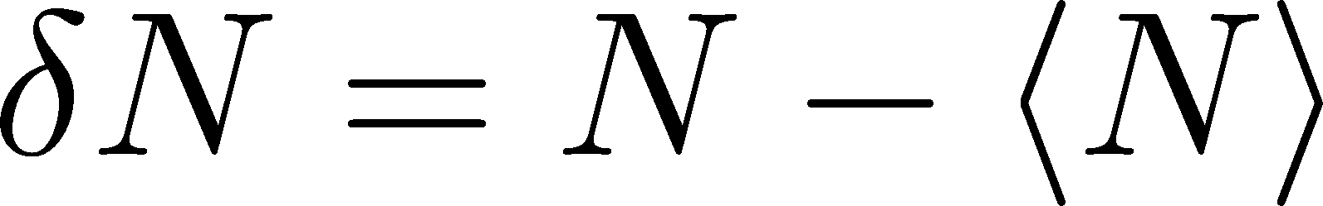
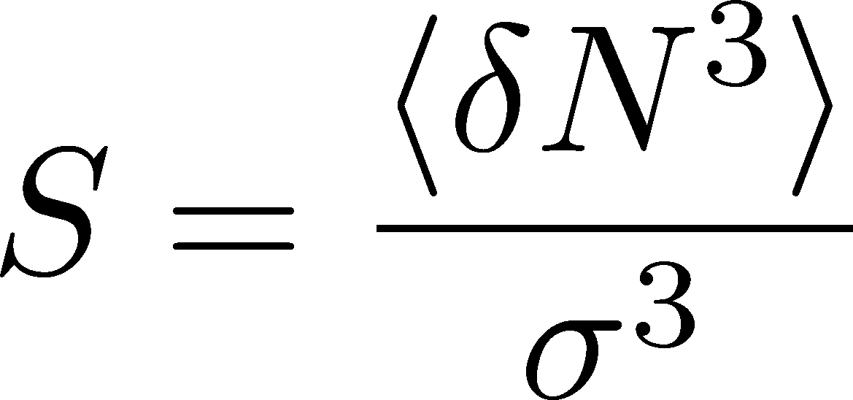
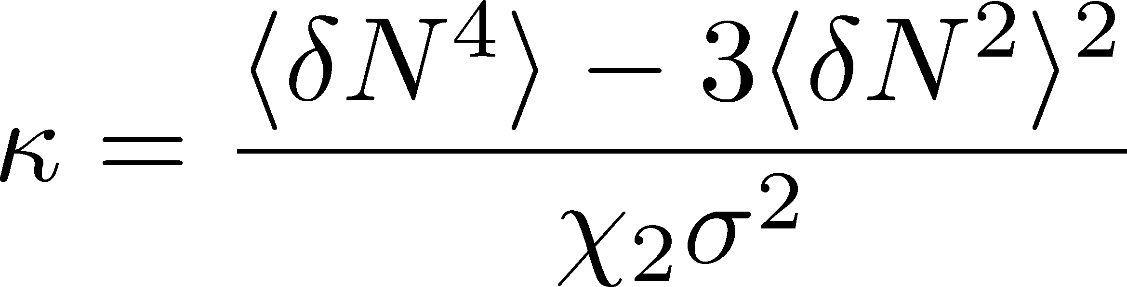
Fluctuations
Observables in equilibrium are fluctuating.
P(N)
N
V
N
Variance:
Skewness:
Kurtosis:

Slide 7

Event-by-Event Analysis @ HIC
Fluctuations can be measured by e-by-e analysis in experiments.
V
Detector

Slide 8

Event-by-Event Analysis @ HIC
Fluctuations can be measured by e-by-e analysis in experiments.
STAR, PRL105 (2010)
Detector

Slide 9

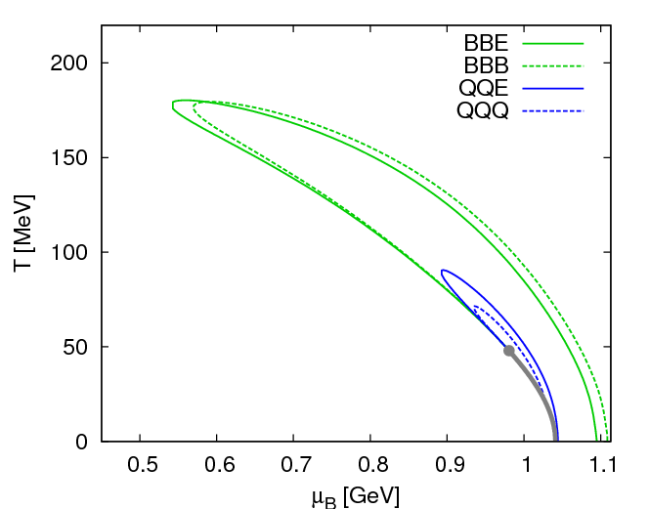
Fluctuations
Fluctuations reflect properties of matter.
  Enhancement near the critical point
  Stephanov,Rajagopal,Shuryak(’98); Hatta,Stephanov(’02); Stephanov(’09);…
  Ratios between cumulants of conserved charges
  Asakawa,Heintz,Muller(’00); Jeon, Koch(’00); Ejiri,Karsch,Redlich(’06)
  Signs of higher order cumulants
  Asakawa,Ejiri,MK(’09); Friman,et al.(’11); Stephanov(’11)

Slide 10
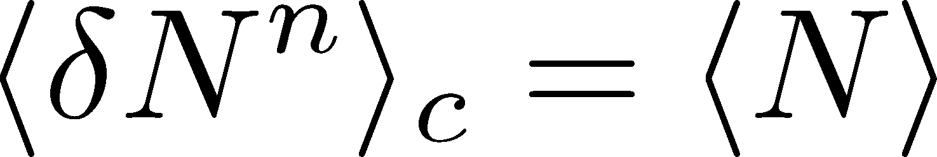
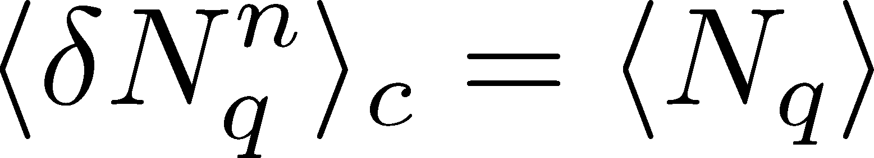
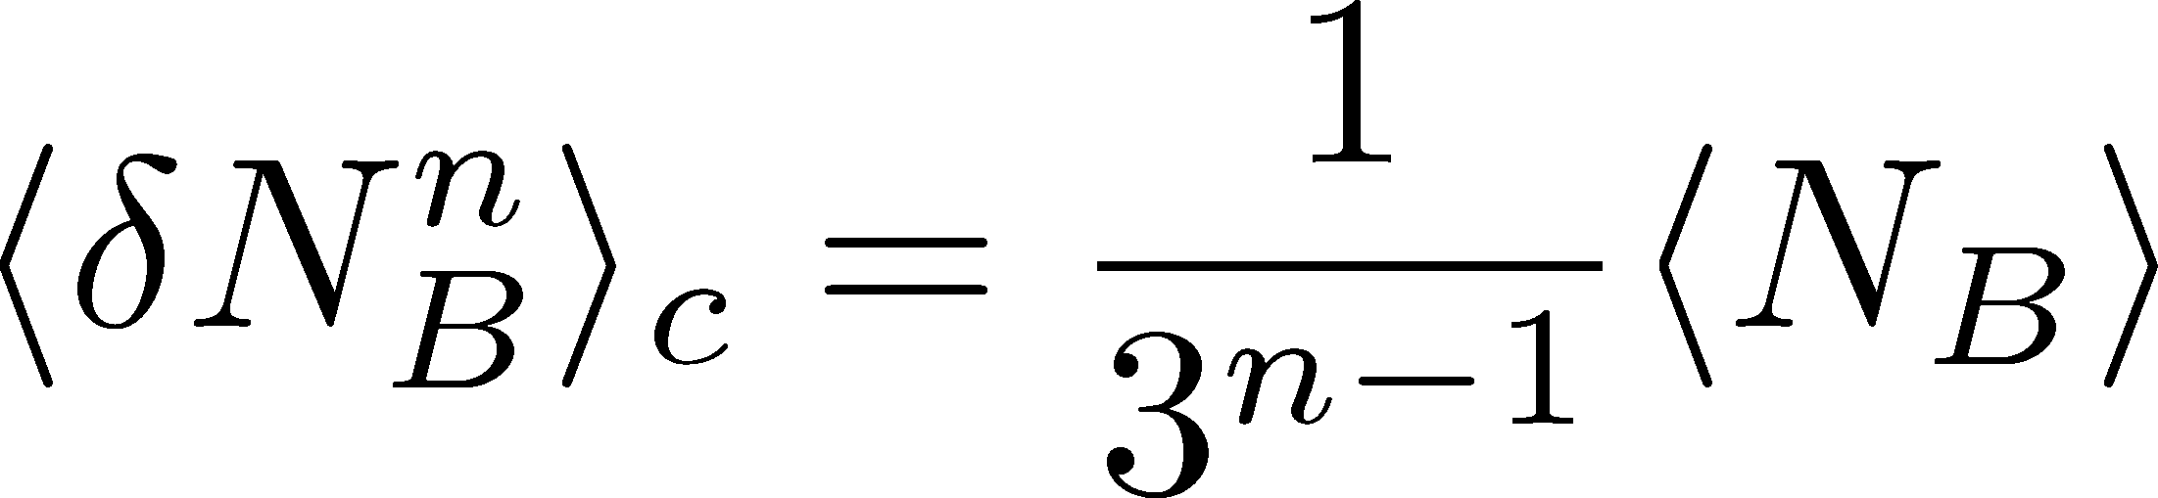
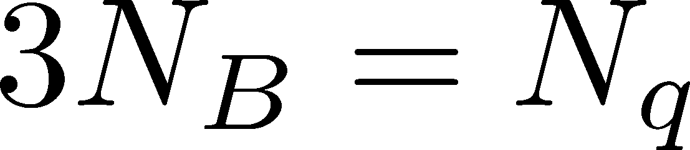
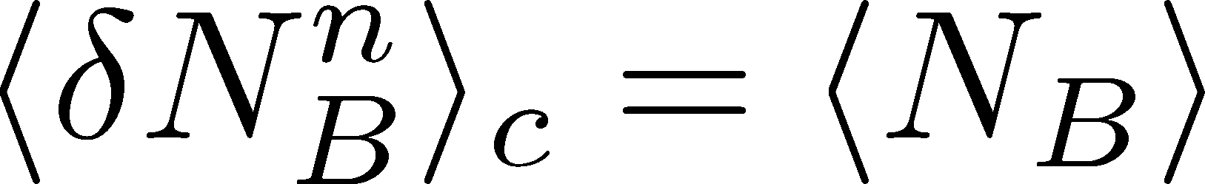
Fluctuations
Free Boltzmann → Poisson

Slide 11
Fluctuations
Free Boltzmann → Poisson
RBC-Bielefeld ’09

Slide 12
Central Limit Theorem
CLT
Large system → Gaussian
Higher-order cumulants suppressed
as system volume becomes larger?

Slide 13
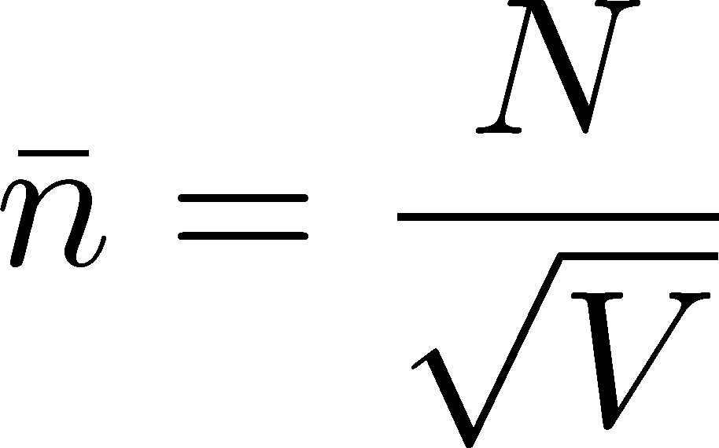
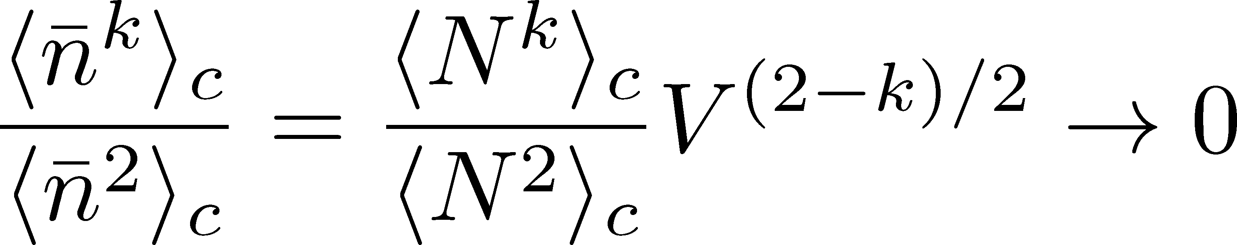

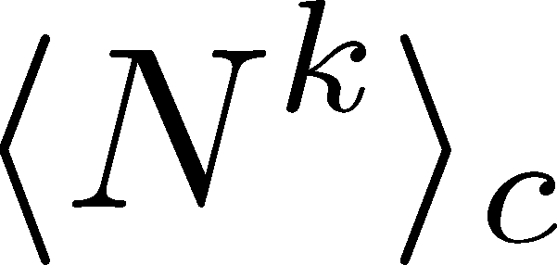
Central Limit Theorem
CLT
:Gaussian
In a large system,
Cumulants are nonzero.
Their experimental measurements are difficult.

Slide 14
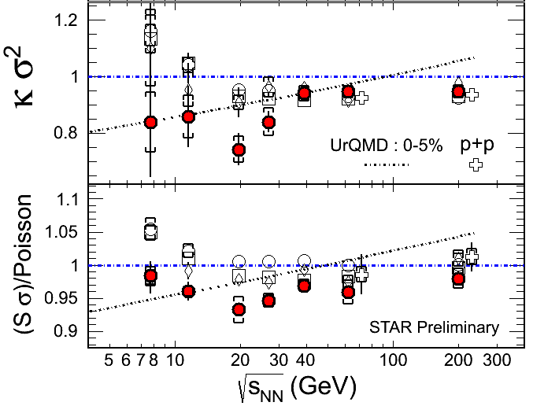
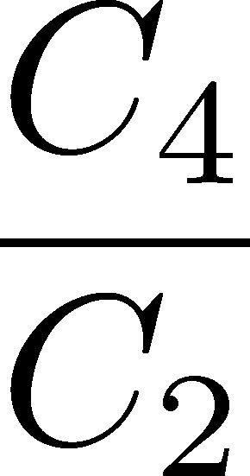
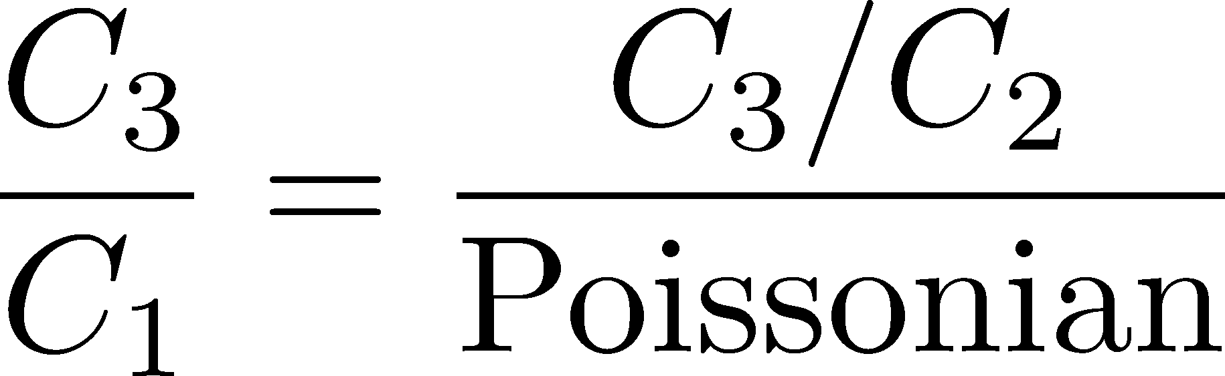
Proton # Cumulants @ STAR-BES
STAR,QM2012
No characteristic signals on
phase transition to QGP nor QCD CP

Slide 15
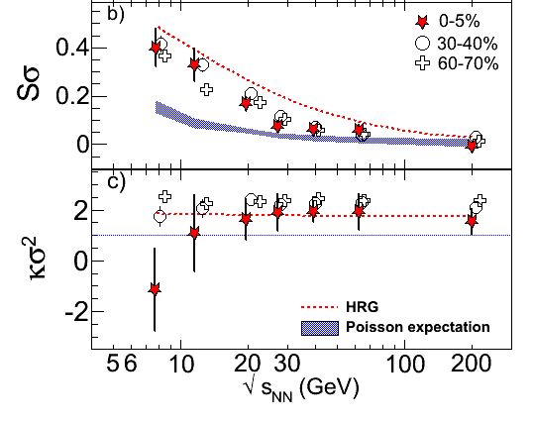
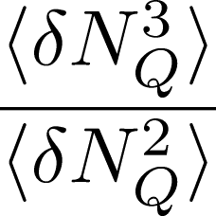
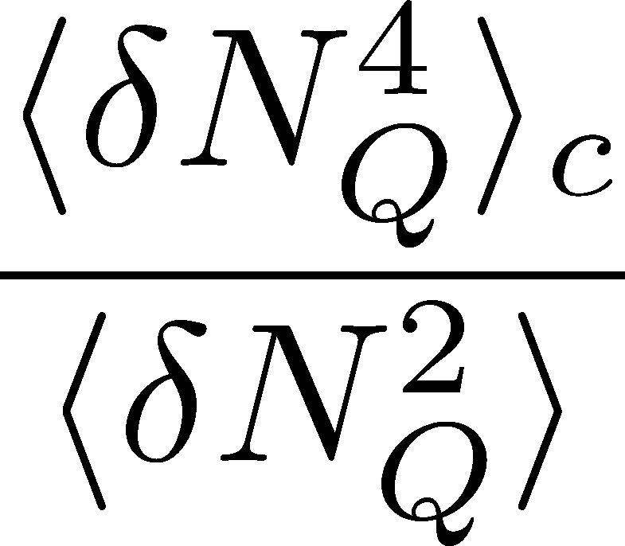
Charge Fluctuations @ STAR-BES
STAR, QM2012
No characteristic signals on
phase transition to QGP nor QCD CP

Slide 16
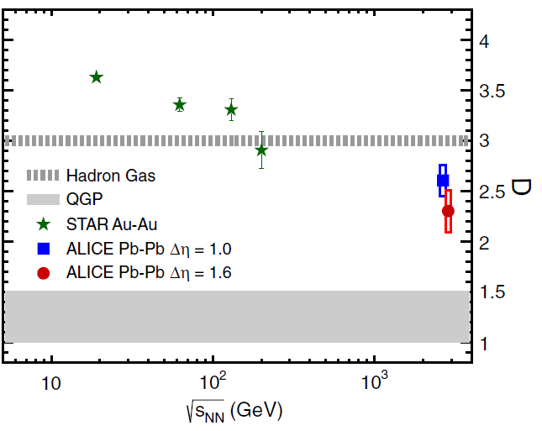

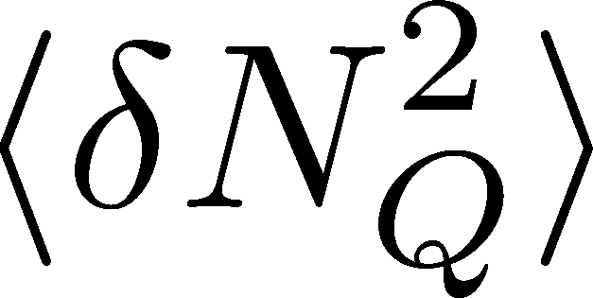
Charge Fluctuation @ LHC
ALICE, PRL110,152301(2013)
D-measure
D ~ 3-4 Hadronic
D ~ 1 Quark
LHC:
significant suppression
from hadronic value
is not equilibrated at freeze-out at LHC energy!

Slide 17

Δη Dependence @ ALICE
ALICE
PRL 2013
t
Δη
z
rapidity acceptane

Slide 18
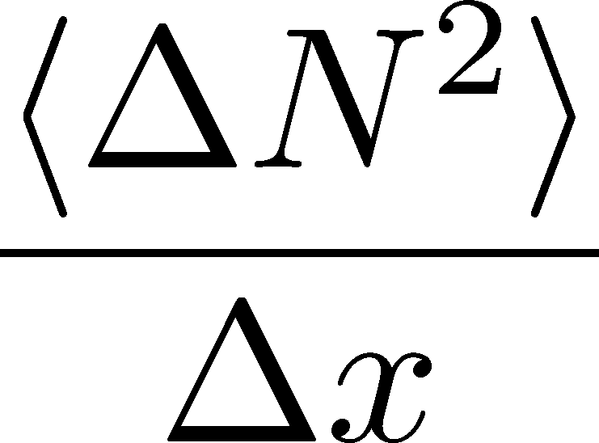




Dissipation of a Conserved Charge

Slide 19
Dissipation of a Conserved Charge

Slide 20
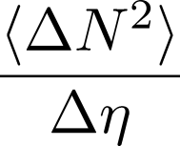




Time Evolution in HIC
Quark-Gluon Plasma
Hadronization
Freezeout

Slide 21
Time Evolution in HIC
Pre-Equilibrium
Quark-Gluon Plasma
Hadronization
Freezeout

Slide 22
Time Evolution in HIC
Pre-Equilibrium
Quark-Gluon Plasma
Hadronization
Freezeout

Slide 23
Δη Dependence @ ALICE
ALICE
PRL 2013
t
Δη
z
Δη dependences of fluctuation observables
encode history of the hot medium!
rapidity acceptane
Higher-order cumulants as
thermometer?
HotQCD,2012

Slide 24
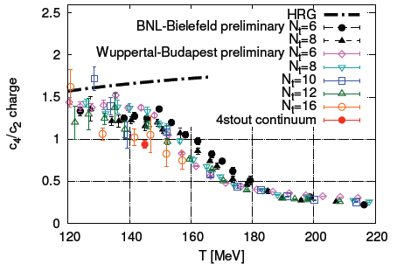
Conserved Charges : Theoretical Advantage
Definite definition for operators
as a Noether current
calculable on any theory
ex: on the lattice

Slide 25
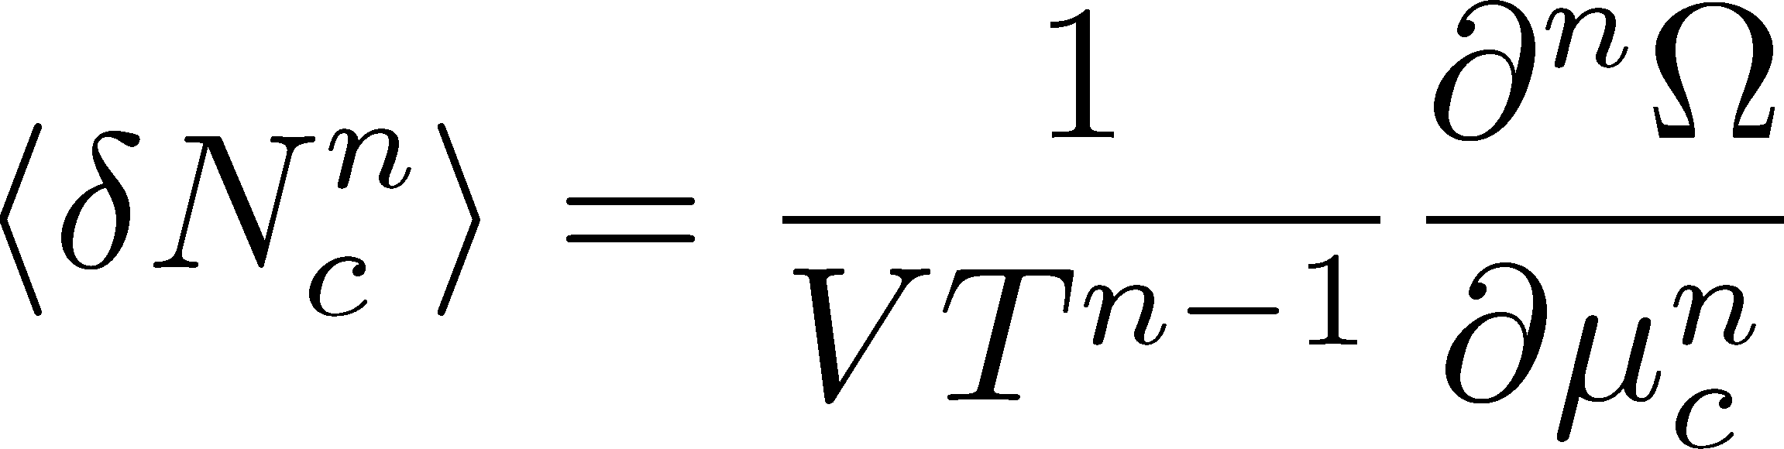

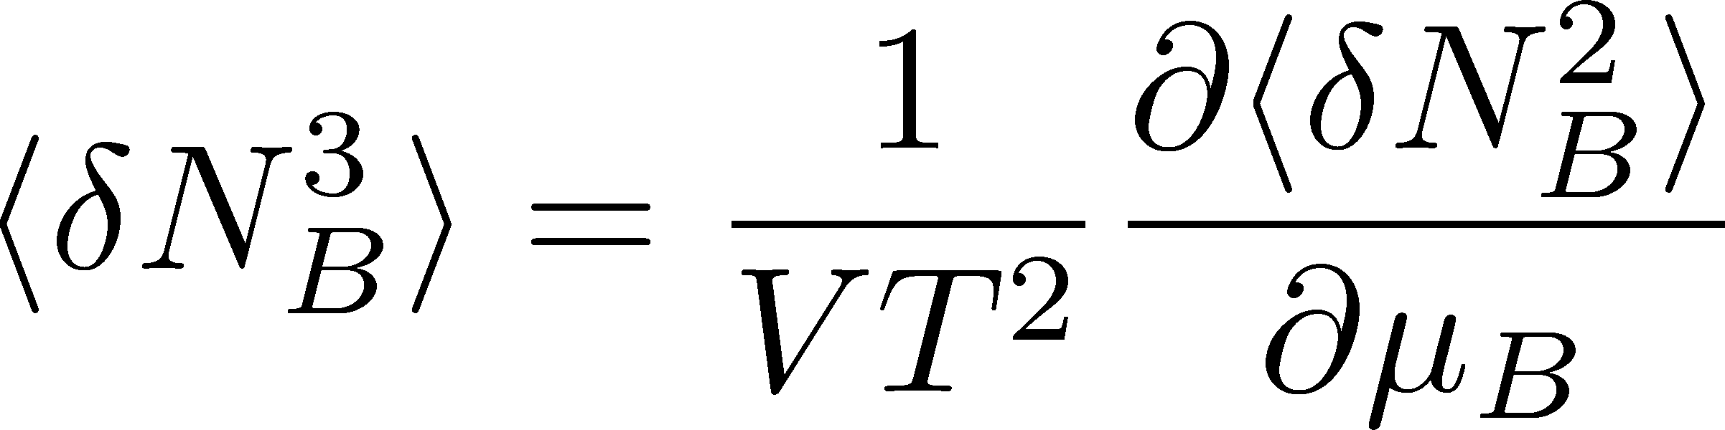
Conserved Charges : Theoretical Advantage
Definite definition for operators
as a Noether current
calculable on any theory
ex: on the lattice
Simple thermodynamic relations
Intuitive interpretation for the behaviors of cumulants
ex:

Slide 26
Fluctuations of Conserved Charges
Under Bjorken expansion
Asakawa, Heintz, Muller, 2000
Jeon, Koch, 2000
Shuryak, Stephanov, 2001
t
Δy
N_{Q}
z
Δη
Variation of a conserved charge in Δη is slow, since it is achieved only through diffusion.
Primordial values can survive until freezeout.
The wider Δη, more earlier fluctuation.

Slide 27


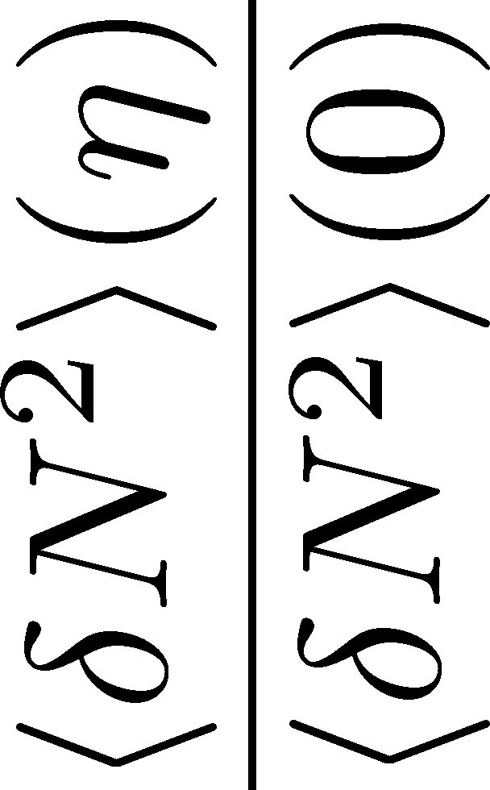
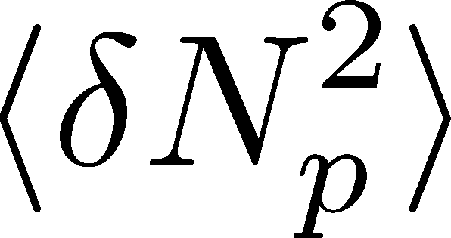

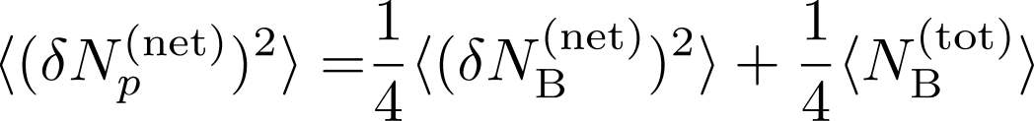
<δN_{B}²> and < δN_{p}² > @ LHC ?
should have different Δη dependence.

Slide 28
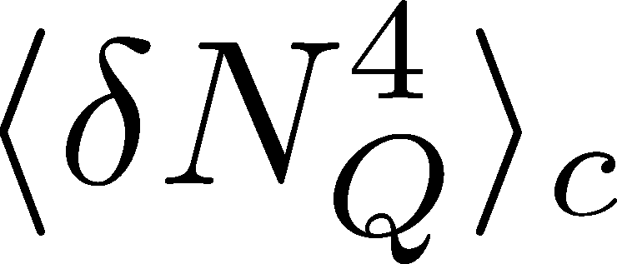

<δN_{Q}⁴> @ LHC ?
How does behave as a function of Δη?
Left
(suppression)
Right
(hadronic)
or

Slide 29
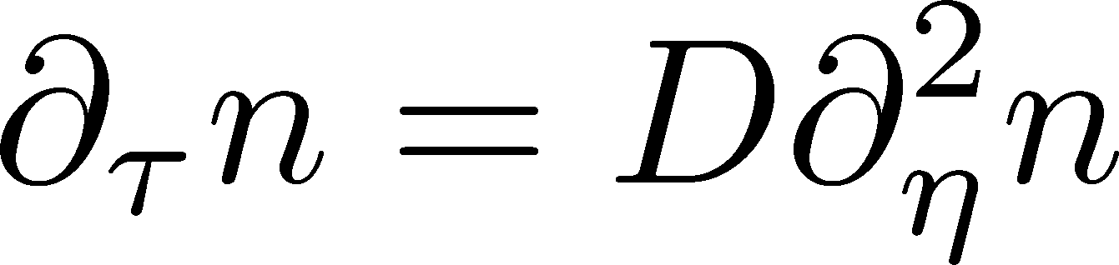

Hydrodynamic Fluctuations
Landau, Lifshitz, Statistical Mechaniqs II
Kapusta, Muller, Stephanov, 2012
Diffusion equation
Stochastic diffusion equation

Slide 30
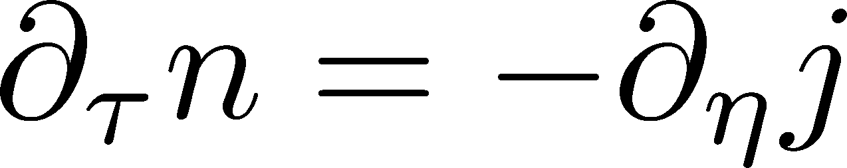
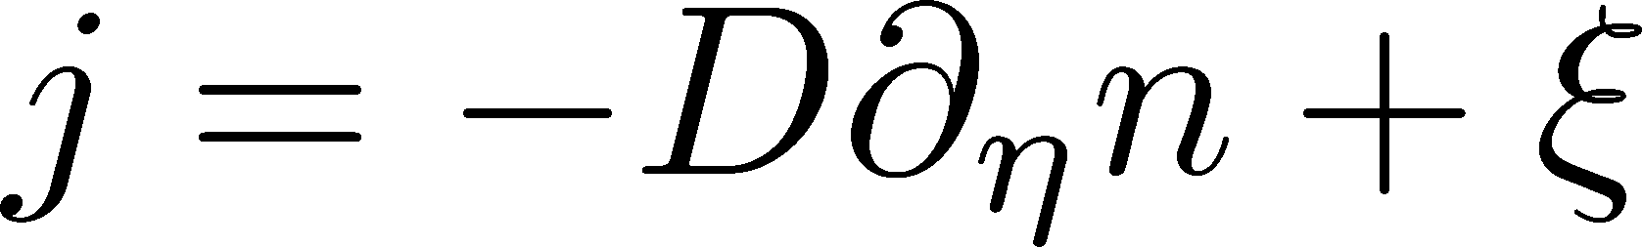
Hydrodynamic Fluctuations
Landau, Lifshitz, Statistical Mechaniqs II
Kapusta, Muller, Stephanov, 2012
Diffusion equation
Stochastic diffusion equation
Conservation Law
Fick’s Law

Slide 31
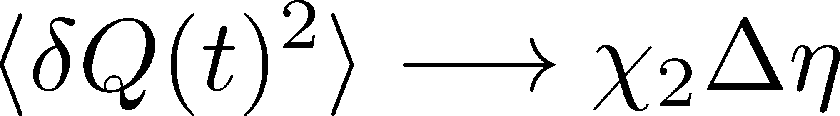
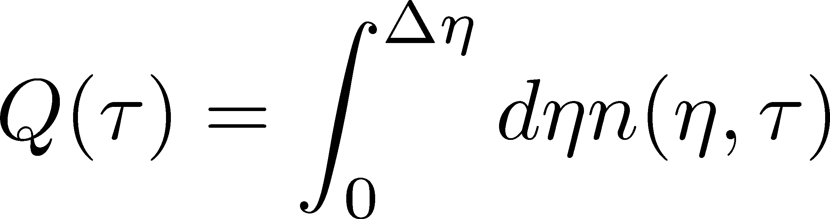
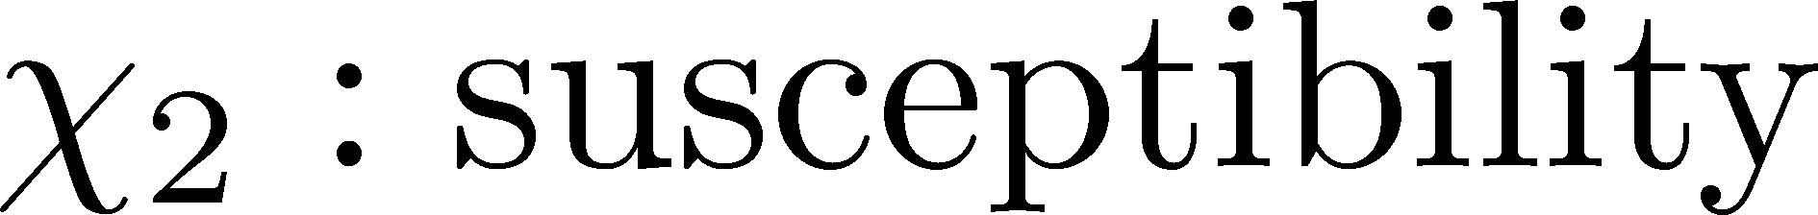
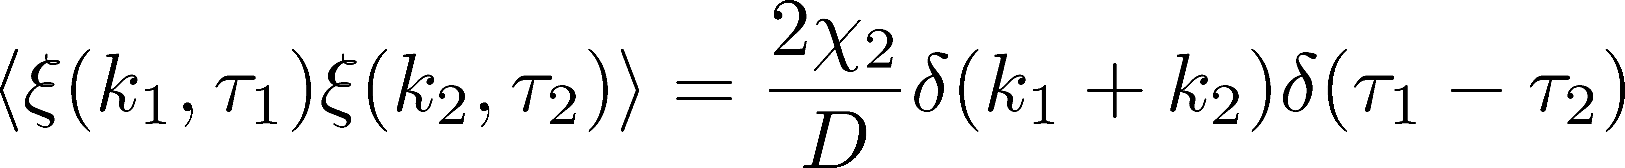
Fluctuation-Dissipation Relation
Stochastic force
Local correlation
(hydrodynamics)
Equilibrium fluc.

Slide 32
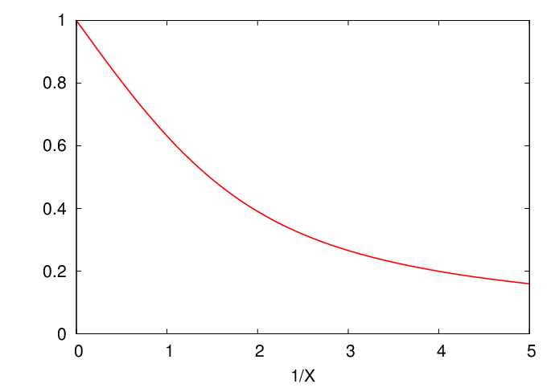
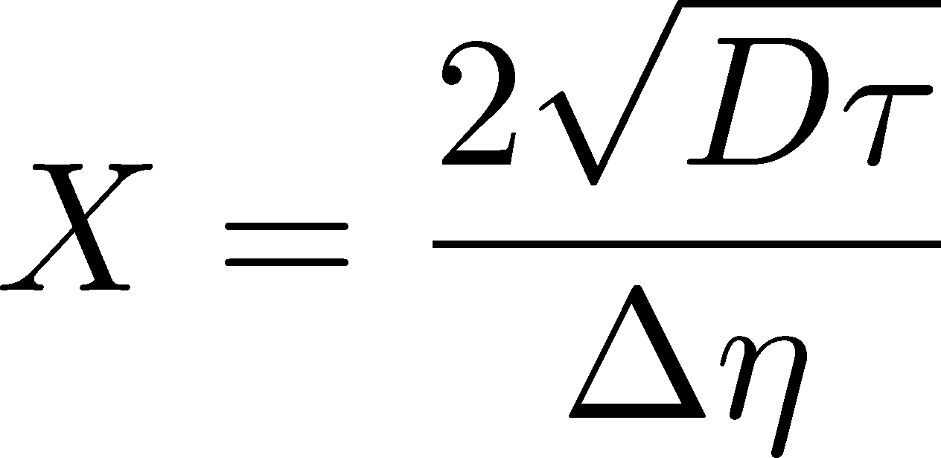
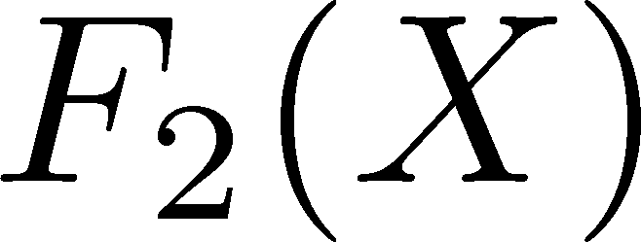

Δη Dependence
Shuryak, Stephanov, 2001
Initial condition:
Translational invariance
initial
equilibrium
initial
equilibrium

Slide 33
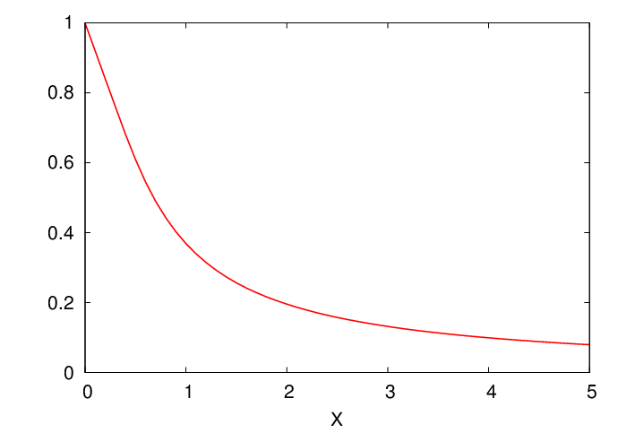

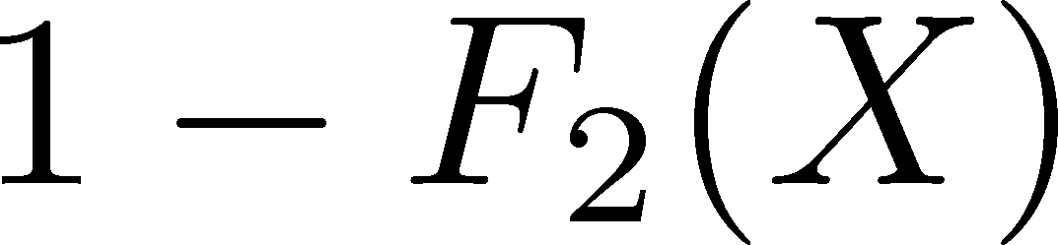

Δη Dependence
Shuryak, Stephanov, 2001
Initial condition:
Translational invariance
initial
equilibrium
equilibrium
initial

Slide 34
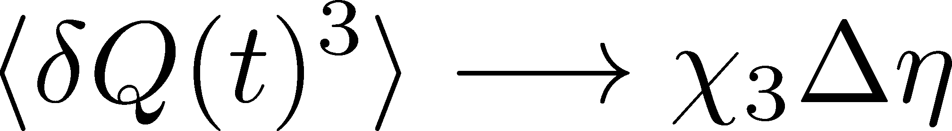
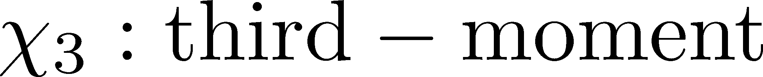
Non-Gaussian Stochastic Force ??
Stochastif Force : 3rd order
Local correlation
(hydrodynamics)
Equilibrium fluc.

Slide 35
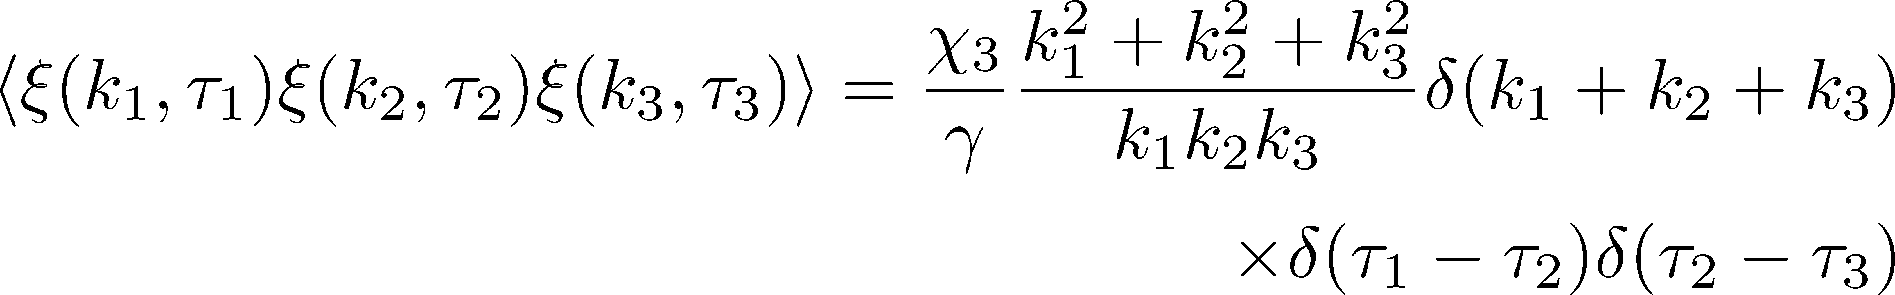
Caution!
diverge in long wavelength
No a priori extension of FD relation to higher orders

Slide 36
Caution!
diverge in long wavelength
No a priori extension of FD relation to higher orders
Markov process＋continuous variable
Theorem
➔Gaussian random force
cf) Gardiner, “Stochastic Methods”
Hydrodynamics
Local equilibrium with many particles
Gaussian due to central limit theorem

Slide 37
Three “NON”s
Physics of non-Gaussianity in heavy-ion
collisions is a particular problem.
Non-Gaussian
Non-critical
Non-equilibrium
Non-Gaussianitiy is
irrelevant in large systems
fluctuations observed so far
do not show critical enhancement
Fluctuations are not
equilibrated

Slide 38
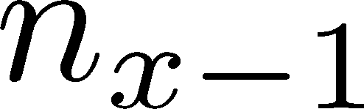






Diffusion Master Equation
Divide spatial coordinate into discrete cells
probability

Slide 39
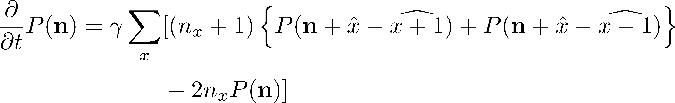
Diffusion Master Equation
Divide spatial coordinate into discrete cells
probability
Master Equation for P(n)
x-hat: lattice-QCD notation
Solve the DME exactly, and take a→0 limit
No approx., ex. van Kampen’s system size expansion

Slide 40
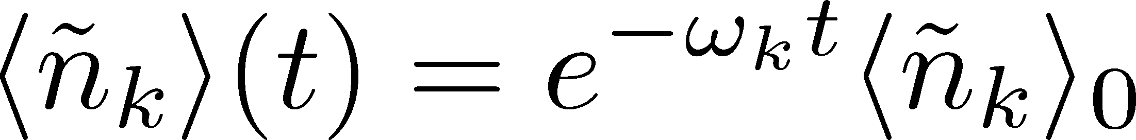
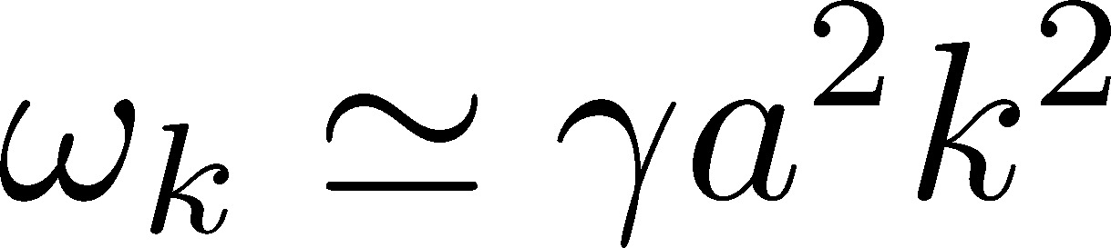

Solution of DME
1st
initial
Deterministic part ←→ diffusion equation
at long wave length (1/a<<k)
Appropriate continuum limit with γa²=D

Slide 41


Solution of DME
1st
initial
Deterministic part ←→ diffusion equation
at long wave length (1/a<<k)
Appropriate continuum limit with γa²=D
2nd
Consistent with stochastic diffusion eq.
(for sufficiently smooth initial condition)

Slide 42


Total Charge in Δη
FT of step func.
0
1
x

Slide 43



Net Charge Number
Prepare 2 species of (non-interacting) particles
Let us investigate
at freezeout time t

Slide 44


Initial Condition at Hadronization
Boost invariance / infinitely long system
Local equilibration / local correlation
Initial fluctuations
suppression owing to
local charge conservation
strongly dependent on
hadronization mechanism

Slide 45


Δη Dependence at Freezeout
Initial fluctuations:
2nd
4th

Slide 46
<δN_{Q}⁴> @ LHC
boost invariant system
tiny fluctuations of CC at hadronization
short correlaition in hadronic stage
Assumptions
Suppression of
4th-order cumulant is anticipated at LHC energy!

Slide 47


Δη Dependence at STAR
STAR, QM2012
decreases as Δη becomes larger at RHIC.

Slide 48






Chemical Reaction 1
x: # of X
a: # of A (fixed)
Master eq.:
Cumulants with fixed initial condition
initial
equilibrium

Slide 49





Chemical Reaction 2
2nd
3rd
4th
Higher-order
cumulants
grow slower.

Slide 50

Δη Dependence at Freezeout
Initial fluctuations:
2nd
4th

Slide 51

Summary
Plenty of physics in Δη dependences of
various cumulants
Diagnozing dynamics of HIC
history of hot medium
mechanism of hadronization
diffusion constant
Physical meanings
of fluctuation obs.
in experiments.

Slide 52
Summary
Plenty of physics in Δη dependences of
various cumulants
Diagnozing dynamics of HIC
history of hot medium
mechanism of hadronization
diffusion constant
Physical meanings
of fluctuation obs.
in experiments.
Search of QCD Phase Structure

Slide 53
Open Questions & Future Work
Why the primordial fluctuations are observed only at the LHC, and not the RHIC ?
Extract more information on each stage of fireballs using fluctuations
Model refinement
Including the effects of
nonzero correlation length / relaxation time
global charge conservation
Non Poissonian system ← interaction of particles

Slide 54

Evolution of Fluctuations
Fluctuation
in initial state
Time evolution
in the QGP
approach to HRG
by diffusion
experimental effects
particle missID, etc.
volume fluctuation

