Slide 1
Non-Gaussianity in Heavy Ion Collisions
Masakiyo Kitazawa
（Osaka U.）
MK, Asakawa, Ono, to be submitted soon
RIKEN Seminar, 2013/Jul./8

Slide 2
Baryon vs Proton Number Fluctuations
MK, Asakawa, PRC85,021901C(2012); PRC86, 024904(2012)
10min
Time Evolution of
Higher Order Cumulants
MK, Asakawa, Ono, arXiv:1307.xxxx
30min

Slide 3
Beam-Energy Scan
T
Hadrons
Color SC
0
μ

Slide 4

Beam-Energy Scan
STAR 2012
high
beam energy
T
low
Hadrons
Color SC
0
μ

Slide 5
Fluctuations
Observables in equilibrium are fluctuating.
P(N)
N
V
N

Slide 6
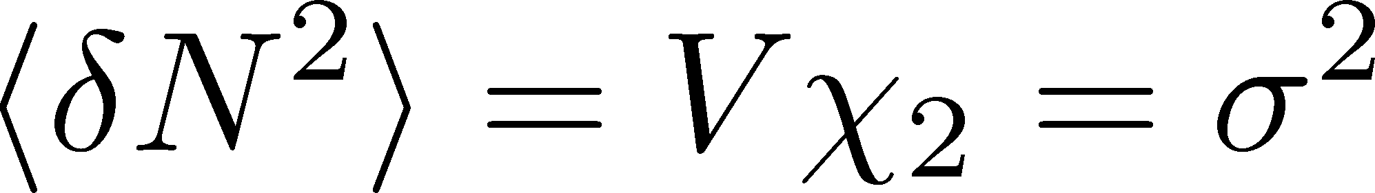
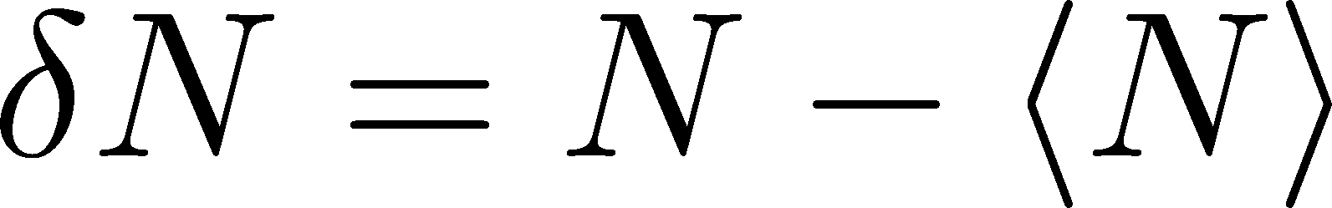
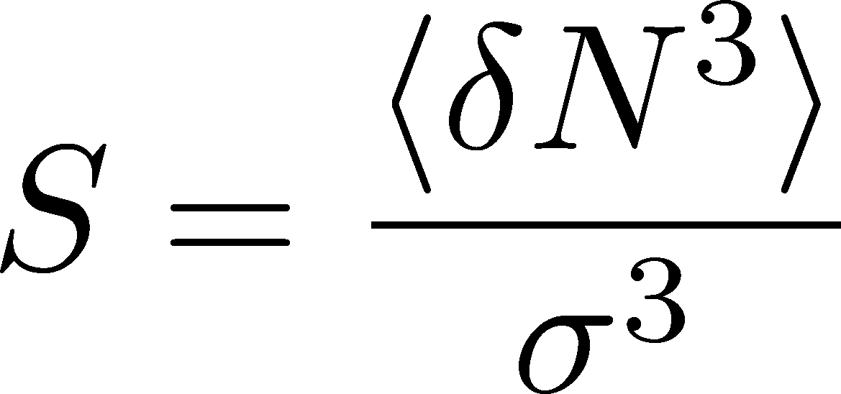
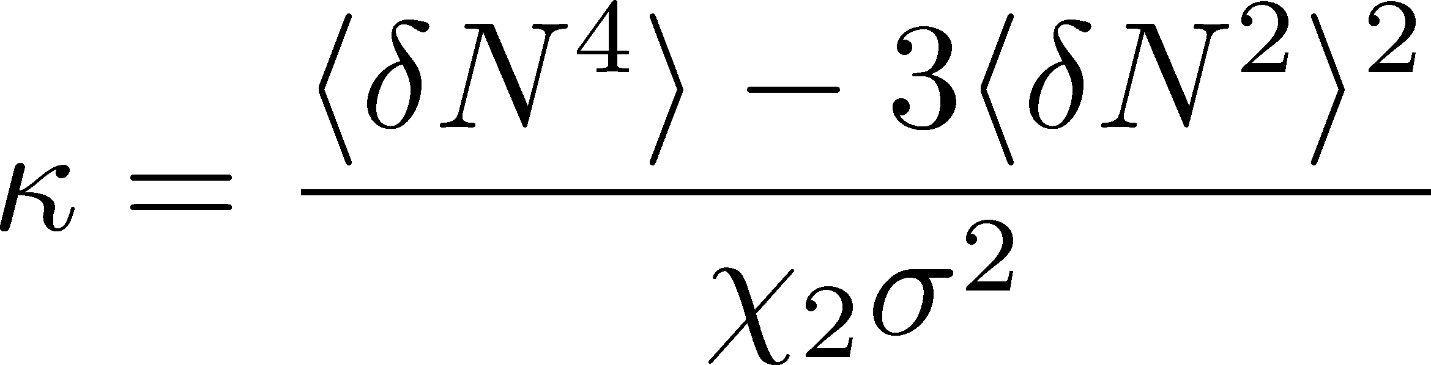
Fluctuations
Observables in equilibrium are fluctuating.
P(N)
N
V
N
Variance:
Skewness:
Kurtosis:

Slide 7

Event-by-Event Analysis @ HIC
Fluctuations can be measured by e-by-e analysis in experiments.
V
Detector

Slide 8

Event-by-Event Analysis @ HIC
Fluctuations can be measured by e-by-e analysis in experiments.
STAR, PRL105 (2010)
Detector

Slide 9

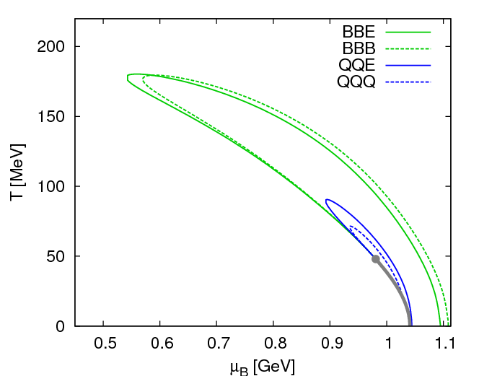
Fluctuations
Fluctuations reflect properties of matter.
  Enhancement near the critical point
  Stephanov,Rajagopal,Shuryak(’98); Hatta,Stephanov(’02); Stephanov(’09);…
  Ratios between cumulants of conserved charges
  Asakawa,Heintz,Muller(’00); Jeon, Koch(’00); Ejiri,Karsch,Redlich(’06)
  Signs of higher order cumulants
  Asakawa,Ejiri,MK(’09); Friman,et al.(’11); Stephanov(’11)

Slide 10
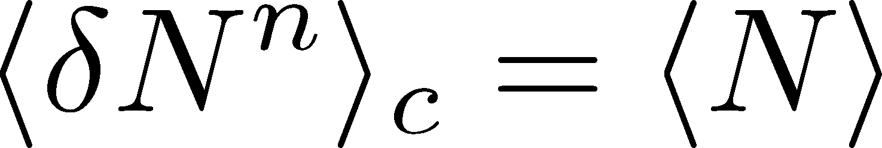
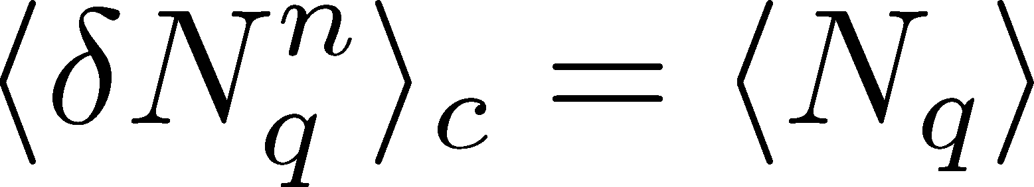
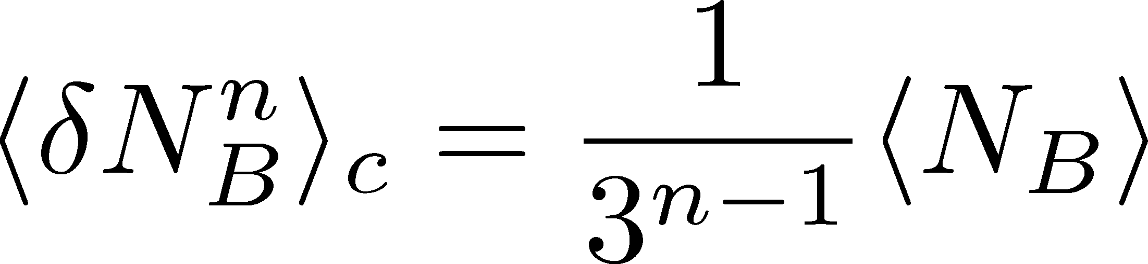
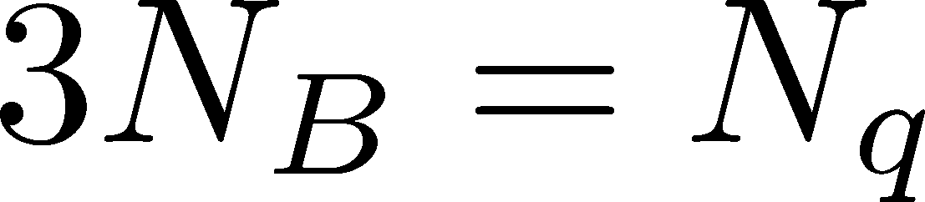
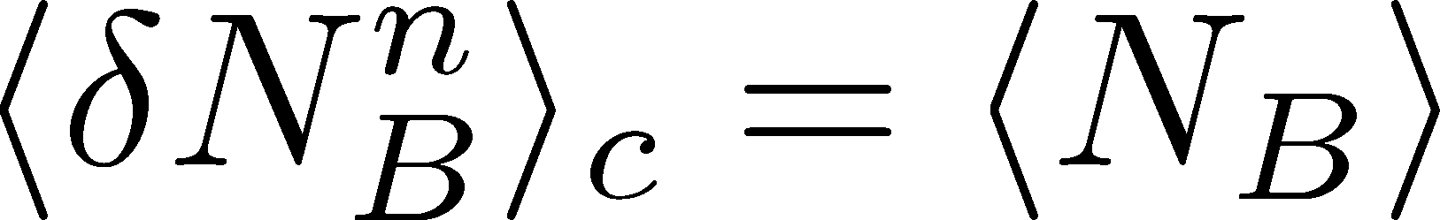
Fluctuations
Free Boltzmann → Poisson

Slide 11
Fluctuations
Free Boltzmann → Poisson
RBC-Bielefeld ’09

Slide 12
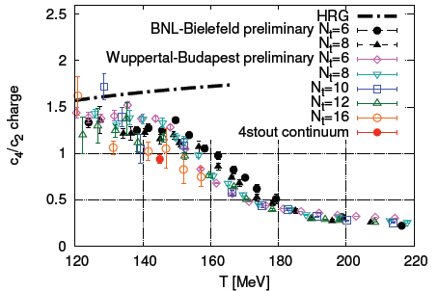
Conserved Charges : Theoretical Advantage
Definite definition for operators
as a Noether current
calculable on any theory
ex: on the lattice

Slide 13
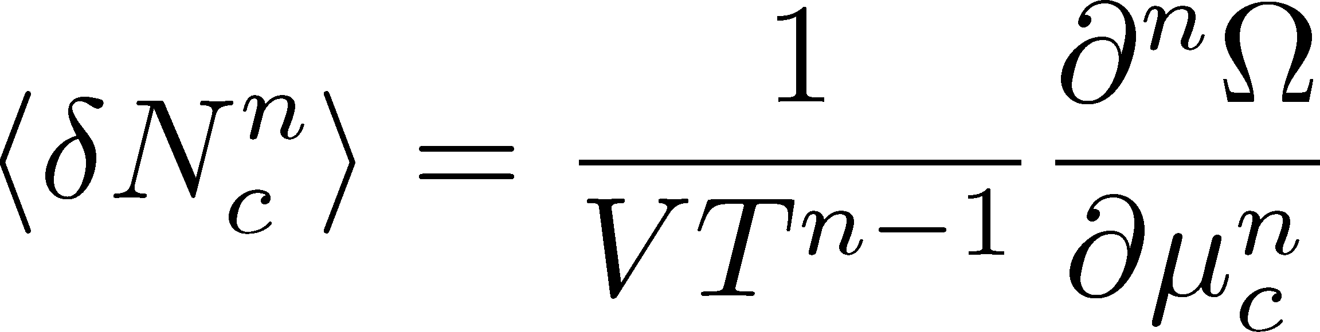

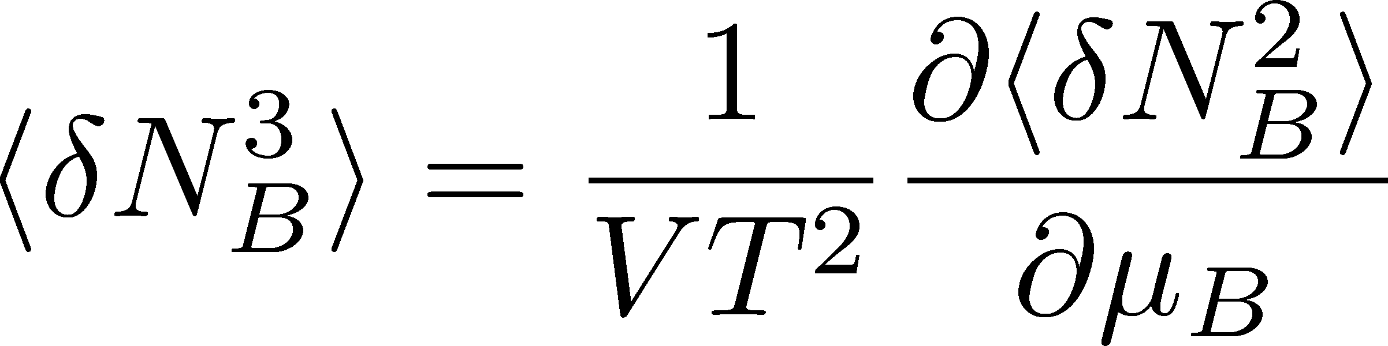
Conserved Charges : Theoretical Advantage
Definite definition for operators
as a Noether current
calculable on any theory
ex: on the lattice
Simple thermodynamic relations
Intuitive interpretation for the behaviors of cumulants
ex:

Slide 14
Fluctuations of Conserved Charges
Under Bjorken expansion
Asakawa, Heintz, Muller, 2000
Jeon, Koch, 2000
Shuryak, Stephanov, 2001
t
Δy
N_{Q}
z
Δη
Variation of a conserved charge in Δη is slow, since it is achieved only through diffusion.
Primordial values can survive until freezeout.
The wider Δη, more earlier fluctuation.

Slide 15
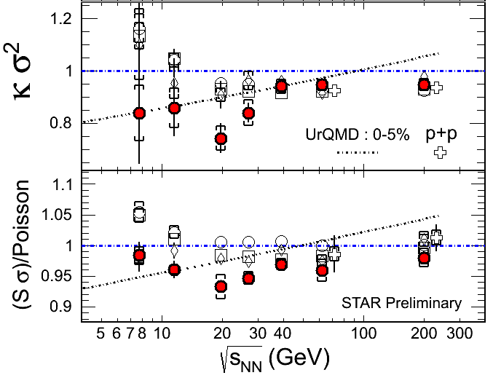
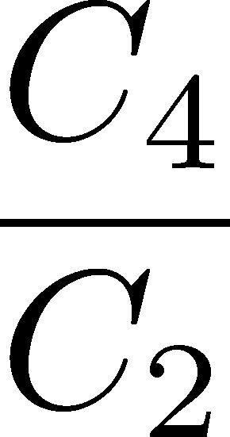
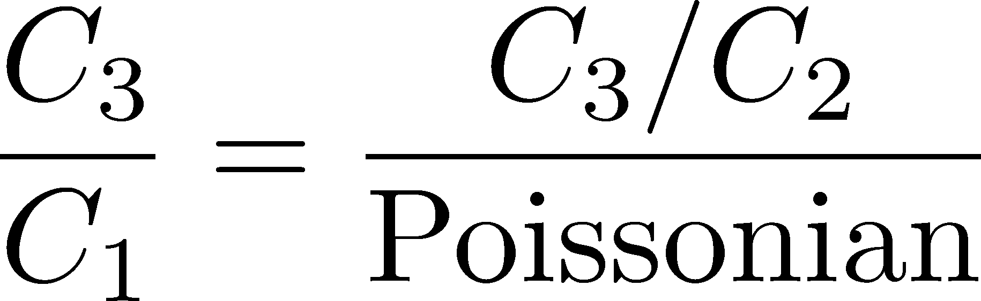
Proton # Cumulants @ STAR-BES
STAR,QM2012
No characteristic signals on
phase transition to QGP nor QCD CP

Slide 16
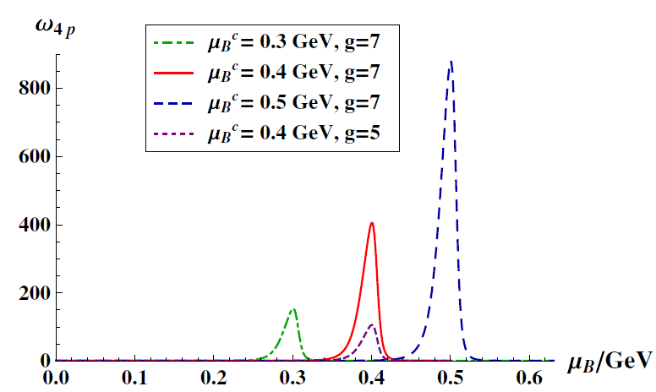
Proton # Cumulants @ STAR-BES
STAR,QM2012
Athanasiou, Rajagopal,
Stephanov, 2010
No characteristic signals on
phase transition to QGP nor QCD CP

Slide 17
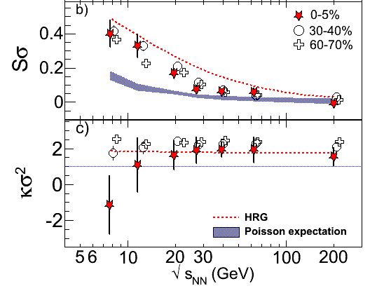
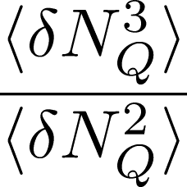
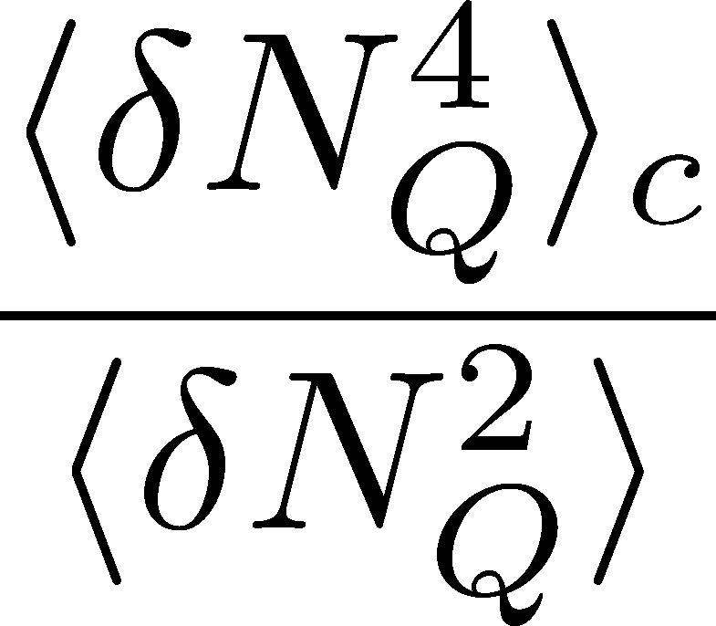
Charge Fluctuations @ STAR-BES
STAR, QM2012
No characteristic signals on
phase transition to QGP nor QCD CP

Slide 18
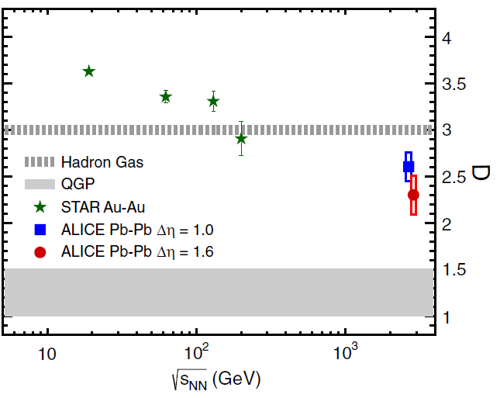

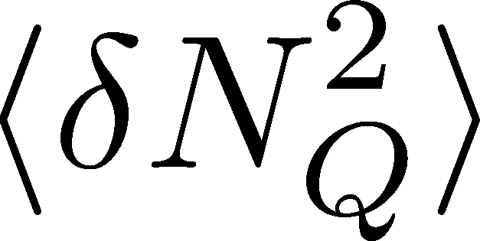
Charge Fluctuation @ LHC
ALICE, PRL110,152301(2013)
D-measure
D ~ 3-4 Hadronic
D ~ 1 Quark
LHC:
significant suppression
from hadronic value
is not equilibrated at freeze-out at LHC energy!

Slide 19

Δη Dependence @ ALICE
ALICE
PRL 2013
t
Δη
z
rapidity window

Slide 20
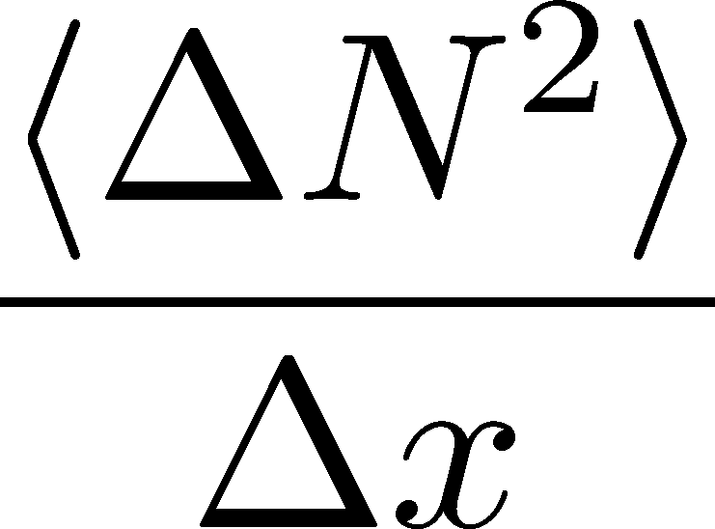




Dissipation of a Conserved Charge

Slide 21
Dissipation of a Conserved Charge

Slide 22
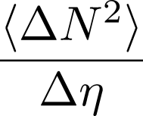
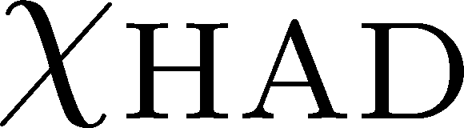
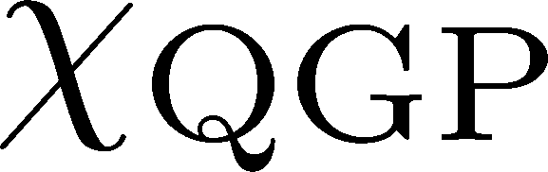


Time Evolution in HIC
Quark-Gluon Plasma
Hadronization
Freezeout

Slide 23
Δη Dependence @ ALICE
ALICE
PRL 2013
t
Δη
z
Δη dependences of fluctuation observables
encode history of the hot medium!
Higher-order cumulants as
thermometer?

Slide 24


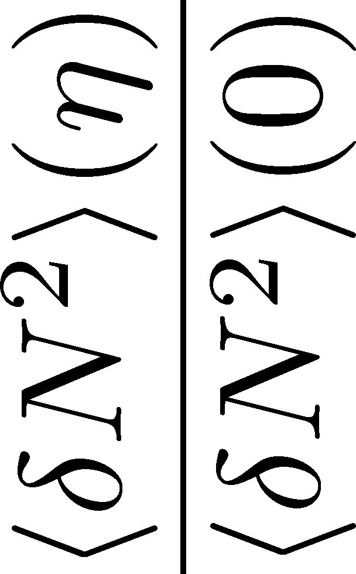
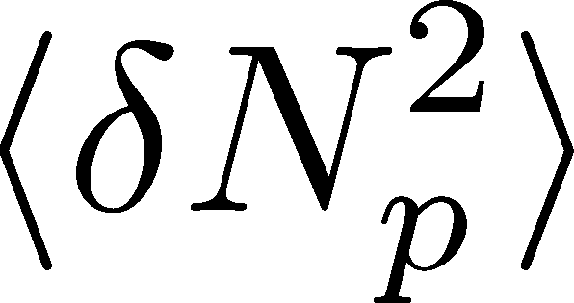

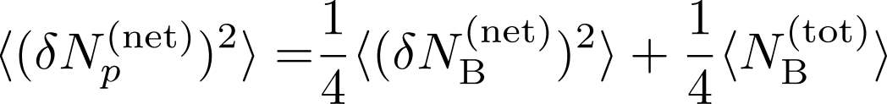
<δN_{B}²> and < δN_{p}² > @ LHC ?
should have different Δη dependence.

Slide 25
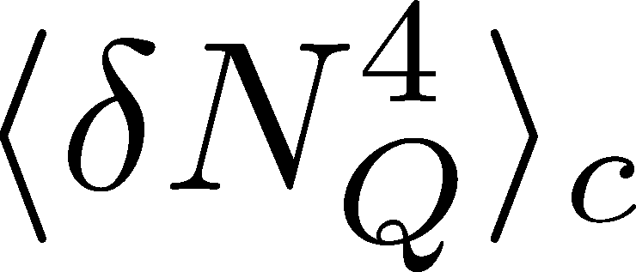

<δN_{Q}⁴> @ LHC ?
How does behave as a function of Δη?
Left
(suppression)
Right
(hadronic)
or

Slide 26
Baryon vs Proton Number Fluctuations
MK, Asakawa, PRC85,021901C(2012); PRC86, 024904(2012)
10min
Time Evolution of
Higher Order Cumulants
MK, Asakawa, Ono, arXiv:1307.xxxx
30min

Slide 27
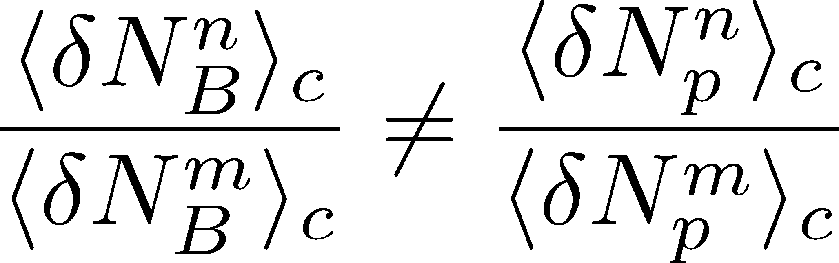
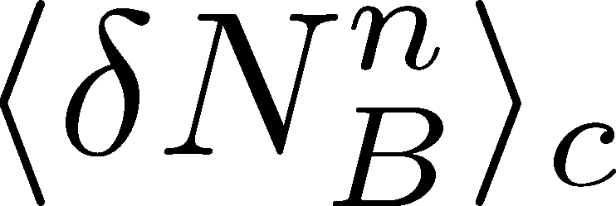
Baryon vs Proton Number Fluctuations
MK, Asakawa, PRC85,021901C(2012); PRC86, 024904(2012)
are experimentally observable

Slide 28
Conserved Charges : Theoretical Advantage
Definite definition for operators
as a Noether current
calculable on any theory
ex: on the lattice
Simple thermodynamic relations
Intuitive interpretation for the behaviors of cumulants
ex:

Slide 29
Nucleon Isospin as Two Sides of a Coin
N
p
n
Nucleons have
two isospin states.
MK, Asakawa,2012

Slide 30
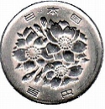
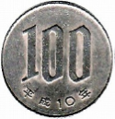
Nucleon Isospin as Two Sides of a Coin
a coin
N
p
n
Nucleons have
two isospin states.
Coins have two sides.
MK, Asakawa,2012

Slide 31



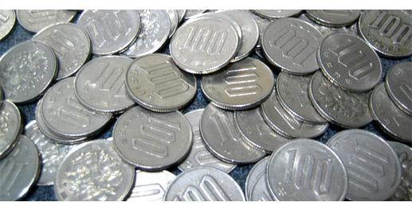
Slot Machine Analogy
= +
P (N)
N
P (N)
N

Slide 32
Extreme Examples
Fixed # of coins
Constant probabilities
N
N
N
N

Slide 33


Reconstructing Total Coin Number
P (N )= P (N )B_{1/2}(N ;N )
:binomial distr. func.

Slide 34
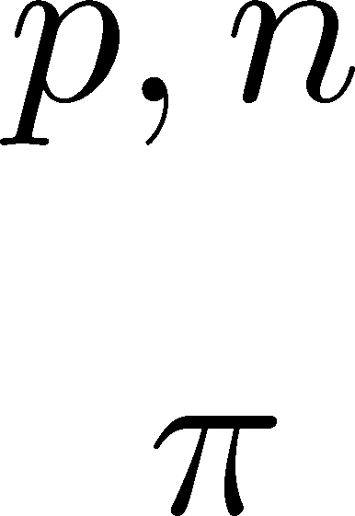
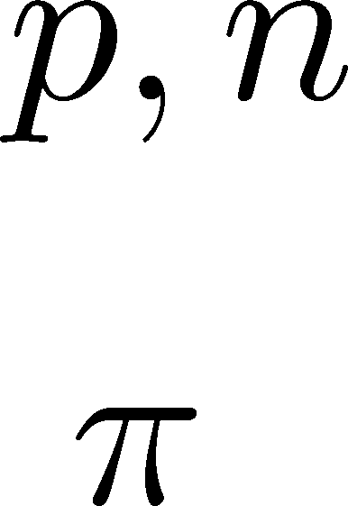
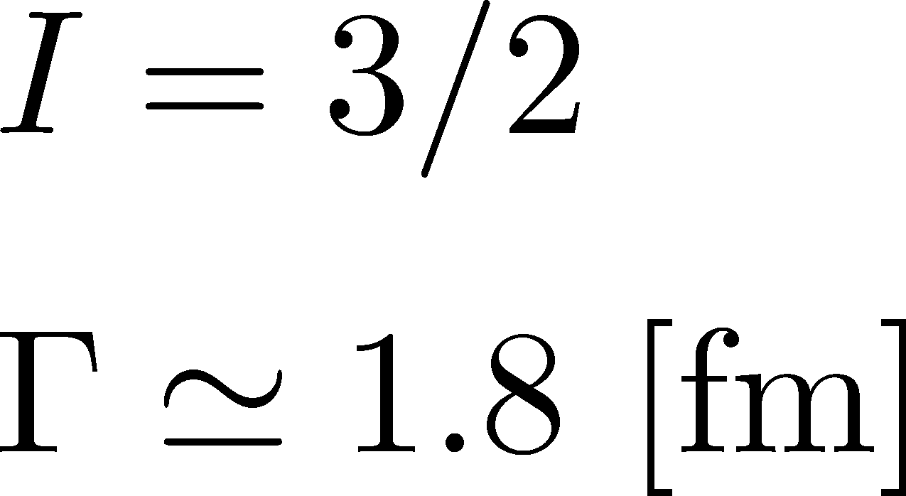

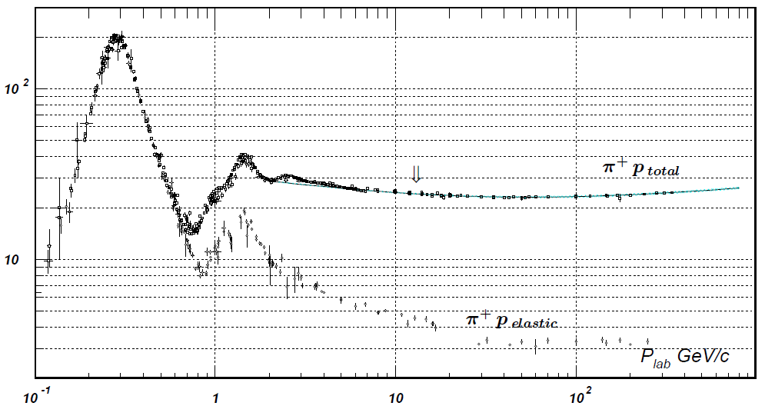


Nucleon Isospin in Hadronic Medium
Isospin of baryons can vary after chemical freezeout
via charge exchange reactions mediated by Δ(1232):
200mb=20fm²
cross section

Slide 35
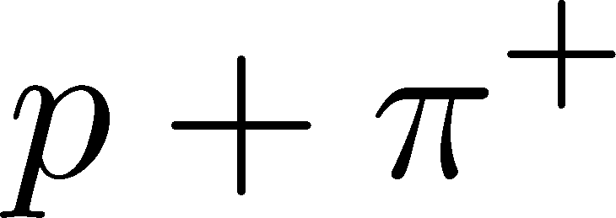
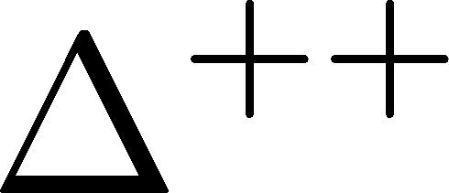
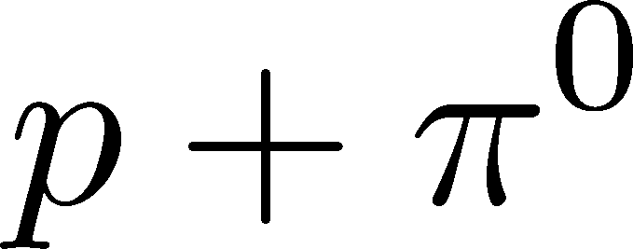

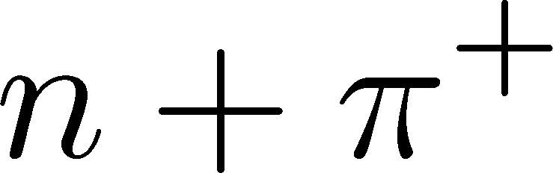
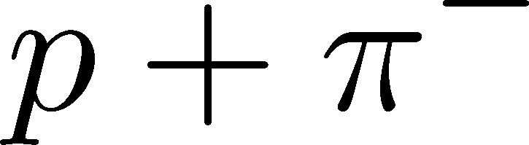

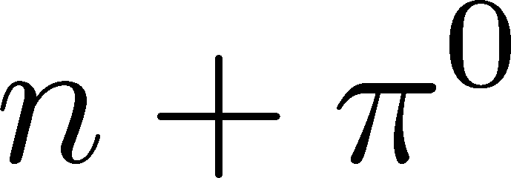


Δ(1232)
cross sections of p
3
1
2:1
2
1:2
decay rates of Δ

Slide 36
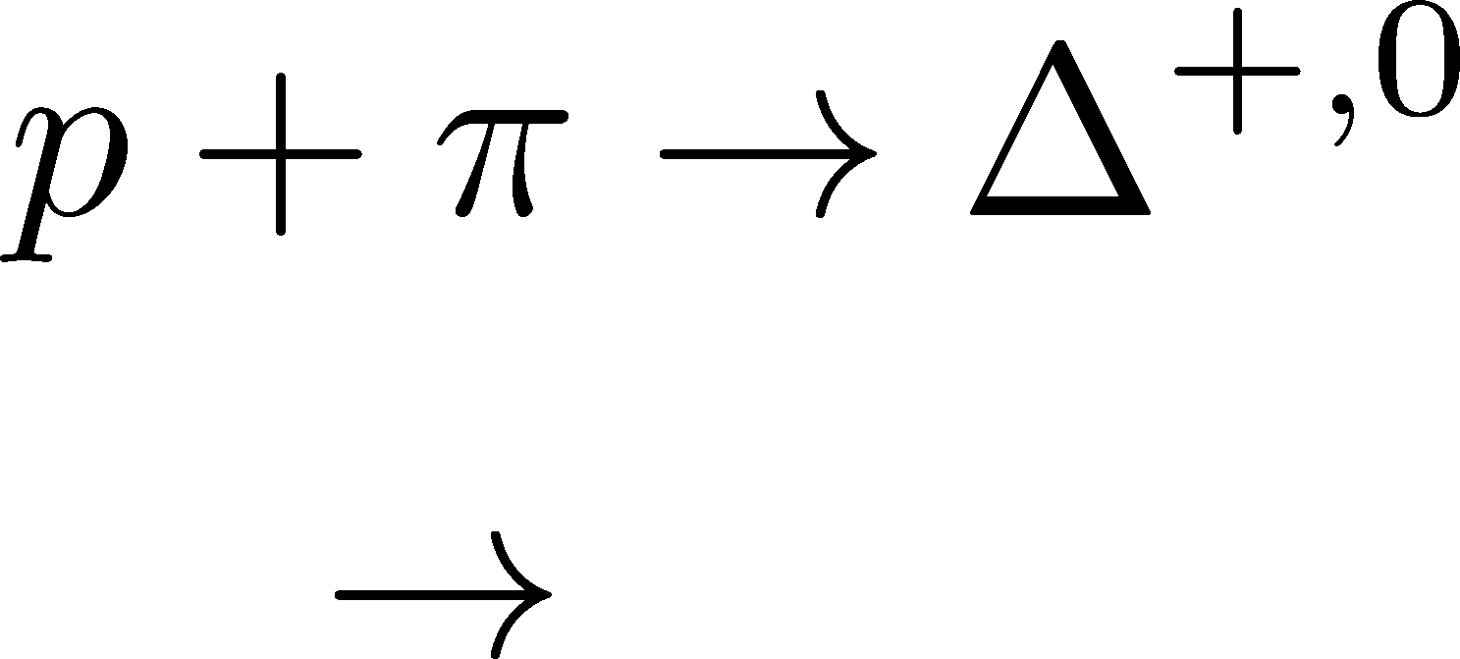


Δ(1232)
cross sections of p
3
1
2:1
2
1:2
decay rates of Δ

Slide 37
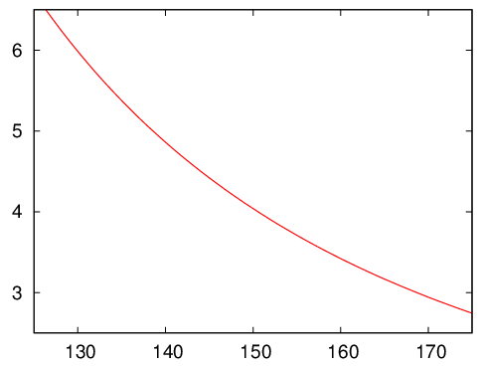
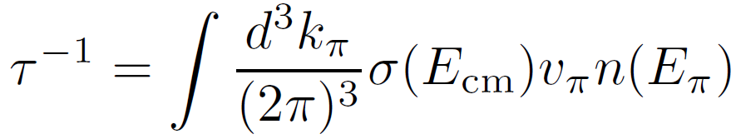


Δ(1232)
cross sections of p
3
1
2:1
2
1:2
decay rates of Δ
BW for σ & thermal pion
Lifetime to create Δ⁺ or Δ⁰

Slide 38
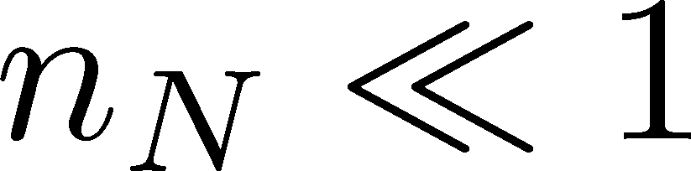


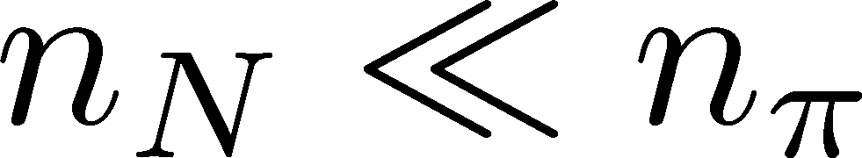
Nucleons in Hadronic Phase
time
chem. f.o.
hadronize
10~20fm
kinetic f.o.
rare NN collisions
no quantum corr.
mesons
baryons
many pions

Slide 39







Probability Distribution
Detector
binomial distribution func.
for any phase space in the final state.

Slide 40







Nucleon & Proton Number Fluctuations
for isospin symmetric medium
effect of isospin density <10%
Similar formulas up to any order!
For free gas

Slide 41




3rd & 4th Order Fluctuations

Slide 42


Difference btw Baryon and Proton Numbers
(1)
deviates from the equilibrium value.
(2) Boltzmann (Poisson) distribution for

Slide 43


Difference btw Baryon and Proton Numbers
(1)
deviates from the equilibrium value.
(2) Boltzmann (Poisson) distribution for
genuine info.
noise
For free gas

Slide 44













Strange Baryons
Decay Rates:
Decay modes:
Regarding these ratios even, protons from these decays
is incorporated into the binomial distribution. Then, N_{N}→N_{B}

Slide 45
Time Evolution of
Higher Order Cumulants
MK, Asakawa, Ono, arXiv:1307.xxxx
30min

Slide 46
<δN_{Q}⁴> @ LHC ?
How does behave as a function of Δη?
Left
(suppression)
Right
(hadronic)
or

Slide 47


Hydrodynamic Fluctuations
Landau, Lifshitz, Statistical Mechaniqs II
Kapusta, Muller, Stephanov, 2012
Diffusion equation
Stochastic diffusion equation

Slide 48


Hydrodynamic Fluctuations
Landau, Lifshitz, Statistical Mechaniqs II
Kapusta, Muller, Stephanov, 2012
Diffusion equation
Stochastic diffusion equation
Conservation Law
Fick’s Law

Slide 49




Fluctuation-Dissipation Relation
Stochastic force
Local correlation
(hydrodynamics)
Equilibrium fluc.

Slide 50




Δη Dependence
Shuryak, Stephanov, 2001
Initial condition:
Translational invariance
initial
equilibrium
initial
equilibrium

Slide 51




Δη Dependence
Shuryak, Stephanov, 2001
Initial condition:
Translational invariance
initial
equilibrium
equilibrium
initial

Slide 52


Non-Gaussian Stochastic Force ??
Stochastif Force : 3rd order
Local correlation
(hydrodynamics)
Equilibrium fluc.

Slide 53

Caution!
diverge in long wavelength
No a priori extension of FD relation to higher orders

Slide 54
Caution!
diverge in long wavelength
No a priori extension of FD relation to higher orders
Markov process＋continuous variable
Theorem
➔Gaussian random force
cf) Gardiner, “Stochastic Methods”
Hydrodynamics
Local equilibrium with many particles
Gaussian due to central limit theorem

Slide 55
Three “NON”s
Physics of non-Gaussianity in heavy-ion
collisions is a particular problem!
Non-Gaussian
Non-critical
Non-equilibrium
Non-Gaussianitiy is
irrelevant in large systems
critical enhancement is
not observed in HIC so far
Fluctuations are not
equilibrated in HIC

Slide 56







Diffusion Master Equation
Divide spatial coordinate into discrete cells
probability

Slide 57

Diffusion Master Equation
Divide spatial coordinate into discrete cells
probability
Master Equation for P(n)
x-hat: lattice-QCD notation
Solve the DME exactly, and take a→0 limit
No approx., ex. van Kampen’s system size expansion

Slide 58



Solution of DME
1st
initial
Deterministic part ←→ diffusion equation
at long wave length (1/a<<k)
Appropriate continuum limit with γa²=D

Slide 59

Solution of DME
1st
initial
Deterministic part ←→ diffusion equation
at long wave length (1/a<<k)
Appropriate continuum limit with γa²=D
2nd
Consistent with stochastic diffusion eq.
(for sufficiently smooth initial condition)

Slide 60




Net Charge Number
Prepare 2 species of (non-interacting) particles
Let us investigate
at freezeout time t

Slide 61


Initial Condition at Hadronization
Boost invariance / infinitely long system
Local equilibration / local correlation
Initial fluctuations
suppression owing to
local charge conservation
strongly dependent on
hadronization mechanism

Slide 62


Δη Dependence at Freezeout
Initial fluctuations:
2nd
4th

Slide 63
<δN_{Q}⁴> @ LHC
boost invariant system
small fluctuations of CC at hadronization
short correlation in hadronic stage
Assumptions
Suppression of
4th-order cumulant is anticipated at LHC energy!

Slide 64


Δη Dependence at STAR
STAR, QM2012
decreases as Δη becomes larger at RHIC.

Slide 65

Δη Dependence at Freezeout
Initial fluctuations:
2nd
4th

Slide 66

Summary
Plenty of physics in Δη dependences of
various cumulants
Diagnosing dynamics of HIC
history of hot medium
mechanism of hadronization
diffusion constant
Physical meanings
of fluctuation obs.
in experiments.

Slide 67
Summary
Plenty of physics in Δη dependences of
various cumulants
Diagnosing dynamics of HIC
history of hot medium
mechanism of hadronization
diffusion constant
Physical meanings
of fluctuation obs.
in experiments.
Search of QCD Phase Structure

Slide 68
Open Questions & Future Work
Why the primordial fluctuations are observed only at LHC, and not RHIC ?
Extract more information on each stage of fireballs using fluctuations
Model refinement
Including the effects of
nonzero correlation length / relaxation time
global charge conservation
Non Poissonian system ← interaction of particles

Slide 69






Chemical Reaction 1
x: # of X
a: # of A (fixed)
Master eq.:
Cumulants with fixed initial condition
initial
equilibrium

Slide 70





Chemical Reaction 2
2nd
3rd
4th
Higher-order
cumulants
grow slower.

Slide 71

Evolution of Fluctuations
Fluctuation
in initial state
Time evolution
in the QGP
approach to HRG
by diffusion
experimental effects
particle missID, etc.
volume fluctuation

Slide 72
Central Limit Theorem
CLT
Large system → Gaussian
Higher-order cumulants suppressed
as system volume becomes larger?

Slide 73




Central Limit Theorem
CLT
:Gaussian
In a large system,
Cumulants are nonzero.
Their experimental measurements are difficult.

Slide 74
Time Evolution in HIC
Quark-Gluon Plasma
Hadronization
Freezeout

Slide 75
Time Evolution in HIC
Pre-Equilibrium
Quark-Gluon Plasma
Hadronization
Freezeout

Slide 76
Time Evolution in HIC
Pre-Equilibrium
Quark-Gluon Plasma
Hadronization
Freezeout

