Slide 1
重イオン衝突における
ゆらぎの話
北沢 正清
（阪大）
筑波大学, 2013/Jul./9

Slide 2
Beam-Energy Scan
T
Hadrons
Color SC
0
μ

Slide 3

Beam-Energy Scan
STAR 2012
high
beam energy
T
low
Hadrons
Color SC
0
μ

Slide 4
Fluctuations
Observables in equilibrium are fluctuating.
P(N)
N
V
N

Slide 5
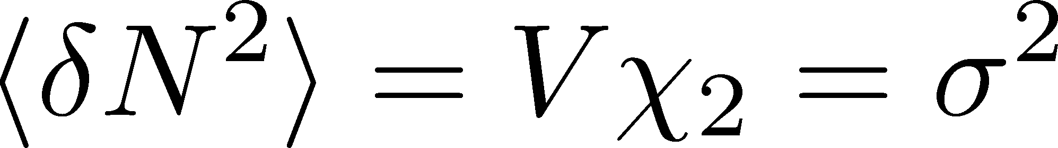
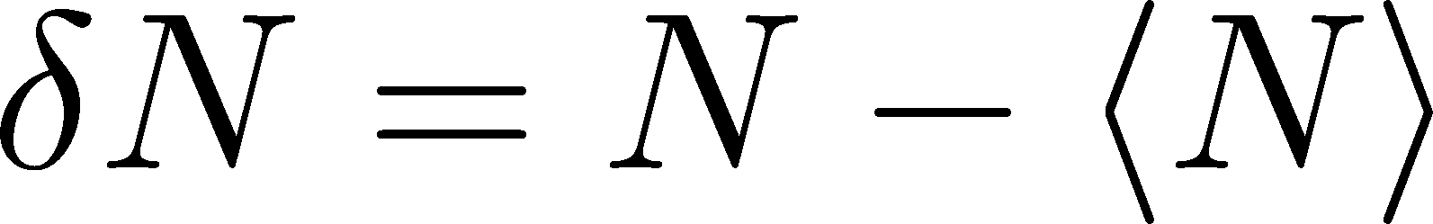
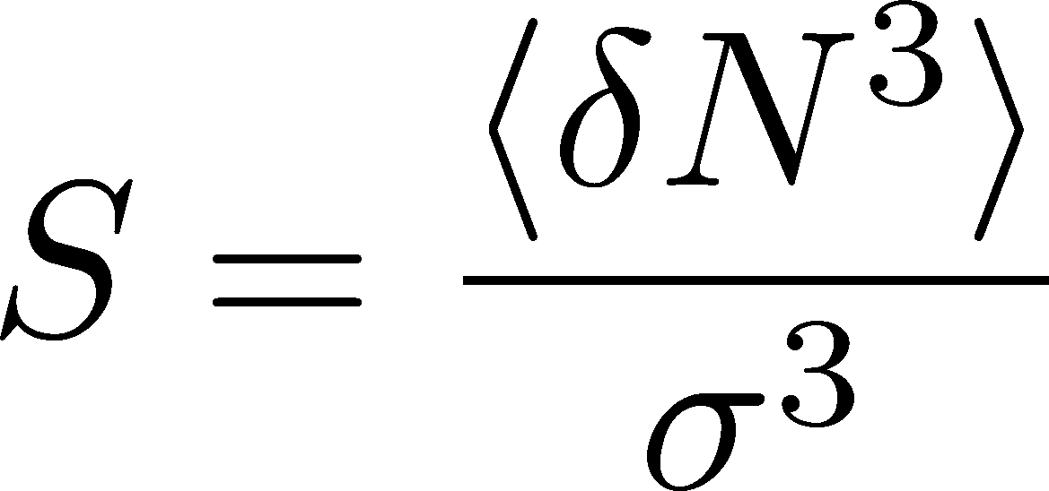
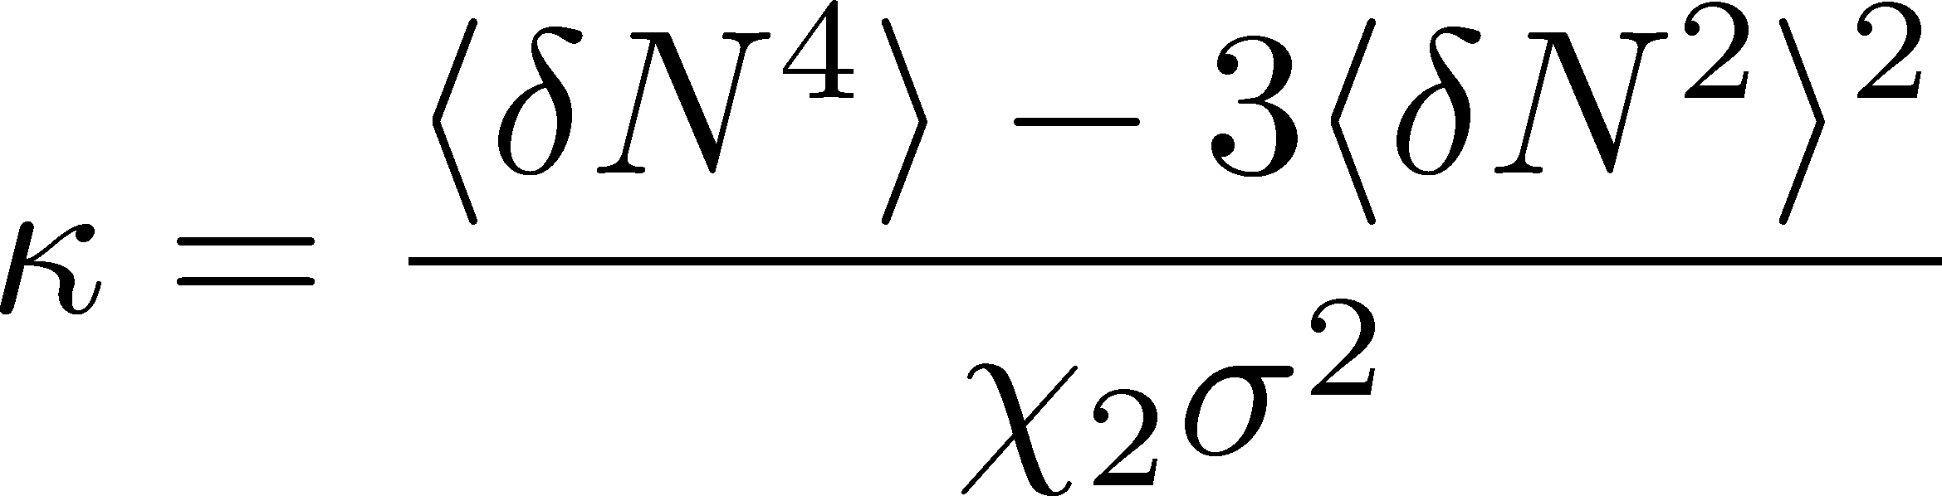
Fluctuations
Observables in equilibrium are fluctuating.
P(N)
N
V
N
Variance:
Skewness:
Kurtosis:

Slide 6

Event-by-Event Analysis @ HIC
Fluctuations can be measured by e-by-e analysis in experiments.
V
Detector

Slide 7

Event-by-Event Analysis @ HIC
Fluctuations can be measured by e-by-e analysis in experiments.
STAR, PRL105 (2010)
Detector

Slide 8
観測にかかるゆらぎは、いつ形成されたのか？
ゆらぎのダイナミクス（動的振る舞い）の議論が必要
Detector

Slide 9



観測にかかるゆらぎは、いつ形成されたのか？
ゆらぎのダイナミクス（動的振る舞い）の議論が必要
保存電荷の場合
非保存電荷の場合
V
V
境界を通過する電荷
のみが変化に寄与
体積内の任意の場所で
電荷が変化できる
for
for

Slide 10
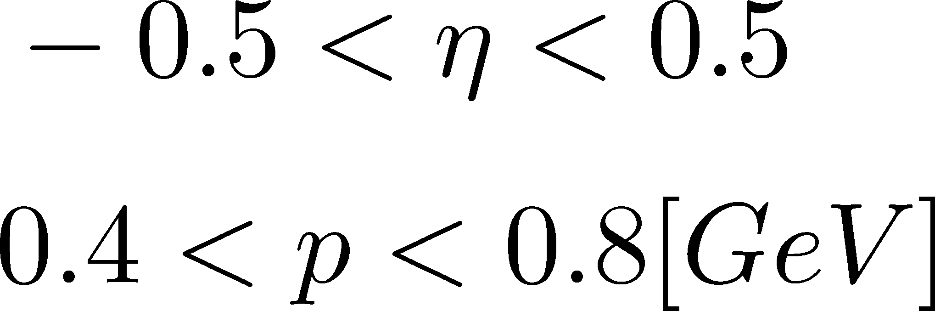
観測にかかるゆらぎは、いつ形成されたのか？
Δη内の保存電荷量は、初期段階のものが終状態まで生き残ることが期待できる。
N_{Q}
Asakawa, Heinz, Muller, ’00
Jeon, Koch, ’00
Shuryak, Stephanov, ’02
Δy
t
Note:
Δy
ＳＴＡＲ
z

Slide 11
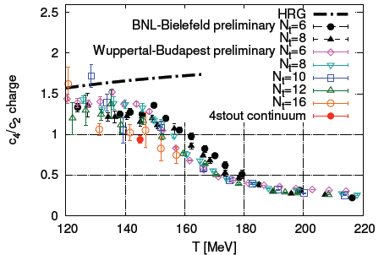
Conserved Charges : Theoretical Advantage
Definite definition for operators
as a Noether current
calculable on any theory
ex: on the lattice

Slide 12
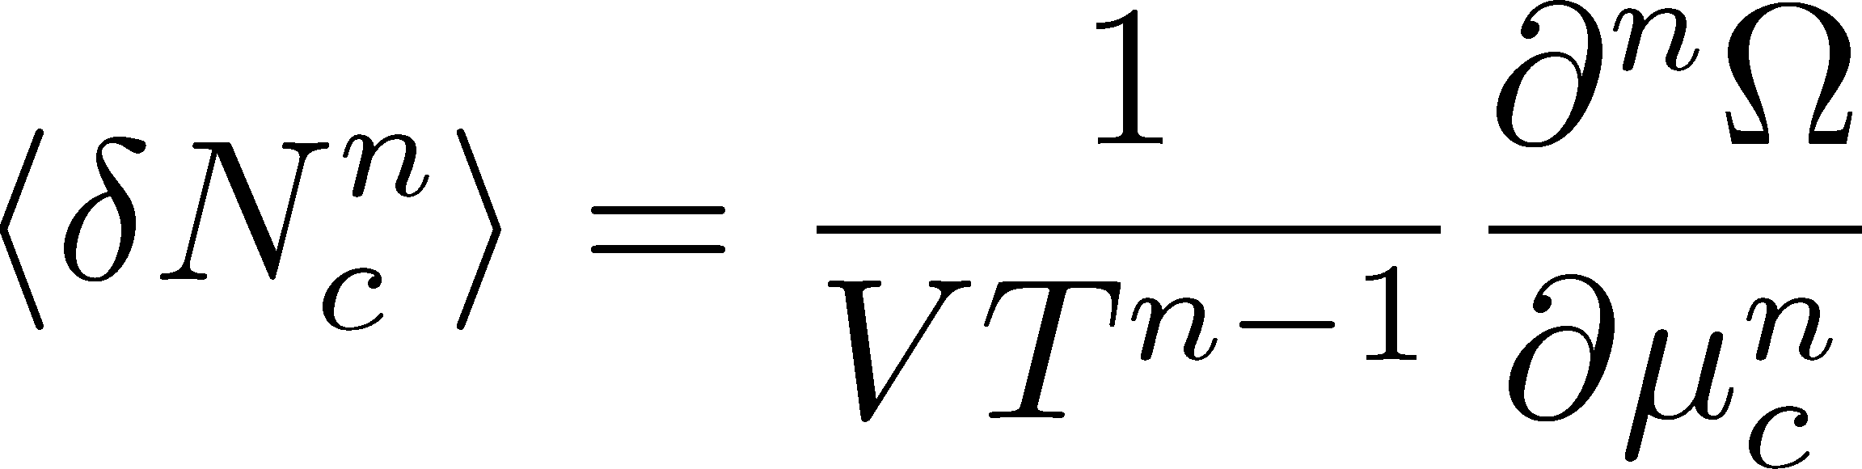

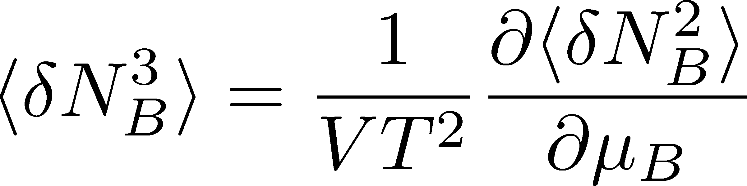
Conserved Charges : Theoretical Advantage
Definite definition for operators
as a Noether current
calculable on any theory
ex: on the lattice
Simple thermodynamic relations
Intuitive interpretation for the behaviors of cumulants
ex:

Slide 13

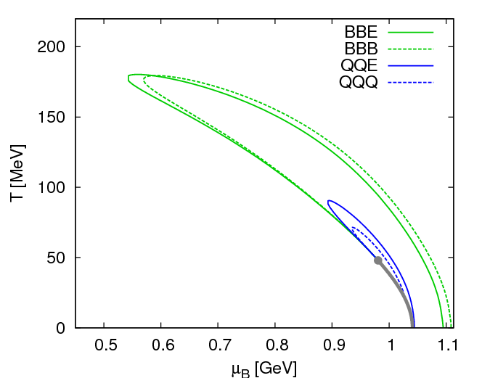
Fluctuations
Fluctuations reflect properties of matter.
  Enhancement near the critical point
  Stephanov,Rajagopal,Shuryak(’98); Hatta,Stephanov(’02); Stephanov(’09);…
  Ratios between cumulants of conserved charges
  Asakawa,Heintz,Muller(’00); Jeon, Koch(’00); Ejiri,Karsch,Redlich(’06)
  Signs of higher order cumulants
  Asakawa,Ejiri,MK(’09); Friman,et al.(’11); Stephanov(’11)

Slide 14
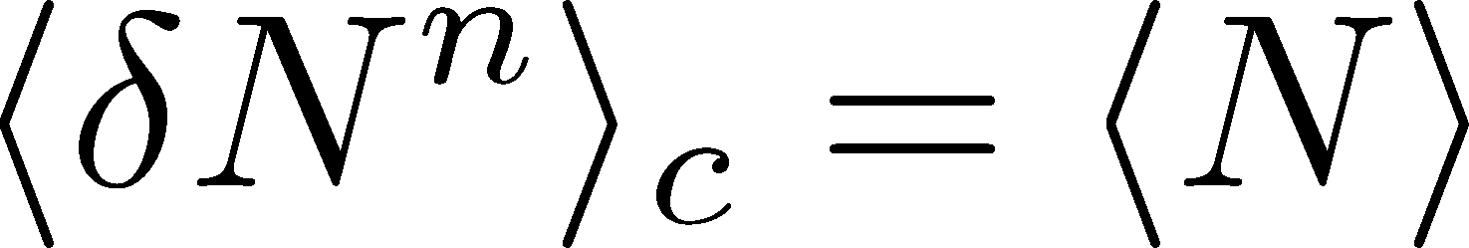
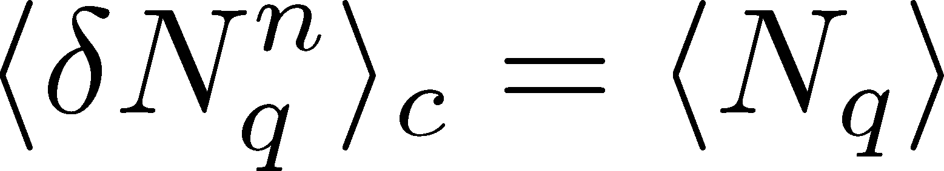
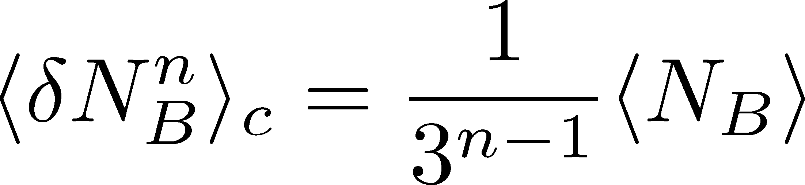
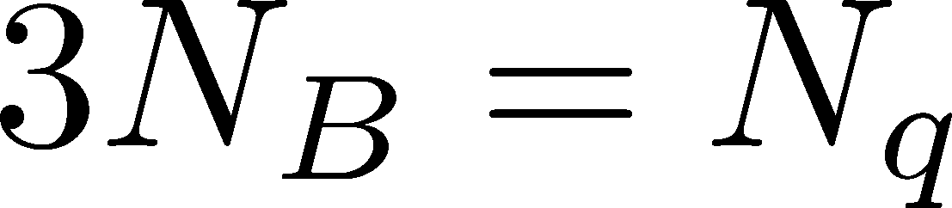
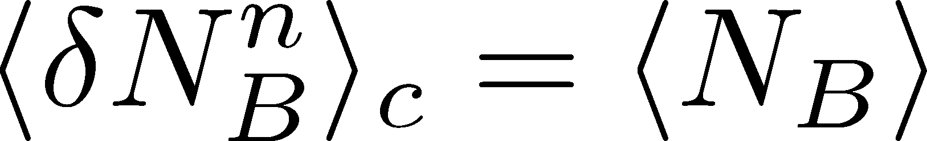
Fluctuations
Free Boltzmann → Poisson

Slide 15
Fluctuations
Free Boltzmann → Poisson
RBC-Bielefeld ’09

Slide 16
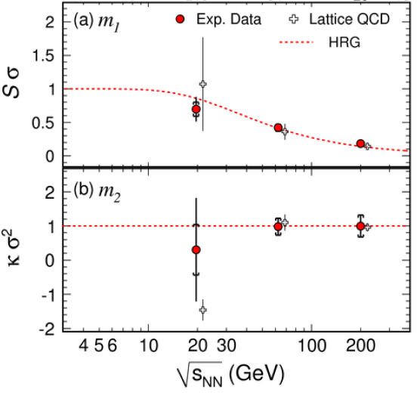
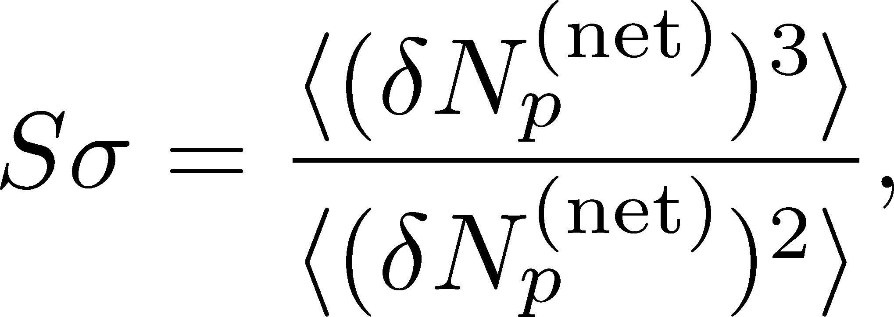
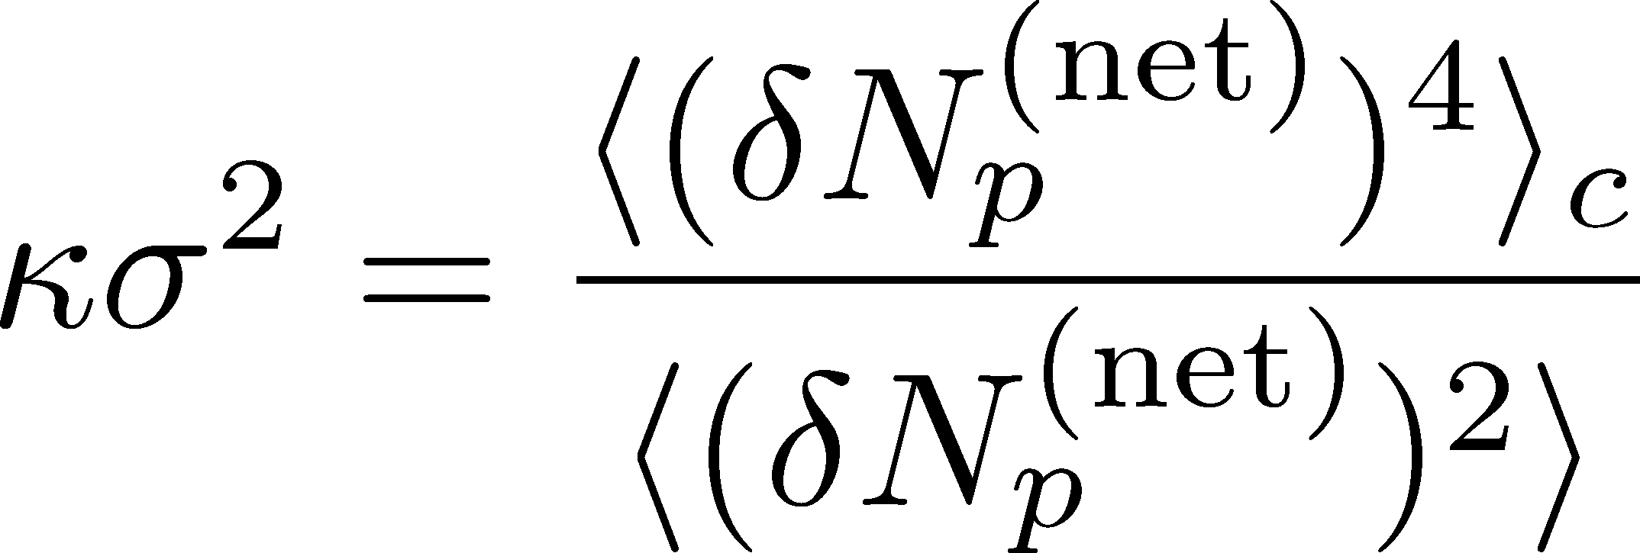
Proton # Fluctuations @ STAR-BES
STAR, PRL2010

Slide 17
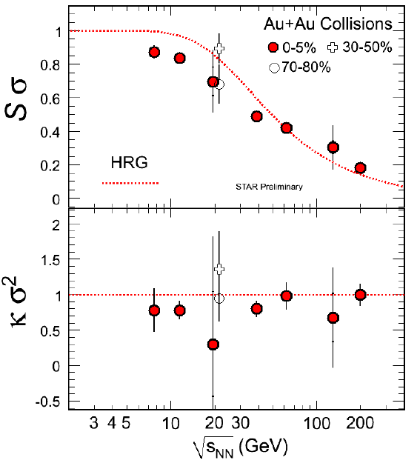
Proton # Fluctuations @ STAR-BES
STAR, PRL2010
STAR, 2011
high μ
low μ

Slide 18
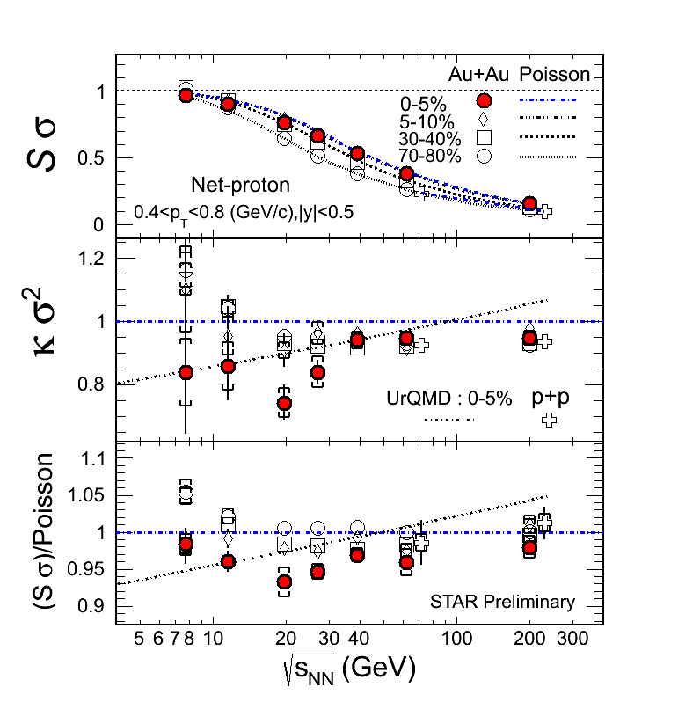
Proton # Fluctuations @ STAR-BES
STAR, 2012 (Quark Matter)
STAR, 2011
high μ
low μ

Slide 19
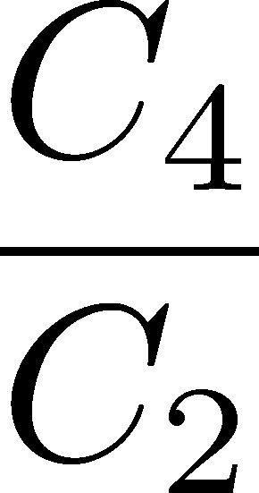
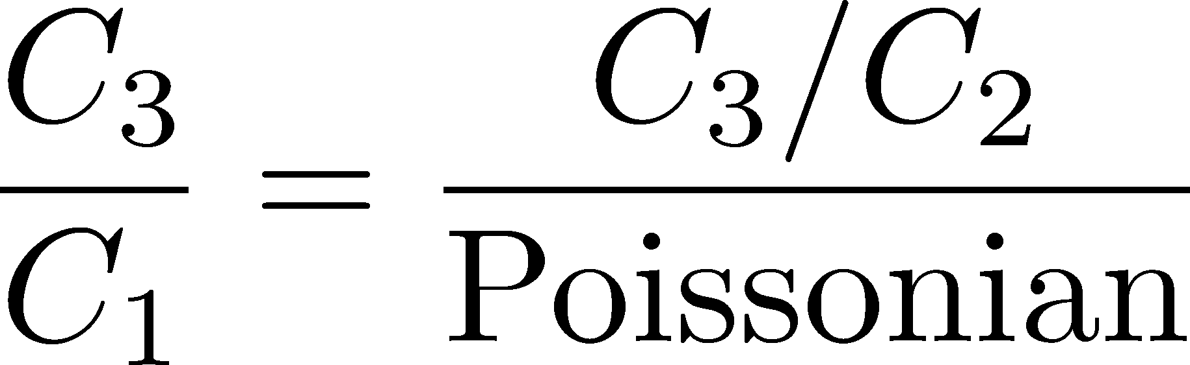
Proton # Cumulants @ STAR-BES
STAR,QM2012
No characteristic signals on
phase transition to QGP nor QCD CP

Slide 20
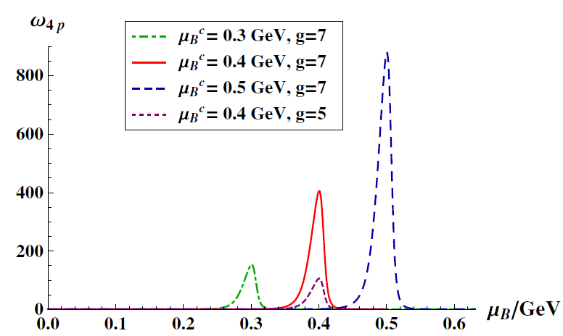
Proton # Cumulants @ STAR-BES
STAR,QM2012
Athanasiou, Rajagopal,
Stephanov, 2010
No characteristic signals on
phase transition to QGP nor QCD CP

Slide 21
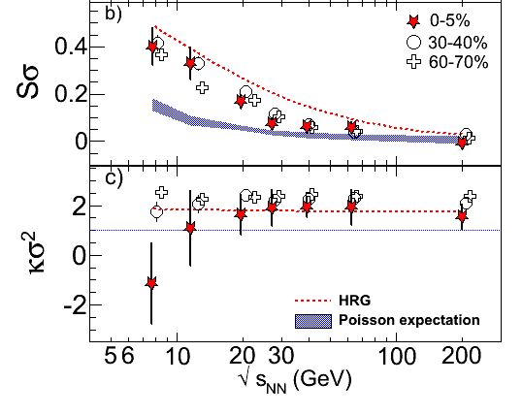
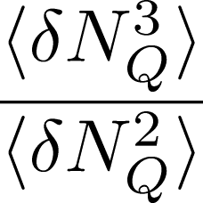
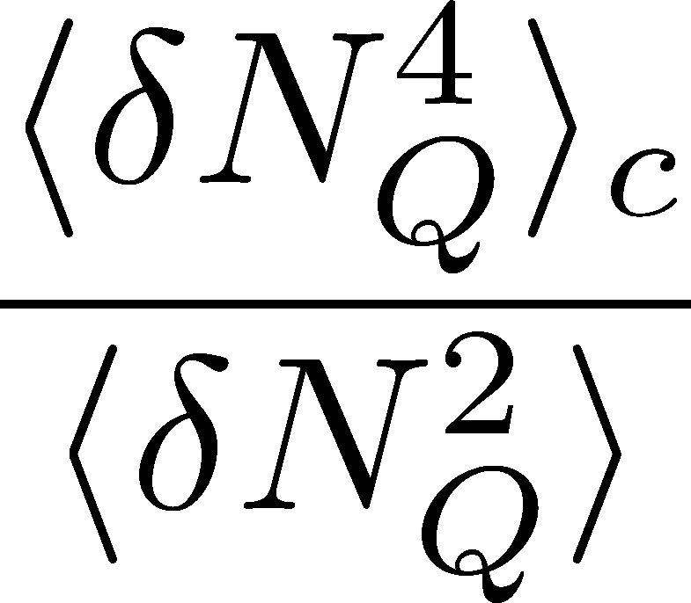
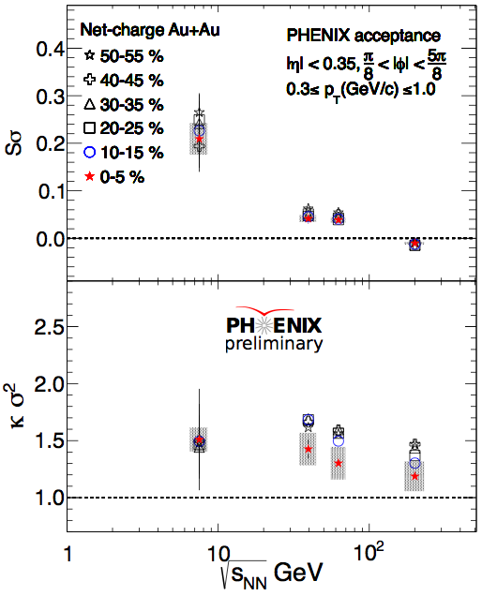
Charge Fluctuations @ STAR-BES
STAR, QM2012
Suppression??
Similar result @ PHENIX
UrQMD

Slide 22
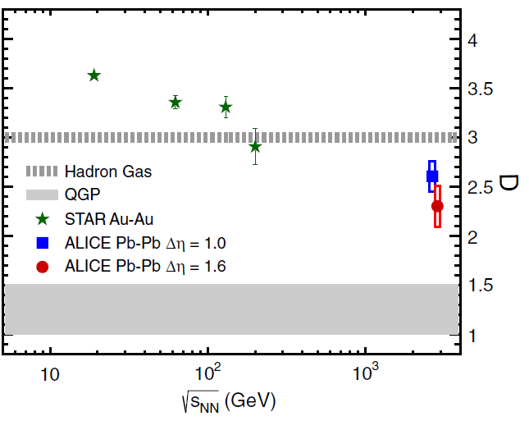

Charge Fluctuation @ LHC
ALICE, PRL110,152301(2013)
D-measure
D ~ 3-4 Hadronic
D ~ 1 Quark
LHC:
significant suppression
from hadronic value
ＬＨＣ終状態の電荷ゆらぎは、ハドロン化
以前に生成されたものを強く反映している！

Slide 23

Δη Dependence @ ALICE
ALICE
PRL 2013
t
Δη
z
rapidity window

Slide 24
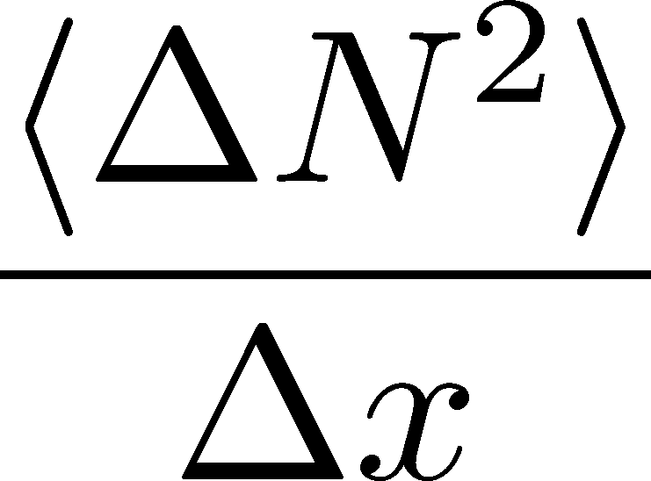




Dissipation of a Conserved Charge

Slide 25
Dissipation of a Conserved Charge

Slide 26
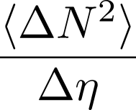




Time Evolution in HIC
Quark-Gluon Plasma
Hadronization
Freezeout

Slide 27
Δη Dependence @ ALICE
ALICE
PRL 2013
t
Δη
z
ゆらぎのΔη 依存性には、高温物質の
時間発展の情報が刻まれている！

Slide 28


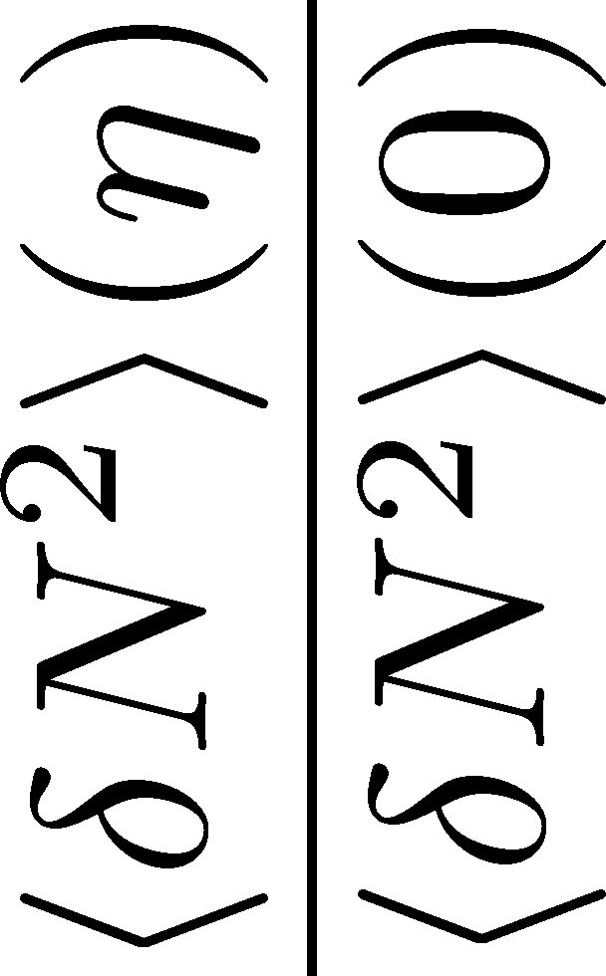
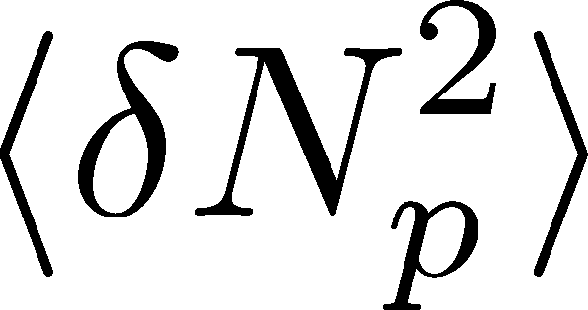
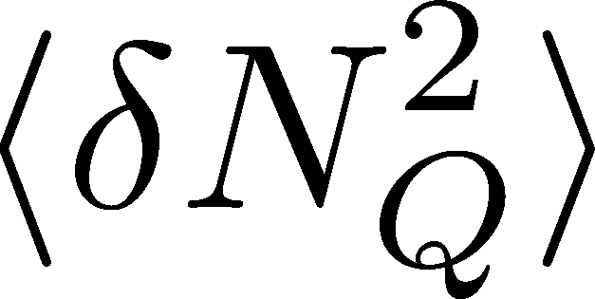

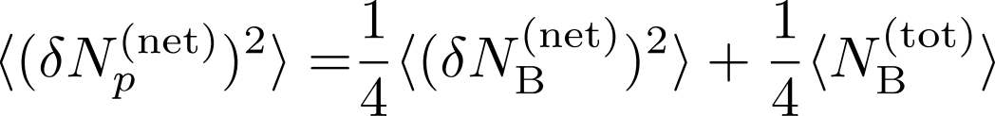
<δN_{B}²> and < δN_{p}² > @ LHC ?
should have different Δη dependence.

Slide 29
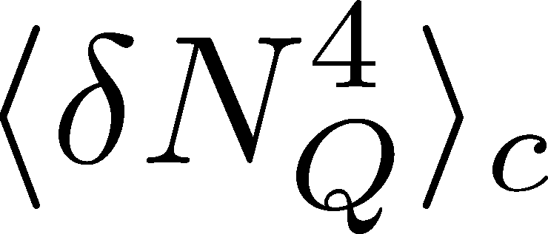

<δN_{Q}⁴> @ LHC ?
How does behave as a function of Δη?
Left
(suppression)
Right
(hadronic)
or

Slide 30
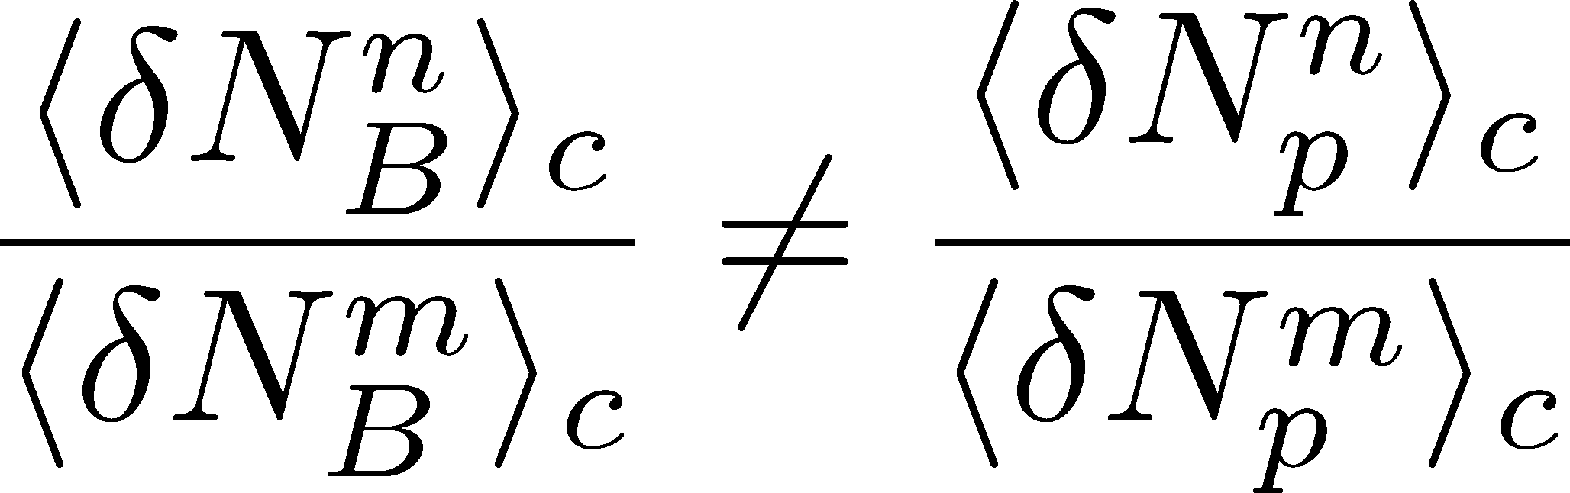
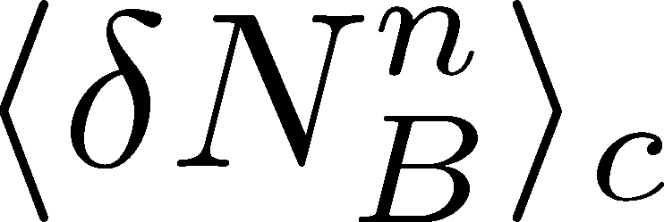
Baryon vs Proton Number Fluctuations
MK, Asakawa, PRC85,021901C(2012); PRC86, 024904(2012)
are experimentally observable

Slide 31
Nucleon Isospin as Two Sides of a Coin
N
p
n
Nucleons have
two isospin states.
MK, Asakawa,2012

Slide 32

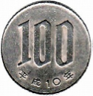
Nucleon Isospin as Two Sides of a Coin
a coin
N
p
n
Nucleons have
two isospin states.
Coins have two sides.
MK, Asakawa,2012

Slide 33



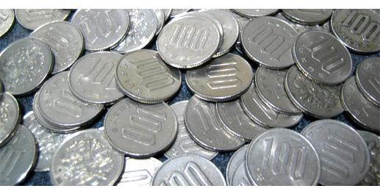
Slot Machine Analogy
= +
P (N)
N
P (N)
N

Slide 34
Extreme Examples
Fixed # of coins
Constant probabilities
N
N
N
N

Slide 35


Reconstructing Total Coin Number
P (N )= P (N )B_{1/2}(N ;N )
:binomial distr. func.

Slide 36
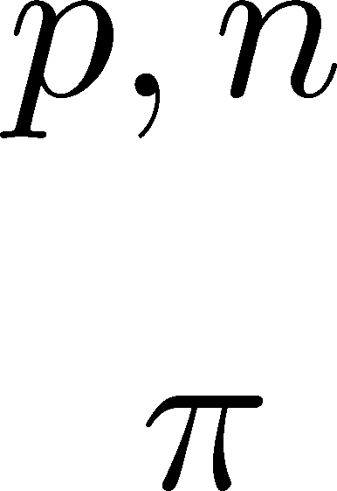
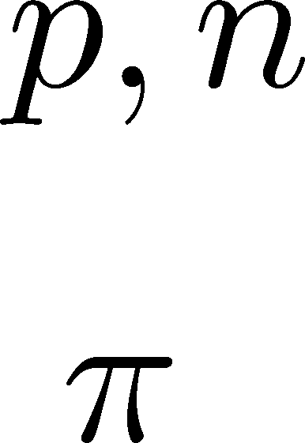
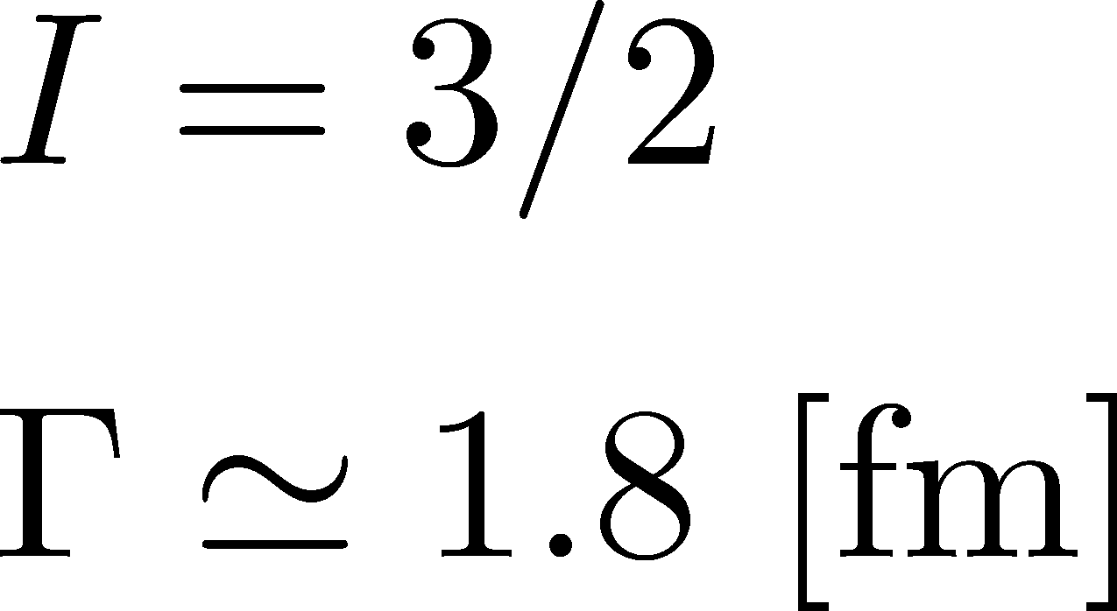

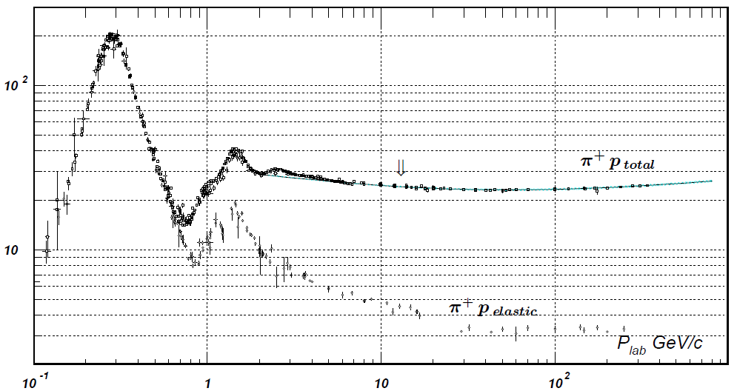


Nucleon Isospin in Hadronic Medium
Isospin of baryons can vary after chemical freezeout
via charge exchange reactions mediated by Δ(1232):
200mb=20fm²
cross section

Slide 37
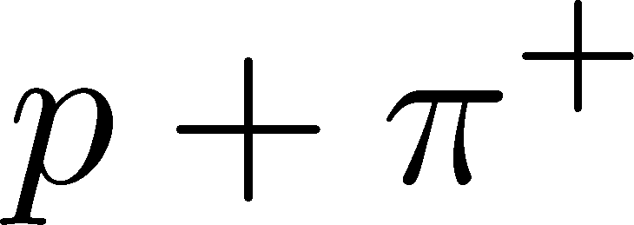
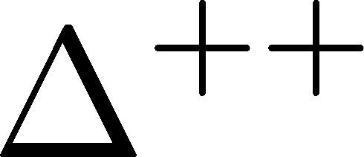
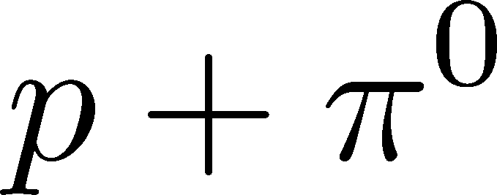

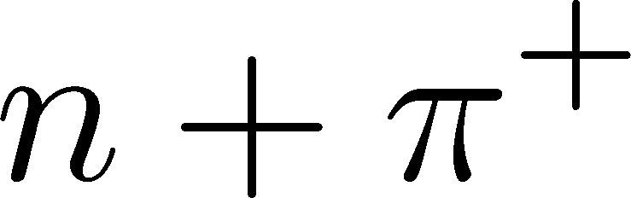
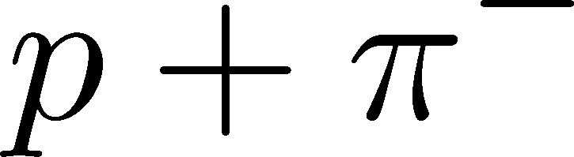

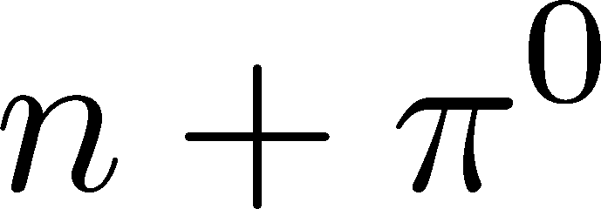


Δ(1232)
cross sections of p
3
1
2:1
2
1:2
decay rates of Δ

Slide 38
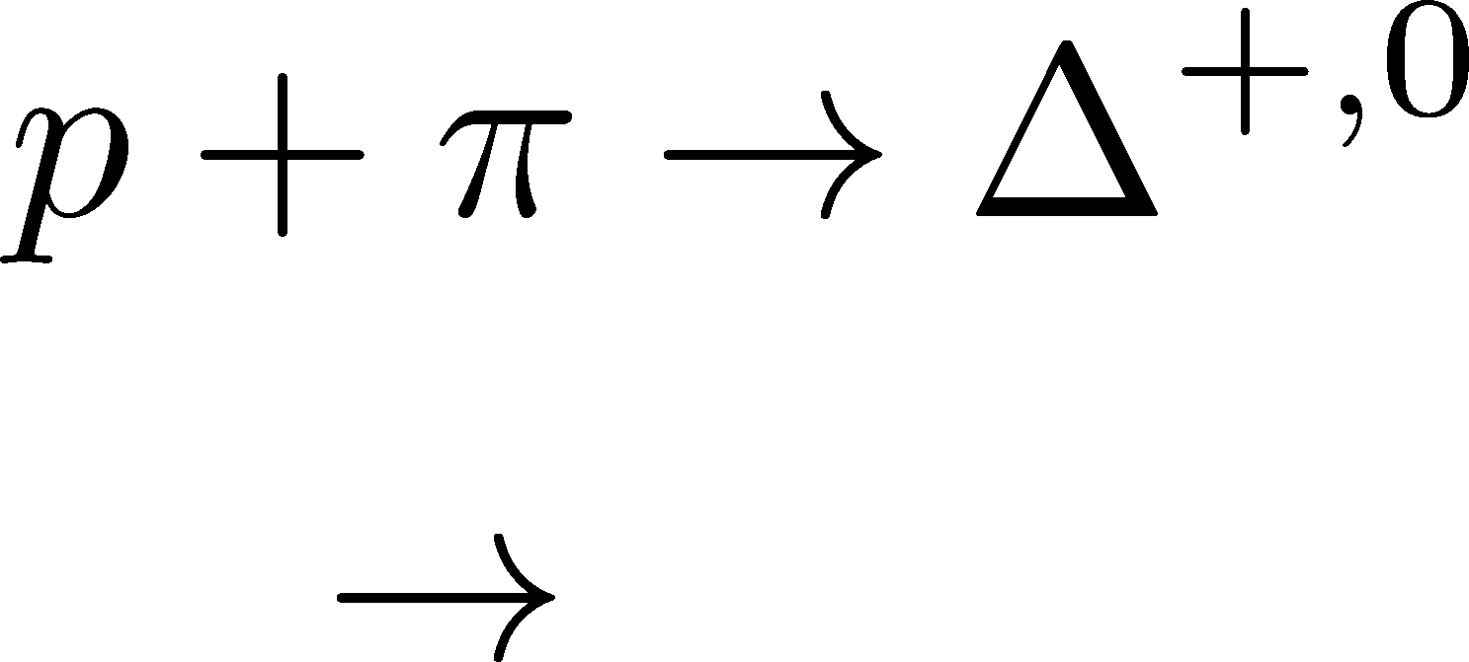


Δ(1232)
cross sections of p
3
1
2:1
2
1:2
decay rates of Δ

Slide 39
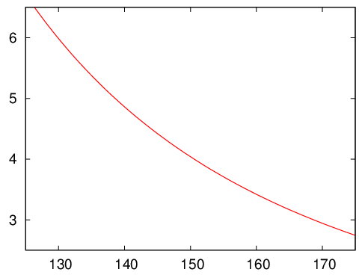



Δ(1232)
cross sections of p
3
1
2:1
2
1:2
decay rates of Δ
BW for σ & thermal pion
Lifetime to create Δ⁺ or Δ⁰

Slide 40




Nucleons in Hadronic Phase
time
chem. f.o.
hadronize
10~20fm
kinetic f.o.
rare NN collisions
no quantum corr.
mesons
baryons
many pions

Slide 41







Probability Distribution
Detector
binomial distribution func.
for any phase space in the final state.

Slide 42




Difference btw Baryon and Proton Numbers
(1)
deviates from the equilibrium value.
(2) Boltzmann (Poisson) distribution for
genuine info.
noise
For free gas

Slide 43

Secondary Protons
MK+, in preparation
Secondary (knockout) protons
20% of observed protons @ STAR
detector
dca [cm]
Measurement
STAR, PRC79,034909(2009)

Slide 44



Secondary Protons
MK+, in preparation
Secondary (knockout) protons
20% of observed protons @ STAR
detector
dca [cm]
Measurement
STAR, PRC79,034909(2009)
Their contribution can be eliminated!

Slide 45
Time Evolution of
Higher Order Cumulants
MK, Asakawa, Ono, arXiv:1307.xxxx

Slide 46
Time Evolution in HIC
Quark-Gluon Plasma
Hadronization
Freezeout

Slide 47


Hydrodynamic Fluctuations
Landau, Lifshitz, Statistical Mechaniqs II
Kapusta, Muller, Stephanov, 2012
Diffusion equation
Stochastic diffusion equation

Slide 48







Δη Dependence
Shuryak, Stephanov, 2001
Initial condition:
Translational invariance
initial
equilibrium
equilibrium
initial

Slide 49
Thee “NON”s
重イオン衝突での高次ゆらぎの観測・解析は、
物理学として相当に特殊な問題である。
Non-Gaussian
通常、高次ゆらぎは観測困難。
適度に小さい系

Slide 50
Thee “NON”s
重イオン衝突での高次ゆらぎの観測・解析は、
物理学として相当に特殊な問題である。
Non-Gaussian
Non-critical
通常、高次ゆらぎは観測困難。
適度に小さい系
観測されたゆらぎの値は、
自由ガスとたかだか２倍のずれ

Slide 51
Thee “NON”s
重イオン衝突での高次ゆらぎの観測・解析は、
物理学として相当に特殊な問題である。
Non-Gaussian
Non-critical
Non-equilibrium
通常、高次ゆらぎは観測困難。
適度に小さい系
観測されたゆらぎの値は、
自由ガスとたかだか２倍のずれ
平衡に至る非定常過程を
記述する必要性。

Slide 52







Diffusion Master Equation
Divide spatial coordinate into discrete cells
probability

Slide 53

Diffusion Master Equation
Divide spatial coordinate into discrete cells
probability
Master Equation for P(n)
x-hat: lattice-QCD notation
Solve the DME exactly, and take a→0 limit
No approx., ex. van Kampen’s system size expansion

Slide 54



Solution of DME
1st
initial
Deterministic part ←→ diffusion equation
at long wave length (1/a<<k)
Appropriate continuum limit with γa²=D

Slide 55

Solution of DME
1st
initial
Deterministic part ←→ diffusion equation
at long wave length (1/a<<k)
Appropriate continuum limit with γa²=D
2nd
Consistent with stochastic diffusion eq.
(for sufficiently smooth initial condition)

Slide 56




Net Charge Number
Prepare 2 species of (non-interacting) particles
Let us investigate
at freezeout time t

Slide 57


Initial Condition at Hadronization
Boost invariance / infinitely long system
Local equilibration / local correlation
Initial fluctuations
suppression owing to
local charge conservation
strongly dependent on
hadronization mechanism

Slide 58


Δη Dependence at Freezeout
Initial fluctuations:
2nd
4th

Slide 59
<δN_{Q}⁴> @ LHC
boost invariant system
small fluctuations of CC at hadronization
short correlation in hadronic stage
Assumptions
Suppression of
4th-order cumulant is anticipated at LHC energy!

Slide 60


Δη Dependence at STAR
STAR, QM2012
decreases as Δη becomes larger at RHIC.

Slide 61

Δη Dependence at Freezeout
Initial fluctuations:
2nd
4th

Slide 62

高温物質の時間発展
熱平衡化
段階での
ゆらぎ
検出器
QGP相内での
時間発展
拡散による
HRGへの接近
初期エネルギー密度
体積ゆらぎ

Slide 63
まとめ
保存量初期ゆらぎの痕跡は終状態に残されており
LHC、RHICで観測にかかり始めている
ただし、RHIC-BES領域では即座にQCD相構造が
直ちに見えるほど明瞭ではないので、
実験的課題
理論的課題
バリオン数ゆらぎの構成
Q₄/Q₂＠ALICE
efficiency, acceptance, …
エネルギーゆらぎ
BES from RHIC to LHC
RHIC D-puzzleの解決
RHIC-BESの結果の解釈
ゆらぎの動的時間発展
2点相関関数等との比較
新しい観測量の提案

Slide 64
Evolution of Fluctuations
Fluctuation
in initial state
Time evolution
in the QGP
approach to HRG
by diffusion
experimental effects
particle missID, etc.
volume fluctuation

Slide 65
Time Evolution in HIC
Quark-Gluon Plasma
Hadronization
Freezeout

Slide 66
Time Evolution in HIC
Pre-Equilibrium
Quark-Gluon Plasma
Hadronization
Freezeout

Slide 67
Time Evolution in HIC
Pre-Equilibrium
Quark-Gluon Plasma
Hadronization
Freezeout

