Slide 1
重イオン衝突における
非ガウスゆらぎ
北沢 正清
（阪大）
MK, Asakawa, Ono, arXiv:1307.2978
「熱場の量子論とその応用」、京大基研、2013年8月28日

Slide 2
Beam-Energy Scan
T
Hadrons
Color SC
0
μ

Slide 3

Beam-Energy Scan
STAR 2012
high
beam energy
T
low
Hadrons
Color SC
0
μ

Slide 4

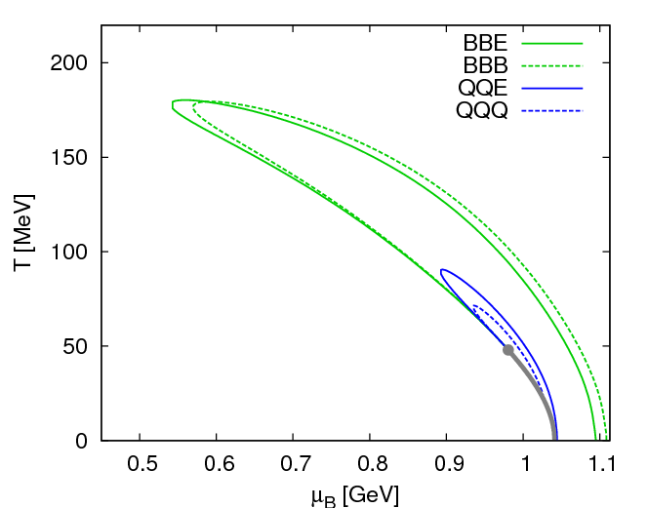
Fluctuations
Fluctuations reflect properties of matter.
  Enhancement near the critical point
  Stephanov,Rajagopal,Shuryak(’98); Hatta,Stephanov(’02); Stephanov(’09);…
  Ratios between cumulants of conserved charges
  Asakawa,Heinz,Muller(’00); Jeon, Koch(’00); Ejiri,Karsch,Redlich(’06)
  Signs of higher order cumulants
  Asakawa,Ejiri,MK(’09); Friman,et al.(’11); Stephanov(’11)

Slide 5
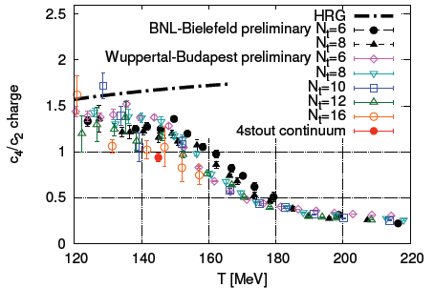
Conserved Charges : Theoretical Advantage
Definite definition for operators
as a Noether current
calculable on any theory
ex: on the lattice

Slide 6
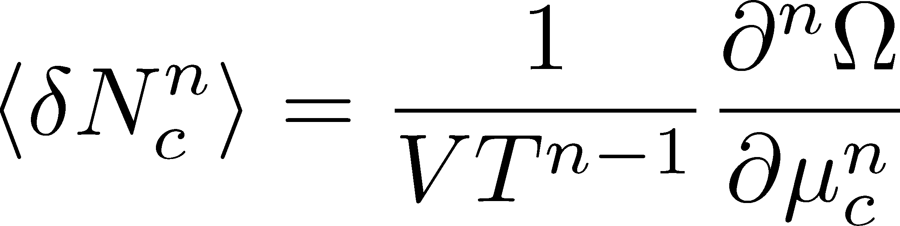

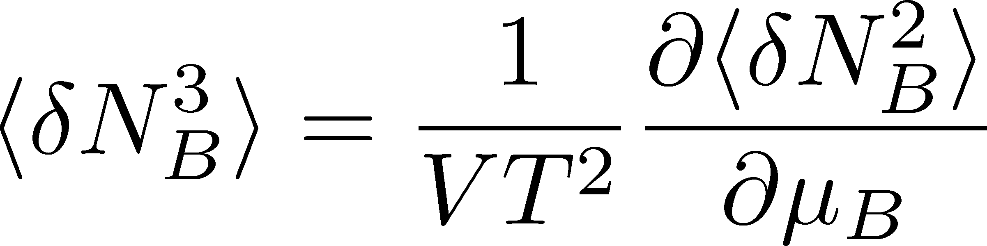
Conserved Charges : Theoretical Advantage
Definite definition for operators
as a Noether current
calculable on any theory
ex: on the lattice
Simple thermodynamic relations
Intuitive interpretation for the behaviors of cumulants
ex:
Asakawa, Ejiri, MK, 2009

Slide 7
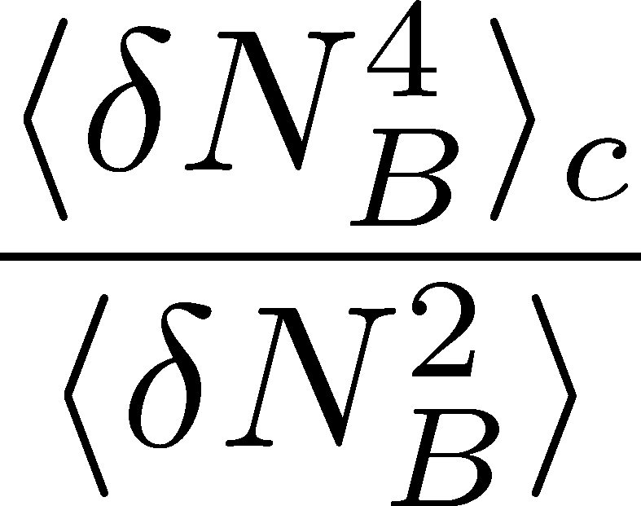
Conserved Charge Fluctuations
RBC-Bielefeld ’09
Cumulants of N_{B} and N_{Q} are suppressed at high T.
Asakawa, Heinz, Muller, 2000; Jeon, Koch, 2000;
Ejiri, Karsch, Redlich, 2006; Asakawa, Ejiri, MK, 2009;
Friman, et al., 2011; Stephanov, 2011

Slide 8
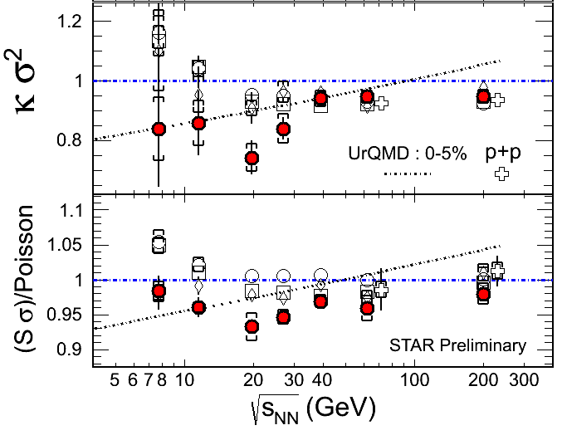
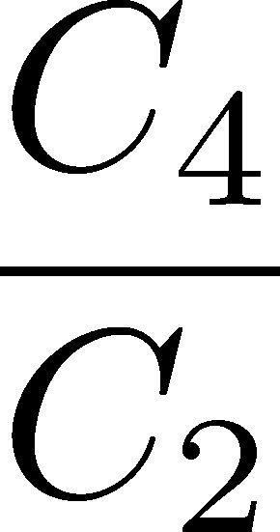
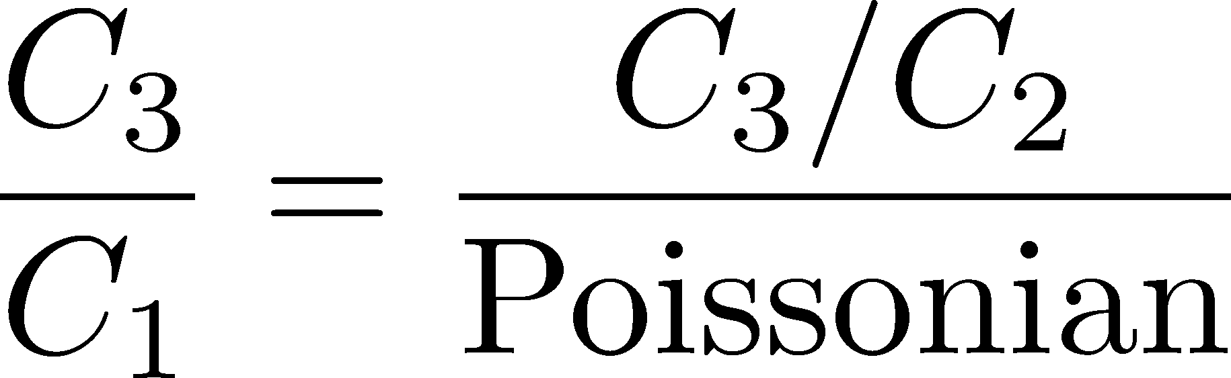


Proton # Cumulants @ STAR-BES
STAR,QM2012
Something
interesting??
CAUTION!
proton number
baryon number
MK, Asakawa, 2011;2012

Slide 9
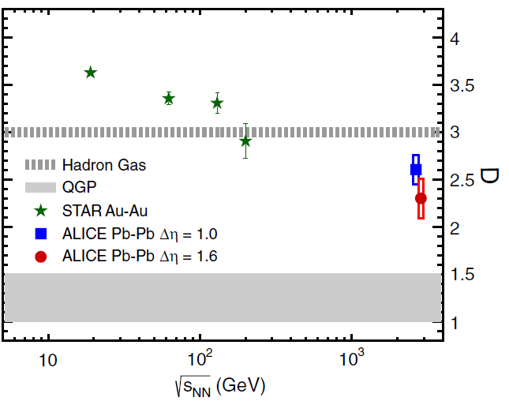

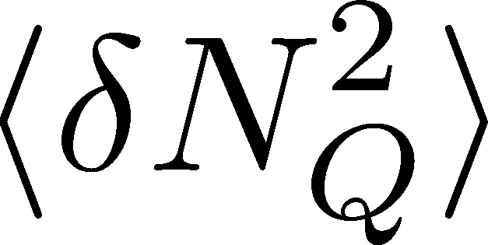
Charge Fluctuation @ LHC
ALICE, PRL110,152301(2013)
D-measure
D ~ 3-4 Hadronic
D ~ 1 Quark
significant suppression
from hadronic value
at LHC energy!
is not equilibrated at freeze-out at LHC energy!

Slide 10

Δη Dependence @ ALICE
ALICE
PRL 2013
t
Δη
z
rapidity window

Slide 11
Time Evolution of CC
t
Δy
N_{Q}
z
Δy
Variation of a conserved charge in Δy is achieved only through diffusion.
The larger Δy, the slower diffusion

Slide 12
Δη Dependence @ ALICE
ALICE
PRL 2013
t
Δη
z
Δη dependences of fluctuation observables
encode history of the hot medium!
Higher-order cumulants as
thermometer?

Slide 13
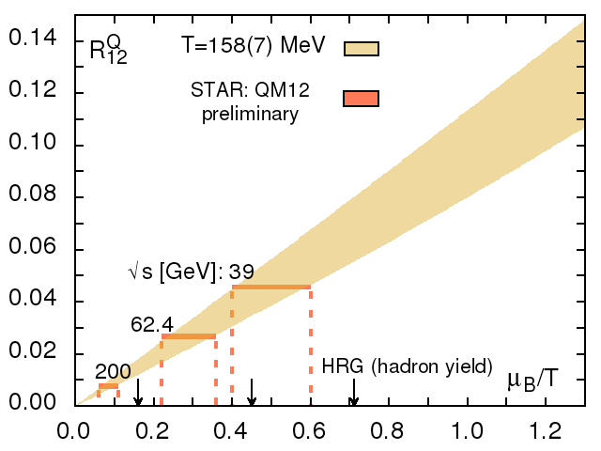
Cumulants : HIC vs Lattice
格子QCDで得られた
ゆらぎ- μ/T 関係線
HotQCD,
LATTICE2013
μ /T
実験の観測値＋格子
化学凍結
不一致

Slide 14



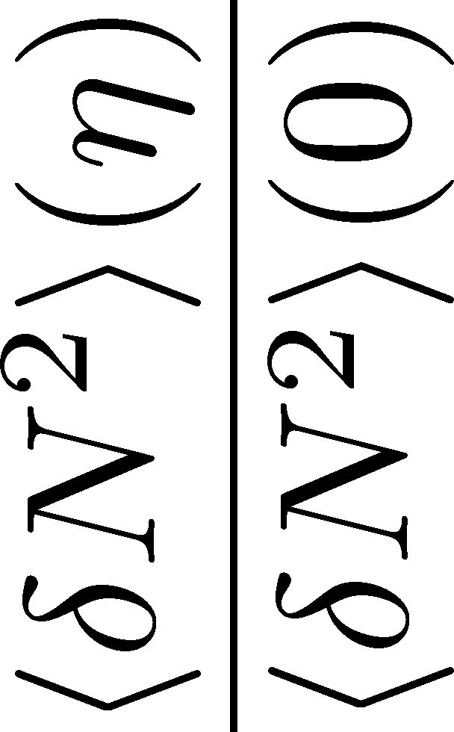

<δN_{B}²> and < δN_{p}² > @ LHC ?
should have different Δη dependence.
Baryon # cumulants are experimentally observable! MK, Asakawa, 2011;2012

Slide 15

<δN_{B}²> and < δN_{p}² > @ LHC ?
should have different Δη dependence.
Baryon # cumulants are experimentally observable! MK, Asakawa, 2011;2012

Slide 16
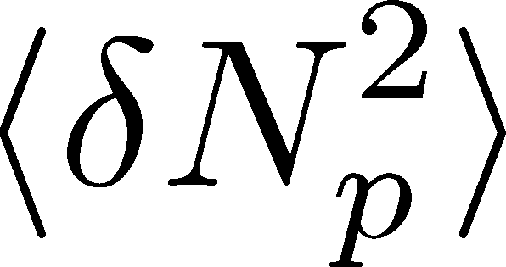
<δN_{B}²> and < δN_{p}² > @ LHC ?
should have different Δη dependence.
Baryon # cumulants are experimentally observable! MK, Asakawa, 2011;2012

Slide 17
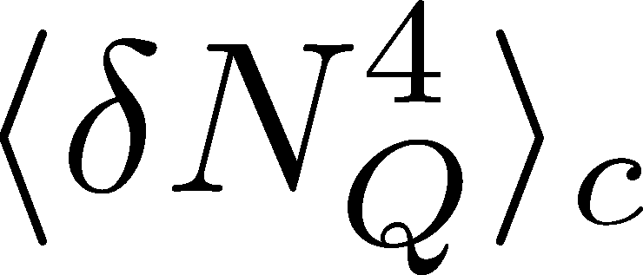

<δN_{Q}⁴> @ LHC ?
How does behave as a function of Δη?
suppression
or
enhancement

Slide 18
Three “NON”s
Physics of non-Gaussianity in heavy-ion
collision is a particular problem!
Non-Gaussian
Non-critical
Non-equilibrium
Non-Gaussianitiy is
irrelevant in large systems
Critical enhancement is
not observed in HIC so far
Fluctuations are not
equilibrated in HIC

Slide 19

Hydrodynamic Fluctuations
Landau, Lifshitz, Statistical Mechaniqs II
Kapusta, Muller, Stephanov, 2012
Stephanov, Shuryak, 2001
Stochastic diffusion equation
Markov (temporary local)
+
continuity
Gaussian fluctuation
in equilibrium
Gaussian

Slide 20
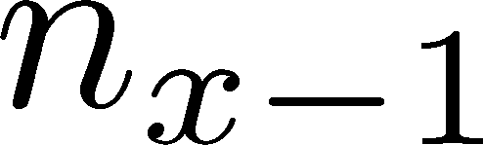






Diffusion Master Equation
Divide spatial coordinate into discrete cells
probability

Slide 21
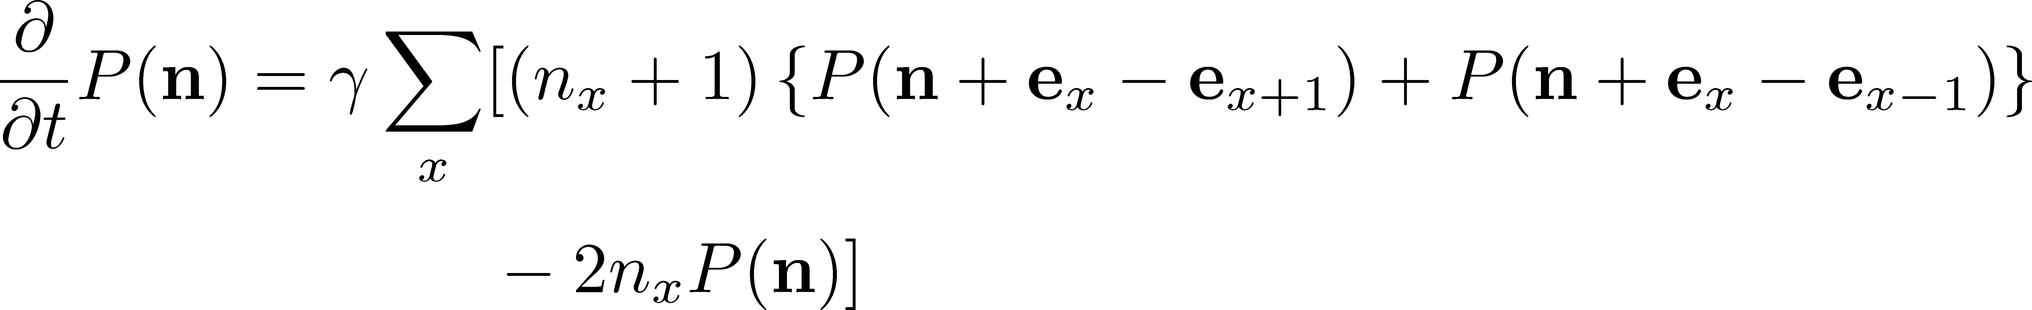
Diffusion Master Equation
Divide spatial coordinate into discrete cells
probability
Master Equation for P(n)
Solve the DME exactly, and take a→0 limit
No approx., ex. van Kampen’s system size expansion

Slide 22
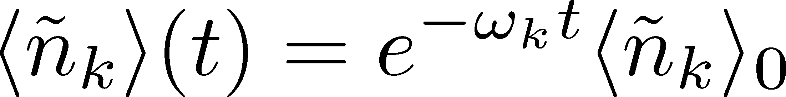
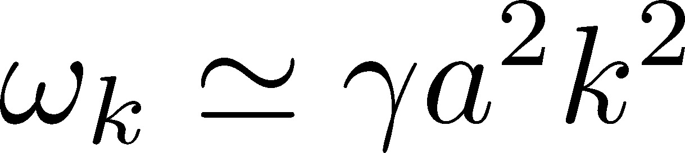
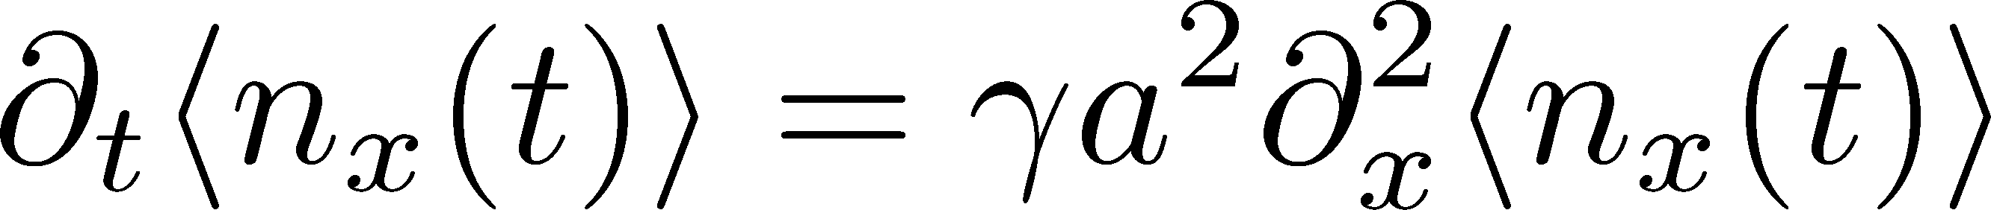
Solution of DME
1st
initial
Deterministic part ←→ diffusion equation
at long wave length (1/a<<k)
Appropriate continuum limit with γa²=D

Slide 23
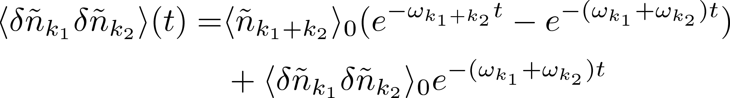
Solution of DME
1st
initial
Deterministic part ←→ diffusion equation
at long wave length (1/a<<k)
Appropriate continuum limit with γa²=D
2nd
Consistent with stochastic diffusion eq.
(for smooth initial condition)
Shuryak, Stephanov, 2001

Slide 24

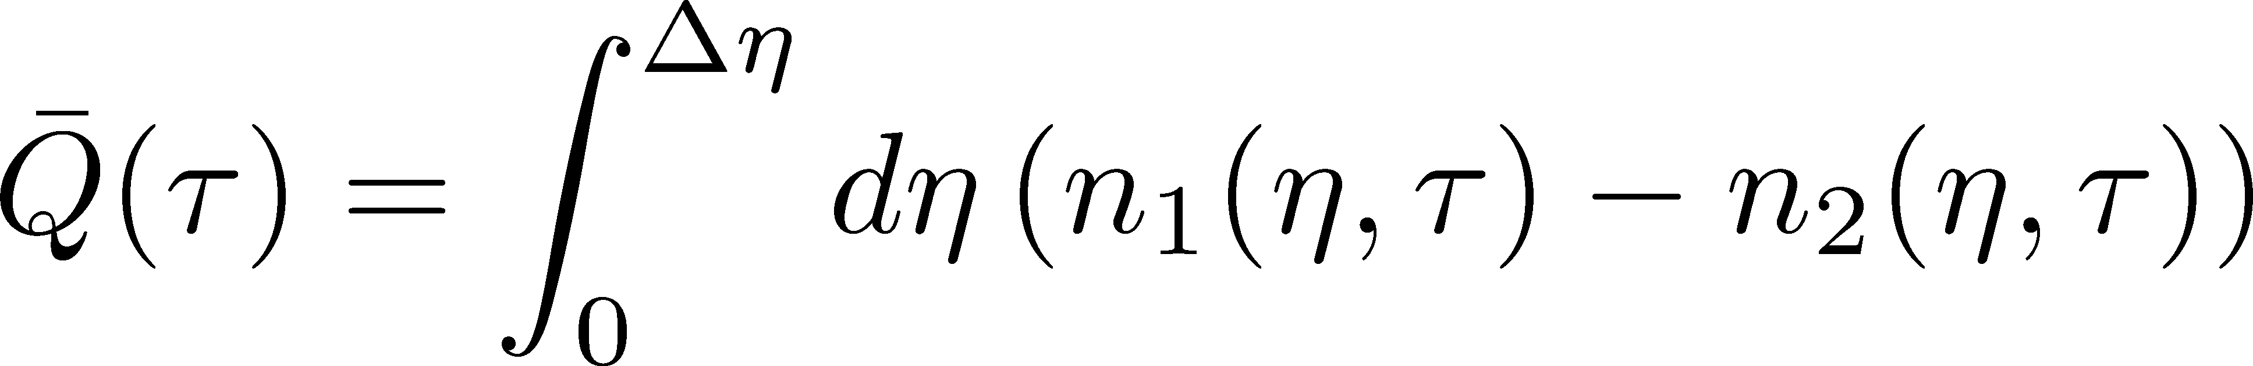
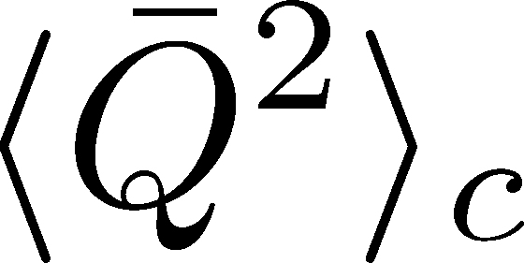
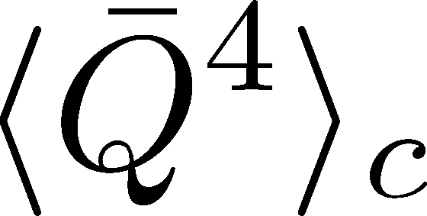
Net Charge Number
Prepare 2 species of (non-interacting) particles
Let us investigate
at freezeout time t

Slide 25

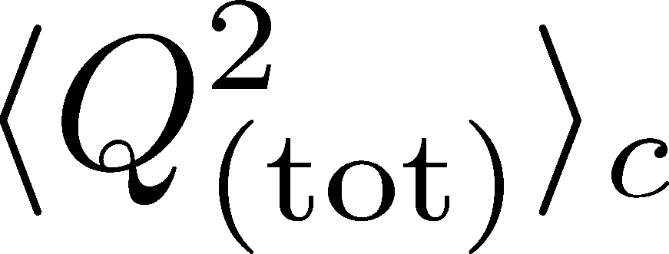
Time Evolution in Hadronic Phase
Hadronization (initial condition)
Boost invariance / infinitely long system
Local equilibration / local correlation
suppression owing to
local charge conservation
strongly dependent on
hadronization mechanism

Slide 26
Time Evolution in Hadronic Phase
Hadronization (initial condition)
Boost invariance / infinitely long system
Local equilibration / local correlation
Time evolution via DME
suppression owing to
local charge conservation
strongly dependent on
hadronization mechanism
Freezeout

Slide 27
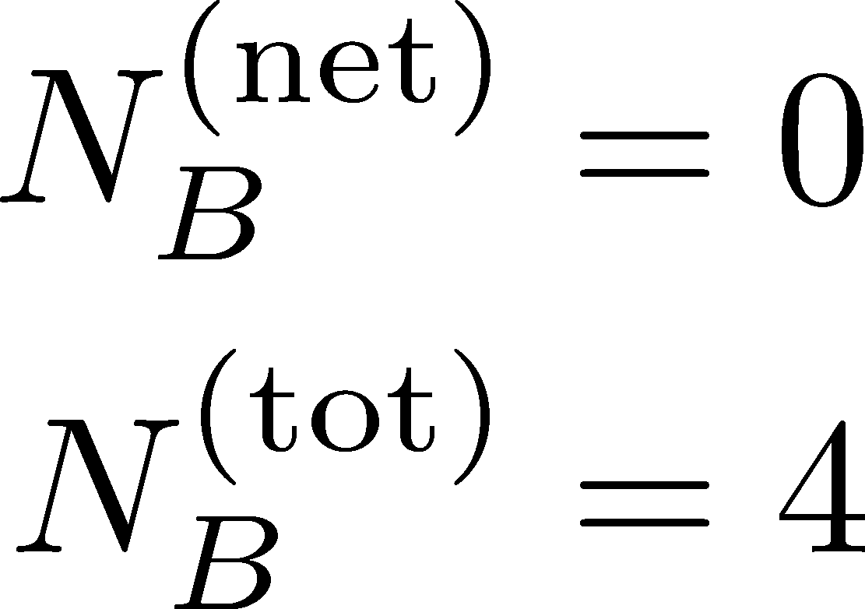
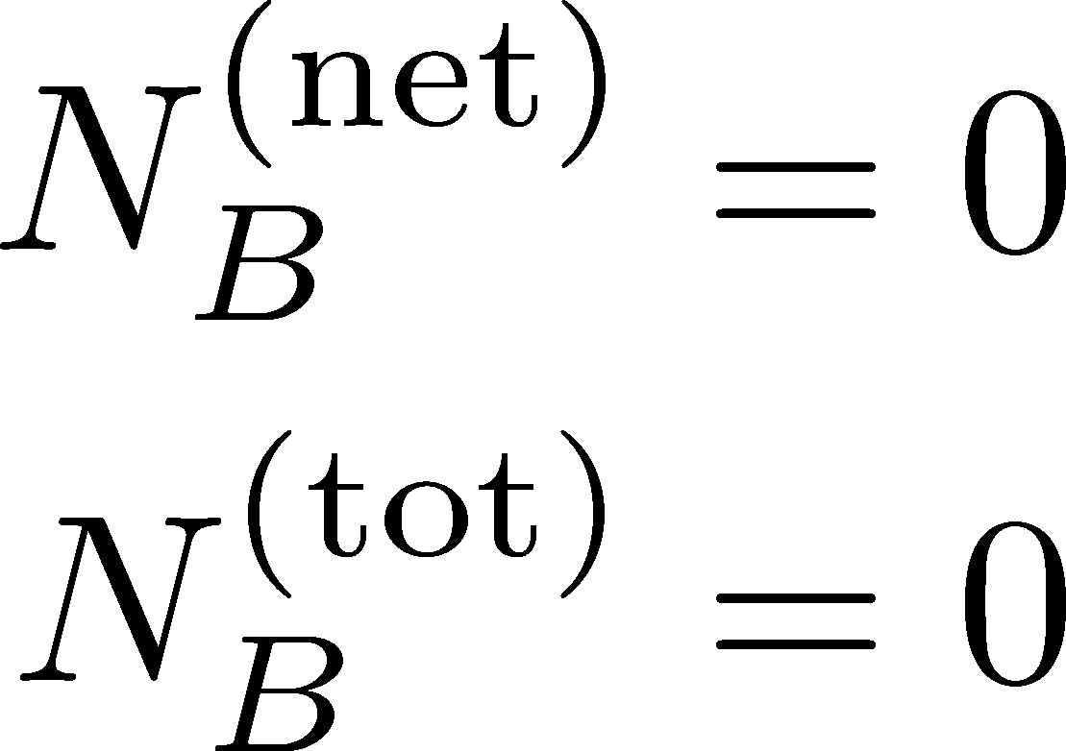
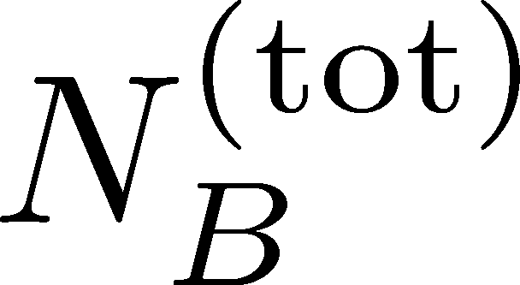
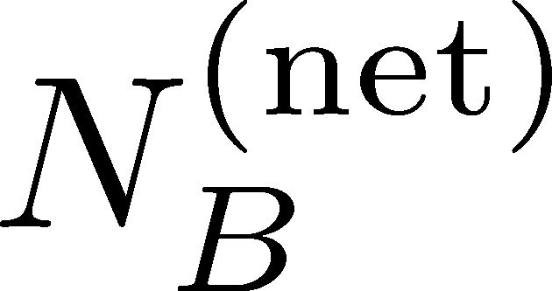
Total Charge Number
In recombination model,
6 quarks
6 antiquarks
can fluctuate, while does not.

Slide 28
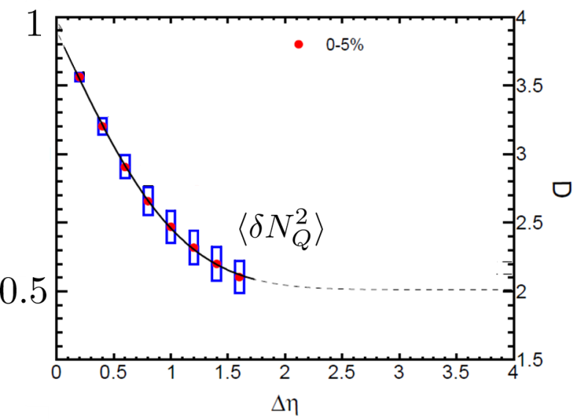



Δη Dependence at Freezeout
Initial fluctuations:
2nd
4th
parameter
sensitive to
hadronization

Slide 29
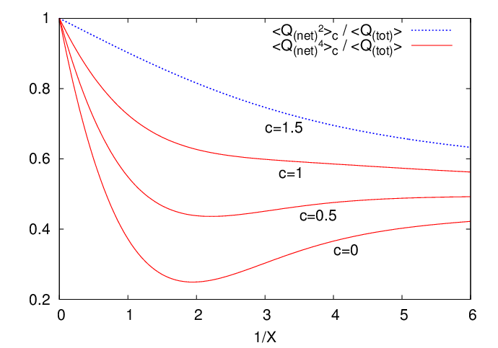
Δη Dependence at Freezeout
Initial fluctuations:
2nd
4th
parameter
sensitive to
hadronization

Slide 30
<δN_{Q}⁴> @ LHC
boost invariant system
small fluctuations of CC at hadronization
short correlation in hadronic stage
Assumptions
1
4th-order cumulant will be suppressed at LHC energy!
Δη dependences encode various information on the dynamics of HIC!
0.5

Slide 31
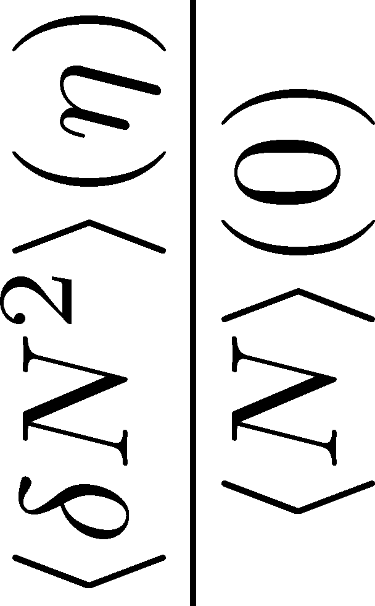
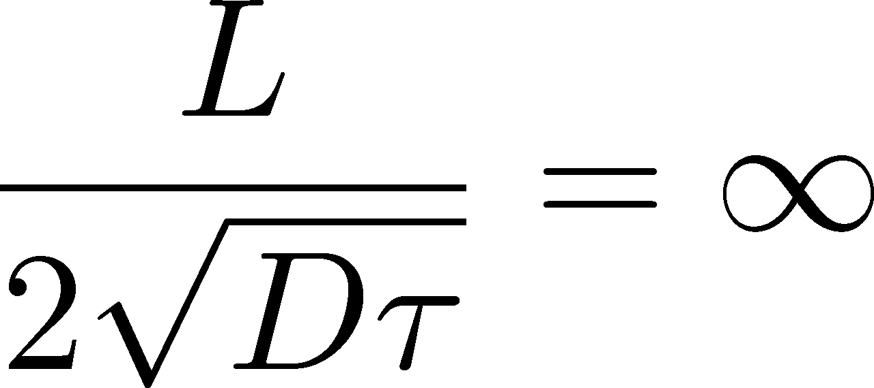

Global Charge Conservation
坂井田、26日ポスター
HICで作られたQGPは有限系
有限長さLの系でゆらぎの時間発展を解く
系の長さL が大きいと、Δη<<Lの領域は境界の影響を受けない
有限体積効果は、Δη依存性から読み取ることができる
ALICEの結果は、 有限体積効果が寄与していないことを示唆

Slide 32
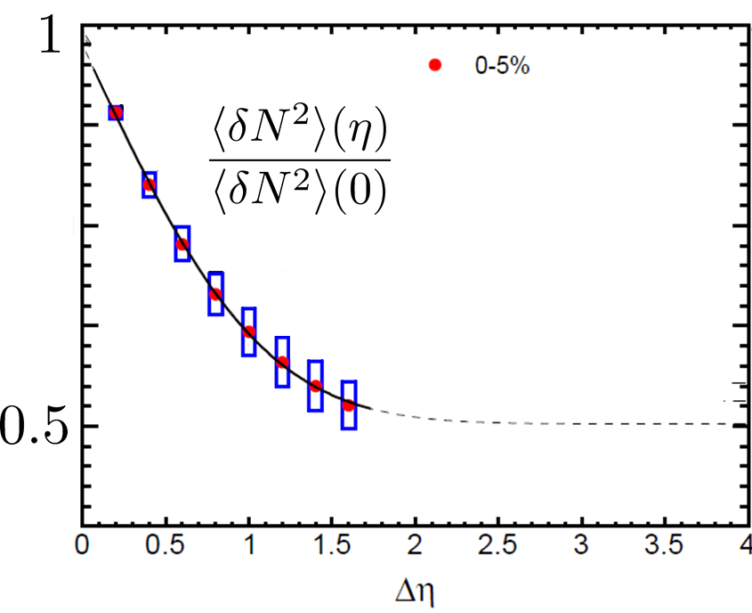
Global Charge Conservation
坂井田、26日ポスター
HICで作られたQGPは有限系
有限長さLの系でゆらぎの時間発展を解く
系の長さL が大きいと、Δη<<Lの領域は境界の影響を受けない
有限体積効果は、Δη依存性から読み取ることができる
ALICEの結果は、 有限体積効果が寄与していないことを示唆

Slide 33
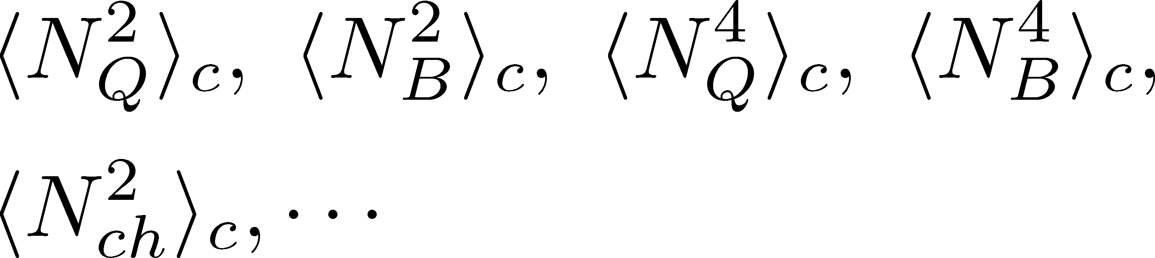
Summary
Plenty of physics in Δη dependences of
various cumulants
Diagnosing dynamics of HIC
history of hot medium
mechanism of hadronization
diffusion constant
Physical meanings
of fluctuation obs.
in experiments.

Slide 34
Summary
Plenty of physics in Δη dependences of
various cumulants
Diagnosing dynamics of HIC
history of hot medium
mechanism of hadronization
diffusion constant
Physical meanings
of fluctuation obs.
in experiments.
Search of QCD Phase Structure

Slide 35
Open Questions & Future Work
Why the primordial fluctuations are observed only at LHC, and not RHIC ?
Extract more information on each stage of fireballs using fluctuations
Model refinement
Including the effects of
nonzero correlation length / relaxation time
global charge conservation
Non Poissonian system ← interaction of particles

Slide 36
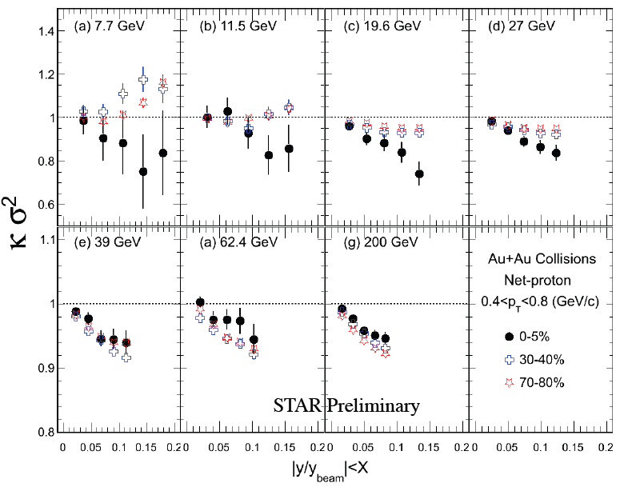
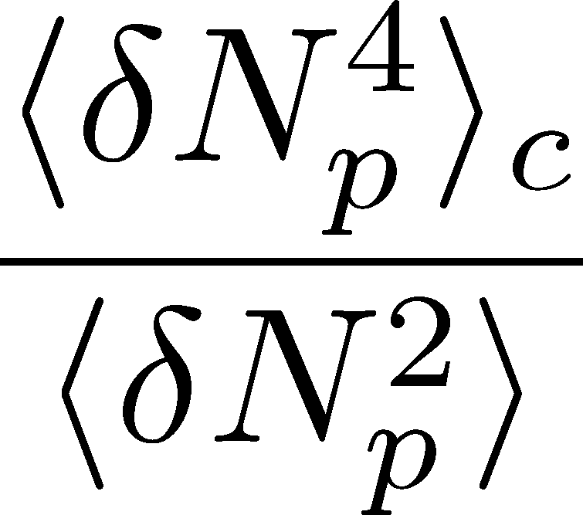
Δη Dependence at STAR
STAR, QM2012
decreases as Δη becomes larger at RHIC energy.

Slide 37



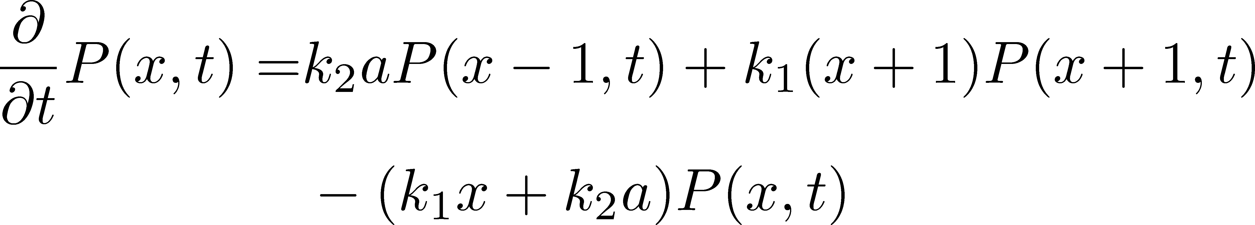

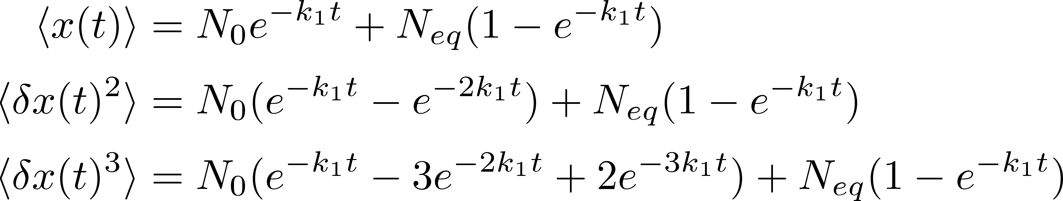
Chemical Reaction 1
x: # of X
a: # of A (fixed)
Master eq.:
Cumulants with fixed initial condition
initial
equilibrium

Slide 38
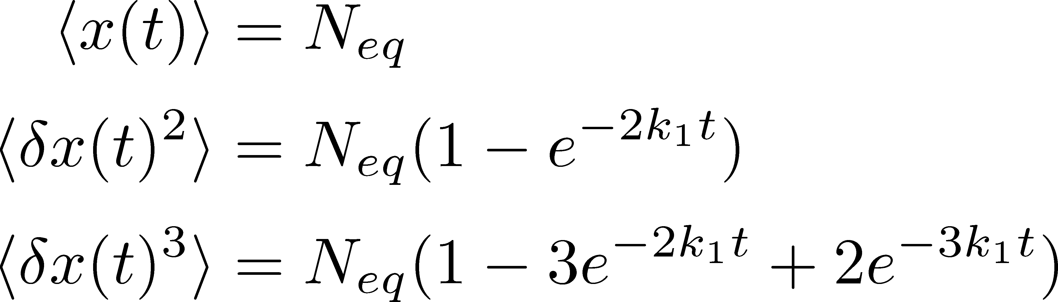

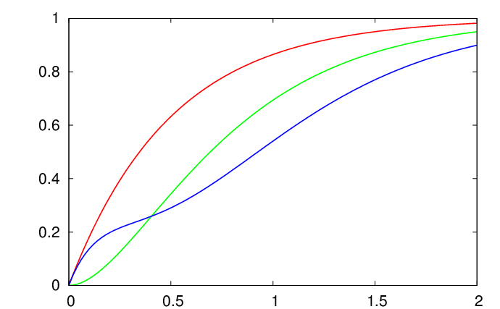
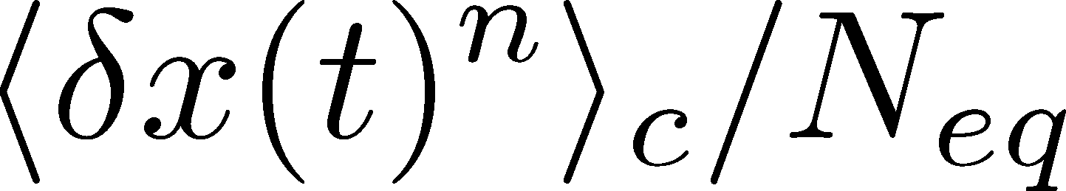

Chemical Reaction 2
2nd
3rd
4th
Higher-order
cumulants
grow slower.

Slide 39
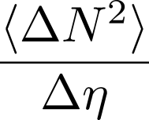




Time Evolution in HIC
Quark-Gluon Plasma
Hadronization
Freezeout

Slide 40
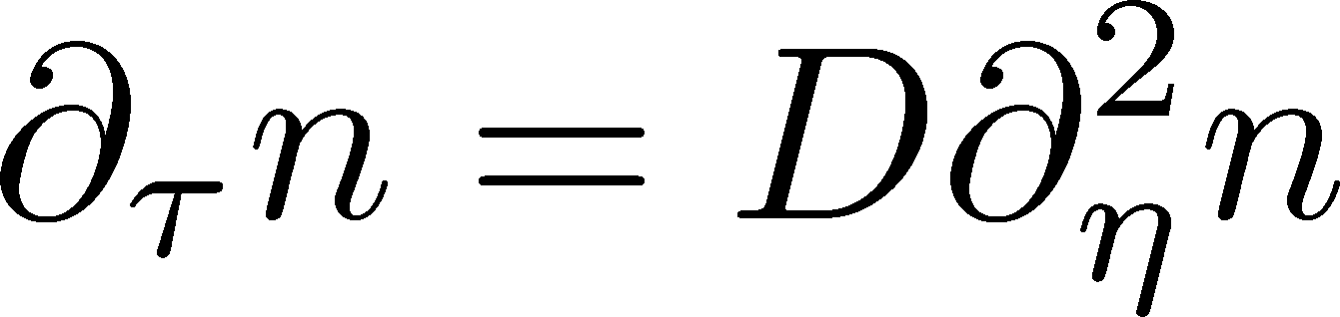
Hydrodynamic Fluctuations
Landau, Lifshitz, Statistical Mechaniqs II
Kapusta, Muller, Stephanov, 2012
Diffusion equation
Stochastic diffusion equation
Stochastic Force
determined by fluctuation-dissipation relation

Slide 41
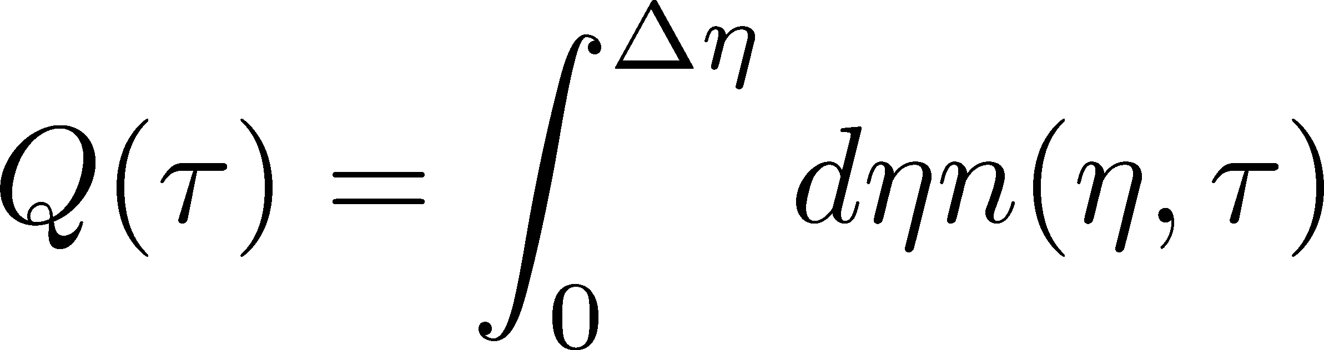
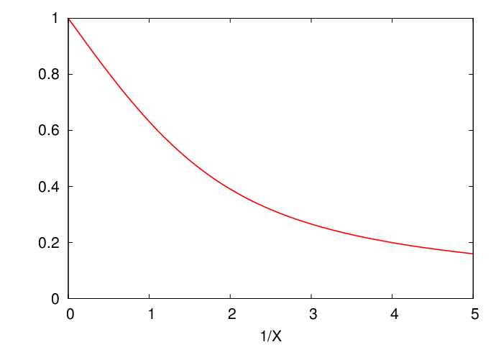
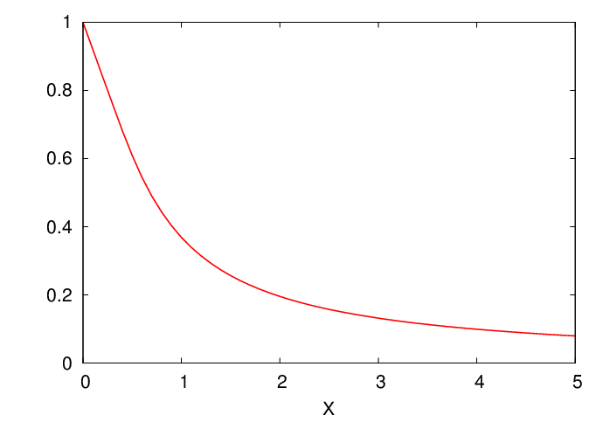
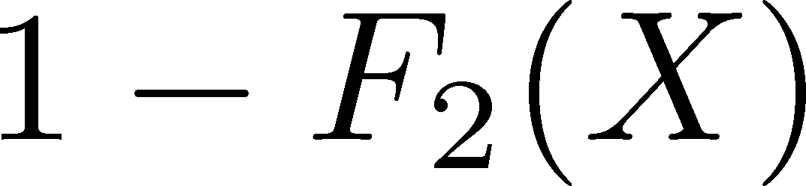


Δη Dependence
Shuryak, Stephanov, 2001
Initial condition:
Translational invariance
initial
equilibrium
equilibrium
initial

Slide 42
Non-Gaussianity in Fluctuating Hydro?
It is impossible to directly extend the theory
of hydro fluctuations to treat higher orders.
No a priori extension of FD relations to higher orders
Markov process＋continuous variable
Theorem
➔Gaussian random force
cf) Gardiner, “Stochastic Methods”

Slide 43


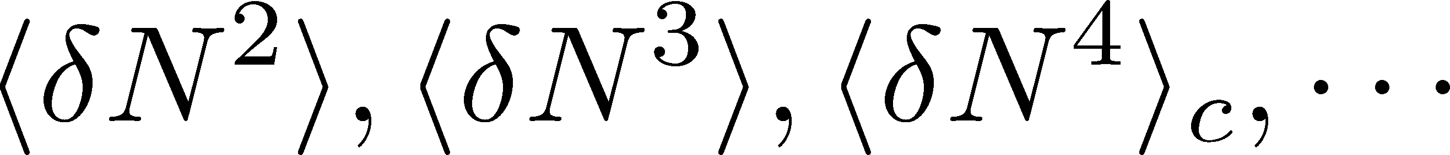
Event-by-Event Analysis @ HIC
Fluctuations can be measured by e-by-e analysis in HIC.
STAR, PRL105 (2010)
Detector

Slide 44
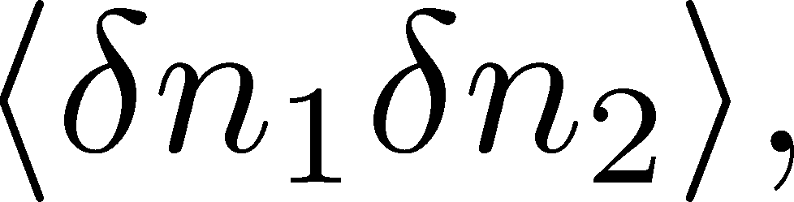
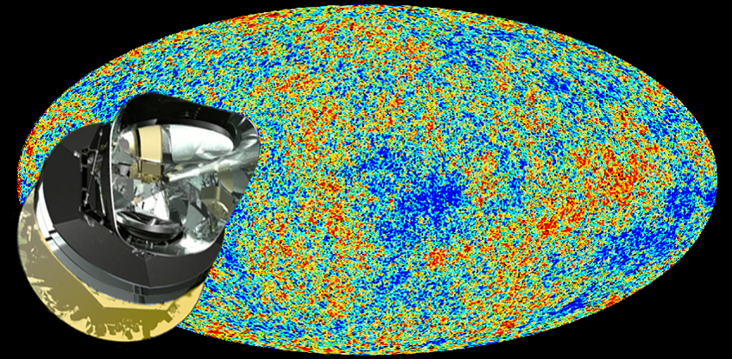
Non-Gaussianity
fluctuations (correlations)
Non-Gaussianity
PLANCK
: statistics insufficient to see non-Gaussianity…(2013)

