Slide 1
重イオン衝突における
保存電荷ゆらぎの
ダイナミクス
北沢 正清
（阪大）
第17回Heavy Ion Pub, 広島大学、2013/Sep./13

Slide 2
Beam-Energy Scan
T
Hadrons
Color SC
0
μ

Slide 3

Beam-Energy Scan
STAR 2012
high
beam energy
T
low
Hadrons
Color SC
0
μ

Slide 4
Fluctuations
Observables in equilibrium are fluctuating.
P(N)
N
V
N

Slide 5
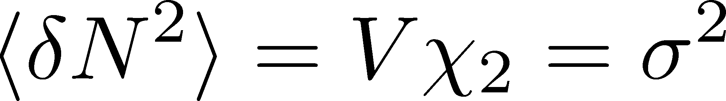

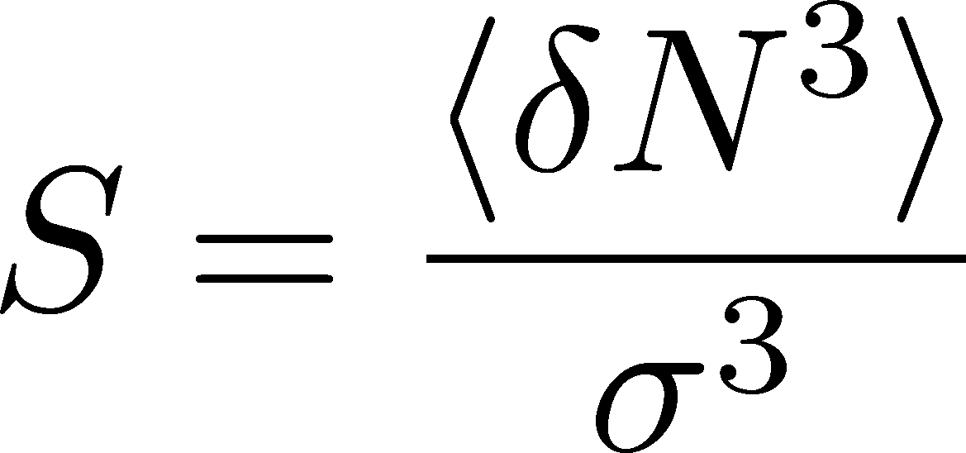
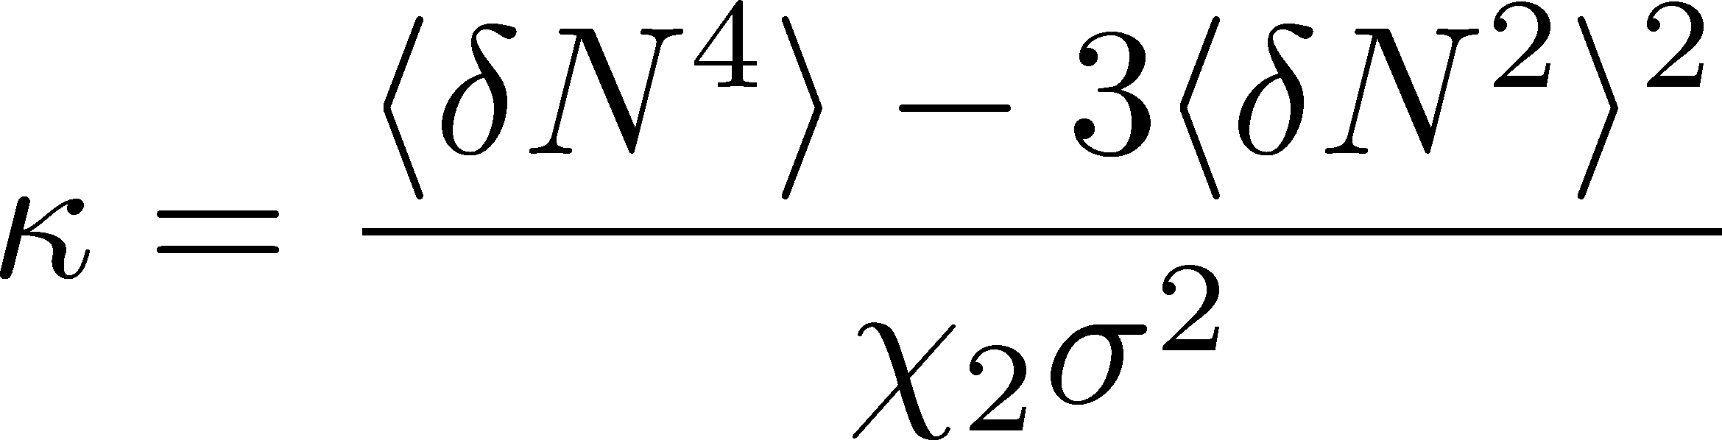
Fluctuations
Observables in equilibrium are fluctuating.
P(N)
N
V
N
Variance:
Non-Gaussianity
Skewness:
Kurtosis:

Slide 6

Event-by-Event Analysis @ HIC
Fluctuations can be measured by e-by-e analysis in experiments.
V
Detector

Slide 7

Event-by-Event Analysis @ HIC
Fluctuations can be measured by e-by-e analysis in experiments.
STAR, PRL105 (2010)
Detector

Slide 8
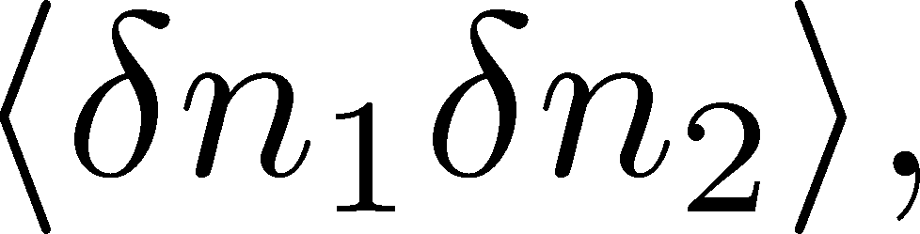
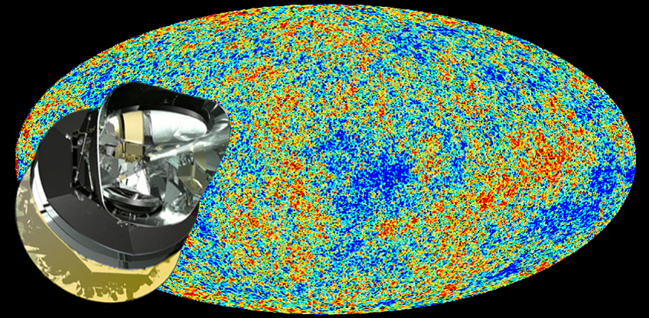
Non-Gaussianity in CMB
fluctuations (correlations)
Non-Gaussianity
PLANCK
: statistics insufficient to see non-Gaussianity…(2013)

Slide 9

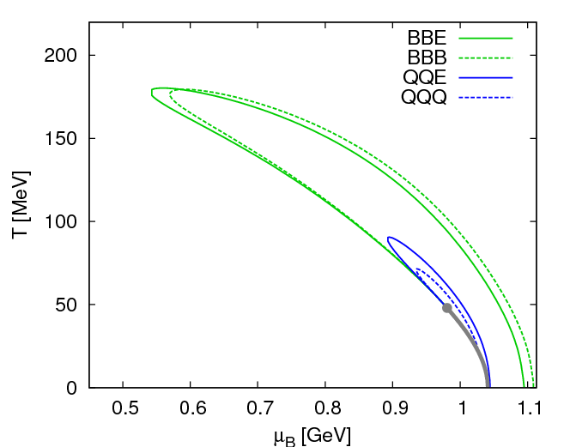
Fluctuations
Fluctuations reflect properties of matter.
  Enhancement near the critical point
  Stephanov,Rajagopal,Shuryak(’98); Hatta,Stephanov(’02); Stephanov(’09);…
  Ratios between cumulants of conserved charges
  Asakawa,Heintz,Muller(’00); Jeon, Koch(’00); Ejiri,Karsch,Redlich(’06)
  Signs of higher order cumulants
  Asakawa,Ejiri,MK(’09); Friman,et al.(’11); Stephanov(’11)

Slide 10
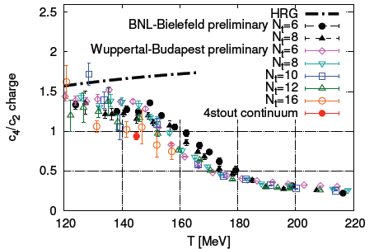
Conserved Charges : Theoretical Advantage
Definite definition for operators
as a Noether current
calculable on any theory
ex: on the lattice

Slide 11
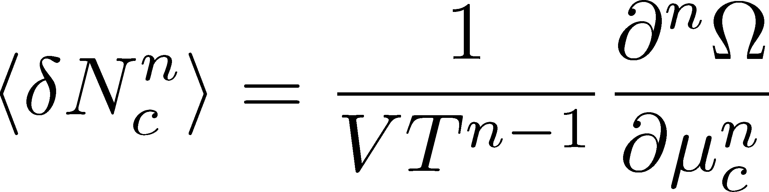

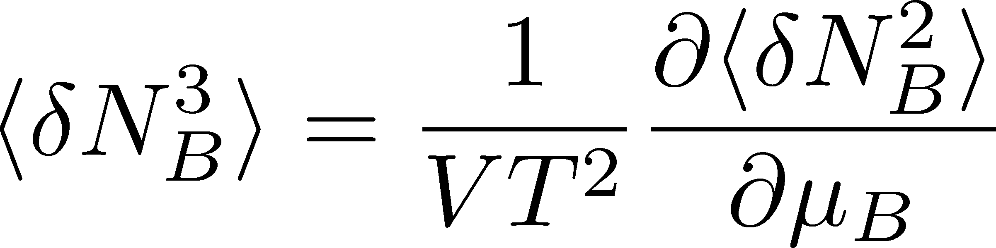
Conserved Charges : Theoretical Advantage
Definite definition for operators
as a Noether current
calculable on any theory
ex: on the lattice
Simple thermodynamic relations
Intuitive interpretation for the behaviors of cumulants
ex:

Slide 12



観測にかかるゆらぎは、いつ形成されたのか？
ゆらぎのダイナミクス（動的振る舞い）の議論が必要
保存電荷の場合
非保存電荷の場合
V
V
境界を通過する電荷
のみが変化に寄与
体積内の任意の場所で
電荷が変化できる
for
for

Slide 13
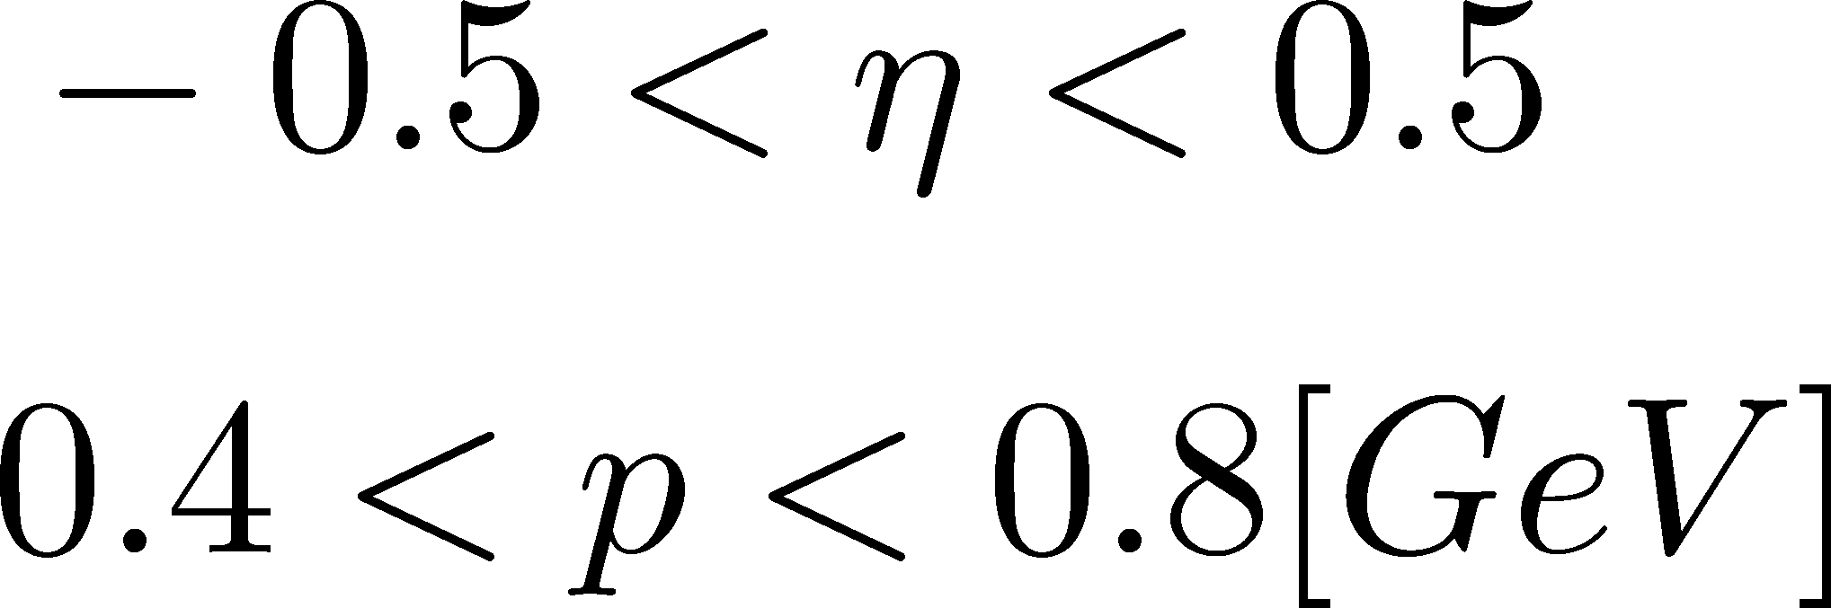
観測にかかるゆらぎは、いつ形成されたのか？
Δη内の保存電荷量は、初期段階のものが終状態まで生き残ることが期待できる。
N_{Q}
Asakawa, Heinz, Muller, ’00
Jeon, Koch, ’00
Shuryak, Stephanov, ’02
Δy
t
Note:
Δy
ＳＴＡＲ
z

Slide 14
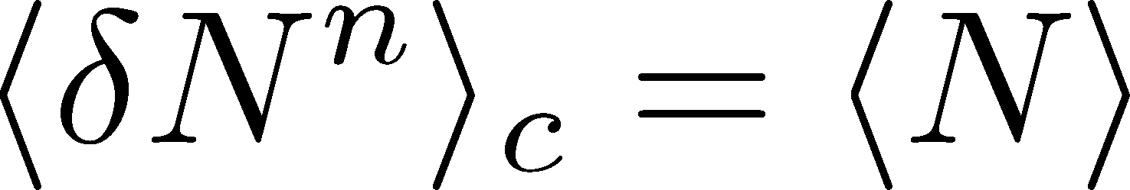
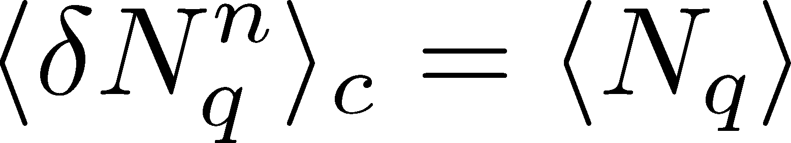
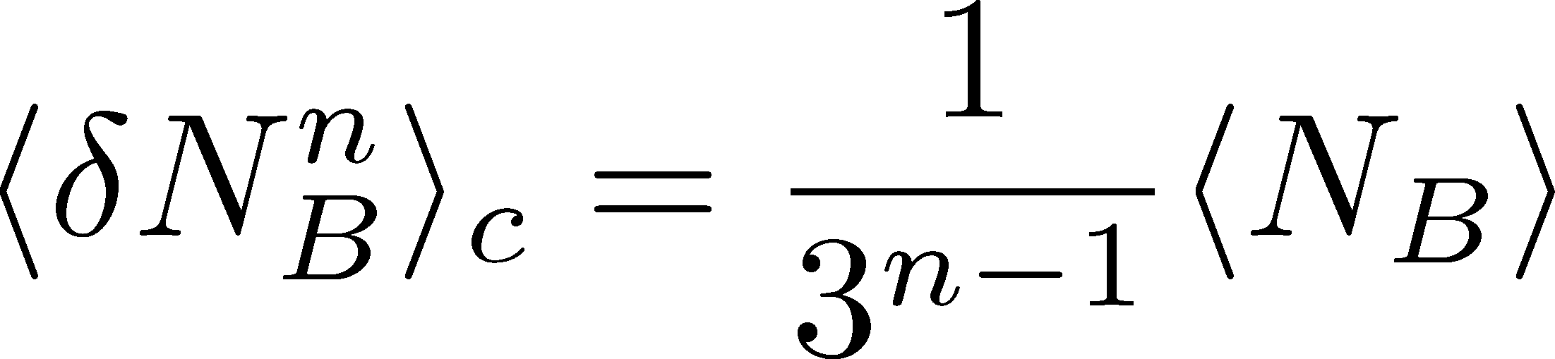
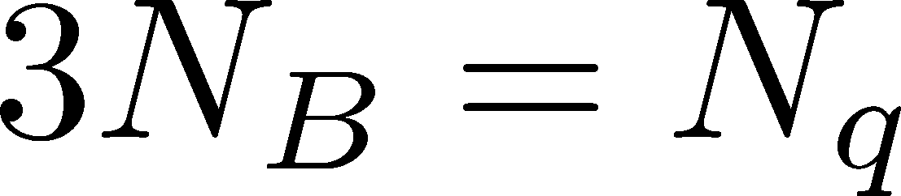
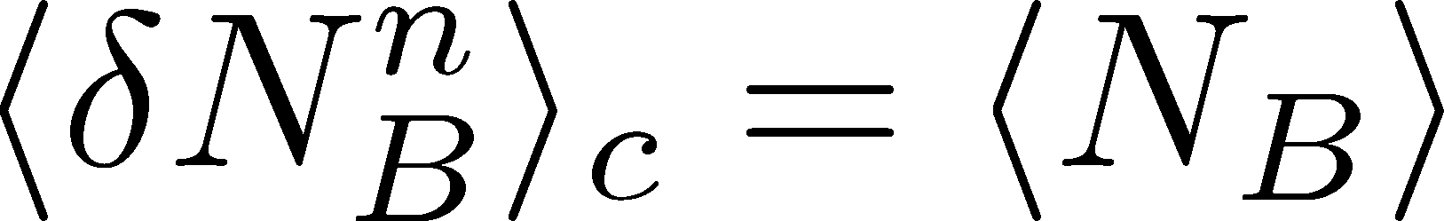
Fluctuations
Free Boltzmann → Poisson

Slide 15
Fluctuations
Free Boltzmann → Poisson
RBC-Bielefeld ’09

Slide 16
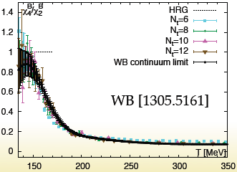
Fluctuations
Free Boltzmann → Poisson
RBC-Bielefeld ’09

Slide 17
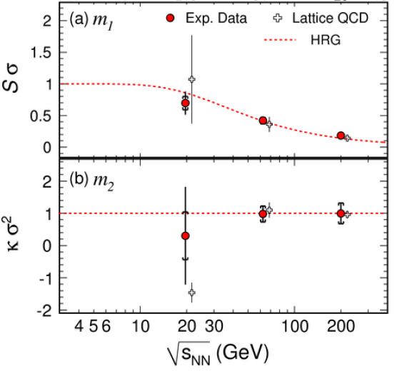
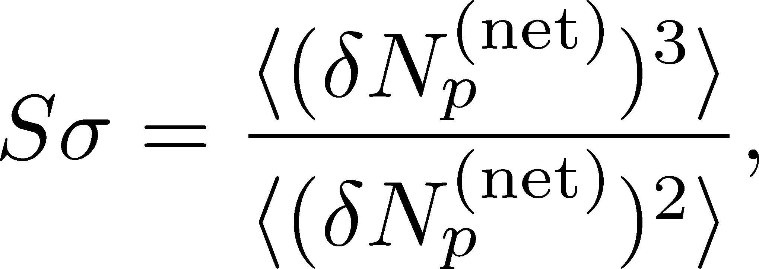
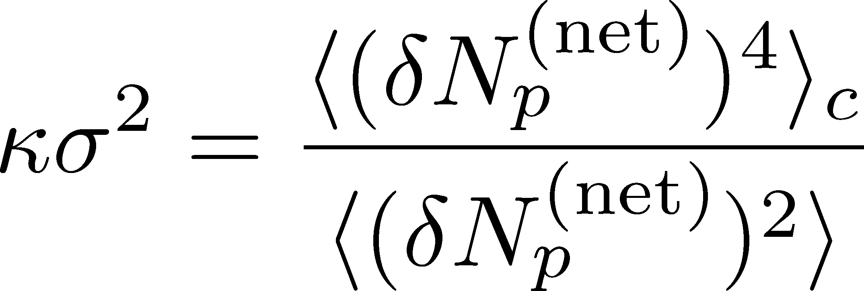
Proton # Fluctuations @ STAR-BES
STAR, PRL2010

Slide 18
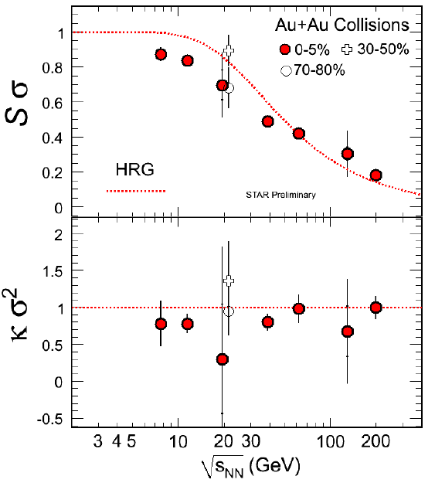
Proton # Fluctuations @ STAR-BES
STAR, PRL2010
STAR, 2011
high μ
low μ

Slide 19
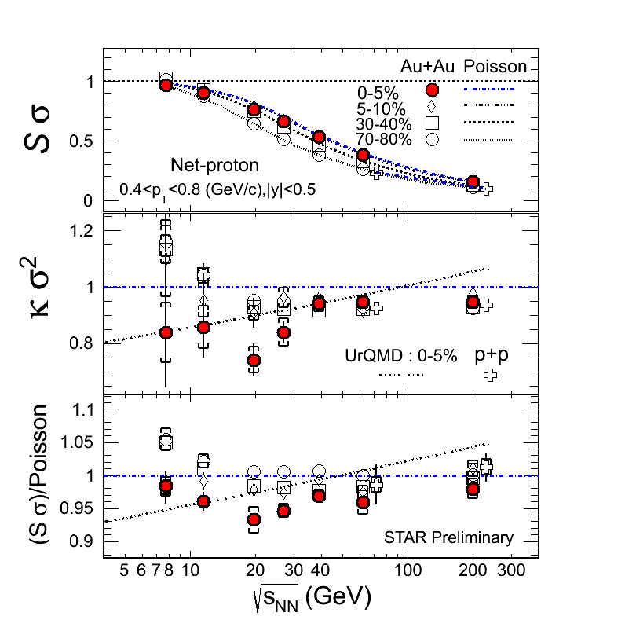
Proton # Fluctuations @ STAR-BES
STAR, 2012 (Quark Matter)
STAR, 2011
high μ
low μ

Slide 20
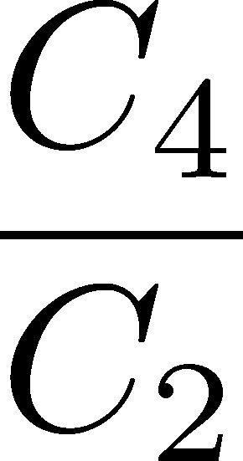
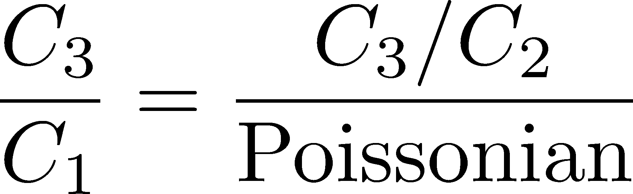


Proton # Cumulants @ STAR-BES
STAR,QM2012
Something
interesting??
CAUTION!
proton number
baryon number
MK, Asakawa, 2011;2012

Slide 21
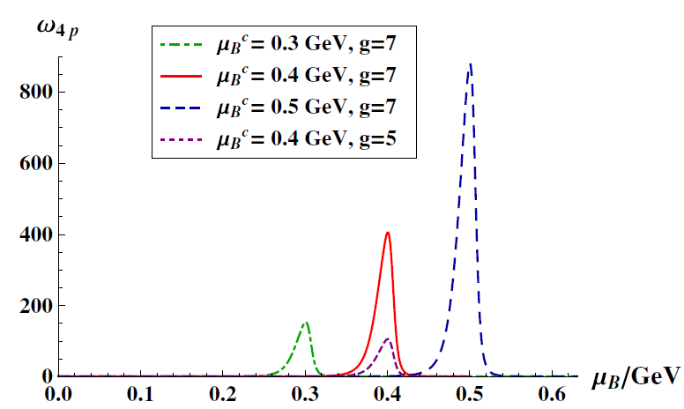
Proton # Cumulants @ STAR-BES
STAR,QM2012
Something
interesting??
Athanasiou, Rajagopal,
Stephanov, 2010
CAUTION!
proton number
baryon number
MK, Asakawa, 2011;2012

Slide 22
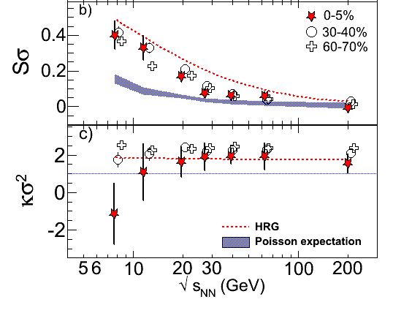
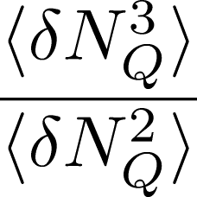
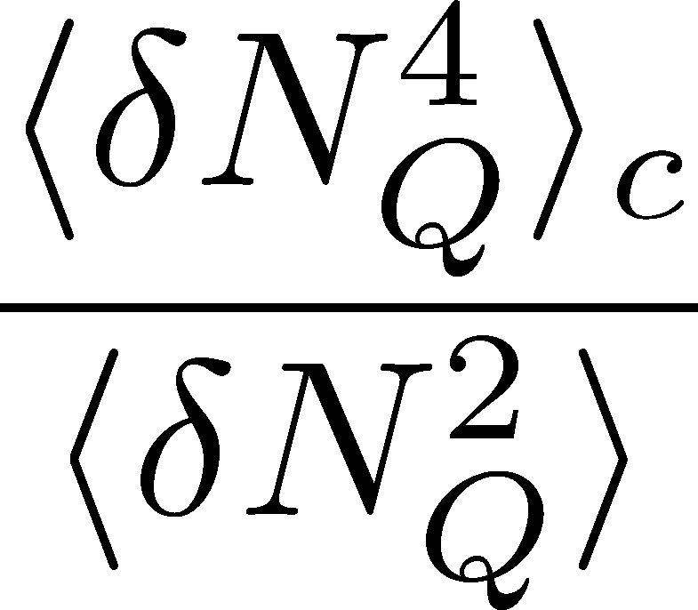
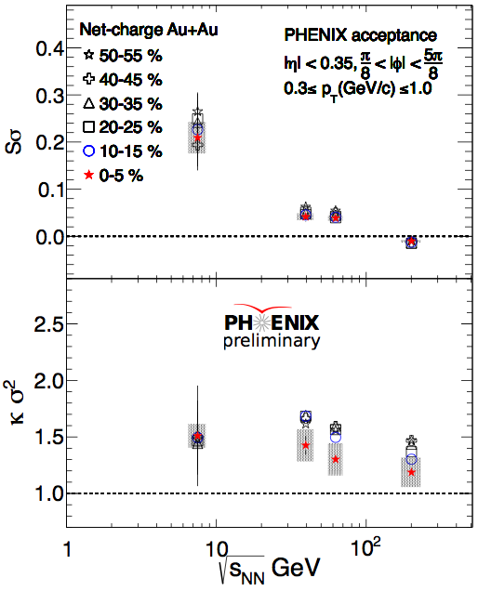
Charge Fluctuations @ STAR-BES
STAR, QM2012
Suppression??
Similar result @ PHENIX
UrQMD

Slide 23
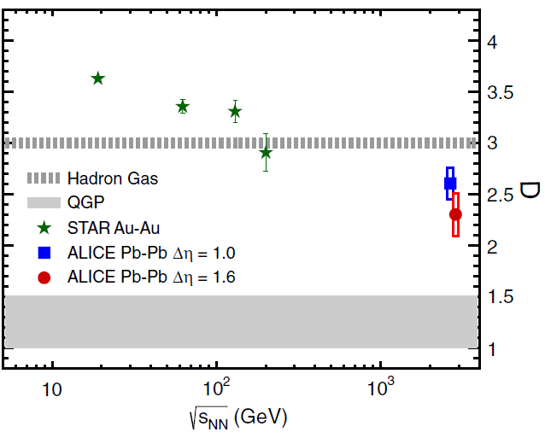

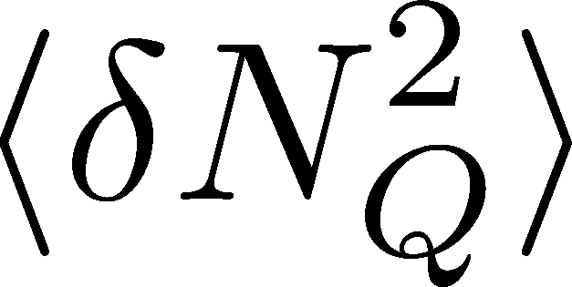
Charge Fluctuation @ LHC
ALICE, PRL110,152301(2013)
D-measure
D ~ 3-4 Hadronic
D ~ 1 Quark
significant suppression
from hadronic value
at LHC energy!
is not equilibrated at freeze-out at LHC energy!

Slide 24

Δη Dependence @ ALICE
ALICE
PRL 2013
t
Δη
z
rapidity window

Slide 25
Time Evolution of CC
t
Δy
N_{Q}
z
Δy
Variation of a conserved charge in Δy is achieved only through diffusion.
The larger Δy, the slower diffusion

Slide 26
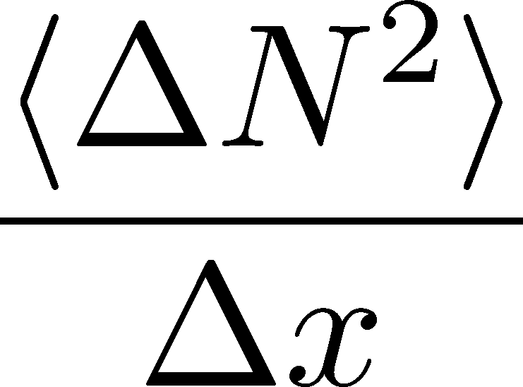




Dissipation of a Conserved Charge

Slide 27
Dissipation of a Conserved Charge

Slide 28
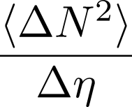




Time Evolution in HIC
Quark-Gluon Plasma
Hadronization
Freezeout

Slide 29
Time Evolution in HIC
Quark-Gluon Plasma
Hadronization
Freezeout

Slide 30
Time Evolution in HIC
Pre-Equilibrium
Quark-Gluon Plasma
Hadronization
Freezeout

Slide 31
Time Evolution in HIC
Pre-Equilibrium
Quark-Gluon Plasma
Hadronization
Freezeout

Slide 32
Δη Dependence @ ALICE
ALICE
PRL 2013
t
Δη
z
ゆらぎのΔη 依存性には、高温物質の
時間発展の歴史が刻まれている！

Slide 33
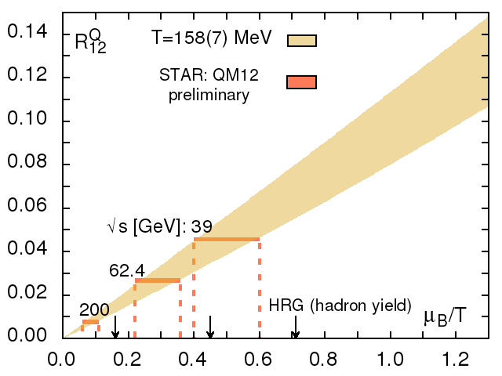
Cumulants : HIC vs Lattice
格子QCDで得られた
ゆらぎ- μ/T 関係線
HotQCD,
LATTICE2013
μ /T
実験の観測値＋格子
化学凍結
不一致

Slide 34
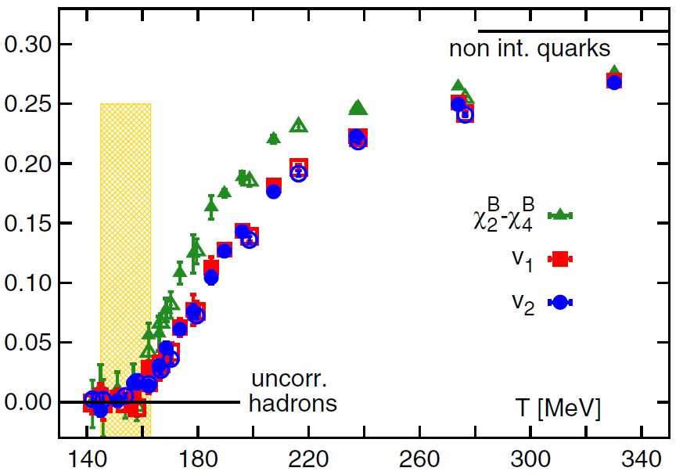
Cumulants as Probes of the Medium
高次キュムラントは、媒質の性質を理解するうえで有用
HotQCD, PRL 2013
ハドロン共鳴ガス(HRG)
模型ではゼロになる量
T<150MeVでの格子データは、HRG描像と矛盾しない

Slide 35
Time Evolution of
Higher Order Cumulants
MK, Asakawa, Ono, arXiv:1307.2978
Sakaida, Asakawa, MK, in progress

Slide 36
Δη Dependence @ ALICE
ALICE
PRL 2013
t
Δη
z
ゆらぎのΔη 依存性には、高温物質の
時間発展の歴史が刻まれている！

Slide 37



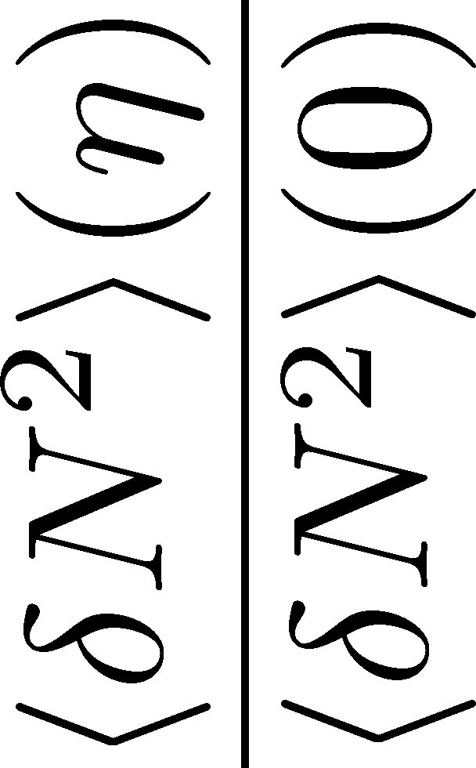
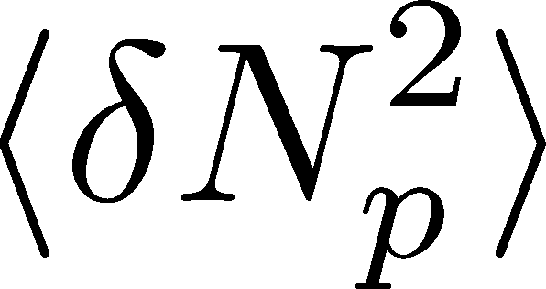


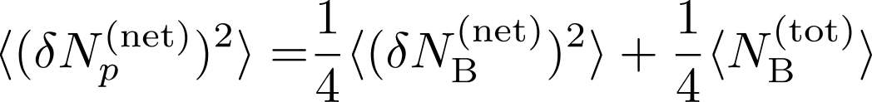
<δN_{B}²> and < δN_{p}² > @ LHC ?
should have different Δη dependence.

Slide 38
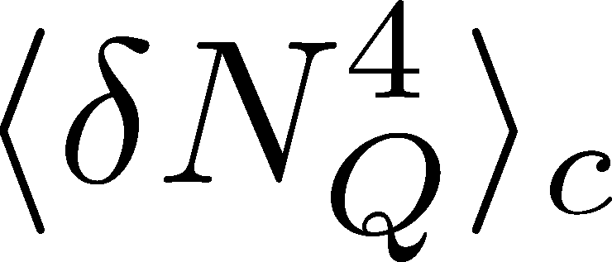

<δN_{Q}⁴> @ LHC ?
How does behave as a function of Δη?
suppression
or
enhancement

Slide 39
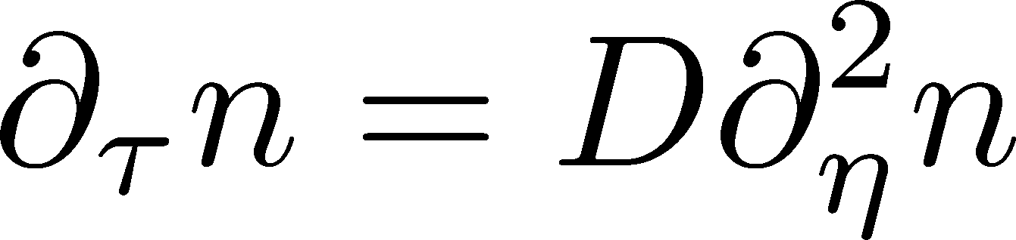

Hydrodynamic Fluctuations
Landau, Lifshitz, Statistical Mechaniqs II
Kapusta, Muller, Stephanov, 2012
Diffusion equation
Stochastic diffusion equation

Slide 40
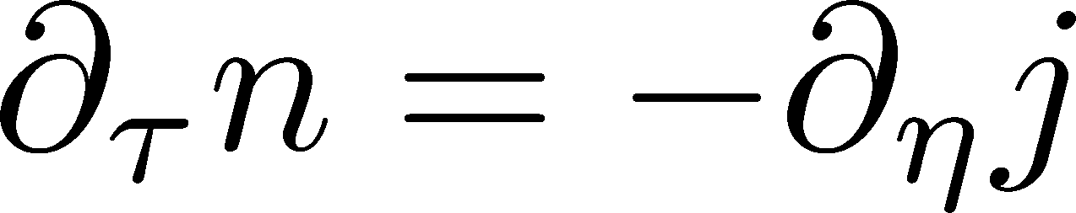
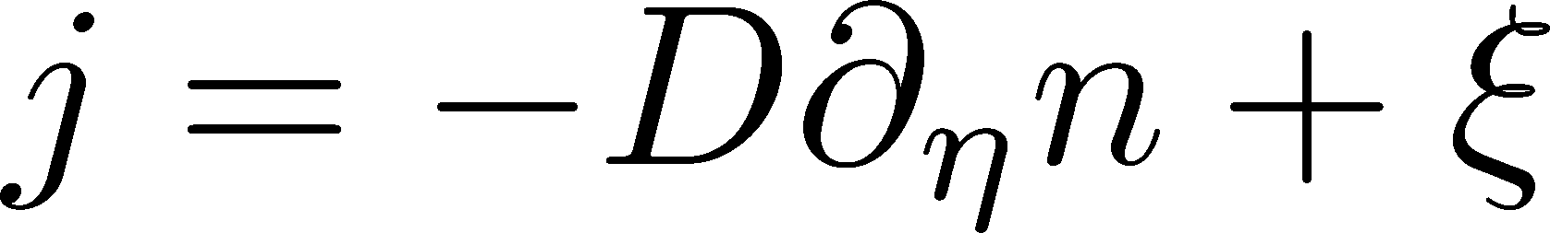
Hydrodynamic Fluctuations
Landau, Lifshitz, Statistical Mechaniqs II
Kapusta, Muller, Stephanov, 2012
Diffusion equation
Stochastic diffusion equation
Conservation Law
Fick’s Law

Slide 41
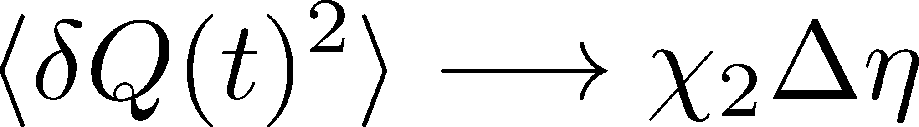
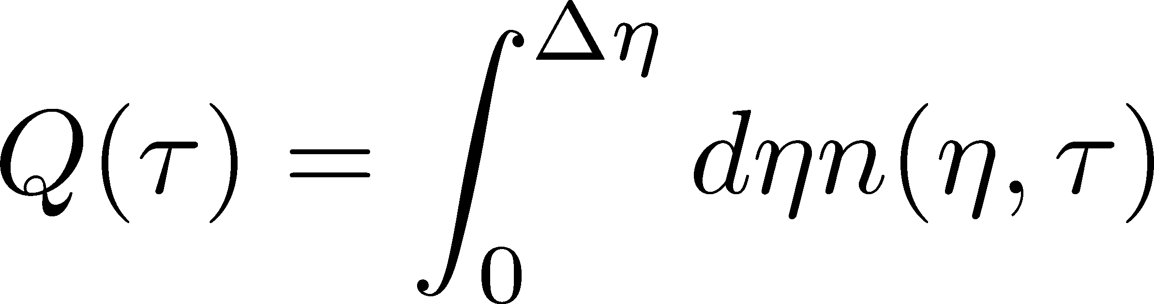
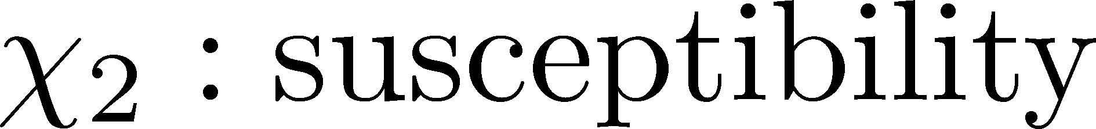
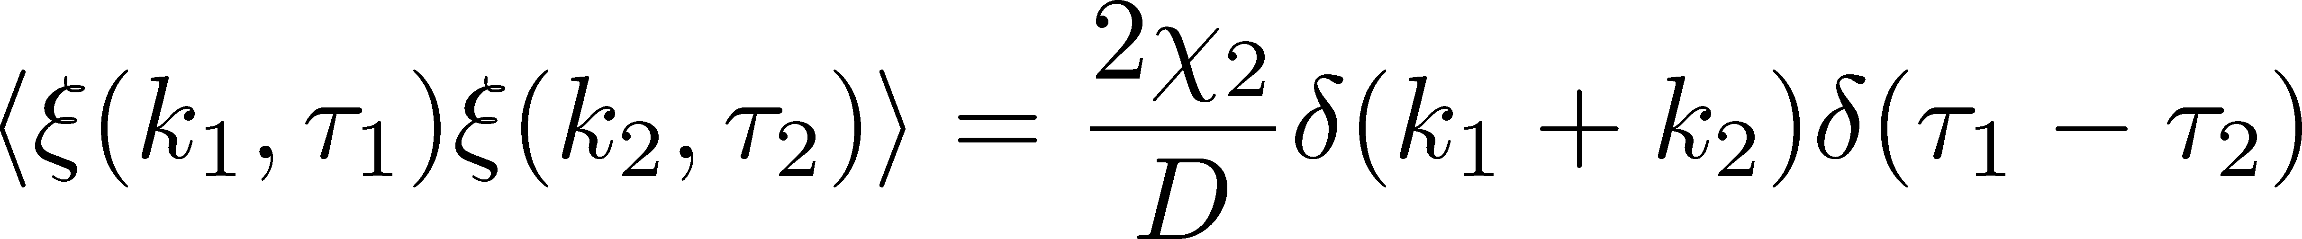
Fluctuation-Dissipation Relation
Stochastic force
Local correlation
(hydrodynamics)
Equilibrium fluc.

Slide 42


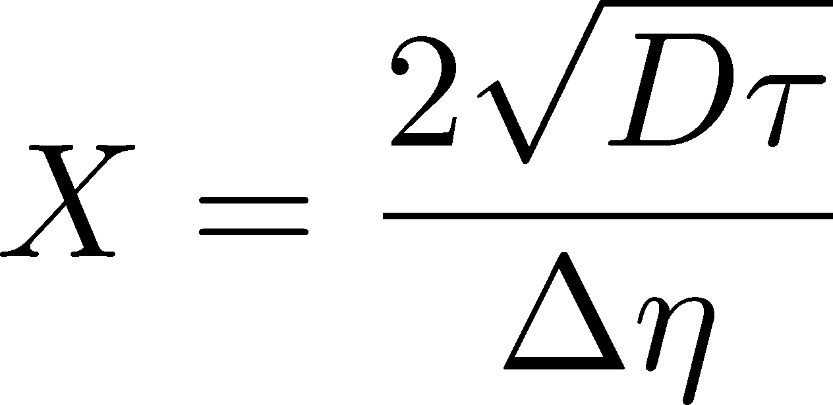
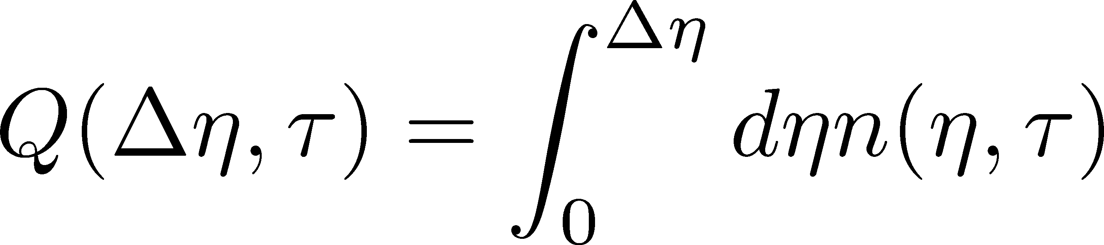
Δη Dependence
Initial condition:
Translational invariance

Slide 43
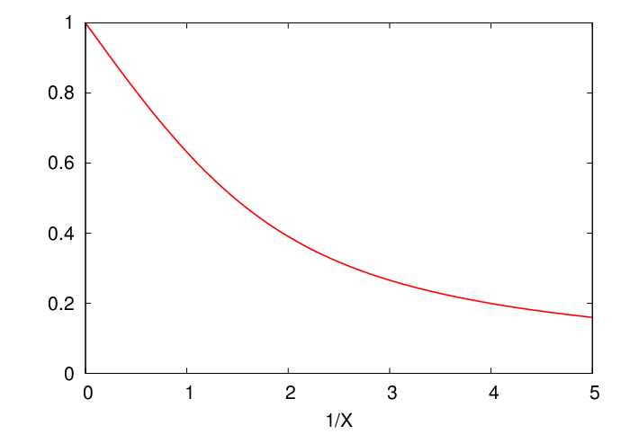
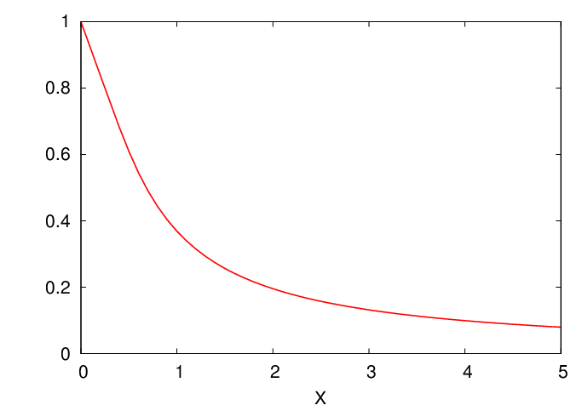

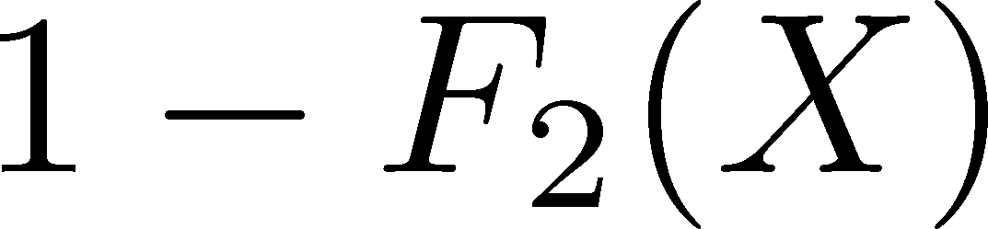

Δη Dependence
Shuryak, Stephanov, 2001
Initial condition:
Translational invariance
initial
equilibrium
equilibrium
initial

Slide 44


Non-Gaussian Stochastic Force ??
Stochastif Force : 3rd order
Local correlation
(hydrodynamics)
Equilibrium fluc.

Slide 45

Caution!
diverge in long wavelength
No a priori extension of FD relation to higher orders

Slide 46
Caution!
diverge in long wavelength
No a priori extension of FD relation to higher orders
Markov process＋continuous variable
Theorem
➔Gaussian random force
cf) Gardiner, “Stochastic Methods”
Hydrodynamics
Local equilibrium with many particles
Gaussian due to central limit theorem

Slide 47
Thee “NON”s
重イオン衝突での高次ゆらぎの観測・解析は、
物理学として相当に特殊な問題である。
Non-Gaussian
通常、高次ゆらぎは観測困難。
適度に小さい系

Slide 48
Thee “NON”s
重イオン衝突での高次ゆらぎの観測・解析は、
物理学として相当に特殊な問題である。
Non-Gaussian
Non-critical
通常、高次ゆらぎは観測困難。
適度に小さい系
観測されたゆらぎの値は、
自由ガスとたかだか２倍のずれ

Slide 49
Thee “NON”s
重イオン衝突での高次ゆらぎの観測・解析は、
物理学として相当に特殊な問題である。
Non-Gaussian
Non-critical
Non-equilibrium
通常、高次ゆらぎは観測困難。
適度に小さい系
観測されたゆらぎの値は、
自由ガスとたかだか２倍のずれ
平衡に至る非定常過程を
記述する必要性。

Slide 50







Diffusion Master Equation
Divide spatial coordinate into discrete cells
probability

Slide 51

Diffusion Master Equation
Divide spatial coordinate into discrete cells
probability
Master Equation for P(n)
Solve the DME exactly, and take a→0 limit
No approx., ex. van Kampen’s system size expansion

Slide 52



Solution of DME
1st
initial
Deterministic part ←→ diffusion equation
at long wave length (1/a<<k)
Appropriate continuum limit with γa²=D

Slide 53

Solution of DME
1st
initial
Deterministic part ←→ diffusion equation
at long wave length (1/a<<k)
Appropriate continuum limit with γa²=D
2nd
Consistent with stochastic diffusion eq.
(for smooth initial condition)

Slide 54




Net Charge Number
Prepare 2 species of (non-interacting) particles
Let us investigate
at freezeout time t

Slide 55


Time Evolution in Hadronic Phase
Hadronization (initial condition)
Boost invariance / infinitely long system
Local equilibration / local correlation
suppression owing to
local charge conservation
strongly dependent on
hadronization mechanism

Slide 56
Time Evolution in Hadronic Phase
Hadronization (initial condition)
Boost invariance / infinitely long system
Local equilibration / local correlation
Time evolution via DME
suppression owing to
local charge conservation
strongly dependent on
hadronization mechanism
Freezeout

Slide 57




Total Charge Number
In recombination model,
6 quarks
6 antiquarks
can fluctuate, while does not.

Slide 58




Δη Dependence at Freezeout
Initial fluctuations:
2nd
4th
parameter
sensitive to
hadronization

Slide 59

Δη Dependence at Freezeout
Initial fluctuations:
2nd
4th
parameter
sensitive to
hadronization

Slide 60
<δN_{Q}⁴> @ LHC
boost invariant system
small fluctuations of CC at hadronization
short correlation in hadronic stage
Assumptions
1
4th-order cumulant will be suppressed at LHC energy!
Δη dependences encode various information on the dynamics of HIC!
0.5

Slide 61


Δη Dependence at STAR
STAR, QM2012
decreases as Δη becomes larger at RHIC.

Slide 62



Global Charge Conservation
坂井田、et al., in prep.
HICで作られたQGPは有限系
全系を観測すれば、保存電荷はゆらがない
N_{Q}
有限体積効果の考慮？？

Slide 63


Diffusion Equation w/ Boundaries
拡散方程式を、境界条件付きで解く
3 Free Parameters

Slide 64





Global Charge Conservation
：固定

Slide 65

Global Charge Conservation
：固定
系の長さL が大きいと、Δη<<Lの領域は境界の影響を受けない
時間が十分経過すると、二項分布に漸近
（熱平衡化）

Slide 66






Global Charge Conservation
：固定
有限体積効果は、Δη依存性から読み取ることができる
ALICEの結果には、 有限体積効果はほとんど寄与しない

Slide 67

Global Charge Conservation
：固定
観測可能
領域
有限体積効果は、Δη依存性から読み取ることができる
ALICEの結果には、 有限体積効果はほとんど寄与しない
STARでは？！？

Slide 68

Summary
Plenty of physics in Δη dependences of
various cumulants
Diagnosing dynamics of HIC
history of hot medium
mechanism of hadronization
diffusion constant
Physical meanings
of fluctuation obs.
in experiments.

Slide 69
Summary
Plenty of physics in Δη dependences of
various cumulants
Diagnosing dynamics of HIC
history of hot medium
mechanism of hadronization
diffusion constant
Physical meanings
of fluctuation obs.
in experiments.
Search of QCD Phase Structure

Slide 70
Summary
Conserved charge fluctuations are observable both in lattice simulations and heavy ion collisions. The comparison of the results in these two “experiments” will provide us many information to understand the QCD at nonzero T/m.
A lot of efforts are required both sides:
  Lattice: Higher statistics
  HIC: reconstructing baryon #, acceptance, etc.
Rapidity window dependences of cumulants in HIC are valuable tools to understand the non-thermal nature of fluctuations.

Slide 71

高温物質の時間発展
熱平衡化
段階での
ゆらぎ
検出器
QGP相内での
時間発展
拡散による
HRGへの接近
初期エネルギー密度
体積ゆらぎ

Slide 72
まとめ
保存量初期ゆらぎの痕跡は終状態に残されており
LHC、RHICで観測にかかり始めている
ただし、RHIC-BES領域では即座にQCD相構造が
直ちに見えるほど明瞭ではないので、
実験的課題
理論的課題
バリオン数ゆらぎの構成
Q₄/Q₂＠ALICE
Dy依存性＠STAR
efficiency, acceptance, …
エネルギーゆらぎ
BES from RHIC to LHC
RHIC D-puzzleの解決
RHIC-BESの結果の解釈
2点相関関数等との比較
新しい観測量の提案

Slide 73

Secondary Protons
MK+, in preparation
Secondary (knockout) protons
20% of observed protons @ STAR
detector
dca [cm]
Measurement
STAR, PRC79,034909(2009)

Slide 74



Secondary Protons
MK+, in preparation
Secondary (knockout) protons
20% of observed protons @ STAR
detector
dca [cm]
Measurement
STAR, PRC79,034909(2009)
Their contribution can be eliminated!

