Slide 1
QCD臨界点付近での
クォークスペクトルについて
北沢正清
（阪大理）
国広悌二、根本幸雄
MK, Kunihiro, Nemoto, in prep.
20aSB4
日本物理学会2013年秋季大会、2013/9/20、高知大学

Slide 2
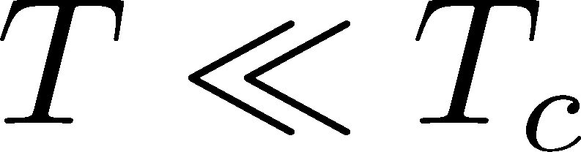
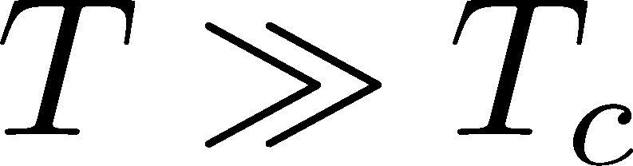
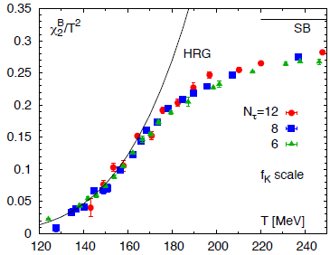
QCD @ T>0
T_{c}*
T
QCD EoS
Success of HRG model for
higher-order cumulants below Tc

Slide 3
QCD @ T>0
T_{c}*
T
How do hadrons cease to exist?
How do quarks and gluons disappear?

Slide 4
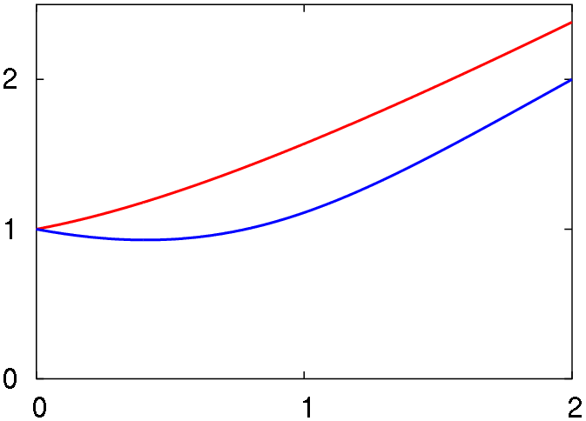



Quarks at Extremely High T
Klimov ’82, Weldon ’83
Braaten, Pisarski ’89
2 collective excitations having “thermal mass” ~gT
width ~g²T
Minimum of the plasmino mode at nonzero p
ω / m_{T}
“plasmino”
p / m_{T}

Slide 5
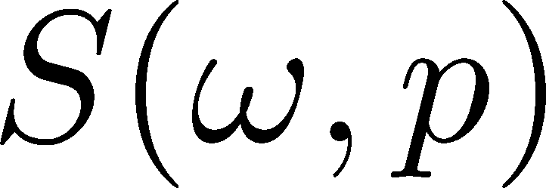
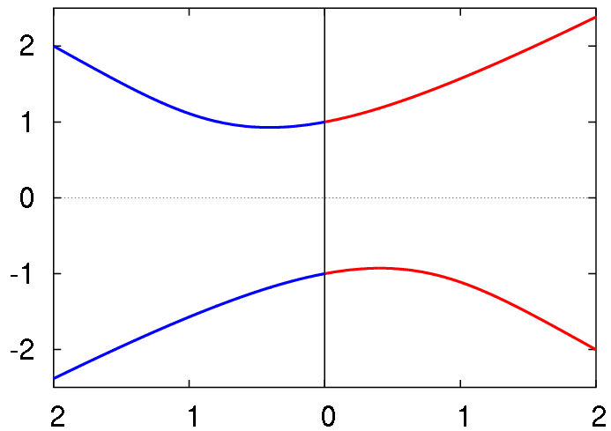
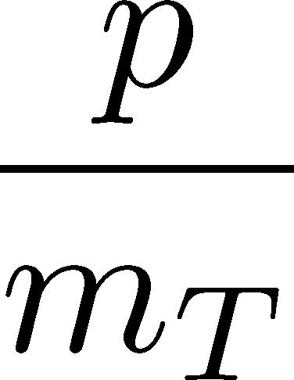
Quarks at Extremely High T
Klimov ’82, Weldon ’83
Braaten, Pisarski ’89
2 collective excitations having “thermal mass” ~gT
width ~g²T
Minimum of the plasmino mode at nonzero p
normal
ω / m_{T}
plasmino

Slide 6
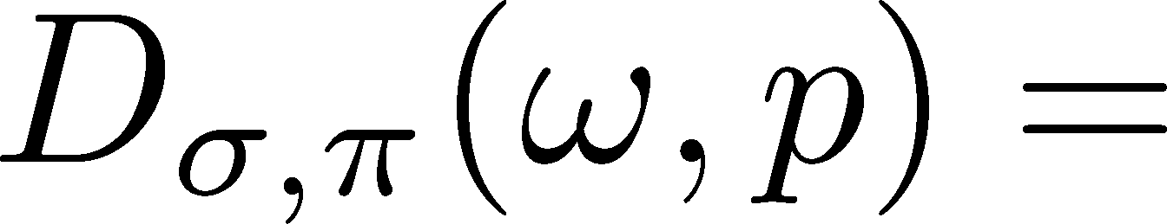
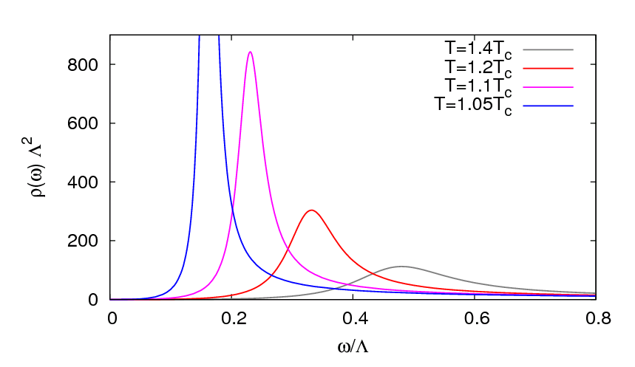
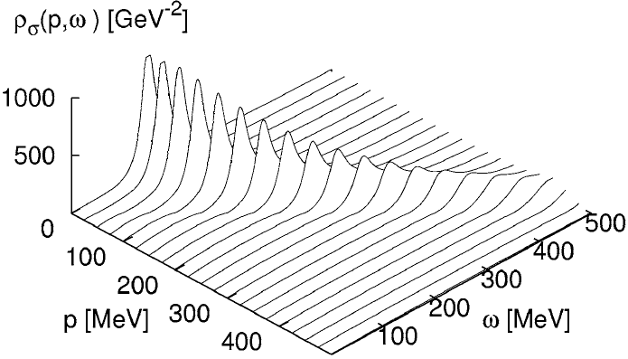

Soft Modes of Chiral Transition
Hatsuda, Kunihiro,1985
Large fluctuations of order parameter near T_{c}
F(Δ)
Chiral transition :σ, π -modes
Δ
Spectral Function
p=0
T=1.05T_{c}
T→T_{c}

Slide 7
Quark Propagator near T_{c}
MK, Kunihiro Nemoto, 2006
NJL model
2-flavor
chiral limit (m₀=0)
Quark Self-Energy

Slide 8
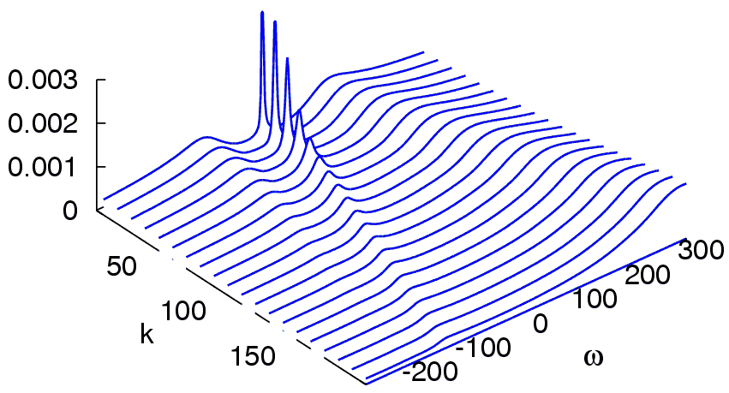
Quark Spectrum near T_{c}
MK, Kunihiro Nemoto, 2006
T= 1.05Tc
k [MeV]
ω [MeV]
Three-peak structure emerges
Sharpest peak around the origin

Slide 9
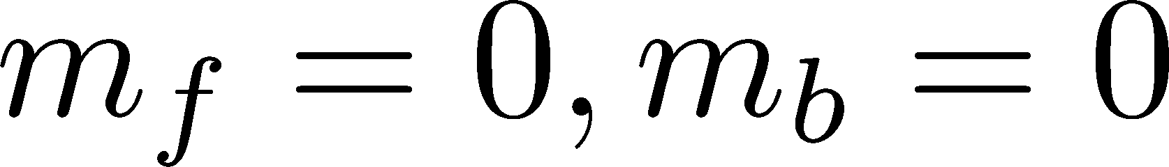
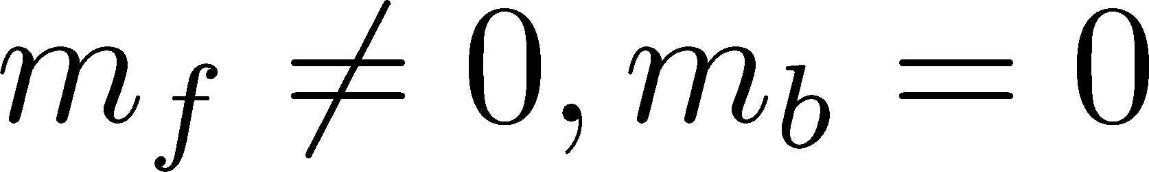
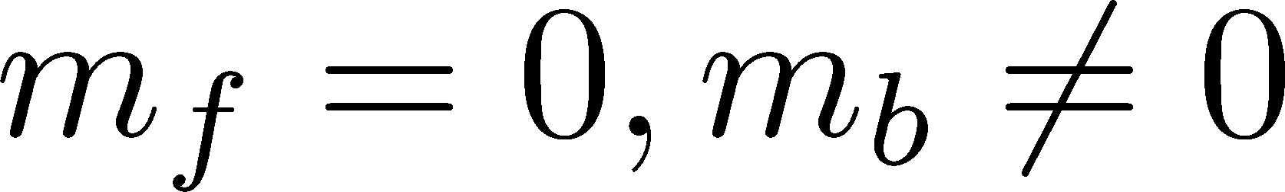
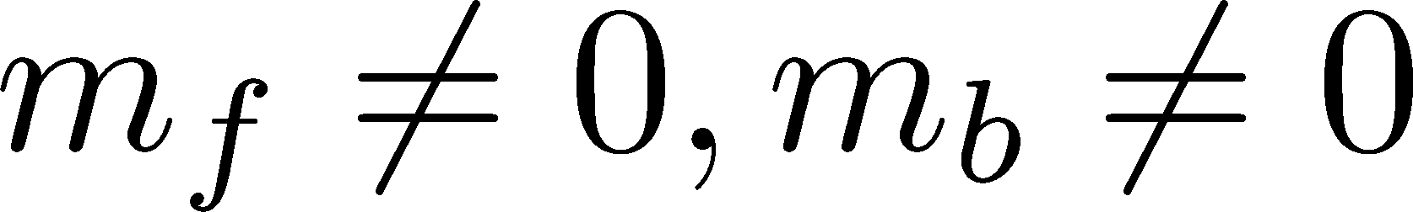
Fermion & Boson System
Yukawa model
“fermion (m_{f}) + boson (m_{b})”
Fermion spectrum at 1-loop order:
Klimov, 1982; Weldon, 1983
Baym, Blaizot, Svetitsky, 1992
MK, Kunihiro, Nemoto, 2007
MK, Kunihiro, Mitsutani, Nemoto, 2008

Slide 10
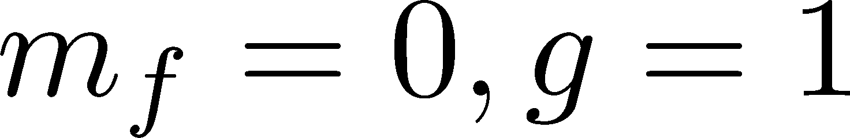
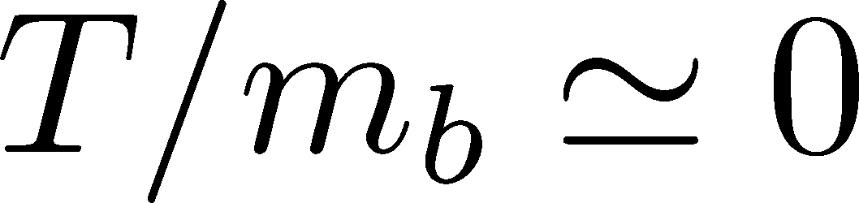
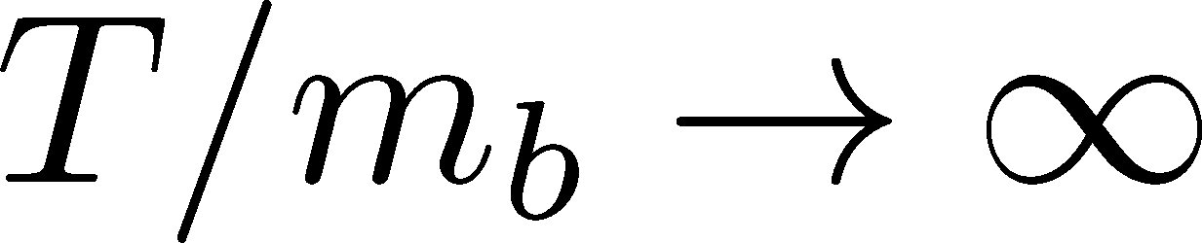
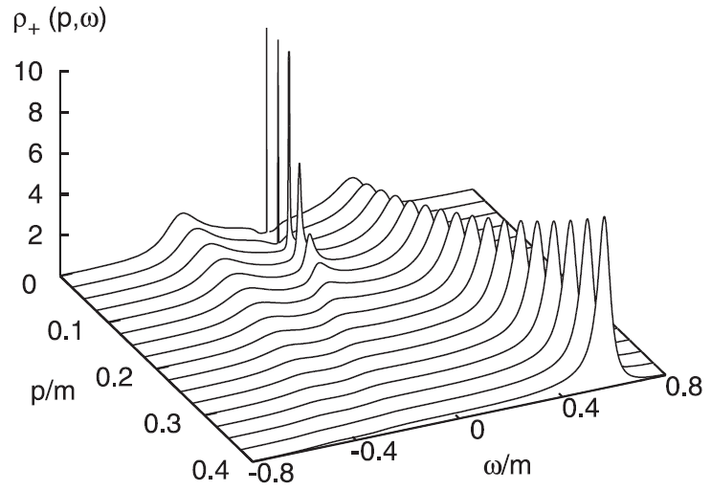
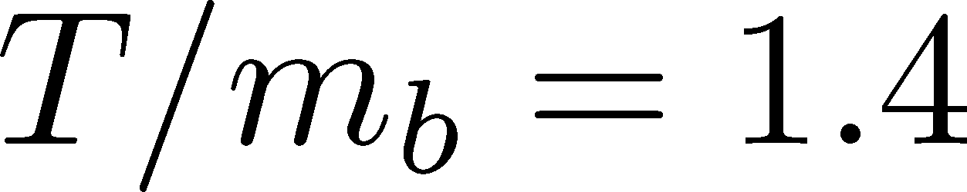
Fermion Spectrum
MK, Kunihiro, Nemoto, 2007
Yukawa model,
T/m_{b}
massless
free fermion
normal &
plasmino
with m_{T}
Three peak structure emerges for T~m_{b}
Low energy peak ceases to exist for m_{f}>0.2m_{b}

Slide 11
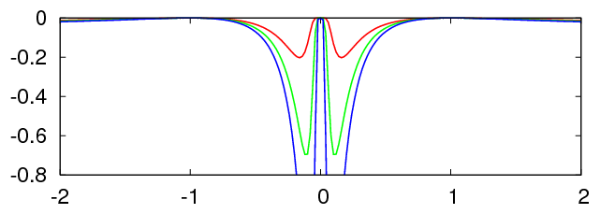
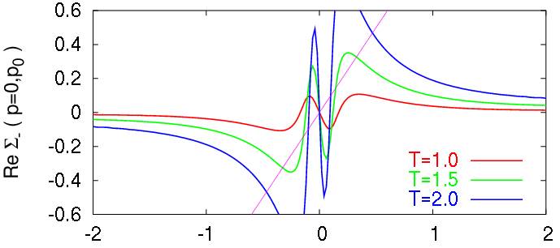
Quark Self-Energy at p=0
Im Σ(ω,0)
Two peaks develop at low energy.
T =1
T =1.5
T =2
T
Re Σ(ω,0)
ω / m_{B}
Two “oscillating behavior” grows as T is raised.
ω / m_{B}

Slide 12
Landau Damping
Im Σ(ω,0)
T =1
T =1.5
T =2
T
ω / m_{B}
quark
boson
ω
ω
Landau damping

Slide 13
Introducing Nonzero m₀
2-flavor NJL model
What’s
NEW!
Effect of m₀
Phase transition becomes crossover.
Constituent quarks stay massive.
Soft modes do not become massless.

Slide 14
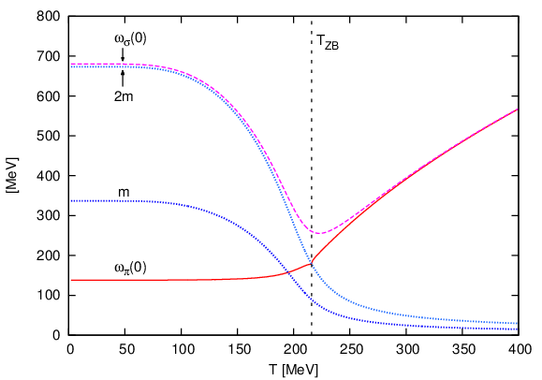

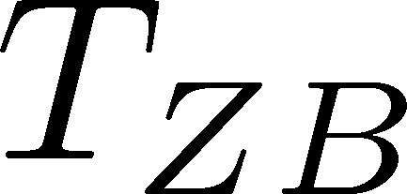

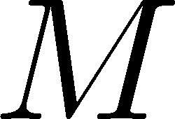

Stable π modes above T_{PC}
π modes can be stable even above T_{PC}
for m_{π}<2M

Slide 15
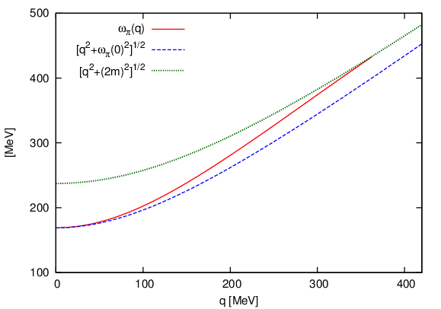
Pion Dispersion Relation
T=206MeV
Continuum threshold
Lorentz invariant
dispersion
Dispersion relation of stable pion deviates from Lorentz form.
Pionic modes become unstable at nonzero p.

Slide 16
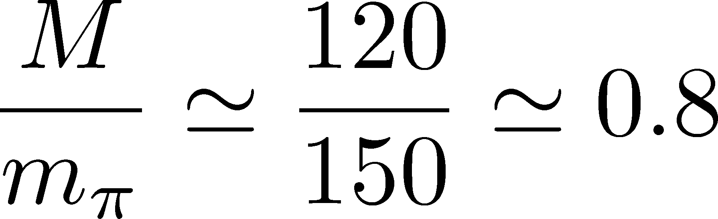
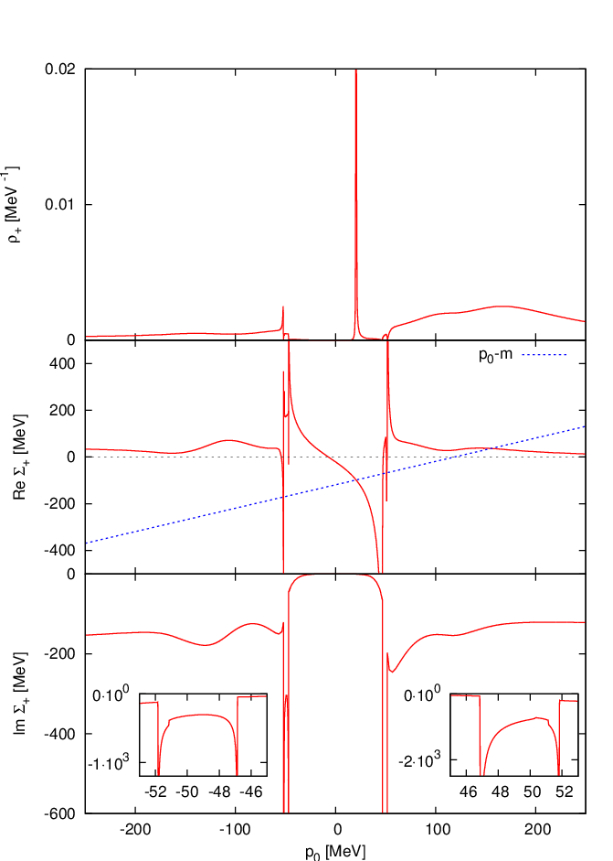
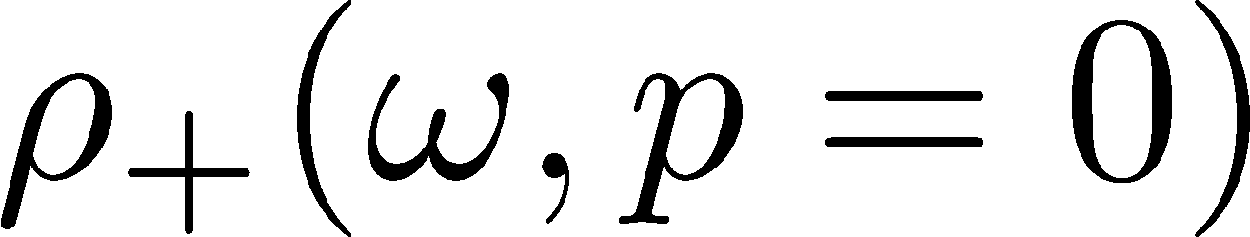
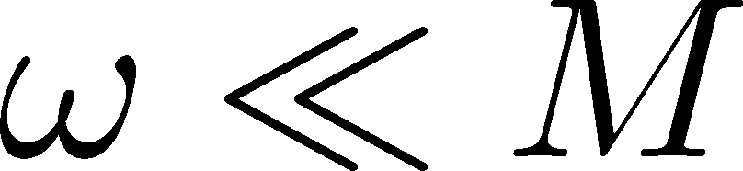
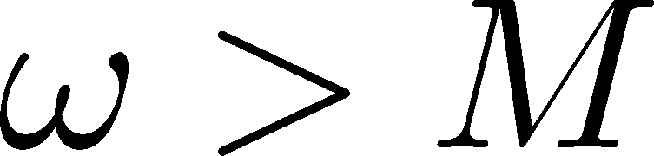
Quark Spectrum
T=206 MeV, p=0
M
sharp peak
at
broad peak
at
ω [MeV]
Strong modification of the quark spectrum
Appearance of sharp peak at low energy

Slide 17

Im Σ
T=206 MeV, p=0
ω [MeV]
There exist divergences in Im Σ₊(ω)!

Slide 18
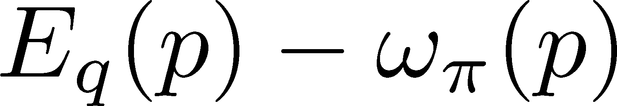
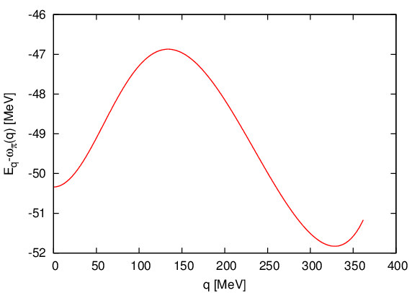
van Hove Singularity
ω
Relative group velocity
of quarks and pions
Zeros of group velocity
Divergences of joint DoS
van Hove singularity

Slide 19
Summary
We have studied quark spectrum near but above T_{PC}
coupled with the chiral soft modes off the chiral limit.
Effects of nonzero m₀
nonvanishing masses of
constituent quarks
soft modes
pionic modes:
stable even above TPC
non-relativistic dispersion
Quark spectrum is significantly modified by the van Hove singularity induced by the scattering of quarks and pions.
Quark spectrum near TPC can have a sharp peak with a small energy.

Slide 20


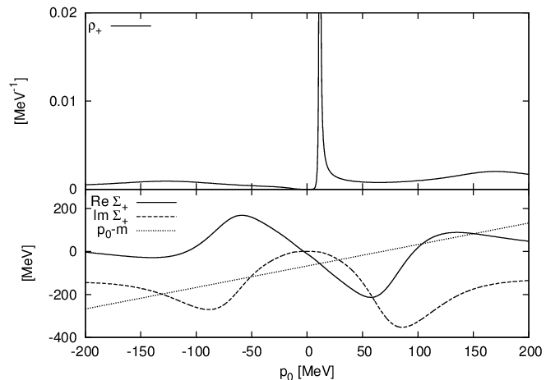
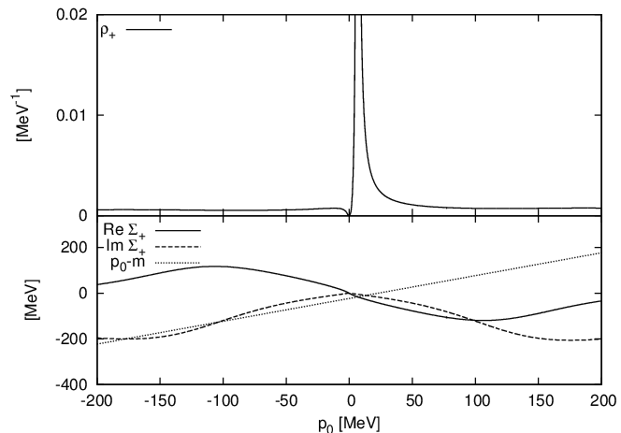
T Dependence of Quark Spectrum

Slide 21
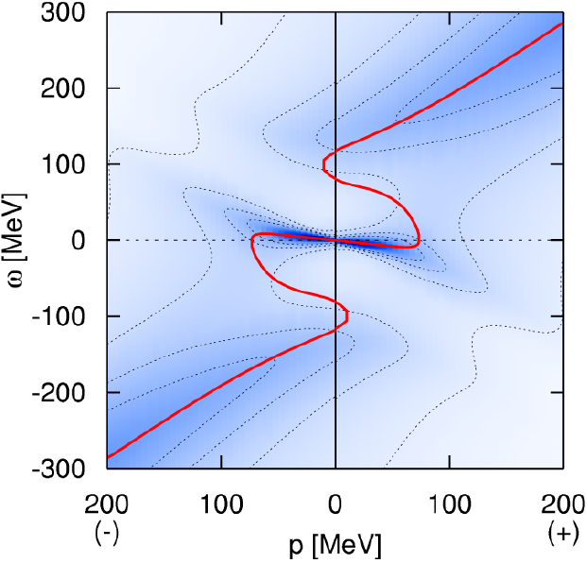
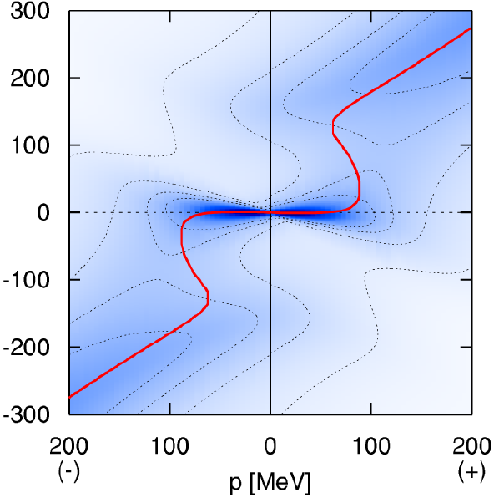
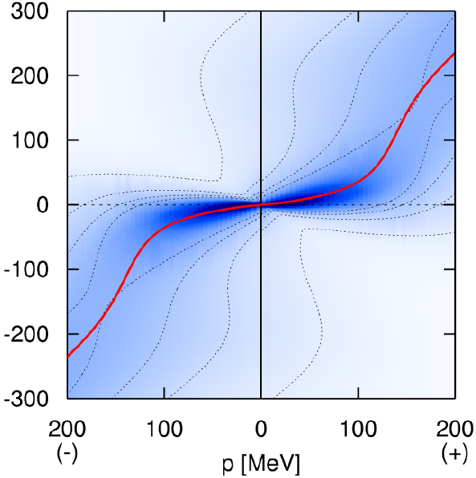
T Dependence
T → T_{c}
T =1.1T_{c}
T → large
T =1.2T_{c}
T =1.5T_{c}

Slide 22
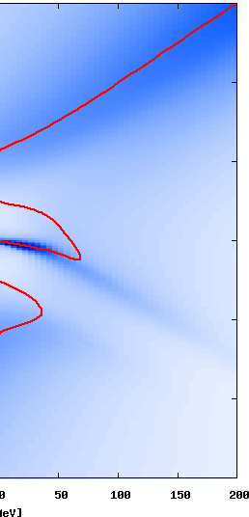
Quark Spectrum near T_{c}
MK, Kunihiro Nemoto, 2006
T= 1.05Tc
ω [MeV]
k [MeV]
k [MeV]
ω [MeV]
Quasi-dispersion relation

