Slide 1
Fluctuations of Conserved Charges
- Theory, Experiment, and Lattice -
Masakiyo Kitazawa
（Osaka U.）
KEK, 2014/Jan./20

Slide 2
QCD @ nonzero T
Theory
(Motivation)
QCD @ nonzero T
Lattice
Heavy Ion
Collisions

Slide 3
QCD @ nonzero T
Theory
(Motivation)
QCD @ nonzero T
Fluctuations of
conserved charges
Lattice
Heavy Ion
Collisions

Slide 4
QCD @ nonzero T
Theory
(Motivation)
QCD @ nonzero T
Lattice
Heavy Ion
Collisions

Slide 5
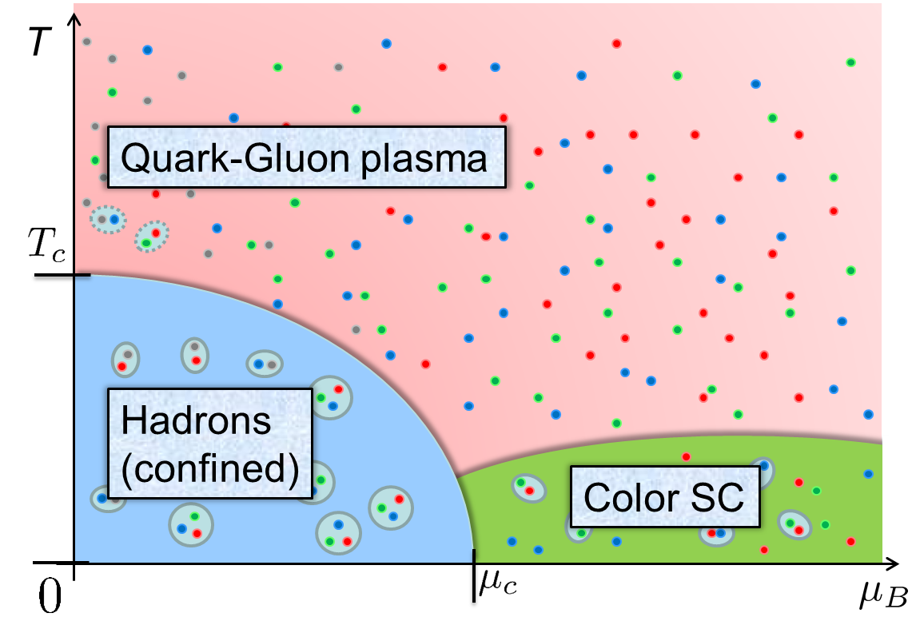
Why QCD @ nonzero T and μ ?
Form of the matter under extreme conditions
  QCD Phase diagram
  New many body properties

Slide 6


Why QCD @ nonzero T and μ ?
Form of the matter under extreme conditions
  QCD Phase diagram
  New many body properties
State of the matter realized in
  Early Universe
  Compact stars

Slide 7
Why QCD @ nonzero T and μ ?
Form of the matter under extreme conditions
  QCD Phase diagram
  New many body properties
State of the matter realized in
  Early Universe
  Compact stars
Relativistic heavy ion collisions

Slide 8

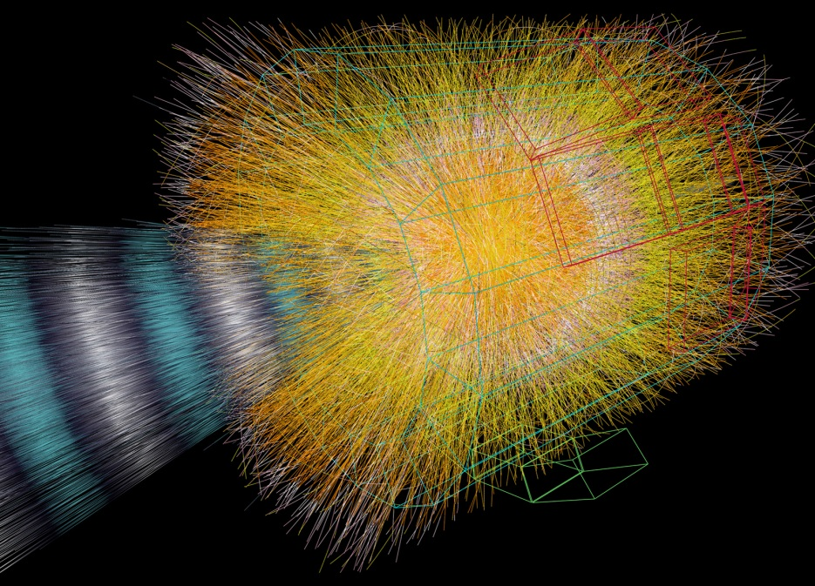
Relativistic Heavy Ion Collisions

Slide 9
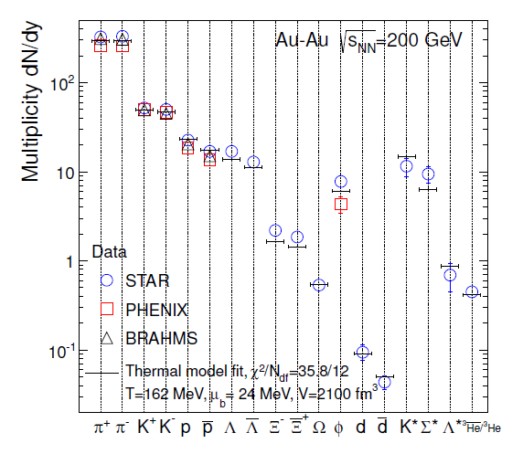
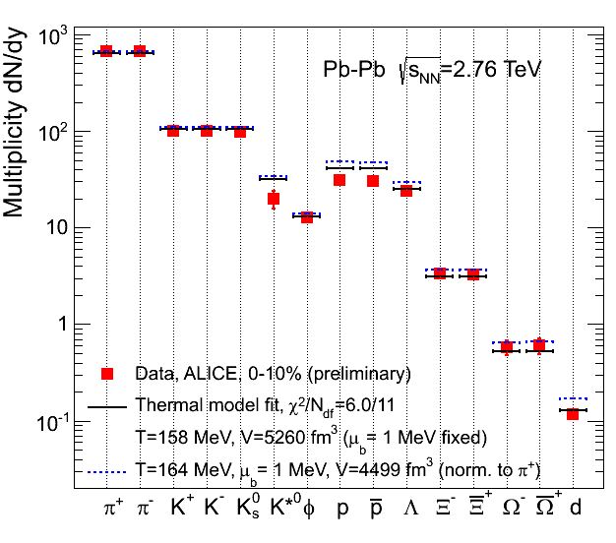
Chemical Freezeout
RHIC
LHC
Particle yields can be well described only by T, μ_{B}!
chemical equilibration?

Slide 10

Beam-Energy Scan Program
STAR 2012
high
beam energy
T
low
Hadrons
Color SC
0
μ

Slide 11
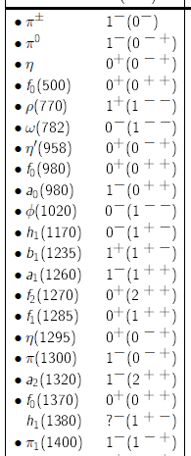
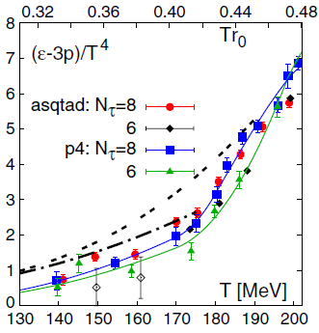
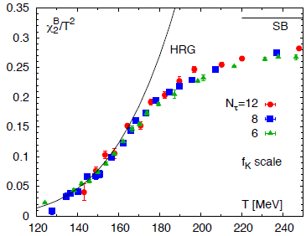
Hadron Resonance Gas (HRG) Model
HRG model
free gas composed of
known hadrons
particle data group
The HRG model well describes thermodynamics calculated on the lattice.
“Trace Anomaly”
Baryon # fluctuation

Slide 12
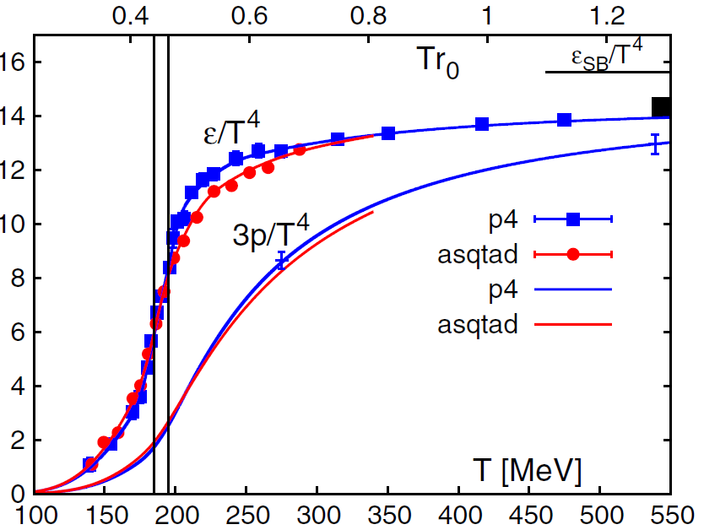
Lattice and HIC : EoS
Equation of states
Input
Lattice
Heavy Ion
Collisions
Challenge!
Robust modelling of space-time evolution
Small shear viscosity

Slide 13
Lattice and HIC : Heavy Quarkonia
Heavy quarkonia will disappear in QGP
Matsui, Satz, 1986
Theory
(Motivation)
Lattice
Input
Heavy Ion
Collisions
Charmonium SPC
Asakawa, Hatsuda, 2004

Slide 14
Fluctuations of
Conserved Charges

Slide 15
Fluctuations
Observables in equilibrium are fluctuating.
P(N)
N
V
N

Slide 16
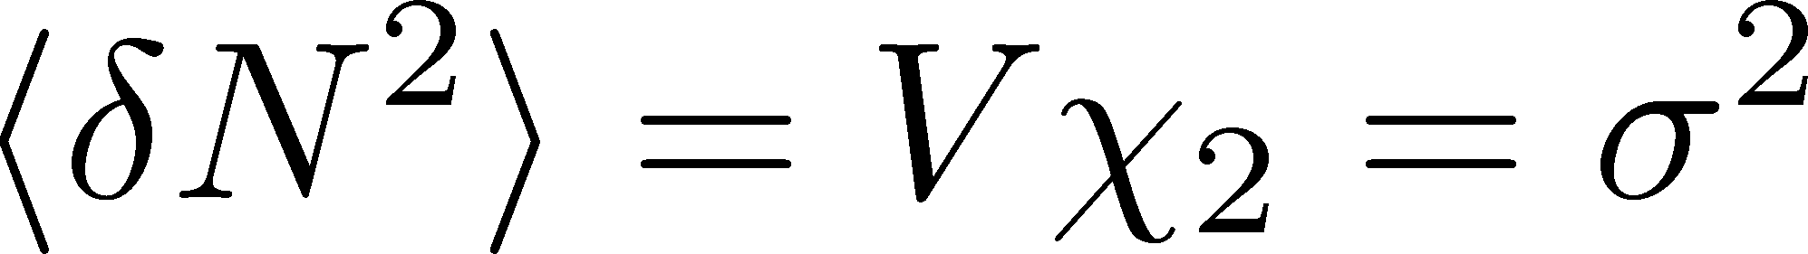

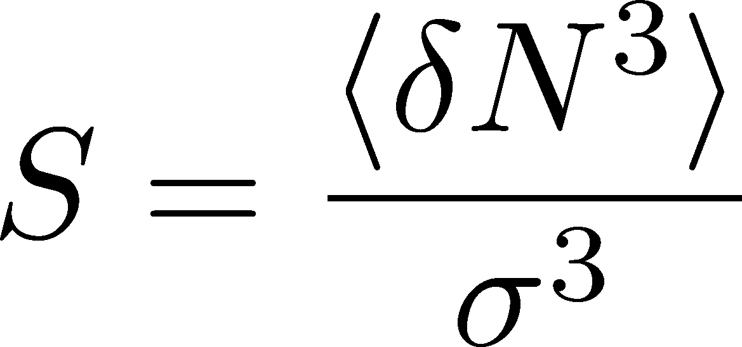
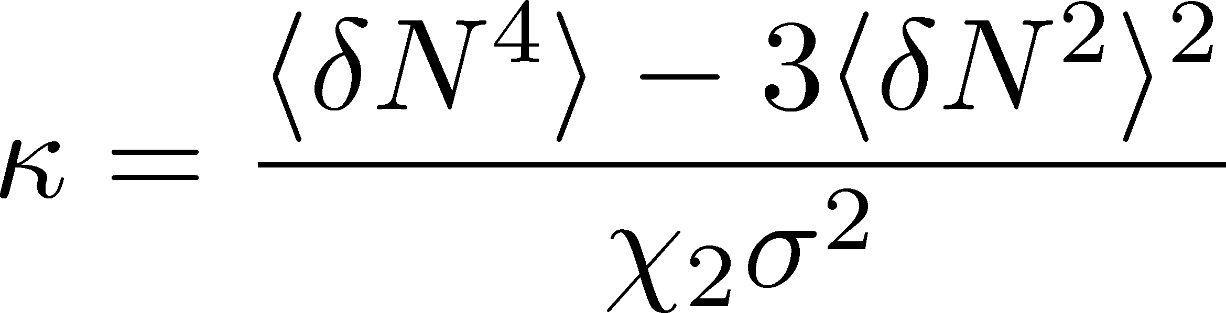
Fluctuations
Observables in equilibrium are fluctuating.
P(N)
N
V
N
Variance:
Non-Gaussianity
Skewness:
Kurtosis:

Slide 17

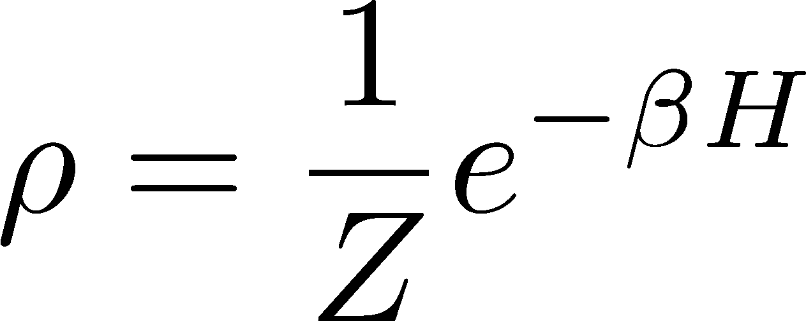
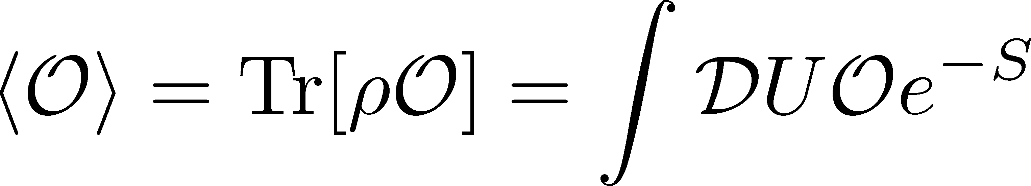
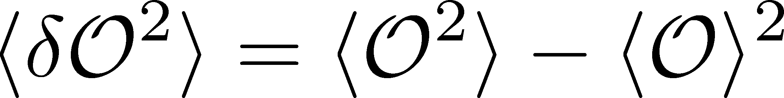
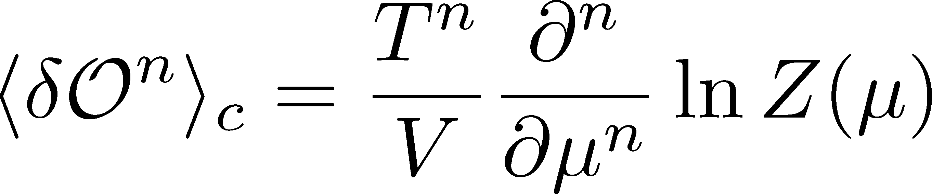
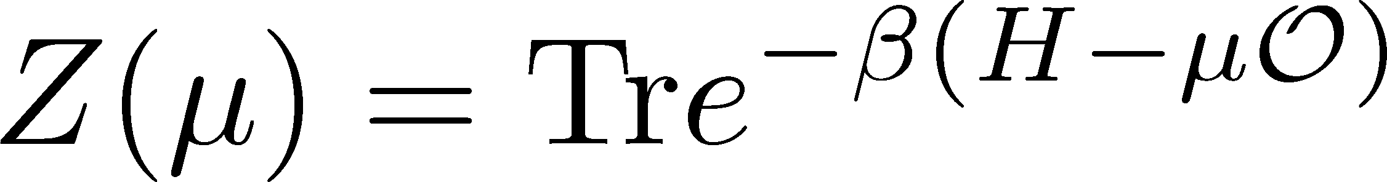
Conserved Charge Fluctuations
Definite definition of the operator
as a Noether current
Expectation value:
Fluctuation:
Simple thermodynamic relation

Slide 18
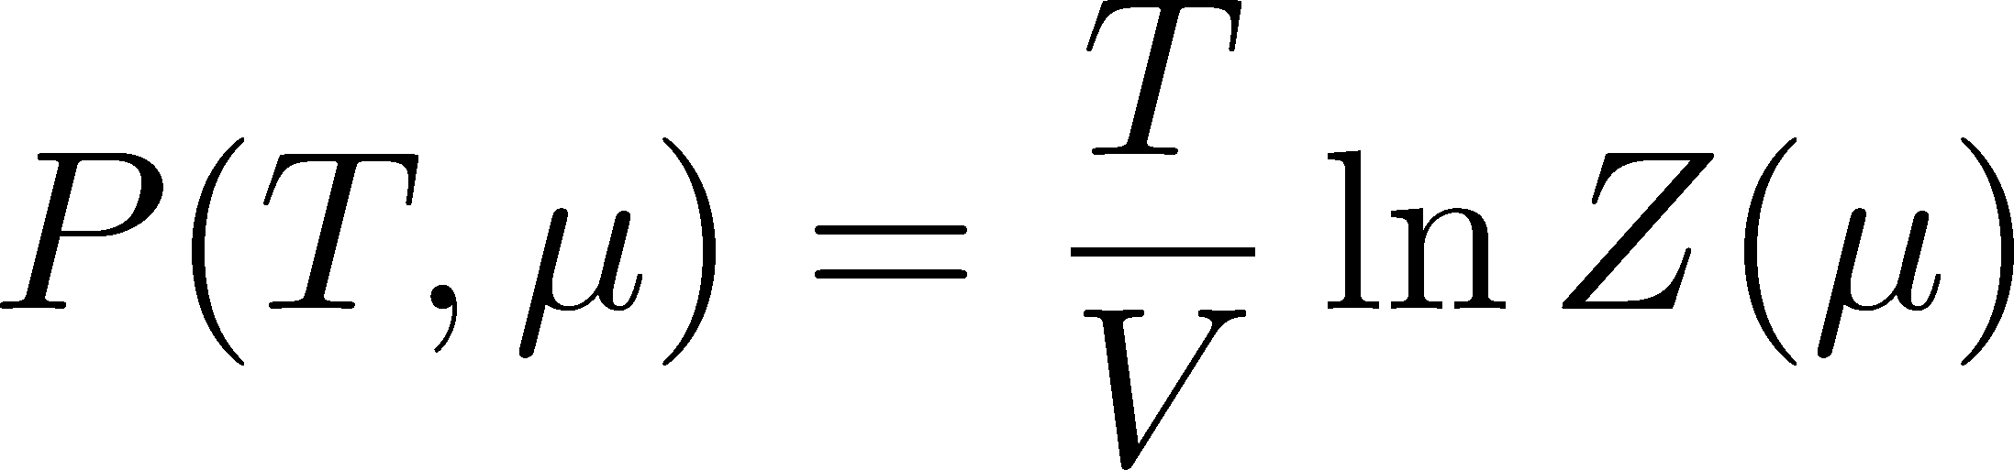
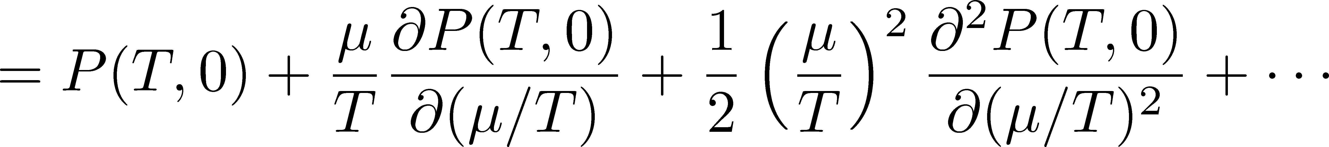

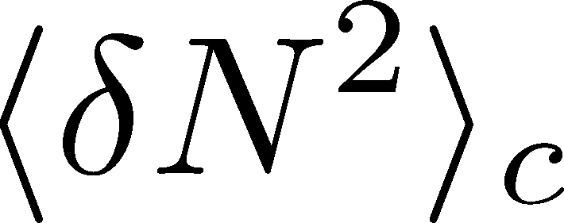
Taylor Expansion Method & Cumulants
Baryon number cumulants = Taylor expansion coeffs.

Slide 19
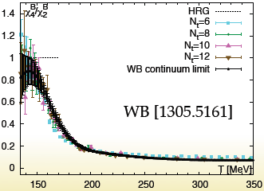
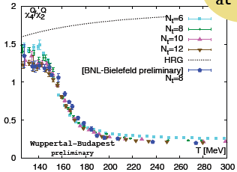
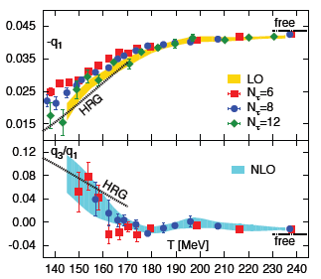
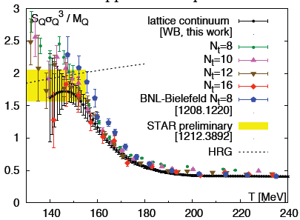
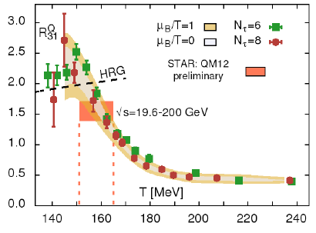
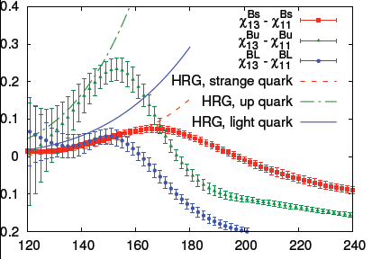
Recent Progress in Lattice Simulations
From LATTICE2013
presentations

Slide 20
QCD @ nonzero T
Theory
(Motivation)
QCD @ nonzero T
Lattice
Heavy Ion
Collisions

Slide 21
Event-by-Event Analysis @ HIC
Fluctuations can be measured by e-by-e analysis in experiments.
V
Detector

Slide 22

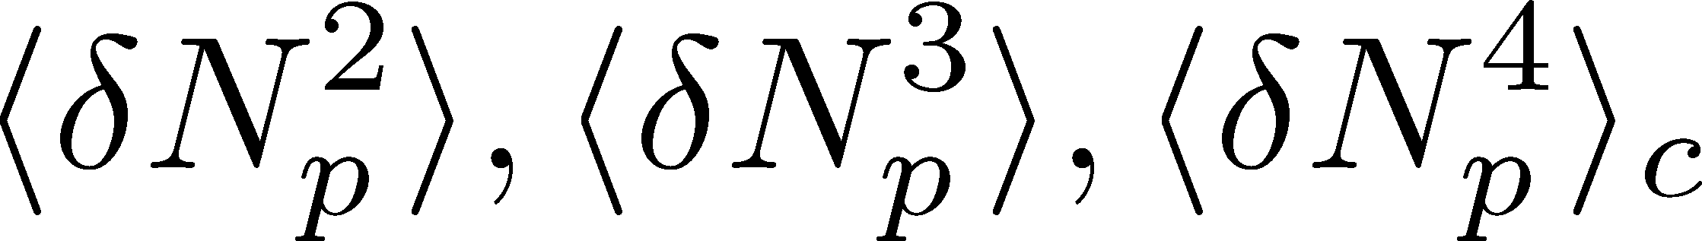
Event-by-Event Analysis @ HIC
Fluctuations can be measured by e-by-e analysis in experiments.
STAR, PRL105 (2010)
Detector

Slide 23
What are Fluctuations observed in HIC?
QUESTION:
When the experimentally-observed
fluctuations are formed?
at chemical freezeout?
at kinetic freezeout?
or, much earlier?
Detector

Slide 24
QCD @ nonzero T
Theory
(Motivation)
QCD @ nonzero T
Lattice
Heavy Ion
Collisions

Slide 25

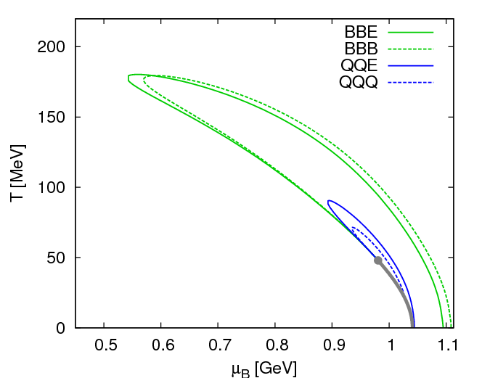
Fluctuations
Fluctuations reflect properties of matter.
  Enhancement near the critical point
  Stephanov,Rajagopal,Shuryak(’98); Hatta,Stephanov(’02); Stephanov(’09);…
  Ratios between cumulants of conserved charges
  Asakawa,Heintz,Muller(’00); Jeon, Koch(’00); Ejiri,Karsch,Redlich(’06)
  Signs of higher order cumulants
  Asakawa,Ejiri,MK(’09); Friman,et al.(’11); Stephanov(’11)

Slide 26
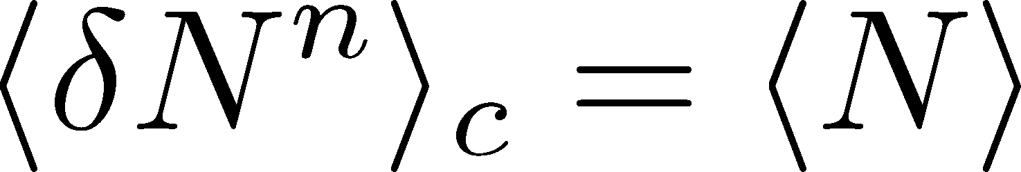
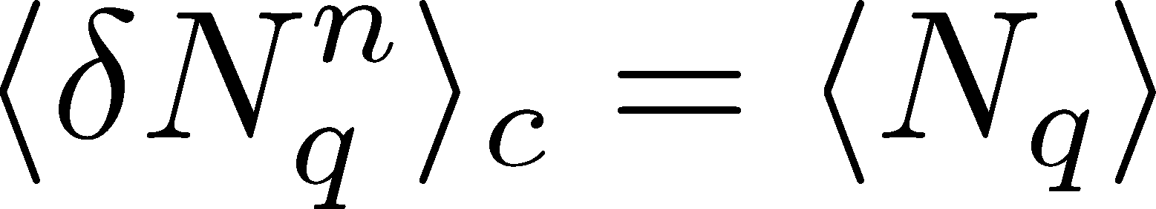
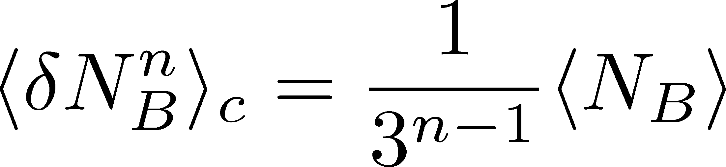
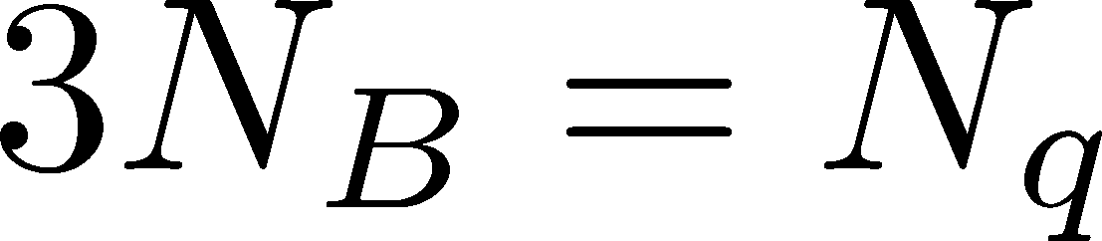
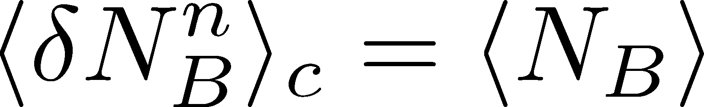
Fluctuations
Free Boltzmann → Poisson

Slide 27
Fluctuations
Free Boltzmann → Poisson
RBC-Bielefeld ’09

Slide 28
Fluctuations
Free Boltzmann → Poisson
RBC-Bielefeld ’09

Slide 29

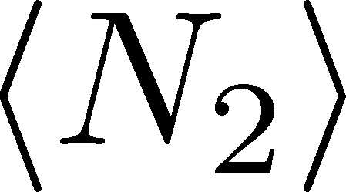
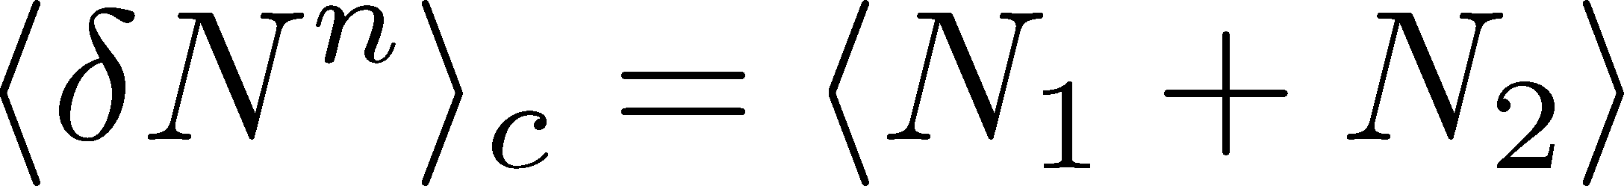
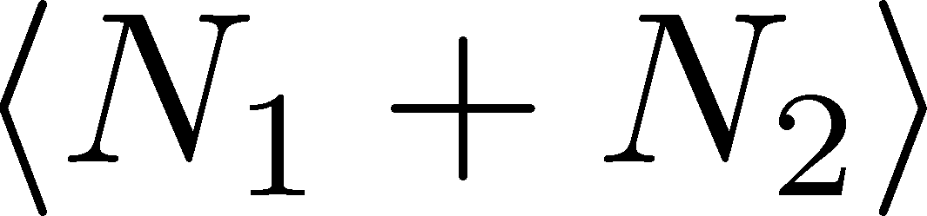
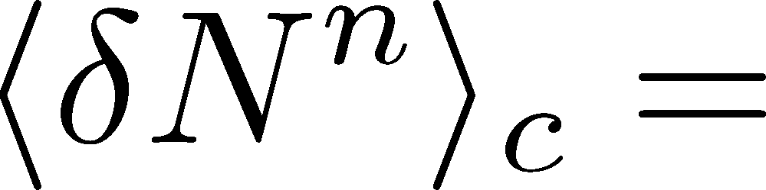

Skellam Distribution
Poisson + Poisson = Poisson
Poisson — Poisson = Skellam distribution
(n:even)
(n:odd)
In the HRG model,
(Net-)baryon and electric charge fluctuations
are of Skellam distribution.

Slide 30

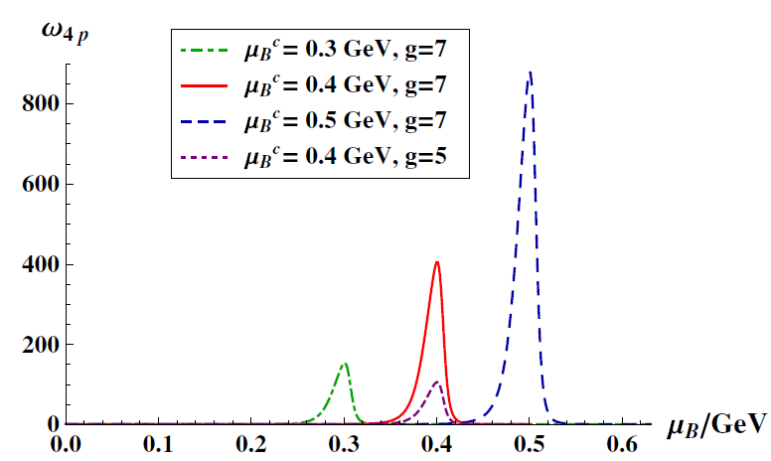
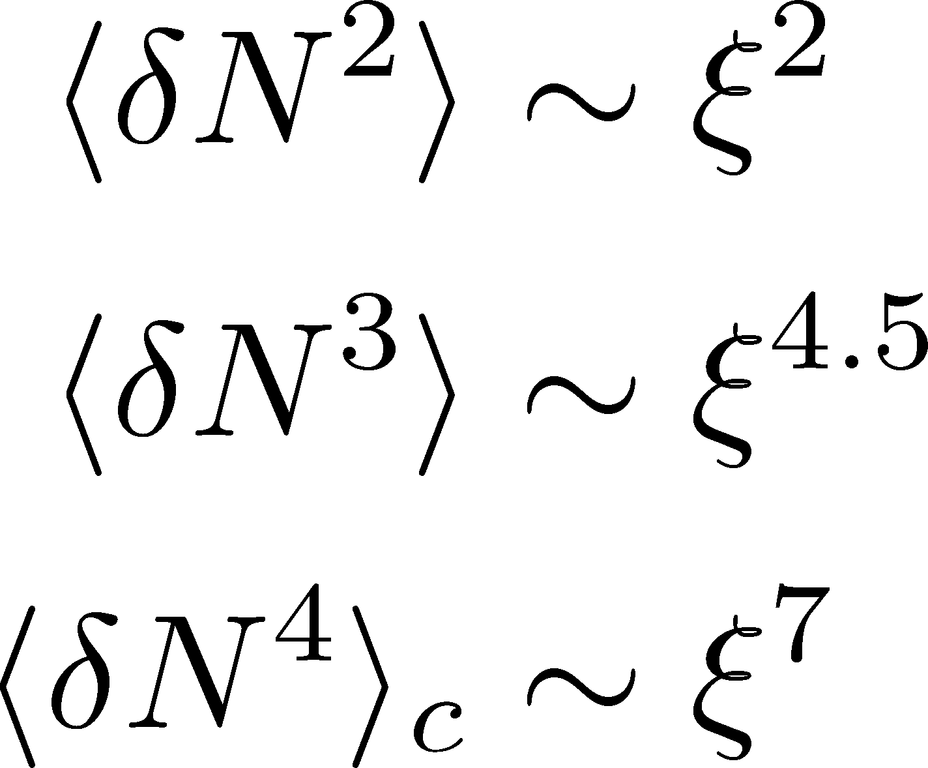
Search of QCD Critical Point
Fluctuations diverge at the QCD critical point.
Example:
Higher order cumulants are more sensitive to correlation length
Stephanov,
PRL, 2010
Athanasiou, Rajagopal,
Stephanov, 2010

Slide 31
Sign of Higher Order Cumulants
Asakawa, Ejiri, MK, PRL,2009
χ_{B} has an edge along the phase boundary
changes the sign at
QCD phase boundary!

Slide 32

Impact of Negative Third Moments
Once negative m₃(BBB) is established, it is evidences that
(1) χ_{B} has a peak structure in the QCD phase diagram.
(2) Hot matter beyond the peak is created in the collisions.
No dependence on any specific models.
Just the sign! No normalization (such as by N_{ch}).

Slide 33
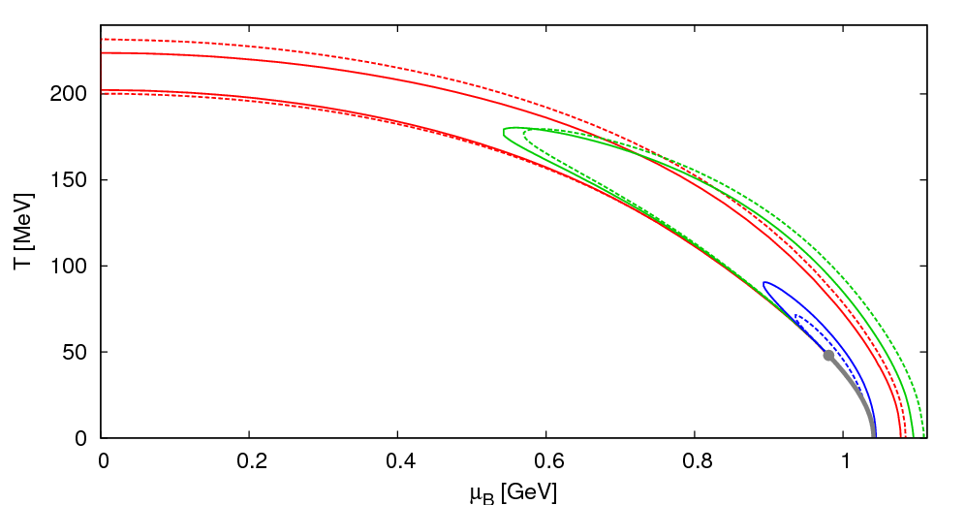
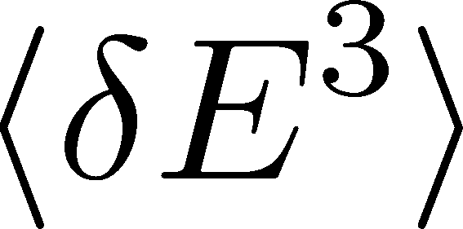
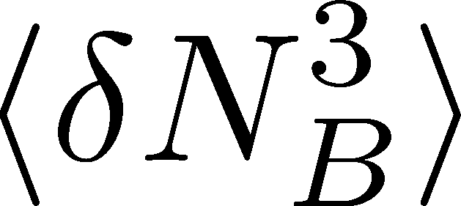
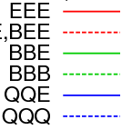
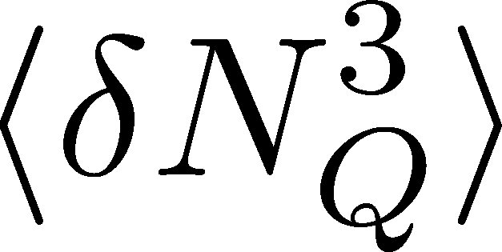
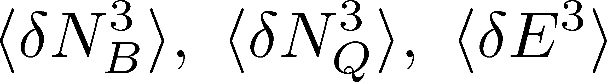
Various Third Moments
Asakawa, Ejiri, MK, PRL,2009
Negative
Negative
Negative
Various third moments,
become negative near the phase boundary.
The behaviors can be checked by lattice and HIC!
  See also, Friman,et al.(’11); Stephanov(’11)

Slide 34
Exploring Medium Properties
Hadronic
Quark-Gluon
s
s
s
s
s
s
strangeness with
baryon number
B=0,1
B=1/3

Slide 35
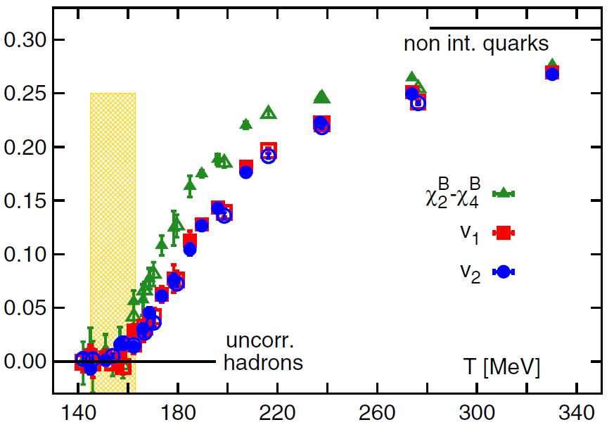
Exploring Medium Properties
Hadronic
Quark-Gluon
s
s
s
s
s
s
strangeness with
baryon number
B=0,1
B=1/3
BNL-Bielefeld, PRL 2013
Combinations of
cumulants which vanish
in the HRG model

Slide 36
QCD @ nonzero T
Theory
(Motivation)
QCD @ nonzero T
Lattice
Heavy Ion
Collisions

Slide 37
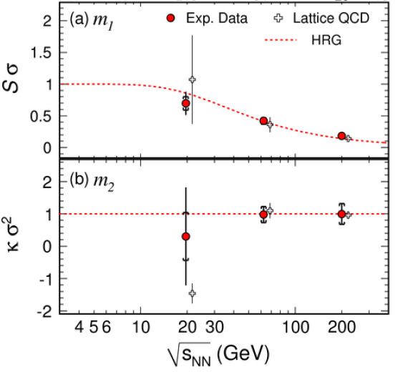
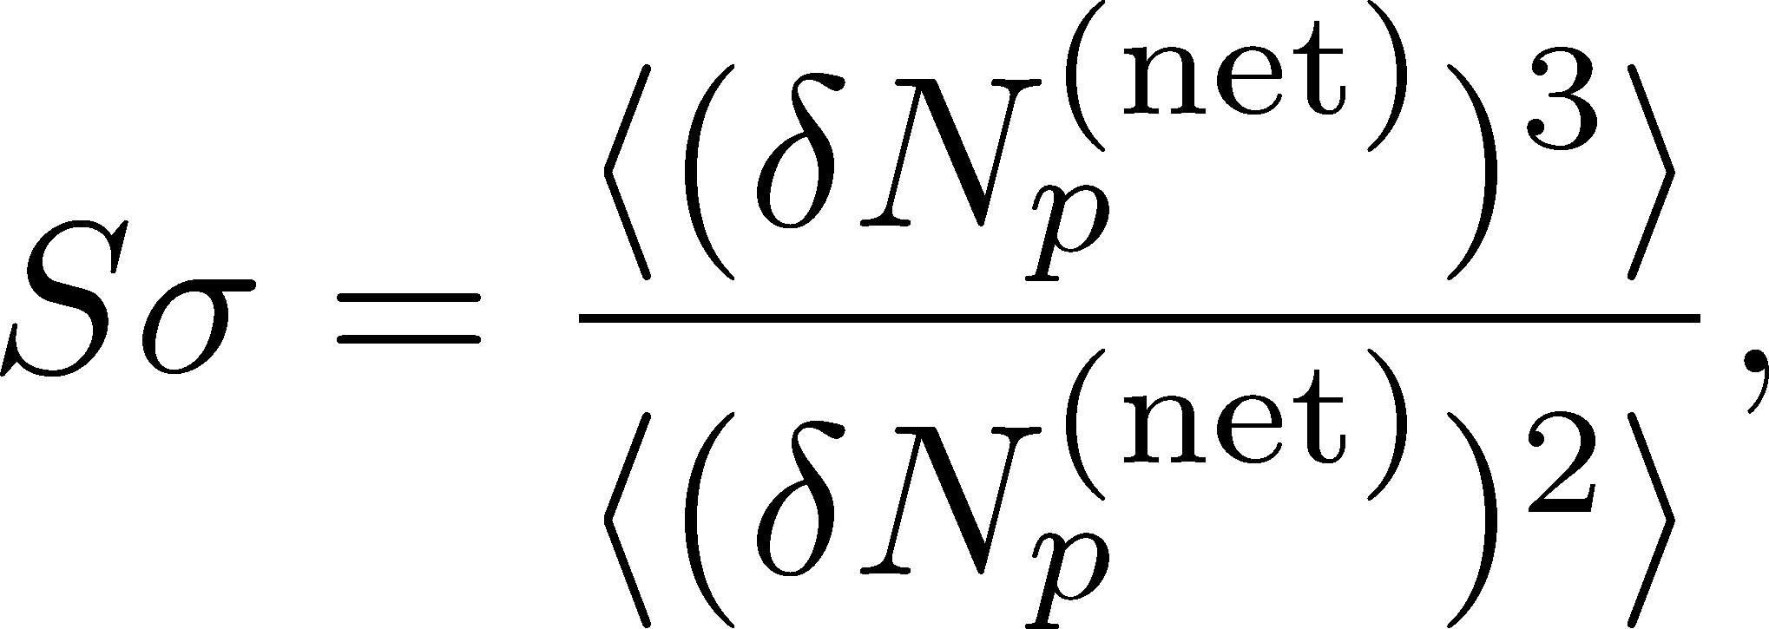
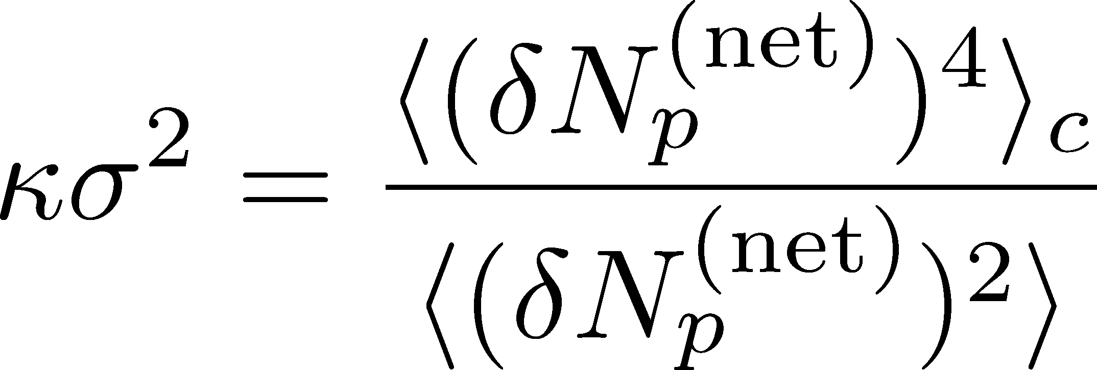
Proton # Fluctuations @ STAR-BES
STAR, PRL2010
STAR 2012

Slide 38
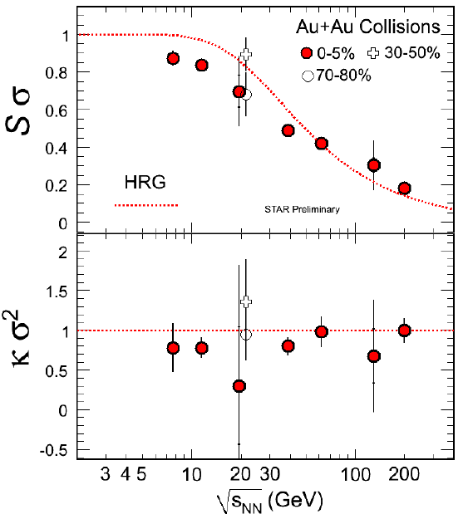
Proton # Fluctuations @ STAR-BES
STAR, PRL2010
STAR, 2011
high μ
low μ

Slide 39
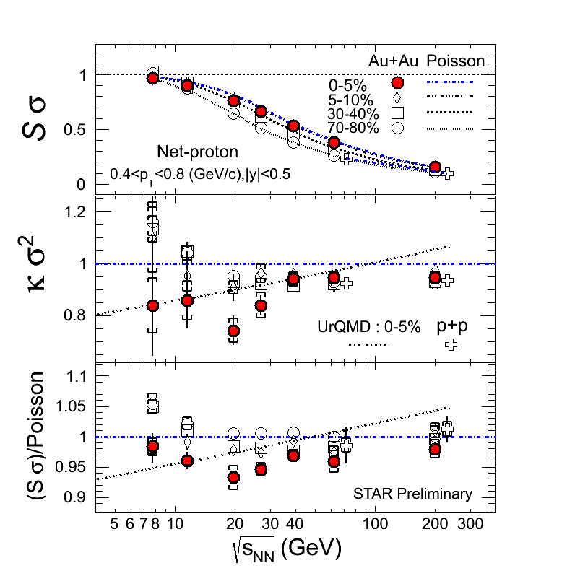
Proton # Fluctuations @ STAR-BES
STAR, 2012 (Quark Matter)
STAR, 2011
high μ
low μ

Slide 40





Proton # Cumulants @ STAR-BES
STAR,1309.5681
CAUTION!
Something
interesting??
proton number
baryon number
MK, Asakawa, 2011;2012

Slide 41
Proton # Cumulants @ STAR-BES
STAR,1309.5681
Athanasiou, Rajagopal,
Stephanov, 2010
Something
interesting??

Slide 42



Electric Charge Fluctuation @ LHC
ALICE, PRL110,152301(2013)
D-measure
D ~ 3-4 Hadronic
D ~ 1-1.5 Quark
significant suppression
from hadronic value
at LHC energy!
is not equilibrated at freeze-out at LHC energy!

Slide 43

Δη Dependence @ ALICE
ALICE
PRL 2013
t
Δη
z
rapidity window

Slide 44





Dissipation of a Conserved Charge

Slide 45
Dissipation of a Conserved Charge

Slide 46





Time Evolution of Fluctuations
Quark-Gluon Plasma
Hadronization
Freezeout
Variation of a conserved charge is achieved only through diffusion.
The larger Δη,
the slower diffusion

Slide 47
Δη Dependence @ ALICE
ALICE
PRL 2013
t
Δη
z
Δη dependences of conserved charge
fluctuations encode history of dynamical evolution

Slide 48
QCD @ nonzero T
Theory
(Motivation)
QCD @ nonzero T
Lattice
Heavy Ion
Collisions

Slide 49
Comparison b/w Lattice & HIC
Gupta, Xu, et al., Science, 2009
Taylor expansion method
Chemical freezeout T,μ
Pade approx.

Slide 50

Cumulants : HIC@RHIC vs Lattice
parameter window
constrained by lattice
BNL-Bielefeld,
LATTICE2013
fluctuations
“exp + lattice”
μ /T
particle abundance
(chem. freezeout T)
discrepancy

Slide 51
Many Things to Do
Proton vs baryon number cumunants
Are fluctuations generated with fixed T?
Experimental environments
  Acceptance, efficiency
  Particle missid
  Global charge conservation

Slide 52


Baryon vs Proton Number Fluctuations
MK, Asakawa, PRC85,021901C(2012); PRC86, 024904(2012)
are experimentally observable

Slide 53
Nucleon Isospin as Two Sides of a Coin
N
p
n
Nucleons have
two isospin states.
MK, Asakawa,2012

Slide 54


Nucleon Isospin as Two Sides of a Coin
a coin
N
p
n
Nucleons have
two isospin states.
Coins have two sides.
MK, Asakawa,2012

Slide 55



Slot Machine Analogy
= +
P (N)
N
P (N)
N

Slide 56
Extreme Examples
Fixed # of coins
Constant probabilities
N
N
N
N

Slide 57


Reconstructing Total Coin Number
P (N )= P (N )B_{1/2}(N ;N )
:binomial distr. func.

Slide 58







Nucleon Isospin in Hadronic Medium
Isospin of baryons can vary after chemical freezeout
via charge exchange reactions mediated by Δ(1232):
200mb=20fm²
cross section

Slide 59










Δ(1232)
cross sections of p
3
1
2:1
2
1:2
decay rates of Δ

Slide 60



Δ(1232)
cross sections of p
3
1
2:1
2
1:2
decay rates of Δ

Slide 61




Nucleons in Hadronic Phase
time
chem. f.o.
hadronize
10~20fm
kinetic f.o.
rare NN collisions
no quantum corr.
mesons
baryons
many pions

Slide 62







Probability Distribution
Detector
binomial distribution func.
for any phase space in the final state.

Slide 63




Difference btw Baryon and Proton Numbers
(1)
deviates from the equilibrium value.
(2) Boltzmann (Poisson) distribution for
genuine info.
noise
For free gas

Slide 64
Time Evolution of
Higher Order Cumulants
MK, Asakawa, Ono, PLB728, 386, 2014

Slide 65
Δη Dependence @ ALICE
ALICE
PRL 2013
t
Δη
z
rapidity window

Slide 66
Dissipation of a Conserved Charge

Slide 67





<δN_{Q}⁴> @ LHC ?
How does behave as a function of Δη?
suppression
or
enhancement

Slide 68

Hydrodynamic Fluctuations
Landau, Lifshitz, Statistical Mechaniqs II
Kapusta, Muller, Stephanov, 2012
Stephanov, Shuryak, 2001
Stochastic diffusion equation
Markov (white noise)
+
continuity
Fluctuation of n is
Gaussian in equilibrium
Gaussian noise
cf) Gardiner, “Stochastic Methods”

Slide 69
How to Introduce Non-Gaussianity?
Stochastic diffusion equation
Choices to introduce non-Gaussianity in equil.:
n dependence of diffusion constant D(n)
colored noise
discretization of n

Slide 70
How to Introduce Non-Gaussianity?
Stochastic diffusion equation
Choices to introduce non-Gaussianity in equil.:
n dependence of diffusion constant D(n)
colored noise
discretization of n
our choice
Fluctuations measured in
HIC are almost Poissonian.
REMARK:

Slide 71







Diffusion Master Equation
Divide spatial coordinate into discrete cells
probability
Hadronization
Freezeout

Slide 72

Diffusion Master Equation
Divide spatial coordinate into discrete cells
probability
Master Equation for P(n)
Solve the DME exactly, and take a→0 limit
No approx., ex. van Kampen’s system size expansion

Slide 73
Baryons in Hadronic Phase
time
chem. f.o.
hadronize
10~20fm
kinetic f.o.
Baryons behave like
Brownian pollens in water
mesons
baryons

Slide 74




Net Charge Number
Prepare 2 species of (non-interacting) particles
Let us investigate
at freezeout time t

Slide 75


Solution of DME in a→0 Limit
1st order (deterministic)
consistent with diffusion equation with D=γa²
Continuum limit with fixed D=γa²
2nd order
consistent with stochastic diffusion eq.
(for sufficiently smooth initial conditions)
Shuryak, Stephanov, 2001
Nontrivial results for non-Gaussian fluctuations

Slide 76


Time Evolution in Hadronic Phase
Hadronization (initial condition)
Boost invariance / infinitely long system
Local equilibration / local correlation
suppression owing to
local charge conservation
strongly dependent on
hadronization mechanism

Slide 77
Time Evolution in Hadronic Phase
Hadronization (initial condition)
Boost invariance / infinitely long system
Local equilibration / local correlation
Time evolution via DME
suppression owing to
local charge conservation
strongly dependent on
hadronization mechanism
Freezeout

Slide 78




Δη Dependence at Freezeout
Initial fluctuations:
2nd
4th
parameter
sensitive to
hadronization

Slide 79
<δN_{Q}⁴> @ LHC
boost invariant system
small fluctuations of CC at hadronization
short correlation in hadronic stage
Assumptions
1
4th-order cumulant will be suppressed at LHC energy!
Δη dependences encode various information on the dynamics of HIC!
0.5

Slide 80


Δη Dependence at STAR
STAR, QM2012
decreases as Δη becomes larger at RHIC energy.

Slide 81
Many Things to do …
Theory
(Motivation)
QCD @ nonzero T
Better understanding on non-thermal nature
Critical phenomena
Other ideas?
Δη dependence of 4th order cumulant
Baryon number cumulants
Acceptance effect, etc.
Lattice
Heavy Ion
Collisions
More accurate data
Various channels
Nonzero μ

Slide 82
Summary
Conserved charge fluctuations are observable both in lattice simulations and heavy ion collisions. The comparison of the results in these two “experiments” will provide us many information to understand the QCD at nonzero T/μ.
A lot of efforts are required both sides:
  Lattice: Higher statistics
  HIC: reconstructing baryon #, acceptance, etc.
Rapidity window dependences of cumulants in HIC are valuable tools to understand the non-thermal nature of fluctuations.

Slide 83




Total Charge Number
In recombination model,
6 quarks
6 antiquarks
can fluctuate, while does not.

Slide 84

Evolution of Fluctuations
Fluctuation
in initial state
Time evolution
in the QGP
approach to HRG
by diffusion
experimental effects
particle missID, etc.
volume fluctuation

Slide 85
Time Evolution in HIC
Quark-Gluon Plasma
Hadronization
Freezeout

Slide 86
Time Evolution in HIC
Pre-Equilibrium
Quark-Gluon Plasma
Hadronization
Freezeout

Slide 87
Time Evolution in HIC
Pre-Equilibrium
Quark-Gluon Plasma
Hadronization
Freezeout

