Slide 1
Fluctuations of Conserved Charges as Probes of QCD Phase Structure
Masakiyo Kitazawa
(Osaka U.)
MK, Asakawa, PRC85,021901C(2012); PRC86, 024904(2012)
MK, Asakawa, Ono, PLB728,386(2014)
JHI2014, J-PARC, 17/Mar./2014

Slide 2
Beam-Energy Scan
T
Hadrons
Color SC
0
μ

Slide 3

Beam-Energy Scan
STAR 2012
high
beam energy
T
low
Hadrons
Color SC
0
μ

Slide 4
Beam-Energy Scan
STAR 2012
high
beam energy
T
J-PARC
FAIR, NICA
low
Hadrons
Color SC
0
μ

Slide 5

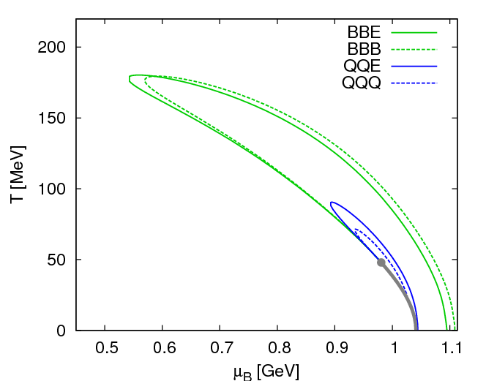
Fluctuations
Fluctuations reflect properties of matter.
  Enhancement near the critical point
  Stephanov,Rajagopal,Shuryak(’98); Hatta,Stephanov(’02); Stephanov(’09);…
  Ratios between cumulants of conserved charges
  Asakawa,Heinz,Muller(’00); Jeon, Koch(’00); Ejiri,Karsch,Redlich(’06)
  Signs of higher order cumulants
  Asakawa,Ejiri,MK(’09); Friman,et al.(’11); Stephanov(’11)

Slide 6
Conserved Charges : Theoretical Advantage
Definite definition for operators
as a Noether current
calculable on any theory
ex: on the lattice

Slide 7
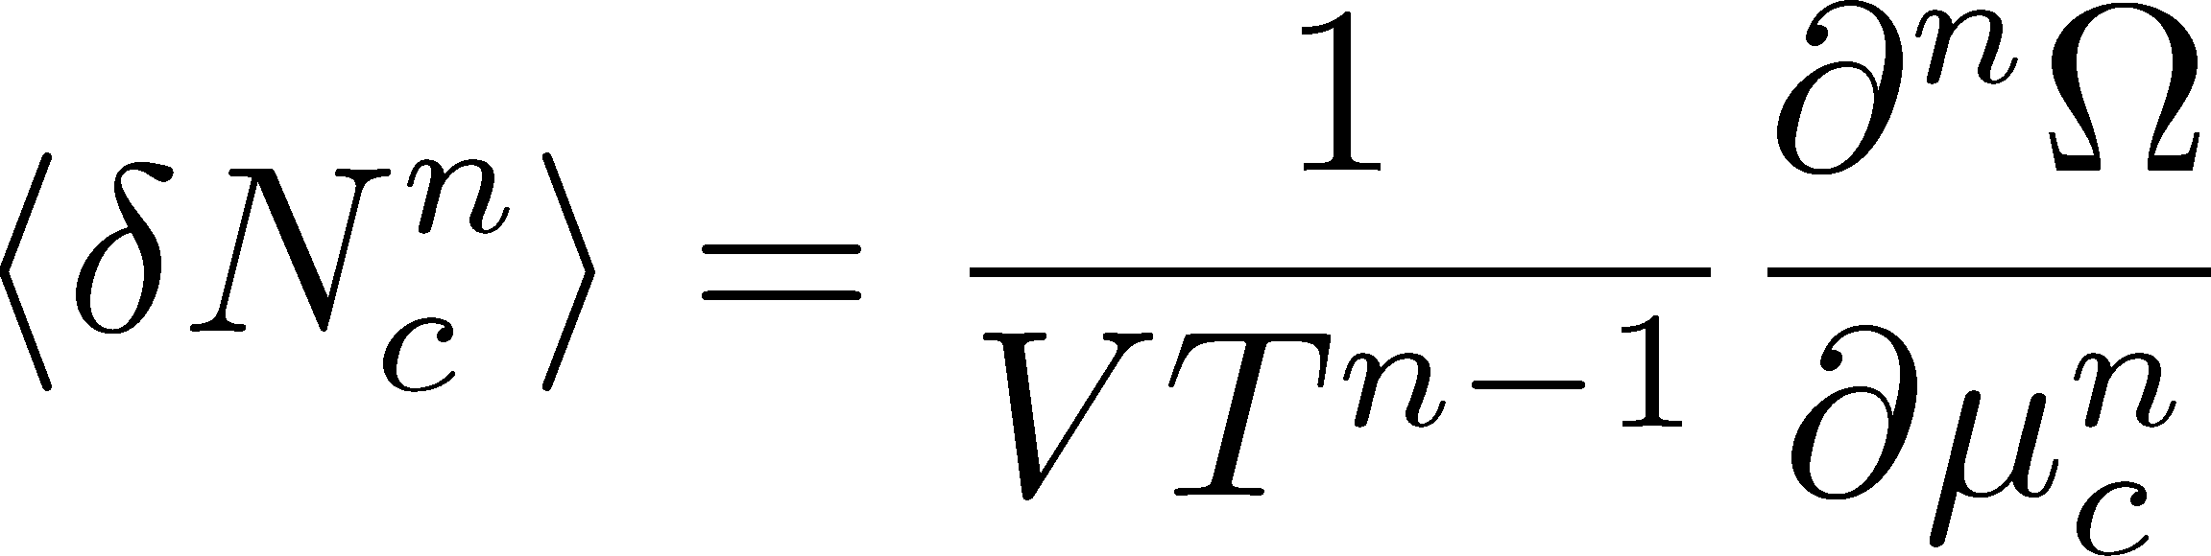

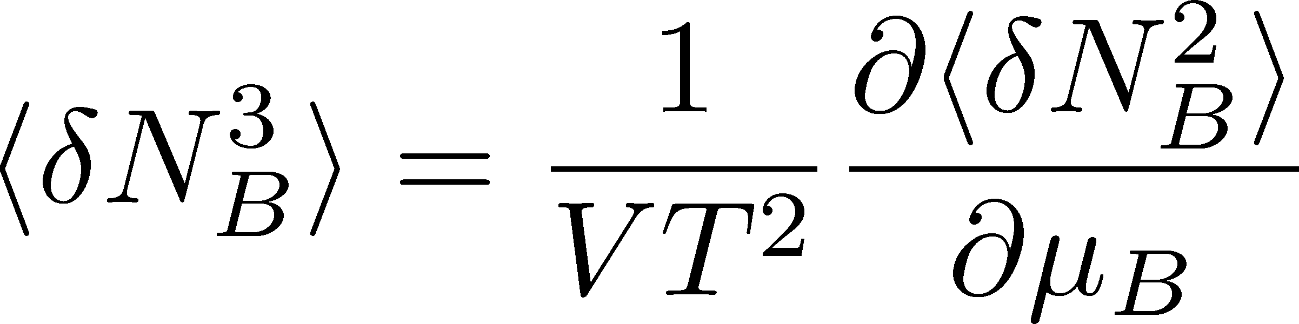
Conserved Charges : Theoretical Advantage
Definite definition for operators
as a Noether current
calculable on any theory
ex: on the lattice
Simple thermodynamic relations
Intuitive interpretation for the behaviors of cumulants
ex:
Asakawa, Ejiri, MK, 2009

Slide 8
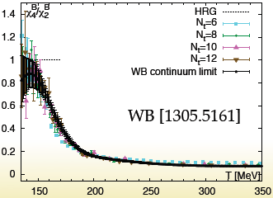
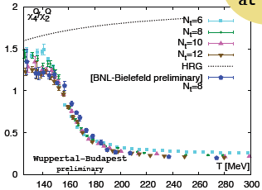
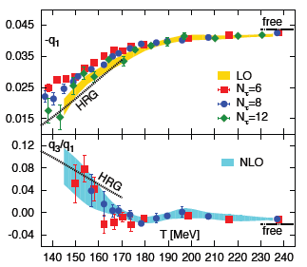
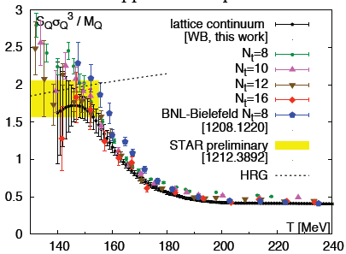
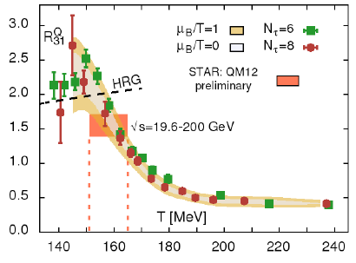
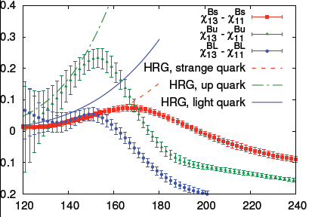
Recent Progress in Lattice Community
From LATTICE2013
presentations

Slide 9
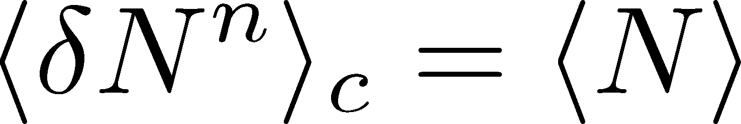
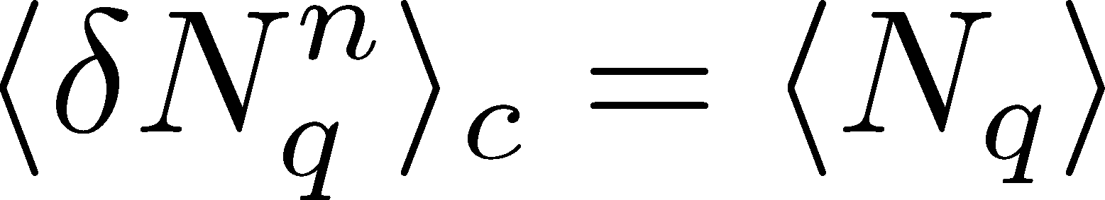
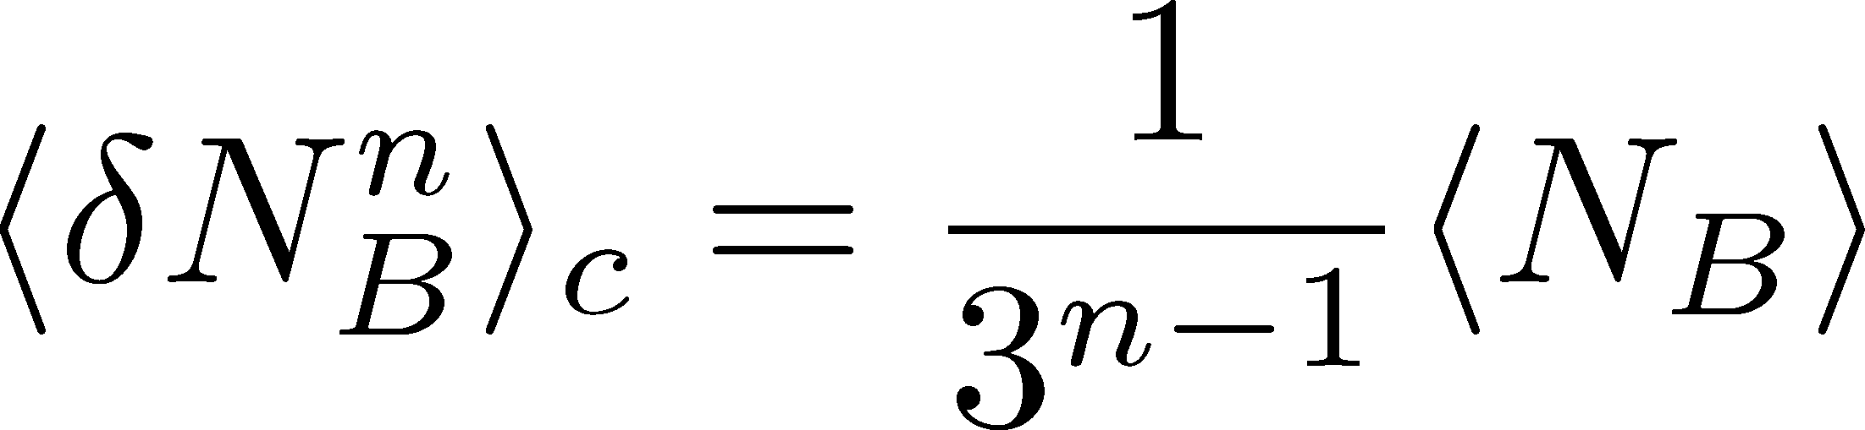
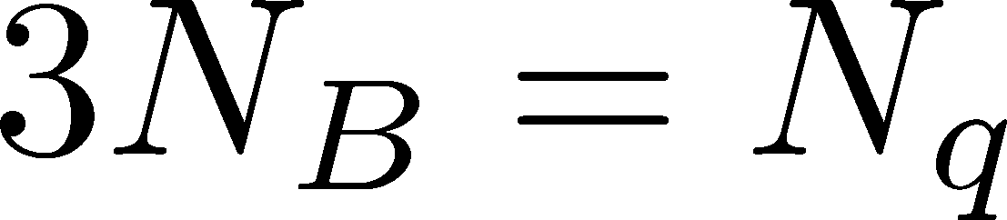
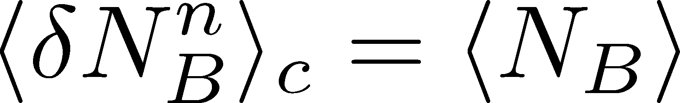
Fluctuations
Free Boltzmann → Poisson

Slide 10
Fluctuations
Free Boltzmann → Poisson
RBC-Bielefeld ’09

Slide 11
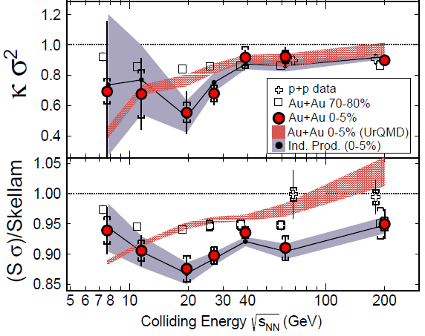
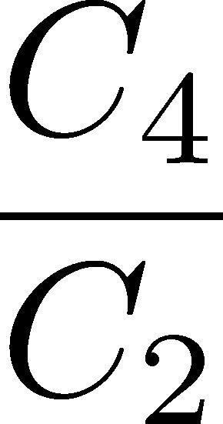
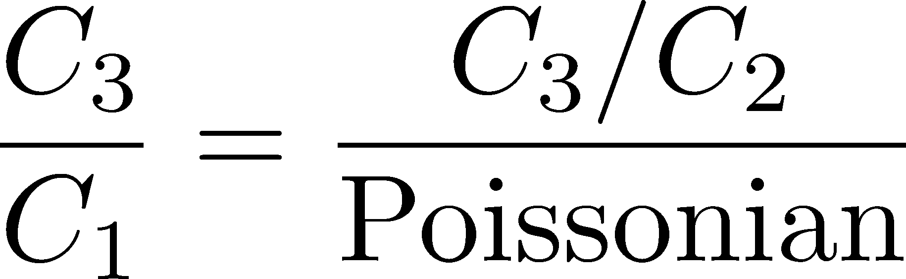


Proton # Cumulants @ STAR-BES
STAR,1309.5681
CAUTION!
Something
interesting??
proton number
baryon number
MK, Asakawa, 2011;2012

Slide 12
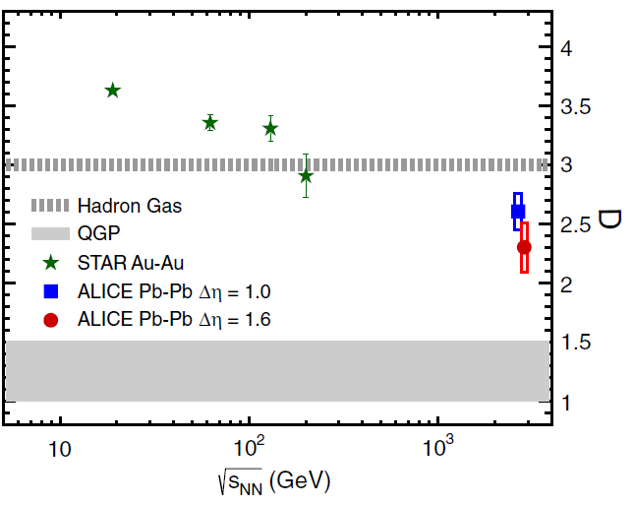

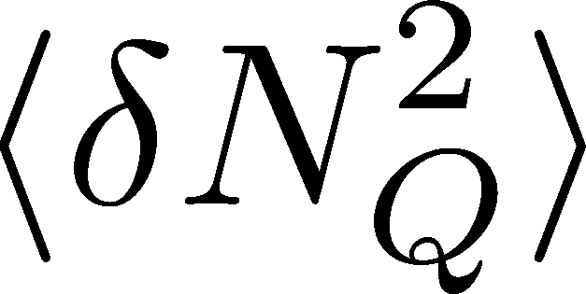
Charge Fluctuation @ LHC
ALICE, PRL110,152301(2013)
D-measure
D ~ 3-4 Hadronic
D ~ 1-1.5 Quark
significant suppression
from hadronic value
at LHC energy!
is not equilibrated at freeze-out at LHC energy!

Slide 13

Δη Dependence @ ALICE
ALICE
PRL 2013
t
Δη
z
rapidity window

Slide 14
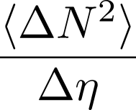
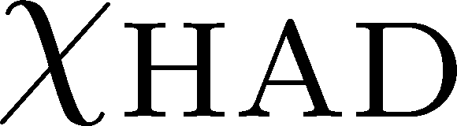
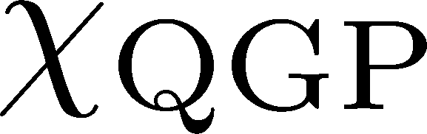


Time Evolution of Fluctuations
Quark-Gluon Plasma
Hadronization
Freezeout
Variation of a conserved charge is achieved only through diffusion.
The larger Δη,
the slower diffusion

Slide 15
Δη Dependence @ ALICE
ALICE
PRL 2013
t
Δη
z
Δη dependences of fluctuation observables
encode history of the hot medium!
Higher-order cumulants as
thermometer?

Slide 16



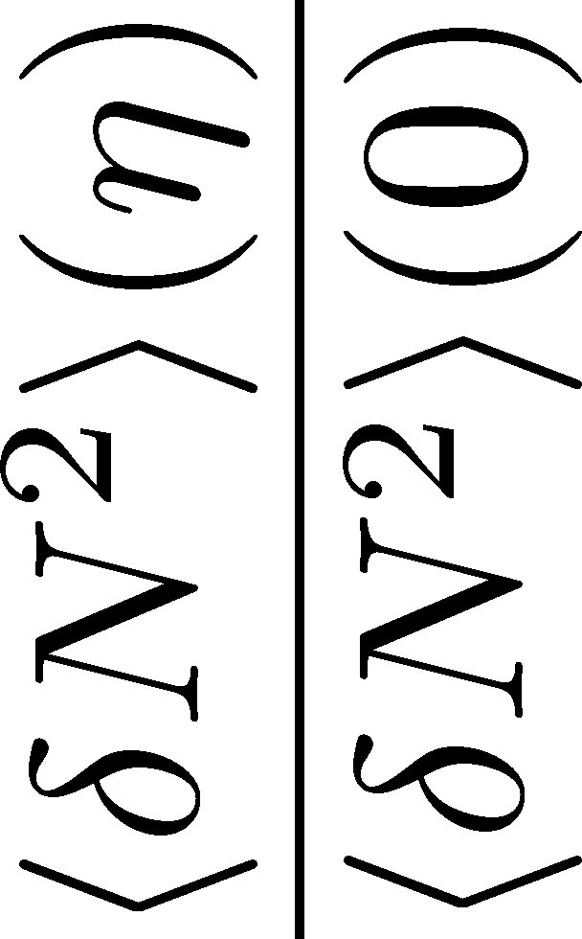

<δN_{B}²> and < δN_{p}² > @ LHC ?
should have different Δη dependence.
Baryon # cumulants are experimentally observable! MK, Asakawa, 2011;2012

Slide 17
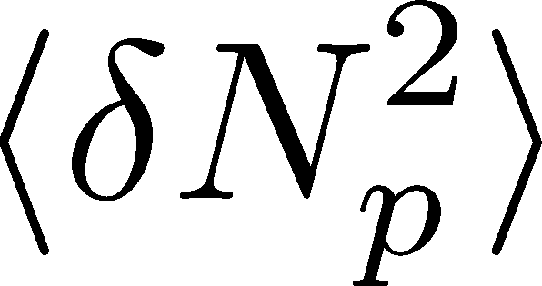

<δN_{B}²> and < δN_{p}² > @ LHC ?
should have different Δη dependence.
Baryon # cumulants are experimentally observable! MK, Asakawa, 2011;2012

Slide 18
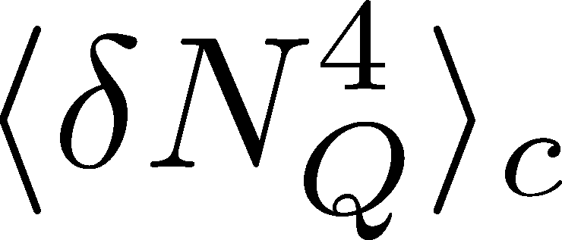

<δN_{Q}⁴> @ LHC ?
How does behave as a function of Δη?
suppression
or
enhancement

Slide 19
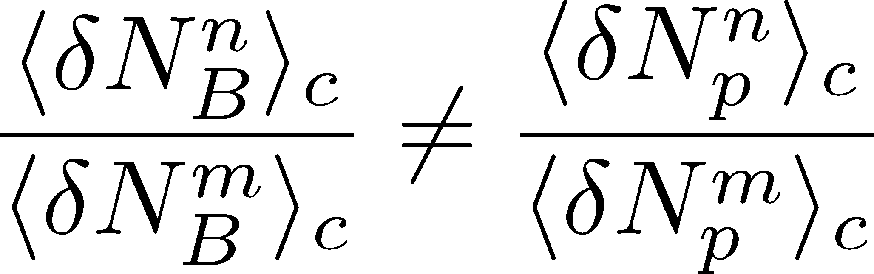
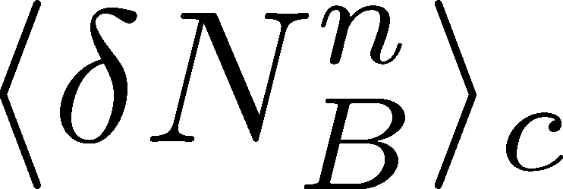
Baryon vs Proton Number Fluctuations
MK, Asakawa, PRC85,021901C(2012); PRC86, 024904(2012)
are experimentally observable

Slide 20
Nucleon Isospin as Two Sides of a Coin
N
p
n
Nucleons have
two isospin states.
MK, Asakawa,2012

Slide 21

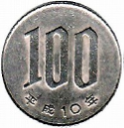
Nucleon Isospin as Two Sides of a Coin
a coin
N
p
n
Nucleons have
two isospin states.
Coins have two sides.
MK, Asakawa,2012

Slide 22


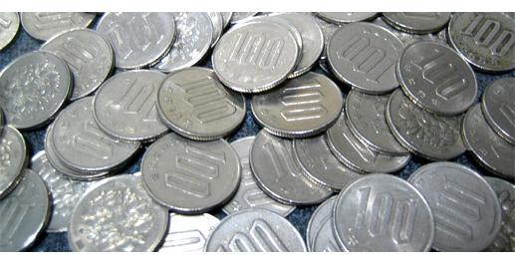
Slot Machine Analogy
= +
P (N)
N
P (N)
N

Slide 23
Extreme Examples
Fixed # of coins
Constant probabilities
N
N
N
N

Slide 24


Reconstructing Total Coin Number
P (N )= P (N )B_{1/2}(N ;N )
:binomial distr. func.

Slide 25
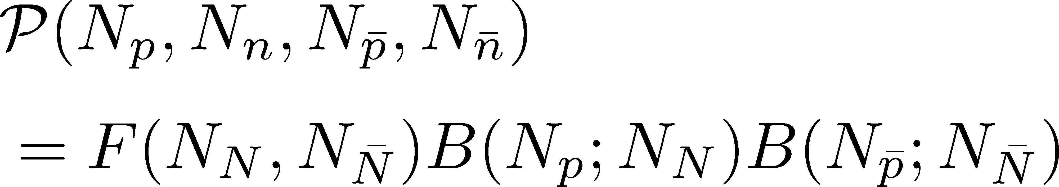
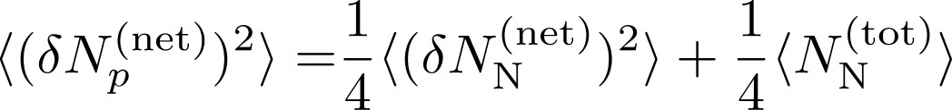
Reconstructing Baryon Number Cumulants
for any phase space in the final state.
for isospin symmetric medium
effect of isospin density <10% for √s>10GeV
Similar formulas up to any order!

Slide 26
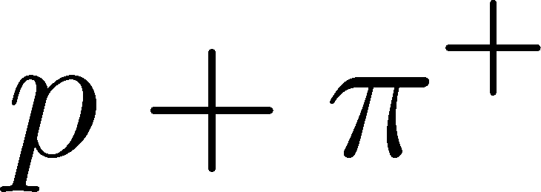
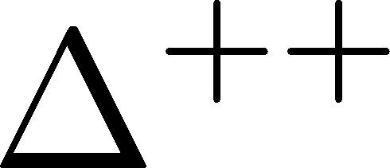
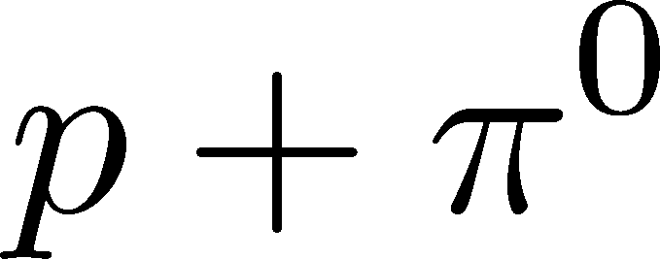

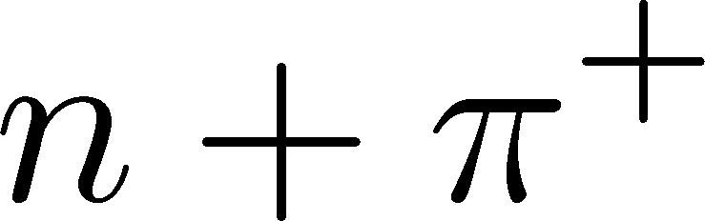
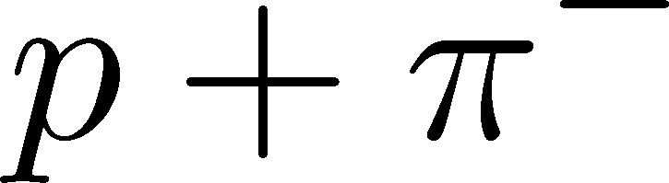

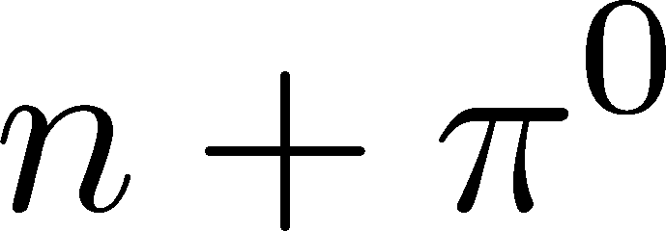
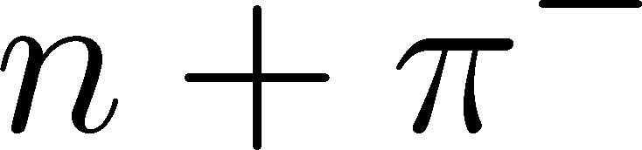

Δ(1232)
cross sections of p
3
1
2:1
2
1:2
decay rates of Δ

Slide 27
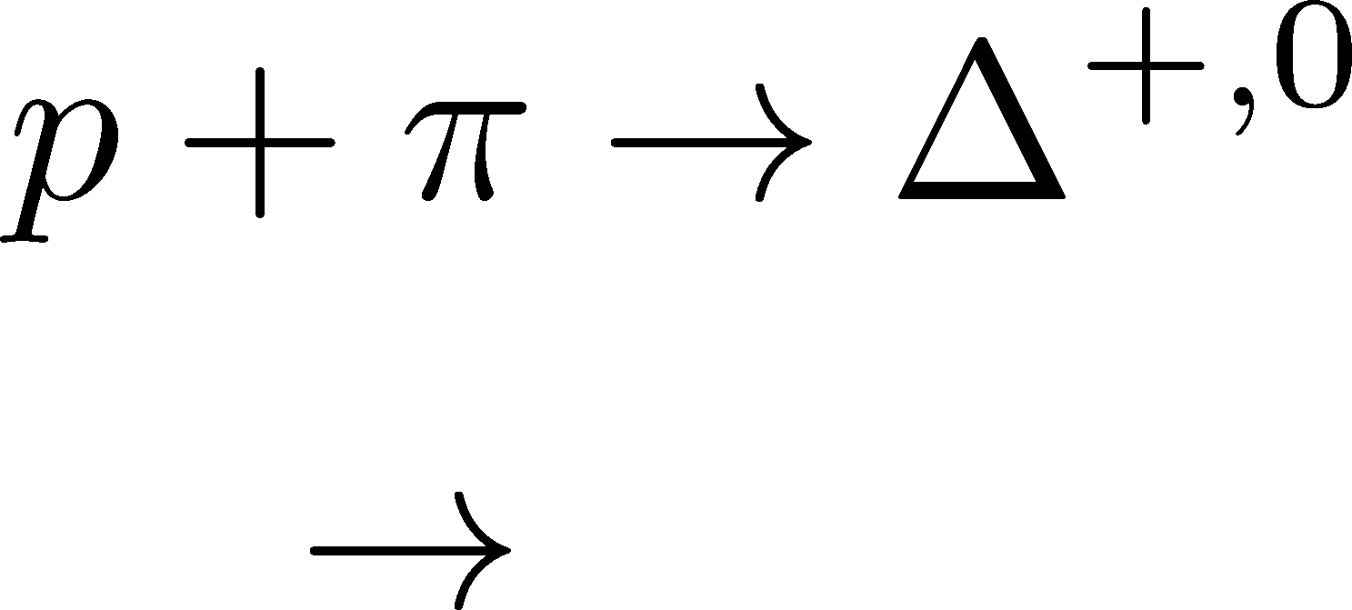


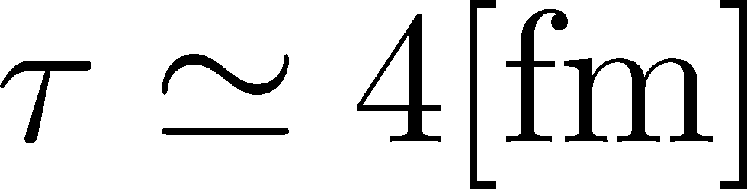

Δ(1232)
cross sections of p
3
1
2:1
2
1:2
decay rates of Δ
Lifetime to create Δ⁺ or Δ⁰
Hadronic stage

Slide 28
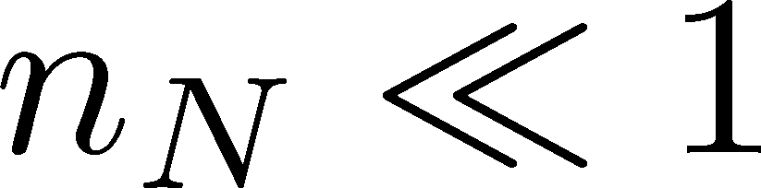


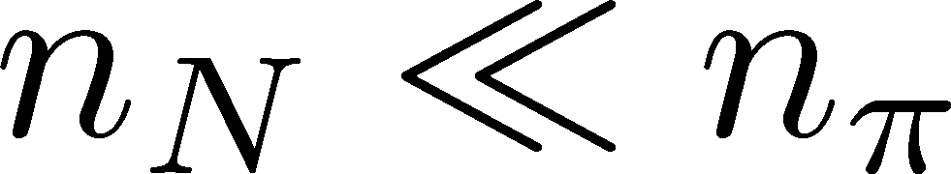

Nucleons in Hadronic Phase
time
chem. f.o.
hadronize
10~20fm
kinetic f.o.
rare NN collisions
no quantum corr.
mesons
baryons
many pions

Slide 29
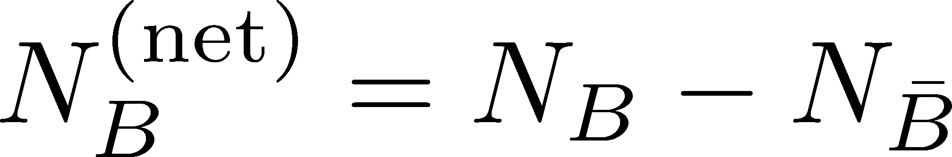
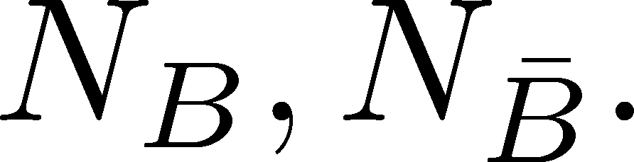
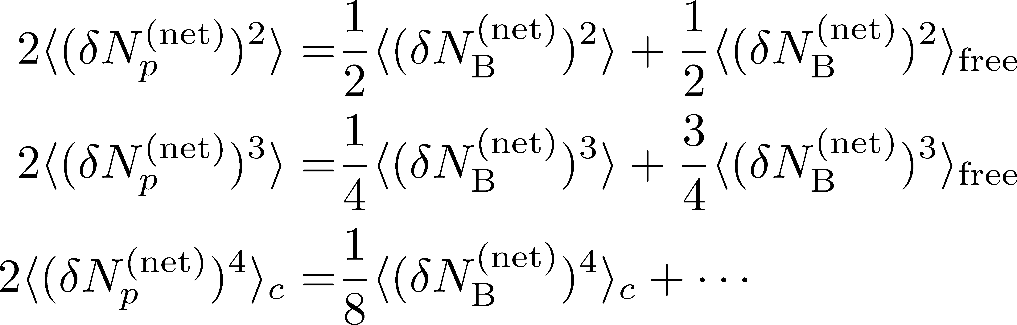
Difference btw Baryon and Proton Numbers
(1)
deviates from the equilibrium value.
(2) Boltzmann (Poisson) distribution for
genuine info.
Poissonian noise
Difference from Poisson (thermal) distribution
is suppressed in proton number fluctuations.

Slide 30
Difference btw Baryon and Proton Numbers
(1)
deviates from the equilibrium value.
(2) Boltzmann (Poisson) distribution for
genuine info.
Poissonian noise
Difference from Poisson (thermal) distribution
is suppressed in proton number fluctuations.

Slide 31
Time Evolution of
Higher Order Cumulants
MK, Asakawa, Ono, PLB728, 386 [arXiv:1307.2978]

Slide 32
<δN_{Q}⁴> @ LHC ?
How does behave as a function of Δη?
suppression
or
enhancement
ALICE
2013

Slide 33

Hydrodynamic Fluctuations
Landau, Lifshitz, Statistical Mechaniqs II
Kapusta, Muller, Stephanov, 2012
Stephanov, Shuryak, 2001
Stochastic diffusion equation
Markov (white noise)
+
continuity
Fluctuation of n is
Gaussian in equilibrium
Gaussian noise
cf) Gardiner, “Stochastic Methods”

Slide 34
How to Introduce Non-Gaussianity?
Stochastic diffusion equation
Choices to introduce non-Gaussianity in equil.:
n dependence of diffusion constant D(n)
colored noise
discretization of n

Slide 35
How to Introduce Non-Gaussianity?
Stochastic diffusion equation
Choices to introduce non-Gaussianity in equil.:
n dependence of diffusion constant D(n)
colored noise
discretization of n
our choice
Fluctuations measured in
HIC are almost Poissonian.
REMARK:

Slide 36
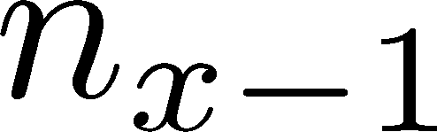






Diffusion Master Equation
Divide spatial coordinate into discrete cells
probability

Slide 37
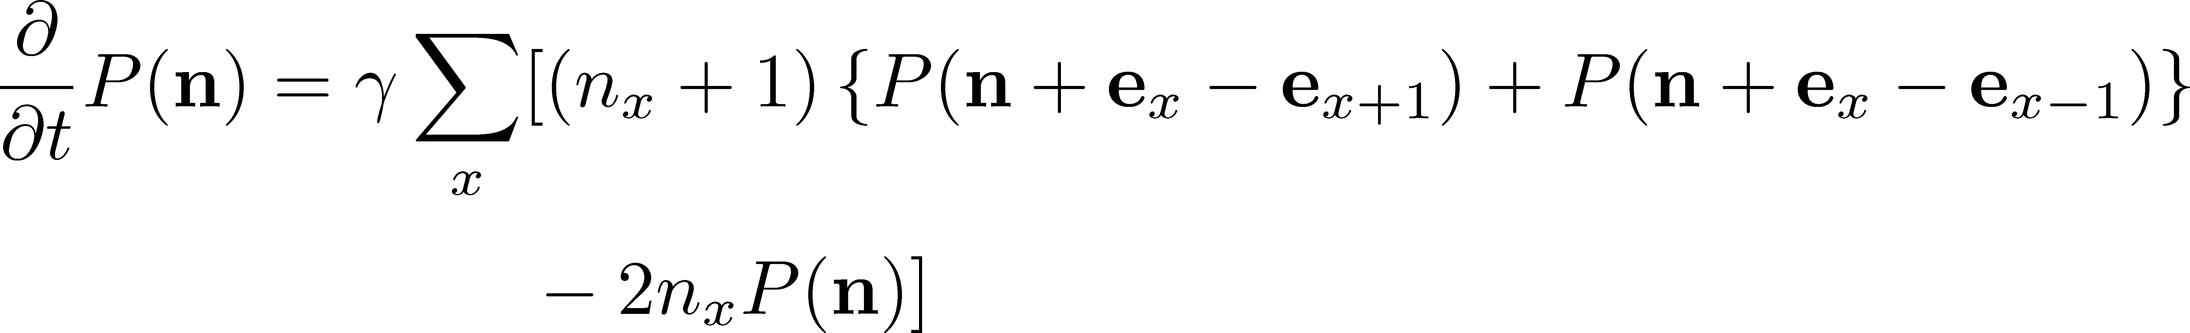
Diffusion Master Equation
Divide spatial coordinate into discrete cells
probability
Master Equation for P(n)
Solve the DME exactly, and take a→0 limit
No approx., ex. van Kampen’s system size expansion

Slide 38
Baryons in Hadronic Phase
time
chem. f.o.
hadronize
10~20fm
kinetic f.o.
Baryons behave like
Brownian pollens in water
mesons
baryons

Slide 39

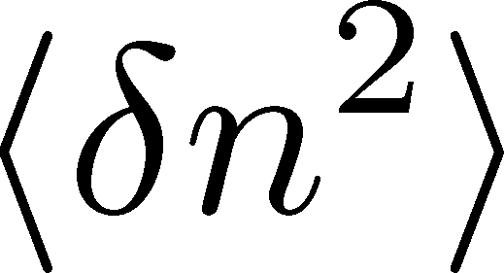
Solution of DME in a→0 Limit
1st order (deterministic)
consistent with diffusion equation with D=γa²
Continuum limit with fixed D=γa²
2nd order
consistent with stochastic diffusion eq.
(for sufficiently smooth initial conditions)
Shuryak, Stephanov, 2001
Nontrivial results for non-Gaussian fluctuations

Slide 40

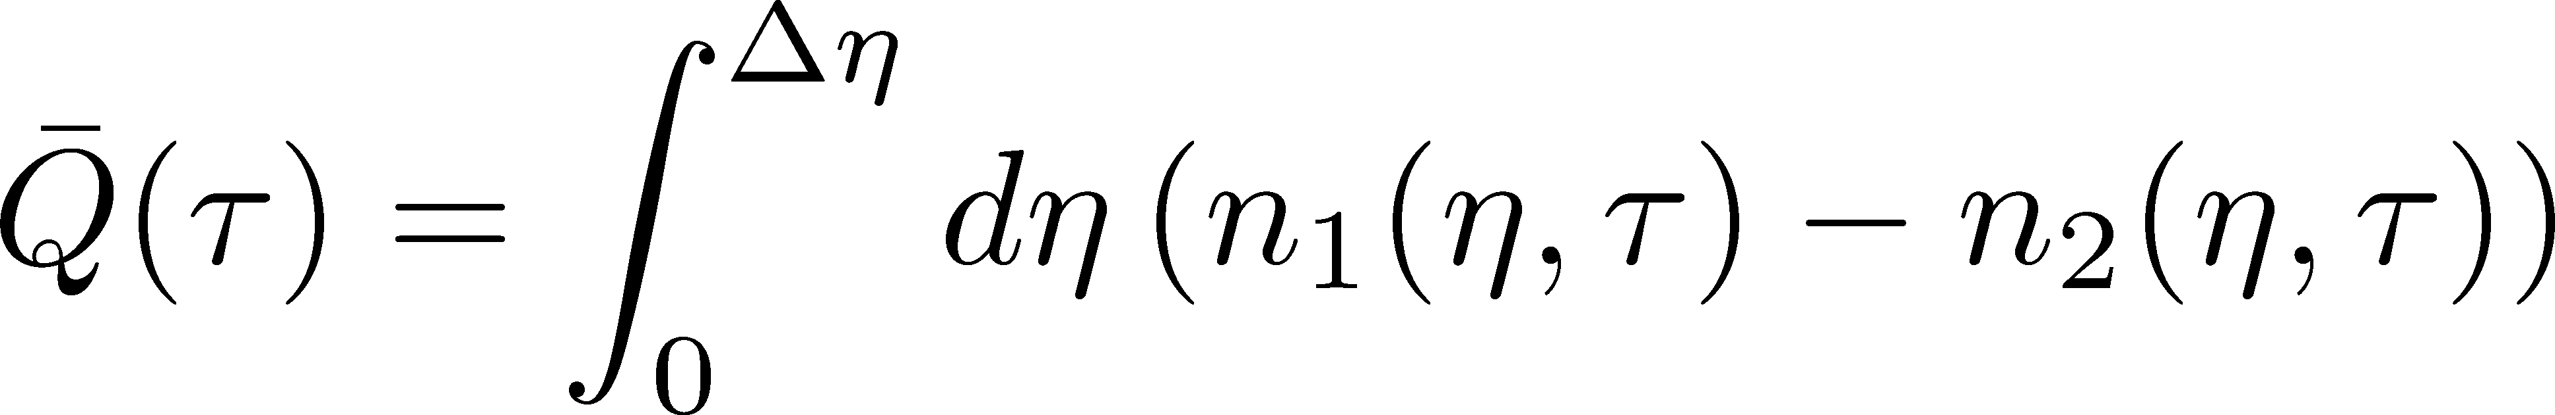
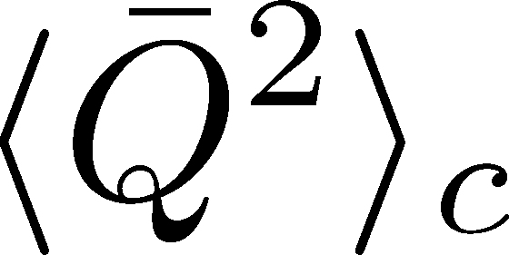

Net Charge Number
Prepare 2 species of (non-interacting) particles
Let us investigate
at freezeout time t

Slide 41




Δη Dependence at Freezeout
Initial fluctuations:
2nd
4th
parameter
sensitive to
hadronization

Slide 42




Total Charge Number
In recombination model,
6 quarks
6 antiquarks
can fluctuate, while does not.

Slide 43
<δN_{Q}⁴> @ LHC
boost invariant system
small fluctuations of CC at hadronization
short correlation in hadronic stage
Assumptions
1
4th-order cumulant will be suppressed at LHC energy!
Δη dependences encode various information on the dynamics of HIC!
0.5

Slide 44


Δη Dependence at STAR
STAR, QM2012
decreases as Δη becomes larger at RHIC energy.

Slide 45
Δη Dependence at STAR
STAR, QM2012
OUR SUGGESTIONS:
Plot <δN²> and <δN⁴> separately
Plot baryon number cumulants

Slide 46

Fluctuations @ J-PARC Energy
D-measure
No suppression of
at low collision energy.
Ingredients to be considered:
Bjorken expansion
pseudo rapidity vs coordinate-space rapidity
finite volume effect (global charge conservation)

Slide 47

Summary
Fluctuations in HIC are nonthermal!
Plenty of physics in Δη dependences of
various cumulants
Diagnosing dynamics of HIC
history of hot medium
mechanism of hadronization
diffusion constant
Physical meanings
of fluctuation obs.
in experiments.

Slide 48
Summary
Fluctuations in HIC are nonthermal!
Plenty of physics in Δη dependences of
various cumulants
Diagnosing dynamics of HIC
history of hot medium
mechanism of hadronization
diffusion constant
Physical meanings
of fluctuation obs.
in experiments.
Search of QCD Phase Structure in HIC

Slide 49
Open Questions & Future Work
Why the primordial fluctuations are observed only at LHC, and not RHIC ?
Extract more information on each stage of fireballs using fluctuations
Model refinement
Including the effects of
nonzero correlation length / relaxation time
global charge conservation
Non Poissonian system ← interaction of particles

Slide 50

Δη Dependence at Freezeout
Initial fluctuations:
2nd
4th
parameter
sensitive to
hadronization

Slide 51



Price of Baryon Number Reconstruction
Statistical error will be large.
Applicable only to high-energy collisions.
  Sufficiently large number of pions
  Approximate isospin symmetry

Slide 52


Time Evolution in Hadronic Phase
Hadronization (initial condition)
Boost invariance / infinitely long system
Local equilibration / local correlation
suppression owing to
local charge conservation
strongly dependent on
hadronization mechanism

Slide 53
Time Evolution in Hadronic Phase
Hadronization (initial condition)
Boost invariance / infinitely long system
Local equilibration / local correlation
Time evolution via DME
suppression owing to
local charge conservation
strongly dependent on
hadronization mechanism
Freezeout

Slide 54






Chemical Reaction 1
x: # of X
a: # of A (fixed)
Master eq.:
Cumulants with fixed initial condition
initial
equilibrium

Slide 55





Chemical Reaction 2
2nd
3rd
4th
Higher-order
cumulants
grow slower.

Slide 56
Time Evolution in HIC
Quark-Gluon Plasma
Hadronization
Freezeout

Slide 57

Hydrodynamic Fluctuations
Landau, Lifshitz, Statistical Mechaniqs II
Kapusta, Muller, Stephanov, 2012
Diffusion equation
Stochastic diffusion equation
Stochastic Force
determined by fluctuation-dissipation relation

Slide 58






Δη Dependence
Shuryak, Stephanov, 2001
Initial condition:
Translational invariance
initial
equilibrium
equilibrium
initial

Slide 59
Non-Gaussianity in Fluctuating Hydro?
It is impossible to directly extend the theory
of hydro fluctuations to treat higher orders.
No a priori extension of FD relations to higher orders
Markov process＋continuous variable
Theorem
➔Gaussian random force
cf) Gardiner, “Stochastic Methods”

Slide 60


Global Charge Conservation
Sakaida,
poster session (3rd week)
Solve SDE or DME in a finite volume
Effect of a boundary
appears only in the
range of diffusion length
NO boundary
with boundary
Effect of GCC can be read off from Δη dependence.
No GCC effect in ALICE experiments!

Slide 61


Non-Gaussianity
fluctuations (correlations)
Non-Gaussianity
PLANCK
: statistics insufficient to see non-Gaussianity…(2013)

Slide 62
Fluctuations
Observables in equilibrium are fluctuating.
P(N)
N
V
N

Slide 63




Fluctuations
Observables in equilibrium are fluctuating.
P(N)
N
V
N
Variance:
Non-Gaussianity
Skewness:
Kurtosis:

Slide 64



Event-by-Event Analysis @ HIC
Fluctuations can be measured by e-by-e analysis in HIC.
STAR, PRL105 (2010)
Detector

