Slide 1
Fluctuations and
QCD Phase Structure
Masakiyo Kitazawa
(Osaka U.)

Slide 2
My Messages
Fluctuations are invaluable observables in HIC
But, we must understand them in more detail
It’s possible, interesting, and important

Slide 3
Why Fluctuations?

Slide 4
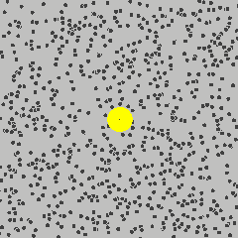
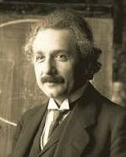
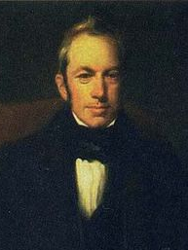
Brownian Motion
A. Einstein
1905
from Wikipedia
Fluctuations opened atomic physics

Slide 5
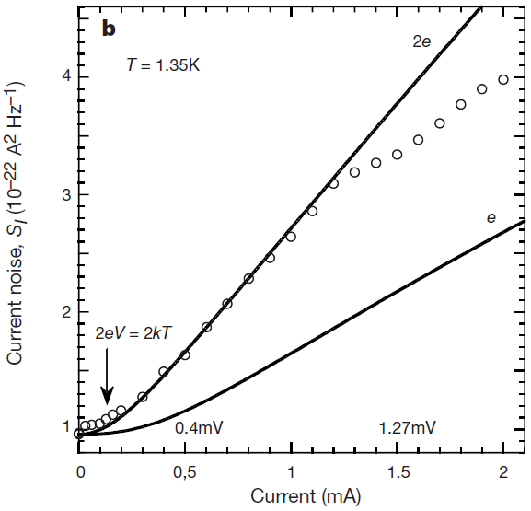
Shot Noise
at Normal-Superconductor Junction
X. Jehl+, Nature405,50 (2000)
Normal
normal
current
super
Super
Normal
Normal
Similar experiments for fractional QHE ex. Saminadayar+, PRL79,2526(1997)

Slide 6
Conserved-Charge Fluctuations
Fluctuations of CC : rigorously defined in a theory
operators as the Noether current
as derivatives of the partition function
They are lattice observables
Fluctuations of CC
=
LAT-HIC crossover
QCD phase diagram 3, Wed. 11:00-13:30

Slide 7



Electric Charge Fluctuation
Asakawa,Heinz,Muller; Jeon,Koch,2000
D-measure
D ~ 3-4 Hadronic
D ~ 1-1.5 QGP

Slide 8
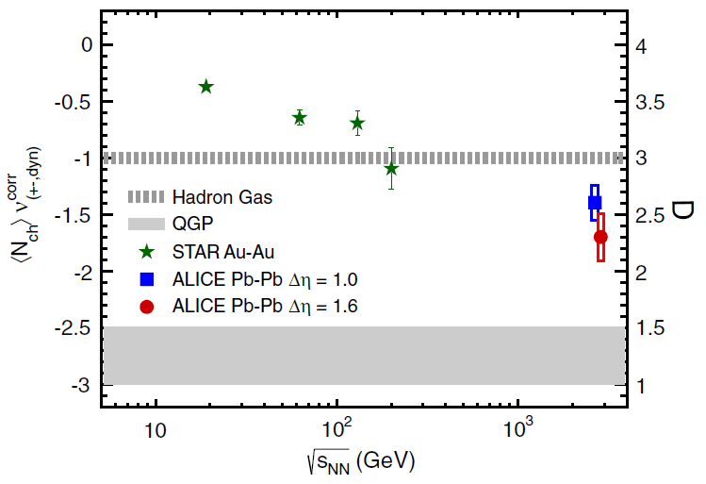
Electric Charge Fluctuation
PHENIX (2002); STAR (2003)
ALICE, PRL 110, 152301 (2013)
hadronic
D measure
STAR
Suppression
@ LHC energy
D ~ 3-4 Hadronic
D ~ 1-1.5 QGP
No suppression at RHIC energy
Fluctuations @ LHC cannot be described by hadronic d.o.f.

Slide 9

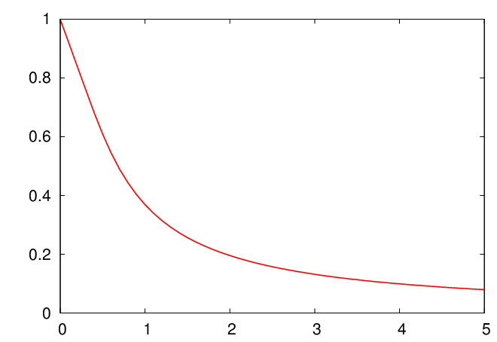



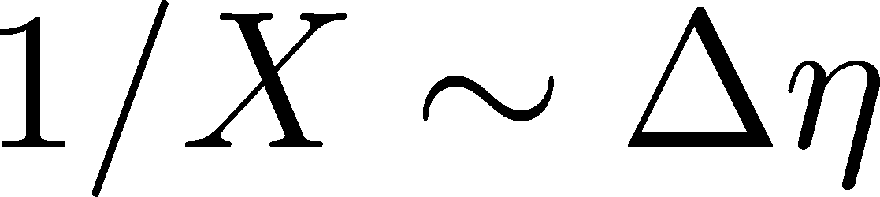
Rapidity Window Dependence
ALICE, PRL 110, 152301 (2013)
hadronic
Smaller Δη
more hadronic
Larger Δη
more QGP like
Stochastic Diffusion eq.
Shuryak,Stephanov,2001
Same information in
balance function
to be studied by fluctuating hydro.

Slide 10
Various Contributions
Initial fluctuations
Effect of jets
Negative binomial (?)
Final state rescattering
Coordinate vs pseudo rapidities
Particle missID
Efficiency correction
Global charge conservation
Enhance
Enhance
Enhance
Enhance to Poisson
Enhance to Poisson
Enhance to Poisson
Enhance to Poisson
Suppress

Slide 11



Global Charge Conservation
Jeon,Koch,2000
Bleicher,Jeon,Koch,2001
For equilibrated medium

Slide 12
Global Charge Conservation
Jeon,Koch,2000
Bleicher,Jeon,Koch,2001
For equilibrated medium
Solving the time evolution…
GCC effect on the hadronic
diffusion is negligible in the
ALICE result!
detector
coverage
GCC effect
Sakaida, Poster I-35

Slide 13
Electric-Charge Fluctuations
Electric charge fluctuations is suppressed at LHC!
The suppression is most probably attributed to primordial physics
Qualitative difference b/w RHIC and LHC
… but why?

Slide 14
Non Gaussianity

Slide 15
Non-Gaussianity
CMB
Cosmic Microwave Background
Mesoscopic Systems
No statistically-significant signals
Full counting statistics
Cumulants up to 5th order
Planck, 2013
Gustavsson+, Surf.Sci.Rep.64,191(2009)

Slide 16
Non-Gaussianity in HIC
Ratio of conserved charges
Critical enhancement
Sign change
Strange confinement
Distribution funcs themselves
Ejiri,Karsch,Redlich(2005)
Stephanov(2009)
Asakawa,Ejiri,MK (2009); Friman+(2011); Stephanov(2011)
BNL-Bielefeld(2013)
Morita+(2013); Nakamura (Wed.)

Slide 17






Ratio of Cumulants
Ejiri, Karsch, Redlich, 2005
hadronic
quark-gluon

Slide 18




Strange Confinement
BNL-Bielefeld,PRL(2013)
H.T. Ding, This Morning
Baryonic
baryons confined
something else
Strangeness
strangeness confined
something else
Many lattice studies (LAT-HIC crossover):
Budapest-Wuppertal, 2013; BW,1403.4578; BNL-Bi.,1404.4043; Gupta+,1405.2206;
Ratti, Wed.; Schmidt, Wed.; Nakamura, Wed.; Sharma, J-13

Slide 19
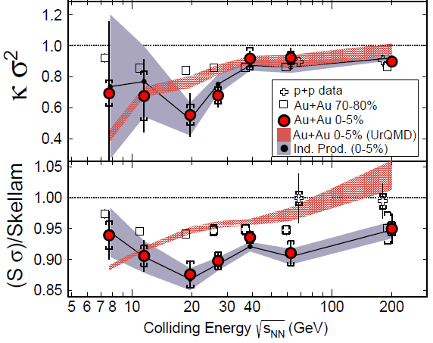


Proton Number Cumulants at RHIC-BES
STAR 2012
STAR, PRL112,032302(2014)
Exp. results are close to and less than Poissonian values.
Something interesting around

Slide 20
Effects of Various Contributions
Initial fluctuations
Effect of jets
Negative binomial (?)
Final state rescattering
Coordinate vs pseudo rapidities
Particle missID
Efficiency correction
Global charge conservation
Enhance
Enhance
Enhance
Enhance to Poisson
Enhance to Poisson
Enhance to Poisson
Enhance to Poisson
Suppress

Slide 21

Caution!!
proton number
cumulants
baryon number
cumulants
Let’s clarify their relation!
MK, Asakawa (2012;2012)

Slide 22


Nucleon isospin and a coin
a coin
N
p
n
Nucleon has
two isospin states.
A coin has two sides.
MK, Asakawa,2012

Slide 23





Slot Machine Analogy
= +

Slide 24

Reconstructing Total Coin Number

Slide 25
















Charge Exchange Reaction
Isospin of N is not
frozen at chemical
freezeout!
cross sections of p
3
1
2:1
2
1:2
mean reaction time
< 5fm/c
decay rates of Δ

Slide 26



Nucleons in Hadronic Medium
time
chem. f.o.
kinetic f.o.
hadronize
NOTE:
so many pions
rare NN collisions
no quantum corr.
mesons
baryons

Slide 27


Difference b/w N_{B} and N_{p}
net-cumulants deviate from thermal value
But, are Poissoian
Assumptions:
genuine info.
noise
Proton number cumulants are dominated by Poissonian noise
cf.) Nahrgang+, arXiv:1402.1238

Slide 28

Efficiency Correction
MK, Asakawa, 2012
Bdzak, Koch, 2012
STAR, 2013
If efficiency for each
particle is uncorrelated
Electric charge
binomial correction to
distribution function
STAR, arXiv:1402.1558
for Particle missID: Ono,Asakawa,MK, PRC,2013

Slide 29
More Information on/from Fluctuations
Δη dependence
MK, Asakawa, Ono,PLB728, 386 (2014)

Slide 30



Δη Dep. of Non-Gaussianity
enhance?
suppress?
How does the 4-th order cumulant
behave as a function of Δη?

Slide 31
Fluctuating Hydrodynamics?
Distributions in experiments are close to Poissonian
Cumulants are expected to increase in the hadronic medium
These behaviors cannot be described by
the theory of hydrodynamic fluctuations

Slide 32
Nucleons in Hadronic Medium
Baryons in hadronic medium
behave like Browinian pollen
time
chem. f.o.
kinetic f.o.
hadronize
mesons
baryons

Slide 33









Diffusion Master Equation
MK,Asakawa,Ono,PLB728,386(2014)
Divide spatial coordinate into discrete cells
probability
Master Equation
Solve the DME exactly, and take a→0 limit

Slide 34

hadronization
chemical freezeout
Initial condition
boost invariance
locality of fluctuations
small cumulants
Brownian
diffusion
kinetic freezeout
Comments:
agreement with stochastic diffusion eq. up to Gaussian fluctuaion
Poisson (Skellam) distribution in equilibrium: consistent with HRG

Slide 35

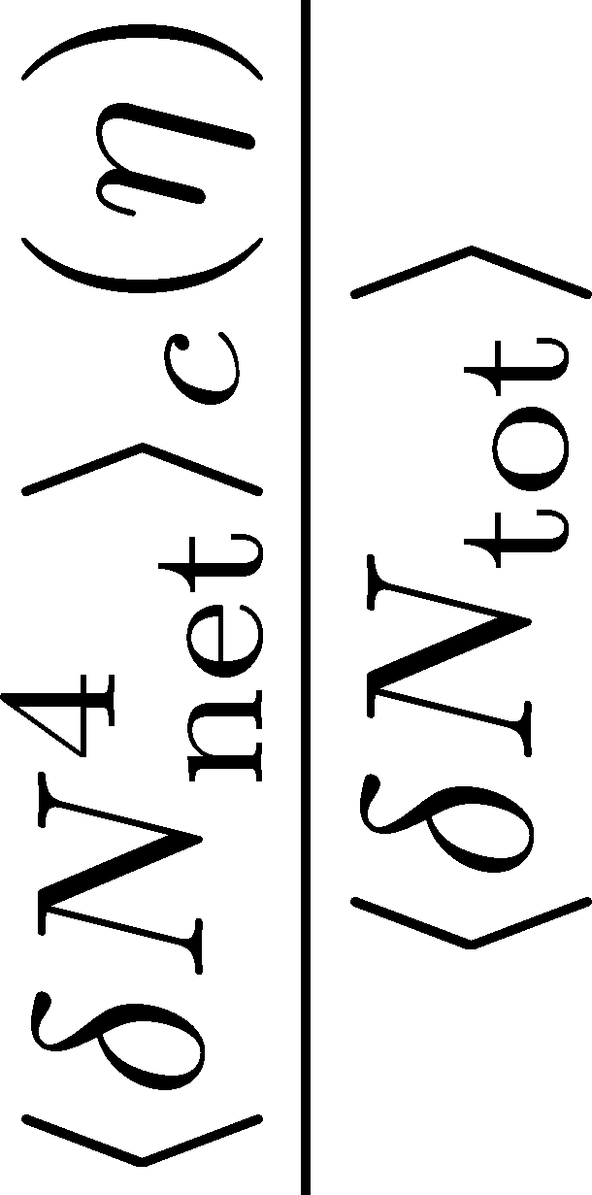

4th order Cumulant at ALICE
MK, Asakawa,Ono (2014)
Sakaida+, poster I-35
rapidity coverage at ALICE
4th order cumulant is sensitive to
initial fluctuation / transport property / confinement
It can be non-monotonic and negative!

Slide 36
Δη Dep. of Non-Gaussianity
enhance?
suppress?
How does the 4-th order cumulant
behave as a function of Δη?

Slide 37
Suggestions to Experimentalists
many conserved charges
electric charge, baryon number, (and strangeness?)
with different diffusion constans
various cumulants
second, third, fourth, mixed, (and much higher?)
Δη window dependences
primordial thermodynamics, transport property, confinement
no normalization
Beam Energy Scan
LHC, RHIC-BES, FAIR, NICA, J-PARC, …

Slide 38
My Messages
Fluctuations are invaluable observables in HIC
But, we must understand them in more detail
It’s possible, interesting, and important
primordial thermodynamics, confinement nature,
transport property, LAT-HIC crossover, etc.
qualitative difference between RHIC and LHC
real baryon number fluc. / various corrections / thermal or non-thermal
We are just arriving at the starting point to explore QCD phase structure with fluctuations!

Slide 39
backup

Slide 40
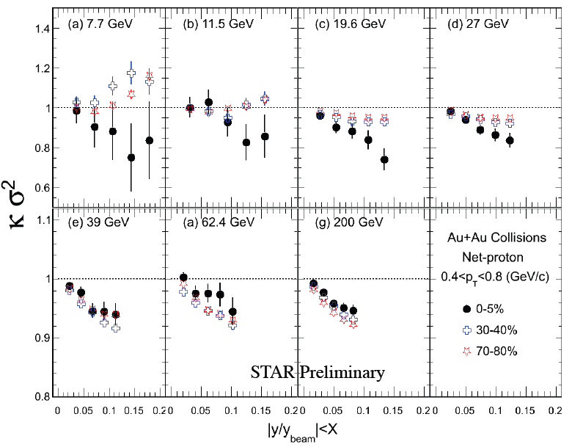
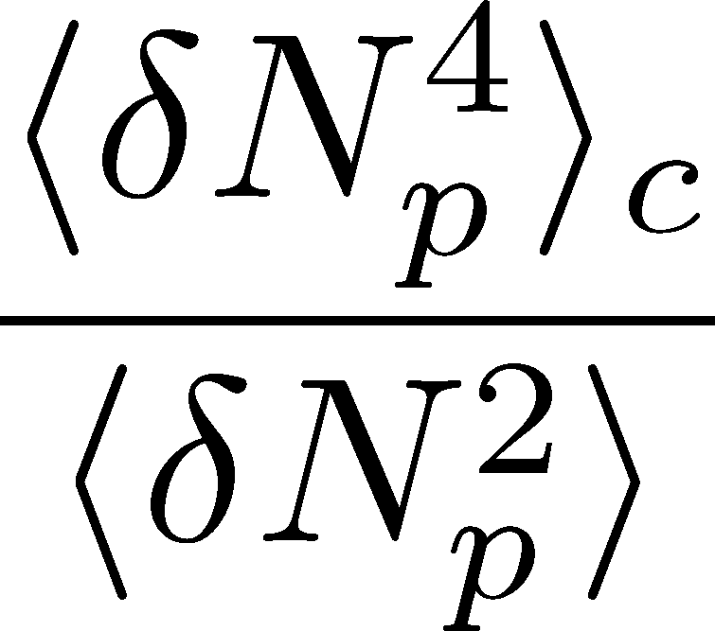
Δη Dependence at STAR
STAR, QM2012
decreases as Δη becomes larger at RHIC energy.

Slide 41

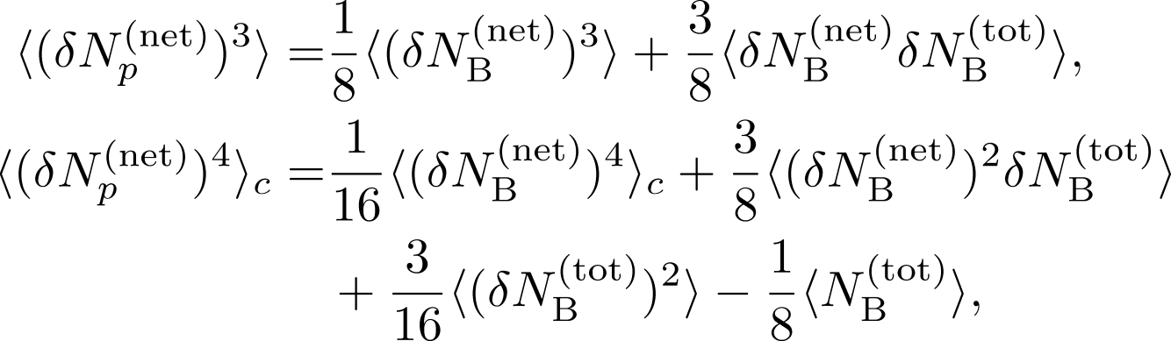

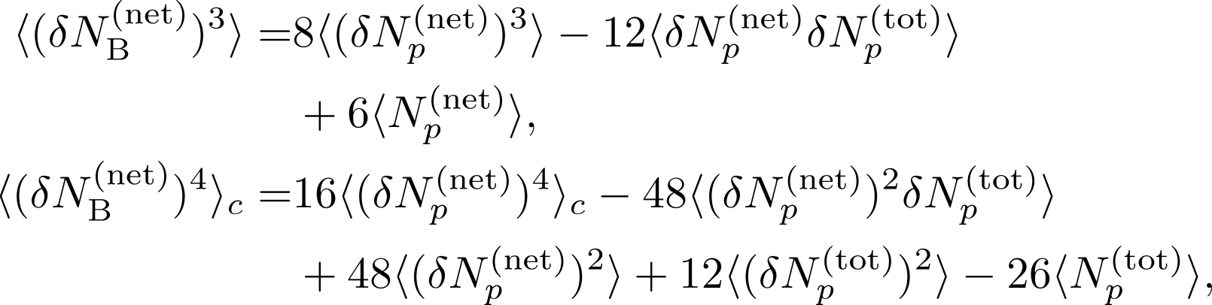
3rd & 4th Order Fluctuations

Slide 42
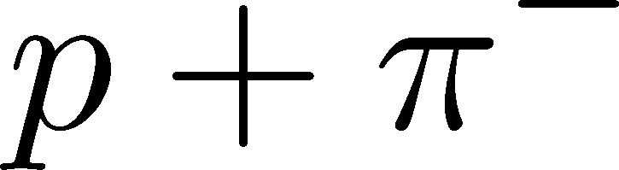


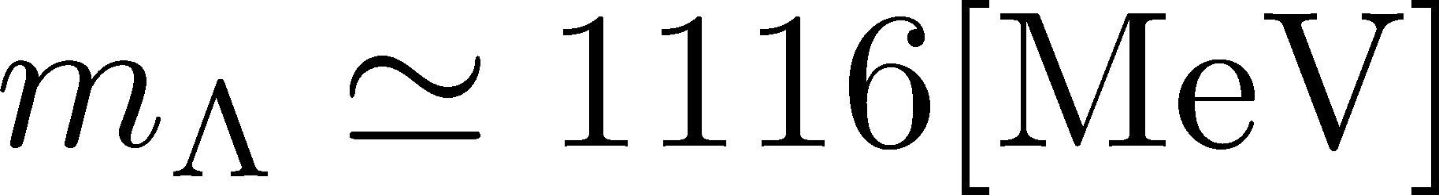
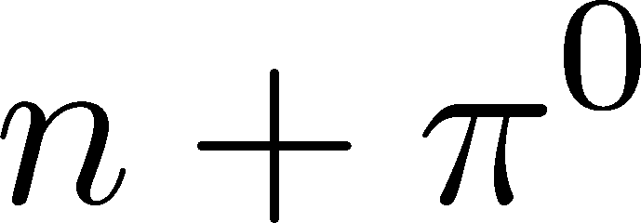
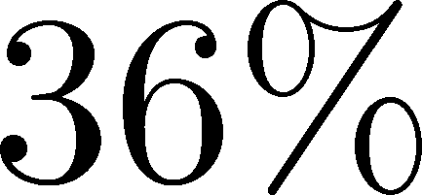

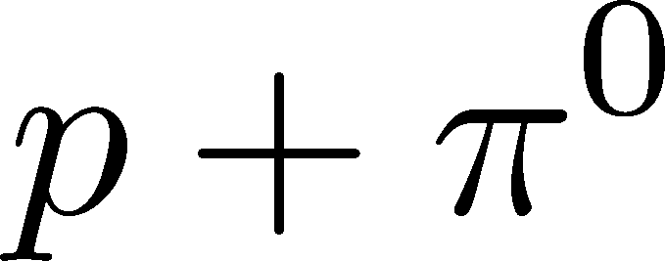


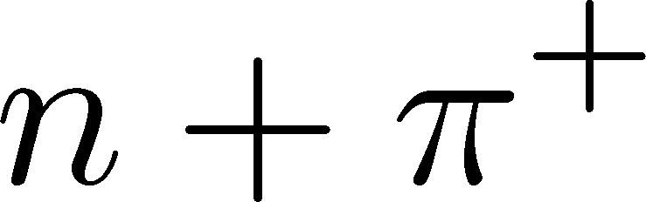


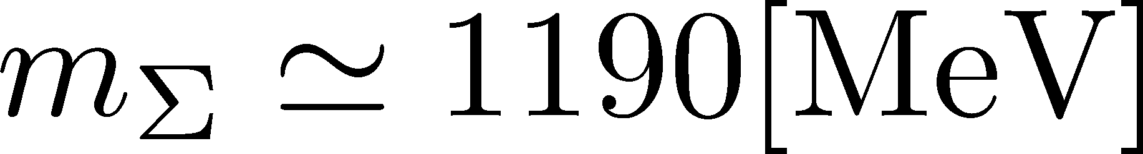

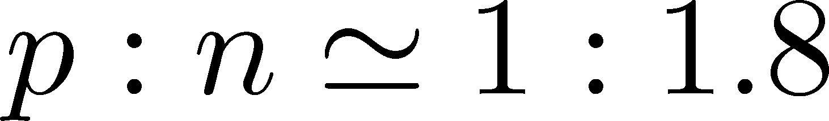


Strange Baryons
Decay Rates:
Decay modes:
Regarding these ratios even, protons from these decays
is incorporated into the binomial distribution. Then, N_{N}→N_{B}

Slide 43
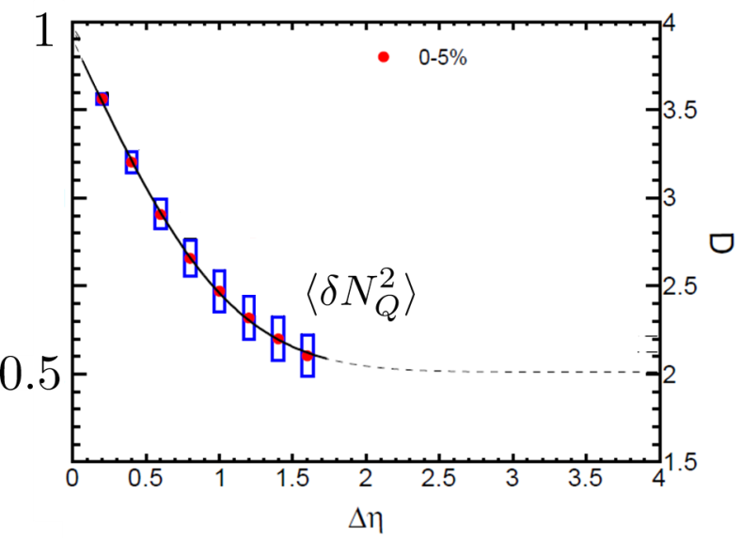


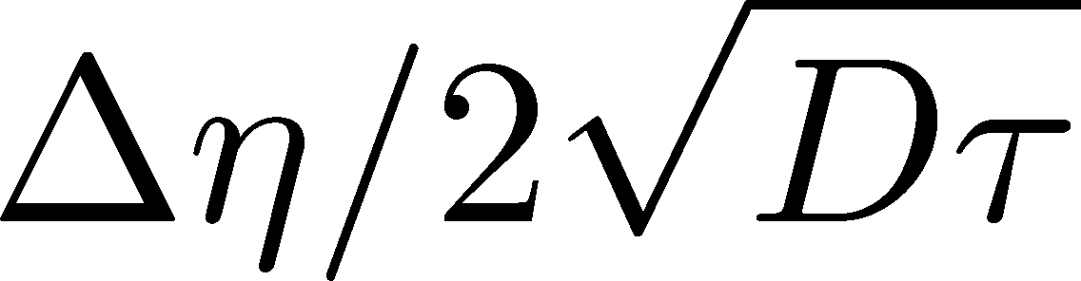
Δη Dependence at Freezeout
Initial fluctuations:
2nd
4th
parameter
sensitive to
hadronization

Slide 44
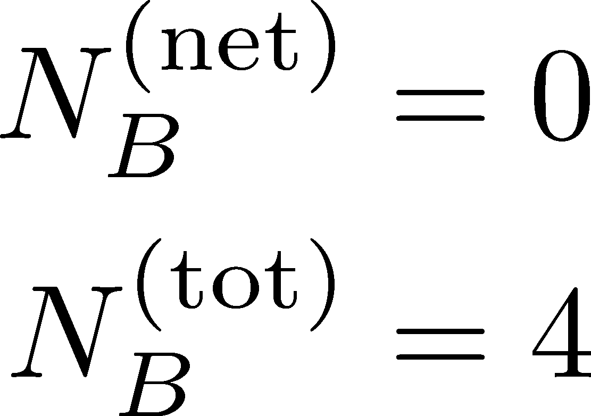
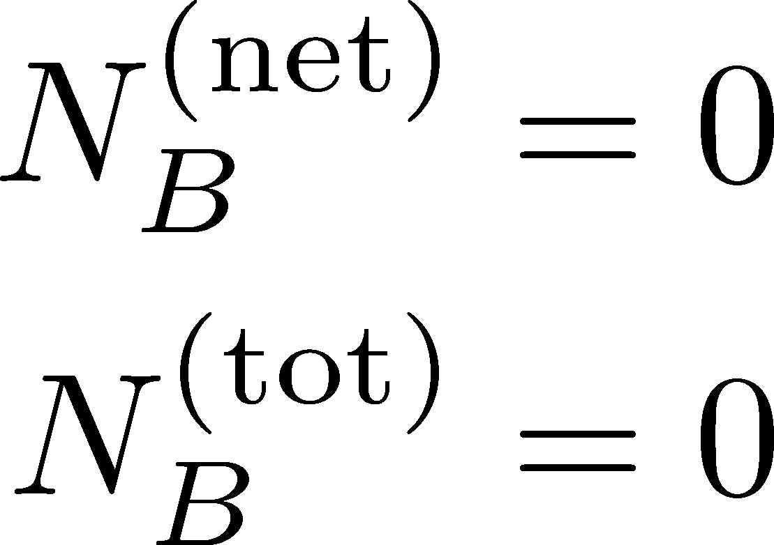
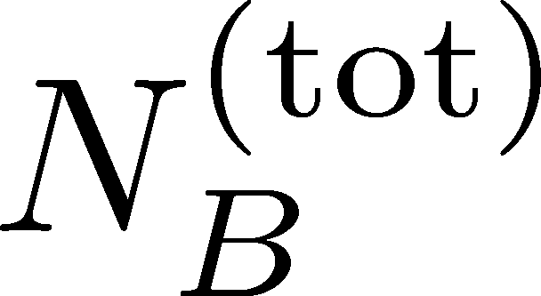
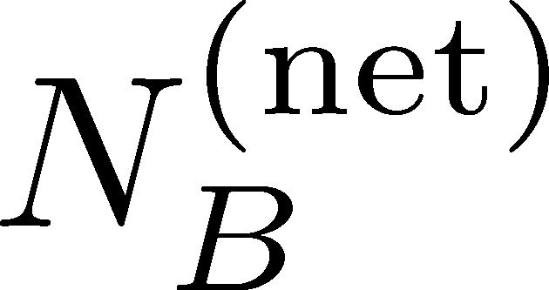
Total Charge Number
In recombination model,
6 quarks
6 antiquarks
can fluctuate, while does not.

