Slide 1
Thermodynamics of SU(3) gauge theory from gradient flow
Masakiyo Kitazawa
(Osaka U.)
Asakawa, Hatsuda, Itou, MK, Suzuki (FlowQCD Collab.), arXiv:1312.7492[hep-lat]

Slide 2



energy
momentum
stress
pressure
Noether current / generator of space-time translation

Slide 3


energy
momentum
stress
pressure
Noether current / generator of space-time translation
Einstein Equation
Hydrodynamic Eq.

Slide 4




The definition of on the lattice is nontrivial…
… because of the lack of translational symmetry
cf) Caracciolo+ (1989)

Slide 5
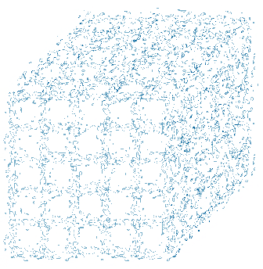
Rough Idea
coarse
graining
no translational
invariance
translational symmetry
is recovered!

Slide 6
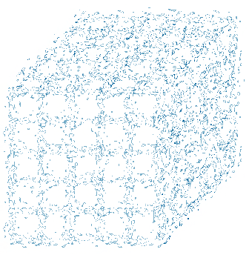

lattice regularized
gauge theory
YM gradient flow
continuum theory
( with dimensional regularization )
continuum theory
( with dimensional regularization )
YM gradient flow
Luescher, Weiss (2012)
Suzuki (2013)

Slide 7

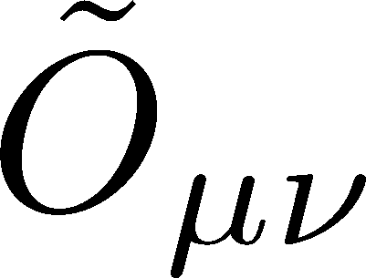
lattice regularized
gauge theory
YM gradient flow
equivalent!
UV finite
continuum theory
( with dimensional regularization )
continuum theory
( with dimensional regularization )
analytic relation
(in perturbation)
YM gradient flow
Luescher, Weiss (2012)
Suzuki (2013)

Slide 8



What we can measure with
bulk thermodynamics
(energy density, pressure)
correlation functions
viscosity, thermal excitation
vacuum structure?
fluctuations, specific heat
non-Gaussian fluctuations, etc.
Asakawa, Ejiri, MK (2009)
pink chars:
T>0 physics

Slide 9
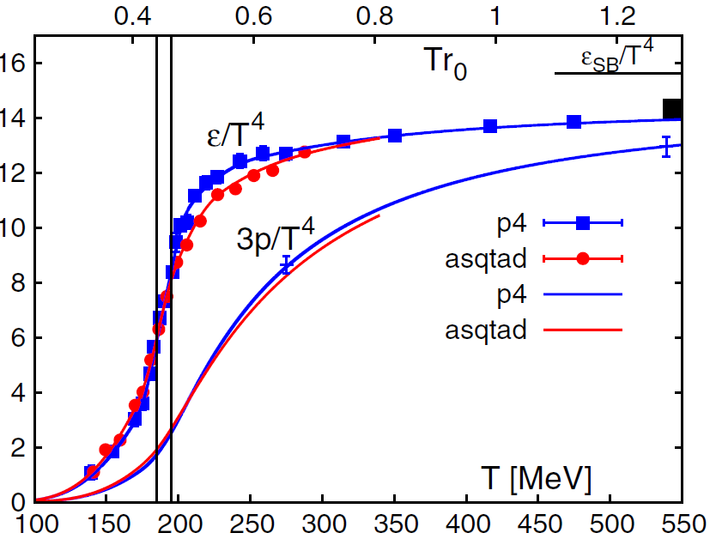
QCD EoS
(Energy Density, Pressure)
BNL-Bielefeld
2011
hadronic
QGP
Rapid increase of ε/T⁴ around T=150-200 MeV
Crossover transition
Rapid but smooth change of medium from hadronic to QGP-like

Slide 10






QCD Thermodynamics
Thermodynamic relations
How do we take T and V derivatives?

Slide 11







Lattice Spacing Derivative
Changing lattice spacing
1/T and V change
-

Slide 12





Differential Method
anisotropic lattice with
2 independent “beta functions”
perturbative result Karsch(1982)
negative pressure with Karsch coeffs.
vacuum subtraction

Slide 13


Integral Method
Boyd+ 1996
measurements of e-3p for many T
vacuum subtraction for each T
information on beta function

Slide 14
Gradient Flow Method

Slide 15


Gradient Flow
Luescher, 2010
t: “flow time”
dim:[length²]
steepest descent
direction of the action

Slide 16

Gradient Flow
Luescher, 2010
t: “flow time”
dim:[length²]
steepest descent
direction of the action
modify gauge field toward the stationary point of the action
smoothing similarly to diffusion equation
diffusion length
All composite operators at t>0 are UV finite Luescher,Weisz,2011

Slide 17




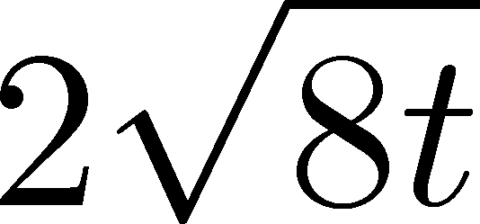
Operator Relation
Luescher, Weisz, 2011
an operator at t>0
remormalized operators
of original theory

Slide 18


Constructing EMT
Suzuki, 2013
gauge-invariant dimension 4 operators

Slide 19



Constructing EMT 2
Suzuki, 2013
Suzuki coefficients

Slide 20

Constructing EMT 2
Suzuki, 2013
Suzuki coefficients
Remormalized EMT

Slide 21
Numerical Simulation
on the Lattice

Slide 22




Gauge field has to be sufficiently smeared!
lattice regularized
gauge theory
YM gradient flow
equivalent
UV finite
continuum theory
( with dimensional regularization )
continuum theory
( with dimensional regularization )
analytic relation
(in perturbation,
operator expansion)
Perturbative relation has to be applicable!
YM gradient flow

Slide 23
solve gradient flow for each confs.
measure U and E
lattice regularized
gauge theory
YM gradient flow
generate gauge configurations
equivalent
UV finite
obtain T_{μν} with Suzuki formula
continuum theory
( with dimensional regularization )
continuum theory
( with dimensional regularization )
analytic relation
(in perturbation,
operator expansion)
YM gradient flow
take a→0, t→0 limit

Slide 24
Numerical Simulation 1
FlowQCD, 1312.7492
SU(3) YM theory
Wilson gauge action
lattice size: 32³xN_{t}
N_{t}=6, 8, 10
configurations: 100-300
Scale setting:
alpha Collab., NPB538,669(1999)

Slide 25
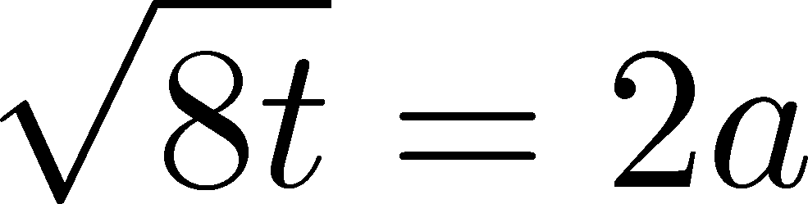


YM Thermodynamics
Emergent plateau!
systematic
error
There exists a wide range of t at which the Suzuki formula is safely used with Nt=10.

Slide 26






YM Thermodynamics
Emergent plateau!
systematic
error
There exists a wide range of t at which the Suzuki formula is safely used with Nt=10.

Slide 27
Continuum Limit
Boyd+1996
Statistical error of e-3p is significantly smaller than Boyd+1996 which used ~10000 confs.
No integral! Direct measurement of e and p at a given T
no vacuum subtraction for e+p

Slide 28
Comparison with Integral Method

Slide 29
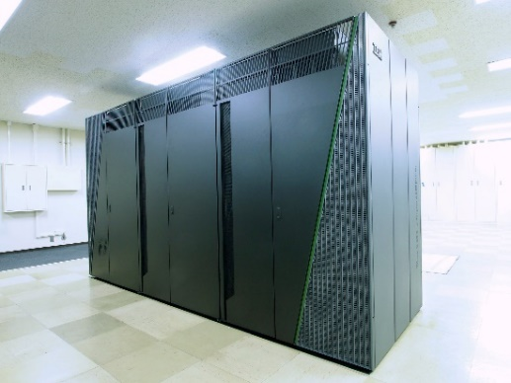
Numerical Simulation 2
SU(3) YM theory
Wilson gauge action
lattice size: 32³xN_{t}
N_{t} = 6, 8, 10, 32
configurations: 100-300
β = 5.89 – 6.56
twice finer lattice spacing!
lattice size: 64³xN_{t}
N_{t}= 8, 10, … ,16, 18, 64
configurations: ~2000
β = 6.4 – 7.4
On BlueGene/Q @ KEK
Efficiency of our code:
Gauge update（HB+OR)：~25%
Gradient flow (RK⁴)： ~40%

Slide 30
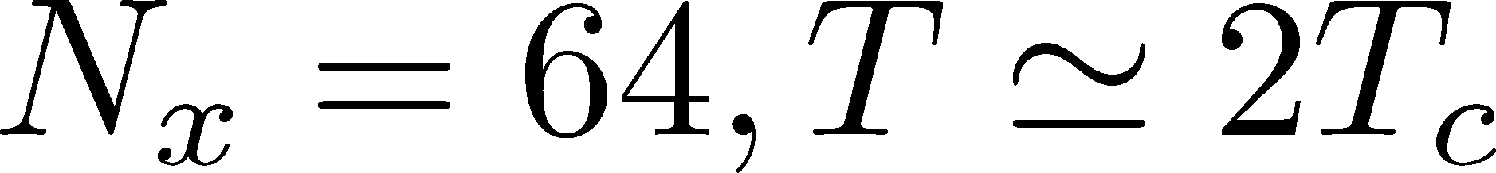
t Dependence of e+p
NEW!!
preliminary
FlowQCD,1312.7492
Plateau region extends toward small t!

Slide 31

Summary

Slide 32

Summary
EMT formula from gradient flow
Our strategy can successfully define the EMT on the lattice in practical simulations
This operator provides us with novel approaches to measure observables on the lattice!
They are direct, intuitive and less noisy

Slide 33


Many Future Works
precision measurement of YM thermodynamics
EMT correlation functions → measurement of viscosity
specific heat, non-Gaussian fluctuations, etc.
scale setting
taking double limit a→0, t→0
full QCD Makino,Suzuki,1403.4772
from
Gradient
flow
to
Hydrodynamic
flow

Slide 34

Two Point Functions

Slide 35


EMT Correlator
Kubo Formula: T₁₂ correlator ←→shear viscosity
Hydrodynamics describes long range behavior of T_{μν}
Energy fluctuation ←→specific heat

Slide 36


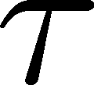
EMT Correlator : Noisy…
With naïve EMT operators
Nakamura, Sakai, PRL,2005
N_{t}=8
improved action
~10⁶ configurations
Nt=16
standard action
5x10⁴ configurations
… no signal

Slide 37


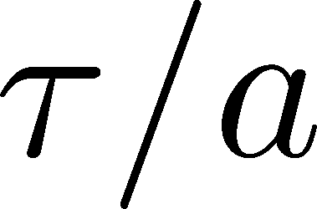
smearing length＝
64³x16
β=7.2 (T~2.2Tc)
1200 confs
converge at
improvement of the statistics at large t

Slide 38
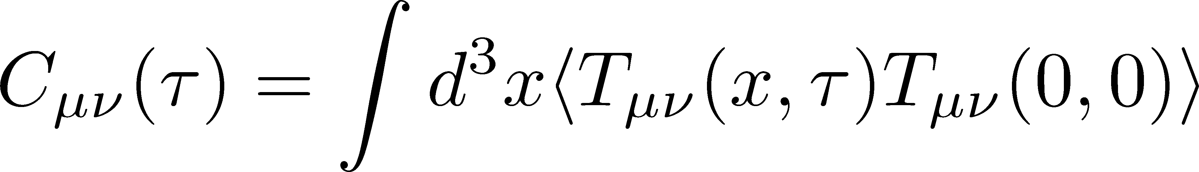


Correlation Function
64³x16
β=7.2 (T~2.2Tc)
1200 confs
t/a²=1.9
C₄₄(τ) :constant
←conservation law!
C₁₂(τ)
smeared
C₄₁(τ)
negative← i²=-1

Slide 39

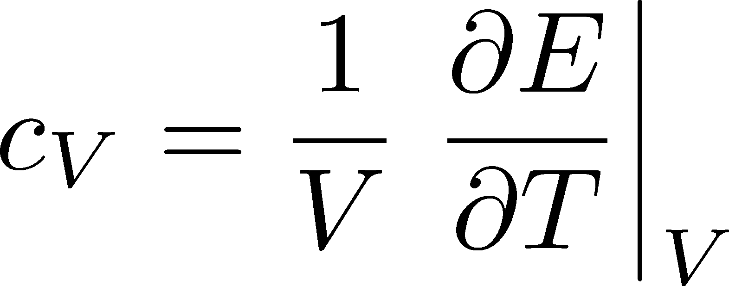
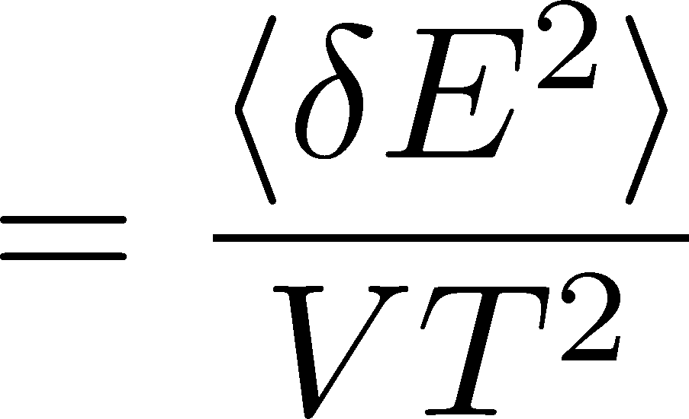
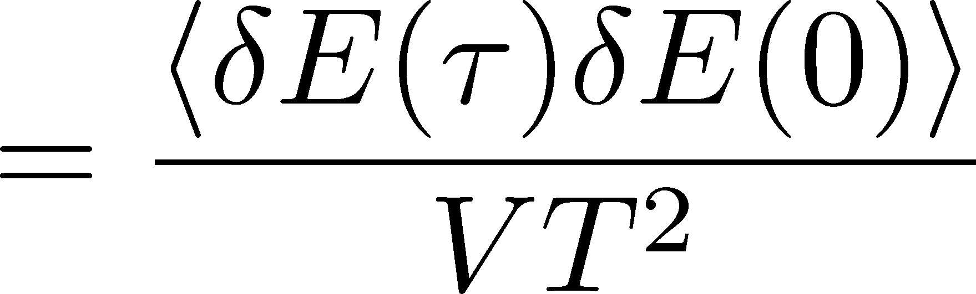
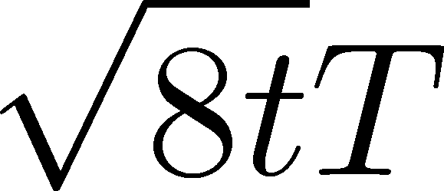
Energy Fluctuation and Specific Heat
64³x16
β=7.2 (T~2.2Tc)
1200 confs
Specific Heat

Slide 40
Energy Fluctuation and Specific Heat
64³x16
β=7.2 (T~2.2Tc)
1200 confs
Specific Heat
Gavai, et al., 2005
differential method
for T=2Tc
Novel approach to measure c_{V}

