Slide 1
Thermodynamics of SU(3) gauge theory from gradient flow
Masakiyo Kitazawa
(Osaka U.)
Asakawa, Hatsuda, Itou, MK, Suzuki (FlowQCD Collab.), arXiv:1312.7492[hep-lat]

Slide 2





momentum
energy
Poincare
symmetry
stress
pressure
Einstein Equation
Hydrodynamic Eq.

Slide 3




: nontrivial observable
on the lattice
Definition of the operator is nontrivial
because of the explicit breaking of Lorentz symmetry
ex:
Its measurement is extremely noisy
due to high dimensionality and etc.

Slide 4
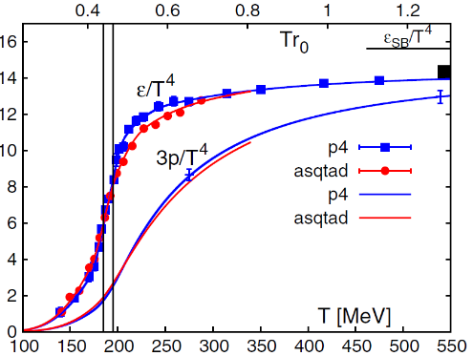
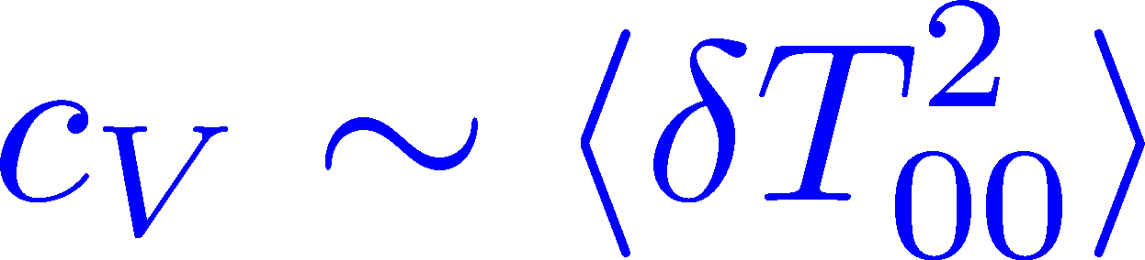
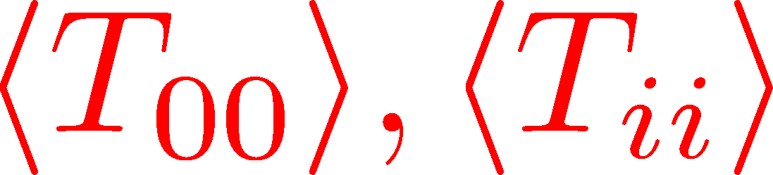
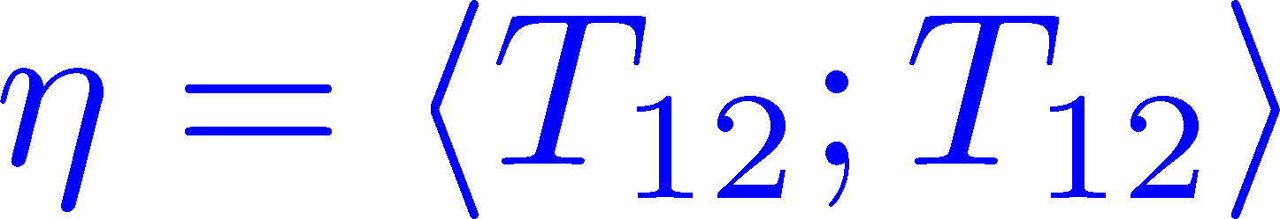

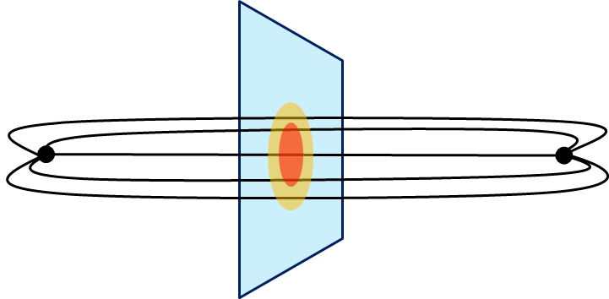
Thermodynamics
Fluctuations and
Correlations
direct measurement of
expectation values
viscosity, specific heat, ...
If we have
confinement string
EM distribution in hadrons
vacuum configuration
mixed state on 1st transition
Hadron Structure
Vacuum Structure

Slide 5
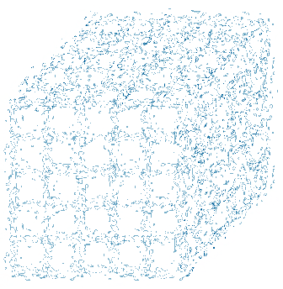
(Too) Rough Idea
coarse
graining
Translational symmetry recovers
Smeared theory tends to be less noisy

Slide 6
Gradient Flow
and
Energy-Momentum Tensor

Slide 7


YM Gradient Flow
Luescher, 2010
t: “flow time”
dim:[length²]

Slide 8

YM Gradient Flow
Luescher, 2010
t: “flow time”
dim:[length²]
smoothing similarly to diffusion equation
diffusion length
All composite operators at t>0 are UV finite Luescher,Weisz,2011

Slide 9
Applications of Gradient Flow
scale setting
operator relation
topology, autocorrelation, etc.

Slide 10




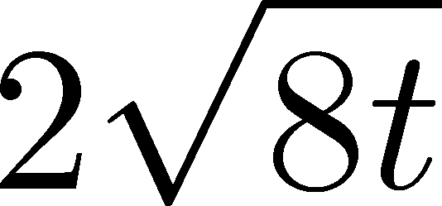
Operator Relation
Luescher, Weisz, 2011
an operator at t>0
remormalized operators
of original theory
original 4-dim theory
t→0 limit

Slide 11


Constructing EMT
Suzuki, 2013
gauge-invariant dimension 4 operators

Slide 12



Constructing EMT 2
Suzuki, 2013
Suzuki coeffs.

Slide 13

Constructing EMT 2
Suzuki, 2013
Suzuki coeffs.
Remormalized EMT

Slide 14
Numerical Simulation
on the Lattice

Slide 15
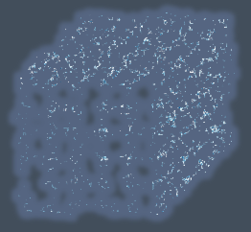


Gradient Flow Method
lattice regularized
gauge theory
gradient flow
continuum theory
(with dim. reg.)
continuum theory
(with dim. reg.)
analytic
(perturbative)
gradient flow

Slide 16


Caveats
Gauge field has to be sufficiently smeared!
lattice regularized
gauge theory
gradient flow
Perturbative relation has to be applicable!
continuum theory
(with dim. reg.)
continuum theory
(with dim. reg.)
analytic
(perturbative)
gradient flow

Slide 17

Numerical Simulation
SU(3) YM theory
Wilson gauge action
twice finer lattice!
Simulation 1
(arXiv:1312.7492)
Simulation 2
(new, preliminary)
lattice size: 32³xN_{t}
Nt = 6, 8, 10
β = 5.89 – 6.56
~300 configurations
lattice size: 64³xN_{t}
Nt = 10, 12, 14, 16
β = 6.4 – 7.4
~2000 configurations
using
SX8 @ RCNP
SR16000 @ KEK
using BlueGeneQ @ KEK
efficiency ~40%

Slide 18


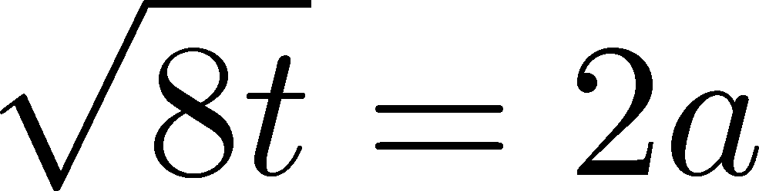


“Trace Anomaly” at T=1.65T_{c}
Emergent plateau!
Nt=6,8,10
~300 confs.
the range of t where the EMT formula is successfully used!

Slide 19






“Trace Anomaly” at T=1.65T_{c}
Emergent plateau!
Nt=6,8,10
~300 confs.
the range of t where the EMT formula is successfully used!

Slide 20
Entropy Density at T=1.65Tc
Emergent plateau!
systematic
error
Nt=6,8,10
~300 confs.
Direct measurement of e+p on a given T!
NO integral / NO vacuum subtraction
cf: Guisti, Meyer

Slide 21



Continuum Limit
Boyd+1996
T/Tc=0.99, 1.24, 1.65
0
Comparison with
previous studies

Slide 22
Numerical Simulation
SU(3) YM theory
Wilson gauge action
twice finer lattice!
Simulation 1
(arXiv:1312.7492)
Simulation 2
(new, preliminary)
lattice size: 32³xN_{t}
Nt = 6, 8, 10
β = 5.89 – 6.56
~300 configurations
lattice size: 64³xN_{t}
Nt = 10, 12, 14, 16
β = 6.4 – 7.4
~2000 configurations
using
SX8 @ RCNP
SR16000 @ KEK
using BlueGeneQ @ KEK
efficiency ~40%

Slide 23
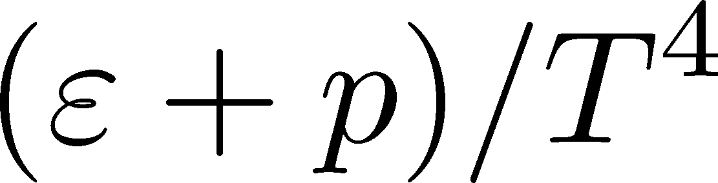
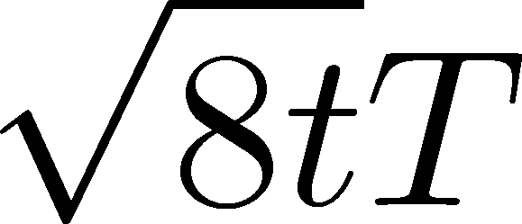
Entropy Density on Finer Lattices
T = 2.31Tc
2000 confs.
Nt = 10, 12, 14, 16
The wider plateau on the finer lattices
Plateau may have a nonzero slope
FlowQCD,2013
T=1.65Tc

Slide 24

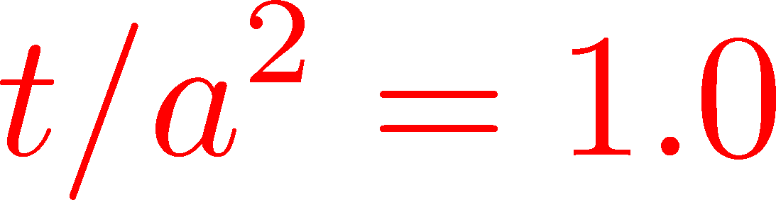
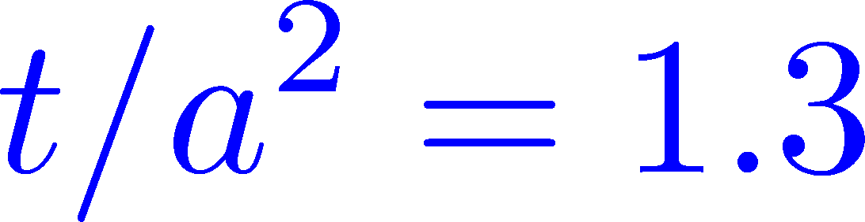

Continuum Extrapolation
T=2.31Tc
2000 confs
Nt = 10 ~ 16
a→0 limit with fixed t/a²
0
16
14
12
10
Continuum extrapolation
is stable

Slide 25

Summary

Slide 26

Summary
EMT formula from gradient flow
This formula can successfully define and calculate the EMT on the lattice
This operator provides us with novel approaches to measure various observables on the lattice!
This method is direct, intuitive and less noisy

Slide 27
Thermodynamics
Fluctuations and
Correlations
Many Future Studies!!
direct measurement of
expectation values
viscosity, specific heat, ...
now we have
confinement string
EM distribution in hadrons
vacuum configuration
mixed state on 1st transition
Hadron Structure
Vacuum Structure

Slide 28


Many Future Works
precision measurement of YM thermodynamics
EMT correlation functions → measurement of viscosity
specific heat, non-Gaussian fluctuations, etc.
scale setting
taking double limit a→0, t→0
full QCD Makino,Suzuki,1403.4772
from
Gradient
flow
to
Hydrodynamic
flow

Slide 29
Comparison with Integral Method

Slide 30
Continuum Limit
Boyd+1996
Statistical error of e-3p is significantly smaller than Boyd+1996 which used ~10000 confs.
No integral! Direct measurement of e and p at a given T
no vacuum subtraction for e+p

Slide 31

Two Point Functions

Slide 32


EMT Correlator
Kubo Formula: T₁₂ correlator ←→shear viscosity
Hydrodynamics describes long range behavior of T_{μν}
Energy fluctuation ←→specific heat

Slide 33


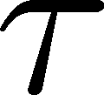
EMT Correlator : Noisy…
With naïve EMT operators
Nakamura, Sakai, PRL,2005
N_{t}=8
improved action
~10⁶ configurations
Nt=16
standard action
5x10⁴ configurations
… no signal

Slide 34



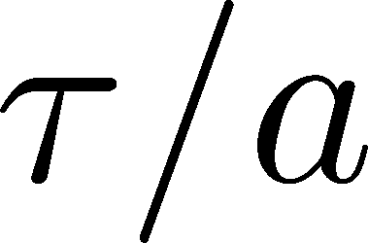
smearing length＝
64³x16
β=7.2 (T~2.2Tc)
1200 confs
converge at
improvement of the statistics at large t

Slide 35
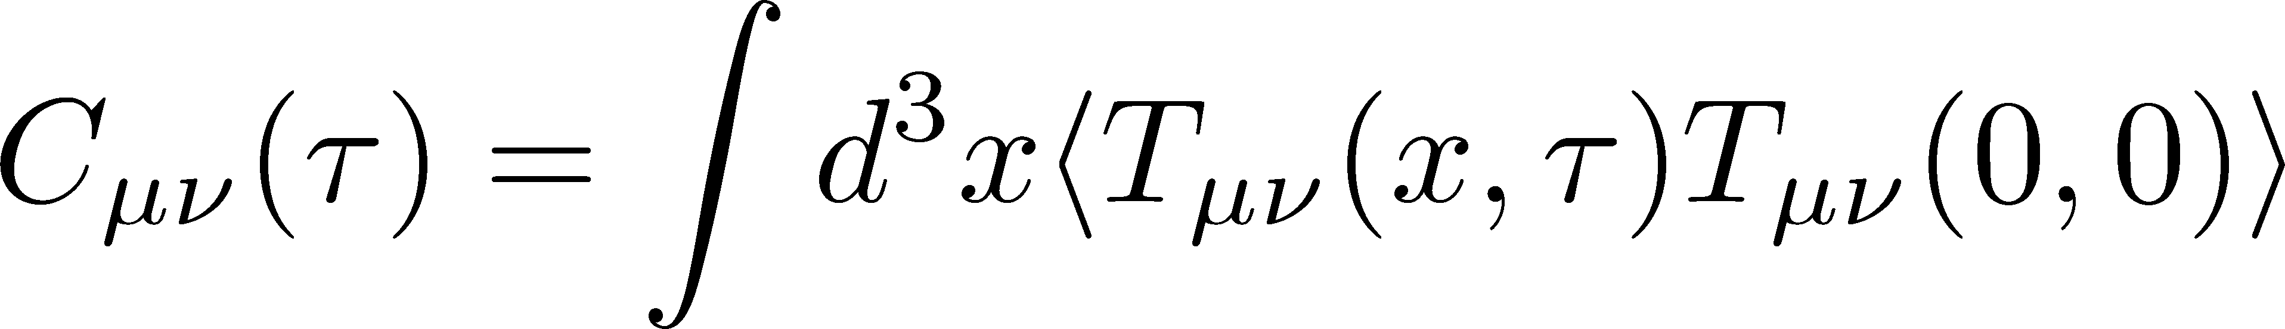


Correlation Function
64³x16
β=7.2 (T~2.2Tc)
1200 confs
t/a²=1.9
C₄₄(τ) :constant
←conservation law!
C₁₂(τ)
smeared
C₄₁(τ)
negative← i²=-1

Slide 36

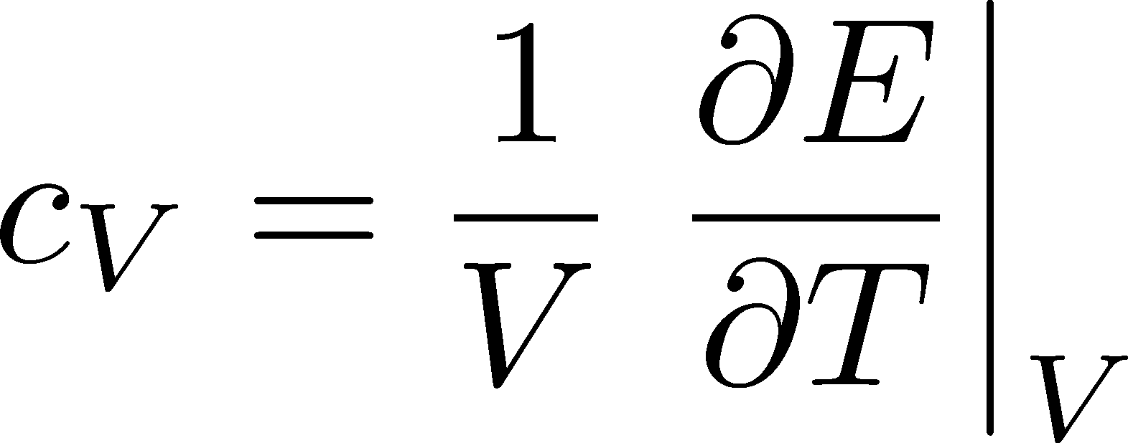
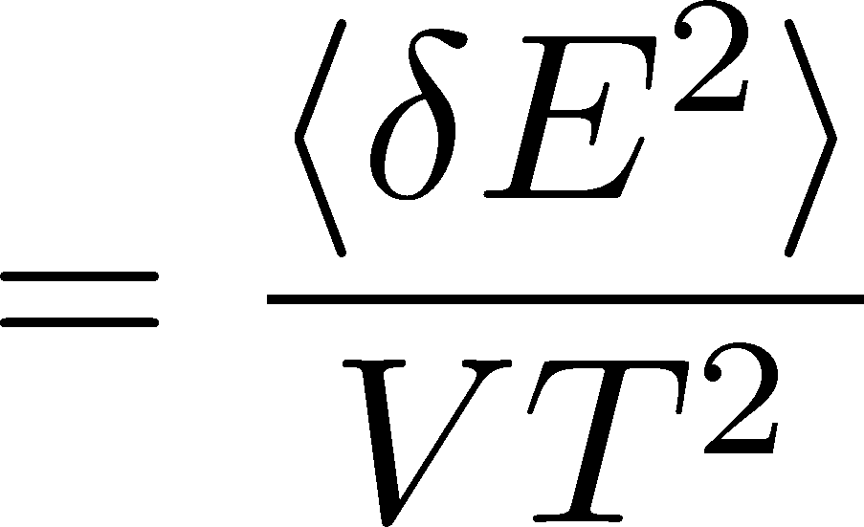
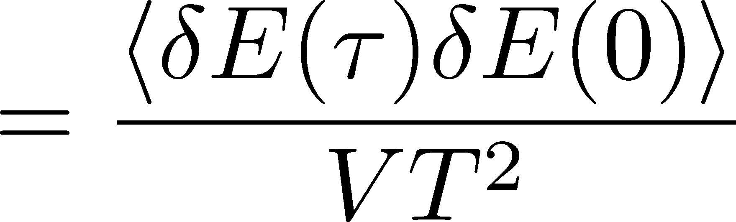
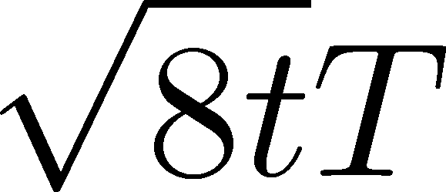
Energy Fluctuation and Specific Heat
64³x16
β=7.2 (T~2.2Tc)
1200 confs
Specific Heat

Slide 37
Energy Fluctuation and Specific Heat
64³x16
β=7.2 (T~2.2Tc)
1200 confs
Specific Heat
Gavai, et al., 2005
differential method
for T=2Tc
Novel approach to measure c_{V}

Slide 38
Numerical Simulation 1
FlowQCD, 1312.7492
SU(3) YM theory
Wilson gauge action
lattice size: 32³xN_{t}
N_{t}=6, 8, 10
configurations: 100-300
Scale setting:
alpha Collab., NPB538,669(1999)

Slide 40
lattice regularized
gauge theory
YM gradient flow
continuum theory
(with dim. reg.)
continuum theory
(with dim. reg.)
analytic
(perturbative)
YM gradient flow

