Slide 1
Thermodynamics of Gauge Theory from Gradient Flow
For FlowQCD Collaboration

Slide 2
Thermodynamics of Gauge Theory from Gradient Flow
For FlowQCD Collaboration

Slide 3



Slide 4



Slide 5



Slide 6
Poincare
symmetry

Slide 7

momentum
energy
Poincare
symmetry
stress
pressure

Slide 8


momentum
energy
Poincare
symmetry
stress
pressure
Einstein Equation
Hydrodynamic Eq.

Slide 9




: nontrivial observable
on the lattice
Definition of the operator is nontrivial
because of the explicit breaking of Lorentz symmetry
ex:
Its measurement is extremely noisy
due to high dimensionality and etc.

Slide 10

If we have

Slide 11
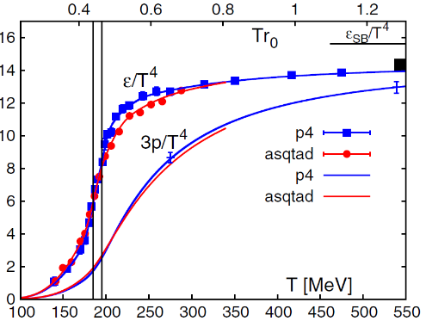
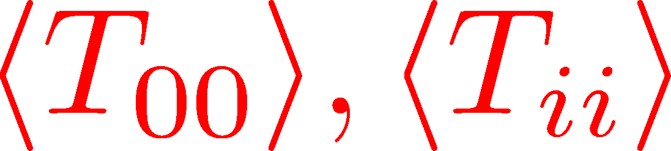
Thermodynamics
direct measurement of
expectation values
If we have

Slide 12
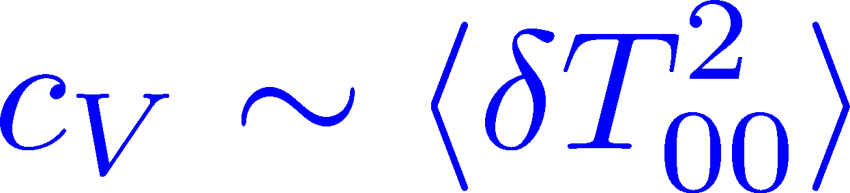
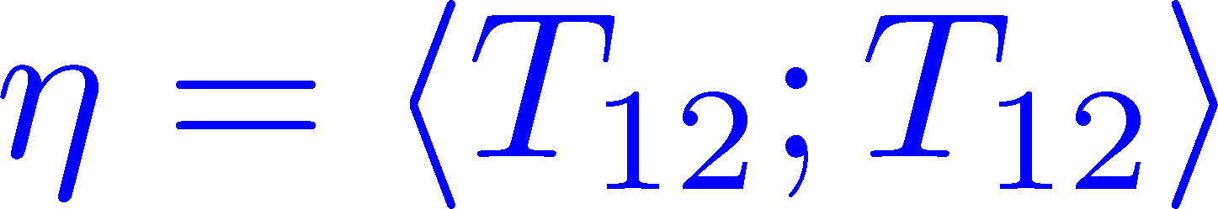
Thermodynamics
Fluctuations and
Correlations
direct measurement of
expectation values
viscosity, specific heat, ...
If we have

Slide 13
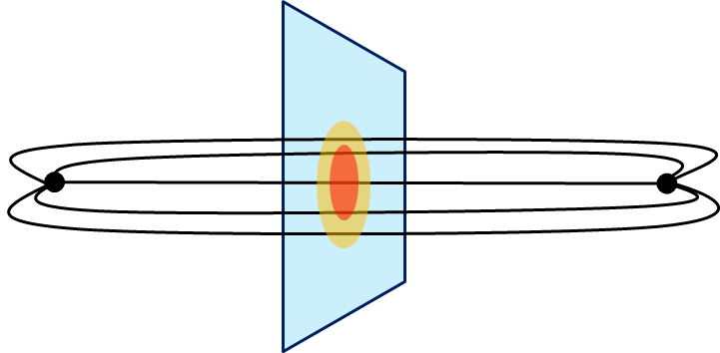
Thermodynamics
Fluctuations and
Correlations
direct measurement of
expectation values
viscosity, specific heat, ...
If we have
confinement string
EM distribution in hadrons
vacuum configuration
mixed state on 1st transition
Hadron Structure
Vacuum Structure

Slide 14
Measurement of Thermodynamics using gradient flow
Masakiyo Kitazawa (Osaka U.)
for FlowQCD Collaboration
Asakawa, Hatsuda, Iritani, Itou, MK, Suzuki
FlowQCD, arXiv:1312.7492[hep-lat]; to appear in PRD
LATTICE2014, 28 June 2014, New York

Slide 15
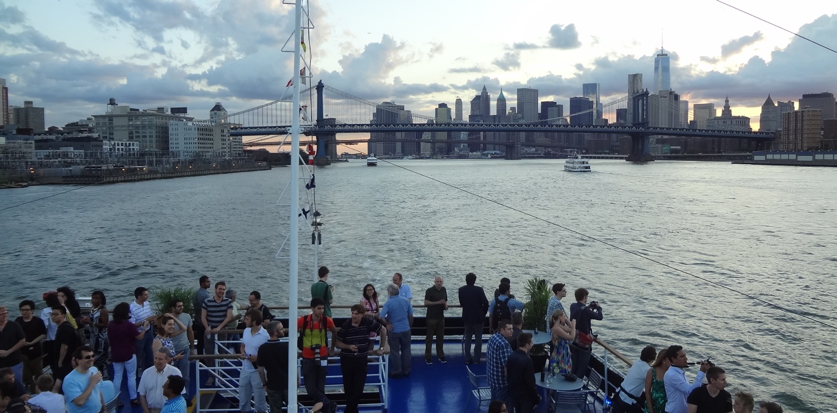
Flow QCD Collaboration

Slide 16

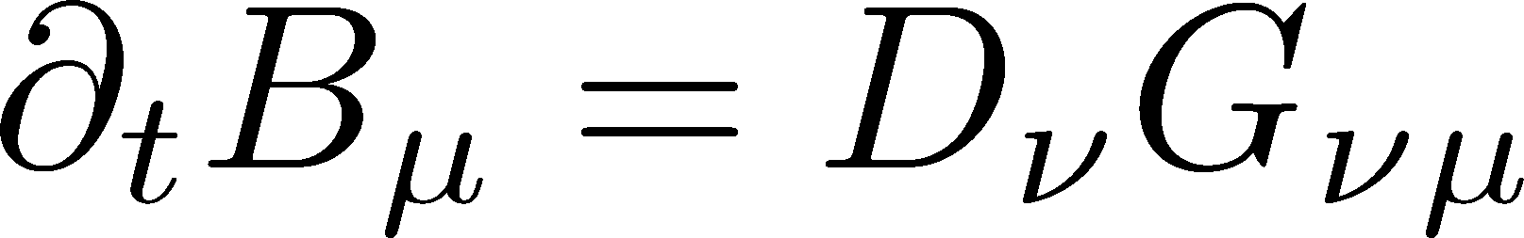
Flow QCD Collaboration
from
Gradient
flow

Slide 17

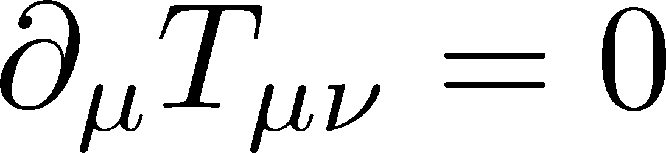
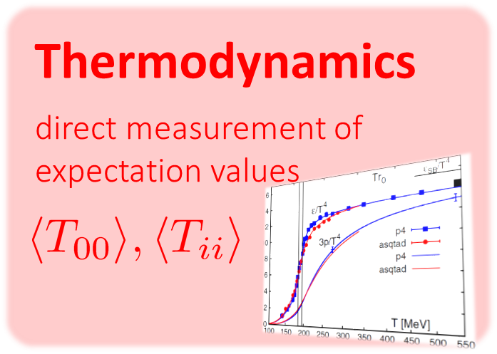
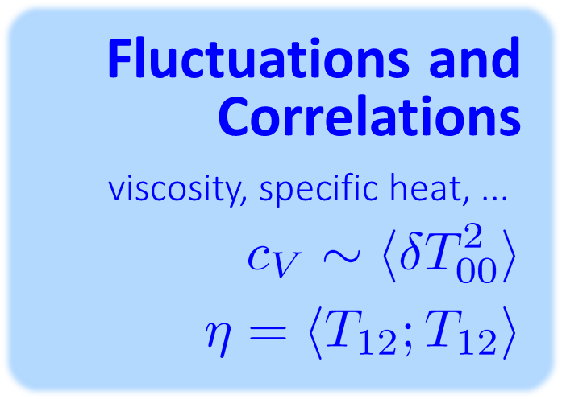
Flow QCD Collaboration
from
Gradient
flow
to
Hydrodynamic
flow

Slide 18
Gradient Flow

Slide 19


YM Gradient Flow
Luescher, 2010
A. Ramos, plenary, Friday
t: “flow time”
dim:[length²]

Slide 20

YM Gradient Flow
Luescher, 2010
A. Ramos, plenary, Friday
t: “flow time”
dim:[length²]
transform gauge field like diffusion equation
diffusion length
This is NOT the standard cooling/smearing
All composite operators at t>0 are UV finite Luescher,Weisz,2011

Slide 21
Applications of Gradient Flow
A. Ramos, plenary, Friday
scale setting
running coupling
topology
operator relation
autocorrelation, etc.

Slide 22
Small Flow Time Expansion
of Operators and EMT

Slide 23


Operator Relation
Luescher, Weisz, 2011
an operator at t>0
remormalized operators
of original theory

Slide 24


Operator Relation
Luescher, Weisz, 2011
an operator at t>0
remormalized operators
of original theory

Slide 25
Operator Relation
Luescher, Weisz, 2011
an operator at t>0
remormalized operators
of original theory

Slide 26


Constructing EMT
Suzuki, 2013
DelDebbio,Patella,Rago,2013
gauge-invariant dimension 4 operators

Slide 27



Constructing EMT 2
Suzuki, 2013
Suzuki coeffs.
See also, Patella, Parallel7E, Thu.

Slide 28

Constructing EMT 2
Suzuki, 2013
Suzuki coeffs.
Remormalized EMT

Slide 29
Numerical Analysis
on the Lattice

Slide 30
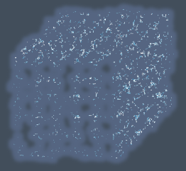


Gradient Flow Method
lattice regularized
gauge theory
gradient flow
continuum theory
(with dim. reg.)
continuum theory
(with dim. reg.)
analytic
(perturbative)
gradient flow

Slide 31
Gradient Flow Method
lattice regularized
gauge theory
gradient flow
measurement
on the lattice
continuum theory
(with dim. reg.)
continuum theory
(with dim. reg.)
analytic
(perturbative)
gradient flow

Slide 32


Caveats
Gauge field has to be sufficiently smeared!
lattice regularized
gauge theory
gradient flow
Perturbative relation has to be applicable!
measurement
on the lattice
continuum theory
(with dim. reg.)
continuum theory
(with dim. reg.)
analytic
(perturbative)
gradient flow

Slide 33

Caveats
Gauge field has to be sufficiently smeared!
lattice regularized
gauge theory
gradient flow
Perturbative relation has to be applicable!
continuum theory
(with dim. reg.)
continuum theory
(with dim. reg.)
analytic
(perturbative)
gradient flow

Slide 34




in continuum
non-perturbative
region
O(t) effect
classical

Slide 35
in continuum
non-perturbative
region
O(t) effect
classical
on the lattice
t→0 limit with keeping t>>a²

Slide 36

Numerical Simulation
SU(3) YM theory
Wilson gauge action
twice finer lattice!
Simulation 1
(arXiv:1312.7492)
Simulation 2
(new, preliminary)
lattice size: 32³xN_{t}
Nt = 6, 8, 10
β = 5.89 – 6.56
~300 configurations
lattice size: 64³xN_{t}
Nt = 10, 12, 14, 16
β = 6.4 – 7.4
~2000 configurations
using
SX8 @ RCNP
SR16000 @ KEK
using BlueGeneQ @ KEK
efficiency ~40%

Slide 37
Numerical Simulation
SU(3) YM theory
Wilson gauge action
twice finer lattice!
Simulation 1
(arXiv:1312.7492)
Simulation 2
(new, preliminary)
lattice size: 32³xN_{t}
Nt = 6, 8, 10
β = 5.89 – 6.56
~300 configurations
lattice size: 64³xN_{t}
Nt = 10, 12, 14, 16
β = 6.4 – 7.4
~2000 configurations
using
SX8 @ RCNP
SR16000 @ KEK
using BlueGeneQ @ KEK
efficiency ~40%

Slide 38
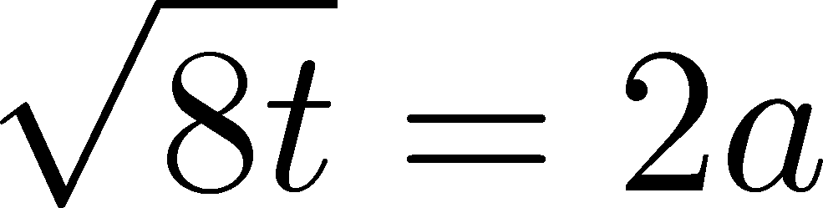


ε-3p at T=1.65T_{c}
Emergent plateau!
Nt=6,8,10
~300 confs.
the range of t where the EMT formula is successfully used!

Slide 39






ε-3p at T=1.65T_{c}
Emergent plateau!
Nt=6,8,10
~300 confs.
the range of t where the EMT formula is successfully used!

Slide 40
Entropy Density at T=1.65Tc
Emergent plateau!
systematic
error
Nt=6,8,10
~300 confs.
Direct measurement of e+p on a given T!
NO integral / NO vacuum subtraction

Slide 41



Continuum Limit
32³xNt
Nt = 6, 8, 10
T/Tc=0.99, 1.24, 1.65
Boyd+1996
0

Slide 42
Continuum Limit
32³xNt
Nt = 6, 8, 10
T/Tc=0.99, 1.24, 1.65
Boyd+1996
0
Comparison with
previous studies

Slide 43
Numerical Simulation
SU(3) YM theory
Wilson gauge action
twice finer lattice!
Simulation 1
(arXiv:1312.7492)
Simulation 2
(new, preliminary)
lattice size: 32³xN_{t}
Nt = 6, 8, 10
β = 5.89 – 6.56
~300 configurations
lattice size: 64³xN_{t}
Nt = 10, 12, 14, 16
β = 6.4 – 7.4
~2000 configurations
using
SX8 @ RCNP
SR16000 @ KEK
using BlueGeneQ @ KEK
efficiency ~40%

Slide 44
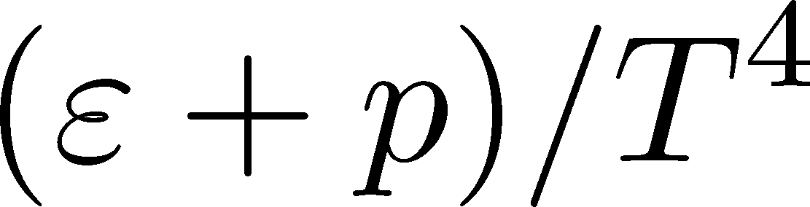
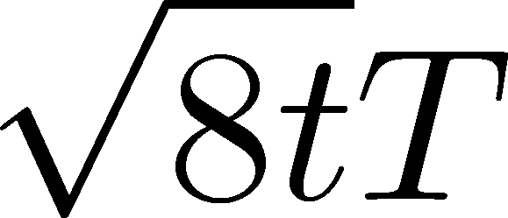
Entropy Density on Finer Lattices
T = 2.31Tc
64³xNt
Nt = 10, 12, 14, 16
2000 confs.
Preliminary!!
The wider plateau on the finer lattices
Plateau may have a nonzero slope
FlowQCD,2013
T=1.65Tc

Slide 45

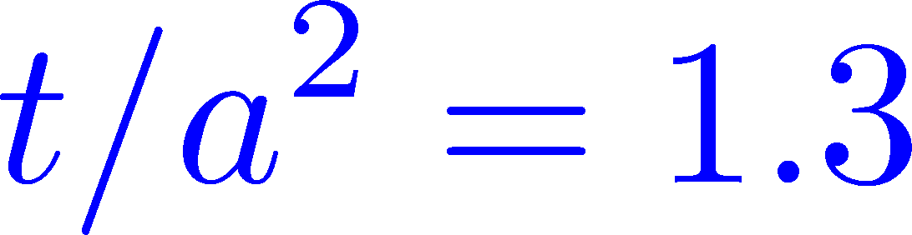
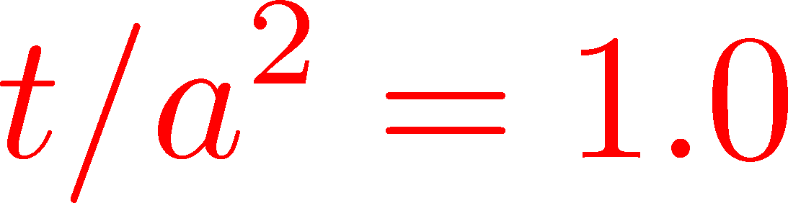

Continuum Extrapolation
T=2.31Tc
2000 confs
Nt = 10 ~ 16
Preliminary!!
a→0 limit with fixed t/a²
1312.7492
Preliminary!!
0
Nt=16
14
12
10
Continuum extrapolation
is stable

Slide 46

Summary

Slide 47

Summary
EMT formula from gradient flow
This formula can successfully define and calculate the EMT on the lattice
This operator provides us with novel approaches to measure various observables on the lattice!
This method is direct, intuitive and less noisy

Slide 48
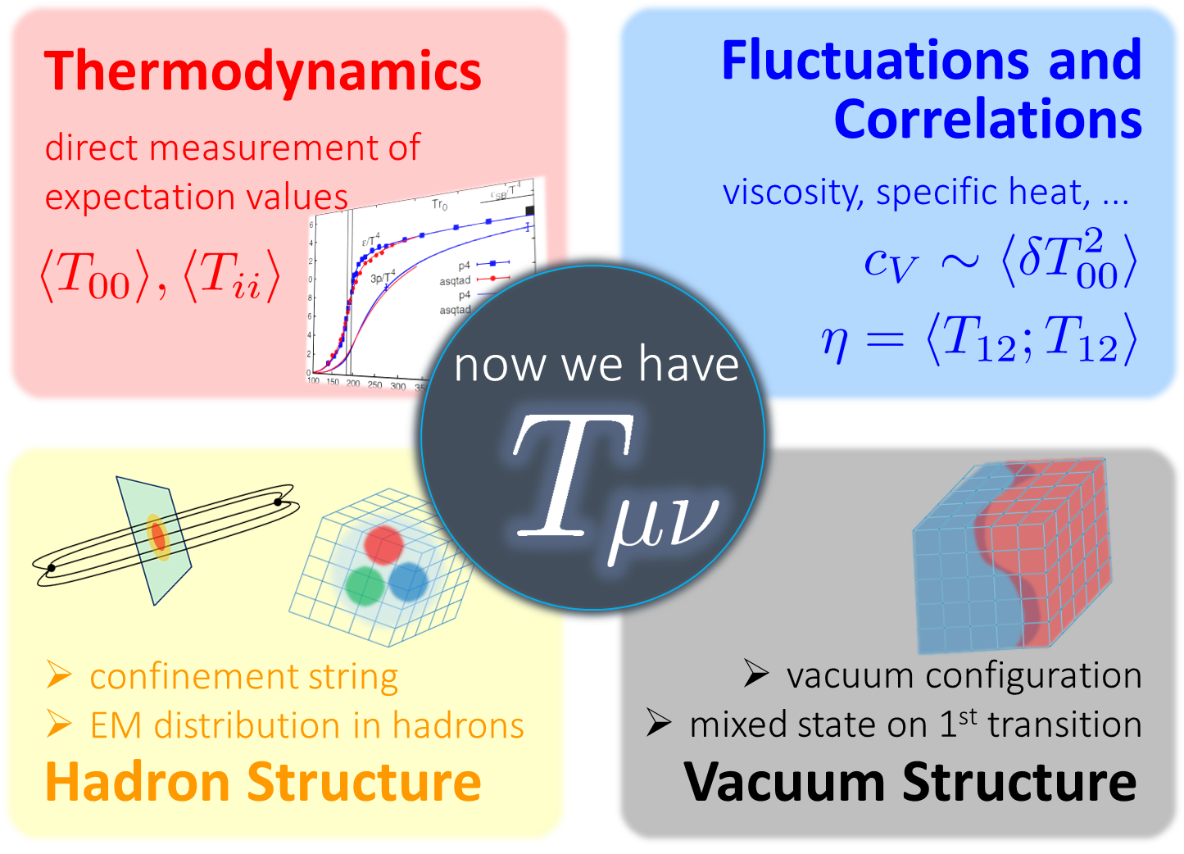
Many Future Studies!!
Other observables
full QCD Makino,Suzuki,2014
non-pert. improvement Patella 7E(Thu)
O(a) improvement
Nogradi, 7E(Thu); Sint, 7E(Thu)
Monahan, 7E(Thu)
and etc.

Slide 49
One More Thing…

Slide 50
One More Thing…
Fluctuations and
Correlations
viscosity, specific heat, ...

Slide 51

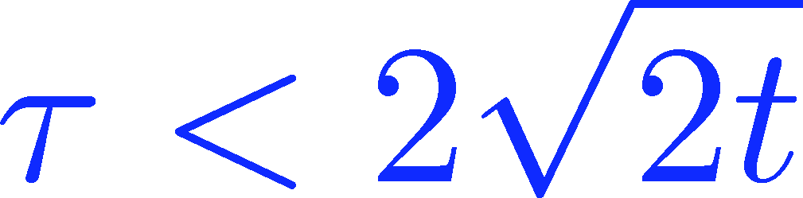
Energy Correlation Function
T=2.31Tc
b=7.2, Nt=16
2000 confs
p=0 correlator
Preliminary!!
smeared

Slide 52
Energy Correlation Function
T=2.31Tc
b=7.2, Nt=16
2000 confs
p=0 correlator
Preliminary!!
τ independent const.
→ energy conservation
smeared

Slide 53


Energy Correlation Function
T=2.31Tc
b=7.2, Nt=16
2000 confs
p=0 correlator
Preliminary!!
τ independent const.
→ energy conservation
specific heat
smeared
→ Novel approach to
measure specific heat!

Slide 54
Keep your attention to this new flow
just like…

Slide 55
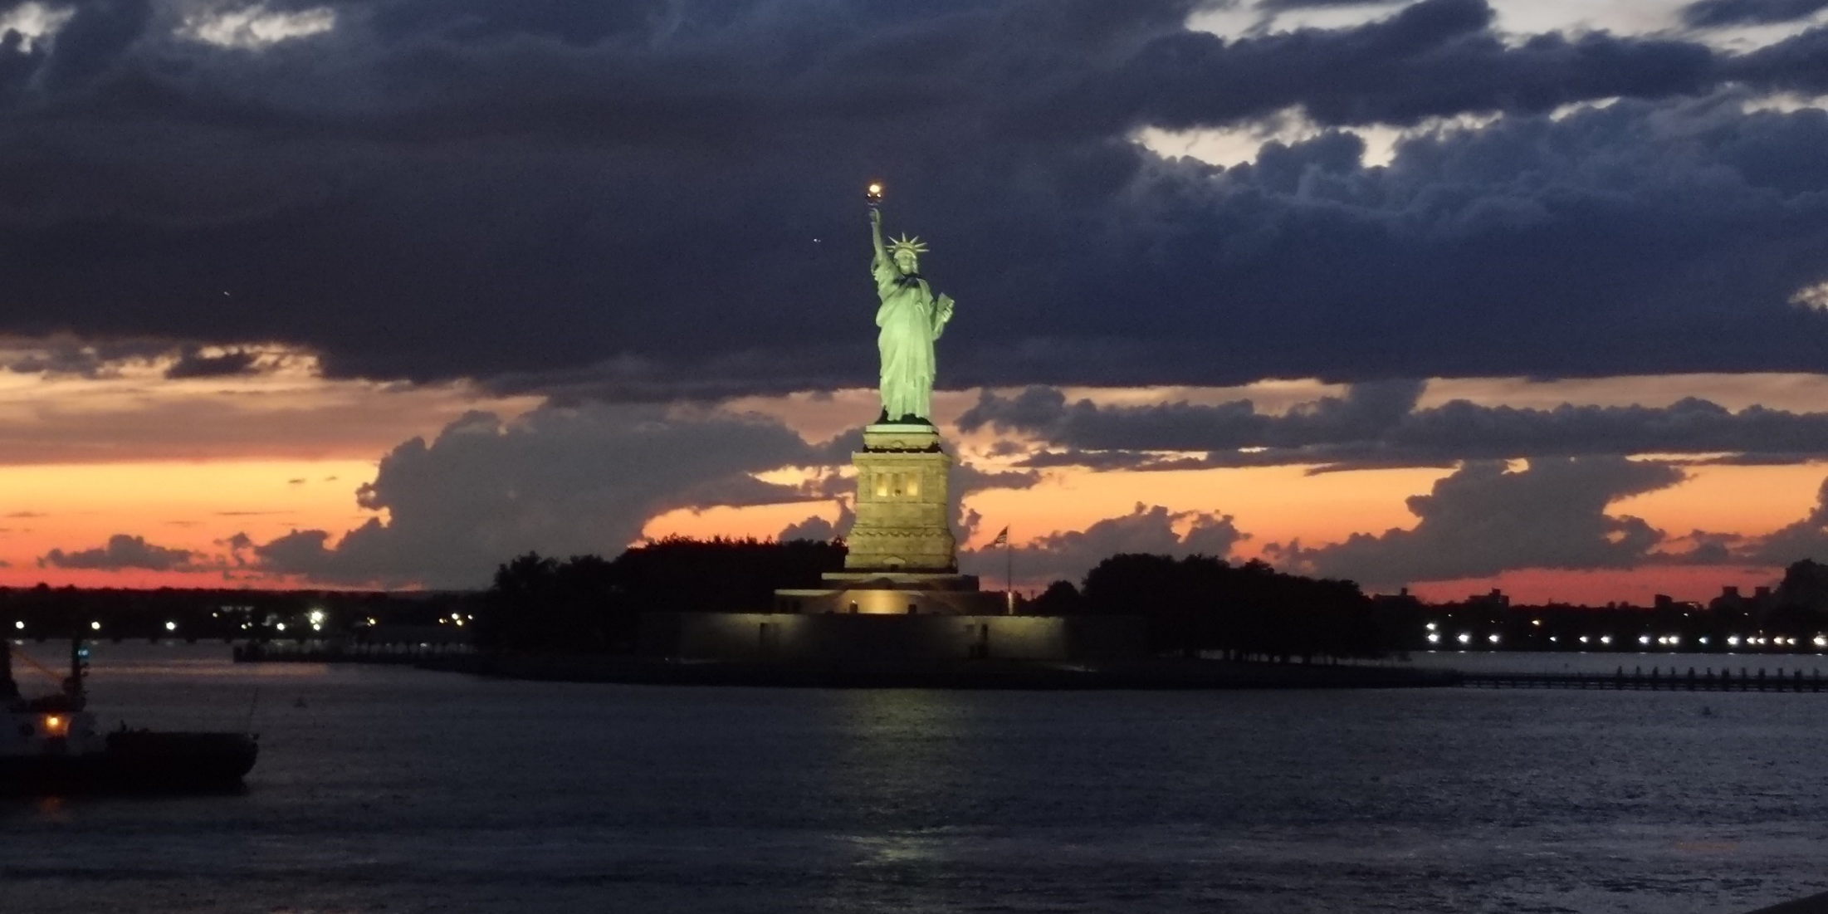
Keep your attention to this new flow
just like…
Thank you for your attention!

