Slide 1
Gradient Flow and Energy-Momentum Tensor in Lattice Gauge Theory
Masakiyo Kitazawa (Osaka U.)
for FlowQCD Collaboration
Asakawa, Hatsuda, Iritani, Itou, MK, Suzuki
FlowQCD, arXiv:1312.7492[hep-lat]; to appear in PRD
BNL seminar, 30 June 2014

Slide 2

Lattice QCD
First principle calculation of QCD
Monte Carlo for path integral
hadron spectra, chiral symmetry, phase transition, etc.

Slide 3

Gradient Flow
Luscher, 2010
A powerful tool for various analyses on the lattice

Slide 4
Gradient Flow
Luscher, 2010
A powerful tool for various analyses on the lattice
D. Nogradi, LATTICE2014,7B

Slide 5
Gradient Flow
Luscher, 2010
A powerful tool for various analyses on the lattice
Applications:
scale setting
running coupling
topology
operator relation
autocorrelation
etc.
thermodynamics
EMT correlator

Slide 6
Lattice Scale Setting
a(β)
previous references
string tension
Sommer scale
SU(3) pure YM
Wilson gauge
Edwards, Heller, Klassen, 1998
Alpha-Collab., 1998
Necco, Sommer, 2002
(Durr, Fodor, Hoelbling, 2007
β<6.56
β<6.57
β<6.92
β<6.92)
We perform the precision scale setting of
SU(3) YM theory up tp β=7.5 using gradient flow

Slide 7



Slide 8



momentum
energy
Poincare
symmetry
stress
pressure
Einstein Equation
Hydrodynamic Eq.

Slide 9



: nontrivial observable
on the lattice
Definition of the operator is nontrivial
because of the explicit breaking of Lorentz symmetry
ex:
Its measurement is extremely noisy
due to high dimensionality and etc.

Slide 10

If we have

Slide 11
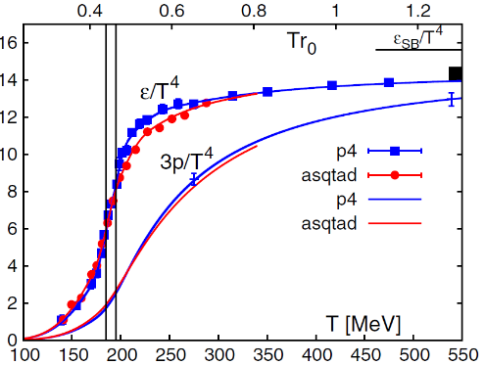
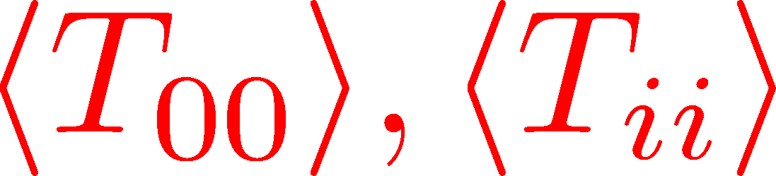
Thermodynamics
direct measurement of
expectation values
If we have

Slide 12
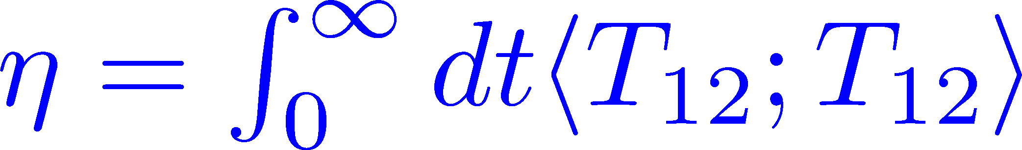
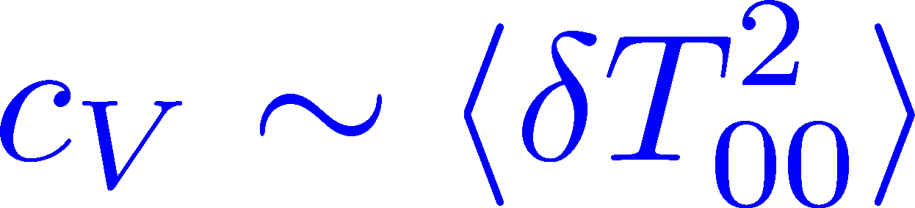
Thermodynamics
Fluctuations and
Correlations
direct measurement of
expectation values
viscosity, specific heat, ...
If we have
We construct the EMT using gradient flow
and measure these quantities

Slide 13
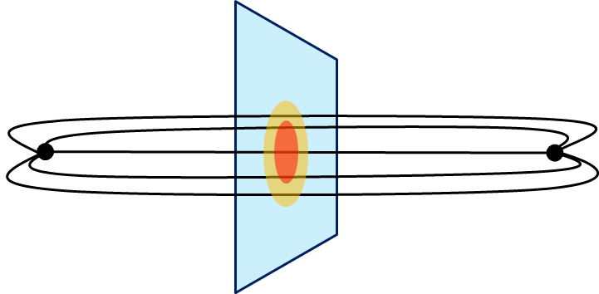
Thermodynamics
Fluctuations and
Correlations
direct measurement of
expectation values
viscosity, specific heat, ...
If we have
confinement string
EM distribution in hadrons
vacuum configuration
mixed state on 1st transition
Hadron Structure
Vacuum Structure

Slide 14
Gradient Flow

Slide 15

YM Gradient Flow
Luscher, 2010
t: “flow time”
dim:[length²]

Slide 16

YM Gradient Flow
Luscher, 2010
t: “flow time”
dim:[length²]
transform gauge field like diffusion equation
diffusion length
This is NOT the standard cooling/smearing
All composite operators at t>0 are UV finite Luescher,Weisz,2011

Slide 17
Lattice Scale Setting

Slide 18







Flow Time Dep. of an Observable
Luscher, 2010
: universal function of t
: an observable
use this function used to determine a(β)
standard choice of O:
perturbative formula:

Slide 19




t dep of t²<E>
one-loop perturbation
violated
lattice discretization effect

Slide 20
t# Scale Setting
clover operator
for FF
plaquette action
good agreement with previous scales

Slide 21

Numerical Analysis
SU(3) YM theory
Wilson gauge action
w₀ scaling
β | size | N_{conf} | β | size | N_{conf}
6.3 | 64⁴ | 30 | 6.9 | 64⁴ | 30
6.4 | 64⁴ | 100 | 7.0 | 96⁴ | 100
6.5 | 64⁴ | 30 | 7.2 | 96⁴ | 50
6.6 | 64⁴ | 100 | 7.4 | 128⁴ | 40
6.7 | 64⁴ | 30 | 7.5 | 128⁴ | 40
6.8 | 64⁴ | 100
each configuration is separated by 1000 gauge updates (HB+OR⁵)

Slide 22


Comparison with Previous Studies
w_{0.4}/r₀
determined by
4 data points at
6.5<β<6.92
Very
Preliminary!!
scale determined
by w₀ scaling
EHK: Edwards, Heller, Klassen, 1998
Alpha-Collaboration, 1998
NS: Necco, Sommer, 2002
DFHK: Durr, Fodor, Hoelbling, 2007

Slide 23
Small Flow Time Expansion
of Operators and EMT

Slide 24




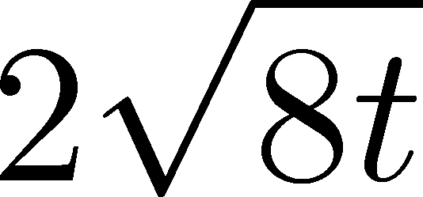
Operator Relation
Luescher, Weisz, 2011
an operator at t>0
remormalized operators
of original theory
original 4-dim theory
t→0 limit

Slide 25


Constructing EMT
Suzuki, 2013
DelDebbio,Patella,Rago,2013
gauge-invariant dimension 4 operators

Slide 26



Constructing EMT 2
Suzuki, 2013
Suzuki coeffs.
See also, Patella, Parallel7E, Thu.

Slide 27

Constructing EMT 2
Suzuki, 2013
Suzuki coeffs.
Remormalized EMT

Slide 28
Numerical Analysis: thermodynamics
Thermodynamics
direct measurement of
expectation values

Slide 29
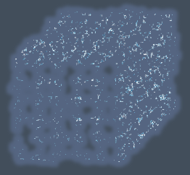


Gradient Flow Method
lattice regularized
gauge theory
gradient flow
continuum theory
(with dim. reg.)
continuum theory
(with dim. reg.)
analytic
(perturbative)
gradient flow

Slide 30
Gradient Flow Method
lattice regularized
gauge theory
gradient flow
measurement
on the lattice
continuum theory
(with dim. reg.)
continuum theory
(with dim. reg.)
analytic
(perturbative)
gradient flow

Slide 31


Caveats
Gauge field has to be sufficiently smeared!
lattice regularized
gauge theory
gradient flow
Perturbative relation has to be applicable!
measurement
on the lattice
continuum theory
(with dim. reg.)
continuum theory
(with dim. reg.)
analytic
(perturbative)
gradient flow

Slide 32

Caveats
Gauge field has to be sufficiently smeared!
lattice regularized
gauge theory
gradient flow
Perturbative relation has to be applicable!
measurement
on the lattice
continuum theory
(with dim. reg.)
continuum theory
(with dim. reg.)
analytic
(perturbative)
gradient flow

Slide 33




in continuum
non-perturbative
region
O(t) effect
classical

Slide 34
in continuum
non-perturbative
region
O(t) effect
classical
on the lattice
t→0 limit with keeping t>>a²

Slide 35
Numerical Simulation
SU(3) YM theory
Wilson gauge action
twice finer lattice!
Simulation 1
(arXiv:1312.7492)
Simulation 2
(new, preliminary)
lattice size: 32³xN_{t}
Nt = 6, 8, 10
β = 5.89 – 6.56
~300 configurations
lattice size: 64³xN_{t}
Nt = 10, 12, 14, 16
β = 6.4 – 7.4
~2000 configurations
using
SX8 @ RCNP
SR16000 @ KEK
using BlueGeneQ @ KEK
efficiency ~40%

Slide 36
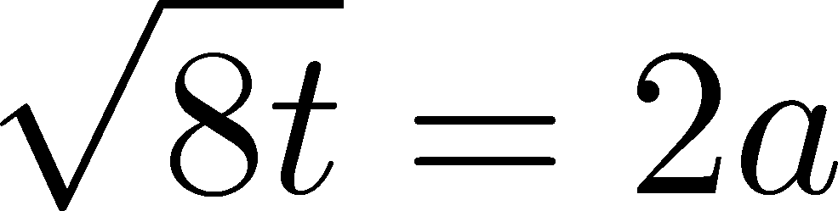


ε-3p at T=1.65T_{c}
Emergent plateau!
Nt=6,8,10
~300 confs.
the range of t where the EMT formula is successfully used!

Slide 37






ε-3p at T=1.65T_{c}
Emergent plateau!
Nt=6,8,10
~300 confs.
the range of t where the EMT formula is successfully used!

Slide 38
Entropy Density at T=1.65Tc
Emergent plateau!
systematic
error
Nt=6,8,10
~300 confs.
Direct measurement of e+p on a given T!
NO integral / NO vacuum subtraction

Slide 39



Continuum Limit
32³xNt
Nt = 6, 8, 10
T/Tc=0.99, 1.24, 1.65
Boyd+1996
0

Slide 40
Continuum Limit
32³xNt
Nt = 6, 8, 10
T/Tc=0.99, 1.24, 1.65
Boyd+1996
0
Comparison with
previous studies

Slide 41
Numerical Simulation
SU(3) YM theory
Wilson gauge action
twice finer lattice!
Simulation 1
(arXiv:1312.7492)
Simulation 2
(new, preliminary)
lattice size: 32³xN_{t}
Nt = 6, 8, 10
β = 5.89 – 6.56
~300 configurations
lattice size: 64³xN_{t}
Nt = 10, 12, 14, 16
β = 6.4 – 7.4
~2000 configurations
using
SX8 @ RCNP
SR16000 @ KEK
using BlueGeneQ @ KEK
efficiency ~40%

Slide 42
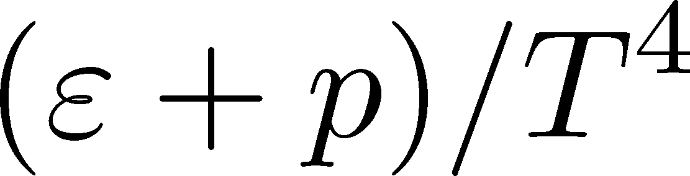
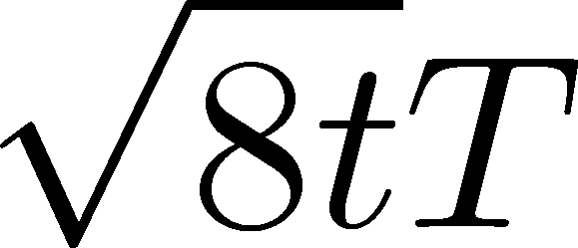
Entropy Density on Finer Lattices
T = 2.31Tc
64³xNt
Nt = 10, 12, 14, 16
2000 confs.
Preliminary!!
The wider plateau on the finer lattices
Plateau may have a nonzero slope
FlowQCD,2013
T=1.65Tc

Slide 43

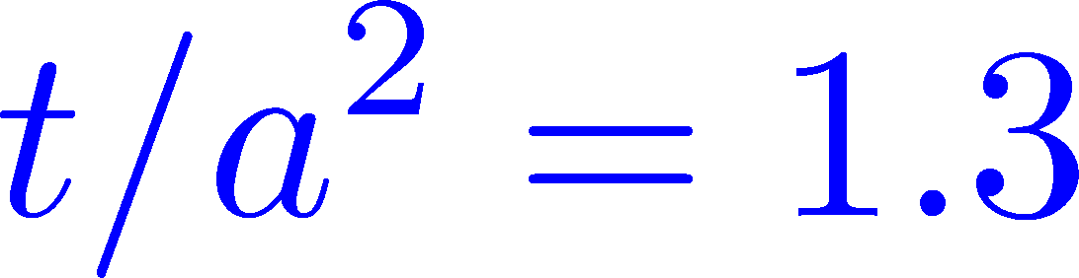
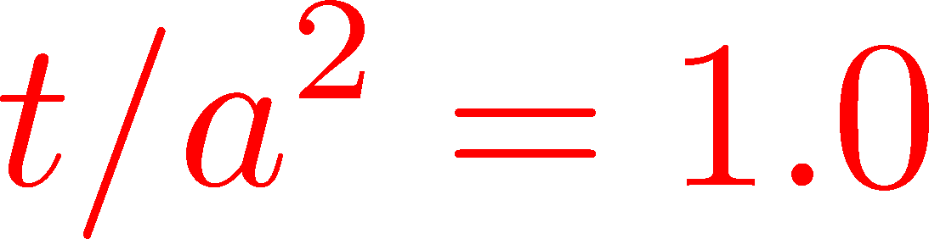

Continuum Extrapolation
T=2.31Tc
2000 confs
Nt = 10 ~ 16
Preliminary!!
a→0 limit with fixed t/a²
1312.7492
Preliminary!!
0
Nt=16
14
12
10
Continuum extrapolation
is stable

Slide 44
Numerical Analysis: EMT Correlators
Fluctuations and
Correlations
viscosity, specific heat, ...

Slide 45


EMT Correlator
Kubo Formula: T₁₂ correlator ←→shear viscosity
Hydrodynamics describes long range behavior of T_{μν}
Energy fluctuation ←→specific heat

Slide 46


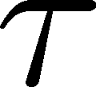
EMT Correlator : Noisy…
With naïve EMT operators
Nakamura, Sakai, PRL,2005
N_{t}=8
improved action
~10⁶ configurations
Nt=16
standard action
5x10⁴ configurations
… no signal

Slide 47

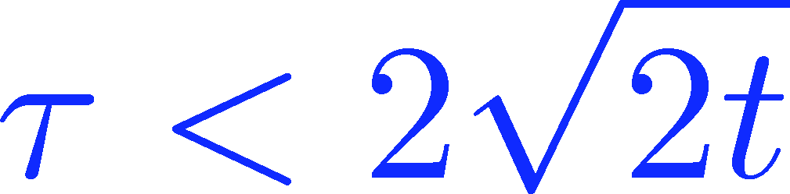
Energy Correlation Function
T=2.31Tc
b=7.2, Nt=16
2000 confs
p=0 correlator
Preliminary!!
smeared

Slide 48
Energy Correlation Function
T=2.31Tc
b=7.2, Nt=16
2000 confs
p=0 correlator
Preliminary!!
τ independent const.
→ energy conservation
smeared

Slide 49



Energy Correlation Function
T=2.31Tc
b=7.2, Nt=16
2000 confs
p=0 correlator
specific heat
Preliminary!!
→ Novel approach to
measure specific heat!
smeared
Gavai, Gupta, Mukherjee, 2005
differential method / cont lim.

Slide 50

Summary

Slide 51

Summary
EMT formula from gradient flow
This formula can successfully define and calculate the EMT on the lattice
It provides us with novel approaches to measure various observables on the lattice!
This method is direct, intuitive and less noisy

Slide 52
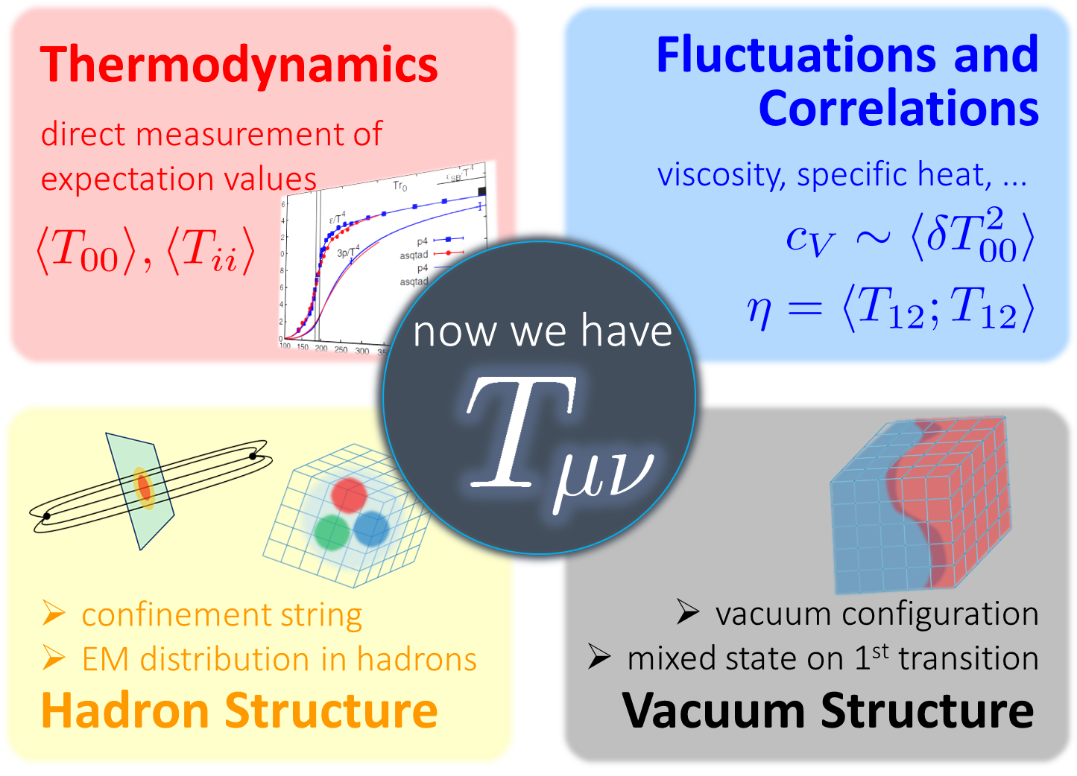
Many Future Studies!!
Other observables
full QCD Makino,Suzuki,2014
non-pert. improvement Patella 7E(Thu)
O(a) improvement
Nogradi, 7E(Thu); Sint, 7E(Thu)
Monahan, 7E(Thu)
and etc.

Slide 53
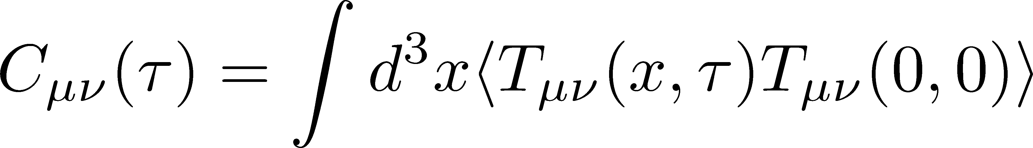


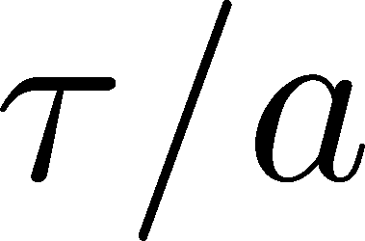
Correlation Function
64³x16
β=7.2 (T~2.3Tc)
1200 confs
t/a²=1.9
C₄₄(τ) :constant
←conservation law!
C₁₂(τ)
smeared
C₄₁(τ)
negative← i²=-1

