Slide 1
Thermal Fluctuations in Heavy Ion Collisions
Masakiyo Kitazawa
(Osaka U.)

Slide 2
Beam-Energy Scan
T
Quark-Gluon Plasma
Hadrons
Color SC
0
μ

Slide 3

Beam-Energy Scan
STAR 2012
high
beam energy
T
low
Hadrons
Color SC
0
μ

Slide 4






Bulk (Thermal) Fluctuations
Observables in equilibrium are fluctuating!
variance
V
Gaussian
non-Gaussianity

Slide 5

Event-by-Event Analysis
Detector
Pioneering studies on σ :
Search of QCD critical point Stephanov,Rajagopal,Shuryak,PRL(1998)
Quark deconfinement Asakawa,Heinz,Muller PRL; Jeon,Koch PRL(2000)

Slide 6
My Messages
Fluctuations are invaluable observables in HIC
But, we must understand them in more detail
It’s possible, interesting, and important

Slide 7
Why Fluctuations?

Slide 8
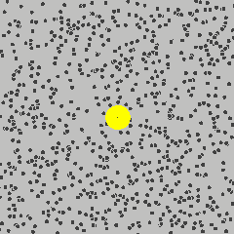
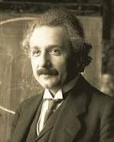
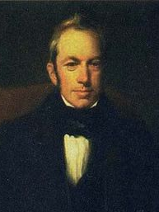
Brownian Motion
A. Einstein
1905
from Wikipedia
Fluctuations opened atomic physics

Slide 9
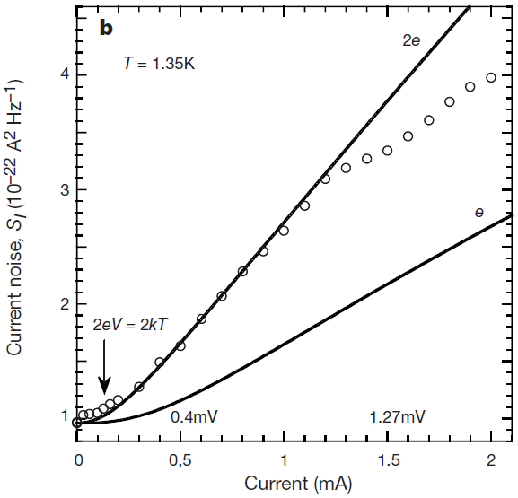
Shot Noise
at Normal-Superconductor Junction
X. Jehl+, Nature405,50 (2000)
Normal
normal
current
super
Super
Normal
Normal
Similar experiments for fractional QHE ex. Saminadayar+, PRL79,2526(1997)

Slide 10
Conserved Charges : Theoretical Advantage
Definite definition for operators
as a Noether current
calculable on any theory
ex: on the lattice

Slide 11
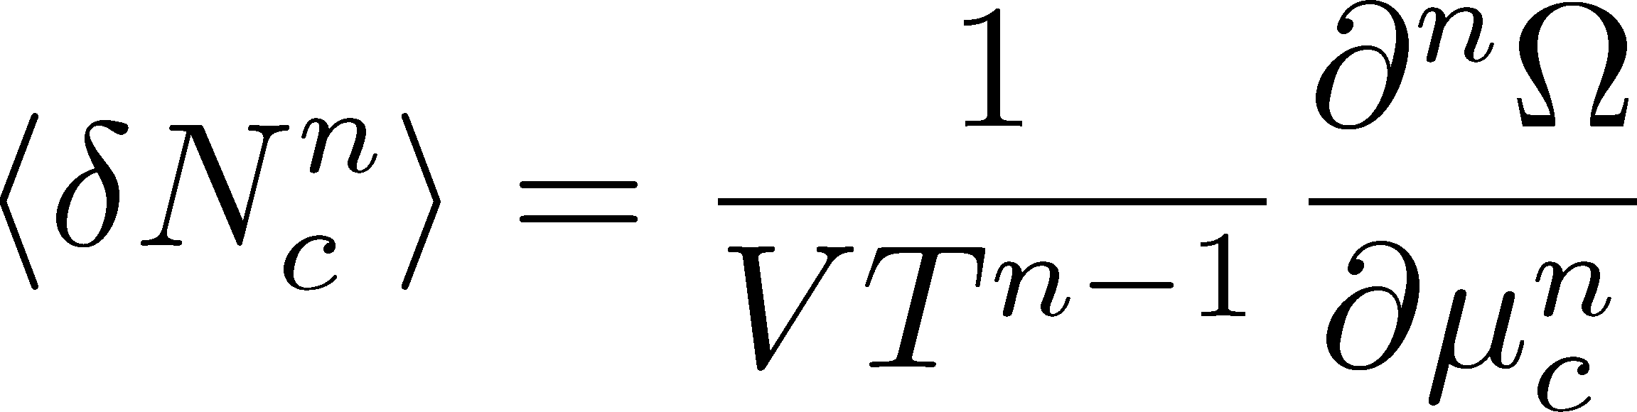

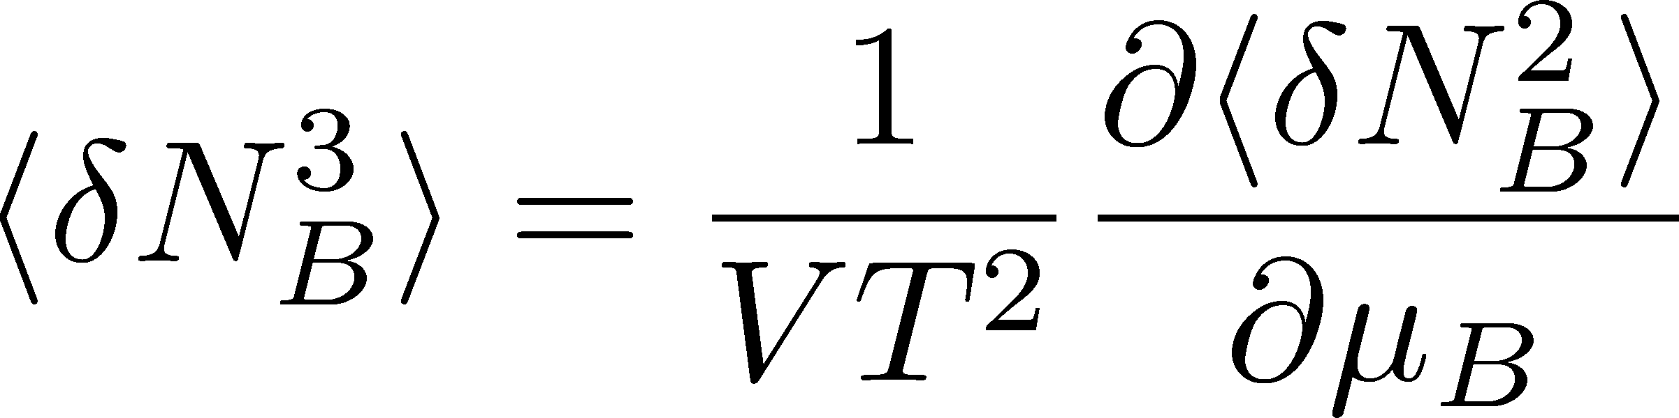
Conserved Charges : Theoretical Advantage
Definite definition for operators
as a Noether current
calculable on any theory
ex: on the lattice
Simple thermodynamic relations
Intuitive interpretation for the behaviors of cumulants
ex:
Asakawa, Ejiri, MK, 2009

Slide 12
Conserved-Charge Fluctuations
Fluctuations of CC : rigorously defined in a theory
operators as the Noether current
as derivatives of the partition function
They are lattice observables
Fluctuations of CC
=
LAT-HIC crossover
QCD phase diagram 3, Wed. 11:00-13:30

Slide 13
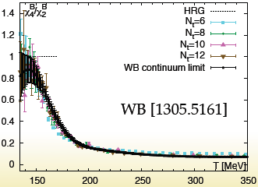
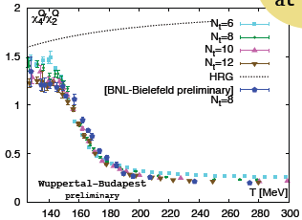
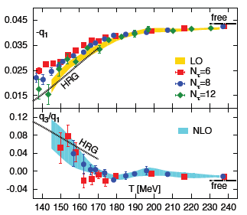
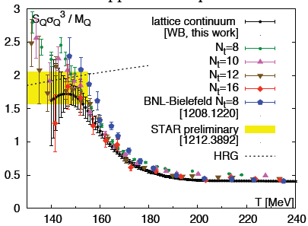
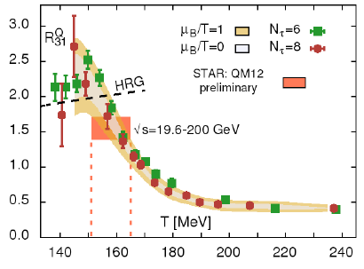
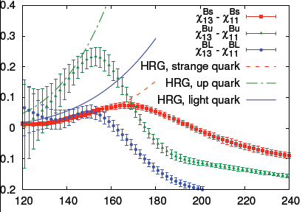
Recent Progress in Lattice Community
From LATTICE2013
presentations

Slide 14
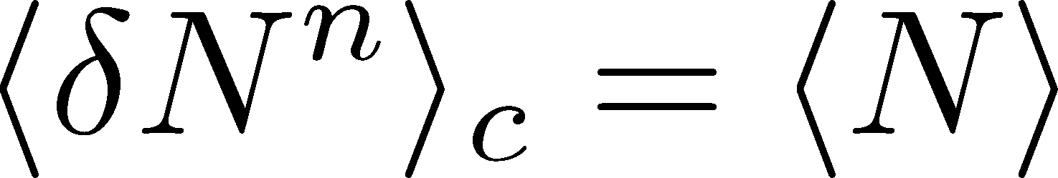
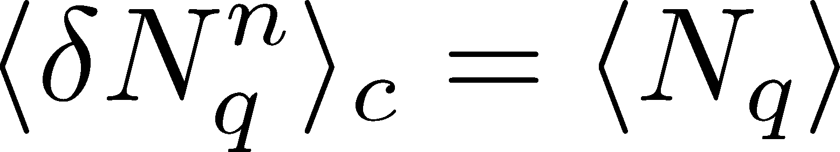
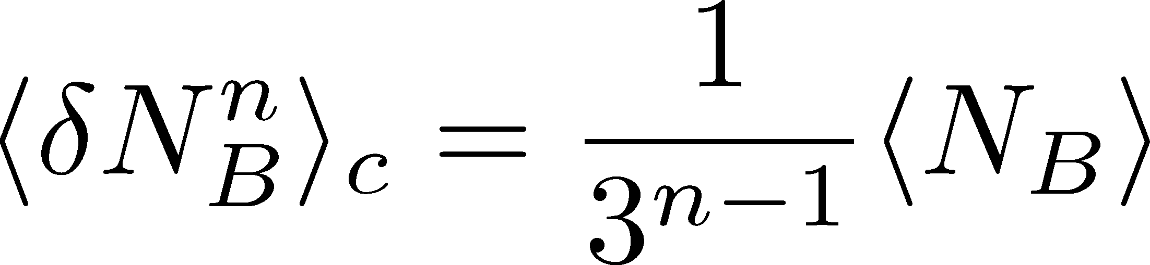
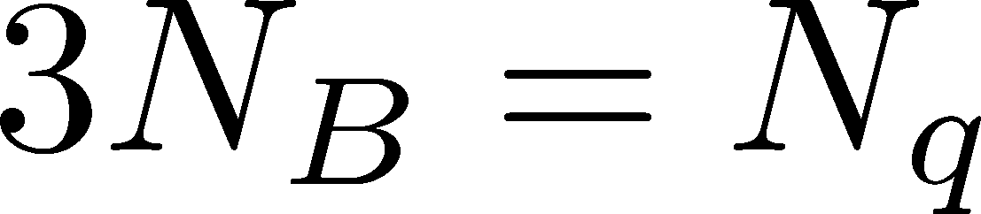
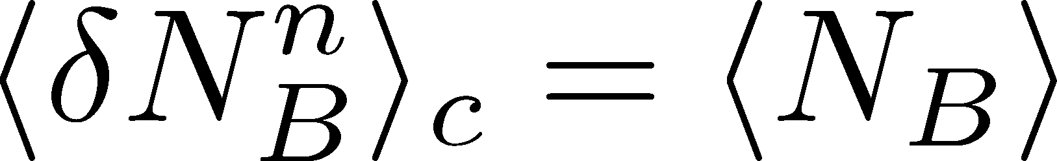
Fluctuations
Free Boltzmann → Poisson

Slide 15
Fluctuations
Free Boltzmann → Poisson
RBC-Bielefeld ’09

Slide 16



Electric Charge Fluctuation
Asakawa,Heinz,Muller; Jeon,Koch,2000
D-measure
D ~ 3-4 Hadronic
D ~ 1-1.5 QGP

Slide 17
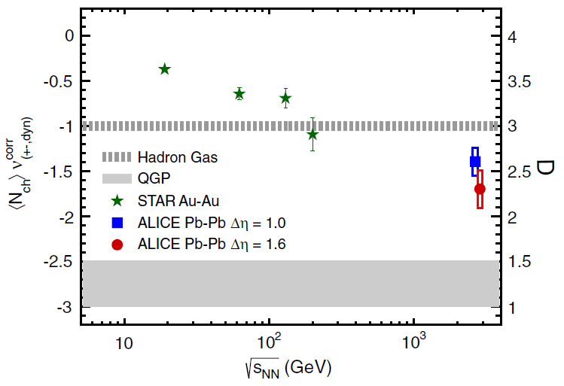
Electric Charge Fluctuation
PHENIX (2002); STAR (2003)
ALICE, PRL 110, 152301 (2013)
hadronic
D measure
STAR
Suppression
@ LHC energy
D ~ 3-4 Hadronic
D ~ 1-1.5 QGP
No suppression at RHIC energy
Fluctuations @ LHC cannot be described by hadronic d.o.f.

Slide 18

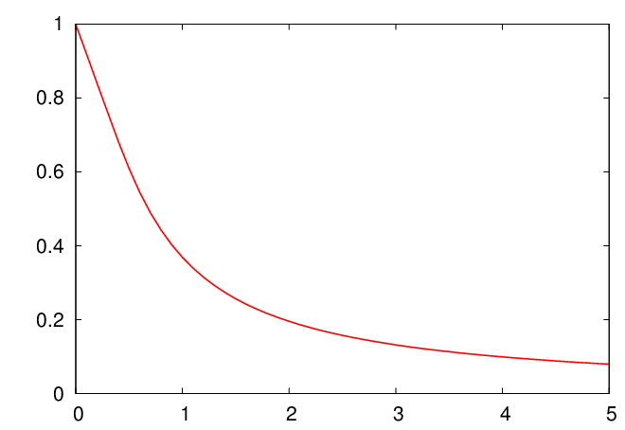



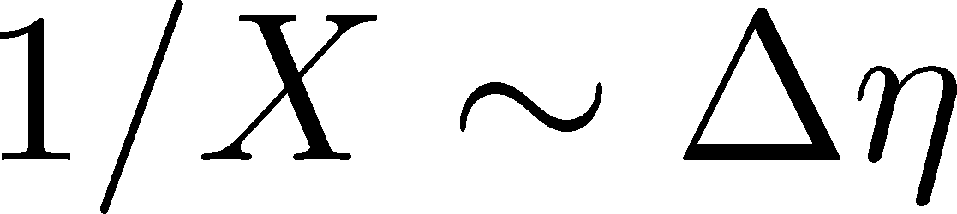
Rapidity Window Dependence
ALICE, PRL 110, 152301 (2013)
hadronic
Smaller Δη
more hadronic
Larger Δη
more QGP like
Stochastic Diffusion eq.
Shuryak,Stephanov,2001
Same information in
balance function
to be studied by fluctuating hydro.

Slide 19
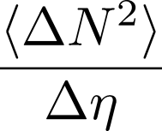
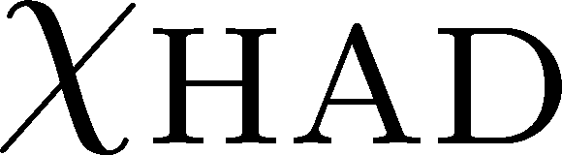
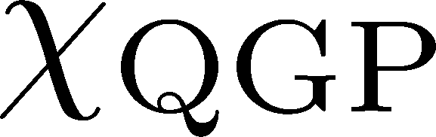


Time Evolution in HIC
Quark-Gluon Plasma
Hadronization
Freezeout

Slide 20
Various Contributions
Initial fluctuations
Effect of jets
Negative binomial (?)
Final state rescattering
Coordinate vs pseudo rapidities
Particle missID
Efficiency correction
Global charge conservation
Enhance
Enhance
Enhance
Enhance to Poisson
Enhance to Poisson
Enhance to Poisson
Enhance to Poisson
Suppress

Slide 21



Global Charge Conservation
Jeon,Koch,2000
Bleicher,Jeon,Koch,2001
For equilibrated medium

Slide 22
Global Charge Conservation
Jeon,Koch,2000
Bleicher,Jeon,Koch,2001
For equilibrated medium
Solving the time evolution…
GCC effect on the hadronic
diffusion is negligible in the
ALICE result!
detector
coverage
GCC effect
Sakaida, Poster I-35

Slide 23
Electric-Charge Fluctuations
Electric charge fluctuations is suppressed at LHC!
The suppression is most probably attributed to primordial physics
Qualitative difference b/w RHIC and LHC
… but why?

Slide 24
Non Gaussianity

Slide 25
Non-Gaussianity
CMB
Cosmic Microwave Background
Mesoscopic Systems
No statistically-significant signals
Full counting statistics
Cumulants up to 5th order
Planck, 2013
Gustavsson+, Surf.Sci.Rep.64,191(2009)

Slide 26
Non-Gaussianity in HIC
Ratio of conserved charges
Critical enhancement
Sign change
Strange confinement
Distribution funcs themselves
Ejiri,Karsch,Redlich(2005)
Stephanov(2009)
Asakawa,Ejiri,MK (2009); Friman+(2011); Stephanov(2011)
BNL-Bielefeld(2013)
Morita+(2013); Nakamura (Wed.)

Slide 27






Ratio of Cumulants
Ejiri, Karsch, Redlich, 2005
hadronic
quark-gluon

Slide 28




Strange Confinement
BNL-Bielefeld,PRL(2013)
H.T. Ding, This Morning
Baryonic
baryons confined
something else
Strangeness
strangeness confined
something else
Many lattice studies (LAT-HIC crossover):
Budapest-Wuppertal, 2013; BW,1403.4578; BNL-Bi.,1404.4043; Gupta+,1405.2206;
Ratti, Wed.; Schmidt, Wed.; Nakamura, Wed.; Sharma, J-13

Slide 29
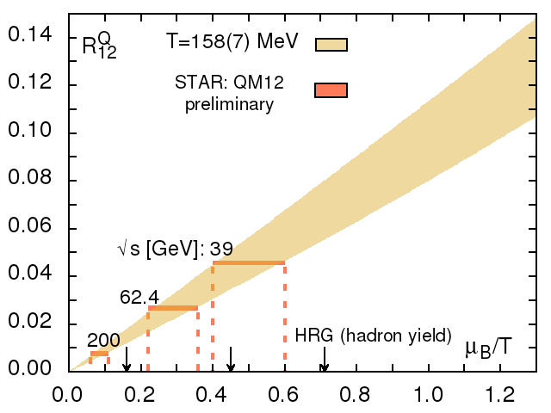
Cumulants : HIC@RHIC vs Lattice
parameter window
constrained by lattice
BNL-Bielefeld,
LATTICE2013
fluctuations
“exp + lattice”
μ /T
particle abundance
(chem. freezeout T)
discrepancy

Slide 30
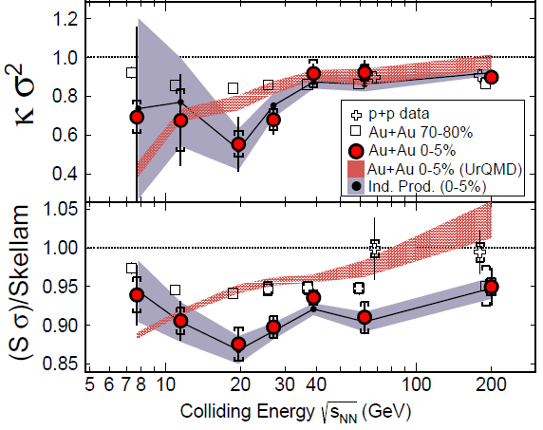

Proton Number Cumulants at RHIC-BES
STAR 2012
STAR, PRL112,032302(2014)
Exp. results are close to and less than Poissonian values.
Something interesting around

Slide 31
Effects of Various Contributions
Initial fluctuations
Effect of jets
Negative binomial (?)
Final state rescattering
Coordinate vs pseudo rapidities
Particle missID
Efficiency correction
Global charge conservation
Enhance
Enhance
Enhance
Enhance to Poisson
Enhance to Poisson
Enhance to Poisson
Enhance to Poisson
Suppress

Slide 32

Caution!!
proton number
cumulants
baryon number
cumulants
Let’s clarify their relation!
MK, Asakawa (2012;2012)

Slide 33


Nucleon isospin and a coin
a coin
N
p
n
Nucleon has
two isospin states.
A coin has two sides.
MK, Asakawa,2012

Slide 34





Slot Machine Analogy
= +

Slide 35

Reconstructing Total Coin Number

Slide 36

















Charge Exchange Reaction
Isospin of N is not
frozen at chemical
freezeout!
cross sections of p
3
1
2:1
2
1:2
mean reaction time
< 5fm/c
decay rates of Δ

Slide 37



Nucleons in Hadronic Medium
time
chem. f.o.
kinetic f.o.
hadronize
NOTE:
so many pions
rare NN collisions
no quantum corr.
mesons
baryons

Slide 38


Difference b/w N_{B} and N_{p}
net-cumulants deviate from thermal value
But, are Poissoian
Assumptions:
genuine info.
noise
Proton number cumulants are dominated by Poissonian noise
cf.) Nahrgang+, arXiv:1402.1238

Slide 39

Efficiency Correction
MK, Asakawa, 2012
Bdzak, Koch, 2012
STAR, 2013
If efficiency for each
particle is uncorrelated
Electric charge
binomial correction to
distribution function
STAR, arXiv:1402.1558
for Particle missID: Ono,Asakawa,MK, PRC,2013

Slide 40
More Information on/from Fluctuations
Δη dependence
MK, Asakawa, Ono,PLB728, 386 (2014)

Slide 41



Δη Dep. of Non-Gaussianity
enhance?
suppress?
How does the 4-th order cumulant
behave as a function of Δη?

Slide 42
Fluctuating Hydrodynamics?
Distributions in experiments are close to Poissonian
Cumulants are expected to increase in the hadronic medium
These behaviors cannot be described by
the theory of hydrodynamic fluctuations

Slide 43

Hydrodynamic Fluctuations
Landau, Lifshitz, Statistical Mechaniqs II
Kapusta, Muller, Stephanov, 2012
Stephanov, Shuryak, 2001
Stochastic diffusion equation
Markov (white noise)
+
continuity
Fluctuation of n is
Gaussian in equilibrium
Gaussian noise
cf) Gardiner, “Stochastic Methods”

Slide 44
How to Introduce Non-Gaussianity?
Stochastic diffusion equation
Choices to introduce non-Gaussianity in equil.:
n dependence of diffusion constant D(n)
colored noise
discretization of n

Slide 45
How to Introduce Non-Gaussianity?
Stochastic diffusion equation
Choices to introduce non-Gaussianity in equil.:
n dependence of diffusion constant D(n)
colored noise
discretization of n
our choice
Fluctuations measured in
HIC are almost Poissonian.
REMARK:

Slide 46
Nucleons in Hadronic Medium
Baryons in hadronic medium
behave like Browinian pollen
time
chem. f.o.
kinetic f.o.
hadronize
mesons
baryons

Slide 47









Diffusion Master Equation
MK,Asakawa,Ono,PLB728,386(2014)
Divide spatial coordinate into discrete cells
probability
Master Equation
Solve the DME exactly, and take a→0 limit

Slide 48

hadronization
chemical freezeout
Initial condition
boost invariance
locality of fluctuations
small cumulants
Brownian
diffusion
kinetic freezeout
Comments:
agreement with stochastic diffusion eq. up to Gaussian fluctuaion
Poisson (Skellam) distribution in equilibrium: consistent with HRG

Slide 49

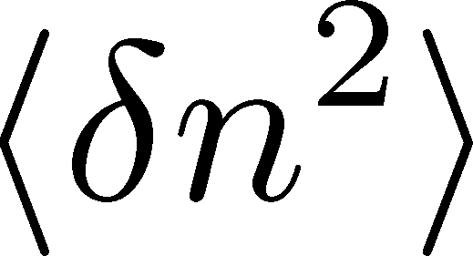
Solution of DME in a→0 Limit
1st order (deterministic)
consistent with diffusion equation with D=γa²
Continuum limit with fixed D=γa²
2nd order
consistent with stochastic diffusion eq.
(for sufficiently smooth initial conditions)
Shuryak, Stephanov, 2001
Nontrivial results for non-Gaussian fluctuations

Slide 50

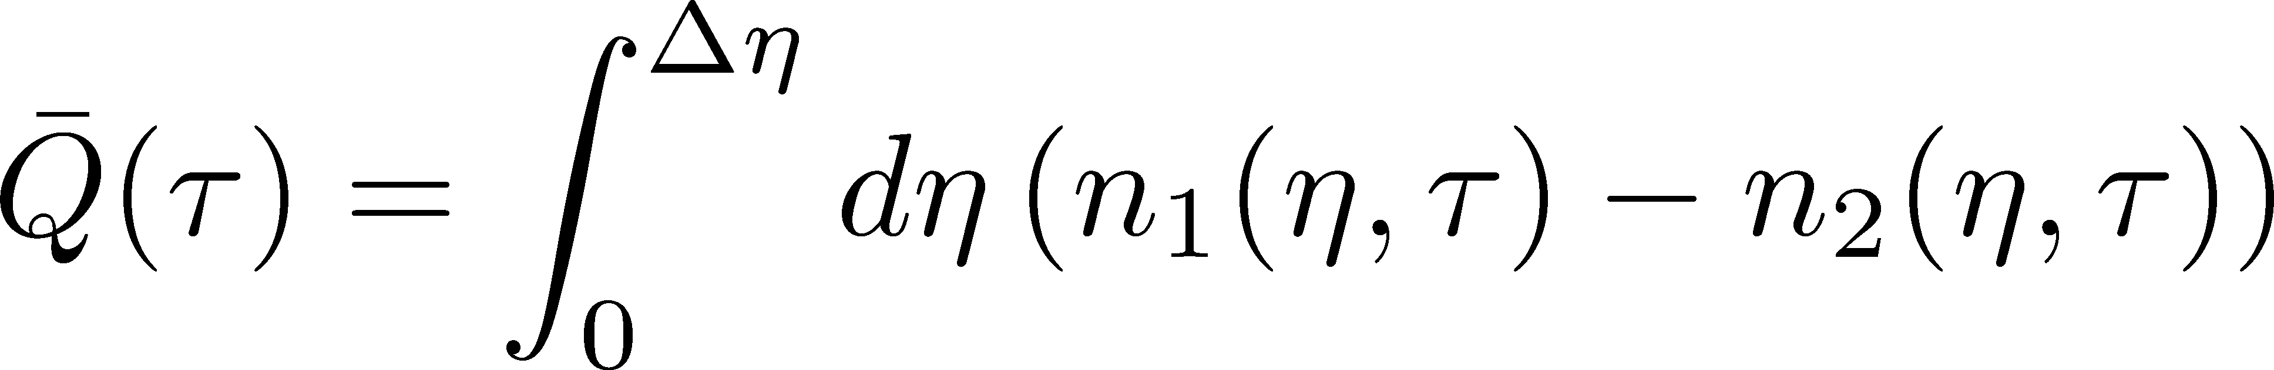
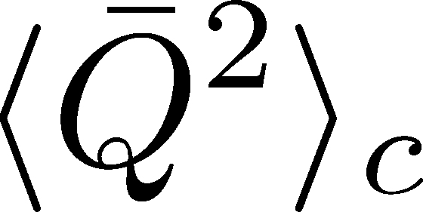
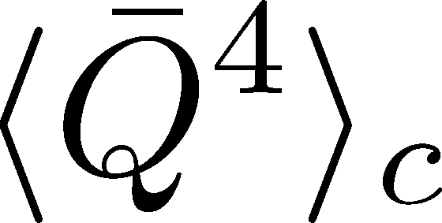
Net Charge Number
Prepare 2 species of (non-interacting) particles
Let us investigate
at freezeout time t

Slide 51

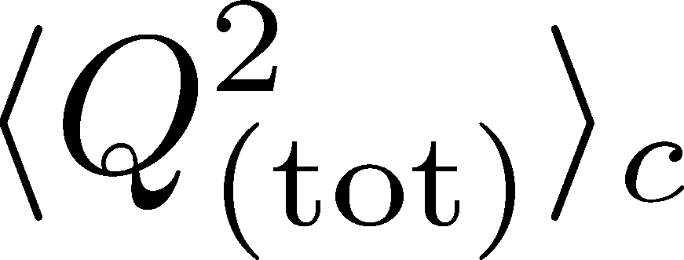
Time Evolution in Hadronic Phase
Hadronization (initial condition)
Boost invariance / infinitely long system
Local equilibration / local correlation
suppression owing to
local charge conservation
strongly dependent on
hadronization mechanism

Slide 52
Time Evolution in Hadronic Phase
Hadronization (initial condition)
Boost invariance / infinitely long system
Local equilibration / local correlation
Time evolution via DME
suppression owing to
local charge conservation
strongly dependent on
hadronization mechanism
Freezeout

Slide 53
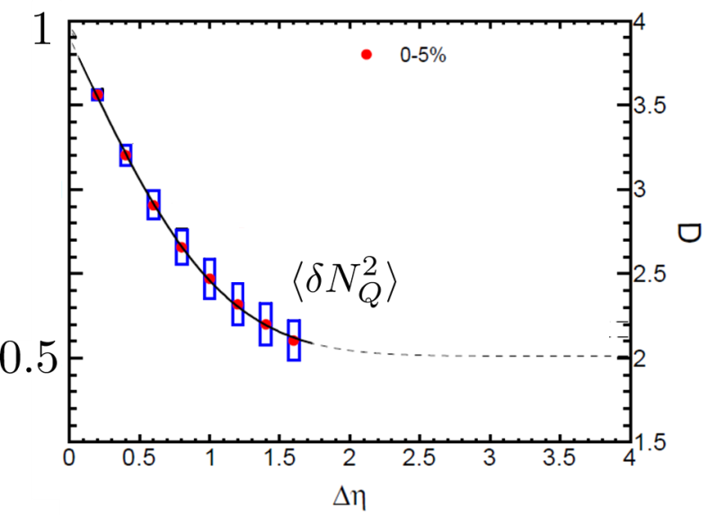


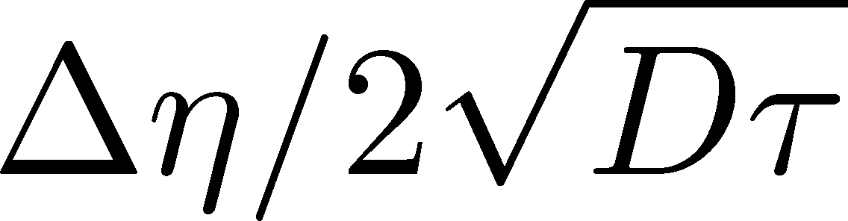
Δη Dependence at Freezeout
Initial fluctuations:
2nd
4th
parameter
sensitive to
hadronization

Slide 54
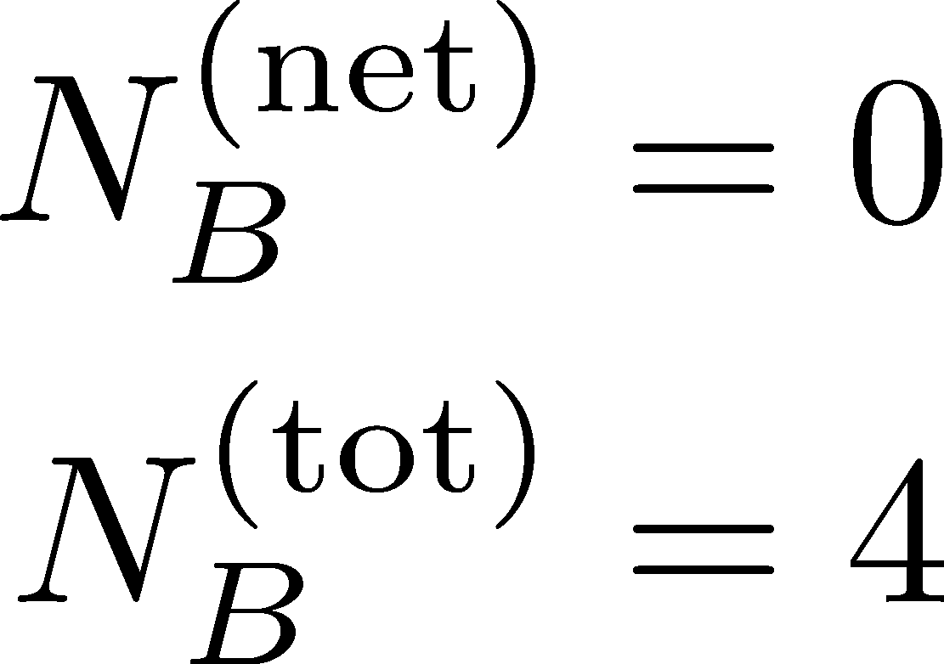
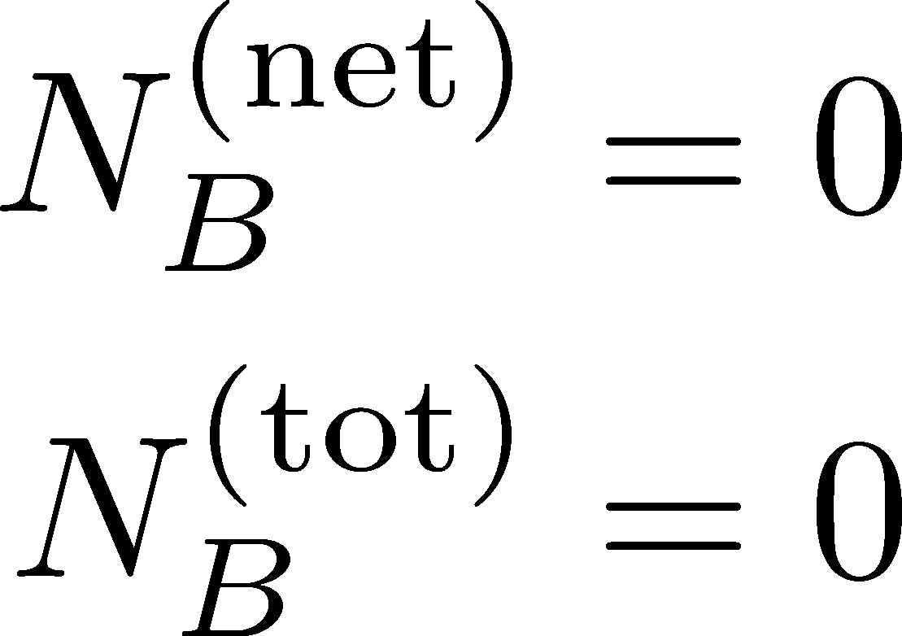
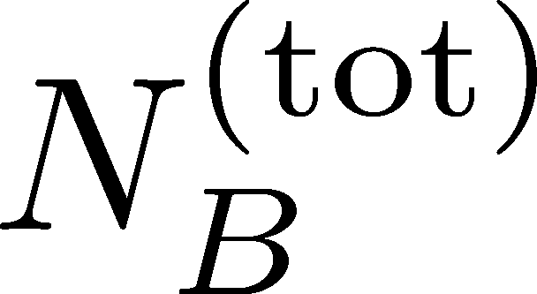
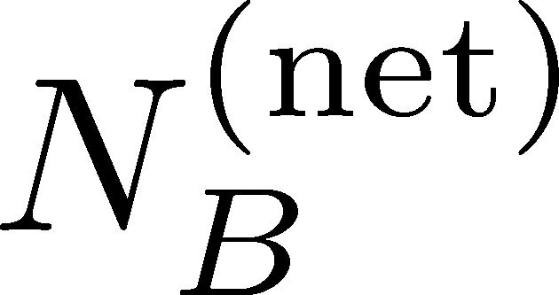
Total Charge Number
In recombination model,
6 quarks
6 antiquarks
can fluctuate, while does not.

Slide 55
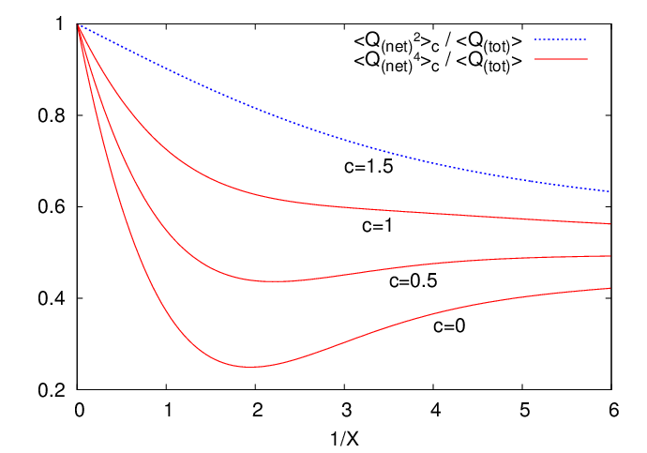
Δη Dependence at Freezeout
Initial fluctuations:
2nd
4th
parameter
sensitive to
hadronization

Slide 56

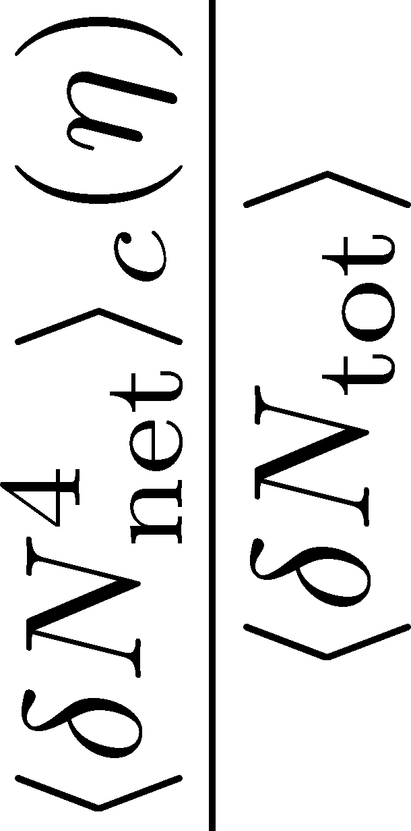

4th order Cumulant at ALICE
MK, Asakawa,Ono (2014)
Sakaida+, poster I-35
rapidity coverage at ALICE
4th order cumulant is sensitive to
initial fluctuation / transport property / confinement
It can be non-monotonic and negative!

Slide 57
Δη Dep. of Non-Gaussianity
enhance?
suppress?
How does the 4-th order cumulant
behave as a function of Δη?

Slide 58
Suggestions to Experimentalists
many conserved charges
electric charge, baryon number, (and strangeness?)
with different diffusion constans
various cumulants
second, third, fourth, mixed, (and much higher?)
Δη window dependences
primordial thermodynamics, transport property, confinement
no normalization
Beam Energy Scan
LHC, RHIC-BES, FAIR, NICA, J-PARC, …

Slide 59
My Messages
Fluctuations are invaluable observables in HIC
But, we must understand them in more detail
It’s possible, interesting, and important
We are just arriving at the starting point to explore QCD phase structure with fluctuations!

Slide 60
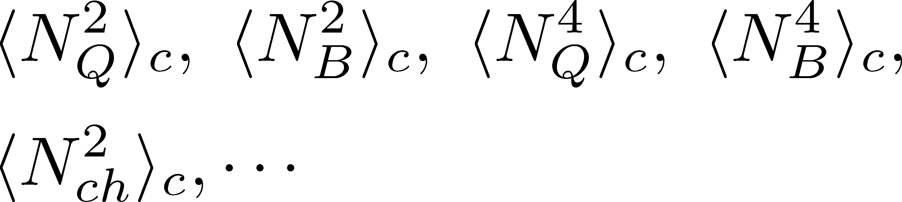
Summary
Fluctuations in HIC are nonthermal!
Plenty of physics in Δη dependences of
various cumulants
Diagnosing dynamics of HIC
history of hot medium
mechanism of hadronization
diffusion constant
Physical meanings
of fluctuation obs.
in experiments.

Slide 61
backup

Slide 62
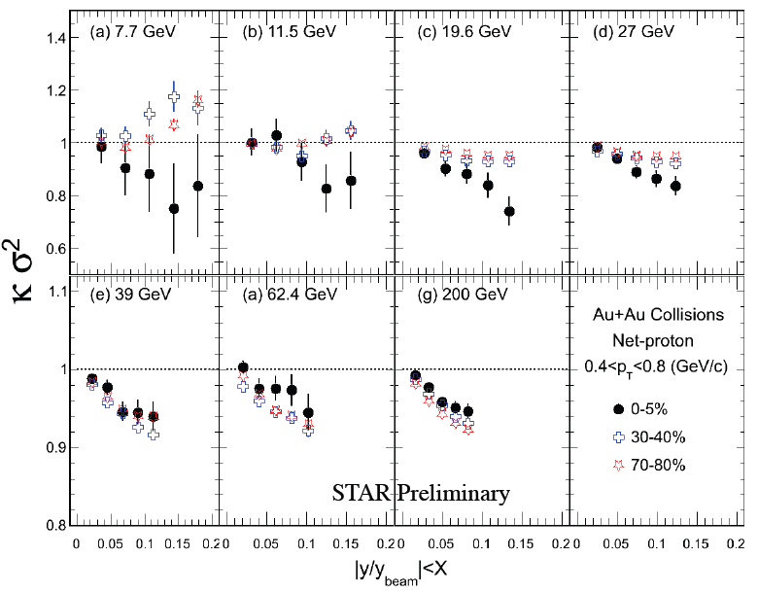
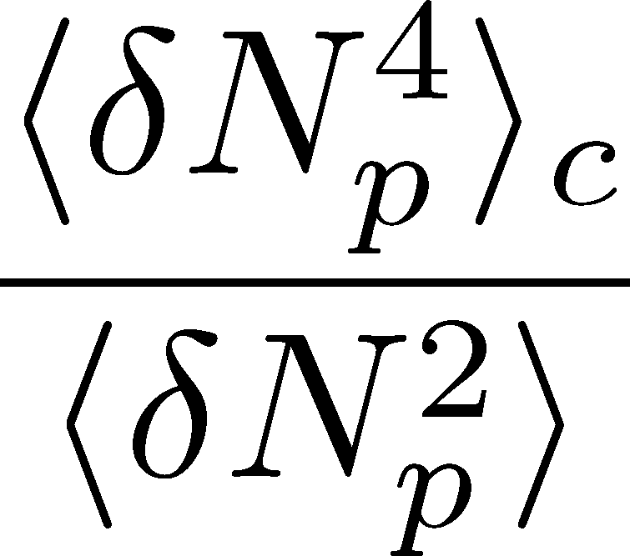
Δη Dependence at STAR
STAR, QM2012
decreases as Δη becomes larger at RHIC energy.

Slide 63
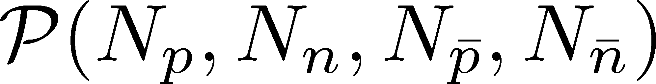
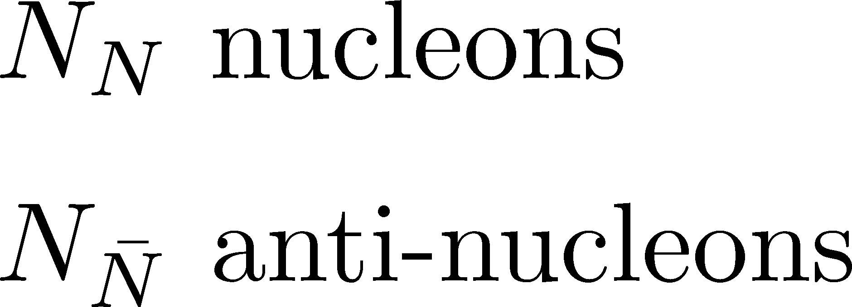
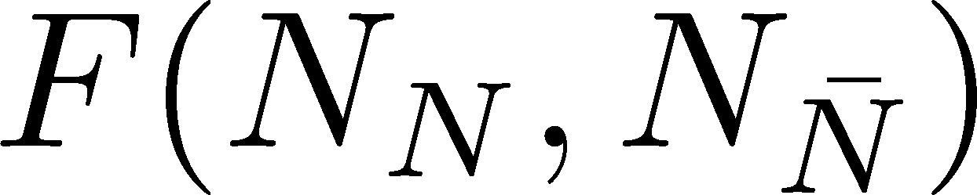
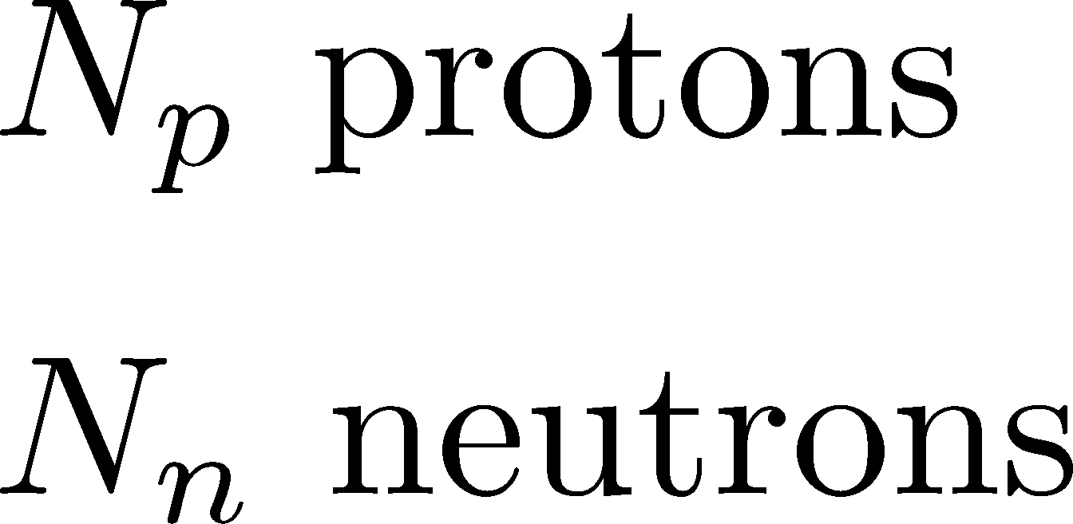

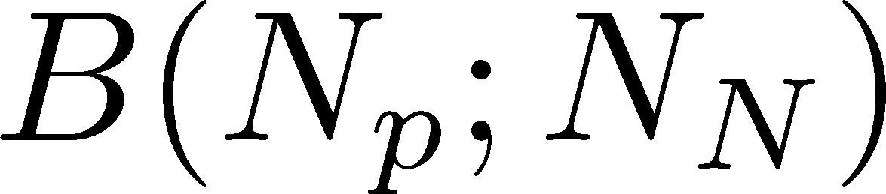
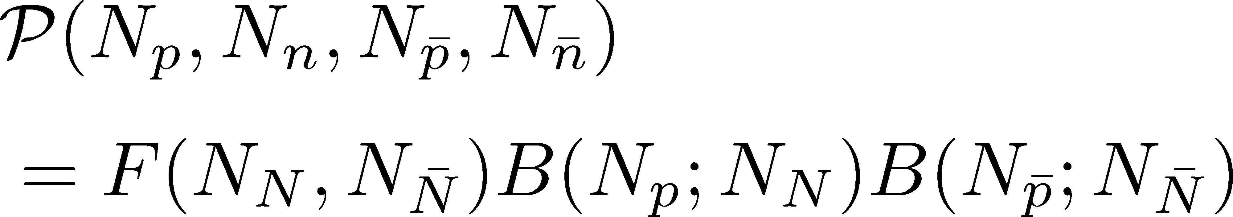
Probability Distribution
Detector
binomial distribution func.
for any phase space in the final state.

Slide 64

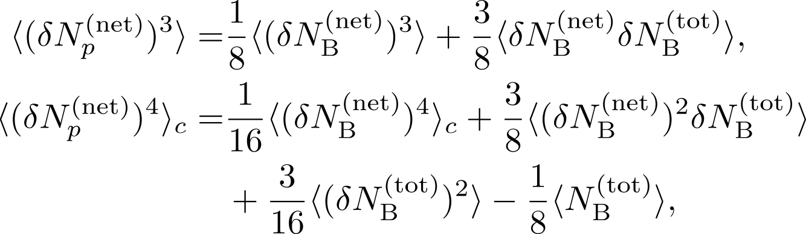

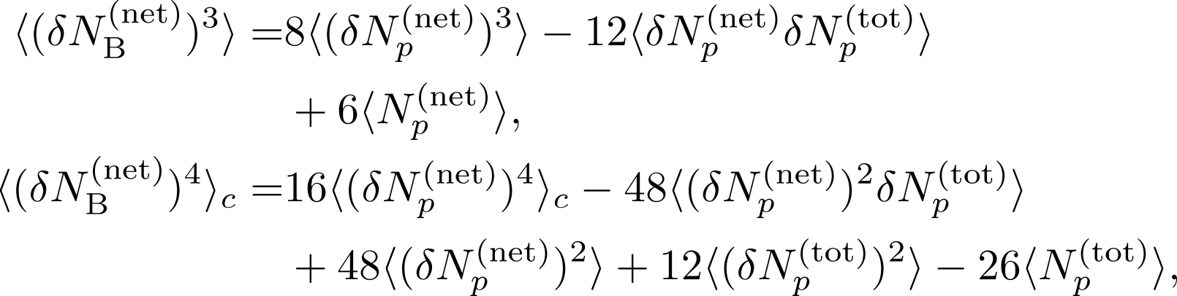
3rd & 4th Order Fluctuations

Slide 65
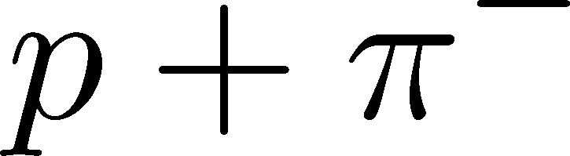

















Strange Baryons
Decay Rates:
Decay modes:
Regarding these ratios even, protons from these decays
is incorporated into the binomial distribution. Then, N_{N}→N_{B}

Slide 66
Δη Dependence at Freezeout
Initial fluctuations:
2nd
4th
parameter
sensitive to
hadronization

Slide 67
Total Charge Number
In recombination model,
6 quarks
6 antiquarks
can fluctuate, while does not.

Slide 68
Higher Order Cumulants @ STAR
(Net-) Proton Number
(Net-) Electric Charge
STAR, PRL112,032302(2014)
STAR, arXiv:1402.1558
Exp. results are close to Poissonian values.
Proton number cumulants are lower than the Poissonian values.

Slide 69
2nd Order Cumulant
consistent with stochastic
diffusion equation

Slide 70



Search of QCD Phase Structure
Stronger correlation length dep.
Stephanov, 2009
Sign of cumulants
Asakawa, Ejiri, MK, 2009
Friman+, 2011
Stephanov, 2011

Slide 71

Fluctuations
Fluctuations reflect properties of matter.
  Enhancement near the critical point
  Stephanov,Rajagopal,Shuryak(’98); Hatta,Stephanov(’02); Stephanov(’09);…
  Ratios between cumulants of conserved charges
  Asakawa,Heinz,Muller(’00); Jeon, Koch(’00); Ejiri,Karsch,Redlich(’06)
  Signs of higher order cumulants
  Asakawa,Ejiri,MK(’09); Friman,et al.(’11); Stephanov(’11)

