Slide 1
格子QCD上でエネルギー運動量テンソルを測定する新しい試み
北沢正清 （阪大理）
for FlowQCD Collaboration
Asakawa, Hatsuda, Iritani, Itou, MK, Suzuki,
FlowQCD, PRD90,011501R (2014)
高エネルギーQCD・核子構造勉強会, 18 Aug. 2014, 京都大学

Slide 2

Lattice QCD
First principle calculation of QCD
Monte Carlo for path integral
hadron spectra, chiral symmetry, phase transition, etc.

Slide 3

Gradient Flow
Luscher, 2010
A powerful tool for various analyses on the lattice

Slide 4
Gradient Flow
Luscher, 2010
D. Nogradi, LATTICE2014, June

Slide 5
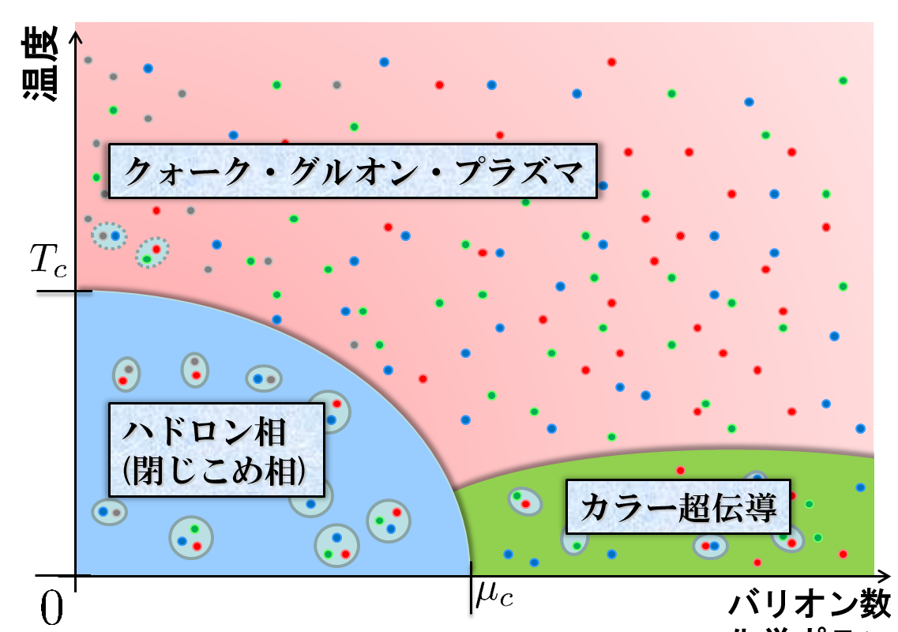

Physics Motivation
Condensed matter physics of QCD
Relativistic heavy ion collisions

Slide 6
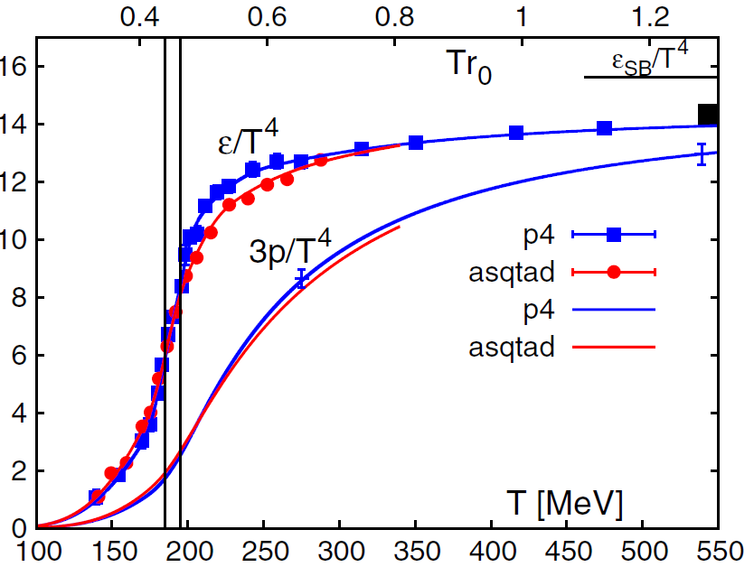
QCD EoS
(Energy Density, Pressure)
BNL-Bielefeld
2011
hadronic
QGP
Rapid increase of ε/T⁴ around T=150-200 MeV
Crossover transition
Rapid but smooth change of medium from hadronic to QGP-like

Slide 7



Slide 8



momentum
energy
Poincare
symmetry
stress
pressure
Einstein Equation
Hydrodynamic Eq.

Slide 9



: nontrivial observable
on the lattice
Definition of the operator is nontrivial
because of the explicit breaking of Lorentz symmetry
ex:
Its measurement is extremely noisy
due to high dimensionality and etc.
the more severe on the finer lattices

Slide 10
stem from
small
lose
big
因小失大

Slide 11
stem from
small
lose
big
因小失大
miss the wood for the trees
見小利則大事不成
孔子（論語、子路13）

Slide 12

If we have

Slide 13
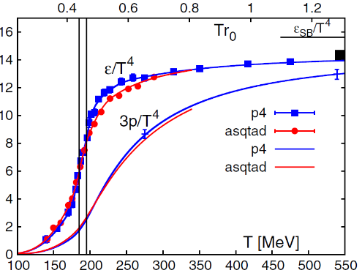
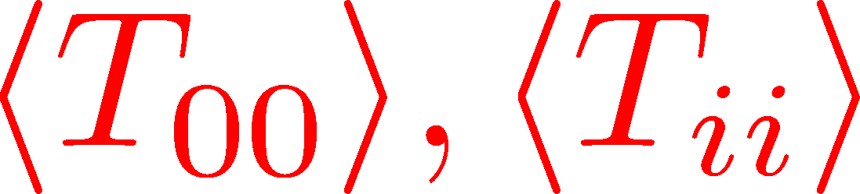
Thermodynamics
direct measurement of
expectation values
If we have

Slide 14
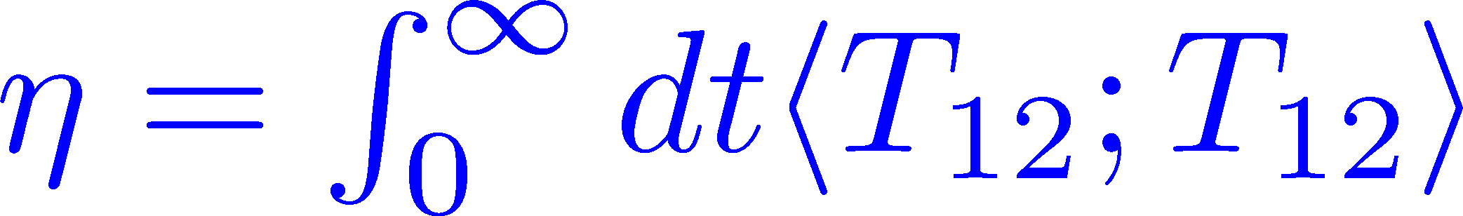
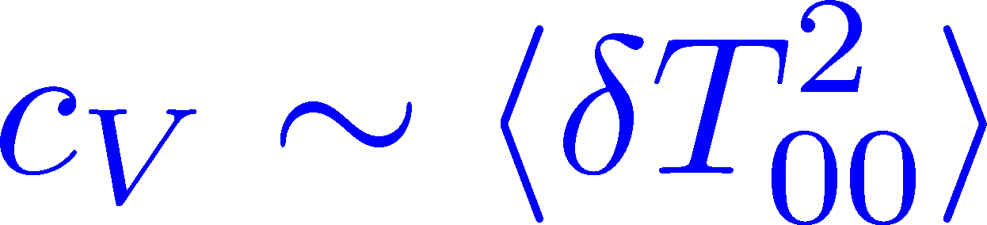
Thermodynamics
Fluctuations and
Correlations
direct measurement of
expectation values
viscosity, specific heat, ...
If we have

Slide 15
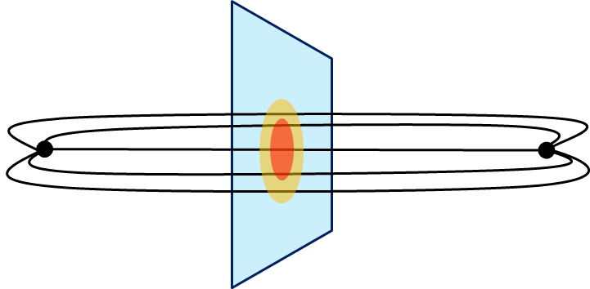
Thermodynamics
Fluctuations and
Correlations
direct measurement of
expectation values
viscosity, specific heat, ...
If we have
confinement string
EM distribution in hadrons
vacuum configuration
mixed state on 1st transition
Hadron Structure
Vacuum Structure

Slide 16
Gradient Flow

Slide 17

YM Gradient Flow
Luscher, 2010
t: “flow time”
dim:[length²]

Slide 18

YM Gradient Flow
Luscher, 2010
t: “flow time”
dim:[length²]
transform gauge field like diffusion equation
diffusion length
This is NOT the standard cooling/smearing
All composite operators at t>0 are UV finite Luescher,Weisz,2011

Slide 19
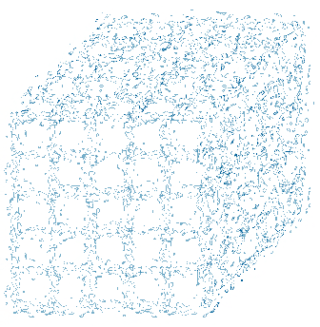
失小得大
This is NOT the standard cooling
coarse
graining

Slide 20
Gradient Flow : Applications
Applications:
scale setting
running coupling
topology
operator relation
autocorrelation
etc.
thermodynamics
EMT correlator

Slide 21
Lattice Scale Setting

Slide 22







Flow Time Dep. of an Observable
Luscher, 2010
: universal function of t
: an observable
use this function to determine a(β)
standard choice of O:
perturbative formula:

Slide 23




t dep of t²<E>
one-loop perturbation
violated
lattice discretization effect

Slide 24
Small Flow Time Expansion
of Operators and EMT

Slide 25




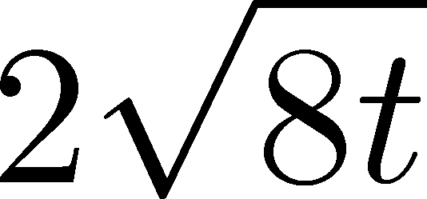
Small t Expansion
Luescher, Weisz, 2011
an operator at t>0
remormalized operators
of original theory
original 4-dim theory
t→0 limit

Slide 26


Constructing EMT
Suzuki, 2013
DelDebbio,Patella,Rago,2013
gauge-invariant dimension 4 operators

Slide 27



Constructing EMT 2
Suzuki, 2013
Suzuki coeffs.

Slide 28

Constructing EMT 2
Suzuki, 2013
Suzuki coeffs.
Renormalized EMT

Slide 29
Numerical Analysis: Thermodynamics
Thermodynamics
direct measurement of
expectation values

Slide 30
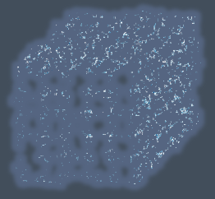


Gradient Flow Method
lattice regularized
gauge theory
gradient flow
“失小得大”
continuum theory
(with dim. reg.)
continuum theory
(with dim. reg.)
analytic
(perturbative)
gradient flow

Slide 31
Gradient Flow Method
lattice regularized
gauge theory
gradient flow
“失小得大”
measurement
on the lattice
continuum theory
(with dim. reg.)
continuum theory
(with dim. reg.)
analytic
(perturbative)
gradient flow
“失而復得”

Slide 32


Caveats
Gauge field has to be sufficiently smeared!
lattice regularized
gauge theory
gradient flow
Perturbative relation has to be applicable!
measurement
on the lattice
continuum theory
(with dim. reg.)
continuum theory
(with dim. reg.)
analytic
(perturbative)
gradient flow

Slide 33

Caveats
Gauge field has to be sufficiently smeared!
lattice regularized
gauge theory
gradient flow
Perturbative relation has to be applicable!
measurement
on the lattice
continuum theory
(with dim. reg.)
continuum theory
(with dim. reg.)
analytic
(perturbative)
gradient flow

Slide 34




in continuum
non-perturbative
region
O(t) effect
classical

Slide 35
in continuum
non-perturbative
region
O(t) effect
classical
on the lattice
t→0 limit with keeping t>>a²

Slide 36

Numerical Simulation
SU(3) YM theory
Wilson gauge action
twice finer lattice!
Simulation 1
(arXiv:1312.7492)
Simulation 2
(new, preliminary)
lattice size: 32³xN_{t}
Nt = 6, 8, 10
β = 5.89 – 6.56
~300 configurations
lattice size: 64³xN_{t}
Nt = 10, 12, 14, 16
β = 6.4 – 7.4
~2000 configurations
using
SX8 @ RCNP
SR16000 @ KEK
using BlueGeneQ @ KEK
efficiency ~40%

Slide 37
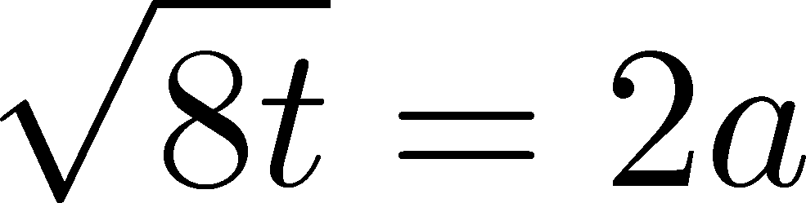


ε-3p at T=1.65T_{c}
Emergent plateau!
Nt=6,8,10
~300 confs.
the range of t where the EMT formula is successfully used!

Slide 38






ε-3p at T=1.65T_{c}
Emergent plateau!
Nt=6,8,10
~300 confs.
the range of t where the EMT formula is successfully used!

Slide 39
Entropy Density at T=1.65Tc
Emergent plateau!
systematic
error
Nt=6,8,10
~300 confs.
Direct measurement of e+p on a given T!
NO integral / NO vacuum subtraction

Slide 40



Continuum Limit
32³xNt
Nt = 6, 8, 10
T/Tc=0.99, 1.24, 1.65
Boyd+1996
0

Slide 41
Continuum Limit
32³xNt
Nt = 6, 8, 10
T/Tc=0.99, 1.24, 1.65
Boyd+1996
0
Comparison with
previous studies

Slide 42
Numerical Simulation
SU(3) YM theory
Wilson gauge action
twice finer lattice!
Simulation 1
(arXiv:1312.7492)
Simulation 2
(new, preliminary)
lattice size: 32³xN_{t}
Nt = 6, 8, 10
β = 5.89 – 6.56
~300 configurations
lattice size: 64³xN_{t}
Nt = 10, 12, 14, 16
β = 6.4 – 7.4
~2000 configurations
using
SX8 @ RCNP
SR16000 @ KEK
using BlueGeneQ @ KEK
efficiency ~40%

Slide 43
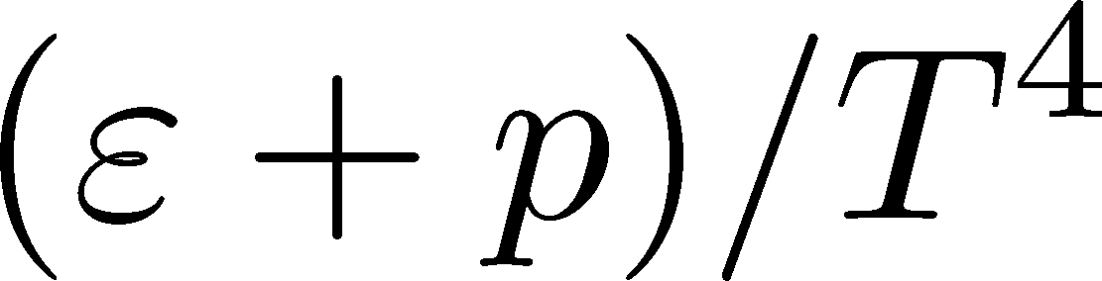
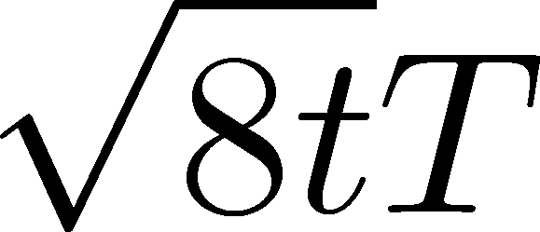
Entropy Density on Finer Lattices
T = 2.31Tc
64³xNt
Nt = 10, 12, 14, 16
2000 confs.
Preliminary!!
The wider plateau on the finer lattices
Plateau may have a nonzero slope
FlowQCD,2013
T=1.65Tc

Slide 44

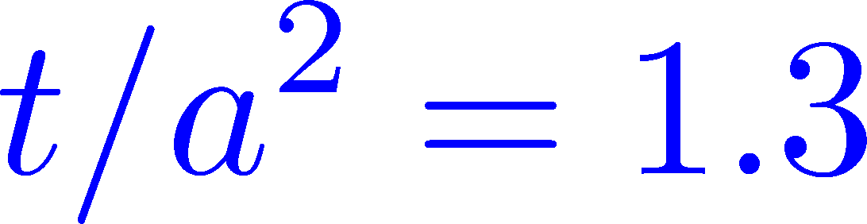
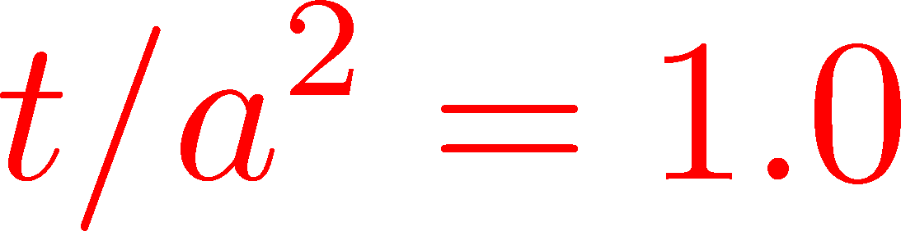

Continuum Extrapolation
T=2.31Tc
2000 confs
Nt = 10 ~ 16
Preliminary!!
a→0 limit with fixed t/a²
1312.7492
Preliminary!!
0
Nt=16
14
12
10
Continuum extrapolation
is stable

Slide 45
Numerical Analysis: EMT Correlators
Fluctuations and
Correlations
viscosity, specific heat, ...

Slide 46


EMT Correlator
Kubo Formula: T₁₂ correlator ←→shear viscosity
Hydrodynamics describes long range behavior of T_{μν}
Energy fluctuation ←→specific heat

Slide 47


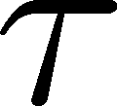
EMT Correlator : Noisy…
With naïve EMT operators
Nakamura, Sakai, PRL,2005
N_{t}=8
improved action
~10⁶ configurations
Nt=16
standard action
5x10⁴ configurations
… no signal

Slide 48

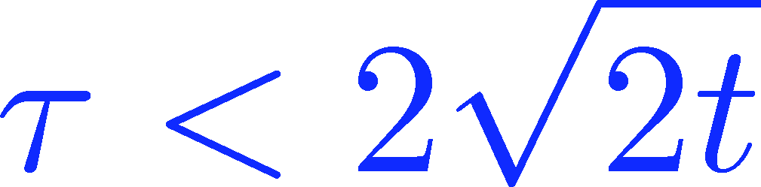
Energy Correlation Function
T=2.31Tc
b=7.2, Nt=16
2000 confs
p=0 correlator
Preliminary!!
smeared

Slide 49
Energy Correlation Function
T=2.31Tc
b=7.2, Nt=16
2000 confs
p=0 correlator
Preliminary!!
τ independent const.
→ energy conservation
smeared

Slide 50



Energy Correlation Function
T=2.31Tc
b=7.2, Nt=16
2000 confs
p=0 correlator
specific heat
Preliminary!!
→ Novel approach to
measure specific heat!
smeared
Gavai, Gupta, Mukherjee, 2005
differential method / cont lim.

Slide 51

Summary

Slide 52

Summary
EMT formula from gradient flow
This formula can successfully define and calculate the EMT on the lattice. It’s direct and intuitive
Gradient flow provides us novel methods of various analyses on the lattice avoiding 因小失大 problem

Slide 53
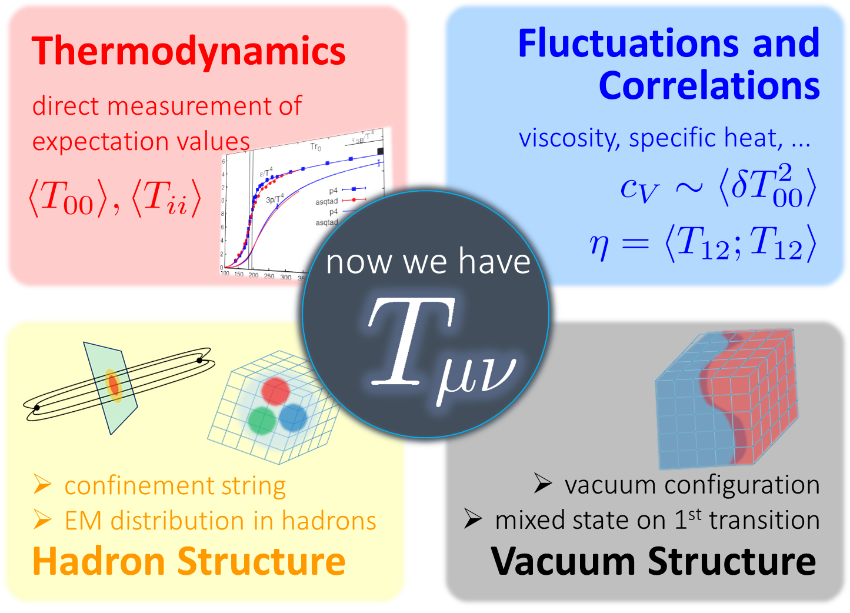
Many Future Studies!!
Other observables
full QCD Luscher,2013; Makino,Suzuki,2014
non-pert. improvement Patella 7E(Thu)
O(a) improvement
Nogradi, 7E(Thu); Sint, 7E(Thu)
Monahan, 7E(Thu)
and etc.

Slide 54



Themodynamics: Integral Method
: energy density
: pressure
directly observable

Slide 55

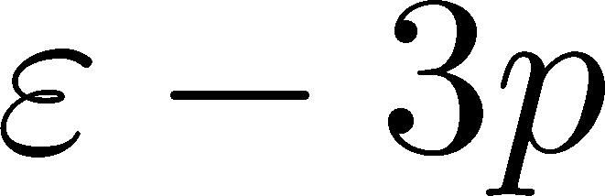

Themodynamics: Integral Method
: energy density
: pressure
directly observable
Boyd+ 1996
measurements of e-3p for many T
vacuum subtraction for each T
information on beta function

