Slide 1
Gradient Flowと
エネルギー運動量テンソル
Masakiyo Kitazawa (Osaka U.)
for FlowQCD Collaboration
Asakawa, Hatsuda, Iritani, Itou, MK, Suzuki
FlowQCD, PRD90,011501R (2014)
「熱場の量子論とその応用」・理研・2014年9月4日

Slide 2



Slide 3



momentum
energy
Poincare
symmetry
stress
pressure
Einstein Equation
Hydrodynamic Eq.

Slide 4




: nontrivial observable
on the lattice
Definition of the operator is nontrivial
because of the explicit breaking of Lorentz symmetry
ex:
Its measurement is extremely noisy
due to high dimensionality and etc.

Slide 5

If we have

Slide 6
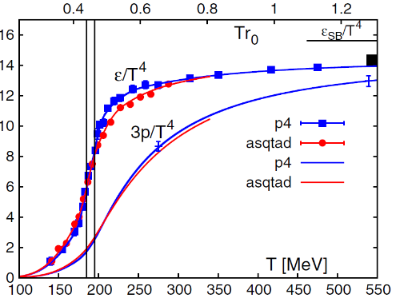
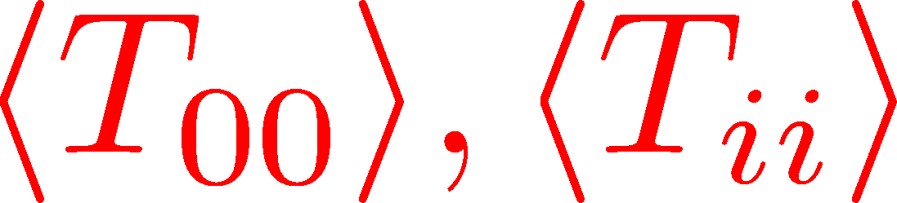
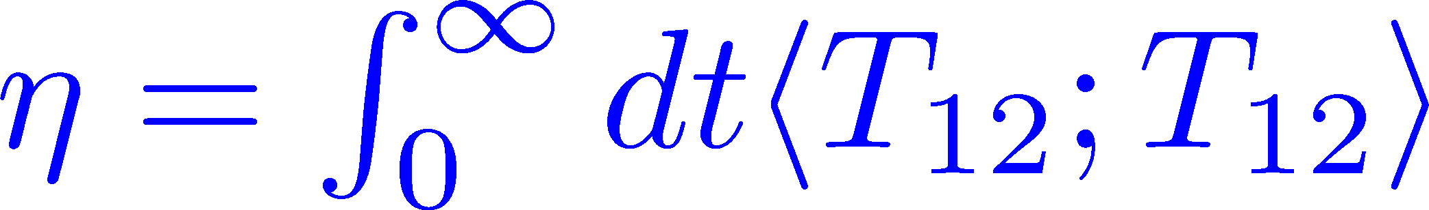
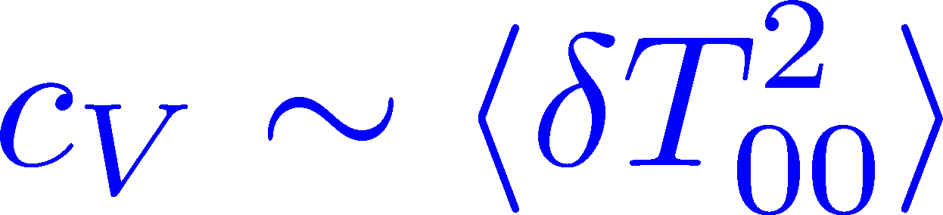
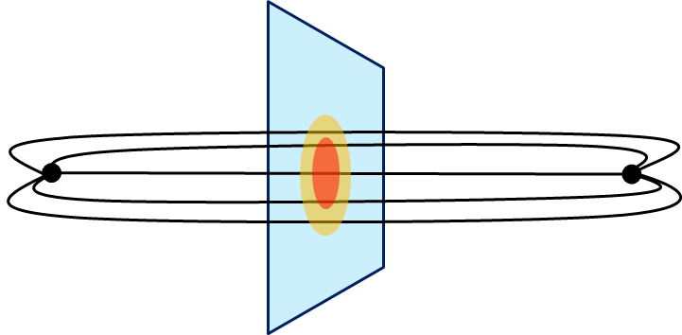
Thermodynamics
Fluctuations and
Correlations
direct measurement of
expectation values
viscosity, specific heat, ...
If we have
confinement string
EM distribution in hadrons
vacuum configuration
mixed state on 1st transition
Hadron Structure
Vacuum Structure

Slide 7
Gradient Flow

Slide 8


YM Gradient Flow
Luescher, 2010
t: “flow time”
dim:[length²]

Slide 9

YM Gradient Flow
Luescher, 2010
t: “flow time”
dim:[length²]
transform gauge field like diffusion equation
diffusion length
This is NOT the standard cooling/smearing
All composite operators at t>0 are UV finite Luescher,Weisz,2011

Slide 10
Applications of Gradient Flow
scale setting
running coupling
topology
operator construction
autocorrelation, etc.

Slide 11
Small Flow Time Expansion
of Operators and EMT

Slide 12


Operator Relation
Luescher, Weisz, 2011
an operator at t>0
remormalized operators
of original theory

Slide 13


Operator Relation
Luescher, Weisz, 2011
an operator at t>0
remormalized operators
of original theory

Slide 14


Constructing EMT
Suzuki, 2013
gauge-invariant dimension 4 operators

Slide 15



Constructing EMT 2
Suzuki, 2013
Suzuki coeffs.

Slide 16

Constructing EMT 2
Suzuki, 2013
Suzuki coeffs.
Remormalized EMT

Slide 17
Numerical Analysis
on the Lattice

Slide 18
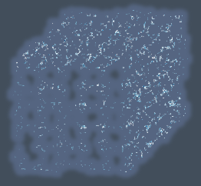


Gradient Flow Method
lattice regularized
gauge theory
gradient flow
measurement
on the lattice
continuum theory
(with dim. reg.)
continuum theory
(with dim. reg.)
analytic
(perturbative)
gradient flow

Slide 19

Caveats
Gauge field has to be sufficiently smeared!
lattice regularized
gauge theory
gradient flow
measurement
on the lattice
continuum theory
(with dim. reg.)
continuum theory
(with dim. reg.)
analytic
(perturbative)
gradient flow

Slide 20


Caveats
Gauge field has to be sufficiently smeared!
lattice regularized
gauge theory
gradient flow
Perturbative relation has to be applicable!
continuum theory
(with dim. reg.)
continuum theory
(with dim. reg.)
analytic
(perturbative)
gradient flow

Slide 21




in continuum
non-perturbative
region
O(t) effect
classical

Slide 22
in continuum
non-perturbative
region
O(t) effect
classical
on the lattice
t→0 limit with keeping t>>a²

Slide 23

Numerical Simulation
SU(3) YM theory
Wilson gauge action
twice finer lattice!
Simulation 1
(arXiv:1312.7492)
Simulation 2
(new, preliminary)
lattice size: 32³xN_{t}
Nt = 6, 8, 10
β = 5.89 – 6.56
~300 configurations
lattice size: 64³xN_{t}
Nt = 10, 12, 14, 16
β = 6.4 – 7.4
~2000 configurations
using
SX8 @ RCNP
SR16000 @ KEK
using BlueGeneQ @ KEK
efficiency ~40%

Slide 24
Thermodynamics
Thermodynamics
direct measurement of
expectation values

Slide 25
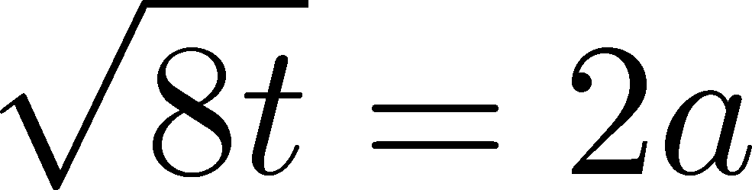


“Trace Anomaly” at T=1.65T_{c}
Emergent plateau!
Nt=6,8,10
~300 confs.
the range of t where the EMT formula is successfully used!

Slide 26






“Trace Anomaly” at T=1.65T_{c}
Emergent plateau!
Nt=6,8,10
~300 confs.
the range of t where the EMT formula is successfully used!

Slide 27
Entropy Density at T=1.65Tc
Emergent plateau!
systematic
error
Nt=6,8,10
~300 confs.
Direct measurement of e+p on a given T!
NO integral / NO vacuum subtraction

Slide 28



Continuum Limit
32³xNt
Nt = 6, 8, 10
T/Tc=0.99, 1.24, 1.65
Boyd+1996
0

Slide 29
Continuum Limit
32³xNt
Nt = 6, 8, 10
T/Tc=0.99, 1.24, 1.65
Boyd+1996
0
Comparison with
previous studies

Slide 30
Numerical Simulation
SU(3) YM theory
Wilson gauge action
twice finer lattice!
Simulation 1
(arXiv:1312.7492)
Simulation 2
(new, preliminary)
lattice size: 32³xN_{t}
Nt = 6, 8, 10
β = 5.89 – 6.56
~300 configurations
lattice size: 64³xN_{t}
Nt = 10, 12, 14, 16
β = 6.4 – 7.4
~2000 configurations
using
SX8 @ RCNP
SR16000 @ KEK
using BlueGeneQ @ KEK
efficiency ~40%

Slide 31
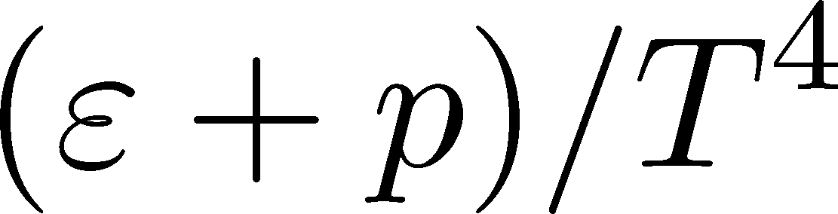
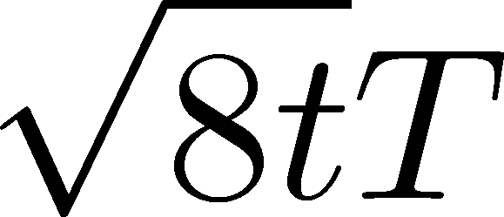
Entropy Density on Finer Lattices
T = 2.31Tc
64³xNt
Nt = 10, 12, 14, 16
2000 confs.
Preliminary!!
The wider plateau on the finer lattices
Plateau may have a nonzero slope
FlowQCD,2013
T=1.65Tc

Slide 32

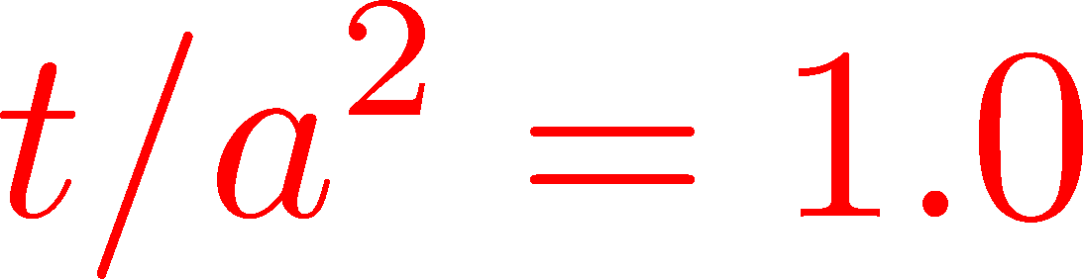
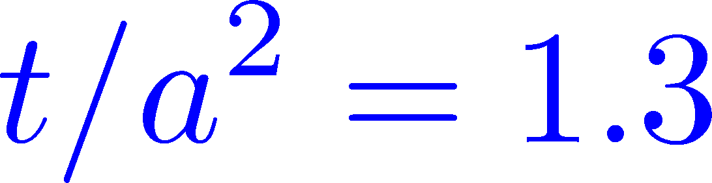

Continuum Extrapolation
T=2.31Tc
2000 confs
Nt = 10 ~ 16
a→0 limit with fixed t/a²
1312.7492
Preliminary!!
0
Nt=16
14
12
10
Continuum extrapolation
is stable

Slide 33
EMT Correlators
Fluctuations and
Correlations
viscosity, specific heat, ...

Slide 34


EMT Correlator
Kubo Formula: T₁₂ correlator ←→shear viscosity
Hydrodynamics describes long range behavior of T_{μν}
Energy fluctuation ←→specific heat

Slide 35


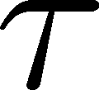
EMT Correlator : Noisy…
With naïve EMT operators
Nakamura, Sakai, PRL,2005
N_{t}=8
improved action
~10⁶ configurations
Nt=16
standard action
5x10⁴ configurations
… no signal

Slide 36

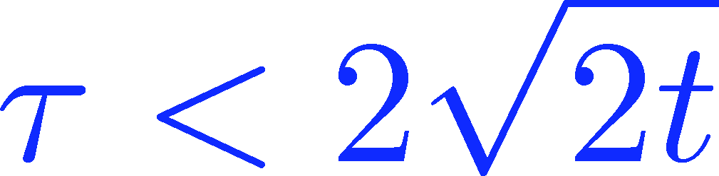
Energy Correlation Function
T=2.31Tc
b=7.2, Nt=16
2000 confs
p=0 correlator
Preliminary!!
smeared

Slide 37
Energy Correlation Function
T=2.31Tc
b=7.2, Nt=16
2000 confs
p=0 correlator
Preliminary!!
τ independent const.
→ energy conservation
smeared

Slide 38



Energy Correlation Function
T=2.31Tc
b=7.2, Nt=16
2000 confs
p=0 correlator
specific heat
Preliminary!!
→ Novel approach to
measure specific heat!
smeared
Gavai, Gupta, Mukherjee, 2005
differential method / cont lim.

Slide 39

Summary

Slide 40

Summary
EMT formula from gradient flow
This formula can successfully define and calculate the EMT on the lattice
This operator provides us with novel approaches to measure various observables on the lattice!
This method is direct, intuitive and less noisy

Slide 41
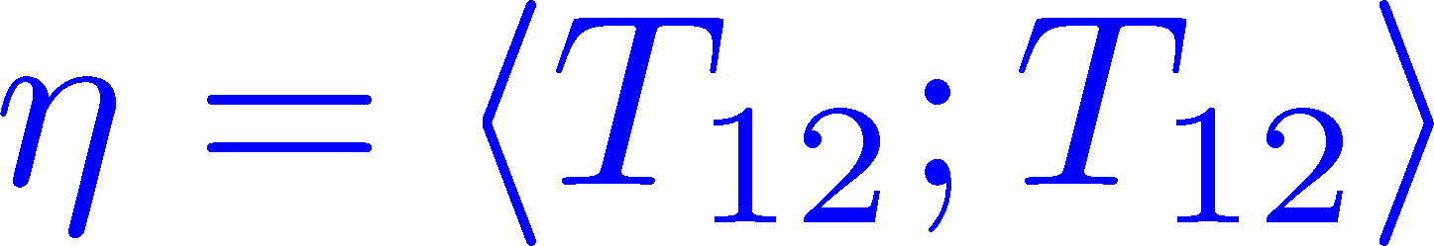
Thermodynamics
Fluctuations and
Correlations
Many Future Studies!!
direct measurement of
expectation values
viscosity, specific heat, ...
now we have
confinement string
EM distribution in hadrons
vacuum configuration
mixed state on 1st transition
Hadron Structure
Vacuum Structure
and scale setting, full QCD Makino,Suzuki,2014, etc.

