Slide 1
Understanding Fluctuations using rapidity window and collision energy dependences
Masakiyo Kitazawa
(Osaka U.)
MK, Asakawa, Ono, Phys. Lett. B728 (2014) 386-392
Sakaida, Asakawa, MK, arXiv:1409.6866
MK, to appear soon!
BES-II workshop, Berkeley, 28/Sep./2014

Slide 2
Beam-Energy Scan
T
Hadrons
Color SC
0
μ

Slide 3

Beam-Energy Scan
STAR 2012
high
beam energy
T
low
Hadrons
Color SC
0
μ

Slide 4
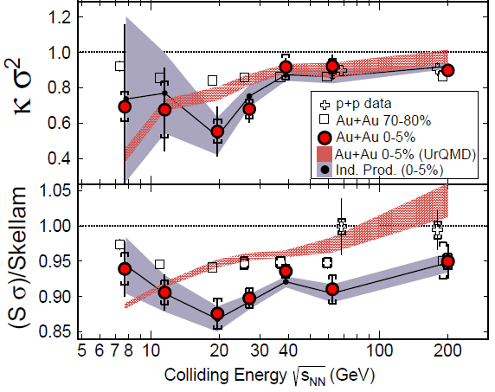
Cumulants up to 4th Order in 2014
STAR, PRL 2014
This is a great achievement in physics!

Slide 5
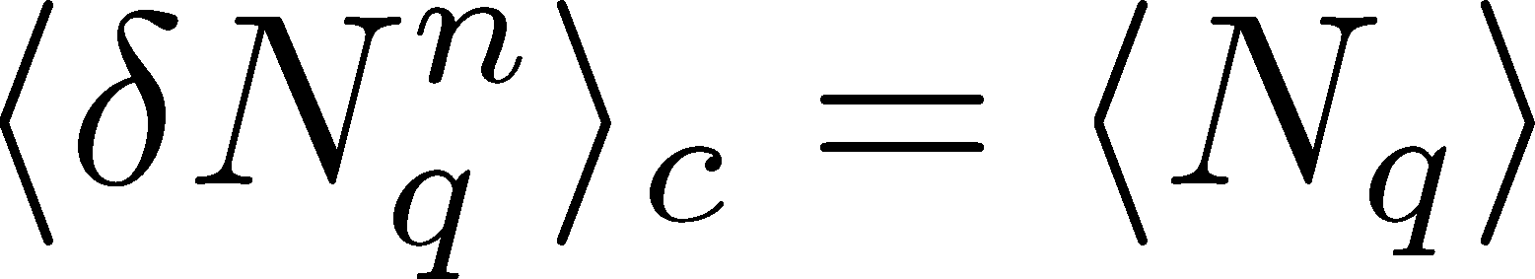
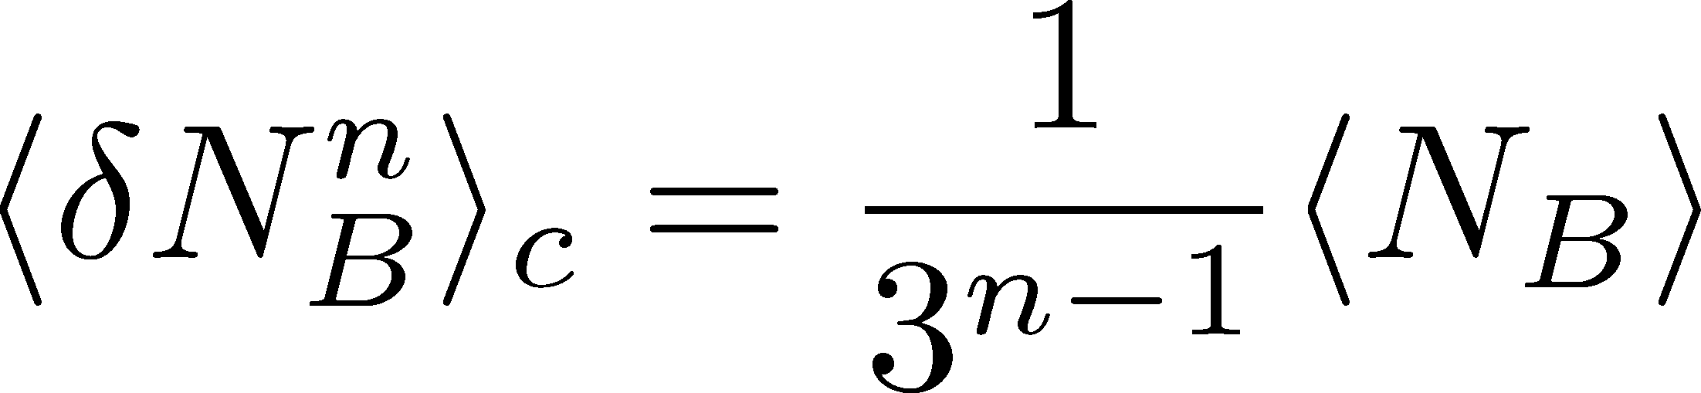
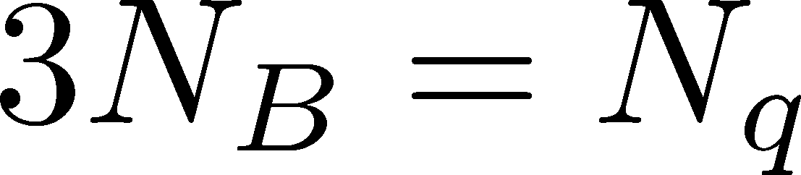
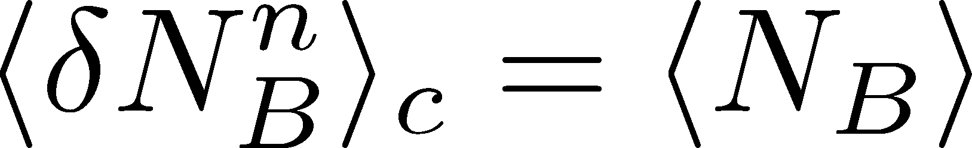
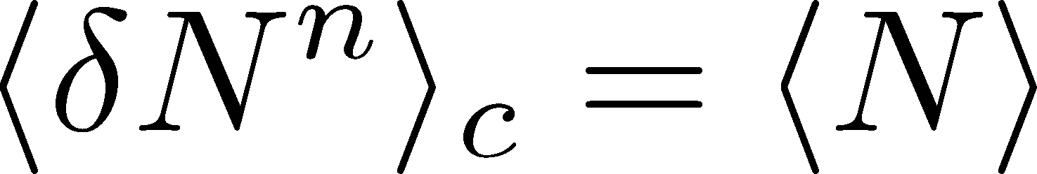
Fluctuations and Elemental Charge
Asakawa, Heinz, Muller, 2000
Jeon, Koch, 2000
Ejiri, Karsch, Redlich, 2005
Free Boltzmann → Poisson

Slide 6

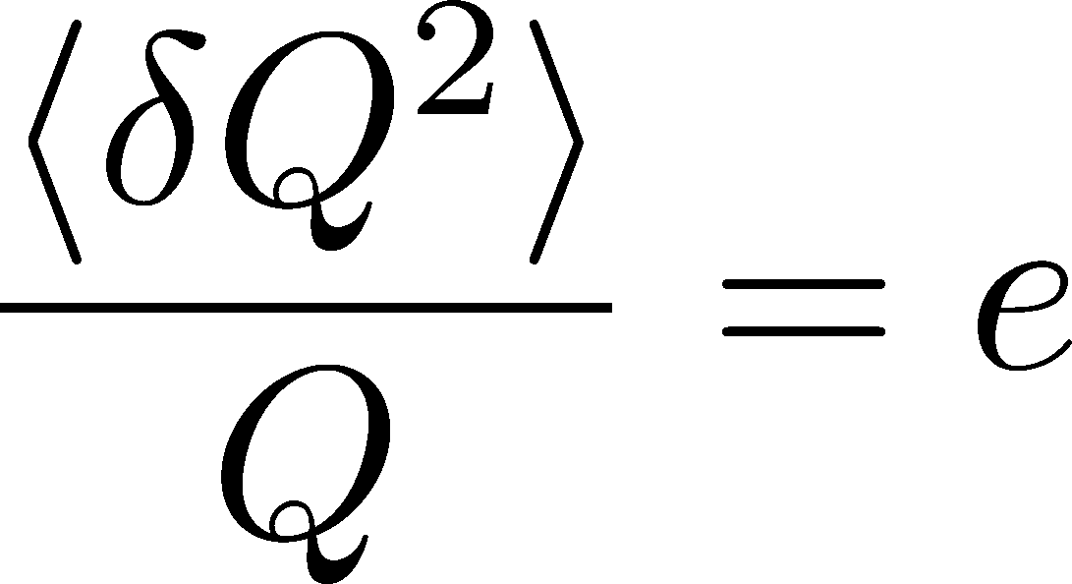


Shot Noise
Total charge in the interval
N : # of electrons in a time interval
Quantum Hall effect
Saminadayar+, PRL79,2526(1997)
Superconductor
Schottky, 1918
X. Jehl+, Nature405,50 (2000)

Slide 7
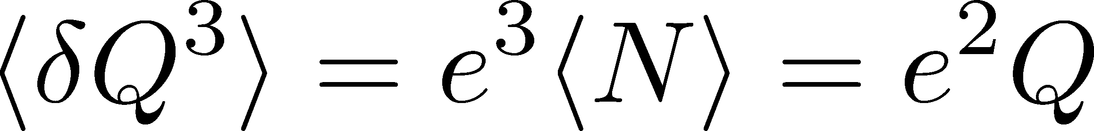
Shot Noise
Total charge in the interval
N : # of electrons in a time interval
Quantum Hall effect
Saminadayar+, PRL79,2526(1997)
Superconductor
Schottky, 1918
X. Jehl+, Nature405,50 (2000)
3rd order
ex. Beenakker+, PRL90,176802(2003)
Higher order cumulants:
up to 5th order
Gustavsson+, Surf.Sci.Rep.64,191(2009)

Slide 8
Cumulants up to 4th Order in 2014
This is a great achievement in physics!
I lose…
However,
still a lot of things
to do…

Slide 9
Many Things to Do
Message to Experimentalists:
Measure rapidity window dependences
Determine baryon number cumulants
Message to Theorists:
Do not directly compare your thermal results with exp.
Let’s pursue descriptions of non-eq. non-Gaussianity.
Message to Latticians:
Do not directly compare your results with exp.
Measure more cumulants more accurately

Slide 10
Caveats
Non-equilibrium state
Non-Gaussian fluctuations
Experimental results on

Slide 11
Caveats
Non-equilibrium state
Non-Gaussian fluctuations
Experimental results on
From a Review
Koch, 0810.2520
①
②

Slide 12
Rapidity Window Dependences of
Higher Order Cumulants
MK, Asakawa, Ono, Phys. Lett. B728 (2014) 386-392;
MK, to appear soon!

Slide 13
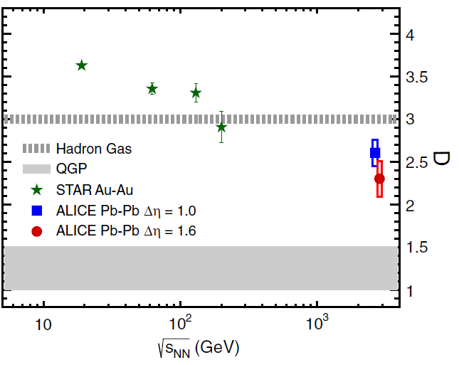

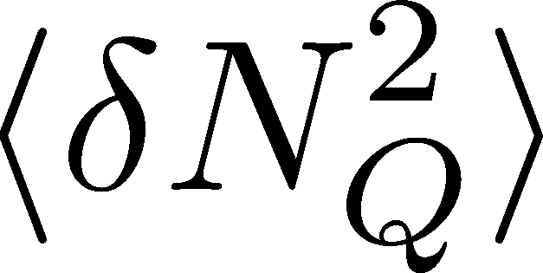
Charge Fluctuation @ LHC
ALICE, PRL110,152301(2013)
D-measure
D ~ 3-4 Hadronic
D ~ 1-1.5 Quark
significant suppression
from hadronic value
at LHC energy!
is not equilibrated at freeze-out at LHC energy!

Slide 14

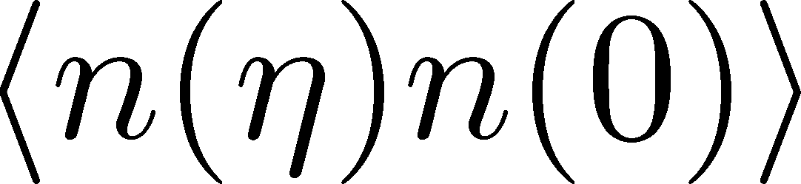
Δη Dependence @ ALICE
ALICE
PRL 2013
t
Δη
z
Same information as
rapidity window
2 particle corr.:
Balance function

Slide 15
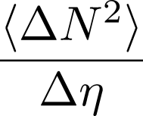




Time Evolution of Fluctuations
Quark-Gluon Plasma
Hadronization
Freezeout
Fluctuations continue to change until kinetic freezeout!!

Slide 16
Time Evolution of Fluctuations
Quark-Gluon Plasma
Hadronization
Freezeout
Variation of a conserved charge is achieved only through diffusion.
The larger Δη,
the slower diffusion

Slide 17
Conversion of Rapidities
Quark-Gluon Plasma
Hadronization
Freezeout
conversion
from coordinate-space
to momentum-space
rapidities
detector

Slide 18
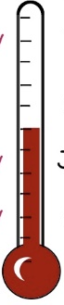

Δη Dependence @ ALICE
Δη dependent
thermometer?
ALICE
PRL 2013
large
small
Δη dependences of fluctuation observables
encode history of the hot medium!
Higher-order cumulants as
thermometer?

Slide 19



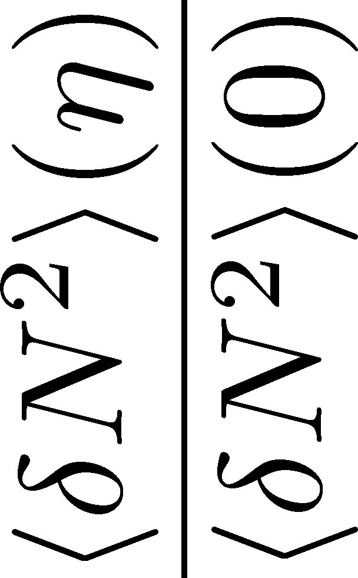

<δN_{B}²> and < δN_{p}² > @ LHC ?
should have different Δη dependence.
NEW
normalization!

Slide 20
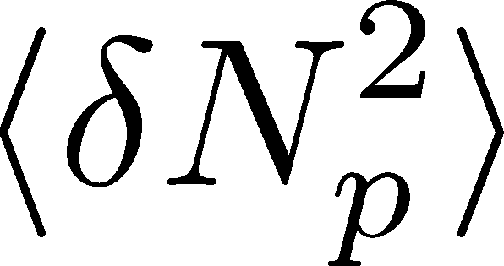


<δN_{B}²> and < δN_{p}² > @ LHC ?
should have different Δη dependence.
Baryon # cumulants are experimentally observable! MK, Asakawa, 2011;2012

Slide 21
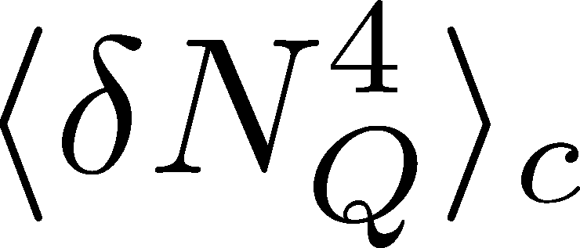

<δN_{Q}⁴> @ LHC ?
How does behave as a function of Δη?
suppression
or
enhancement

Slide 22

Hydrodynamic Fluctuations
Landau, Lifshitz, Statistical Mechaniqs II
Kapusta, Muller, Stephanov, 2012
Stochastic diffusion equation
Stephanov, Shuryak, 2001
Markov (white noise)
+
continuity
Fluctuation of n is
Gaussian in equilibrium
Gaussian noise
cf) Gardiner, “Stochastic Methods”

Slide 23
How to Introduce Non-Gaussianity?
Stochastic diffusion equation
Choices to introduce non-Gaussianity in equil.:
n dependence of diffusion constant D(n)
colored noise
discretization of n

Slide 24
How to Introduce Non-Gaussianity?
Stochastic diffusion equation
Choices to introduce non-Gaussianity in equil.:
n dependence of diffusion constant D(n)
colored noise
discretization of n
our choice
Fluctuations measured in
HIC are almost Poissonian.
REMARK:

Slide 25
A Brownian Particle’s Model
Hadronization (specific initial condition)
Time evolution
Freezeout
① Describe time evolution of Brownian particles exactly
② Obtain cumulants of particle # in Δη

Slide 26



Baryons in Hadronic Phase
time
chem. f.o.
hadronize
10~20fm
kinetic f.o.
Baryons behave like
Brownian pollens in water
mesons
baryons

Slide 27
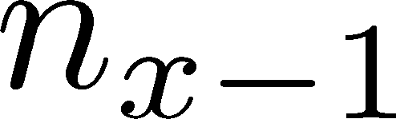






Diffusion Master Equation
MK, Asakawa, Ono, 2014
Divide spatial coordinate into discrete cells
probability

Slide 28
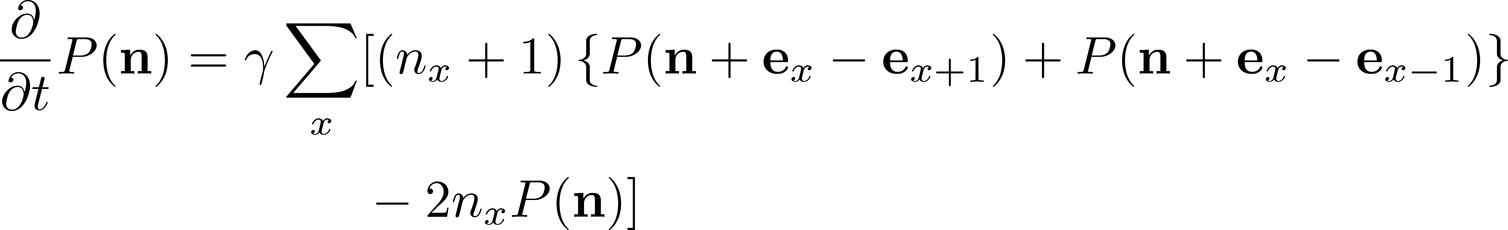
Diffusion Master Equation
MK, Asakawa, Ono, 2014
Divide spatial coordinate into discrete cells
probability
Master Equation for P(n)
Solve the DME exactly, and take a→0 limit
No approx., ex. van Kampen’s system size expansion

Slide 29

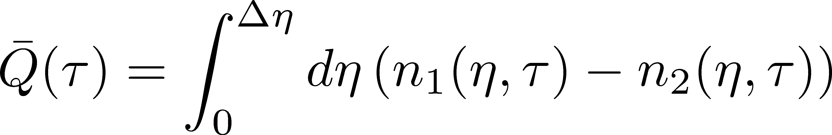
Net Charge Number
Prepare 2 species of (non-interacting) particles
Time evolution of Q up to Gauusianity is
consistent with the stochastic diffusion equation

Slide 30


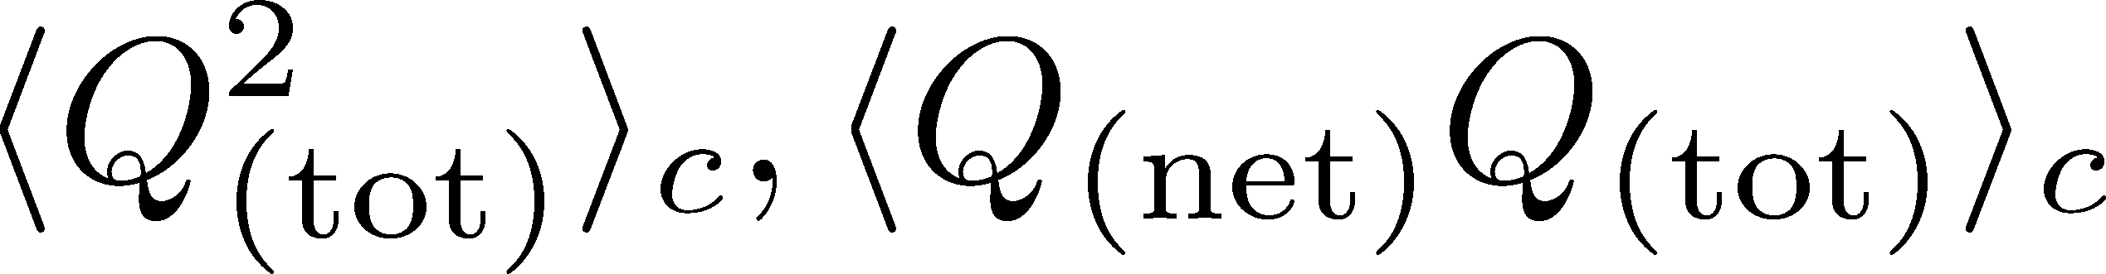
Time Evolution in Hadronic Phase
Hadronization (initial condition)
Boost invariance / infinitely long system
Local equilibration / local correlation
suppression owing to
local charge conservation
strongly dependent on
hadronization mechanism

Slide 31
Time Evolution in Hadronic Phase
Hadronization (initial condition)
Boost invariance / infinitely long system
Local equilibration / local correlation
Time evolution via DME
suppression owing to
local charge conservation
strongly dependent on
hadronization mechanism
Freezeout

Slide 32
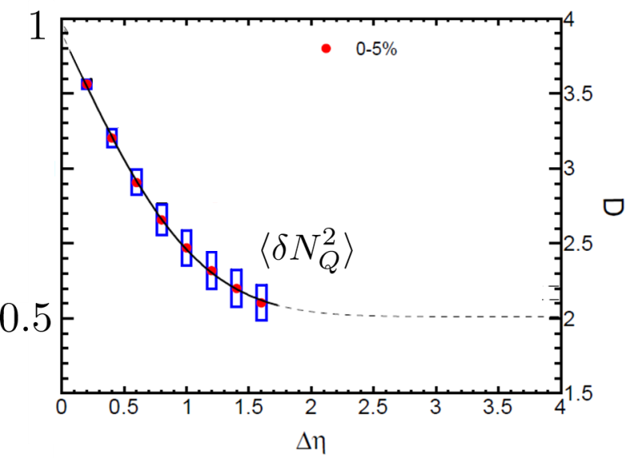


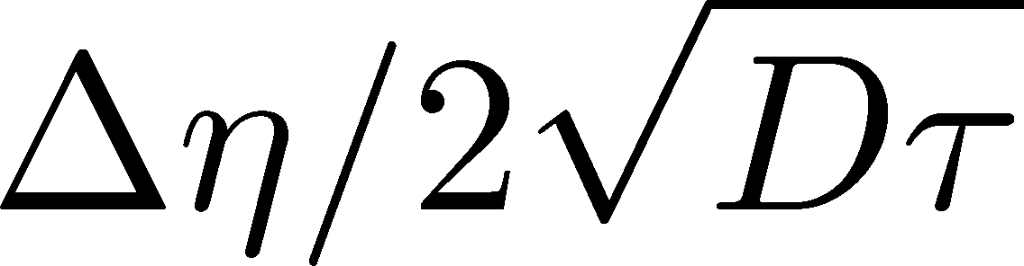
Δη Dependence at Freezeout
Initial fluctuations:
2nd
4th
parameter
sensitive to
hadronization

Slide 33
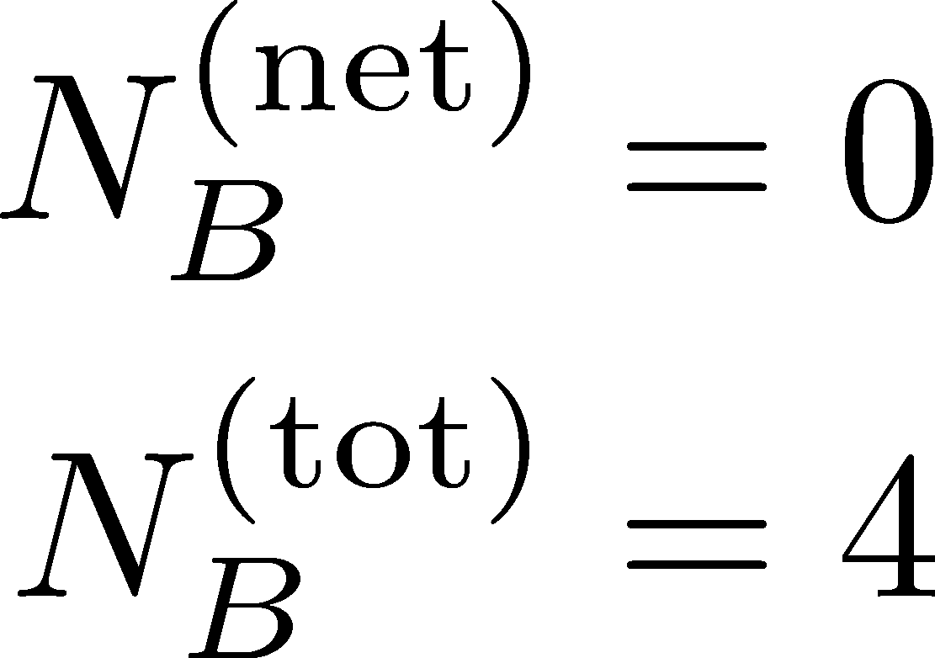
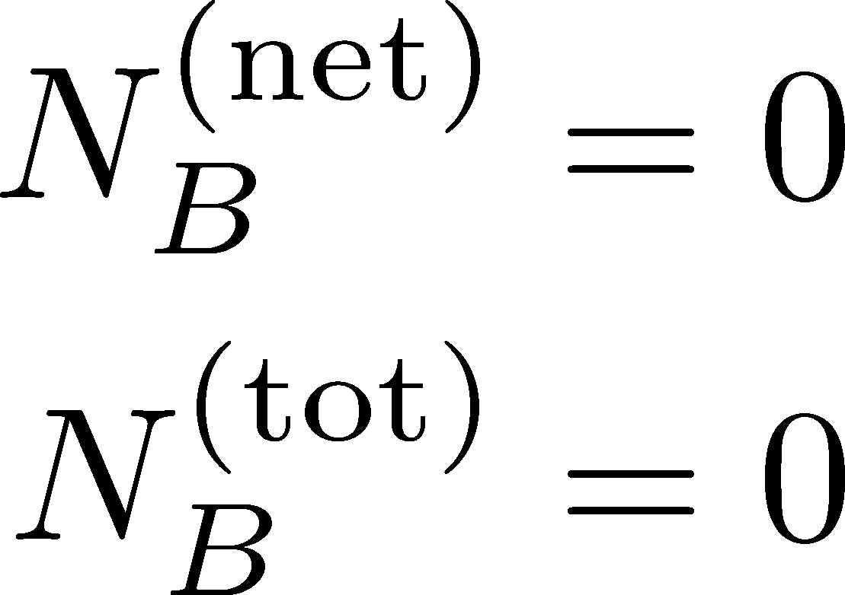
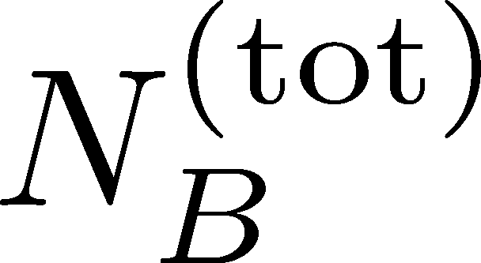
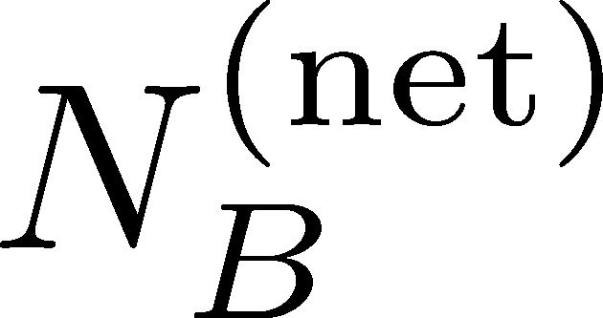
Total Charge Number
In recombination model,
6 quarks
6 antiquarks
can fluctuate, while does not.

Slide 34
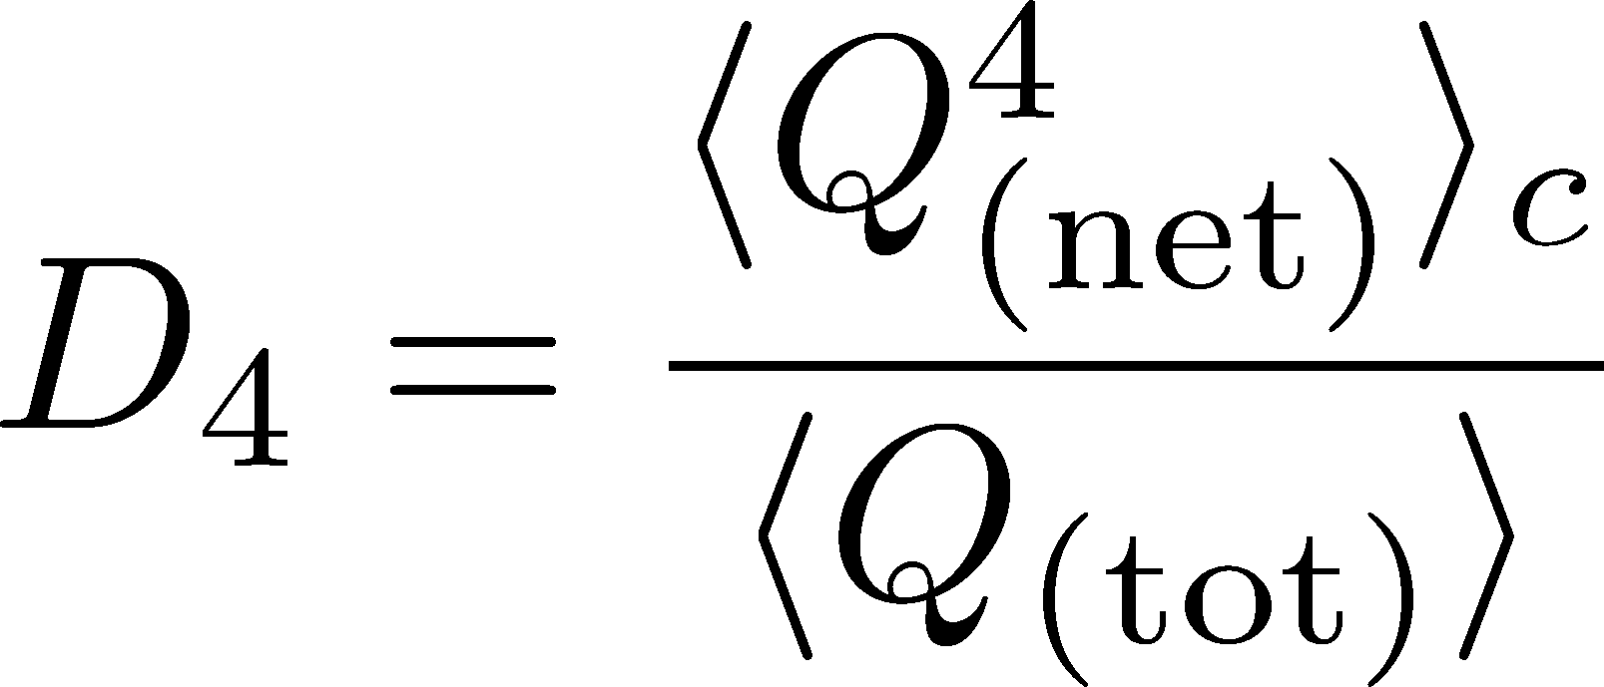

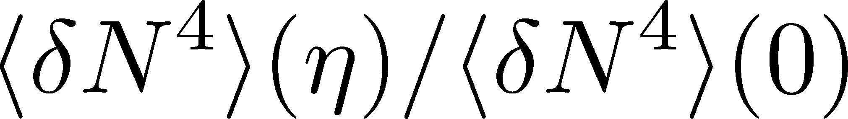
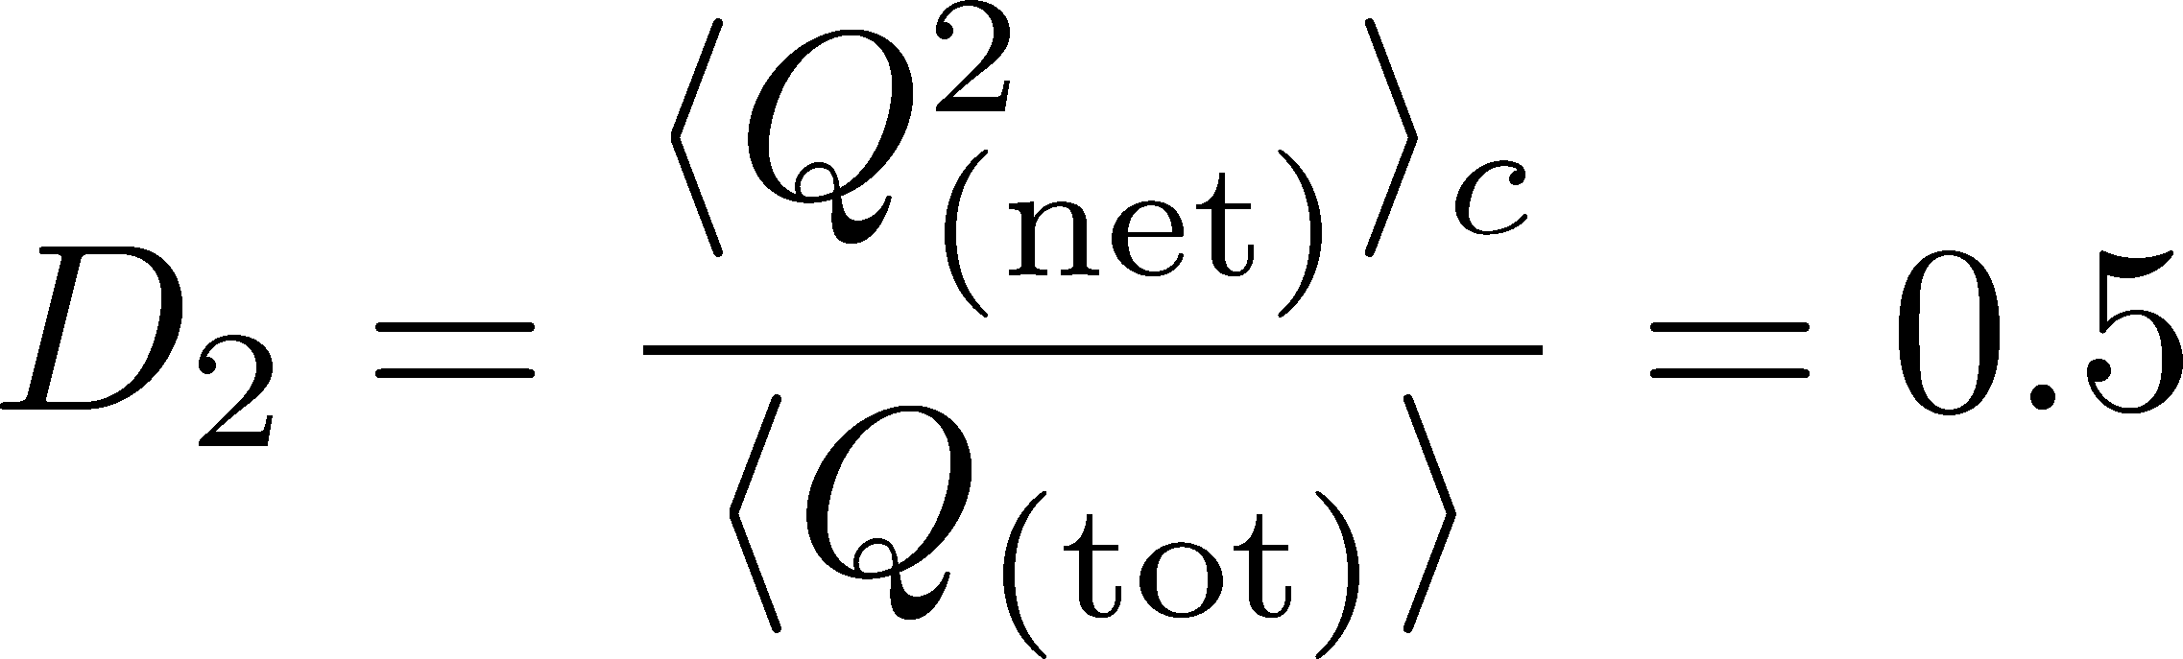
Δη Dependence: 4th order
MK, to appear soon
Initial Condition
Charcteristic Δη dependences!

Slide 35
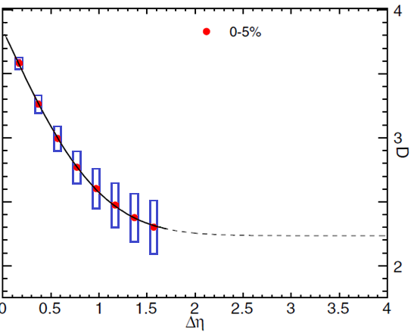


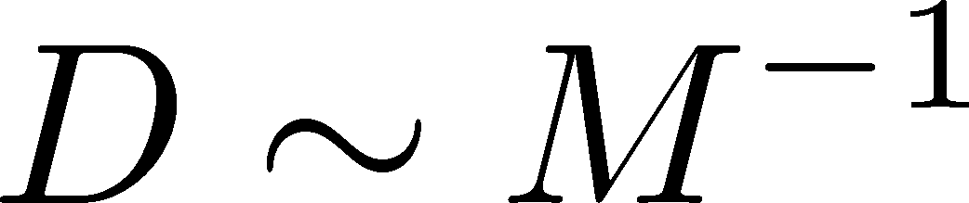
Δη Dependence: 4th order
MK, to appear soon
Initial Condition
baryon #
at ALICE
at ALICE

Slide 36
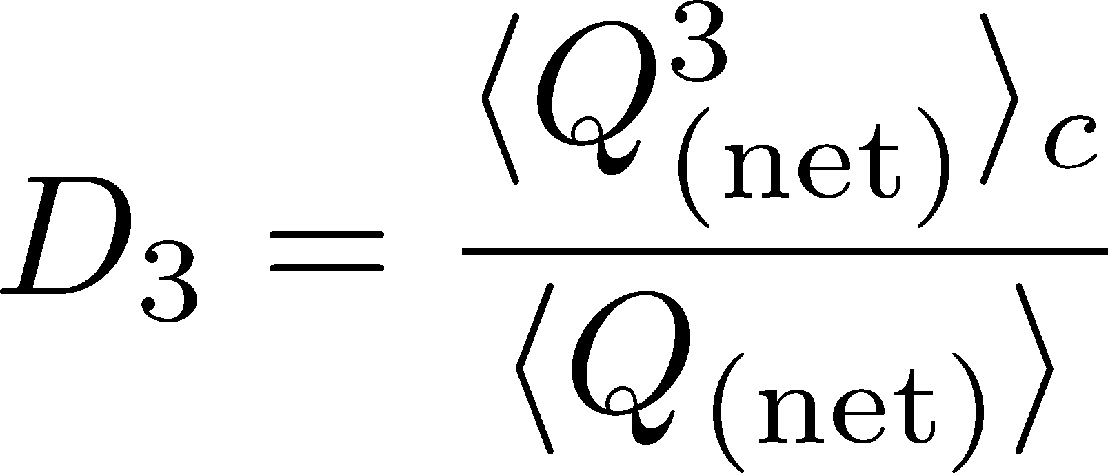
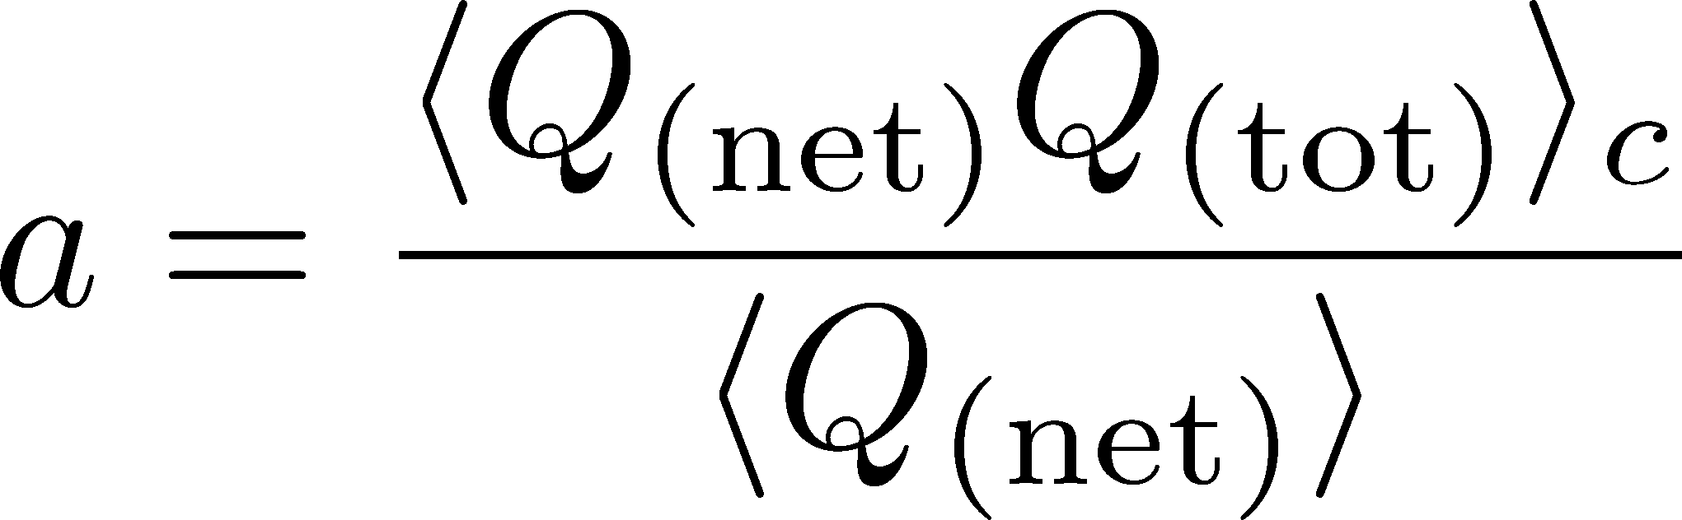
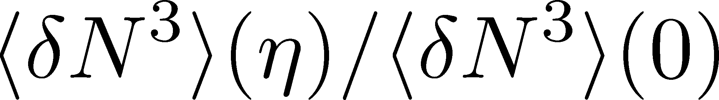
Δη Dependence: 3rd order
MK, to appear soon
Initial Condition
baryon #
at ALICE
at ALICE

Slide 37
Problems
Relaxation from a specific initial condition to Skellam value
We assume perfect equilibration at T_{c}
Cumulants near T_{c} can be studied by Lattice.
No pair creation/annihilation below T_{chem}
For baryons, this would be justified below T_{c}
But, may not for electric charges.
No finite volume effect

Slide 38
Effect of Global Charge Conservation
(Finite Volume Effect)
Sakaida, Asakawa, MK, arXiv:1409.6866

Slide 39
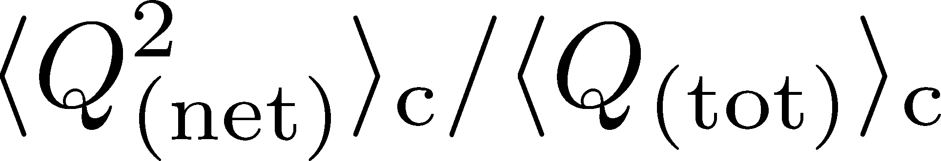

Global Charge Conservation
Conserved charges in the total system do no fluctuate!
1
0

Slide 40
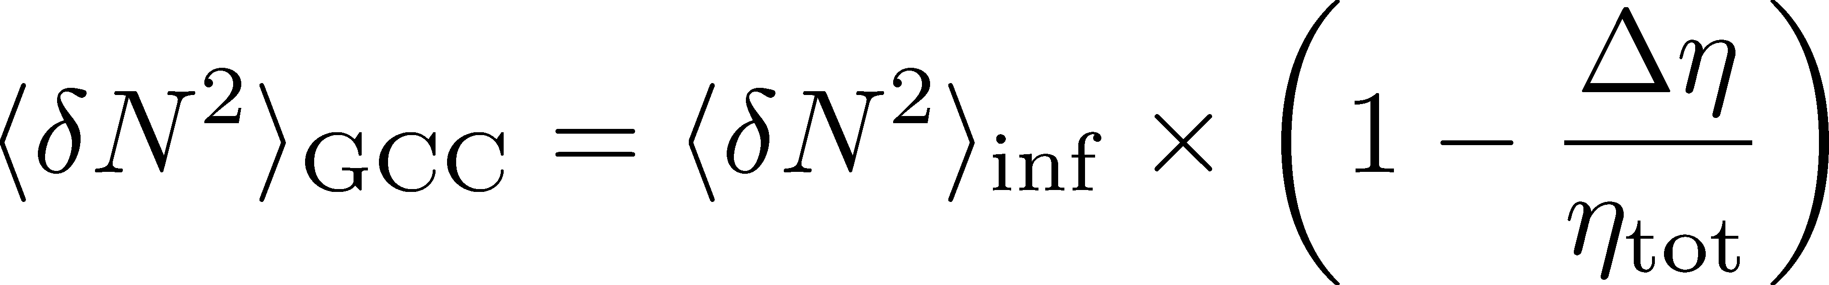
Global Charge Conservation
Conserved charges in the total system do no fluctuate!
1
0
An Estimate of GCC Effect
Jeon, Koch, PRL2000; Bleicher, Jeon, Koch (2000)

Slide 41
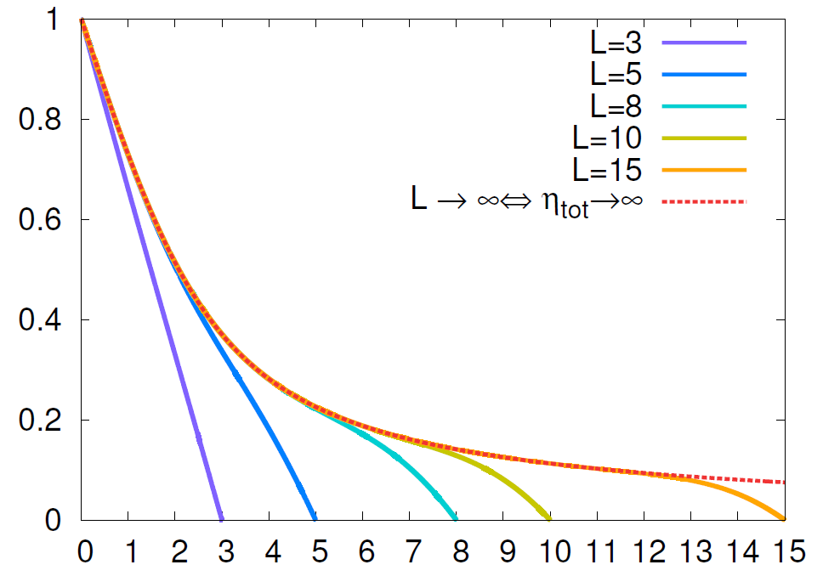
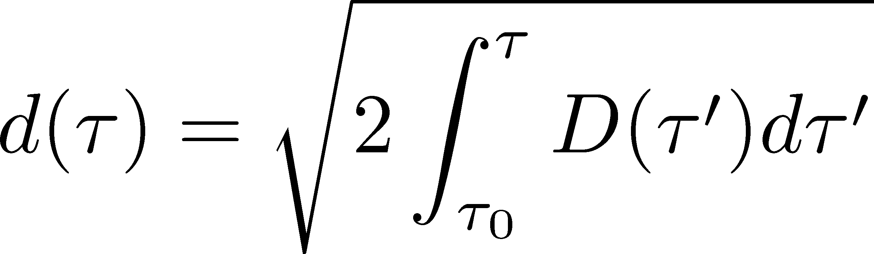
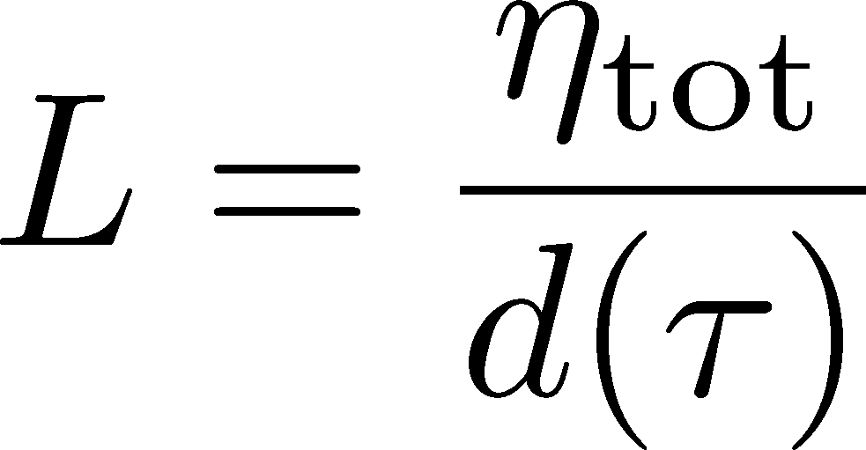

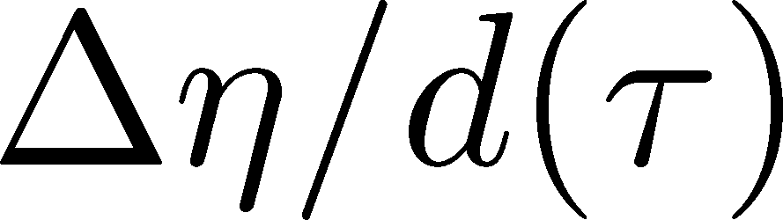
Diffusion in Finite Volume
Solve the diffusion master equation in finite volume
Infinite Sys.
(No GCC Effect)
: Average
Diffusion Length
: Diffusion
Coefficient

Slide 42
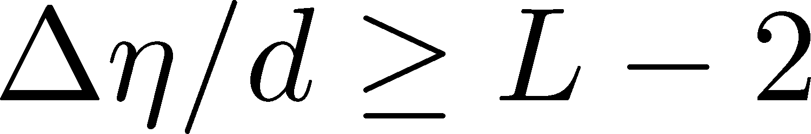
Diffusion in Finite Volume
Solve the diffusion master equation in finite volume
Infinite Sys.
(No GCC Effect)
: Average
Diffusion Length
effect of
GCC
: Diffusion
Coefficient
effect of
GCC
suppression only for

Slide 43

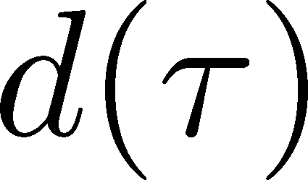
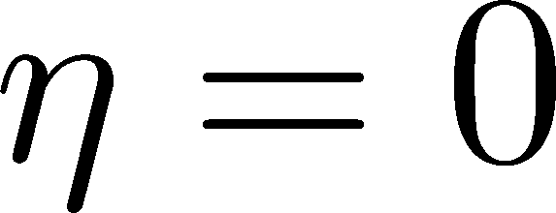



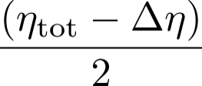
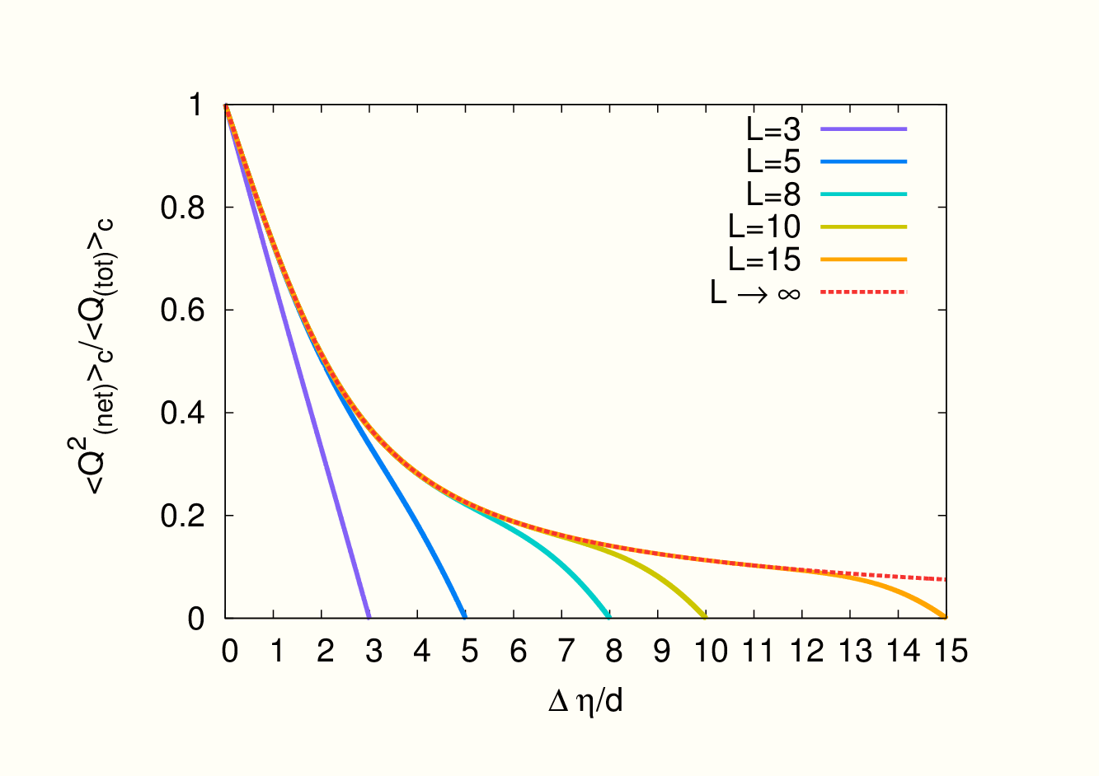
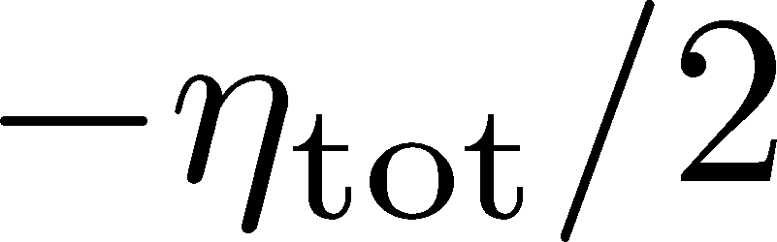
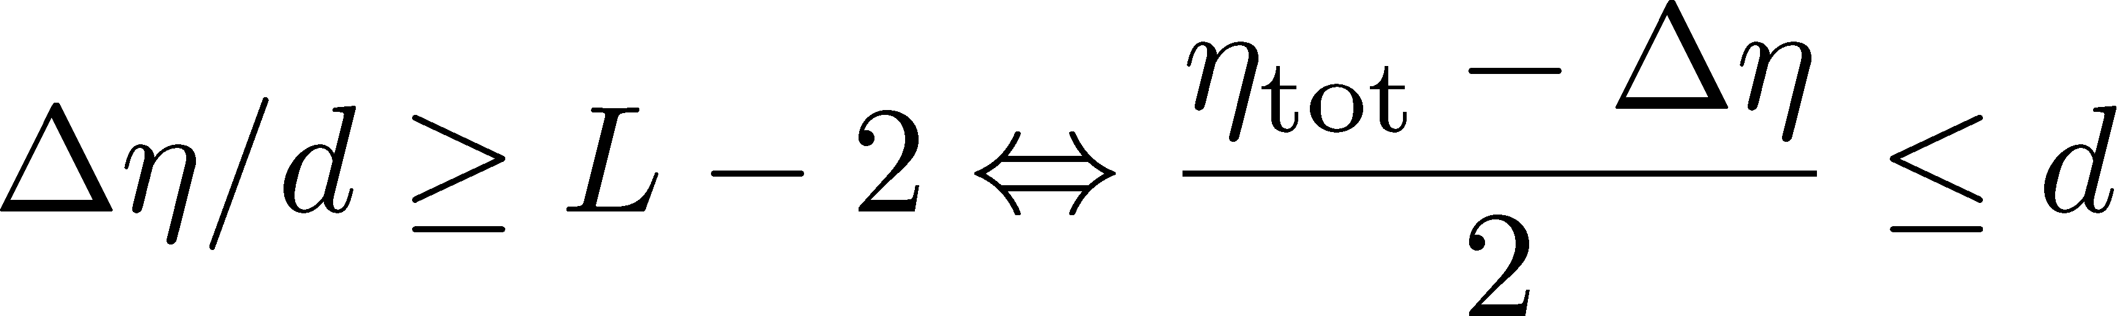
Physical Interpretation
slide by M. Sakaida
: Averaged Diffusion Distance
: Diffusion Coefficient
: Total Length of Matter
Time Passes…
Condition for effects of the GCC
Effects of the GCC appear
only near the boundaries.

Slide 44
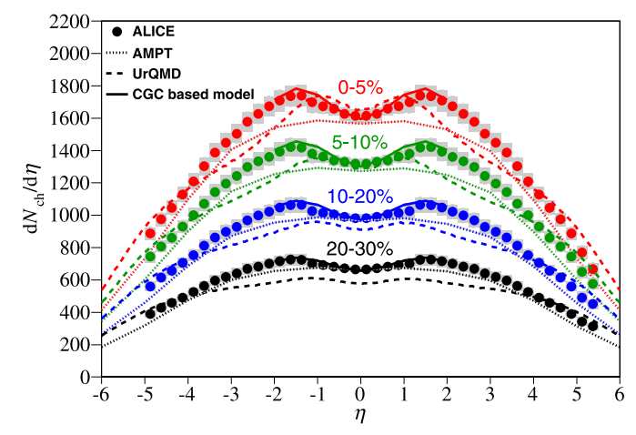
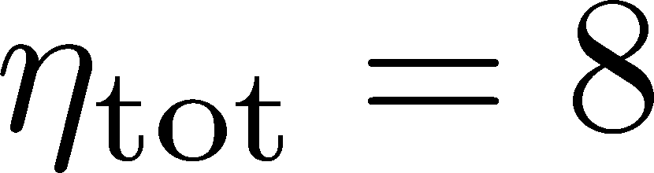
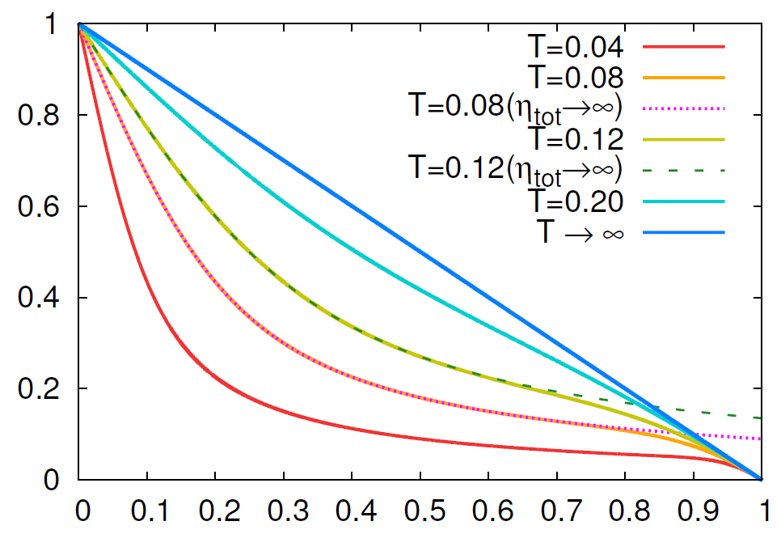



Comparison with ALICE Result
without initial fluc.
with initial fluc.
time
No GCC effect in ALICE experiments!
Same conclusion for higher order cumulants

Slide 45
Very Low Energy Collisions
Large contribution of global charge conservation
Violation of Bjorken scaling
detector
Careful treatment is required to interpret fluctuations at low beam energies!
Many information should be encoded in Δη dep.

Slide 46
Summary
Measurement of non-Gaussianity at STAR
Non-equilibrium behavior at ALICE
Theoretical description to treat both “non”s is needed!
Plenty of information in Δη dependences of various cumulants
and those of non-conserved charges, mixed cumulants…

Slide 47
Many Things to Do
Message to Experimentalists:
Measure rapidity window dependences
Determine baryon number cumulants
Message to Theorists:
Do not directly compare your thermal results with exp.
Let’s pursue descriptions of non-eq. non-Gaussianity.
Message to Latticians:
Do not directly compare your results with exp.
Measure more cumulants more accurately

Slide 48






Δη Dependence
Shuryak, Stephanov, 2001
Initial condition:
Translational invariance
initial
equilibrium
equilibrium
initial

Slide 49
Open Questions & Future Work
Why the primordial fluctuations are observed only at LHC, and not RHIC ?
Extract more information on each stage of fireballs using fluctuations
Model refinement
Including the effects of
nonzero correlation length / relaxation time
global charge conservation
Non Poissonian system ← interaction of particles

