Slide 1
Non-Gaussian fluctuations in relativistic heavy ion collisions
Masakiyo Kitazawa

Slide 2
一本の草も涼風宿りけり
even on one blade of grass the cool wind lives
小林一茶
Issa Kobayashi
1814

Slide 3
Physicits can feel hot early Universe
13 800 000 000 years ago
in tiny fluctuations of
cosmic microwave

Slide 4
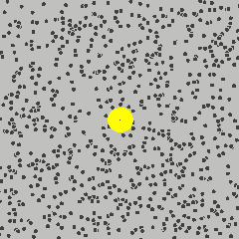
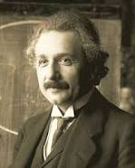
Physicists can feel the existence of microscopic
atoms behind random fluctuations
of Brownian pollens
A. Einstein
1905

Slide 5
Feel quarks behind fluctuations

Slide 6
Feel quarks behind fluctuations
in relativistic heavy ion collisions
2014
Feel quarks behind fluctuations

Slide 7
Non-Gaussian Fluctuations in Relativistic Heavy Ion Collisions
Masakiyo Kitazawa (Osaka U.)
Frontiers of Theoretical Science, Kavli IPMU, Nov. 6, 2014

Slide 8
Quark-Gluon Plasma
vacuum
baryon
meson

Slide 9
Quark-Gluon Plasma
vacuum
As T increases …
baryon
meson
Early Universe

Slide 10
Quark-Gluon Plasma (QGP)
vacuum
As T increases …
baryon
meson
quark-gluon plasma
Early Universe

Slide 11
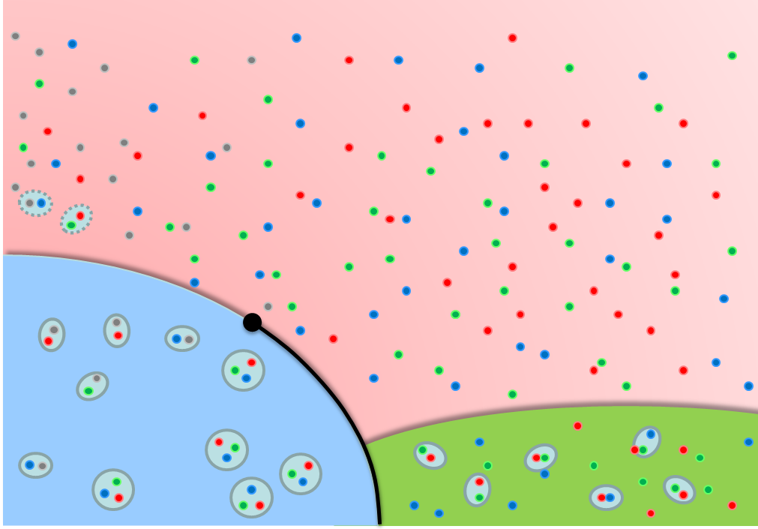
QCD Phase Diagram
temperature
Quark-Gluon Plasma (QGP)
QCD Critical Point
Hadronic Phase
(Confined)
Color Superconductivity
baryon chemical potential

Slide 12
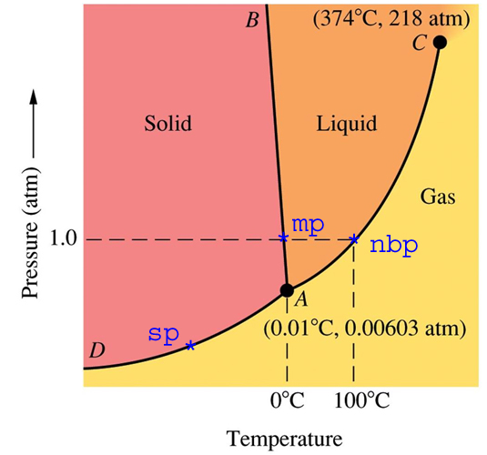
QCD Phase Diagram
Phase diagram of water
temperature
Quark-Gluon Plasma (QGP)
QCD Critical Point
Hadronic Phase
(Confined)
Color Superconductivity
baryon chemical potential

Slide 13
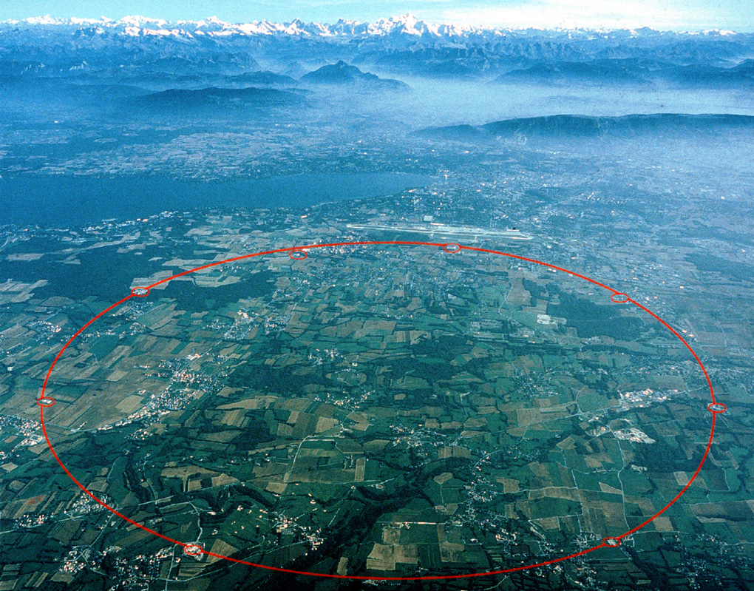
Relativistic Heavy Ion Collisions
LHC – Large Hadron Collider

Slide 14
Relativistic Heavy Ion Collisions
For the search of
new particles
proton
proton
LHC – Large Hadron Collider

Slide 15
Relativistic Heavy Ion Collisions
For the search of
new particles
proton
proton
To create the early
Universe
LHC – Large Hadron Collider

Slide 16
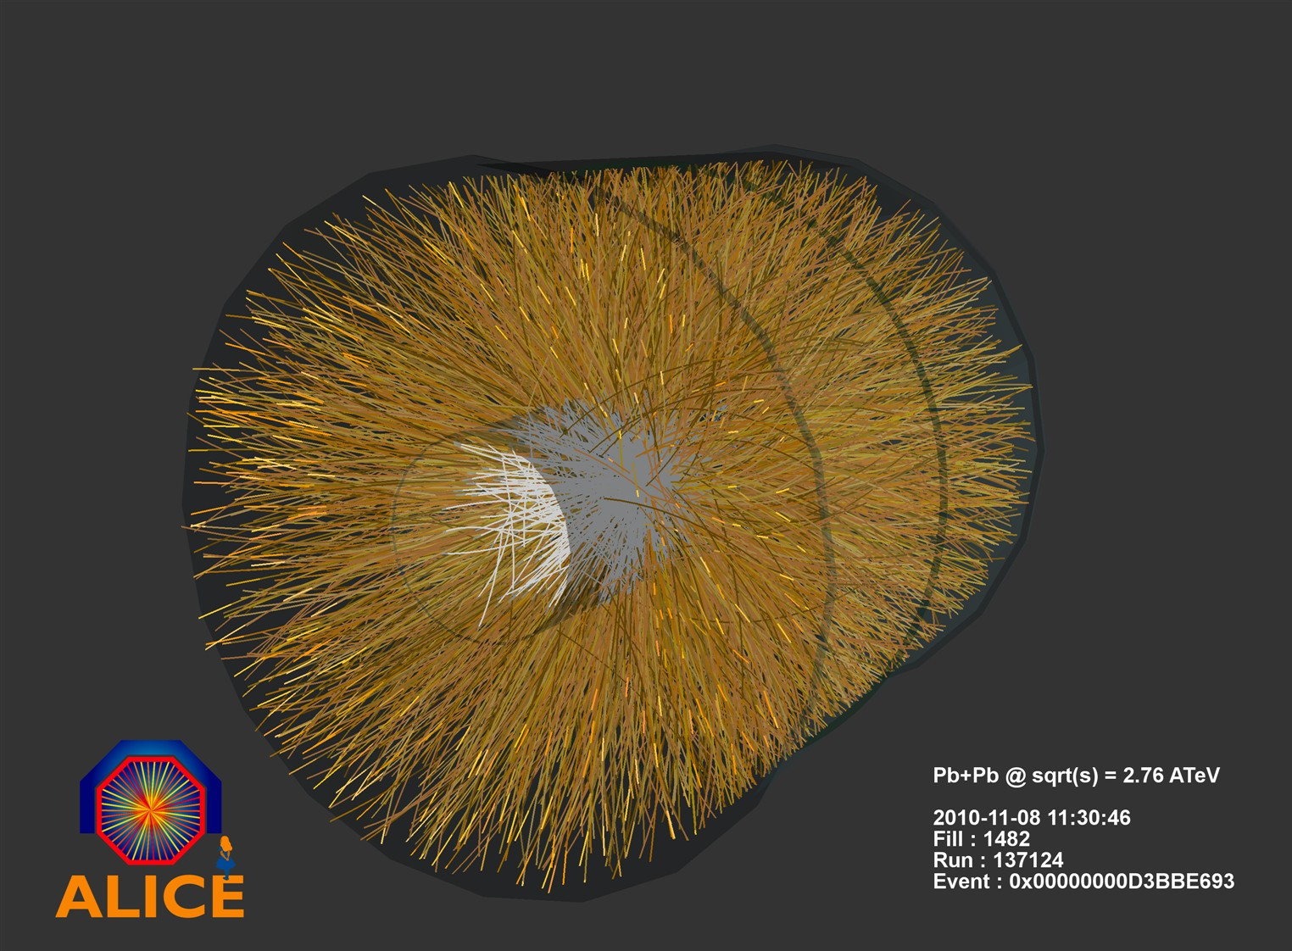
①
Quark-Gluon Plasma
temperature : T~4x10¹²K
lifetime : t~10⁻²² seconds.
②
The medium then cools
down with an expansion.
③
Confined particles
arrive at the detector.

Slide 17
Thermal Fluctuations
Observables in equilibrium are fluctuating!
variance
V
Gaussian
non-Gaussianity

Slide 18
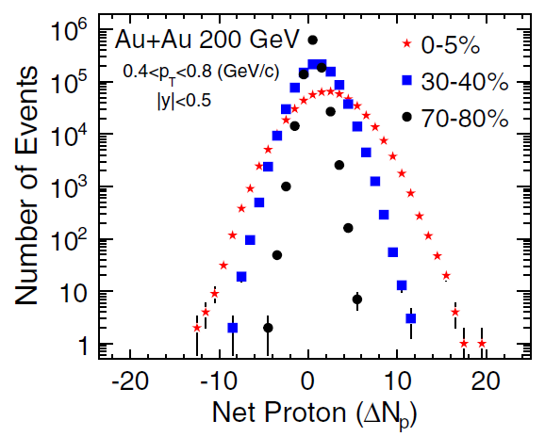
Event-by-Event Measurement
Detector
STAR Collaboration, PRL 2010

Slide 19
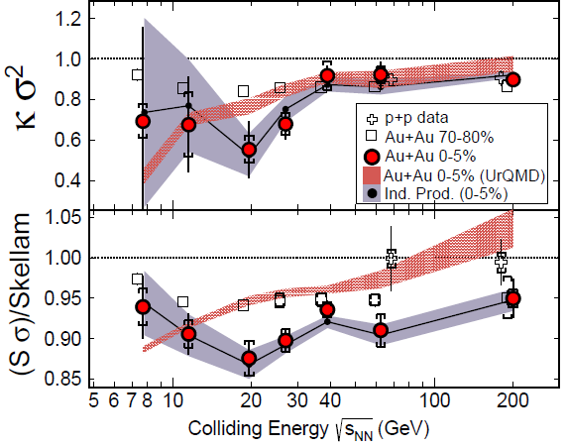
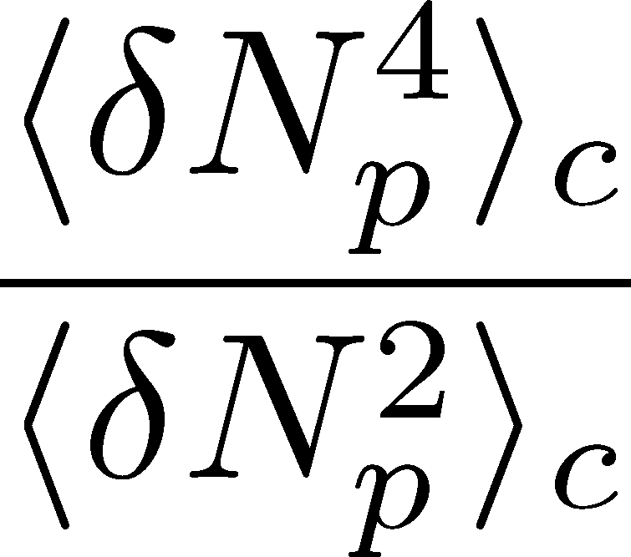
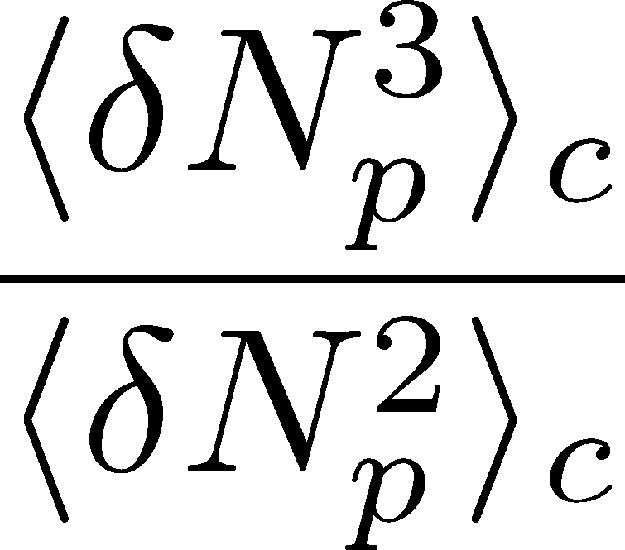
Non-Gaussianity @ RHIC
STAR Collaboration, PRL 2014
kurtosis
skewness
Nonzero higher-order cumulants of conserved charges (skewness and kurtosis)
They are not far from Poissonian values.

Slide 20
Search for QCD Phase Structure
LHC
2010~
RHIC-BES
Phase I
2010~2013
Phase II
2015~
J-PARC
2018~ ??
LHC
temperature
RHIC
beam energy scan
future facilities
ex. J-PARC @ Tokai
baryon chemical potential

Slide 21
Signal of Quark Deconfinement
Hadronic
Quark-Gluon
Elemental charge carried by quasi-particles decreases in QGP
Asakawa, Heinz, Muller PRL (2000); Jeon, Koch, ibid.

Slide 22
Signal of Quark Deconfinement
Hadronic
Quark-Gluon
Elemental charge carried by quasi-particles decreases in QGP
Corresponding thermal fluctuations decrease in QGP
Asakawa, Heinz, Muller PRL (2000); Jeon, Koch, ibid.

Slide 23
Shot Noise
e*
charge of quasi-particles

Slide 24
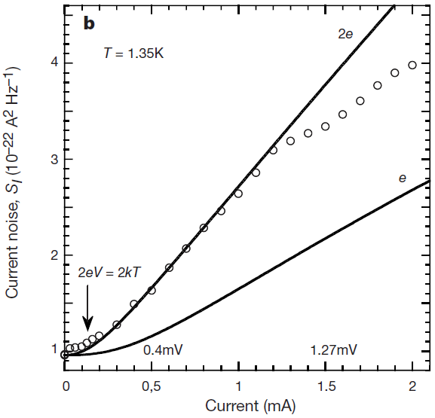
Shot Noise
e*
charge of quasi-particles
Superconductors
with Cooper Pairs
doubled!
Jehl+, Nature 405,50 (2000)

Slide 25
Shot Noise
e*
charge of quasi-particles
Superconductors
with Cooper Pairs
Fractional Quantum
Hall Systems
doubled!
Jehl+, Nature 405,50 (2000)
Saminadayar+, PRL79,2526 (1997)

Slide 26
Diffusion of Fluctuations
QGP
Experiments can vary
spatial volume
to measure fluctuations
Confinement
Freezeout
The larger Δη,
the earlier fluctuations
detector

Slide 27
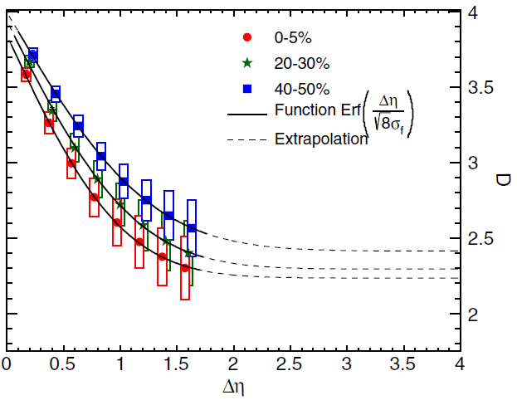
Electric Charge Fluctuations @ LHC
ALICE Collaboration,
PRL 110, 152301 2013
Hadronic
一本の草も涼風
宿りけり 一茶
Quark-gluon
Fluctuation is more QGP-like as V becomes larger.
The Δη dependence encodes history of the medium!

Slide 28
Diffusion of non-Gaussianity
MK,Asakawa,Ono,PLB728,386(2014)

Slide 29
Electric Charge Fluctuations @ LHC
ALICE Collaboration,
PRL 110, 152301 2013
Hadronic
Quark-gluon
Experimental results only for 2nd order fluctuation
No results on Δη dependence of higher-order cumulants

Slide 30
Stochastic Formalism
Fluctuating hydrodynamics
Landau, Lifshitz,
Statistical Mechanics II
(stochastic hydrodynamics)
Counterpart for diffusive processes
Stochastic diffusion equation
Random force determined by FDR
This formalism cannot describe non-Gaussianity!

Slide 31
Diffusion Master Equation
MK,Asakawa,Ono,PLB728,386(2014)
Divide spatial coordinate into discrete cells
probability
Master Equation
Solve the DME exactly, and take a→0 limit

Slide 32
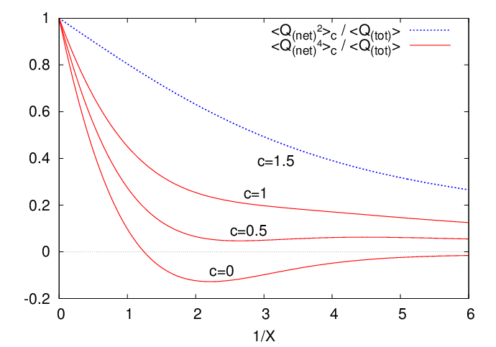
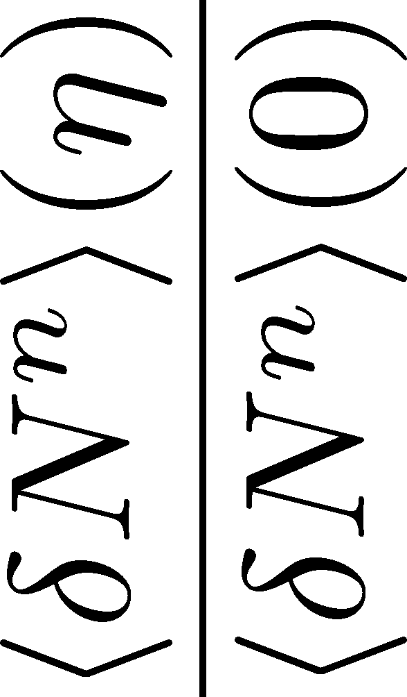
Our Predictions
ALICE Collaboration, 2013
experimentally
accessible
2nd
4th
Volume dep. of non-Gaussianity encodes more information!

Slide 33
Summary
Fluctuations are invaluable tools in physics, as well as in our daily life.
Fluctuations acquires much attention in relativistic heavy-ion collisions. In particular, their non-Gaussianity is one of the latest topics in this realm.
1998
Rolf Landauer
The noise is the signal

Slide 34
A poet said
一本の草も涼風宿りけり
even on one blade of grass the cool wind lives
小林一茶
Issa Kobayashi
1814
A physicist said
1998
Rolf Landauer
The noise is the signal

