Slide 1
低エネルギー衝突での
熱ゆらぎ観測に関する問題点
Masakiyo Kitazawa
(Osaka U.)
MK, Asakawa, Ono, Phys. Lett. B728 (2014) 386-392
Sakaida, Asakawa, MK, arXiv:1409.6866
MK, to appear soon!
『J-PARCにおける重イオン衝突実験が拓く新しい物理』, KEK, 2014/11/26

Slide 2
Beam-Energy Scan
T
Hadrons
Color SC
0
μ

Slide 3

Beam-Energy Scan
STAR 2012
LHC
RHIC BES
T
J-PARC
Hadrons
Color SC
0
μ

Slide 4
Fluctuations
Observables in equilibrium are fluctuating.
P(N)
N
V
N

Slide 5
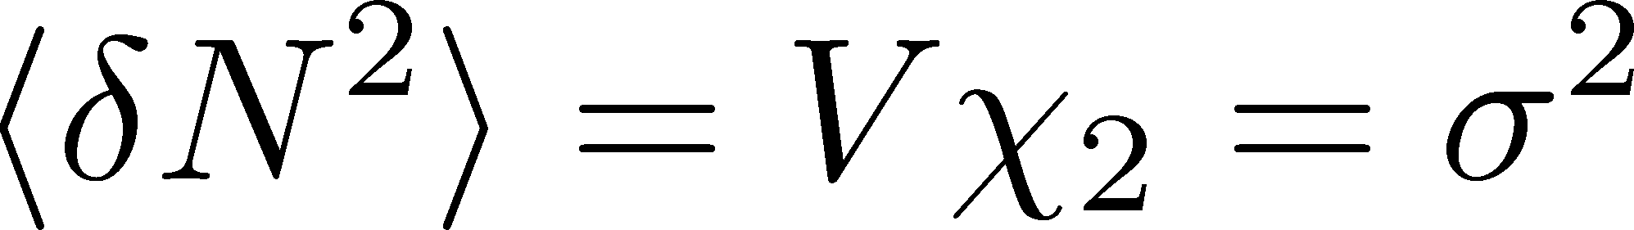
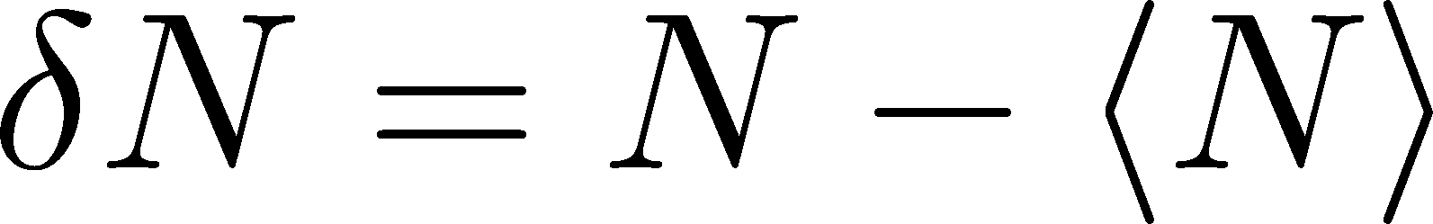
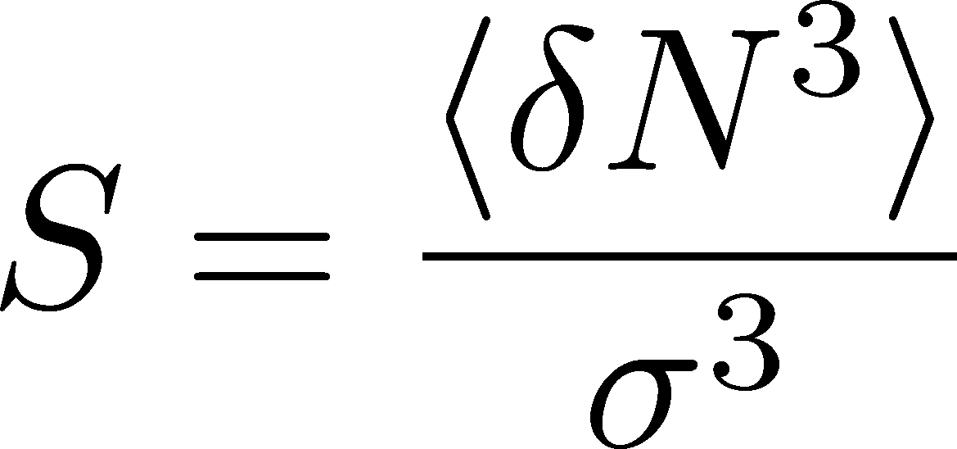
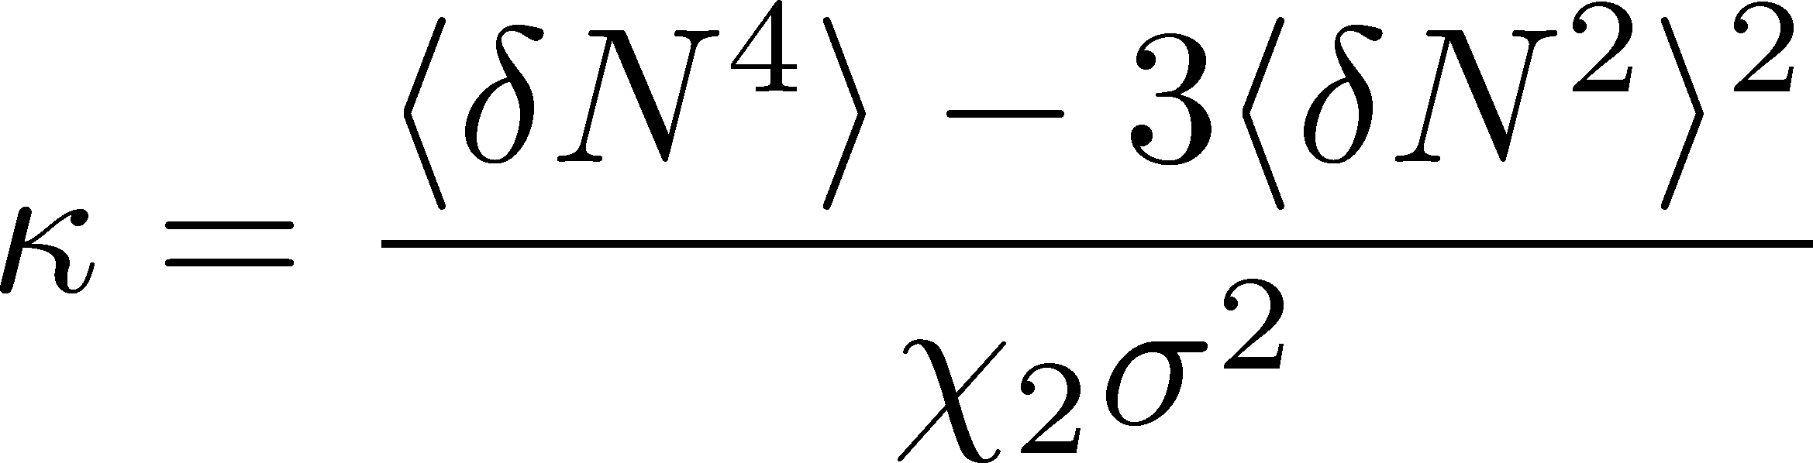
Fluctuations
Observables in equilibrium are fluctuating.
P(N)
N
V
N
Variance:
Skewness:
Kurtosis:

Slide 6

Event-by-Event Analysis @ HIC
Fluctuations can be measured by e-by-e analysis in experiments.
V
Detector

Slide 7

Event-by-Event Analysis @ HIC
Fluctuations can be measured by e-by-e analysis in experiments.
STAR, PRL105 (2010)
Detector

Slide 8
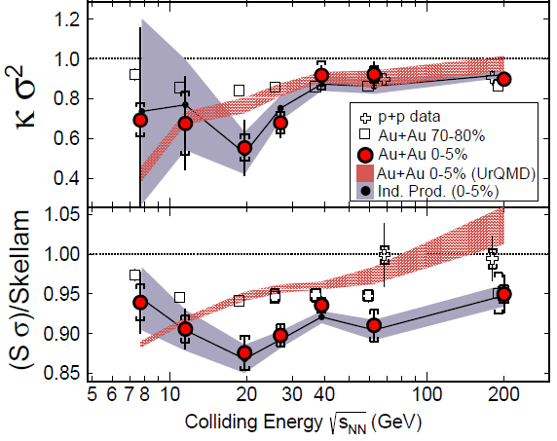
Cumulants up to 4th Order in 2014
STAR, PRL 2014
This is a great achievement in physics!

Slide 9
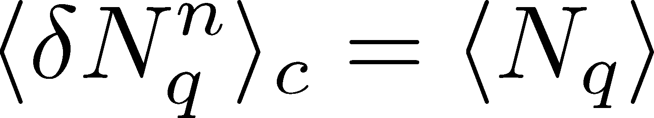
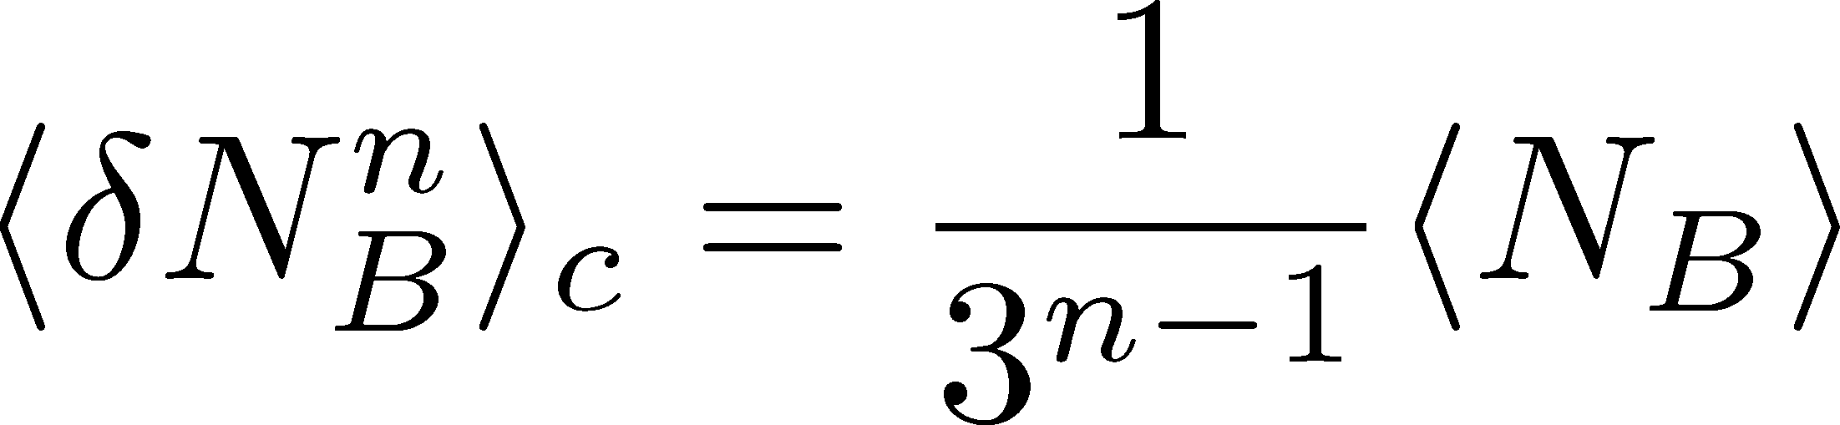
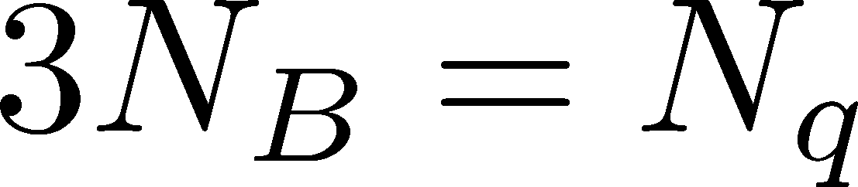
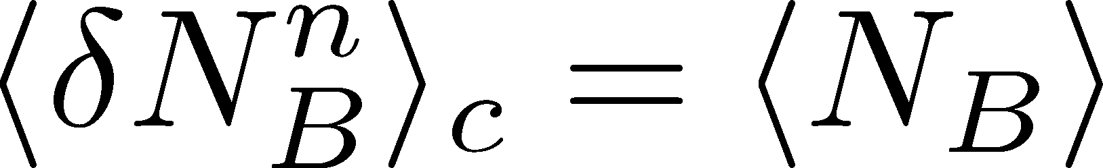
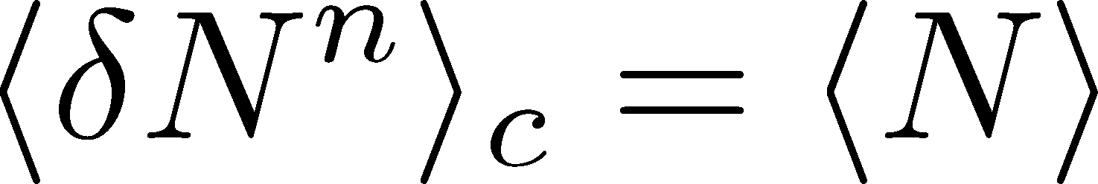
Fluctuations and Elemental Charge
Asakawa, Heinz, Muller, 2000
Jeon, Koch, 2000
Ejiri, Karsch, Redlich, 2005
Free Boltzmann → Poisson

Slide 10




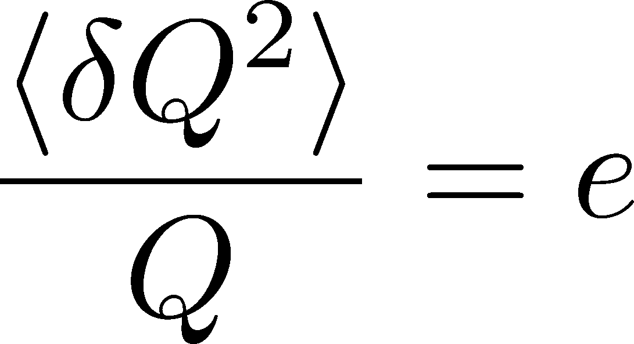
Shot Noise
e*
charge of quasi-particles
Total charge Q:

Slide 11
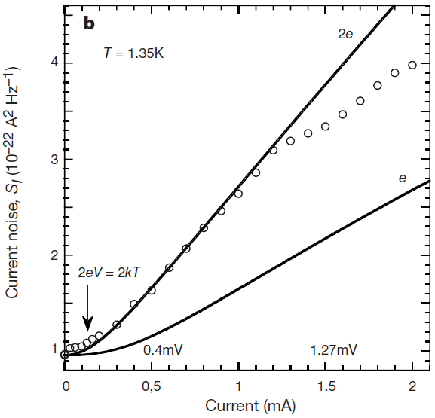


Shot Noise
e*
charge of quasi-particles
Superconductors
with Cooper Pairs
Fractional Quantum
Hall Systems
doubled!
Jehl+, Nature 405,50 (2000)
Saminadayar+, PRL79,2526 (1997)
Higher order cumulants:
3rd order: ex. Beenakker+, PRL90,176802(2003)
up to 5th order: Gustavsson+, Surf.Sci.Rep.64,191(2009)

Slide 12
Cumulants up to 4th Order in 2014
This is a great achievement in physics!
重イオン衝突実験は
完全計数統計解析が可能である
I lose…
However,
still a lot of things
to do…

Slide 13
Many Things to Do
Message to Experimentalists:
Measure rapidity window dependences
Determine baryon number cumulants
Message to Theorists:
Do not directly compare your thermal results with exp.
Let’s pursue descriptions of non-eq. non-Gaussianity.
Message to Latticians:
Do not directly compare your results with exp.
Measure more cumulants more accurately

Slide 14
HICが観測するゆらぎは、何者か？
実験が観測するゆらぎは、化学フリーズアウト時における熱平衡状態のもの？
From V. Koch,
0810.2520

Slide 15
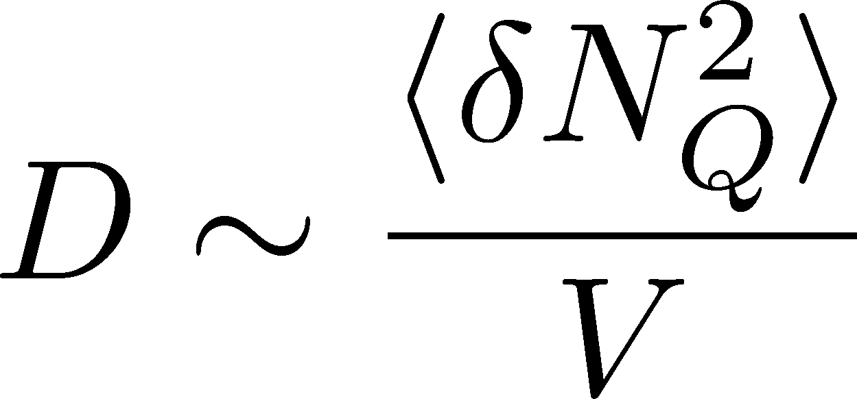

Δη Dependence @ ALICE
ALICE
PRL 2013
t
Δη
large
z
rapidity window

Slide 16
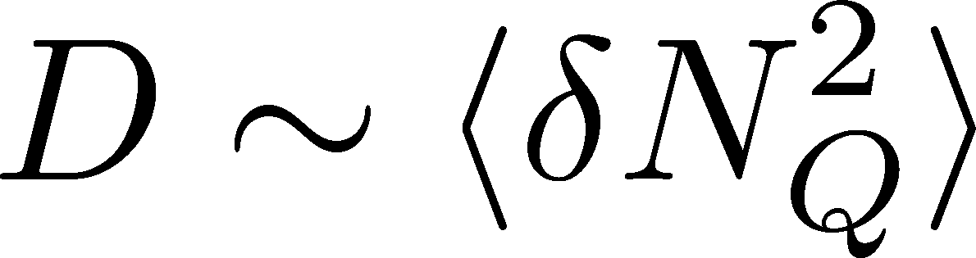
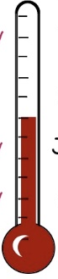


Δη Dependence @ ALICE
ALICE
PRL 2013
t
Δη
Δη dependent
thermometer?
large
z
small
rapidity window

Slide 17
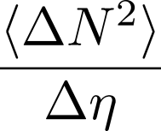



Time Evolution of Fluctuations
Quark-Gluon Plasma
Hadronization
Freezeout
Fluctuations continue to change until kinetic freezeout!!

Slide 18
Time Evolution of Fluctuations
Quark-Gluon Plasma
Hadronization
Freezeout
Variation of a conserved charge is achieved only through diffusion.
The larger Δη,
the slower diffusion

Slide 19
Δη Dependence @ ALICE
Δη dependent
thermometer?
ALICE
PRL 2013
large
small
Δη dependences of fluctuation observables
encode history of the hot medium!
Higher-order cumulants as
thermometer?

Slide 20

Conversion of Rapidities
Quark-Gluon Plasma
Hadronization
Freezeout
conversion
from coordinate-space
to momentum-space
rapidities
detector

Slide 21
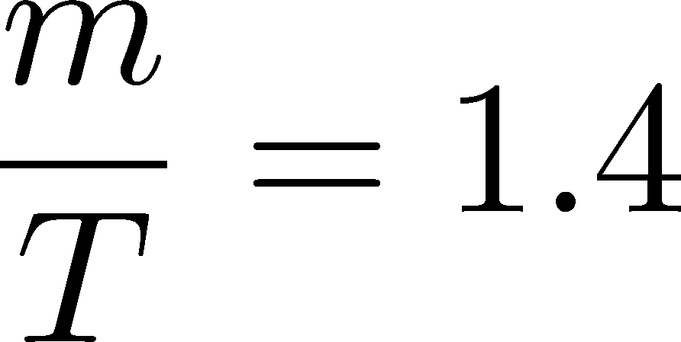
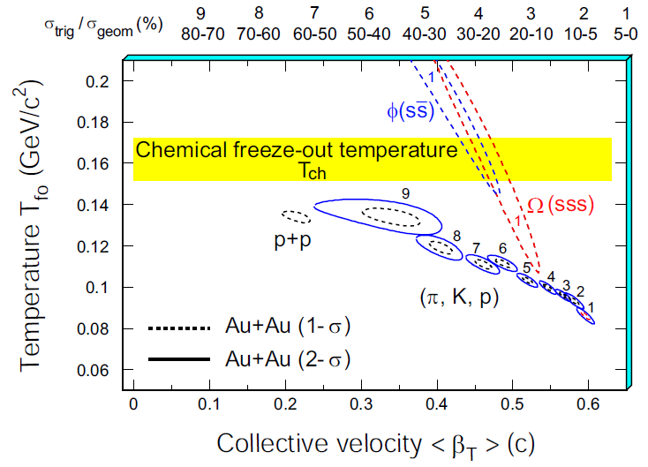
Blurring with Rapidity Conversion
Y. Onishi+,
in prep
（修士論文）
y distribution of a particle at η=0
Assume Bjorken expansion
y: momentum rapidity
η: coordinate-space rapidity
blast wave fit for 200GeV
@STAR
thermal distribution + blast wave

Slide 22
Width of Blurring
pion
kaon
proton
top RHIC
LHC
σ~0.6 for pions
σ~0.3 for protons

Slide 23
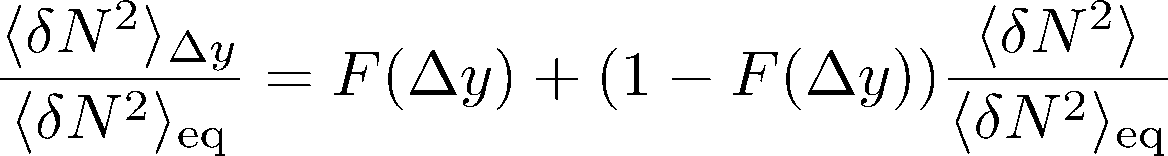
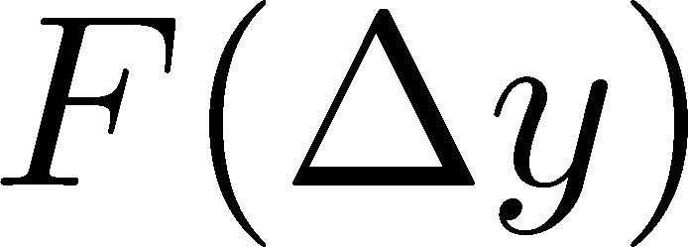

y dependence
ALICE electric charge 2nd
電磁電荷に対し、にじみ効果はかなり大きい。
Δy=1では、熱平衡値との平均程度。

Slide 24
Very Low Energy Collisions
Large contribution of global charge conservation
Violation of Bjorken scaling
→坂井田さんの
トーク
detector
Careful treatment is required to interpret fluctuations at low beam energies!
統計力学との比較は、おそらくほとんど意味をなさない。
多点相関関数から物理を抜き出す等の新しいアイディアを…

Slide 25
Rapidity Window Dependences of
Higher Order Cumulants
MK, Asakawa, Ono, Phys. Lett. B728 (2014) 386-392;
MK, to appear soon

Slide 26



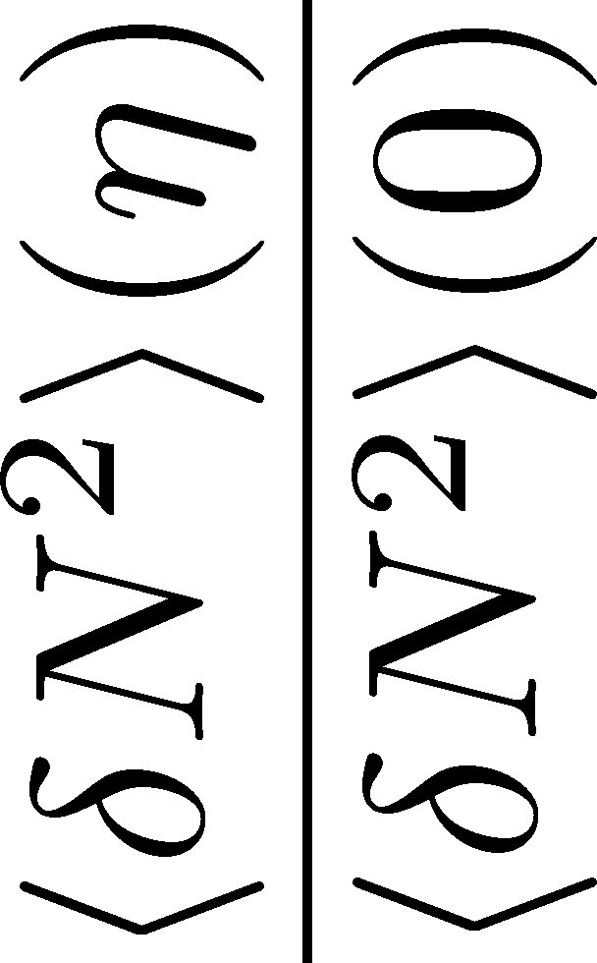
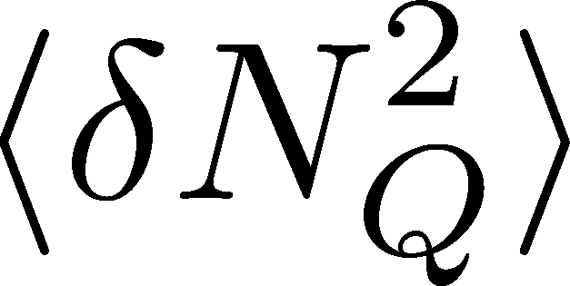

<δN_{B}²> and < δN_{p}² > @ LHC ?
should have different Δη dependence.
NEW
normalization!

Slide 27
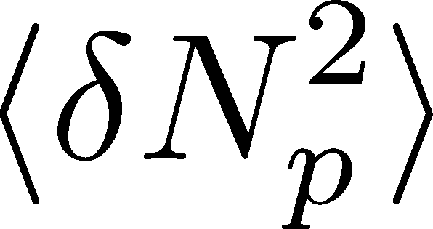


<δN_{B}²> and < δN_{p}² > @ LHC ?
should have different Δη dependence.
Baryon # cumulants are experimentally observable! MK, Asakawa, 2011;2012

Slide 28
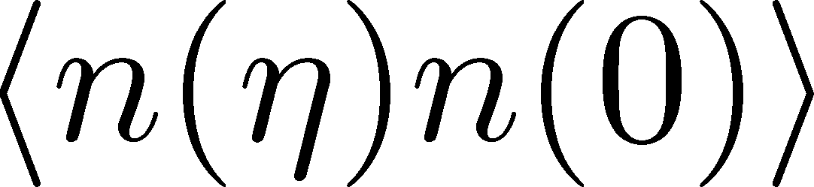
<δN_{B}²> and < δN_{p}² > @ LHC ?
should have different Δη dependence.
Same information as
2 particle corr.:
Balance function
Baryon # cumulants are experimentally observable! MK, Asakawa, 2011;2012

Slide 29
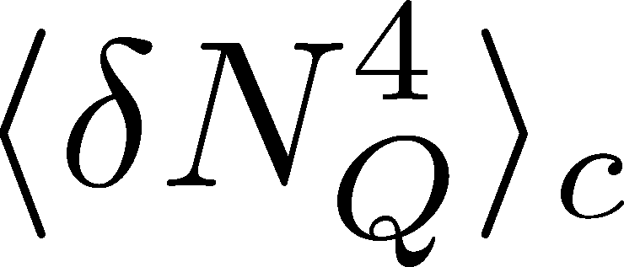

<δN_{Q}⁴> @ LHC ?
How does behave as a function of Δη?
suppression
or
enhancement

Slide 30

How to Introduce Non-Gaussianity?
Stochastic diffusion equation
Fluctuation of n is Gaussian in equilibrium

Slide 31
How to Introduce Non-Gaussianity?
Stochastic diffusion equation
Fluctuation of n is Gaussian in equilibrium
Choices to introduce non-Gaussianity in equil.:
n dependence of diffusion constant D(n)
colored noise
discretization of n
our choice
Fluctuations measured in
HIC are almost Poissonian.
REMARK:

Slide 32
A Brownian Particle’s Model
Hadronization (specific initial condition)
Time evolution
Freezeout
① Describe time evolution of Brownian particles exactly
② Obtain cumulants of particle # in Δη

Slide 33



Baryons in Hadronic Phase
time
chem. f.o.
hadronize
10~20fm
kinetic f.o.
Baryons behave like
Brownian pollens in water
mesons
baryons

Slide 34


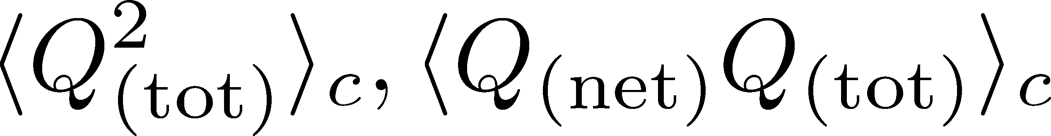
Initial Condition @ Hadronization
Hadronization (initial condition)
Boost invariance / infinitely long system
Local equilibration / local correlation
suppression owing to
local charge conservation
strongly dependent on
hadronization mechanism

Slide 35
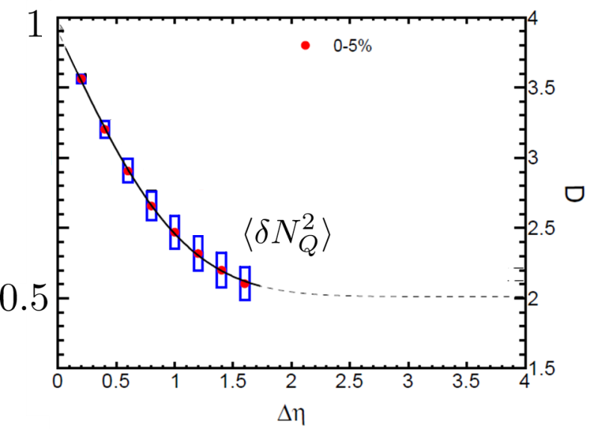


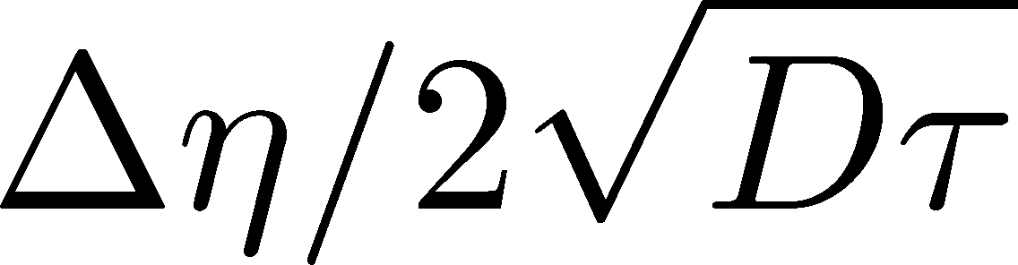
Δη Dependence at Freezeout
Initial fluctuations:
2nd
4th
parameter
sensitive to
hadronization

Slide 36
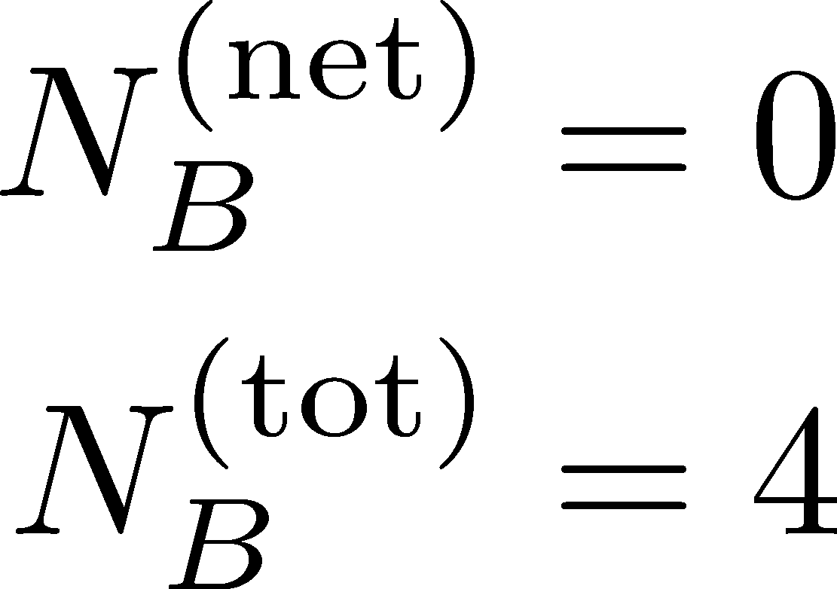
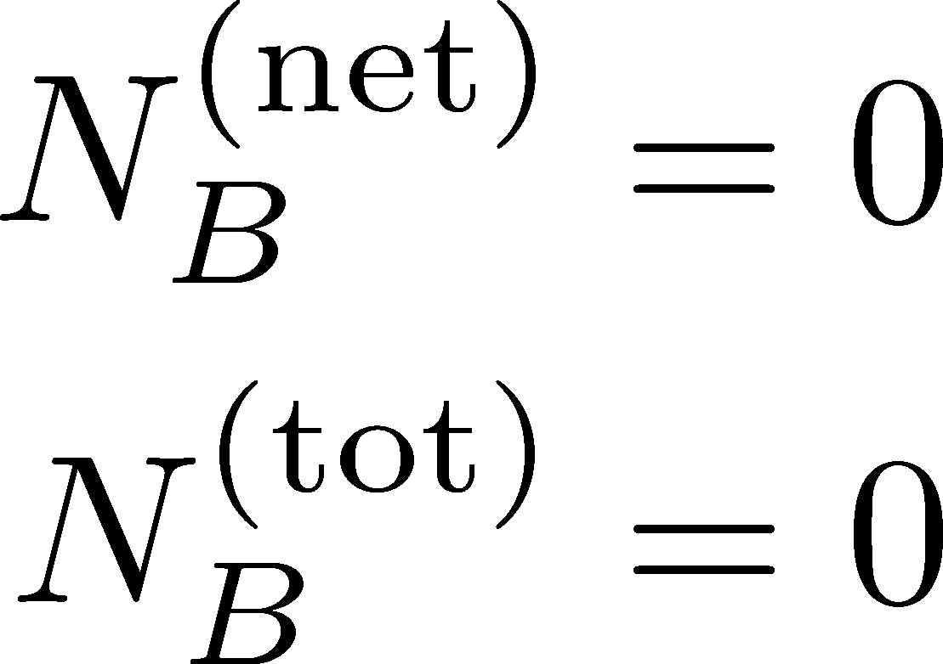
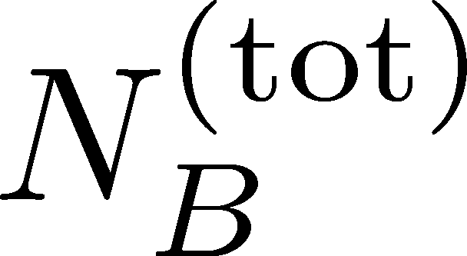
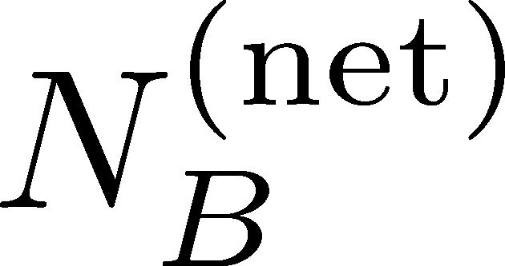
Total Charge Number
In recombination model,
6 quarks
6 antiquarks
can fluctuate, while does not.

Slide 37
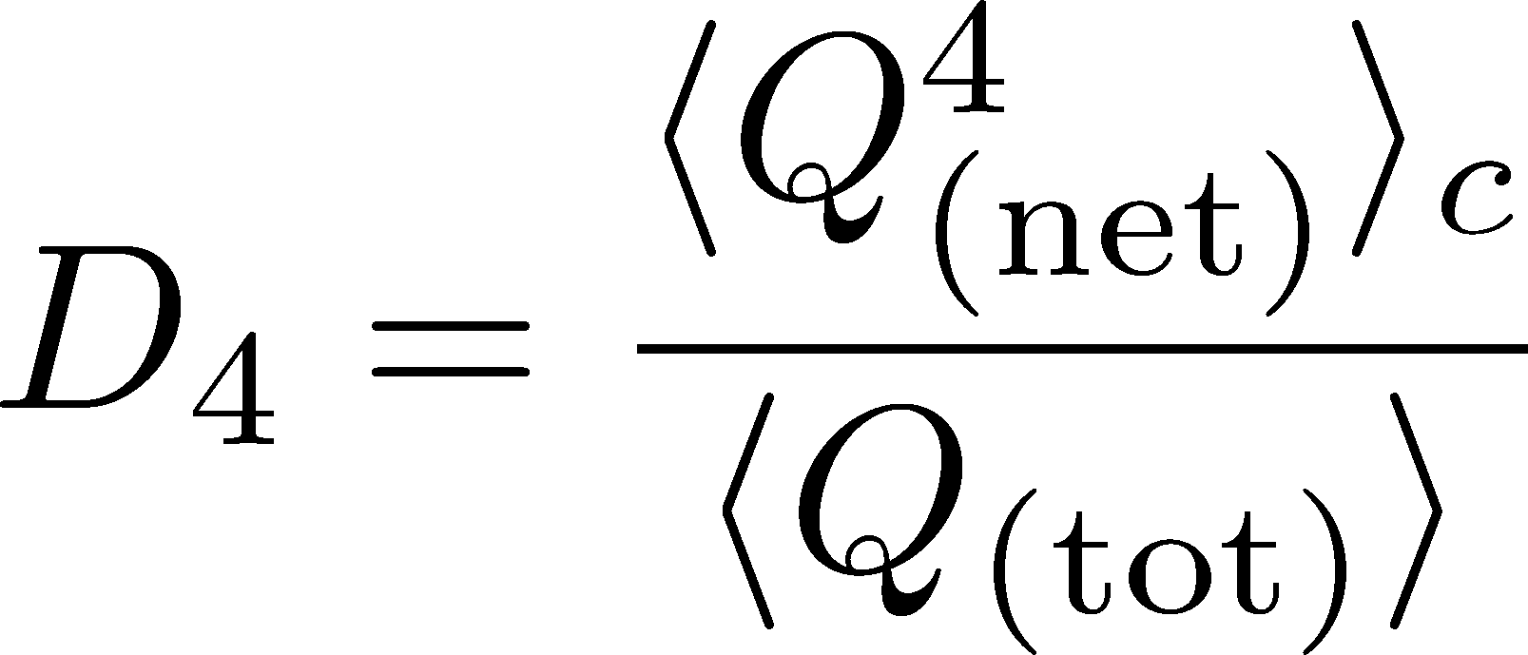

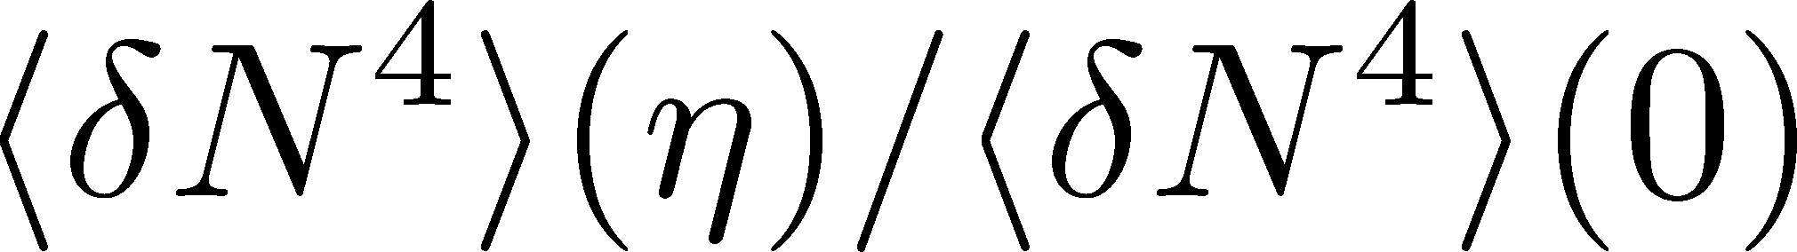
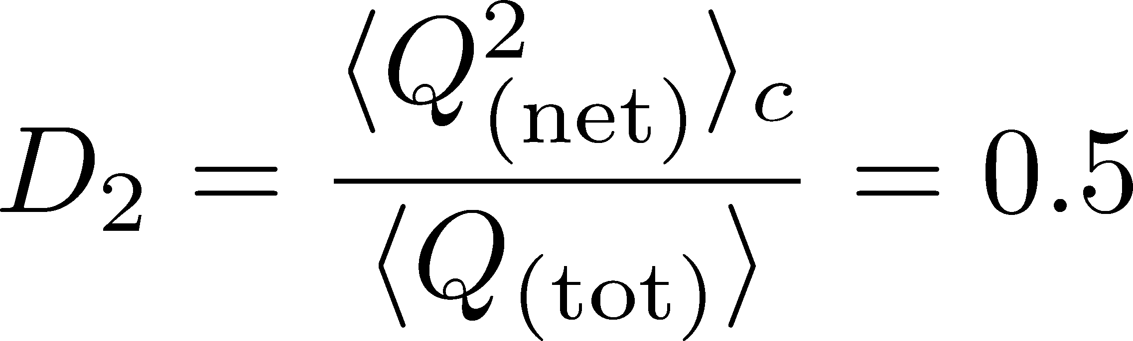
Δη Dependence: 4th order
MK, to appear soon
Initial Condition
Charcteristic Δη dependences!

Slide 38
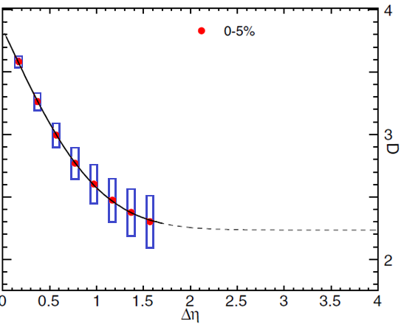


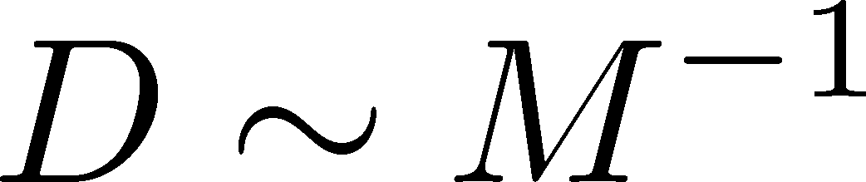
Δη Dependence: 4th order
MK, to appear soon
Initial Condition
baryon #
at ALICE
at ALICE

Slide 39
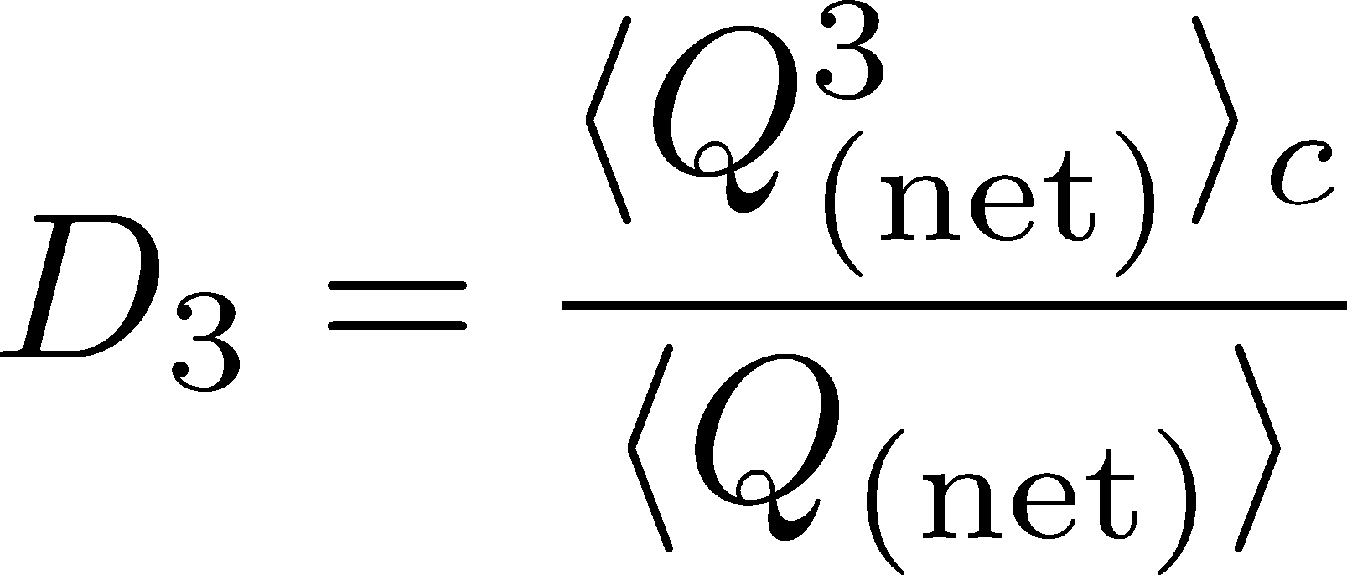
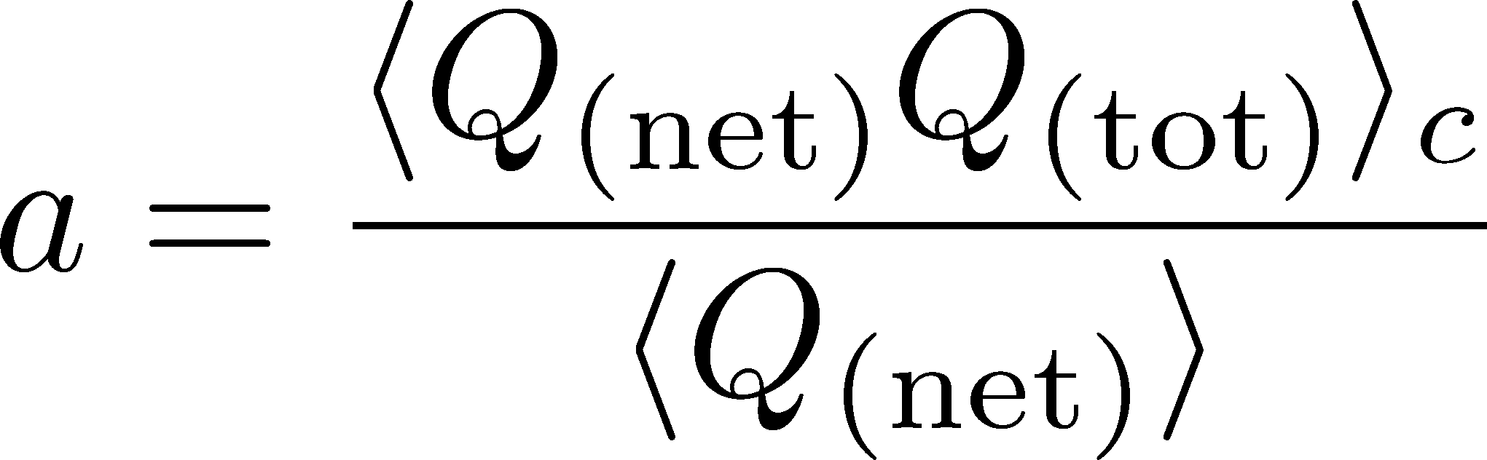
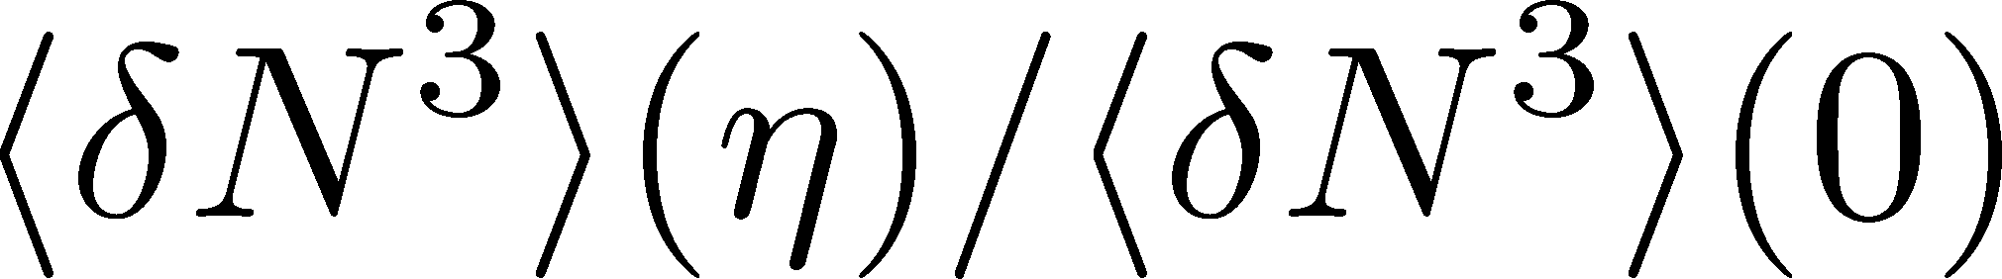
Δη Dependence: 3rd order
MK, to appear soon
Initial Condition
baryon #
at ALICE
at ALICE

Slide 40
Summary
Fluctuations are not frozen at chemical freezeout time.
Careful treatment is required especially for low √s.
Multi-particle correlation should be interesting!
Plenty of information in Δη dependences of various cumulants
and those of non-conserved charges, mixed cumulants…
And, multi-particle correlation functions

Slide 41
Many Things to Do
Message to Experimentalists:
Measure rapidity window dependences
Determine baryon number cumulants
Message to Theorists:
Do not directly compare your thermal results with exp.
Let’s pursue descriptions of non-eq. non-Gaussianity.
Message to Latticians:
Do not directly compare your results with exp.
Measure more cumulants more accurately

Slide 42
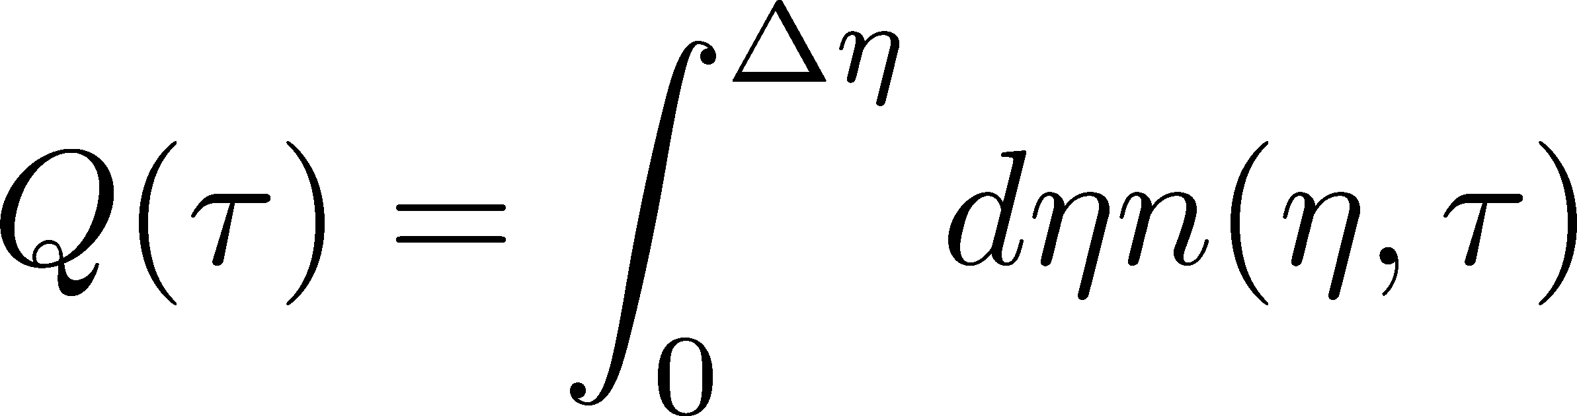
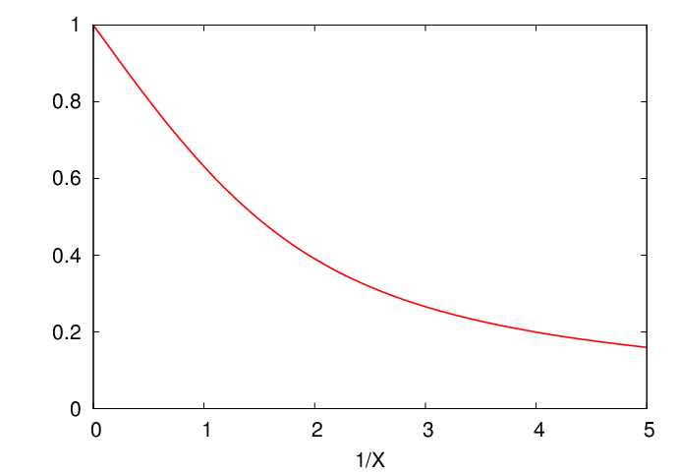
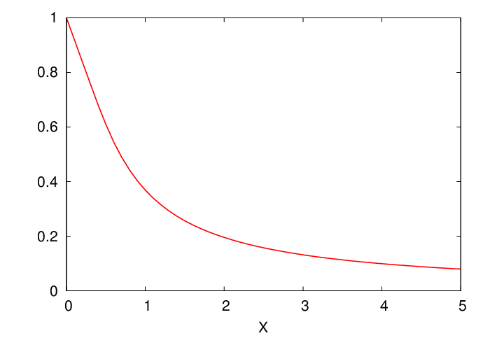
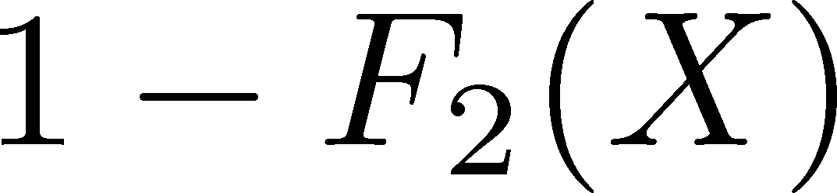

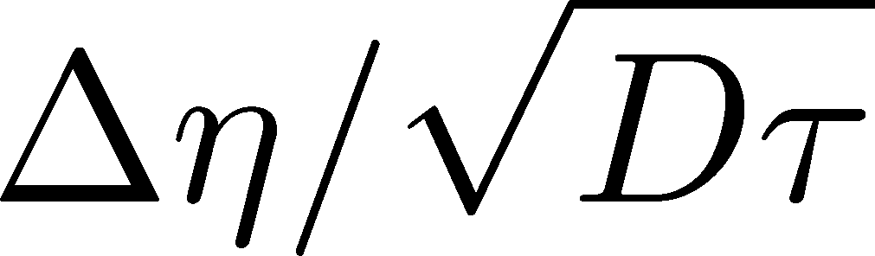
Δη Dependence
Shuryak, Stephanov, 2001
Initial condition:
Translational invariance
initial
equilibrium
equilibrium
initial

Slide 43
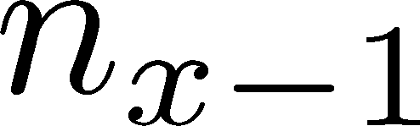






Diffusion Master Equation
MK, Asakawa, Ono, 2014
Divide spatial coordinate into discrete cells
probability

Slide 44
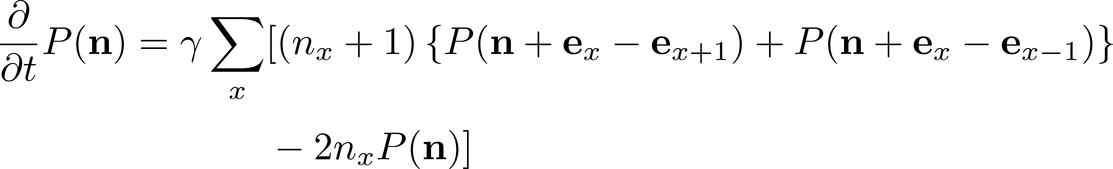
Diffusion Master Equation
MK, Asakawa, Ono, 2014
Divide spatial coordinate into discrete cells
probability
Master Equation for P(n)
Solve the DME exactly, and take a→0 limit
No approx., ex. van Kampen’s system size expansion

Slide 45
Hydrodynamic Fluctuations
Landau, Lifshitz, Statistical Mechaniqs II
Kapusta, Muller, Stephanov, 2012
Stochastic diffusion equation
Stephanov, Shuryak, 2001
Markov (white noise)
+
continuity
Fluctuation of n is
Gaussian in equilibrium
Gaussian noise
cf) Gardiner, “Stochastic Methods”

