Slide 1
Thermodynamics and reference scale of SU(3) gauge theory from gradient flow on fine lattices
Masakiyo Kitazawa
for FlowQCD Collaboration
(Asakawa, Hatsuda, Iritani, Itou, MK, Suzuki)
FlowQCD, arXiv:1503.06516
LATTICE2015, 2015/Jul./15, Kobe, Japan

Slide 2
Outline
Yang-Mills Gradient flow
Reference scale and Lattice spacing
Thermodynamics
FlowQCD, arXiv:1503.06516

Slide 3
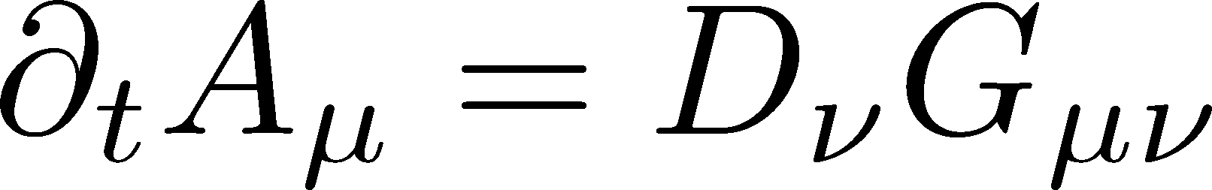
Yang-Mills Gradient Flow

Slide 4
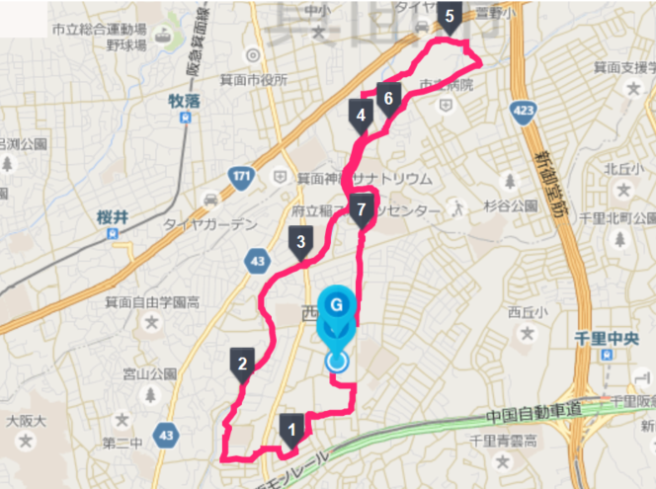
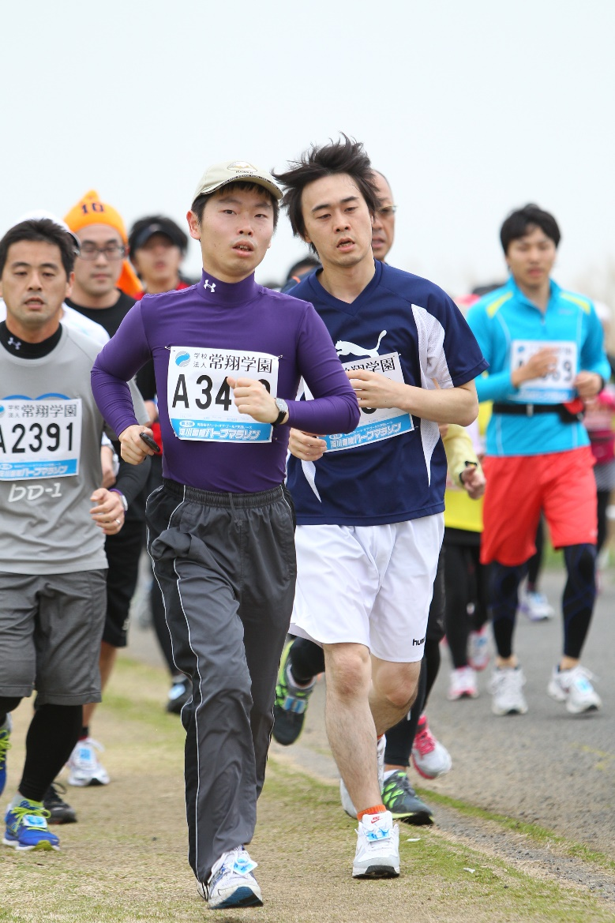
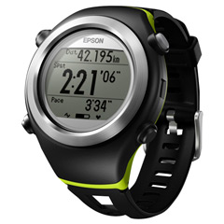
Gradient Flow and Jogging

Slide 5
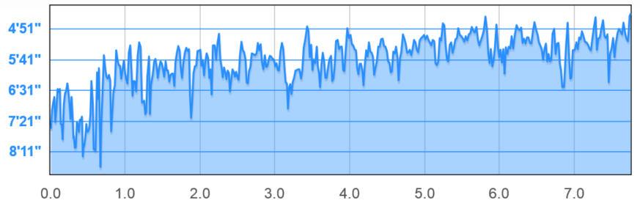
Gradient Flow and Jogging
original data

Slide 6
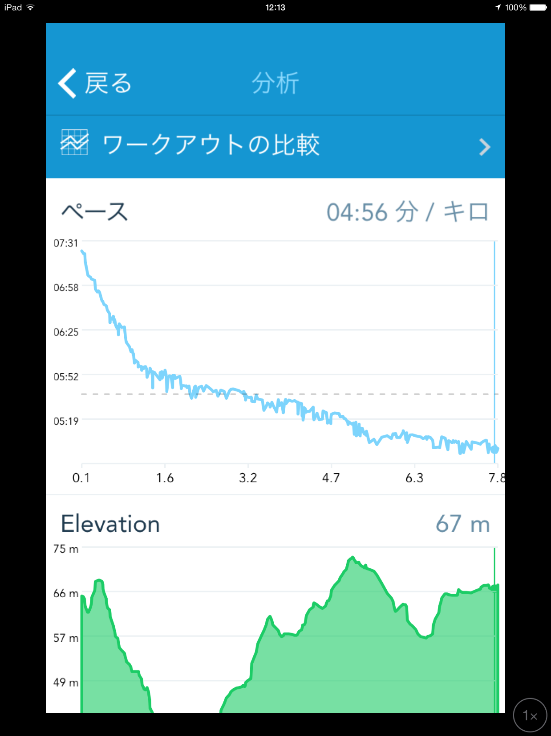

Gradient Flow and Jogging
original data
RunKeeper

Slide 7


Slide 8
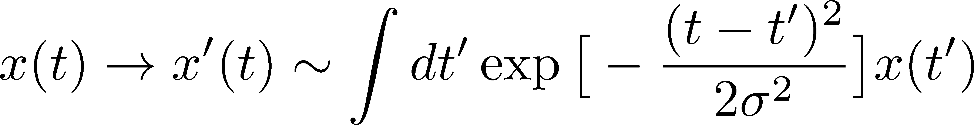
①

Slide 9
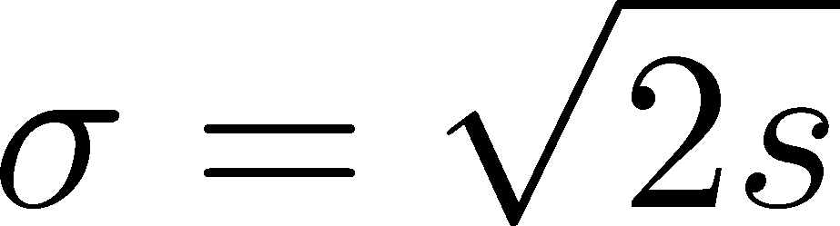
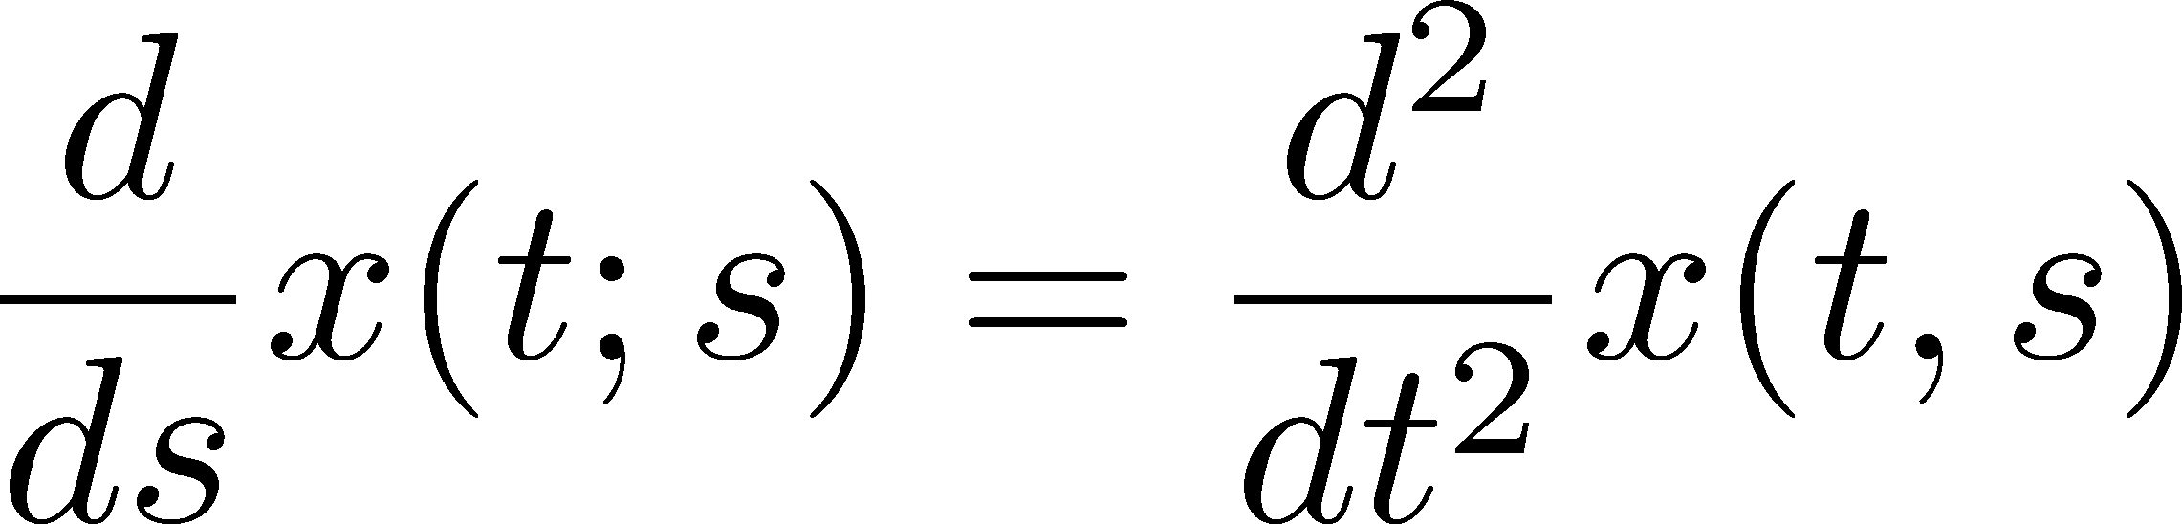
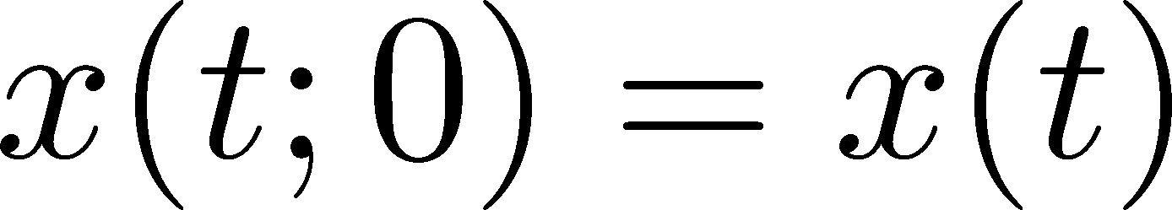
①
②

Slide 10
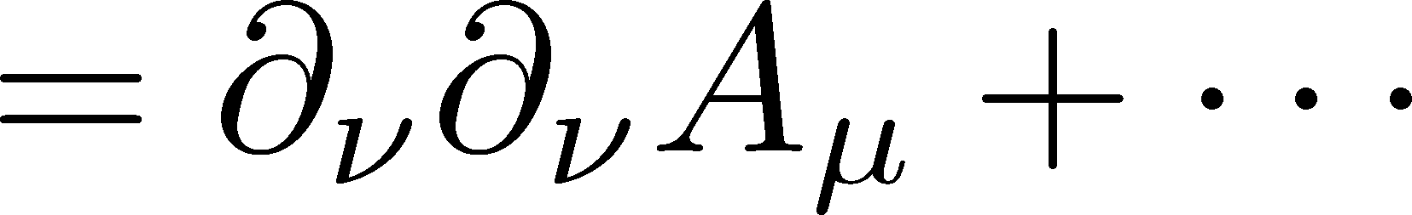
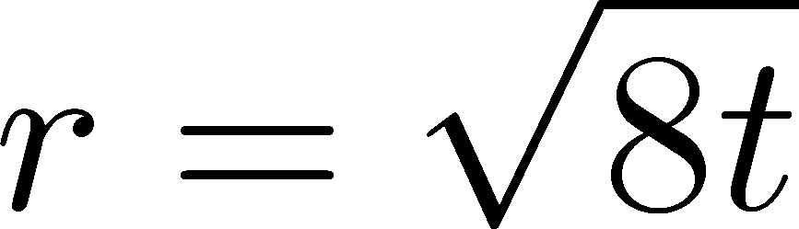
①
②
YM Gradient Flow
t: “flow time” dim: [E⁻²]
smearing length

Slide 11
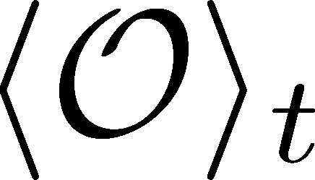
Use of Gradient Flow 1:
Observables at Nonzero Flow Time
function of t
independent of renormalization
Luescher, Weisz, 2011
independent of lattice spacing
(up to O(a²) corrections)
The t dep. can be used for the scale setting of the lattice.

Slide 12
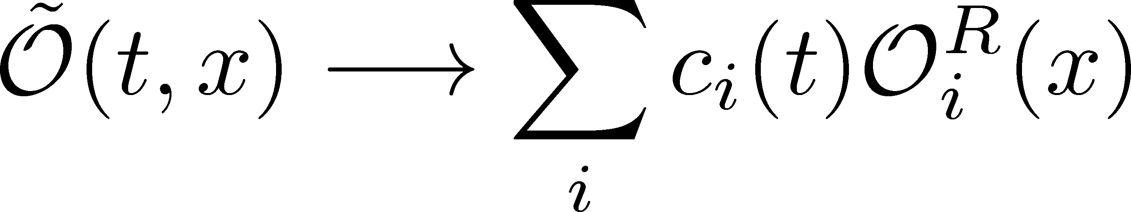
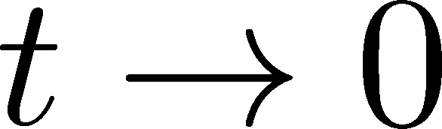
Use of Gradient Flow 2:
Small Flow Time Expansion
Luescher, Weisz, 2011
Suzuki, 2013
An operator
in blurred world
Renormalized operators
in original theory
less noisy, continuous
noisy, lattice discretized
Ex: energy momentum tensor, Suzuki, 2013; FlowQCD, 2014

Slide 13
Reference Scale and Lattice Spacing

Slide 14
Basic Idea
function of t
independent of renormalization

Slide 15
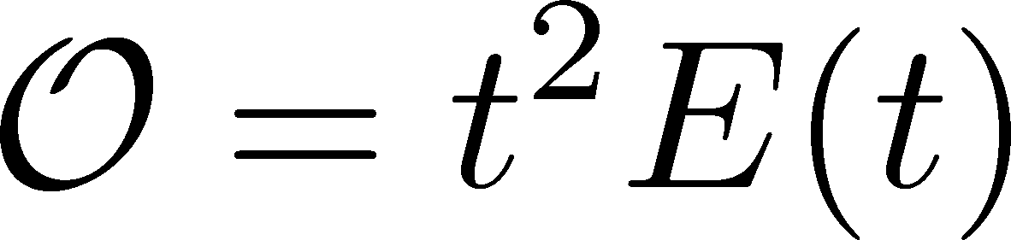
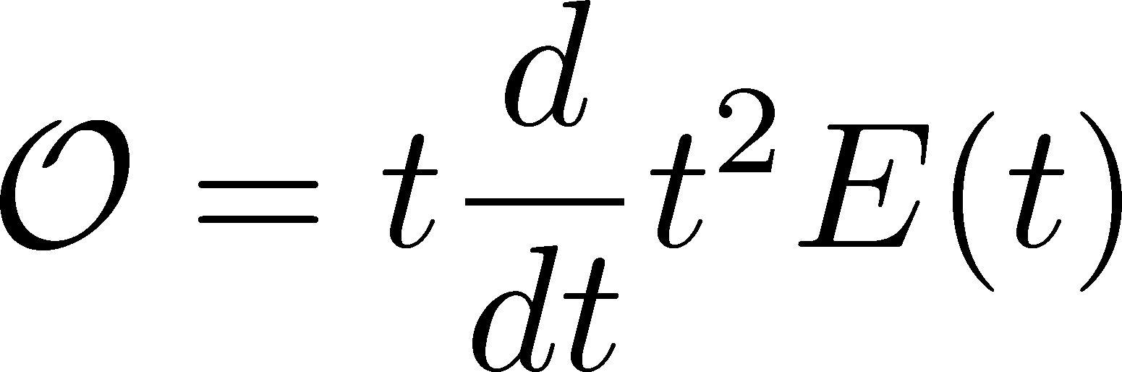
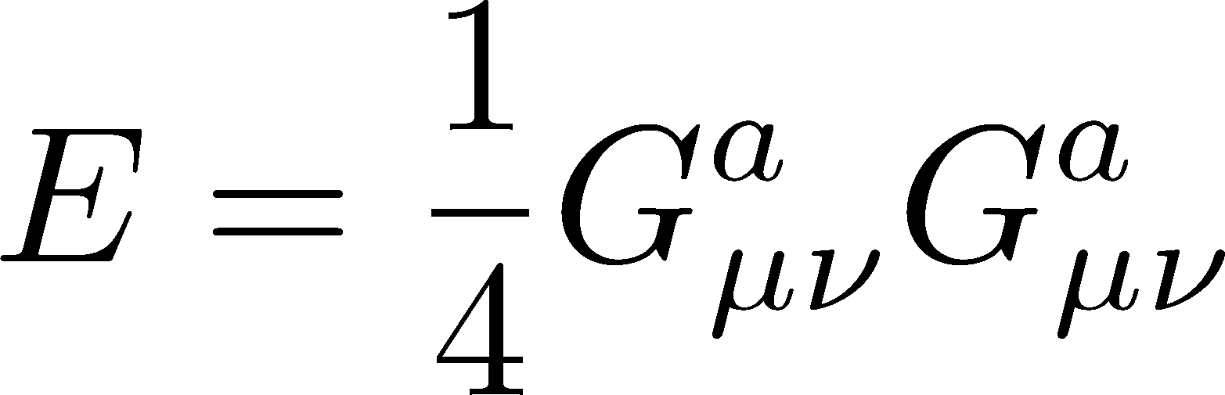
Basic Idea
function of t
independent of renormalization
Choice 1:
Choice 2:
Luescher, 2010
Budapest-Wuppertal, 2012
discretization effect suppressed

Slide 16
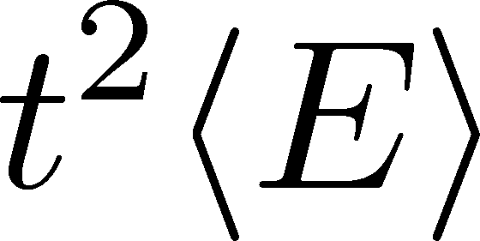
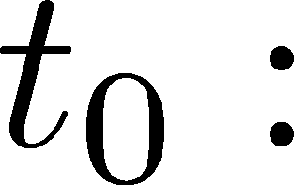
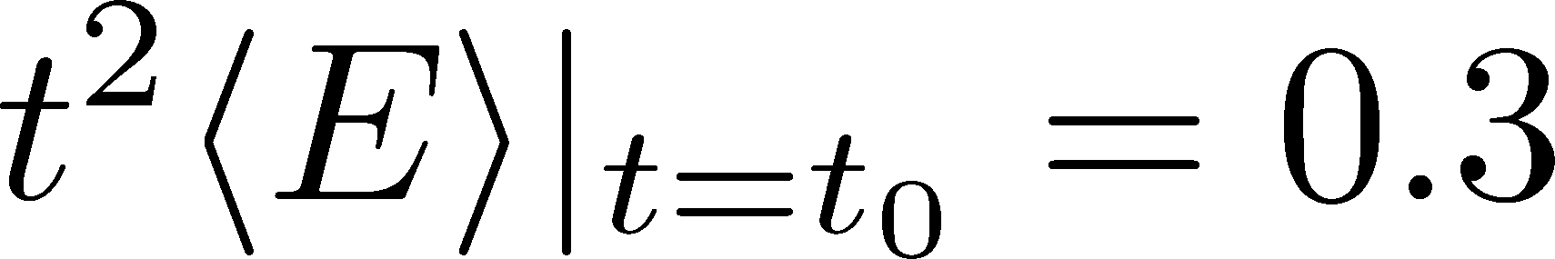
Behavior of t²<E>

Slide 17
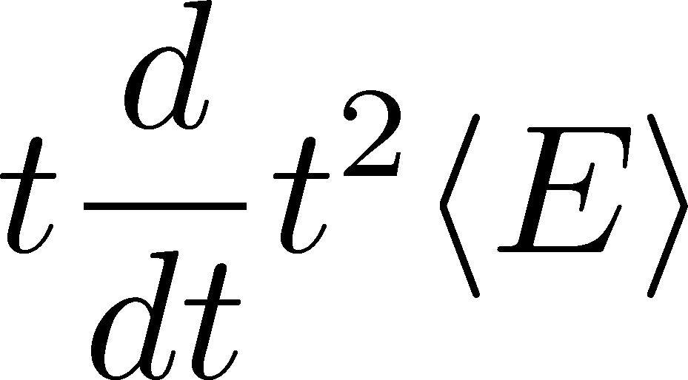
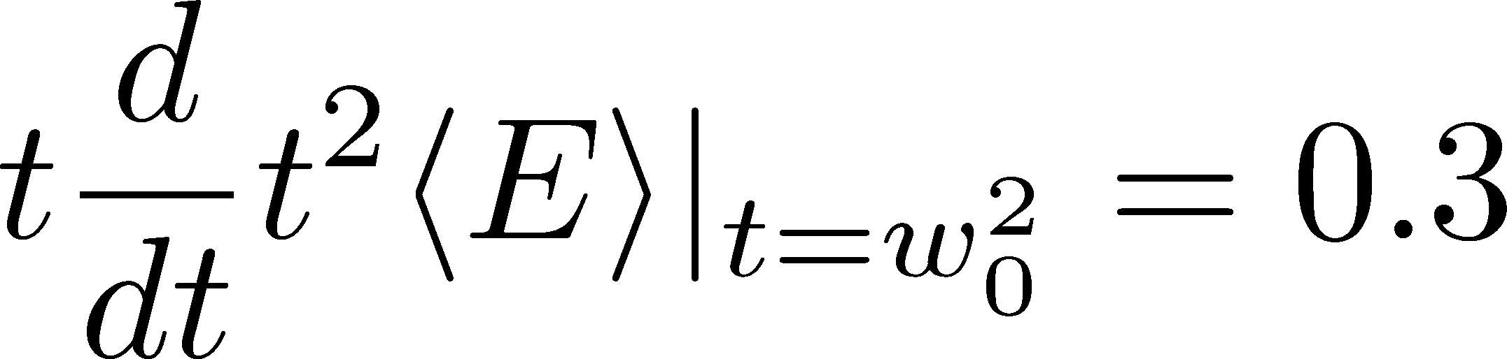

Behavior of t²<E>
Less statistical errors
No fit analyses
No measurement of non-local obs.
Advangates:

Slide 18
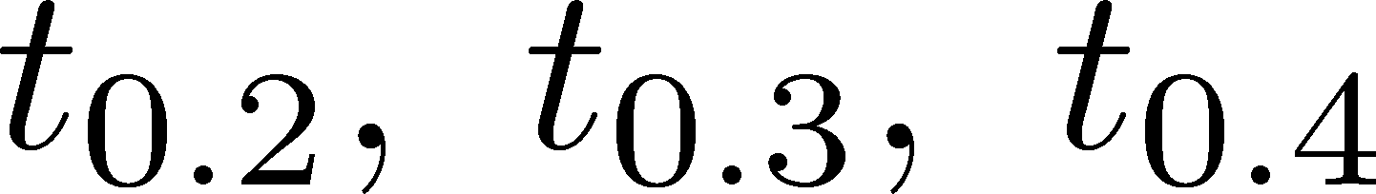
Behavior of t²<E>
Our Choice
value in rhs is arbitrary

Slide 19










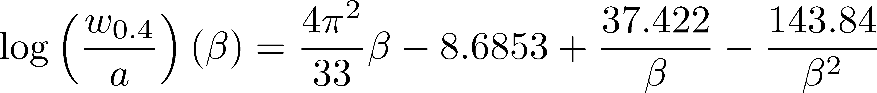
Lattice Spacing of SU(3) Wilson Action
Edwards+ (1998)
Alpha Collab. (1998)
Necco, Sommer (2002)
This Study:
T=2Tc
our parametrization for a
stat. err. < 0.4% / sys. err. < 0.7%

Slide 20

Numerical Setting
SU(3) YM theory
Wilson gauge action
w_{0.4} / w_{0.2} scaling
b | size | N_{conf} | b | size | N_{conf}
6.3 | 64⁴ | 30 | 6.9 | 64⁴ | 30
6.4 | 64⁴ | 100 | 7.0 | 96⁴ | 60
6.5 | 64⁴ | 49 | 7.2 | 96⁴ | 53
6.6 | 64⁴ | 100 | 7.4 | 128⁴ | 40
6.7 | 64⁴ | 30 | 7.5 | 128⁴ | 60
6.8 | 64⁴ | 100
Each configuration is separated by 1000 updates (HB+OR⁵)
BlueGene/Q @ KEK

Slide 21


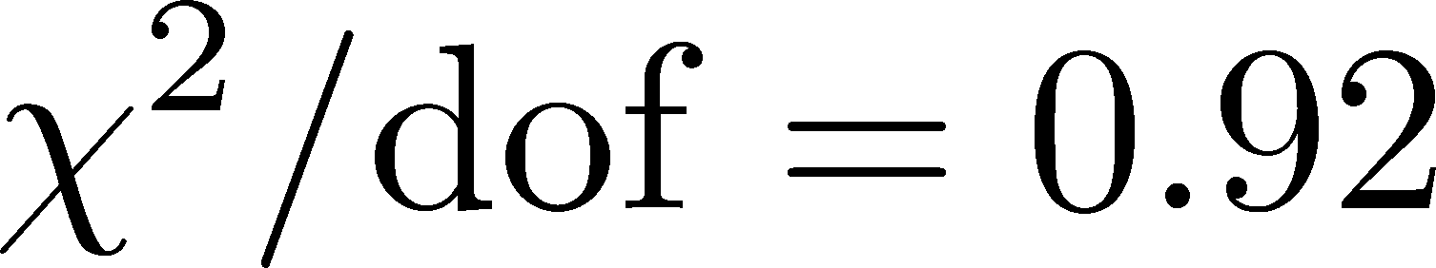
Parametrization with w_{0.4}
Use various fitting funcs
estimate sys. err.
For β=7.4 and 7.5, w_{0.4} is obtained from w_{0.2}.
3 parameter fit
stat. err. < 0.4% / sys. err. < 0.7%

Slide 22
Finite Volume Effects
No difference
in statistics
Spatial extent
used in this analysis
No finite volume effects
(Physical lattice length)/w_{0.2}
2% deviation
larger than stat. err.
No finite volume effects within statistics

Slide 23
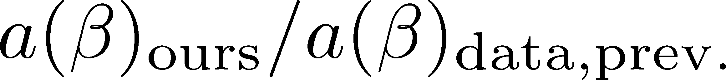
Comparison with Previous Studies
Edwards, Heller, Klassen, 1998
Alpha-Collaboration, 1998
Necco, Sommer, 2002
Durr, Fodor, Hoelbling, 2007
Necco, Sommer
error of w_{0.4}/r_{c}
our parametrization
by w_{0.4}
Parametrizations agree with each other in available ranges.
Errorbars of our data is smaller than previous ones.

Slide 24
Thermodynamics

Slide 25
Basic Idea: Small Flow Time Expansion
An operator
in blurred world
Renormalized operators
in original theory
less noisy, continuous
noisy, lattice discretized

Slide 26
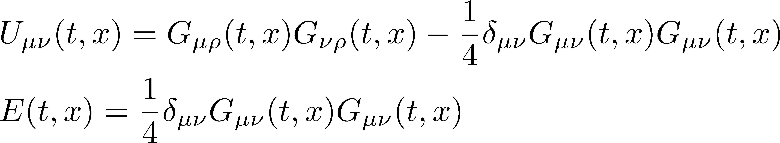
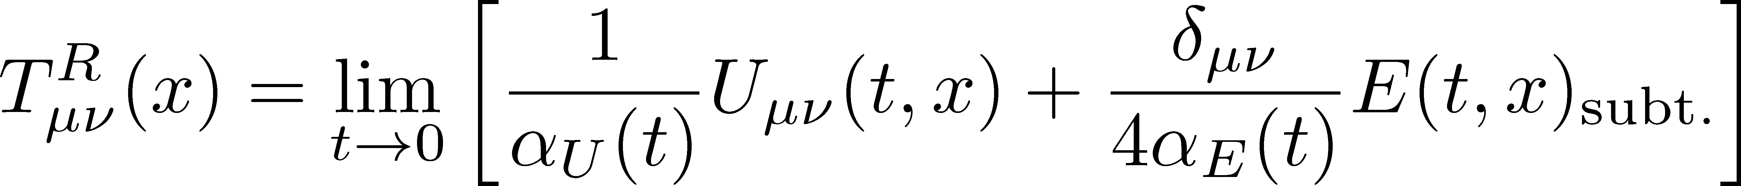
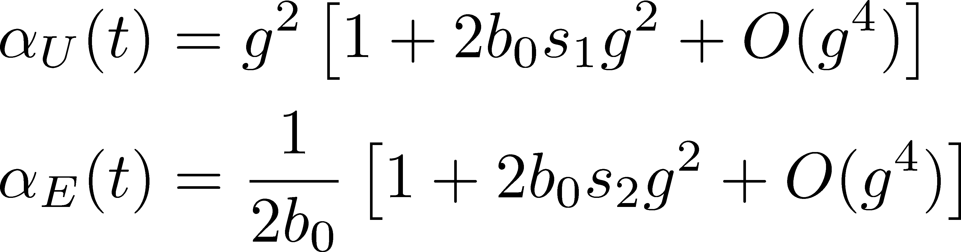
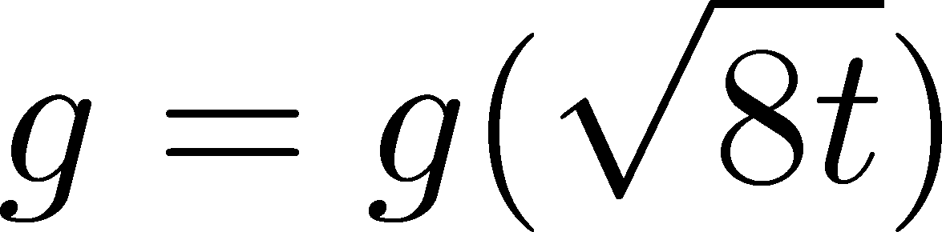
SFTE of Energy-Momentum Tensor
Suzuki, 2013
gauge-invariant dimension 4 operators
Remormalized EMT
Suzuki coeffs.

Slide 27
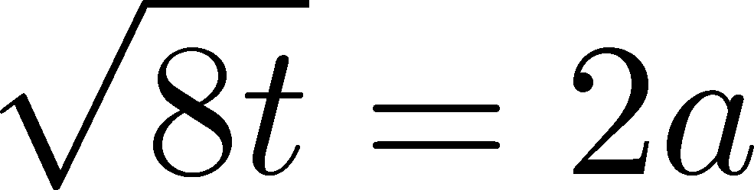
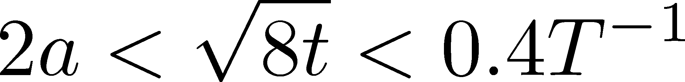
SU(3) Thermodynamics with Nt=6, 8, 10
FlowQCD, PRD90,011501 (2014)
Entropy density T=1.65Tc
Stable region for

Slide 28
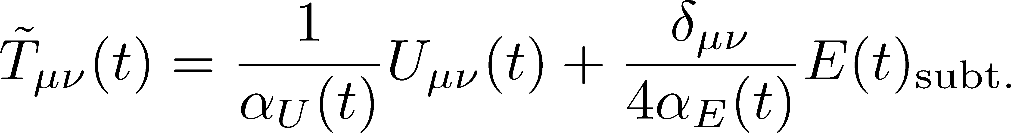
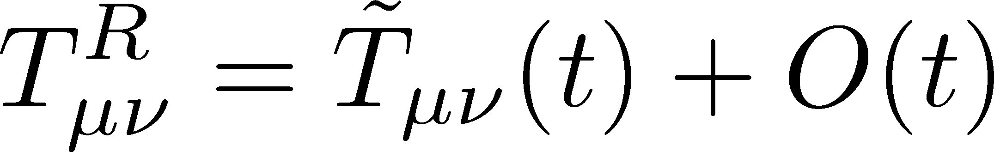
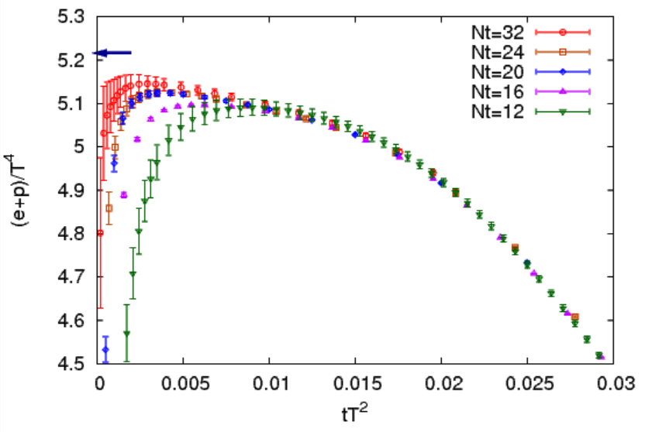
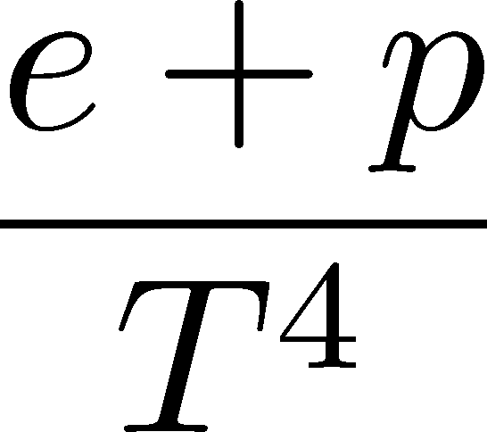
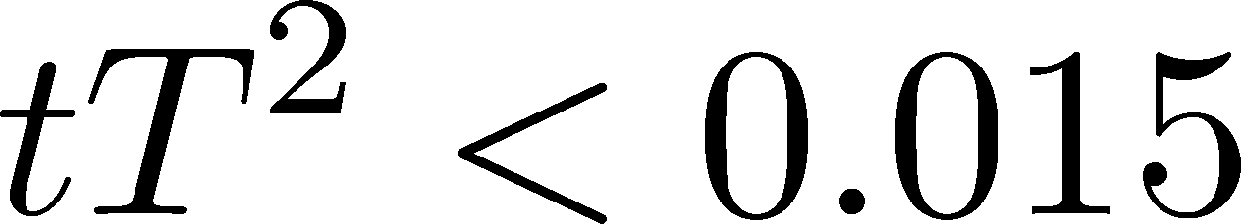
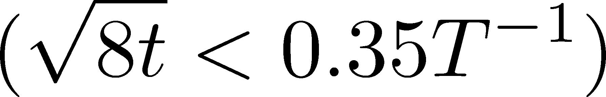
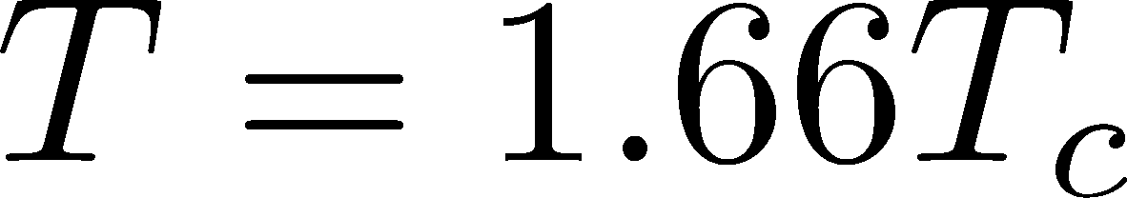
New Results: Thermodynamics (e+p)
FlowQCD, in prep.
BW12
Existence of O(t) effect
Linear behavior for
preliminary
t→0 limit is necessary
BW12:Budapest-Wuppertal, 2012

Slide 29
New Results: Thermodynamics (e+p)
FlowQCD, in prep.
BW12
Existence of O(t) effect
Linear behavior for
preliminary
t→0 limit is necessary
BW12:Budapest-Wuppertal, 2012

Slide 30

New Results: Thermodynamics (e+p)
FlowQCD, in prep.
BW12
Existence of O(t) effect
Linear behavior for
preliminary
t→0 limit is necessary
BW12:Budapest-Wuppertal, 2012

Slide 31
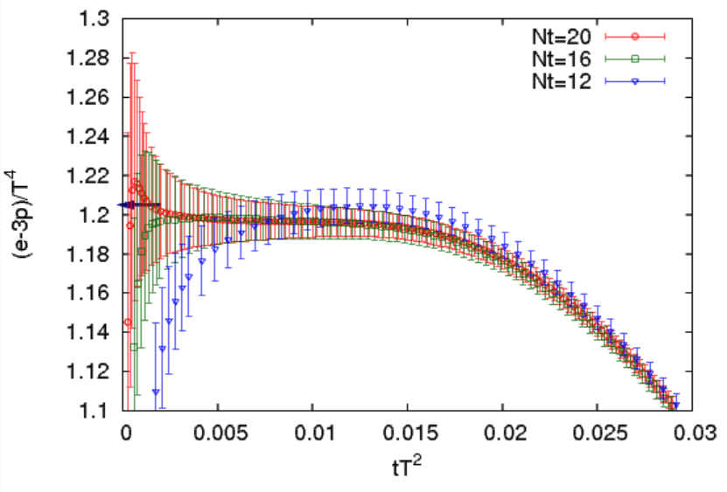
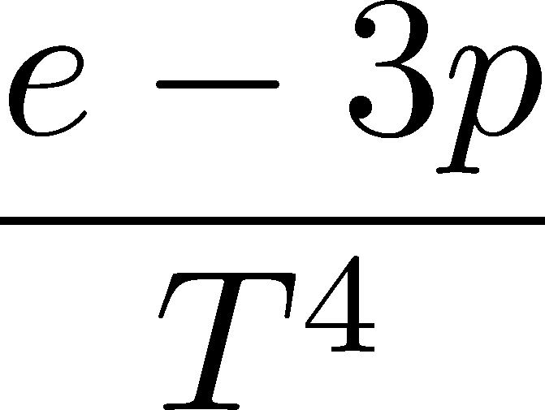
New Results: Thermodynamics (e-3p)
FlowQCD, in prep.
Good agreement with previous study
Stable plateau for
preliminary
BW12
BW12:Budapest-Wuppertal, 2012

Slide 32
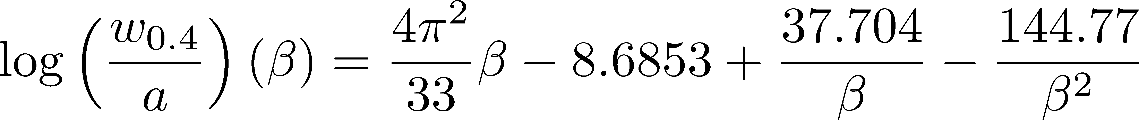
Summary
Accurate lattice spacing of Wilson gauge action for 6.3<β<7.5 is now available.
The EMT defined with gradient flow is nicely applied to the measurement of thermodynamics.
The a→0 behavior is checked on fine lattices.
taking t→0 limit is needed.
application to full QCD → E. Itou, 18th, room 403

Slide 33

Summary
Accurate lattice spacing of Wilson gauge action for 6.3<β<7.5 is now available.
The EMT defined with gradient flow is nicely applied to the measurement of thermodynamics.
The a→0 behavior is checked on fine lattices.
taking t→0 limit is needed.
application to full QCD → E. Itou, 18th, room 403

Slide 34
Backup

Slide 35
Various Reference Scales
plaq.
clover

