Slide 1
Diffusion of non-Gaussian fluctuations of conserved charges
Masakiyo Kitazawa
(Osaka U.)
MK, Asakawa, Ono, Phys. Lett. B728 (2014) 386-392;
MK, Nucl. Phys. A942 (2015) 65-96;
Y. Ohnishi et al., in prep.
『熱場の量子論』, YITP, 2015/9/1

Slide 2
Beam-Energy Scan
T
Hadrons
Color SC
0
μ

Slide 3

Beam-Energy Scan
STAR 2012
LHC
RHIC BES
T
J-PARC
Hadrons
Color SC
0
μ

Slide 4
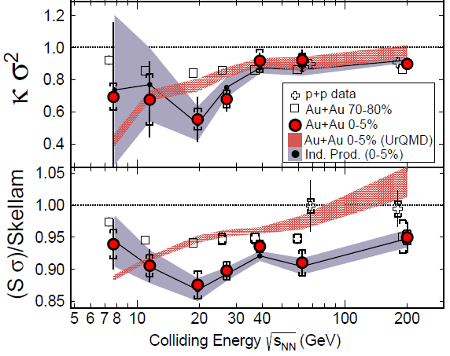
Non-Gaussian Cumulants @ BES
Enhancement?
suppression?
STAR, PRL (early 2014)
STAR, CPOD (Nov., 2014)

Slide 5



Δη Dependence @ ALICE
ALICE
PRL 2013
hadronic
D-measure
suppression
D ~ 3-4 Hadronic
D ~ 1-1.5 Quark
t
Δη
rapidity window
z

Slide 6
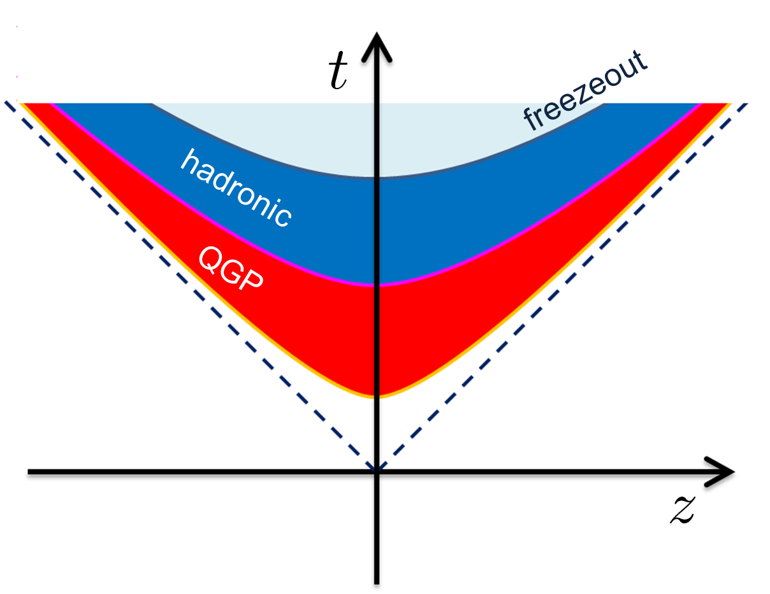
Time Evolution of Fluctuations
Particle # in Δη
continues to change until kinetic freezeout due to diffusion.
changes due to a conversion y → η at kinetic freezeout
“Thermal Blurring”

Slide 7
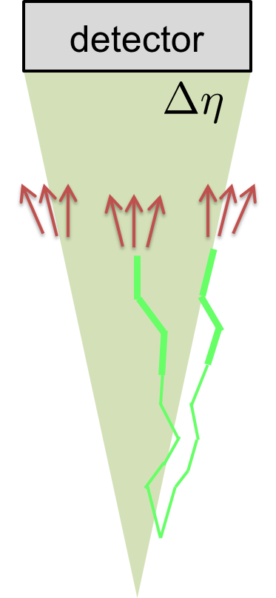
Time Evolution of Fluctuations
Particle # in Δη
continues to change until kinetic freezeout due to diffusion.
changes due to a conversion y → η at kinetic freezeout
“Thermal Blurring”

Slide 8
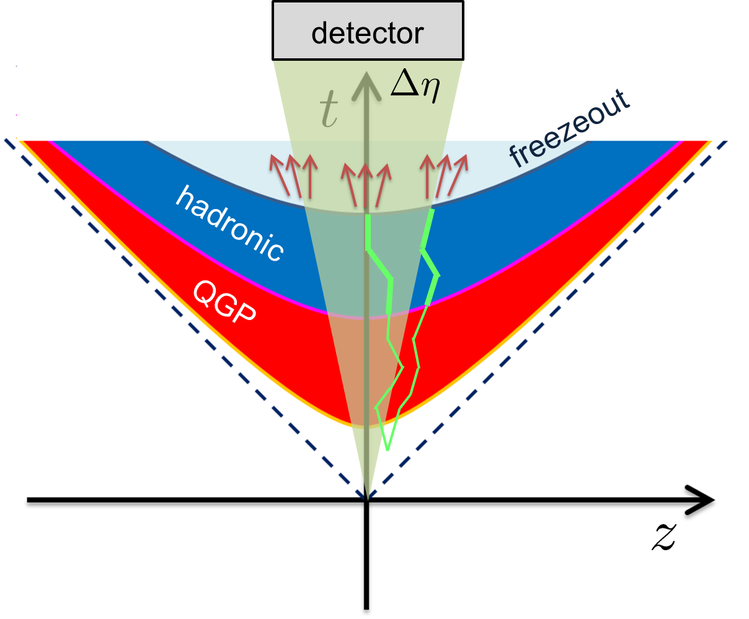
Thermal Blurring
this effect

Slide 9
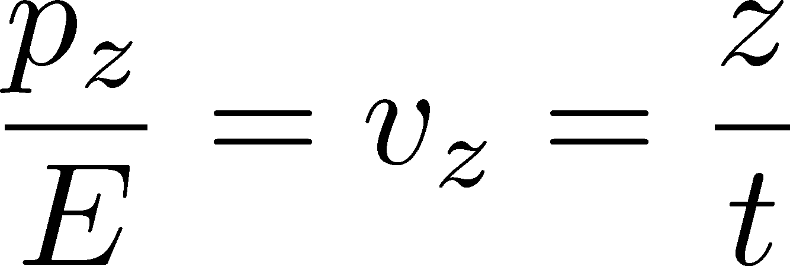




Thermal Blurring
Under Bjorken picture,
coordinate-space rapidity
of medium
momentum-space rapidity
coordinate-space rapidity of individual particles

Slide 10
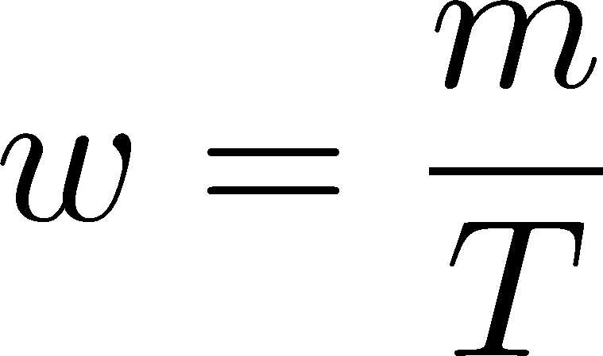


Thermal distribution in η space
Y. Ohnishi+
in preparation
nucleon
pions
nucleons
pion
width (Δy)
blast wave
flat freezeout surface

Slide 11
Centrality Dependence
lower T
larger β
Weaker
blurring
More central
Is the centrality dependence understood solely by the thermal blurring at kinetic f.o.?

Slide 12
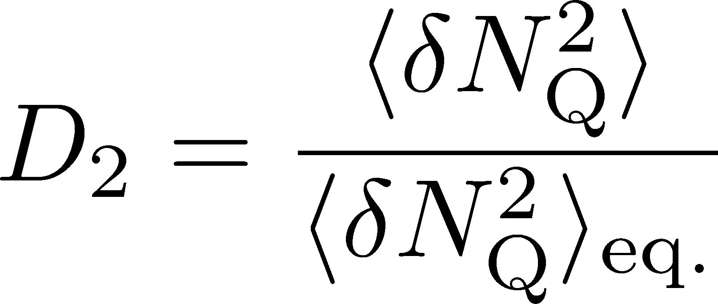
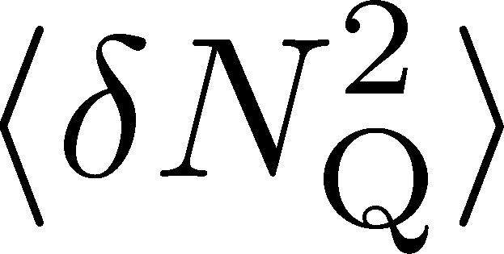
Centrality Dependence
Assumptions:
Centrality independent cumulant at kinetic f.o.
Thermal blurring at kinetic f.o.
Centrality dep. of blast wave parameters can qualitatively describe the one of

Slide 13
Diffusion + Thermal Blurring,
Non-Gaussian Cumulants
these
processes

Slide 14
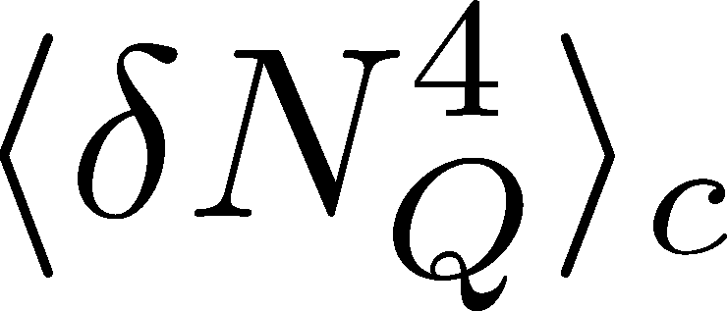




<δN_{Q}⁴> @ LHC ?
How does behave as a function of Δη?
suppression
or
enhancement

Slide 15
<δN_{Q}⁴> @ LHC ?
How does behave as a function of Δη?
suppression
or
enhancement

Slide 16

How to Introduce Non-Gaussianity?
Stochastic diffusion equation
Fluctuation of n is Gaussian in equilibrium

Slide 17
How to Introduce Non-Gaussianity?
Stochastic diffusion equation
Fluctuation of n is Gaussian in equilibrium
Choices to introduce non-Gaussianity in equil.:
n dependence of diffusion constant D(n)
colored noise
discretization of n
our choice
Fluctuations measured in
HIC are almost Poissonian.
REMARK:

Slide 18

A Brownian Particle’s Model
Hadronization (specific initial condition)
Time evolution
Freezeout
Initial distribution + motion of each particle
→ cumulants of particle # in Δη

Slide 19

A Brownian Particle’s Model
Hadronization (specific initial condition)
Time evolution
Freezeout
Initial distribution + motion of each particle
→ cumulants of particle # in Δη

Slide 20



Baryons in Hadronic Phase
time
chem. f.o.
hadronize
10~20fm
kinetic f.o.
Baryons behave like
Brownian pollens in water
mesons
baryons

Slide 21


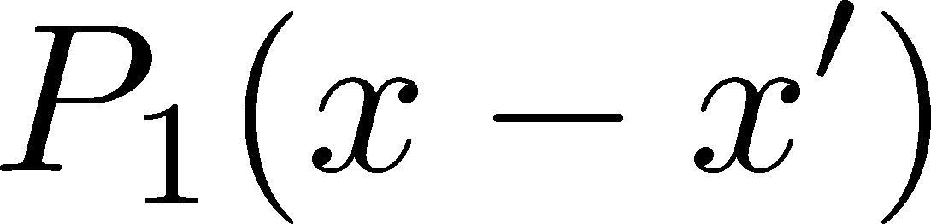
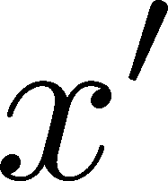
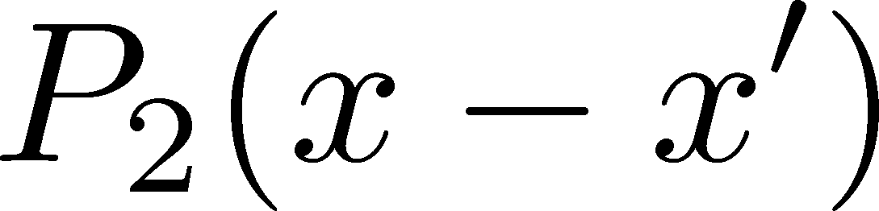

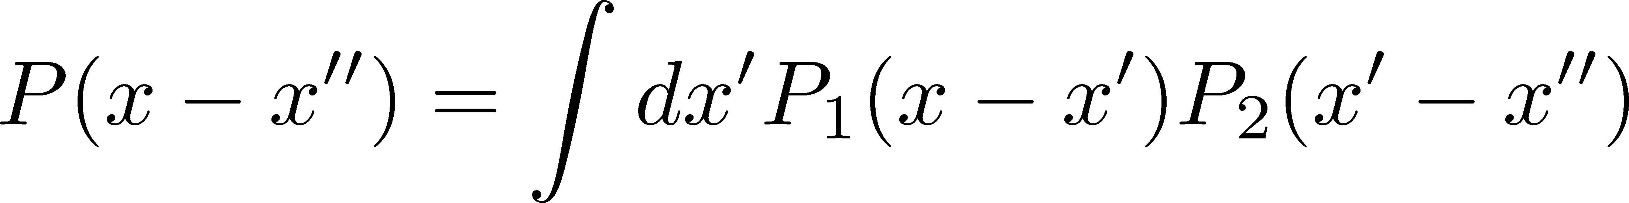
Diffusion + Thermal Blurring
Hadronization
diffusion
Kinetic f.o. (coordinate space)
blurring
Kinetic f.o. (momentum space)
Total diffusion:
Diffusion + thermal blurring = described by a single P(x)
Both are consistent with Gaussian → Single Gaussian

Slide 22
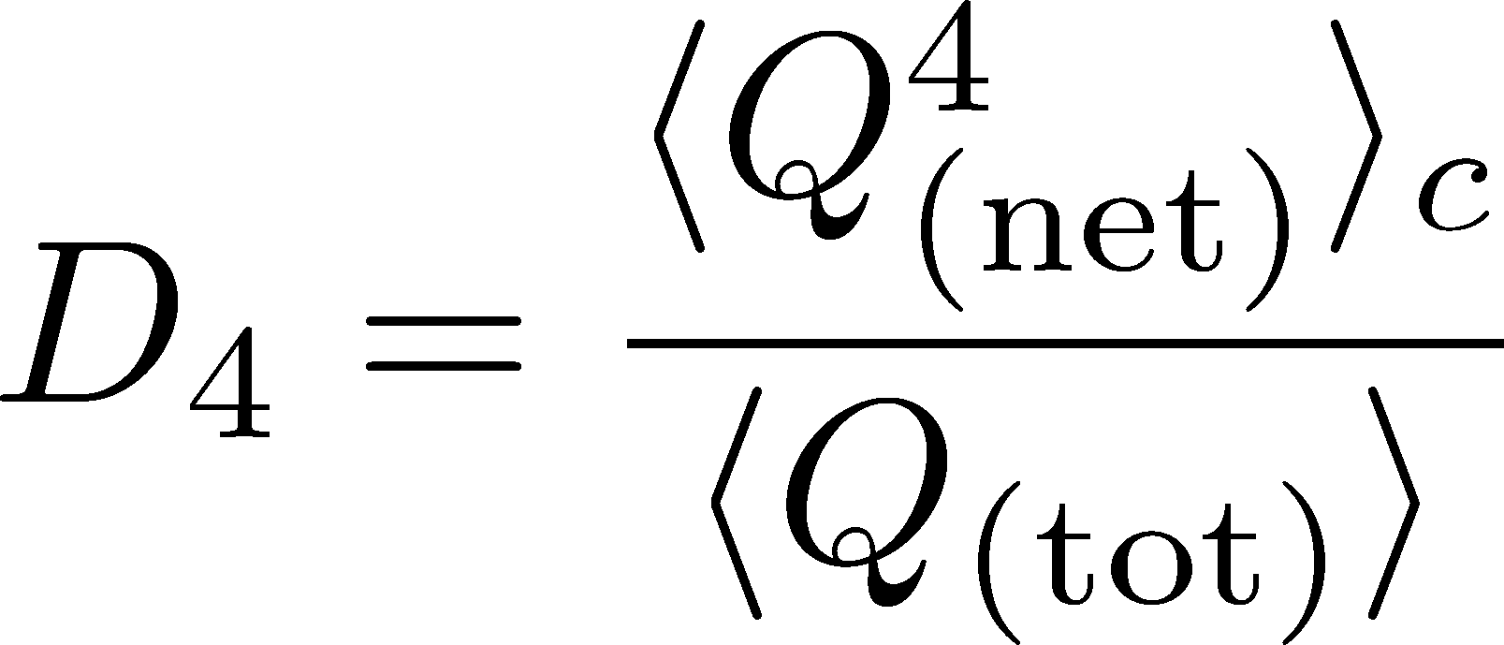

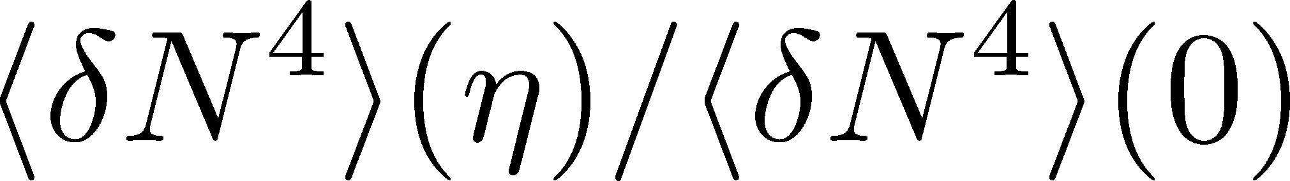

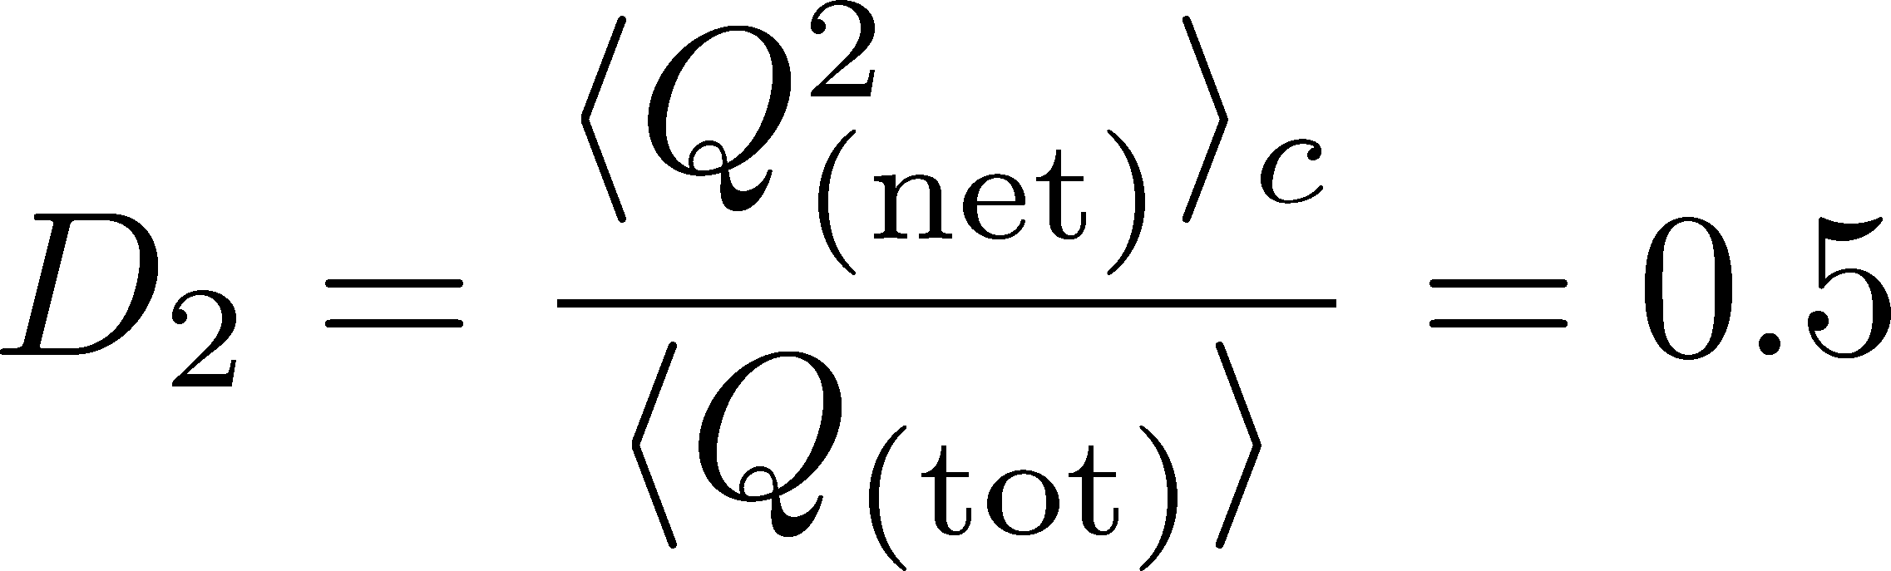
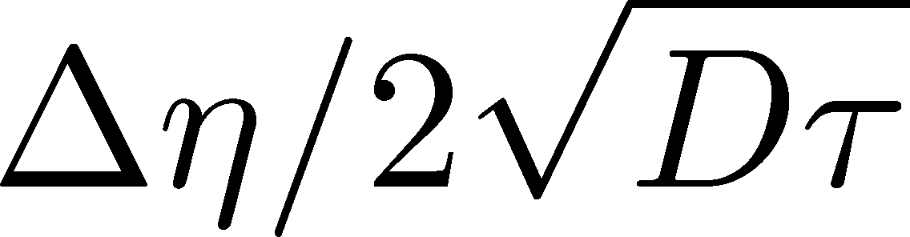
Δη Dependence: 4th order
MK, NPA (2015)
Initial Condition
Characteristic Δη dependences!

Slide 23
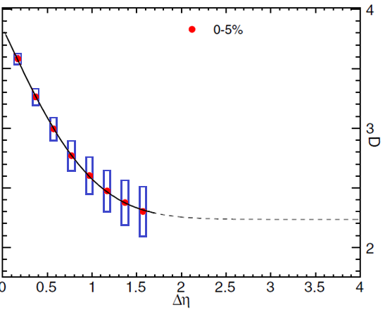


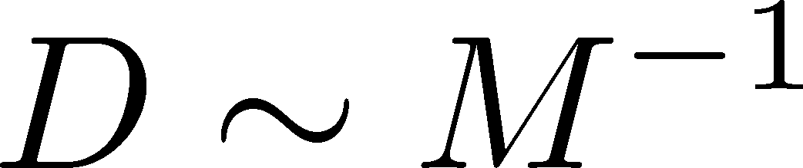
Δη Dependence: 4th order
MK, NPA (2015)
Initial Condition
baryon #
at ALICE
at ALICE

Slide 24
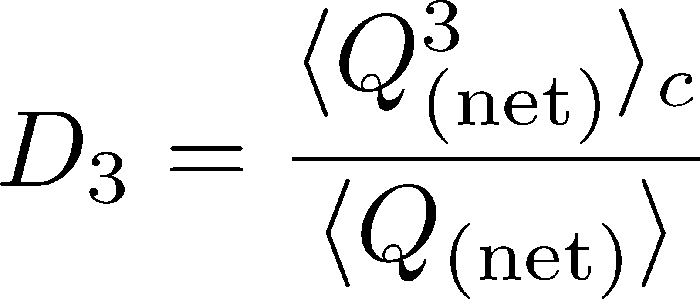
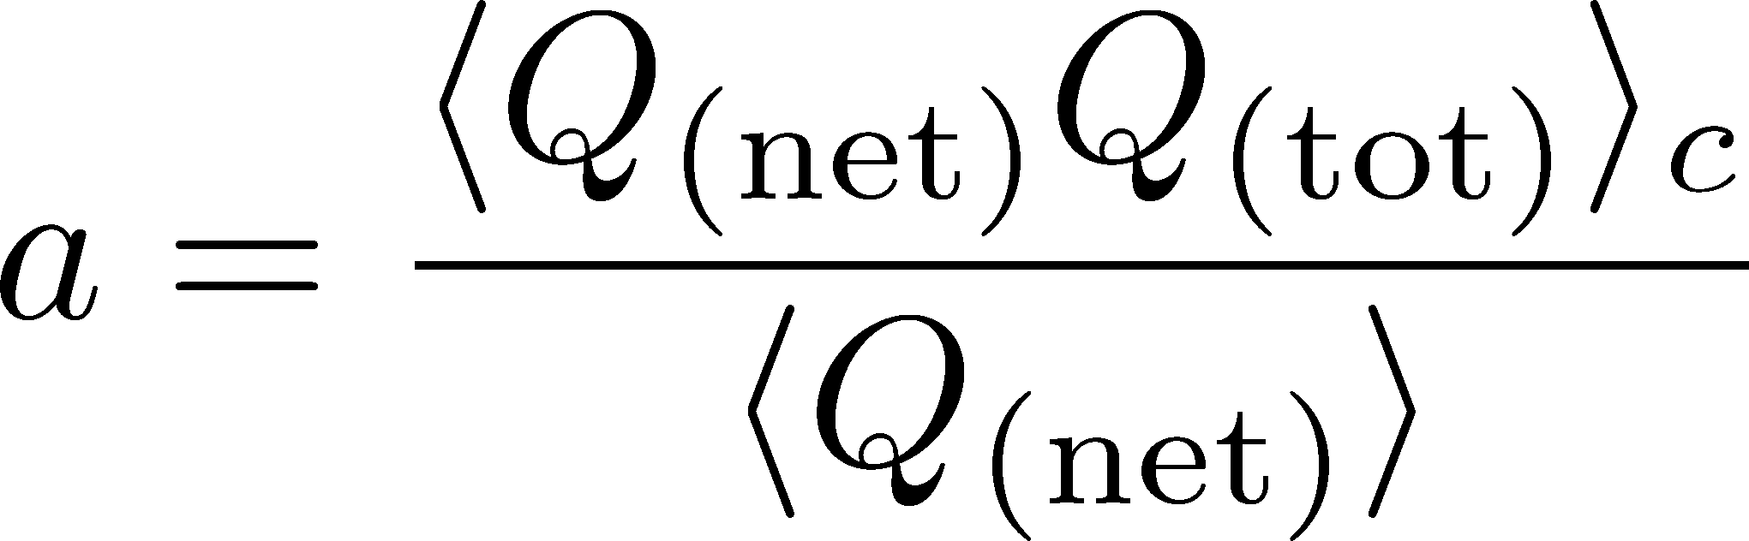
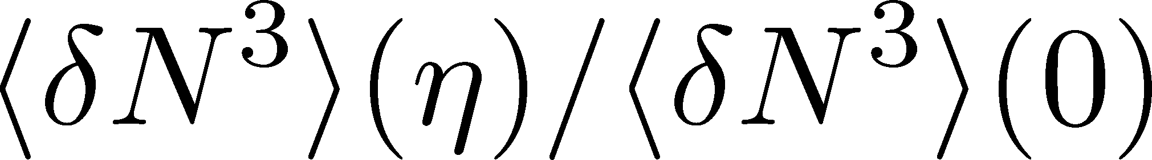
Δη Dependence: 3rd order
MK, NPA (2015)
Initial Condition
baryon #
at ALICE
at ALICE

Slide 25
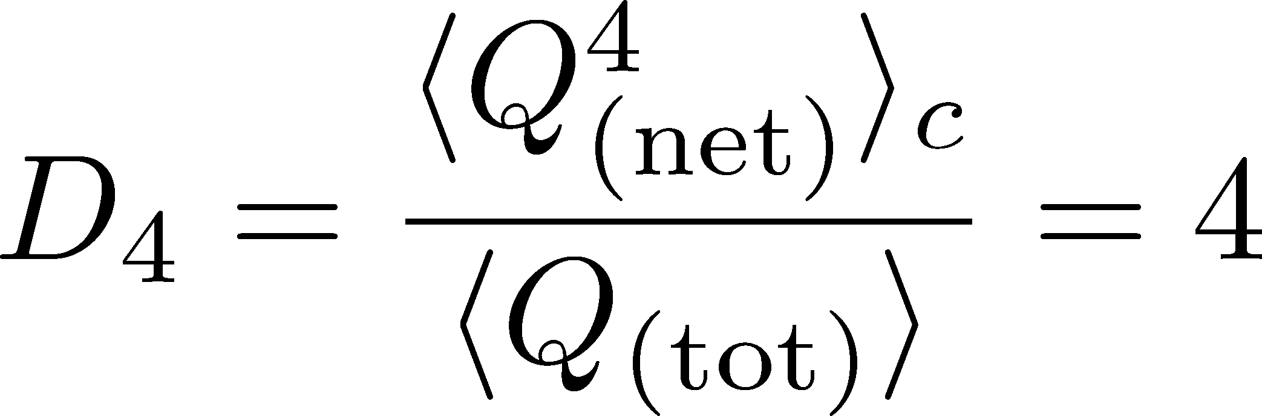
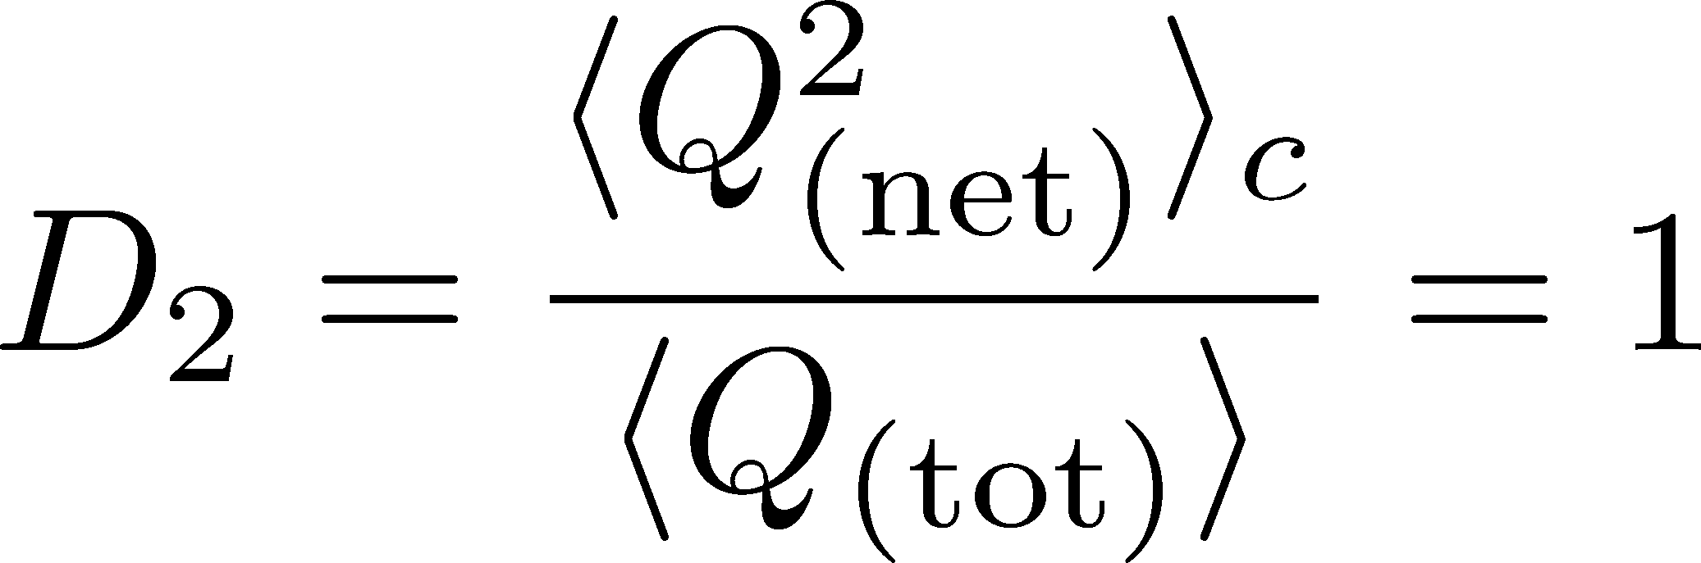
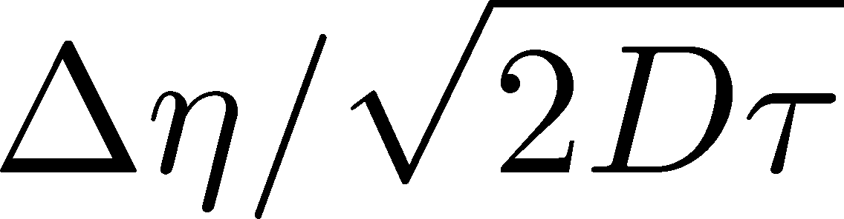
4th order : Large Initial Fluc.
MK, NPA (2015)
Initial Condition
baryon #
at ALICE
at ALICE

Slide 26
Δη Dependence @ STAR
from X. Luo, CPOD2014
MK, 2015
Non-monotonic dependence on Δη ?

Slide 27
Summary
Plenty of information in Δη and centrality
dependences of various cumulants
and those of non-conserved charges, mixed cumulants…
With Δη dep. we can explore
primordial thermodynamics
non-thermal and transport property
effect of thermal blurring

Slide 28
Future Studies
Experimental side:
rapidity window dependences
baryon number cumulants
consistency between RHIC and LHC
Theoretical side:
rapidity window dependences in dynamical models
description of non-equilibrium non-Gaussianity
accurate measurements on the lattice
Both sides:
Compare theory and experiment carefully
Do not use a fixed Δη cumulant for comparison!!!

Slide 29
Very Low Energy Collisions
Large contribution of global charge conservation
Violation of Bjorken scaling
detector
Fluctuations at low √s should be interpreted carefully!
Comparison with statistical mechanics would not make sense…

Slide 30


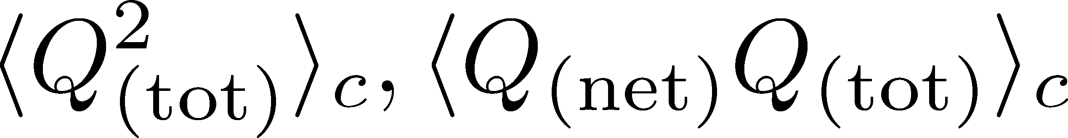
Initial Condition @ Hadronization
Hadronization (initial condition)
Boost invariance / infinitely long system
Local equilibration / local correlation
suppression owing to
local charge conservation
strongly dependent on
hadronization mechanism

Slide 31

Thermal distribution in η space
Y. Ohnishi+
in preparation
nucleon
pions
nucleons
pion
Blast wave squeezes the
distribution in rapidity space
blast wave
flat freezeout surface

Slide 32
Time Evolution of Fluctuations

Slide 33
Time Evolution of Fluctuations
detector
Particle # in Δη
freezeout
continues to change until kinetic freezeout due to diffusion.
hadronic
QGP
changes due to a conversion y → η at kinetic freezeout
“Thermal Blurring”

