Slide 1
QCD Thermodynamics from Gradient Flow
Masakiyo Kitazawa
for FlowQCD Collaboration
(Asakawa, Hatsuda, Iritani, Itou, MK, Suzuki)
XQCD2015, 2015/Sep./22, Wuhan, China

Slide 2
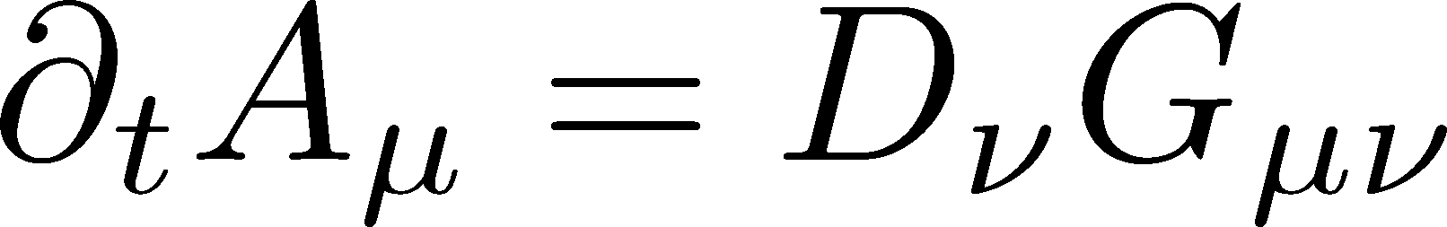
Yang-Mills Gradient Flow
A new flow in lattice community (2010~)

Slide 3
Applications of Gradient Flow
Lattice spacing / reference scales
Energy-momentum tensor
  thermodynamics
  correlation functions
Topology
Running coupling
and etc…
topics
coverted by
this talk

Slide 4
Yang-Mills Gradient Flow

Slide 5
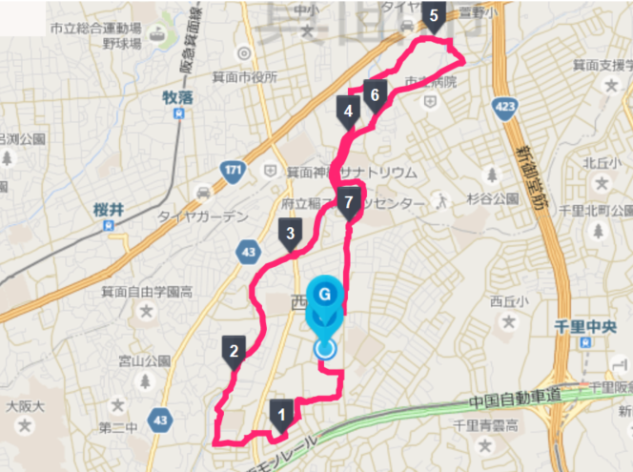
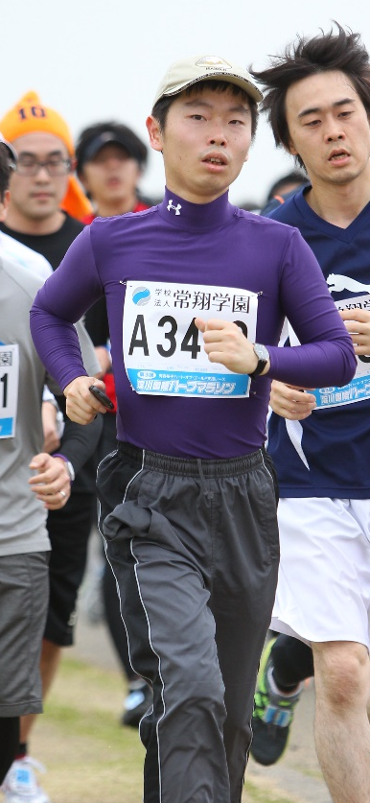
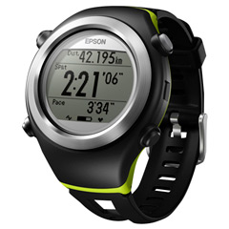
Gradient Flow and Jogging

Slide 6
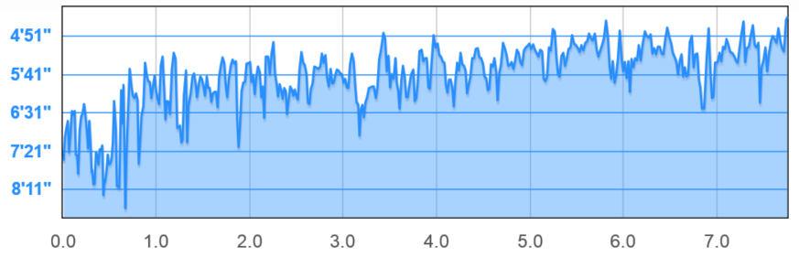
Gradient Flow and Jogging
original data

Slide 7
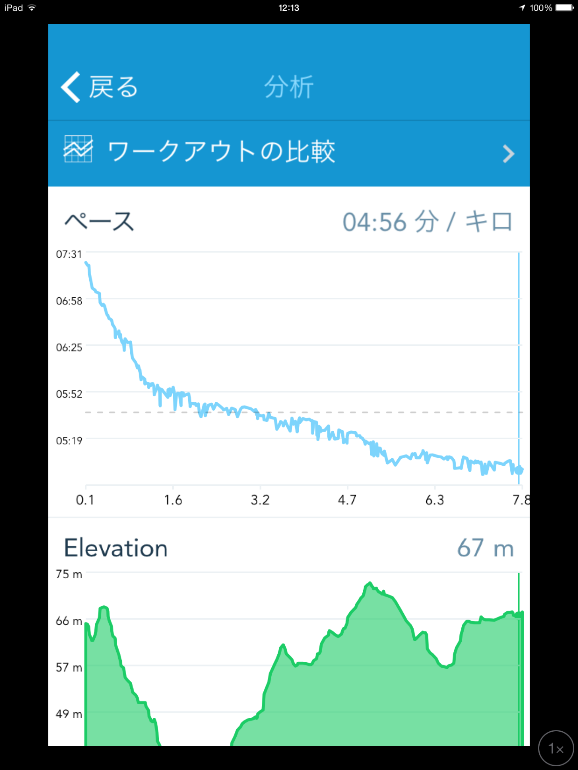

Gradient Flow and Jogging
original data
RunKeeper

Slide 8


Slide 9
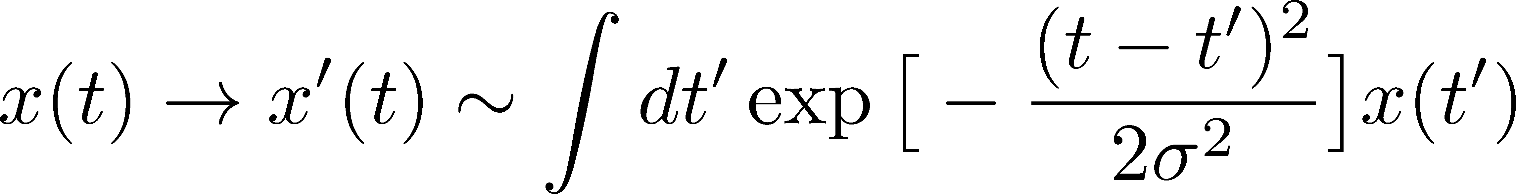
Gaussian
①

Slide 10
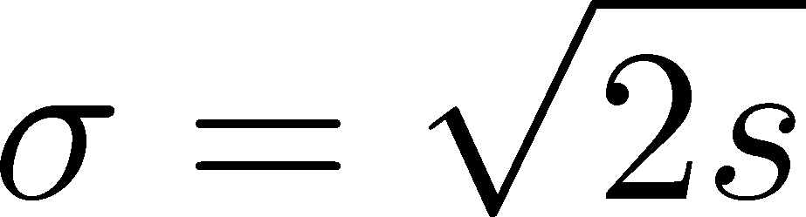
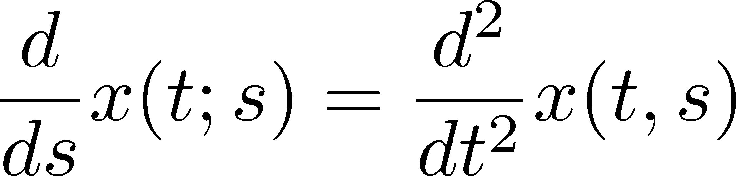
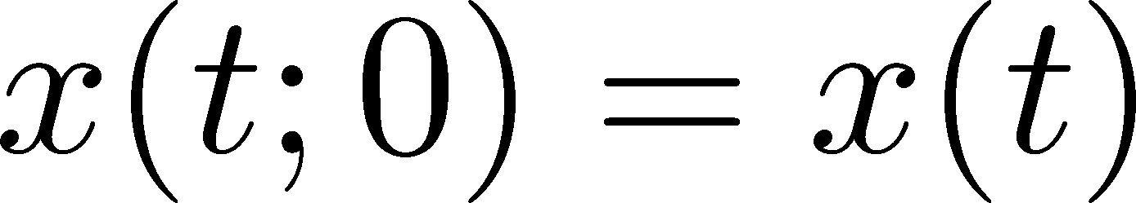
Gaussian
①
②

Slide 11
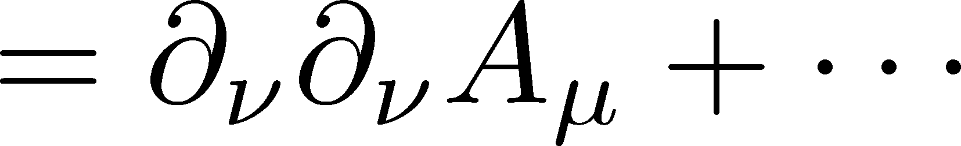
Gaussian
①
②
YM Gradient Flow
Gauge invariant version of 4-dim. diffusion equation

Slide 12
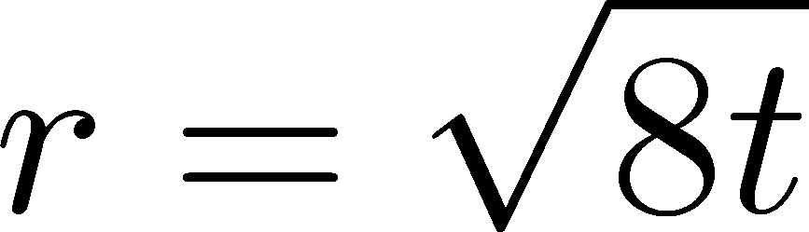
YM Gradient Flow
= Continuous smoothing transformation of gauge field
t: “flow time” dim: [E⁻²]
smearing length
Remarks:
All observables are UV finite at t>0. Luscher, Weiss, 2011
Smoothed field is no longer the original gauge field!

Slide 13
Applications of Gradient Flow
Lattice spacing / reference scales
Energy-momentum tensor
  thermodynamics
  correlation functions
Topology
Running coupling
and etc…

Slide 14
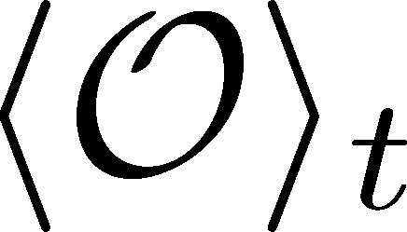
Observables at Nonzero Flow Time
function of t
independent of renormalization
Luescher, Weisz, 2011
independent of lattice spacing
(up to O(a²) corrections)
The t dep. can be used for the scale setting of the lattice.

Slide 15
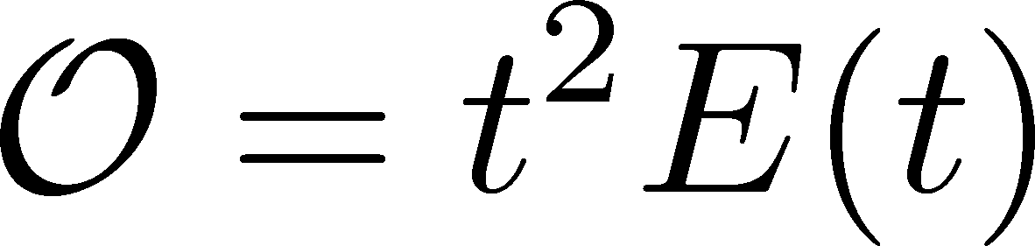
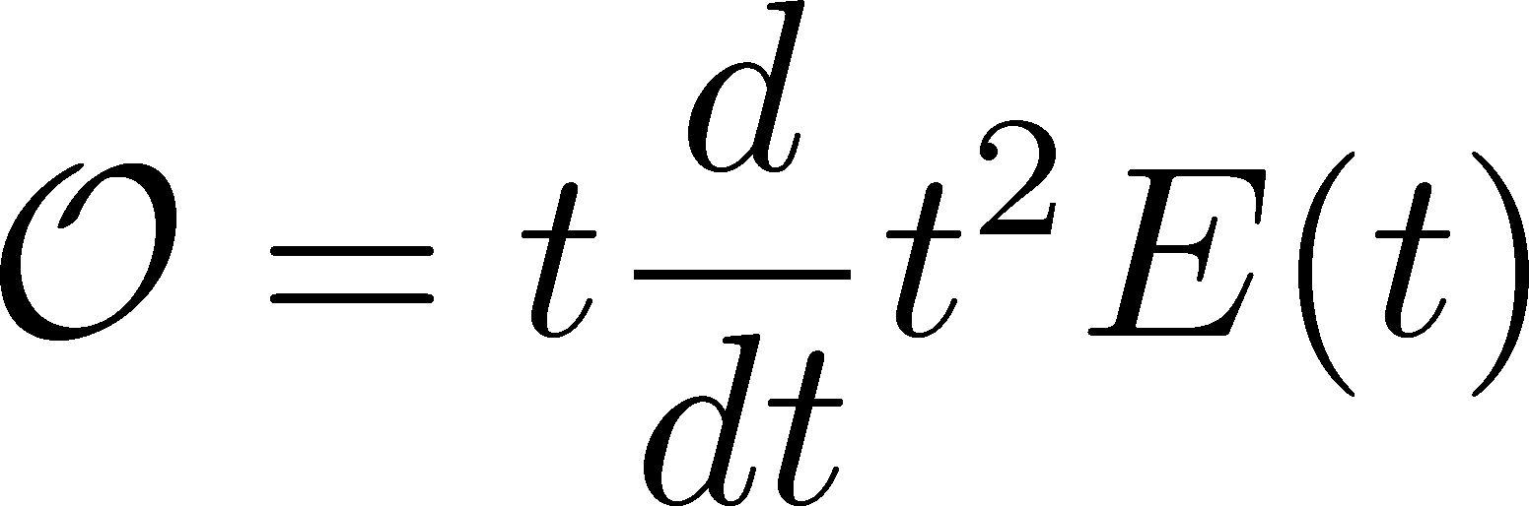
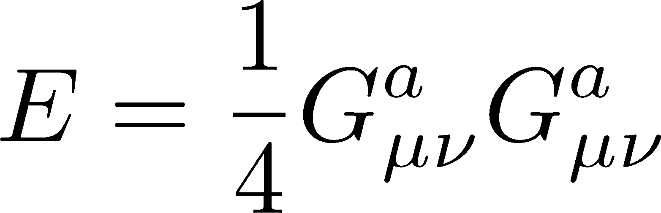
Observables at Nonzero Flow Time
function of t
independent of renormalization
Choice 1:
Choice 2:
Luescher, 2010
Budapest-Wuppertal, 2012
discretization effect suppressed

Slide 16
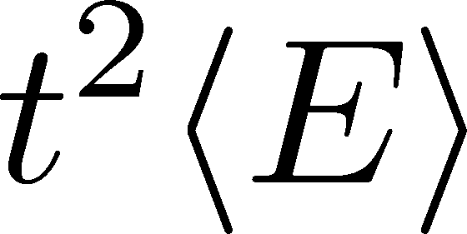

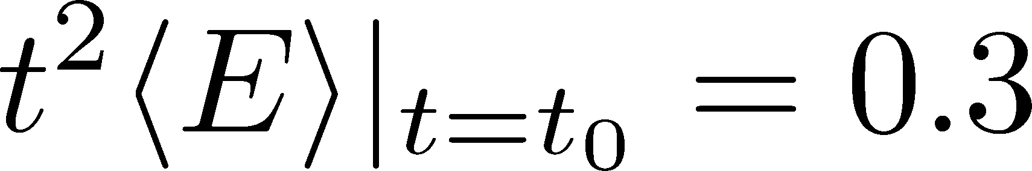
Behavior of t²<E>

Slide 17
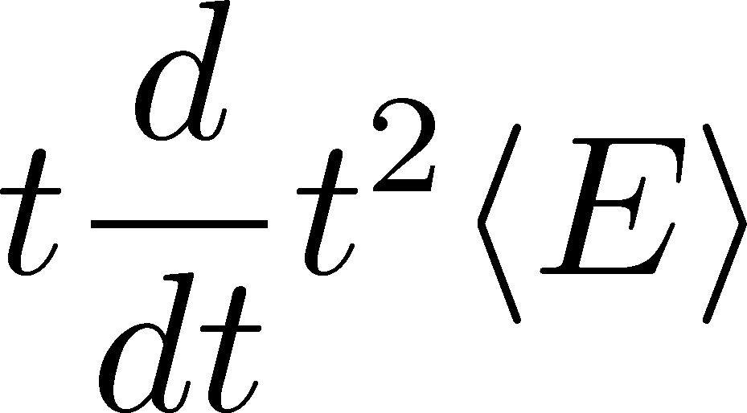
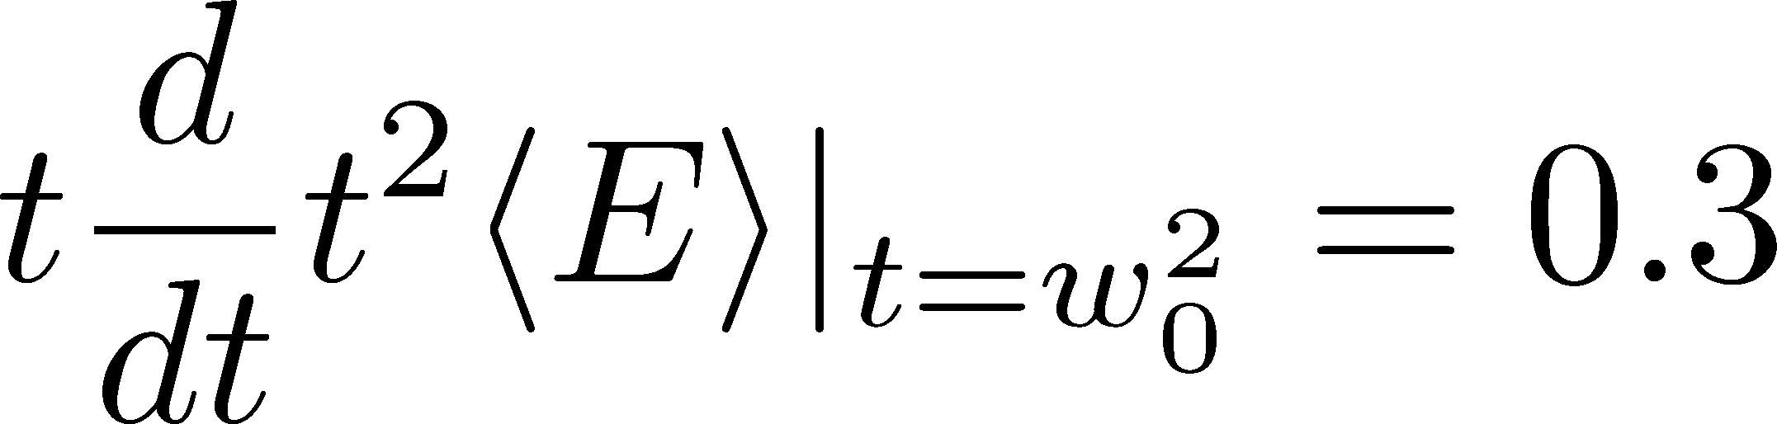

Behavior of t²<E>
Less statistical errors
No fit analyses
No measurement of non-local obs.
Advangates:

Slide 18
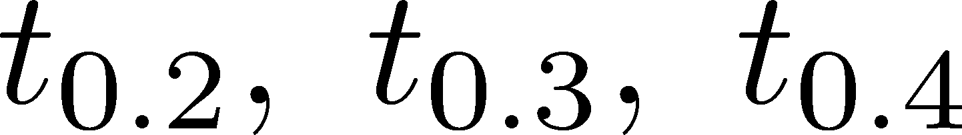
Behavior of t²<E>
Our Choice
value in rhs is arbitrary

Slide 19










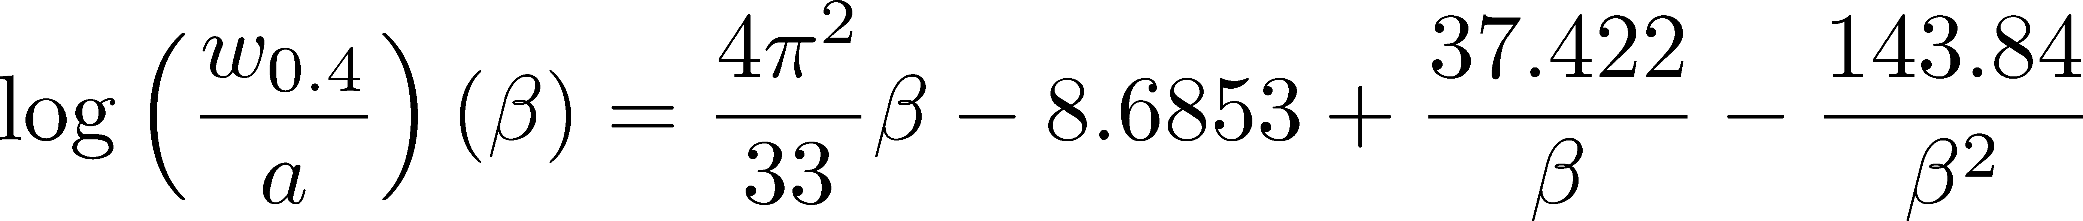
Lattice Spacing of SU(3) Wilson Action
Edwards+ (1998)
Alpha Collab. (1998)
Necco, Sommer (2002)
This Study:
T=2Tc
our parametrization for a
stat. err. < 0.4% / sys. err. < 0.7%

Slide 20

Numerical Setting
SU(3) YM theory
Wilson gauge action
w_{0.4} / w_{0.2} scaling
b | size | N_{conf} | b | size | N_{conf}
6.3 | 64⁴ | 30 | 6.9 | 64⁴ | 30
6.4 | 64⁴ | 100 | 7.0 | 96⁴ | 60
6.5 | 64⁴ | 49 | 7.2 | 96⁴ | 53
6.6 | 64⁴ | 100 | 7.4 | 128⁴ | 40
6.7 | 64⁴ | 30 | 7.5 | 128⁴ | 60
6.8 | 64⁴ | 100
Each configuration is separated by 1000 updates (HB+OR⁵)
BlueGene/Q @ KEK

Slide 21


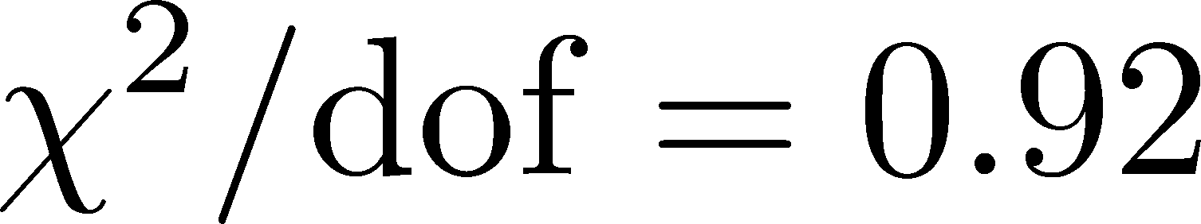
Parametrization with w_{0.4}
Use various fitting funcs
estimate sys. err.
For β=7.4 and 7.5, w_{0.4} is obtained from w_{0.2}.
3 parameter fit
stat. err. < 0.4% / sys. err. < 0.7%

Slide 22
Finite Volume Effects
No difference
in statistics
Spatial extent
used in this analysis
No finite volume effects
(Physical lattice length)/w_{0.2}
2% deviation
larger than stat. err.
No finite volume effects within statistics

Slide 23
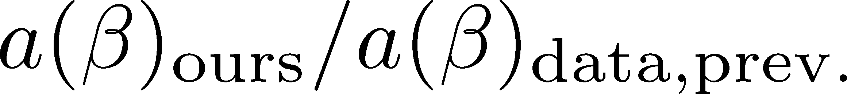
Comparison with Previous Studies
Edwards, Heller, Klassen, 1998
Alpha-Collaboration, 1998
Necco, Sommer, 2002
Durr, Fodor, Hoelbling, 2007
Necco, Sommer
error of w_{0.4}/r_{c}
our parametrization
by w_{0.4}
Recent study:
Francis+, arXiv:1503.05652
Agreements in available ranges.
Need the analysis of the topological freezing effect.

Slide 24
Applications of Gradient Flow
Lattice spacing / reference scales
Energy-momentum tensor
  thermodynamics
  correlation functions
Topology
Running coupling
and etc…

Slide 25
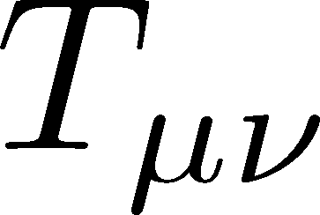

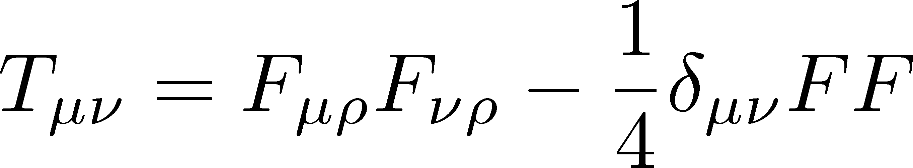
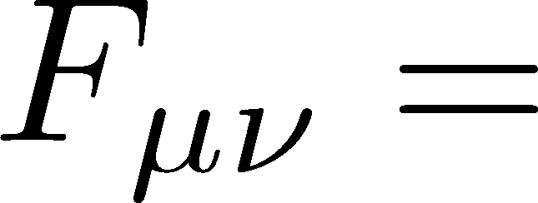
: nontrivial observable
on the lattice
Definition of the operator is nontrivial
because of the explicit breaking of Lorentz symmetry
ex:
Its measurement is extremely noisy
due to high dimensionality and etc.

Slide 26


If we have

Slide 27
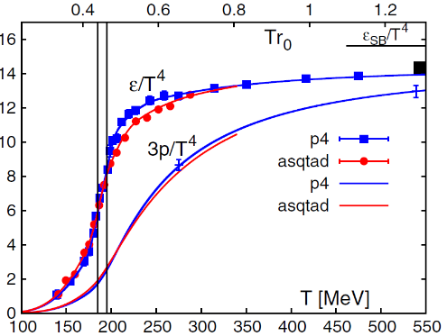

Thermodynamics
direct measurement of
expectation values
If we have

Slide 28
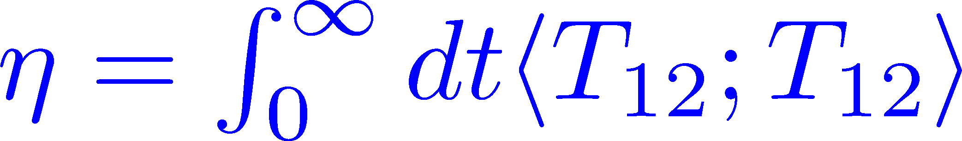
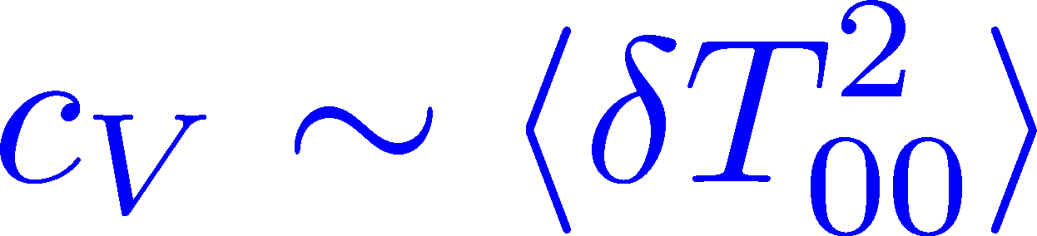
Thermodynamics
Fluctuations and
Correlations
direct measurement of
expectation values
viscosity, specific heat, ...
If we have

Slide 29
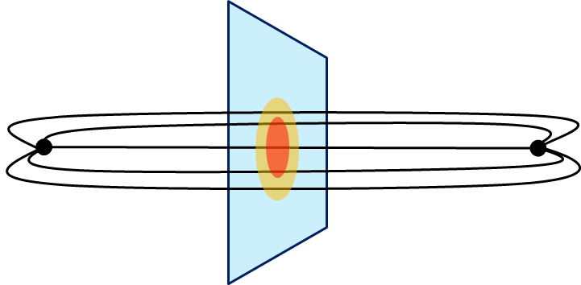
Thermodynamics
Fluctuations and
Correlations
direct measurement of
expectation values
viscosity, specific heat, ...
If we have
confinement flux tube
EM distribution in hadrons
vacuum configuration
mixed state on 1st transition
Hadron Structure
Vacuum Structure

Slide 30
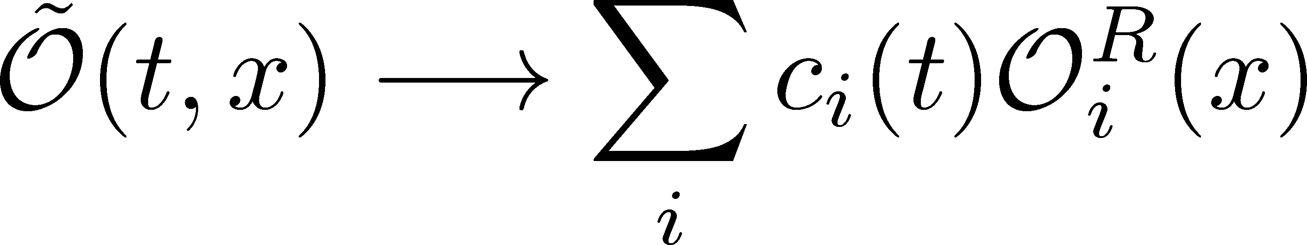
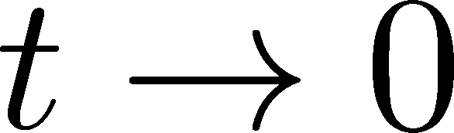
Small Flow-time Expansion
Luescher, Weisz, 2011
Suzuki, 2013
An operator
in blurred world
Renormalized operators
in original theory
less noisy, continuous
noisy, lattice discretized

Slide 31
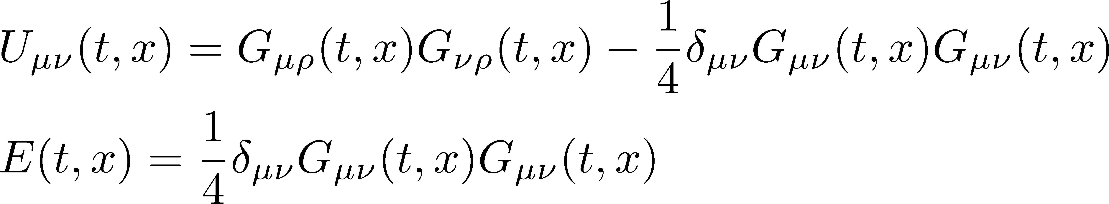

SFTE of Energy-Momentum Tensor
Suzuki, 2013
gauge-invariant dimension 4 operators

Slide 32
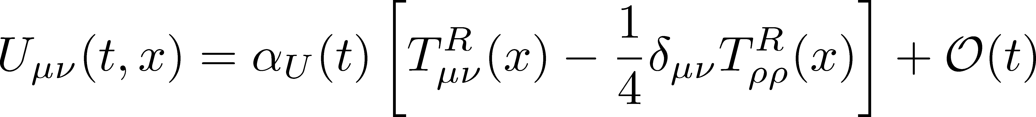
SFTE of Energy-Momentum Tensor
Suzuki, 2013
gauge-invariant dimension 4 operators

Slide 33
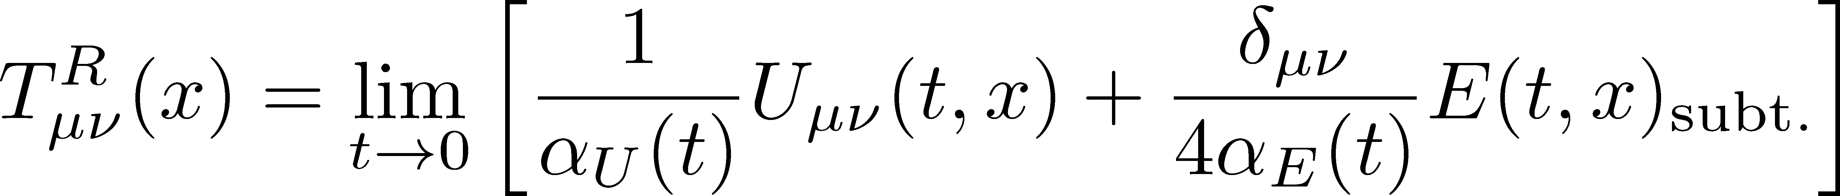
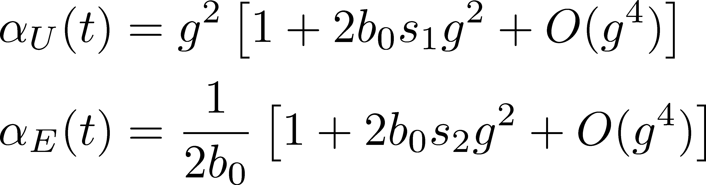
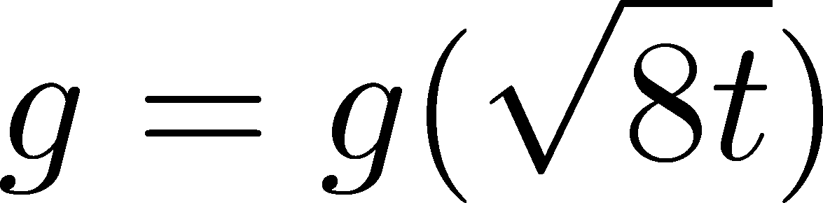
SFTE of Energy-Momentum Tensor
Suzuki, 2013
gauge-invariant dimension 4 operators
Remormalized EMT
Suzuki coeffs.

Slide 34
Thermodynamics
Fluctuations and
Correlations
direct measurement of
expectation values
viscosity, specific heat, ...
If we have
confinement string
EM distribution in hadrons
vacuum configuration
mixed state on 1st transition
Hadron Structure
Vacuum Structure

Slide 35
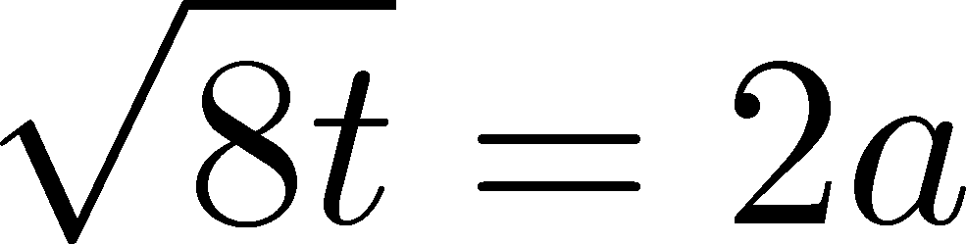
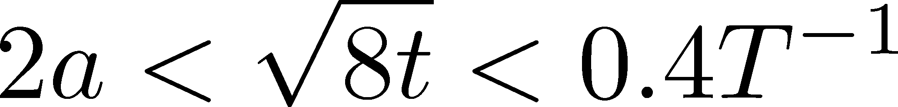
SU(3) Thermodynamics with Nt=6, 8, 10
FlowQCD, PRD90,011501 (2014)
Entropy density T=1.65Tc
Nt=6,8,10
~300confs.
Stable region for

Slide 36
An Erratum: Error in Suzuki Coefficients
FlowQCD, PRD90,011501 (2014)
Modified (in erratum)

Slide 37
Simulation on Fine Lattices: Nt = 12 - 32
Simulation for T=1.66Tc
for (e-3p)/T⁴
for (e+p)/T⁴
Nt | beta | N_{conf}(T>0/vac)
12 | 6.719 | 2000/700
16 | 6.941 | 1680/830
20 | 7.117 | 2000/1020
Nt | Ns/Nt | beta | Nconf
12 | 5.33 | 6.719 | 2k
16 | 16 | 6.941 | 20k
20 | 9.6 | 7.117 | 22k
24 | 8 | 7.265 | 20k
32 | 6 | 7.500 | 18k
5.33<Ns/Nt<6.4
need vacuum simulation
no vacuum simulation required
FlowQCD, in prep.

Slide 38
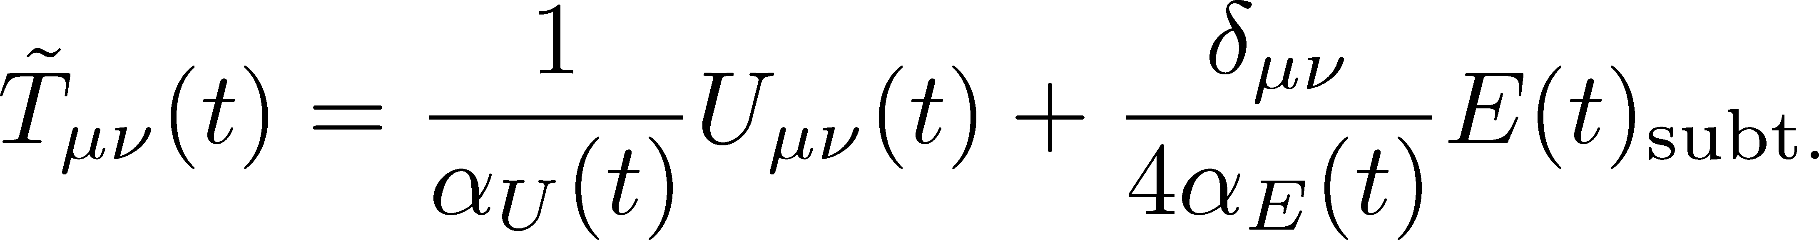
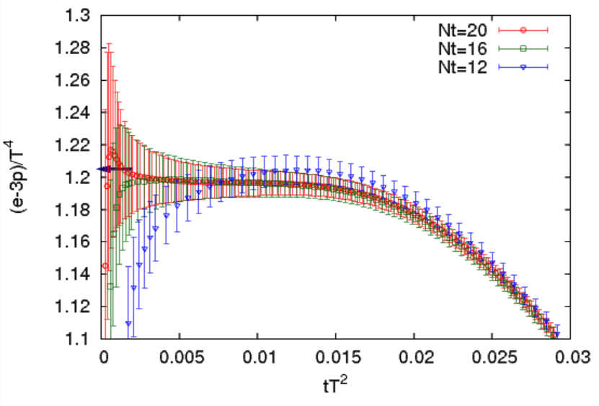
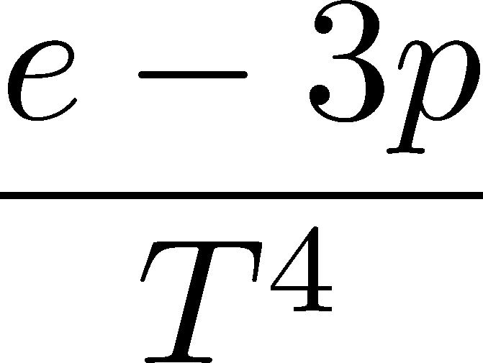
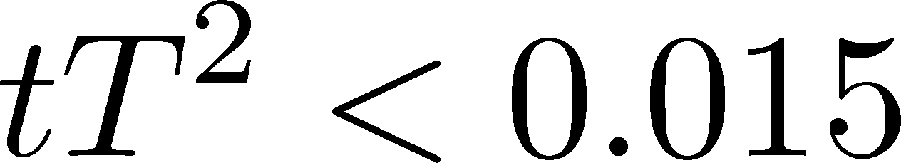
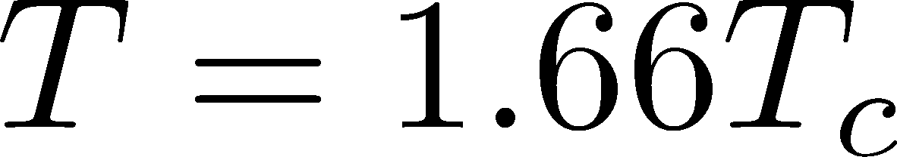
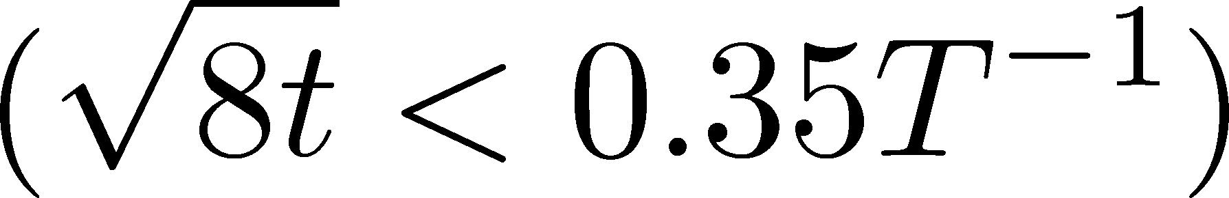
New Results: Thermodynamics (e-3p)
FlowQCD, in prep.
Good agreement with previous study
Stable plateau for
preliminary
BW12
BW12:Budapest-Wuppertal, 2012

Slide 39
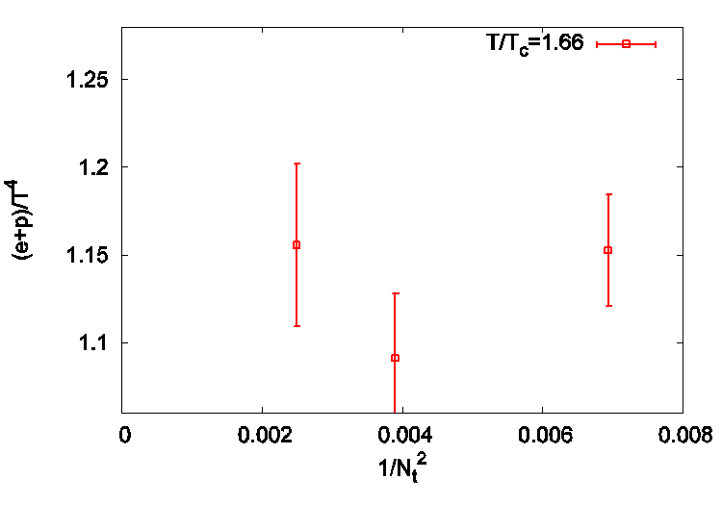
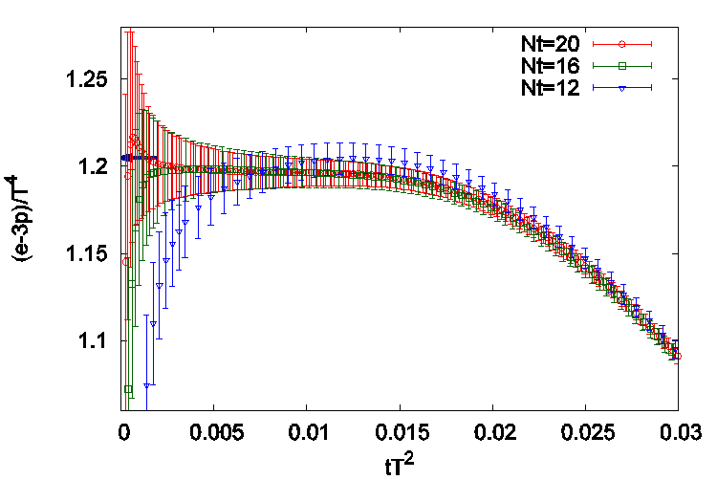
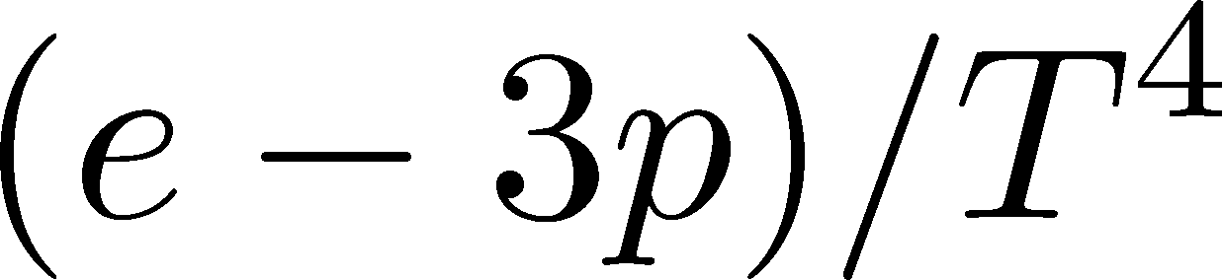
v.s. Conventional Methods (e-3p, 1.66Tc)
Differential method
(beta func.: FlowQCD, 2015)
Gradient flow method
BW12
Nt=20
12
16
A consistent result for two methods
Smaller error in gradient flow method

Slide 40
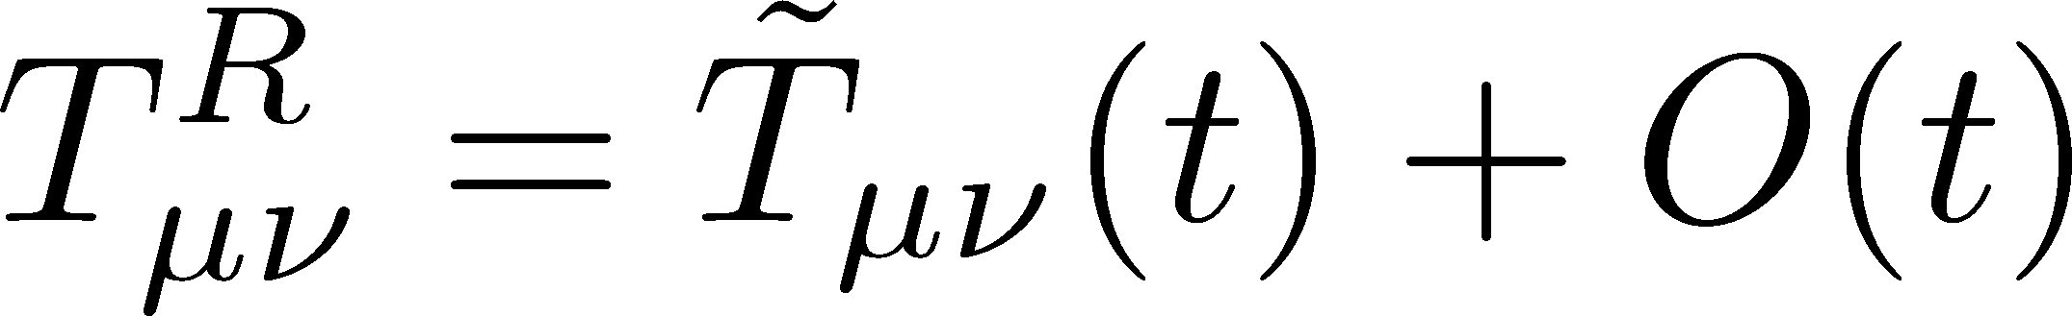


New Results: Thermodynamics (e+p)
FlowQCD, in prep.
BW12
Existence of O(t) effect
Linear behavior for
preliminary
Double limit (a→0, t→0) has to be taken.
BW12:Budapest-Wuppertal, 2012

Slide 41
New Results: Thermodynamics (e+p)
FlowQCD, in prep.
BW12
Existence of O(t) effect
Linear behavior for
preliminary
Double limit (a→0, t→0) has to be taken.
BW12:Budapest-Wuppertal, 2012

Slide 42


v.s. Differential Method (e+p)
Differential method
(Karsch coeffs.: Karsch+, 2000)
Gradient flow method
32
20
16
12
Nt=24
A consistent result for two methods
  deviation may be attributed to c_{σ}
Smaller error in gradient flow method
  the advantage become more prominent on finer lattices

Slide 43
Thermodynamics
Fluctuations and
Correlations
direct measurement of
expectation values
viscosity, specific heat, ...
If we have
confinement string
EM distribution in hadrons
vacuum configuration
mixed state on 1st transition
Hadron Structure
Vacuum Structure

Slide 44


EMT Correlator
Kubo Formula: T₁₂ correlator ←→shear viscosity
Hydrodynamics describes long range behavior of T_{μν}
Energy fluctuation ←→specific heat

Slide 45



EMT Correlator : Extremely Noisy…
With naïve EMT operators
Nakamura, Sakai, PRL,2005
N_{t}=8
improved action
~10⁶ configurations
Nt=16
standard action
50k configurations
… no signal

Slide 46




Correlation Functions
T=1.66Tc
96³x24
50k confs
Smeared

Slide 47
Correlation Functions
T=1.66Tc
96³x24
50k confs
Smeared

Slide 48

Correlation Functions
expand
T=1.66Tc
96³x24
50k confs
Smeared

Slide 49
Energy Correlation Function
T=1.66Tc
96³x24
50k confs
τ independent const.
→ energy conservation

Slide 50


Energy Correlation Function
T=1.66Tc
96³x24
50k confs
τ independent const.
→ energy conservation
specific heat
→ Novel approach to
measure specific heat!
Gavai, Gupta, Mukherjee, 2005
differential method / cont lim.

Slide 51
Gradient Flow for Full QCD
Lattice spacing / reference scales
Energy-momentum tensor
  thermodynamics
  correlation functions
Topology
Running coupling

Slide 52
Gradient Flow for Full QCD
only with gradient flow for gauge field
Possible
(BMW,2012)
Lattice spacing / reference scales
Energy-momentum tensor
  thermodynamics
  correlation functions
Topology
Running coupling
Possible
Possible

Slide 53
Gradient Flow for Full QCD
only with gradient flow for gauge field
Possible
(BMW,2012)
Lattice spacing / reference scales
Energy-momentum tensor
  thermodynamics
  correlation functions
Topology
Running coupling
Gradient flow for
fermion field is needed
as well as SFTE
Possible
Possible

Slide 54



Gradient Flow for Fermion Field
Luscher, 2013
A choice

Slide 55

Gradient Flow for Fermion Field
Luscher, 2013
A choice
Fermion propagator
K: “fundamental solution”
S: propagator at t=0
Study of chiral condensate Luscher, 2013
Application to QCD thermodynamics: just started
by FlowQCD + WHOT QCD = FloWHOT Collaboration

Slide 56
Summary
YM Gradient Flow
A smoothing transformation of gauge field
Many applications: scale setting, thermodynamics, …
Many future studies
EMT correlation functions → transport coefficients, etc.
Topological property of gauge theory
Flow for fermion field → Full QCD thermodynamics

Slide 57
Backup

Slide 58
Various Reference Scales
plaq.
clover

