Slide 1



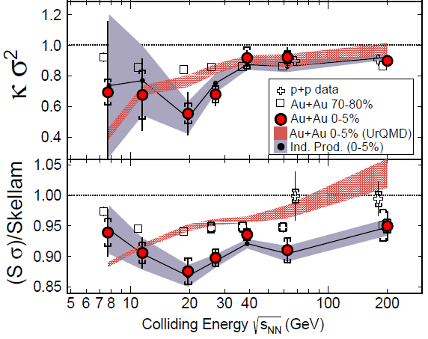

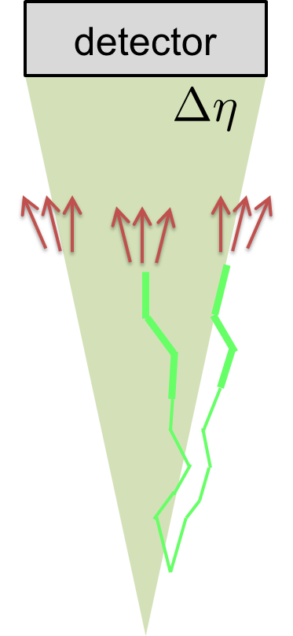
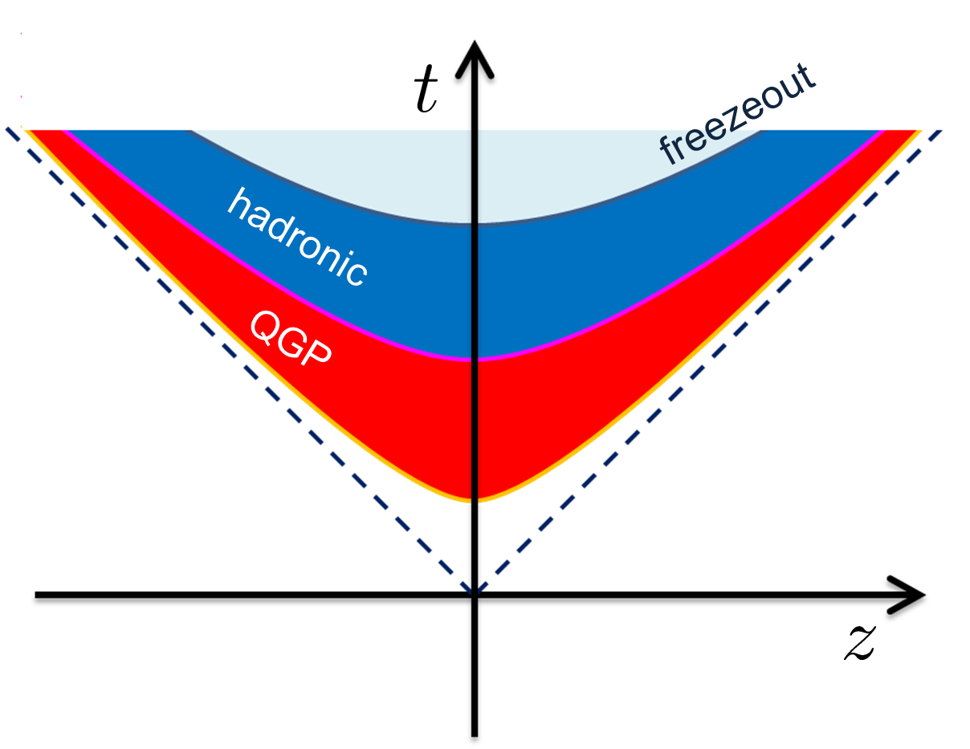
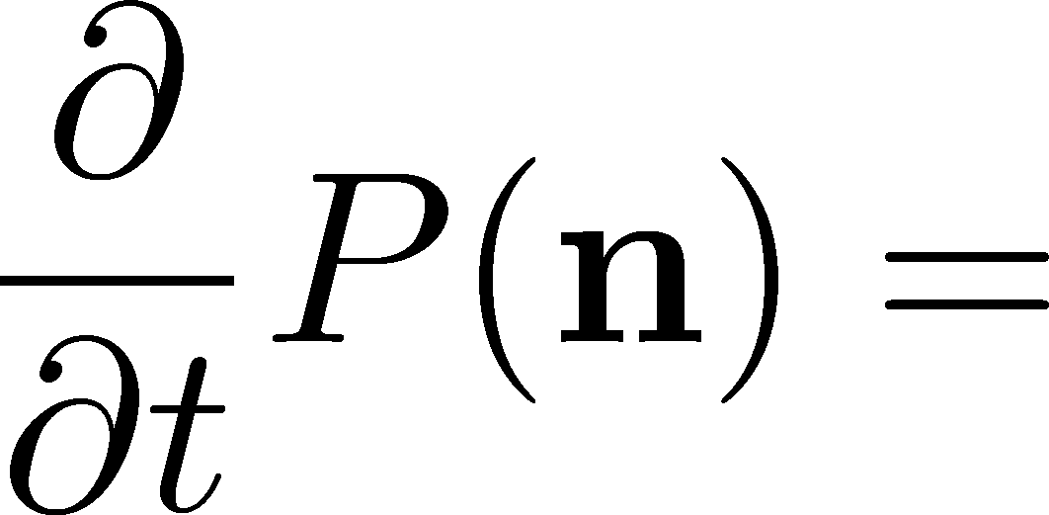
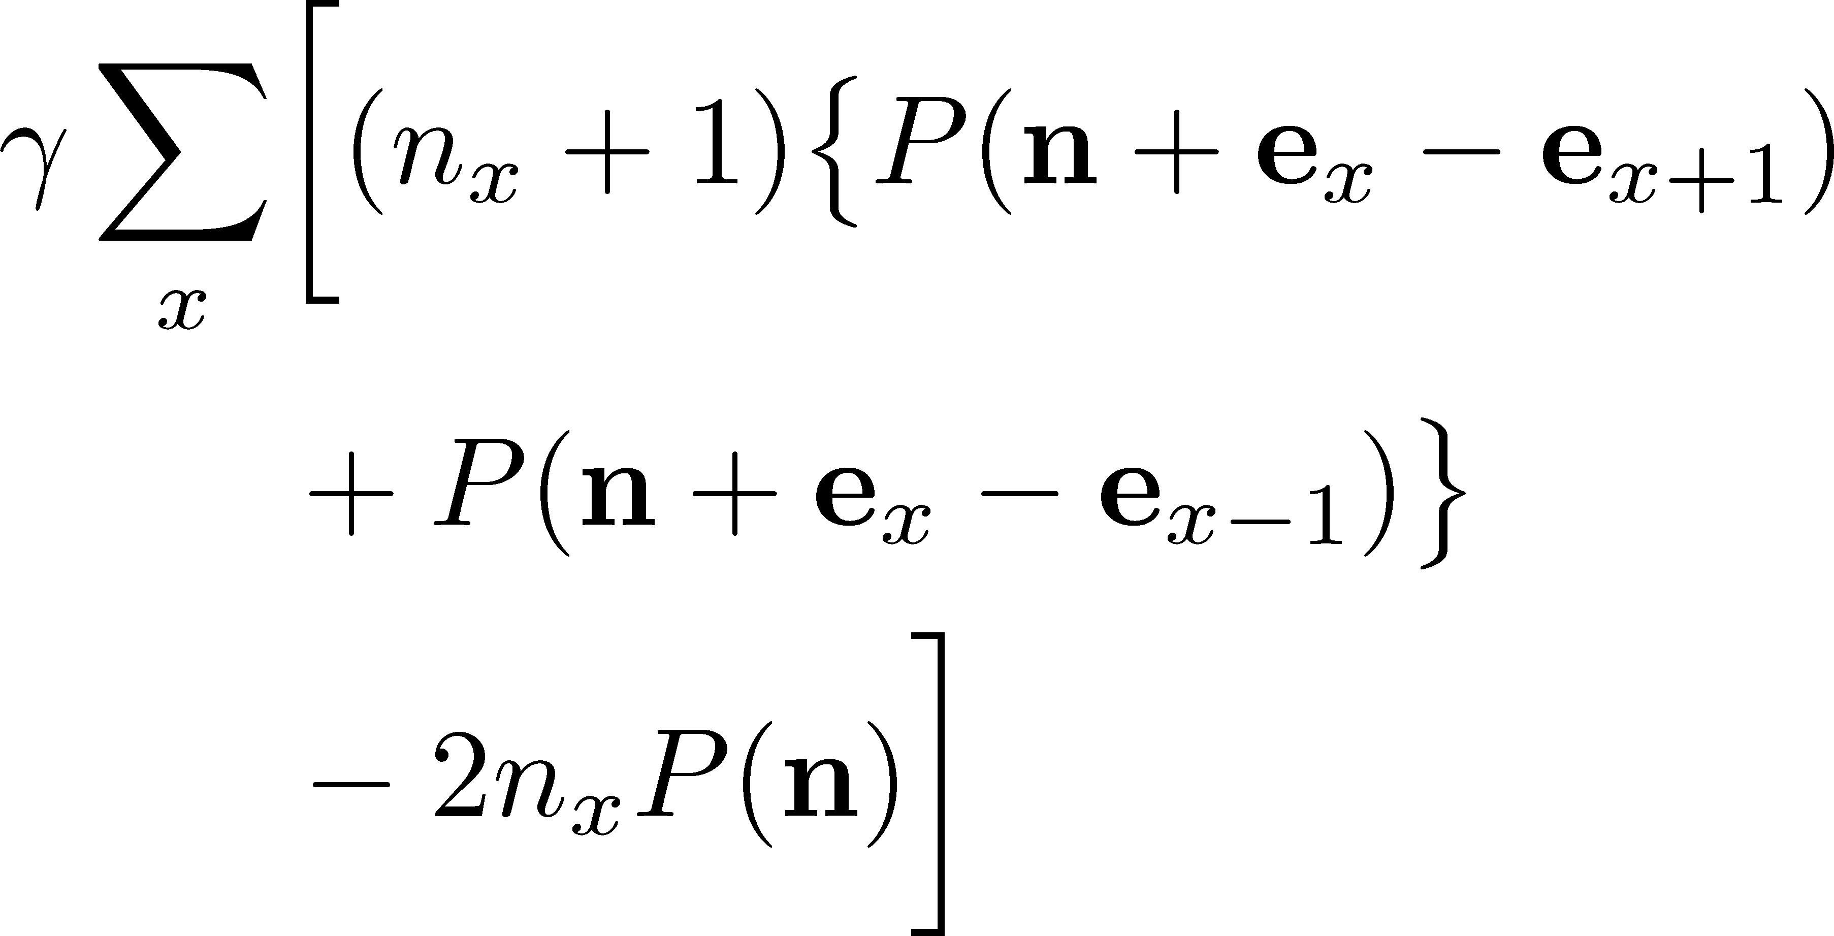
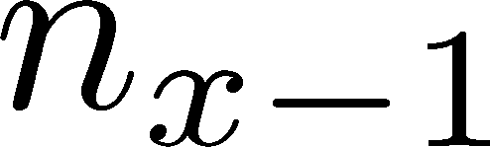



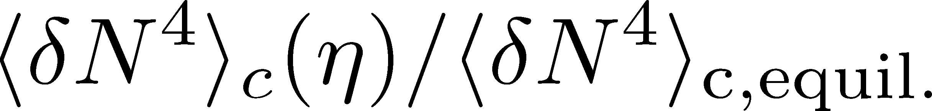
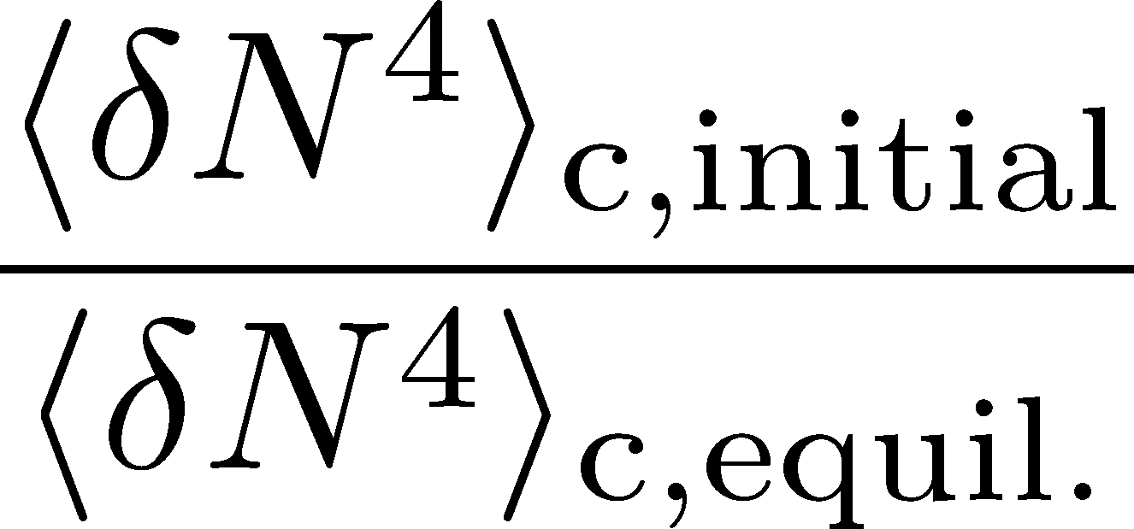


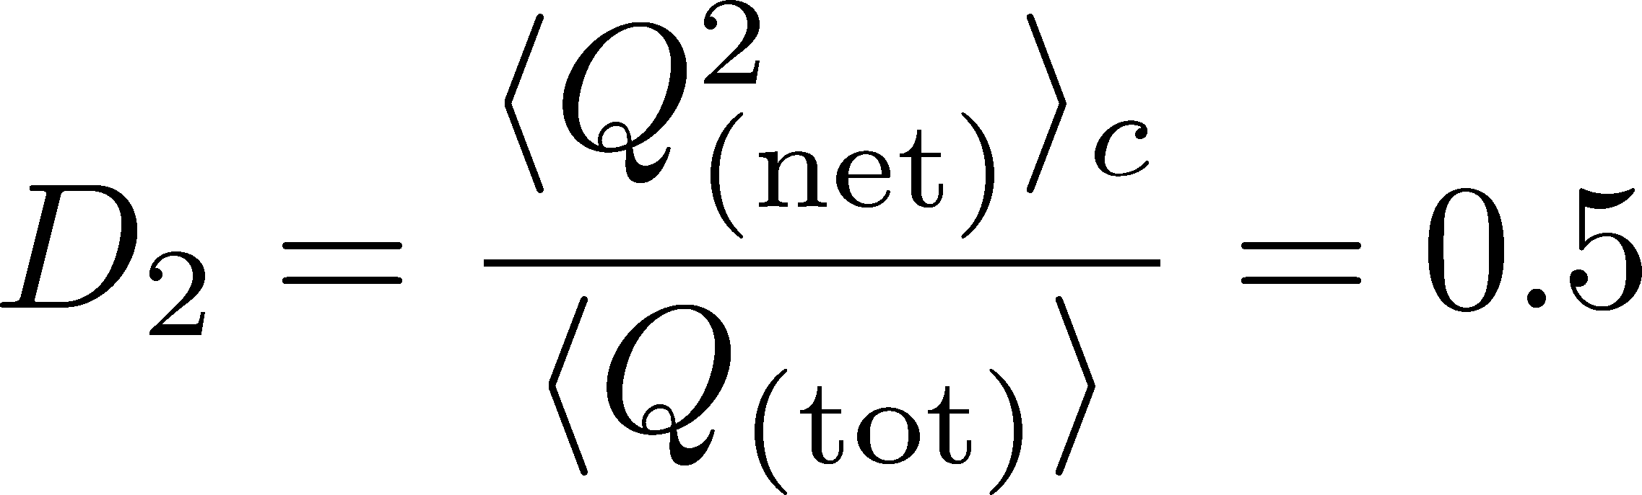
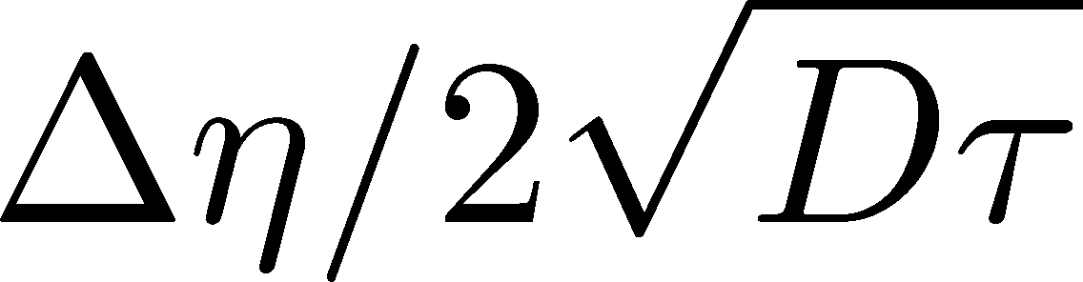
Join me here!!
Rapidity window dependences of
higher order cumulants of
conserved charges
Masakiyo Kitazawa (Osaka Univ.) with Masayuki Asakawa, Yutaro Ohnishi, Miki Sakaida
Background
Refs.: MK, Asakawa, Ono, PLB728, 386 (2014)
Sakaida, Asakawa, MK, PRC90, 064911(2014)
MK, NPA942, 65 (2015); Talk by Asakawa, Monday
Active experimental analysis of fluctuation observables,
especially their non-Gaussianity
STAR, PRL, 2014
Q0
Are these fluctuations the equilibrium one
generated at some time during time evolution?
A0
NO! Fluctuations continue to change
until the medium arrives at the detector.
ALICE, PRL, 2013
Experimental results should be interpreted taking the non-equilibrium effects into account.
Q1
How to describe the non-eq. diffusive process of non-Gaussian cumulants?
Q2
How to verify this
picture experimentally?
A1: Model
Diffusion master equation
(Brownian particles’ model)
NOTE: This model can describe the approach of non-Gaussian
fluctuations toward the equilibrated hadronic value.
Langevin-type eqs.
Non-Gaussianity vanishes in equil.
Result
Rapidity window dep. of 4th-order cumulant
in the final state for various initial conditions
ALICE/STAR
coverage
A2: Conclusion
initial values
Measure the rapidity-window dependences of various cumulants in experiments!
→transport and thermodynamic properties
Do NOT compare experimental results directly with theory assuming equilibrium!
→Take Δη→large limit for comparison!
Cumulant at a Δη differs from their initial values.
Experiments can distinguish different lines in the Fig.

