Slide 1
Diffusion of Conserved-Charge
Fluctuations
Masakiyo Kitazawa
(Osaka U.)
MK, Asakawa, Ono, Phys. Lett. B728, 386-392 (2014)
Sakaida, Asakawa, MK, PRC90, 064911 (2014)
MK, arXiv:1505.04349, Nucl. Phys. A942, 65 (2015)
Workshop on Fluctuation, GSI, 4/Nov./2015

Slide 2


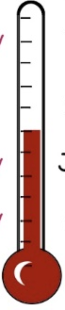

Objective 1: Δη Dependence @ ALICE
ALICE
PRL 2013
Δη dependent
thermometer?
large
small
rapidity window

Slide 3

Objective 2
Theories
on the basis of statistical mechanics
fluctuation in a spatial volume
equilibration (in an early time)
What are their relation?
Experiments
final state fluctuation
fluctuation in a pseudo rapidity
Detector

Slide 4

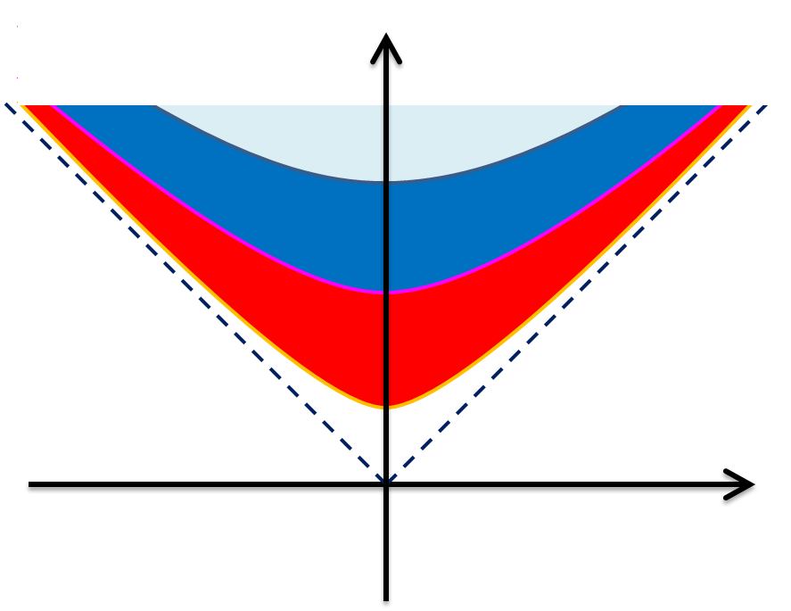



Time Evolution of Fluctuations
Diffusion modifies distribution

Slide 5
Time Evolution of Fluctuations
Detector
(momentum-space)
rapidity
conversion η→y at kinetic f.o.
“Thermal Bluriing” modifies distribution

Slide 6

revisiting
Slot Machine Analogy

Slide 7
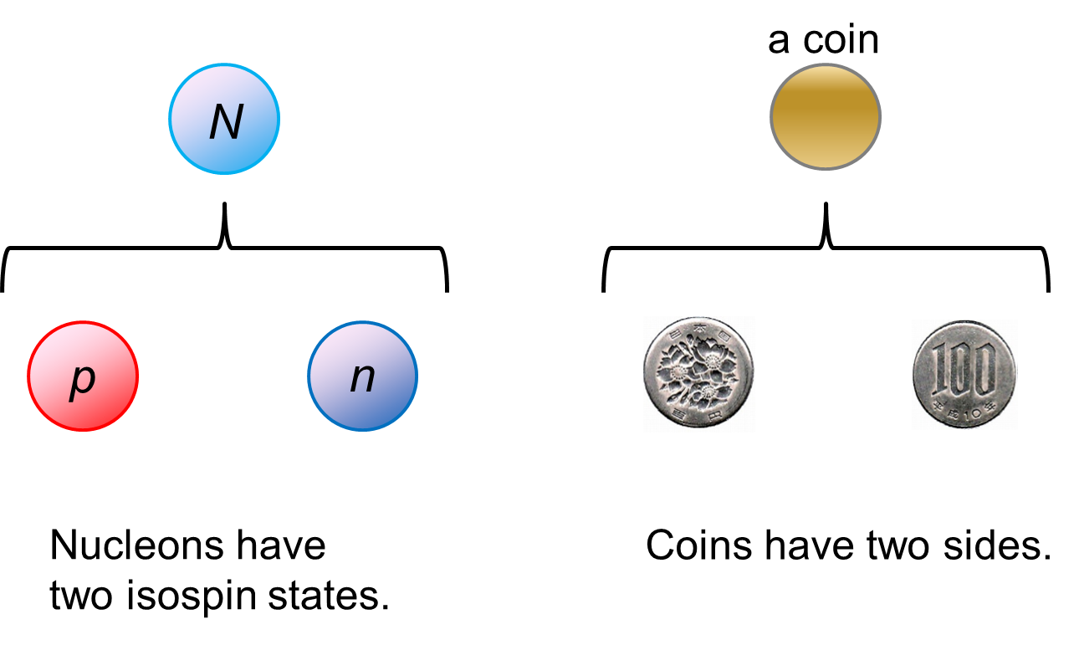
An Exercise (Old Ver.).
Rconstructing Baryon Number Cumulants

Slide 8




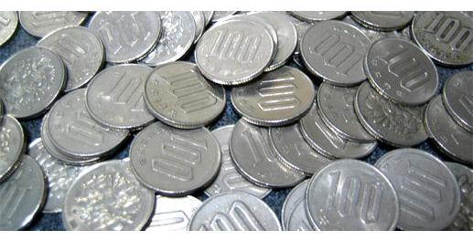
Slot Machine Analogy
= +
P (N)
N
P (N)
N

Slide 9
Extreme Examples
Fixed # of coins
Constant probabilities
N
N
N
N

Slide 10


Reconstructing Total Coin Number
MK, Asakawa, 2012
P (N )= P (N )B_{1/2}(N ;N )
binomial distribution
Application to efficiency correction:
Caveat
We still have 50%
efficiency loss in proton #
MK, Asakawa, 2012
Bzdak, Koch, 2012, 2015
Luo, 2012, 2015, …

Slide 11
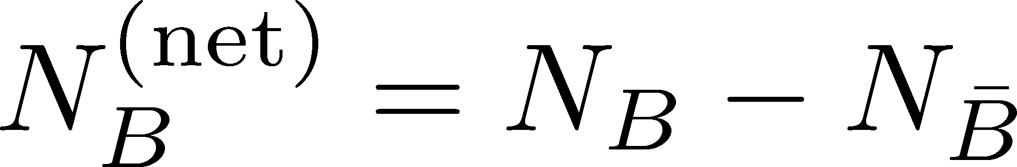
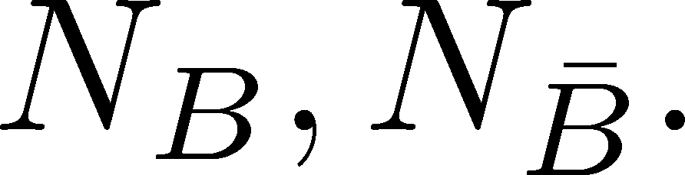
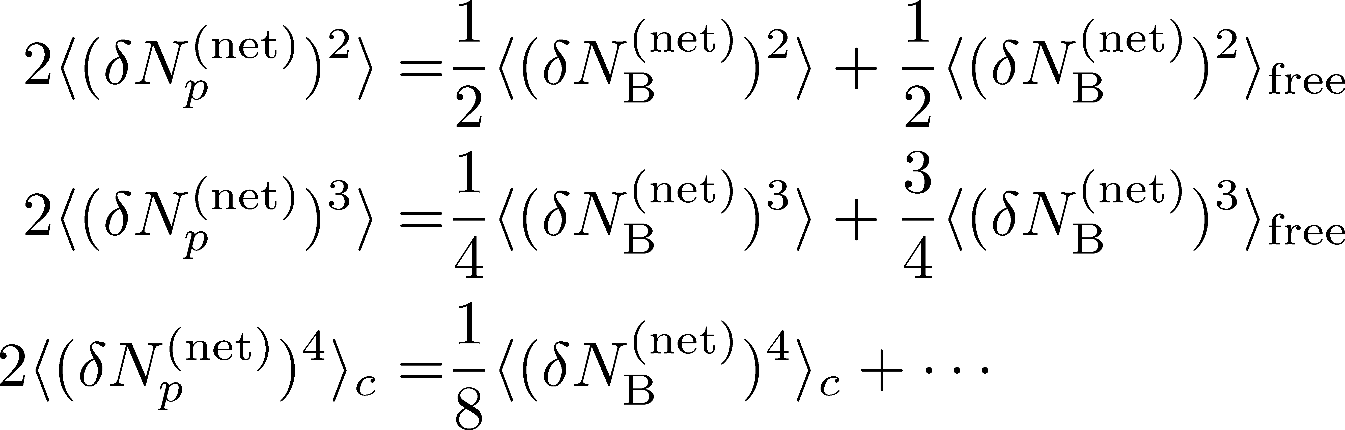
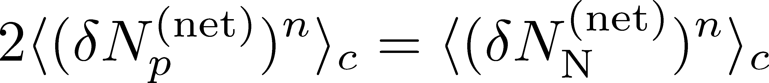
Difference btw Baryon and Proton Numbers
MK, Asakawa, 2012
(1)
deviates from the equilibrium value.
(2) Boltzmann (Poisson) distribution for
genuine info.
noise (Poisson)
For free gas

Slide 12
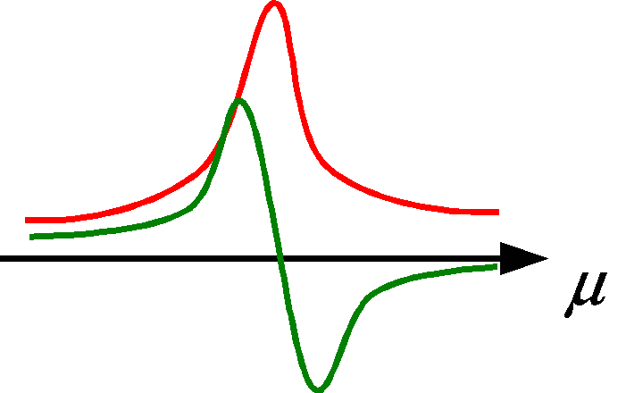
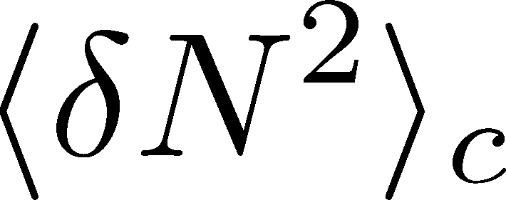
STAR, QM2015
Clear suppression!
ex. Asakawa, Ejiri, MK, 2009

Slide 13
Main Part
Diffusion of conserved-charge fluctuations
and rapidity blurring

Slide 14

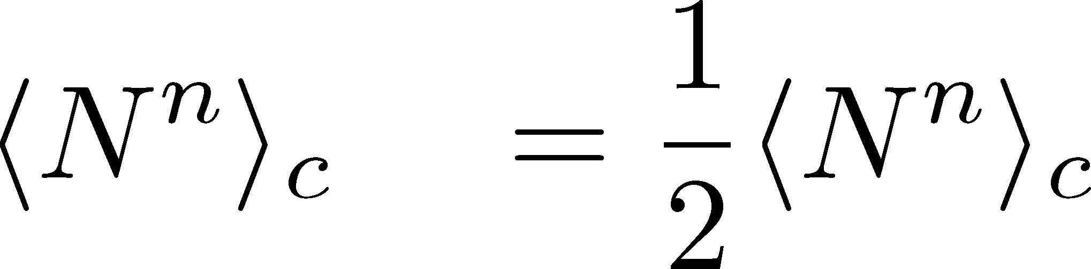

2 Slot Machines
Can we get the cumulants of single slot machine?

Slide 15
2 Slot Machines
Can we get the cumulants of single slot machine?

Slide 16
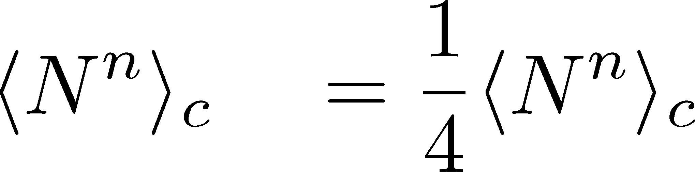
Many Slot Machines

Slide 17

Many Slot Machines

Slide 18
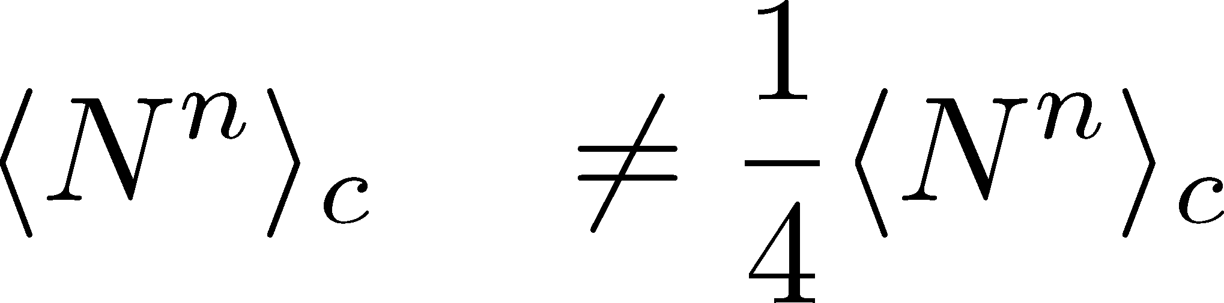
Many Slot Machines

Slide 19


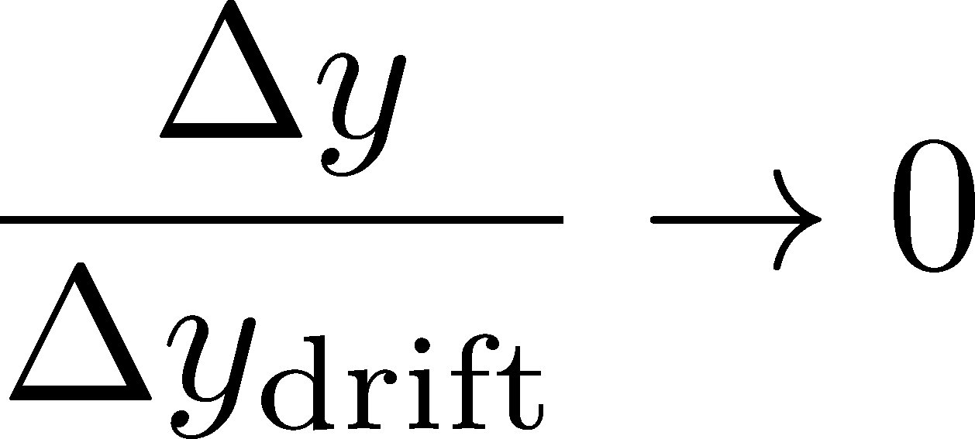
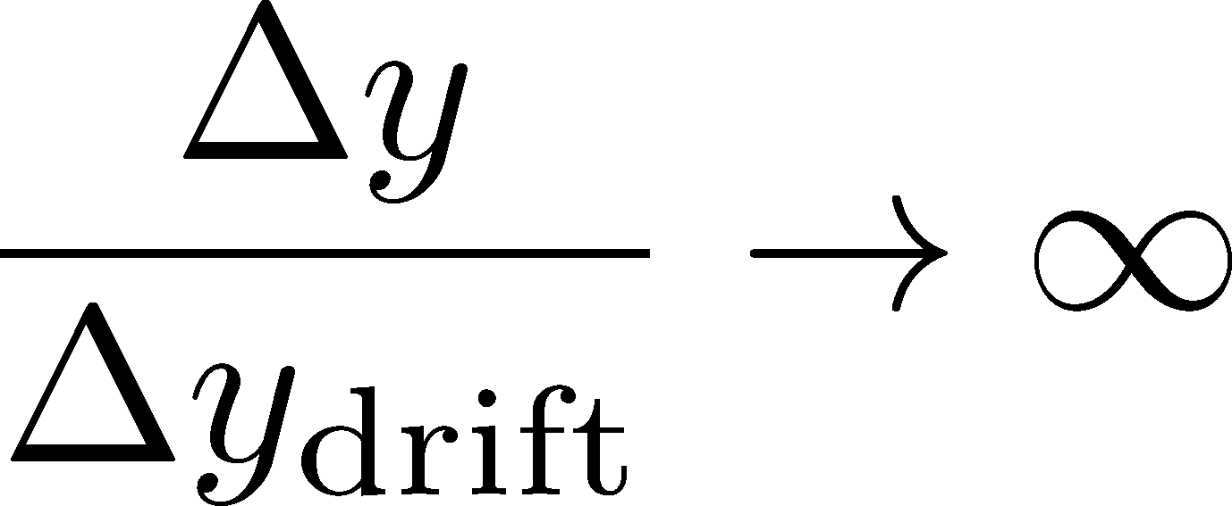
Many Slot Machines
: Poisson
: cumulants of

Slide 20
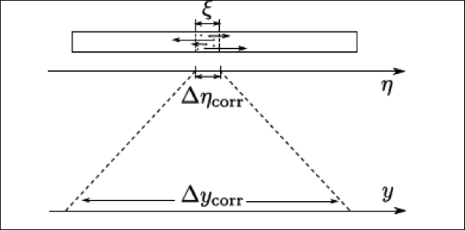
Many Slot Machines
Koch,
0810.2520
: Poisson
: cumulants of

Slide 21
Time Evolution of Fluctuations
Diffusion modifies distribution
Asakawa, Heinz, Muller, 2000
Jeon, Koch, 2000
Shuryak, Stephanov, 2001
(momentum-space)
rapidity
Detector

Slide 22
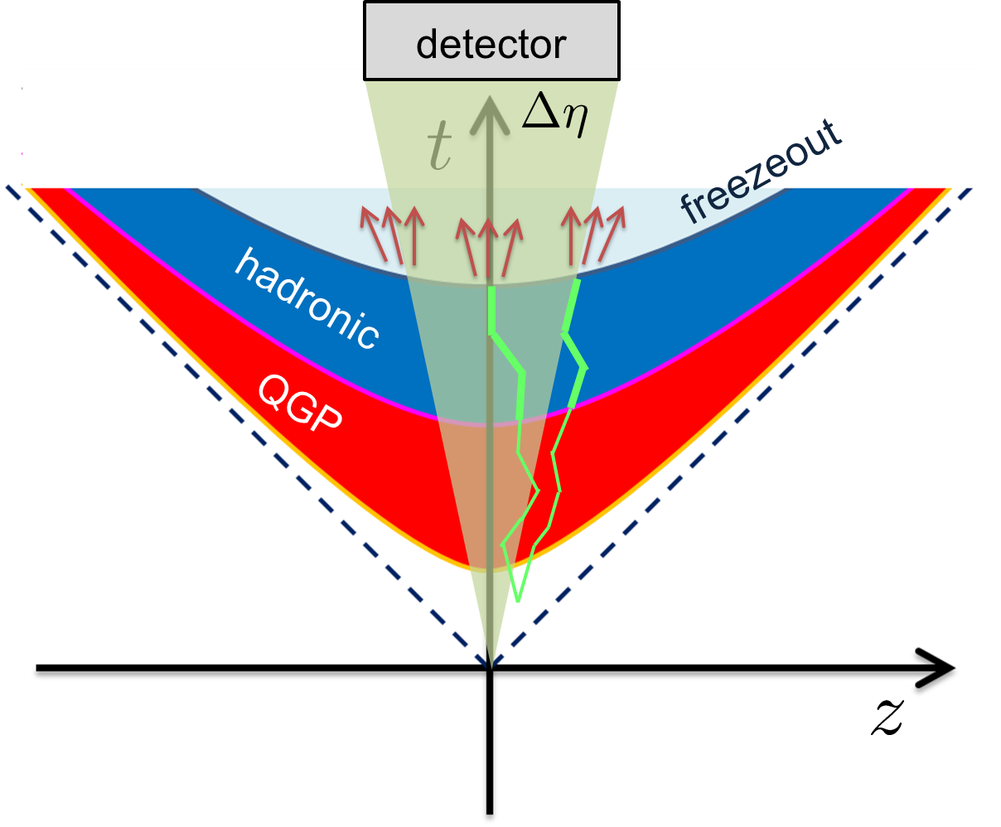
Thermal Blurring
this effect

Slide 23
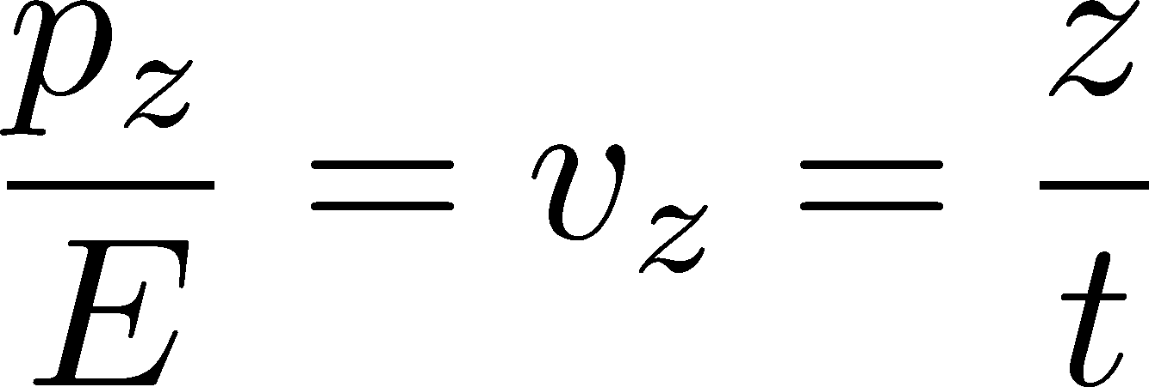




Thermal Blurring
Under Bjorken picture,
coordinate-space rapidity
of medium
momentum-space rapidity
of medium
coordinate-space rapidity of individual particles

Slide 24
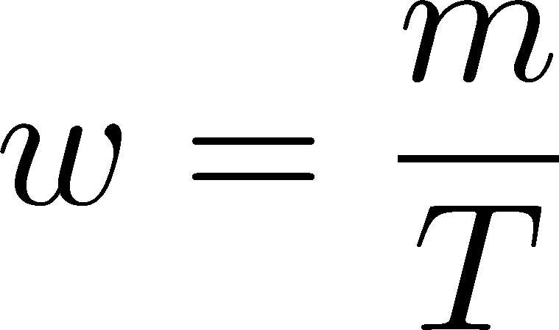



Thermal distribution in η space
Y. Ohnishi+
in preparation
nucleon
pions
nucleons
pion
Blast wave squeezes the
distribution in rapidity space
blast wave
flat freezeout surface

Slide 25
Thermal distribution in η space
Y. Ohnishi+
in preparation
pions
nucleons
half-width (Δy)
kurtosis
Rapidity distribution is not
far away from Gaussian.
blast wave
flat freezeout surface

Slide 26

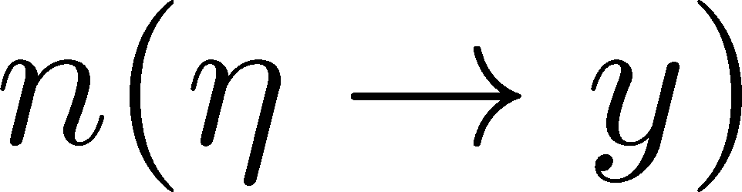
Formalism
Detector
Particles arrive at the detector with some probability.
Sum all of them up. Make the distribution.
Take the continuum limit.

Slide 27
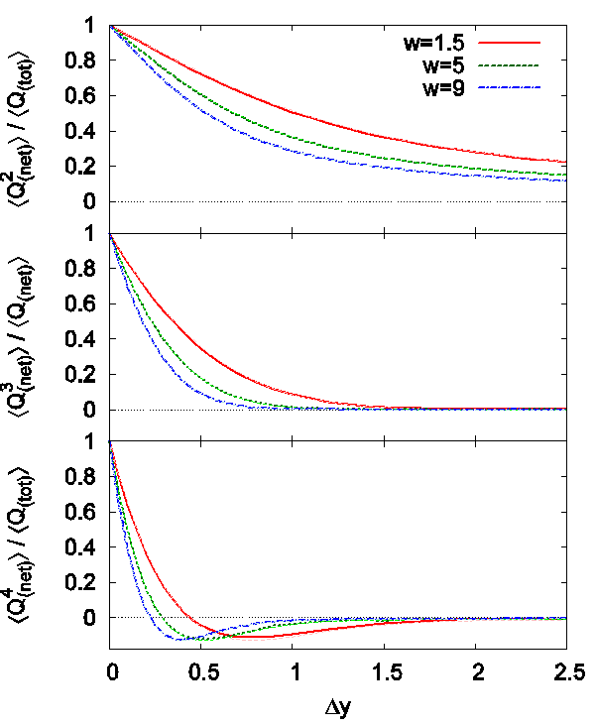
Δη Dependence
Cumulants after blurring
With vanishing fluctuations
before thermal blurring
Cumulants after blurring
take nonzero values
With Δy=1, the effect is
not well suppressed

Slide 28
Centrality Dependence
lower T
larger β
Weaker
blurring
More central
Is the centrality dependence understood solely by the thermal blurring at kinetic f.o.?

Slide 29
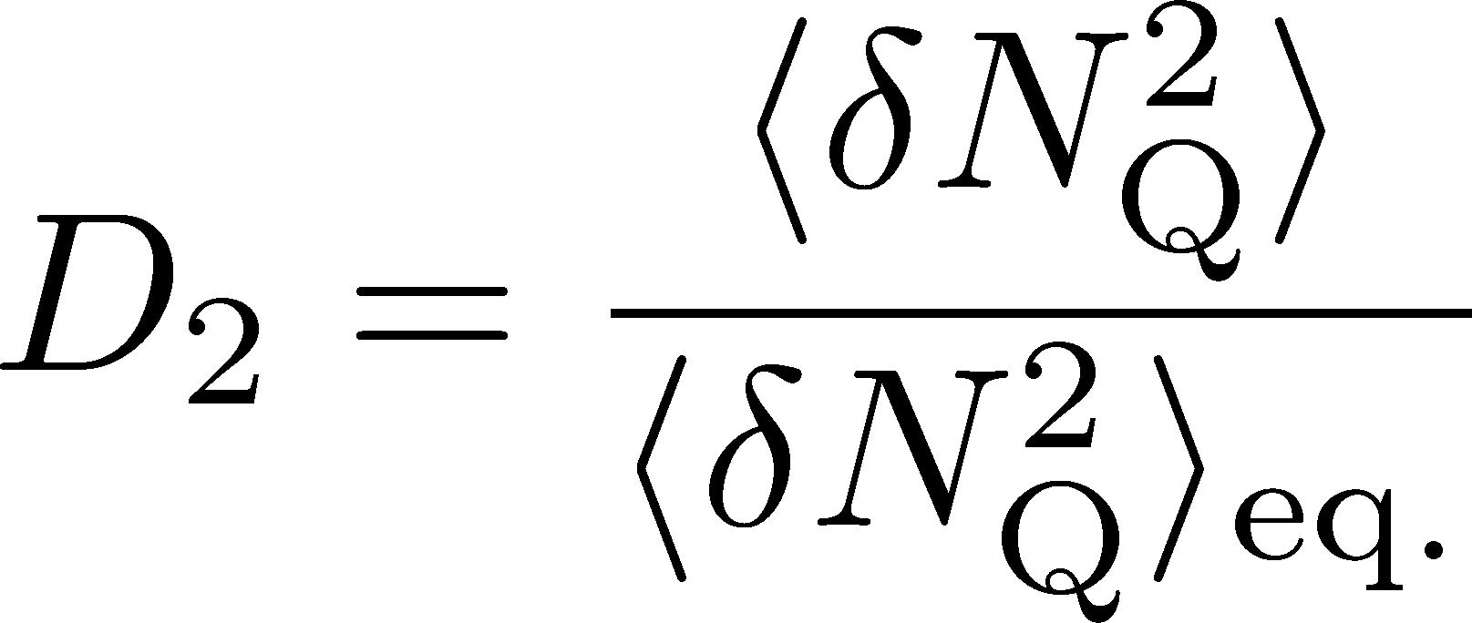
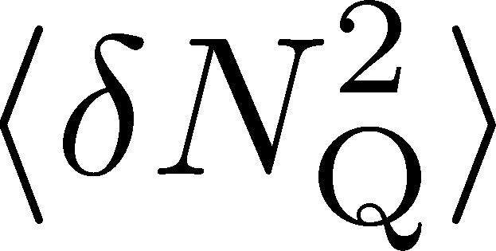
Centrality Dependence
Assumptions:
Centrality independent cumulant at kinetic f.o.
Thermal blurring at kinetic f.o.
Centrality dep. of blast wave parameters can qualitatively describe the one of

Slide 30
Diffusion (+ Thermal Blurring),
of Non-Gaussian Cumulants
these
processes

Slide 31



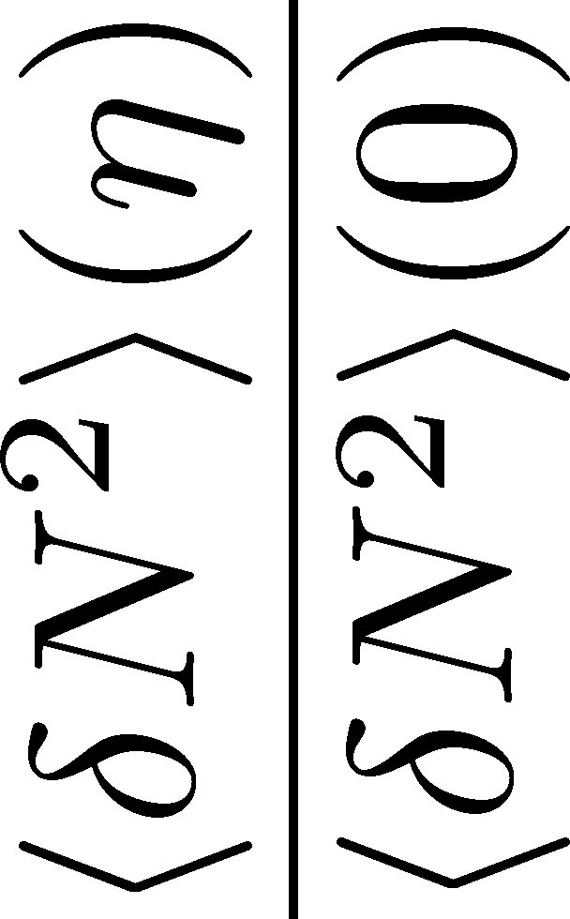
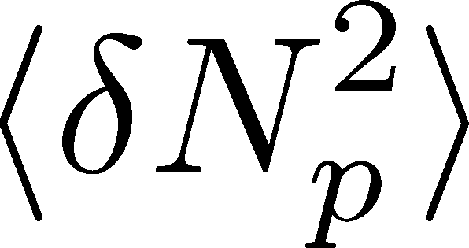
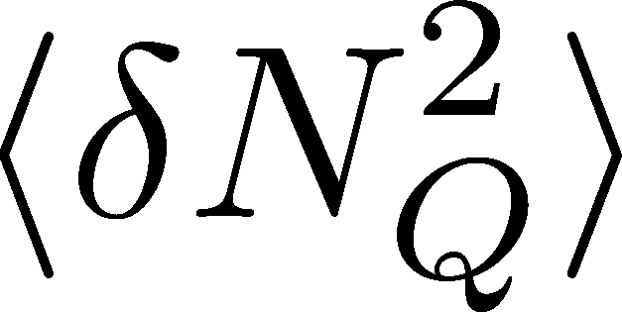


<δN_{B}²> and < δN_{p}² > @ LHC ?
should have different Δη dependence.
Baryon # cumulants are experimentally observable! MK, Asakawa, 2012

Slide 32
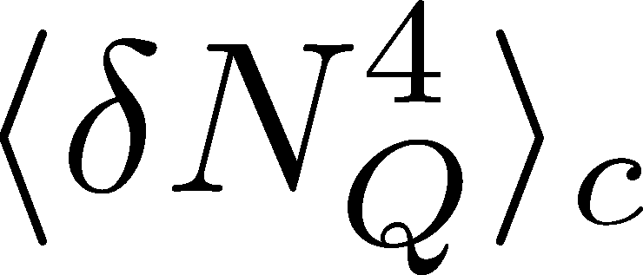

<δN_{Q}⁴> @ LHC ?
How does behave as a function of Δη?
suppression
or
enhancement

Slide 33
<δN_{Q}⁴> @ LHC ?
How does behave as a function of Δη?
suppression
or
enhancement

Slide 34

Hydrodynamic Fluctuations
Landau, Lifshitz, Statistical Mechaniqs II
Kapusta, Muller, Stephanov, 2012
Stochastic diffusion equation
Shuryak, Stephanov, 2001
Markov (white noise)
+
continuity
Fluctuation of n is
Gaussian in equilibrium
Gaussian noise
cf) Gardiner, “Stochastic Methods”

Slide 35
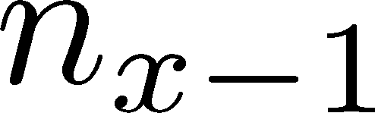






Diffusion Master Equation
MK, Asakawa, Ono, 2014
MK, 2015
Divide spatial coordinate into discrete cells
probability

Slide 36
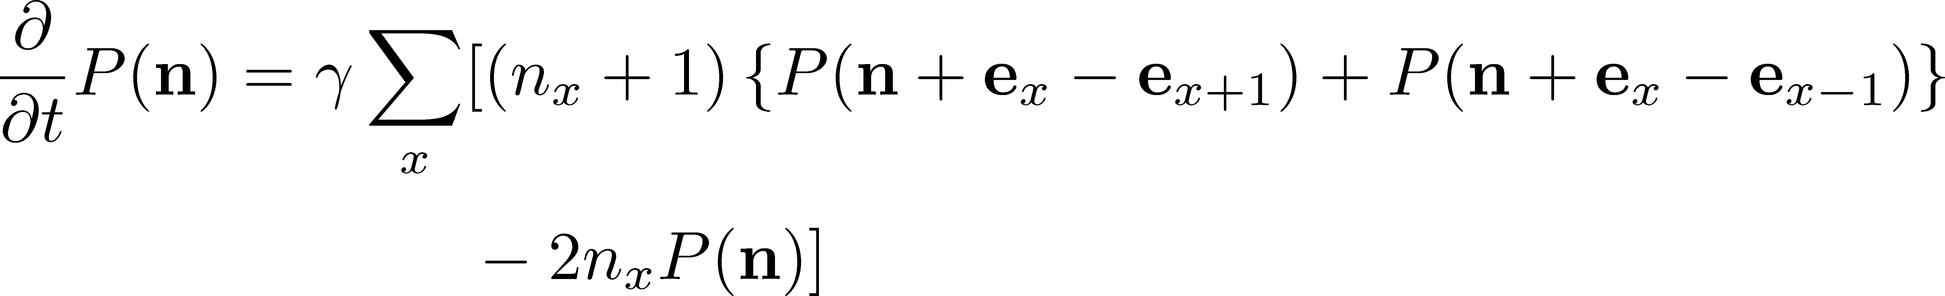
Diffusion Master Equation
MK, Asakawa, Ono, 2014
MK, 2015
Divide spatial coordinate into discrete cells
probability
Master Equation for P(n)
Solve the DME exactly, and take a→0 limit
No approx., ex. van Kampen’s system size expansion

Slide 37
A Brownian Particle’s Model
Hadronization (specific initial condition)
Time evolution
Freezeout
Initial distribution + motion of each particle
→ cumulants of particle # in Δη

Slide 38
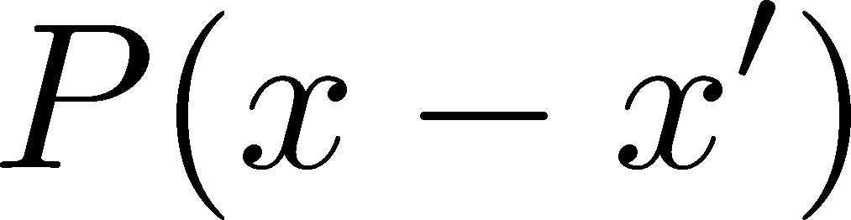
A Brownian Particle’s Model
Hadronization (specific initial condition)
Time evolution
Freezeout
Initial distribution + motion of each particle
→ cumulants of particle # in Δη

Slide 39

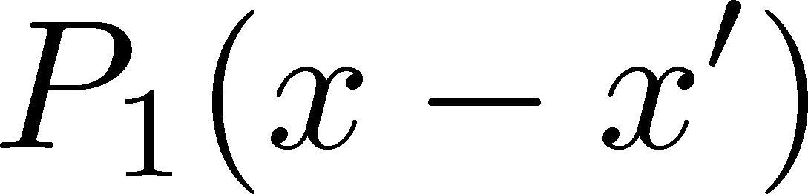
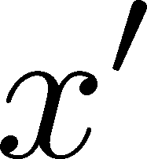
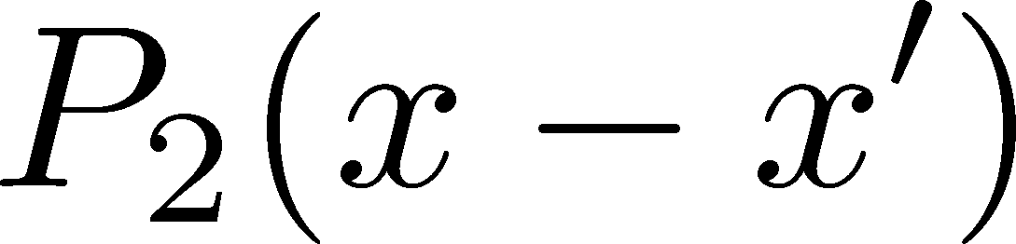
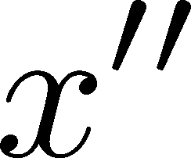
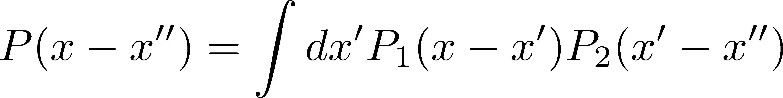
Diffusion + Thermal Blurring
Hadronization
diffusion
Kinetic f.o. (coordinate space)
blurring
Kinetic f.o. (momentum space)
Total diffusion:
Diffusion + thermal blurring = described by a single P(x)
Both are consistent with Gaussian → Single Gaussian

Slide 40



Baryons in Hadronic Phase
time
chem. f.o.
hadronize
10~20fm
kinetic f.o.
Baryons behave like
Brownian pollens in water
mesons
baryons

Slide 41


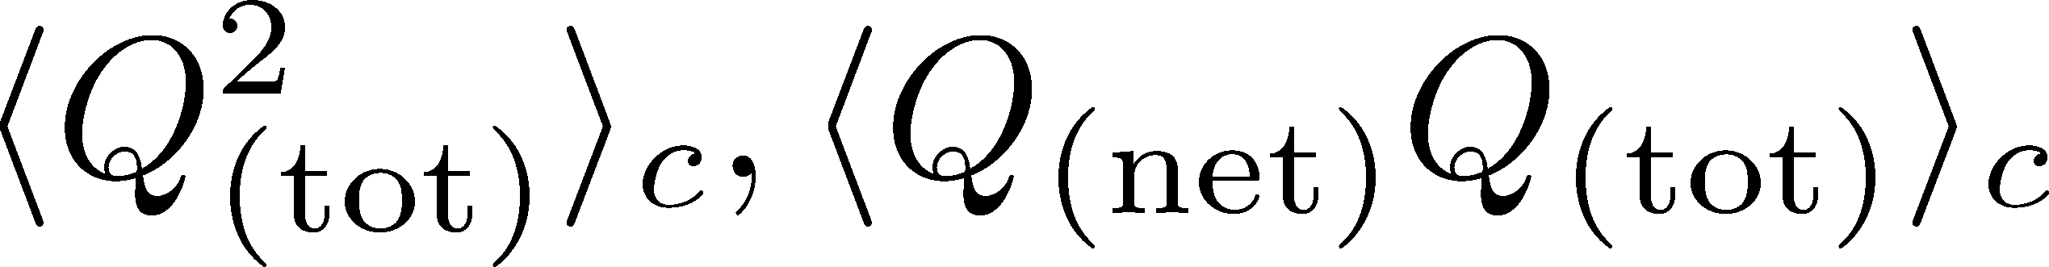
Time Evolution in Hadronic Phase
Hadronization (initial condition)
Boost invariance / infinitely long system
Local equilibration / local correlation
suppression owing to
local charge conservation
strongly dependent on
hadronization mechanism

Slide 42
Time Evolution in Hadronic Phase
Hadronization (initial condition)
Boost invariance / infinitely long system
Local equilibration / local correlation
Diffusion + Blurring
suppression owing to
local charge conservation
strongly dependent on
hadronization mechanism
Detector

Slide 43
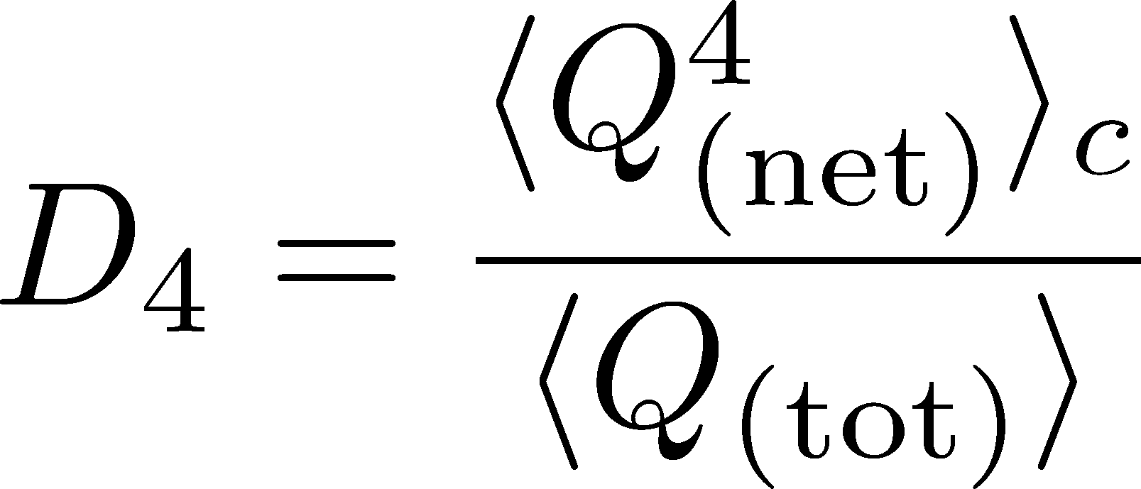



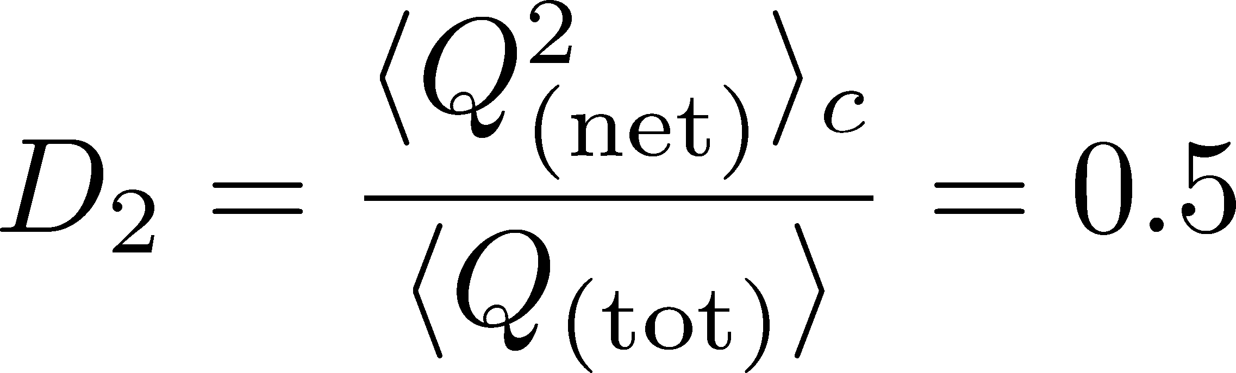
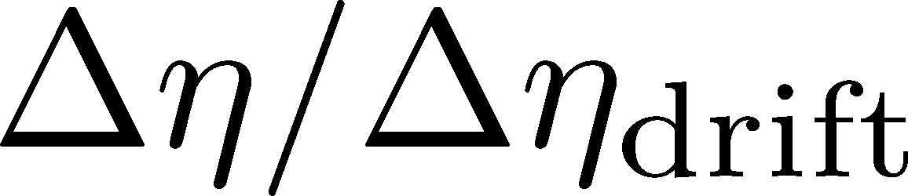
Δη Dependence: 4th order
MK, NPA (2015)
Initial Condition
new
normalization
Characteristic Δη dependences!

Slide 44
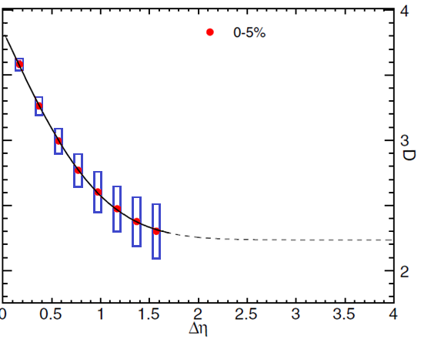

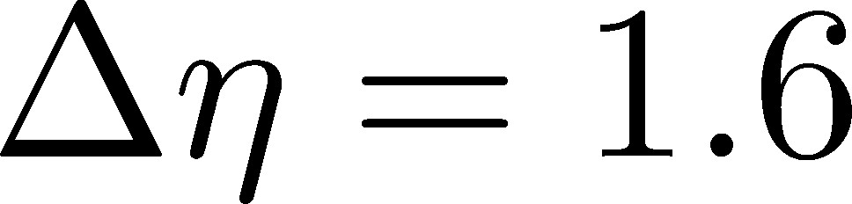
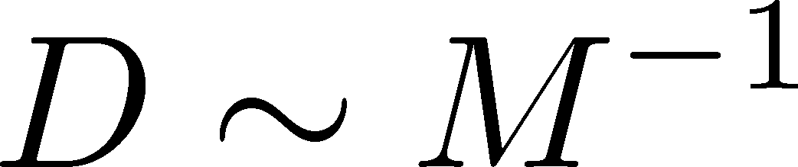
Δη Dependence: 4th order
MK, NPA (2015)
Initial Condition
baryon #
at ALICE
at ALICE

Slide 45
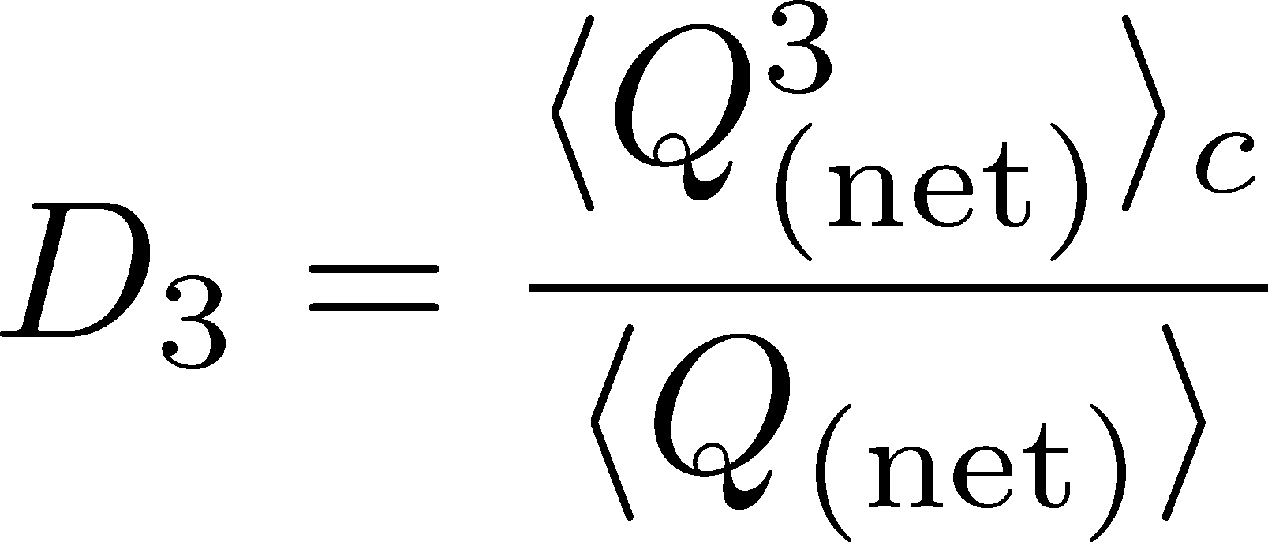
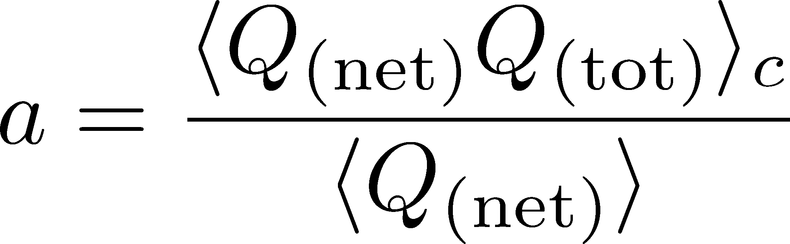
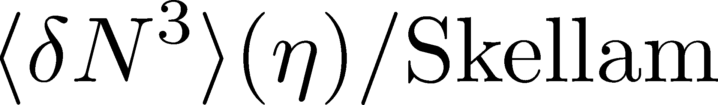
Δη Dependence: 3rd order
MK, NPA (2015)
Initial Condition
baryon #
at ALICE
at ALICE

Slide 46
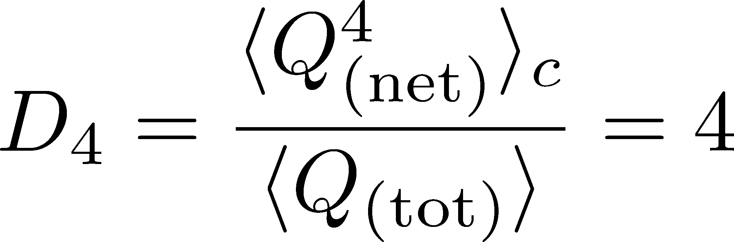
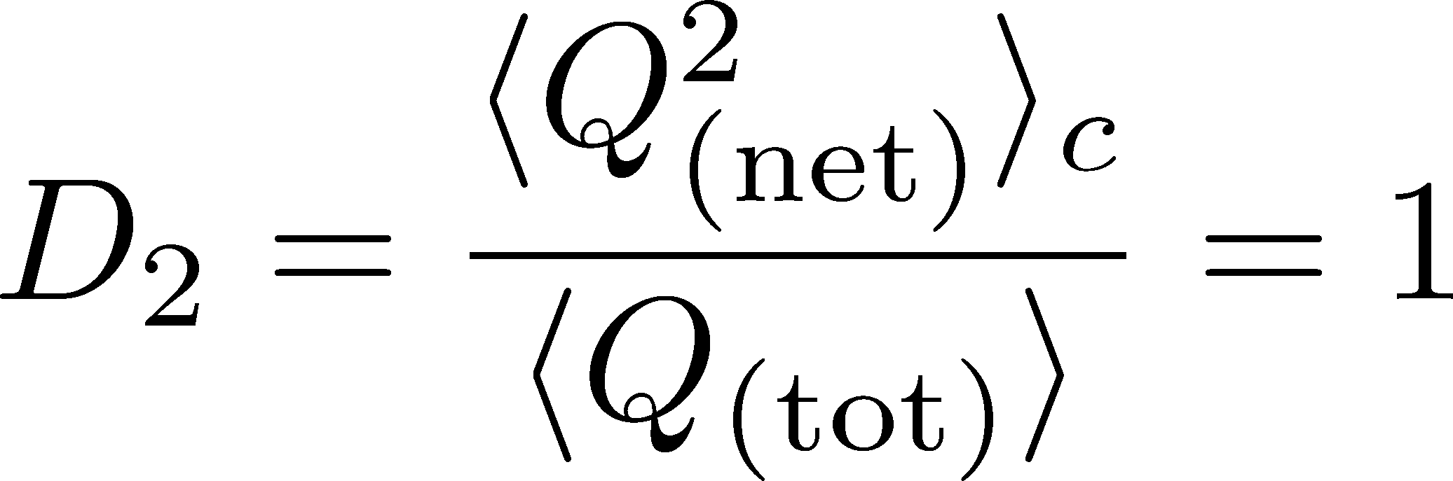
4th order : Large Initial Fluc.
MK, NPA (2015)
Initial Condition
baryon #
at ALICE
at ALICE

Slide 47
Δη Dependence @ STAR
X. Luo, CPOD2014
MK, 2015
Non-monotonic
dependence on Δy ?

Slide 48
Summary
Plenty of information in Δη
dependences of various cumulants
and those of non-conserved charges, mixed cumulants…
With Δη dep. we can explore
primordial thermodynamics
non-thermal and transport property
effect of thermal blurring

Slide 49
Future Studies
Experimental side:
rapidity window dependences
baryon number cumulants
BES for SPS- to LHC-energies
Theoretical side:
rapidity window dependences in dynamical models
description of non-equilibrium non-Gaussianity
accurate measurements on the lattice
Both sides:
Compare theory and experiment carefully
Let’s accelerate our understanding on fluctuations!

Slide 50
Very Low Energy Collisions
Large contribution of global charge conservation
Violation of Bjorken scaling
detector
Fluctuations at low √s should be interpreted carefully!
Comparison with statistical mechanics would not make sense…

Slide 51
How to Introduce Non-Gaussianity?
Stochastic diffusion equation
Choices to introduce non-Gaussianity in equil.:
n dependence of diffusion constant D(n)
colored noise
discretization of n

Slide 52
How to Introduce Non-Gaussianity?
Stochastic diffusion equation
Choices to introduce non-Gaussianity in equil.:
n dependence of diffusion constant D(n)
colored noise
discretization of n
our choice
Fluctuations measured in
HIC are almost Poissonian.
REMARK:

Slide 53
Time Evolution of Fluctuations

Slide 54
Time Evolution of Fluctuations
detector
Particle # in Δη
freezeout
continues to change until kinetic freezeout due to diffusion.
hadronic
QGP
changes due to a conversion y → η at kinetic freezeout
“Thermal Blurring”

