Slide 1
Non-Gaussian Fluctuations in Relativistic Heavy Ion Collisions
Masakiyo Kitazawa
(Osaka U.)
Asakawa, MK, arXiv:1512.05038 [Review]
MK, Asakawa, Ono, Phys. Lett. B728, 386-392 (2014)
Sakaida, Asakawa, MK, PRC90, 064911 (2014)
MK, Nucl. Phys. A942, 65 (2015)
CiRfSE Workshop, Tsukuba U.,19/Jan./2016

Slide 2
Beam-Energy Scan
T
Hadrons
Color SC
0
μ

Slide 3

Beam-Energy Scan
STAR 2012
high
beam energy
T
low
Hadrons
Color SC
0
μ

Slide 4
Fluctuations

Slide 5




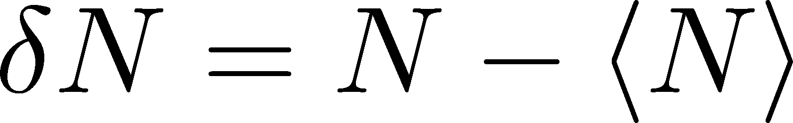
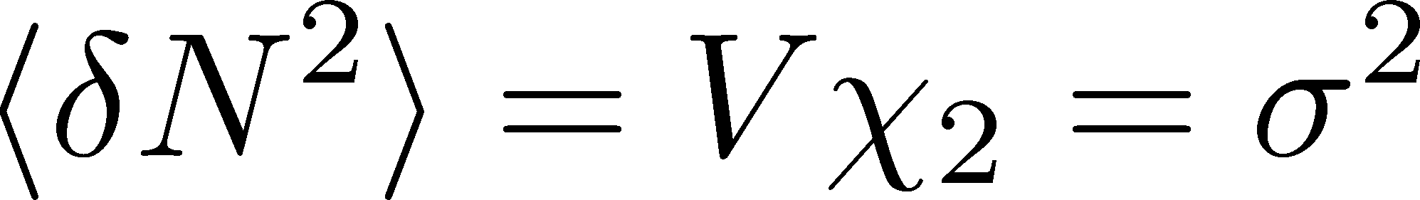
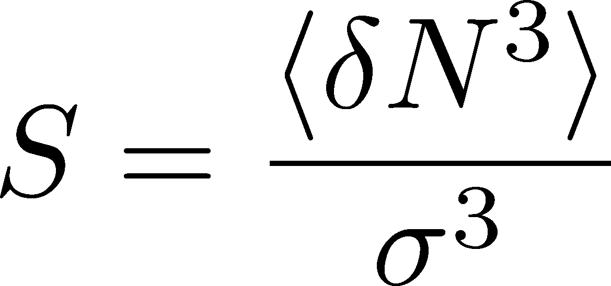
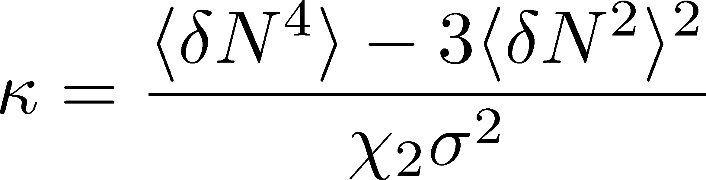
Fluctuations
Observables in equilibrium are fluctuating.
variance
N
V
Variance:
Gaussian
Skewness:
non-Gaussianity
Kurtosis:

Slide 6
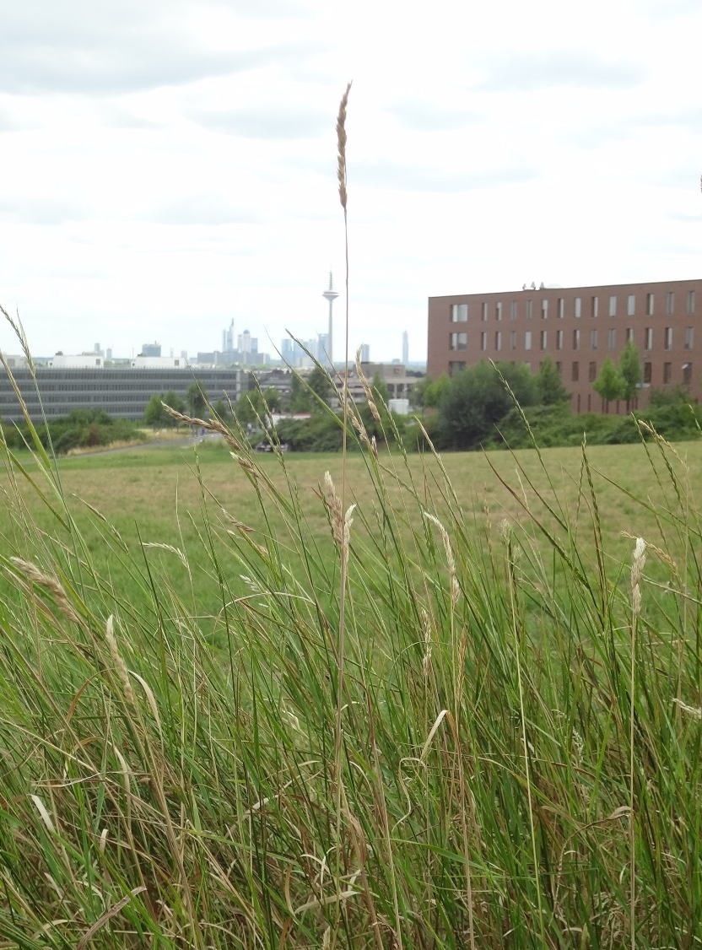
In “haiku”, a Japanese short style poem, a poet wrote…
Even on one blade of grass
the cool wind lives
Issa Kobayashi
1814
一本の草も涼風宿りけり
小林一茶

Slide 7
Physicists can feel hot early Universe
13 800 000 000 years ago
in tiny fluctuations of
cosmic microwave

Slide 8
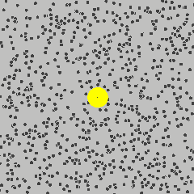
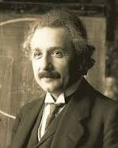
Physicists can feel the existence of microscopic
atoms behind random fluctuations
of Brownian pollens
A. Einstein
1905

Slide 9
Feel hot quark wind behind fluctuations
in relativistic heavy ion collisions
2010-

Slide 10
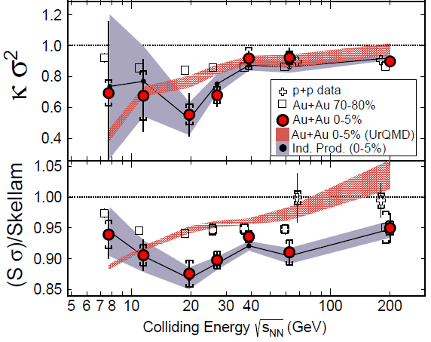

Feel hot quark wind behind fluctuations
in relativistic heavy ion collisions
2010-

Slide 11
Non-Gaussian Fluctuations in Heavy-Ion Collisions

Slide 12
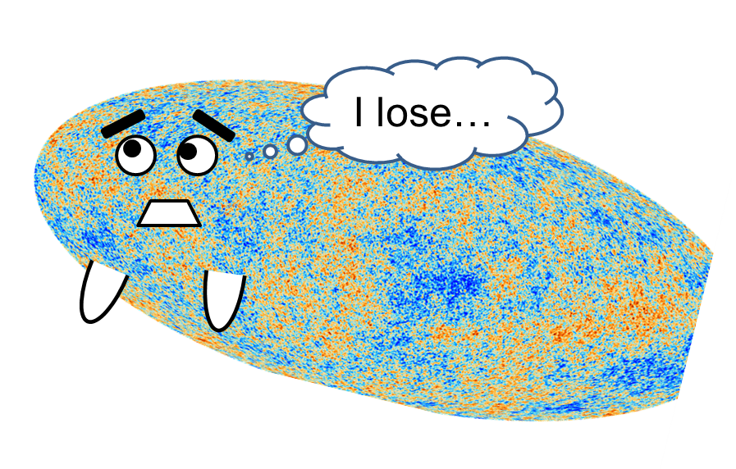
Non-Gaussianity in Exp.
X. Luo+, STAR Collab.
2010~
Non-zero non-Gaussian cumulants
have been established!

Slide 13
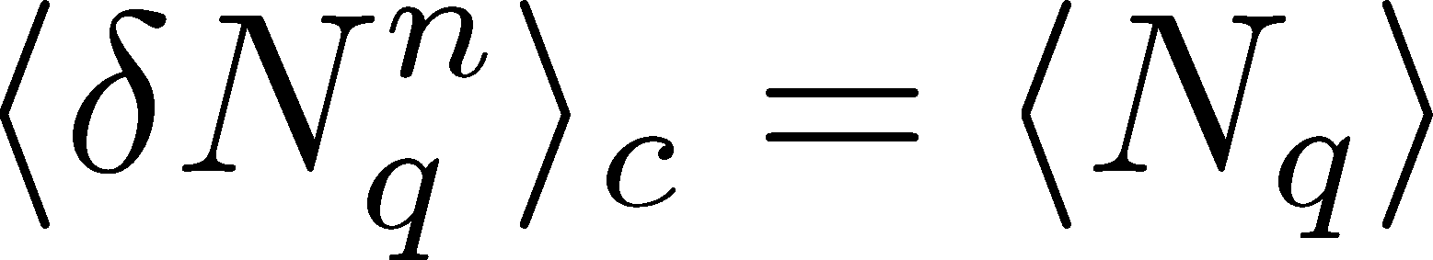
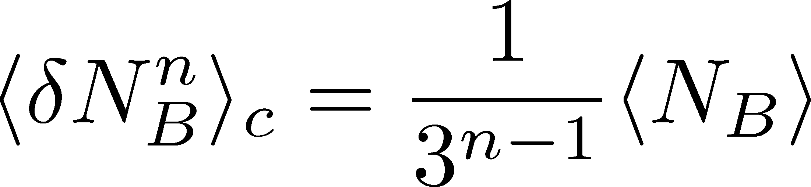
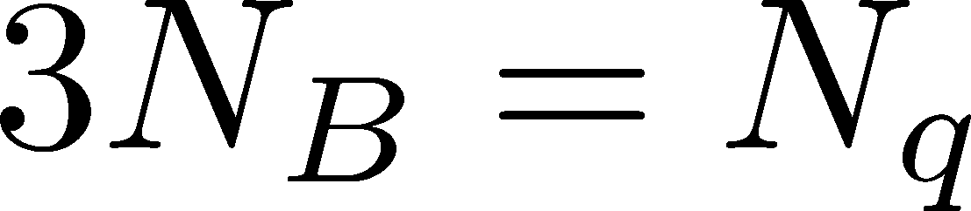
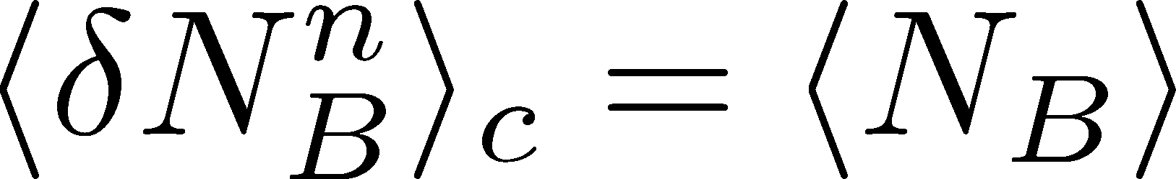
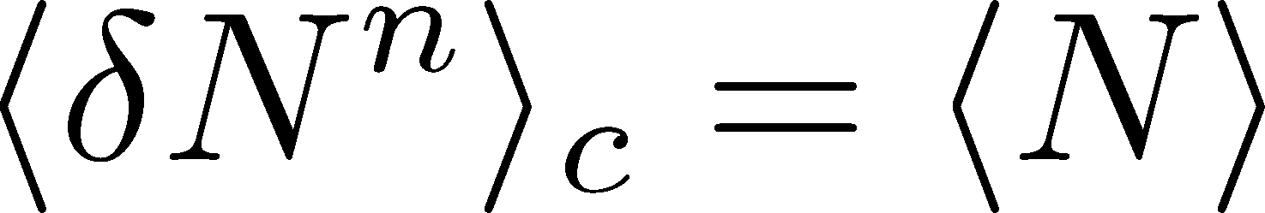
Fluctuations and Elemental Charge
Asakawa, Heinz, Muller, 2000
Jeon, Koch, 2000
Ejiri, Karsch, Redlich, 2005
Free Boltzmann → Poisson

Slide 14
Fluctuations and Elemental Charge
Asakawa, Heinz, Muller, 2000
Jeon, Koch, 2000
Ejiri, Karsch, Redlich, 2005
RBC-Bielefeld ’09
Free Boltzmann → Poisson

Slide 15
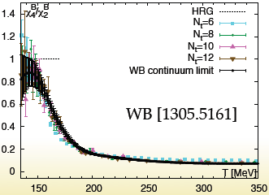
Fluctuations and Elemental Charge
Asakawa, Heinz, Muller, 2000
Jeon, Koch, 2000
Ejiri, Karsch, Redlich, 2005
Free Boltzmann → Poisson

Slide 16




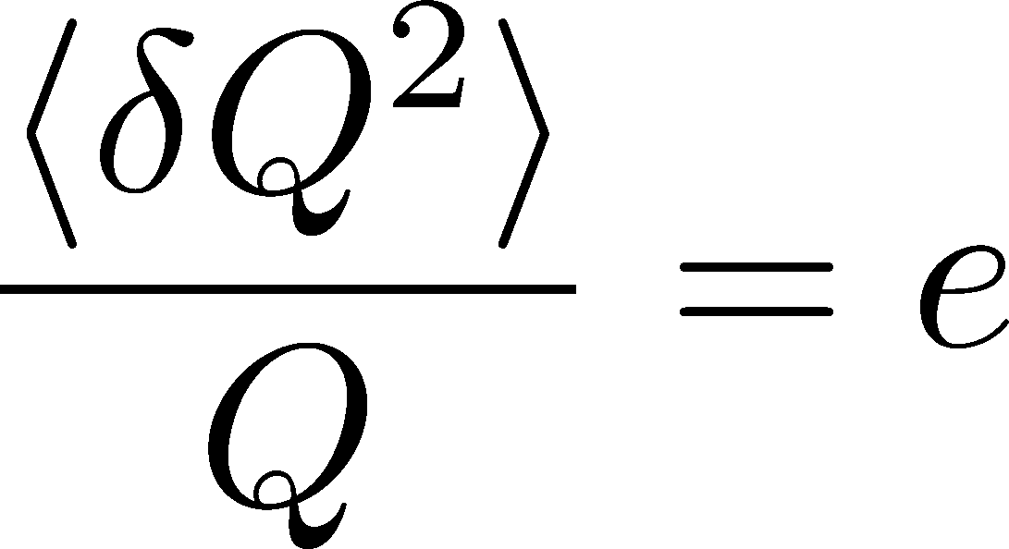
Shot Noise
e*
charge of quasi-particles
Total charge Q:

Slide 17
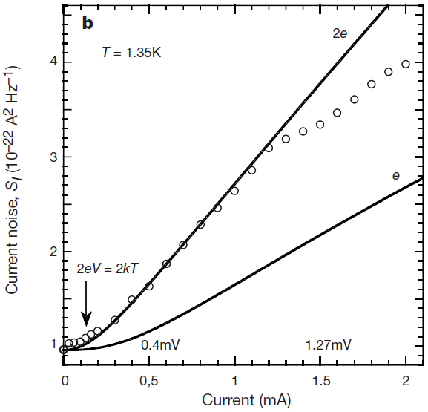


Shot Noise
e*
charge of quasi-particles
Superconductors
with Cooper Pairs
Fractional Quantum
Hall Systems
doubled!
Jehl+, Nature 405,50 (2000)
Saminadayar+, PRL79,2526 (1997)
Higher order cumulants:
3rd order: ex. Beenakker+, PRL90,176802(2003)
up to 5th order: Gustavsson+, Surf.Sci.Rep.64,191(2009)

Slide 18


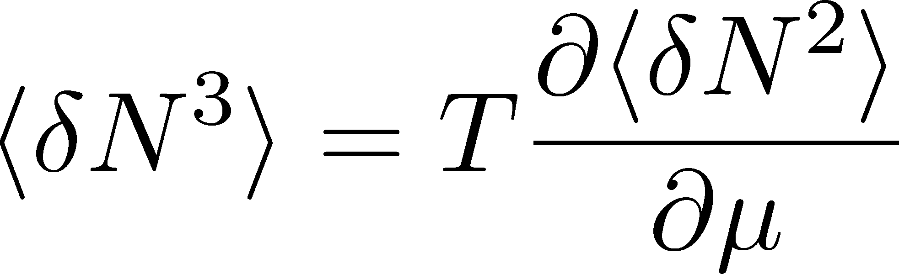

Fluctuation and QCD Critical Point
Fluctuations diverge at
the QCD critical point
Geometric interpretation to
signs of higher order cumulants
Asakawa, Ejiri, MK
2009
More severe divergence for higher-order cumulants
Stephanov, 2009

Slide 19

Impact of Negative Third Moments
Once negative <dN_{B}³> is established, it is evidences that
(1) χ_{B} has a peak structure in the QCD phase diagram.
(2) Hot matter beyond the peak is created in the collisions.
No dependence on any specific models.
Just the sign! No normalization (such as by N_{ch}).

Slide 20
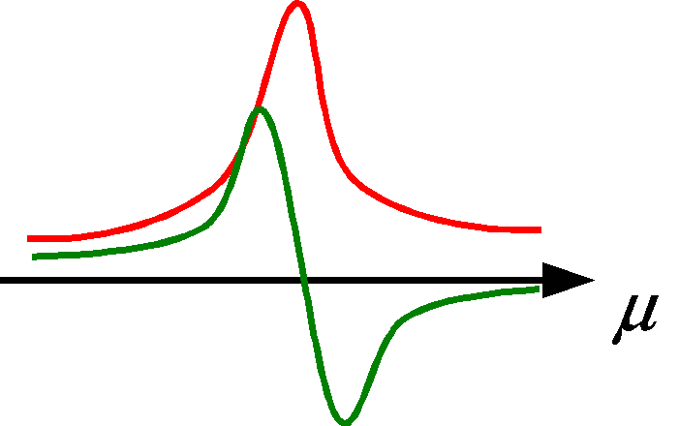
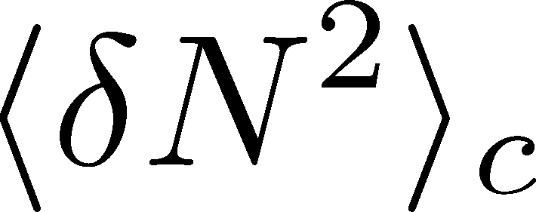
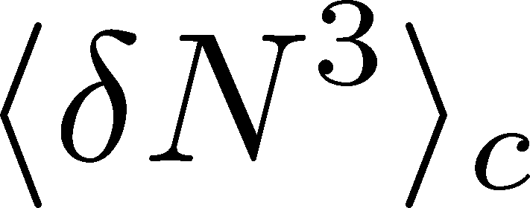
X. Luo, STAR, QM2015
Clear suppression!
ex. Asakawa, Ejiri, MK, 2009
Even on one blade of grass
the cool wind lives

Slide 21
Rapidity Window Dependences
of Gaussian Fluctuations

Slide 22

Δη Dependence @ ALICE
ALICE
PRL 2013
hadronic
D-measure
D ~ 3-4 Hadronic
D ~ 1-1.5 Quark
t
Δη
rapidity window
z

Slide 23
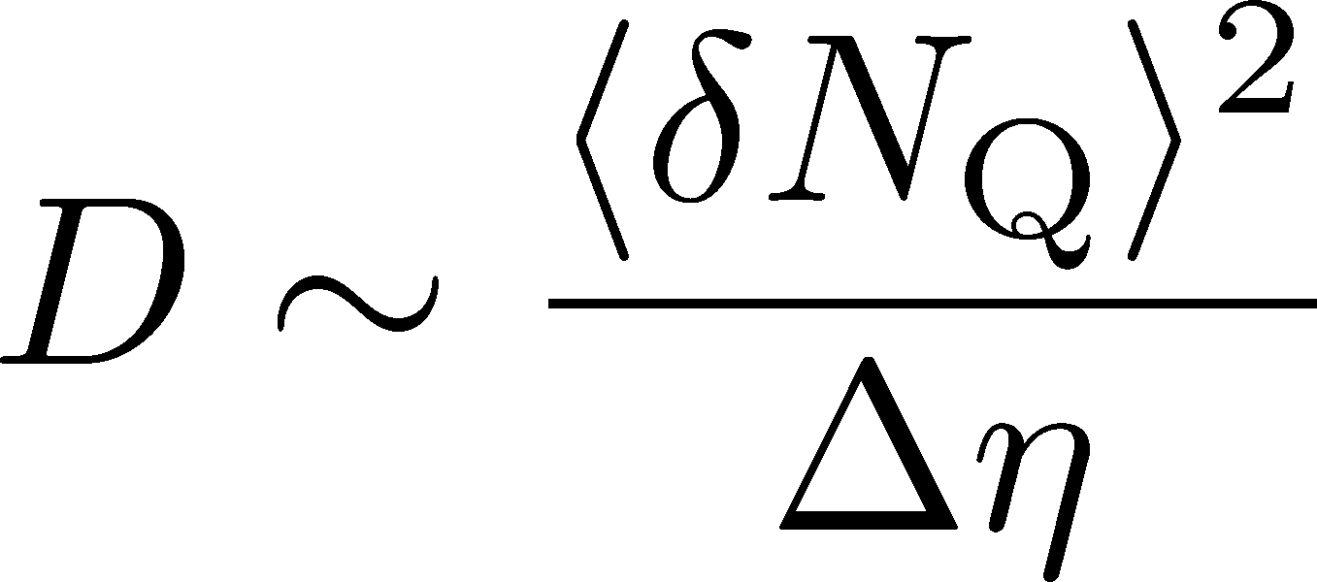
Δη Dependence @ ALICE
hadronic
has to be a constant
in equil. medium
Fluctuation of N_{Q}
at ALICE is not the
equilibrated one.
rapidity window

Slide 24
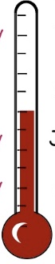


Δη Dependence @ ALICE
Δη dependent
thermometer?
ALICE
PRL 2013
large
small
rapidity window

Slide 25
Δη Dependence @ ALICE
Δη dependent
thermometer?
ALICE
PRL 2013
large
small
Δη dependences of fluctuation observables
encode history of the hot medium!
Higher-order cumulants as
thermometer?

Slide 26

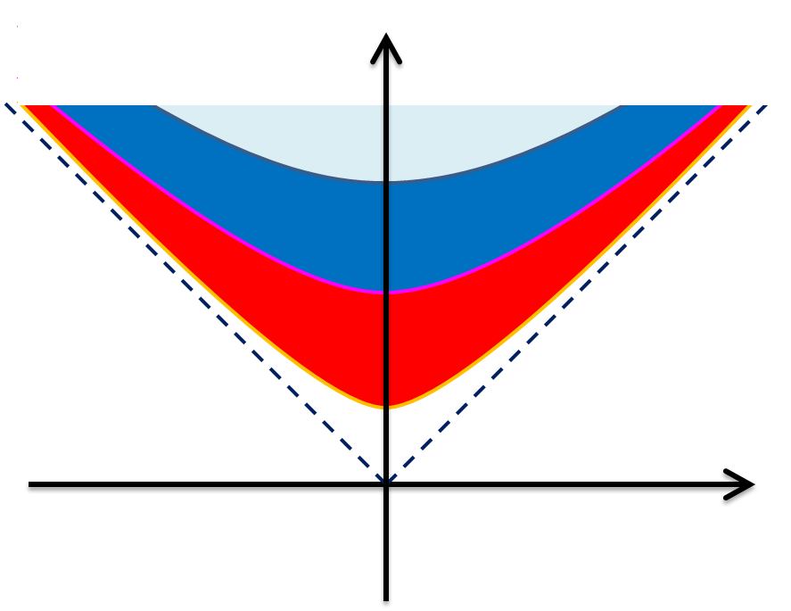


Time Evolution of Fluctuations
Diffusion modifies distribution

Slide 27
Time Evolution of Fluctuations
Detector
(momentum-space)
rapidity
conversion η→y at kinetic f.o.
“Thermal Bluriing” modifies distribution

Slide 28
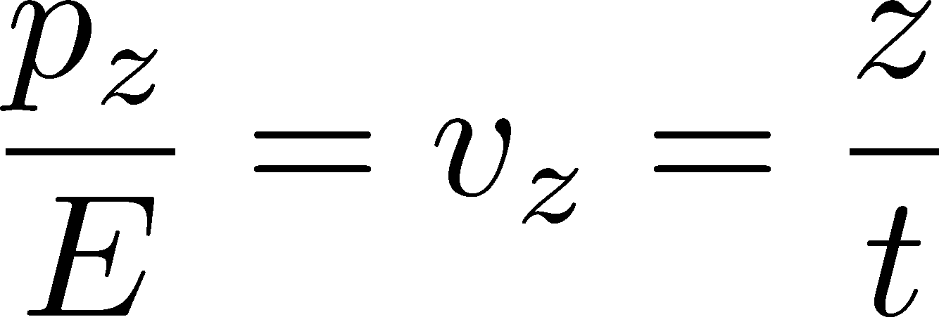




Thermal Blurring
Under Bjorken picture,
coordinate-space rapidity
of medium
momentum-space rapidity
of medium
momentum-space rapidity of individual particles

Slide 29
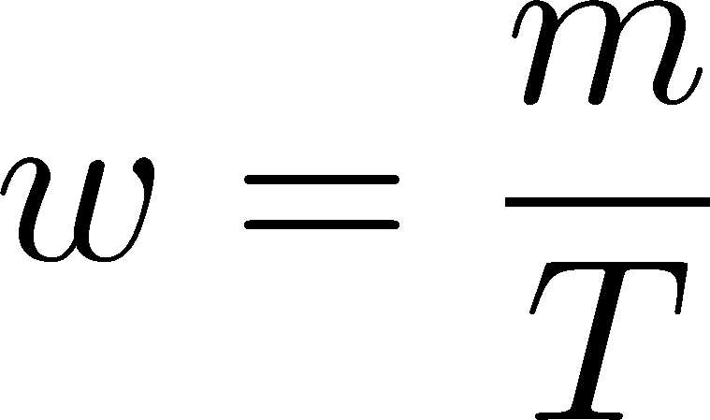



Thermal distribution in η space
Y. Ohnishi+
in preparation
nucleon
pions
nucleons
pion
Blast wave squeezes the
distribution in rapidity space
blast wave
flat freezeout surface

Slide 30
Thermal distribution in η space
Y. Ohnishi+
in preparation
pions
nucleons
half-width (Δy)
kurtosis
Rapidity distribution is not
far away from Gaussian.
blast wave
flat freezeout surface

Slide 31

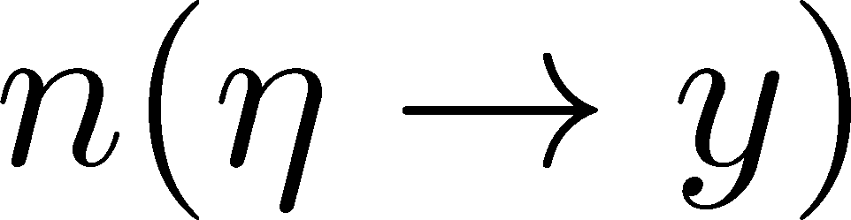

Formalism
Detector
Particles arrive at the detector with some probability.
Sum all of them up. Make the distribution.
Take the continuum limit.

Slide 32
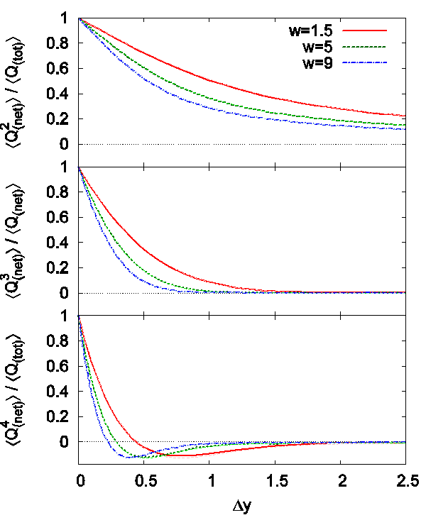
Δη Dependence
Cumulants after blurring
With vanishing fluctuations
before thermal blurring
Cumulants after blurring
take nonzero values
With Δy=1, the effect is
not well suppressed

Slide 33
Centrality Dependence
lower T
larger β
Weaker
blurring
More central
Is the centrality dependence understood solely by the thermal blurring at kinetic f.o.?

Slide 34
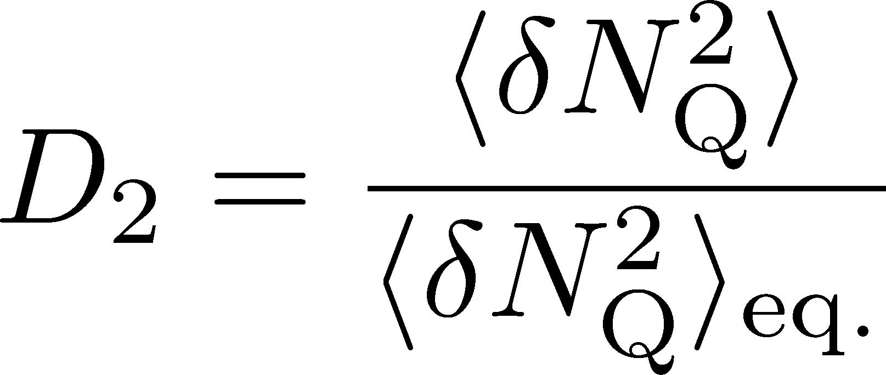
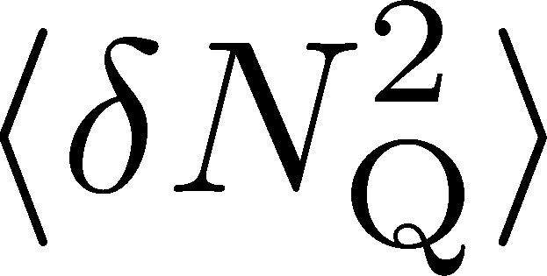
Centrality Dependence
Assumptions:
Centrality independent cumulant at kinetic f.o.
Thermal blurring at kinetic f.o.
Centrality dep. of blast wave parameters can qualitatively describe the one of
Even on one blade of grass
the cool wind lives

Slide 35
Rapidity Window Dependences
of Non-Gaussian Fluctuations

Slide 36



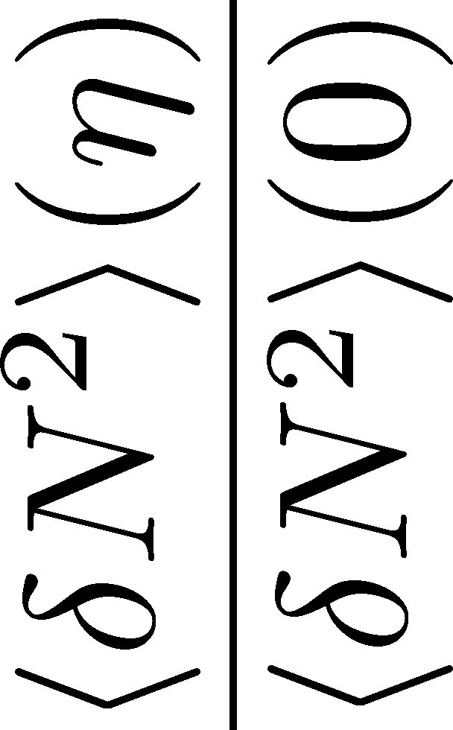
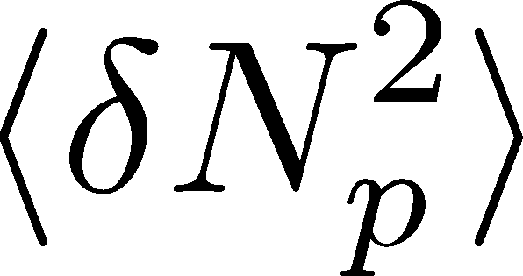
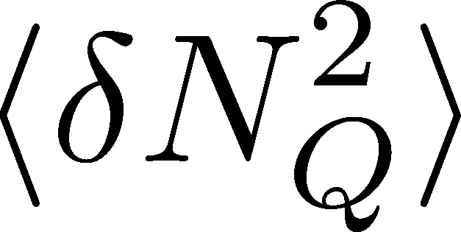


<δN_{B}²> and < δN_{p}² > @ LHC ?
should have different Δη dependence.
Baryon # cumulants are experimentally observable! MK, Asakawa, 2012

Slide 37
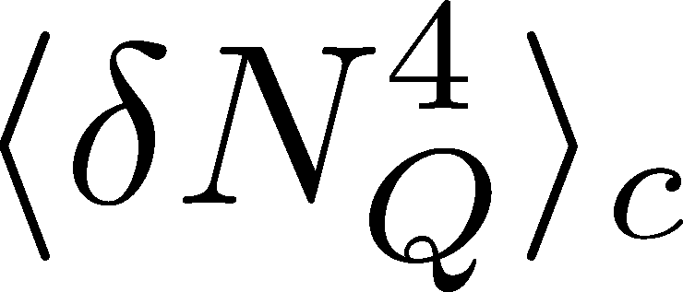

<δN_{Q}⁴> @ LHC ?
How does behave as a function of Δη?
suppression
or
enhancement

Slide 38
<δN_{Q}⁴> @ LHC ?
How does behave as a function of Δη?
suppression
or
enhancement

Slide 39

Hydrodynamic Fluctuations
Landau, Lifshitz, Statistical Mechaniqs II
Kapusta, Muller, Stephanov, 2012
Stochastic diffusion equation
Shuryak, Stephanov, 2001
Markov (white noise)
+
continuity
Fluctuation of n is
Gaussian in equilibrium
Gaussian noise
cf) Gardiner, “Stochastic Methods”

Slide 40
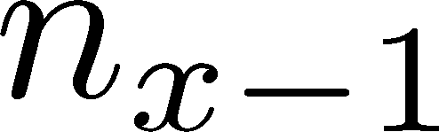






Diffusion Master Equation
MK, Asakawa, Ono, 2014
MK, 2015
Divide spatial coordinate into discrete cells
probability

Slide 41
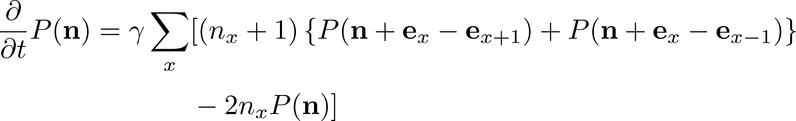
Diffusion Master Equation
MK, Asakawa, Ono, 2014
MK, 2015
Divide spatial coordinate into discrete cells
probability
Master Equation for P(n)
Solve the DME exactly, and take a→0 limit
No approx., ex. van Kampen’s system size expansion

Slide 42
A Brownian Particle’s Model
Hadronization (specific initial condition)
Time evolution
Freezeout
Initial distribution + motion of each particle
→ cumulants of particle # in Δη

Slide 43

A Brownian Particle’s Model
Hadronization (specific initial condition)
Time evolution
Freezeout
Initial distribution + motion of each particle
→ cumulants of particle # in Δη

Slide 44

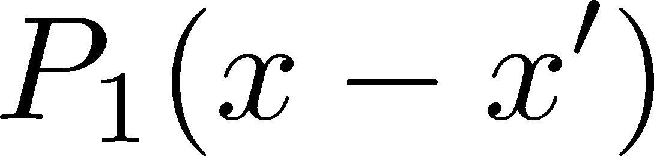
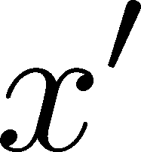
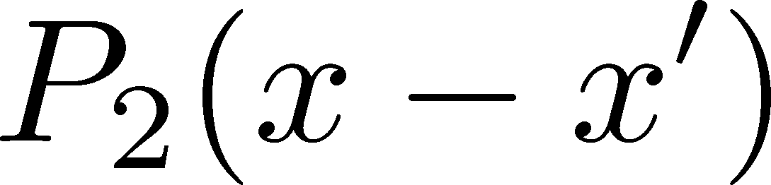
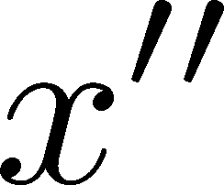
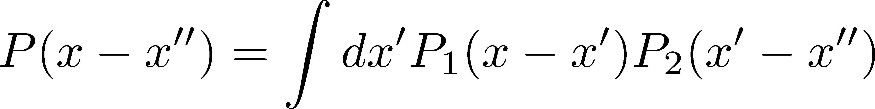
Diffusion + Thermal Blurring
Hadronization
diffusion
Kinetic f.o. (coordinate space)
blurring
Kinetic f.o. (momentum space)
Total diffusion:
Diffusion + thermal blurring = described by a single P(x)
Both are consistent with Gaussian → Single Gaussian

Slide 45



Baryons in Hadronic Phase
time
chem. f.o.
hadronize
10~20fm
kinetic f.o.
Baryons behave like
Brownian pollens in water
mesons
baryons

Slide 46


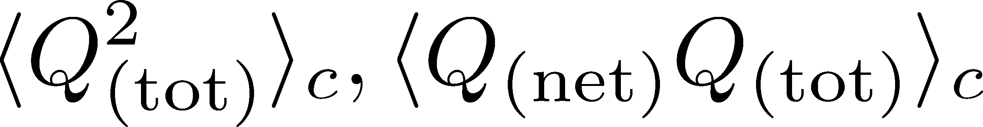
Time Evolution in Hadronic Phase
Hadronization (initial condition)
Boost invariance / infinitely long system
Local equilibration / local correlation
suppression owing to
local charge conservation
strongly dependent on
hadronization mechanism

Slide 47
Time Evolution in Hadronic Phase
Hadronization (initial condition)
Boost invariance / infinitely long system
Local equilibration / local correlation
Diffusion + Blurring
suppression owing to
local charge conservation
strongly dependent on
hadronization mechanism
Detector

Slide 48
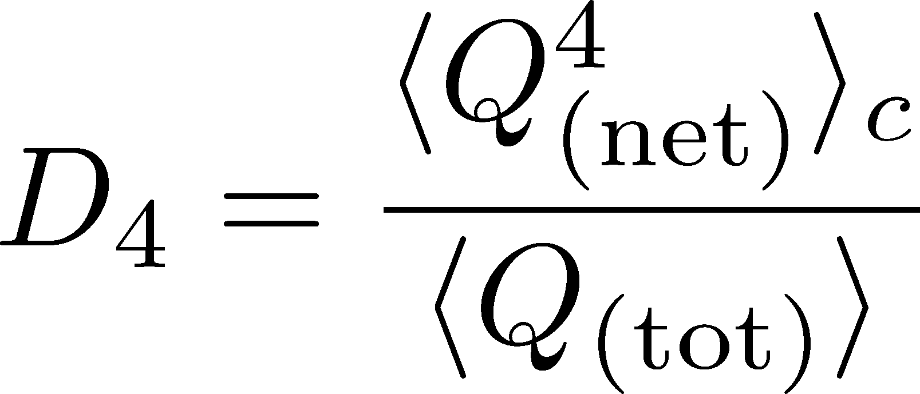



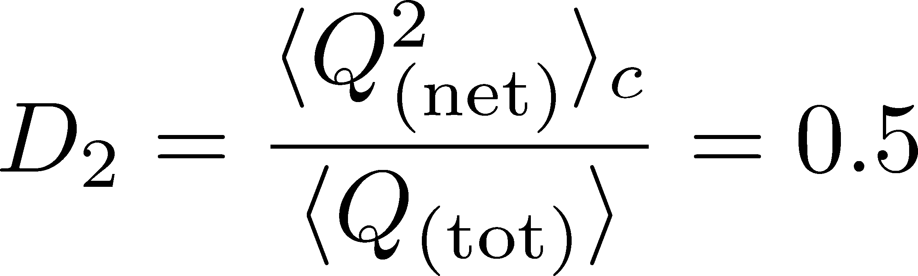

Δη Dependence: 4th order
MK, NPA (2015)
Initial Condition
new
normalization
Characteristic Δη dependences!

Slide 49
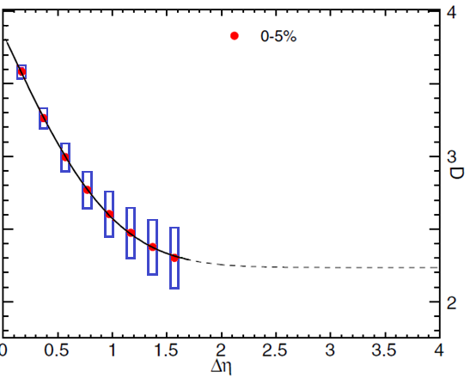

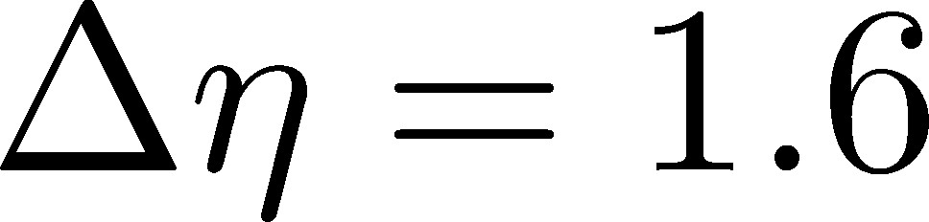
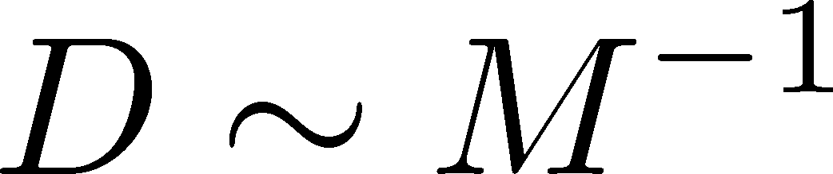
Δη Dependence: 4th order
MK, NPA (2015)
Initial Condition
baryon #
at ALICE
at ALICE

Slide 50
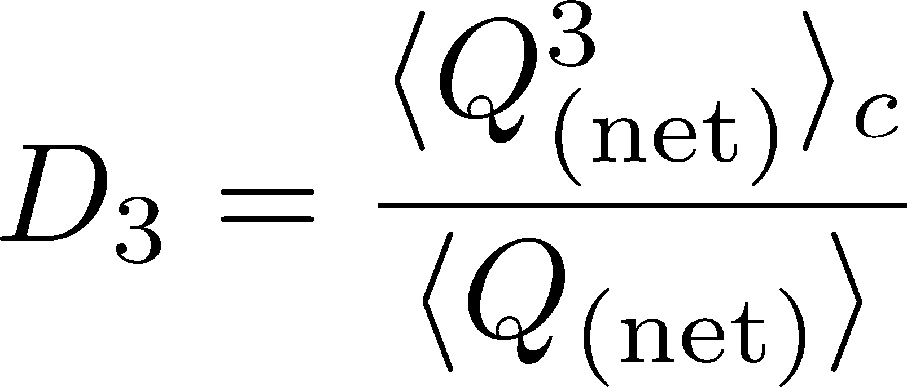
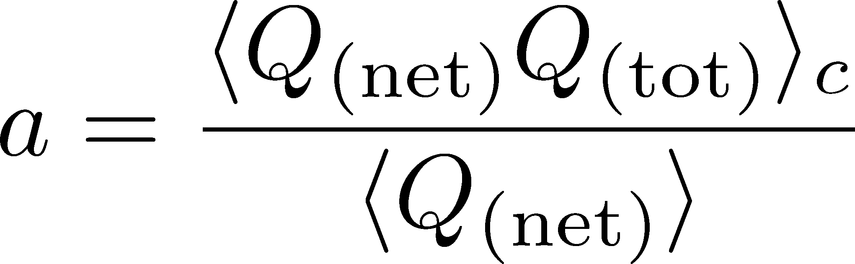
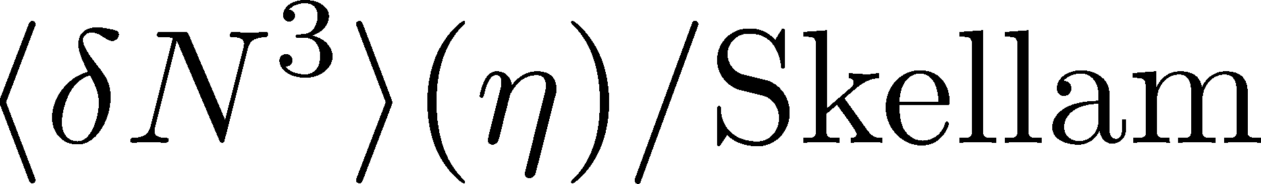
Δη Dependence: 3rd order
MK, NPA (2015)
Initial Condition
baryon #
at ALICE
at ALICE

Slide 51


4th order : Large Initial Fluc.
MK, NPA (2015)
Initial Condition
baryon #
at ALICE
at ALICE

Slide 52

Δη Dependence @ STAR
X. Luo, CPOD2014
MK, 2015
Non-monotonic
dependence on Δy ?

Slide 53
Effect of Global Charge Conservation
(Finite Volume Effect)
Sakaida, Asakawa, MK, PRC, 2014

Slide 54


Global Charge Conservation
Conserved charges in the total system do no fluctuate!
1
0

Slide 55

Global Charge Conservation
Conserved charges in the total system do no fluctuate!
1
0
An Estimate of GCC Effect
Jeon, Koch, PRL2000; Bleicher, Jeon, Koch (2000)

Slide 56





Diffusion in Finite Volume
Solve the diffusion master equation in finite volume
Infinite Sys.
(No GCC Effect)
: Average
Diffusion Length
: Diffusion
Coefficient

Slide 57

Diffusion in Finite Volume
Solve the diffusion master equation in finite volume
Infinite Sys.
(No GCC Effect)
: Average
Diffusion Length
effect of
GCC
: Diffusion
Coefficient
effect of
GCC
suppression only for

Slide 58









Physical Interpretation
slide by M. Sakaida
: Averaged Diffusion Distance
: Diffusion Coefficient
: Total Length of Matter
Time Passes…
Condition for effects of the GCC
Effects of the GCC appear
only near the boundaries.

Slide 59






Comparison with ALICE Result
without initial fluc.
with initial fluc.
time
No GCC effect in ALICE experiments!
Same conclusion for higher order cumulants

Slide 60
Summary
Plenty of information in Δη
dependences of various cumulants
and those of non-conserved charges, mixed cumulants…
With Δη dep. we can explore
primordial thermodynamics
non-thermal and transport property
effect of thermal blurring

Slide 61
Future Studies
Experimental side:
rapidity window dependences
baryon number cumulants
BES for SPS- to LHC-energies
Theoretical side:
rapidity window dependences in dynamical models
description of non-equilibrium non-Gaussianity
accurate measurements on the lattice
Both sides:
Compare theory and experiment carefully
Let’s accelerate our understanding on fluctuations!

