Slide 1
For the J-PARC Heavy-Ion Collisions
Masakiyo Kitazawa

Slide 2
Remarks!
No solid results in this talk. Just delusional ideas.
I am waiting for your opinions / discussions (throughout this meeting)!
I welcome your criticisms.

Slide 3
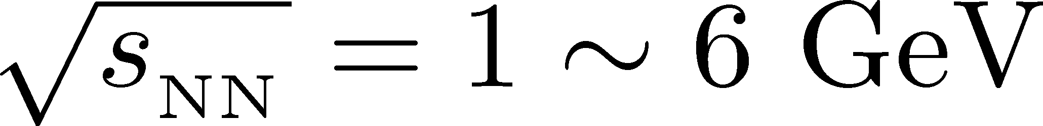
What Physics are Suitable for J-PARC HIC?
Characteristics of J-PARC HIC
High density
High luminosity
QCD phase transitions
Neutron stars / NS-NS merger
Various event selections
Rare probes
Event-by-event analyses
Take advantages of these properties!

Slide 4
What Physics are Suitable for J-PARC HIC?
Characteristics of J-PARC HIC
High density
High luminosity
QCD phase transitions
Neutron stars / NS-NS merger
Various event selections
Rare probes
Event-by-event analyses

Slide 5
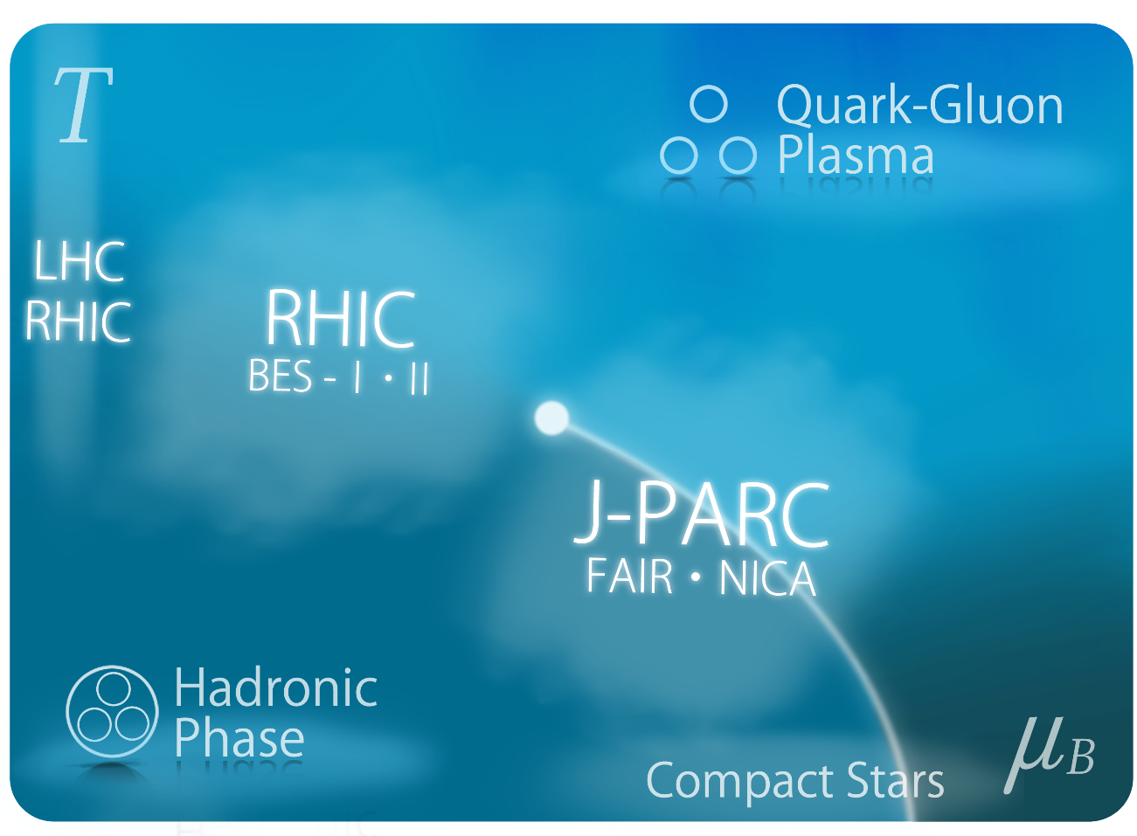
High Density
Special thanks to
C. Matsumura
Search of dense medium / QCD phase transitions

Slide 6
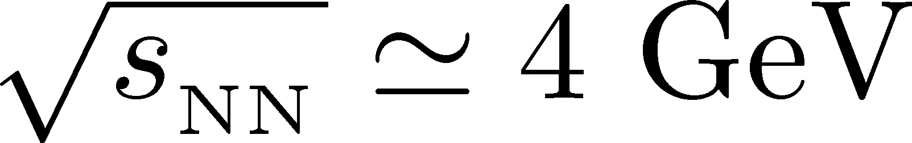

How Dense? : Freezeout
Chemical Freezeout
The most dense system at CFO
with ρ ~ 0.7 ρ₀ is realized at
Randrup, Cleymans, 2006
It is in J-PARC energy

Slide 7

How Dense? : Highest
would be realized!
On the other hand,
JAM can reproduce dv₁/dy and p_{T} spectra for J-PARC energy.
Nara-san’s talk, yesterday
Why?
I.C. Arsene+, PRC 75, 034902 (2007)

Slide 8
What Physics are Suitable for J-PARC HIC?
Characteristics of J-PARC HIC
High density
High luminosity
QCD phase transitions
Neutron stars / NS-NS merger
Various event selections
Event-by-event analyses
Rare Probes

Slide 9
Large E-v-E Fluctuation?
Ohnishi, 2002
Baryon stopping seems to have strong e-v-e fluctuation.

Slide 10

Origin of e-v-e fluctuation 1:
Stopping → Penetrate Transition
Structural Transition
stopping → penetrate
Large fluctuation!

Slide 11
Origin of e-v-e fluctuation 2:
Softening of EoS
Softening of the EoS
Enhanced susceptibility
Large Fluctuation!

Slide 12
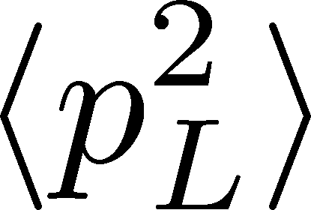

E-v-E Fluctuation of Density
How to Observe Them?
We need observables
sensitive to baryon stopping
Ex.
Or, strange number?
(by Nu Xu)

Slide 13

E-v-E Fluctuation of Density:
How to Use Them?
Event selection by
baryon stopping
BDS
BES
Baryon density Scan??
(BDS)

Slide 14

BDS (Baryon Density Scan)
average transverse energy
non-monotonic
behavior
as evidence of 1st. tr?
Baryon-rich
events
faster
increase

Slide 15
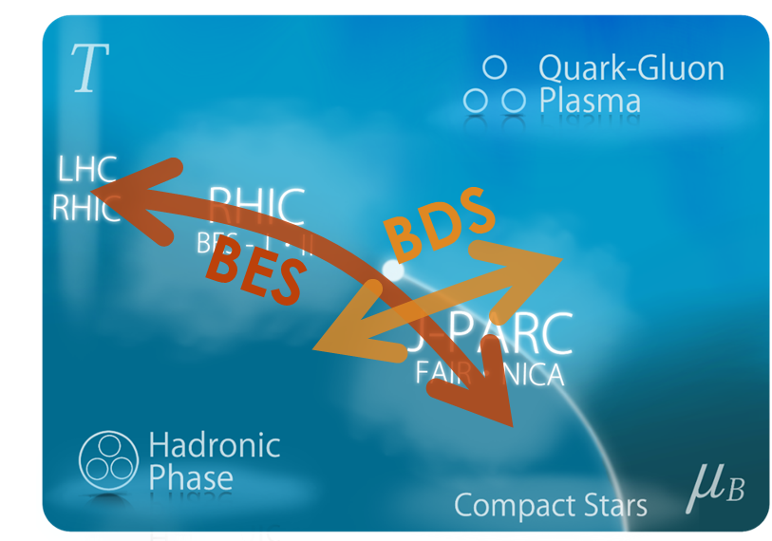

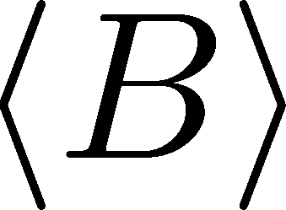

BDS (Baryon Density Scan)
average transverse energy
B
Baryon-rich
events
A
A
B
Softening of EoS
by 1st transition

Slide 16
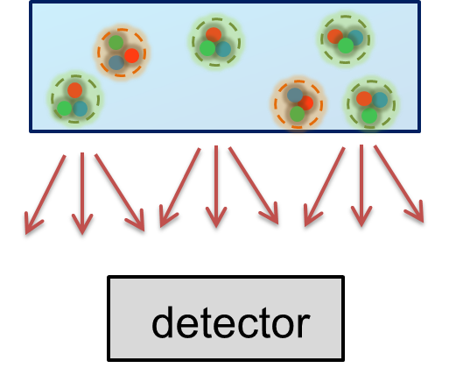
Event-by-event Fluctuations:
Compared with high energy
Thermal fluctuations
are concerned @ high √s.
Measurement of thermal fluc.
justified only under Bjorken picture
Asakawa, MK, arXiv:1512.05038
Pictorial
view for
low √s
STAR Collaboration, 2015

Slide 17
Other Ideas
Event-by-event dv₁/dy, raial flow, …
Correlation b/w baryon stopping and
  v₁, strangeness, dE_{T}/dy, …

Slide 18
What Physics are Suitable for J-PARC HIC?
Characteristics of J-PARC HIC
High density
High luminosity
QCD phase transitions
Neutron stars / NS-NS merger
Various event selections
Event-by-event analyses
Rare Probes

Slide 19
Rare Probes
Exotic hadrons
Strangelet
Strangeness
Anti-protons

Slide 20
Stochastic Description for anti-p and s transports?
Creation:
pp-bar pair production
Transport:
diffusion +
survival game
against annihilation

Slide 21
And, of course,
Other Many Important Topics

Slide 22
Liquid-Gas Phase Transition of
Nuclear Medium
Any possibility to perform a similar analysis in HIC…?

Slide 23
Summary
Characteristics of J-PARC HIC
High density / High luminosity
We should be able to have more ideas to take these advantages of low-energy collisions!
event selections / e-b-e analyses / rare probes
Important to accelerate J-PARC/FAIR/NICA programs!

