Slide 1
Understanding Experimentally-Observed Fluctuations
Masakiyo Kitazawa
(Osaka U.)
MK, Asakawa, Ono, Phys. Lett. B728, 386-392 (2014)
Sakaida, Asakawa, MK, PRC90, 064911 (2014)
MK, Nucl. Phys. A942, 65 (2015)
MK, Phys. Rev. C93, 044911 (2016)
Ohnishi, MK, Asakawa, to appear soon.
CPOD2016, Wroclaw, Poland, 2/Jun./2016

Slide 2
J-PARC Heavy-Ion Program
fixed target HI experiment
E_{lab}<20GeV/A (√s_{NN}<6.2 GeV)
Exploit Main Ring for p accel.
High luminosity beam
Earliest possible schedule
Jun 2016
Jun 2016
2016-2019
2020
2021
2021-2022
2021-2023
2023-2024
2025
White paper completed
Submission of LOI
Discussions in J-PARC, KEK, Japanese Nuclear Physics Committee, Science Council of Japan
Funding request to MEXT
Approval of funding
Construction of HI Injector
Construction of HI injection system in RCS
Construction of HI spectrometer
First collision

Slide 3
J-PARC Heavy-Ion Program
fixed target HI experiment
E_{lab}<20GeV/A (√s_{NN}<6.2 GeV)
Exploit Main Ring for p accel.
High luminosity beam
White Paper
Earliest possible schedule
Jun 2016
Jun 2016
2016-2019
2020
2021
2021-2022
2021-2023
2023-2024
2025
White paper completed
Submission of LOI
Discussions in J-PARC, KEK, Japanese Nuclear Physics Committee, Science Council of Japan
Funding request to MEXT
Approval of funding
Construction of HI Injector
Construction of HI injection system in RCS
Construction of HI spectrometer
First collision
Now available on
http://asrc.jaea.go.jp/soshiki/gr/hadron/jparc-hi/

Slide 4

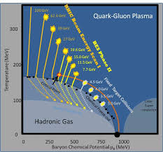


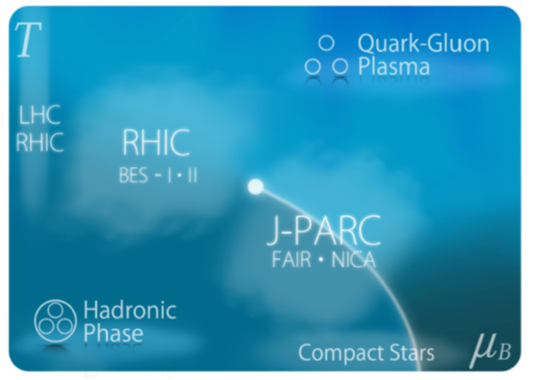
J-PARC Heavy-Ion Program
BES-II
FAIR
NICA
J-PARC
New Useful Application
for your research!!
fixed target HI experiment
E_{lab}<20GeV/A (√s_{NN}<6.2 GeV)
Exploit Main Ring for p accel.
High luminosity beam
White Paper
Earliest possible schedule
Jun 2016
Jun 2016
2016-2019
2020
2021
2021-2022
2021-2023
2023-2024
2025
White paper completed
Submission of LOI
Discussions in J-PARC, KEK, Japanese Nuclear Physics Committee, Science Council of Japan
Funding request to MEXT
Approval of funding
Construction of HI Injector
Construction of HI injection system in RCS
Construction of HI spectrometer
First collision
Now available on
http://asrc.jaea.go.jp/soshiki/gr/hadron/jparc-hi/

Slide 5
Fluctuations

Slide 6
Thermal Fluctuations
Observables are fluctuating even in an equilibrated medium.
P(N)
N
V
N

Slide 7
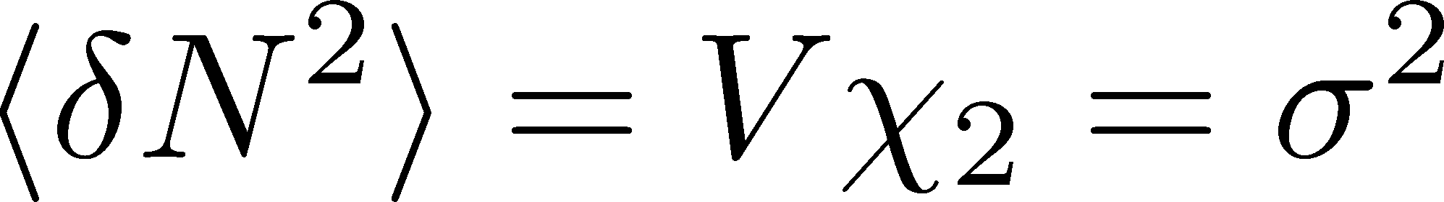

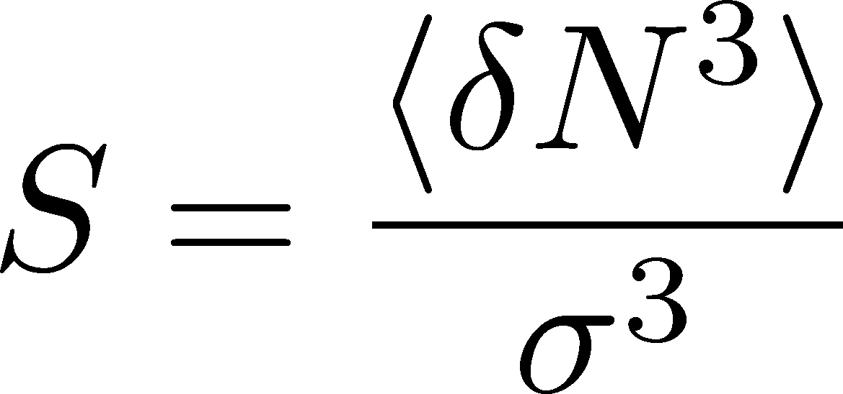
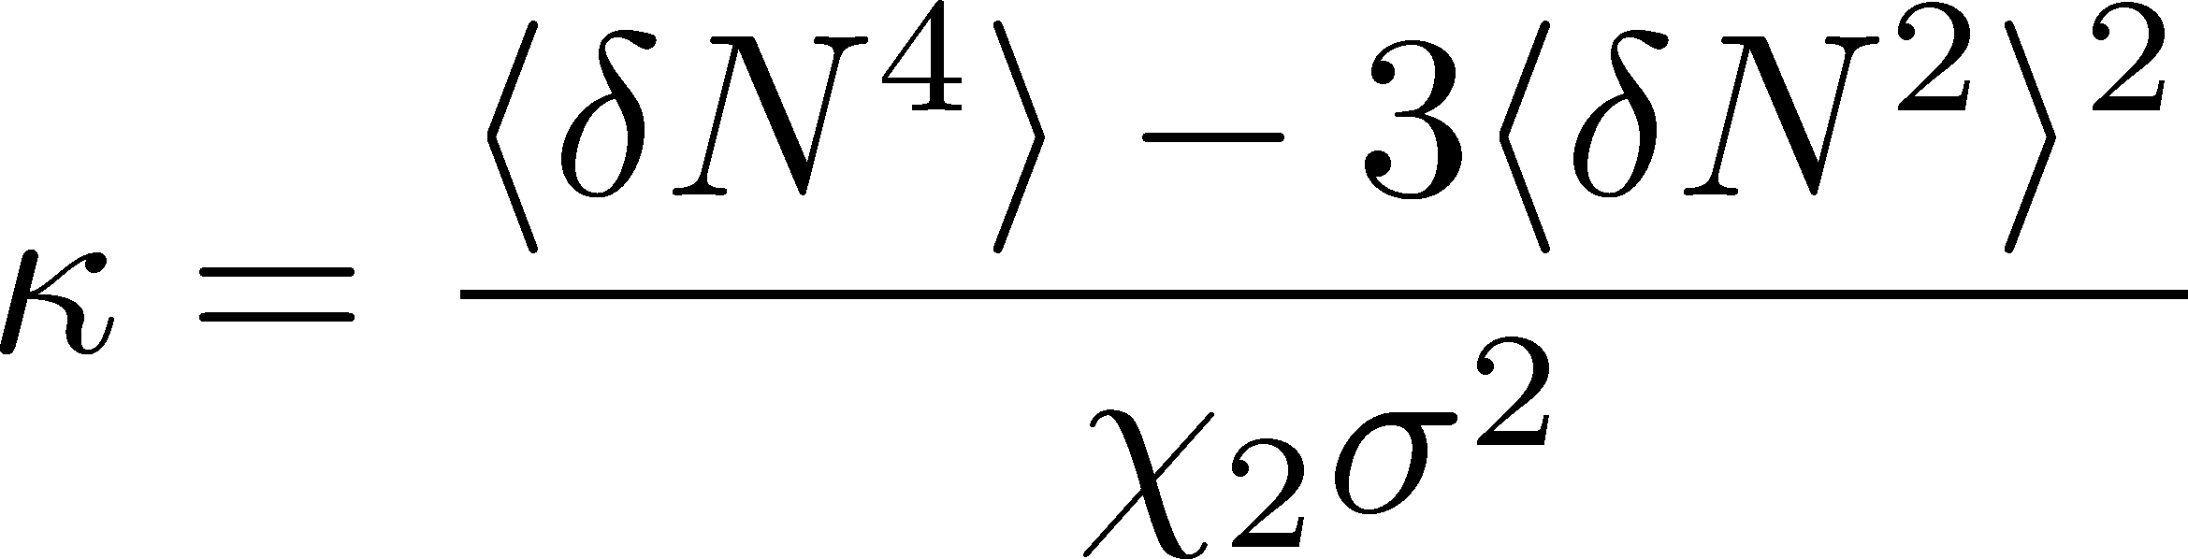
Thermal Fluctuations
Observables are fluctuating even in an equilibrated medium.
P(N)
N
V
N
Variance:
Non-Gaussianity
Skewness:
Kurtosis:

Slide 8


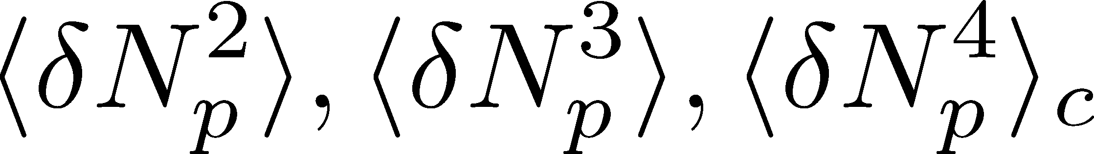
Event-by-Event Analysis @ HIC
Fluctuations can be measured by e-by-e analysis in experiments.
STAR, PRL105 (2010)
Detector

Slide 9
Event-by-Event Analysis @ HIC
Fluctuations can be measured by e-by-e analysis in experiments.
V
Detector

Slide 10
A Review Article
PPNP, in press,
arXiv:1512.05038v2
What are cumulants?
Why Sσ/(Skellam) and κσ²?
  what are the “baselines”?
Why conserved charges?
What are event-by-event fluctuations?
  their relation with theoretical analyses?

Slide 12
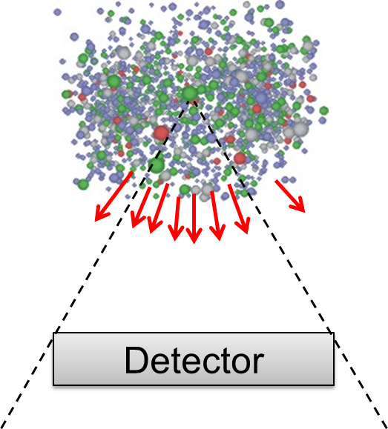
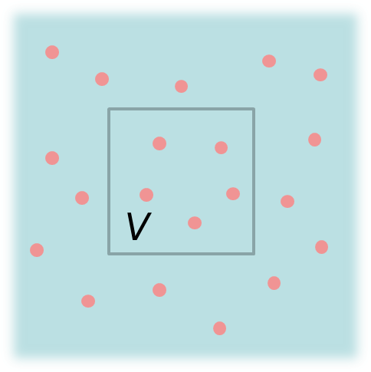
Two Problems
in connecting experiments with theories
1. Thermal blurring and diffusion of fluctuations
MK, Asakawa, Ono, PLB328, 386 (2014);
Sakaida, Asakawa, MK, PRC90, 064911 (2014);
MK, NPA942, 65 (2015);
Ohnishi, MK, Asakawa, to appear soon.
2. Efficiency correction of cumulants
MK, PRC93, 044911 (2016).

Slide 13
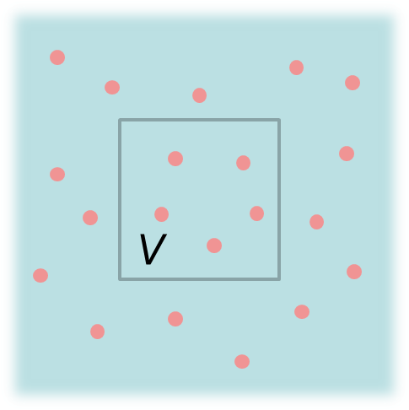
Fluctuations: Theory vs Experiment
Theoretical analyses
based on statistical mechanics
Experiments
lattice, critical point,
effective models, …
Fluctuation in
a spatial volume
Fluctuations in
a momentum space
discrepancy in phase spaces
Asakawa, Heinz, Muller, 2000; Jeon, Koch, 2000; Shuryak, Stephanov, 2001

Slide 14
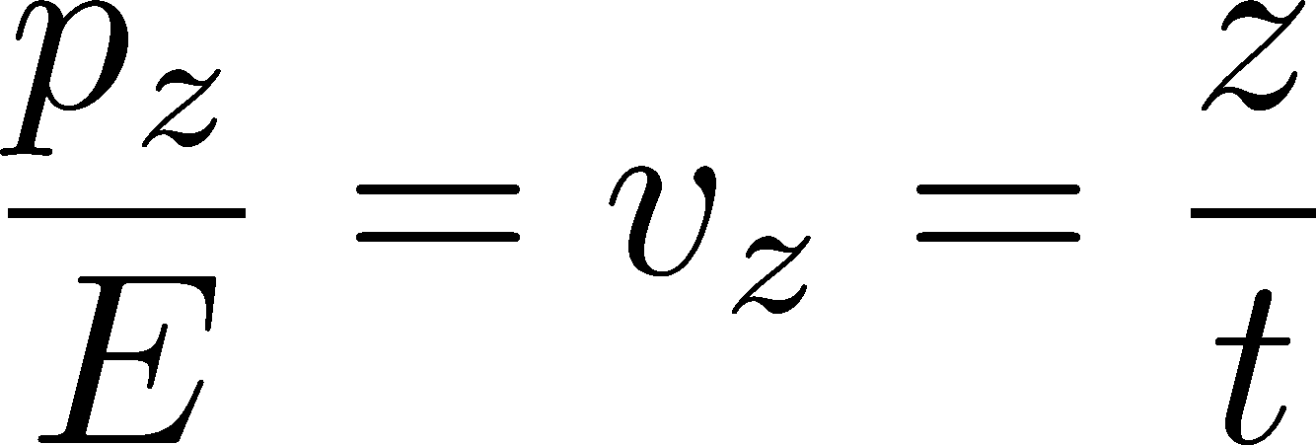






Connecting Phase Spaces
Asakawa, Heinz, Muller, 2000
Jeon, Koch, 2000
Under Bjorken picture,
coordinate-space rapidity Y
momentum-space rapidity y
of medium
momentum-space rapidity y
of individual particles

Slide 15




Thermal Blurring
Asakawa, Heinz, Muller, 2000
Jeon, Koch, 2000
Detector
Distributions in ΔY and
Δy are different due to
“thermal blurring”.

Slide 16
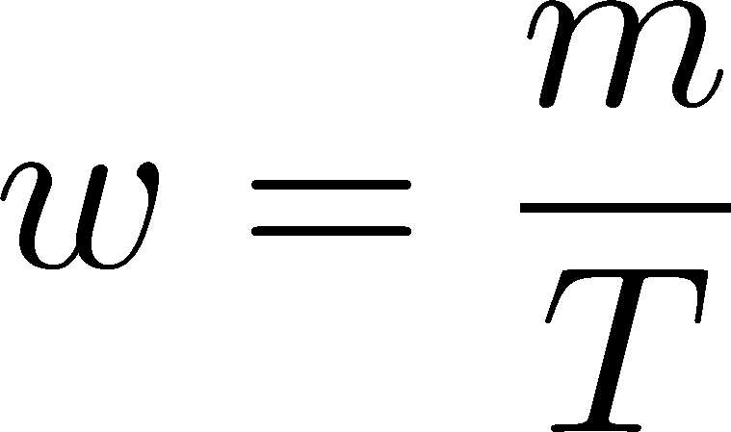



Thermal distribution in y space
Y. Ohnishi+
to appear soon
nucleon
pions
nucleons
pion
Blast wave squeezes the
distribution in rapidity space
blast wave
flat freezeout surface

Slide 17
Thermal distribution in y space
Y. Ohnishi+
to appear soon
pions
nucleons
half-width (Δy)
kurtosis
Rapidity distribution can be
well approximated by Gaussian.
blast wave
flat freezeout surface

Slide 18


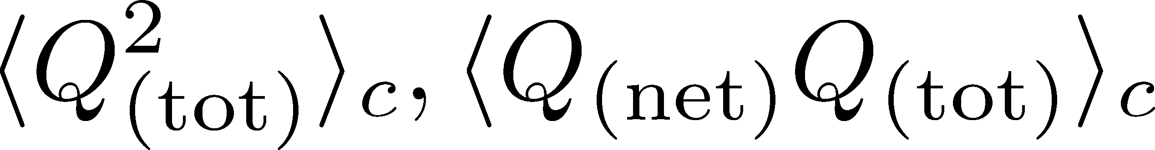
Initial Condition
Boost invariance / infinitely long system
Local equilibration / local correlation
Detector
We need 6 parameters
to specify the initial fluctuation

Slide 19
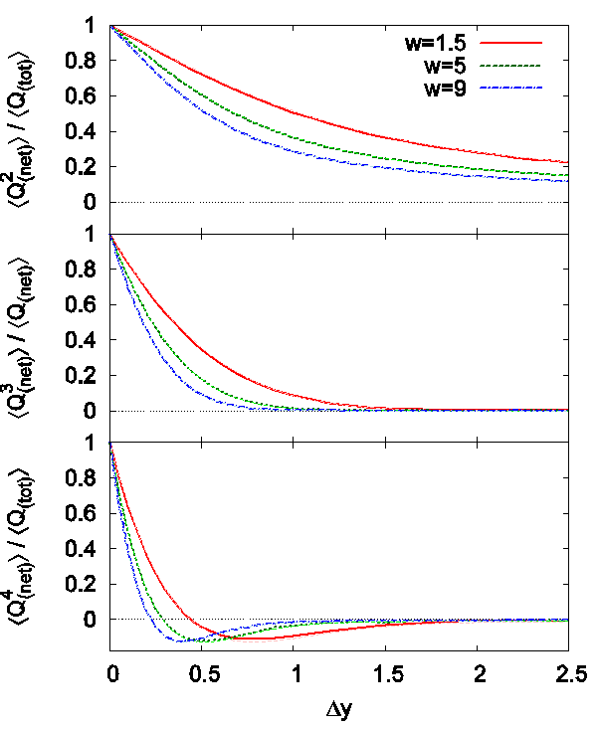
Δη Dependence
Cumulants after blurring
Initial condition
(before blurring)
no e-v-e fluctuations
Cumulants after blurring
can take nonzero values
With Δy=1, the effect is
not well suppressed

Slide 20

Centrality Dependence
ALICE, 2013
lower T
larger β
Weaker
blurring
More central
Is the centrality dependence understood solely by the thermal blurring at kinetic f.o.?

Slide 21
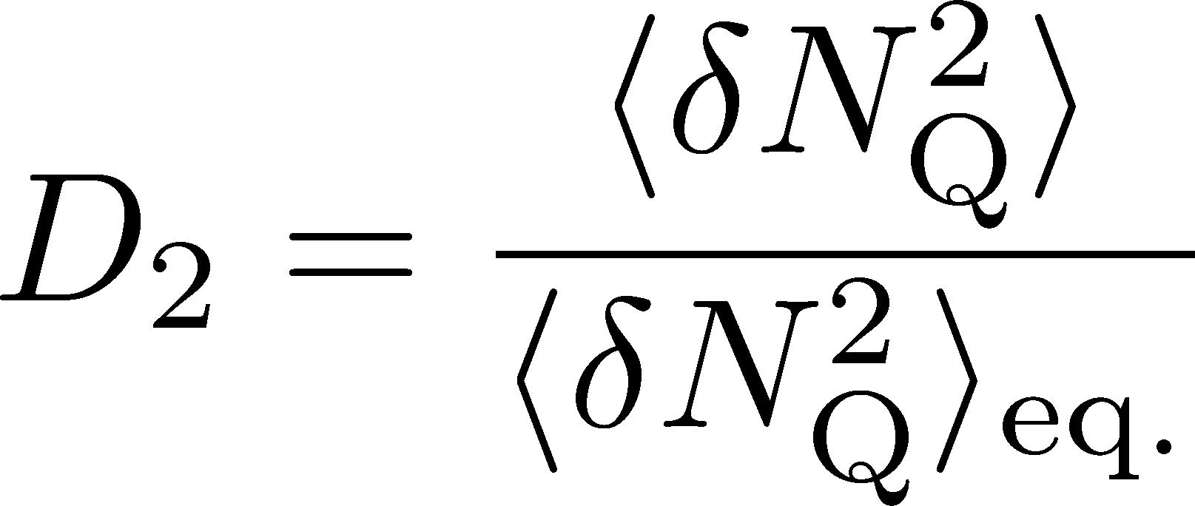
Centrality Dependence @ ALICE
Assumptions:
Centrality independent cumulant at kinetic f.o.
Thermal blurring at kinetic f.o.
Centrality dep. of fluctuation can be described
by a simple thermal blurring picture.

Slide 22
Diffusion Before Kinetic F.O.
Detector
Distributions in ΔY and
Δy are different due to
“thermal blurring”.
Fluctuations in ΔY continue
to change before kinetic f.o.
These 2 processes can be
treated as a single diffusion.

Slide 23
Diffusion Before Kinetic F.O.
Boost invariance / infinitely long system
Local equilibration / local correlation
Detector
Initial Condition
We need 6 parameters
to specify the initial fluctuation

Slide 24
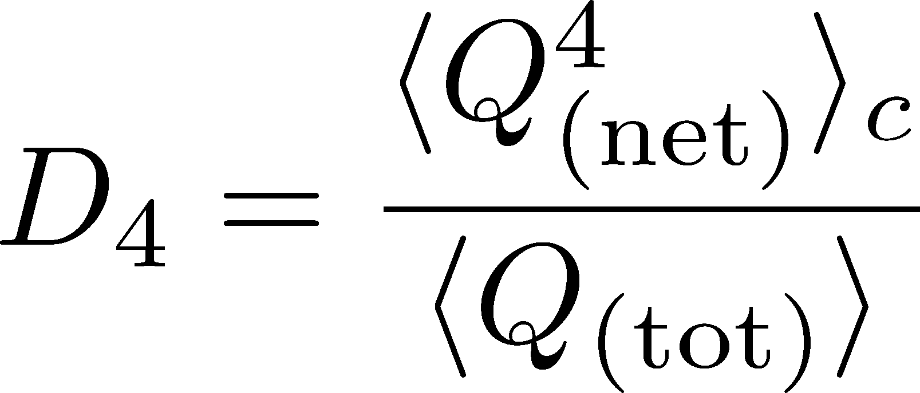



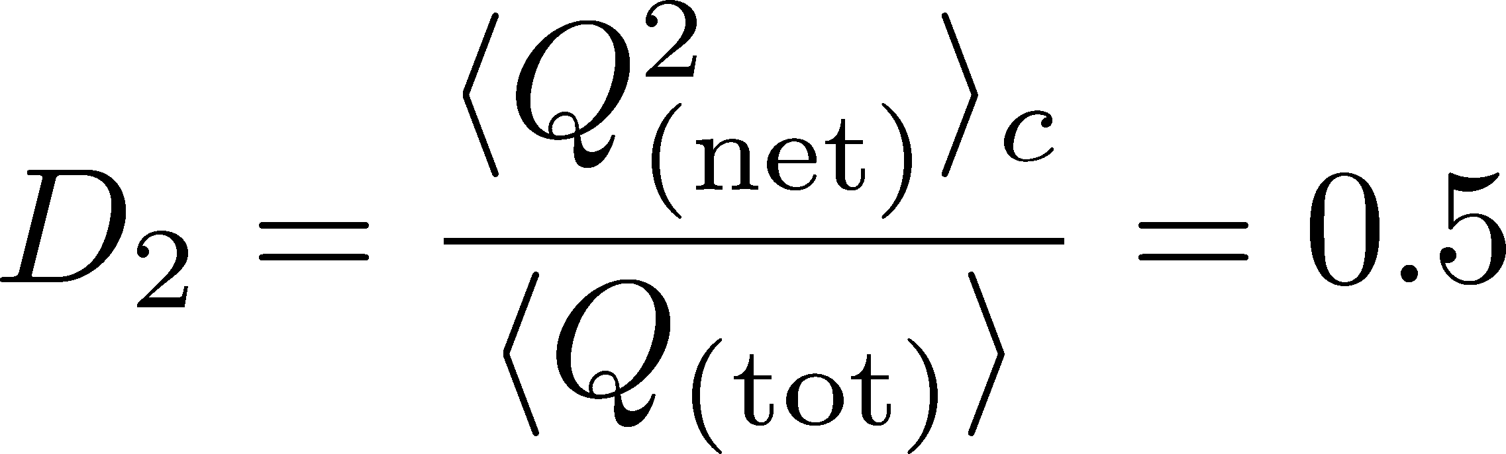

Δη Dependence: 4th order
MK, Asakawa, PLB(2014)
MK, NPA(2015)
Initial Condition
Characteristic Δη dependences!

Slide 25
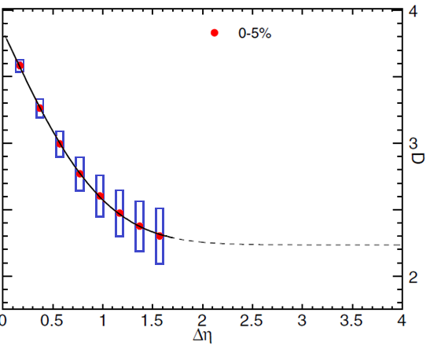


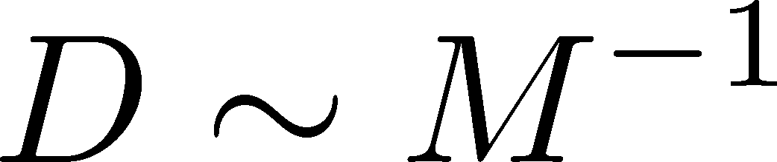
Δη Dependence: 4th order
MK, Asakawa, PLB(2014)
MK, NPA(2015)
Initial Condition
baryon #
at ALICE
at ALICE

Slide 26
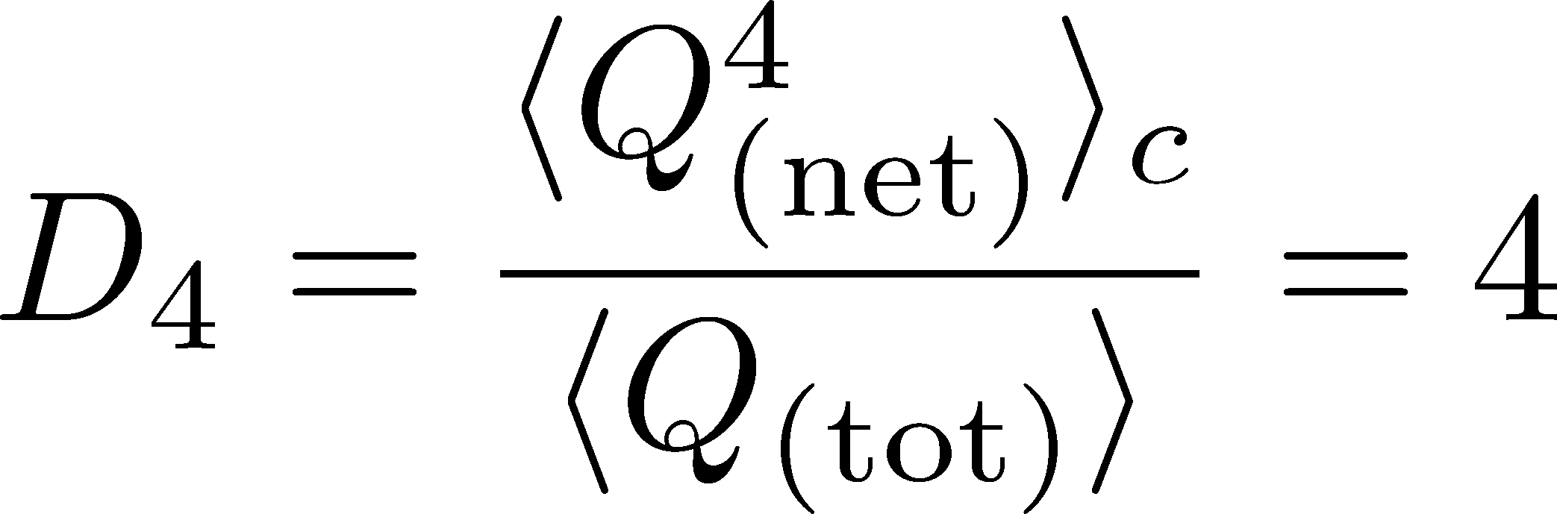
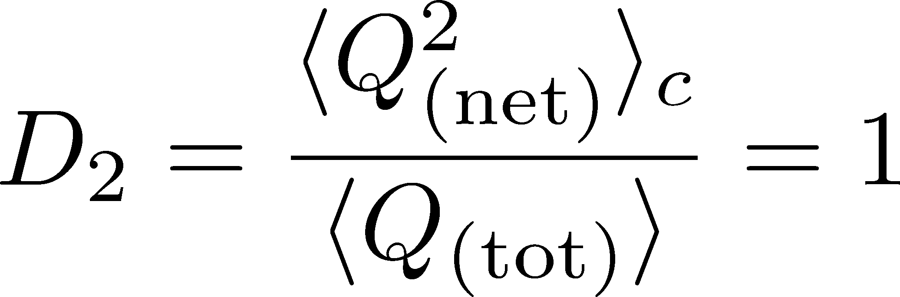
4th order : w/ Critical Fluctuation
MK, Asakawa, PLB(2014)
MK, NPA(2015)
Initial Condition
baryon #
at ALICE
at ALICE

Slide 27
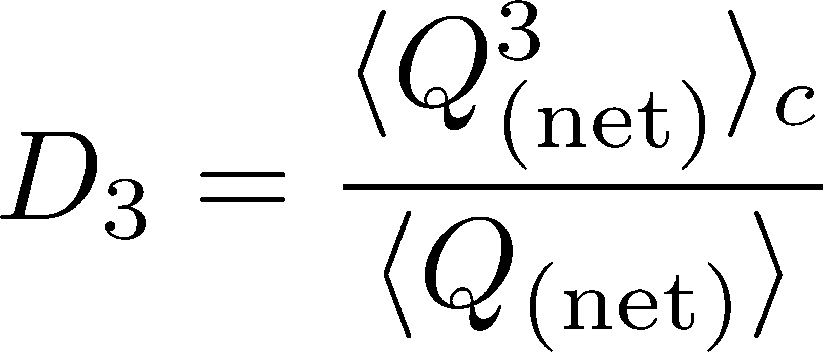
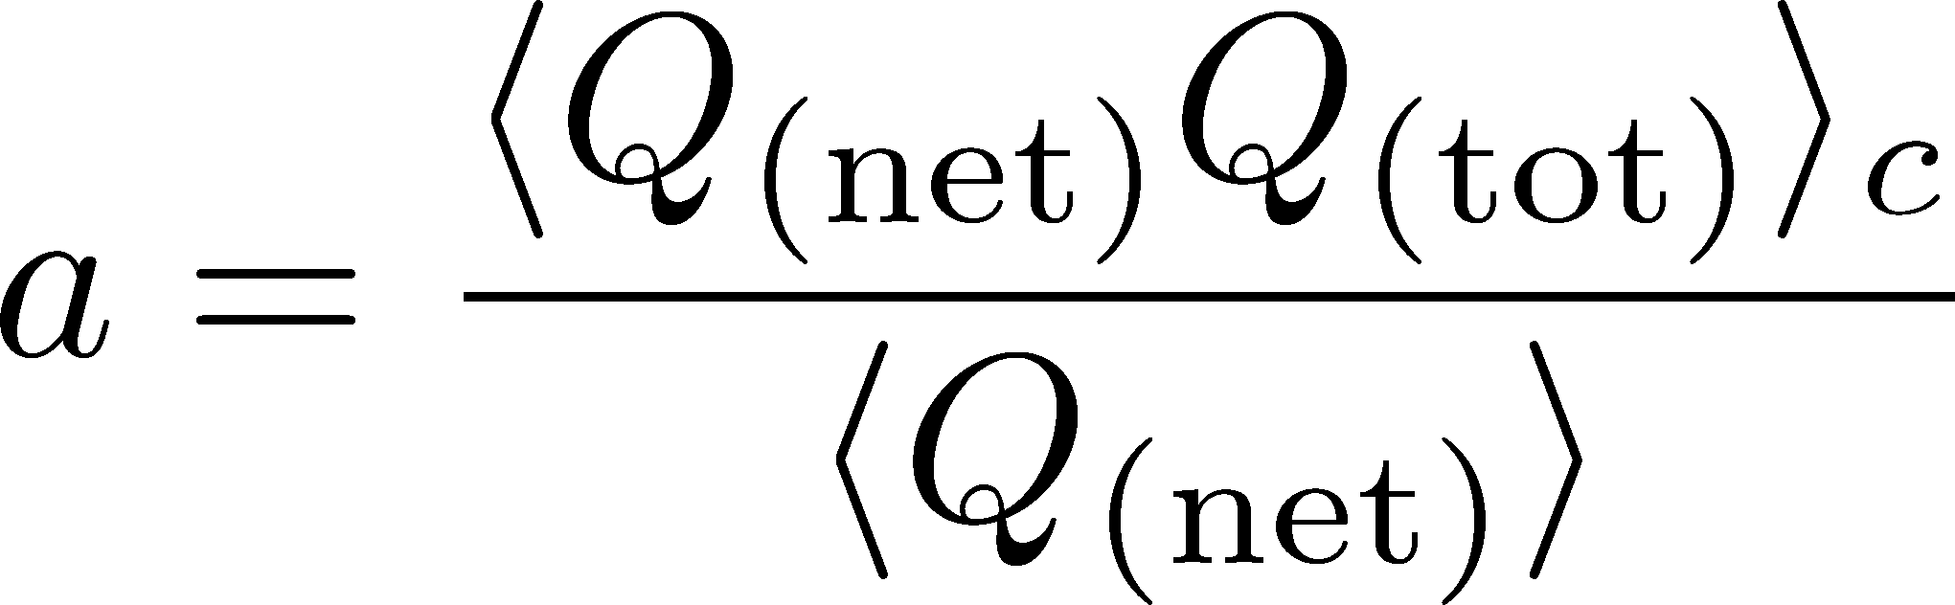
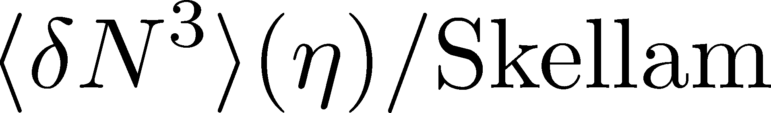
Δη Dependence: 3rd order
MK, Asakawa, PLB(2014)
MK, NPA(2015)
Initial Condition
baryon #
at ALICE
at ALICE

Slide 28

Δη Dependence @ STAR
X. Luo, CPOD2014
MK, 2015
Non-monotonic dependence on Δy ?

Slide 29

Very Low Energy Collisions
Large contribution of global charge conservation
Violation of Bjorken scaling
detector
Fluctuations at low √s should be interpreted carefully!

Slide 30
Summary of 1st Part
Effect of thermal blurring provoked by rapidity conversion is not negligible with Δy=1.0.
Higher order cumulants can behave characteristically as functions of Δy.
This behavior can be used to constrain
  the magnitude of thermal blurring, and
  fluctuations in the early stage.
The study of centrality dependence is also interesting.

Slide 31
Two Problems
in connecting experiments with theories
1. Thermal blurring and diffusion of fluctuations
MK, Asakawa, Ono, PLB328, 386 (2014);
Sakaida, Asakawa, MK, PRC90, 064911 (2014);
MK, NPA942, 65 (2015);
Ohnishi, MK, Asakawa, to appear soon.
2. Efficiency correction of cumulants
MK, PRC93, 044911 (2016).

Slide 32
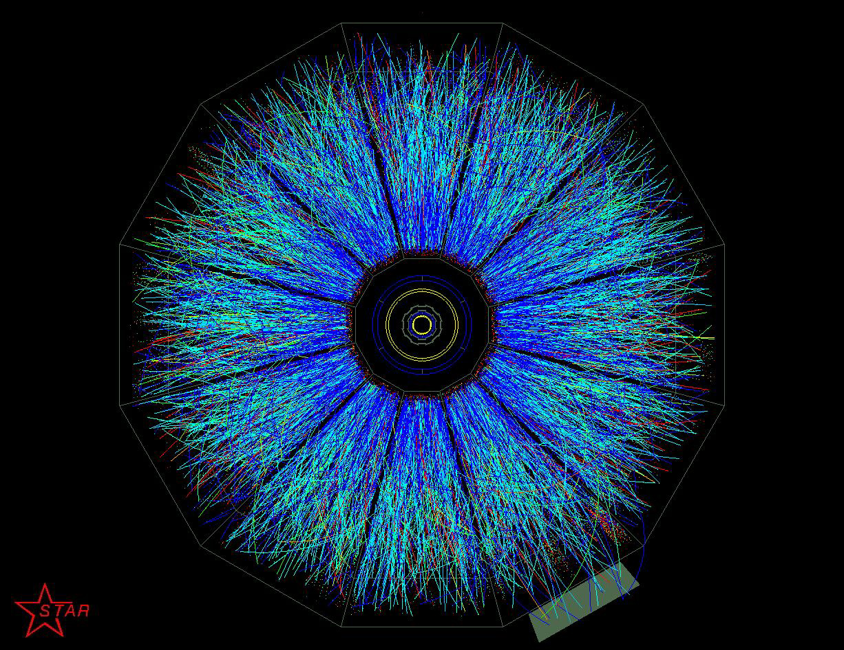
Efficiency
Detectors cannot definitely measure
all particles entering there
efficiency ε
probability to detect a particle
Efficiency correction is essential for all observables in experiments.

Slide 33
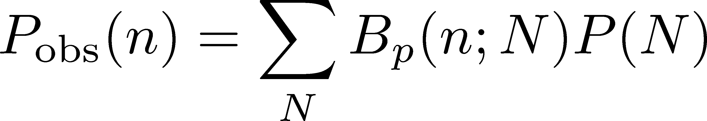
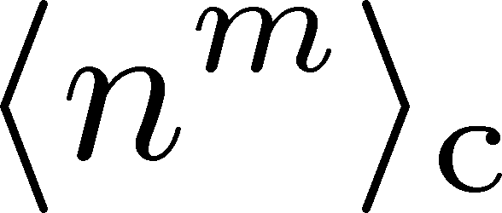
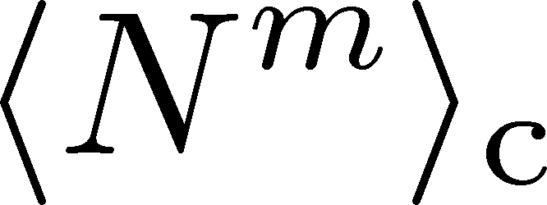
The Binomial Model
MK, Asakawa, 2012; 2012
Bzdak, Koch, 2012
When efficiency for individual particles are independent
dist. func. of
observed particle #
binmial
dist. func.
dist. func. of
original particle #
The cumulants connected with each other
Caveat: Effects of nonvanishing correlations: Holtzman+ 2016

Slide 34
Formulas using factorial moments: Bzdak, Koch, 2012

Slide 35
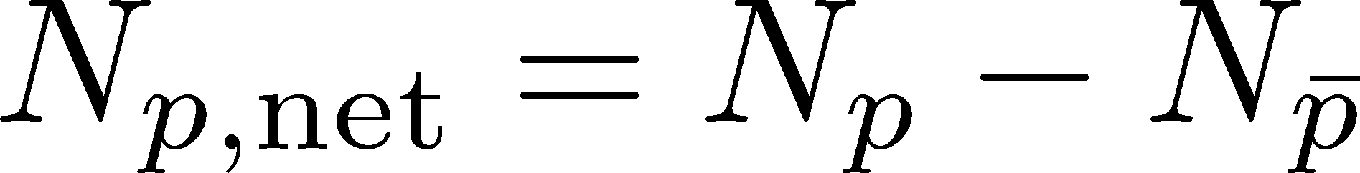


Summing up Multiple Variables
Net-particle number
STAR, PRL2014
MK, Asakawa, 2012; Bzdak, Koch, 2012
Multi-particle species
net-electric charge
p_{T} dependent efficiency
average (common)
efficiency for p and p
-
Bzdak, Koch, 2015; Luo, 2014
cf, Nonaka+, 1604.06212
STAR, net proton
TPC ε∼80%
TPC+TOF ε∼50%

Slide 36
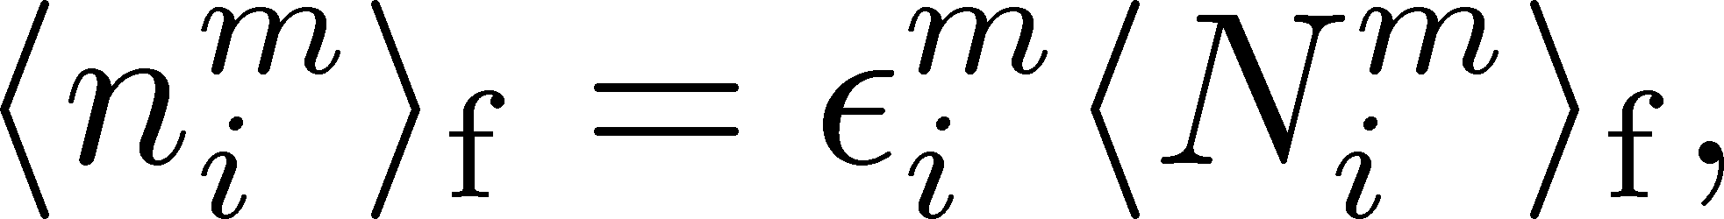
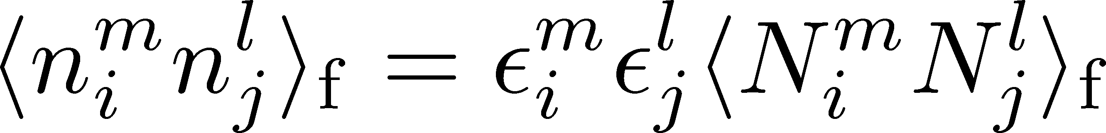

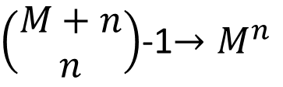
Efficiency Correction with Factorial Moments
Bzdak, Koch, 2015; Luo, 2014
Simple relations
b/w factorial moments
n_{i}: observed particle #
N_{i}: original particle #
ε_{i}: efficiency
Calculate all factorial moments of n_{i}
Translate it into original moments N_{i}
Construct the cumulant N_{i}
Problem
Number of f-moments for
nth order with M variables
$\left(\begin{matrix}M+n \\ n\end{matrix}\right)$-1$→M^{n}$
Require huge
numerical power

Slide 37
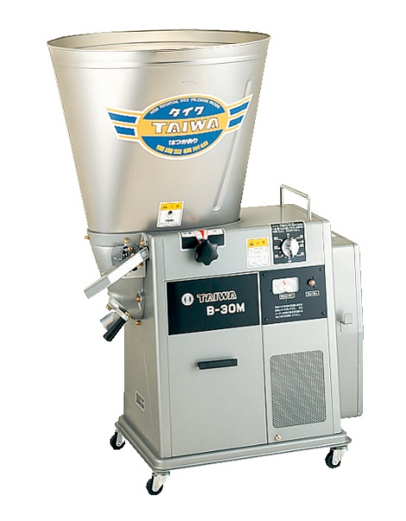
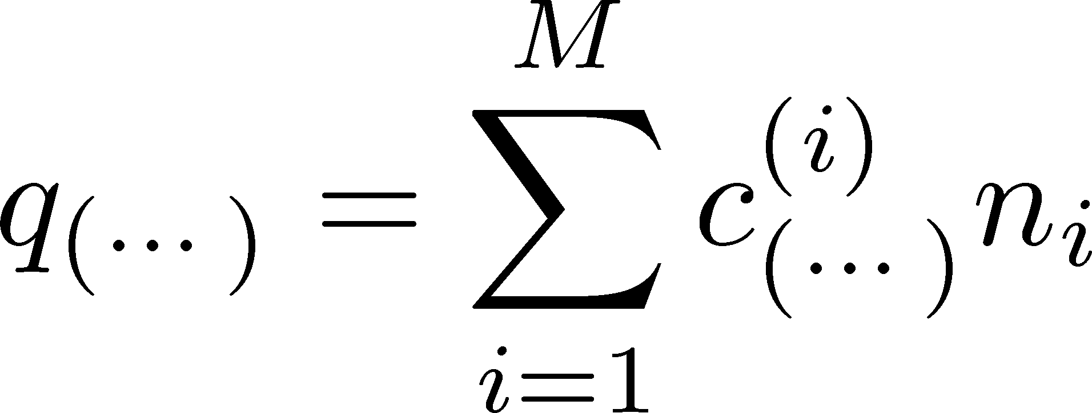
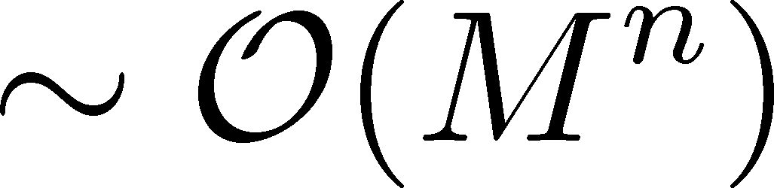


New Formulas for Efficiency Correction
MK, PRC,2016
[1602.01234]
linear combination of
original particle numbers
linear combination of
observed particle numbers
Numerical Cost
For nth order and M variables
F-moment method
Our method

Slide 38
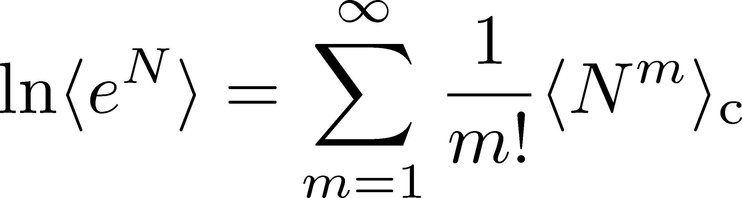
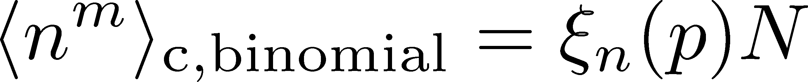

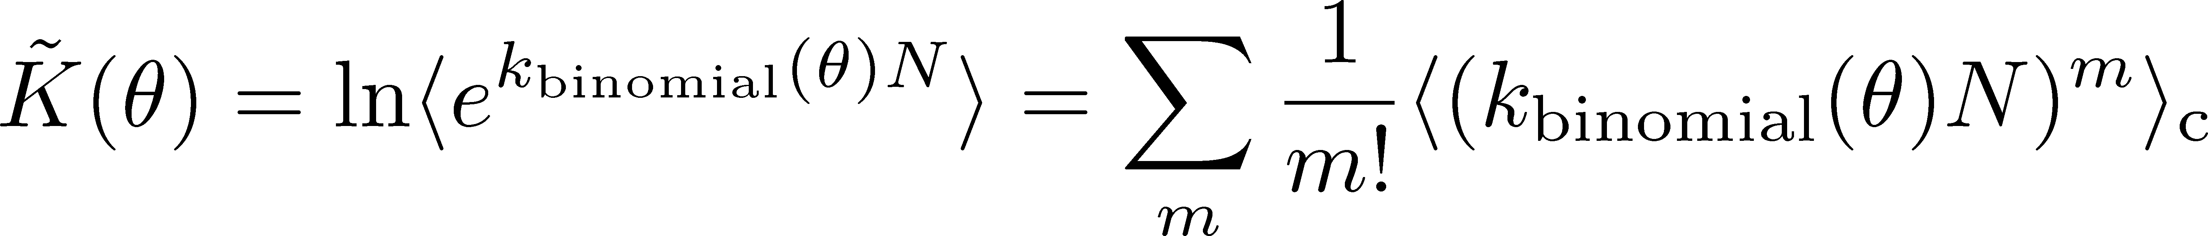
Derivation
(1) Cumulant expansion
(2) “Linearity” of binomial distribution
(3) Treating multi-variable dist. func.

Slide 39
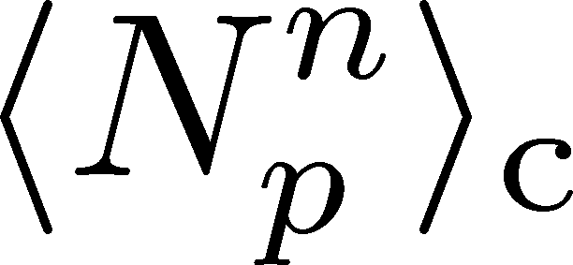
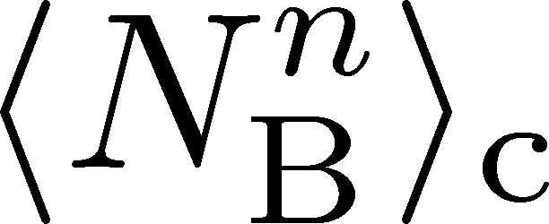
Proton v.s. Baryon Number Cumulants
MK, Asakawa, 2012; 2012
Experiments
proton number cumulants
Many theories
baryon number cumulants
measurement with
50% efficiency loss
The difference would be large.
Reconstruction of <N_{B}^{n}>_{c} is possible using the binomial model.
The use of binomial model is justified by “isospin randomization.”

Slide 40
Summary of 2nd Part
Efficiency correction of fluctuations is a nontrivial subject. The binomial model is a solution.
The new formulas will drastically reduce the numerical cost required for the efficiency corrections.
Efficiency correction with realistic p_{T}-dependent efficiency can be carried out with the new formulas.

Slide 41


Summary
Critical Point
Still many many things to do
for the search of the QCD CP
using fluctuations.
A lot of careful, steady and honest researches are needed.
But, after hard efforts, the gift from God will be delivered!

Slide 42


A Coin Game
Bet 50 PLN
You get head coins of
A. 50 x 2 PLN
B. 20 x 5 PLN
Same expectation value.

Slide 43
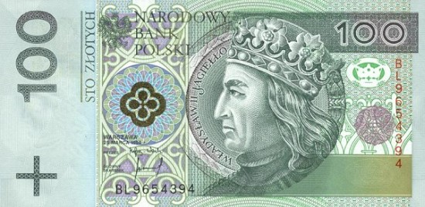
A Coin Game
Bet 50 PLN
You get head coins of
A. 50 x 2 PLN
B. 20 x 5 PLN
C. 1 x 100 PLN
Same expectation value,
but different fluctuation

Slide 44



Baryons in Hadronic Phase
time
chem. f.o.
hadronize
10~20fm
kinetic f.o.
Baryons behave like
Brownian pollens in water
mesons
baryons

Slide 45





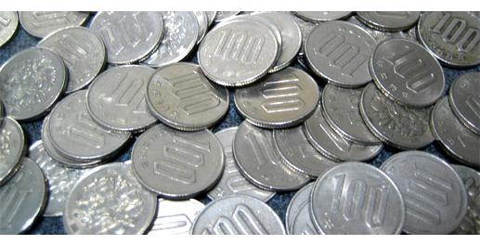
Slot Machine Analogy
= +
P (N)
N
P (N)
N

Slide 46
Extreme Examples
Fixed # of coins
Constant probabilities
N
N
N
N

Slide 47
Time Evolution of Fluctuations

Slide 48
Time Evolution of Fluctuations
detector
Particle # in Δη
freezeout
continues to change until kinetic freezeout due to diffusion.
hadronic
QGP
changes due to a conversion y → η at kinetic freezeout
“Thermal Blurring”

Slide 49
Future Studies
Experimental side:
rapidity window dependences
baryon number cumulants
BES for SPS- to LHC-energies
Theoretical side:
rapidity window dependences in dynamical models
description of non-equilibrium non-Gaussianity
accurate measurements on the lattice
Both sides:
Compare theory and experiment carefully
Let’s accelerate our understanding on fluctuations!

Slide 50
BES-II
FAIR
NICA
J-PARC
New Useful Application
for your research!!

