Slide 1
Energy-momentum tensor and thermodynamics
(of SU(3) gauge theory) from gradient flow
Masakiyo Kitazawa
for FlowQCD Collaboration / WHOT-QCD Collaboration
Japanese-German Seminar 2016, Niigata, 26-28 Sep, 2016

Slide 2
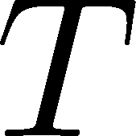

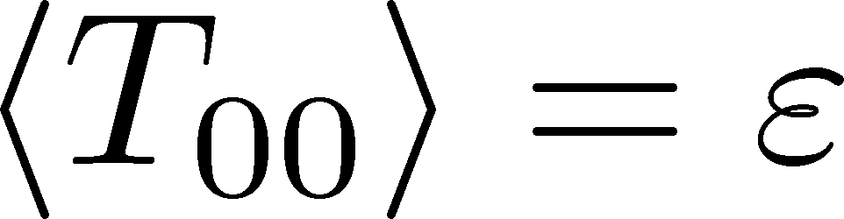
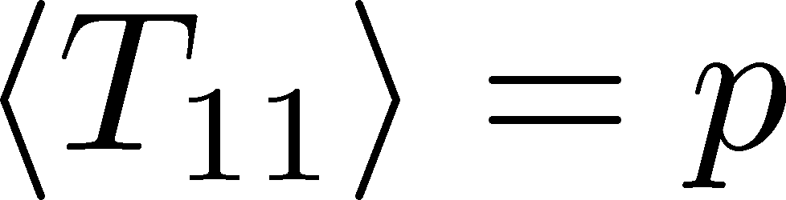
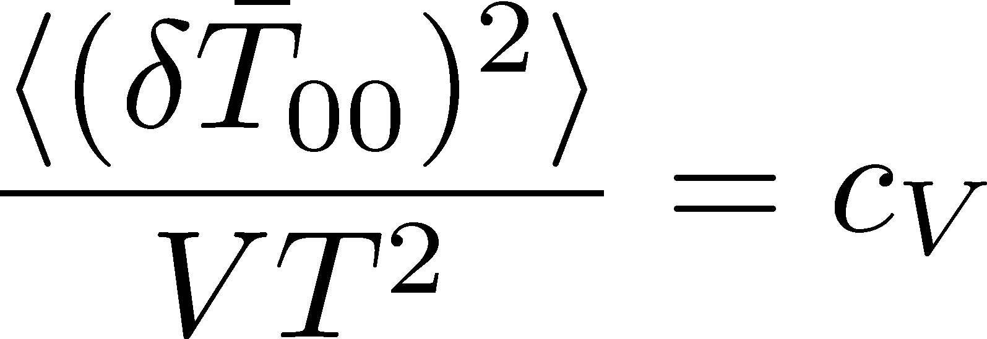
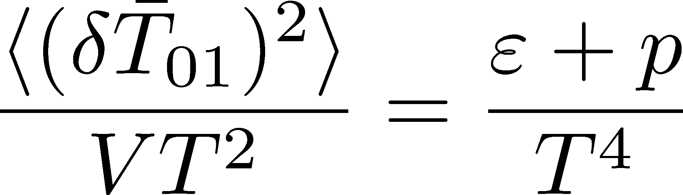
Energy-momentum
tensor (EMT)
One of the most fundamental quantities in physics
Contain various thermal properties
1-point expectation value
2-point correlator (fluctuations)

Slide 3

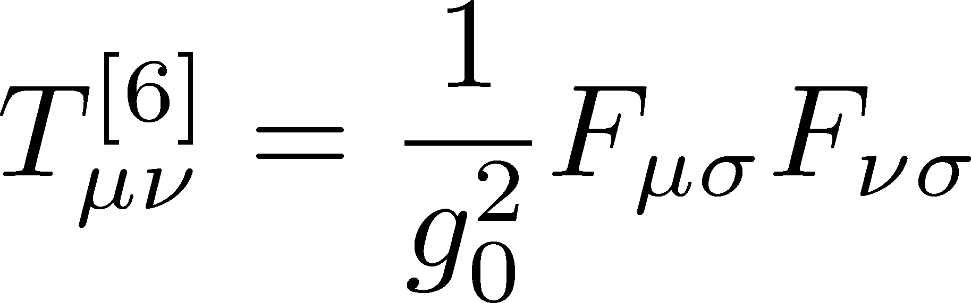
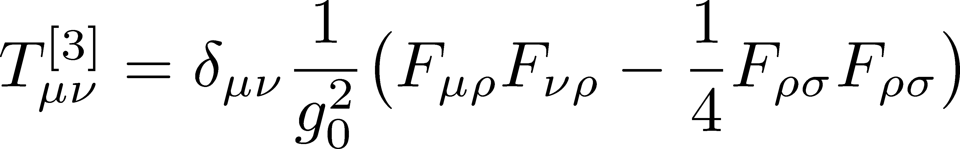
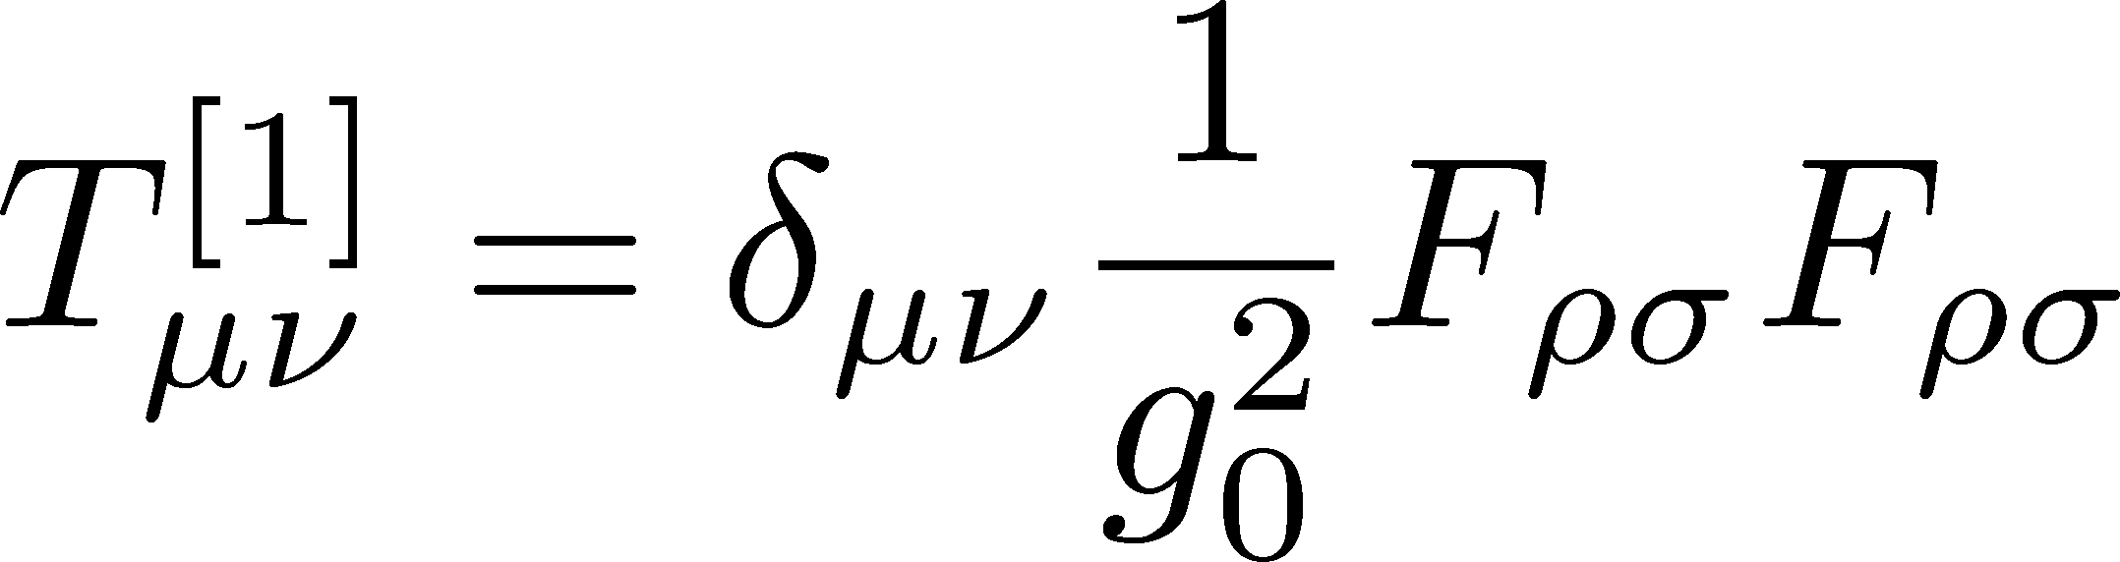
EMT on the Lattice a standard construction
Caracciolo+, 1990
Non-perturbative determination of Z₆, Z₃, Z₁
shifted boundary condition
accurate nonperturbative Z₆ available
Giusti, Meyer, 2011-13
Giusti, Pepe, 2014-

Slide 4
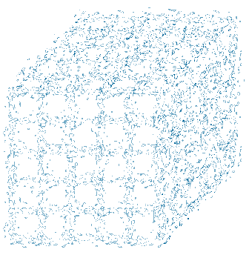
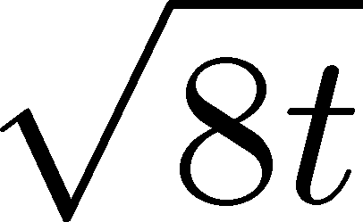
Gradient Flow
Gradient Flow
Lüscher(2009–)
Narayanan, Neuberger(2006)
Diffusion-like equation
smearing radius
gradient flow

Slide 5
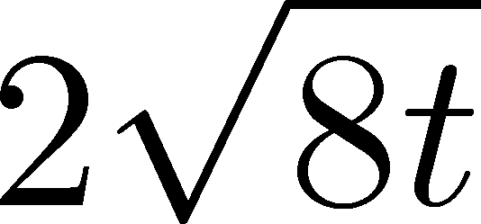
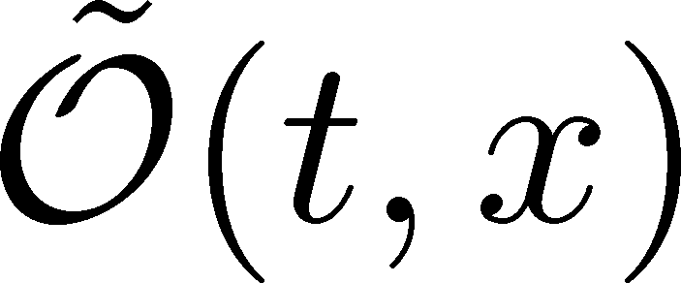
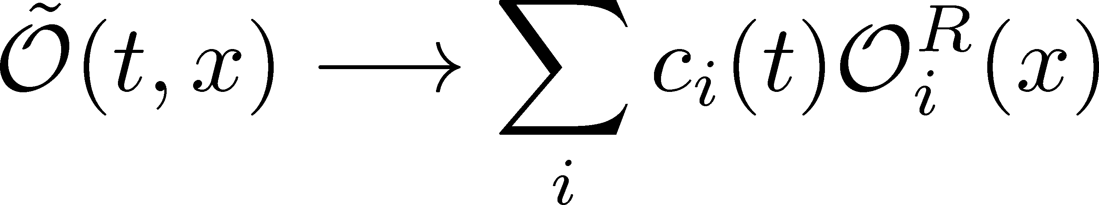

Gradient Flow
Gradient Flow
Lüscher(2009–)
Narayanan, Neuberger(2006)
Diffusion-like equation
smearing radius
gradient flow
Small Flow-time expansion
original 4-dim theory
Lüscher, Weisz (2011)
t→0 limit

Slide 6
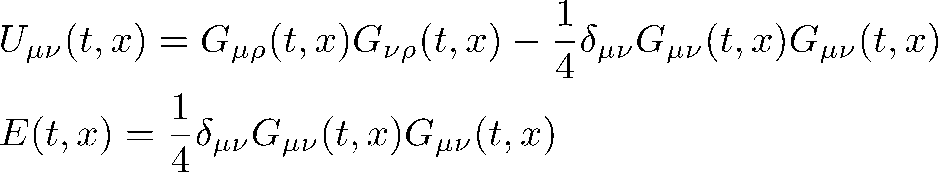
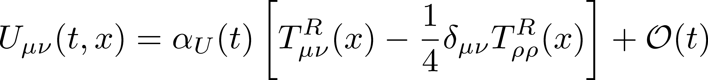
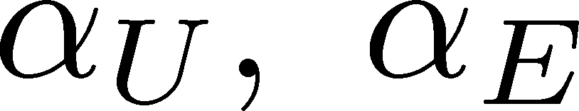
EMT from Gradient Flow
Suzuki, 2013
small
flow-time
expansion
: perturbative formula
by Suzuki, 2013
Correctly Renormalized EMT

Slide 7
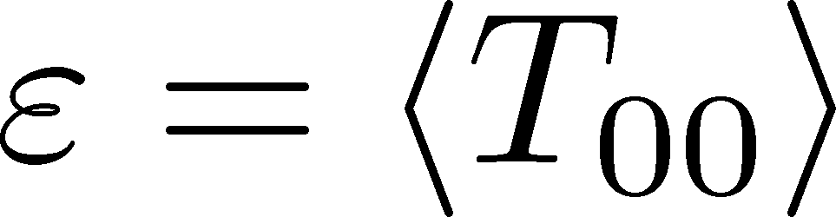
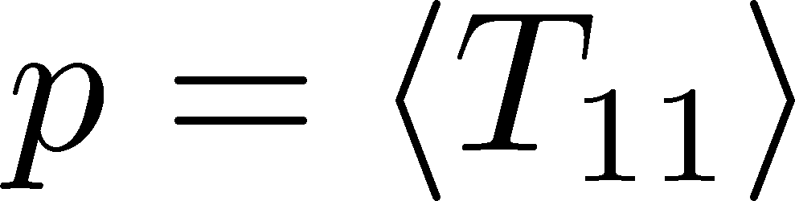
Thermodynamics
FlowQCD, PRD90 (2014)
SU(3) Wilson gauge
32³xN_{t}
N_{t}=6,8,10
~300 confs.
continuum extrapolated
Good agreement with integral method result
Statistical error well suppressed

Slide 8
Applications
1. Thermodynamics
FlowQCD (2014); in preparation
2. Latent heat at 1st order phase transition
Shirogane+, PRD (2016); WHOT-QCD, in preparation
3. Correlation functions
FlowQCD, in preparation
Application to full QCD: WHOT-QCD, 1609.01471 (Next talk by Kanaya)

Slide 9
New Result on
Thermodynamics
FlowQCD, in preparation

Slide 10

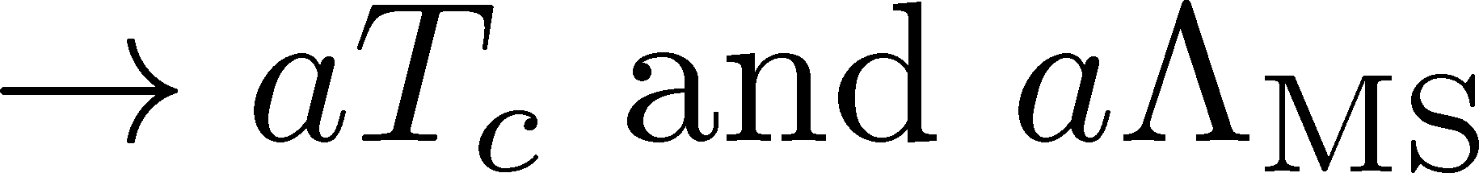
Numerical Simulation
SU(3) YM theory
Wilson gauge action
Parameters:
Scale setting from gradient flow
N_{t} = 12, 16, 20-24
aspect ratio 5.3<N_{s}/N_{t}<8
1500~2000 configurations
FlowQCD
1503.06516

Slide 11
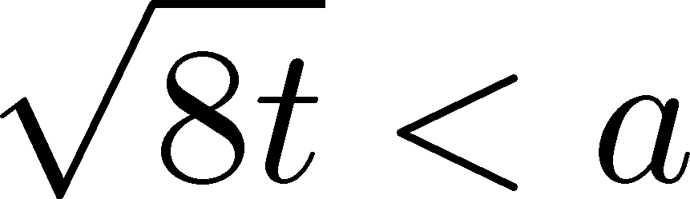
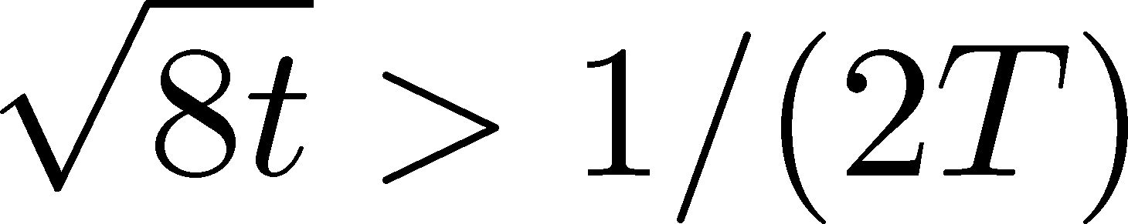
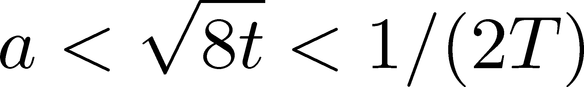
t Dependence
clover+plaq
clover
: strong discretization effect
: oversmeared
: Linear t dependence

Slide 12
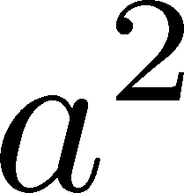
Double Extrapolation
Continuum extrapolation
strong
discretization
effect
FlowQCD, 2014: continuum extrapolation only
WHOT-QCD, 2016: small t limit only
Note:

Slide 13
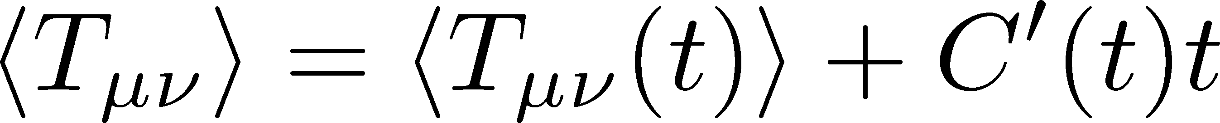
Double Extrapolation
Continuum extrapolation
strong
discretization
effect
Small t extrapolation
FlowQCD, 2014: continuum extrapolation only
WHOT-QCD, 2016: small t limit only
Note:

Slide 14
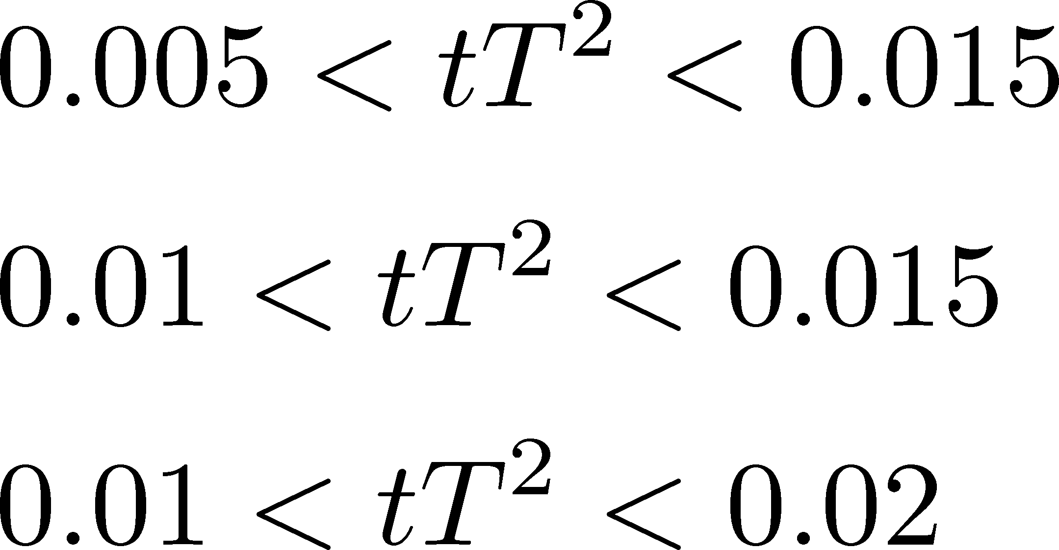
Double Extrapolation
Black band: continuum extrapolated
range of t for fitting:

Slide 15
T Dependence
Error includes
statistical error
choice of t range for t→0 limit
uncertainty in aΛ_{MS}
Excellent agreement with integral method
High accuracy only with ~2000 confs.
total error <1.5% for T>1.1T_{c}

Slide 16
Latent Heat at 1st order transition
WHOT-QCD Collaboration
Shirogane+, PRD (2016); in preparation
(see, poster by Shirogane)

Slide 17
1st Order Transition
SU(3) gauge theory has a 1st order phase transition
discontinuity
Latent heat Δε
A universal constant
Pressure gap Δp=0
Δε: Universal dimension-full quantity
Δp: check of the measurement
technics for 1st tr. → future study for μ>0??

Slide 18
Phase Coexistence at T_{c}
Shirogane+, PRD (2016)
histogram in
plaquette - Polyakov loop plane
at T=T_{c}
48³x8
multi-point reweighting
high T
low T
Classification of configuration
into low/high phases is possible

Slide 19

Result in Differential Method
Shirogane+, PRD (2016)
Nt=4, 6, 8, 12
nonperturbatively determined Karsch coefficients
continuum extrapolation
no pressure gap within statistics

Slide 20
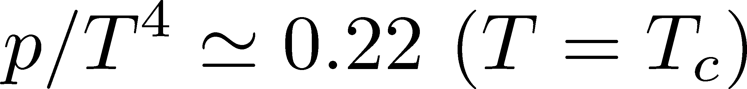
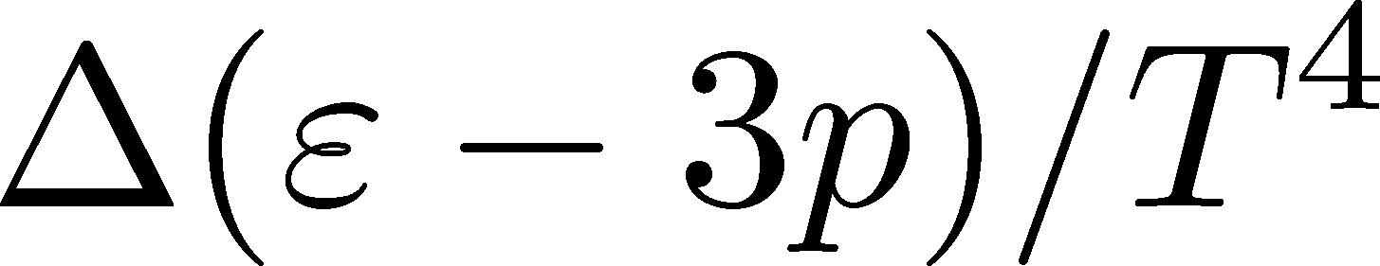
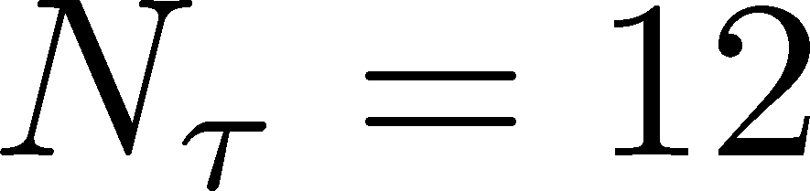
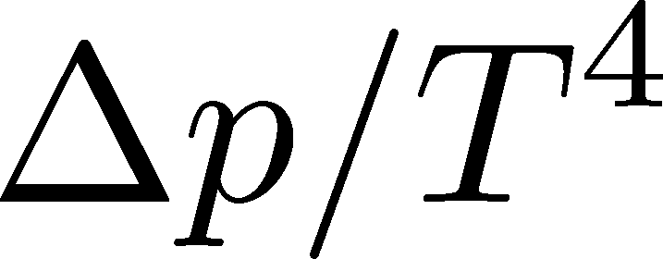
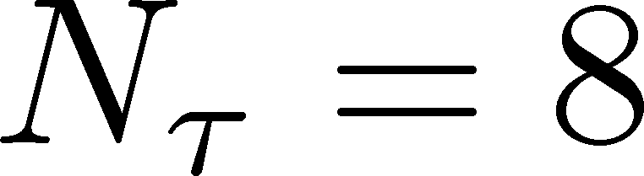
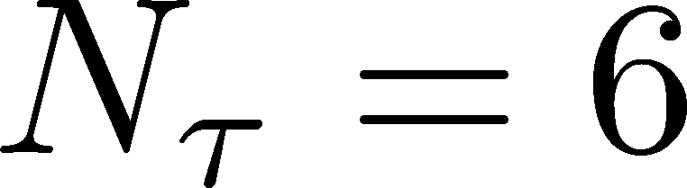
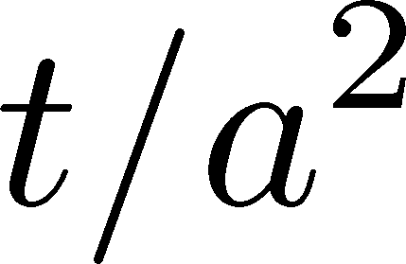
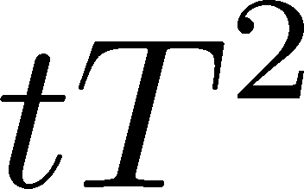
Gradient Flow Method
96³x12
Preliminary
Latent heats in two methods agree with each other.
Statistical error is drastically reduced by GF method.
Nonzero pressure gap exists, but it becomes smaller for larger N_{t}.
Visit Shirogane’s poster

Slide 21
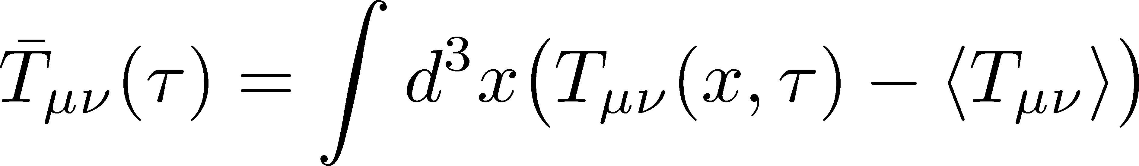
Correlation Functions
FlowQCD, in preparation
Zero-momentum correlator

Slide 22
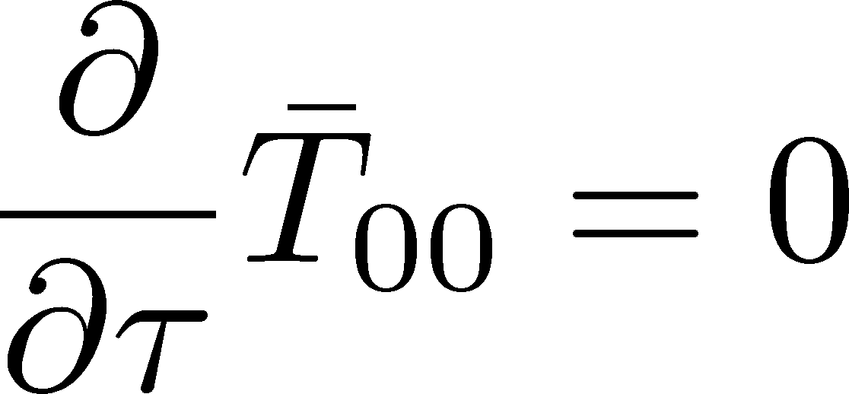
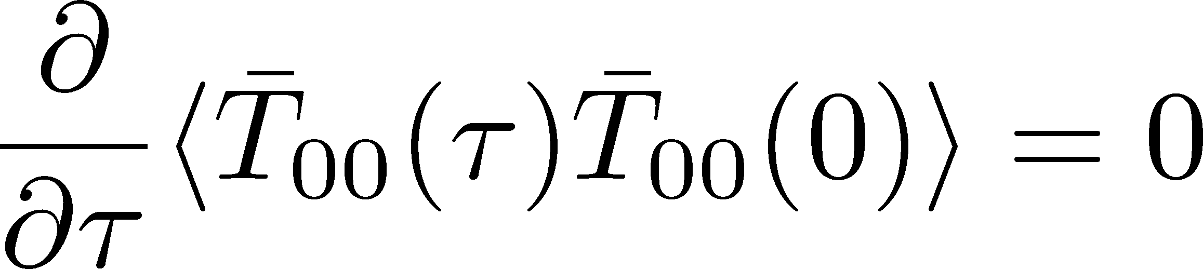
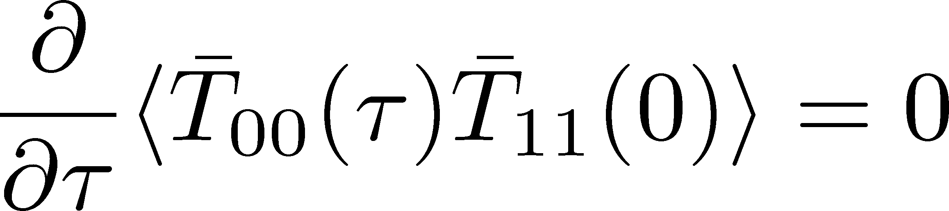
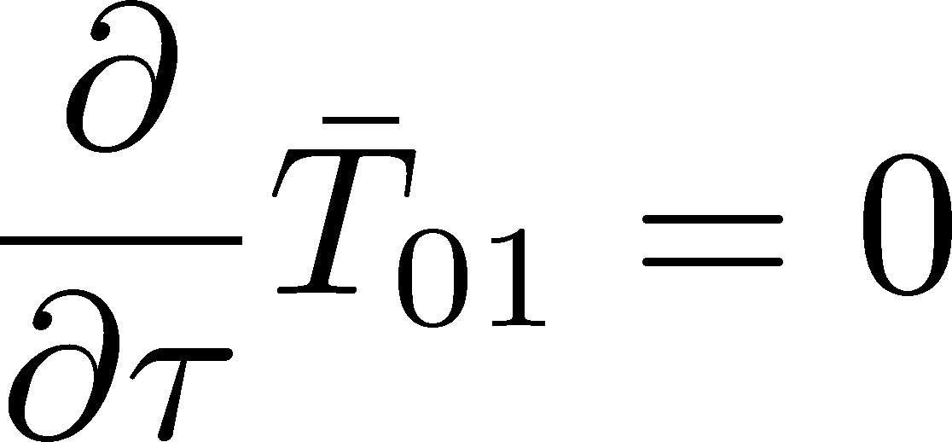
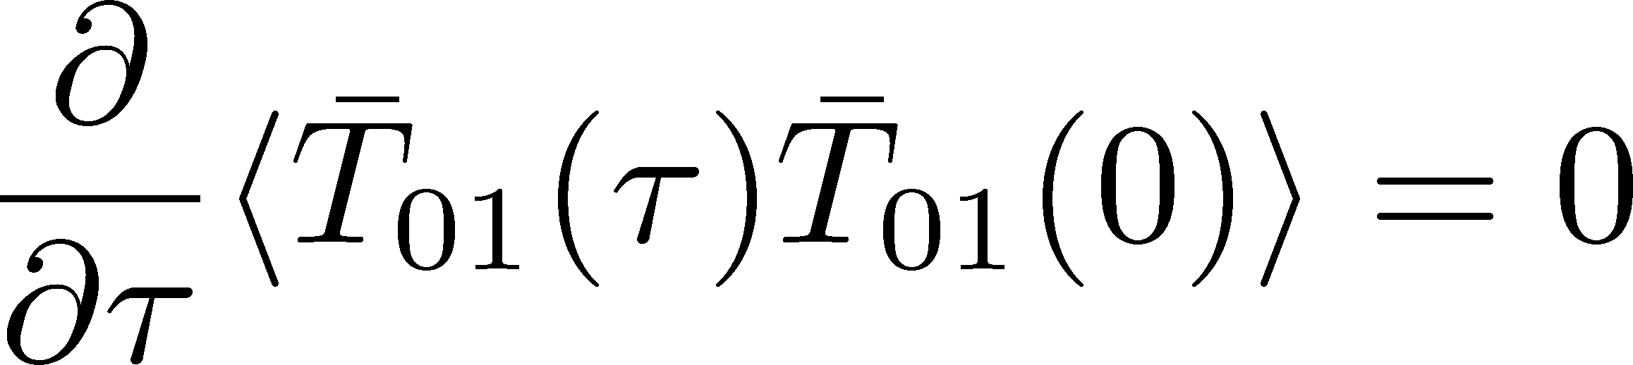
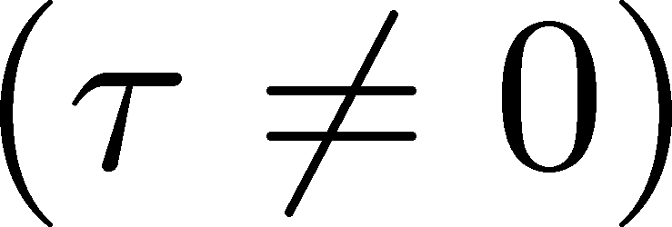
Conservation Law

Slide 23
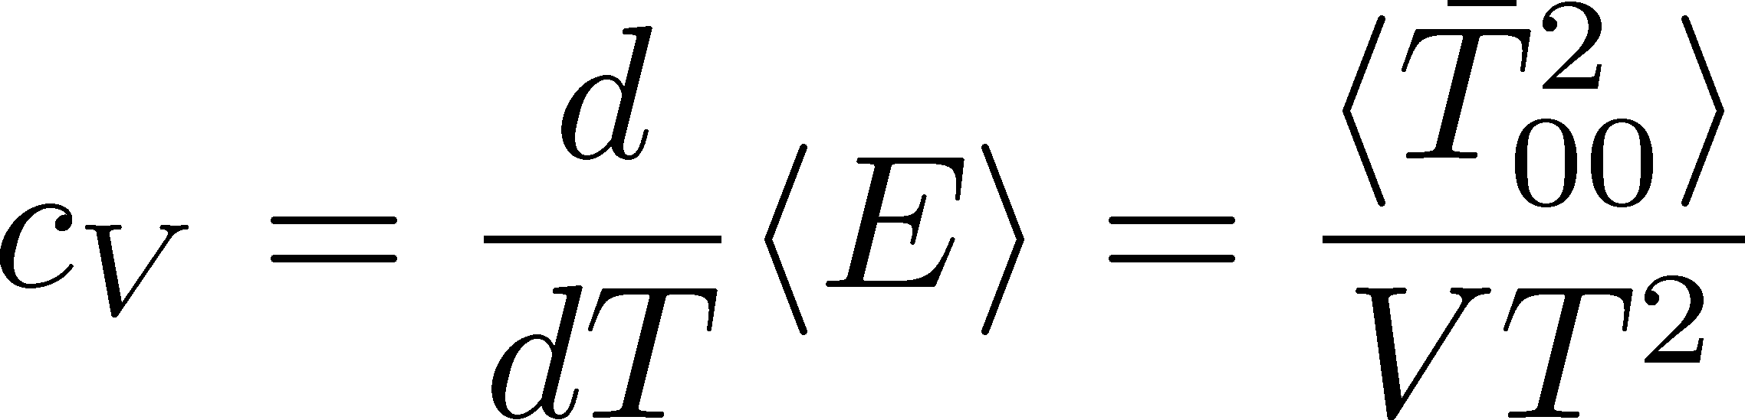
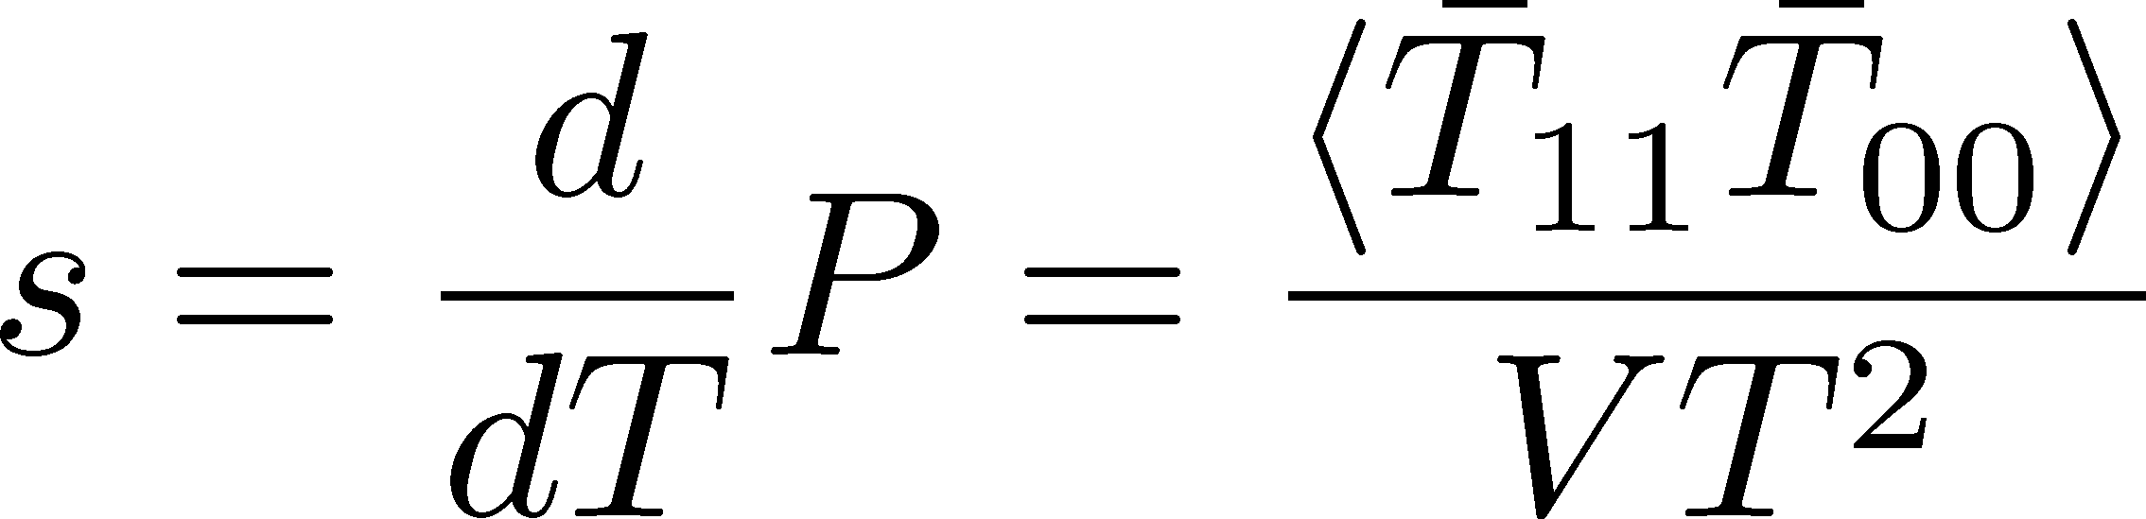
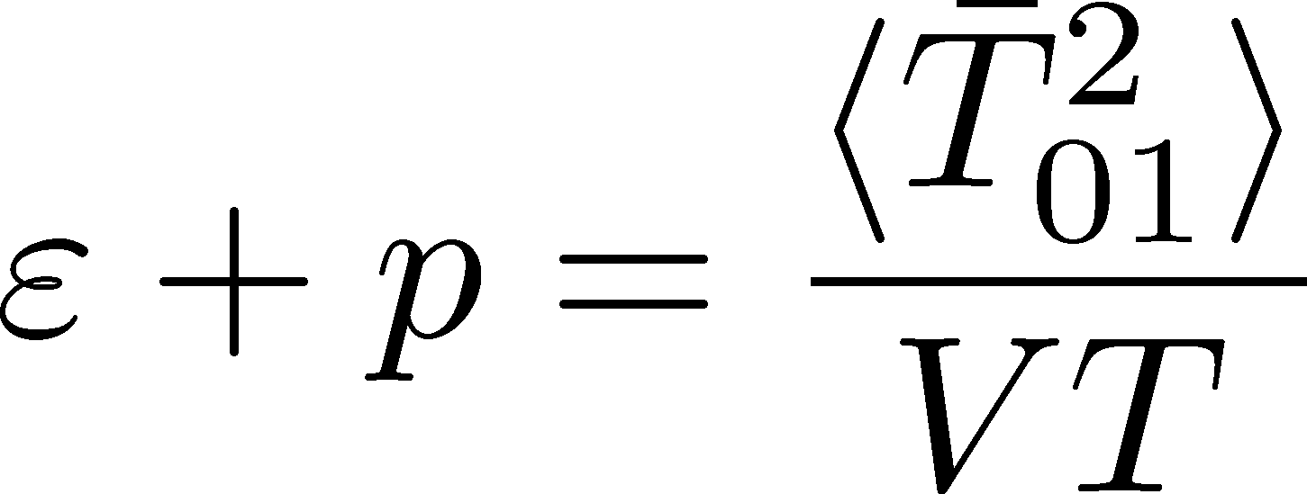
Linear Response Relations
Specific heat
entropy density
Giusti, Meyer, 2011
enthalpy density

Slide 24
Numerical Simulation
Wilson gauge action
clover operator
aspect ratio N_{s}/N_{t}=4
200,000 configurations
β | T=1.67T_{c} | T=2.22T_{c}
48³x12 | 6.719 | 6.943
64³x16 | 6.941 | 7.170
96³x24 | 7.265 | 7.500
Numerical analysis: Bluegene/Q @KEK

Slide 25
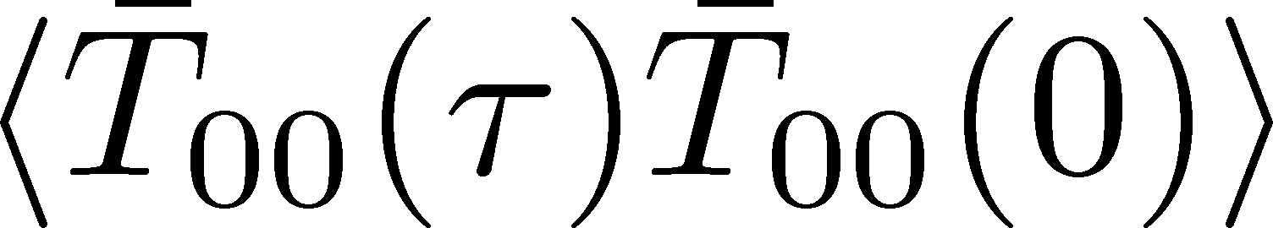
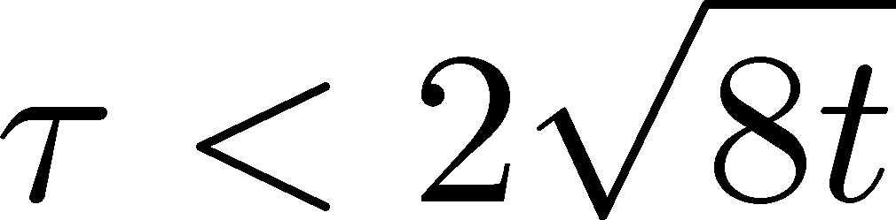
Energy-energy correlator
Nt=24
T=2.22Tc
Existence of a plateau → energy conservation
Larger flow time ←→ smaller error
Oversmearing for

Slide 26
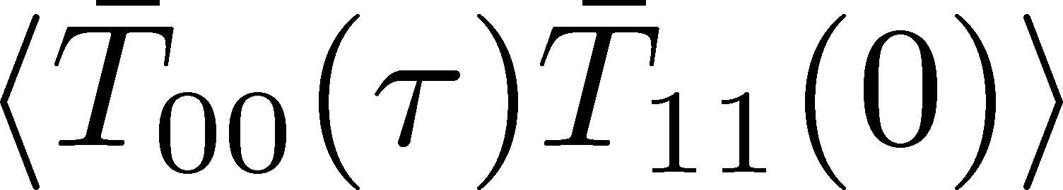
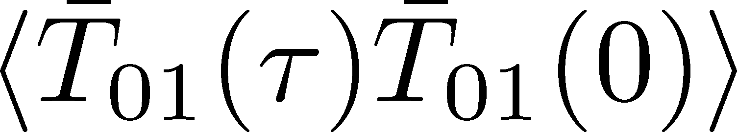
Correlation Functions
The value of constant is consistent with (e+p)/T⁴.
Oversmearing effect is much stroner.

Slide 27
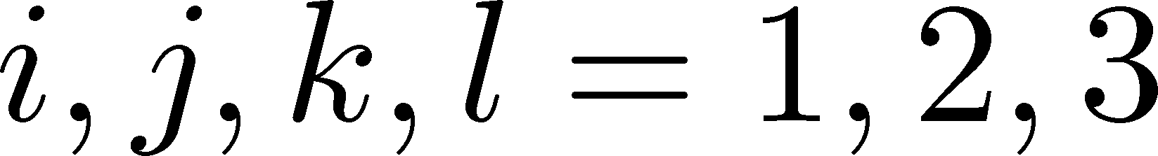
Constraint from Rot. Symm.
Karsch, Wyld, 1987
zero within statistics
for τ/a>4

Slide 28
Summary
We measured EMT expectation value and correlation function of SU(3) gauge theory by using the operator constructed from gradient flow.
Expectation values of EMT agrees well with the previous results on thermodynamics.
Behaviors of the correlation functions are consistent with the conservation law and linear response relations.
Our method can be applied to full QCD → Next talk

Slide 29
Double Extrapolation

Slide 30
Shear and Bulk Channels
No plateau behavior in non-conserved channels

