Slide 1
Transport of Fluctuations
Masakiyo Kitazawa
(Osaka U.)
INT Workshop 16-3
Exploring the QCD Phase Diagram through Energy Scan
INT, Seattle, 6/Oct./2016

Slide 2
J-PARC Heavy-Ion Program
(J-PARC-HI)

Slide 3
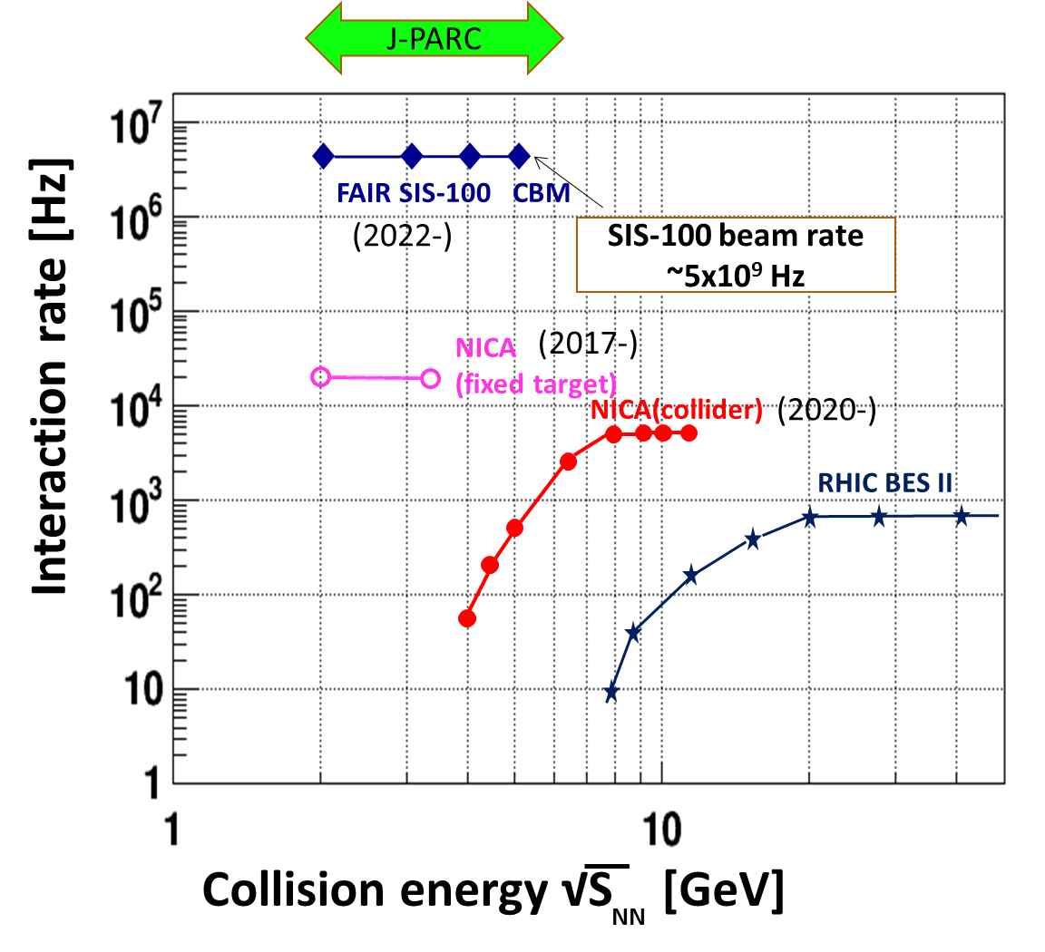
J-PARC-HI Program
J-PARC Heavy Ion
Toroidal Spectrometer
New HI Injector
high intensity
RCS & Main Ring
stable
well established
J-PARC-HI
fixed target HI experiment
E_{lab}<20GeV/A (√s_{NN}<6.2 GeV)
High luminosity beam

Slide 4
J-PARC-HI Program
White Paper
Recent Activities
June 2016
July 2016
Aug. 2016
Sep. 2016
White Paper uploaded
Submission of LOI
International Workshop
Symposium @ JPS meeting
Future Plan
Visit J-PARC-HI Web Page
http://asrc.jaea.go.jp/soshiki/gr/hadron/jparc-hi/
2020
2021
2021-2022
2021-2023
2023-2024
2025
Funding request to MEXT
Earliest approval of funding
Construction of HI Injector
Construction of HI injection system in RCS
Construction of HI spectrometer
First collision

Slide 5
Fluctuations

Slide 6
Contents
Transport of fluctuations
    MK, Asakawa, Ono, PLB (2014); MK, NPA (2015)
Thermal blurring by rapidity conversion
    Ohnishi, MK, Asakawa, PRC (2016)
Transport near QCD critical point
    Sakaida, Asakawa, Fujii, MK, in prep.
    Review: Asakawa, MK, PPNP (2016)

Slide 7
Before Main Topics…
Fluctuations
Regular
Singular
=
+

Slide 8
Before Main Topics…
Fluctuations
Regular
Poisson
Noise
Singular
NON-Poisson
Signal
=
+

Slide 9
Before Main Topics…
Fluctuations
Regular
Poisson
Noise
Singular
NON-Poisson
Signal
=
+

Slide 10
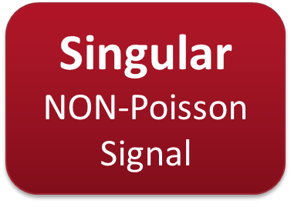
Before Main Topics…
Fluctuations
Regular
Poisson
Noise
Singular
NON-Poisson
Signal
=
+

Slide 11
Before Main Topics…
Fluctuations
Regular
Poisson
Noise
Singular
NON-Poisson
Signal
=
+

Slide 12
Before Main Topics…
Fluctuations
Regular
Poisson
Noise
=
+
Off-equilibrium effects make the separation of
two contributions impossible.
(diffusion, experimental cuts, efficiency, … )

Slide 13
Fragile Higher Orders

Slide 14
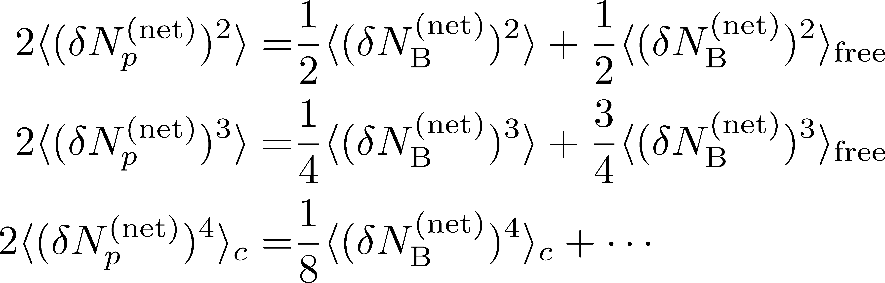
Fragile Higher Orders
Ex.: Relation b/w baryon & proton # cumulants
(with an approximation)
MK, Asakawa, 2012
genuine info.
Poisson noise
Higher orders are more seriously affected by efficiency loss.

Slide 15
Transport of Fluctuations

Slide 16






Diffusion After Chemical F.O.
Asakawa, Heinz, Muller (2000)
Jeon, Koch (2000)
Shuryak, Stephanov (2001)
Detector
Distributions in ΔY and
Δy are different due to
“thermal blurring”.
Fluctuations in ΔY continue
to change until kinetic f.o.

Slide 17

How to Describe Transport of Fluctuations?
A candidate
Stochastic diffusion equation
Noise: Gaussian
Fluctuation in equil.
is Gaussian.
Undesirable to describe relaxation
of cumulants toward Poisson value.

Slide 18


Non-Interacting Brownian Particle System
Initial condition (uniform)
cumulants:
random
walk
diffusion master equation: MK+, PLB(2014)
probabilistic argument: Ohnishi+, PRC(2016)

Slide 19


Non-Interacting Brownian Particle System
Initial condition (uniform)
cumulants:
diffusion
distance
random
walk
Study ΔY dependence
Poisson distribution
diffusion master equation: MK+, PLB(2014)
probabilistic argument: Ohnishi+, PRC(2016)

Slide 20


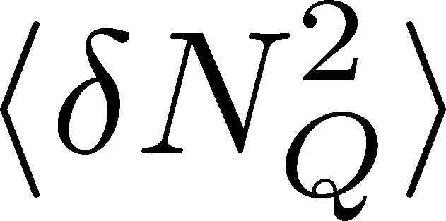
Rapidity Window Dependence
ALICE, PRL (2013)
X. Luo, CPOD2014
Cumulants are dependent on rapidity window.

Slide 21



Baryons in Hadronic Phase
time
chem. f.o.
hadronize
10~20fm
kinetic f.o.
Baryons behave like
Brownian pollens in water
mesons
baryons

Slide 22
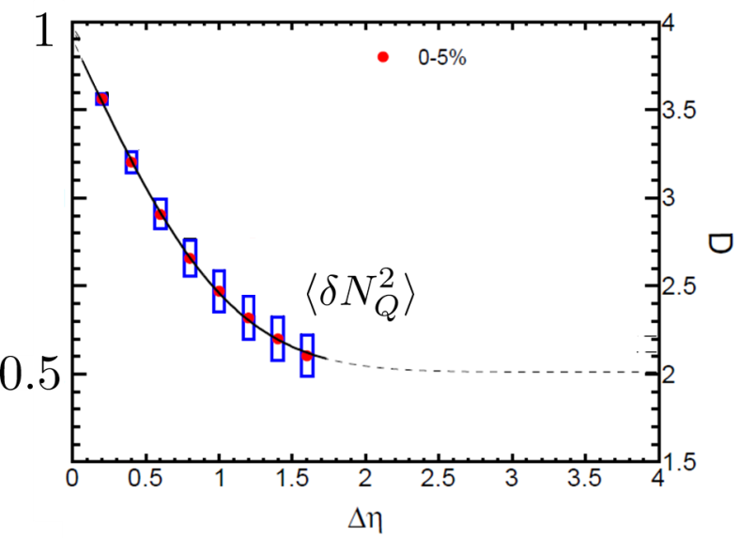


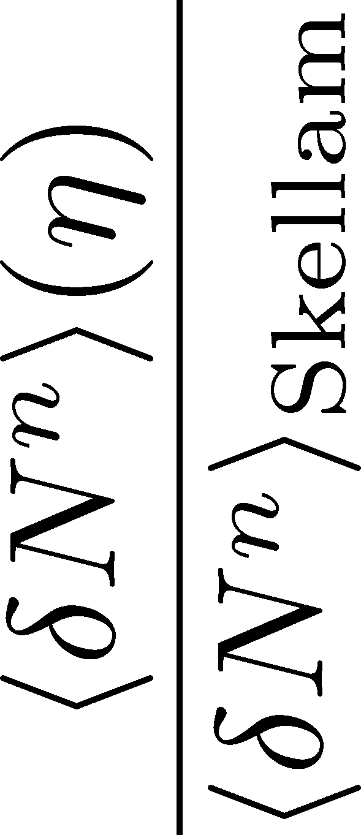

Rapidity Window Dependence
No initial net fluctuation:
2nd
4th
parameter
sensitive to
hadronization

Slide 23
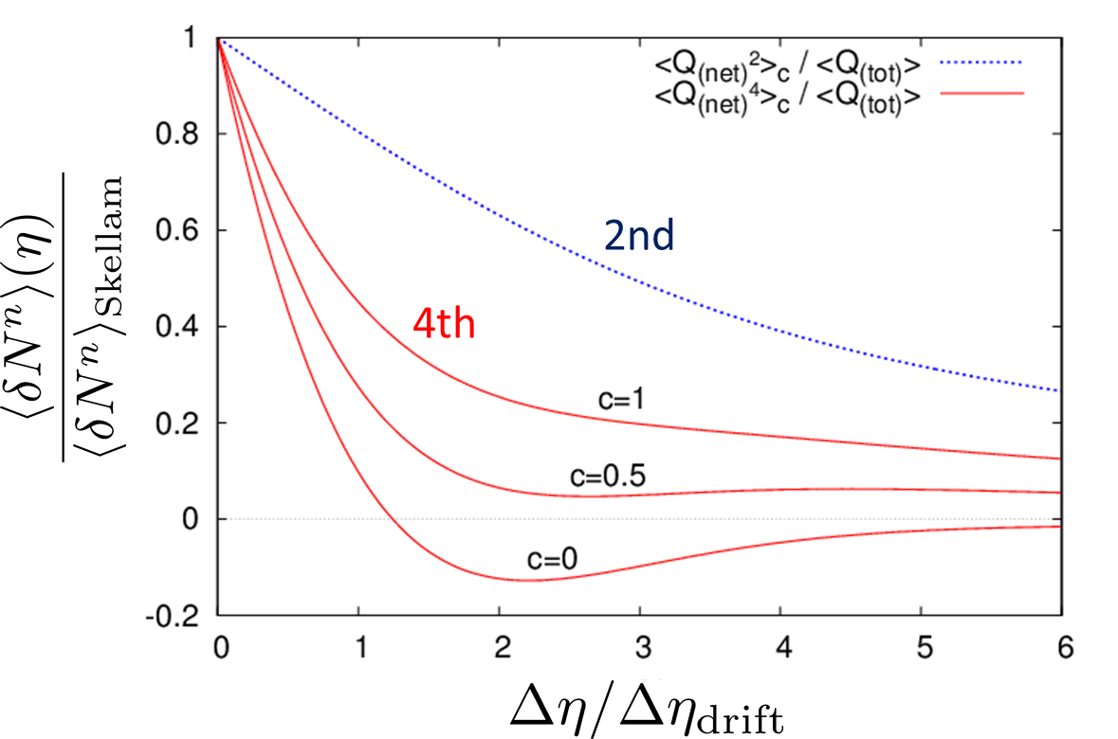
Rapidity Window Dependence
MK+, PLB(2014)
Cumulants at finite Δy is different from initial value.
4th cumulant can have a sign change.
4th cumulant can have non-monotonic behavior.
Poisson / non-Poisson : Not separable!

Slide 24
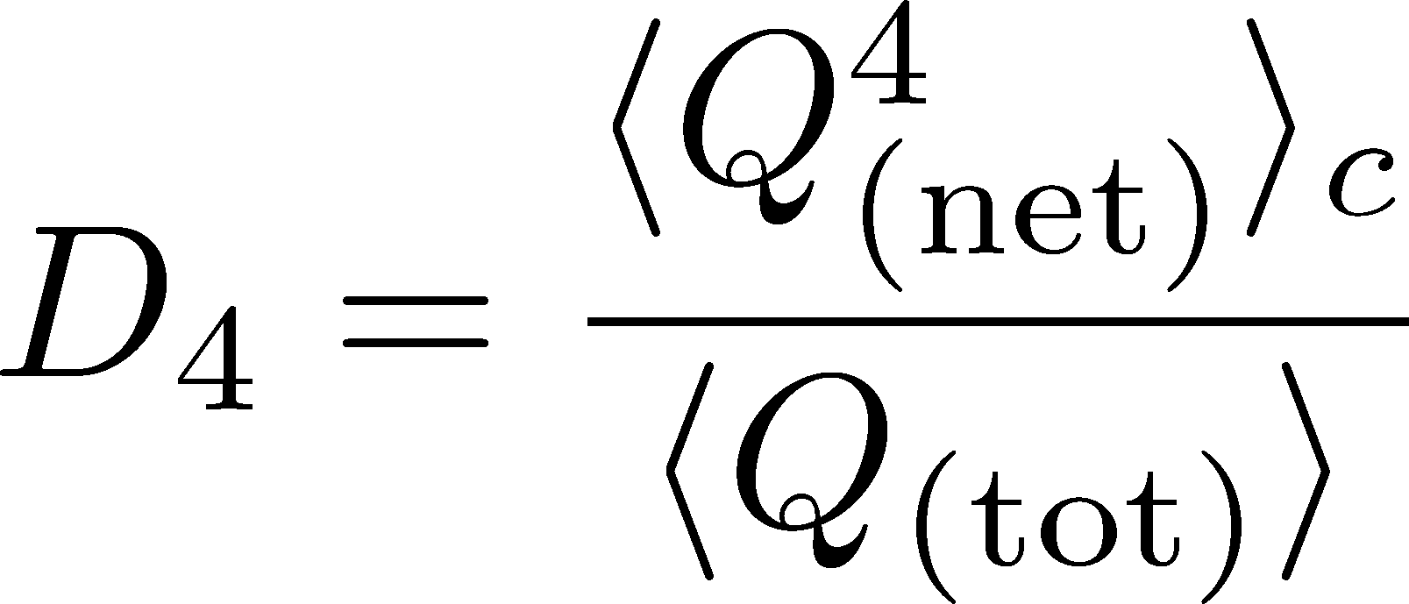


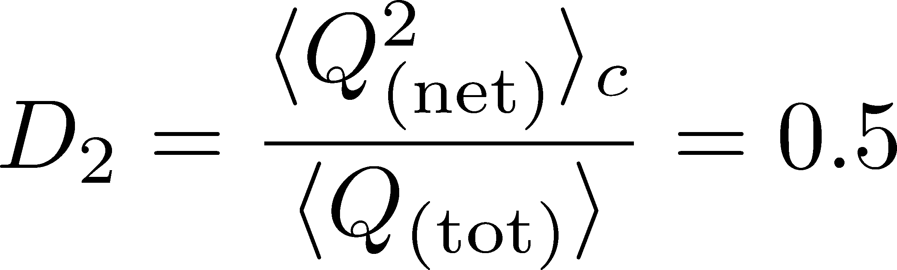

Δη Dependence: 4th order
MK, NPA(2015)
Initial Condition
Characteristic Δη dependences!

Slide 25
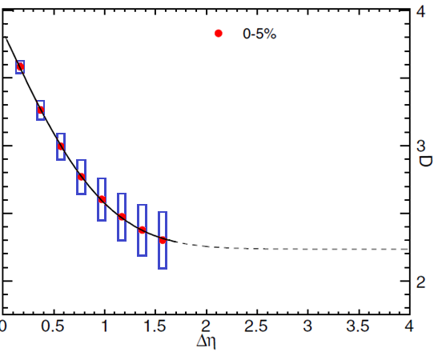

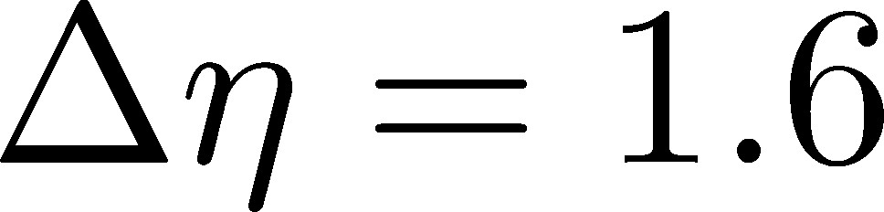
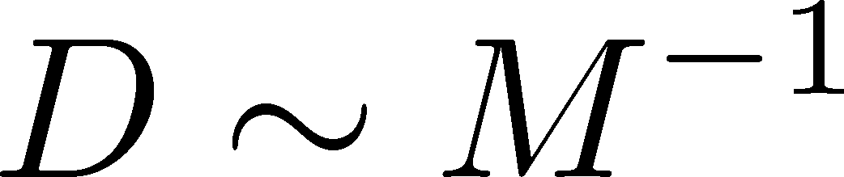
Δη Dependence: 4th order
MK, NPA(2015)
Initial Condition
baryon #
at ALICE
at ALICE

Slide 26
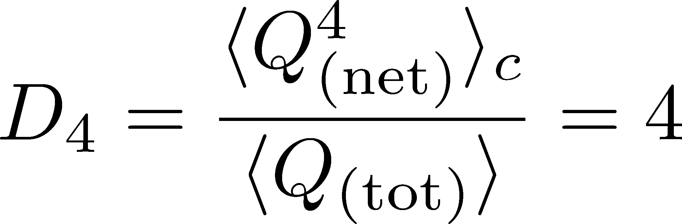
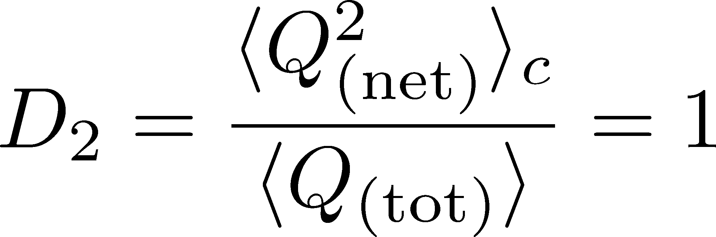
4th order : w/ Critical Fluctuation
Initial Condition
baryon #
at ALICE
at ALICE

Slide 27
Δη Dependence @ STAR
MK+ (2014)
MK (2015)
X. Luo, CPOD2014
Approach initial value as Δy→large
No power law ~(Δy)⁴ behavior at small Δy
Ling, Stephanov (2016)
finite volume effect: Sakaida+, PRC064911(2014)

Slide 28
Non-Interacting Brownian Particle System
Initial condition (uniform)
cumulants:
Compare with lattice
trace back
time evolution
diffusion distance ←→ diffusion coefficient

Slide 29
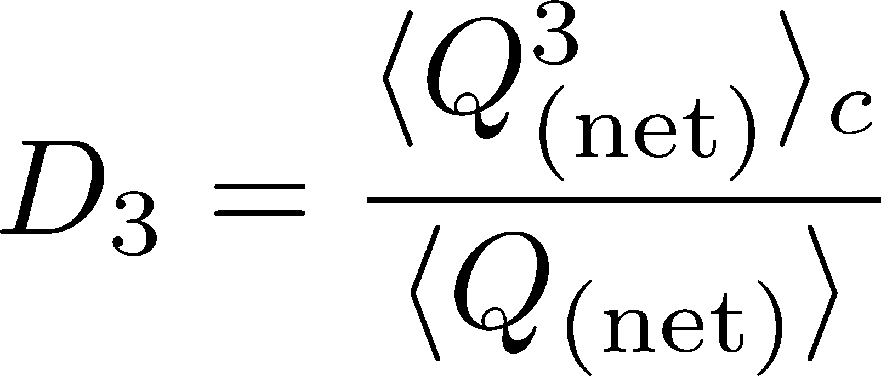
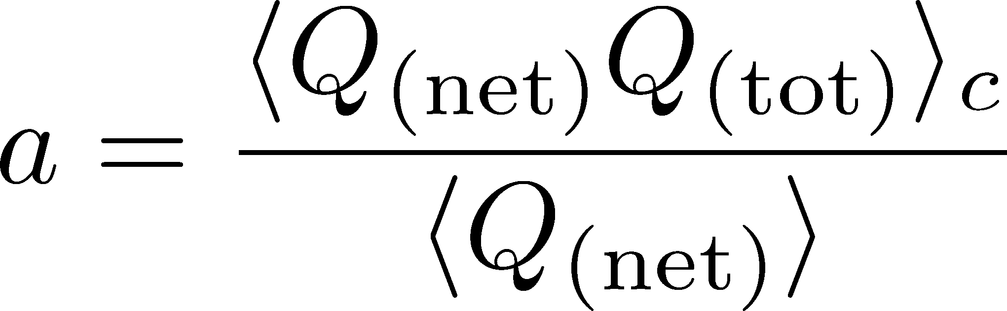
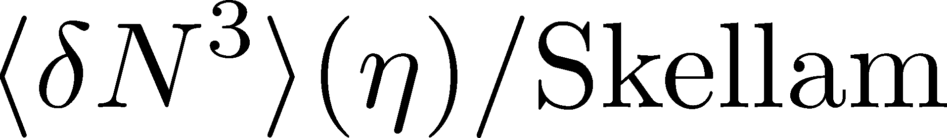
Δη Dependence: 3rd order
Initial Condition
baryon #
at ALICE
at ALICE

Slide 30
Themal Blurring
Ohnishi, MK, Asakawa, PRC, in press

Slide 31
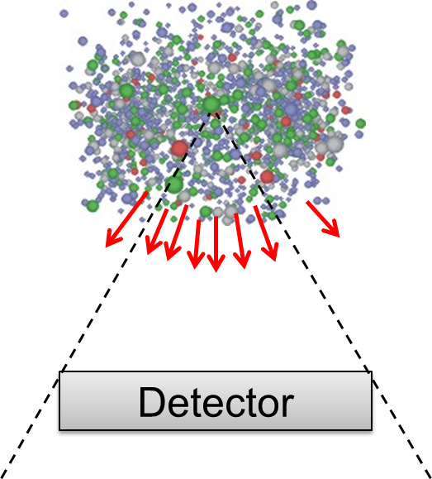
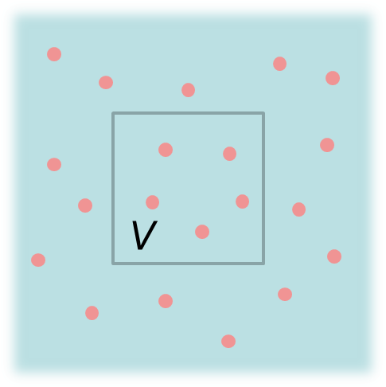
Fluctuations: Theory vs Experiment
Theoretical analyses
based on statistical mechanics
Experiments
lattice, critical point,
effective models, …
Fluctuation in
a spatial volume
Fluctuations in
a momentum space
discrepancy in phase spaces
Asakawa, Heinz, Muller, 2000; Jeon, Koch, 2000; Shuryak, Stephanov, 2001

Slide 32
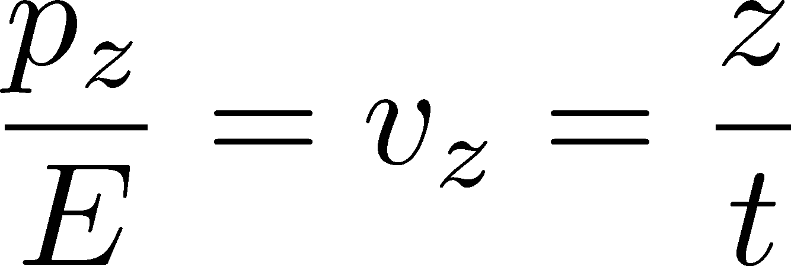




Connecting Phase Spaces
Asakawa, Heinz, Muller, 2000
Jeon, Koch, 2000
Under Bjorken picture,
coordinate-space rapidity Y
momentum-space rapidity y
of medium
momentum-space rapidity y
of individual particles

Slide 33
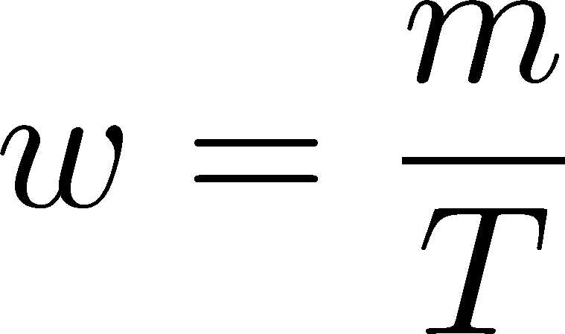



Thermal distribution in y space
nucleon
pions
nucleons
pion
Blast wave squeezes the
distribution in rapidity space
blast wave
flat freezeout surface

Slide 34
Thermal distribution in y space
pions
nucleons
half-width (Δy)
kurtosis
Rapidity distribution can be
well approximated by Gaussian.
blast wave
flat freezeout surface

Slide 35
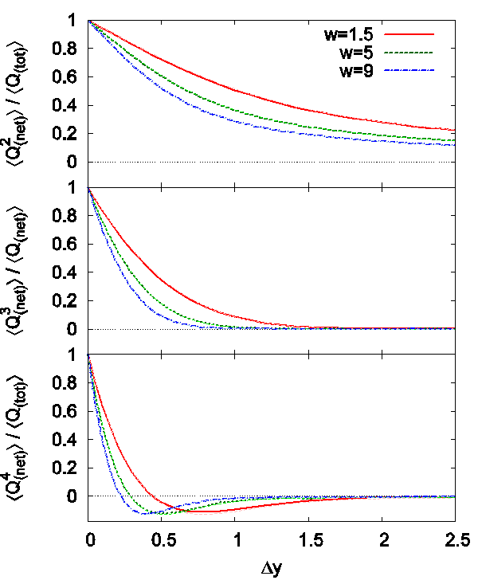
Δη Dependence
Initial condition
(before blurring)
no e-v-e fluctuations
Cumulants after blurring
Cumulants after blurring
can take nonzero values
With Δy=1, the effect is
not well suppressed
pions
nucleons

Slide 36


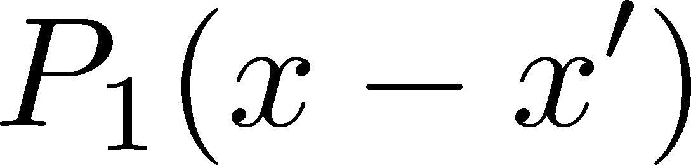
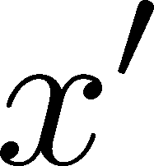
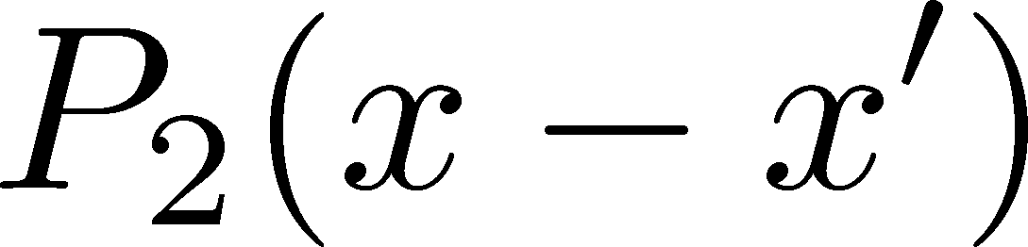
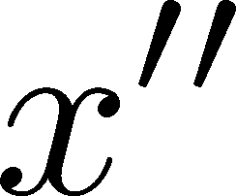
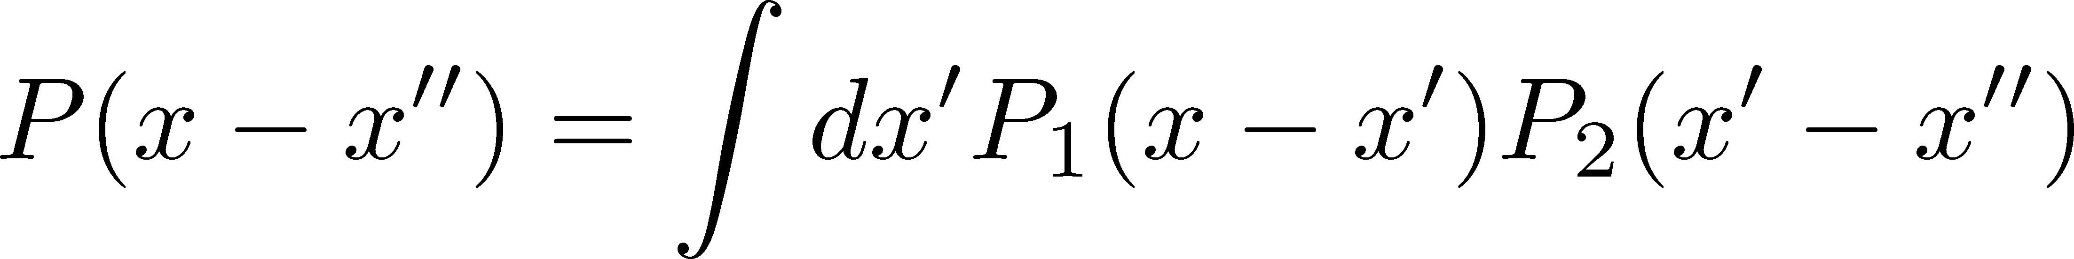
Diffusion + Thermal Blurring
Thermal blurring can be regarded as a part of diffusion
Chemical f.o. (coordinate space)
diffusion
Kinetic f.o. (coordinate space)
blurring
Kinetic f.o. (momentum space)
Total diffusion:

Slide 37
Centrality Dependence
ALICE, 2013
lower T
larger β
Weaker
blurring
More central
Is the centrality dependence understood solely by the thermal blurring at kinetic f.o.?

Slide 38
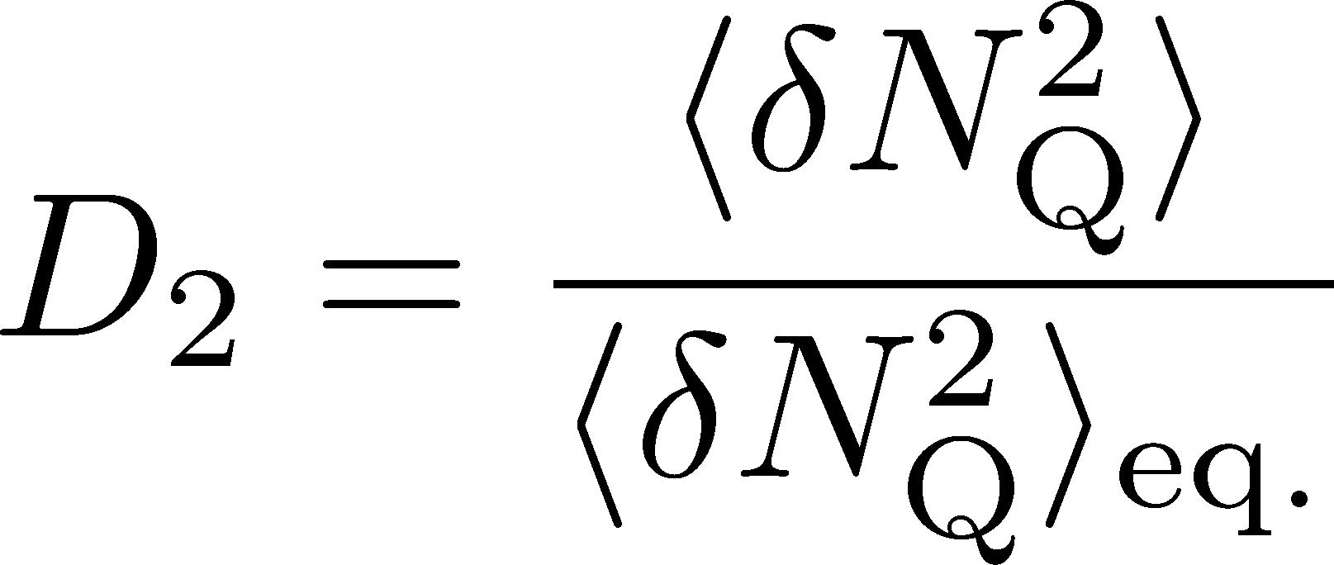
Centrality Dependence @ ALICE
Assumptions:
Centrality independent cumulant at kinetic f.o.
Thermal blurring at kinetic f.o.
Centrality dep. of fluctuation can be described
by a simple thermal blurring picture.

Slide 39
Time Evolution of Fluctuation
near QCD Critical Point
Sakaida, Asakawa, Fujii, MK, in preparation

Slide 40
Dynamical Evolution of Critical Fluctuations
Evolution of correlation length
Berdnikov, Rajagopal (2000)
Asakawa, Nonaka (2002)
Higher orders (spatially uniform “σ” mode)
Mukherjee, Venugopalan, Yin (2015)
Correlation functions
Kapusta, Torres-Rincon (2012)

Slide 41

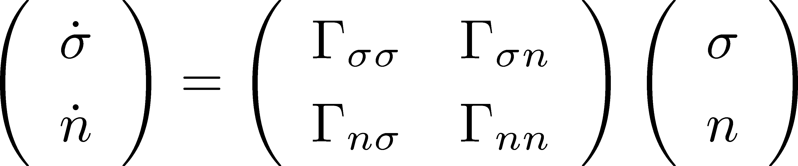
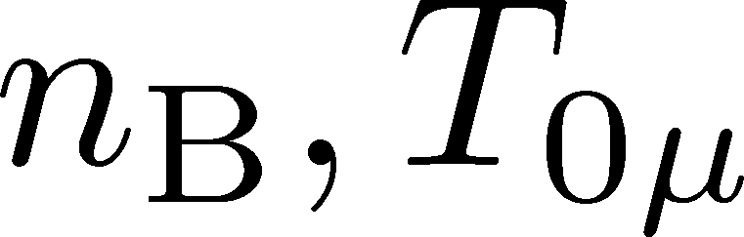
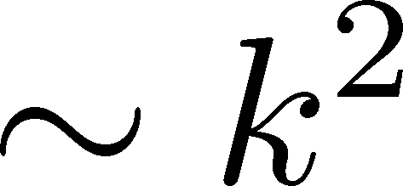
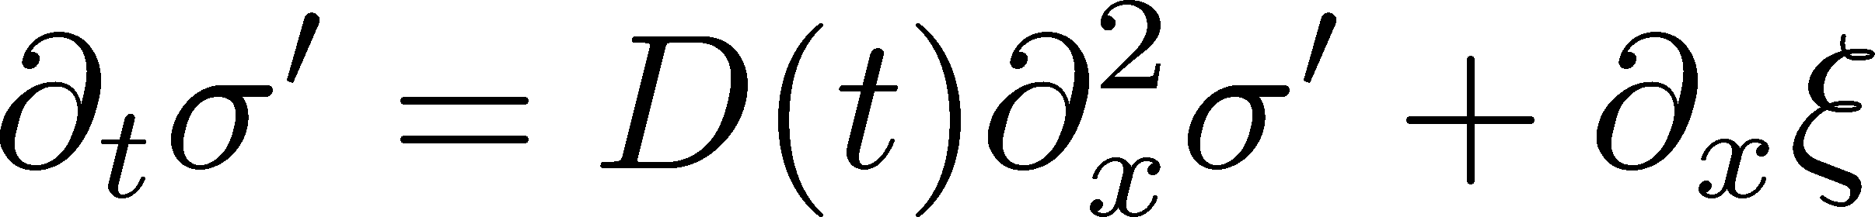
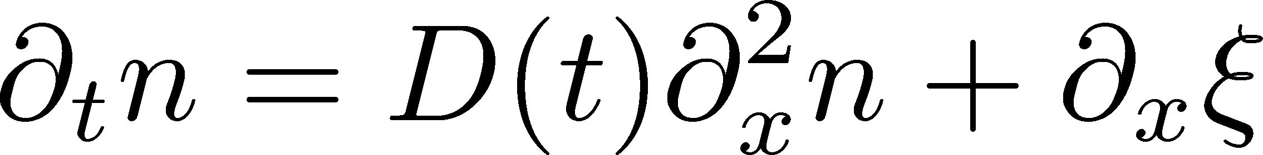

Critical Mode = Diffusive Mode
Fujii (2004)
Fujii, Ohtani (2005)
Son, Stephanov (2005)
Soft mode of QCD CP
Soft mode
σ: fast damping
Evolution of baryon number density
:parameters characterizing criticality

Slide 42
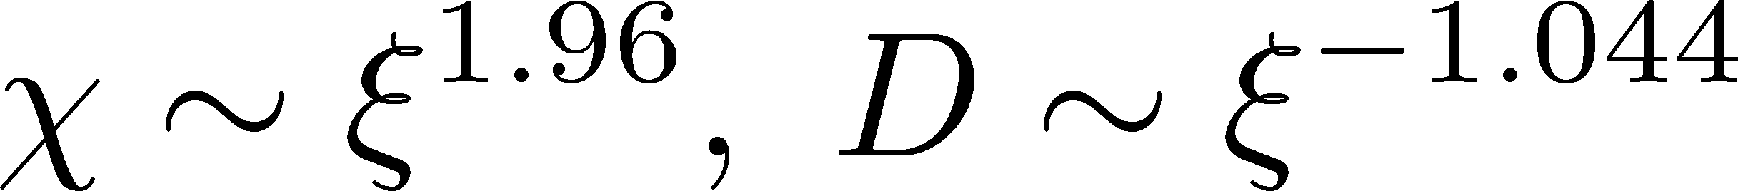
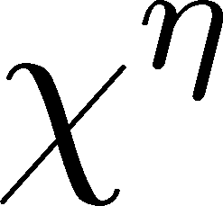

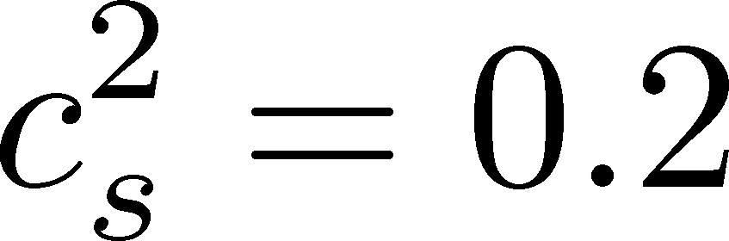

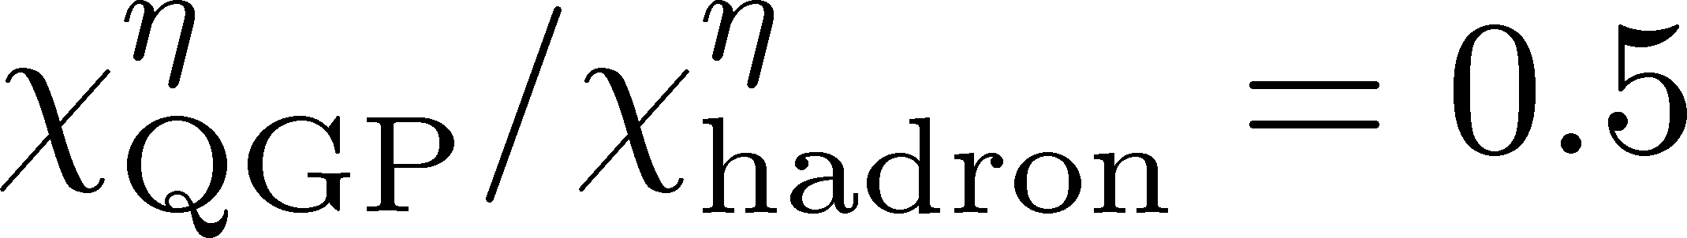

Parametrization of D & χ₂
Berdnikov, Rajagopal (2000)
Stephanov (2011)
Mukherjee, Venugopalan, Yin
(2015)
model-H (3d-Ising)
mapping to (T,μ) / time evolution
1D Bjorken expansion
QCD CP at T=160MeV
kinetic f.o. at T=100MeV

Slide 43
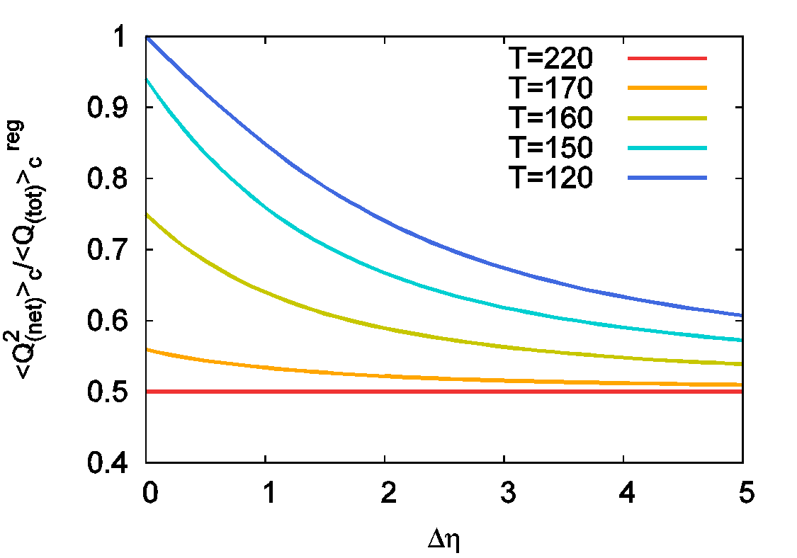
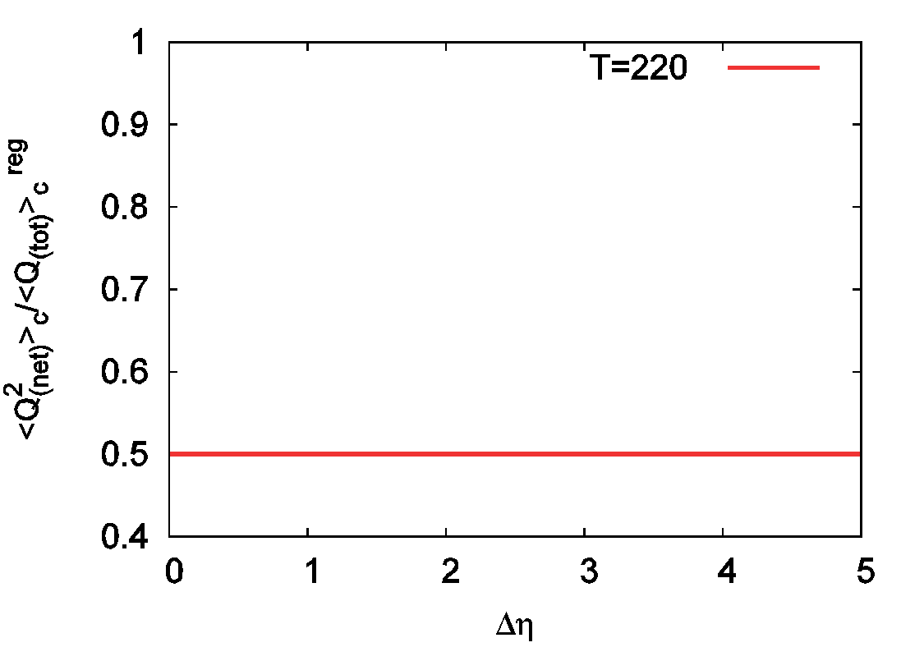
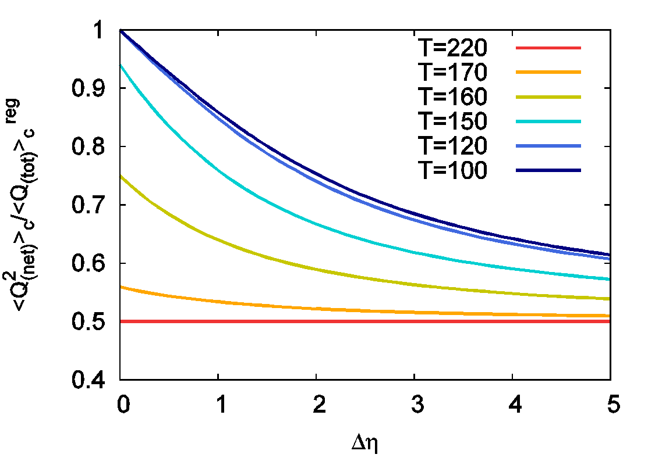
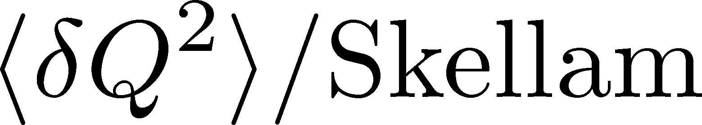
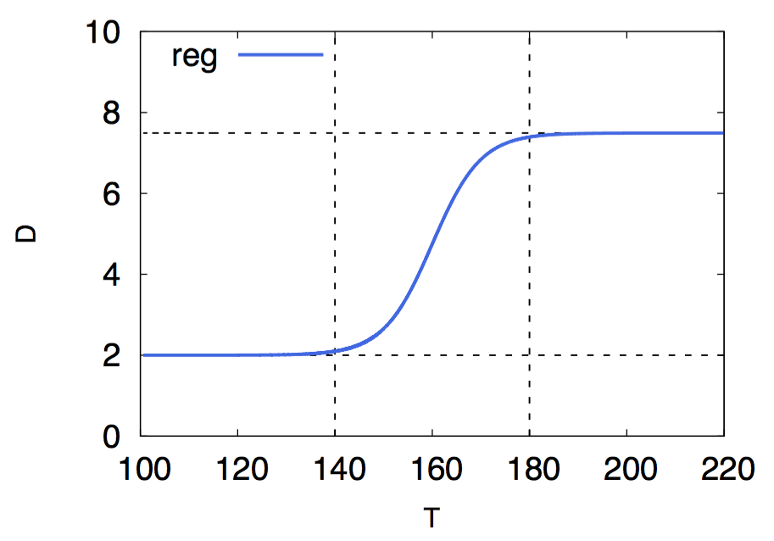
Time Evolution 1: No CP

Slide 44
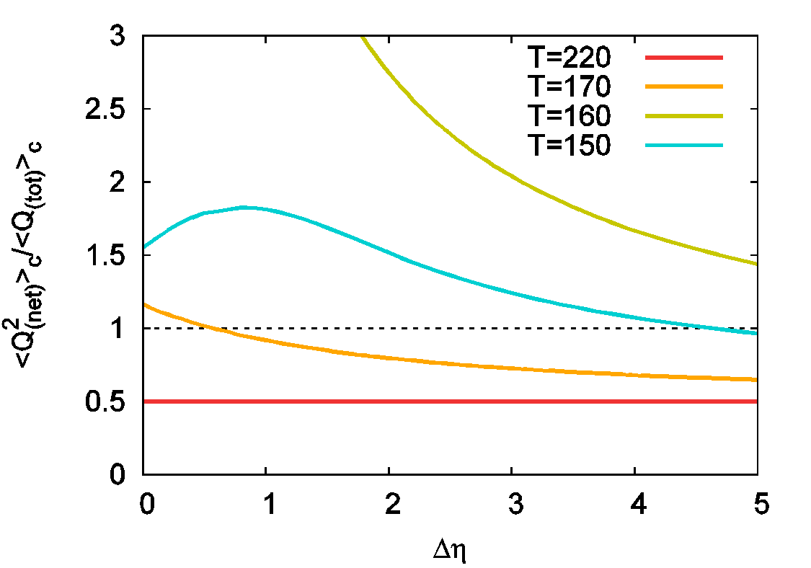
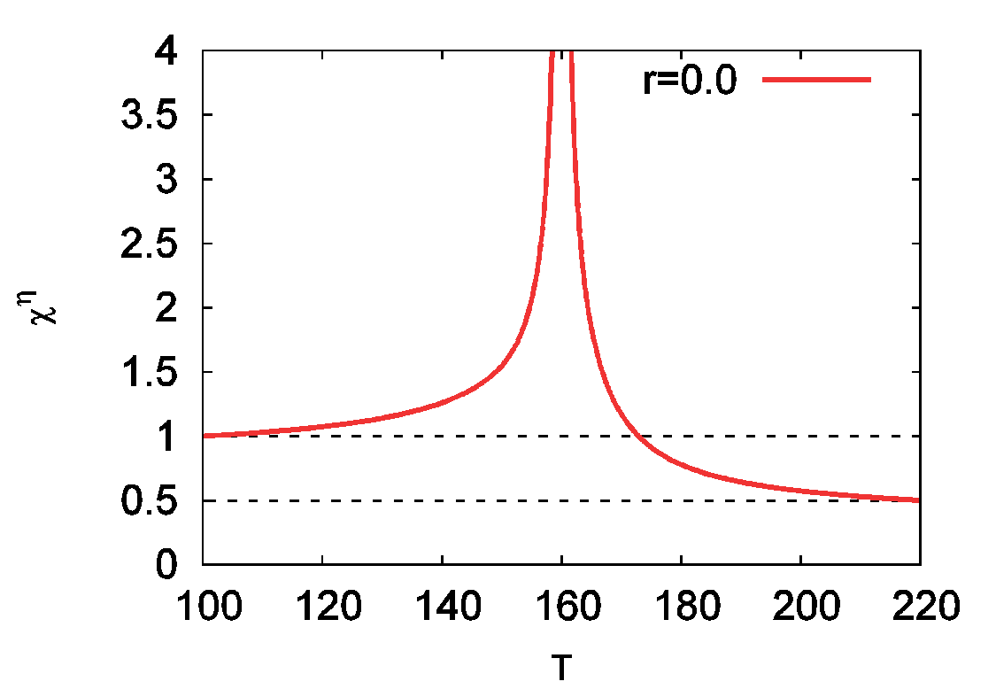
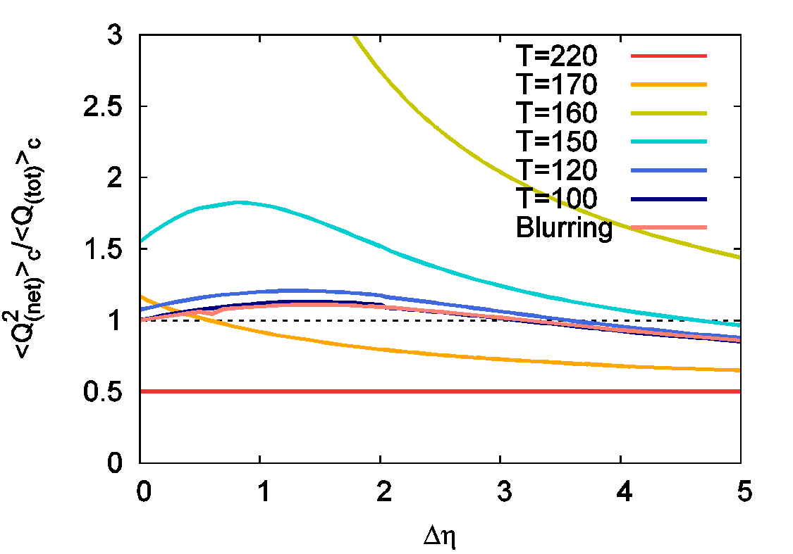
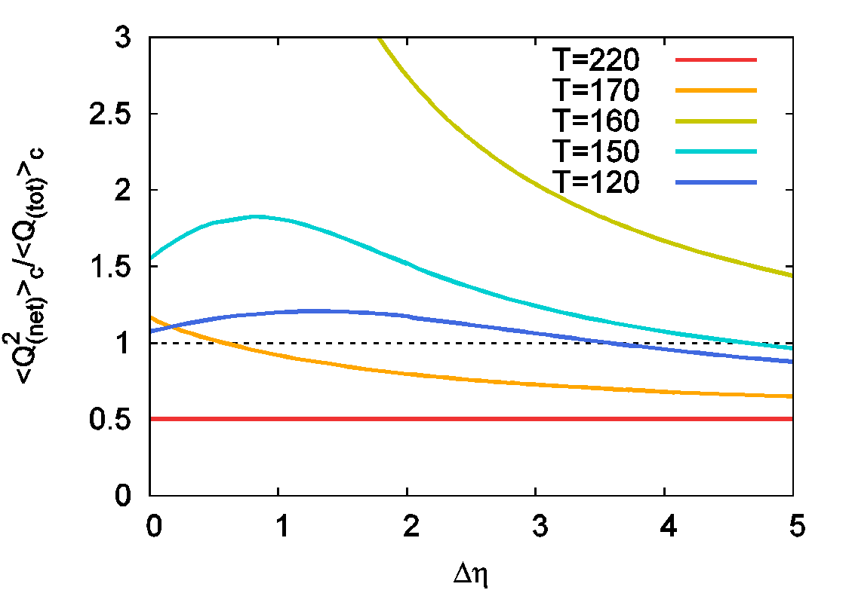
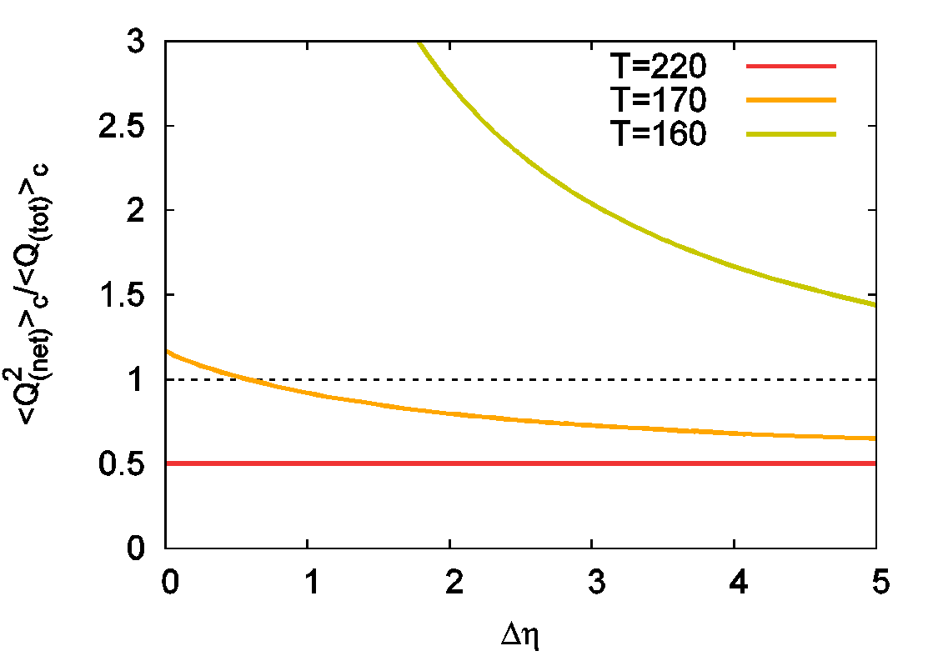
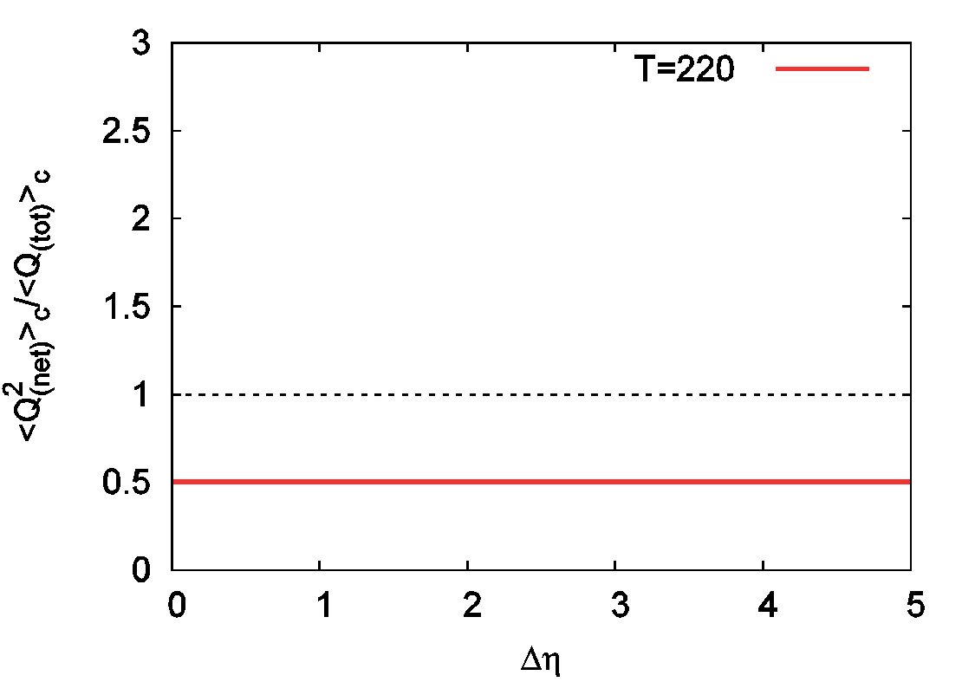
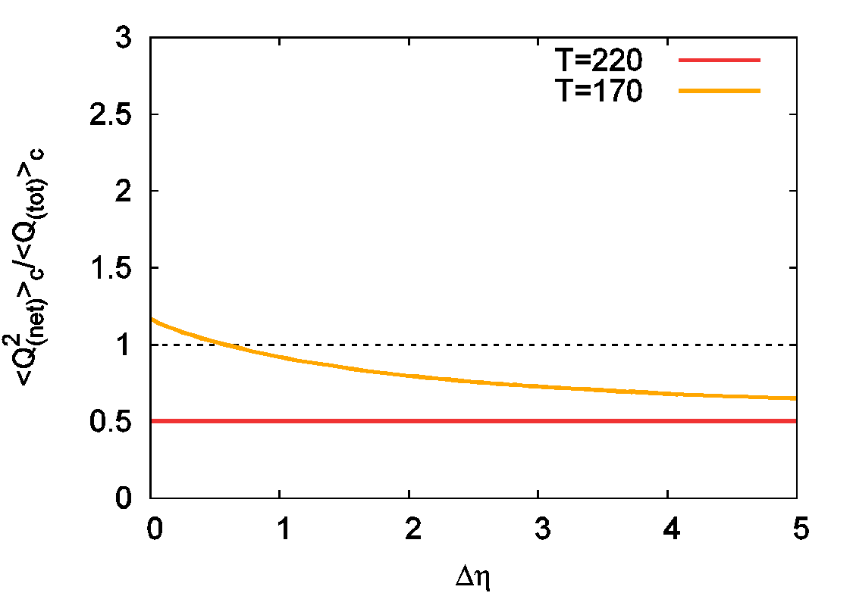
2: Critical Point
Non-monotonic Δy dependence manifests itself.
Robust experimental evidence of
the existence of a peak in χ(T)

Slide 45
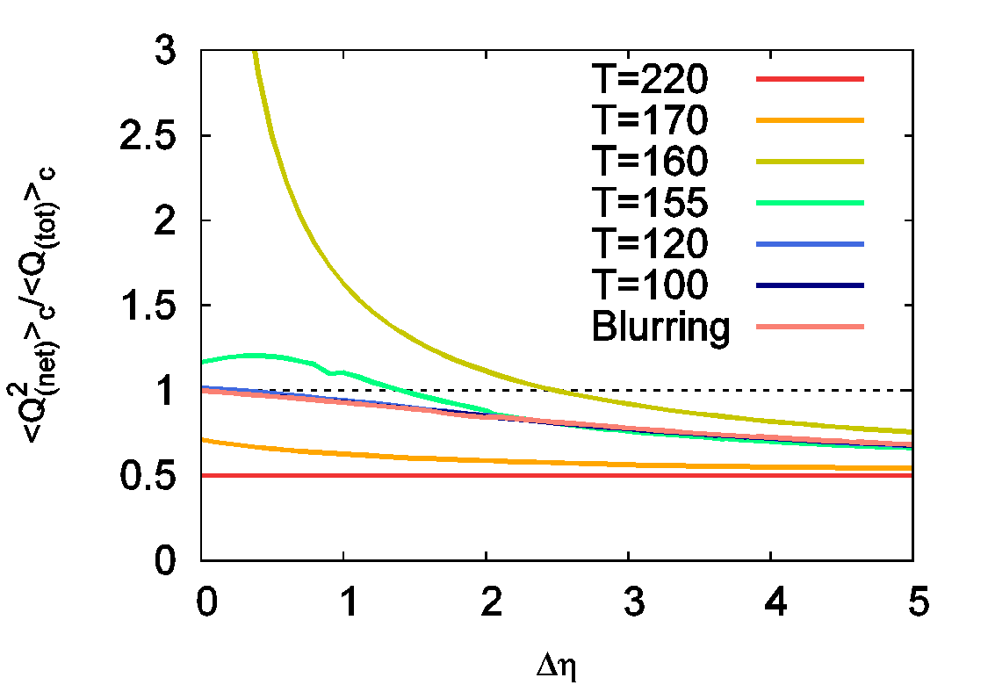





3: Critical Point (Narrower Critical Region)
non-monotonic
behavior
Peak in

Slide 46




Net-Electric Charge
From N. Sahoo, Ph.D thesis
No non-monotonic dependence in net-electric charge fluc.
How about net-proton number fluctuation??

Slide 47

Summary
Fragile Higher Orders
Interpret experimental results carefully.
Plenty of information in Δη dependences
Cumulants at chemical freezeout
Diffusion coefficients / thermal blurring
Signal of QCD-CP as a non-monotonic behavior in 2nd order
Future
Δy dependence of
Evolution of higher orders near CP with diffusive nature

Slide 48
Higher Order Cumulants??
Relaxation of cumulants is slower for higher order.
Longer survival?
Slower enhancement?
Non-monotonic Δy dependence can appear only by diffusion → It’s not the experimental evidence of peak in (higher order) susceptibility.
Non-linear equation has to be solved.

