Slide 1
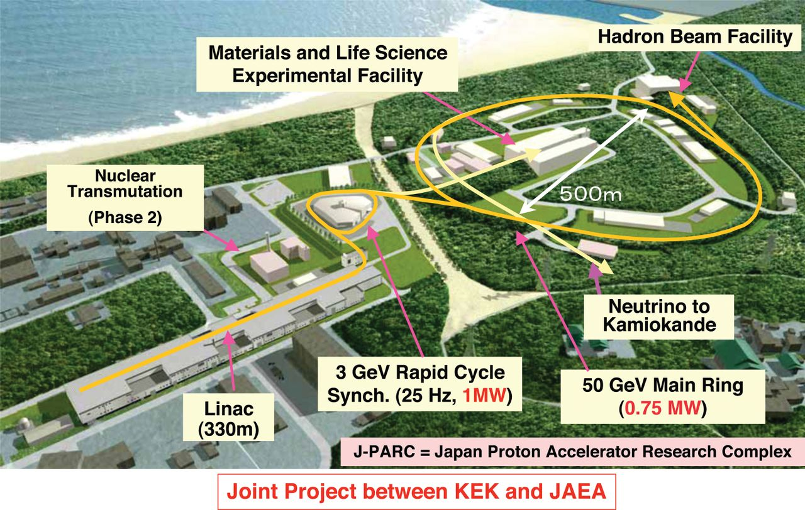
Heavy Ion Physics at J-PARC
KEK Theory Center Workshop “Hadron and Nuclear Physics in 2017”, 2017/1/9, KEK
Masakiyo Kitazawa
(Osaka University)

Slide 2
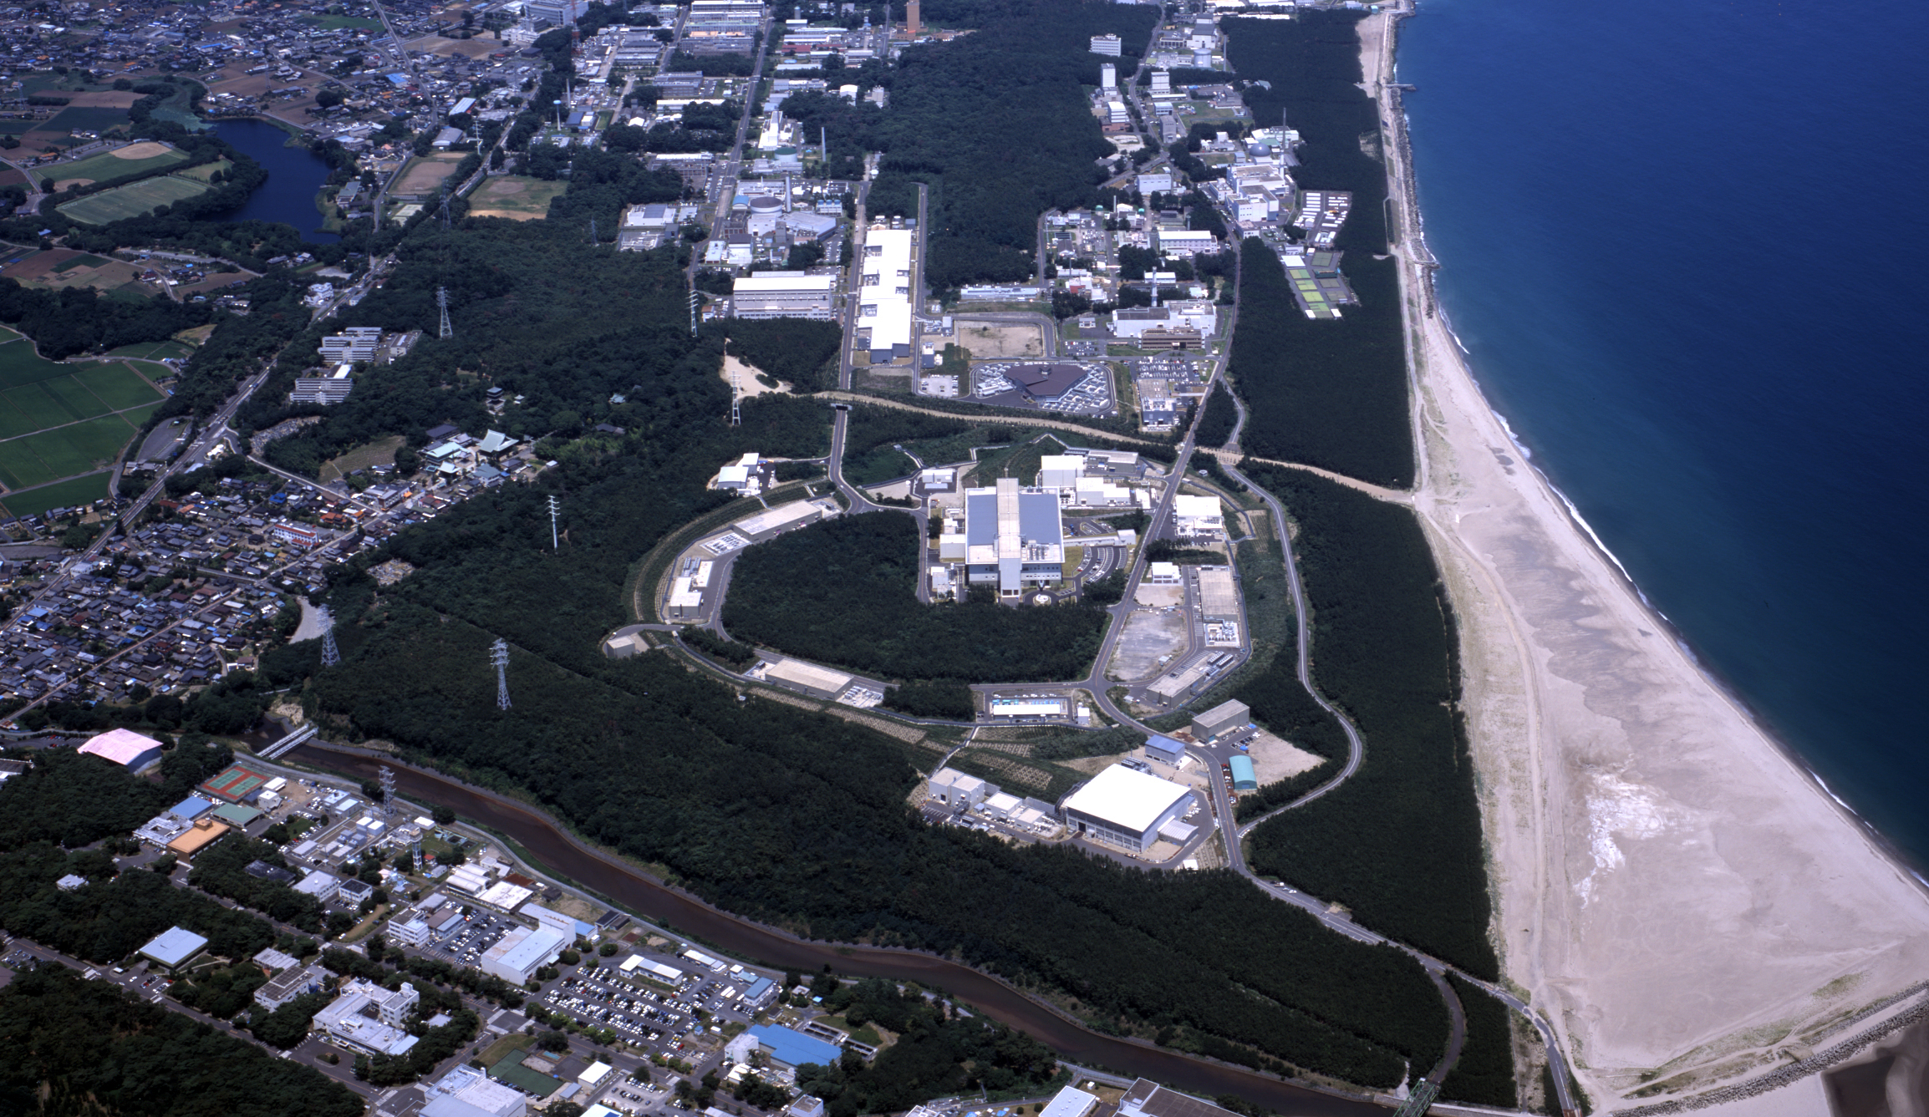
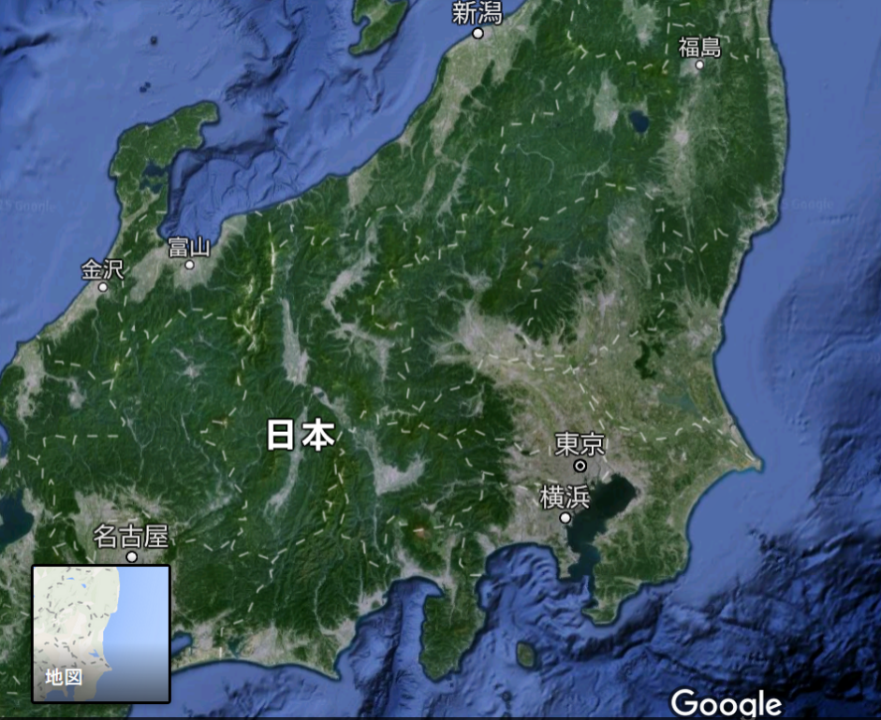
J-PARC
Japan Proton Accelerator Research Complex
High-power Proton Beam
T2K(Tokai-to-Kaminoka)
Hadron physics
etc…
J-PARC
KEK
Nagoya
Tokyo
Narita

Slide 3
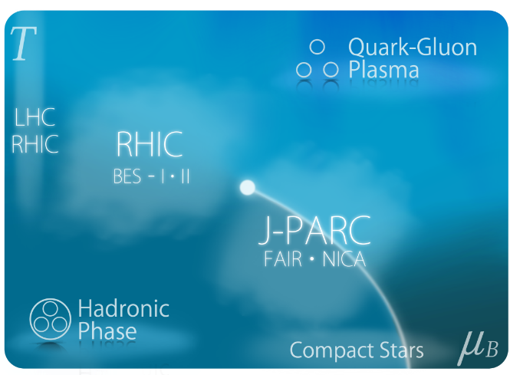
J-PARC
Japan Proton Accelerator Research Complex
J-PARC-HI = J-PARC Heavy-Ion Program
Dense Medium
Rare events
QCD phase diagram
1st order transition
Equation of state
Hypernuclei
Exotic hadrons
Hadron interaction

Slide 4
J-PARC
Japan Proton Accelerator Research Complex
J-PARC-HI = J-PARC Heavy-Ion Program
Beam energy: ~20GeV/A (√s~6.2GeV)
High luminosity: collision rate ~10⁸Hz
Fixed target experiment
Launch: (hopefully) 2025~
White paper / Letter of Intent (2016)
  http://asrc.jaea.go.jp/soshiki/gr/hadron/jparc-hi/

Slide 5




AGS
-1996
SPS
1994-2000
RHIC
2000-
LHC
2010-
RHIC-BES
2010-
creation of quark-gluon plasma,
strongly-interacting QGP
FAIR
2022-?
NICA
2025-?
~2010
History of HIC = increasing energy
2010~
Beam-energy scan
Low-energy exp.
Heavy-Ion Collisions
J-PARC-HI
2025~?
2-6.2 GeV

Slide 6
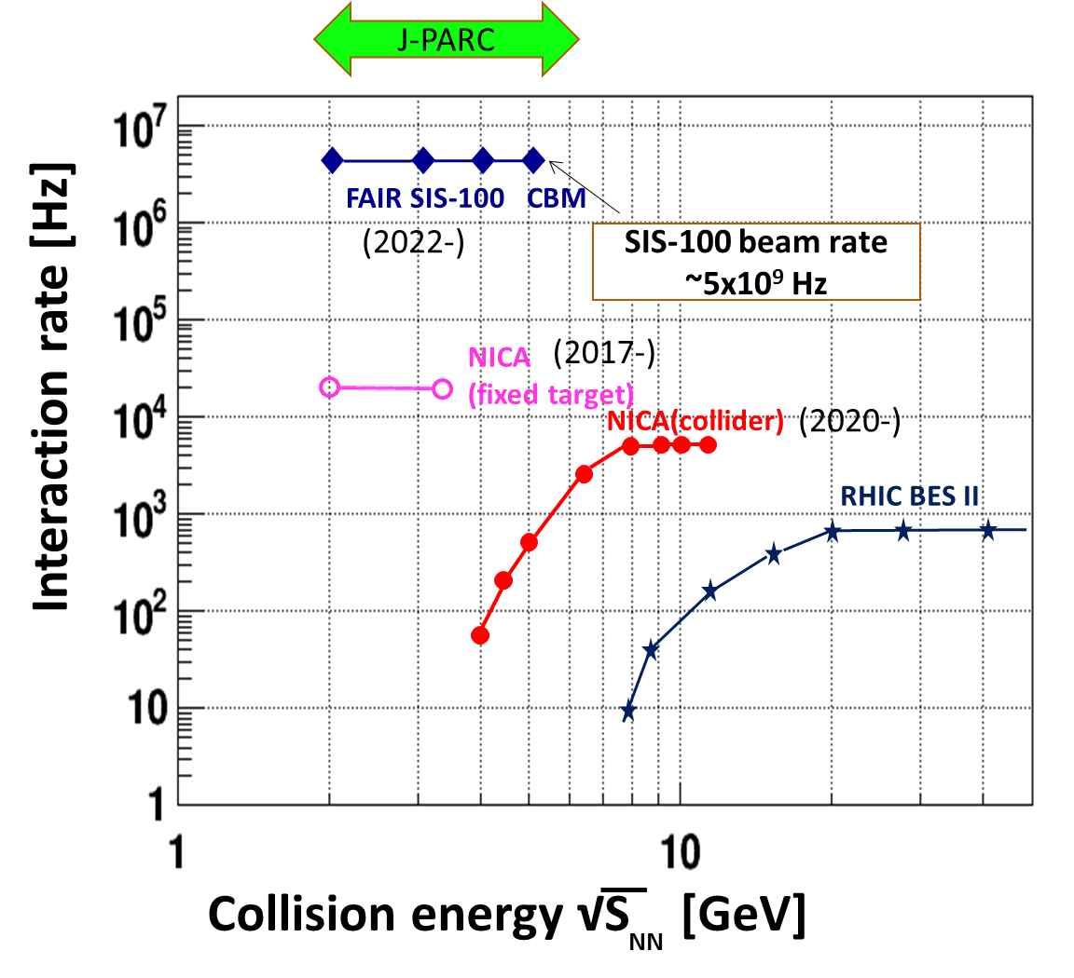
Collision Rate
J-PARC-HI
J-PARC-HI:
High-luminosity X Fixed target
→World highest rate～10⁸Hz
5-order higher than AGS,SPS
SPS
AGS
AGS, SPS
1 year
J-PARC-HI
5 min.
＝
High-statistical exp.
various event selections
higher order correlations
search of rare events

Slide 7
HI Acceleration @ J-PARC
J-PARC Heavy Ion
Spectrometer
New HI Injector
high intensity
RCS & Main Ring
stable
well established
Use of reliable / high-performance RCS & main ring
→Reduce cost and time

Slide 8

2 Main Goals of J-PARC-HI
Exploring Dense Medium
QCD phase diagram
1st order phase transition
equation of state
Rare-event Factory
hyper nuclei
exotic hadrons
hadron interaction

Slide 9
Why Low-E Collisions?

Slide 10
Why Low-E Collisions?
High energy
Low energy
Nuclear transparency
Baryon stopping
net-baryon #: small
net-baryon #: large

Slide 11

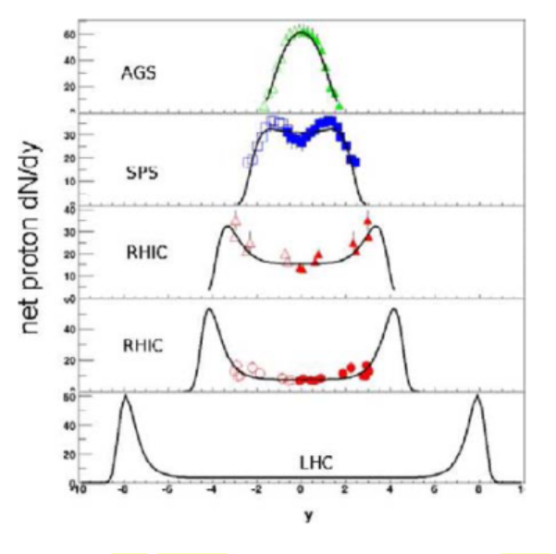





Baryon Stopping
rapidity dep. of net-proton #
Baryons stop at collision point
stopping
Baryons pass through
transparency
rapidity
phase diagram from
J-PARC White Paper

Slide 12

Beam-Energy Scan
T, μ from particle yield
Translation to baryon density
J-PARC-HI
STAR,2012
J-PARC energy = highest baryon density

Slide 13



Maximum Density
Time evolution in T-ρ plane by JAM
A. Ohnishi, 2002
Maximum density 5~10ρ₀ @ J-PARC energy
Large event-by-event fluctuations?

Slide 14

Theoretical Challenges
RHIC / LHC
creation of QGP
hydro. models
early thermalization
(boost invariance)
RHIC/LHC:
Thermalization
Hydrodynamics
Cascade

Slide 15
Theoretical Challenges
RHIC / LHC
Low-E Collisions
creation of QGP
hydro. models
early thermalization
(boost invariance)
Initial condition?
Thresholod of QGP formation
“Integrated” approach
  Hydro x Cascade
J-PARC:
Cascade
Hydrodynamics

Slide 16
Modelling Low-E Collisions
Controlling EOS by changing interaction in cascade
cascade + hydro + cascade
3-fluid dynamics
PHSD + chiral restoration
Chiral fluid
JAM/ Nara, Ohnishi, Stoecker, 2016-
UrQMD/ Petersen; Steinheimer
Karpenko+, 2016-
THESEUS/ Blaschke, Ivanov, +, 2016
Cassing+, 2016; Palmese+, 2016
Dumitru+; Nahrgang+, 2014-; Song+, 2016-

Slide 17
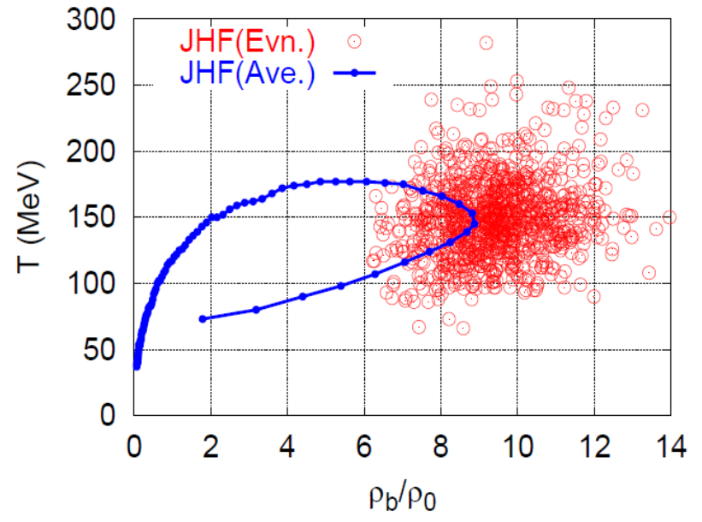
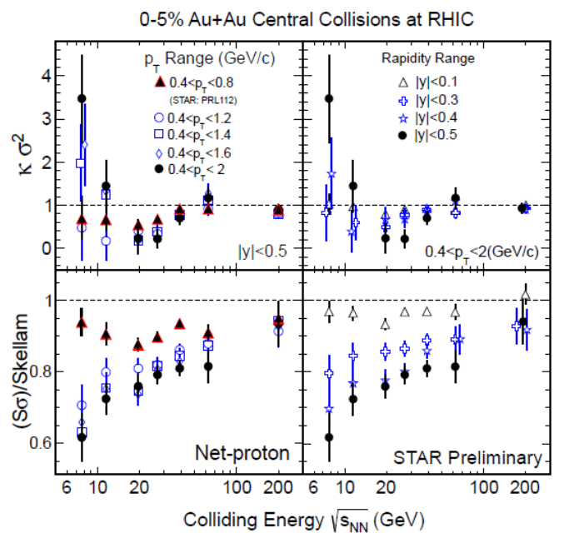
Various New Observables
Dilepton / photon
Fluctuations, higher-order cumulants
Ξ, Ω, …
Sophisticated event selections
Various correlations
Can we select
these events??
MK, Sakaguchi, Sako,
Nara, Ohnishi, …

Slide 18

Lepton & Photon:
Hierarchical Observation
gravitational wave
photons
Time scale: 10⁻¹s
di-lepton yield
EM probes
hadronic observables
time scale: 10⁻²²s

Slide 19
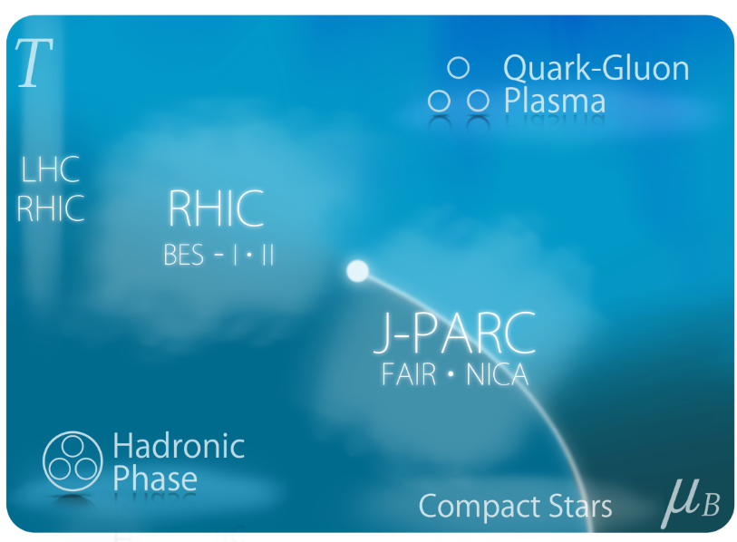
Fluctuations & QCD Critical Point
Is the signal of QCD-CP indicated in fluctuation observables??
Careful theor./exp. analyses are needed!
Non-eq. effects / rapidity dependences / experimental cuts / etc.
Asakawa, MK, Prog. Part. Nucl. Phys. (2016)

Slide 20
2 Main Goals of J-PARC-HI
Exploring Dense Medium
QCD phase diagram
1st order phase transition
equation of state
Rare-event Factory
hyper nuclei
exotic hadrons
hadron interaction

Slide 21
Search of Rare Events
Exotic
Hadrons
High density
High luminosity
High strange yield
Hypernuclei
Rare-event
Factory
Strangelets
hadron
Interaction
creation
properties
interaction

Slide 22
Production Rate
Accessible
@ J-PARC
Particle yield in thermal model

Slide 23
Hypernuclei
JHIPER
Experimental
setting for
hypernucler
physics
Particle yield in thermal model
has a maximum around
J-PARC energy

Slide 24
Hyper-Nuclear Phyics @ J-PARC
Negatively-charged hypernuclei (Ξ⁻n, Ξ⁻nn, …)
Nuclear strangelets
n-rich / p-rich hypernuclei
Measurement of magnetic moments

Slide 25
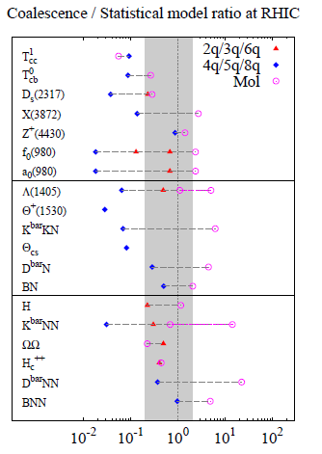
Creation, Properties
or
Structure of Hadrons
Particle yields
ExHIC Collaboration, 2012

Slide 26

Hadron-hadron Interaction
ΛΛ Correlation function
STAR,2015
Hadron interaction can be studied from correlation function.
emission source
func.
+
relative
wave func.
Morita, Furumoto, Ohnishi, 2015

Slide 27
The most difficult Problem…

Slide 28
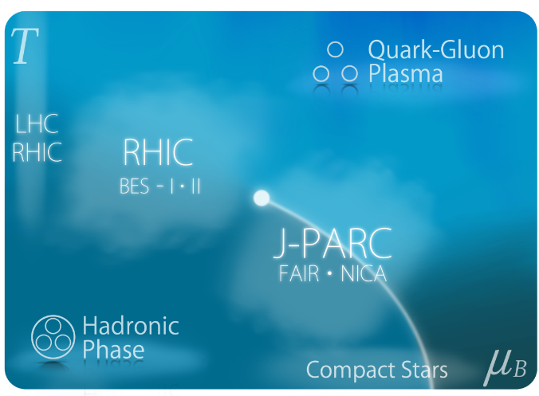
Future Plan
Recent activities:
June 2016
July 2016
Aug. 2016
Sep. 2016
White Paper uploaded
Submission of LOI
International Workshop
Symposium @ JPS meeting
Visit J-PARC-HI Web Page
http://asrc.jaea.go.jp/soshiki/gr/hadron/jparc-hi/
Future plan:
2020
2021
2021-2022
2021-2023
2023-2024
2025
Funding request to MEXT
Earliest approval of funding
Construction of HI Injector
Construction of HI injection system in RCS
Construction of HI spectrometer
First collision

Slide 29
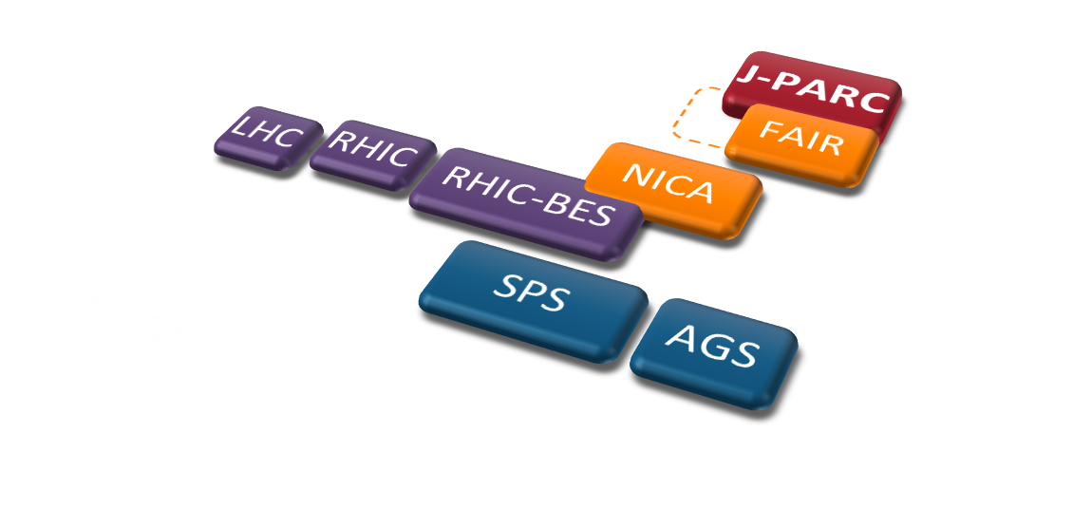
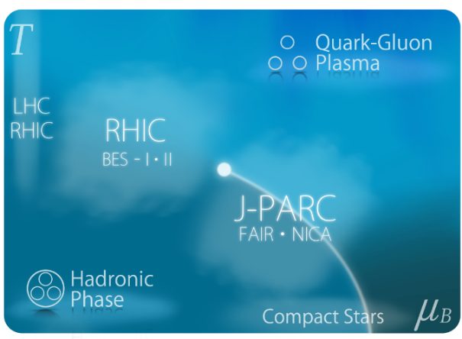
Summary
J-PARC-HI will explore extremely dense medium with world’s
highest statistics.
It will reveal many interesting aspects of
Dense medium
Rare events

Slide 30



Directed Flow
Directed Flow:

Slide 31
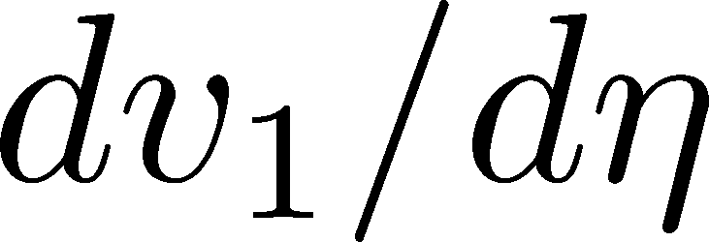
Directed Flow:
dv₁/dy: two sign change
No transport models can reproduce it quantitatively

Slide 32
LHC
RHIC
RHIC-BES
SPS
NICA
LHC
J-PARC
AGS
FAIR
RHIC
collision rate
RHIC-BES
SPS
NICA
FAIR
J-PARC
AGS
collision rate

Slide 33
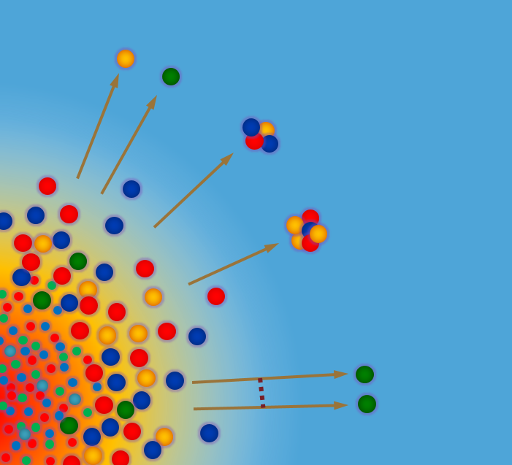
Search of Rare Events

