Slide 1
Non-Gaussian Fluctuations in Relativistic Heavy-Ion Collisions
Masakiyo Kitazawa
(Osaka U.)
Asakawa, MK, Prog. Part. Nucl. Phys. 90, 299 (2016)
Sakaida, Asakawa, Fujii, MK, to appear in PRC
MK, Nucl. Phys. A942, 65 (2015)
Sakaida, Asakawa, MK, PRC90, 064911 (2014)
MK, Asakawa, Ono, Phys. Lett. B728, 386-392 (2014)
Nagoya Seminar, Nagoya U., 31/May/2017

Slide 2
Beam-Energy Scan
T
Hadrons
Color SC
0
μ

Slide 3

Beam-Energy Scan
STAR 2012
high
beam energy
T
low
Hadrons
Color SC
0
μ

Slide 4
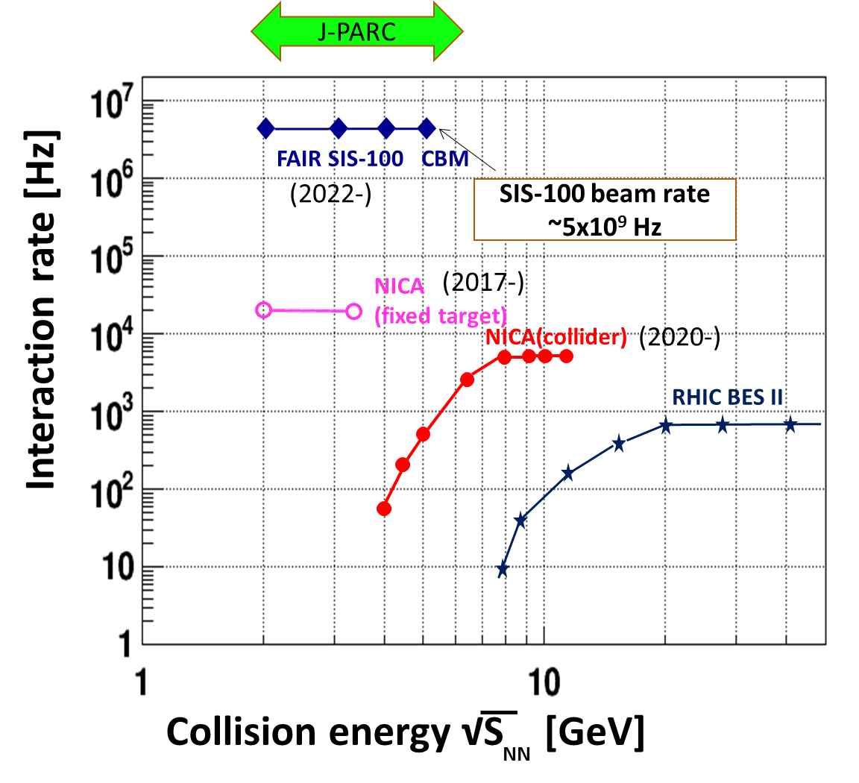
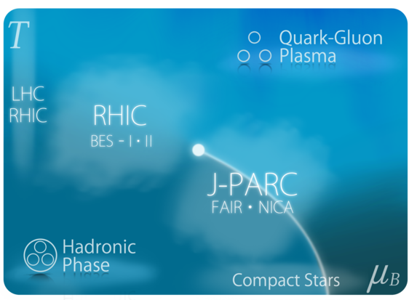
Beam-Energy Scan
RHIC-BES
Active experimental researches/plans
for the beam-energy scan
BES-II
2019-2020
J-PARC-HI
J-PARC-HI
2025~?
SPS
AGS
Search for QCD phase structure
/ critical point

Slide 5
Fluctuations

Slide 6
Thermal Fluctuations
Observables are fluctuating even in an equilibrated medium.
P(N)
N
V
N

Slide 7
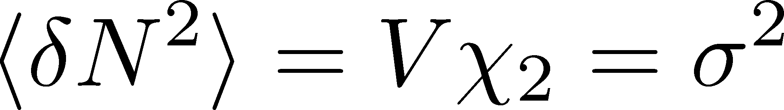
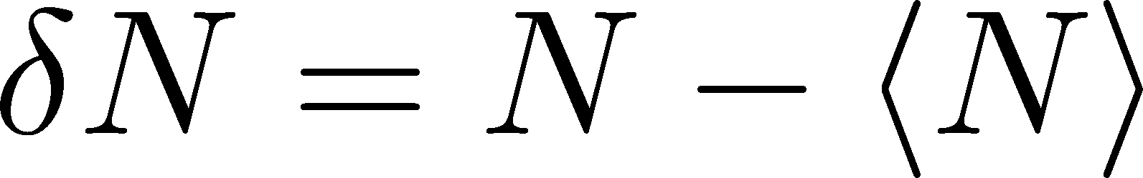
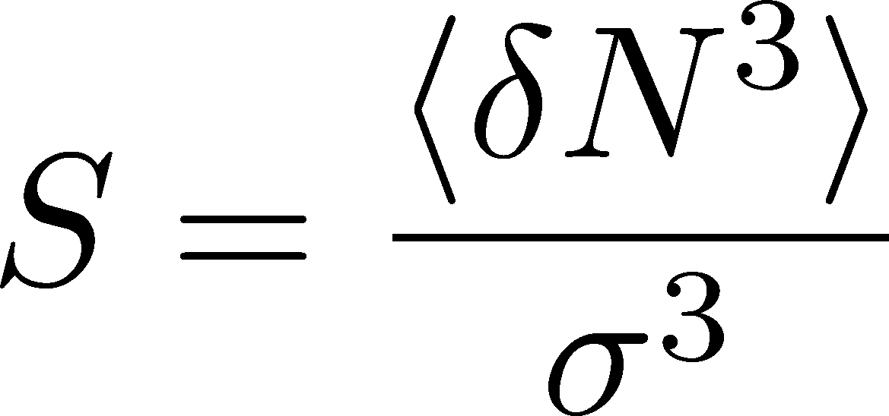
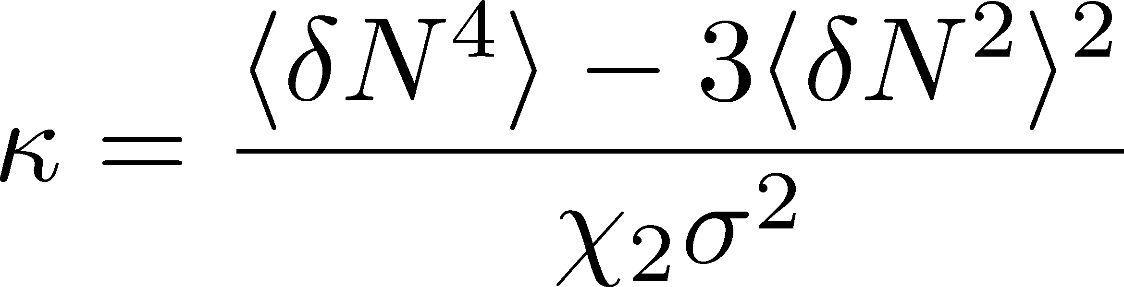
Thermal Fluctuations
Observables are fluctuating even in an equilibrated medium.
P(N)
N
V
N
Variance:
Non-Gaussianity
Skewness:
Kurtosis:

Slide 8
The noise is the signal.
R. Landauer
1998

Slide 9


A Coin Game
Bet 250 JPY
You get head coins of
A. 100 x 5 JPY
B. 50 x 10 JPY
Same expectation value.

Slide 10
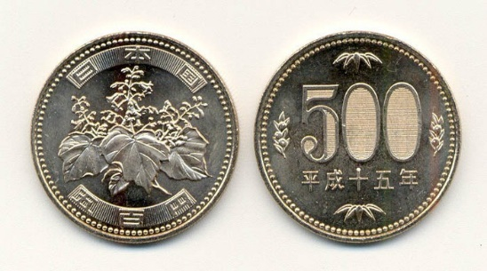
A Coin Game
Bet 250 JPY
You get head coins of
A. 100 x 5 JPY
B. 50 x 10 JPY
C. 1 x 500 JPY
Same expectation value.
But, different fluctuation

Slide 11


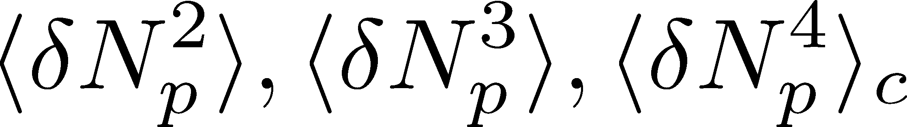
Event-by-Event Fluctuations
Review: Asakawa, MK, PPNP 90 (2016)
Fluctuations can be measured by e-by-e analysis in experiments.
STAR, PRL105 (2010)
Detector
Cumulants

Slide 12
Event-by-Event Analysis @ HIC
Fluctuations can be measured by e-by-e analysis in experiments.
V
Detector

Slide 13


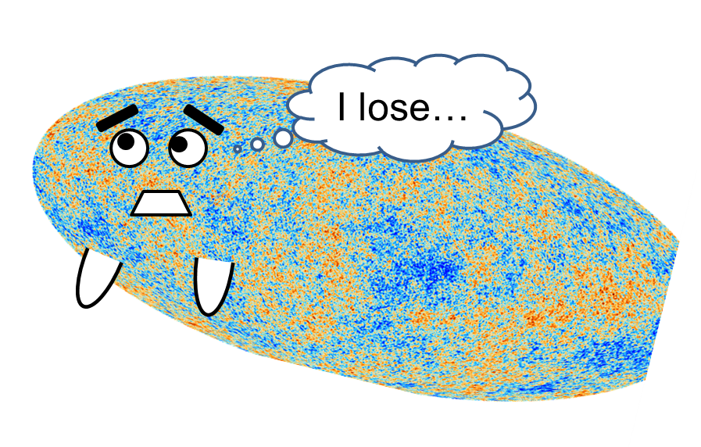
Higher-Order Cumulants
STAR Collab.
2010~
Enhancement
Non-zero non-Gaussian cumulants
have been established!
Have we measured critical fluctuations?

Slide 14
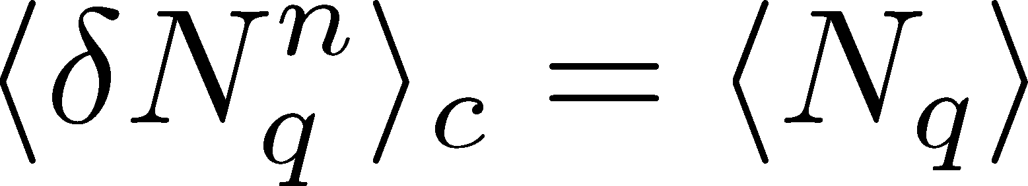
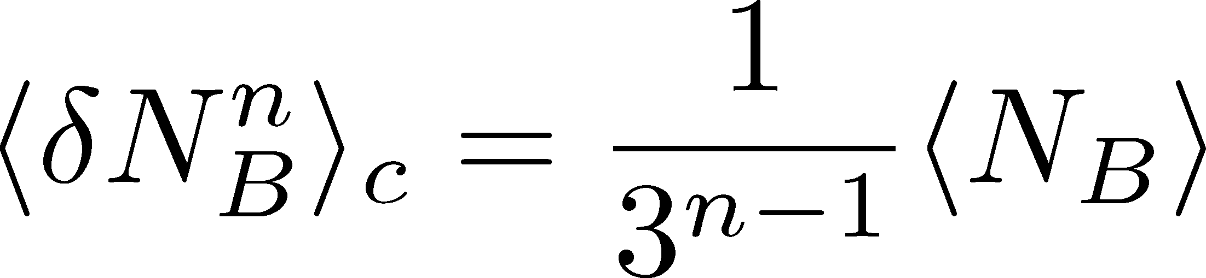
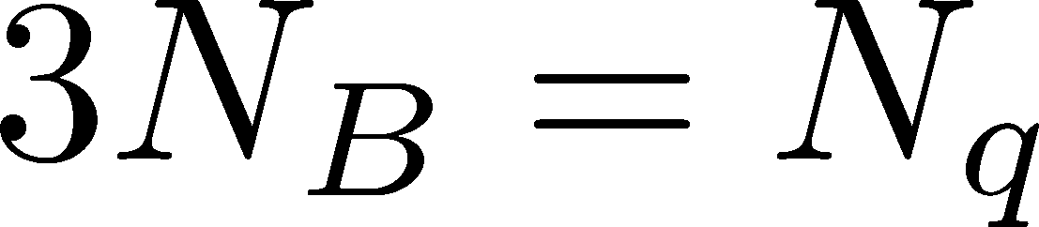
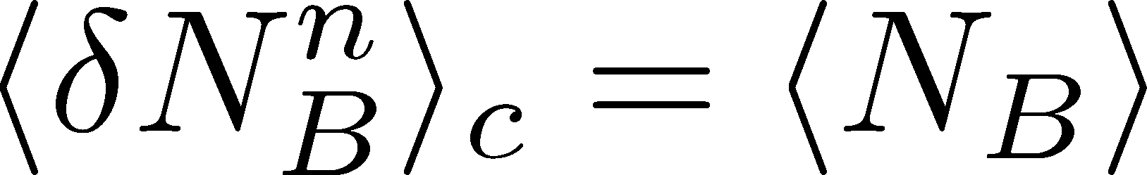
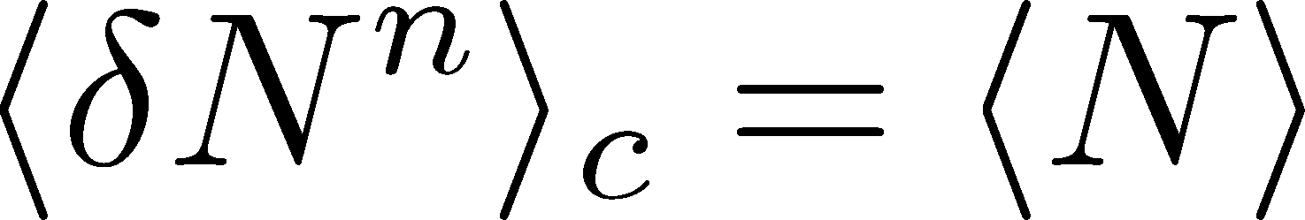
Fluctuations and Elemental Charge
Asakawa, Heinz, Muller, 2000
Jeon, Koch, 2000
Ejiri, Karsch, Redlich, 2005
Free Boltzmann → Poisson

Slide 15
Fluctuations and Elemental Charge
Asakawa, Heinz, Muller, 2000
Jeon, Koch, 2000
Ejiri, Karsch, Redlich, 2005
RBC-Bielefeld ’09
Free Boltzmann → Poisson

Slide 16
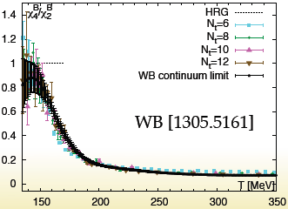
Fluctuations and Elemental Charge
Asakawa, Heinz, Muller, 2000
Jeon, Koch, 2000
Ejiri, Karsch, Redlich, 2005
Free Boltzmann → Poisson

Slide 17




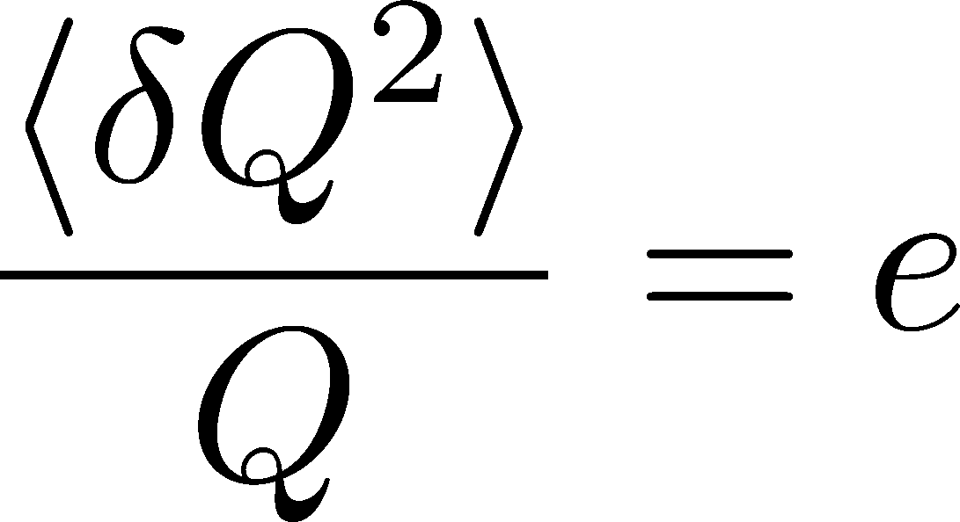
Shot Noise
e*
charge of quasi-particles
Total charge Q:

Slide 18
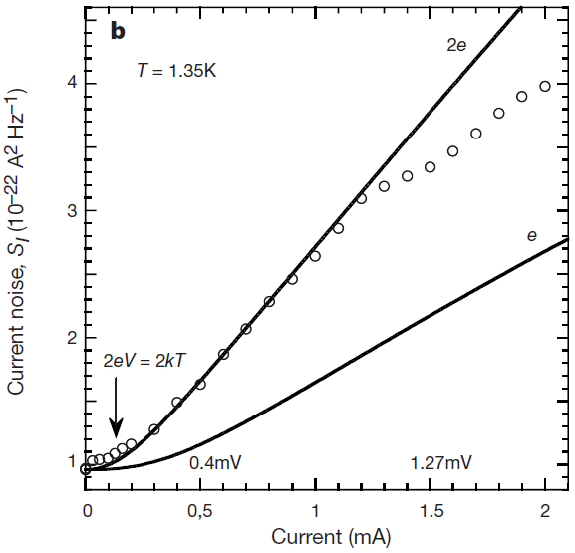


Shot Noise
e*
charge of quasi-particles
Superconductors
with Cooper Pairs
Fractional Quantum
Hall Systems
doubled!
Jehl+, Nature 405,50 (2000)
Saminadayar+, PRL79,2526 (1997)
Higher order cumulants:
3rd order: ex. Beenakker+, PRL90,176802(2003)
up to 5th order: Gustavsson+, Surf.Sci.Rep.64,191(2009)

Slide 19


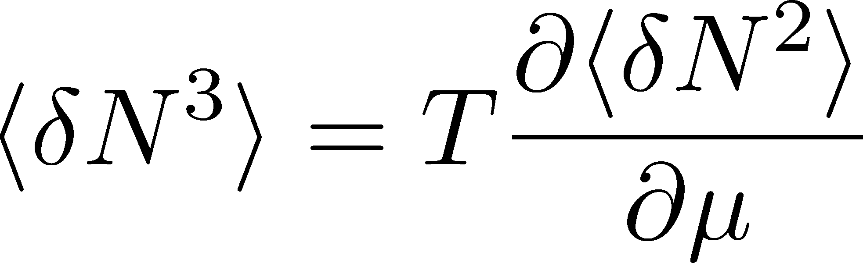

Fluctuation and QCD Critical Point
Fluctuations diverge at
the QCD critical point
Geometric interpretation to
signs of higher order cumulants
Asakawa, Ejiri, MK
2009
More severe divergence for higher-order cumulants
Stephanov, 2009

Slide 20

Impact of Negative Third Cumulants
Once negative <dN_{B}³> is established, it is evidences that
(1) χ_{B} has a peak structure in the QCD phase diagram.
(2) Hot matter beyond the peak is created in the collisions.
No dependence on any specific models.
Just the sign! No normalization (such as by N_{ch}).

Slide 21
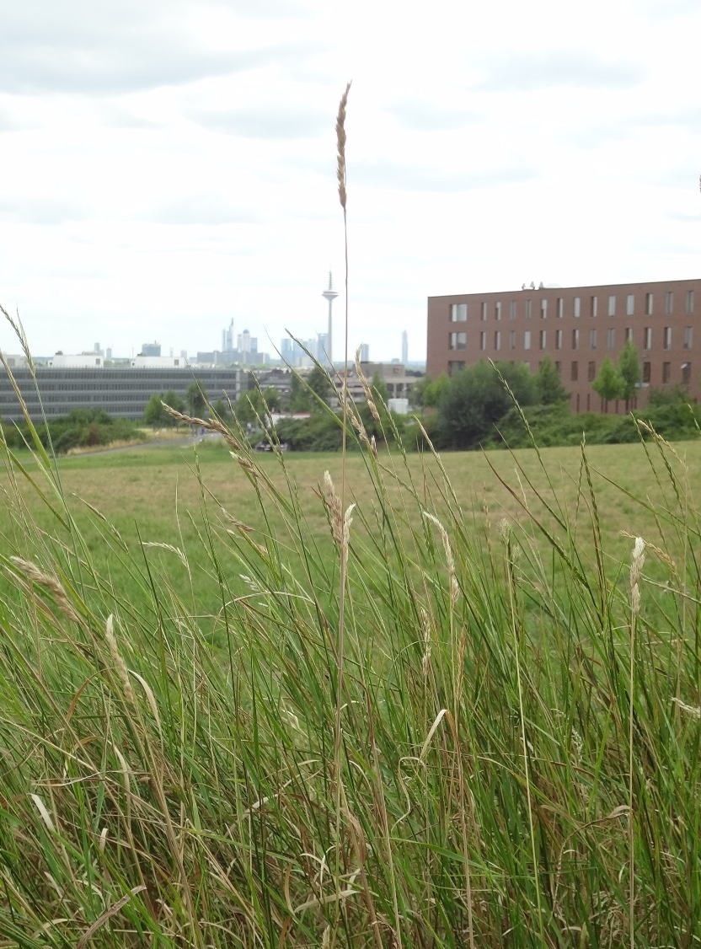
In “haiku”, Japanese short-style poem, a poet wrote…
Even on one blade of grass
the cool wind lives
Issa Kobayashi
1814
一本の草も涼風宿りけり
小林一茶

Slide 22
Physicists can feel hot early Universe
13 800 000 000 years ago
in tiny fluctuations of
cosmic microwave

Slide 23
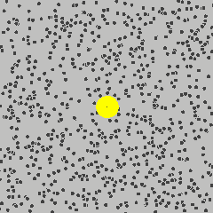
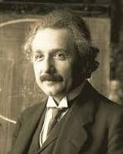
Physicists can feel the existence of microscopic
atoms behind random fluctuations
of Brownian pollens
A. Einstein
1905

Slide 24
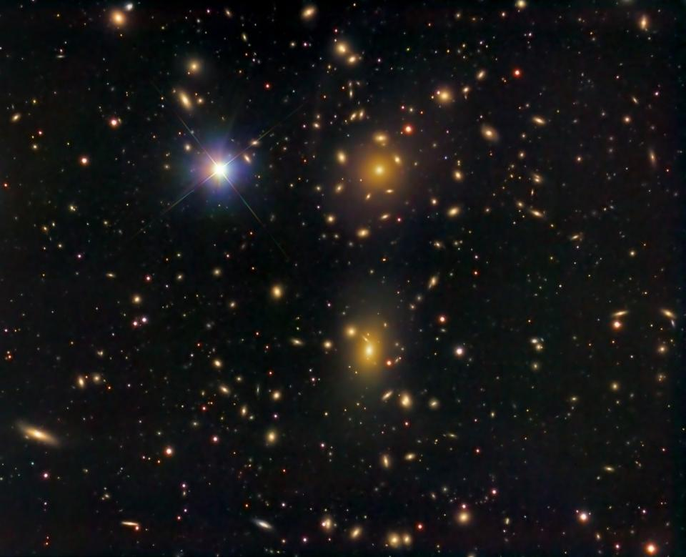
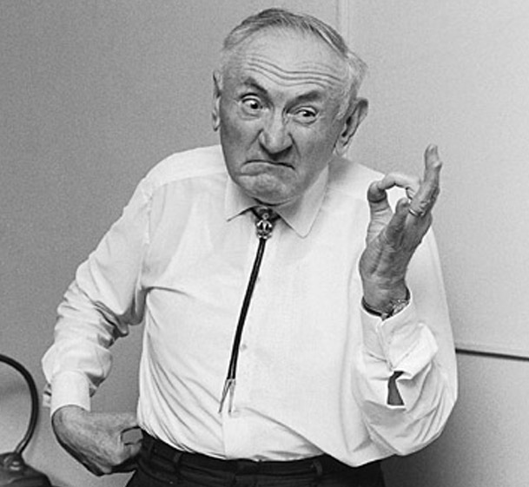

Zwicky 1933
Virial theorem
Physicists can feel dark matter behind
fluctuations of galaxies billion light years away

Slide 25
Feel hot quark wind behind fluctuations
in relativistic heavy ion collisions
2010-

Slide 26
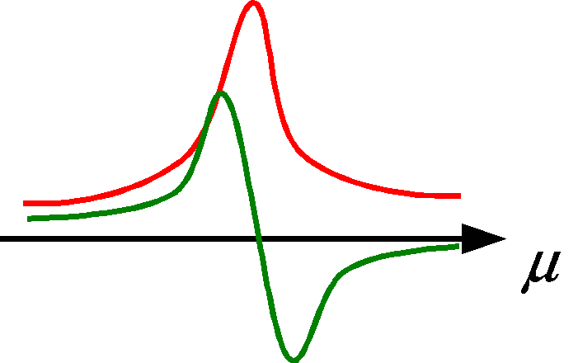
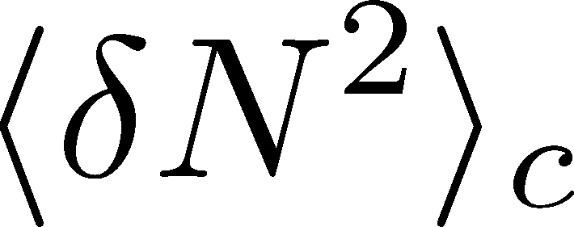
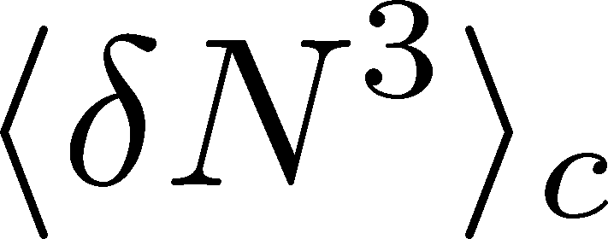
X. Luo, STAR, QM2015
Clear suppression!
ex. Asakawa, Ejiri, MK, 2009
Even on one blade of grass
the cool wind lives

Slide 27
Rapidity Window Dependences
of Fluctuations

Slide 28
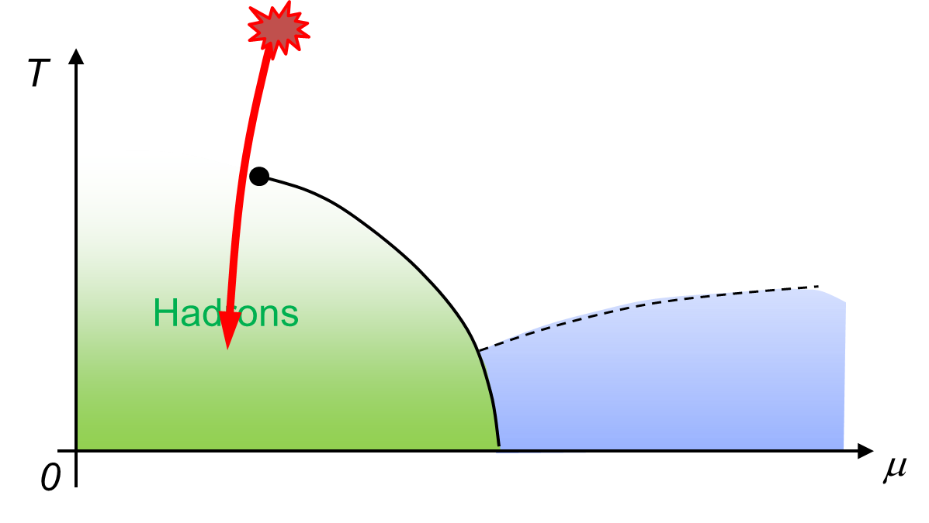
Remarks on Critical Fluctuation
Experiments cannot observe
critical fluctuation in equilibrium directly.
Growth
Critical fluctuation has to be well developed.
But, relaxation toward equilibration is slow around CP because of the critical slowing down.
Decay by diffusion
Fluctuations developed at CP are modified by the time evolution in later stage.

Slide 29

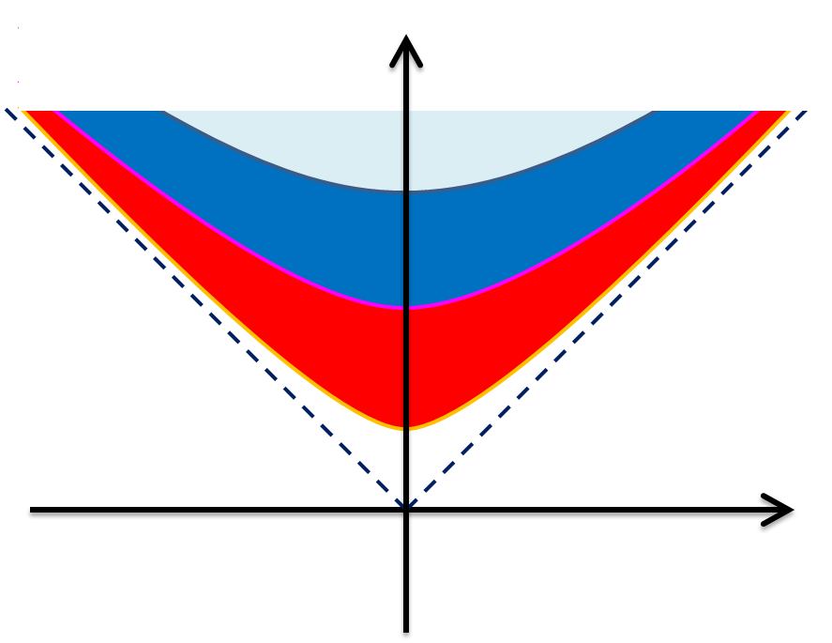



Time Evolution of Fluctuations
Diffusion modifies distribution

Slide 30


Δη Dependence @ ALICE
ALICE
PRL 2013
hadronic
D-measure
D ~ 3-4 Hadronic
D ~ 1-1.5 Quark
t
Δη
rapidity window
z

Slide 31
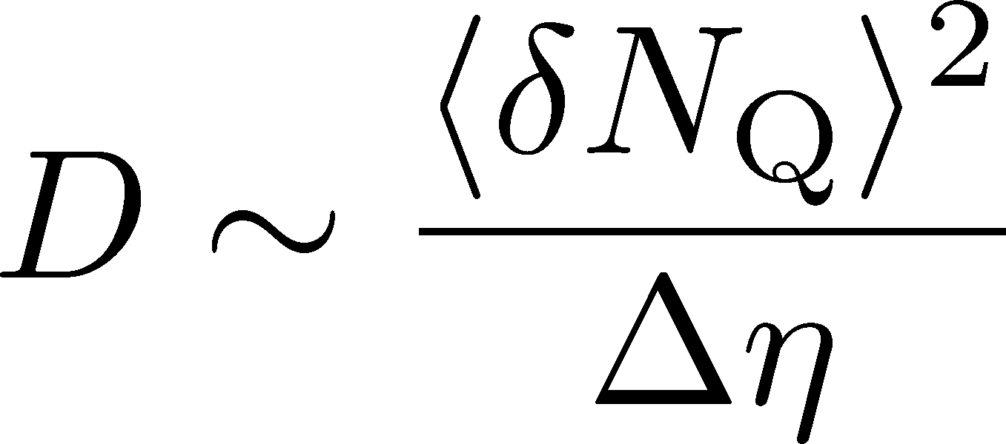
Δη Dependence @ ALICE
hadronic
has to be a constant
in equil. medium
Fluctuation of N_{Q}
at ALICE is not the
equilibrated one.
rapidity window

Slide 32
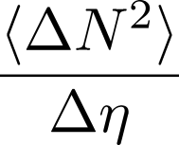

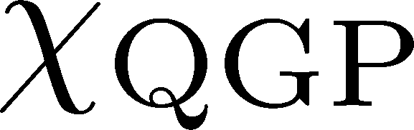


Time Evolution of Fluctuations
Quark-Gluon Plasma
Hadronization
Freezeout
Variation of a conserved charge is achieved only through diffusion.
The larger Δη,
the slower diffusion

Slide 33
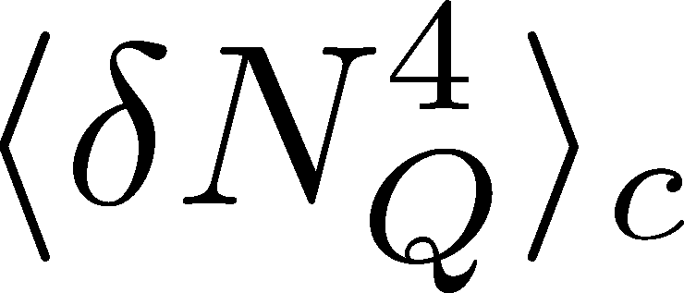




<δN_{Q}⁴> @ LHC ?
How does behave as a function of Δη?
suppression
or
enhancement

Slide 34
<δN_{Q}⁴> @ LHC ?
How does behave as a function of Δη?
suppression
or
enhancement

Slide 35
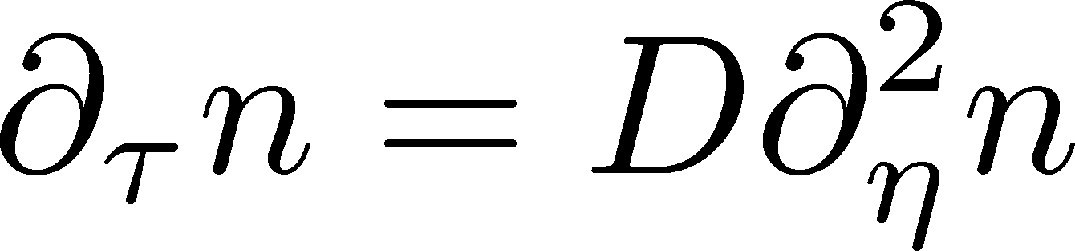

Stochastic Diffusion Equation (SDE)
Diffusion equation
Describe a relaxation of a conserved density n toward uniform state without fluctuation
Stochastic diffusion equation
Describe a relaxation toward fluctuating uniform state
χ: susceptibility (fluctuation in equil.)
Review: Asakawa, MK, PPNP 90 (2016)

Slide 36
Hydrodynamic Fluctuations
Landau, Lifshitz, Statistical Mechaniqs II
Kapusta, Muller, Stephanov, 2012
Stochastic diffusion equation
Shuryak, Stephanov, 2001
Markov (white noise)
+
continuity
Fluctuation of n is
Gaussian in equilibrium
Gaussian noise
cf) Gardiner, “Stochastic Methods”

Slide 37



Baryons in Hadronic Phase
time
chem. f.o.
hadronize
10~20fm
kinetic f.o.
Baryons behave like
Brownian pollens in water
mesons
baryons

Slide 38


Non-Interacting Brownian Particle System
Initial condition (uniform)
cumulants:
random
walk
diffusion master equation: MK+, PLB(2014)
probabilistic argument: Ohnishi+, PRC(2016)

Slide 39



Non-Interacting Brownian Particle System
Initial condition (uniform)
cumulants:
diffusion
distance
random
walk
Study ΔY dependence
Poisson distribution
diffusion master equation: MK+, PLB(2014)
probabilistic argument: Ohnishi+, PRC(2016)

Slide 40
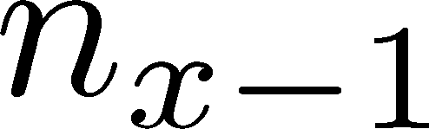






Diffusion Master Equation
MK, Asakawa, Ono, 2014
MK, 2015
Divide spatial coordinate into discrete cells
probability

Slide 41
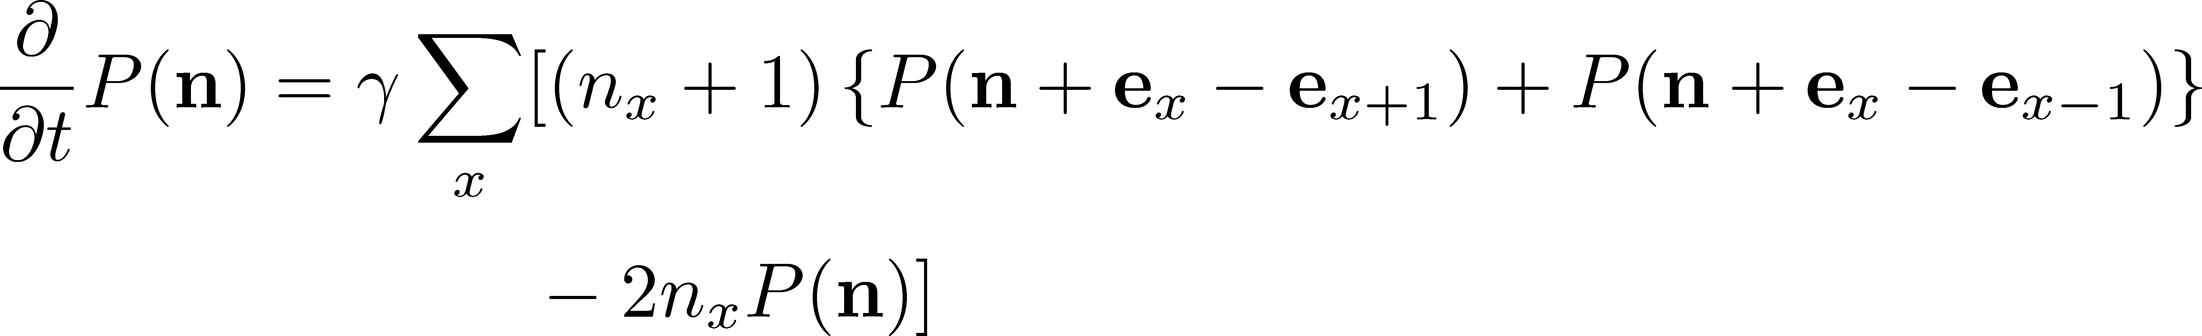
Diffusion Master Equation
MK, Asakawa, Ono, 2014
MK, 2015
Divide spatial coordinate into discrete cells
probability
Master Equation for P(n)
Solve the DME exactly, and take a→0 limit
No approx., ex. van Kampen’s system size expansion

Slide 42
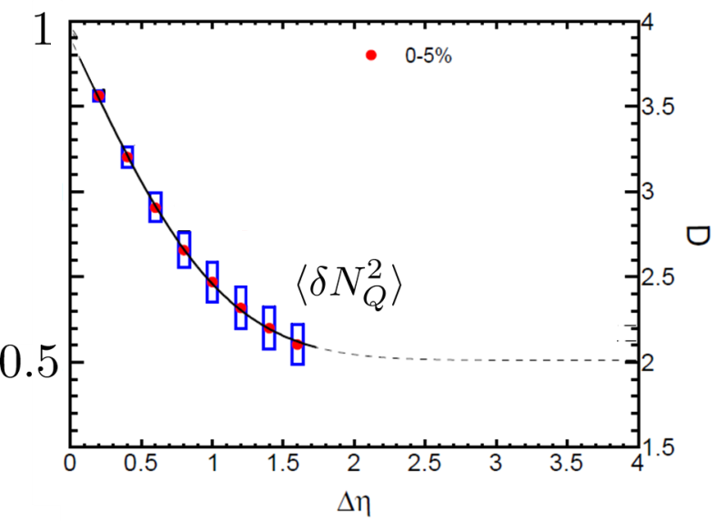


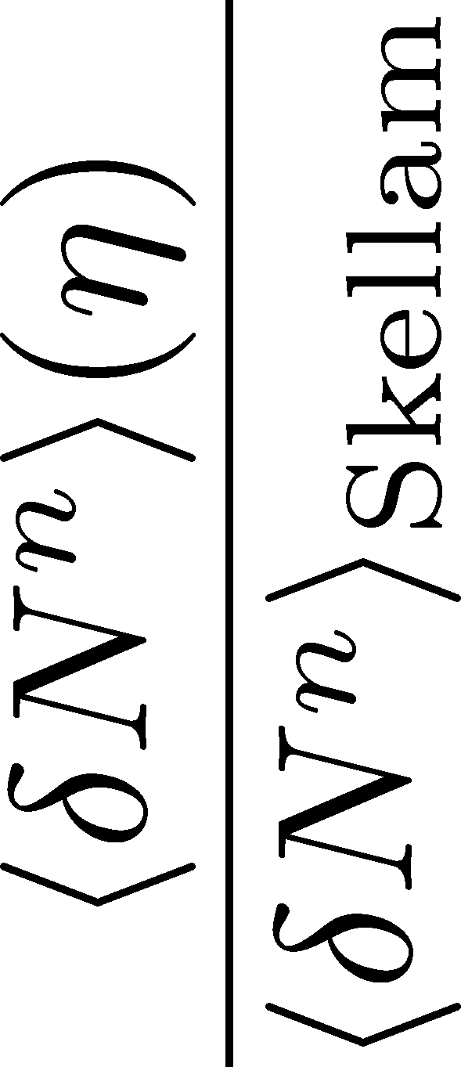

Rapidity Window Dependence
No initial net fluctuation:
2nd
4th
parameter
sensitive to
hadronization

Slide 43
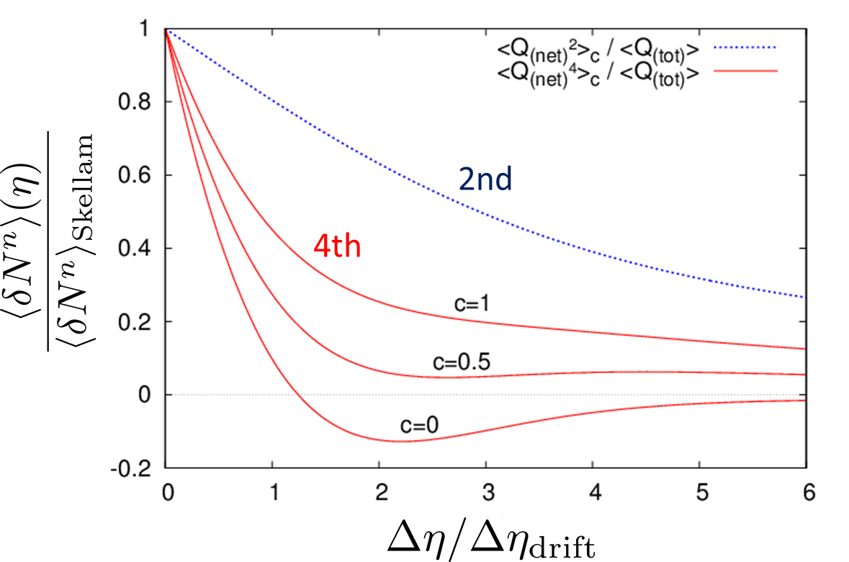
Rapidity Window Dependence
MK+, PLB(2014)
Cumulants at finite Δy is different from initial value.
4th cumulant can have a sign change.
4th cumulant can have non-monotonic behavior.

Slide 44
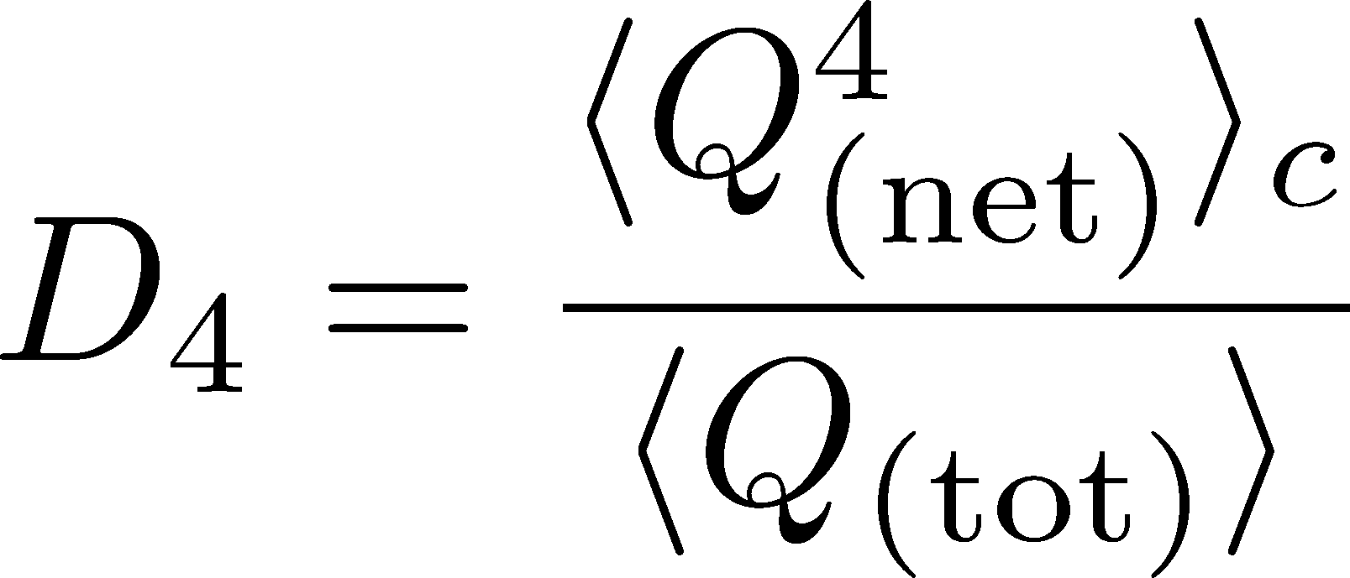


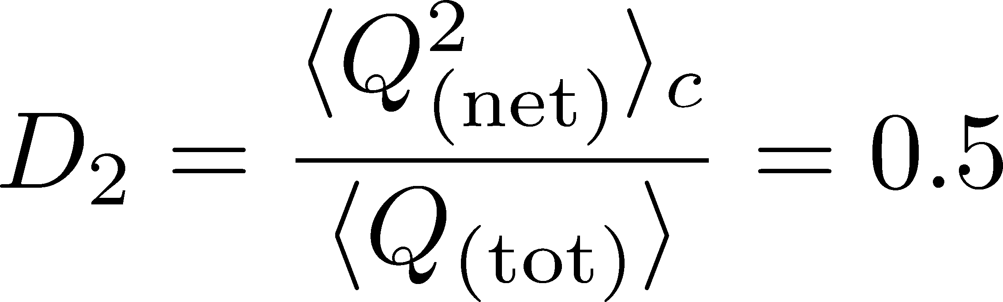

Δη Dependence: 4th order
MK, NPA(2015)
Initial Condition
Characteristic Δη dependences!

Slide 45
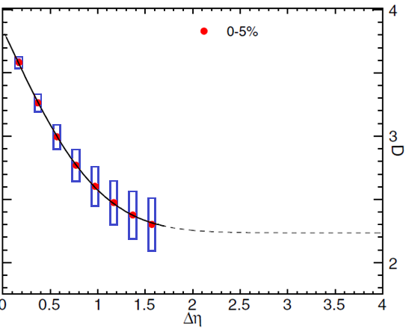

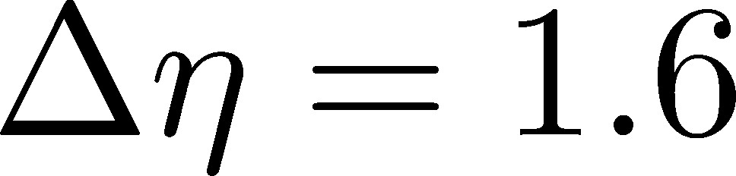
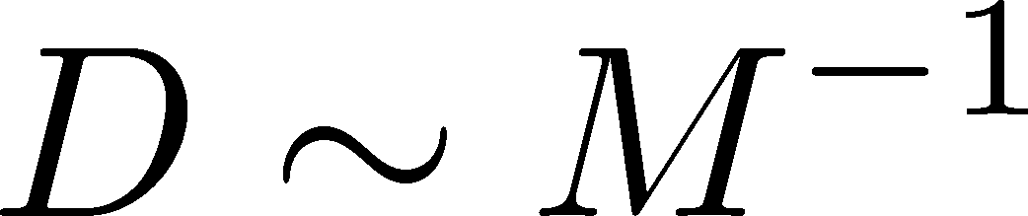
Δη Dependence: 4th order
MK, NPA(2015)
Initial Condition
baryon #
at ALICE
at ALICE

Slide 46
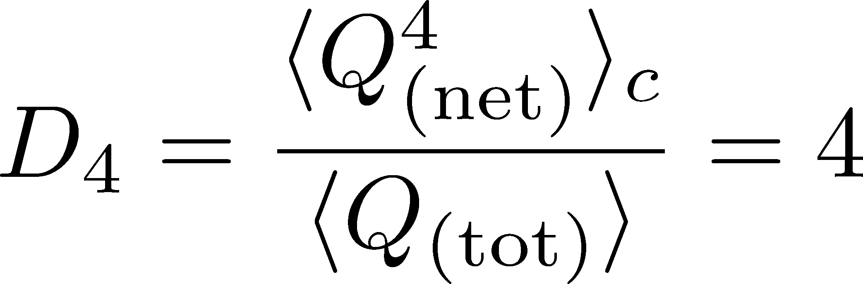
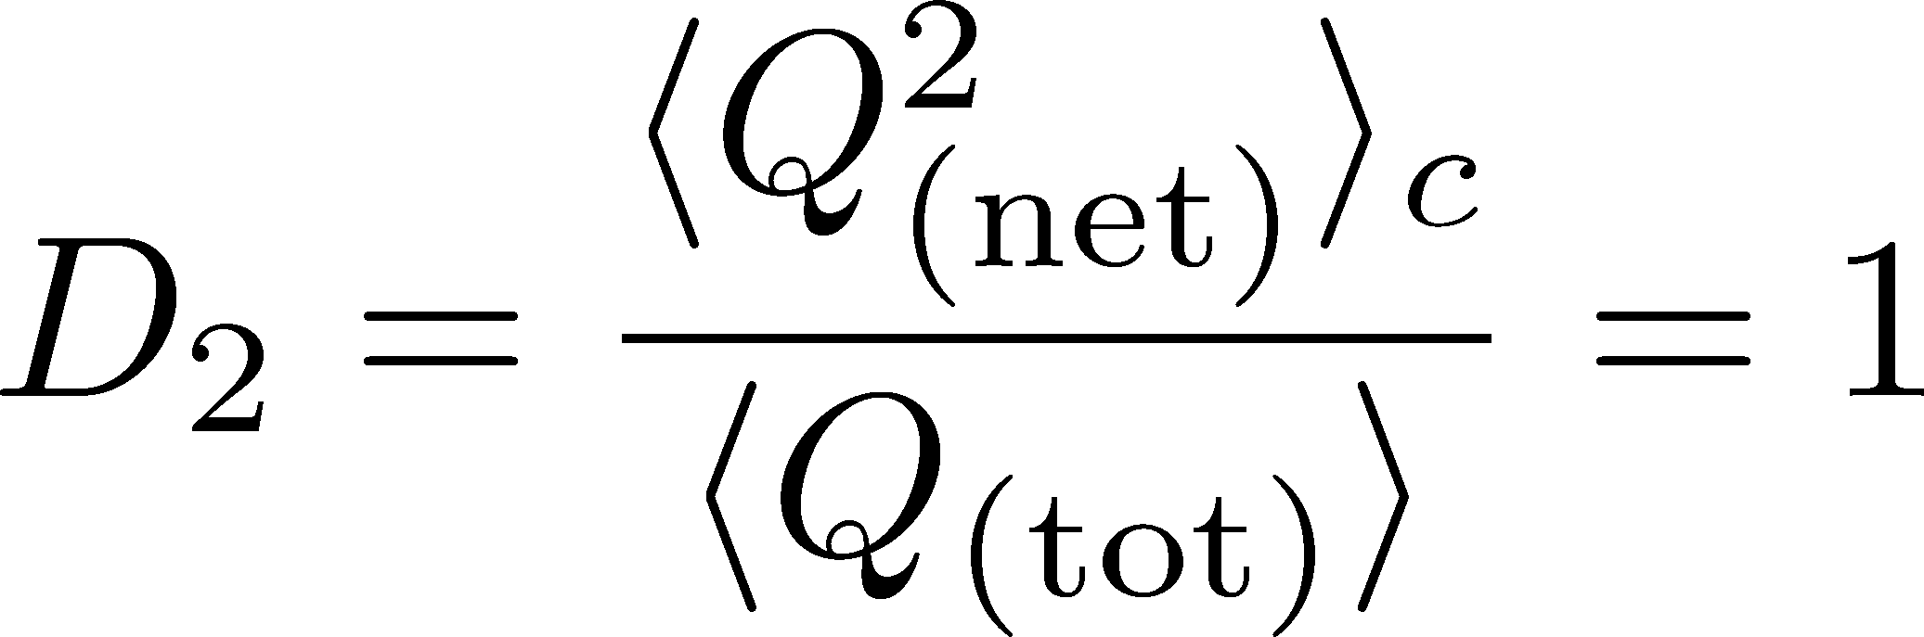
4th order : w/ Critical Fluctuation
Initial Condition
baryon #
at ALICE
at ALICE

Slide 47

Δη Dependence @ STAR
MK+ (2014)
MK (2015)
X. Luo, CPOD2014
Non monotonic behavior of cumulants.
Approach initial value as Δy→large
finite volume effect: Sakaida+, PRC064911(2014)
More sophisticated analysis with factorial cumulants, MK, Luo (2017)

Slide 48
Non-Interacting Brownian Particle System
Initial condition (uniform)
cumulants:
trace back
time evolution
diffusion distance ←→ diffusion coefficient

Slide 49
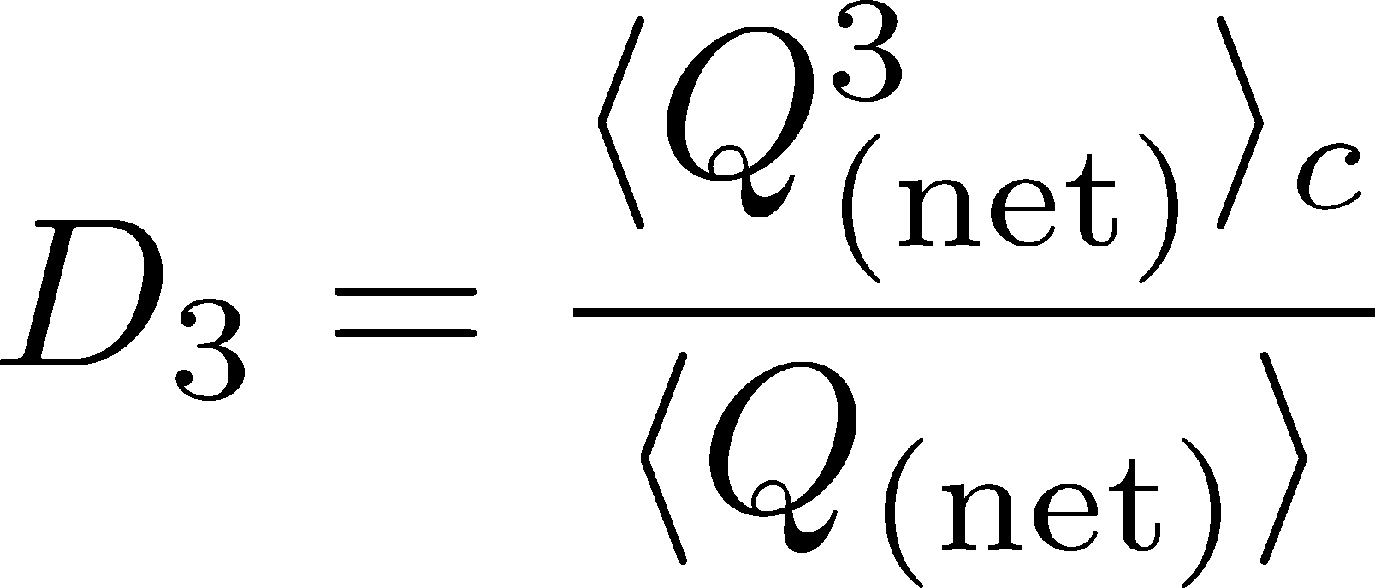
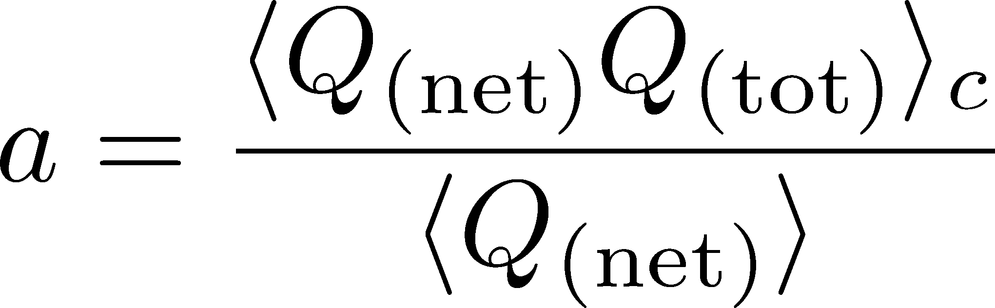
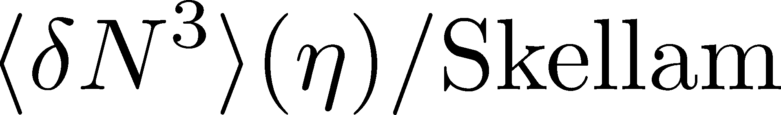
Δη Dependence: 3rd order
Initial Condition
baryon #
at ALICE
at ALICE

Slide 50
Summary
Non-Gaussian fluctuations are one of the most interesting topics in relativistic heavy ion collisions.
Using fluctuation observables, we can explore early thermodynamics and QCD phase structure.
Rapidity window dependences of higher-order cumulants encode various information on fluctuation.
More information in future experiments. More theoretical studies are required!

Slide 51
Search for QCD Critical Point
Sakaida, Asakawa, Fujii, MK, to appear in PRC
arXiv:1703.08008

Slide 52
Remarks on Critical Fluctuation 1
Experiments cannot observe
critical fluctuation in equilibrium directly.
Growth
Critical fluctuation has to be well developed.
But, relaxation toward equilibration is slow around CP because of the critical slowing down.
Decay by diffusion
Fluctuations developed at CP are modified by the time evolution in later stage.

Slide 53

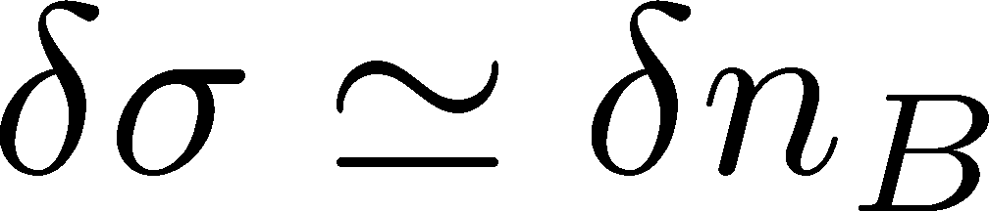
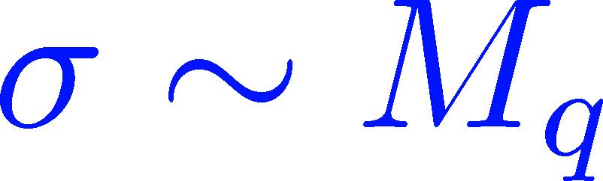





Remarks on Critical Fluctuation 2
Critical fluctuation is a conserved mode!
Fujii 2003; Fujii, Ohtani, 2004; Son, Stephanov, 2004
Fluctuations of σ and n_{B} are coupled
around the CP!
critical
soft mode
σ: fast damping

Slide 54
Dynamical Evolution of Critical Fluctuations
Evolution of correlation length
Berdnikov, Rajagopal (2000)
Asakawa, Nonaka (2002)
Higher orders (spatially uniform “σ” mode)
Mukherjee, Venugopalan, Yin (2015)
Dynamical evolution in chiral fluid model
Nahrgang, Herold, … (2014~)
Correlation functions
Kapusta, Torres-Rincon (2012)

Slide 55
Aim of This Study
Describe conserved nature of critical fluctuation.
We want to study experimental observables.
  focus on a conserved charge (baryon number)
  study evolution of conserved-charge fluctuation
Concentrate on 2nd order fluctuation. (not higher)
We study
  rapidity window denepdence of the cumulant
  2-particle correlation function
Our Main Conclusion
Non-monotonicity in
cumulants or correlation func.
=
Signal of
QCD-CP

Slide 56



Cumulants and Correlation Function
total charge
charge density
2nd order cumulant
(fluctuation)
correlation function
1-to-1 correspondence
1-dim case

Slide 57
Stochastic Diffusion Equation (SDE)
Diffusion equation
Describe a relaxation of a conserved density n toward uniform state without fluctuation
Stochastic diffusion equation
Describe a relaxation toward fluctuating uniform state
χ: susceptibility (fluctuation in equil.)
Review: Asakawa, MK, PPNP 90 (2016)

Slide 58




Soft Mode of QCD Critical Point
Fujii 2003; Fujii, Ohtani, 2004; Son, Stephanov, 2004
Effective potential
critical
soft mode
Time dependent Ginzburg-Landau
For slow and
long wavelength,
σ: fast damping
SDE
singularities in

Slide 59


Parametrizing D(τ) and χ(τ)
Critical behavior
(critical point)
3D Ising (r,H)
model H
Temperature dep.
critical
slowing
down
critical
enhancement

Slide 60



Crossover / Cumulant
monotonically decresing
Analytic
property
monotonically
increasing
monotonically
decreasing

Slide 61
Δη Dependence @ ALICE
ALICE
PRL 2013
hadronic
D-measure
D ~ 3-4 Hadronic
D ~ 1-1.5 Quark
t
Δη
rapidity window
z

Slide 62

Crossover / Correlation Func.
monotonically decresing
Analytic
property
monotonically
increasing
monotonically
decreasing

Slide 63
Critical Point / Cumulant
non-monotonic Δy dep.
Analytic
property
non-monotonic
non-monotonic

Slide 64

Criticap Point / Correlation Func.
non-monotonic Δy dep.
Analytic
property
non-monotonic
non-monotonic

Slide 65

Weaker Critical Enhancement
Non-monotonicity in K(Δy) disappears.
But C(y) is still non-monotonic.
Analytic
property
no information on
monotonic
C(y) is better to see non-monotonicity.

Slide 66
Away from the CP
Signal of the critical enhancement can be clearer on a path away from the CP.
Away from the CP → Weaker critical slowing down

Slide 67
Summary
Soft mode of the QCD critical point is a conserved mode. Its time evolution depends on the size defining the charge.
Time evolution of conserved charges (especially baryon number) is well described by the stochastic diffusion equation.
A non-monotonic behavior of cumulant or correlation function is the signal of the critical enhancement!
Suggestion to experimentalists
Δy dep. of 2nd order cumulant
y dep. of correlation function
To find the CP, measure
Study lower-order fluctuation in more detail

Slide 68
Future Studies
Experimental side:
rapidity window dependences
baryon number cumulants
BES for SPS- to LHC-energies
Theoretical side:
rapidity window dependences in dynamical models
description of non-equilibrium non-Gaussianity
accurate measurements on the lattice
Both sides:
Compare theory and experiment carefully
Let’s accelerate our understanding on fluctuations!

Slide 69
Themal Blurring
Ohnishi, MK, Asakawa, PRC, in press

Slide 70


Fluctuations: Theory vs Experiment
Theoretical analyses
based on statistical mechanics
Experiments
lattice, critical point,
effective models, …
Fluctuation in
a spatial volume
Fluctuations in
a momentum space
discrepancy in phase spaces
Asakawa, Heinz, Muller, 2000; Jeon, Koch, 2000; Shuryak, Stephanov, 2001

Slide 71






Connecting Phase Spaces
Asakawa, Heinz, Muller, 2000
Jeon, Koch, 2000
Under Bjorken picture,
coordinate-space rapidity Y
momentum-space rapidity y
of medium
momentum-space rapidity y
of individual particles

Slide 72




Thermal distribution in y space
nucleon
pions
nucleons
pion
Blast wave squeezes the
distribution in rapidity space
blast wave
flat freezeout surface

Slide 73
Thermal distribution in y space
pions
nucleons
half-width (Δy)
kurtosis
Rapidity distribution can be
well approximated by Gaussian.
blast wave
flat freezeout surface

Slide 74

Δη Dependence
Initial condition
(before blurring)
no e-v-e fluctuations
Cumulants after blurring
Cumulants after blurring
can take nonzero values
With Δy=1, the effect is
not well suppressed
pions
nucleons

Slide 75






Diffusion + Thermal Blurring
Thermal blurring can be regarded as a part of diffusion
Chemical f.o. (coordinate space)
diffusion
Kinetic f.o. (coordinate space)
blurring
Kinetic f.o. (momentum space)
Total diffusion:

Slide 76
Centrality Dependence
ALICE, 2013
lower T
larger β
Weaker
blurring
More central
Is the centrality dependence understood solely by the thermal blurring at kinetic f.o.?

Slide 77

Centrality Dependence @ ALICE
Assumptions:
Centrality independent cumulant at kinetic f.o.
Thermal blurring at kinetic f.o.
Even on one blade of grass
the cool wind lives
Centrality dep. of fluctuation can be described
by a simple thermal blurring picture.

