Slide 1
Dispersion Relation of Charmonia above T_{c}
Masakiyo Kitazawa (Osaka U.)
Ikeda, Asakawa, MK, PRD95 (2017) 014504
LATTICE2017, Granada, Spain, June 20, 2017

Slide 2
Charm Quarks in HIC
Impurity of QGP
= unique experimental probe
production only in first stage
small abundance
J/ｐ suppression
transport property
heavy-quark potential
Figs. from arXiv:1506.03981

Slide 3
Charmonia above Tc
Property of charmonia at rest
Melting temperature
Mass shift?

Slide 4

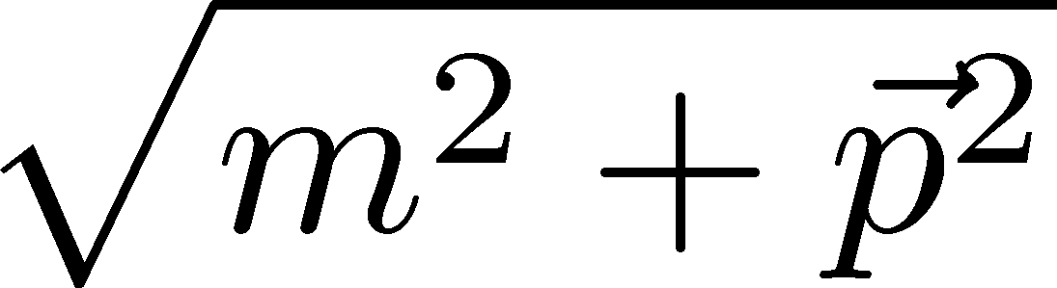


Charmonia above Tc
Property of charmonia at rest
Melting temperature
Mass shift?
Property of moving charmonia
Dispersion relation
residue
decay rate
In heavy-ion collisions,
charmonia are typically moving!

Slide 5
Charmonia above Tc
Property of charmonia at rest
Melting temperature
Mass shift?
Let’s study
on the lattice
Property of moving charmonia
Dispersion relation
residue
decay rate
In heavy-ion collisions,
charmonia are typically moving!

Slide 6
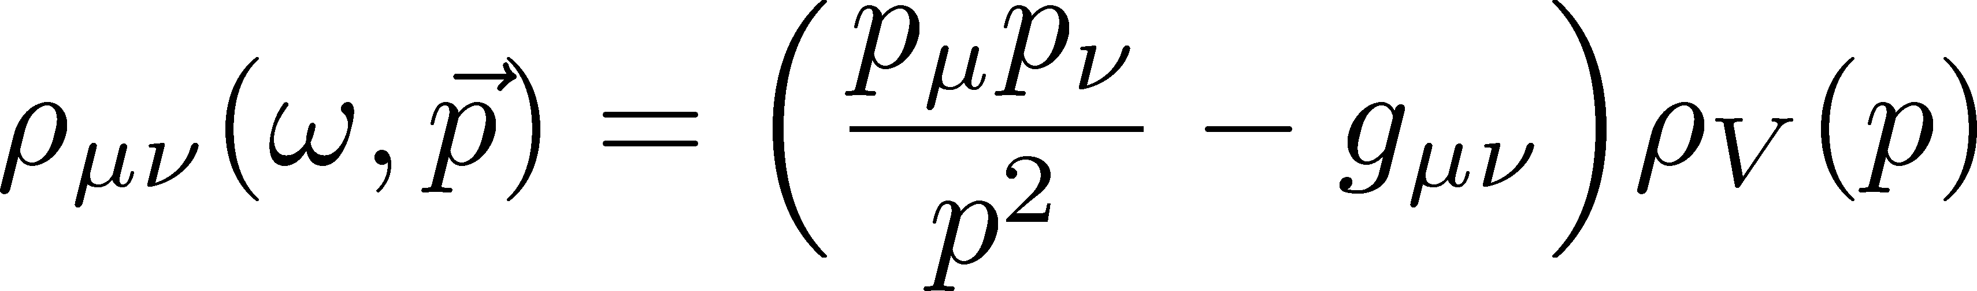
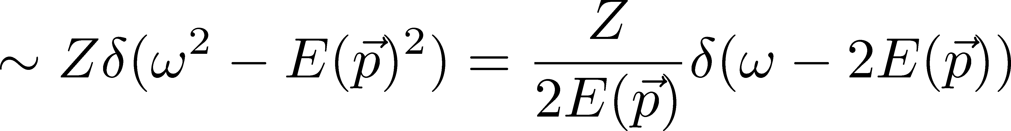
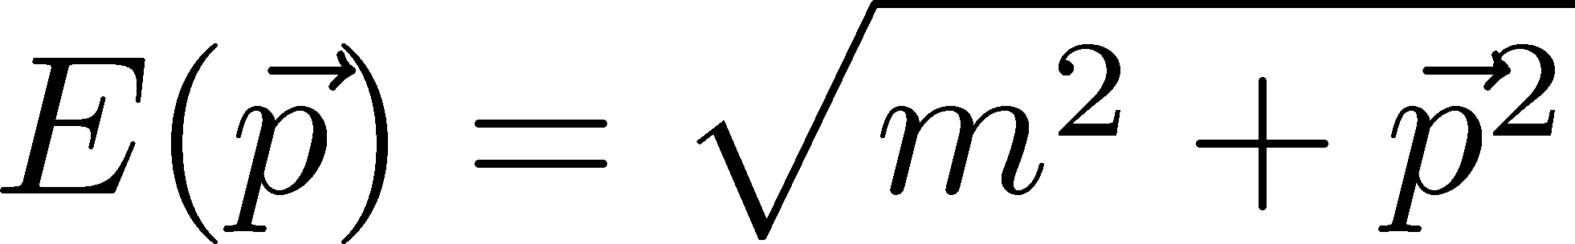
Nonzero-p Spectral Func.
In vacuum
:Lorentz symmetry
Tensor structure (V)
Bound-state pole
Dispersion relation

Slide 7
Nonzero-p Spectral Func.
In vacuum
:Lorentz symmetry
Tensor structure (V)
Bound-state pole
Dispersion relation
In medium
Transverse and longitudinal splitting
Dispersion relation can be modified
Z no longer be a constant

Slide 8
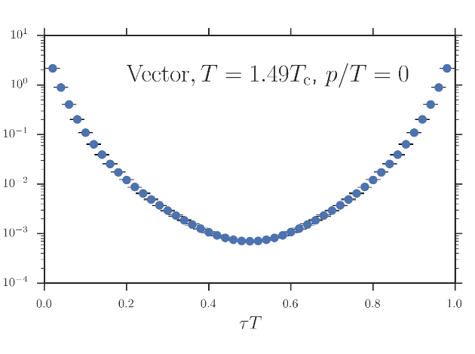
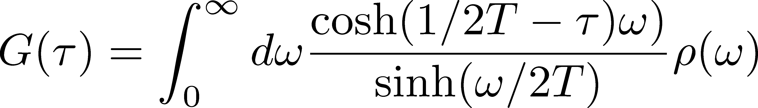
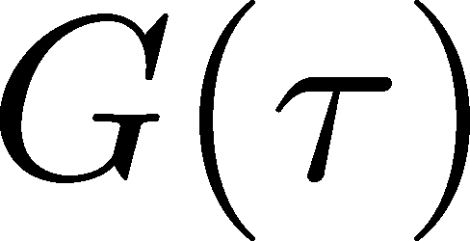

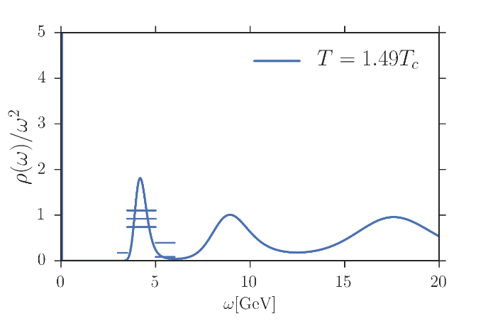
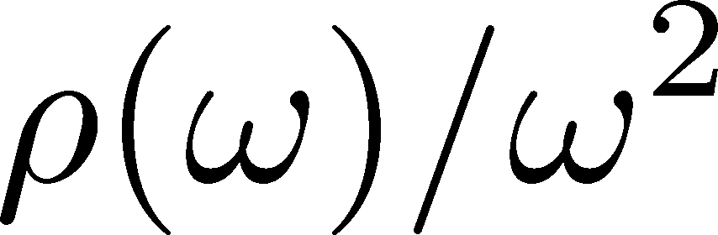
Maximum Entropy Method
Lattice data
“ill-posed problem”
Spectral Function

Slide 9
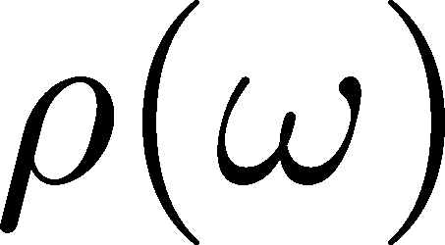
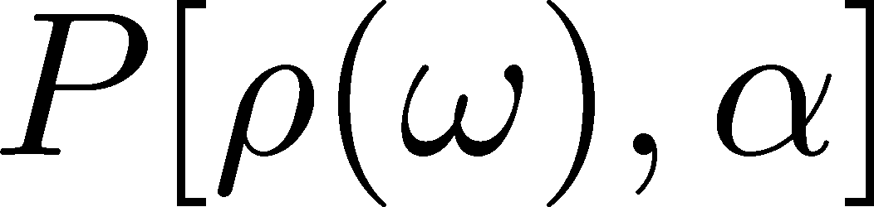
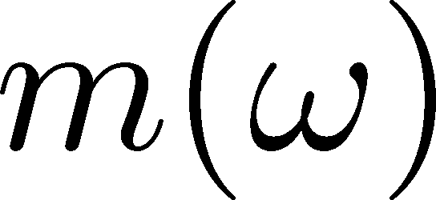
Maximum Entropy Method
Lattice data
Bayes
theorem
Prior probability
Probability
of
Shannon-Jaynes entropy
default model
Spectral Function

Slide 10
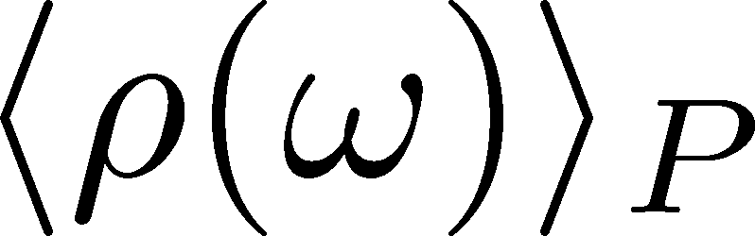
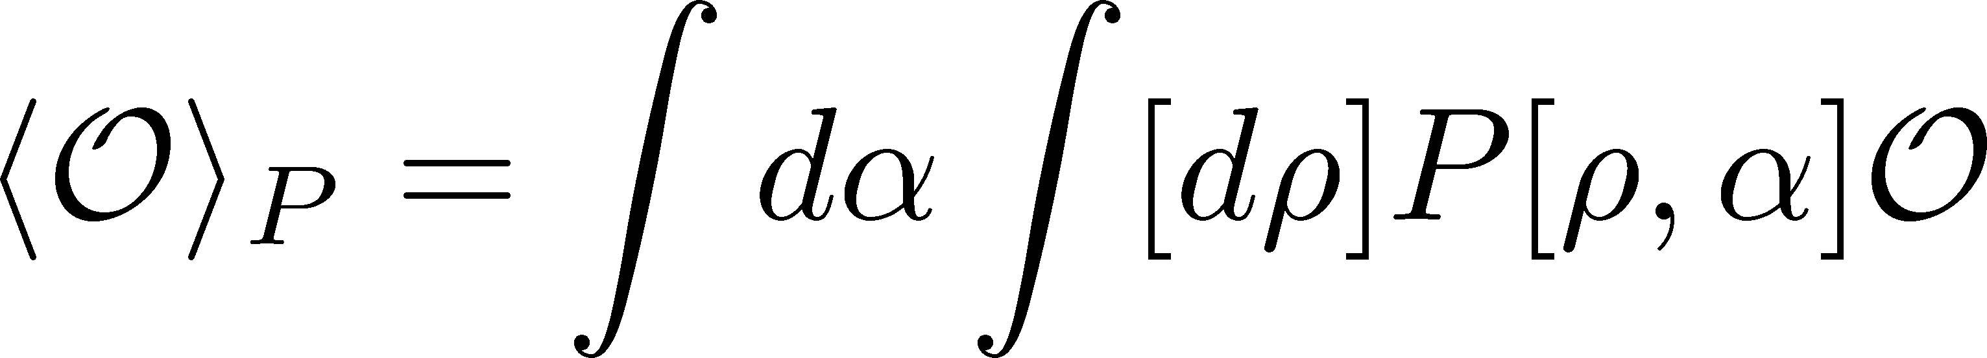
Maximum Entropy Method
Lattice data
Bayes
theorem
Prior probability
Probability
of
Shannon-Jaynes entropy
default model
Spectral Function
expectation value

Slide 11
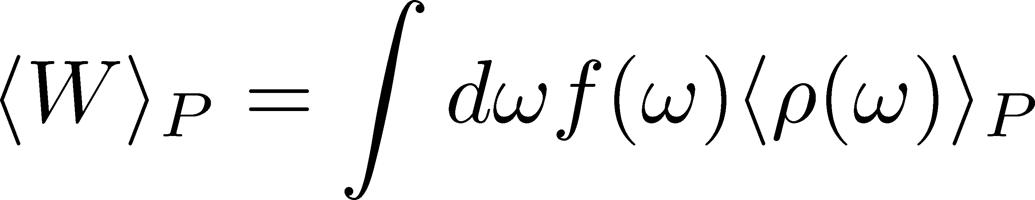
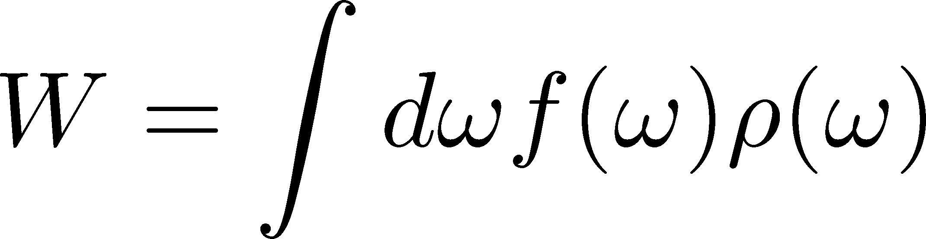
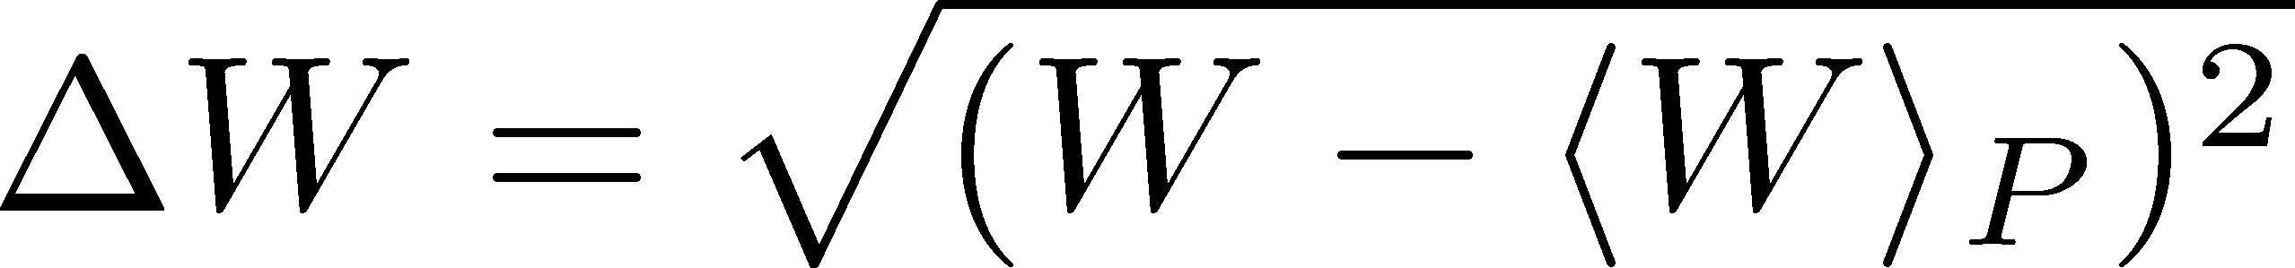
Error in MEM
MEM error = variance in P[ρ(ω),α] space
exp. val.:
error:

Slide 12
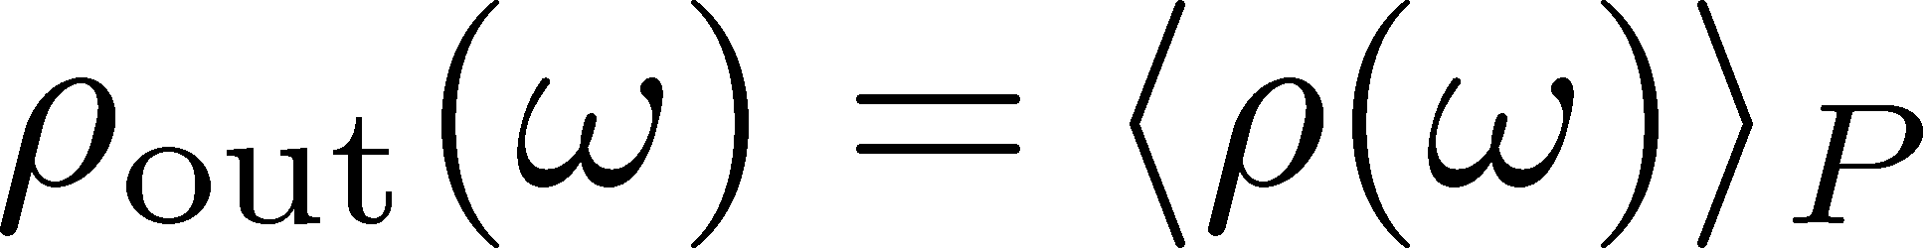
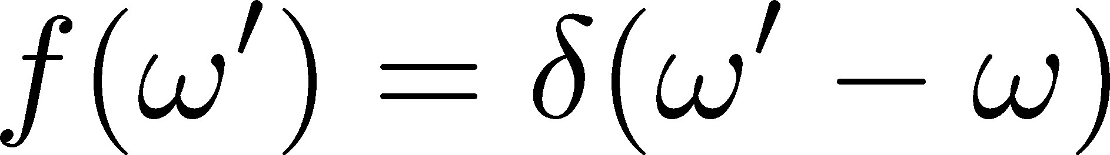
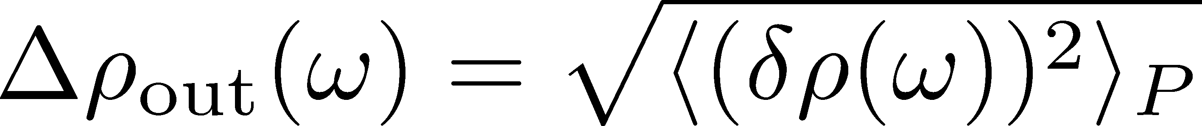
Error in MEM
MEM error = variance in P[ρ(ω),α] space
exp. val.:
error:
typically
huge

Slide 13
Error in MEM
MEM error = variance in P[ρ(ω),α] space
exp. val.:
error:
typically
huge
NOTE
SPC obtained by MEM is just an image. No robust meaning.
MEM error is more conservative than statistical one.

Slide 14

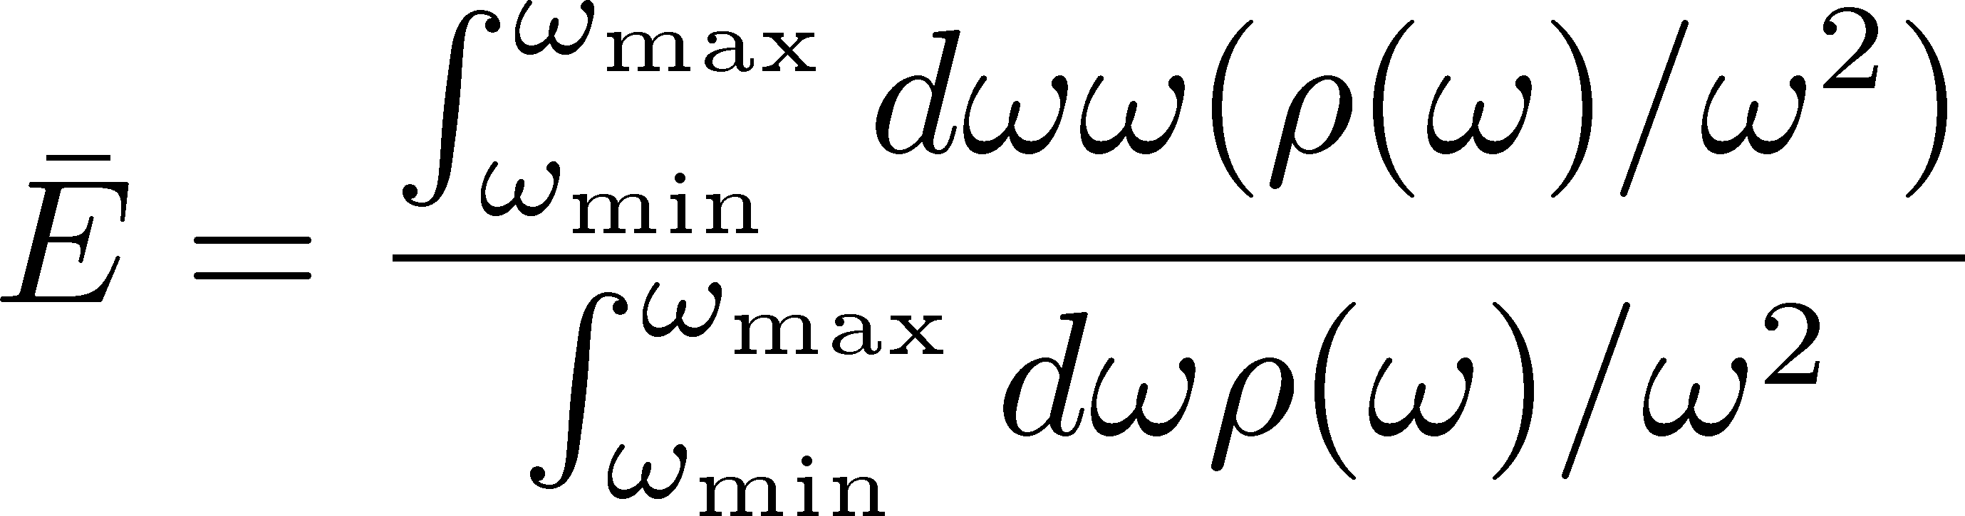


Defining Peak Position
Center of weight in a range
Represent peak position for a sufficiently sharp peak
Error analysis in MEM is possible!
[ω_{min}, ω_{max}] dependence has to be checked

Slide 15
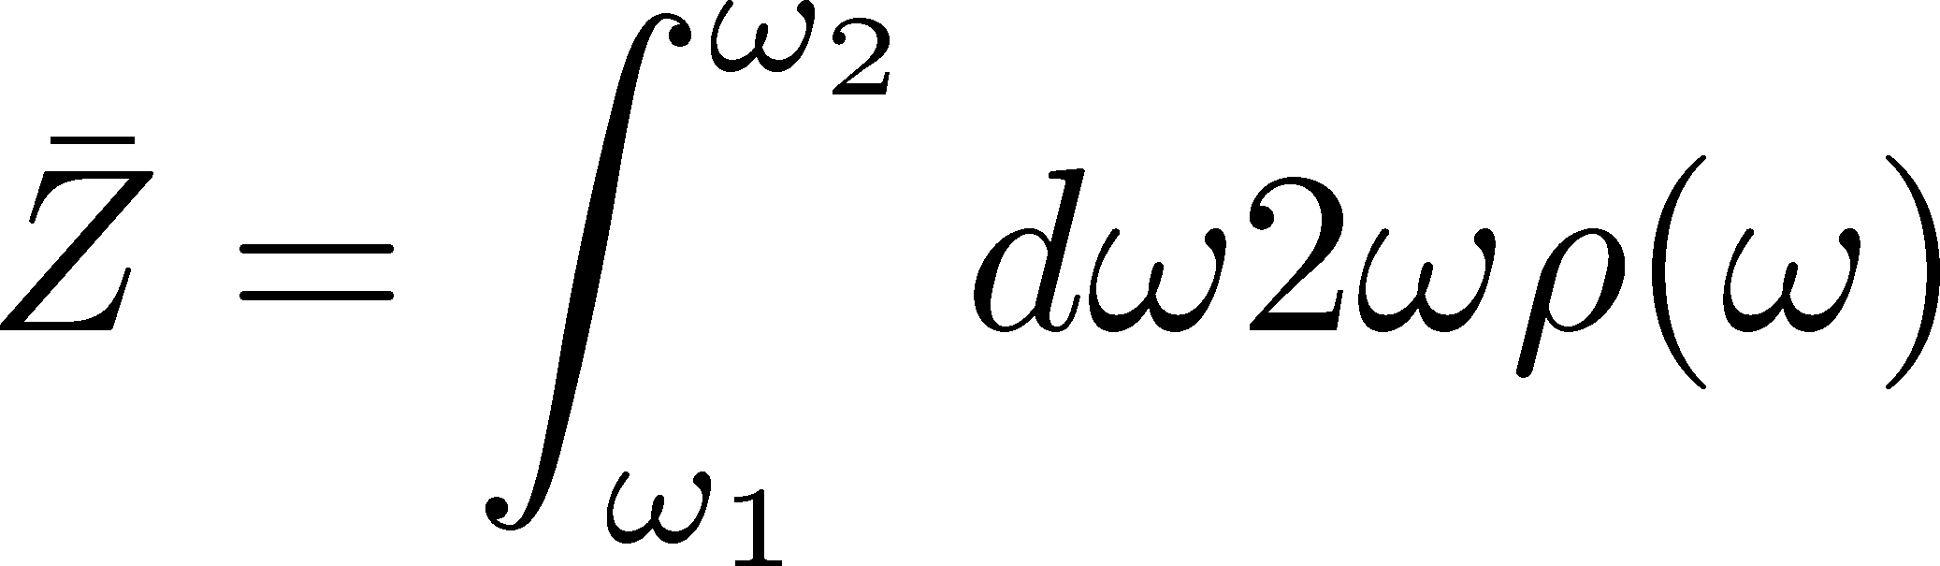
Defining Peak Position
Center of weight in a range
Represent peak position for a sufficiently sharp peak
Error analysis in MEM is possible!
[ω_{min}, ω_{max}] dependence has to be checked
Residue:

Slide 16
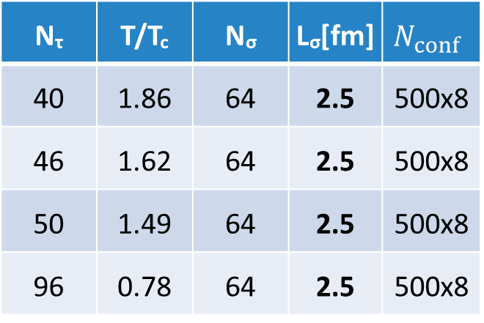
Lattice Setup
quenched simulation
Wilson fermion / gauge
anisotropic lattice (a_{σ}/a_{τ}=4)
N_{τ} | T/T_{c} | N_{σ} | L_{σ}[fm] | $$N_{conf}$$
40 | 1.86 | 64 | 2.5 | 500x8
46 | 1.62 | 64 | 2.5 | 500x8
50 | 1.49 | 64 | 2.5 | 500x8
96 | 0.78 | 64 | 2.5 | 500x8
Asakawa, Hatsuda, 2004
8 measurements
on each conf.
BlueGene/Q@KEK
fermion part: Iroiro++
Large spatial volume → high momentum resolution
Large Nt / high statistics → high MEM precision

Slide 17
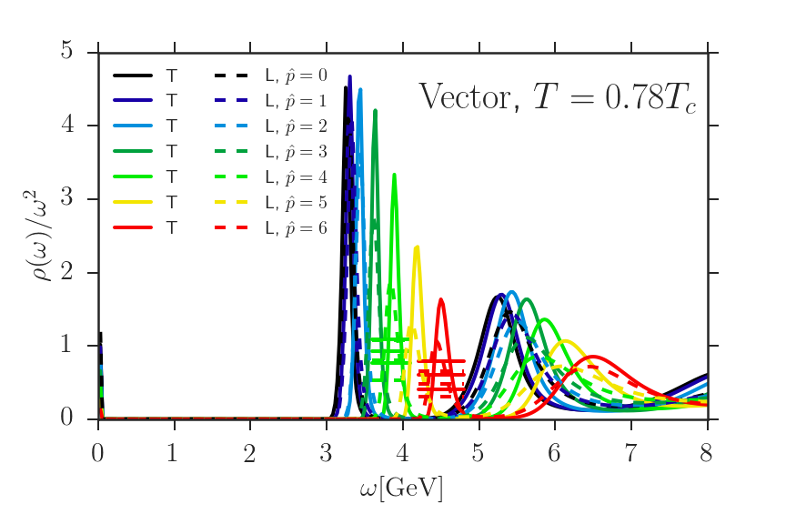

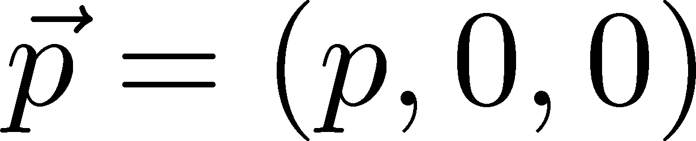
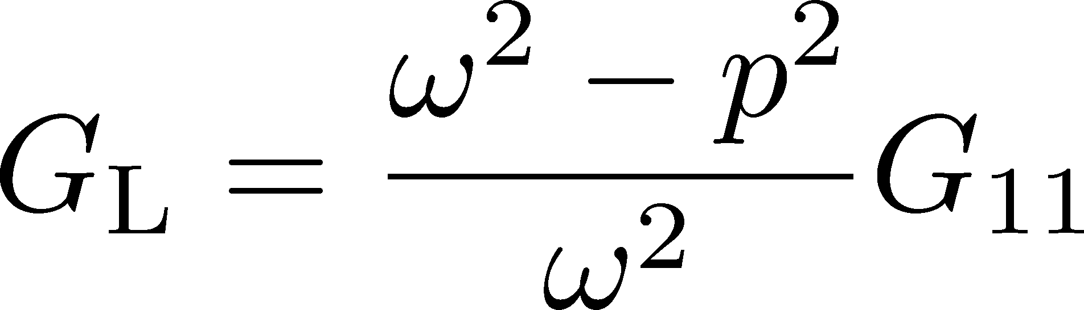
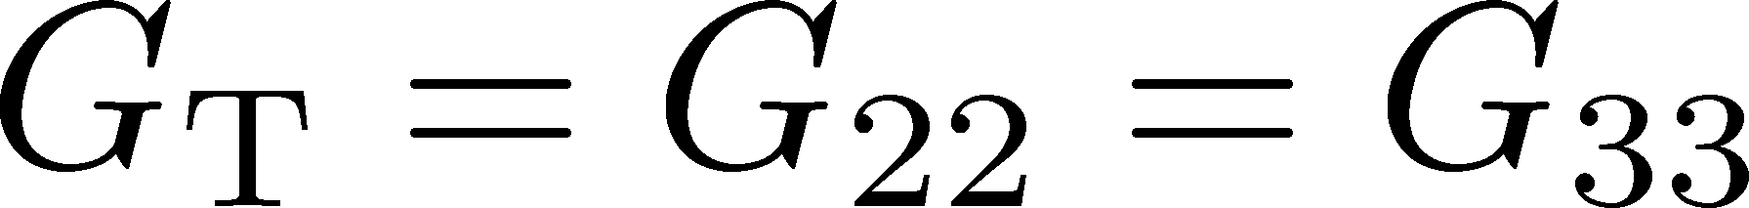
Spectral Func. @ T=0.78T
ρ_{T} and ρ_{L} channels degenerate
although correlators are different

Slide 18
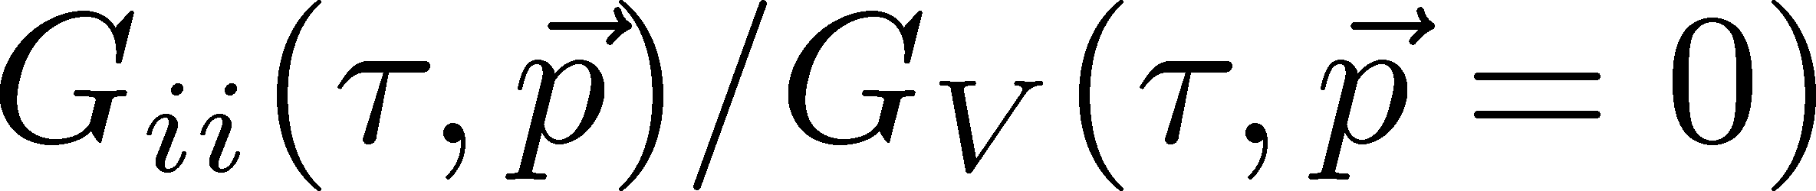
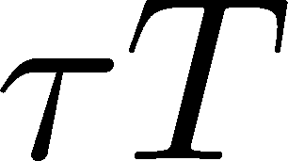
Spectral Func. @ T=0.78T
ρ_{T} and ρ_{L} channels degenerate
although correlators are different

Slide 19
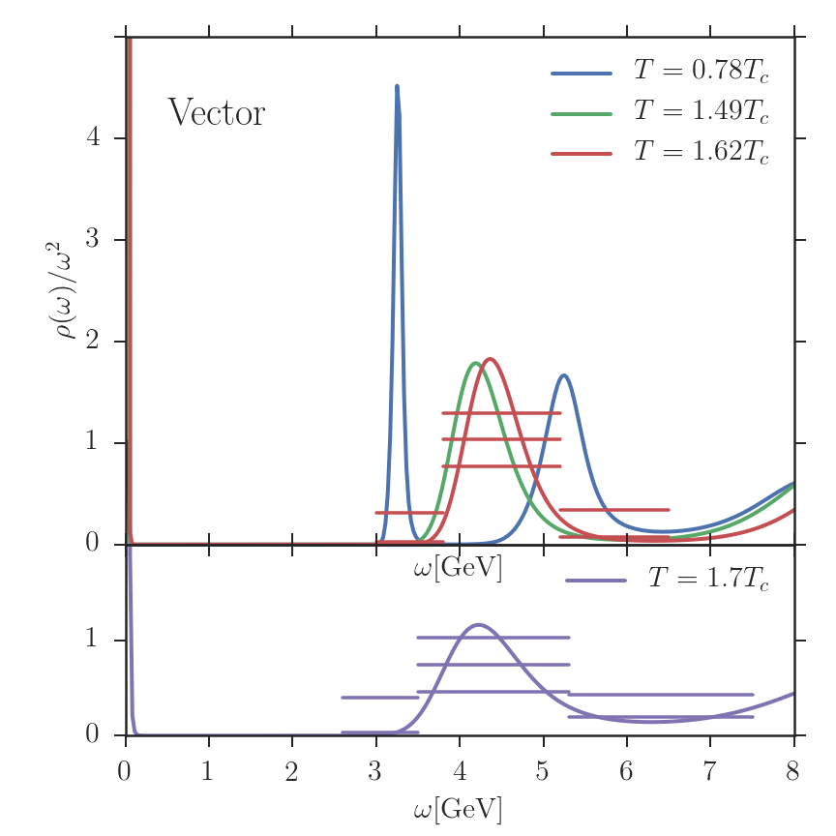
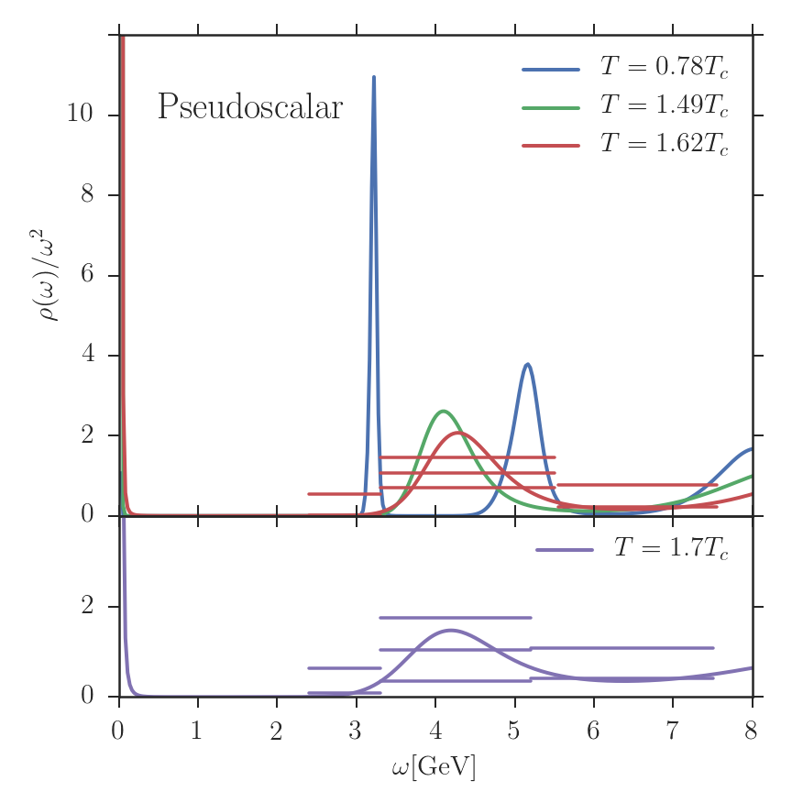
Spectral Function @ p=0
Vector channel
PS channel
Bound state peaks seem to exist at T=1.62Tc.

Slide 20
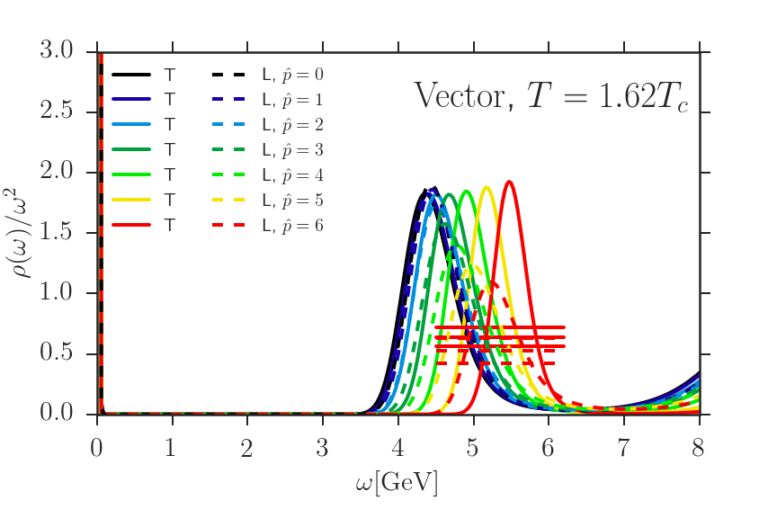
Spectral Func. @ T=1.62T
ρ_{T} and ρ_{L} channels seem to degenerate.
Peak exists for all momentum.

Slide 21

Dispersion Relation
Energy interval [ω_{min}, ω_{max}] for disp. rel.
:first minimum

Slide 22
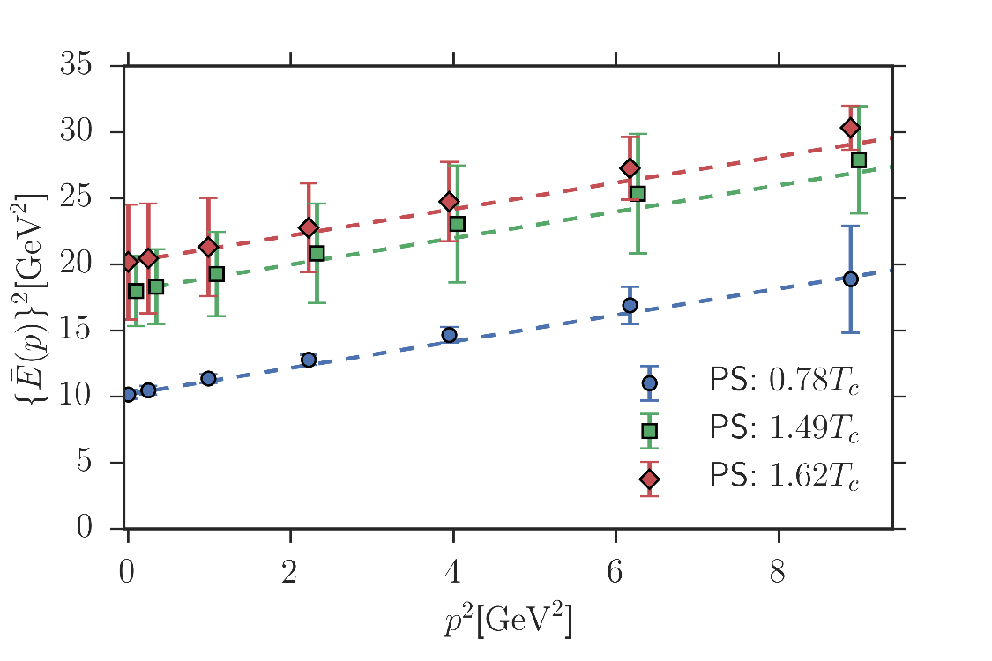
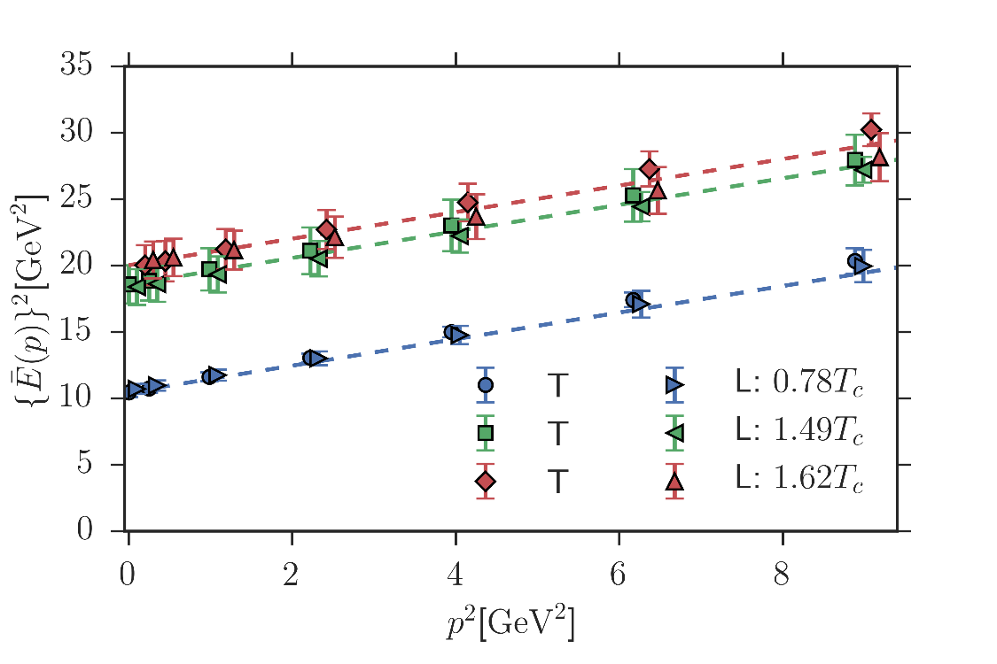
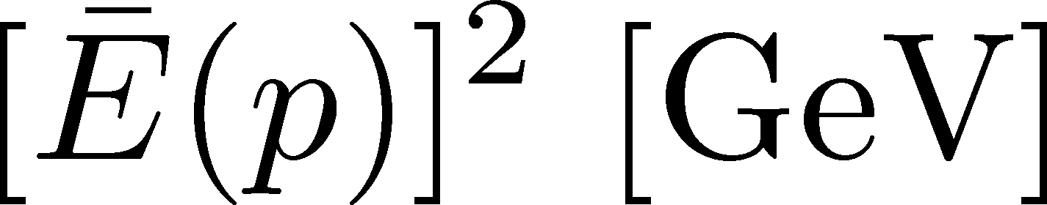
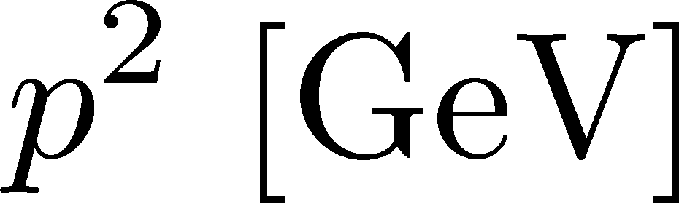
Dispersion Relation
Clear mass enhancement in medium.
Dispersion relation is consistent with the Lorentz covariant form even at T=1.62Tc.
mass E(p=0)
[GeV]

Slide 23
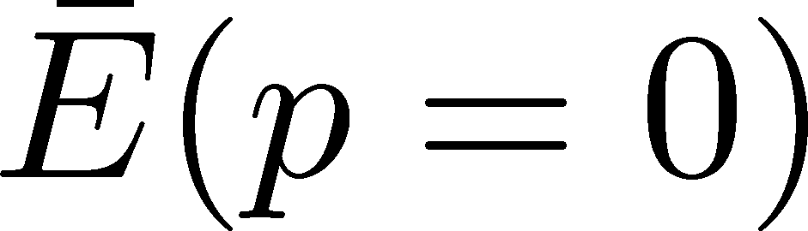
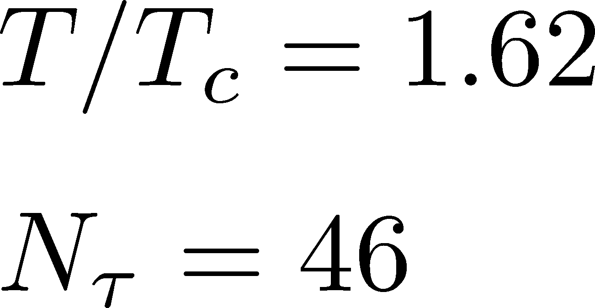

Dependence on
ω_{max} dependence is well suppressed.
No ω_{min} dependence for ω_{min}<3GeV.

Slide 24
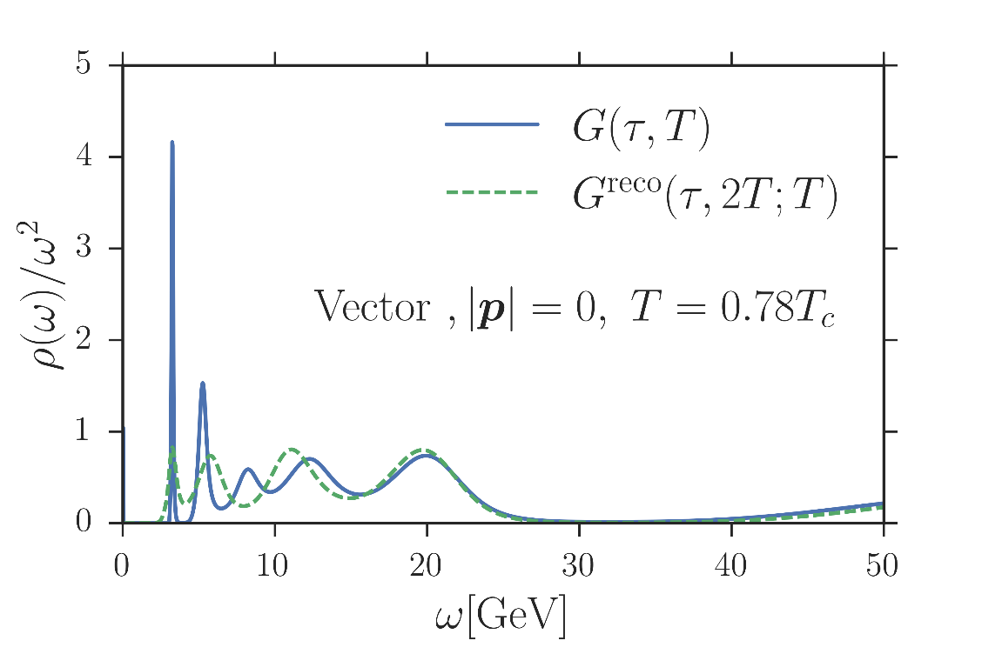
Test: N_{t} Dependence
Special thanks to A. Rothkopf
correlator
reconstructed cor.
Peak position does not shift with the change of N_{t}

Slide 25
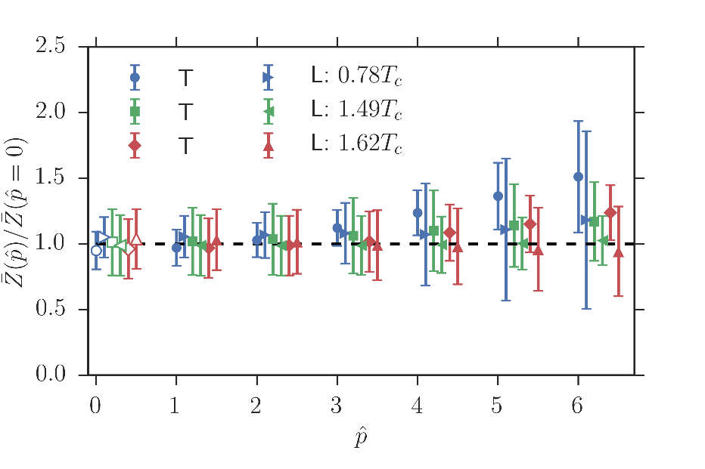
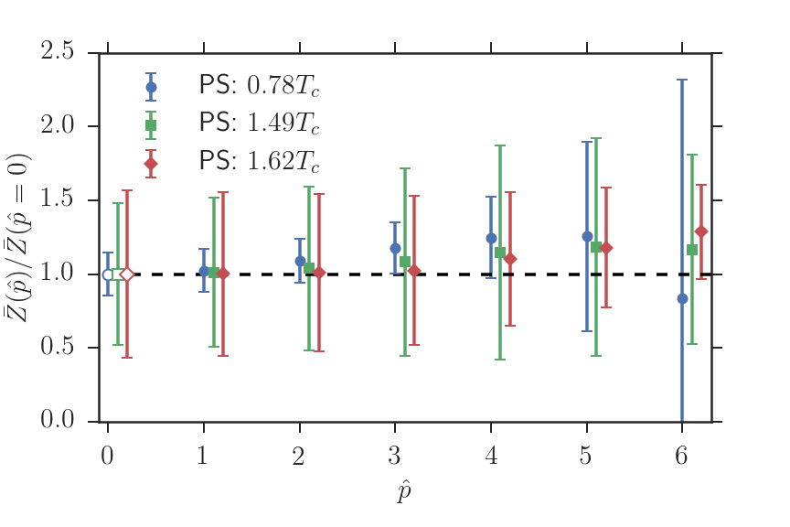
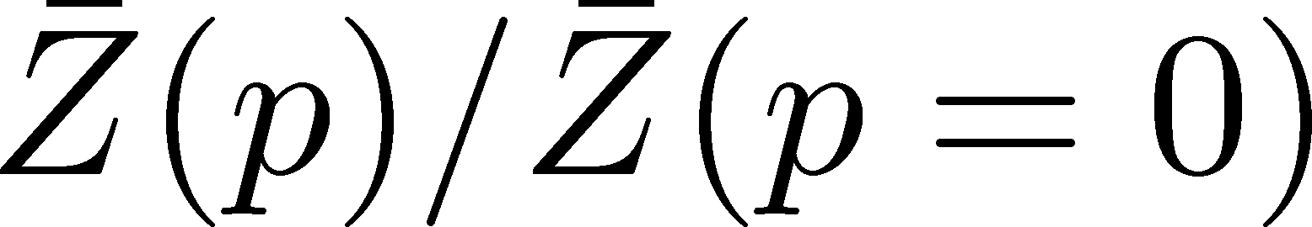
Residue
Vector
PS
No p dependence of Z even for T=1.62Tc
No T/L splitting in vector channel

Slide 26
Summary
We analyzed the peak positions in SPC with MEM error by defining them in terms of the center of weight.
Charmonia have significant mass enhancement.
Dispersion relations are consistent with Lorentz covariant form even at T=1.62Tc.
Future Work
much finer p resolution
m_{q} dependence
comparison with potential models and etc.

