Slide 1
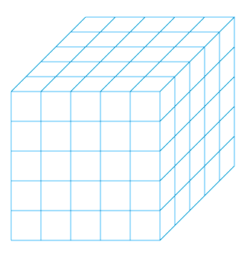
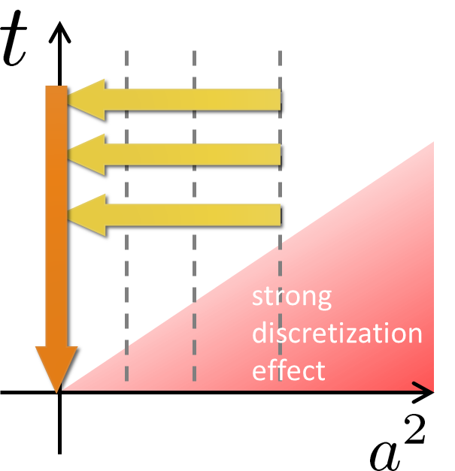
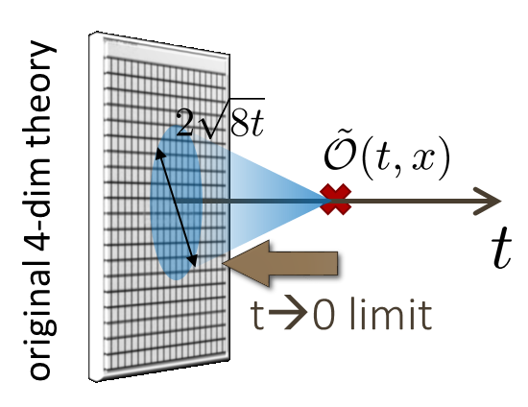
Correlation function of energy-momentum tensor
in SU(3) gauge theory from gradient flow
Masakiyo Kitazawa (For FlowQCD Collaboration)
MK, T. Iritani, M. Asakawa, T. Hatsuda, to appear soon
EMT correlator
Many useful info.
thermodynamics
transport properties
etc.
Conserved channels
From linear response
τ indep. const!
Check them on the lattice!
New method for studying thermodynamics!
Numerical Results on quenched lattice
Continuum & t→0 extrapol.
t indep. const. → confirmation of conservation law
small error owing to gradient flow
Summary
continuum extrap.
new analysis of c_{V}
EMT on the lattice
confirmed
gradient flow
small flow-time exp.
Thermodynamics FlowQCD, 2016
Suzuki, 2013
XQCD2017, 15th International Conference on QCD in Extreme Conditions, Pisa, 26-28 June

