Slide 1
_{格子QCDによる、}
_{有限温度媒質中の}
_{チャーモニウム分散関係}
_{の解析}
Masakiyo Kitazawa (Osaka U.)
Ikeda, Asakawa, MK, PRD95 (2017) 014504
日本物理学会秋季大会2017年9月12日＠宇都宮大学12aS31-3

Slide 2
Charm Quarks in HIC
Impurity of QGP
= unique experimental probe
抑制
production only in first stage
small abundance
J/ｐ suppression
transport property
heavy-quark potential
Figs. from arXiv:1506.03981
フロー形成

Slide 3
Charmonia above Tc
Property of charmonia at rest
Melting temperature
Mass shift?

Slide 4

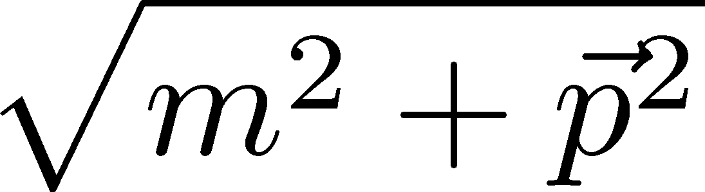


Charmonia above Tc
Property of charmonia at rest
Melting temperature
Mass shift?
Property of moving charmonia
Dispersion relation
residue
decay rate
In heavy-ion collisions,
charmonia are typically moving!

Slide 5
Charmonia above Tc
Property of charmonia at rest
Melting temperature
Mass shift?
Let’s study
on the lattice
Property of moving charmonia
Dispersion relation
residue
decay rate
In heavy-ion collisions,
charmonia are typically moving!

Slide 6
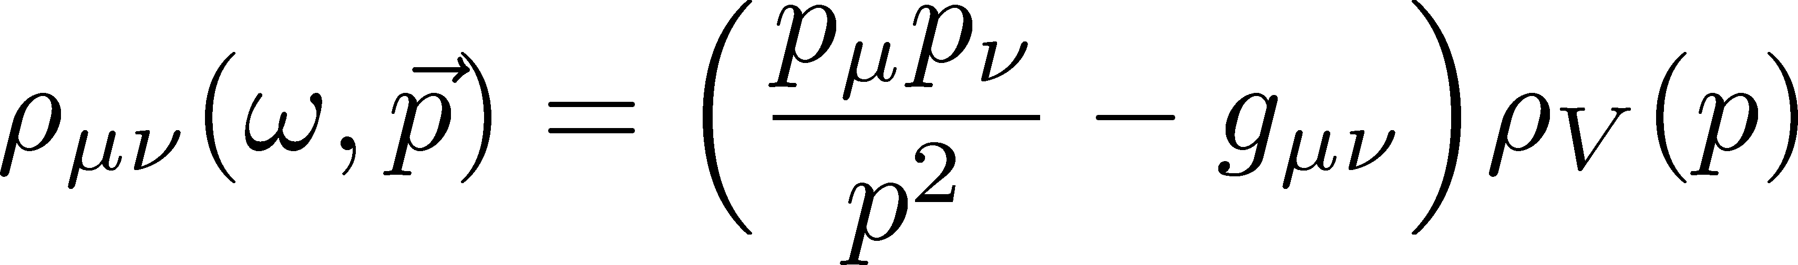
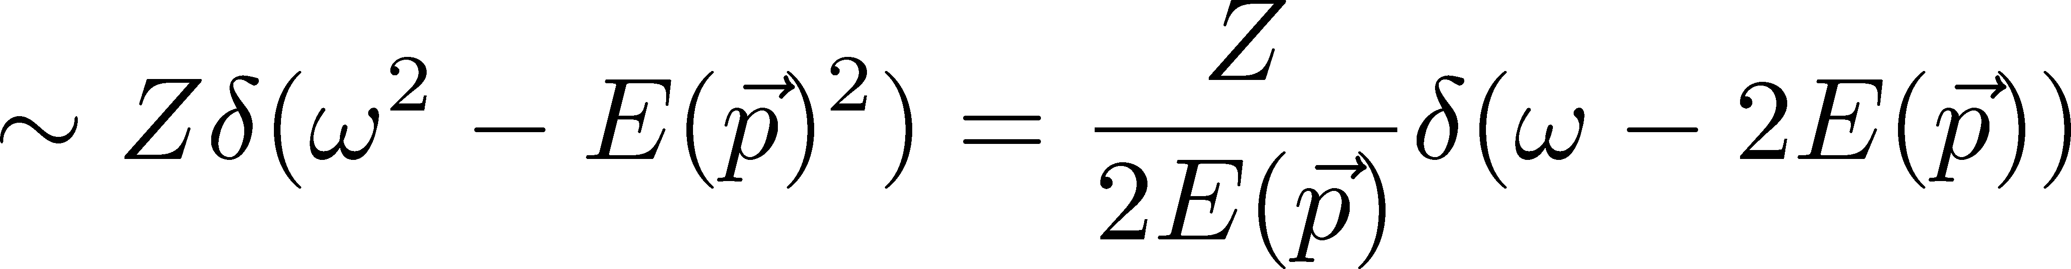
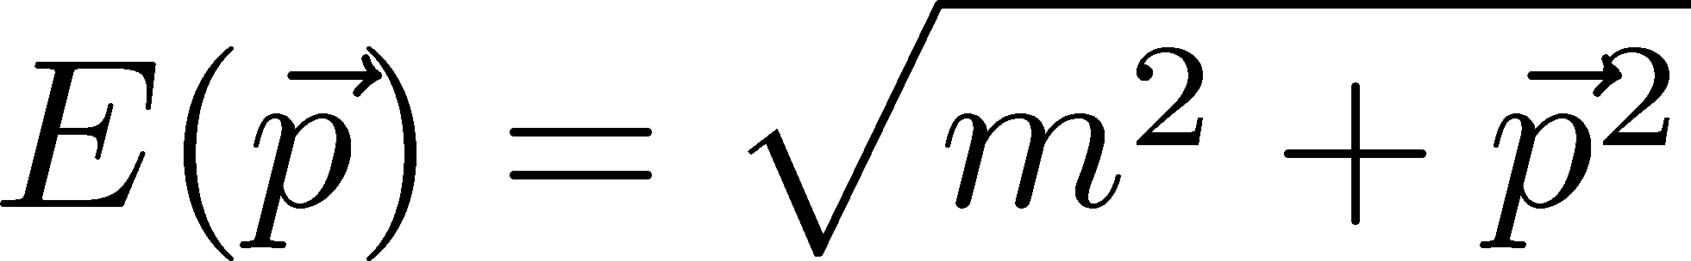
Nonzero-p Spectral Func.
In vacuum
:Lorentz symmetry
Tensor structure (V)
Bound-state pole
Dispersion relation

Slide 7
Nonzero-p Spectral Func.
In vacuum
:Lorentz symmetry
Tensor structure (V)
Bound-state pole
Dispersion relation
In medium
Transverse and longitudinal splitting
Dispersion relation can be modified
Z no longer be a constant

Slide 8
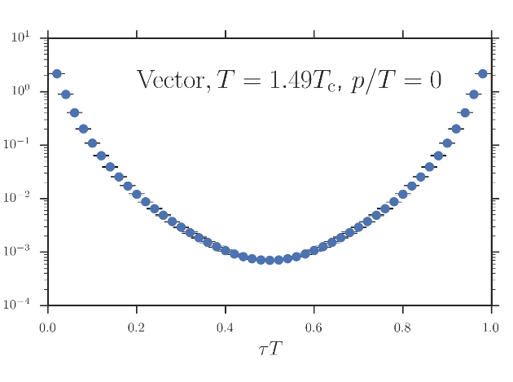
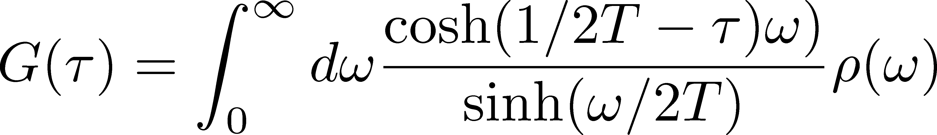
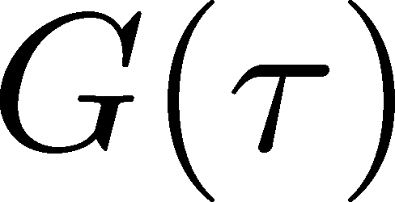

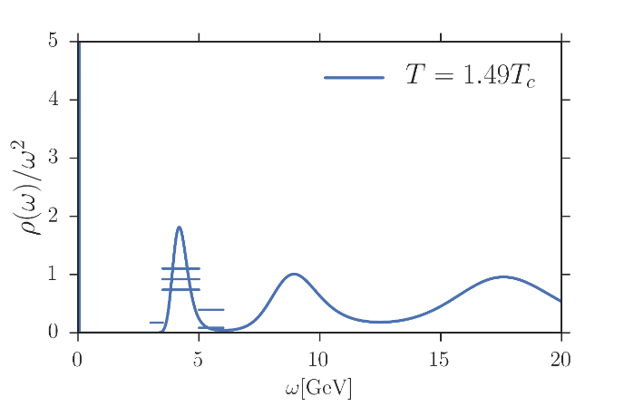
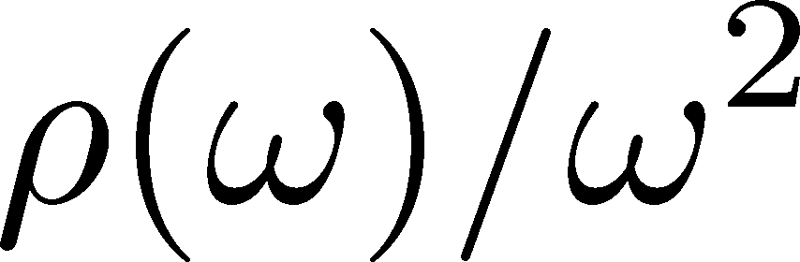
Obtaining Spectral Funciton
Lattice data
“ill-posed problem”
Spectral Function

Slide 9
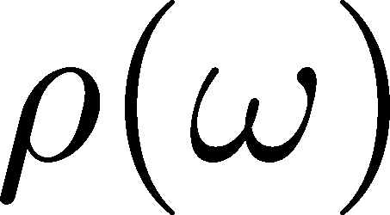
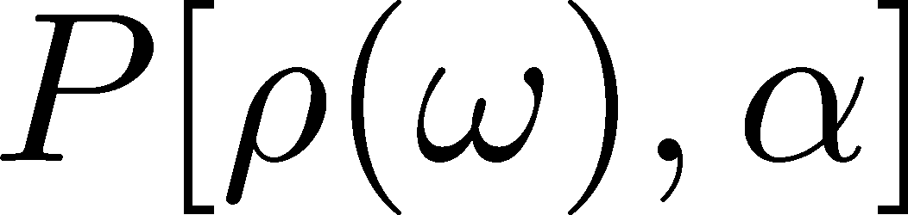
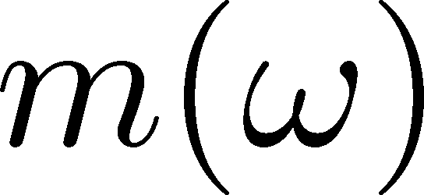
Maximum Entropy Method
Lattice data
Bayes
theorem
Prior probability
Probability
of
Shannon-Jaynes entropy
default model
Spectral Function

Slide 10
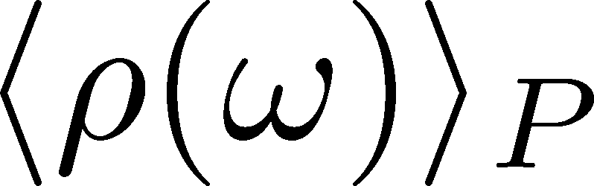
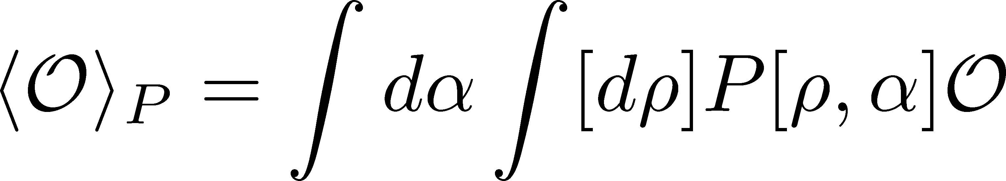
Maximum Entropy Method
Lattice data
Bayes
theorem
Prior probability
Probability
of
Shannon-Jaynes entropy
default model
Spectral Function
expectation value
MEM出力は単なる期待値➔要誤差評価

Slide 11
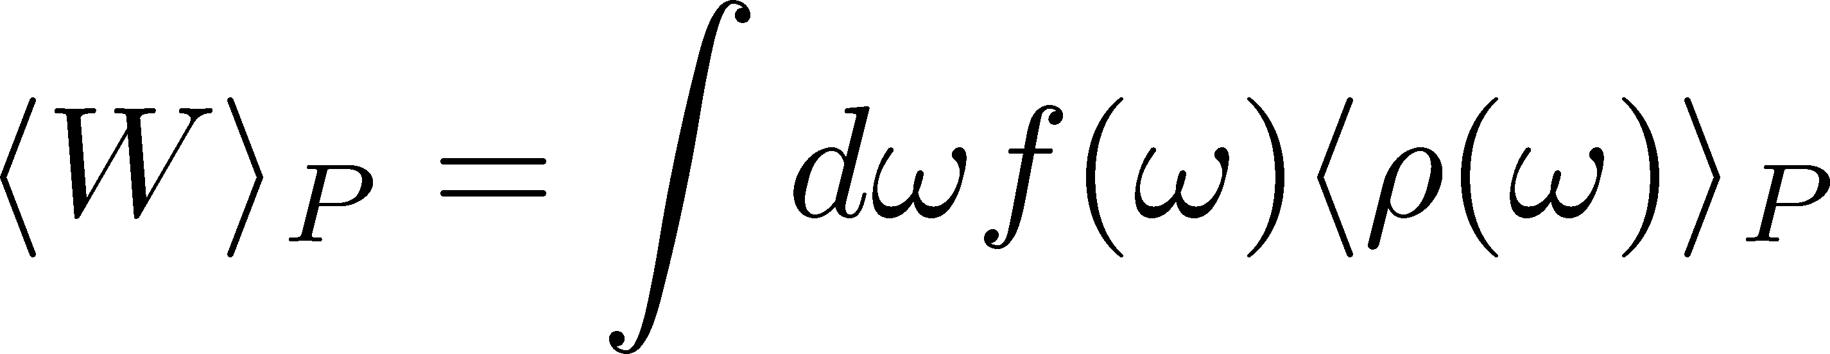
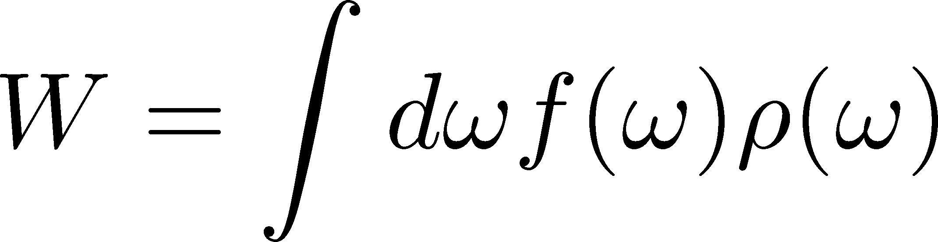
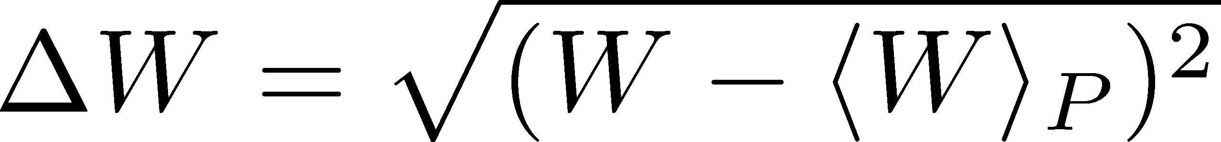
Error in MEM
MEM error = variance in P[ρ(ω),α] space
exp. val.:
error:

Slide 12
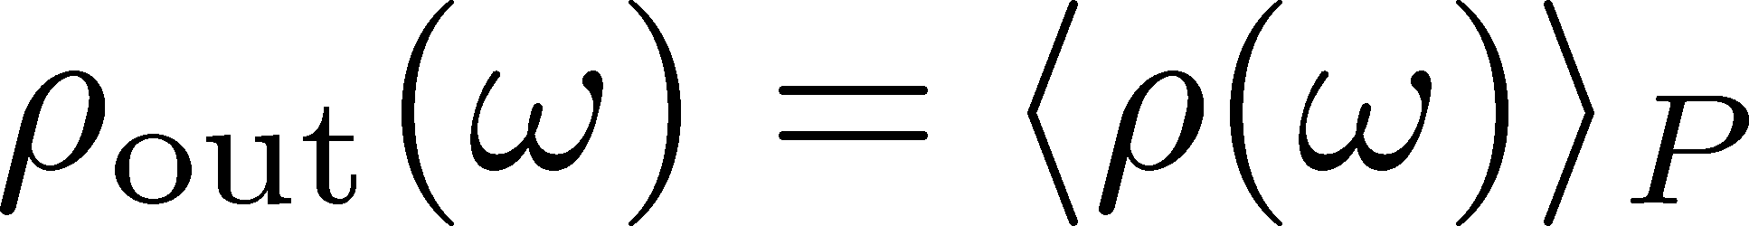
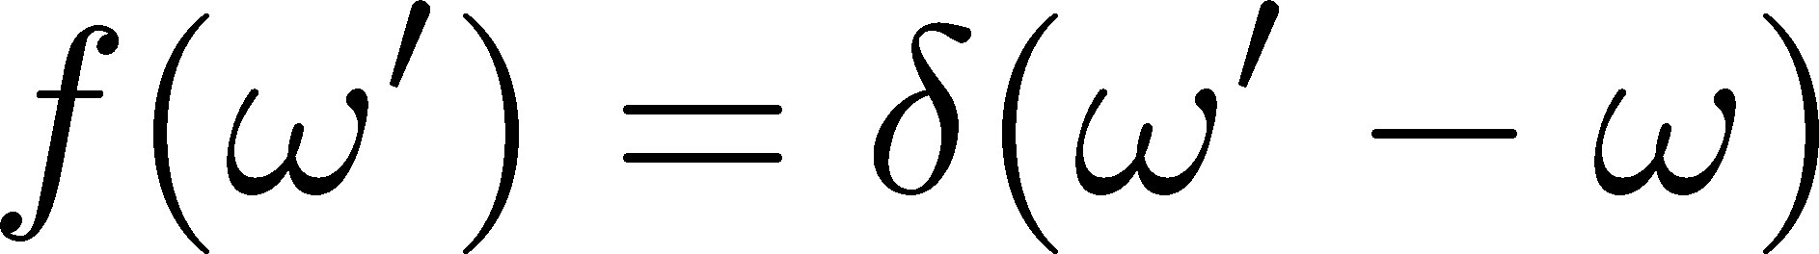
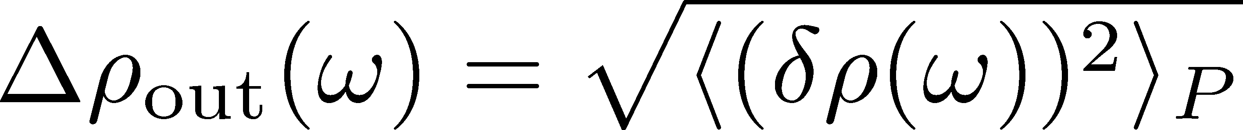
Error in MEM
MEM error = variance in P[ρ(ω),α] space
exp. val.:
error:
typically
huge
NOTE
SPC by MEM is just an image. No robust meaning.
MEM error is more conservative than statistical one.

Slide 13

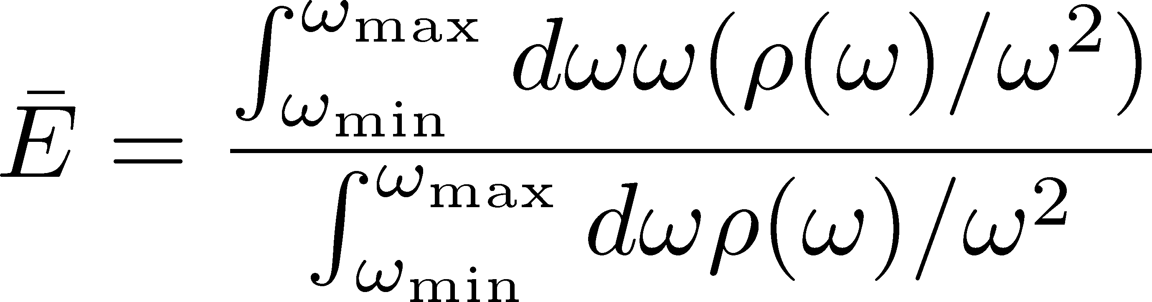


Defining Peak Position
Center of weight in a range
Represent peak position for a sufficiently sharp peak
Error analysis in MEM is possible!
[ω_{min}, ω_{max}] dependence has to be checked

Slide 14
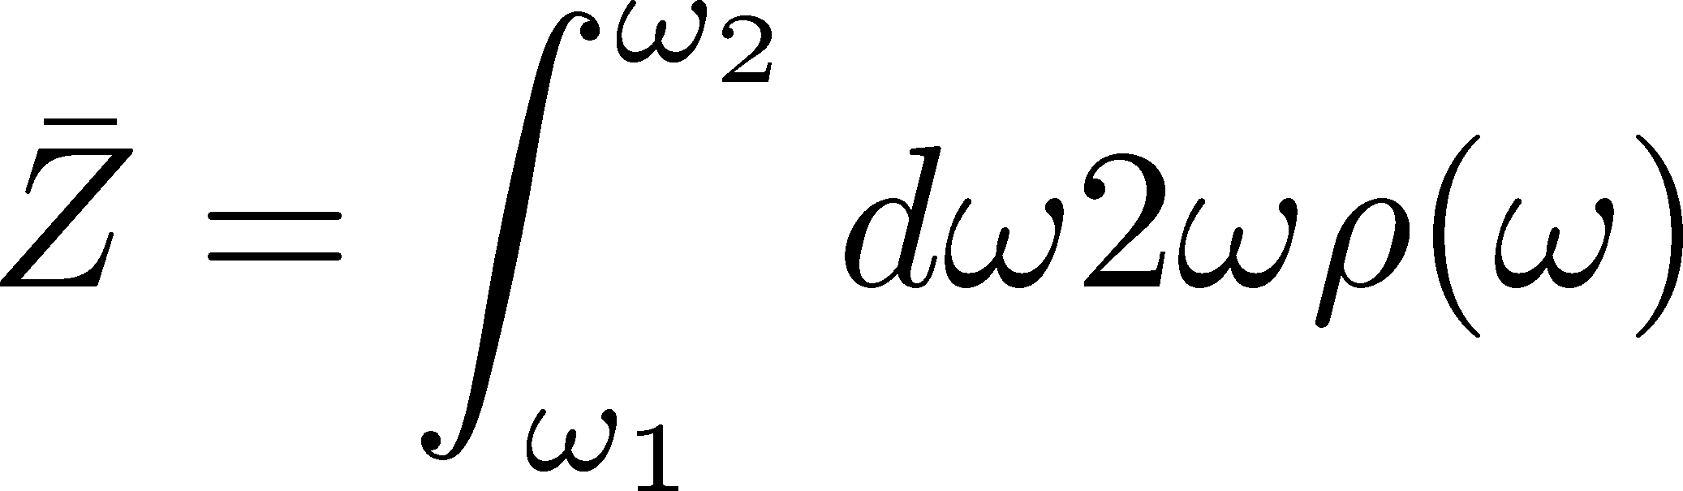
Defining Peak Position
Center of weight in a range
Represent peak position for a sufficiently sharp peak
Error analysis in MEM is possible!
[ω_{min}, ω_{max}] dependence has to be checked
Residue:

Slide 15
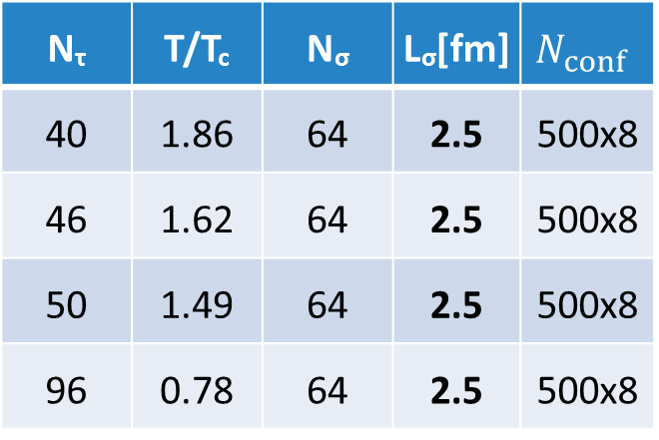
Lattice Setup
Quenched simulation
Wilson fermion / gauge
Anisotropic lattice (a_{σ}/a_{τ}=4)
N_{τ} | T/T_{c} | N_{σ} | L_{σ}[fm] | $$N_{conf}$$
40 | 1.86 | 64 | 2.5 | 500x8
46 | 1.62 | 64 | 2.5 | 500x8
50 | 1.49 | 64 | 2.5 | 500x8
96 | 0.78 | 64 | 2.5 | 500x8
Asakawa, Hatsuda, 2004
8 measurements
on each conf.
BlueGene/Q@KEK
fermion part: Iroiro++
Large spatial volume → high momentum resolution
Large Nt / high statistics → high MEM precision

Slide 16
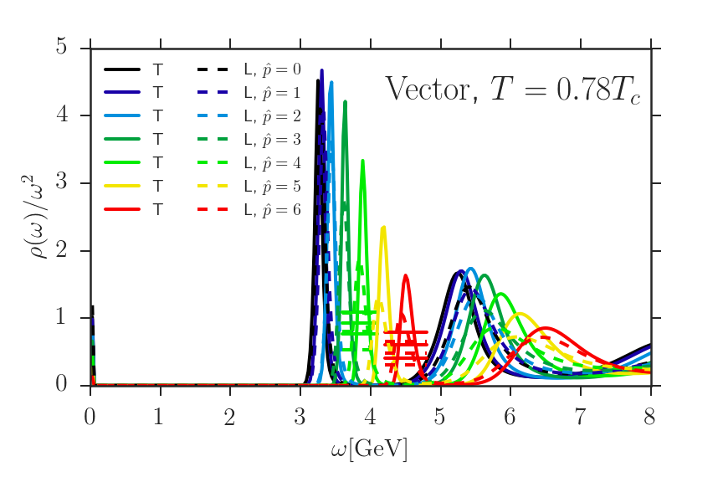
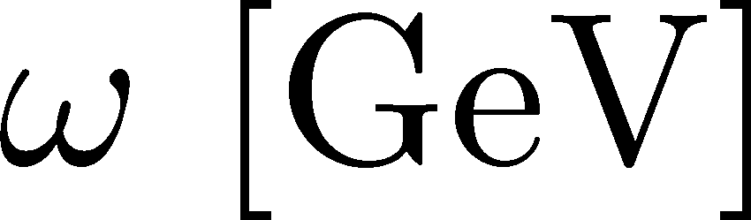
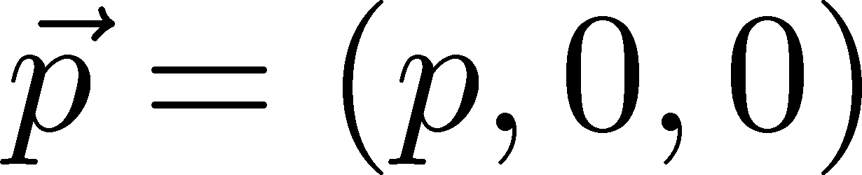
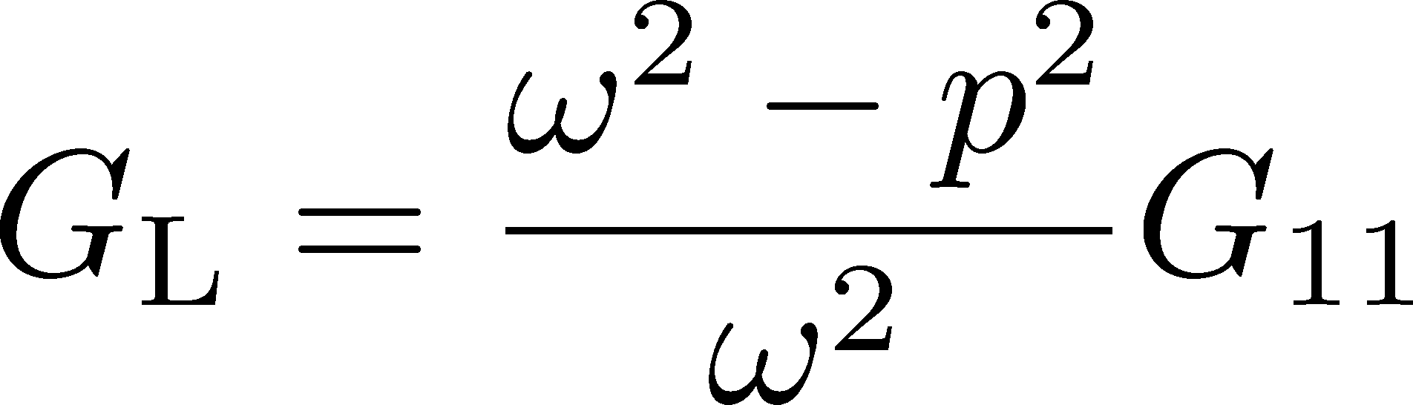
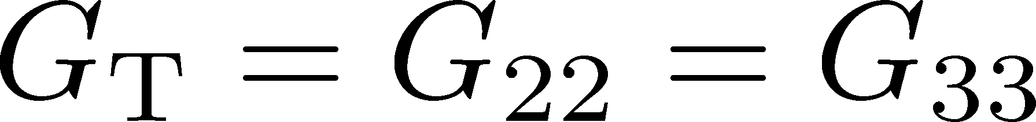
Spectral Func. @ T=0.78Tc
ρ_{T} and ρ_{L} channels degenerate
although correlators are different

Slide 17
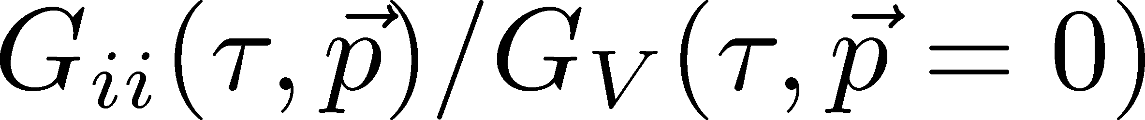
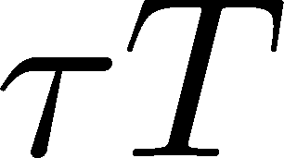
Spectral Func. @ T=0.78Tc
ρ_{T} and ρ_{L} channels degenerate
although correlators are different

Slide 18
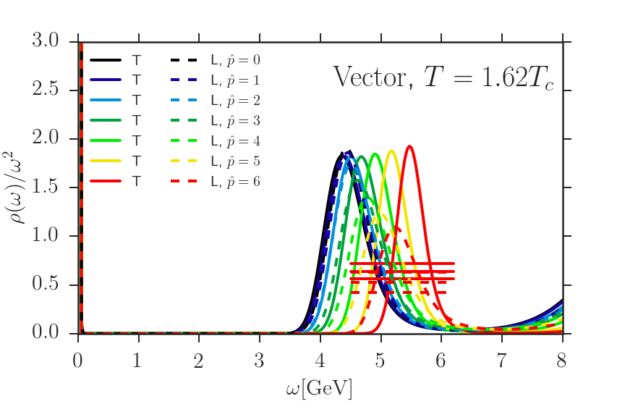
Spectral Func. @ T=1.62Tc
ρ_{T} and ρ_{L} channels seem to degenerate yet.
Peak exists for all momenta.

Slide 19

Dispersion Relation
Energy interval [ω_{min}, ω_{max}] for disp. rel.
:first minimum

Slide 20
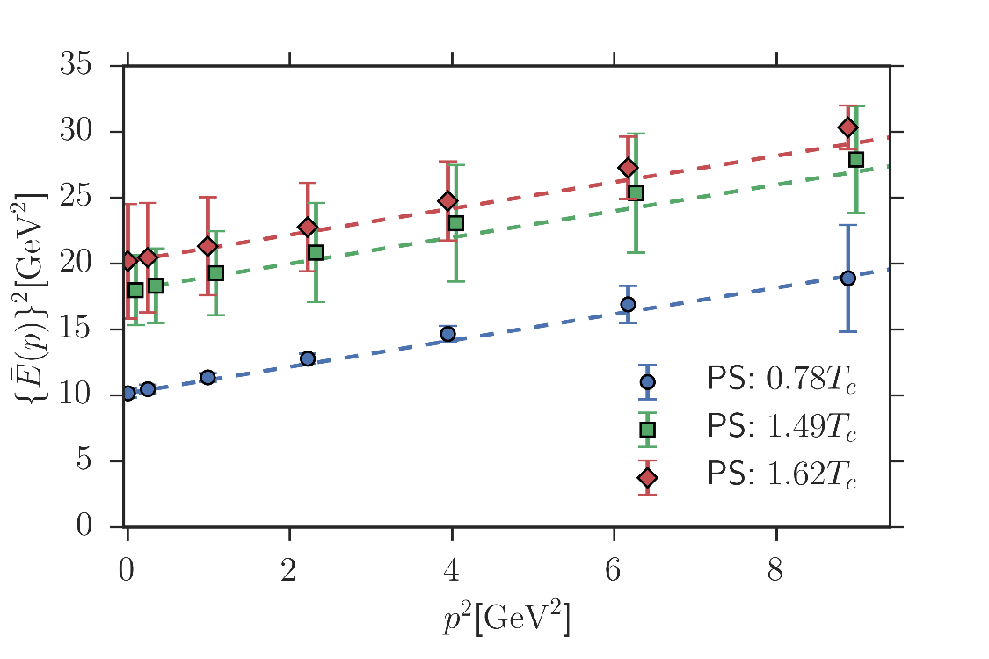
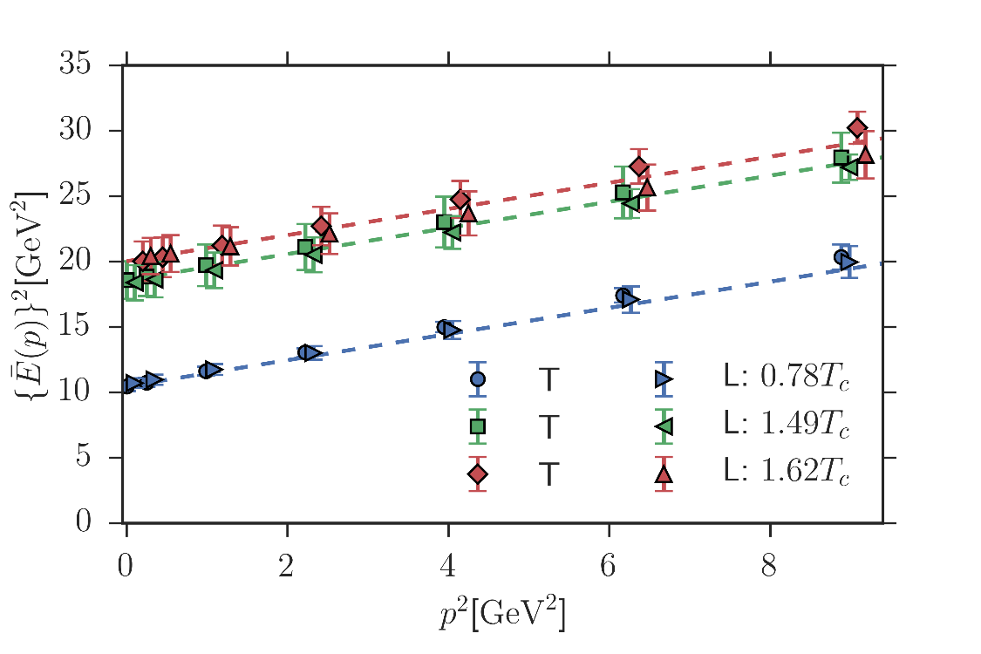
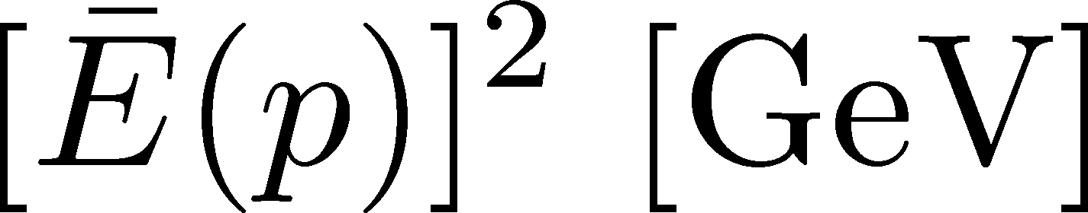
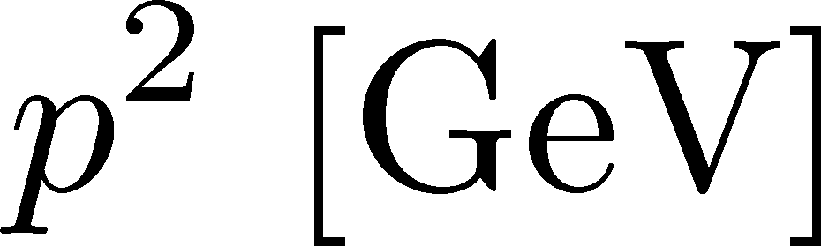
Dispersion Relation
Clear mass enhancement in medium.
Dispersion relation is consistent with the Lorentz covariant form even at T=1.62Tc.
mass E(p=0)
[GeV]

Slide 21
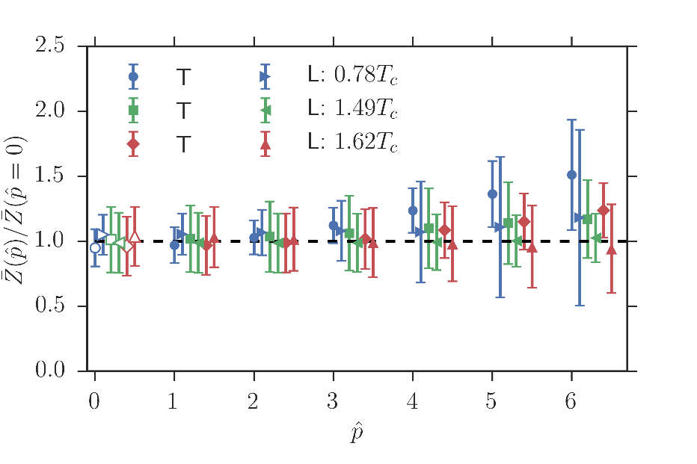
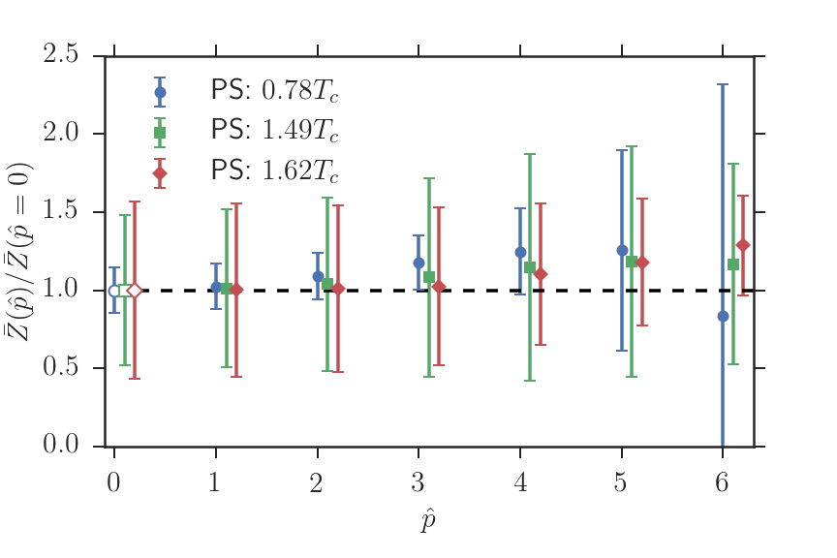
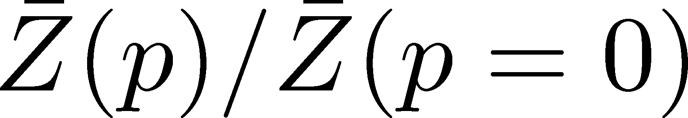
Residue
Vector
PS
No p dependence of Z even at T=1.62Tc
No T/L splitting in vector channel

Slide 22
Summary
We analyzed the peak positions in SPC with MEM error by defining them in terms of the center of weight.
Charmonia have significant mass enhancement.
Dispersion relations are consistent with Lorentz covariant form even at T=1.62Tc.
Future Work
Why Lorentz invariant Disp. Rel. in medium?
  comparison with potential models and etc.?
m_{q} dependence / other channels / finer p resolution

Slide 23
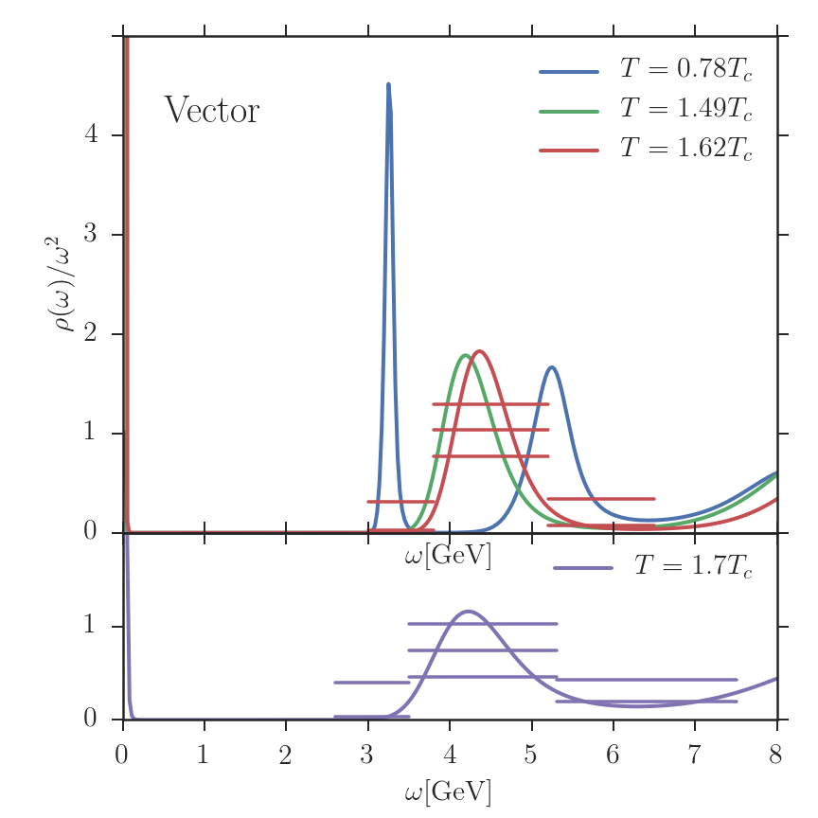
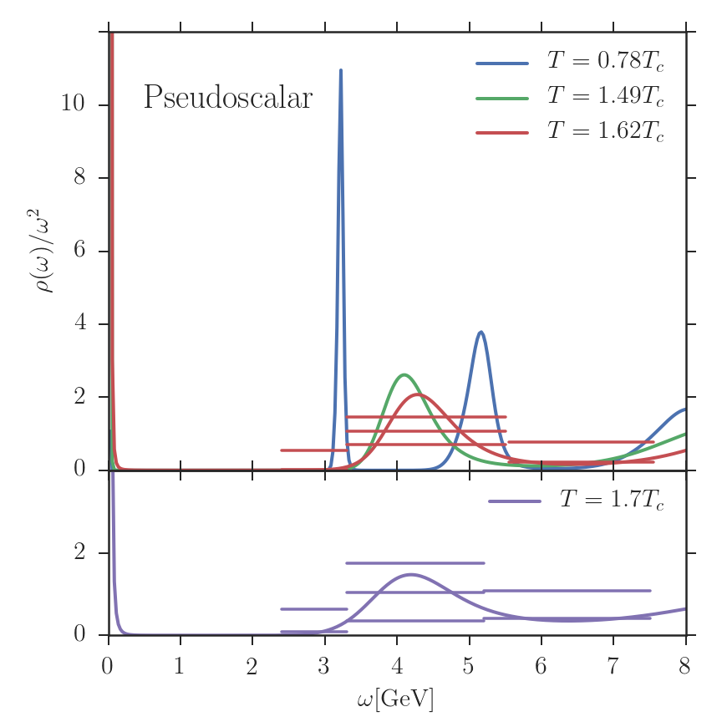
Spectral Function @ p=0, T>0
Vector channel
PS channel
Bound state peaks seem to exist at T=1.62Tc.

Slide 24
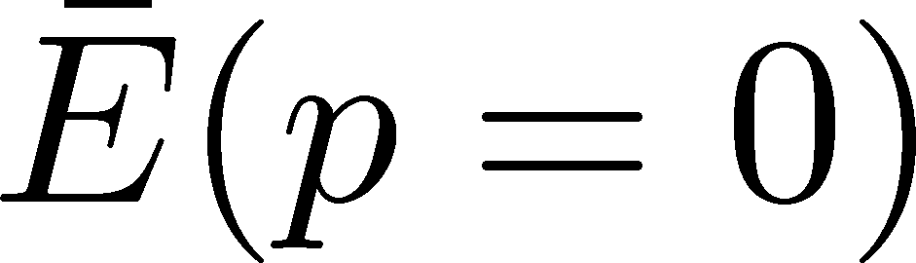
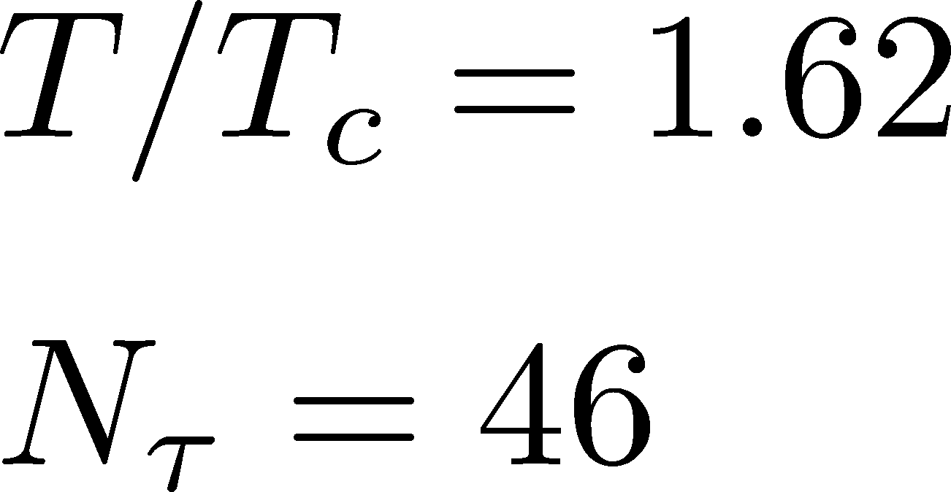
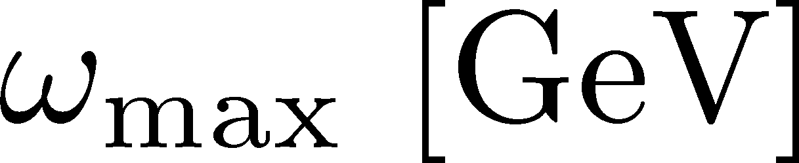
Dependence on
ω_{max} dependence is well suppressed.
No ω_{min} dependence for ω_{min}<3GeV.

Slide 25
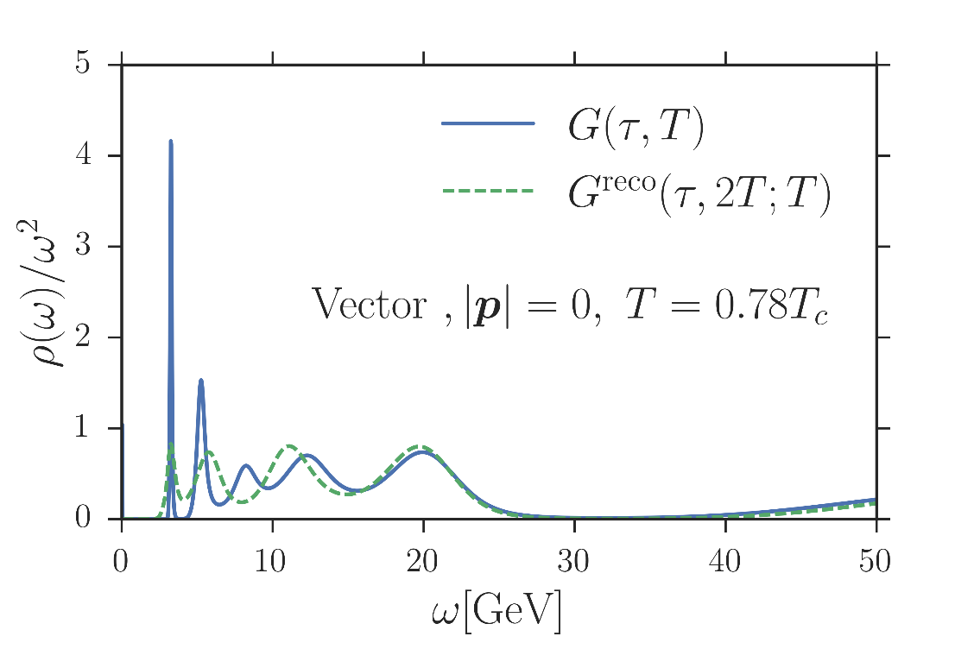
Test: N_{t} Dependence
Special thanks to A. Rothkopf
correlator
reconstructed cor.
Peak position does not shift with the change of N_{t}

