Slide 1
Critical Enhancement and Diffusion of Non-Gaussian Fluctuations
Masakiyo Kitazawa
(Osaka U.)
Asakawa, MK, Prog. Part. Nucl. Phys. 90, 299 (2016)
MK, Luo, Phys. Rev. D95 (2017)
Nonaka, MK, Esumi, Phys. Rev. C95 (2017)
Sakaida, Asakawa, Fujii, MK, Phys. Rev. C95, 064905 (2017)
Ohnishi, MK, Asakawa, Phys. Rev. C94, 044905 (2016)
MK, Nucl. Phys. A942, 65 (2015)
Sakaida, Asakawa, MK, Phys. Rev. C90, 064901 (2014)
MK, Asakawa, Ono, Phys. Lett. B728, 386 (2014)
EMMI workshop on Critical Fluctuations, Oct. 10-13, 2017, CCNU, China

Slide 2
Beam-Energy Scan
T
Hadrons
Color SC
0
μ

Slide 3

Beam-Energy Scan
STAR 2012
high
beam energy
T
low
Hadrons
Color SC
0
μ

Slide 4
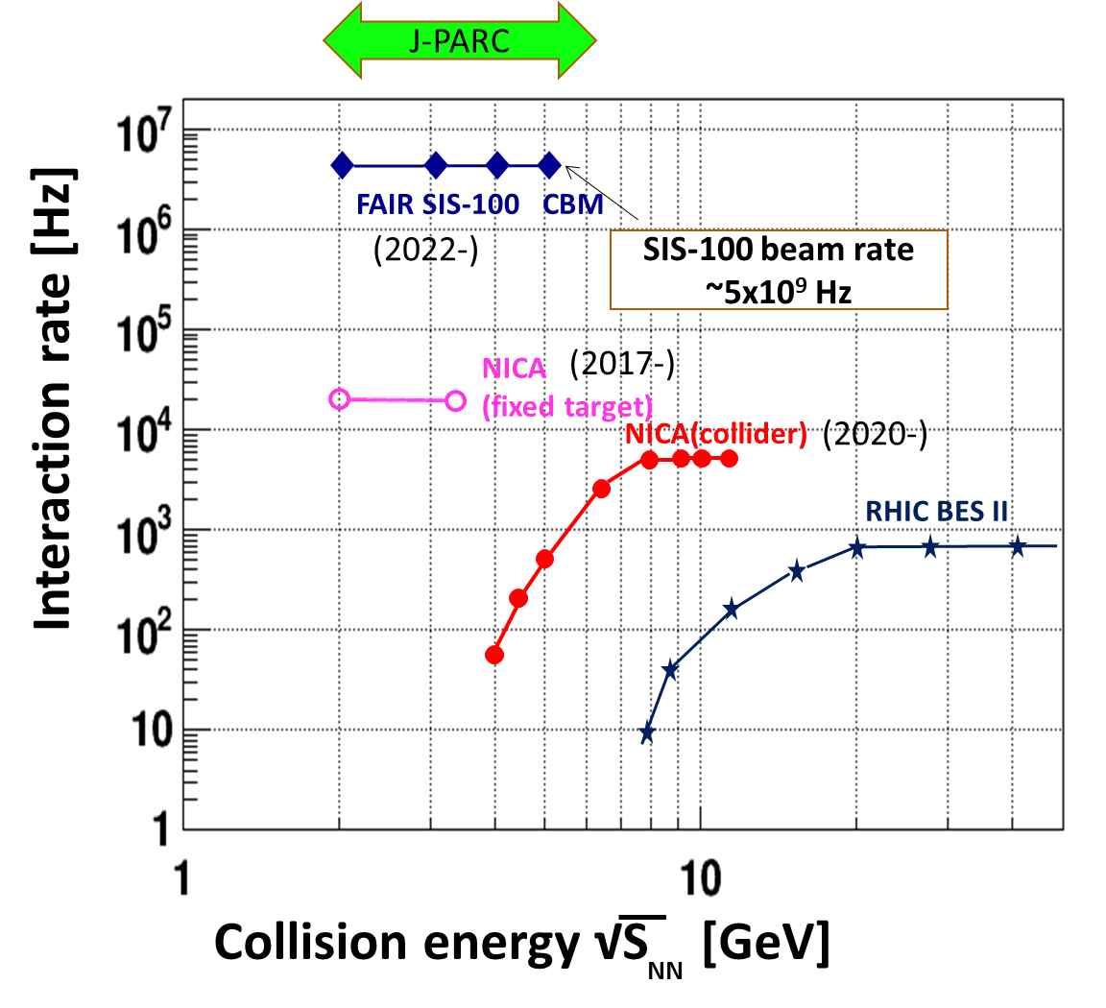
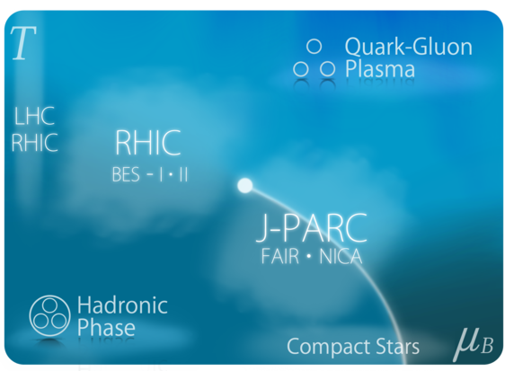
Beam-Energy Scan
RHIC-BES
Active experimental researches/plans
for the beam-energy scan
BES-II
2019-2020
J-PARC-HI
J-PARC-HI
2025~?
SPS
AGS
Search for QCD phase structure
/ critical point

Slide 5


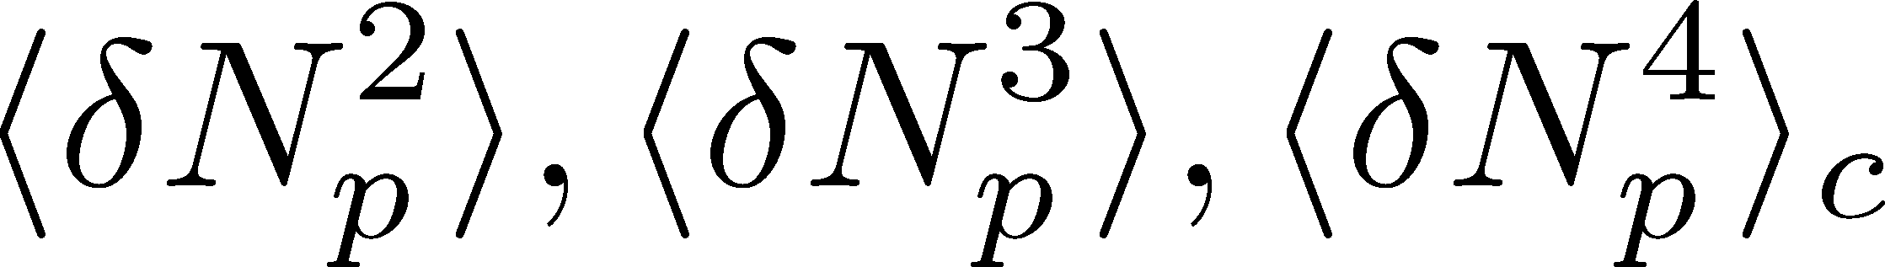
Event-by-Event Fluctuations
Review: Asakawa, MK, PPNP 90 (2016)
Fluctuations can be measured by e-by-e analysis in experiments.
STAR, PRL105 (2010)
Detector
Cumulants

Slide 6


Higher-Order Cumulants
STAR Collab.
2010~
Enhancement
Non-zero non-Gaussian and non-Poissonian cumulants
have been established!
Have we measured critical fluctuations?

Slide 7
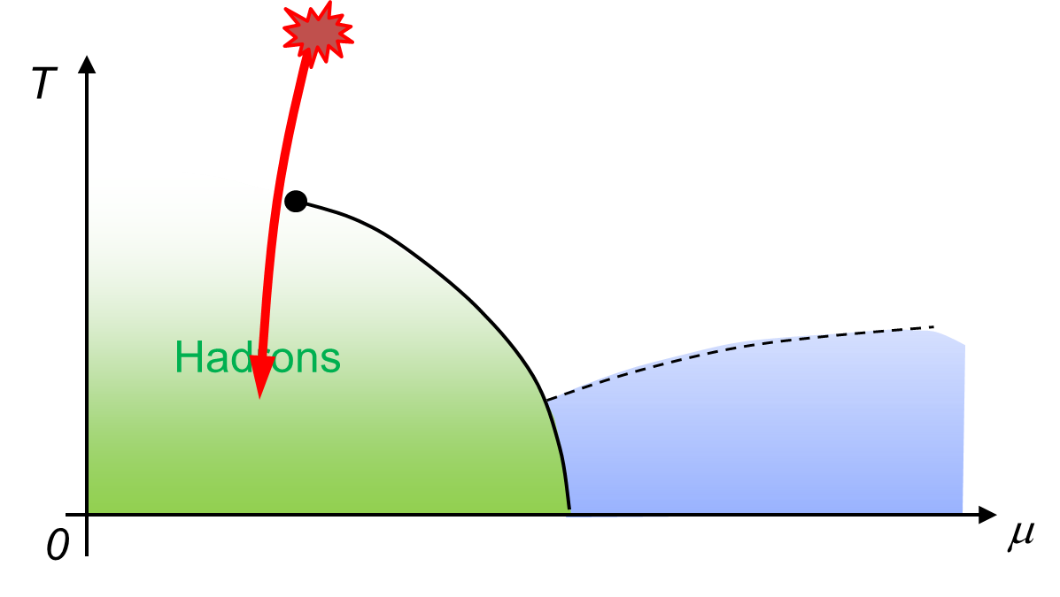
Remark on Critical Fluctuation
Experiments cannot observe
critical fluctuation in equilibrium directly.
Growth
Critical fluctuation has to be well developed.
But, the relaxation is slow around CP because of the critical slowing down.
Decay by diffusion
Fluctuations developed at CP are modified by the time evolution in later stage.

Slide 8
Three Topics
Diffusion of fluctuations
Analysis of fluctuations with factorial cumulants
Critical enhancement and diffusion

Slide 9
Diffusion of Fluctuations
Ohnishi, MK, Asakawa, Phys. Rev. C94, 044905 (2016)
MK, Nucl. Phys. A942, 65 (2015)
MK, Asakawa, Ono, Phys. Lett. B728, 386 (2014)

Slide 10

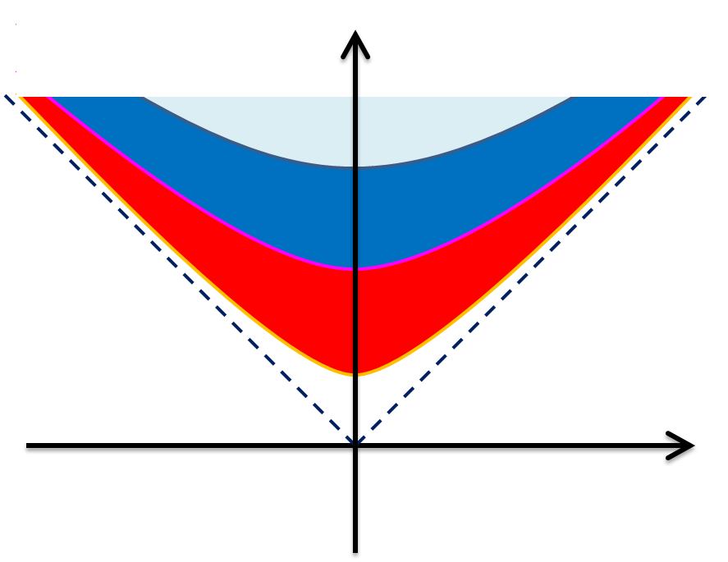




Diffusion of Fluctuations
Fluctuations in ΔY
continue to change
until kinetic f.o.
Fluctuations are ΔY dependent
Diffusion modifies e-v-e fluctuations

Slide 11


(Non-Interacting) Brownian Particle Model
Initial condition (uniform)
cumulants:
random
walk
diffusion master equation: MK+, PLB(2014)
probabilistic argument: Ohnishi+, PRC(2016)

Slide 12


(Non-Interacting) Brownian Particle Model
Initial condition (uniform)
cumulants:
diffusion
distance
random
walk
Study ΔY dependence
Poisson distribution
diffusion master equation: MK+, PLB(2014)
probabilistic argument: Ohnishi+, PRC(2016)

Slide 13



Baryons in Hadronic Phase
time
chem. f.o.
hadronize
10~20fm
kinetic f.o.
Baryons behave like
Brownian pollens in water
mesons
baryons

Slide 14
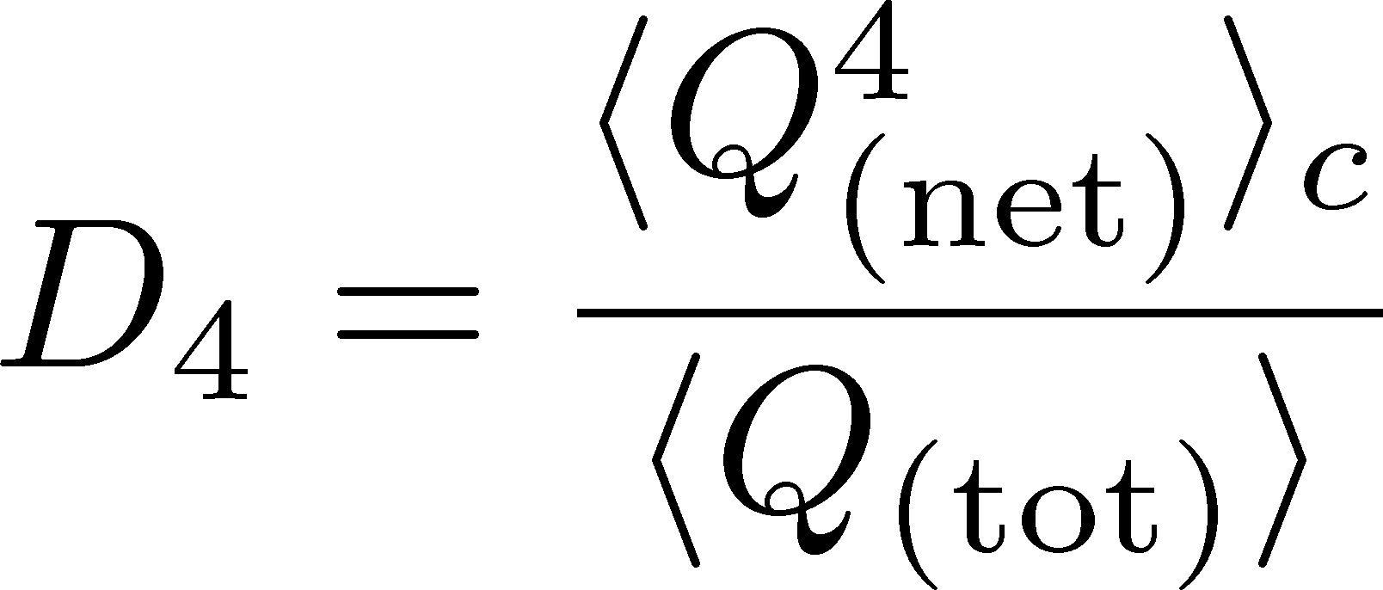





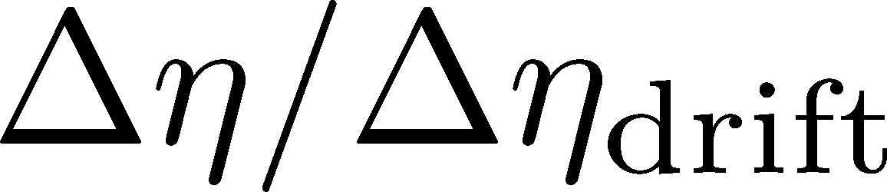
Rapidity Window Dep.
Initial Conditions
4th-order cumulant
MK+, 2014
MK, 2015
Different initial conditions give rise to different characteristic Δη dependence.
Non-monotonic behaviors can appear in Δη dependence.
Finite volume effects: Sakaida+, PRC90 (2015)

Slide 15

Rapidity Window Dep.
Initial Conditions
4th-order cumulant
MK+, 2014
MK, 2015
STAR Collab. (X. Luo, CPOD2014)
Different initial conditions give rise to different characteristic Δη dependence.
Non-monotonic behaviors can appear in Δη dependence.
Finite volume effects: Sakaida+, PRC90 (2015)

Slide 16
Analysis of Fluctuations
with Factorial Cumulants
MK, Luo, Phys. Rev. C94, 044905 (2016)
Nonaka, MK, Esumi, Phys. Rev. C95, (2016)

Slide 17
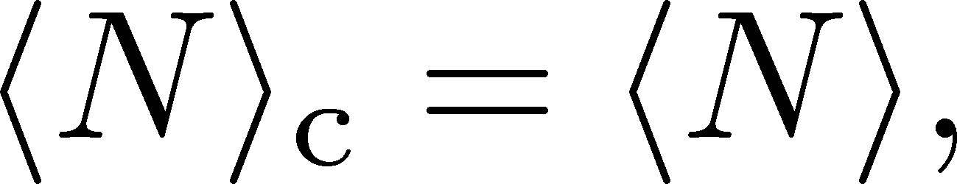
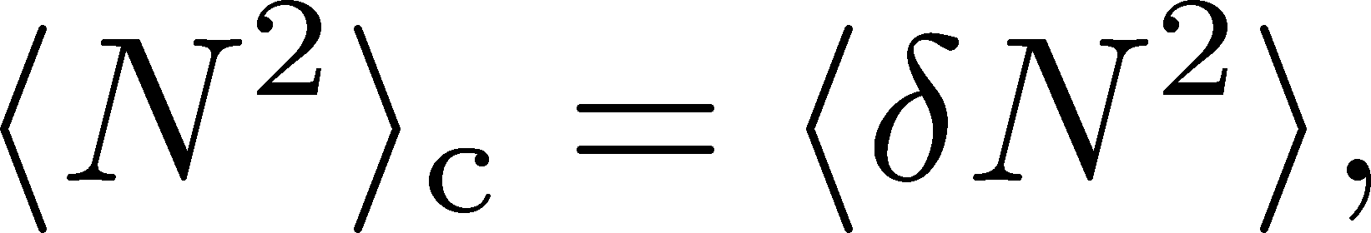
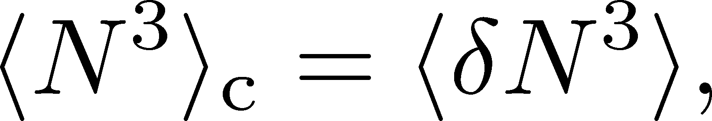
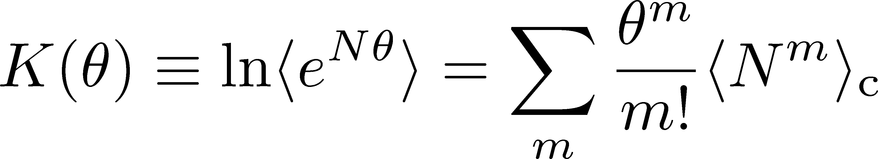
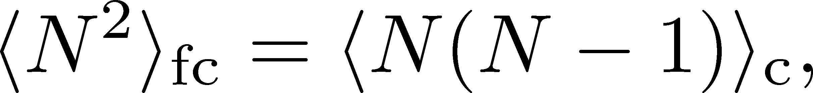
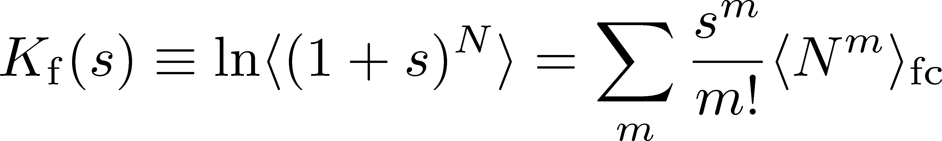
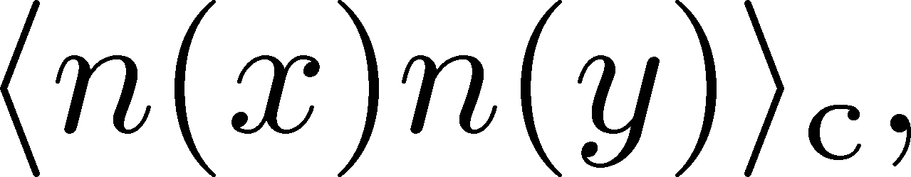
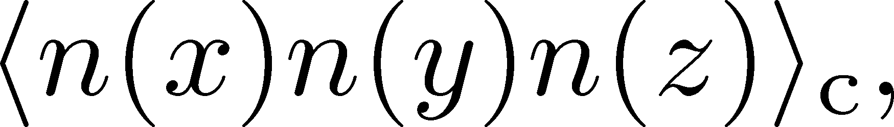
Definition of Terminology
Cumulants
Factorial Cumulants
Correlation Functions

Slide 18
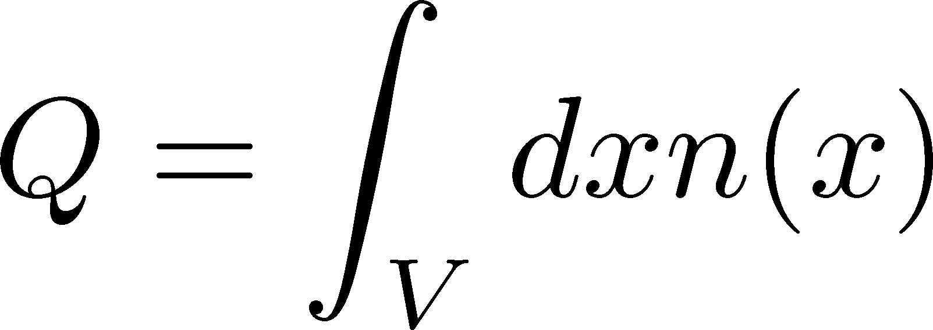
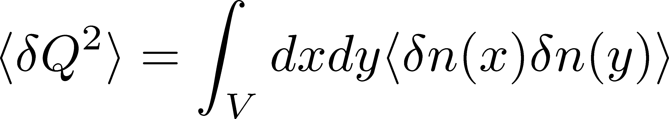
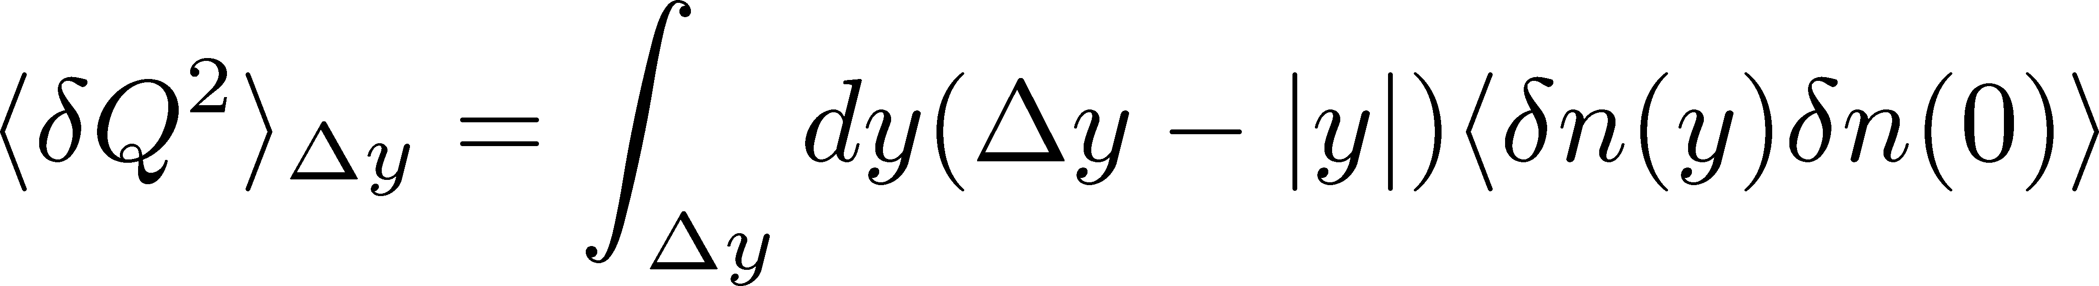
Cumulants and Correlation Function
total charge
charge density
2nd order cumulant
(fluctuation)
correlation function
1-to-1 correspondence
1-dim case

Slide 19
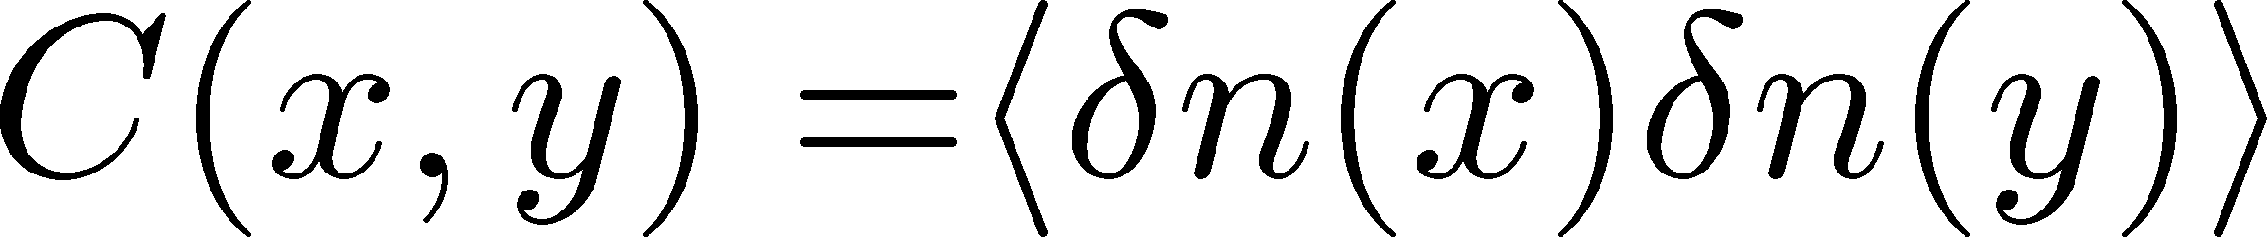
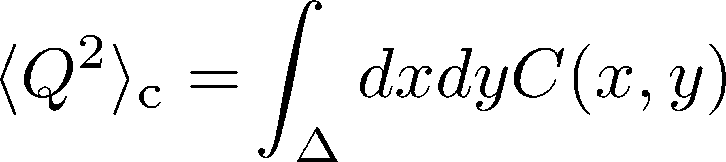
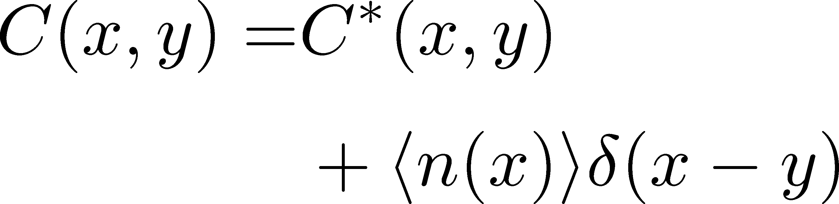
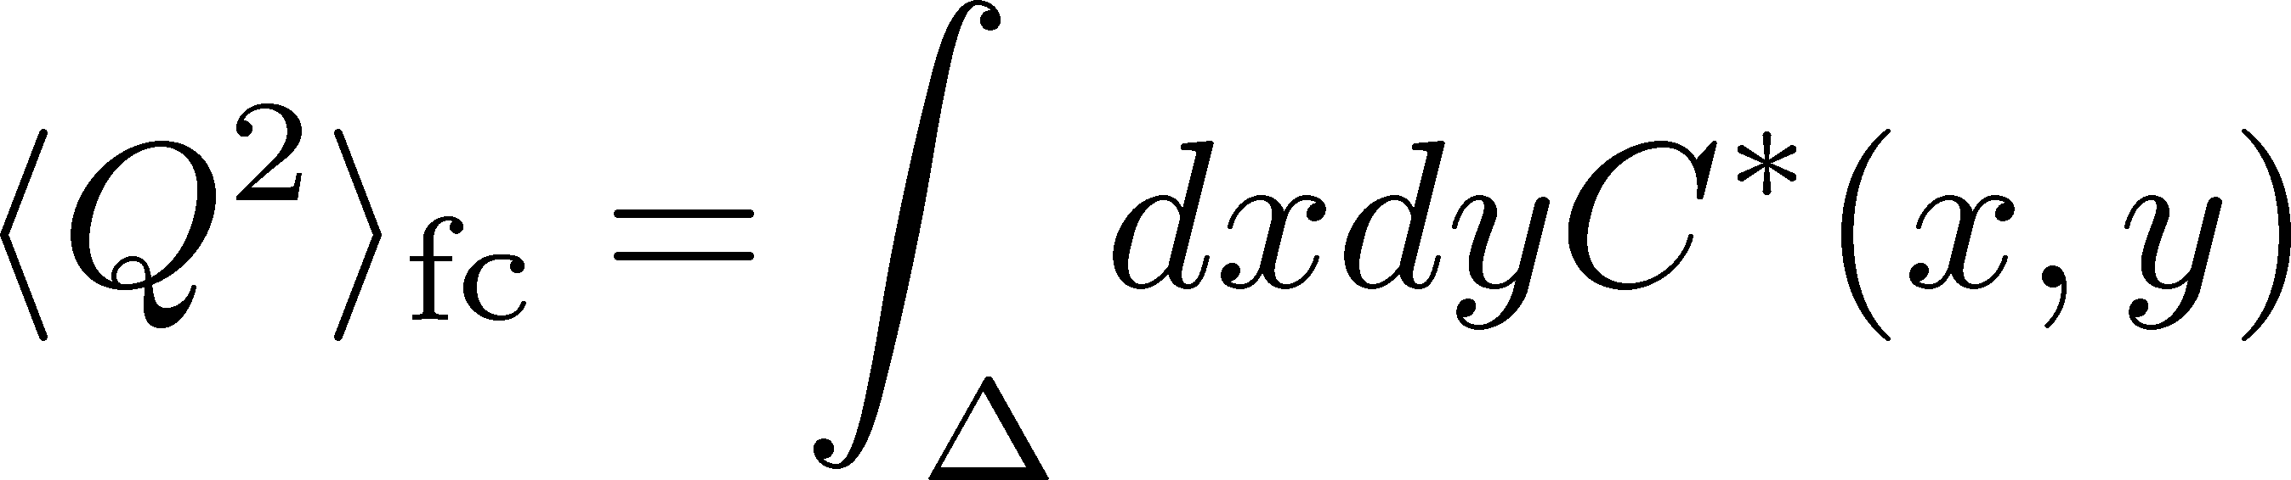
Factorial Cumulants
Ling, Stephanov, 2016
Bzdak, Koch, 2017
= Cumulants after removing “self-correlation”
Correlation function
Cumulant
Factorial cumulant
Caveats:
This interpretation is valid only for classical particle systems.
When quasi-particles are lost, f-cumulants are not well-defined.
Values of f-cumulants are modified by inelastic scatterings.
Cumulants of conserved charges have desirable properties.

Slide 20
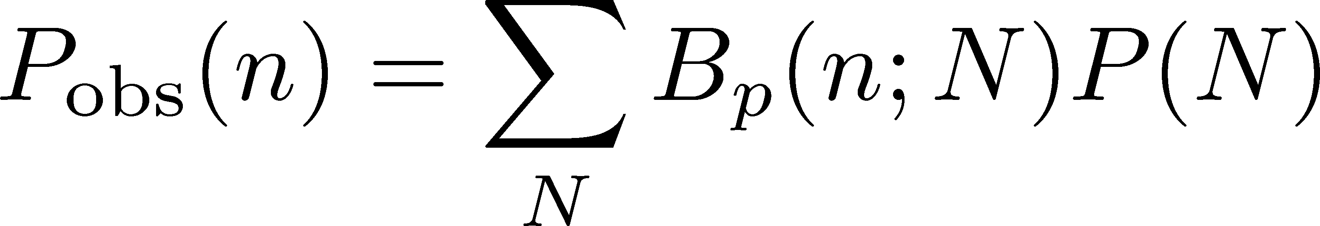
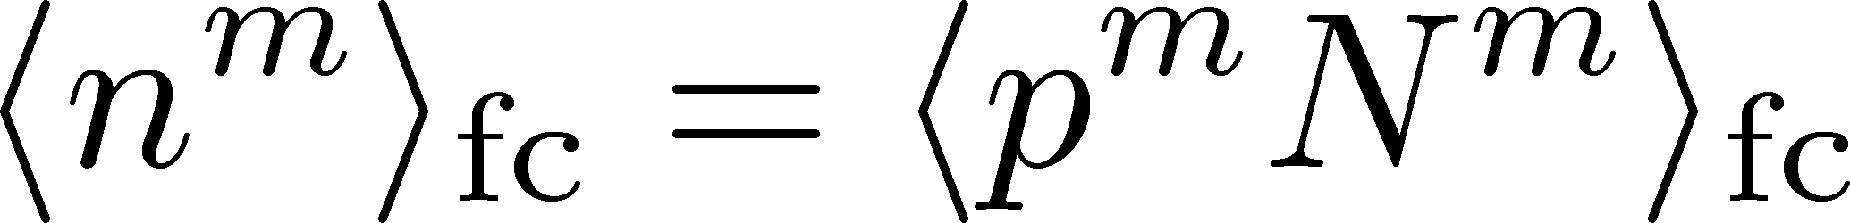

Usage of F-Cumulants
Suggestion
F-cumulants play useful roles in revealing underlying physics described (approximately) by the binomial model.
independent probabilistic events
Binomial Model
F-cumulants
“observed” distribution
“original” distribution
Ex: efficiency correction
Nonaka, MK, Esumi, 2017

Slide 21
p_{T}-cut Dependence
MK, Luo, PRC, 2017
Enhancement of cumulant with increasing p_{T} acceptance

Slide 22
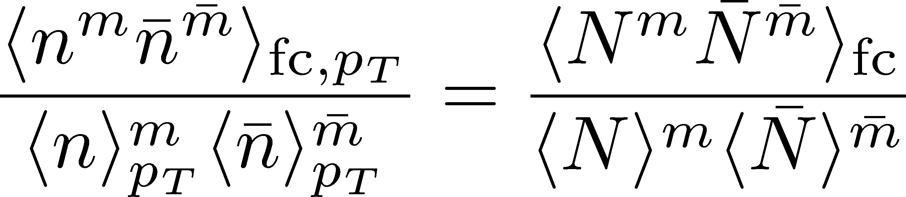
p_{T}-cut Dependence
MK, Luo, PRC, 2017
Enhancement of cumulant with increasing p_{T} acceptance
Assumption:
independent and random p_{T} distribution in the final state
Power-law behavior of f-cum.
const.
Study particle emission mechanism
Construction of cumulants
Detector

Slide 23
Non-Interacting Brownian Particle System
Initial condition (uniform)
cumulants:
diffusion
distance
random
walk
Diffusion in Brownian particle model can be described by the binomial model.

Slide 24
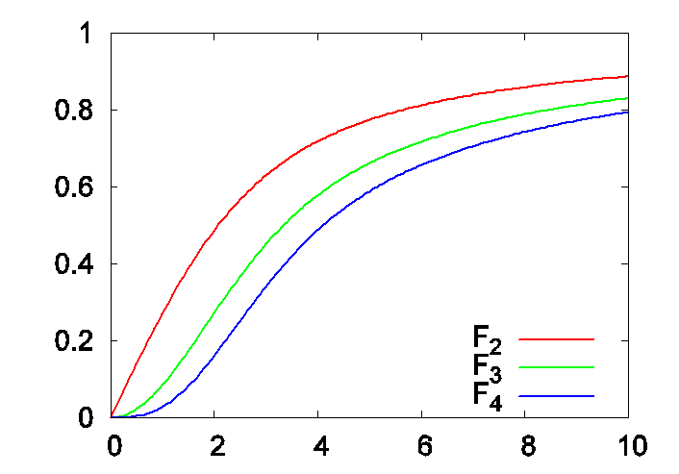
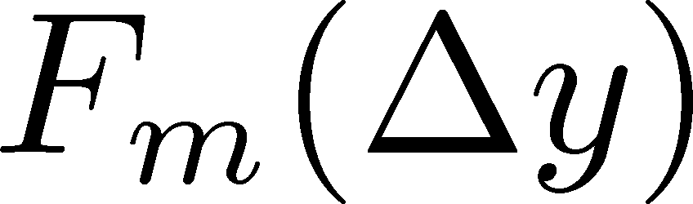
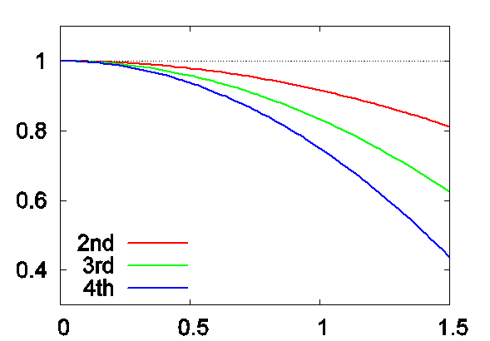
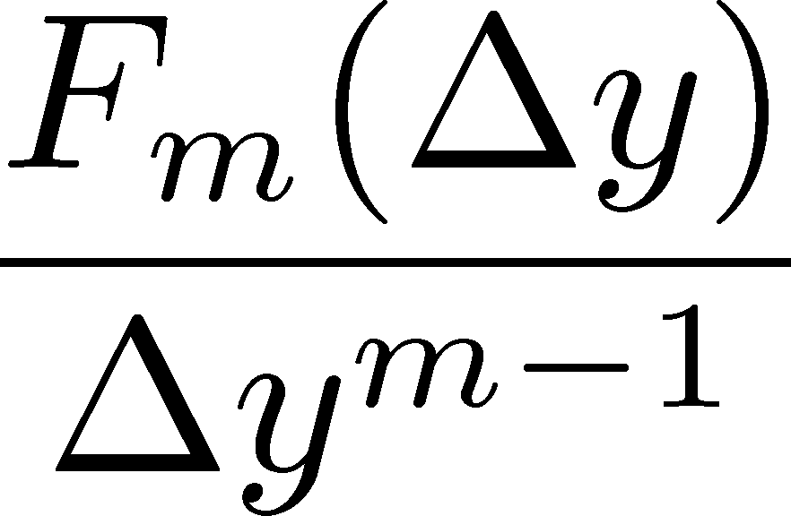
Δη Dependences of F-Cumulants
MK, Luo, PRC, 2017
f-cumulant at initial cond.
diffusion distance
All f-cumulants at the same order have the same Δy dependence up to normalization.
f-cumulants and diffusion distance can be inferred.
reconstruct cumulants of conserved charges

Slide 25
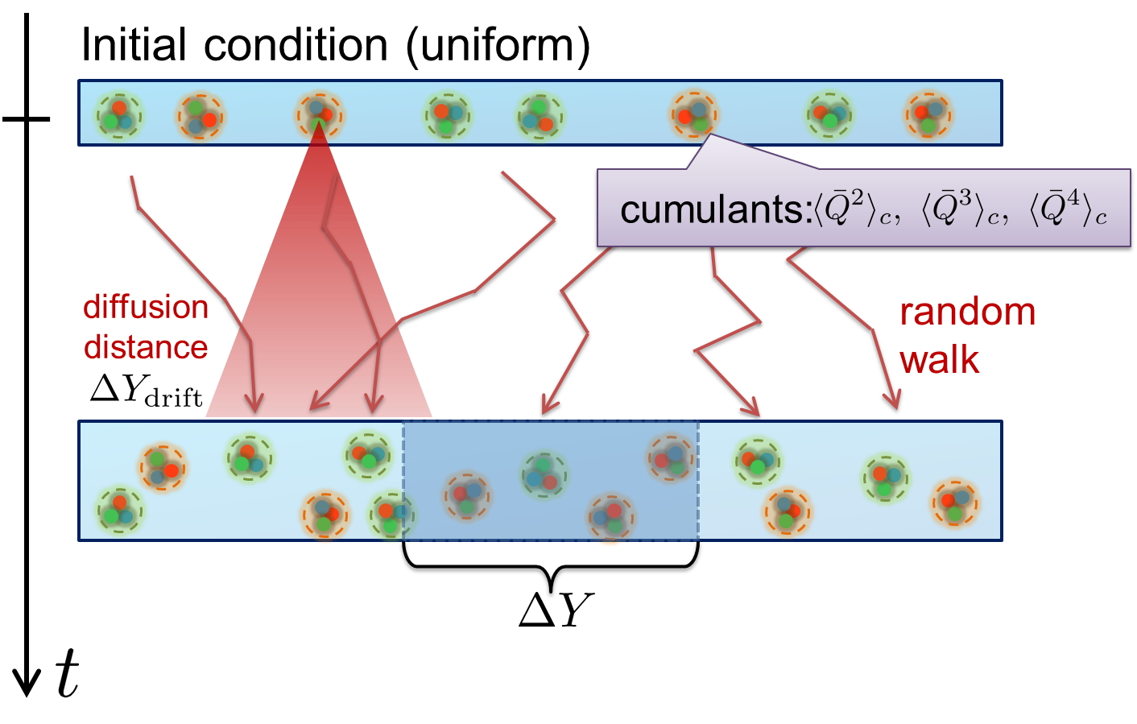
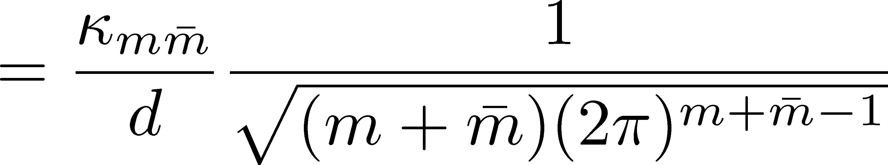
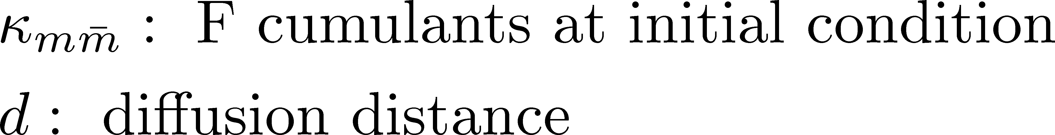
Translating Languages
Brownian particle model
From Bzdak’s talk

Slide 26
Critical Enhancement
and Diffusion
Sakaida, Asakawa, Fujii, MK, Phys. Rev. C95, 064905 (2017)

Slide 27
Remarks on Critical Fluctuation 1
Experiments cannot observe
critical fluctuation in equilibrium directly.
Growth
Critical fluctuation has to be well developed.
But, relaxation toward equilibration is slow around CP because of the critical slowing down.
Decay by diffusion
Fluctuations developed at CP are modified by the time evolution in later stage.

Slide 28

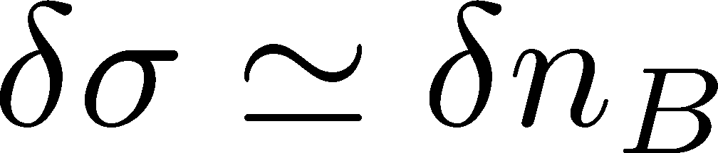
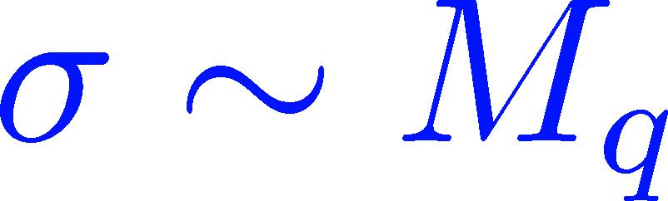

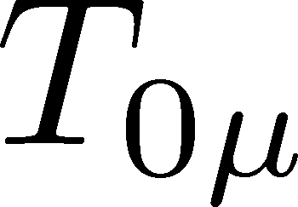


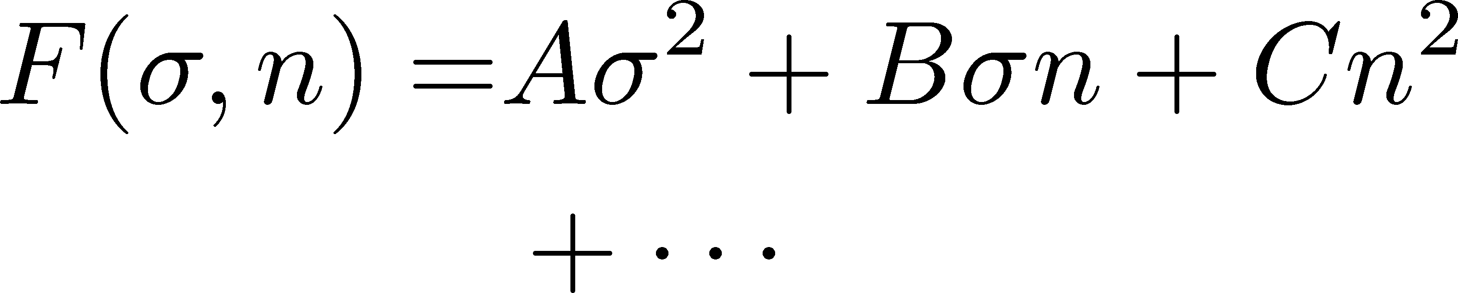
Remarks on Critical Fluctuation 2
Critical fluctuation is a conserved mode!
Fujii 2003; Fujii, Ohtani, 2004; Son, Stephanov, 2004
Fluctuations of σ and n_{B} are coupled
around the CP!
critical
soft mode
σ: fast damping

Slide 29
Dynamical Evolution of Critical Fluctuations
Evolution of correlation length
Berdnikov, Rajagopal (2000)
Asakawa, Nonaka (2002)
Higher orders (spatially uniform “σ” mode)
Mukherjee, Venugopalan, Yin (2015)
Dynamical evolution in chiral fluid model
Nahrgang, Herold, … (2014~)
Correlation functions
Kapusta, Torres-Rincon (2012)

Slide 30
Aim of This Study
Describe conserved nature of critical fluctuation.
We want to study experimental observables.
  focus on a conserved charge (baryon number)
  study evolution of conserved-charge fluctuation
Concentrate on 2nd order fluctuation. (not higher)
We study
  rapidity window denepdence of the cumulant
  2-particle correlation function
Our Main Conclusion
Non-monotonicity in
cumulants or correlation func.
=
Signal of
QCD-CP

Slide 31
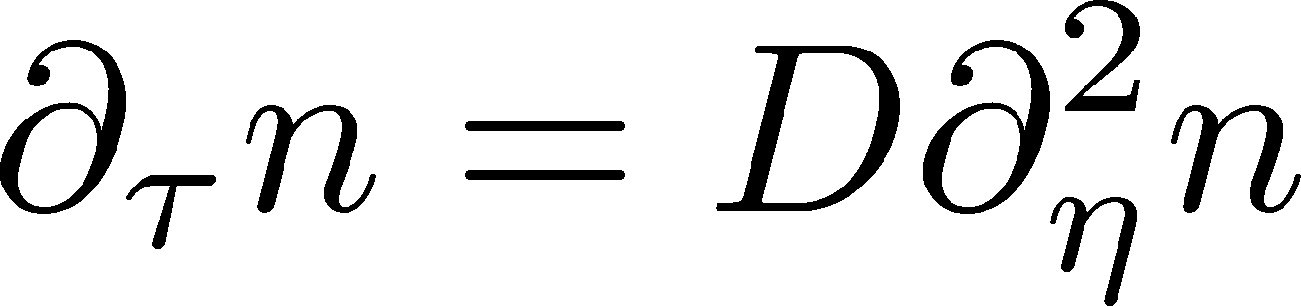

Stochastic Diffusion Equation (SDE)
Diffusion equation
Describe a relaxation of a conserved density n toward uniform state without fluctuation
Stochastic diffusion equation
Describe a relaxation toward fluctuating uniform state
χ: susceptibility (fluctuation in equil.)
Review: Asakawa, MK, PPNP 90 (2016)

Slide 32
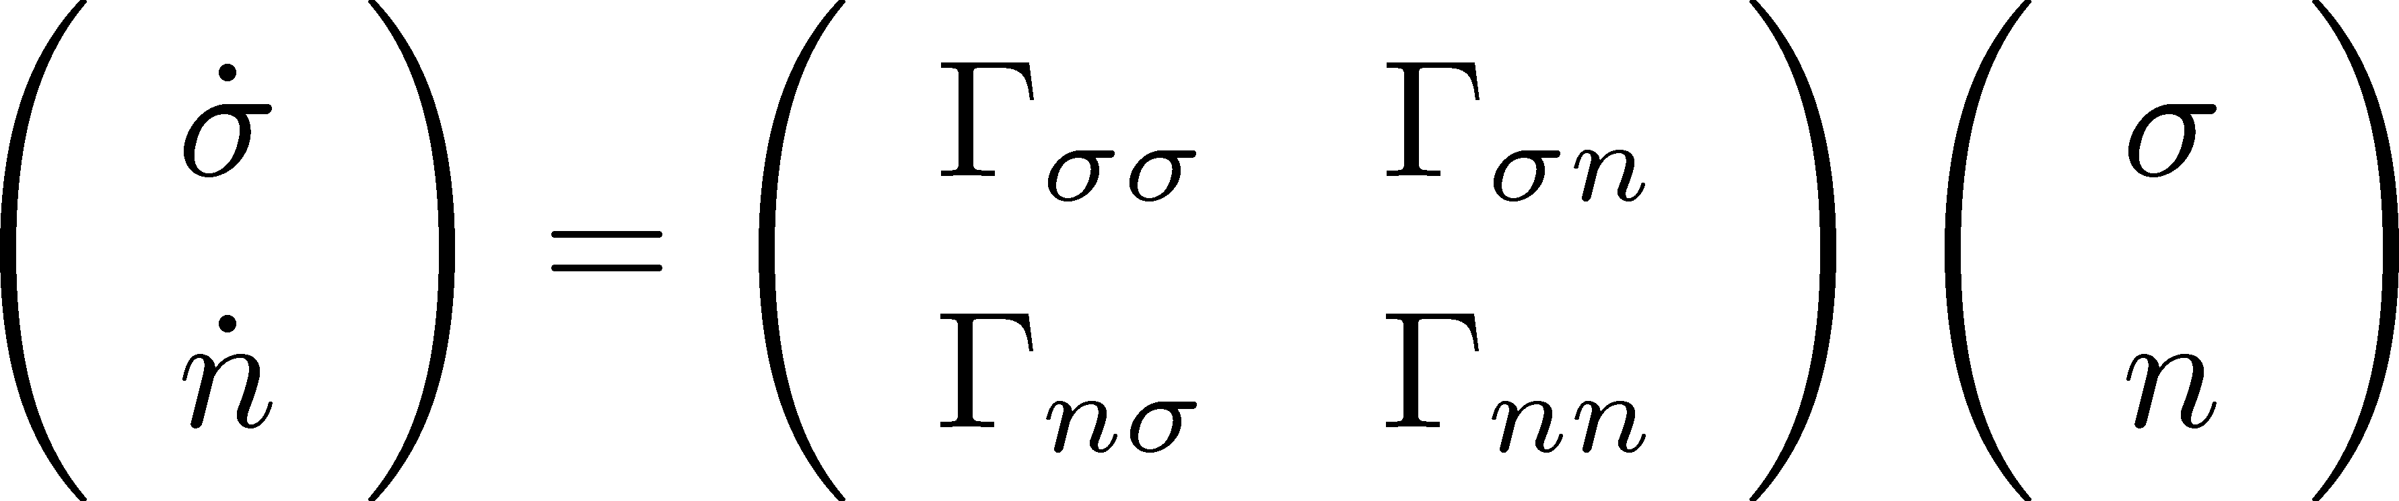
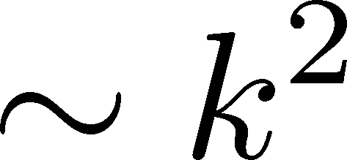
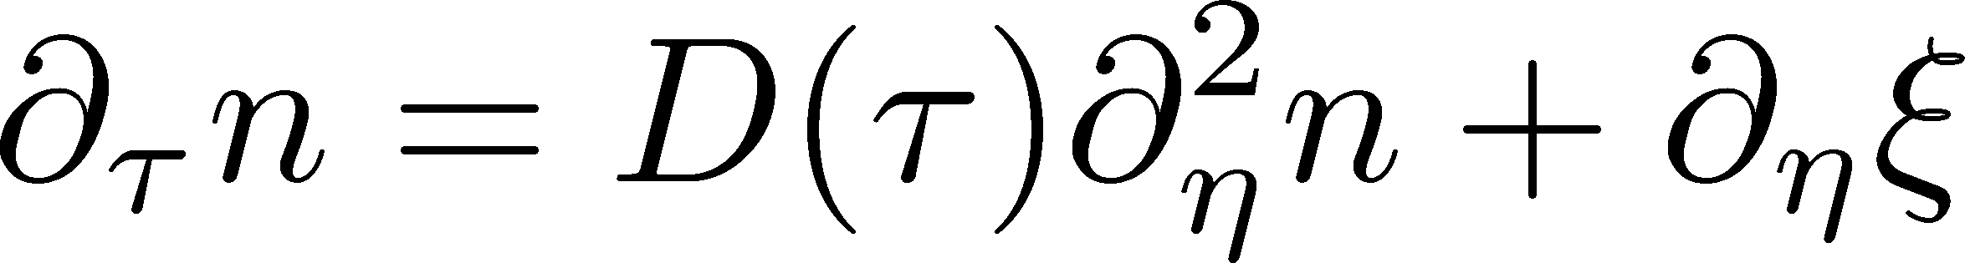
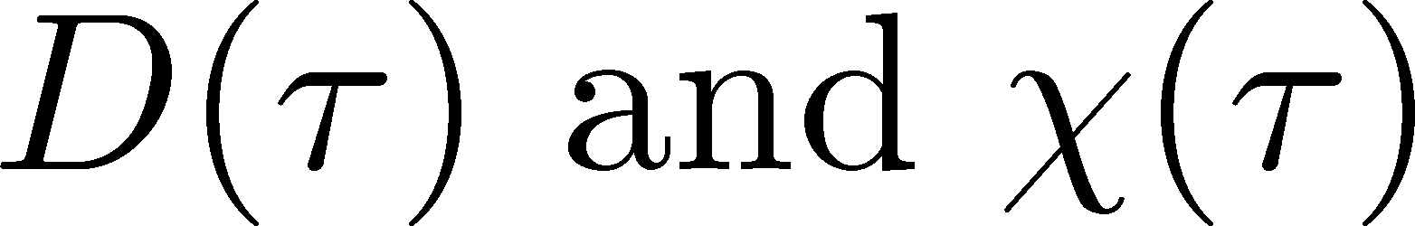
Soft Mode of QCD Critical Point
Fujii 2003; Fujii, Ohtani, 2004; Son, Stephanov, 2004
Effective potential
critical
soft mode
Time dependent Ginzburg-Landau
σ: fast damping
For slow and
long wavelength,
SDE
singularities in

Slide 33
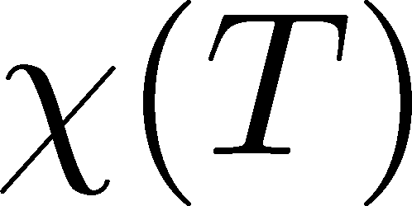
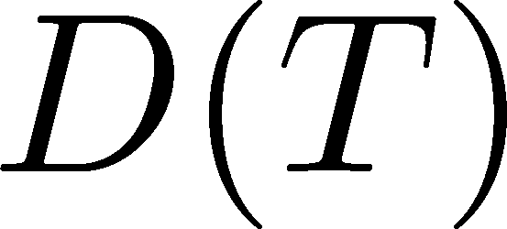
Parametrizing D(τ) and χ(τ)
Critical behavior
(critical point)
3D Ising (r,H)
model H
Temperature dep.
critical
slowing
down
critical
enhancement

Slide 34
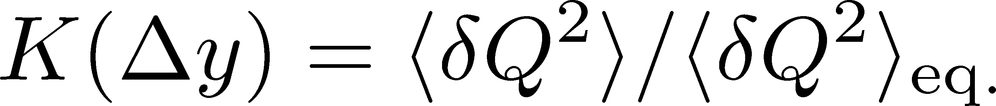

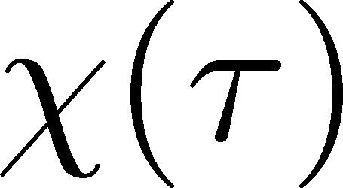
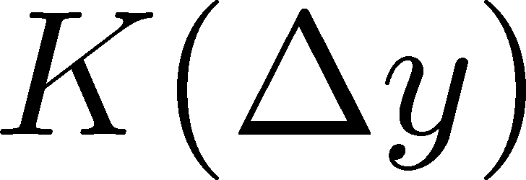
Crossover / Cumulant
ALICE
PRL 2013
monotonically decresing
Analytic
result
monotonically
increasing
monotonically
decreasing

Slide 35
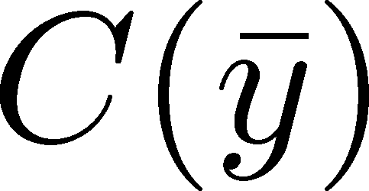
Crossover / Correlation Func.
monotonically decresing
Analytic
result
monotonically
increasing
monotonically
decreasing

Slide 36
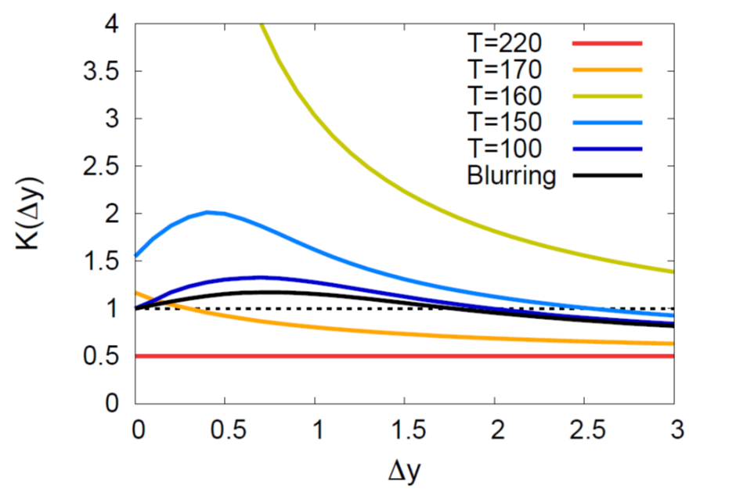
Critical Point / Cumulant
non-monotonic Δy dep.
Analytic
result
non-monotonic
non-monotonic

Slide 37
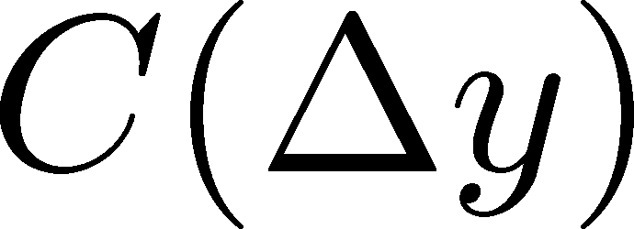
Criticap Point / Correlation Func.
non-monotonic Δy dep.
Analytic
result
non-monotonic
non-monotonic

Slide 38
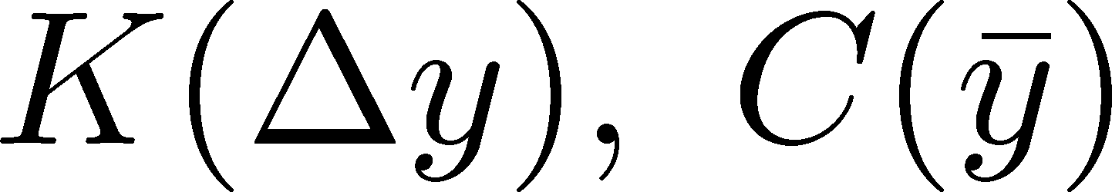
Weaker Critical Enhancement
Non-monotonicity in K(Δy) disappears.
But C(y) is still non-monotonic.
Analytic
result
no information on
monotonic
C(y) is better to see non-monotonicity.

Slide 39
Away from the CP
Signal of the critical enhancement can be clearer on a path away from the CP.
Away from the CP → Weaker critical slowing down

Slide 40








Summary
Non-equilibrium dynamics is crucial for a proper understanding of experimentally-observed fluctuations.
Δη dependences of (factorial) cumulants and correlation functions are useful information to understand fluctuations.
A non-monotonic behavior of 2nd-order cumulant or correlation function is the signal of the critical enhancement!
Suggestion to experimentalists
cumulants / factorial cumulants / correlation funcs.
Δη dependence / p_{T} dependence / Baryon number / etc.

Slide 41


Fluctuations: Theory vs Experiment
Theoretical analyses
based on statistical mechanics
Experiments
lattice, critical point,
effective models, …
Fluctuation in
a spatial volume
Fluctuations in
a momentum space
discrepancy in phase spaces
Asakawa, Heinz, Muller, 2000; Jeon, Koch, 2000; Shuryak, Stephanov, 2001

Slide 42






Thermal Blurring
Ohnishi, MK, Asakawa,
PRC94, 044905 (2016)
Under Bjorken picture,
coordinate-space rapidity Y
momentum-space rapidity y
of medium
momentum-space rapidity y
of individual particles

Slide 43

Δη Dependence @ ALICE
ALICE
PRL 2013
hadronic
D-measure
D ~ 3-4 Hadronic
D ~ 1-1.5 Quark
t
Δη
rapidity window
z

Slide 44





Time Evolution of Fluctuations
Quark-Gluon Plasma
Hadronization
Freezeout
Variation of a conserved charge is achieved only through diffusion.
The larger Δη,
the slower diffusion

