Slide 1
Lattice Study of
Energy-Momentum Tensor with Gradient Flow:
Thermodynamics, Correlations, and Stress
Masakiyo Kitazawa (Osaka U.)
In Collaboration with:
FlowQCD Collab.(R. Yanagihara, T. Iritani, Asakawa, Hatsuda, Suzuki)
WHOT Collab.(Taniguchi, Kanaya, Ejiri, Suzuki, Umeda, Shirogane, … )
Workshop of Recent Developments in QCD and QFT, Nov. 10, 2017, Taipei

Slide 2







Energy-Momentum Tensor
One of the most fundamental quantities in physics

Slide 3
Energy-Momentum Tensor
One of the most fundamental quantities in physics
energy
momentum
pressure
stress

Slide 4




: nontrivial observable
on the lattice
Definition of the operator is nontrivial
because of the explicit breaking of Lorentz symmetry
ex:
Its measurement is extremely noisy
due to high dimensionality and etc.

Slide 5
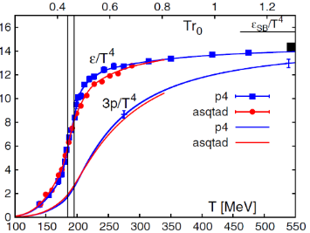
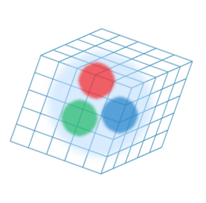
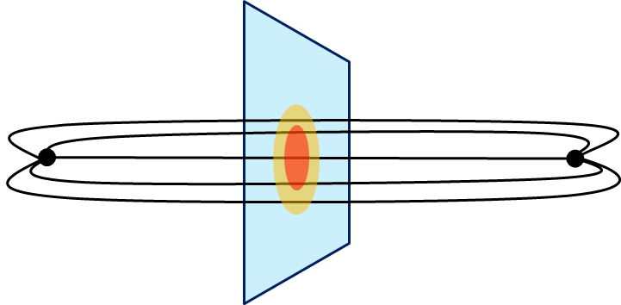
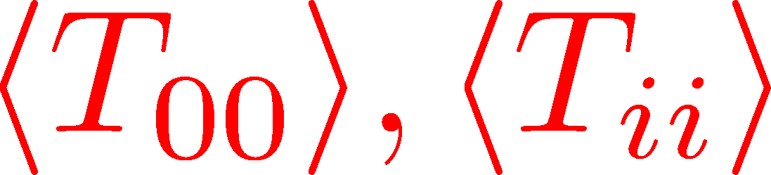
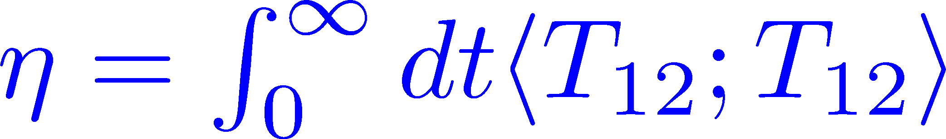
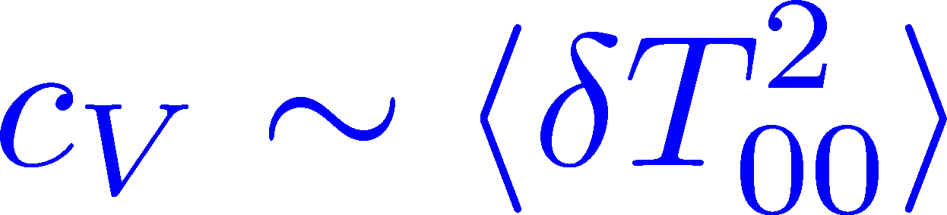
energy
momentum
pressure
stress
Thermodynamics
Fluctuations and
Correlations
Hadron Structure
direct measurement of
expectation values
flux tube / hadrons
stress distribution
viscosity, specific heat, ...

Slide 6

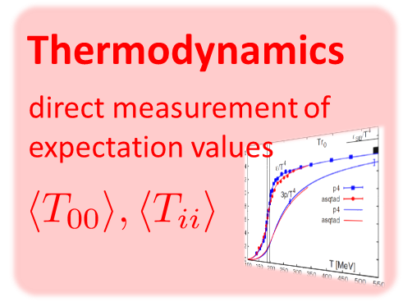
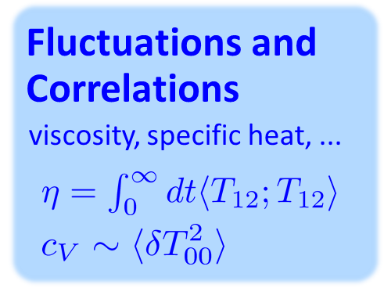
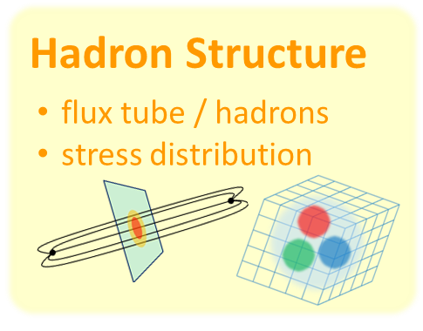
Contents
Constructing EMT on the lattice
Thermodynamics
Correlation Function
Stress distribution in qq system
Summary
ー

Slide 7




(Yang-Mills) Gradient Flow
Luscher 2010
Narayanan, Neuberger, 2006
Luscher, Weiss, 2011
t: “flow time”
dim:[length²]
leading
diffusion equation in 4-dim space
diffusion distance
“continuous” cooling/smearing

Slide 8
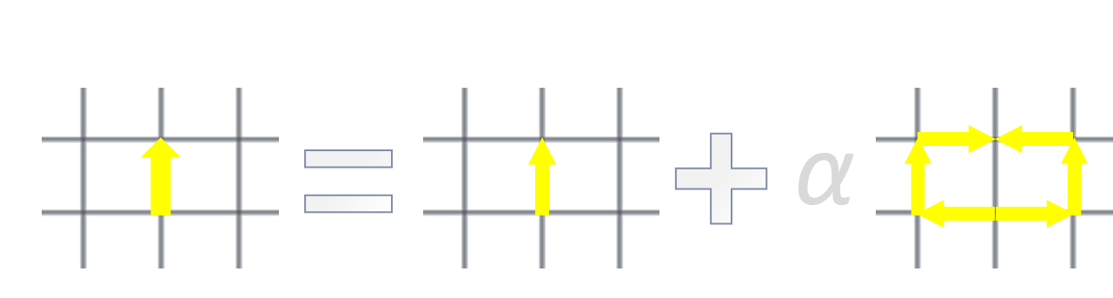
(Yang-Mills) Gradient Flow
Luscher 2010
Narayanan, Neuberger, 2006
Luscher, Weiss, 2011
t: “flow time”
dim:[length²]
leading
diffusion equation in 4-dim space
diffusion distance
“continuous” cooling/smearing

Slide 9
(YM) Gradient Flow: Properties
All (composite) operators are finite at t>0
Quite effective in reducing statistical error.
Flowed field ≠ original field
  Gradient flow is not an approximation method.
Applications
  scale setting
  topological charge/susceptibility
  Structure Func. / PDF
Luscher,Weisz,2011
All operators are renormalized at t>0
Safe a→0 limit

Slide 10
見小利則大事不成
Miss the wood for the trees
小利を見ればすなわち大事成らず
孔子
confucius
（論語、子路13）

Slide 11
見小利則大事不成
UV fluctuations
Physics
Miss the wood for the trees
小利を見ればすなわち大事成らず
孔子
confucius
（論語、子路13）

Slide 12



Gradient Flow for Fermions
Luscher, 2013
Makino, Suzuki, 2014
Taniguchi+ (WHOT) 2016
Not “gradient” flow but a “diffusion” equation.
Flow for gauge field is independent of fermion field.
Divergence in field renormalization of fermions.
All observables becomes finite once Z(t) is determined.

Slide 13




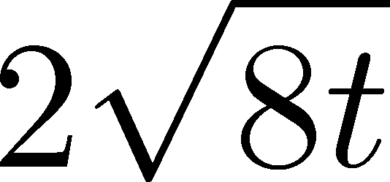
Small Flow-time Expansion
Luescher, Weisz, 2011
Suzuki, 2013
an operator at t>0
remormalized operators
of original theory
original 4-dim theory
t→0 limit

Slide 14


Constructing EMT
Suzuki, 2013
DelDebbio,Patella,Rago,2013
gauge-invariant dimension 4 operators

Slide 15



Constructing EMT 2
Suzuki, 2013
Suzuki coeffs.

Slide 16

Constructing EMT 2
Suzuki, 2013
Suzuki coeffs.
Remormalized EMT

Slide 17


EMT with Fermions
Makino, Suzuki, 2014

Slide 18
Contents
Thermodynamics
direct measurement of
expectation values
Constructing EMT on the lattice
Thermodynamics
Correlation Function
Stress distribution in qq system
Summary
ー

Slide 19
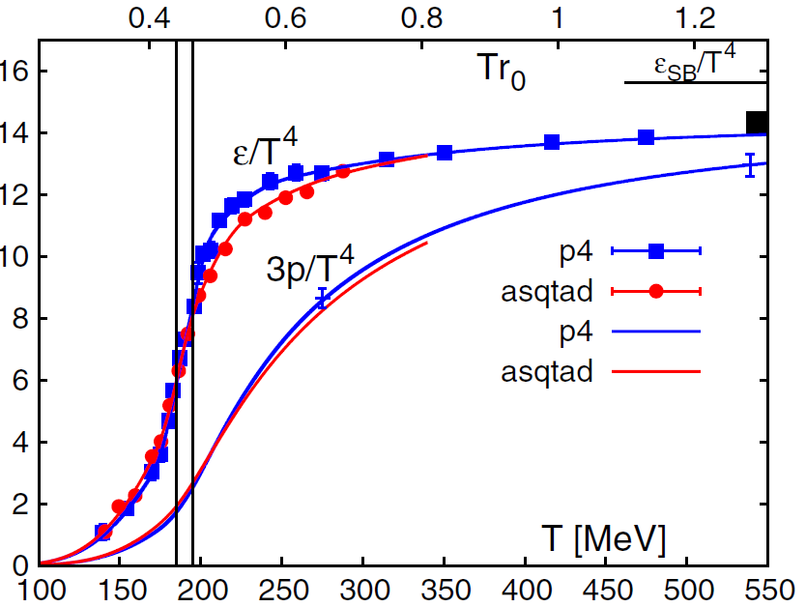
QCD EoS
(Energy Density, Pressure)
BNL-Bielefeld
2011
hadronic
QGP
Rapid increase of ε/T⁴ around T=150-200 MeV
Crossover transition
Low T: hadron resonance gas model / High T: perturbative QCD

Slide 20











QCD Thermodynamics
Statistical Mechanics
Changing lattice spacing
1/T and V change
e-3p

Slide 21


Integral Method
Boyd+ 1996
measurements of e-3p for many T
vacuum subtraction for each T
information on beta function

Slide 22


Numerical Simulation
MK+ (FlowQCD),
PRD94, 114512 (2016)
Expectation values of T_{μν}
SU(3) YM theory
Wilson gauge action
Parameters:
Scale from gradient flow
N_{t} = 12, 16, 20-24
aspect ratio 5.3<N_{s}/N_{t}<8
1500~2000 configurations
FlowQCD 1503.06516

Slide 23



t Dependence
clover+plaq
clover
: strong discretization effect
: over smeared
: Linear t dependence

Slide 24


Double Extrapolation
Continuum extrapolation
strong
discretization
effect
FlowQCD, 2014: continuum extrapolation only
WHOT-QCD, 2016: small t limit only
Note:

Slide 25

Double Extrapolation
Continuum extrapolation
strong
discretization
effect
Small t extrapolation
FlowQCD, 2014: continuum extrapolation only
WHOT-QCD, 2016: small t limit only
Note:

Slide 26

Double Extrapolation
Range2
Range1
Range3
Black line: continuum extrapolated
Fitting ranges:
  range-1:
  range-2:
  range-3:
Systematic error from the
choice of fitting range
≈ statistical error

Slide 27
T Dependence
FlowQCD, PRD, 2016
Error includes
statistical error
choice of t range for t→0 limit
uncertainty in aΛ_{MS}
Excellent agreement with integral method
High accuracy only with ~2000 confs.
total error <1.5% for T>1.1T_{c}

Slide 28
N_{f}=2+1 QCD Thermodynamics
Taniguchi+ (WHOT-QCD),
PRD96, 014509 (2017)
N_{f}=2+1 QCD, Iwasaki gauge + NP-clover
m_{PS}/m_{V} ≈0.63 / almost physical s quark mass
T=0: CP-PACS+JLQCD (ß=2.05, 28³x56, a≈0.07fm)
T>0: 32³xN_{t}, N_{t} = 4, 6, ... , 14, 16):
T≈174-697MeV
t→0 extrapolation only (No continuum limit)

Slide 29








Fermion Propagator
propagator of flow equation
Inverse propagator is needed
fermion field
t=0
gauge field

Slide 30
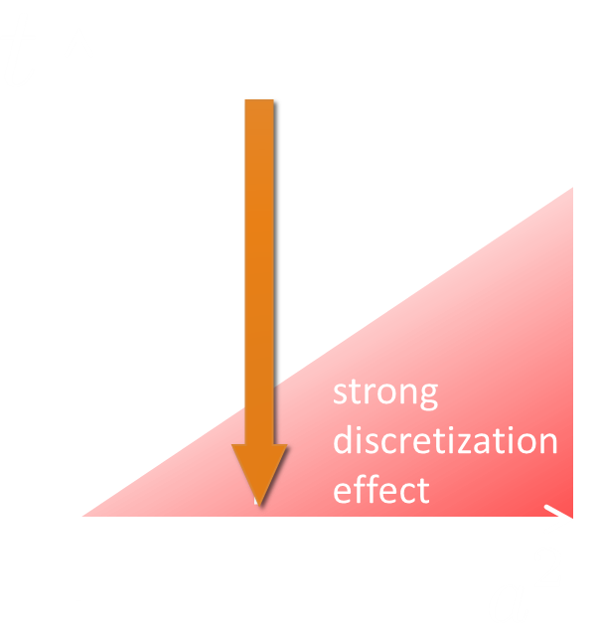


t→0 Extrapolation
Taniguchi+ (WHOT-QCD),
PRD96, 014509 (2017)
”linear window” for Nt>6
Checked: fit range, a²/t term

Slide 31
N_{f}=2+1 Thermodynamics
Taniguchi+ (WHOT-QCD),
PRD96, 014509 (2017)
no linear
window
Agreement with integral method except for N_{t}=4, 6
No stable extrapolation for N_{t}=4, 6
Suppression of statistical error
Physical mass: Kanaya+ (WHOT-QCD), 1710.10015

Slide 32

Chiral Condensate / Suceptibility
Taniguchi+ (WHOT-QCD),
PRD96, 014509 (2017)
Subtracted condensate
Chiral susceptibility
Chiral condensate decreases for T>Tc.
Chiral susceptibility has a sharp peak around T=Tc.

Slide 33
Contents
Fluctuations and
Correlations
Constructing EMT on the lattice
Thermodynamics
Correlation Function
Stress distribution in qq system
Summary
viscosity, specific heat, ...
ー

Slide 34


Why EMT Correlation Func.?
Kubo Formula: T₁₂ correlator ←→shear viscosity
Hydrodynamics describes long range behavior of T_{μν}
Energy fluctuation ←→specific heat

Slide 35


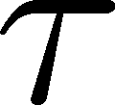
EMT Correlator: Extremely Noisy…
With naïve EMT operators
Nakamura, Sakai, PRL,2005
N_{t}=8
improved action
~10⁶ configurations
Nt=16
standard action
5x10⁴ configurations
… no signal

Slide 36








Conservation Law
τ independent constant

Slide 37





Linear Response Relations
Specific heat
entropy density
enthalpy density
Giusti, Meyer, 2011
Minami, Hidaka, 2012
Derivation

Slide 38
Numerical Simulation
FlowQCD, arXiv:1708.01415
SU(3) pure gauge
Wilson gauge action / clover operator
Ns/Nt=4
Statistics: 18-20x10⁴
β | T=1.66T_{c} | T=2.22T_{c}
48³x12 | 6.719 | 6.943
64³x16 | 6.941 | 7.170
96³x24 | 7.265 | 7.500
on Bluegene/Q @KEK

Slide 39




Euclidean Correlator @T=2.24Tc
FlowQCD, arXiv:1708.01415
τ-independent plateau in all channels ➔ conservation law
small τ region: artificial enhancement due to overlap of operators
linear response relations for 4411, 4141 channels

Slide 40



Mid-Point Correlator @T=2.24Tc
(44;11), (41;41) channels : confirmation of LRR
(44;44) channel: new measurement of c_{V}
2+1 QCD:
Taniguchi+ (WHOT-QCD),
1711.02262

Slide 41
Contents
Hadron Structure
flux tube / hadrons
stress distribution
Constructing EMT on the lattice
Thermodynamics
Correlation Function
Stress distribution in qq system
Summary
ー

Slide 42


Stress
Pressure
force on a surface
per unit area

Slide 43
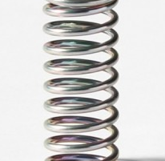

Stress
Pressure
Stress
Generally, F and n are not parallel
v
F
force on a surface
per unit area
Stress Tensor

Slide 44


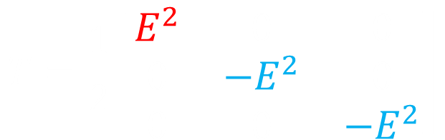
Maxwell Stress
E
$$T=\frac{1}{2}\left[\begin{matrix}E^{2} & 0 & 0 \\ 0 & −E^{2} & 0 \\ 0 & 0 & −E^{2}\end{matrix}\right]$$
Parallel to field: Attractive
Vertical to field: Repulsive

Slide 45

Maxwell Stress
Coulomb
force
E
Parallel to field: Attractive
Vertical to field: Repulsive
attractive eigenvector
(≈Line of electric field)

Slide 46
q-qbar System in YM Theory
＝Flux Tube Formation
Linear potential
Color electric field is
confined into a flux tube
Previous Studies
action density
color electric field
(color electric field)²
This Study: stress
gauge invariant!
definite physical meaning!
establish action thr. medium

Slide 47
Stress Distribution in qq System
R. Yanagihara+ (FlowQCD)
to appear soon!
beta=6.819 (a=0.029fm)
R/a=16
t→0 limit
No continuum limit
Preliminary
First visualization of
distortion in space
due to color charges
attractive eigenvector

Slide 48
Stress Distribution in qq System
R. Yanagihara+ (FlowQCD)
to appear soon!
Yang-Mills SU(3)
Maxwell

Slide 49
Stress Distribution in qq System
R. Yanagihara+ (FlowQCD)
to appear soon!
qq force?
Yang-Mills SU(3)
Maxwell
Don’t miss
Yanagihara’s talk
this afternoon
New insights into physics of confinement

Slide 50



Summary
EMT operator on the lattice is now available!
  Correctly renormalized operator
  Statistical error is suppressed thanks to gradient flow.
The operator is applied to various analyses:
Many future studies
transport coefficient
EM/stress distribution in hadrons
Flux tube: T dependence

Slide 51

EMT (Naïve Constructuion)
Z₁, Z₂, Z₃ have to be determined non-perturbatively.
Accurate determinations of Z₁, Z₃: Giusti, Pepe, 2014-; BW, 2016
So far, only for pure gauge theory
  multi-level algorithm

Slide 52



Gradient Flow Method
lattice regularized
gauge theory
gradient flow
measurement
on the lattice
continuum theory
(with dim. reg.)
continuum theory
(with dim. reg.)
analytic
(perturbative)
gradient flow

Slide 53


Caveats
Gauge field has to be sufficiently smeared!
lattice regularized
gauge theory
gradient flow
Perturbative relation has to be applicable!
measurement
on the lattice
continuum theory
(with dim. reg.)
continuum theory
(with dim. reg.)
analytic
(perturbative)
gradient flow

Slide 54

Caveats
Gauge field has to be sufficiently smeared!
lattice regularized
gauge theory
gradient flow
Perturbative relation has to be applicable!
measurement
on the lattice
continuum theory
(with dim. reg.)
continuum theory
(with dim. reg.)
analytic
(perturbative)
gradient flow

Slide 55
Topological Charge

