Slide 1
On the Efficiency Correction for non-Binomial Efficiency Loss
Masakiyo Kitazawa
2017.12.11, Tsukuba U.

Slide 2
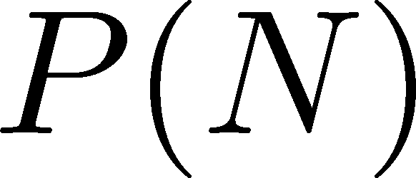
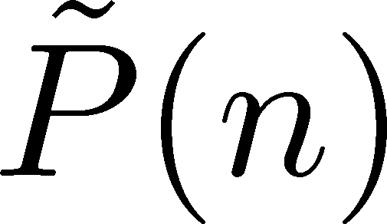
Efficiency Correction
N injected
particles
detector
n observed
particles
Efficiency correction problem:
Construct cumulants of N from distribution of n.

Slide 3
Binomial Model
Bialas, Peschanski, 1986
MK, Asakawa, 2012;
Bzdak, Koch, 2012, 2015;
MK, 2016;
Nonaka, MK, Esumi, 2017
B: binomial distribution funciton
Analytic formulas for efficiency correction
The model is valid when efficiency is independent for individual particles.
Not perfectly applicable to real detectors.
Estimate on non-binomial correction would be crucial for estimating systematic errors reliably.

Slide 4
Why Binomial Model so Useful?
Simple relation b/w factorial cumulants
quite useful in reducing numerical
cost for many efficiency bins
Nonaka, MK, Esumi, 2017
Cumulants of n are proportional to N
Short efficiency correction formula can
be obtained (with a hard algebra)
cumulant of binomial
(with fixed B)
MK, 2016

Slide 5
How to deal with non-binomial efficiency?
Unfolding methods
large phase space / large numerical cost / estimate on convergence, systematics …
Can we perform unfolding only by cumulants?
Use specific distributions?
hypergeometric func., etc.
no a priori justification

Slide 6
My Suggestion 1: New Formula
When B(n;N) satisfies the following property
cumulant of B
We can obtain efficiency correction formula!
(Cumulants of N can be represented by cumulants of n)
Costs are the same order as MK2016.

Slide 7
Example: Hypergeometric Dist.
draw N balls
Probability to find n black balls
P(n;N,X,M)
X black balls among
M total balls
Is this distribution a proxy of experimental detectors??

Slide 8
Formulas: Single Variable Case
Binomial
model:

Slide 9
My Suggestion 2: Understand Your Detector
can be obtained by your
Monte-Carlo simulator
Check validity of the binomial model
When f_{m}(N) are linear functions
→ use efficiency correction formula in MK2016.
Non-linearity can be (in part) included by the new formulas.

Slide 10
Some Comments…
Non-Binomial effects would be estimated perturbatively.
What is the efficiency? I actually do not understand this concept.

