Slide 1
Search for QCD Critical Point at J-PARC Heavy-Ion Program
Masakiyo Kitazawa
(Osaka U.)
REIMEI Workshop, J-PARC, Tokai, Dec. 13, 2017

Slide 2
Search for QCD Critical Point at J-PARC Heavy-Ion Program
Masakiyo Kitazawa
(Osaka U.)
Two topics covered in this talk
J-PARC Heavy-Ion Program
Exp. Search for QCD-CP with fluctuations
REIMEI Workshop, J-PARC, Tokai, Dec. 13, 2017

Slide 3
Beam-Energy Scan
T
Hadrons
Color SC
0
μ

Slide 4

Beam-Energy Scan
STAR 2012
high
beam energy
T
low
Hadrons
Color SC
0
μ
Search for QCD phase structure
/ critical point

Slide 5
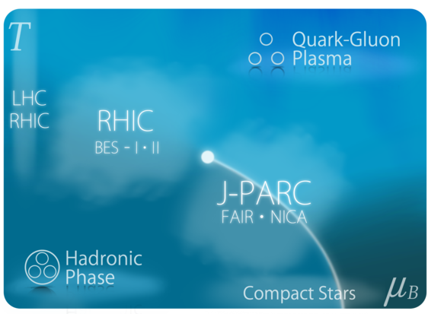
J-PARC Heavy-Ion Program
(J-PARC-HI)

Slide 6
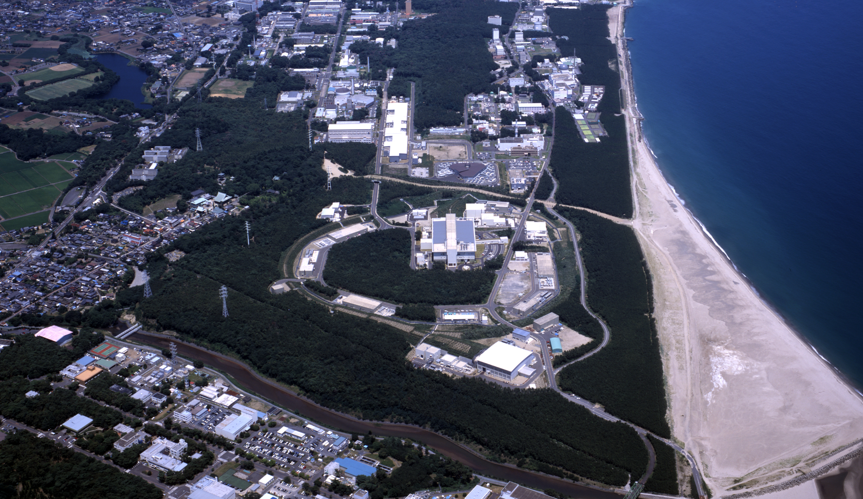
J-PARC-HI
J-PARC = Japan Proton Accelerator Research Complex
J-PARC-HI = J-PARC Heavy-Ion Program
Beam energy: ~20GeV/A (√s~6.2GeV)
Fixed target experiment
High luminosity: collision rate ~10⁸Hz
Launch: (hopefully) 2025~
White paper / Letter of Intent (2016)
  http://asrc.jaea.go.jp/soshiki/gr/hadron/jparc-hi/

Slide 7
HI Acceleration @ J-PARC
J-PARC Heavy Ion
Spectrometer
New HI Injector
high intensity
RCS & Main Ring
stable
well established
Use of reliable / high-performance RCS & main ring
→Reduce cost and time for construction

Slide 8
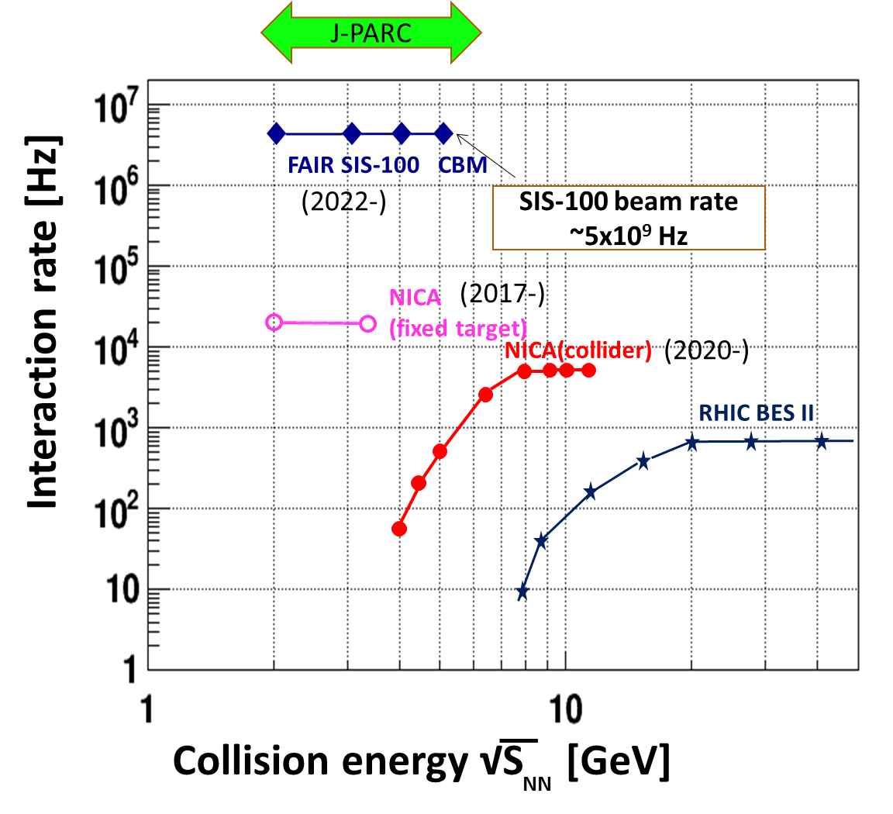
Collision Rate
J-PARC-HI:
High-luminosity x Fixed target
→World highest rate～10⁸Hz
J-PARC-HI
5-order higher than AGS,SPS
SPS
AGS
AGS, SPS
1 year
J-PARC-HI
5 min.
＝
High-statistical exp.
higher order correlations
various event selections
search of rare events

Slide 9
Beam-Energy Scan
T, μ from particle yield
Translation to baryon density
J-PARC-HI
STAR,2012
J-PARC energy = highest baryon density

Slide 10



Maximum Density
Time evolution in T-ρ plane by JAM
A. Ohnishi, 2002
Maximum density 5~10ρ₀ @ J-PARC energy
Large event-by-event fluctuations?

Slide 11



Maximum Density Scan?
Large event-by-event fluctuations even after fixed centrality / collision energy
If we can select events,
“maximum density” dependence
can be studied experimentally.
average transverse energy
non-monotonic
behavior
as evidence of 1st. tr?
Baryon-rich events
Beam-energy scan
(no event selection)
faster
increase
Baryon-rich
events

Slide 12
Search of Rare Events
Exotic
Hadrons
High density
High luminosity
High strange yield
Hypernuclei
Rare-event
Factory
Strangelets
hadron
Interaction
creation
properties
interaction

Slide 13
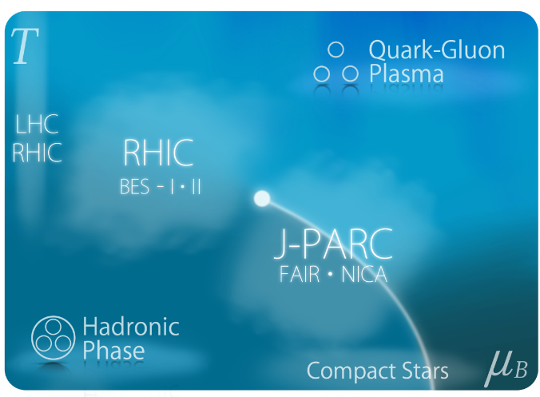
Future Plan
Recent activities:
June 2016
July 2016
Aug. 2016
Sep. 2016
White Paper uploaded
Submission of LOI
International Workshop
Symposium @ JPS meeting
Visit J-PARC-HI Web Page
http://asrc.jaea.go.jp/soshiki/gr/hadron/jparc-hi/
Future plan:
2020
2021
2021-2022
2021-2023
2023-2024
2025
Funding request to MEXT
Earliest approval of funding
Construction of HI Injector
Construction of HI injection system in RCS
Construction of HI spectrometer
First collision

Slide 14
Search for QCD Critical Point
with Fluctuations
Sakaida, Asakawa, Fujii, MK, Phys. Rev. C95, 064509 (2017)
Asakawa, MK, Prog. Part. Nucl. Phys. 90, 299 (2016)
Ohnishi, MK, Asakawa, Phys. Rev. C94, 044905 (2016)
MK, Nucl. Phys. A942, 65 (2015)
MK, Asakawa, Ohno, Phys. Lett. B728, 386 (2014)

Slide 15


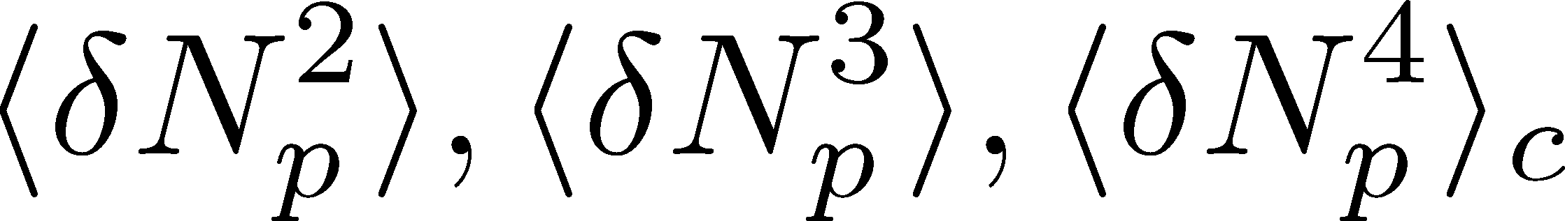
Event-by-Event Fluctuations
Review: Asakawa, MK, PPNP 90 (2016)
Fluctuations can be measured by e-by-e analysis in experiments.
STAR, PRL105 (2010)
Detector
Cumulants

Slide 16


A Coin Game
Bet 500YEN
You get head coins of
A. 20 x 50YEN
B. 10 x 100YEN
Same expectation value.

Slide 17
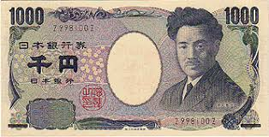
A Coin Game
Bet 500YEN
You get head coins of
A. 20 x 50YEN
B. 10 x 100YEN
C. 1 x 1000YEN
Same expectation value.
But, different fluctuation.

Slide 18


Higher-Order Cumulants
STAR Collab.
2010~
Enhancement
Non-zero non-Gaussian cumulants
have been established!
Have we measured critical fluctuations?

Slide 19
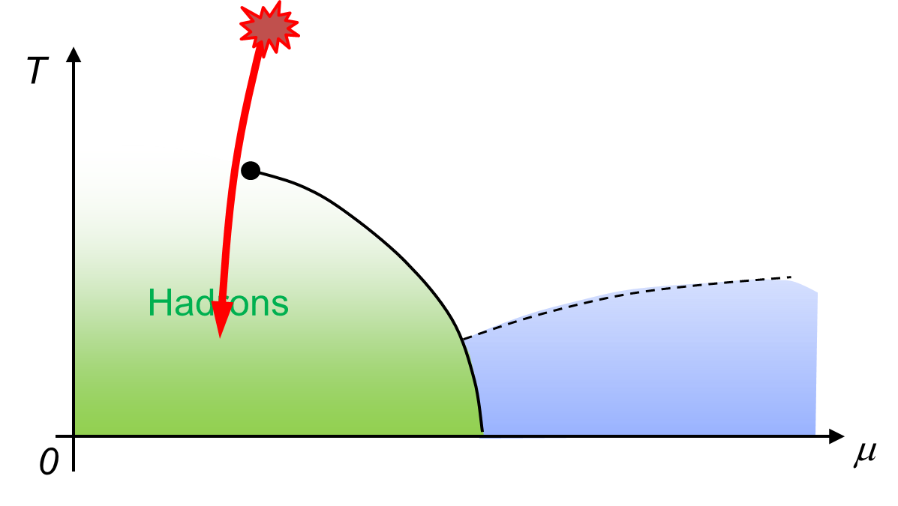
Remarks on Fluctuations in HIC
Experiments cannot observe
critical fluctuation in equilibrium directly.
Growth
Critical fluctuation has to be well developed.
But, relaxation toward equilibration is slow around CP because of the critical slowing down.
Decay by diffusion
Fluctuations developed at CP are modified by the time evolution in later stage.

Slide 20

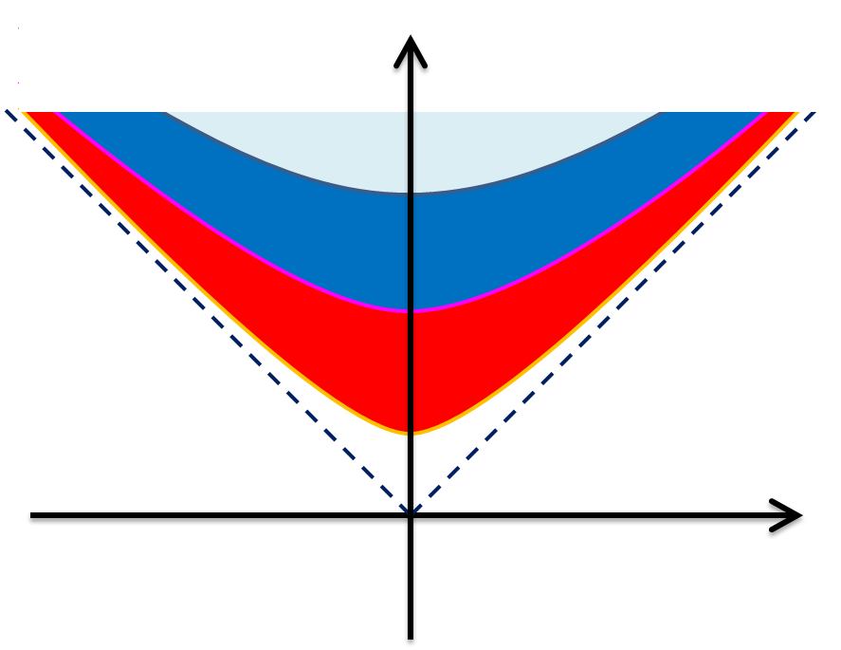



Time Evolution of Fluctuations
Hadronic
QGP
Diffusion modifies distribution

Slide 21
Diffusion in Hadronic Stage

Slide 22


(Non-Interacting) Brownian Particle Model
Initial condition (uniform)
cumulants:
random
walk
diffusion master equation: MK+, PLB(2014)
probabilistic argument: Ohnishi+, PRC(2016)

Slide 23



(Non-Interacting) Brownian Particle Model
Initial condition (uniform)
cumulants:
diffusion
distance
random
walk
Study ΔY dependence
Poisson distribution
diffusion master equation: MK+, PLB(2014)
probabilistic argument: Ohnishi+, PRC(2016)

Slide 24



Baryons in Hadronic Phase
time
chem. f.o.
hadronize
10~20fm
kinetic f.o.
Baryons behave like
Brownian pollens in water
mesons
baryons

Slide 25
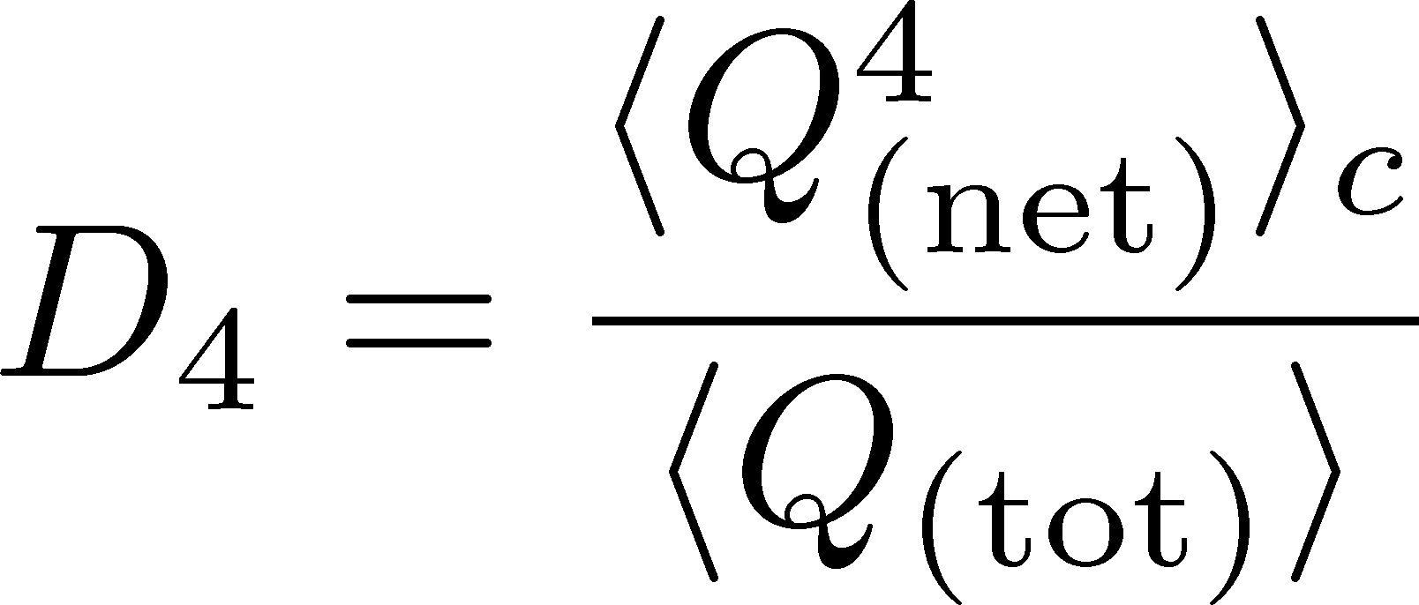






Rapidity Window Dep.
Initial Conditions
4th-order cumulant
MK+, 2014
MK, 2015
Different initial conditions give rise to different characteristic Δη dependence.
Non-monotonic behaviors can appear in Δη dependence.
Finite volume effects: Sakaida+, PRC90 (2015)

Slide 26

Rapidity Window Dep.
Initial Conditions
4th-order cumulant
MK+, 2014
MK, 2015
STAR Collab. (X. Luo, CPOD2014)
Different initial conditions give rise to different characteristic Δη dependence.
Non-monotonic behaviors can appear in Δη dependence.
Finite volume effects: Sakaida+, PRC90 (2015)

Slide 27
Dynamical Evolution
near QCD Critical Point

Slide 28
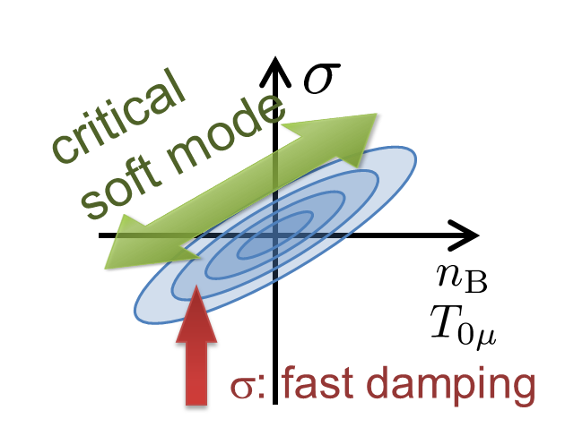
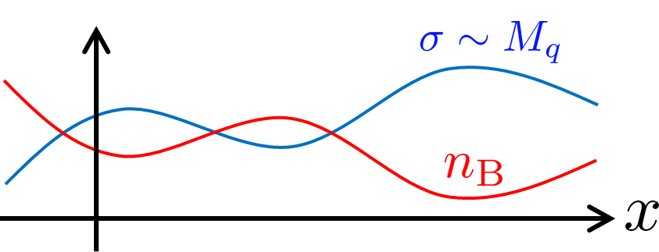
Growth and Decay of Critical Fluc.
Previous studies: uniform σ mode
Berdnikov, Rajagopal (2000)
Asakawa, Nonaka (2002)
Mukherjee+ (2015)
Recent Developments:
Kapusta, Torres-Rincon (2012)
Nahrgang, Herold+ (2014~)
Song+ (2016~)
Problems:
  The soft mode of QCD-CP is a conserved mode
  Sigma mode is not directly observable
Fujii (2003)
Son, Stephanov (2004)

Slide 29
Aim of This Study
Describe conserved nature of critical fluctuation.
We want to study experimental observables.
  focus on a conserved charge (baryon number)
  study evolution of conserved-charge fluctuation
Concentrate on 2nd order fluctuation. (not higher)
We study
  rapidity window denepdence of the cumulant
  2-particle correlation function in rapidity space
Our Main Conclusion
Non-monotonicity in 2nd-order
cumulants or correlation func.
➔
Signal of
QCD-CP

Slide 30
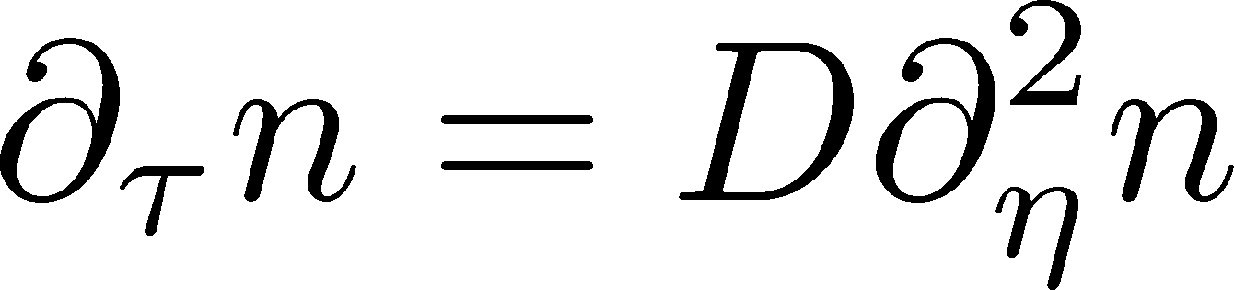

Stochastic Diffusion Equation (SDE)
Diffusion equation
Describe a relaxation of a conserved density n toward uniform state without fluctuation
Stochastic diffusion equation
Describe a relaxation toward fluctuating uniform state
χ: susceptibility (fluctuation in equil.)
Review: Asakawa, MK, PPNP 90 (2016)

Slide 31
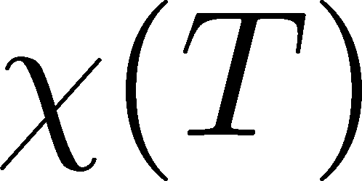

Parametrizing D(τ) and χ(τ)
Sakaida+, 2017
Critical behavior
(critical point)
3D Ising (r,H)
model H
Temperature dep.
critical
slowing
down
critical
enhancement

Slide 32


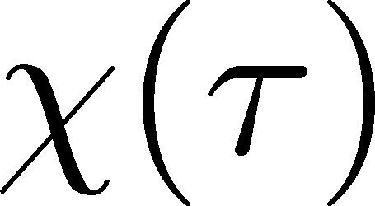
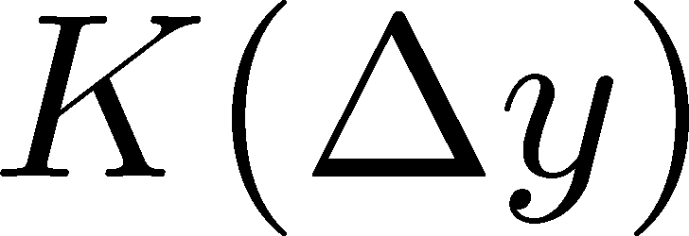
Crossover / Cumulant
ALICE
PRL 2013
monotonically decresing
Analytic
result
monotonically
increasing
monotonically
decreasing

Slide 33
Critical Point / Cumulant
Sakaida+, 2017
non-monotonic Δy dep.
Analytic
result
non-monotonic
non-monotonic

Slide 34

Crossover / Correlation Func.
monotonically decresing
Analytic
result
monotonically
increasing
monotonically
decreasing

Slide 35
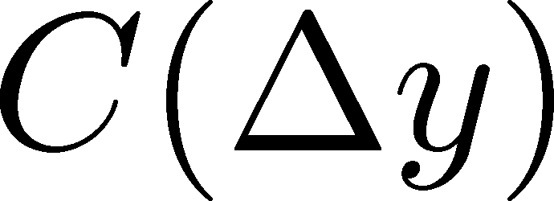
Criticap Point / Correlation Func.
Sakaida+, 2017
non-monotonic Δy dep.
Analytic
result
non-monotonic
non-monotonic

Slide 36
Summary
Fluctuations observed in HIC are not in equilibrium.
Non-equil. property can be understood from Δy dependence of cumulants.
A simple diffusion model leads to non-monotonic Δy dependence of higher order cumulant.
Non-monotnic Δy dependence of 2nd order cumulant is a signal of QCD critical point.
Detailed understanding on fluctuations can be obtained from Δy dependences of various cumulants!
Future experiments will give us many useful information on QCD phase structure!

Slide 37
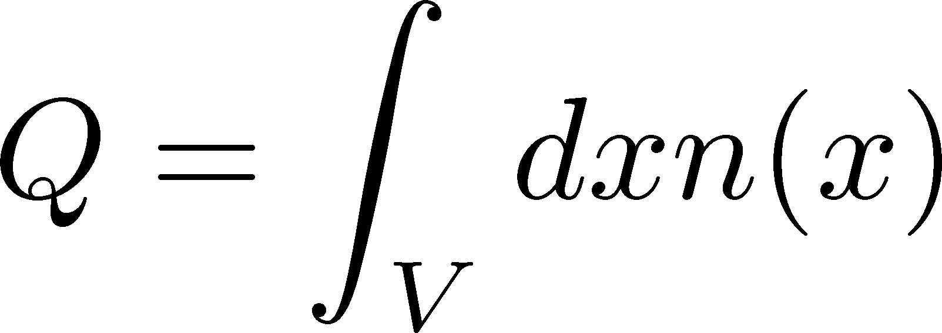
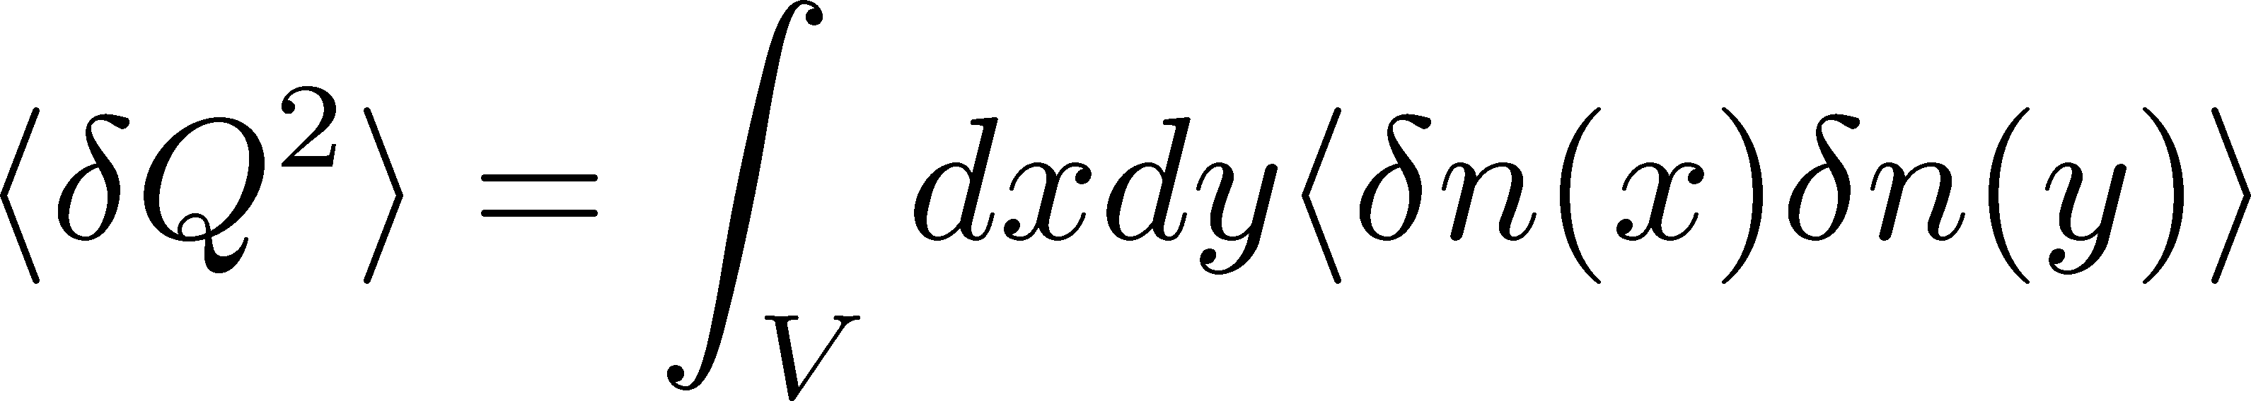
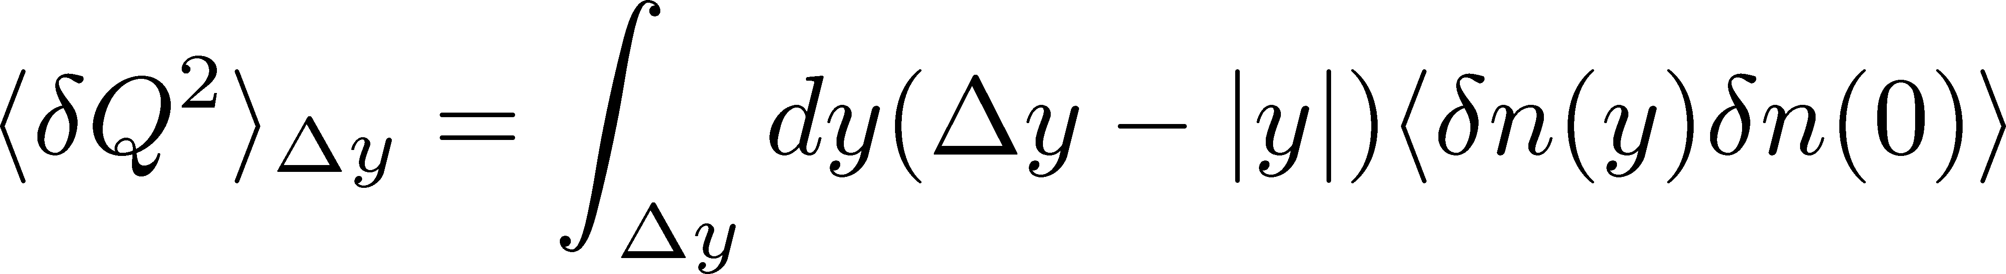
Cumulants and Correlation Function
total charge
charge density
2nd order cumulant
(fluctuation)
correlation function
1-to-1 correspondence
1-dim case

Slide 38
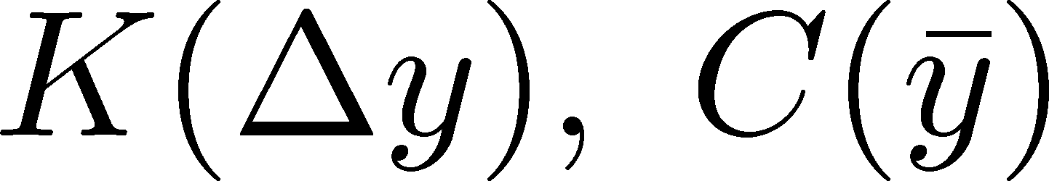
Weaker Critical Enhancement
Sakaida+, 2017
Non-monotonicity in K(Δy) disappears.
But C(y) is still non-monotonic.
Analytic
result
no information on
monotonic
C(y) is better to see non-monotonicity.

Slide 39
Away from the CP
Sakaida+, 2017
Signal of the critical enhancement can be clearer on a path away from the CP.
Away from the CP → Weaker critical slowing down

Slide 40
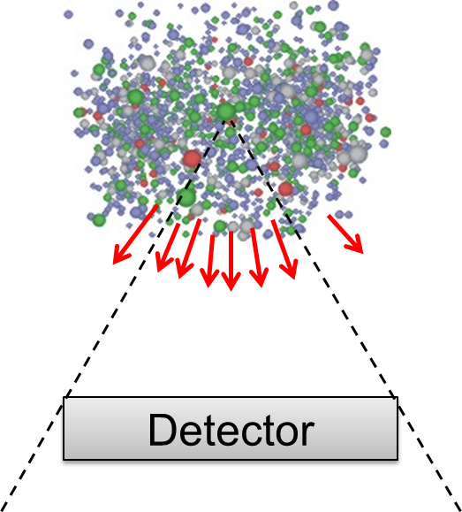
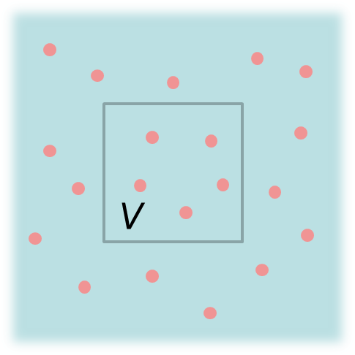
Fluctuations: Theory vs Experiment
Theoretical analyses
based on statistical mechanics
Experiments
lattice, critical point,
effective models, …
Fluctuation in
a spatial volume
Fluctuations in
a momentum space
discrepancy in phase spaces
Asakawa, Heinz, Muller, 2000; Jeon, Koch, 2000; Shuryak, Stephanov, 2001

Slide 41
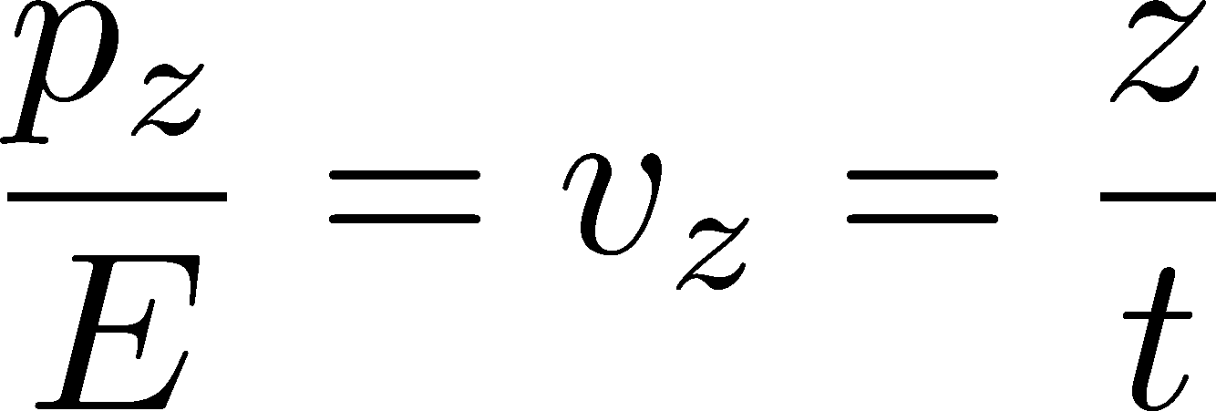





Thermal Blurring
Ohnishi, MK, Asakawa,
PRC94, 044905 (2016)
Under Bjorken picture,
coordinate-space rapidity Y
momentum-space rapidity y
of medium
momentum-space rapidity y
of individual particles

Slide 42
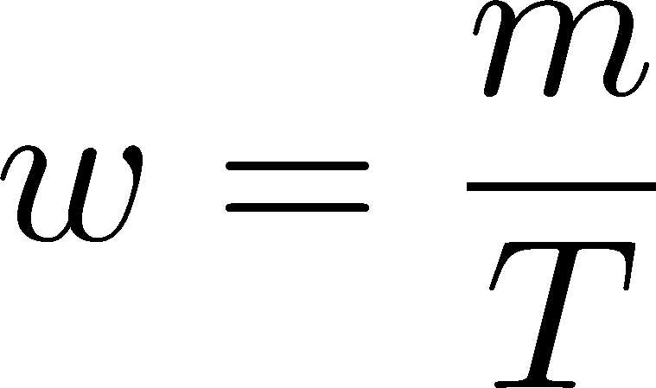


Thermal distribution in y space
Ohnishi, MK, Asakawa,
PRC94, 044905 (2016)
nucleon
pions
nucleons
pion
half-width (Δy)
blast wave
flat freezeout surface

Slide 43
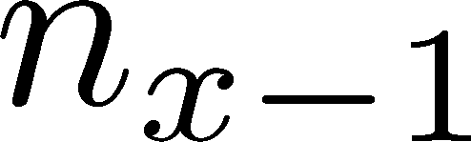






Diffusion Master Equation
MK, Asakawa, Ono, 2014
MK, 2015
Divide spatial coordinate into discrete cells
probability

Slide 44
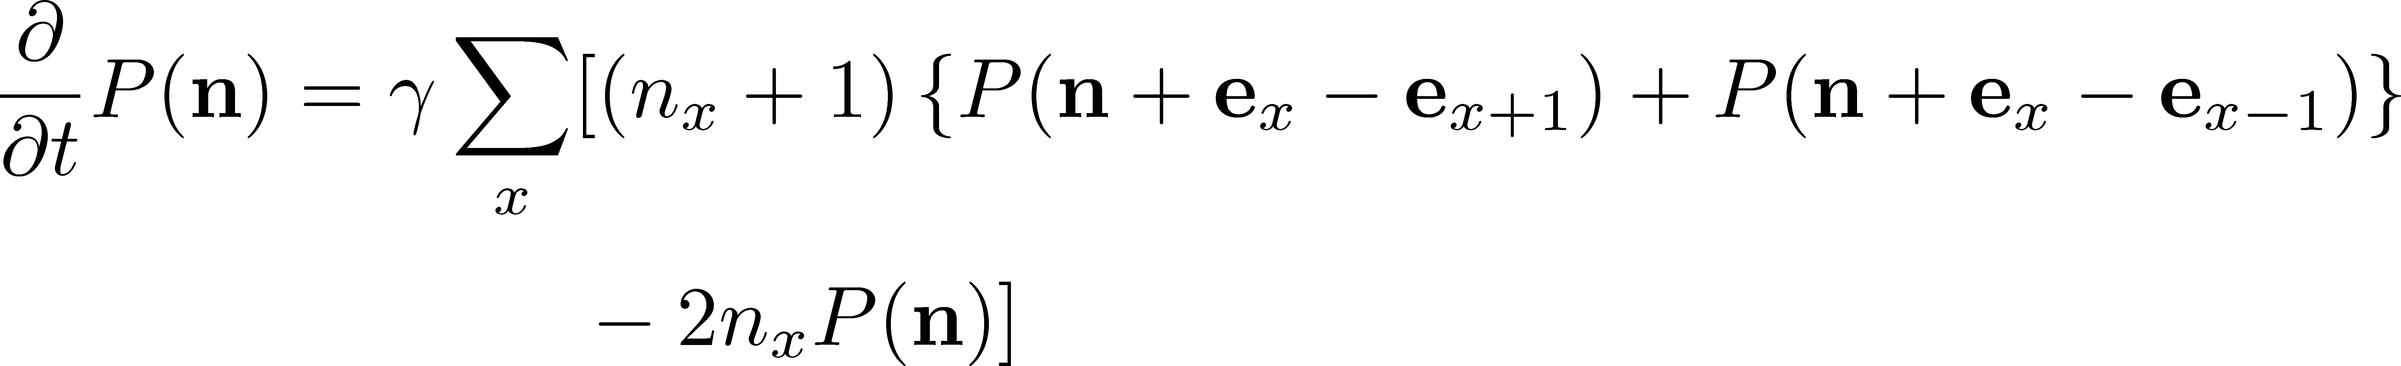
Diffusion Master Equation
MK, Asakawa, Ono, 2014
MK, 2015
Divide spatial coordinate into discrete cells
probability
Master Equation for P(n)
Solve the DME exactly, and take a→0 limit
No approx., ex. van Kampen’s system size expansion

Slide 45




AGS
-1996
SPS
1994-2000
RHIC
2000-
LHC
2010-
RHIC-BES
2010-
creation of quark-gluon plasma,
strongly-interacting QGP
FAIR
2022-?
NICA
2017-
~2010
History of HIC = increasing energy
2010~
Beam-energy scan
Low-energy exp.
Heavy-Ion Collisions
J-PARC-HI
2025~?
2-6.2 GeV

Slide 46

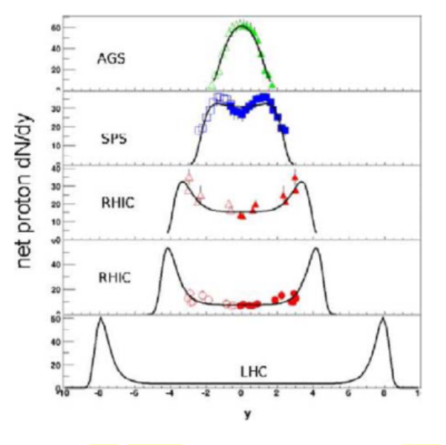



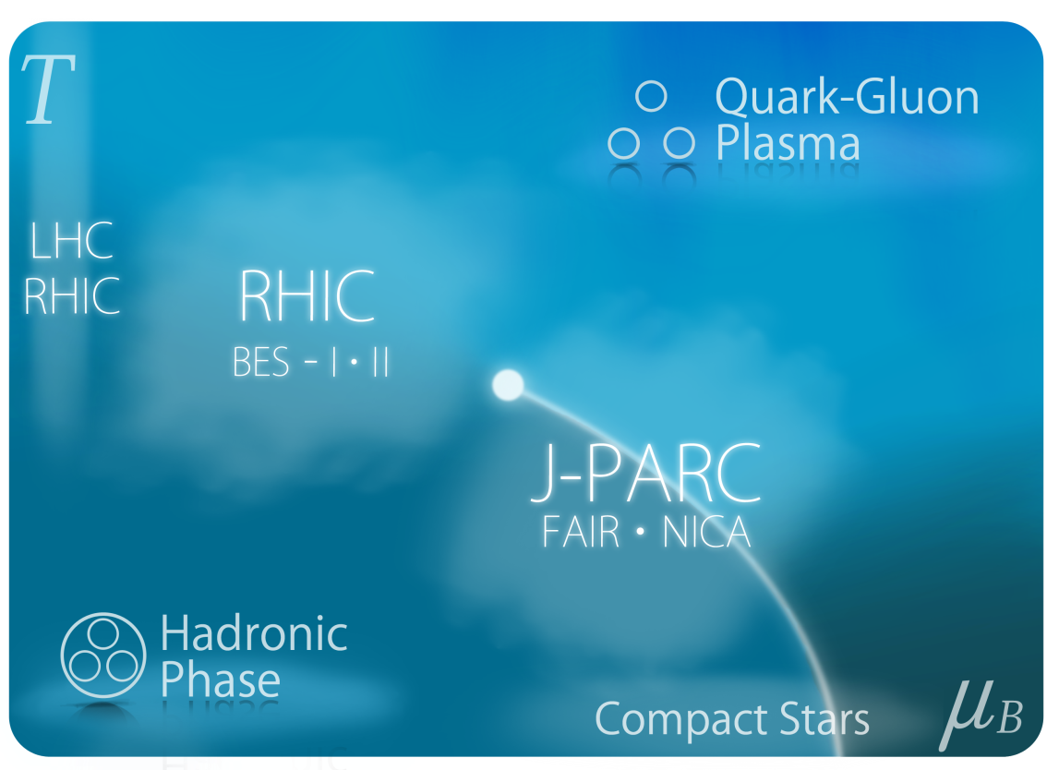

Baryon Stopping
rapidity dep. of net-proton #
Baryons stop at collision point
stopping
Baryons pass through
transparency
rapidity
phase diagram from
J-PARC White Paper

Slide 47
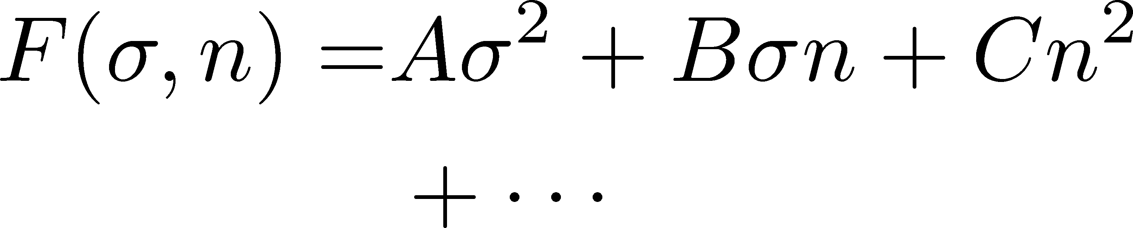

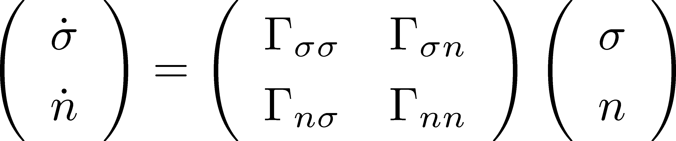

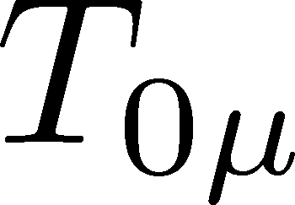
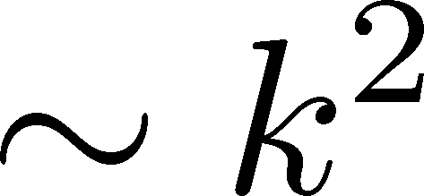
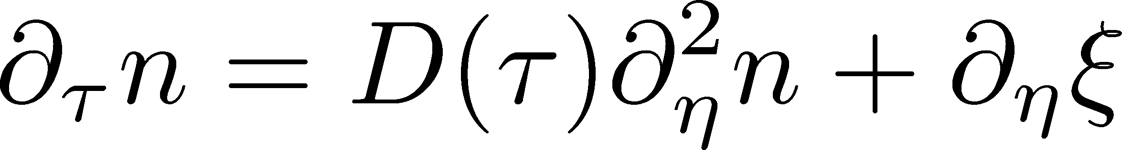

Soft Mode of QCD Critical Point
Fujii 2003; Fujii, Ohtani, 2004; Son, Stephanov, 2004
Effective potential
critical
soft mode
Time dependent Ginzburg-Landau
σ: fast damping
For slow and
long wavelength,
SDE
singularities in

Slide 48
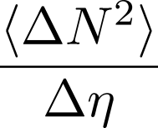




Time Evolution of Fluctuations
Quark-Gluon Plasma
Hadronization
Freezeout
Variation of a conserved charge is achieved only through diffusion.
The larger Δη,
the slower diffusion

Slide 49

Δη Dependence @ ALICE
ALICE
PRL 2013
hadronic
D-measure
D ~ 3-4 Hadronic
D ~ 1-1.5 Quark
t
Δη
rapidity window
z

Slide 50
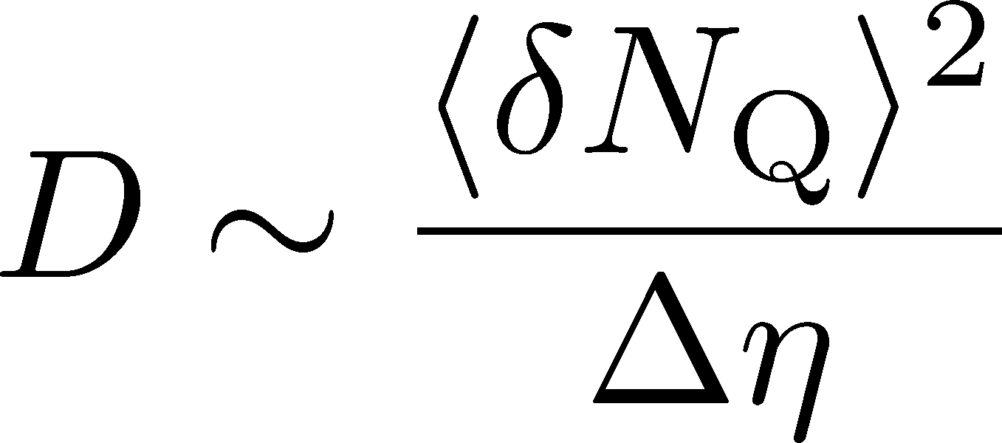
Δη Dependence @ ALICE
hadronic
has to be a constant
in equil. medium
Fluctuation of N_{Q}
at ALICE is not the
equilibrated one.
rapidity window

