Slide 1
Exploring QCD Phase Structure in Heavy-Ion Collisions
Masakiyo Kitazawa
(Osaka U.)
J-PARC分室活動総括研究会
J-PARC、2018年2月2日

Slide 2
Keywords
QCD at nonzero T/μ
  quark-gluon plasma
  chiral transition
  QCD critical point / 1st order phase transition
Relativistic heavy-ion collisions
  beam-energy scan
  J-PARC heavy-ion program
  Modelling dynamics of low-E collisions

Slide 3
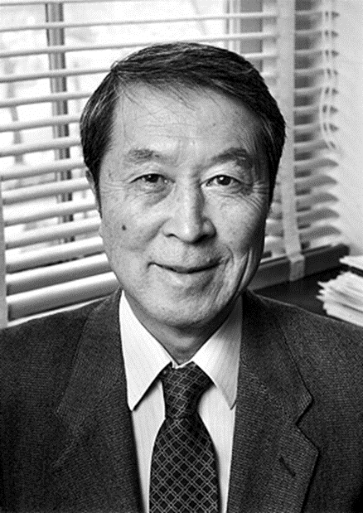




QCD Phase Diagram
T
Early Universe
Quark-Gluon Plasma
150MeV
ＱＣＤ Critical Point
Hadron Phase
(confined)
Color SC
Compact
Stars
Lattice QCD
~10¹⁵g/cm³
μ
Our Universe

Slide 4
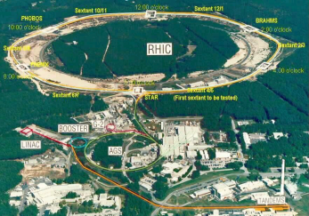
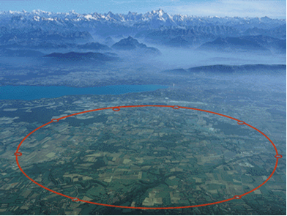

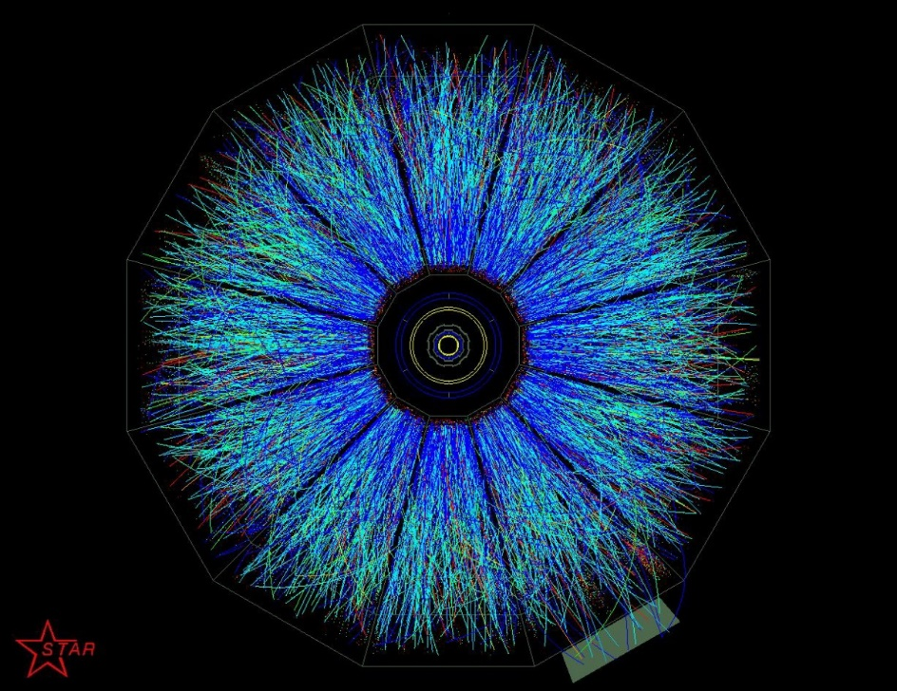
Relativistic Heavy-ion Collisions
Accelerate heavy ions
by accelerators such as,
Then, collisions take
place, llike
And QGP is formed around here
Many particles are created like this.
We study QGP from this exp. data.

Slide 5

Accelerator Experiments
For the search of
new particles
proton
proton
To create the early
Universe
LHC – Large Hadron Collider

Slide 6
Recent Hot Topics in HIC
Beam-energy scan
  search for QCD-CP / 1st transition
chiral magnetic effect
  isobaric collisions A=96 (₄₄Ruthenium/₄₀Zirconium)
small systems
  Is QGP formed in pp, pA collisions?

Slide 7
Beam-Energy Scan
T
high
Quark-Gluon Plasma
beam energy
150MeV
ＱＣＤ Critical Point
low
Hadron Phase
(confined)
Color SC
~10¹⁵g/cm³
μ
Our Universe

Slide 8
Beam-Energy Dependence

Slide 9
Beam-Energy Dependence
High energy
Low energy
Nuclear transparency
Baryon stopping
net-baryon #: small
net-baryon #: large

Slide 10
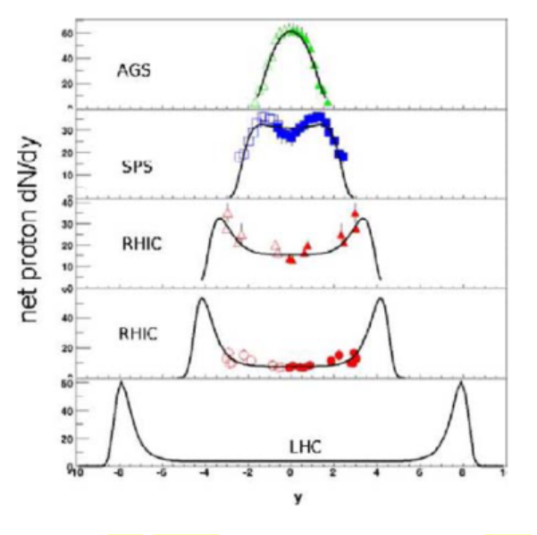





Baryon Stopping
rapidity dep. of net-proton #
stopping
Baryons stop at collision point
transparency
Baryons pass through
rapidity

Slide 11

Beam-Energy Scan
T, μ from particle yield
Translation to baryon density
J-PARC-HI
STAR,2012
J-PARC energy = highest baryon density

Slide 12



Maximum Density
Time evolution in T-ρ plane by JAM
A. Ohnishi, 2002
Maximum density 5~10ρ₀ @ J-PARC energy
Large event-by-event fluctuations?

Slide 13




AGS
-1996
SPS
1994-2000
RHIC
2000-
LHC
2010-
RHIC-BES
2010-
creation of quark-gluon plasma,
strongly-interacting QGP
FAIR
2022-?
NICA
2025-?
~2010
History of HIC = increasing energy
2010~
Beam-energy scan
Low-energy exp.
Heavy-Ion Collisions
J-PARC-HI
2025~?
2-6.2 GeV

Slide 14
HI Acceleration @ J-PARC
J-PARC Heavy Ion
Spectrometer
New HI Injector
high intensity
RCS & Main Ring
stable
well established
Use of reliable / high-performance RCS & main ring
→Reduce cost and time

Slide 15
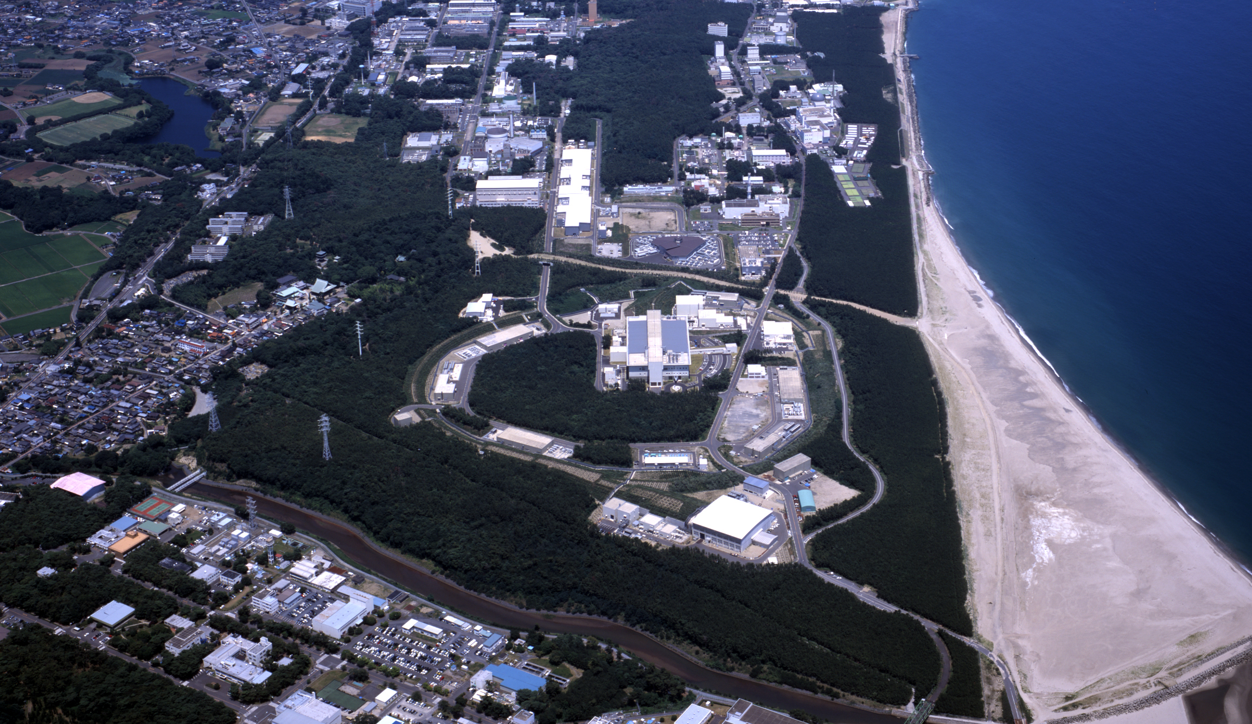
J-PARC-HI
J-PARC = Japan Proton Accelerator Research Complex
J-PARC-HI = J-PARC Heavy-Ion Program
Beam energy: ~20GeV/A (√s~6.2GeV)
Fixed target experiment
High luminosity: collision rate ~10⁸Hz
Launch: (hopefully) 2025~
White paper / Letter of Intent (2016)
  http://asrc.jaea.go.jp/soshiki/gr/hadron/jparc-hi/

Slide 16
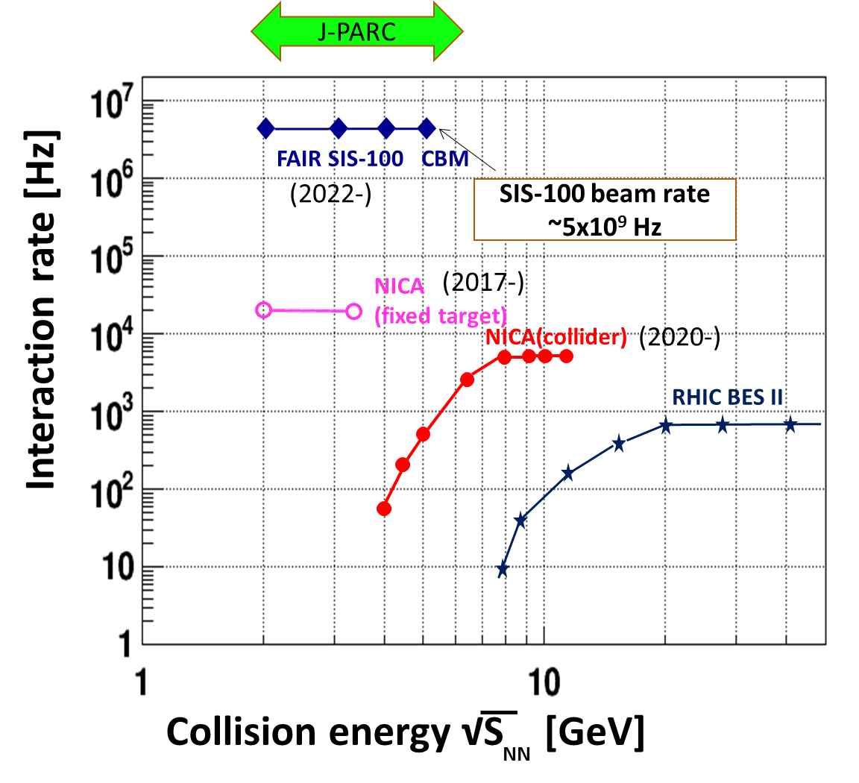
Collision Rate
J-PARC-HI
J-PARC-HI:
High-luminosity X Fixed target
→World highest rate～10⁸Hz
5-order higher than AGS,SPS
SPS
AGS
AGS, SPS
1 year
J-PARC-HI
5 min.
＝
High-statistical exp.
various event selections
higher order correlations
search of rare events

Slide 17
Observables
Directed flow
Fluctuations
Elliptic flow
Higher harmonics
Strange abundance
…

Slide 18



Non-trivial Collision Dynamics
Directed Flow:

Slide 19
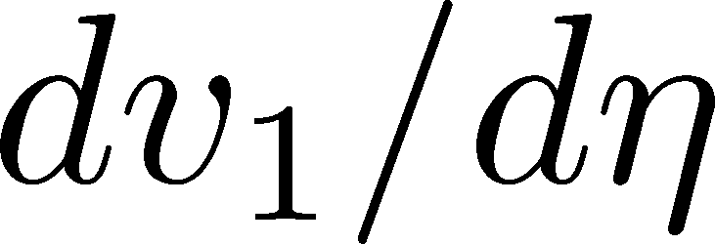
Directed Flow:
dv₁/dy changes sign twice!

Slide 20
dv₁/dy: Signal of 1st Phase Tr.?
Negative v₁
= signal of softening
≅1st order transition??
Nara+, 2017

Slide 21


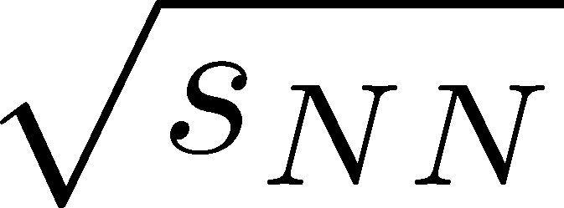
Maximum Density Scan?
Large event-by-event fluctuations even after fixed centrality / collision energy
If we can select events,
“maximum density” dependence
can be studied experimentally.
average transverse energy
non-monotonic
behavior
as evidence of 1st. tr?
Baryon-rich events
Beam-energy scan
(no event selection)
faster
increase
Baryon-rich
events

Slide 22
Search of Rare Events
Exotic
Hadrons
High density
High luminosity
High strange yield
Hypernuclei
Rare-event
Factory
Strangelets
hadron
Interaction
creation
properties
interaction

Slide 23
Fluctuations

Slide 24
Thermal Fluctuations
Observables are fluctuating even in an equilibrated medium.
P(N)
N
V
N

Slide 25
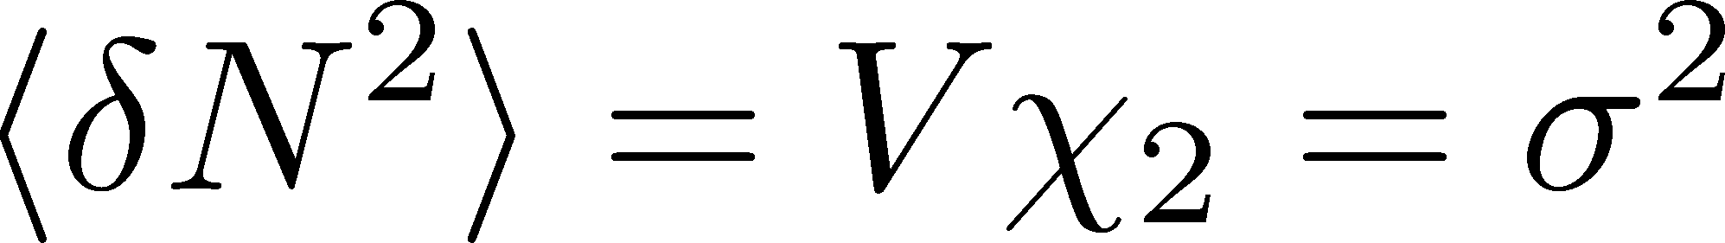
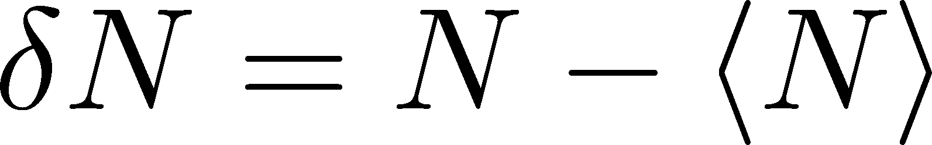
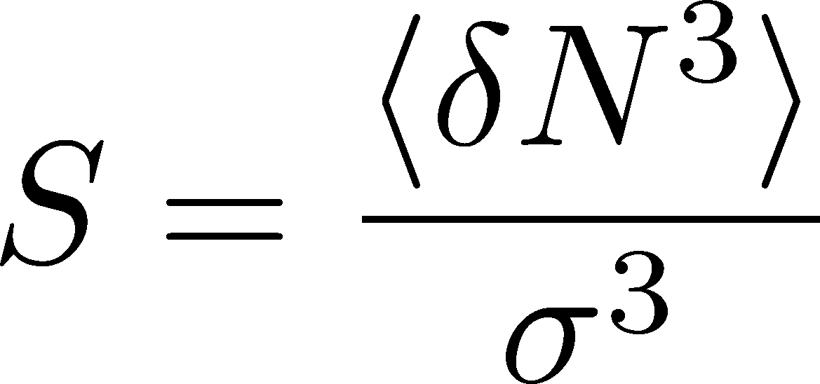
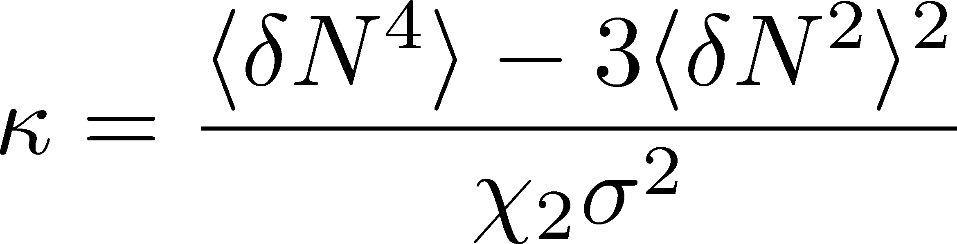
Thermal Fluctuations
Observables are fluctuating even in an equilibrated medium.
P(N)
N
V
N
Variance:
Non-Gaussianity
Skewness:
Kurtosis:
Review:
Asakawa, MK, PPNP90 (’16)

Slide 26

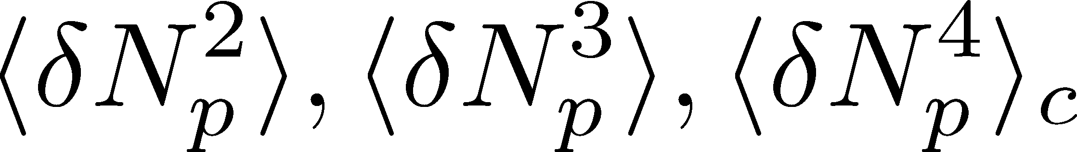
Event-by-Event Fluctuations
Review: Asakawa, MK, PPNP 90 (2016)
Fluctuations can be measured by e-by-e analysis in experiments.
STAR, PRL105 (2010)
Detector
Cumulants

Slide 27


A Coin Game
Bet 500YEN
You get head coins of
A. 20 x 50YEN
B. 10 x 100YEN
Same expectation value.

Slide 28
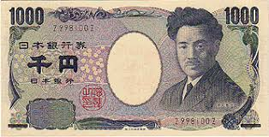
A Coin Game
Bet 500YEN
You get head coins of
A. 20 x 50YEN
B. 10 x 100YEN
C. 1 x 1000YEN
Same expectation value.
But, different fluctuation.

Slide 29


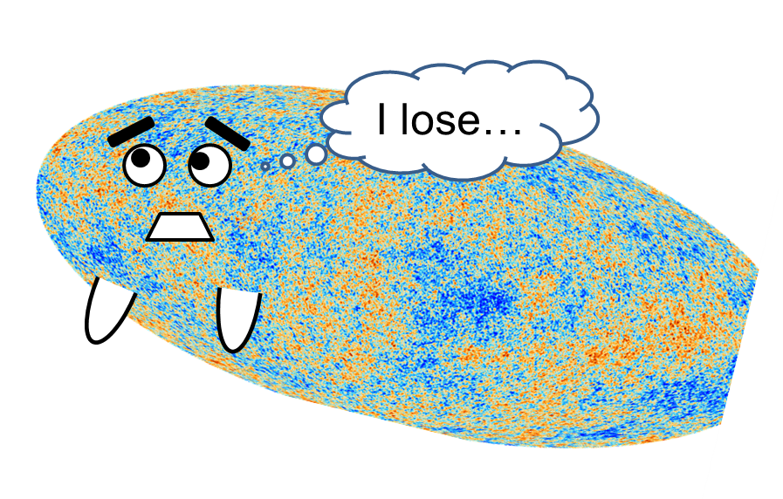
Higher-Order Cumulants
STAR Collab.
2010~
Enhancement
Non-zero non-Gaussian cumulants
have been established!
Have we measured critical fluctuations?

Slide 30
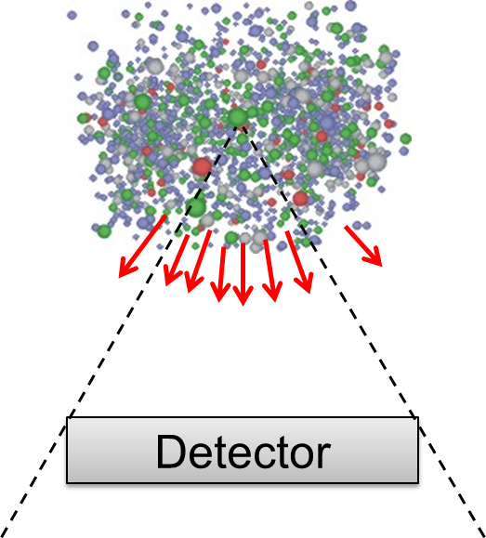
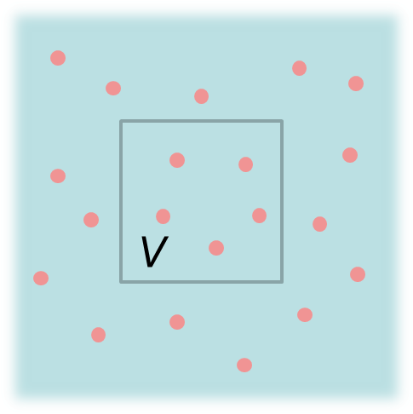
Fluctuations: Theory vs Experiment
Theoretical analyses
based on statistical mechanics
Experiments
lattice, critical point,
effective models, …
Fluctuation in
a spatial volume
Fluctuations in
a momentum space
discrepancy in phase spaces
Asakawa, Heinz, Muller, 2000; Jeon, Koch, 2000; Shuryak, Stephanov, 2001

Slide 31






Thermal Blurring
Asakawa, Heinz, Muller, 2000
Jeon, Koch, 2000
Detector
Distributions in ΔY and
Δy are different due to
“thermal blurring”.

Slide 32


(Non-Interacting) Brownian Particle Model
Initial condition (uniform)
cumulants:
random
walk
diffusion master equation: MK+, PLB(2014)
probabilistic argument: Ohnishi+, PRC(2016)

Slide 33


(Non-Interacting) Brownian Particle Model
Initial condition (uniform)
cumulants:
diffusion
distance
random
walk
Study ΔY dependence
Poisson distribution
diffusion master equation: MK+, PLB(2014)
probabilistic argument: Ohnishi+, PRC(2016)

Slide 34
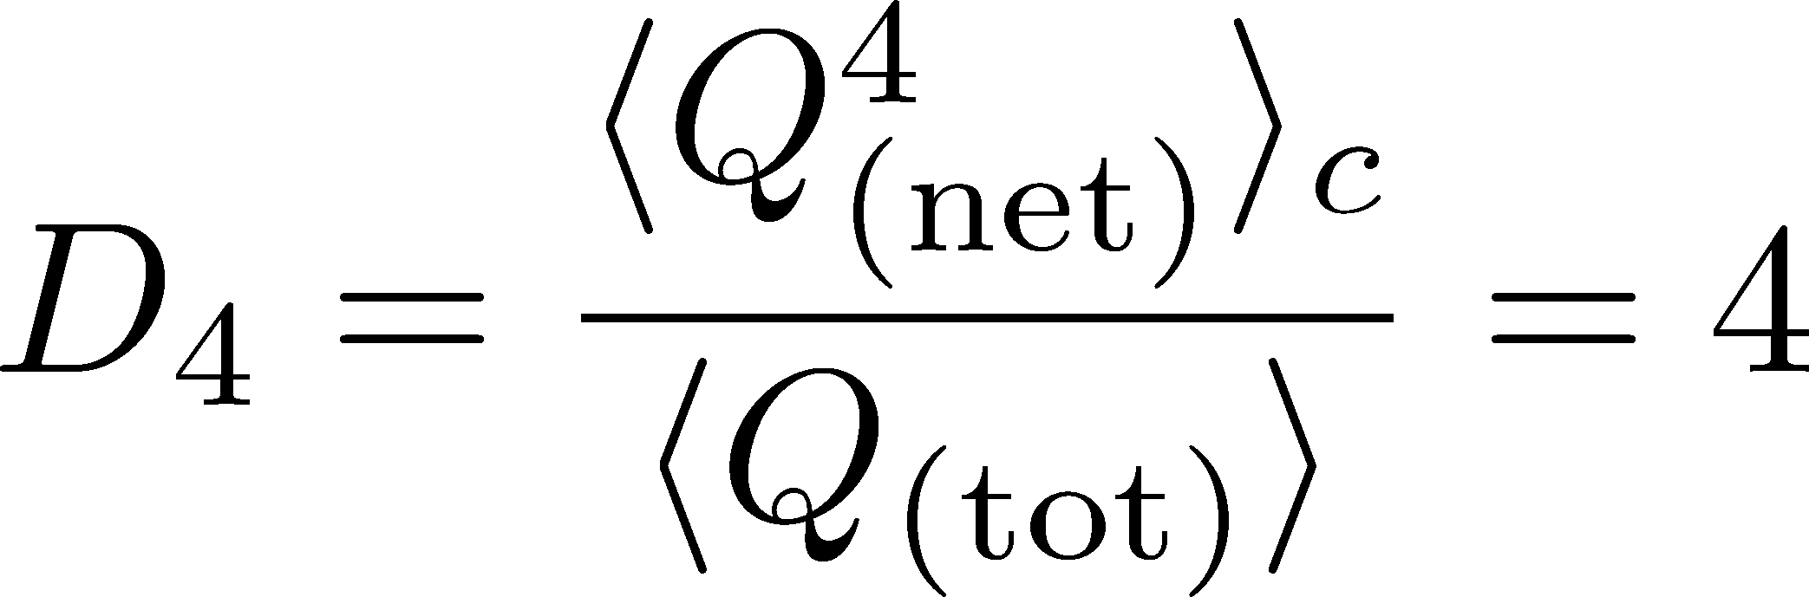




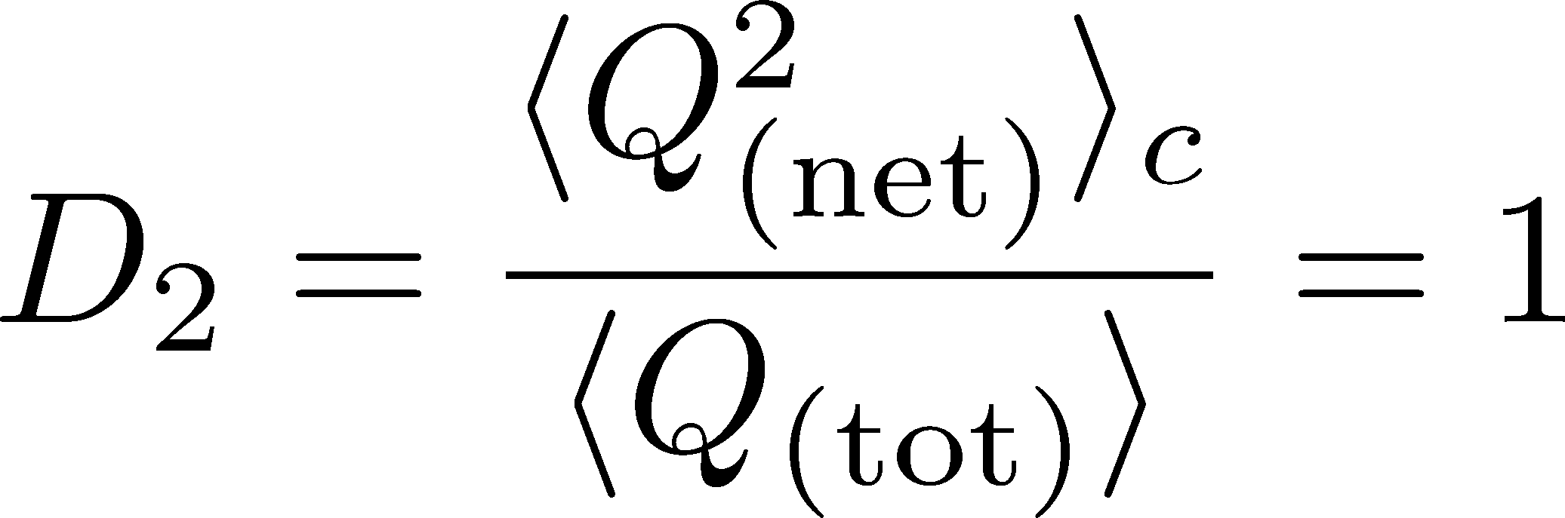

4th order : w/ Critical Fluctuation
MK+ (2014)
MK (2015)
Initial Condition
(rough estimate)
Higher order cumulants can behave non-monotonically.

Slide 35
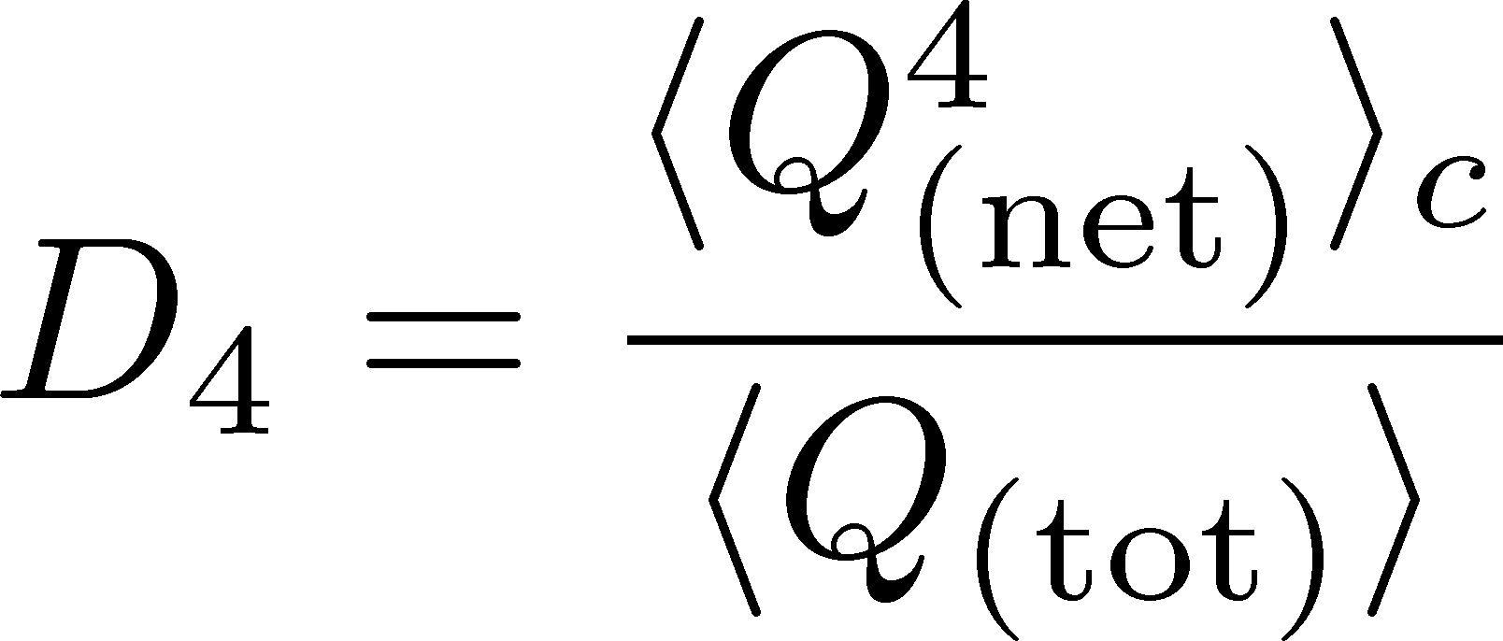


Rapidity Window Dep.
Initial Conditions
4th-order cumulant
MK+, 2014
MK, 2015
STAR Collab. (X. Luo, CPOD2014)
Different initial conditions give rise to different characteristic Δη dependence. → Study initial condition
Non-monotonic behaviors can appear in Δη dependence.
Finite volume effects: Sakaida+, PRC90 (2015)

Slide 36
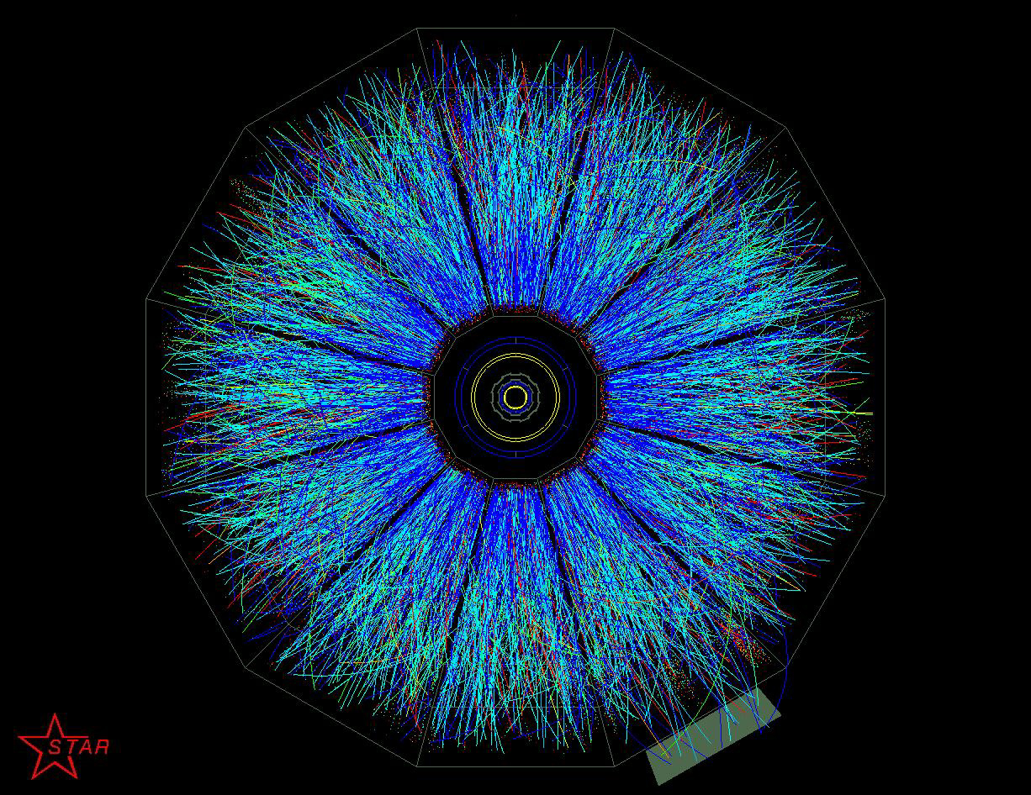
Efficiency Correction
Experimental Detectors cannot
observe all particles
Efficiency ε
probability to observe a particle
Efficiency correction is indispensable in experimental analyses!

Slide 37





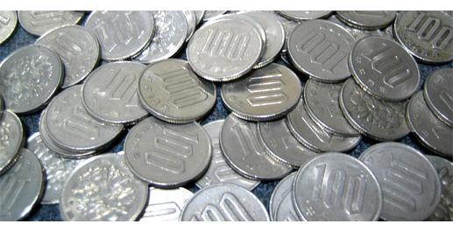
Slot Machine Analogy
= +
P (N)
N
P (N)
N

Slide 38
Slot Machine Analogy
Fixed # of coins
Constant probabilities
N
N
N
N

Slide 39
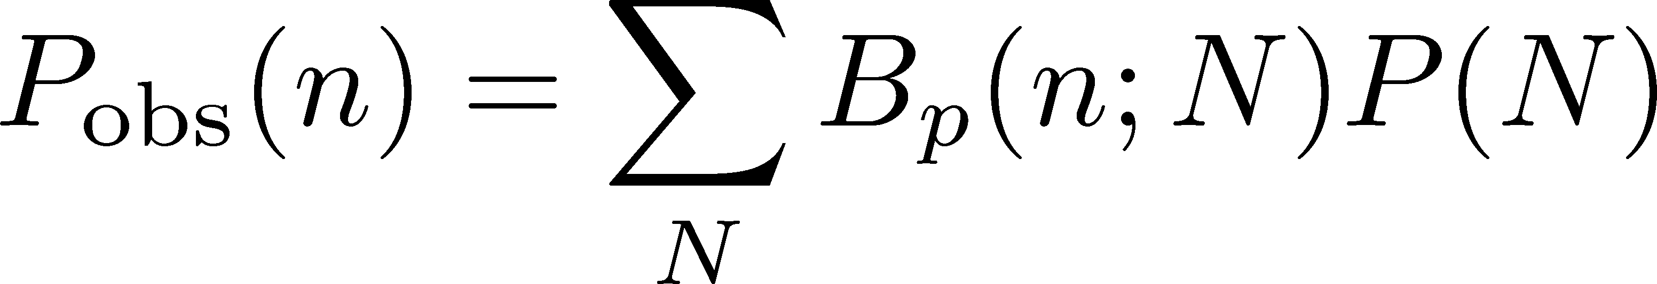
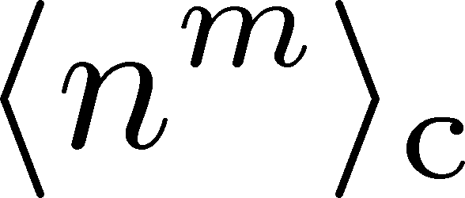
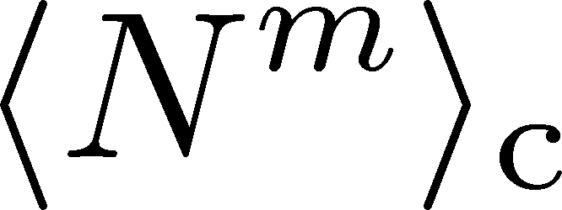
The Binomial Model
MK, Asakawa, 2012; 2012
Bzdak, Koch, 2012
When efficiency for individual particles are independent
dist. func. of
observed particle #
binmial
dist. func.
dist. func. of
original particle #
The cumulants connected with each other
Caveat: Effects of nonvanishing correlations: Holtzman+ 2016

Slide 40
Another formula using factorial moments: Bzdak, Koch, 2012

Slide 41


Multi-efficiency Problem
efficiency for proton ≠ anti-proton
efficiency has p_{T} dependence
STAR, net proton
TPC ε∼80%
TPC+TOF ε∼50%
Multi-variable efficiency correction
A method was proposed,
but too large numerical costs
Luo, 2014
Bzdak, Koch, 2015

Slide 42
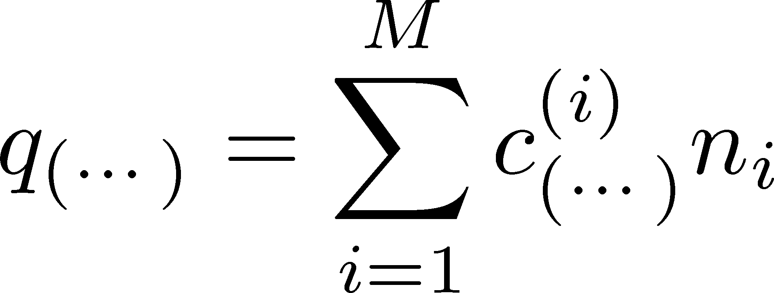
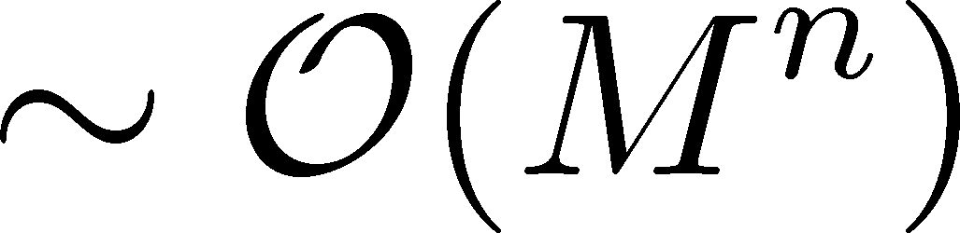


New Formula for Efficiency Correction
MK, PRC,2016
linear combination of
original particle numbers
linear combination of
observed particle numbers
Numerical Cost
For nth order and M variables
F-moment method
Our method
Drastic reduction of numerical cost：private communication with T. Nonaka

Slide 43



検出効率補正への応用
キュムラント検出効率補正小史
最初の提案
2粒子種しか
扱ってない
MK, Asakawa (’12), Bzdak, Koch (’12)
大阪大学
「ワニ博士」
Fモーメントを使った方法
数値解析
重すぎ
Bzdak, Koch (’15), Luo (’15)
大阪大学
「ワニ博士」
キュムラント展開を使った方法
手計算
複雑すぎ
MK (’16)
大阪大学
「ワニ博士」
新しい提案：Fキュムラントを使った方法
T. Nonaka, MK, Esumi, 1702.07106
手計算シンプル、かつ低数値コスト
大阪大学公式キャラクター
「ワニ博士」

Slide 44


More Efficient Formulas
Nonaka, Esumi, MK, 2017
Numerical Cost
A Toy Model Test
Old
New
ε_{A}
ε_{B}
大阪大学公式キャラクター
「ワニ博士」

Slide 45
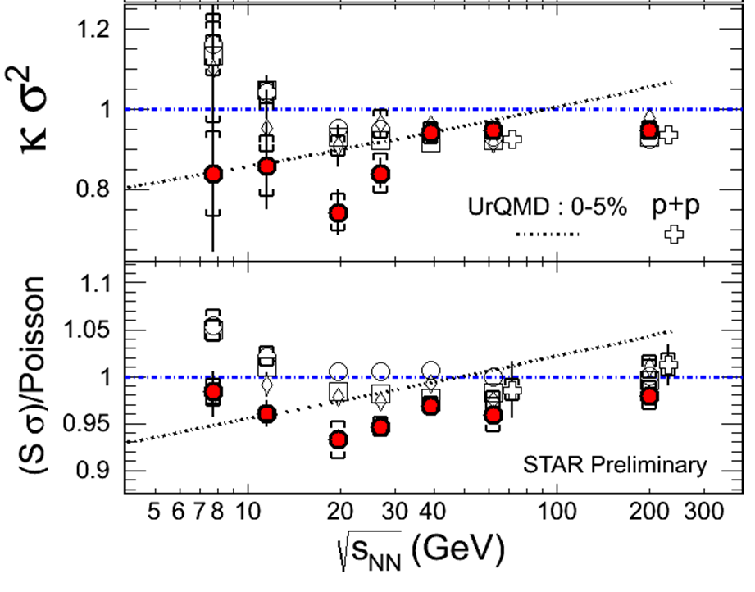
4th Order Cumulant: History
2013年
(PRL(2014))
2014年
(CPOD2014)
2015年
(QM2015)
2012年
(QM2012)

Slide 46
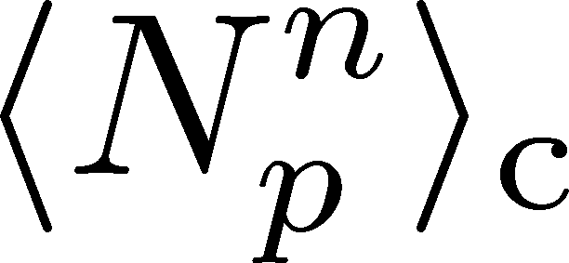
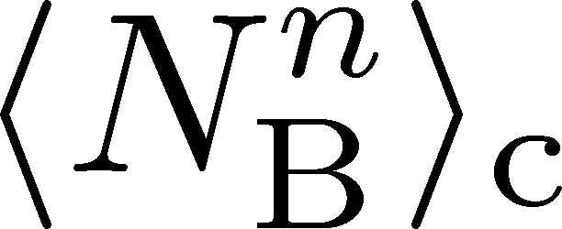
Proton v.s. Baryon Number Cumulants
MK, Asakawa, 2012; 2012
Experiments
proton number cumulants
Many theories
baryon number cumulants
measurement with
50% efficiency loss
The difference would be large.
Reconstruction of <N_{B}^{n}>_{c} is possible using the binomial model.
The use of binomial model is justified by “isospin randomization.”

Slide 47



Baryons in Hadronic Phase
time
chem. f.o.
hadronize
10~20fm
kinetic f.o.
Baryons behave like
Brownian pollens in water
mesons
baryons

Slide 48
Constructing Dynamical Model for Low-E Collisions

Slide 49
Theoretical Challenges
Thermalization
Hydrodynamics
Cascade
Low-E Collisions
RHIC / LHC
Initial condition?
Thresholod of QGP formation
“Integrated” approach
  Hydro x Cascade
hydro. for QGP
early thermalization
(boost invariance)

Slide 50
Theoretical Challenges
Hydrodynamics
Cascade
Low-E Collisions
RHIC / LHC
Initial condition?
Thresholod of QGP formation
“Integrated” approach
  Hydro x Cascade
hydro. for QGP
early thermalization
(boost invariance)

Slide 51
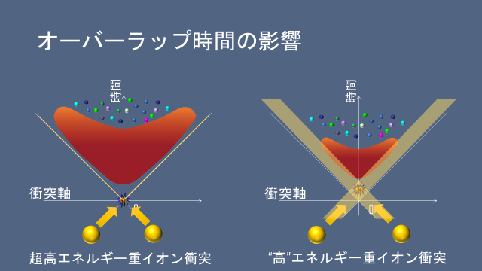
Slide from T. Hirano, 2017/9/10, informal meeting

Slide 52
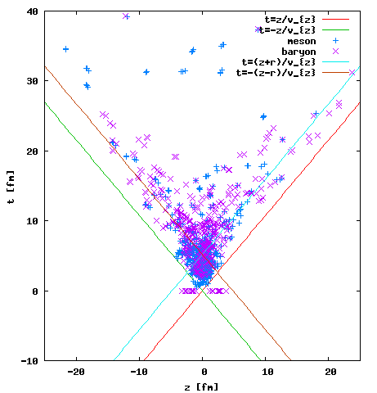
How to Create Initial Condition
Last collision point of hadrons
(without BM/MM interaction)
A dynamical initialization
Shen, Shenke, 1711.10544

Slide 53
Modelling Low-E Collisions
Controlling EOS by changing interaction in cascade
cascade + hydro + cascade
3-fluid dynamics
PHSD + chiral restoration
Dynamical Initialization
Chiral fluid
JAM/ Nara, Ohnishi, Stoecker, 2016-
UrQMD/ Petersen; Steinheimer
Karpenko+, 2016-
THESEUS/ Blaschke, Ivanov, +, 2016
Cassing+, 2016; Palmese+, 2016
Shen, Shenke, Monnai, Heinz, 2017-
Dumitru+; Nahrgang+, 2014-; Song+, 2016-

Slide 54
Project for An Integrated Model
Hydrodynamics
Cascade
JAM+hydro(Nagoya) + realistic EoS(QCD-CP??)
discussion by
Akamatsu, Asakawa, Hirano, Kitazawa, Morita, Nara, Nonaka, Ohnishi
from 2016 Summer

Slide 55
今年度の活動
2017/9/10
  インフォーマルミーティング「動的模型開発」「J-PARC-HI」＠KEK東海キャンパス
2017/9/11
  研究会「J-PARCエネルギー領域重イオン衝突実験のダイナミクス」＠KEK東海キャンパス
2017/12/15
  J-PARC-HIインフォーマルミーティング＠茨城量子ビーム研究セ

Slide 56
Summary
BES is one of the hot topics in HIC.
J-PARC-HI will play an important role in exploring QCD phase structure.
Searches for QCD-CP / 1st tr. are ongoing.
Fluctuations are important observables.
Description of low-E collisions is a theoretically-challenging subject.

Slide 57

Lepton & Photon:
Hierarchical Observation
gravitational wave
photons
Time scale: 10⁻¹s
di-lepton yield
EM probes
hadronic observables
time scale: 10⁻²²s

