Slide 1
Evolution of Critical Fluctuations / Non-binomial Efficiency correction
Masakiyo Kitazawa
(Osaka U.)
GSI Workshop
Constraining the Phase Boundary with Data from HIC
GSI, Darmstadt, 12/Feb./2018

Slide 2
Contents
Diffusion
Evolution of Critical Fluctuations: 2nd order
Evolution of Critical Fluctuations: 3rd order
Non-binomial Efficiency Correction
  Previous methods
  New general method
    General Review: Asakawa, MK, PPNP (2016)

Slide 3


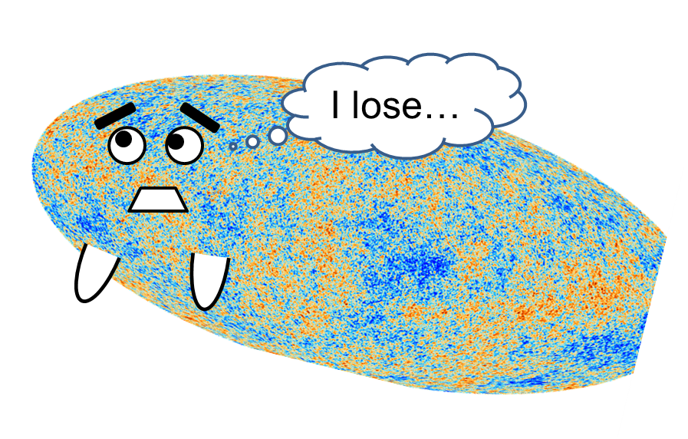
Higher-Order Cumulants
STAR Collab.
2010~
Enhancement
Non-zero non-Gaussian cumulants
have been established!
Have we measured critical fluctuations?

Slide 4
Contents
Diffusion
Evolution of Critical Fluctuations: 2nd order
Evolution of Critical Fluctuations: 3rd order
Non-binomial Efficiency Correction
  Previous methods
  New general method
MK, Asakawa, Ono, PLB 728, 386 (2014)
Sakaida, Asakawa, MK, PRL90, 064911 (2014)
MK, NPA942, 65 (2015)

Slide 5
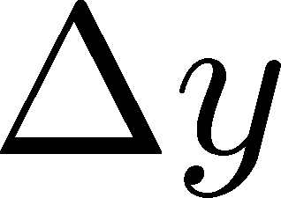
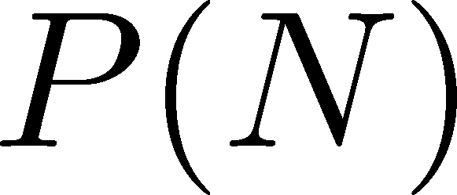



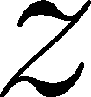
Time Evolution of Fluctuations
Asakawa, Heinz, Muller (2000)
Jeon, Koch (2000)
Shuryak, Stephanov (2001)
Detector
Distributions in ΔY and
Δy are different due to
“thermal blurring”.
Ohnishi, MK, Asakawa, PRC(2016)
Hadronic
QGP
Fluctuations in ΔY continue
to change until kinetic f.o.

Slide 6


(Non-Interacting) Brownian Particle Model
Initial condition (uniform)
cumulants:
random
walk
diffusion master equation: MK+, PLB(2014)
probabilistic argument: Ohnishi+, PRC(2016)

Slide 7
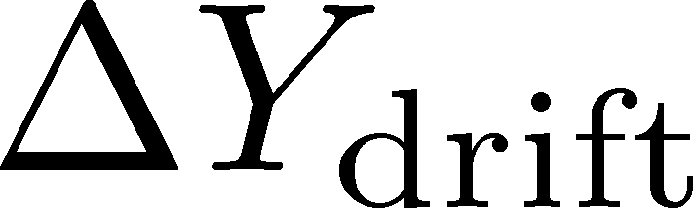
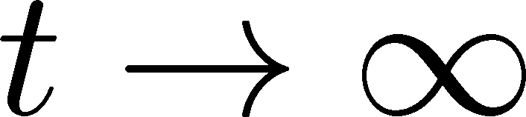
(Non-Interacting) Brownian Particle Model
Initial condition (uniform)
cumulants:
diffusion
distance
random
walk
Study ΔY dependence
Poisson distribution
diffusion master equation: MK+, PLB(2014)
probabilistic argument: Ohnishi+, PRC(2016)

Slide 8
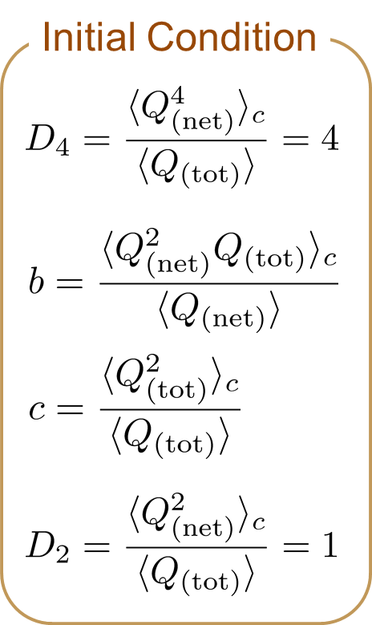

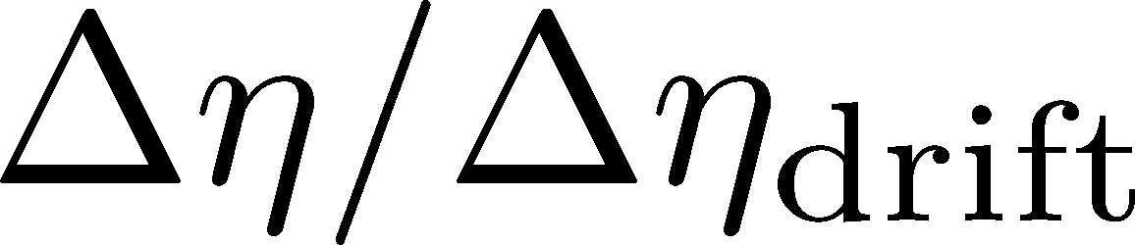
4th Order Cumulant
MK+ (2014)
MK (2015)
Before the diffusion

Slide 9
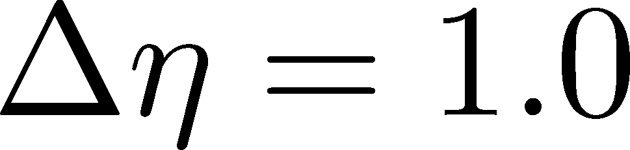
4th Order Cumulant
MK+ (2014)
MK (2015)
After the diffusion
(rough estimate)
Cumulant at small Δη is modified toward a Poisson value.
Non-monotonic behavior can appear.

Slide 10
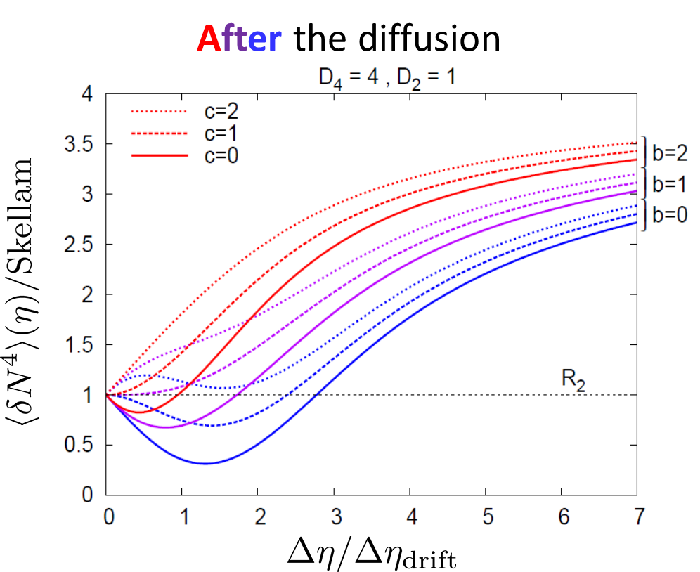
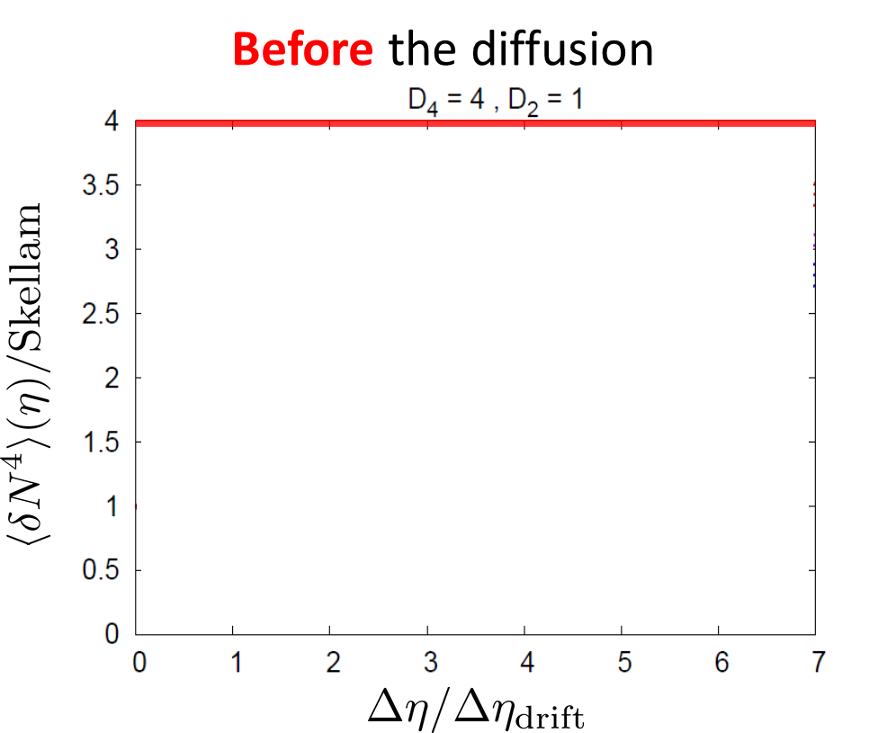
Time Evolution of Fluctuations
Detector
Hadronic
As a result of a simple random walk…
QGP

Slide 11
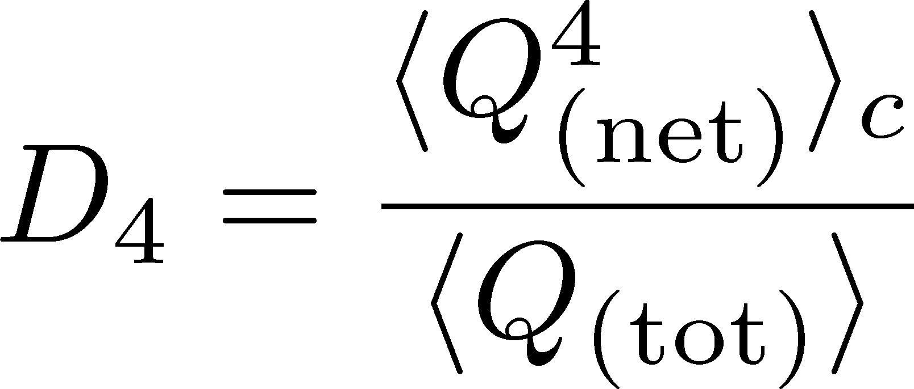




Rapidity Window Dep.
Initial Conditions
4th-order cumulant
MK+, 2014
MK, 2015
STAR Collab. (X. Luo, CPOD2014)
Is non-monotonic Δη dependence already observed?
Different initial conditions give rise to different characteristic Δη dependence. → Study initial condition
Finite volume effects: Sakaida+, PRC90 (2015)

Slide 12
Contents
Diffusion
Evolution of Critical Fluctuations: 2nd order
Evolution of Critical Fluctuations: 3rd order
Non-binomial Efficiency Correction
  Previous methods
  New general method
Sakaida, Asakawa, Fujii, MK, PRC95,064905(2017)

Slide 13
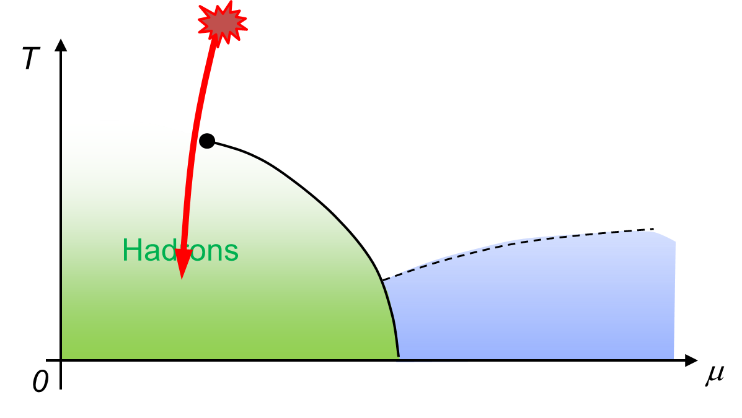
Effect of Dynamical Evolution
Growth
Growth of the critical fluctuation is limited by the critical slowing down.
Decay by diffusion
Fluctuations developed at CP are modified by the time evolution in later stage before observation.

Slide 14
Dynamical Evolution of Critical Fluctuations
Evolution of spatially uniform “σ” mode
Berdnikov, Rajagopal (2000)
Asakawa, Nonaka (2002)
Mukherjee+ (2015)
THIS STUDY
Evolution of conserved charge fluctuations
Sakaida+, PRC2017; Murata, MK, in prep.
Conserved charges are directly observable.
Soft mode at QCD-CP is a conserved mode.
See also, Kapusta, Torres-Rincon (2012); Herold, Nahrgang, … (2015)

Slide 15

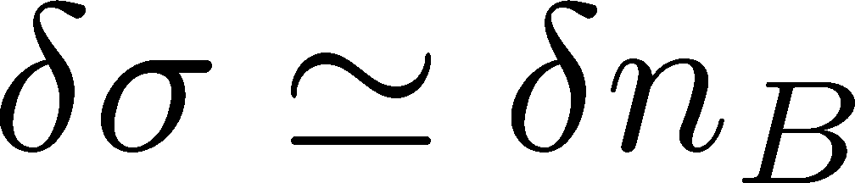
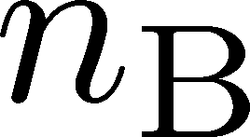
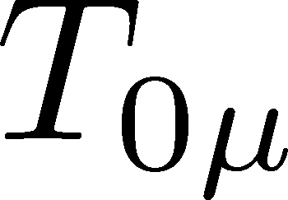
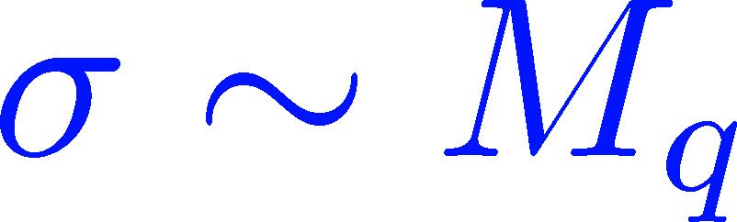
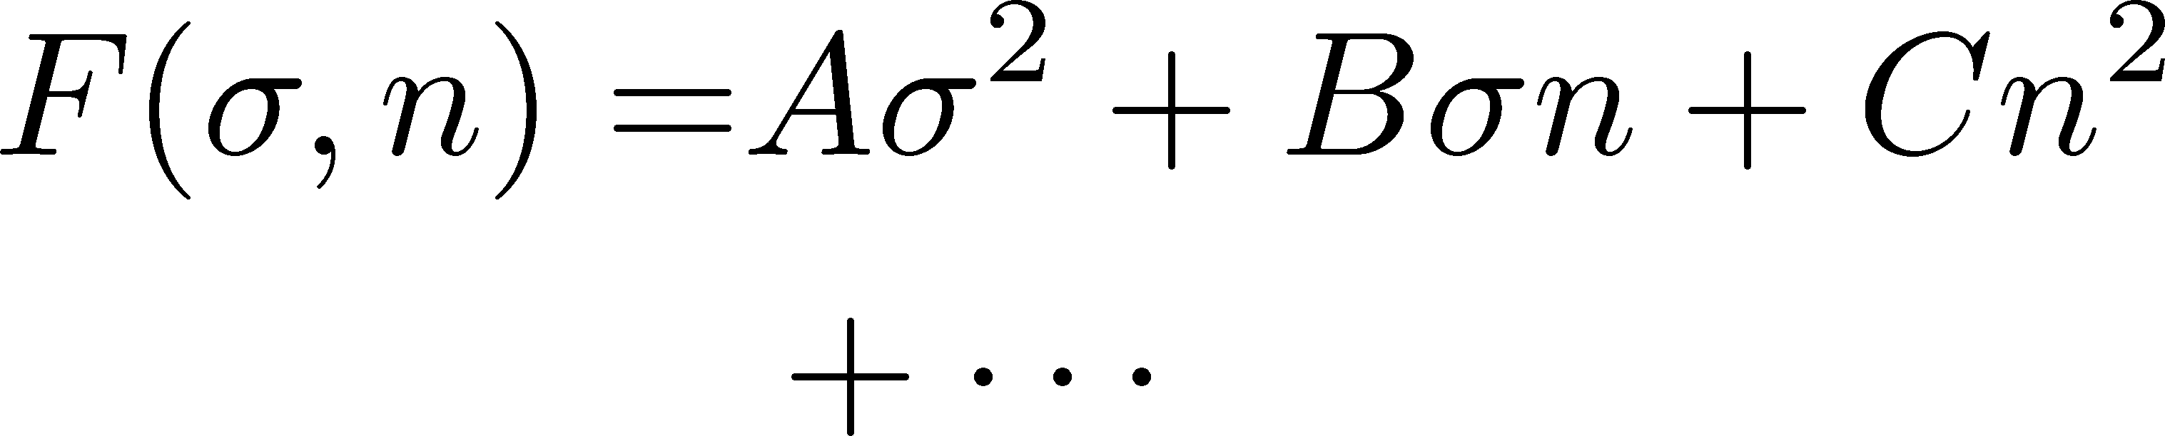


Soft Mode of QCD-CP = Conserved Mode
Fujii 2003; Fujii, Ohtani, 2004; Son, Stephanov, 2004
critical
soft mode
Fluctuations of σ and n_{B} are
coupled around the CP!
σ: fast damping

Slide 16
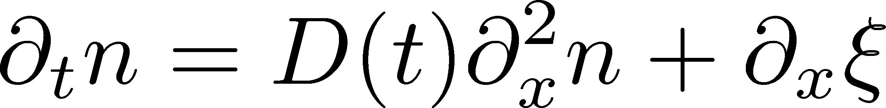
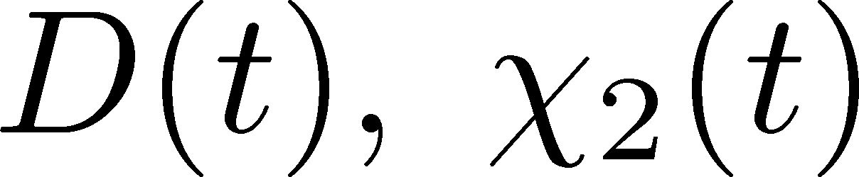
Analysis of 2nd-order Cumulant
Sakaida+ (2017)
Evolution of baryon number density
Stochastic Diffusion Equation
:parameters characterizing criticality
We study the 2nd order cumulant as well as correlation function.
Our Main Conclusion
Non-monotonicity in
cumulants or correlation func.
=
Signal of
QCD-CP

Slide 17
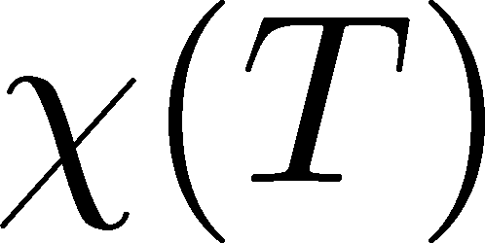
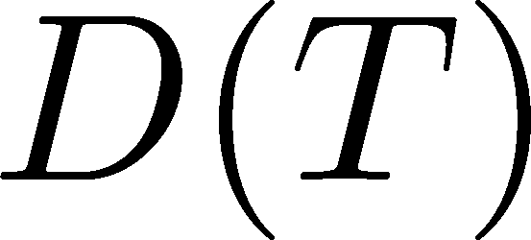
Parametrizing D(τ) and χ(τ)
Critical behavior
(critical point)
3D Ising (r,H)
model H
Berdnikov, Rajagopal (2000)
Stephanov (2011); Mukherjee+(2015)
Temperature dep.
critical
slowing
down
critical
enhancement

Slide 18
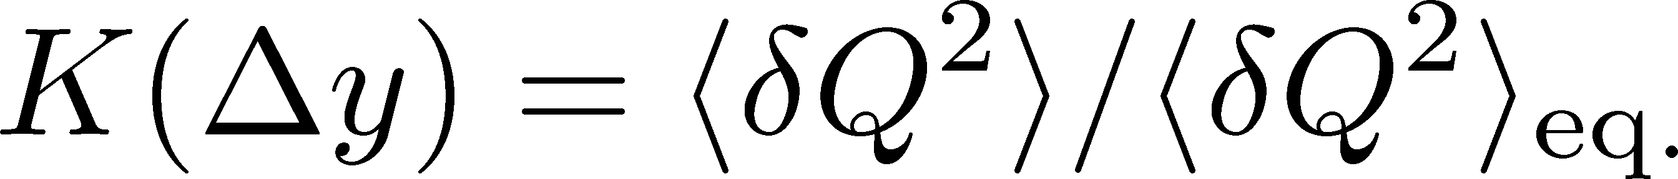

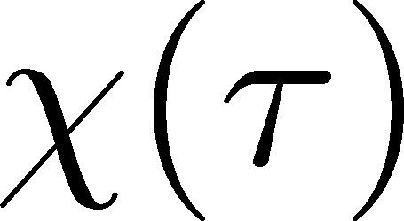
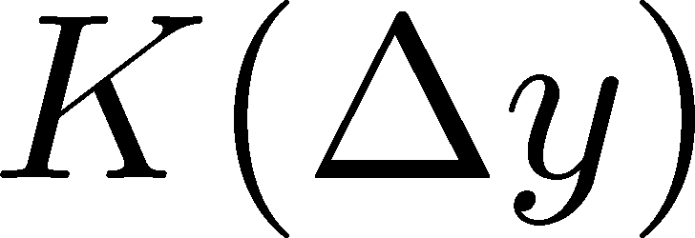
Crossover / Cumulant
ALICE
PRL 2013
monotonically decresing
Analytic
result
monotonically
increasing
monotonically
decreasing

Slide 19
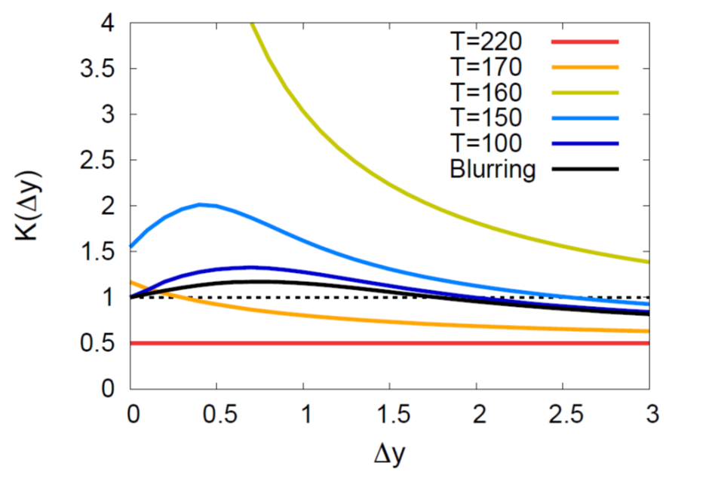
Critical Point / Cumulant
non-monotonic Δy dep.
Analytic
result
non-monotonic
non-monotonic

Slide 20
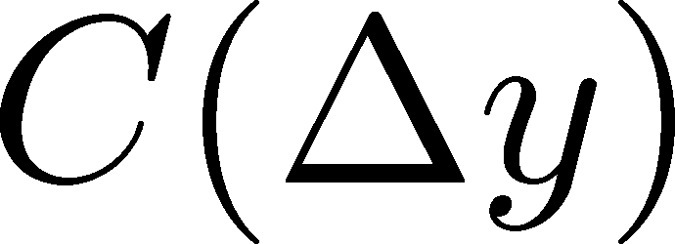
Criticap Point / Correlation Func.
non-monotonic Δy dep.
Analytic
result
non-monotonic
non-monotonic

Slide 21
Contents
Diffusion
Evolution of Critical Fluctuations: 2nd order
Evolution of Critical Fluctuations: 3rd order
Non-binomial Efficiency Correction
  Previous methods
  New general method
Murata, MK, in preparation

Slide 22
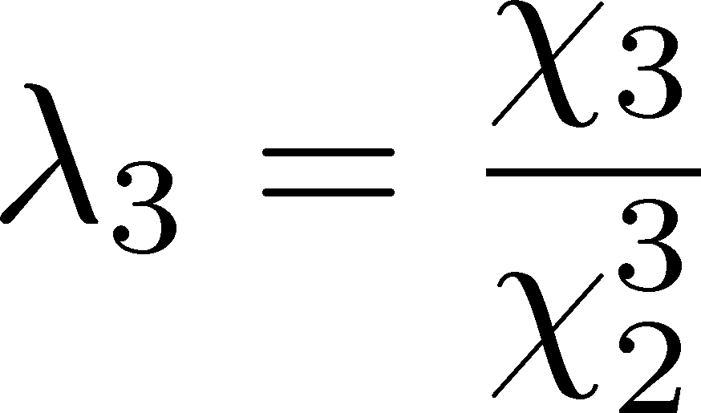
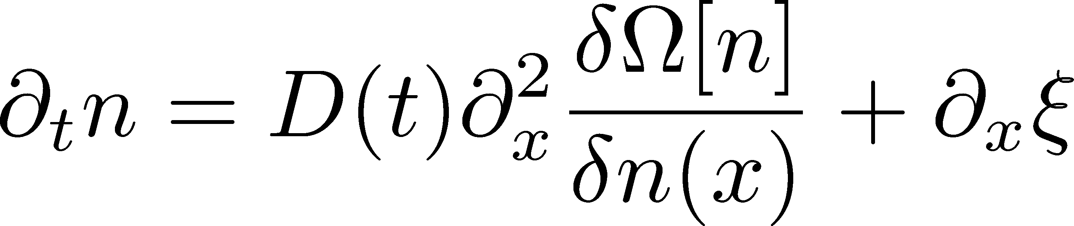
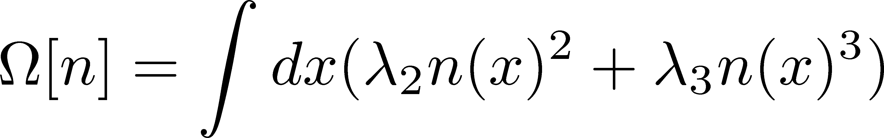
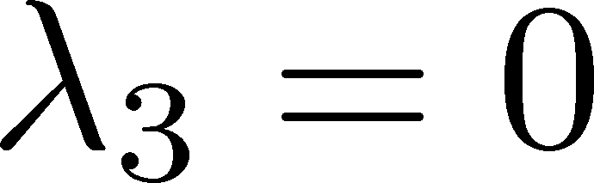
Analysis of 3rd-order Cumulant
Murata, MK
in preparation
SDE: Higher order cumulants vanish in equi.
Include a non-linear effect into SDE
SDE
See, Nahrgang, QM2017
Analytic solution at the leading order in λ₃ for

Slide 23
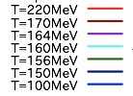
Time Evolution: Near CP
Murata, MK
in preparation
negative
Asakawa, Ejiri, MK
(2009)

Slide 24
Time Evolution: Near CP
Murata, MK
in preparation
negative
Asakawa, Ejiri, MK
(2009)

Slide 25
Time Evolution: Near CP
Murata, MK
in preparation
Sharp peak survives as a remnant of criticarity
Negative 3rd cumulant is buried by the diffusion.
negative
Asakawa, Ejiri, MK
(2009)

Slide 26
Contents
Diffusion
Evolution of Critical Fluctuations: 2nd order
Evolution of Critical Fluctuations: 3rd order
Non-binomial Efficiency Correction
  Previous methods
  New general method
Nonaka, Esumi, MK, to appear soon

Slide 27
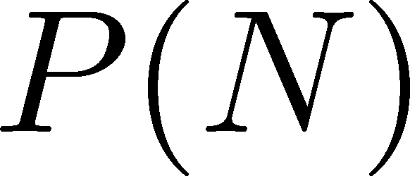
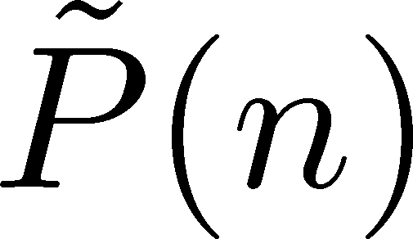
Efficiency / Efficiency Correction
Experimental detectors have miscounting & misidentification…
True particle #
distribution
Detector
Observed particle #
distribution
We need cumulants
of this distribution.
We can measure
this distribution only.
True cumulants have to be
reconstructed from experimental data.

Slide 28

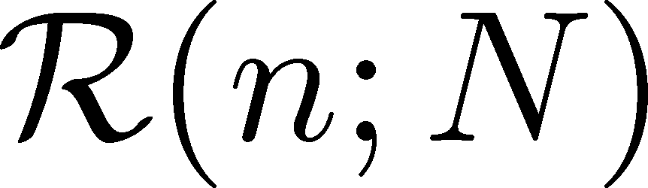
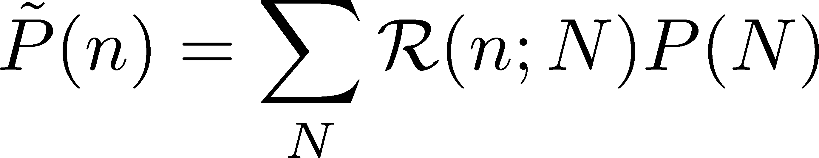

Response Matrix
Fixed injected
particle #
Detector
Probability observing
n particles
If each measurement is uncorrelated…
Response matrix
model of detector

Slide 29

Efficiency Correction
Binomial model
Independence of efficiency loss for individual particles
:Binomial distribution func.
Cumulants of n can be represented by those of N
Bialas, Peschanski (1986); MK, Asakawa (2012); Bzdak, Koch (2012)
Unfolding
Construct true distribution func.
Numerically demanding

Slide 30
Binomial Model
An efficient algorithm for multi-variable system
Nonaka, MK, Esumi, PRC2017
Numerical Cost
A Toy Model Test
source
ε_{A}=0.3
source
ε_{B}=0.7
Conventional
deviation from true cumulant
New

Slide 31
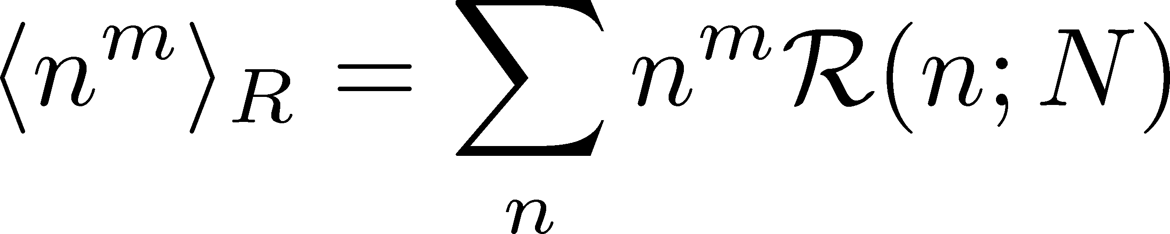
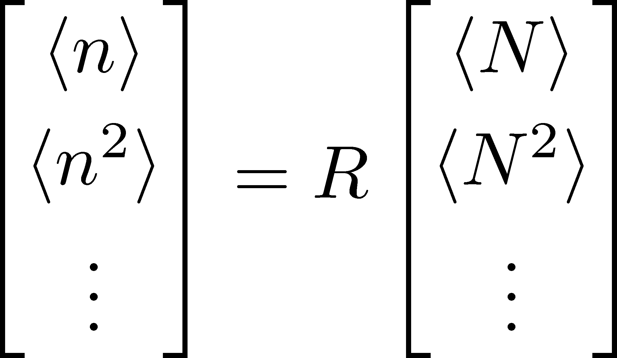
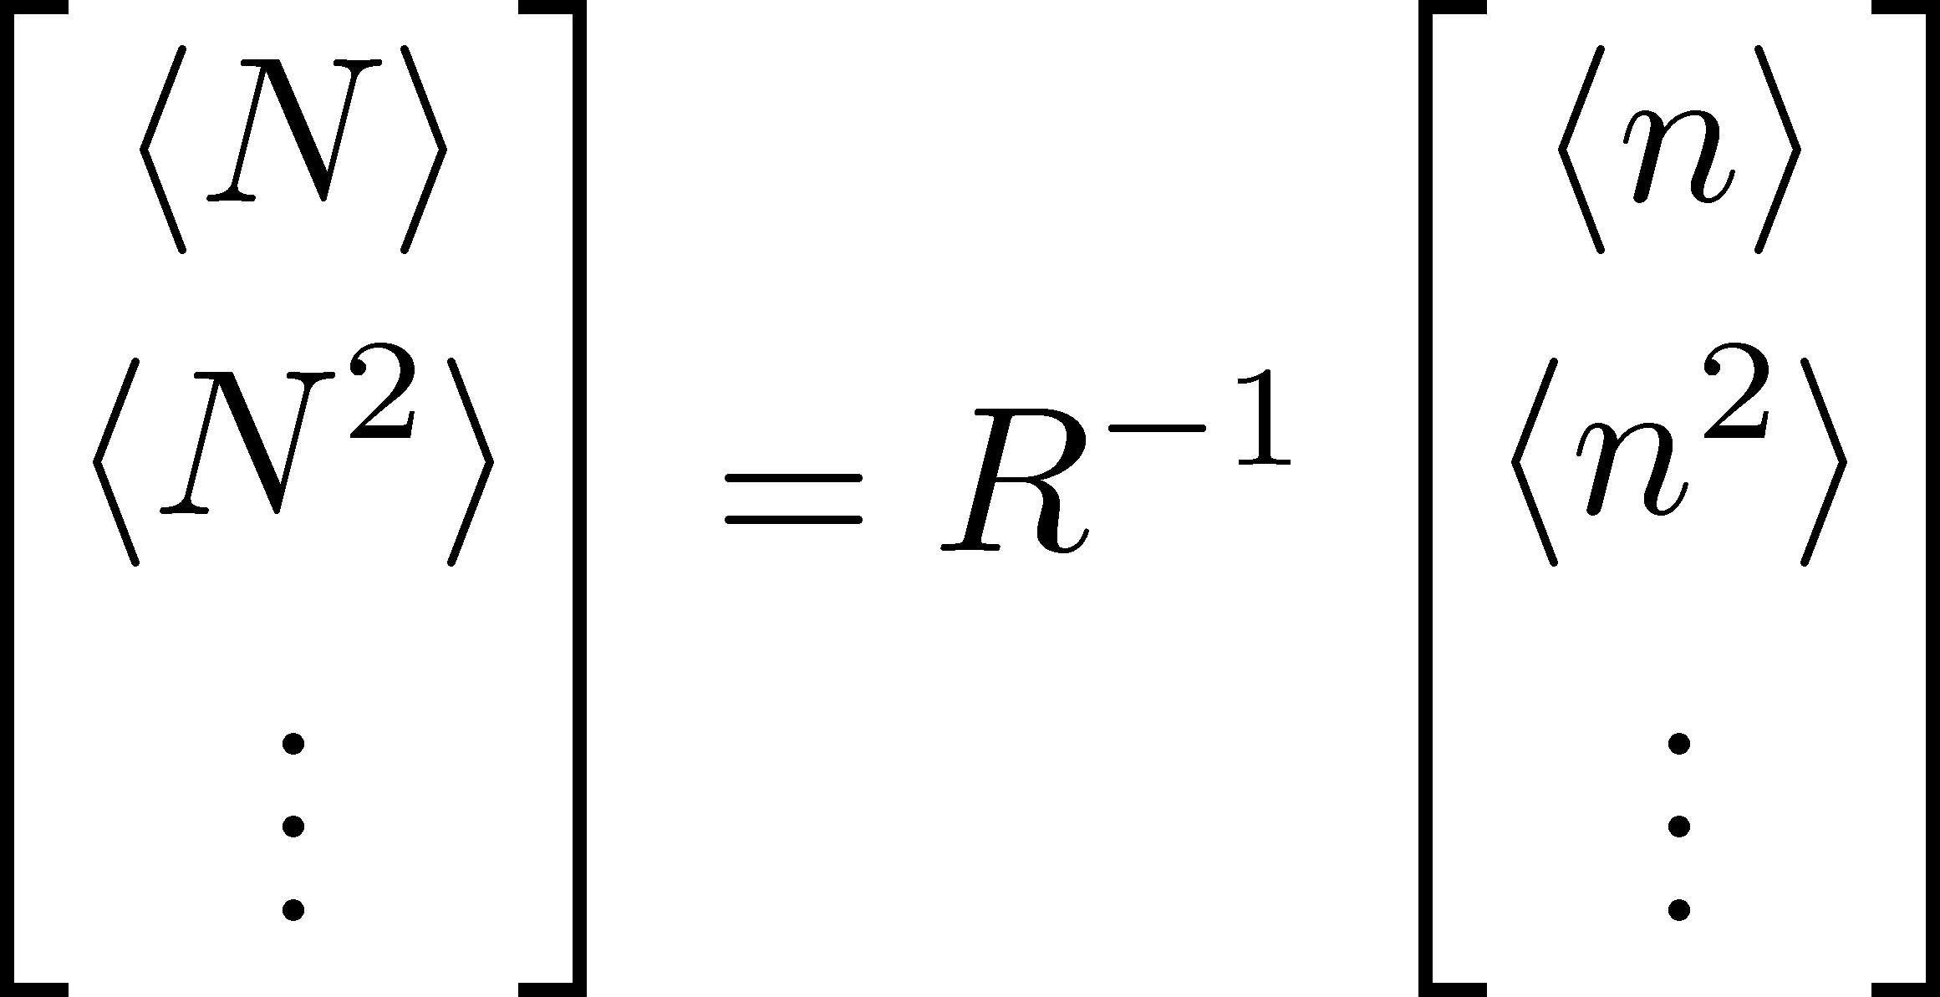
General Efficiency Correction
Nonaka, Esumi, MK,
to appear soon
Use moments of R(n;N)
Taylor expand
Relation b/w true and observed moments
By truncating the Taylor exp. at mth order,
“true” moments up to mth order are obtained.

Slide 32
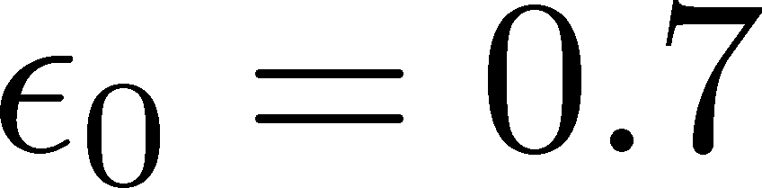
A Toy-Model Analysis
Nonaka, Esumi, MK
to appear soon
Binomial model w/ multiplicity-dependent efficiency
Holtzman, Bzdak,
Koch (16)
Reconstructed cumulants
Input P(N):
Poisson(λ=40)
Red:
true cumulant
True cumulants are
reproduced within
statistics!

Slide 33
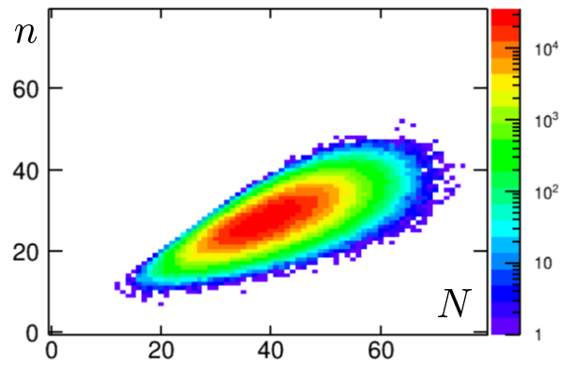
Comments
can be obtained from R(n;N)
The truncation has to be well justified.
Some distributions are automatically truncated.
  Correct efficiency correction is possible.
  binomial, hyper-geometric, beta-binomial, … , binomial with fluctuating probability
Compared to unfolding method,
  numerically cheaper and would be more stable
  origin of error is more apparent
Extension to multi-variable case is straightforward.
He, Luo, last Friday

Slide 34
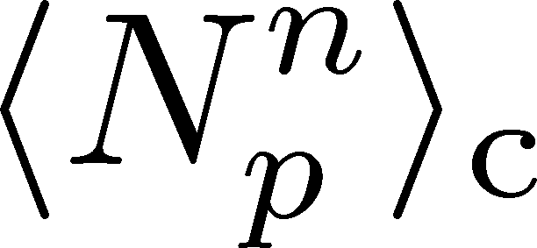
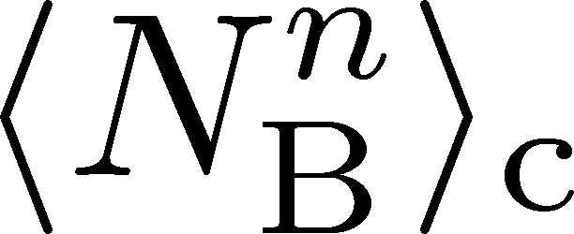
Proton v.s. Baryon Number Cumulants
MK, Asakawa, 2012; 2012
Experiments
proton number cumulants
Many theories
baryon number cumulants
measurement with
50% efficiency loss
The difference would be large.
Reconstruction of <N_{B}^{n}>_{c} is possible using the binomial model.
The use of binomial model is justified by “isospin randomization.”
And the loss due to momentum cut…

Slide 35
Summary
Understanding dynamical aspects of fluctuations is important!
Plenty information in Δy dependence of cumulants:
  Higher order cumulants can behave non-monotonically.
  → can be used for constraining parameters.
  Non-monotonicity in 2nd order cumulant is an experimental signal for the existence of the QCD-CP.
A general algorithm for the efficiency correction:
  Correct reconstruction for non-binomial response.
  Smaller numerical cost than unfolding methods.
Reonstructing baryon # cumulants is important!
Let’s continue the search for the QCD-CP!

Slide 36



Baryons in Hadronic Phase
time
chem. f.o.
hadronize
10~20fm
kinetic f.o.
Baryons behave like
Brownian pollens in water
mesons
baryons

Slide 37
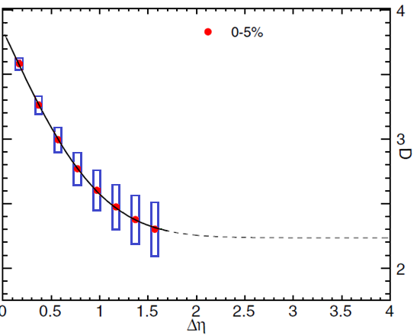
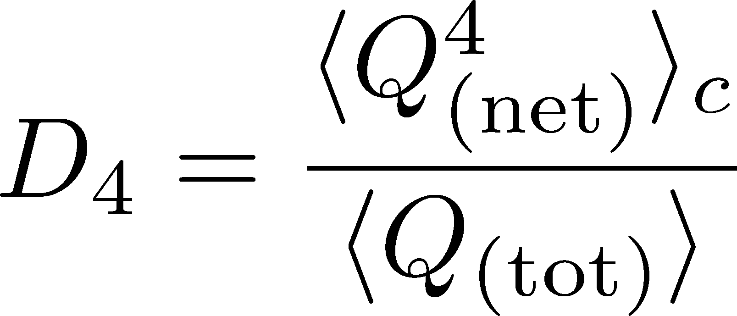
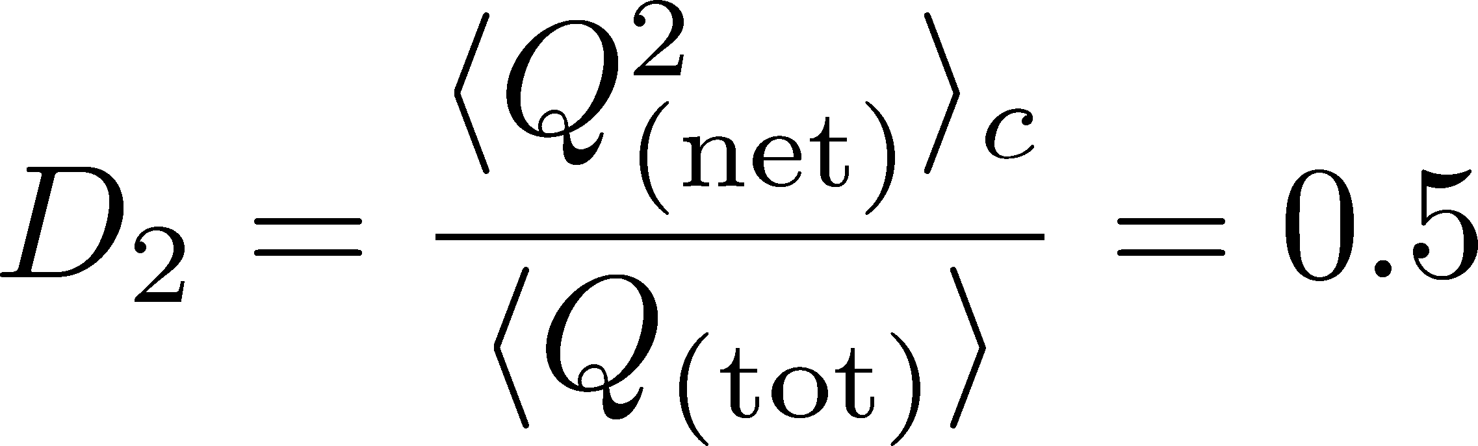
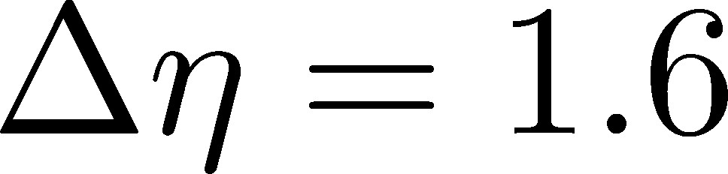
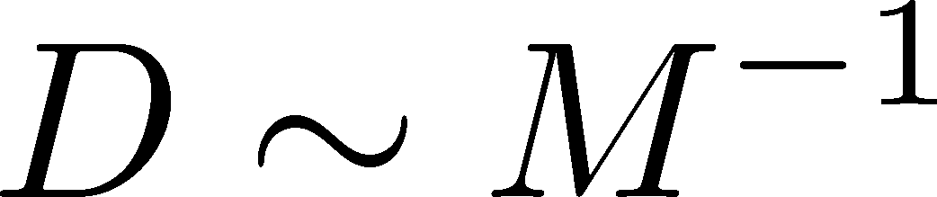
Δη Dependence: 4th order
MK, NPA(2015)
Initial Condition
baryon #
at ALICE
at ALICE

Slide 38
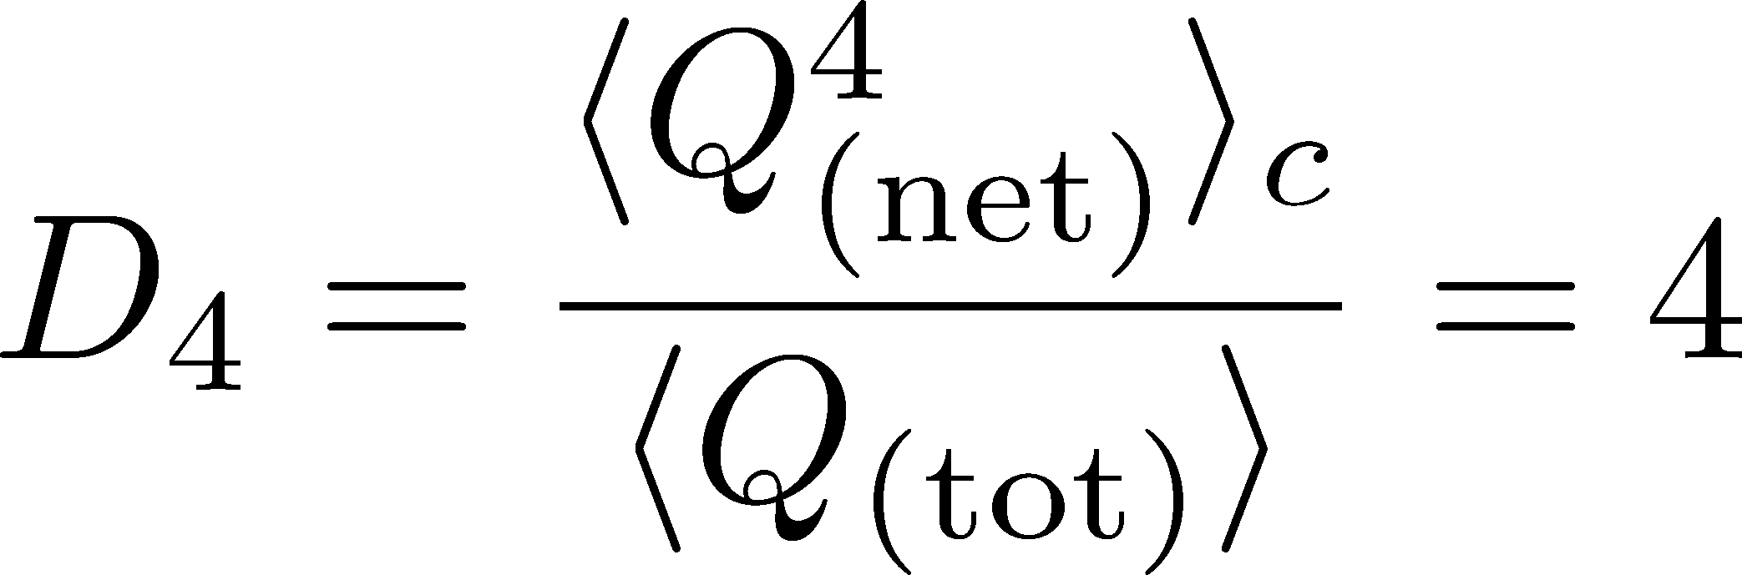
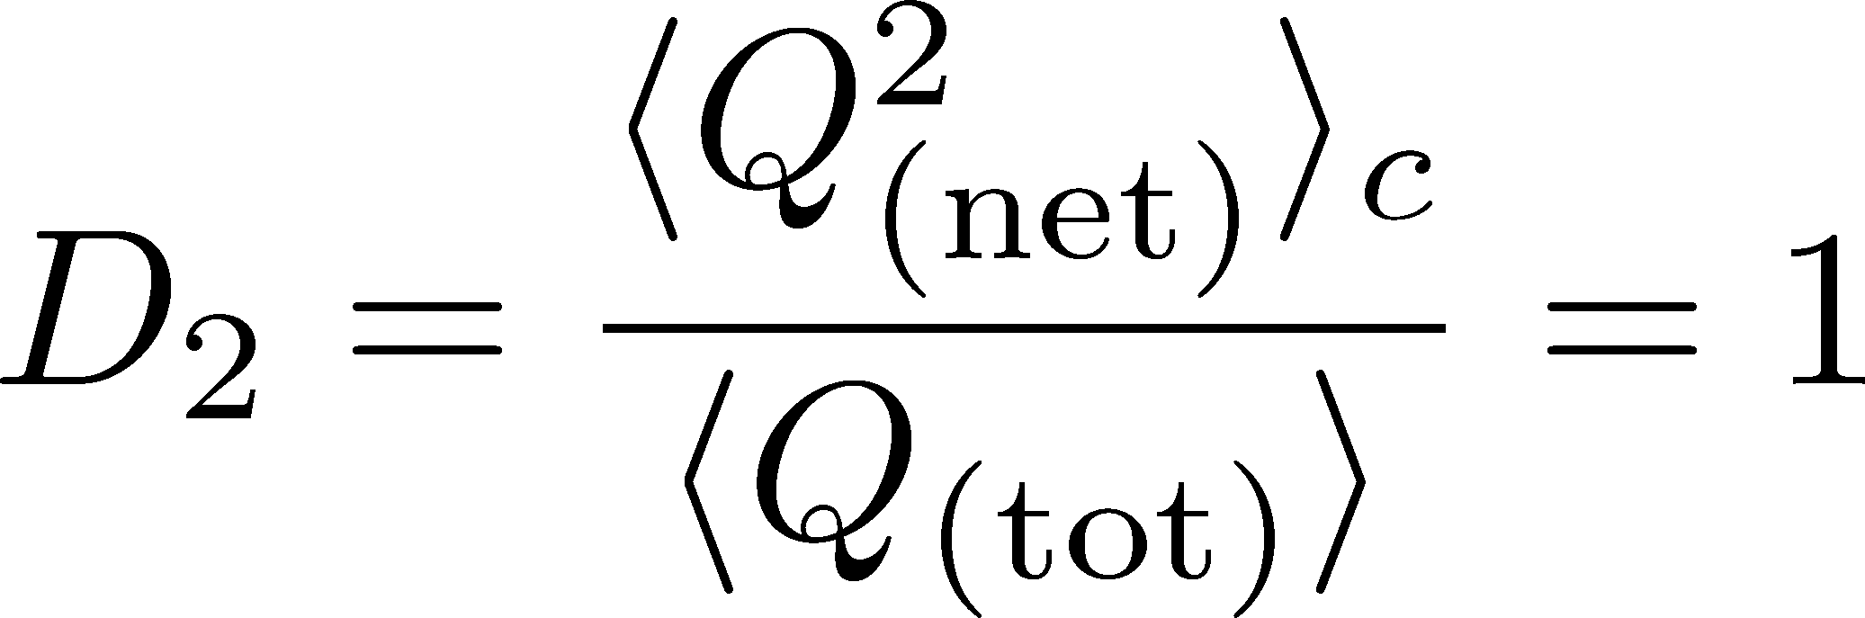
4th order : w/ Critical Fluctuation
Initial Condition
baryon #
at ALICE
at ALICE

Slide 39



Translating Languages
Brownian particle model
From Bzdak’s talk

