Slide 1
QCD臨界点付近における保存電荷高次キュムラントの時間発展
村田大雅、○北沢正清
(大阪大学)
日本物理学会第７３回年次大会
東京理科大学野田キャンパス、2018年3月22日
22pK102-9

Slide 2
Beam-Energy Scan
T
Hadrons
Color SC
0
μ

Slide 3

Beam-Energy Scan
STAR 2012
high
beam energy
T
low
Hadrons
Color SC
0
μ
RHIC-BES-I, LHC, SPS-NA61
Future: RHIC-BES-II, J-PARC-HI, FAIR, NICA

Slide 4


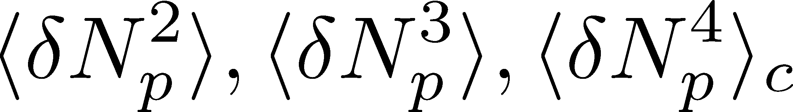
Event-by-Event Fluctuations
Review: Asakawa, MK, PPNP 90 (2016)
Fluctuations can be measured by e-by-e analysis in experiments.
STAR, PRL105 (2010)
Detector
Cumulants

Slide 5


Higher-Order Cumulants
STAR Collab.
2010~
Higher-order cumulants: Sensitive to QCD phase structure!
Stephanov, 2009; Asakawa, Ejiri, MK, 2009
Enhancement
Non-zero non-Gaussian cumulants have been established!
Have we measured critical fluctuations?

Slide 6
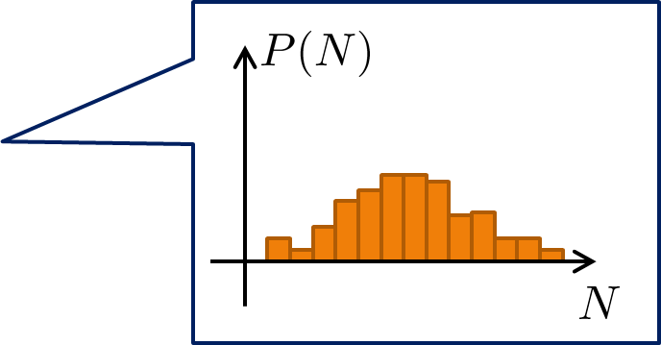
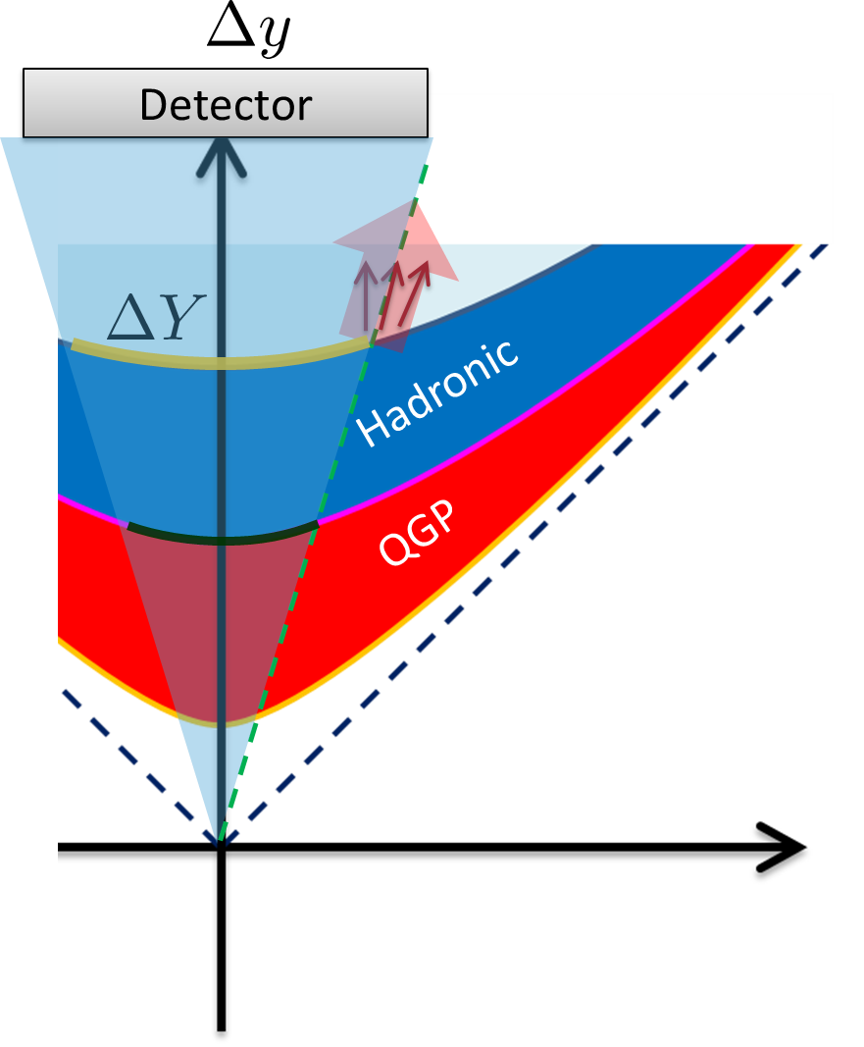
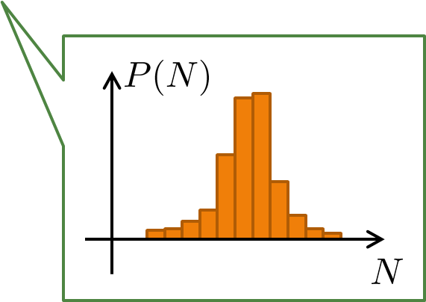
Caution
実験が観測するゆらぎ≠ある時刻の熱ゆらぎ
ゆらぎは、あるラピディティ領域Δyで測定される
Δy領域内の粒子数は、時々刻々と変化する
時間発展を論じる必要性

Slide 7
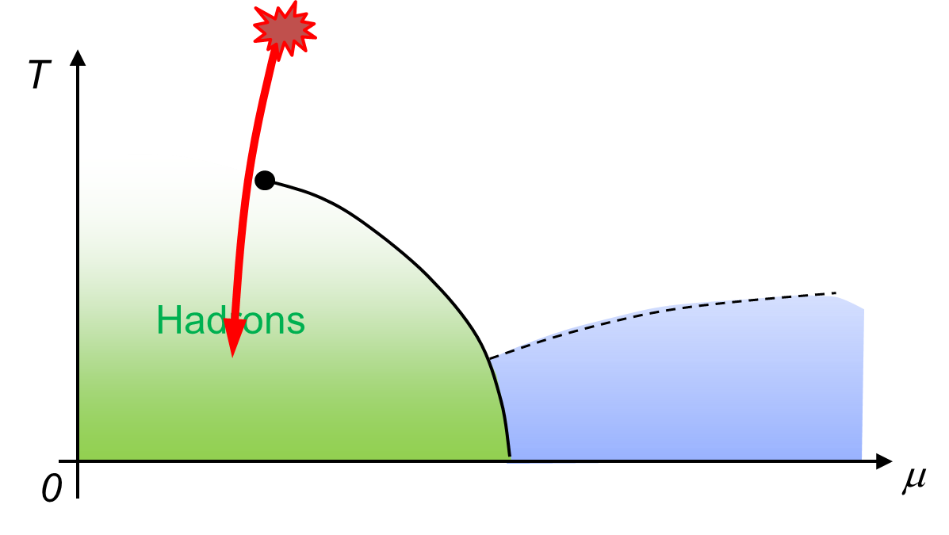
Effect of Dynamical Evolution
Growth
Critical slowing down suppresses the growth of critical fluctuation.
Decay by diffusion
Fluctuations developed at CP are modified by the time evolution in later stage before observation.

Slide 8
Dynamical Evolution of Critical Fluctuations
Evolution of spatially uniform “σ” mode
Berdnikov, Rajagopal (2000)
Asakawa, Nonaka (2002)
Mukherjee+ (2015)
THIS STUDY
Evolution of conserved charge fluctuations
Sakaida+, PRC2017; Murata, MK, in prep.
Conserved charges are directly observable.
Soft mode at QCD-CP is a conserved mode.
See also, Kapusta, Torres-Rincon (2012); Herold, Nahrgang, … (2015)

Slide 9

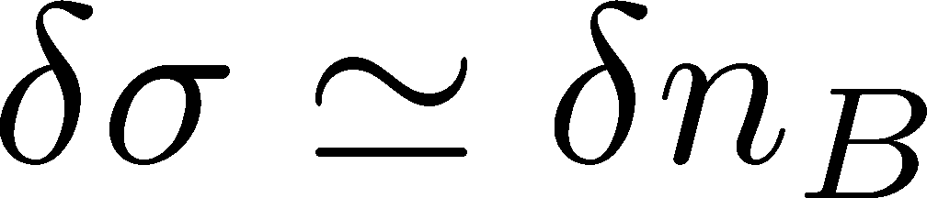



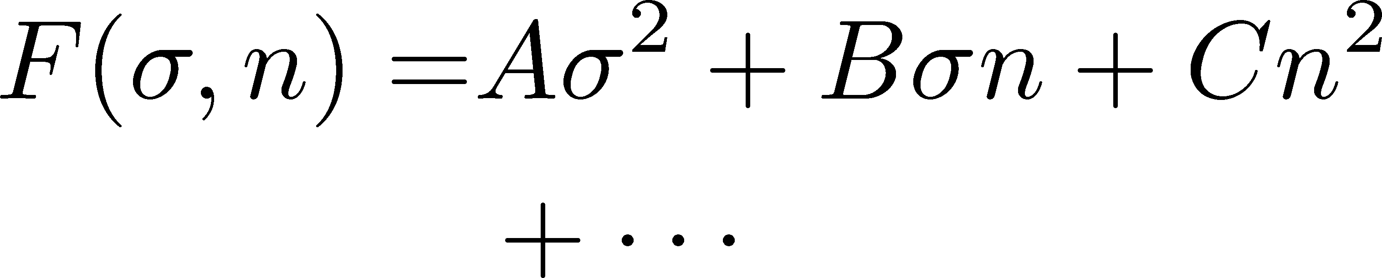


Soft Mode of QCD-CP = Conserved Mode
Fujii 2003; Fujii, Ohtani, 2004; Son, Stephanov, 2004
critical
soft mode
Fluctuations of σ and n_{B} are
coupled around the CP!
σ: fast damping

Slide 10
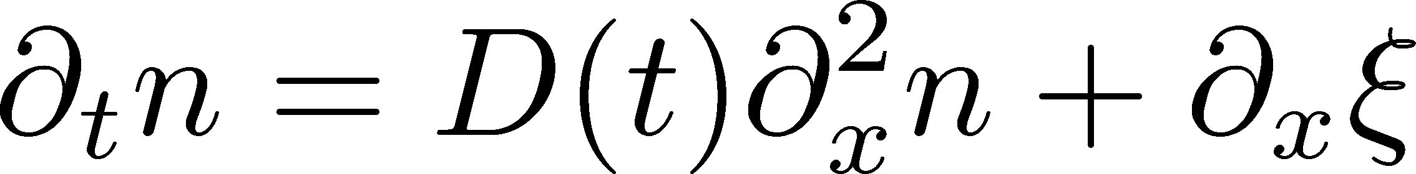

Analysis of 2nd-order Cumulant
Sakaida, Asakawa,
Fujii, MK (2017)
Evolution of baryon number density
Stochastic Diffusion Equation
:parameters characterizing criticality
n is a conserved charge.
Analytically solvable.
Neglect σ : Justified for slow dynamics.
Applicable only to 2nd order fluctuations.
This study: translationally-invariant solution

Slide 11
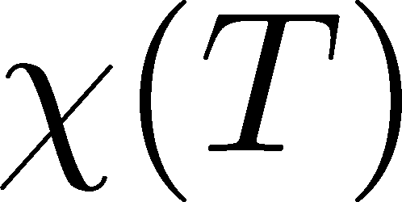

Parametrizing D(τ) and χ(τ)
Critical behavior
(critical point)
3D Ising (r,H)
model H
Berdnikov, Rajagopal (2000)
Stephanov (2011); Mukherjee+(2015)
Temperature dep.
critical
slowing
down
critical
enhancement

Slide 12
Parametrizing D(τ) and χ(τ)
Critical behavior
(critical point)
3D Ising (r,H)
model H
Berdnikov, Rajagopal (2000)
Stephanov (2011); Mukherjee+(2015)
Temperature dep.
critical
slowing
down
critical
enhancement
Negative
Asakawa, Ejiri, MK
(2009)

Slide 13

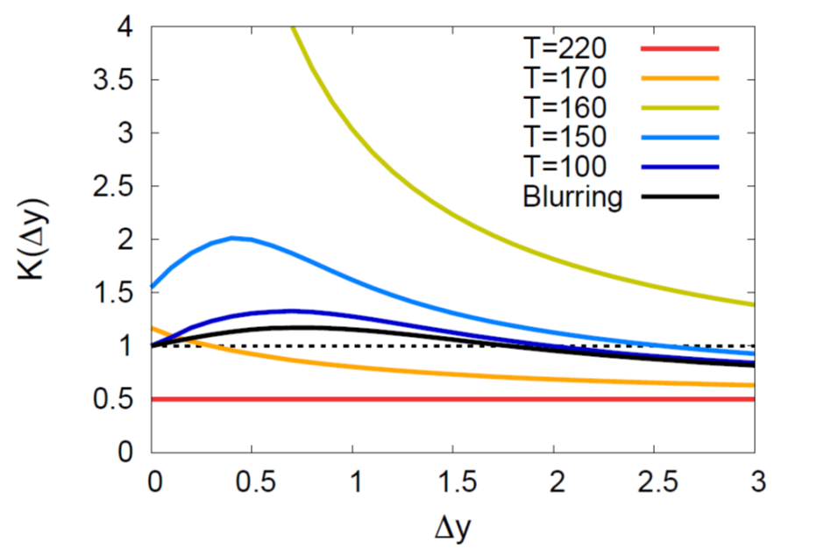
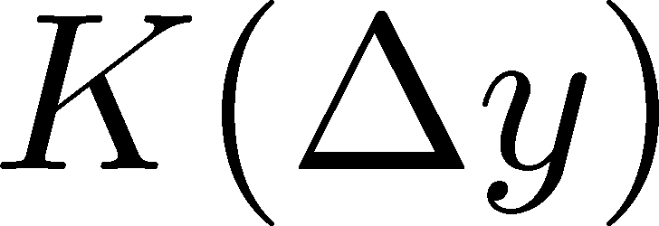

Critical Point / Cumulant
Sakaida+ (2017)
non-monotonic Δy dep.
Analytic
result
non-monotonic
non-monotonic

Slide 14
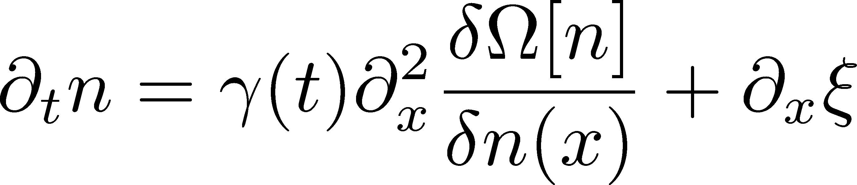
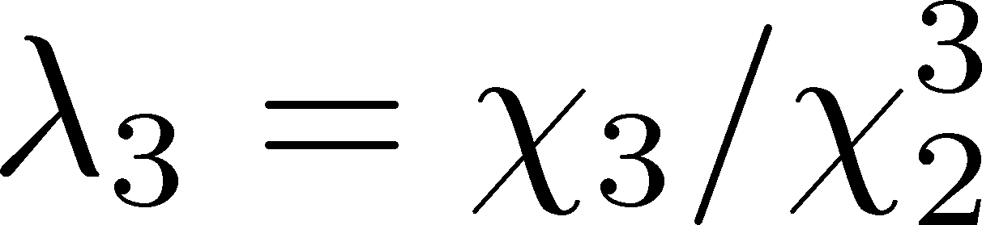
Exploring 3rd-order Cumulant
Murata, MK
in preparation
SDE + Non-linear effects
Effective potential
c=λ₃=0 ➔ SDE
λ₃ characterizes skewness:
Solve this equation at the leading order in λ₃ with c=0.
  λ₃→0 @ QCD-CP
  c=0 → short ξ.
Numerical analysis: Nahrgang, QM2018

Slide 15
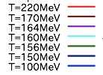
Time Evolution: Near CP
Murata, MK
in preparation
negative
Asakawa, Ejiri, MK
(2009)

Slide 16
Time Evolution: Near CP
Murata, MK
in preparation
negative
Asakawa, Ejiri, MK
(2009)

Slide 17
Time Evolution: Near CP
Murata, MK
in preparation
Sharp peak survives as a remnant of criticarity
Negative 3rd cumulant is buried by the diffusion.
negative
Asakawa, Ejiri, MK
(2009)

Slide 18

Comparison of 2nd/3rd Cumulants
Sharper peak in 3rd order cumulant.
①Diffusion is much slower for higher order
②Remnant of negative χ₃.

Slide 19
まとめ
QCD臨界点付近における保存電荷3次キュムラント時間発展の、電荷保存則を尊重した解析。
有効ポテンシャルの非ガウス性を考慮した方程式を、摂動的に解いた。
3次キュムラントにピーク構造が出現
2,3次キュムラントの実験的解析・比較の重要性
Future
  有限体積効果（並進対称性を課さない解析）
  ４次キュムラントの解析
  数値シミュレーションとの比較
  拡散モデルとの比較

Slide 20


(Non-Interacting) Brownian Particle Model
Initial condition (uniform)
cumulants:
random
walk
diffusion master equation: MK+, PLB(2014)
probabilistic argument: Ohnishi+, PRC(2016)

Slide 21



(Non-Interacting) Brownian Particle Model
Initial condition (uniform)
cumulants:
diffusion
distance
random
walk
Study ΔY dependence
Poisson distribution
diffusion master equation: MK+, PLB(2014)
probabilistic argument: Ohnishi+, PRC(2016)

Slide 22
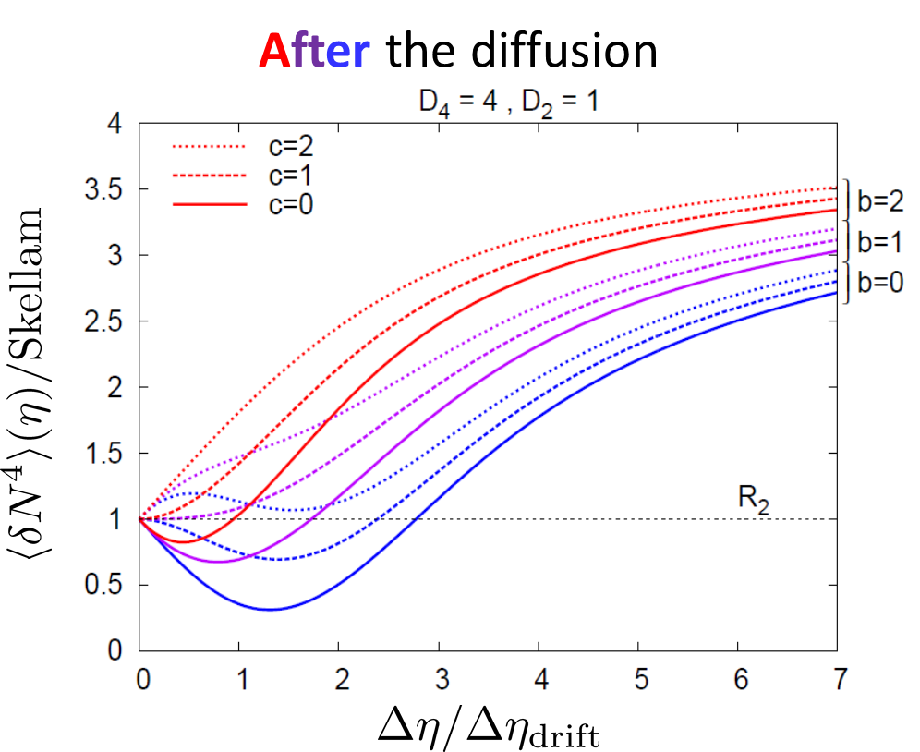


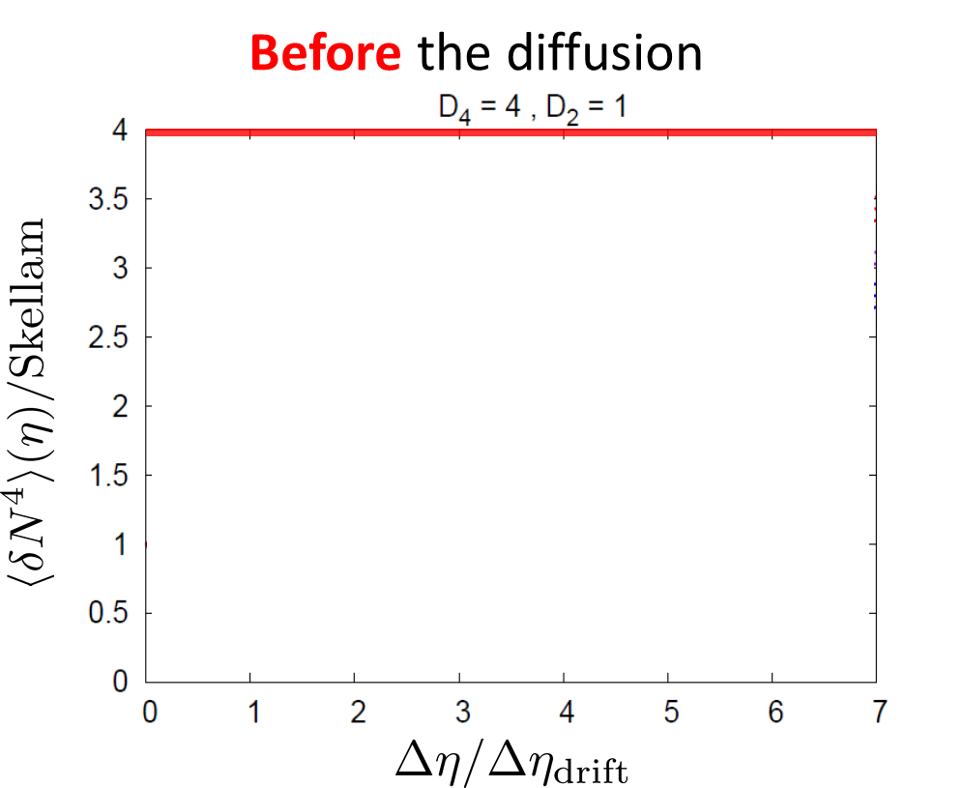

Time Evolution of Fluctuations
Detector
Hadronic
As a result of a simple random walk…
QGP

Slide 23
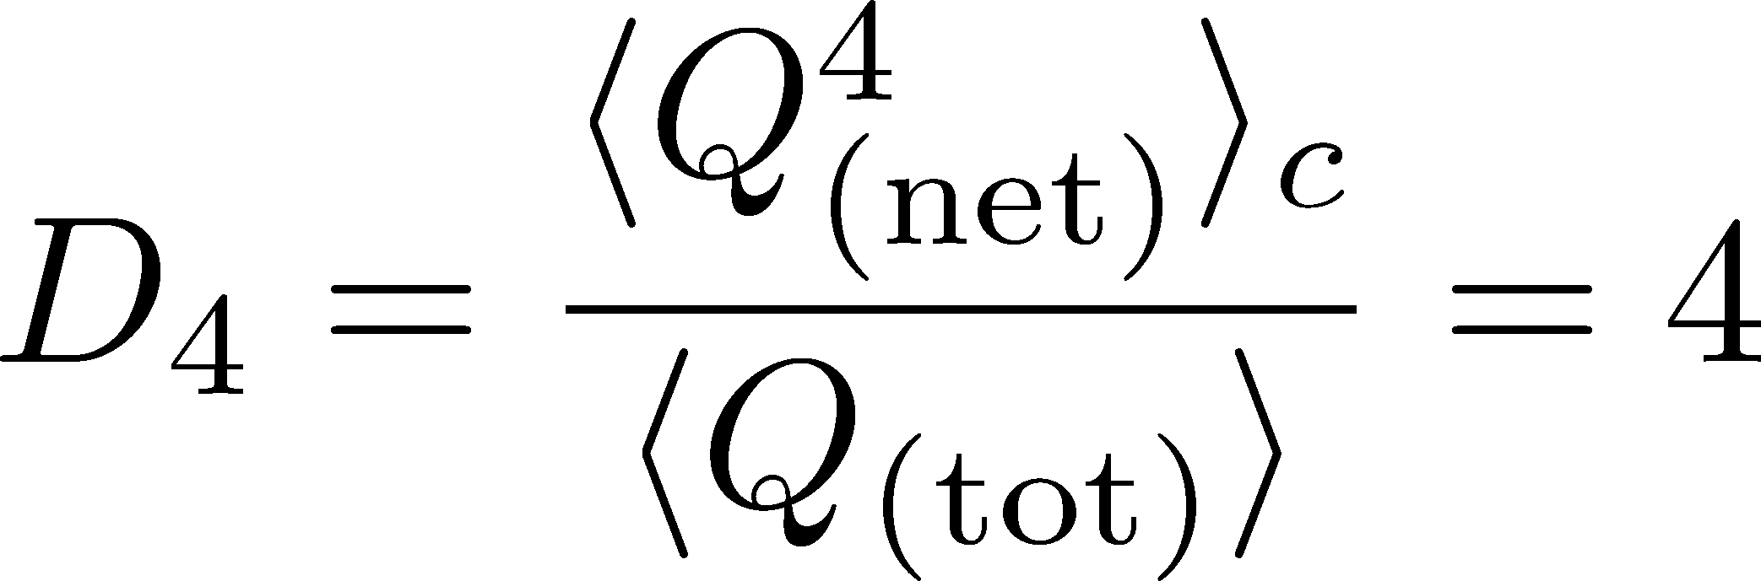



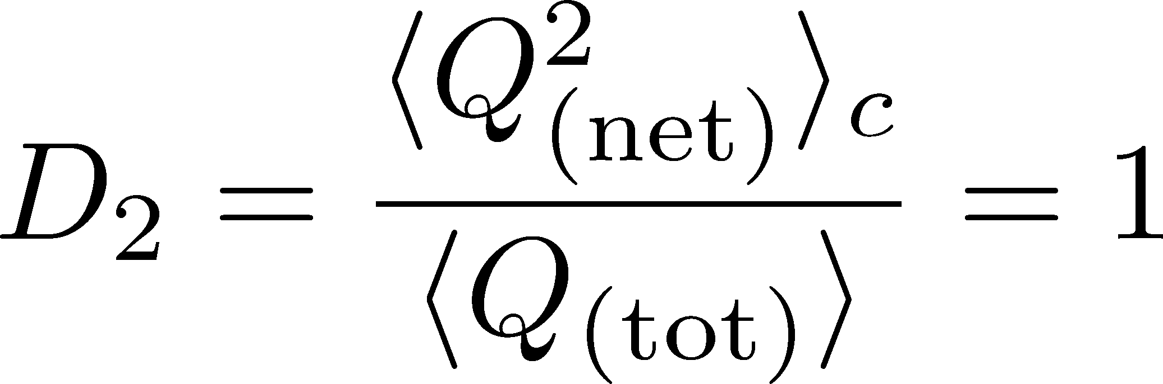



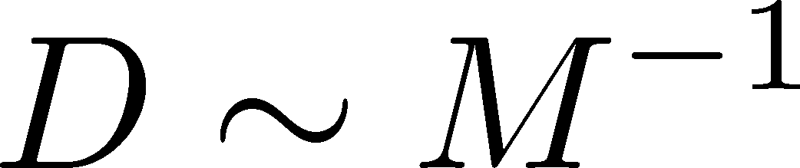
4th order : w/ Critical Fluctuation
Initial Condition
baryon #
at ALICE
at ALICE

Slide 24
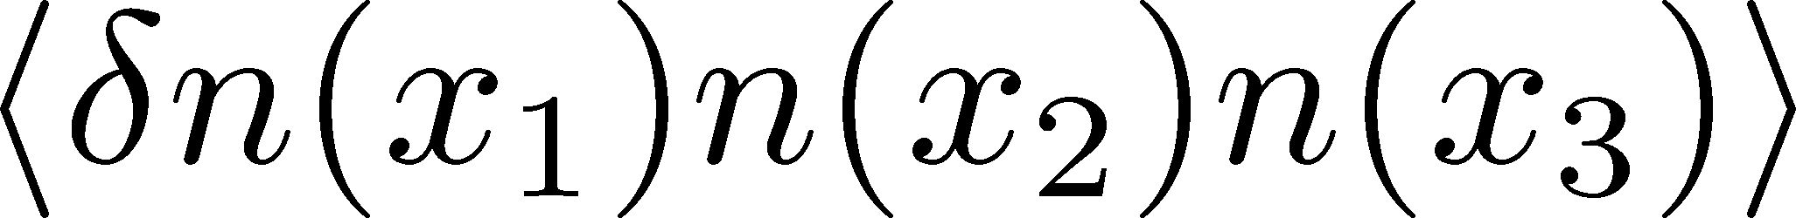
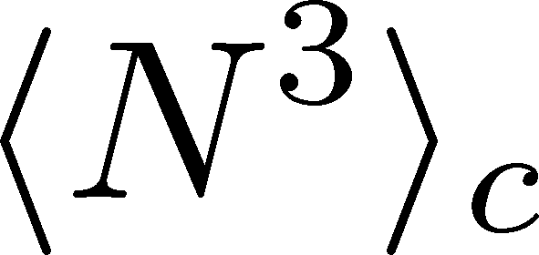
Solution
Evolution eqation of

Slide 25
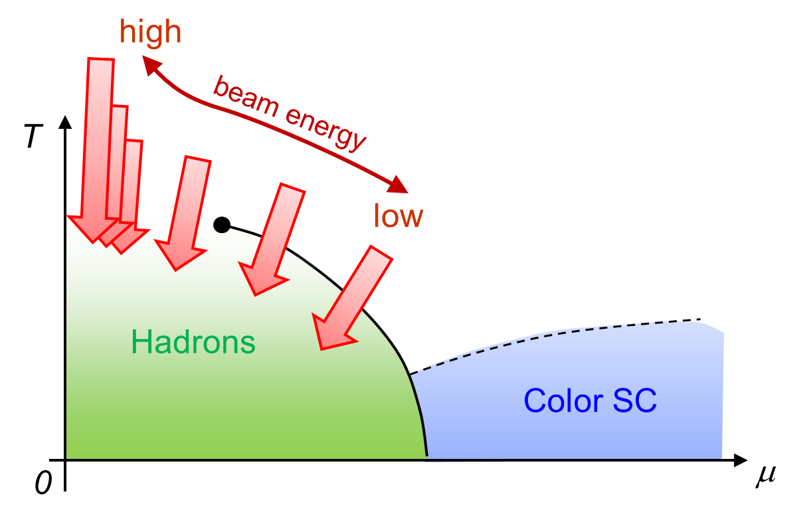
QCD臨界点探索@ HIC
Beam-Energy Scan (BES)
陽子数高次キュムラント
（STAR2016）
Enhancement
保存電荷のイベント毎ゆらぎを用いたQCD臨界点探索
STAR-BES-I (2010~2016) / ALICE (2013~) / NA61
future: STAR-BES-II, J-PARC-HI, NICA, FAIR

Slide 26



Baryons in Hadronic Phase
time
chem. f.o.
hadronize
10~20fm
kinetic f.o.
Baryons behave like
Brownian pollens in water
mesons
baryons

